Slide 1
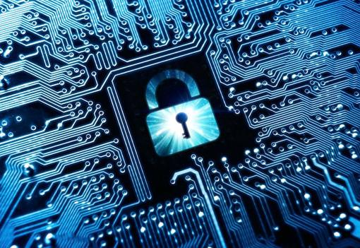


Energy & Mines Digital Trust
Digital Credentials for Organizational Identities in the
Natural Resource Sector
December 1, 2022
Energy & Mines Digital Trust

Slide 2
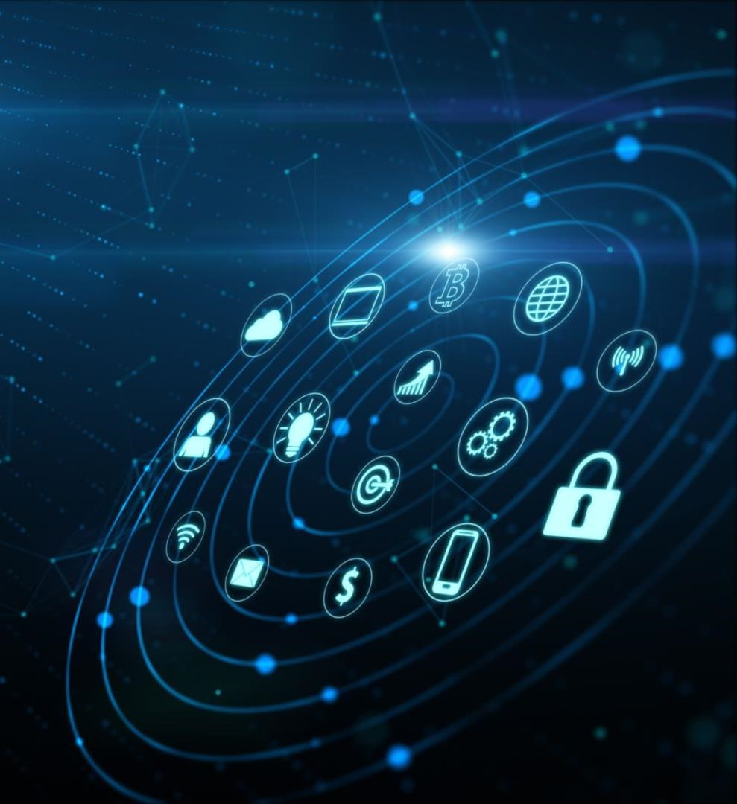
EMDT is enabling and accelerating the B.C. government's entry into a digital trust ecosystem.
This initiative is creating a simple and secure way to share sustainability data, certifications, and credentials.​​​
Notes:
Energy & Mines Digital Trust (or EMDT) is a pilot project that was initiated in November 2020 by the British Columbia Ministry of Energy, Mines and Low Carbon Innovation.
This project is enabling a collaborative digital ecosystem between the B.C. government, natural resource companies, and organizations around the world, making it simple and secure to share sustainability data.
We are working to provide mining and natural gas industry participants with a trusted, verifiable way to share greenhouse gas emissions data.
This initiative actively contributes to B.C. and Canada becoming recognized globally as a desirable, responsible, and competitive jurisdiction for investment.

Slide 3
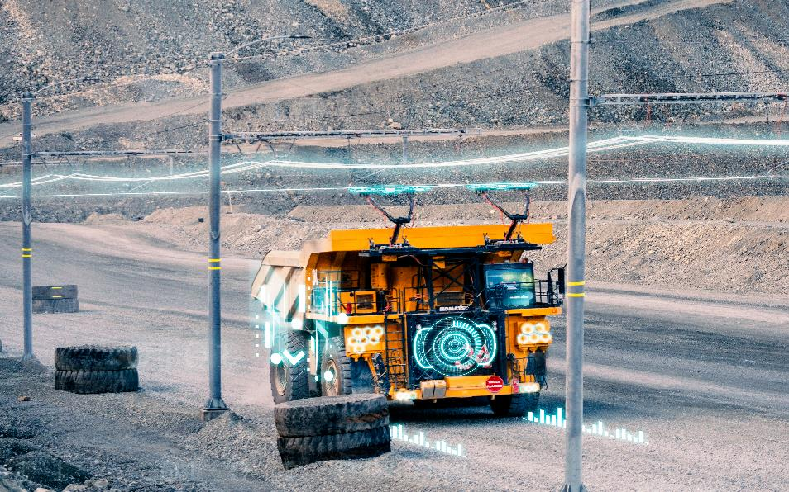



Opportunities to Improve Sustainability Reporting
More Efficient Processes
Increase trust and security
Allow selective disclosure
Image: Copper Mountain Mining Corporation
Notes:
Globally, an increasing emphasis on responsibly sourced natural resource products is pressuring organizations to prove they are globally competitive, environmentally-leading, and socially responsible.
However, the current process for sustainability reporting relies on emails, spreadsheets and .pdf documents, which isn’t efficient and presents a number of challenges relating to security, privacy and administrative burden
EMDT is working to make improvements in a few different ways:
First, by making the process more efficient by providing digital solutions to organizations to reduce the degree of manual effort and administrative burden required to report sustainability data
Second, EMDT is delivering a way for market participants to trust that sustainability reports are accurate and legitimate, and to share information in a secure manner
And finally, EMDT is providing a way for organizations to share only the data that is necessary; this selective disclosure provides greater privacy.

Slide 4
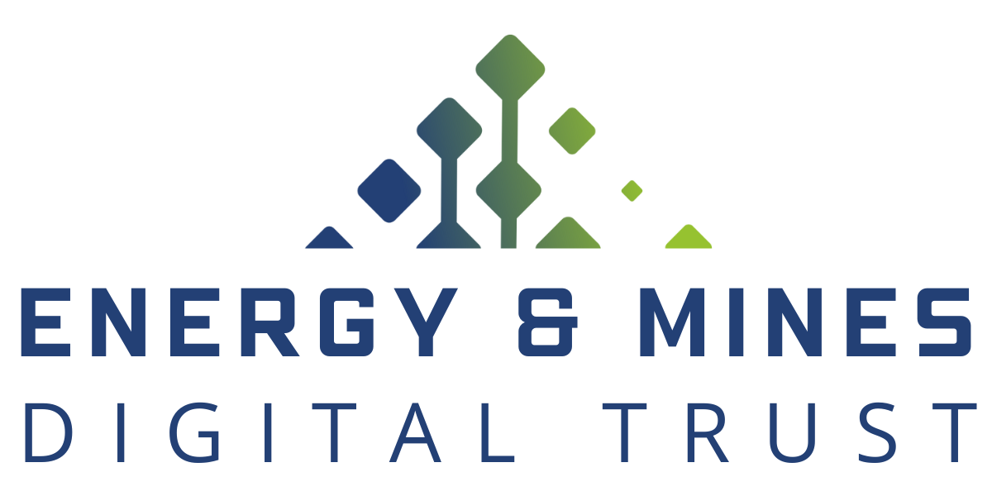
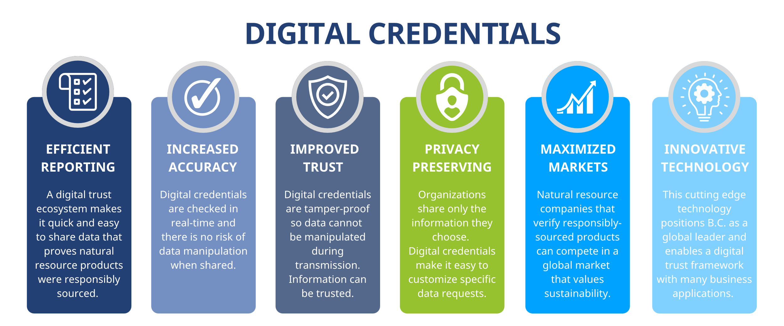
Notes:
Digital credentials offer a huge improvement over pdf documents shared by email because they:
Can be shared quickly and are tamper-proof
Allow organizations to control their data
Guarantee the integrity of the information
Build digital trust

Slide 5






EMDT Technology: Traction
Traction is open-source software built on Hyperledger Aries ACA-Py and Hyperledger Indy.
Broader Interoperability
Multi-tenant Capacity
Collaborative Refinement
API-first Architecture
Safer Data Exchange
Notes:
EMDT is developing a digital wallet for use by organizations, including the B.C. government
Traction is open-source software built on Hyperledger Aries ACA-Py and Hyperledger Indy.
Aries makes Traction highly interoperable with the technological solutions of companies and organizations around the world.
Traction offers multi-tenant capacity. ACA-Py is implemented on a cloud-based server, so multiple wallets can be managed with one Traction instance.
Traction is open-source technology, encouraging collaborative refinement, faster release and higher scalability.
Traction is designed with an API-first architecture, which allows for integration into existing business applications already being used by organizations.
Traction uses Hyperledger Indy distributed ledger technology, which is deliberately designed to be tamper-proof.

Slide 6
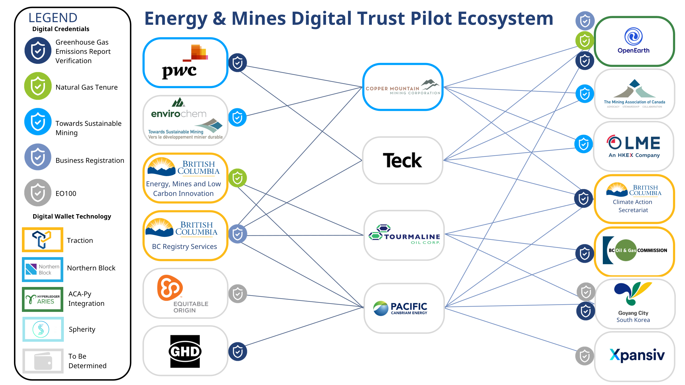
Notes:
Hyperledger Aries and Hyperledger Indy make Traction highly interoperable with the existing digital wallet solutions of organizations around the world.
In this ecosystem diagram, you can see that Traction is interoperable with the digital wallet solutions from Spherity and Northern Block, allowing the Government of British Columbia to exchange digital credentials with companies including Copper Mountain.
In EMDT's mining sector use case, PwC issues Copper Mountain's Greenhouse Gas Verification Statement as a digital credential. As you can see in this diagram, Copper Mountain can use this digital credential to satisfy requests for information from both the Government of British Columbia and the Open Earth Foundation – showcasing the potential for digital credentials to enable both regulatory and voluntary reporting if adopted at scale.

Slide 7
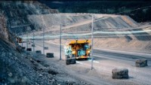
Demonstration Video
Notes:
• We have developed a short demonstration video to show how a digital credential for GHG emissions reports can be exchanged between participants

Slide 8
Q&A

Slide 9

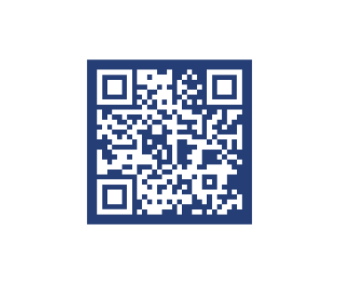
Contact
Kyle Robinson
Senior Strategic Advisor, EMDT
Notes:
For more information, please contact Nancy or Kyle.

