Slide 1
AM1540B
Connected Vehicle Identity Management Using Blockchain
Jim Mason
Jim.mason@skywebteam.com
Tuesday, June 9, 2020 - 1:00 pm

Slide 2
Jim mason
Background
Enterprise Architect, Project Management, Data Services
Sky Web Team – consultant
Citizens Bank
Fidelity
IBM
OTI
Licensed Financial Advisor,
Health insurance agent
Blockchain
Hyperledger Fabric since 2017
Work with Fabric Doc team
DMX blockchain architect
DMX VINblock prototype
Data compliance on blockchain
Hyperledger working groups
MOBI Vehicle Identity Std team
MOBI Connected Data Std team

Slide 3
Agenda
Mobility Marketplace Overview
Blockchain Basics Concepts
Hyperledger Enterprise Blockchain Concepts
VINBlock vehicle identity chain
MOBI vehicle identity project
Summary

Slide 4
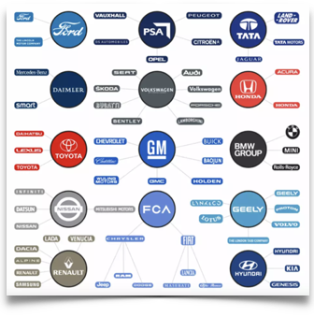
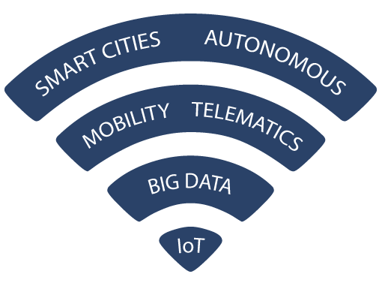
Auto industry snapshot
Auto Industry Snapshot
14 car company conglomerates control 64 brands worldwide
United States
Largest volume auto industry
16 OEMs Operating
39 Badges
50,000+ Dealers
$875+ Billion Sales
250+ Million Vehicles
225+ Million Drivers

Slide 5
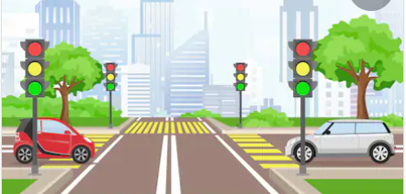
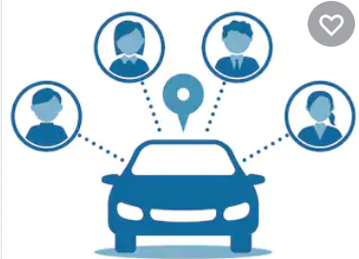
Key concerns in mobility
Lower new car sales trends
Rental car firms reducing fleets
Shifting demands for vehicle types and fuel types
Changes in ownership models, usage with ride sharing and subscriptions
Increased regulations on privacy, vehicle usage
Coordination of supply and demand across all forms of transportation
Changes in supply chains and trade

Slide 6
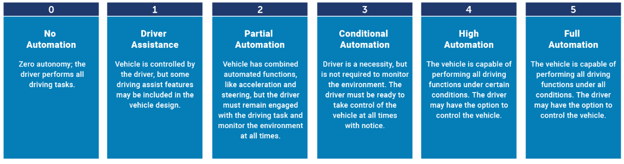
Mobility technology changes
Lower new car sales trends
Software Defined Vehicles: the digital twin
Decentralized, smart vehicle subsystems
OTA vehicle software updates
5G vehicle to X connectivity
AI, Blockchain, IoT, Analytics, Cloud, Automation
Autonomous Driving levels

Slide 7
Agenda
Mobility Marketplace Overview
Blockchain Basics Concepts
Hyperledger Enterprise Blockchain Concepts
VINBlock vehicle identity chain
MOBI vehicle identity project
Summary

Slide 8
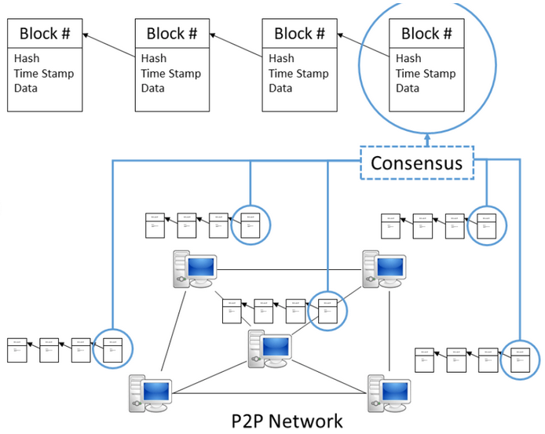
Blockchain features ( dlt )
Peer Network -
host organizations: each maintain a copy of shared ledger in synch using smart contracts
Immutable, shared ledger -
Hash chain of write-only transaction blocks ordered by date replicated on host organizations
Smart contract -
secured program implements a contract between parties to validate, write transactions on the ledger with event support
Consensus method-
policies define how transactions are approved, posted to the ledger
Governance services
to manage the network

Slide 9
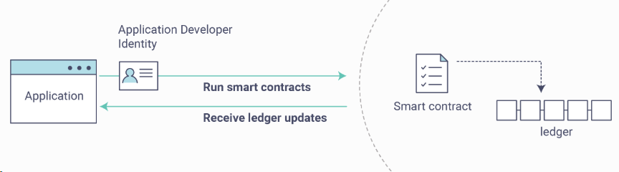
Smart Contracts & Transaction Consensus
Smart Contracts
  All host orgs have contracts and ledgers
  Contracts define business rules
  Client app invokes contract method (buyItem..)
  Contract execution creates transaction on hosts
  Transactions processed on consensus flow >>>
  Apps can receive commit event for automation
  Contracts automatically governed in Fabric v2x
Transaction Consensus Flow
  Flexible consensus methods & policies
  Contract execution creates transaction results
  Hosts must agree transaction as valid
  Agreement based on consensus policy
  If agreed, transactions ordered in blocks
  Ordered transactions commited to ledgers
  transactions stored on ledgers

Slide 10
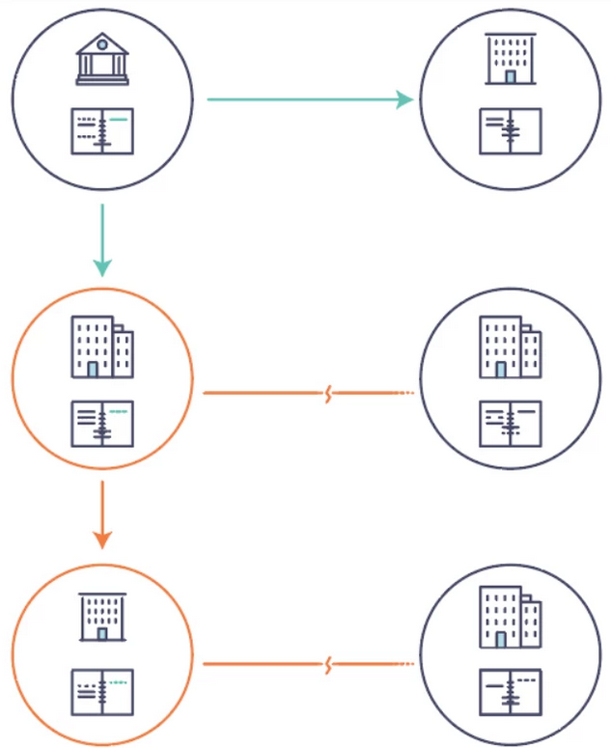
Business Networks – Integration Challenges
Sample scenario looks at commercial paper life cycle
Each organization has separate database with security, maintenance issues
Intermediaries needed for validations to reduce counter party risks
Transactions often move using point to point services
Often signed documents required as well
Added delays, errors, rework, audits, costs, risks, inefficiencies, trust & security issues, compliance issues

Slide 11
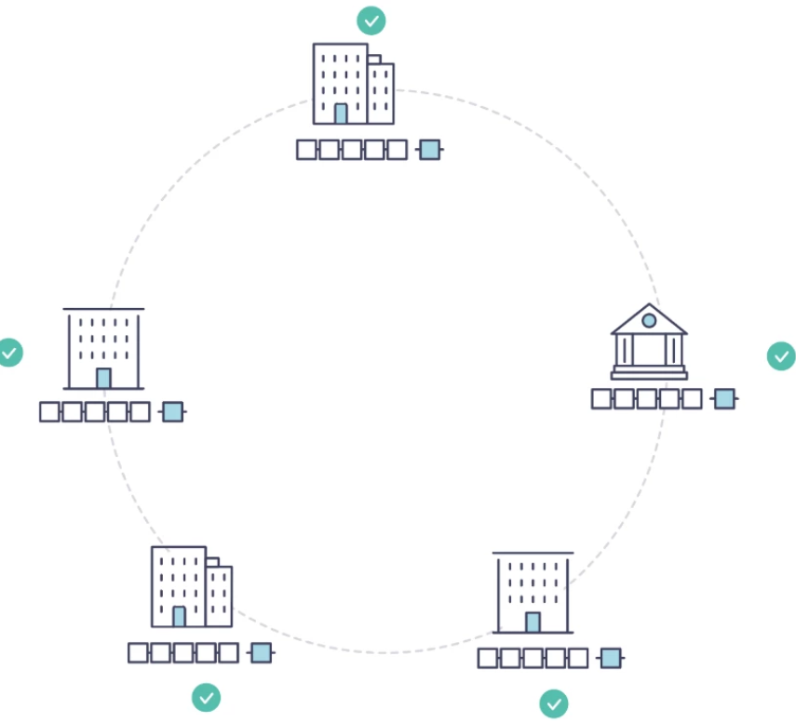
Blockchain Value Networks – Coordination Benefits
Trusted, shared, historical, single version of the truth for all
Client apps call smart contracts to write to the ledger
Smart contracts write approved, signed transactions to shared, immutable ledger
Fewer delays, errors, rework, audits, costs, risks, inefficiencies, security, compliance issues
Coordination creates a Value Chain Network ( VCN )
Add automation, smart features next

Slide 12
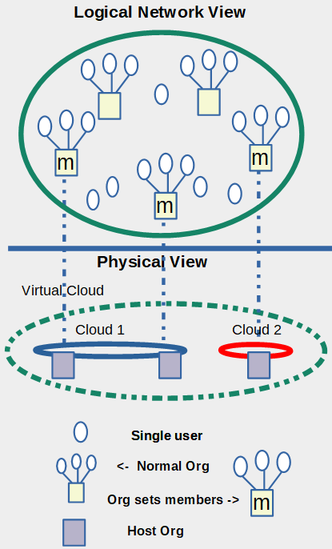
Blockchain Logical vs Physical Network
Blockchain networks with only a few organizations (orgs)
  Every org may be a host on the network and the network can perform well
Blockchain networks with many organizations
  A logical network may be created where:
  A few large host organizations run the physical blockchain network of nodes
  Many participant ( Normal ) organizations, users join the network but do not host it. Gray nodes are the blockchain host nodes.
  Host organizations here set membership for all participants in logical network view ( other users, organizations )
  Green circle (“virtual cloud”) contains physical clouds ( 1, 2 )
  An example would be OEM auto manufacturers and car dealers. A few OEMs host thousands of car dealers.

Slide 13
Agenda
Mobility Marketplace Overview
Blockchain Basics Concepts
Hyperledger Enterprise Blockchain Concepts
VINBlock vehicle identity chain
MOBI vehicle identity project
Summary

Slide 14
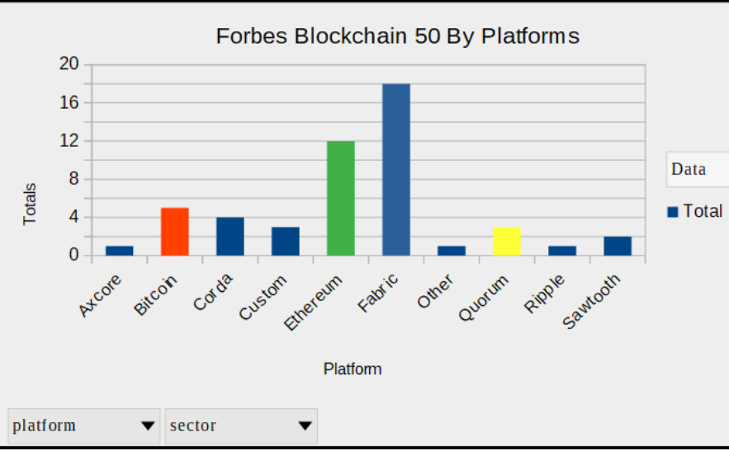
Enterprise Blockchain Platform Choices
Forbes Blockchain 50 article
Edited by Michael del Castillo and Matt Schifrin
Forbes Blockchain 50 article link
Highlights large companies using blockchain solutions
Key impacts: speed business processes, increase transparency, lower costs, improve compliance on value chain networks
Great place to understand blockchain value delivered
I made assumptions on which blockchain platforms companies focused on
Hyperledger Fabric, Ethereum, Corda biggest

Slide 15
Hyperledger Fabric Blockchain: a lot to unpack
Features
A different type of distributed ledger
Users have digital identities to access
Transactions are signed by users
Endorsed transactions hashed are “write-only”
Smart contracts create transactions
Can integrate with payments, tokens
Public or private access, Permissioned or permissionless
Options for private data
Event support
Identity and security options
Java, Javascript, GO languages, tools
Interoperability with other blockchains
Impacts
Shared real-time data across organizations
Trusted, secured identity for users
Proof who created a transaction
Proof transactions approved, are not changed
Authorized access only, no direct data access
Enables payments, incentives for users
Who can read and write to a blockchain
Who can read shared, private transactions
Automated workflows with transaction finality
Easy support for compliance, regs ( GDPR )
Shorter learning curve for developers
Hyperledger Cactus with Besu, Corda and more

Slide 16
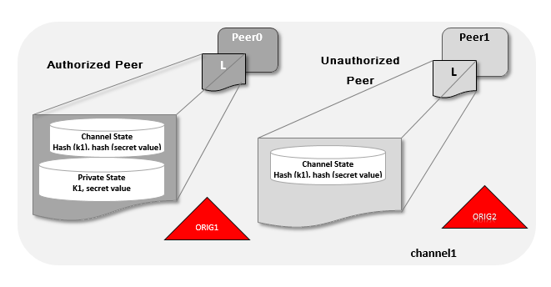
Swt Two content
Use Case:
Org 1 buys an item from Org 3 at a contract price
Org 1 and Org 3 should have access to the transaction detail
Other Orgs ( Org 2 ) should know that the transaction exists without any detail ( just a hash on the blockchain )
The private data for Org 1 and Org 3 is sent signed and encrypted and stored in an off-chain data store

Slide 17
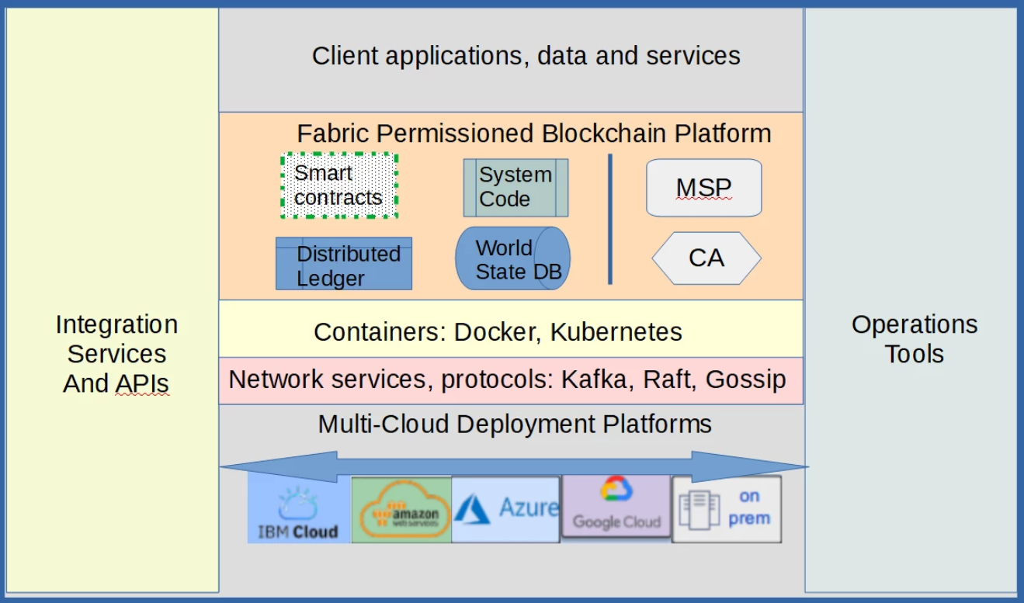
Conceptual Fabric Software Stack

Slide 18
Identity & Security
Identity Management
Fabric provides multiple options for identity management as a permissioned, enterprise blockchain
Strategy 1 > Built in MSP (Membership Services Provider) and CA (Certificate Authority) support
Strategy 2 > Integrate existing Security Services through standard LDAP interfaces
Strategy 3 > Integrate another blockchain identity management system ( Sovrin, Indy, etc )
Security
Organizations configure security policies in Fabric allowing it to fit many usage scenarios
All users and organizations have certificates, keys for digital signatures
All transactions and smart contracts are signed digitally providing an audit trail
A Fabric network uses TLS encrypted connections ensuring all data in-flight is secure
The blockchain ledger can be encrypted ensuring data at-rest is secure
New options are in progress for TEE - Trusted Execution Environments - that can ensure data-in-memory is secure

Slide 19
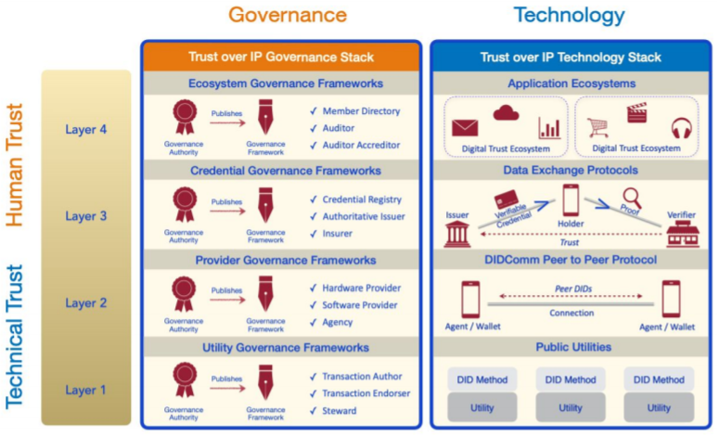
Move to Decentralized Digital Trust Systems
New Digital Trust frameworks
Efficient, peer to peer model
  Reduces need for central systems
SSI – Self Sovereign Identity
  Issuer issues Decentralized ID Doc (DID)
  You decide what data to share when
Digital Wallets
  Store your IDs, credentials, payment types
Trust Over IP framework
  Automates trust between systems
  4 layers for trust with matching governance

Slide 20
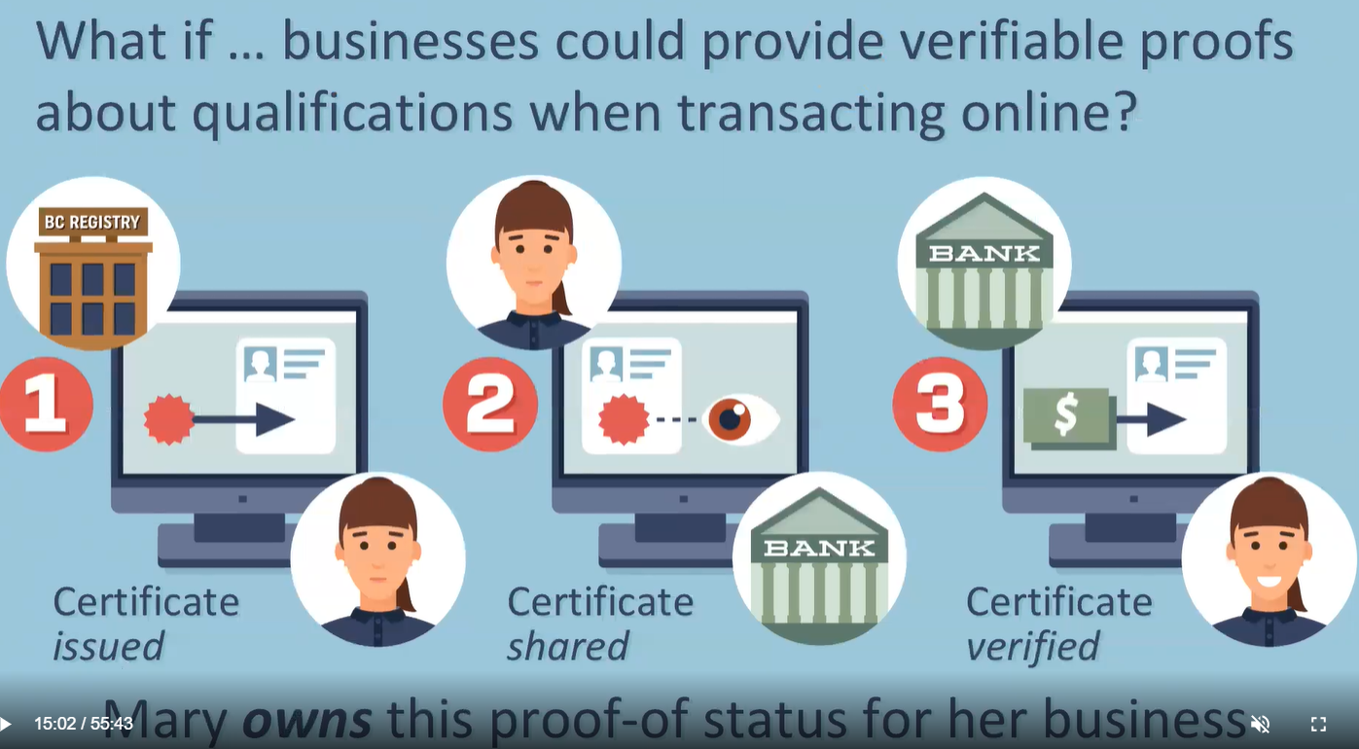
Verifiable Organizations Network ( VON )
Government issues credentials to orgs
Orgs share credentials to other orgs

Slide 21
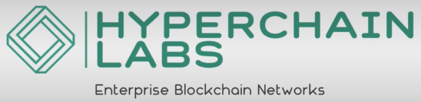
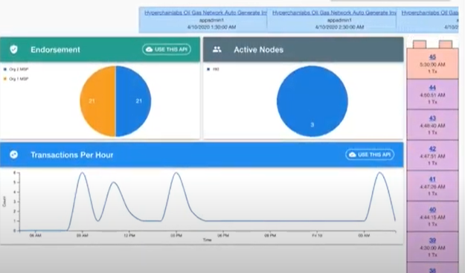
Blockchain Automation
Automates oil field trucking end to end
Cut total overhead costs > 50%
All parties have blockchain identity
Tanks have smart IoT sensors
Sensors call for service when tank full using
smart contract
Truckers accept disposal requests
Mobile app lets trucker accept order using
smart contract
Tank sensors notify tank emptied
automated payment via smart contract
Uses AI, blockchain, IoT, cloud, automation

Slide 22
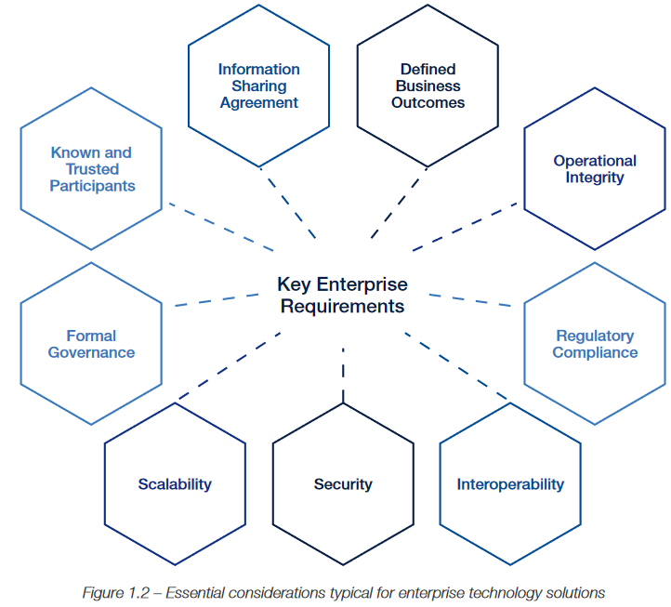
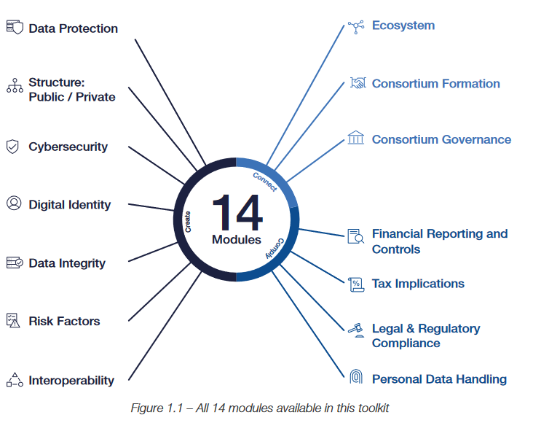
Plan Blockchain: WEF Blockchain Toolkit
World Economic Forum Blockchain Toolkit
Enterprise Blockchain Requirements

Slide 23
Agenda
Mobility Marketplace Overview
Blockchain Basics Concepts
Hyperledger Enterprise Blockchain Concepts
VINBlock vehicle identity chain
MOBI vehicle identity project
Summary

Slide 24

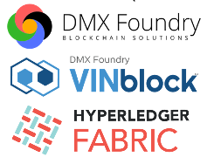

DMX VINblock Concepts
Automotive Ecosystem:
  OEMs, Dealers, Parts, Finance services, Regulators, Infrastructure, Carriers, Consumers
An Enterprise Blockchain Ecosystem for automotive supply chain will improve:
  Trust
  Privacy
  Security
  Mobility
  Transparency

Slide 25
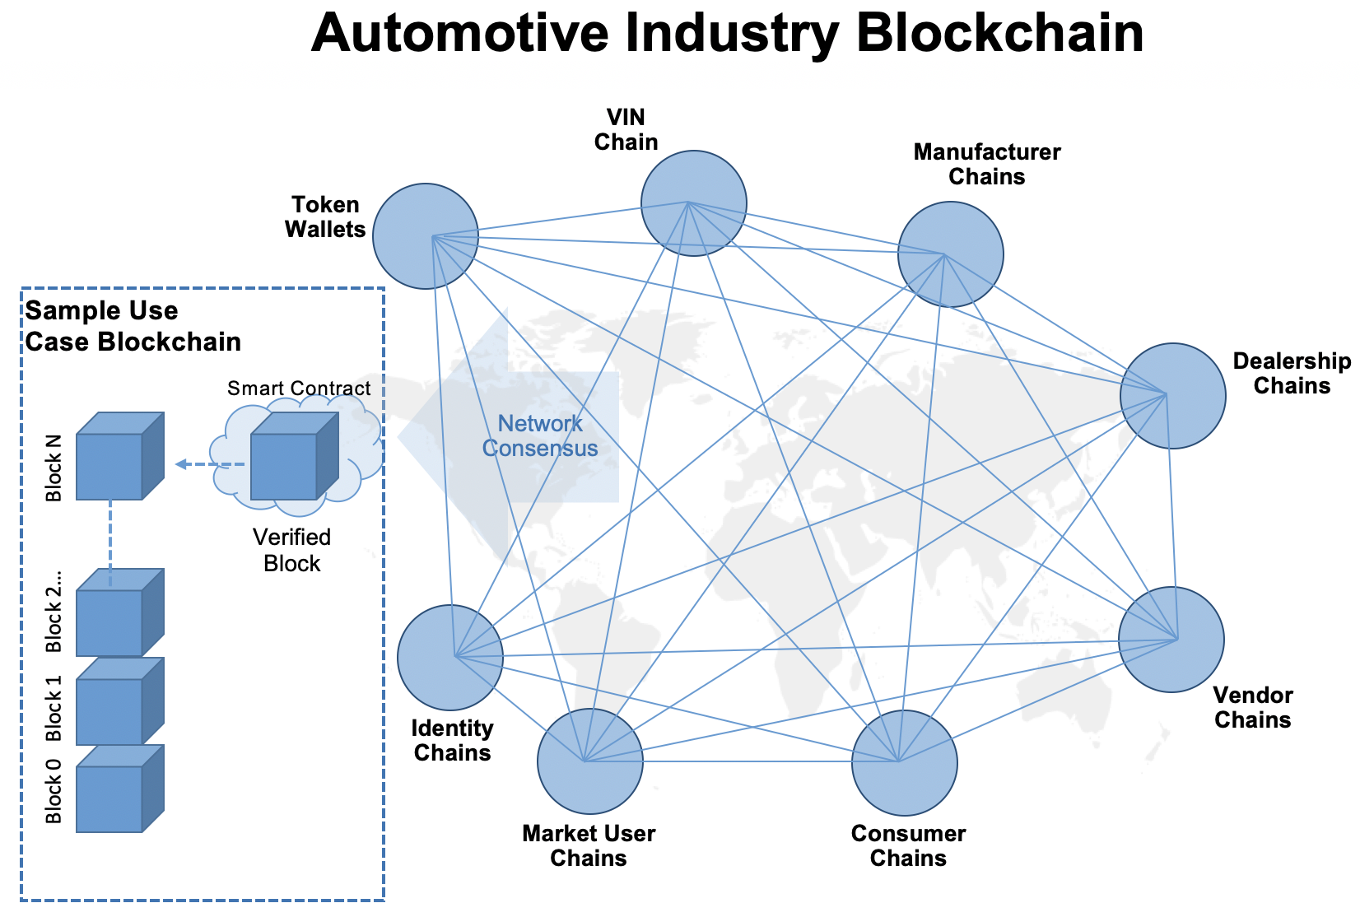

VINblock Solution
Vehicle Identity lifecycle: birth to scrap
Transparent, secure blockchain
ecosystem of life time data
across all parties

Slide 26
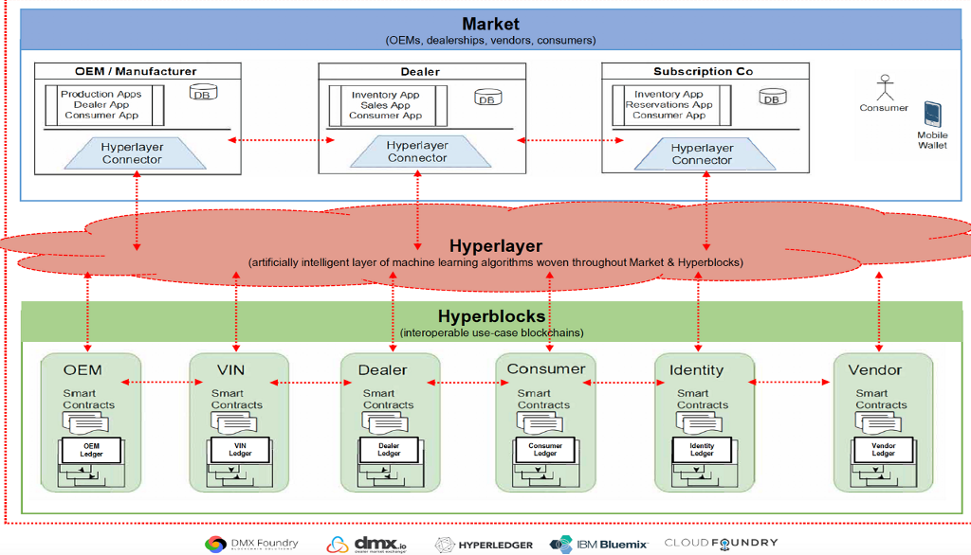
DMX Hyperlayer Blockchain Architecture

Slide 27

Vehicle Identity: the First Use Case
VINblock POC: VirtualBox, Ubuntu,
Fabric
List of VIN operations
Create a VIN
Change a VIN owner
Query a VIN
Remote access VIN in blockchain
CouchDb
VINblock applications
An OEM–dealer–vendor–consumer VIN blockchain providing secure, immutable, transparent and relevant vehicle data to industry users. First in series of interoperable use case blockchains to form industry ecosystem.
VINblock applications list
VIN creation // newly manufactured or historical imports
VIN transactions // title ownership changes
VIN mobility // rentals, subscriptions, loaners
VIN shipments // intrastate, interstate, international
VIN service / repairs // accidents, repairs, maintenance
VIN modifications // vehicle upgrades, rebuilds, modifications
VIN salvage // scrap, junk, salvage status

Slide 28
Agenda
Mobility Marketplace Overview
Blockchain Basics Concepts
Hyperledger Enterprise Blockchain Concepts
VINBlock vehicle identity chain
MOBI vehicle identity project
Summary

Slide 29

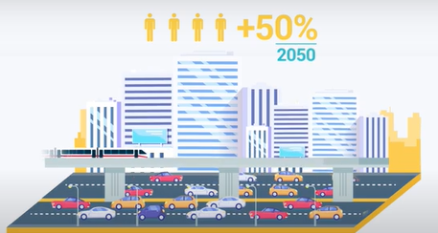
Mobility Open Blockchain Initiative
MOBI is a member-led consortium
Working to make transportation greener, more efficient, and more affordable, using blockchain and related technologies.
Through research, education, innovation platforms, colloquiums, and working groups, MOBI works to create and promote high industry standards for smart mobility blockchain adoption
MOBI Updates
20+ teams
Sample projects
  IOT parking and driving communication
  Decentralized network formation of drones
  Route and vehicle status data on blockchain to help with emergencies
  Preventing odometer fraud
  Smart intersection and negotiation of routes
  Payments on blockchain V2V and V2X
Geographic spread : North America, Europe, China, India
Participants: MOBI members and outside

Slide 30
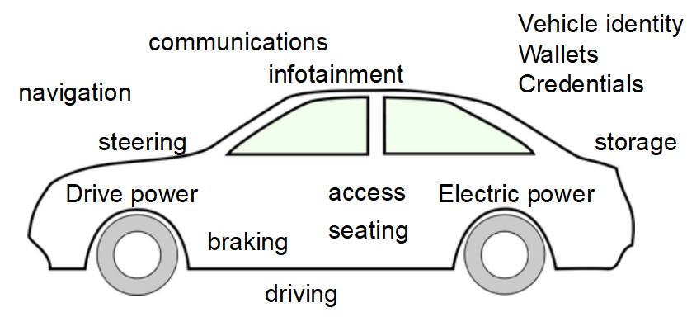
Vehicle Systems & Applications
Vehicle Identity and Birth Certificate
Vehicle Wallets
Vehicle Credentials
( registrations etc)
Trusted vehicle history for significant events and subsystems
Trusted OTA updates
Autonomous driving support levels for vehicles
Infotainment systems
Vehicle operations systems
Vehicle safety systems

Slide 31
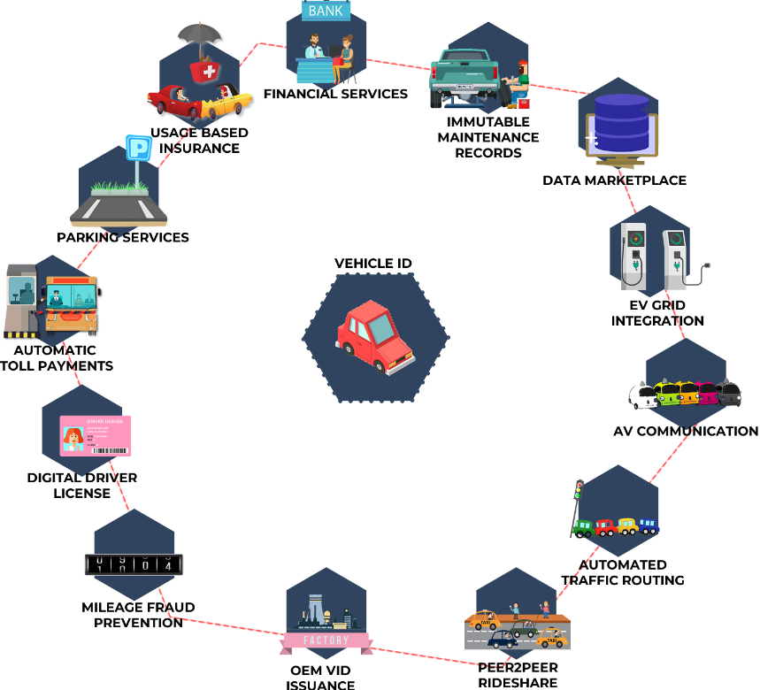
Off Vehicle Applications
pay for road use, tolls, parking
reduce traffic congestion
improve safety and reduce accidents
real-time accident reporting
sell data to businesses and organizations
sell open seats in vehicles for trips
earn credits for taking preferred routes
Alternate transportation methods
  Bus, rail, scooters, bikes, ride shares
real-time carbon emissions tracking
usage-based insurance
automated maintenance and service

Slide 32
Vehicle Identity Project
VID is the digital identity of a unique vehicle providing the necessary bridge to the physical asset that allows vehicle owners, users,and the transportation IoT ecosystem to trust and verify the vehicle's identity
The Mobility Open Blockchain Initiative (MOBI) is working with BMW, Ford, GM, Groupe Renault, Honda, and other major automakers to develop a multi-stakeholder Proof of Concept (PoC) for a blockchain-based Vehicle Identity (VID)
Vehicle Identity ( & wallets ) foundational
First Vehicle Identity (VID) Standard out
VID part 2 – define a valid POC model
Review solutions for: Security, Enterprise readiness, Support for standards, Scalability, Integration of specific protocols
Identity and access management approaches focused on SSI, TOIP
Identity creation, revocation of Identities, Identity Proofing
Scalability, Portability of data across data stores
Portability of identity, keys/key pairs across devices
Decentralization of Infrastructure
Data management: What data is On-Chain vs. Off-Chain? Why? Finality?
Data Sovereignty: Selective Disclosure of data to share
Which automotive use cases are addressed?
Integration with existing IAM: SSO and Enterprise IAM integration?
Interoperability: Support for OIDC, SAML, FIDO for interoperability
Control for private data, public data and asset owner changes
Privacy: How does your solution address privacy concerns?
Protection of data: Do you use solutions like Zero-Knowledge proof ?

Slide 33
Vehicle Connected Data Marketplace Project
Team Focus
The connected vehicle is trusted, intelligent, shared, automated data services to external applications and marketplaces.
Autonomous Vehicles add services for driving, smart applications, direct payment services etc
The team explores how blockchain adds value in connected applications and marketplaces.
Blockchain's trust, transparency, privacy and collaboration features can add value for many connected applications.
Define key use cases for connected data flows
Define models for connected data
Evaluate existing standards, technologies
Draft connected data standards for key use cases
Specify candidate POC recommendations
Candidate Connected Data Use Cases
pay for road use, tolls, parking
reduce traffic congestion
improve safety and reduce accidents, reporting
Autonomous vehicle driving
sell data to businesses and organizations
sell open seats in vehicles for trips
earn credits for taking preferred routes
Alternate transportation methods
  Bus, rail, scooters, bikes, ride shares
real-time carbon emissions tracking
usage-based insurance
automated maintenance and service

Slide 34
Vehicle Services Layer Model
Services
Traffic Control
Congestion Pricing
Tolls
Parking
Marketplaces
Clients
Mobile or Server SDKs
Wallet Mgt (Keys, Crypto, Authentication, Authorization, OS + App integrations
Transaction
Orchestration
Message Buses
P2P protocols
Identifier Communication
VID
capabilities
Key Mgt
Crypto
Operations
ID Mgt
ID
Authentication
Credential Mgt
DLT Anchoring
Compliance Reporting
Enterprise Integration
Storage
Edge Storage
Persistent Store
Hashtable Store
Data Orchestration
DLT
Layer 2 scaling
DLT layer – Fabric, Corda or ?

Slide 35
Agenda
Mobility Marketplace Overview
Blockchain Basics Concepts
Hyperledger Enterprise Blockchain Concepts
VINBlock vehicle identity chain
MOBI vehicle identity project
Summary

Slide 36
Blockchain Solution Delivery Process
Our Delivery Process
Engage – Understand Community, Needs
Assess – Assess Value Opportunities
Plan – Define Solution
Deliver – Deliver Solution
Implement – Implement Solution Support
Grow – Grow the Solution, Network
Keys for a Value Chain Trust Network
Who are the parties are in the Business Network?
What value does each role deliver?
What challenges does each role have?
Is there counter party risk?
How are trust issues resolved?
How are identity, security managed?
Do parties cooperate now? How?
Are the processes clear? Efficient?
What are key decisions & events?
How do intermediaries add value?
What are regulations, compliance issues?
How can the Value Chain Network grow?

Slide 37
Summary
What We Covered:
How the MOBI Vehicle blockchain standards support a trusted, connected vehicle ecosystem
Key Hyperledger Fabric blockchain features that support identity, privacy, transparency, trust and scalability
What a vehicle identity blockchain service is and the steps to build it
Final Thoughts
Mobility methods, fuel sources and preferences are changing rapidly
Newer technologies are providing mobility solutions that were never possible before
  Enterprise blockchain
  Digital Trust
  AI and Machine Learning
  5G connectivity for vehicles
  IoT integration on vehicles and infrastructure
  Automation of many systems
  Cloud services

Slide 38



Thank you! You can find me at:
Jim.mason@skywebteam.com
Questions?
@jmason900
http://linkedin.com/jimmason2

