Slide 1



Setting up a GitHub Repository for Your Lab
If you’re interested in creating a GitHub repository for your lab can help you manage your work, collaborate with peers, and practice using Git. Here's how to do it:
Ledger Academy

Slide 2
Step 1: Sign In or Create an Account
Username
Login
If you don't already have a GitHub account, go to github.com and sign up for one.
If you already have an account, log in to access your dashboard.

Slide 3
Step 2: Create a New Repository
1
"+"
Click on the "+" icon on the top right corner of the page.
2
New Repo
Select "New repository" from the dropdown menu.
3
Repo Name
Name your repository with a descriptive title related to your lab.
4
Visibility
Choose whether to make your repository public, private, or internal. Read the descriptions to choose the option that fits your needs best.

Slide 4

Step 3: Add a Description
1
Description
Add a brief description of your lab's purpose to give others an idea of what it's about.

Slide 5
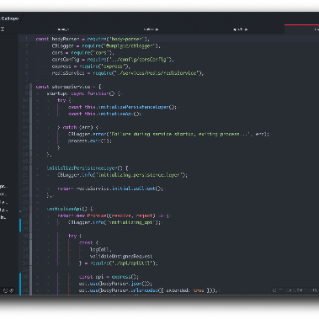
Step 4: Initialize With a README File
README
Check the "Initialize this repository with a README" box to create a landing page for your lab repository where you can provide important information and instructions for others.

Slide 6
Step 5: Choose a License
1
Add a License
In the "Add a license" dropdown, select a license that suits your needs.
2
Research
If you're not sure which license to choose, you can research and select one later.

Slide 7

Step 6: Use a .gitignore File
1
Add .gitignore
To avoid committing and pushing unnecessary or sensitive files to the repository, add a .gitignore file to specify which files should be ignored by Git when tracking changes.

Slide 8

Step 7: Create the Repository
"Create Repository"
Button

Slide 9
Step 8: Clone the Repository to Your Local Machine
1
Clone
After creating the repository, you can clone it to your local machine using Git. Go to the repository's main page and copy the repository URL.
2
Open a Terminal
Open a terminal or command prompt, navigate to the directory where you want to clone the repository, and run the following command:
3
bash git clone <repository_url>
Replace <repository_url> with the URL of your lab repository. You can find the repository URL on the repository's main page.

Slide 10

Step 9: Start Adding Files and Code
Code
Now that the repository is cloned, you can start adding files, code, documentation, or any other relevant content to the repository. Use Git commands like git add, git commit, and git push to manage and sync your changes with the remote repository.

Slide 11

Step 10: Invite Collaborators
1
Add Collaborators
Inviting collaborators is an easy way to share your work and keep others in sync with your progress. To do this, navigate to the repository's main page, click on the "Settings" tab, and select "Collaborators" from the left sidebar. Enter the GitHub usernames or email addresses of the people you want to invite and choose their access permissions.

