Slide 1


Mid-Year 2020
Hyperledger Update
www.LedgerAcademy.com
@LedgerAcademy

Slide 2
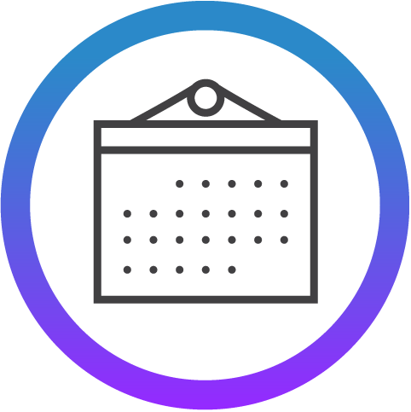
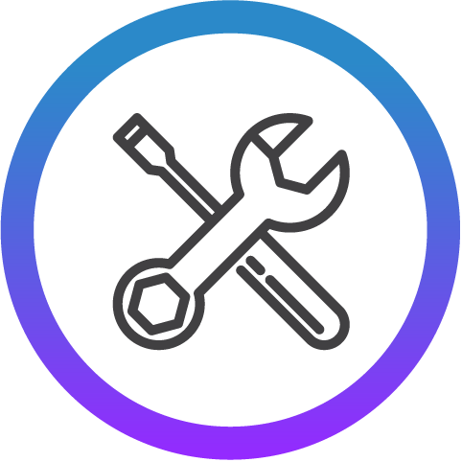
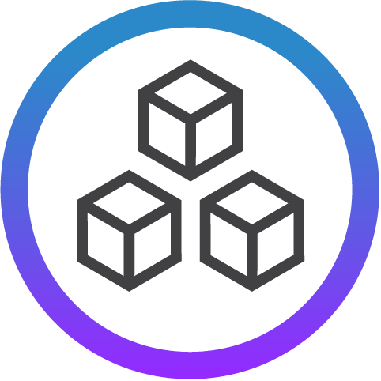


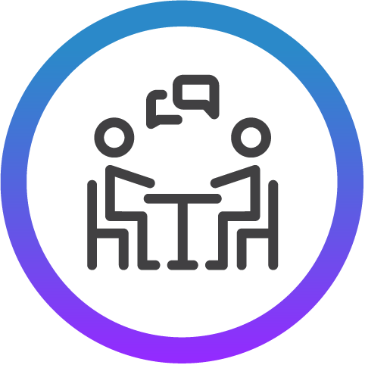
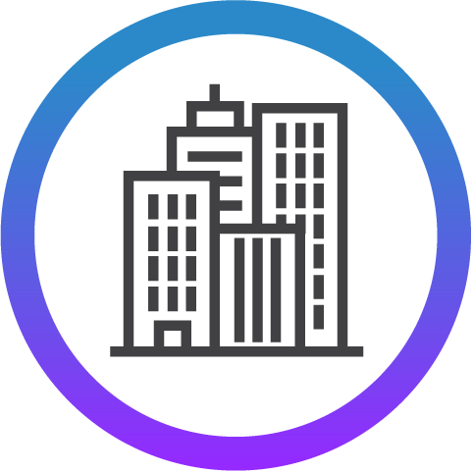
Hyperledger Momentum
4
Years Since Launch
16
Projects
4
1.0 Production Releases
1
2.0 Production Releases
9
Hyperledger
Training and Certification
Courses
16
Active Community Working Groups & SIGs
170+
Meetups Worldwide
67K
Meetup Participants
Notes:
Besu: 1.4.6
Fabric: 1.4.4, 2.1.1
Indy: 1.15.0
Iroha: 1.1.3
Sawtooth: 1.2.5

Slide 3

Hyperledger has a modular approach to hosting projects. Think of Hyperledger as a greenhouse growing and sustaining business blockchain projects from seed to fruition.
The Linux Foundation and Hyperledger provide the infrastructure for open development to occur among a diverse and thriving community.
Notes:
Under Hyperledger’s umbrella there are frameworks and tools that take different approaches to creating blockchains for business.
There are many benefits to this modular approach since we believe that there isn’t one blockchain solution that will work well for every possible use case.

Slide 4
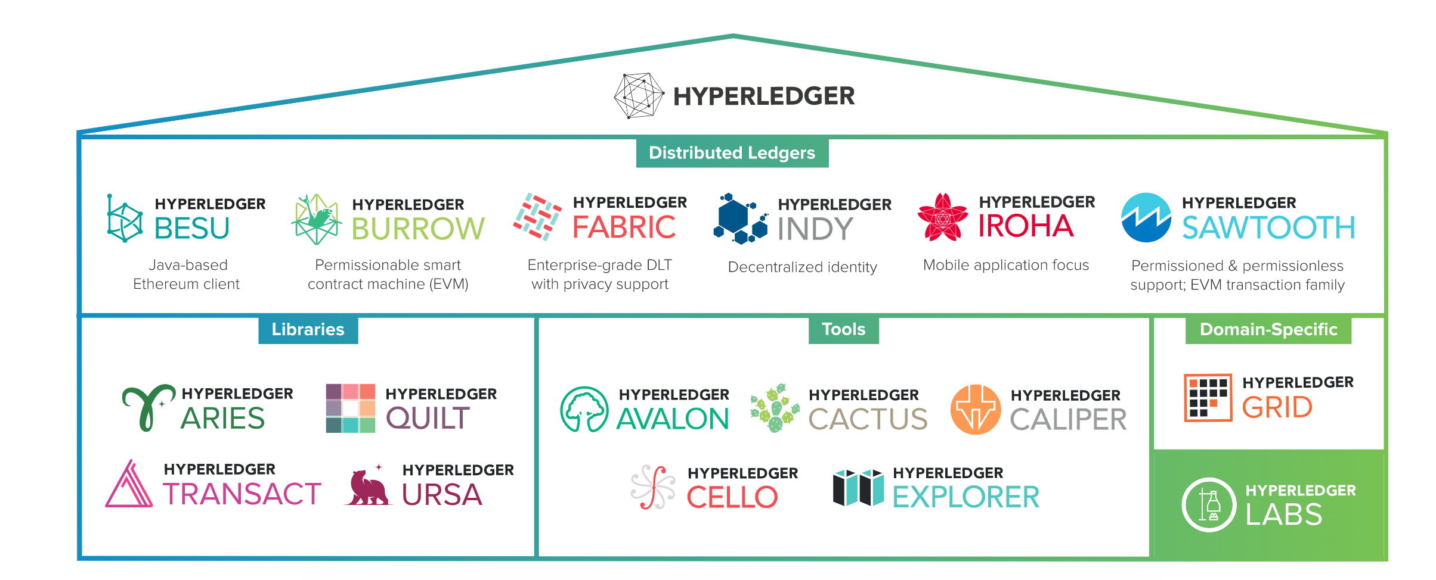
The Hyperledger Greenhouse
View How to Get Involved in Projects

Slide 5


Q2 Project Releases Highlights
Three releases were published this past quarter: Hyperledger Fabric v2.1.0, and Hyperledger Fabric v2.1.1. Hyperledger Fabric v2.2 is planned to be formally released the first week of July and is expected to be the next LTS release, maintaining the regular cadence of roughly quarterly releases.
1.5 Release, scheduled for July 15, 2020. The 1.5 Release is expected to include the following features:
Performance improvements: Performance is a high priority item for the Besu team at this time to ensure it’s a leading Ethereum space. Some of the improvements will include block propagation, block product and validation, transaction pool management, and JSON RPC query response time.
Privacy Improvements
Preliminary Mainnet Berlin support.
All project quarterly reports: https://wiki.hyperledger.org/display/TSC/TSC+Project+Updates
Notes:
This slide covers the major project-related news for this time period, including updates to existing projects and the launch of new projects.

Slide 6
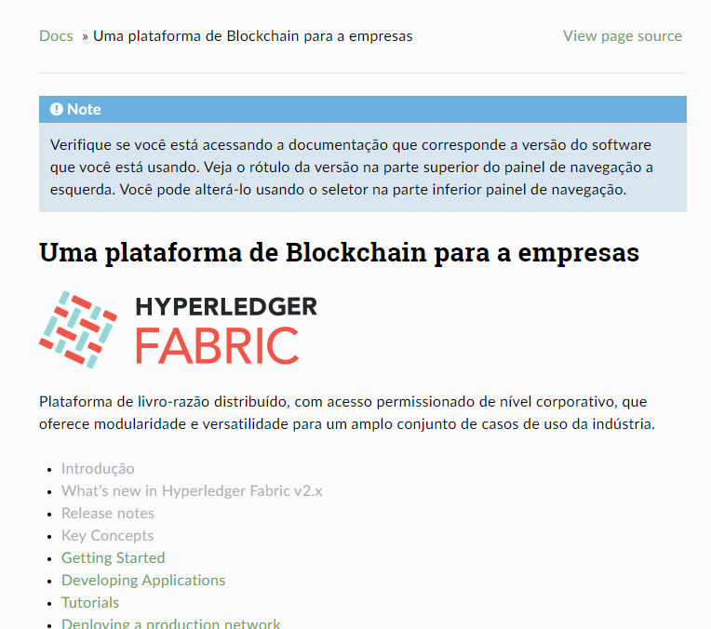
Bringing Hyperledger Projects To More People
The Hyperledger Fabric Documentation Working Group has started working with community members around the world to create translations in more languages.
The Fabric documentation was previously available in English and Chinese and now new translations have started for Portuguese, Japanese, Malayalam and Spanish.
This will make information about Fabric available to more than 800 million people who speak those languages.
And more translation efforts may be starting soon as we share about this new contribution opportunity with the community.
Notes:
This slide covers the major project-related news for this time period, including updates to existing projects and the launch of new projects.

Slide 7

Interoperability and Integration
Developments in the Hyperledger Community
Interoperability and integration are top of mind issues across the blockchain space right now.
From new projects to new solutions, the Hyperledger community is taking on the challenges of cross-chain and cross application communication and data flow.
Read about #HyperledgerInterop
www.hyperledger.org/blog/2020/05/28/interoperability-and-integration-developments-in-the-hyperledger-community

Slide 8
Our Newest Projects

Slide 9

Our Newest Project
Cactus is a blockchain integration tool designed to allow users to securely integrate different blockchains.
The move from Labs to the Hyperledger Greenhouse was an important step in the direction towards production-readiness.
Join US! Now is the time for end-user, SI, and vendor developers to participate in defining the architecture of blockchain integration service.
Notes:
This slide covers the major project-related news for this time period, including updates to existing projects and the launch of new projects.

Slide 10
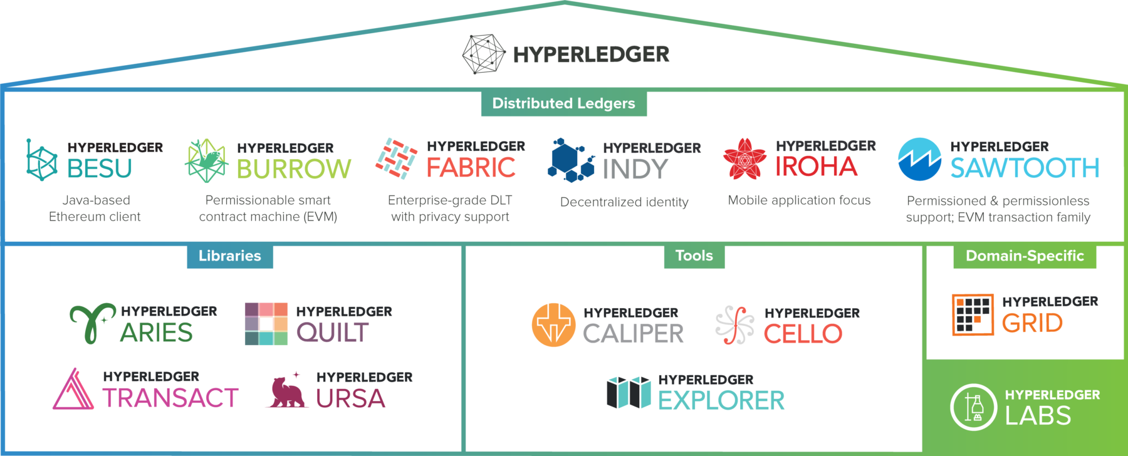
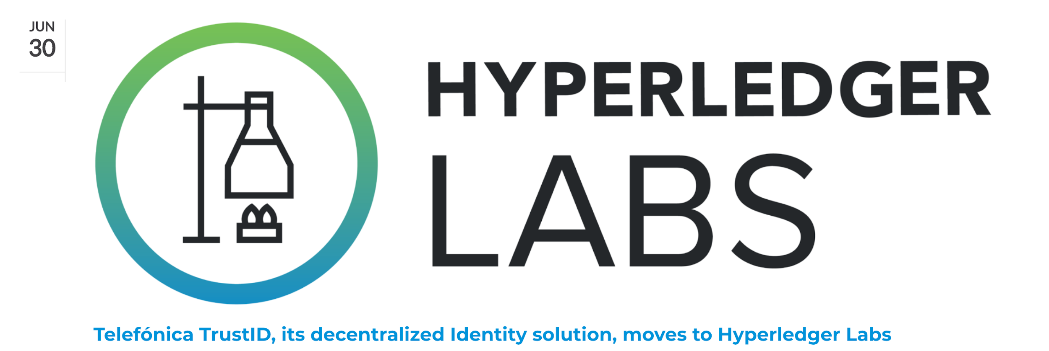
Newest Labs: TrustID
www.hyperledger.org/category/hyperledger-labs

Slide 11
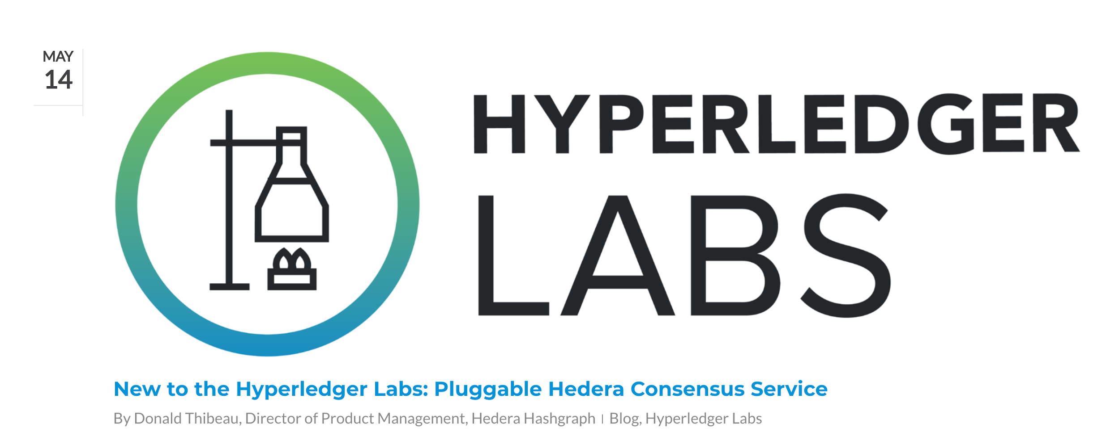
Newest Labs: Pluggable
Hedera Consensus
www.hyperledger.org/category/hyperledger-labs

Slide 12


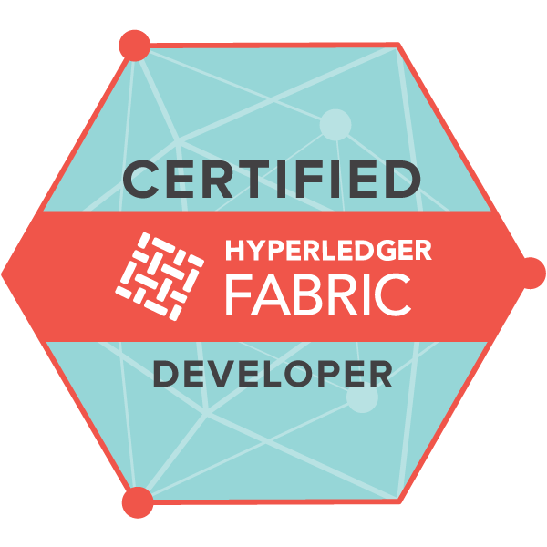
Training and Certifications
Technical training courses and professional certifications to get you up-to-speed on Hyperledger with the highest quality training from The Linux Foundation and Hyperledger Training Partners.
Professional Certification
Certified Hyperledger Fabric Developer (CHFD)
Identity Related Courses
Introduction to Hyperledger Sovereign Identity Blockchain Solutions: Indy, Aries & Ursa
Becoming a Hyperledger Aries Developer
Visit: https://www.hyperledger.org/resources/training
Notes:
This slides has information about the training and certifications that are available for Hyperledger. For people who want more information, please refer them to the link in the bottom right part of the slide.

Slide 13
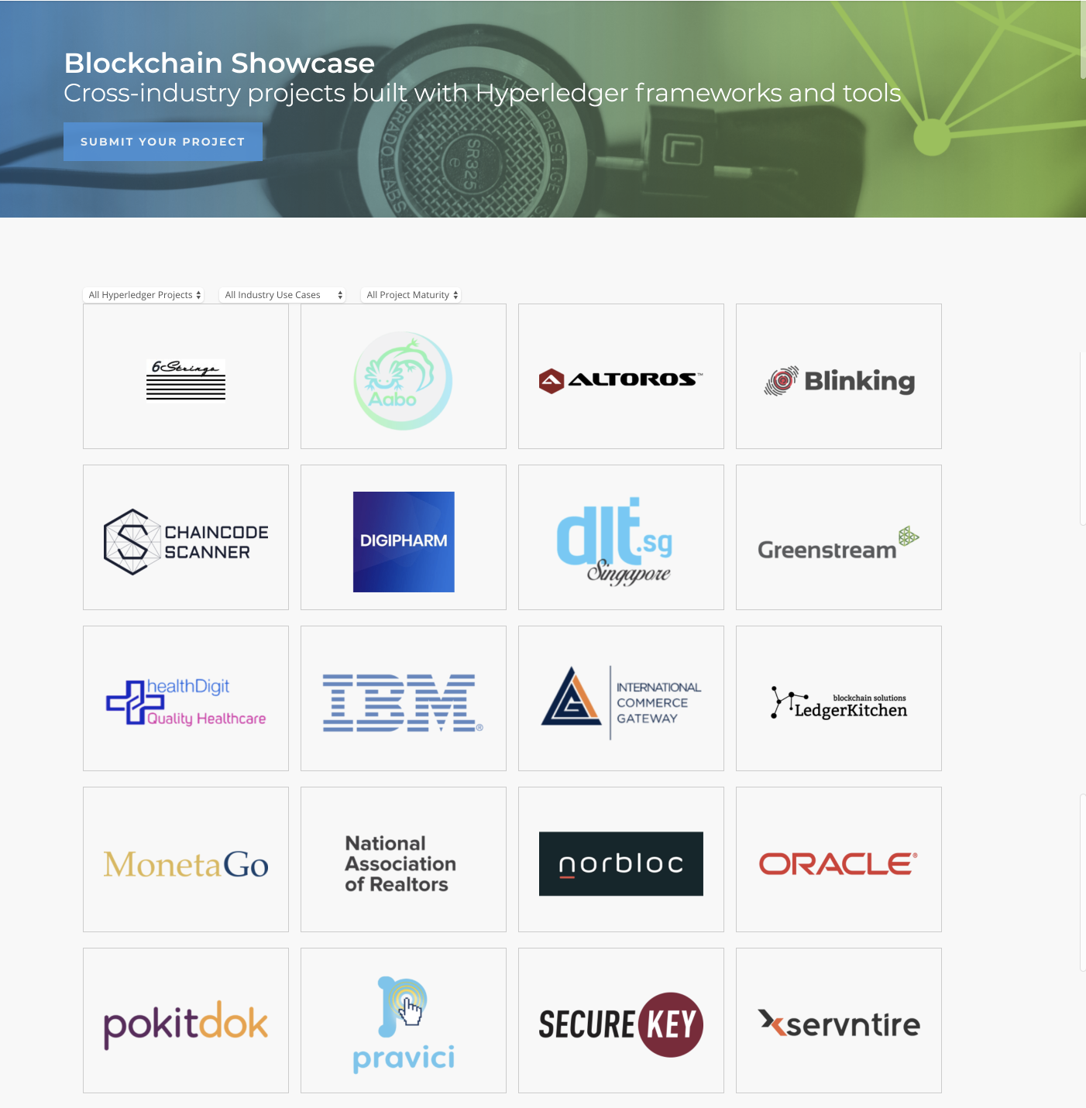

Blockchain Showcase
Cross-industry projects built with Hyperledger frameworks and tools.
65+
Community self submitted projects!
13
Submit your showcase https://www.hyperledger.org/resources/blockchain-showcase
Notes:
This slide talks about the Blockchain Showcase page on the Hyperledger site that has details about the known solutions that organizations have built using Hyperledger. Please point out the link in the bottom right part of the page for people who want to learn more.

Slide 14
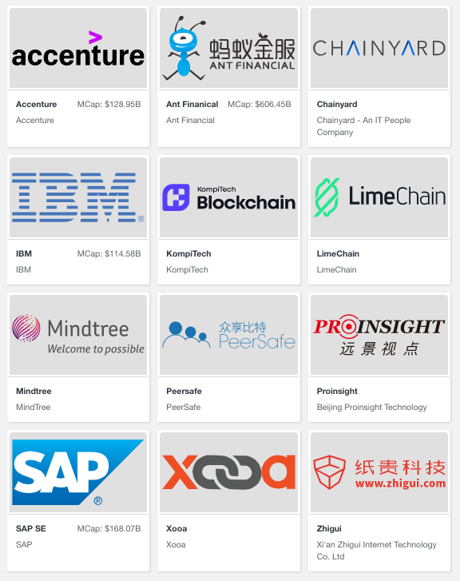
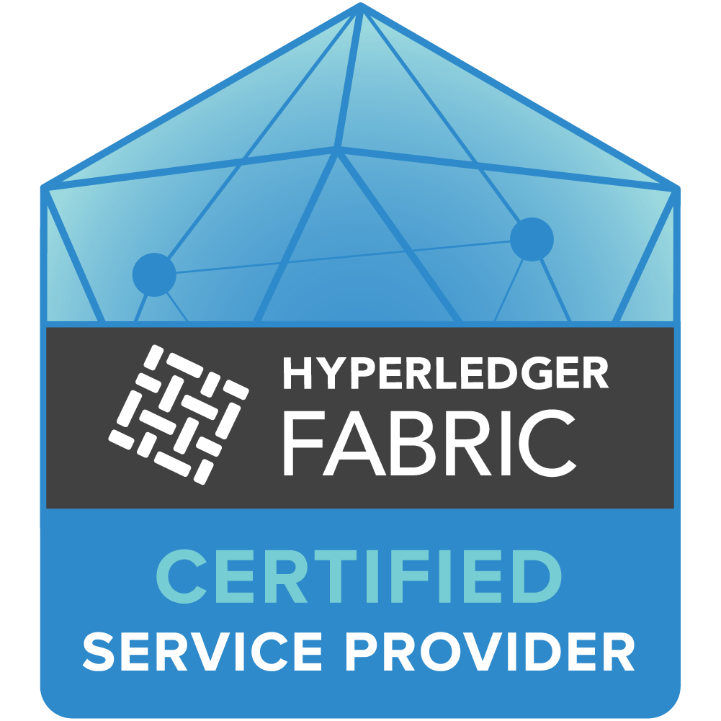
A Global Ecosystem
The Hyperledger Certified Service Provider ecosystem is a global network of technology partners, system integrators, consulting firms and solution vendors from a variety of industries working with Hyperledger technologies.
12
Global
HCSPs
Learn More: https://www.hyperledger.org/use/hcsp

Slide 15
Events Update

Slide 16


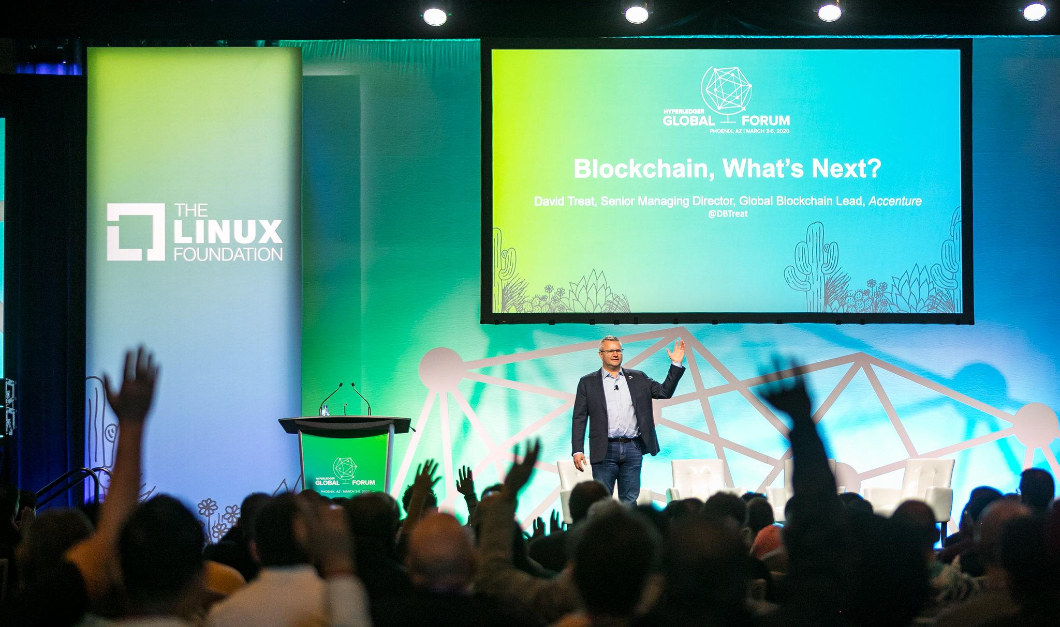

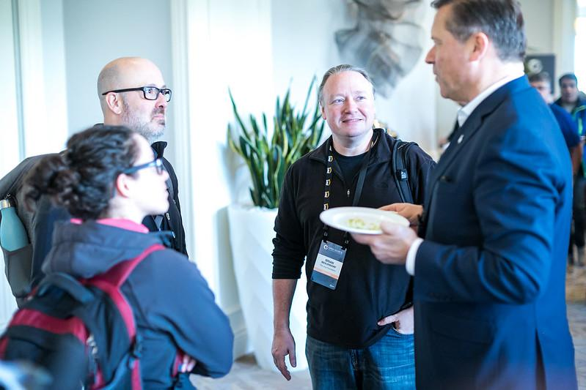
Hyperledger 2020 Global Forum Highlights
450+ global attendees working in over 20 different industries
90+ sessions, including demos, technical how-to’s and workshops
Industry Analysts and Media in attendance w/ 400+ press articles, 1300+ tweets using #hyperledgerforum garnering 17.3M Twitter impressions
All keynotes and session videos, available on Hyperledger YouTube channel
All speaker bios and presentations available publicly on SCHED
Browse pictures from the event
Notes:
To experience the best of this year’s event be sure to watch the keynotes and breakout sessions on the Hyperledger YouTube channel (sessions are still being added), view photos from the event, and review session slides from speakers who provided them via the event schedule.

Slide 17
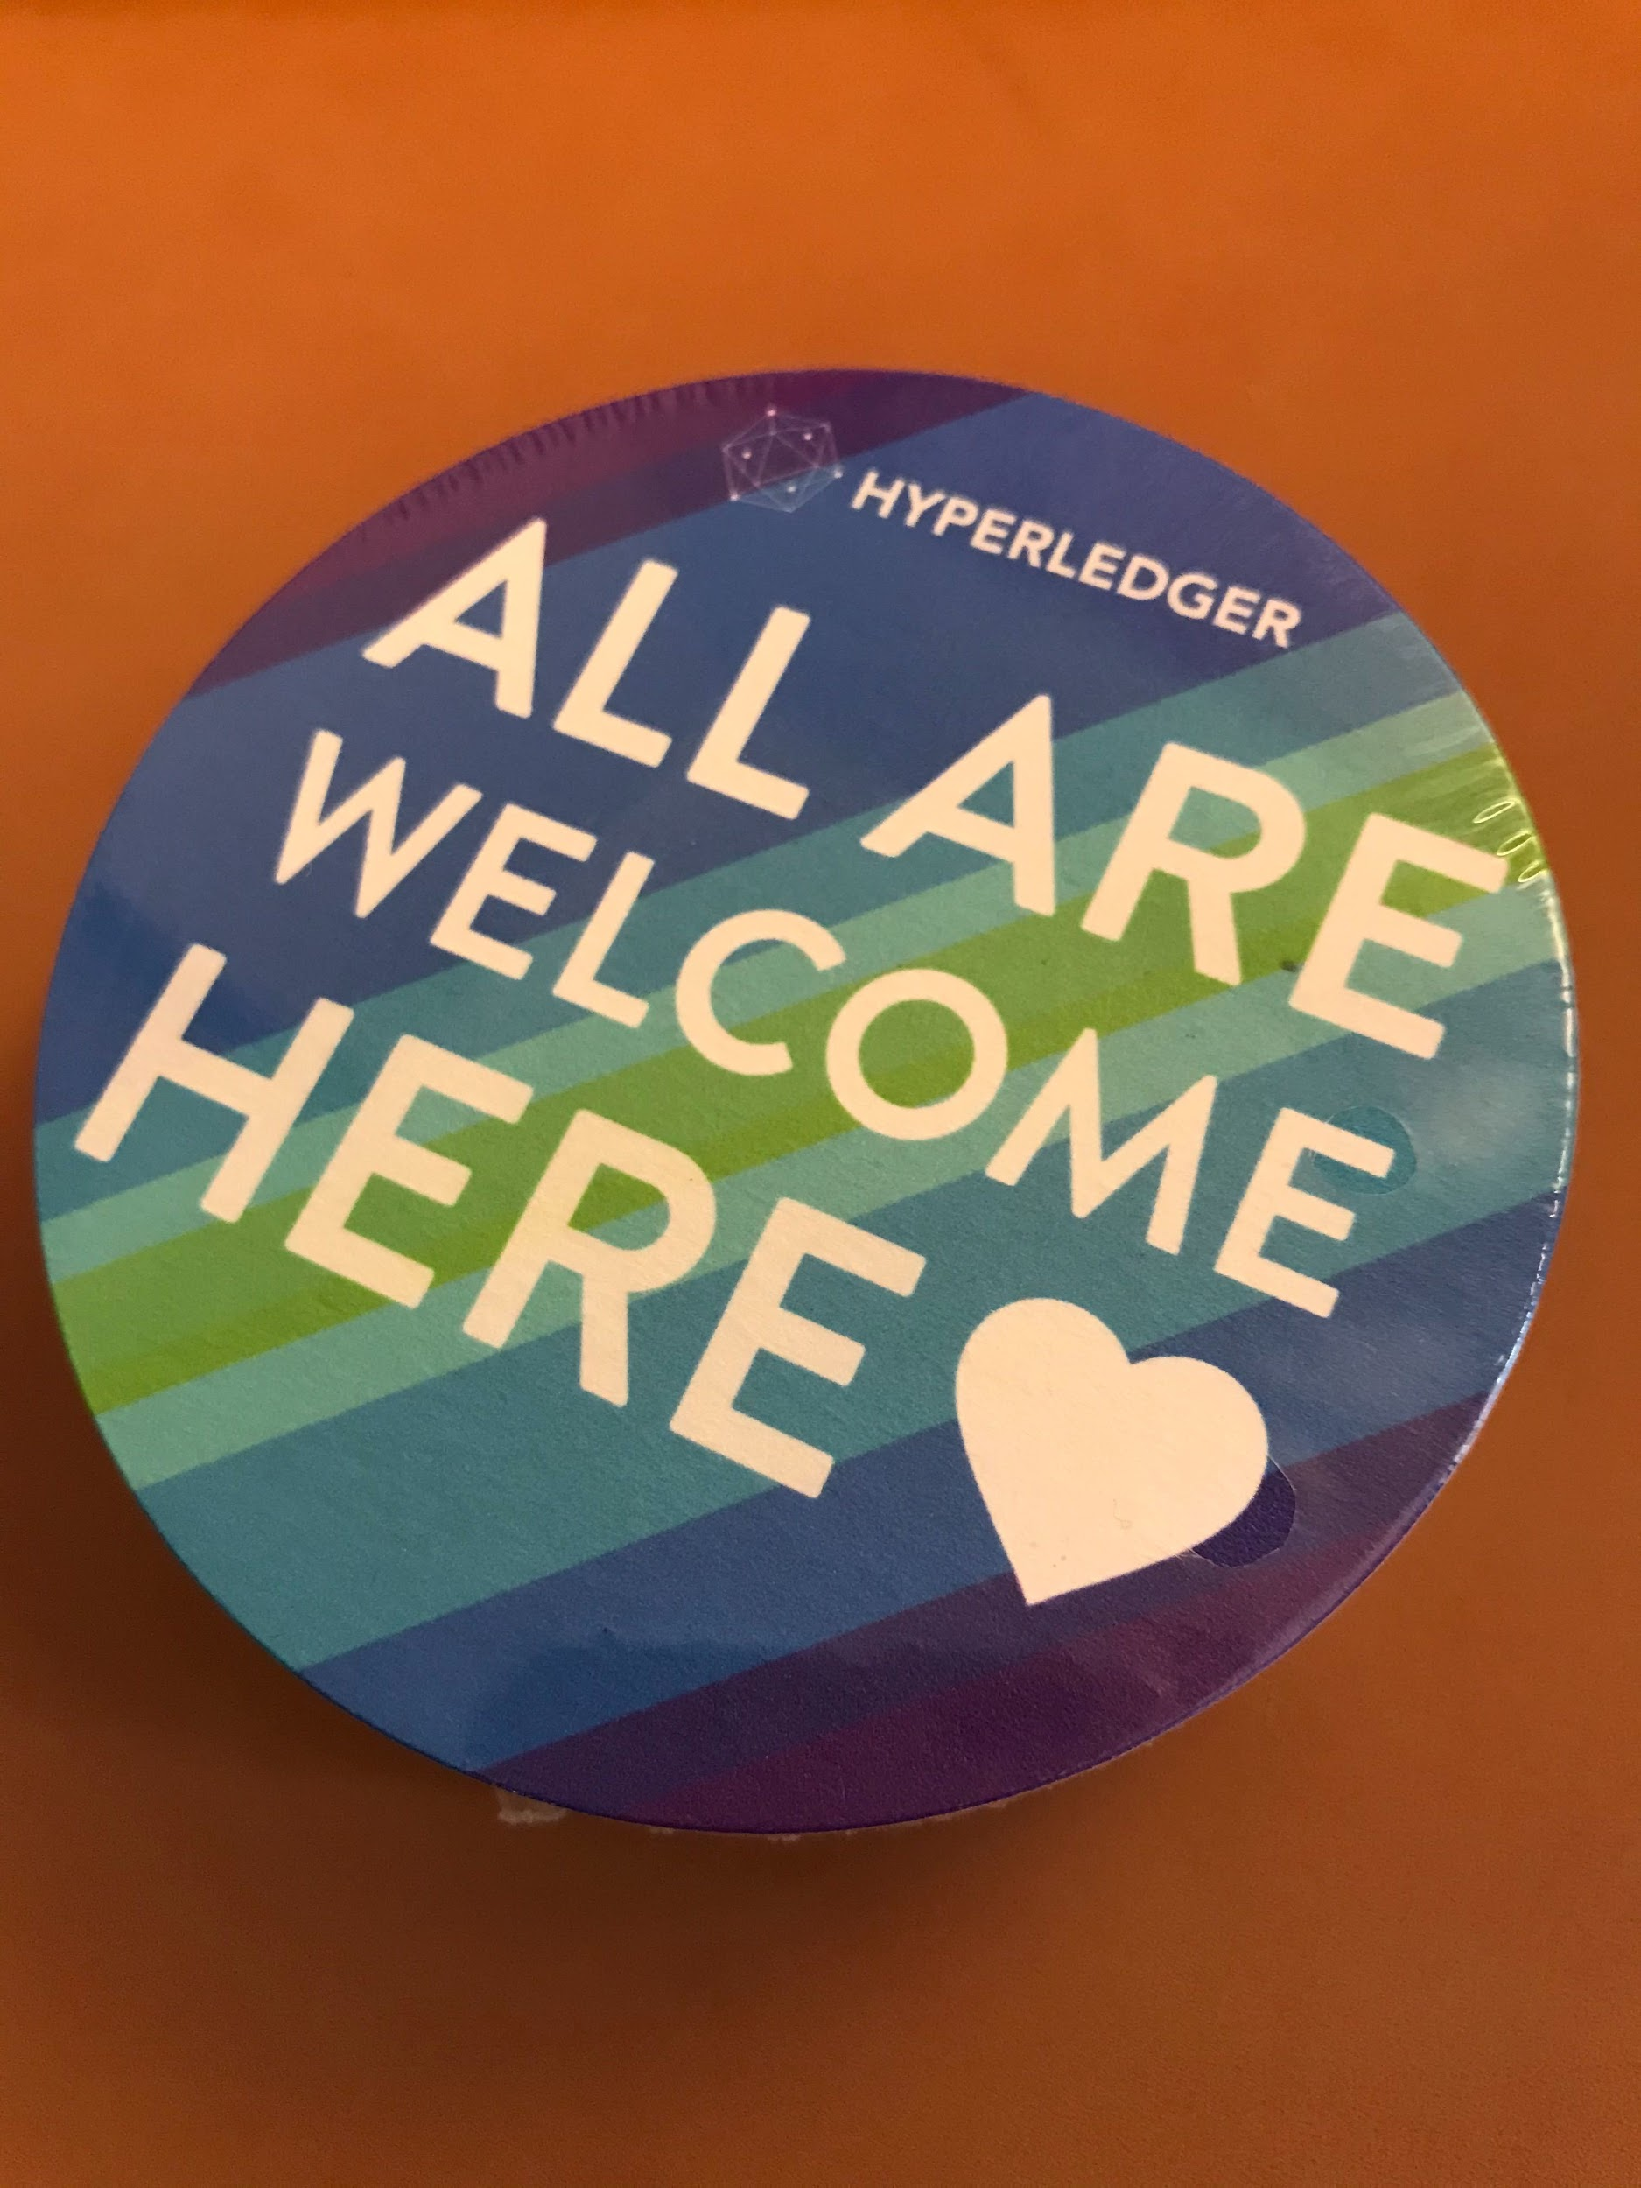

All Are Welcome Here:
Creating an Inclusive Hyperledger Community
Swetha Repakula, IBM & Tracy Kuhrt, Accenture
The phrase “All Are Welcome Here” is a common message heard around Hyperledger events, meetings, and other community interactions. However, how does the community ensure and fulfill that promise? Hyperledger’s community is not a single entity and is comprised of many smaller groups that form around WGs, SIGs, and projects. With so many groups, meetings, mailing lists how can community leaders effectively create an inclusive and civil environment to cultivate a diverse community? This session goes through the best practices for conducting meetings, writing code reviews and enabling asynchronous collaboration to create an inclusive environment. Though focused on Hyperledger tools, these skills can apply broadly to any open source project.
Watch Global Forum Session: https://sched.co/Xoet

Slide 18



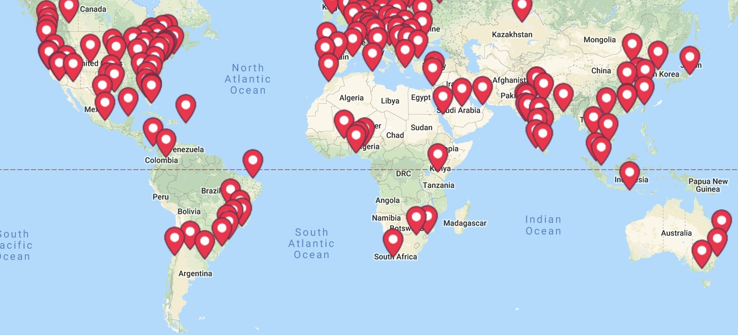

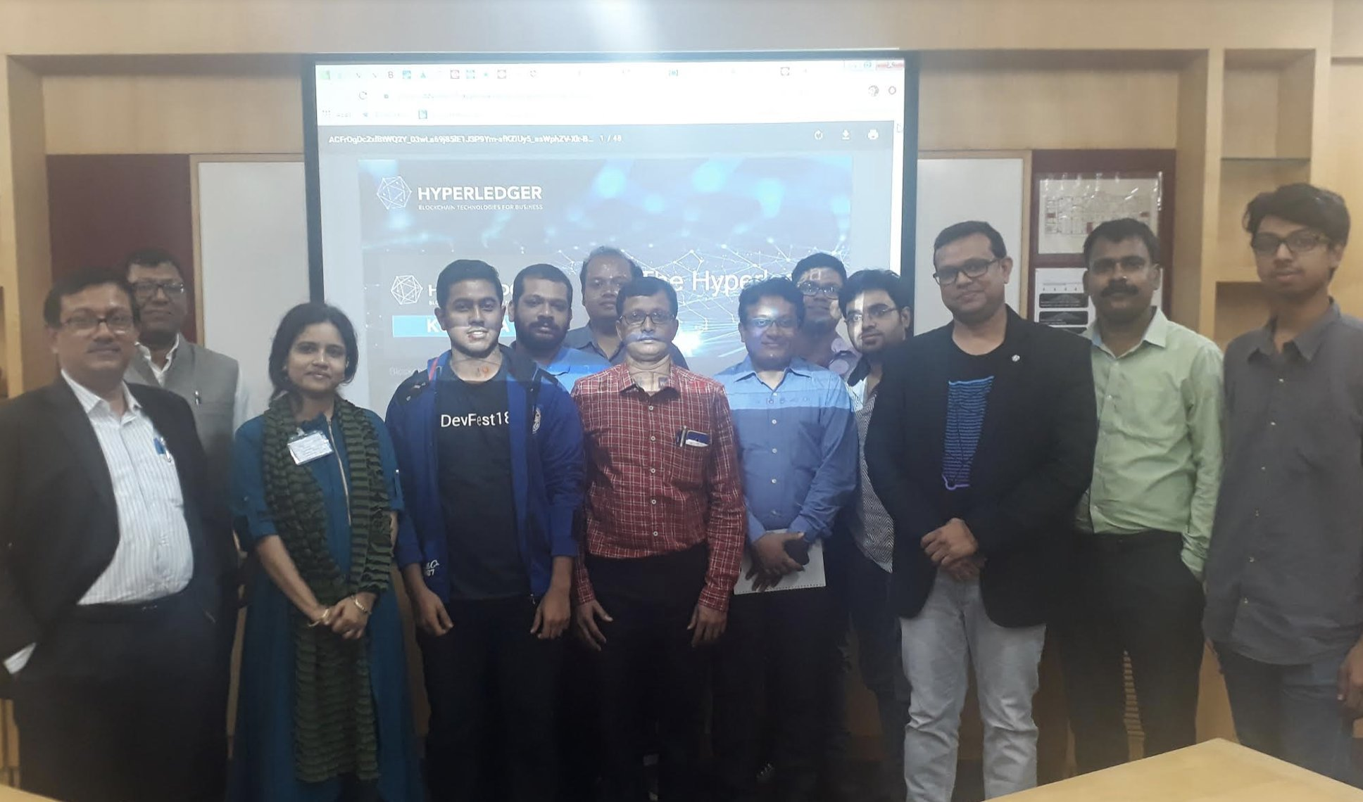
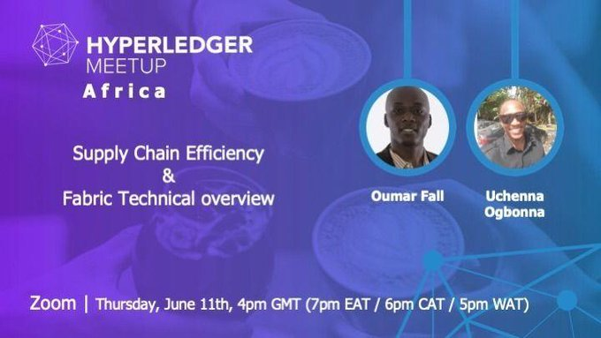

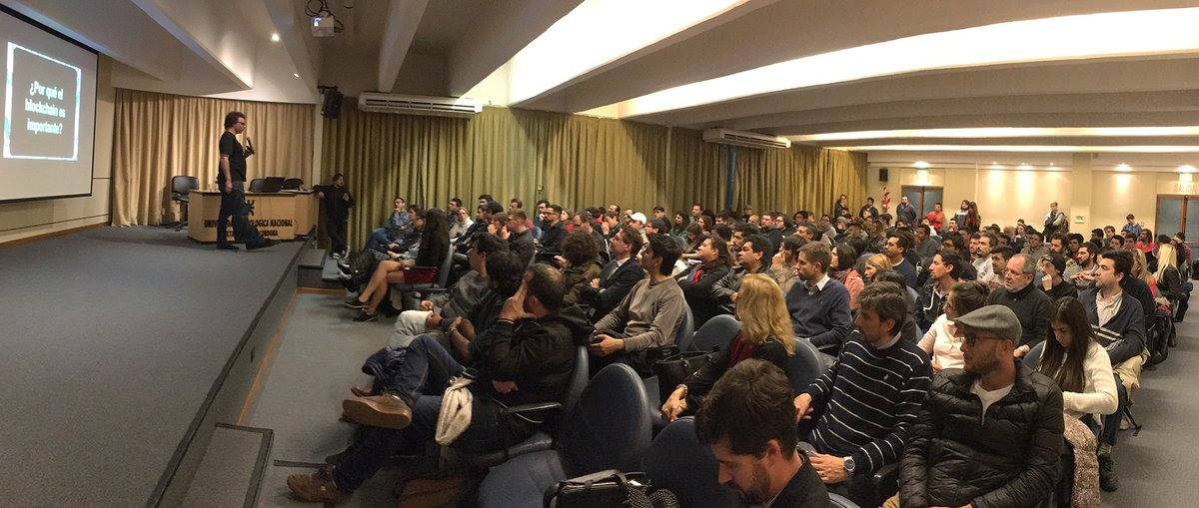
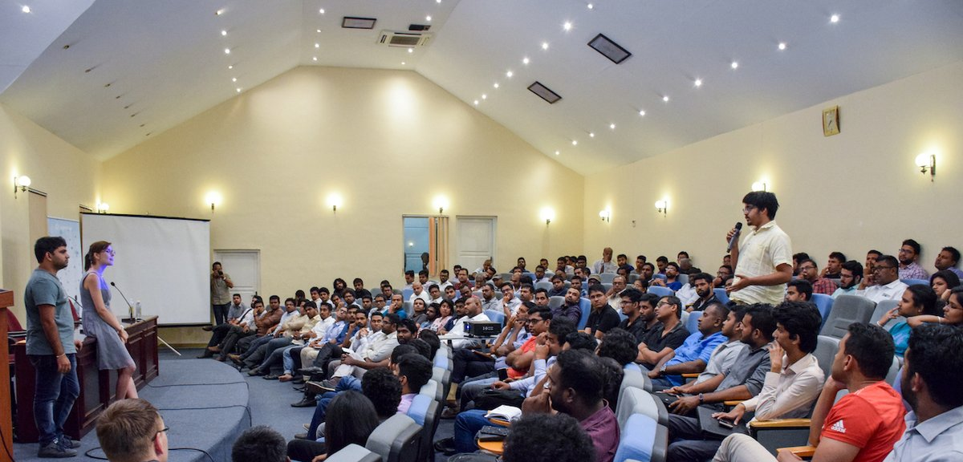
Growing Global Meetup Community
70,000+ Members
179 Groups
80 Countries
Recent Member Meetup Global Talks:
Honeywell
Blockforce
IBM
Tech Mahindra
Soramitsu
Fujitsu
Oracle
DTLedgers
Lenovo
and more!
April-June Activity
50+ virtual meetups held
2,500+ attendees total
6,000+ views of the event recordings on the Hyperledger YouTube channel
Notes:
This page talks about the worldwide group of Hyperledger meetups and includes so relevant statistics, a map and photos from events. For people who want more information, please point them to: https://www.meetup.com/pro/Hyperledger/

Slide 19
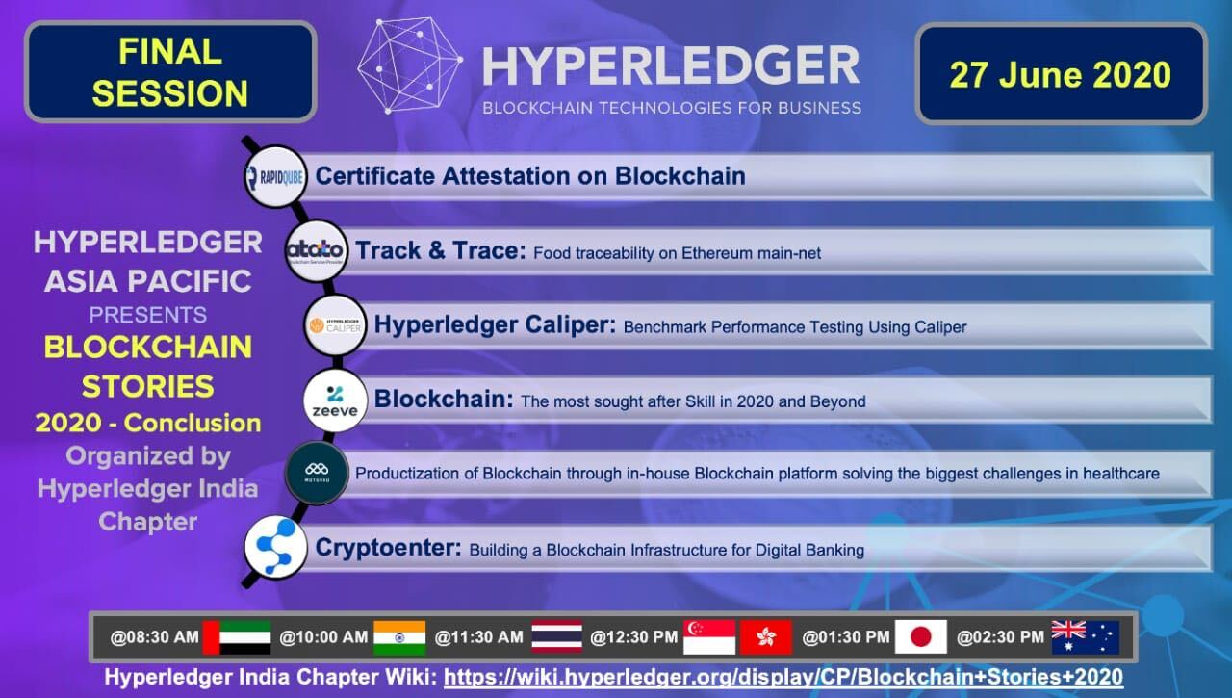
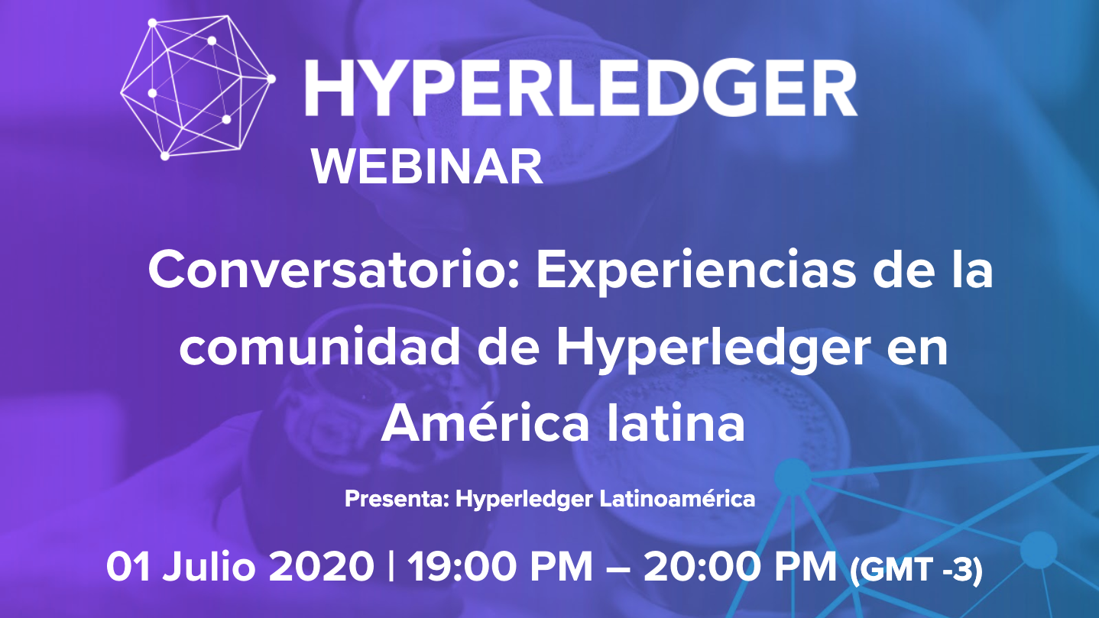
Increased Regional Collaboration
The Hyperledger India Chapter just completed a 5 part series of meetups focused on how Hyperledger is being used in APAC. Check out the recordings.
Brazil and Latinoamerica Chapters have also recently launched and they are running regional events in Portuguese and Spanish
Meetup organizers in Africa have run two virtual events about Hyperledger use there and are planning for a monthly event series
19

Slide 20
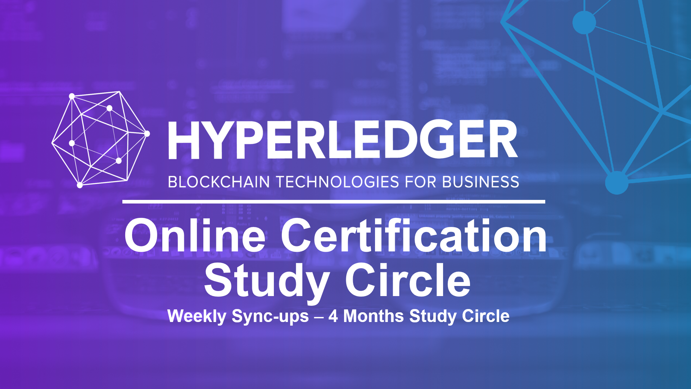
Supportive Learning Resources
Hyperledger Sweden recently started a weekly Study Circle where community members study online training materials together to support each other’s preparation for taking Hyperledger’s certification tests.
This idea has been effective so far and other communities are looking to launch similar efforts in different languages. We hope to launch Malayalam and Japanese Study Circles soon and more groups in other languages are welcome
20

Slide 21

Share Your Meetup Highlights
Let us know about your meetup highlights so we can share the great things you are doing with the rest of the Hyperledger community.
Send updates, photos, tips and ideas to the Meetup mailing list to get in touch with all of the meetup organizers. You can find out how to post to that at: https://lists.hyperledger.org/g/meetups/
When we hear about what active meetup groups are doing we can support you by posting about your group on the Hyperledger Twitter account, send you free swag to give away, help you find speakers for upcoming events and more.
21

Slide 22
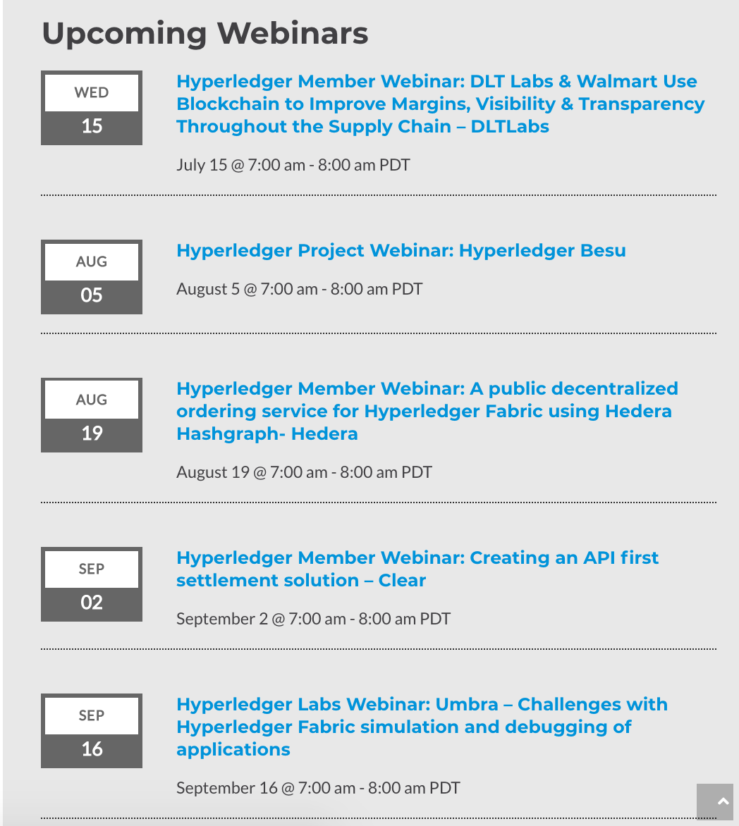
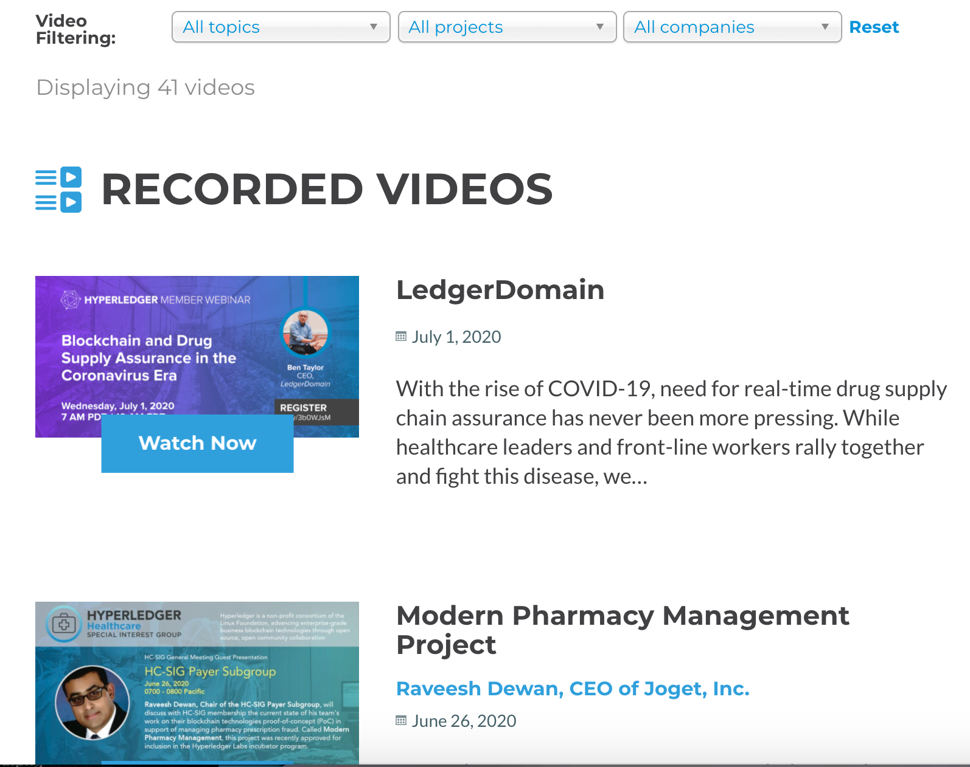
Live Webinars and
On Demand Recordings
https://www.hyperledger.org/learn/webinars

Slide 23
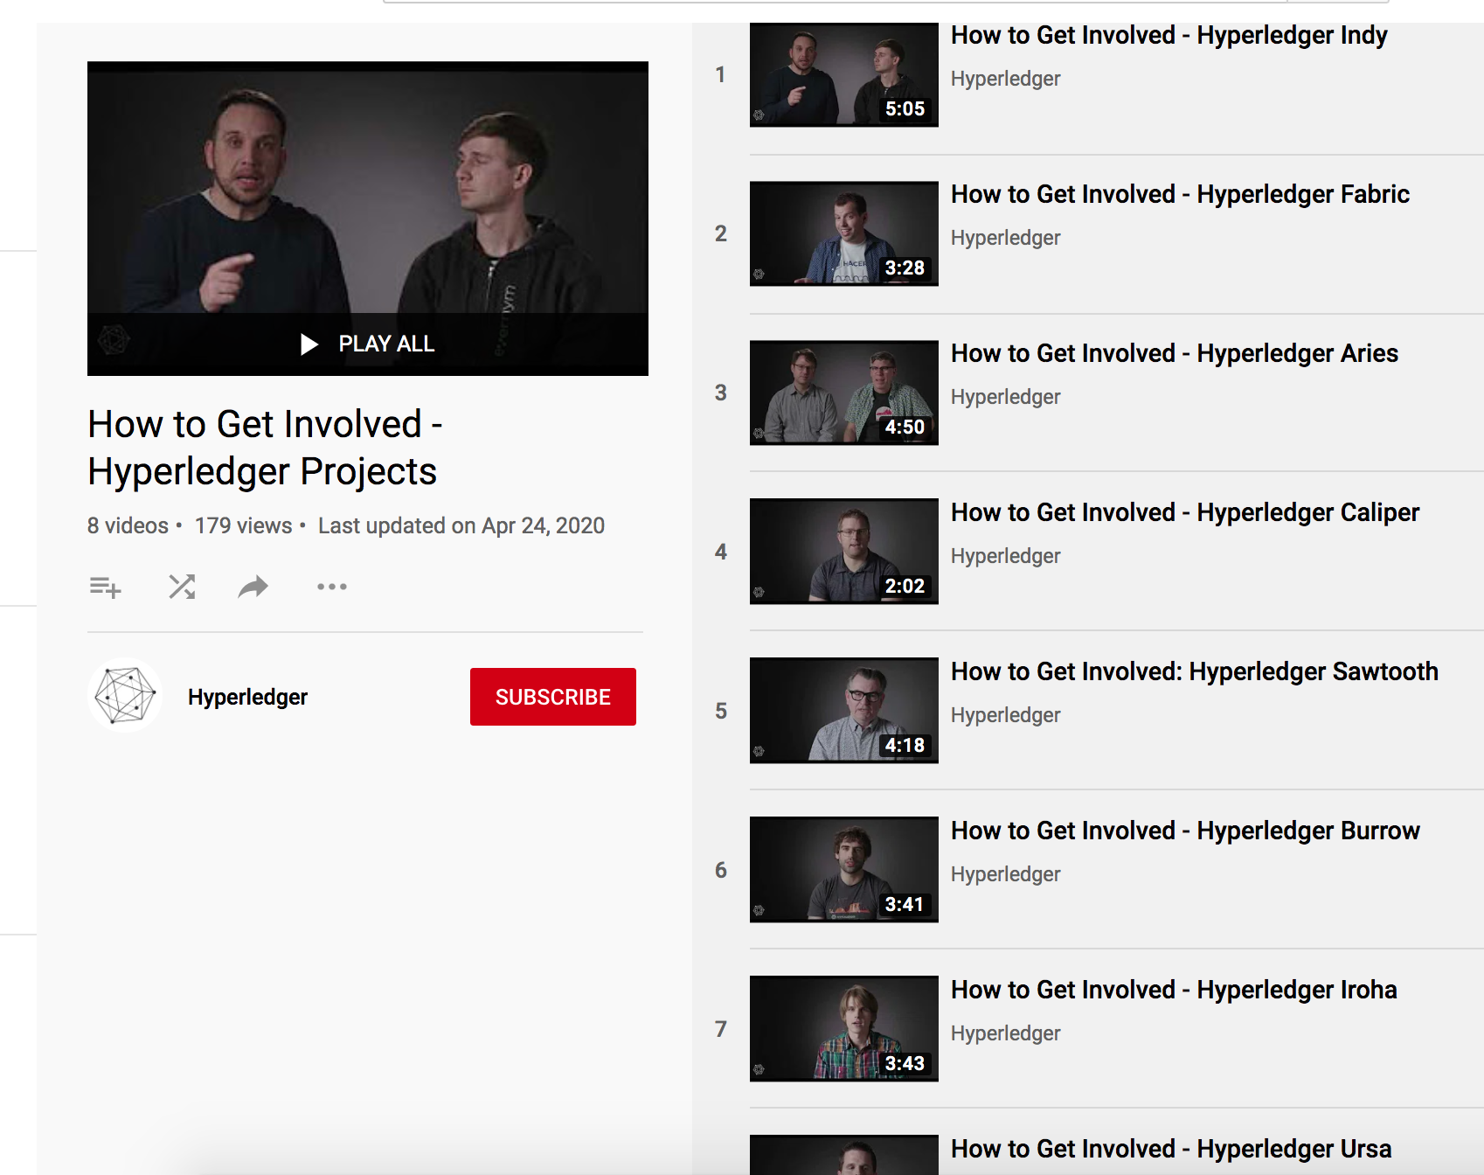

Hyperledger
How to Get Involved PlayLists
Projects
Working Groups
Special Interest Groups

Slide 24
New
Global Use
Cases
Notes:
David

Slide 25

Deloitte Survey: “Blockchain is integral to organizational innovation”
“Leaders no longer consider the technology groundbreaking and merely promising—they now see it as integral to organizational innovation. This year, the C-suite is putting money and resources behind blockchain as a strategic solution in more meaningful and tangible ways—in projects big and not so big— putting into motion more widespread blockchain processes, controls, and even new business models.
As with any business solution, there are still real- world challenges to overcome.”
Deloitte 2020 Global Blockchain Survey

Slide 26

Hyperledger embraces the full spectrum of industry use cases, especially enterprise scenarios with widely varied requirements for decentralization, trust, continuity and confirmation times. Each represents a potentially unique optimization point for the technology.
Notes:
Distributed ledgers for different use cases can have vastly different requirements.
Here you will find industry-specific use cases to illustrate how blockchain technologies can and are being implemented to bring more trust across industries and the world today.
Every problem is not a nail. There is more than just sprinkling blockchain on it.

Slide 27
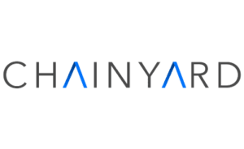


Newest Cross Industry Case Study
Read full Case Study: https://www.hyperledger.org/learn/publications/chainyard-case-study
Watch Member Webinar: Supplier Digital Passport using Trust Your Supplier- Chainyard
https://www.hyperledger.org/event/hyperledger-member-webinar-supplier-digital-passport-using-trust-your-supplier-chainyard

Slide 28


Newest Cross Industry Case Study
Read the Case Study: https://www.hyperledger.org/learn/case-studies/mindtree-case-study

Slide 29

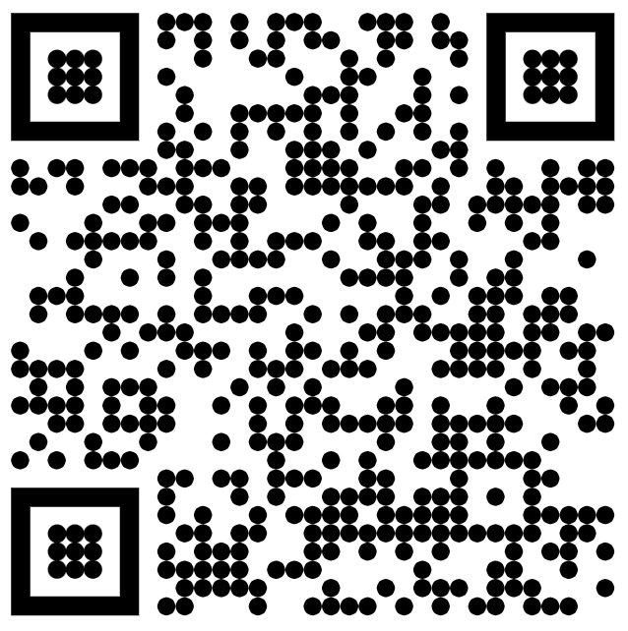
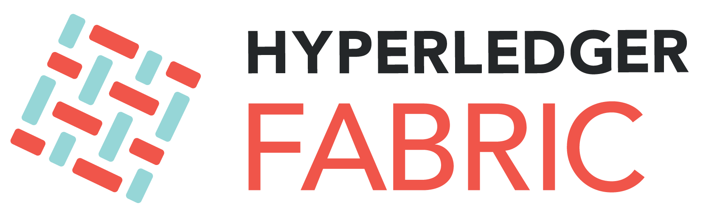
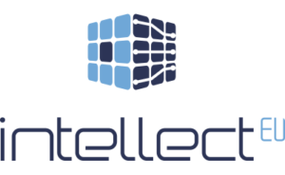
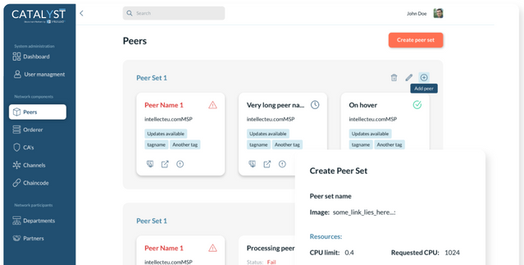
Catalyst Blockchain Platform is a Platform-as-a-Service that supports deployment of Hyperledger Fabric and Corda networks, together with DAML workflows. It utilizes a decentralized network governance and management. Catalyst automates the network set-up and maintenance through an intuitive management console. The Catalyst Blockchain Platform console allows users to deploy organizations and manage peers, orderers, certificate authorities, channels, chaincodes, browse the ledger, etc.

Slide 30
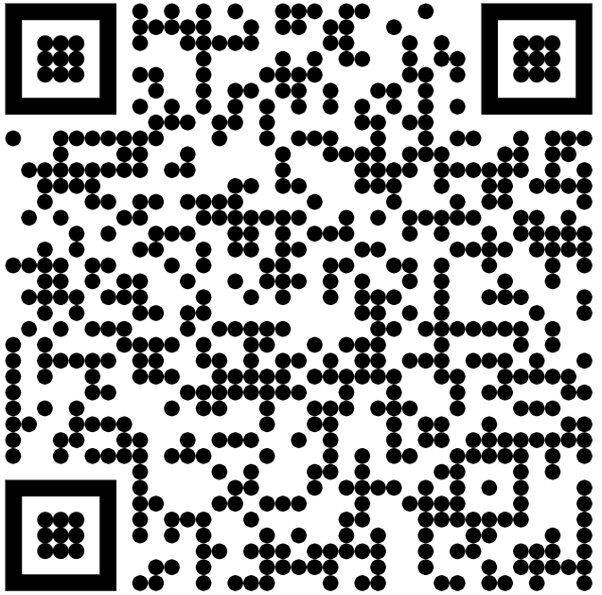

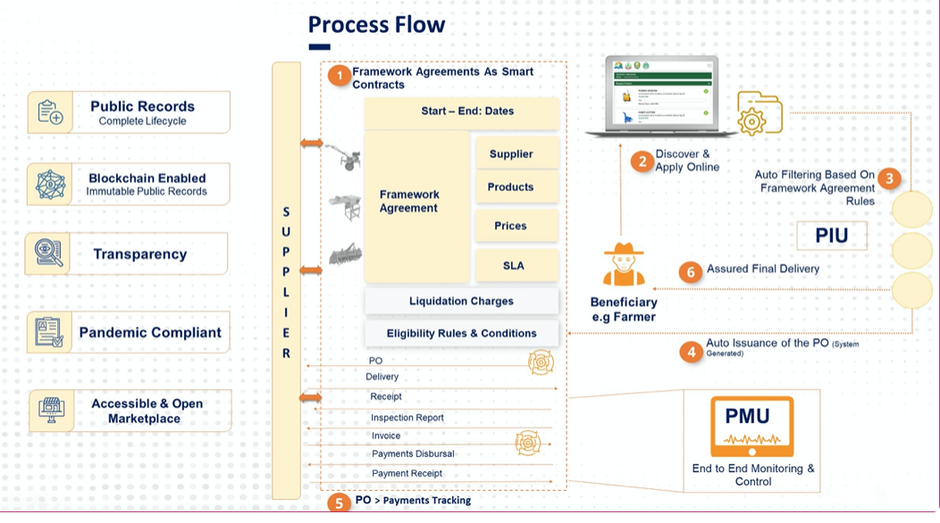
The Government of Sindh with the support of World Bank initiated the SAGP project for the well-being of small-scale farmers and overall development of the agricultural sector. With the help of Collabrex platform, farmers have an access to a digital marketplace from where they can conveniently acquire relevant equipment and resources seamlessly – while organizations can keep a complete and immutable trace of the provided equipment and resource. The platform can be easily extended to support allocation, dispatch and tracking of equipment and resource in any industry vertical. Avanza is proud to to implement the first-ever production grade Blockchain solution in Pakistan.

Slide 31
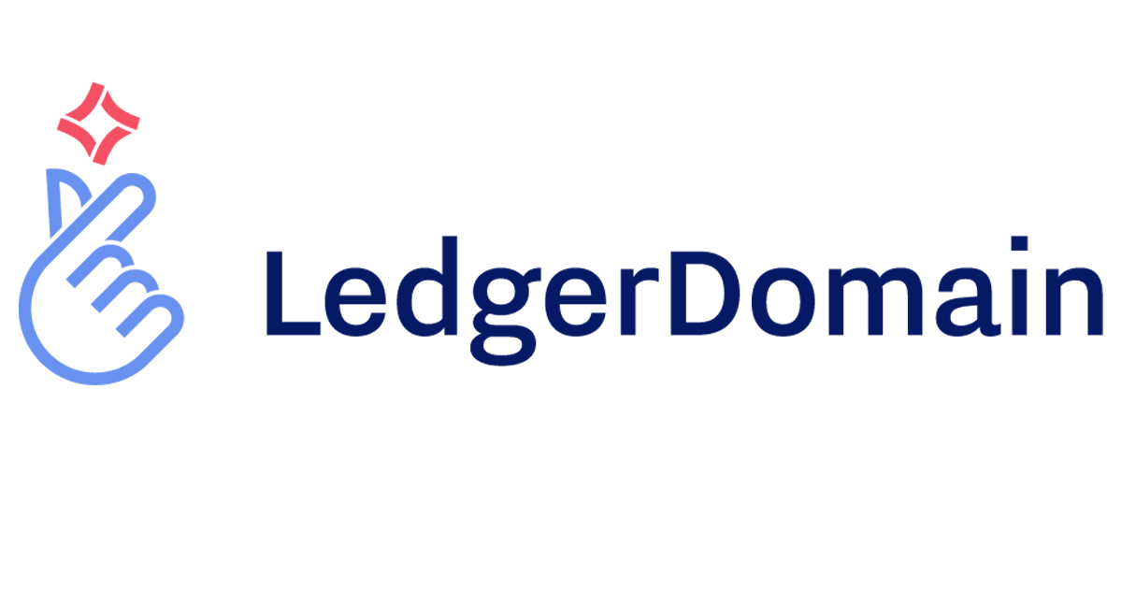

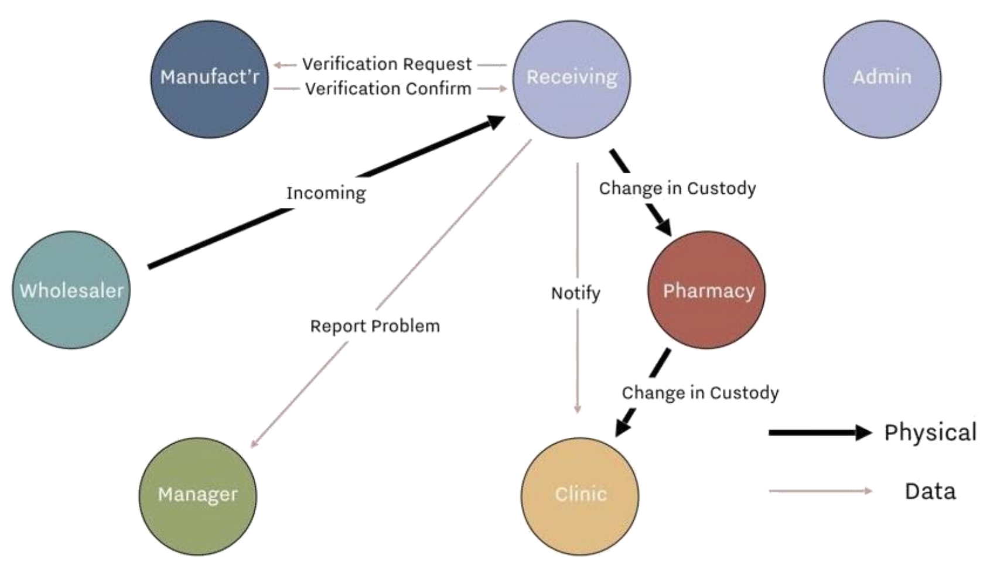
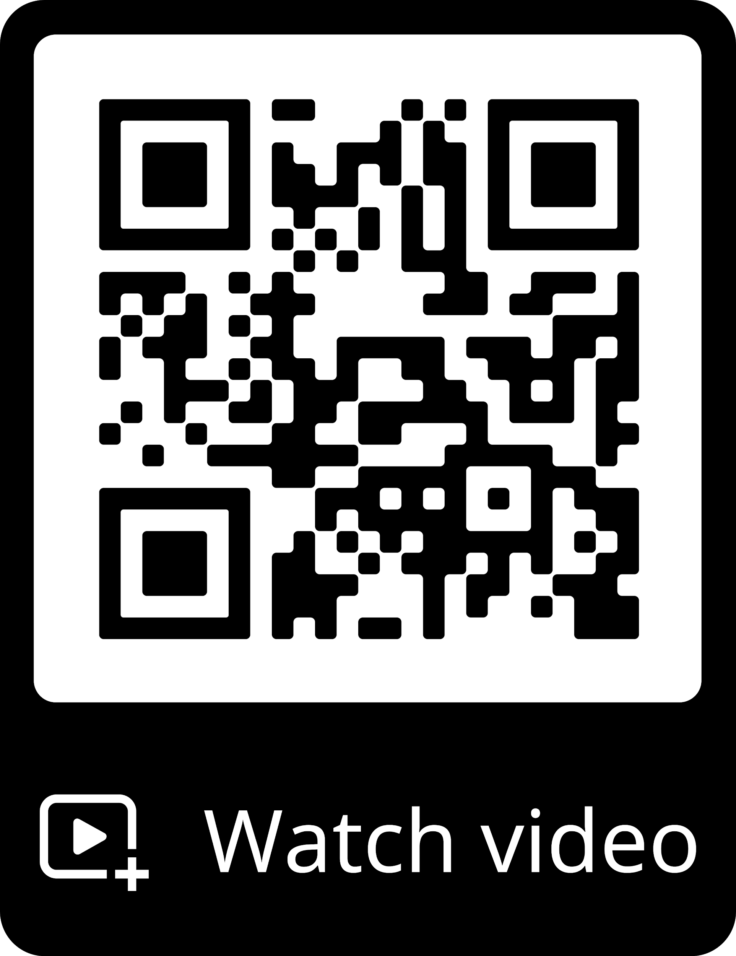

The pharmaceutical supply chain relies on paperwork and manual transcription from one system of record to another. Many medicines go out in bulk and are divided until the dispenser counts the patient’s drug into an amber bottle. The challenge for the 21st century is to reduce suspect or illegitimate product while ensuring patient data security. Ledger Domain and UCLA created a last-mile mobile application that helps deliver lifesaving medications to babies at the famed Ronald Reagan UCLA Medical Center

Slide 32
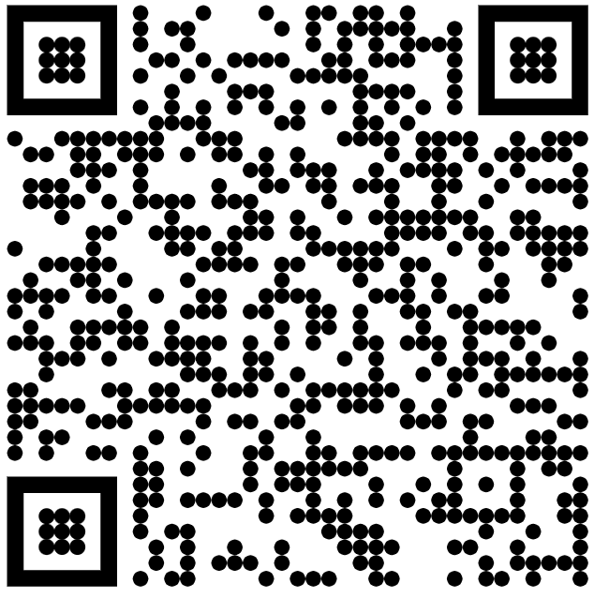
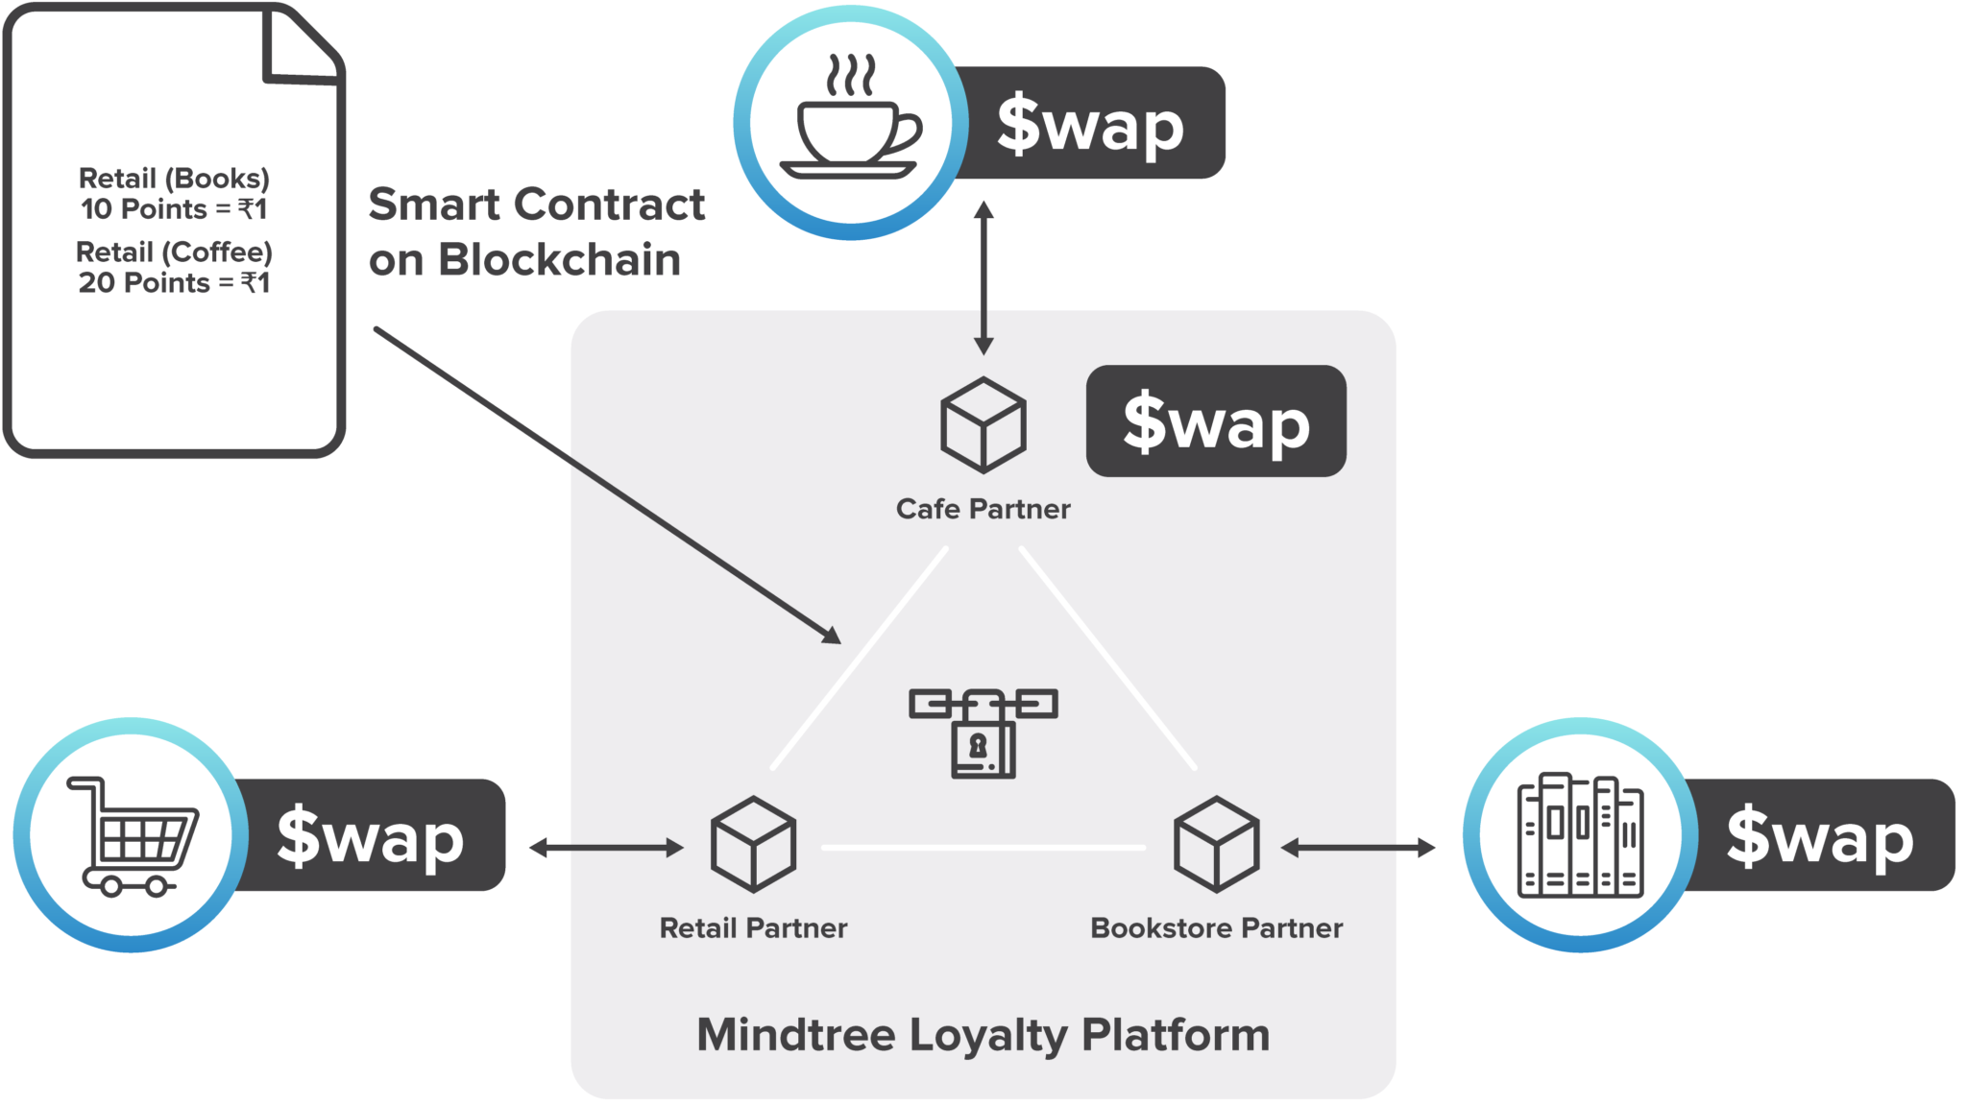
Loyalty programs have been on the rise in the retail, hotel, and airline sectors and for good reason: Consumers who adopt a rewards program (and give it a favorable review) are almost 80 percent more likely to continue spending money with the brand. To help consumers consolidate their rewards programs and to help brands win back customers, Mindtree developed $wap, a blockchain-based loyalty exchange platform in which customers can redeem reward points across providers for goods and services. The platform allows merchants to negotiate exchange rates for points stored on the ledger. Merchants are connected using one channel with different nodes; each node represents a single organization each consisting of two peers. The endorser for each transaction is the $wap organization, which uses Raft consensus spread across different VMs for endorsing transactions.

Slide 33
Appendix:
Hyperledger Blockchain Frameworks
Notes:
The following slides have more details about the different Hyperledger platforms.

Slide 34
Distributed Ledgers
Frameworks that are basis for products and solutions. Differ in programming and smart contract languages, consensus and governance mode

Slide 35

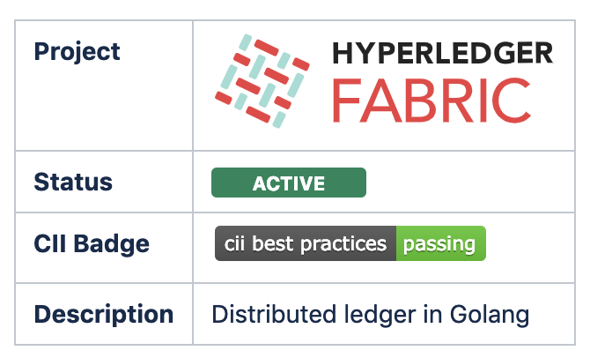
Platform for developing blockchain networks with a modular architecture for consensus and membership services.
Hyperledger Fabric v2.2 is planned to be formally released the first week of July and is expected to be the next LTS release, maintaining the regular cadence of roughly quarterly releases
200+ devs across 100+ companies contributing.
~Hundreds of pilot and production networks deployed.
Learn more at: https://wiki.hyperledger.org/display/fabric/Hyperledger+Fabric

Slide 36


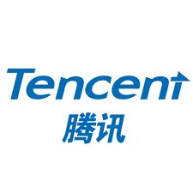



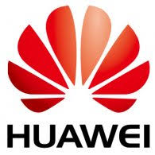




Hyperledger Fabric
Now Available Across All Major Clouds
Notes:
This shows the logos for cloud providers who are offering at least one of the Hyperledger projects on their services.

Slide 37
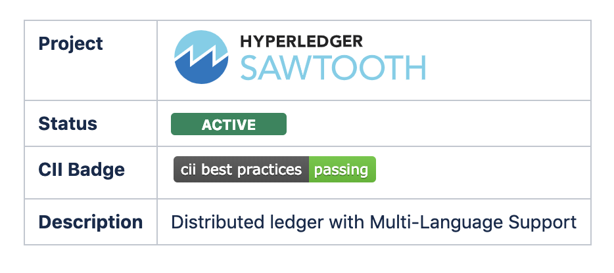
A modular platform for building, deploying, and running distributed ledgers. Hyperledger Sawtooth includes a novel consensus algorithm, Proof of Elapsed Time (PoET), which targets large distributed validator populations with minimal resource consumption. Hyperledger’s second project, released as 1.0 in January 2018 and 1.1 in Dec 2018.
Supports Solidity/EVM smart contracts by linking with HL Burrow.
Learn more at: https://wiki.hyperledger.org/display/sawtooth/Hyperledger+Sawtooth

Slide 38
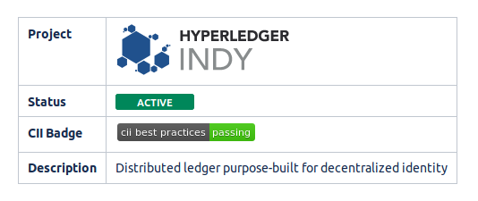
Tools, libraries, and reusable components for providing digital identities rooted on blockchains or other distributed ledgers so that they are interoperable across administrative domains, applications, and any other silo. Utilizes zero-knowledge proofs to provide verifiable claims
which can be used to prove something about the identity without providing access to the underlying data
Suggested Global Forum Videos:
Understanding the Hyperledger Indy Distributed Ledger - https://sched.co/Xof2
Standards and Interoperability for Identity - https://sched.co/Xodv
Learn more at: https://wiki.hyperledger.org/display/indy/Hyperledger+Indy

Slide 39
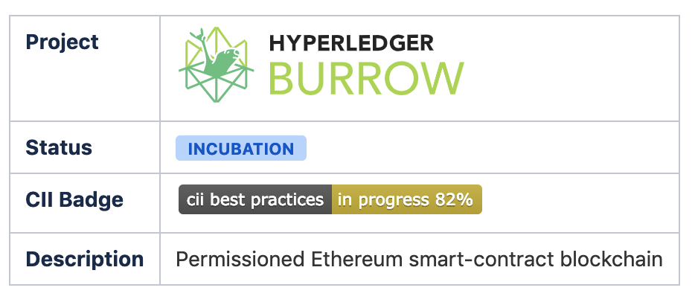
Burrow provides a modular blockchain client with a permissioned smart contract interpreter built in part to the specification of the Ethereum Virtual Machine (EVM). It is the only Apache-licensed EVM. Uses Tendermint as its default consensus mechanism, but has also been ported to Fabric and Sawtooth.
Suggested Global Forum Videos:
Boring into Burrow - https://sched.co/Xoee
Hyperledger Burrow New Features - https://sched.co/XofH
Learn more at: https://wiki.hyperledger.org/display/burrow/Hyperledger+Burrow

Slide 40
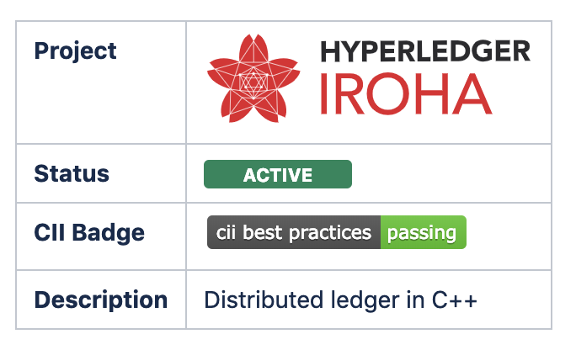
A business blockchain framework designed to be simple and easy to incorporate into infrastructural projects requiring distributed ledger technology. Written in C++ incorporating unique chain-based Byzantine Fault Tolerant consensus. Mobile SDKs. Multisig support for transactions.
Release 1.1.2 in March
Learn more at: https://wiki.hyperledger.org/display/iroha/Hyperledger+Iroha

Slide 41
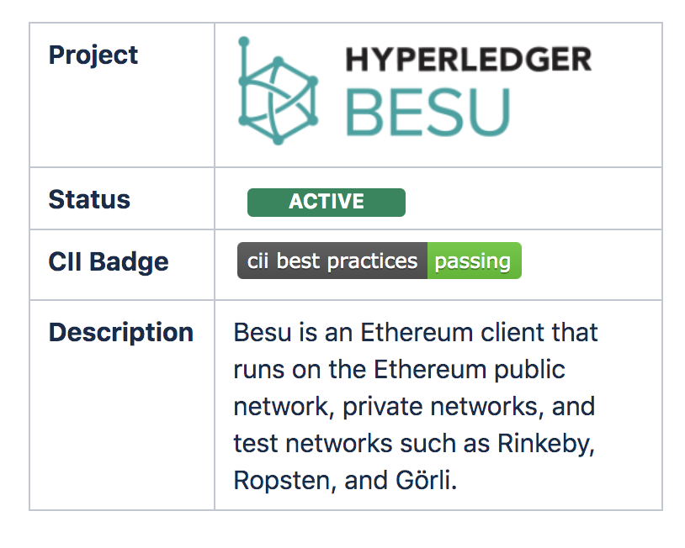
Open source Ethereum client written in Java. It can be run on the Ethereum public network or on private permissioned networks, as well as test networks such as Rinkeby, Ropsten, and Görli. Hyperledger Besu includes several consensus algorithms including PoW, PoA, and IBFT, and has comprehensive permissioning schemes designed specifically for uses in a consortium environment. Working towards its 1.5 Release, scheduled for July 15, 2020.
Suggested Global Forum Video:
Connecting Hyperledger Besu to Enterprise Systems - https://sched.co/Xoee

Slide 42
Libraries
Code basis reusable
across different projects,
not restricted to Hyperledger only.

Slide 43




Hyperledger: Libraries
Infrastructure for blockchain-rooted, peer-to-peer interactions. It provides a shared, reusable, interoperable tool kit designed for initiatives and solutions focused on creating, transmitting and storing verifiable digital credentials.
A shared cryptographic library that would enable people (and projects) to avoid duplicating other cryptographic work and hopefully increase security in the process.
An interoperability solution for blockchains, DLTs and other types of ledgers
Transaction execution platform designed to be used as a library or component when implementing distributed ledgers, including blockchains.
Cactus is a blockchain integration tool designed to allow users to securely integrate different blockchains.

Slide 44
Tools
Application level projects
without business logic

Slide 45




Hyperledger: Tools
Blockchain benchmark framework which allows users to measure the performance of a specific blockchain implementation with a set of predefined use cases.
Deploy, manage and operate blockchains. Support various infrastructures like bare metal, vm platform, and container cloud (e.g., Swarm, Kubernetes). Support advanced operational analytics for the system status and ledger behaviors
User friendly web application to view/query blocks, transactions and associated data, network information (name, status, list of nodes), chain codes/transaction families (view/invoke/deploy/query) and any other relevant information stored in the ledger.
Hyperledger Avalon is a ledger independent implementation of the Trusted Compute Specifications published by the Enterprise Ethereum Alliance. Hyperledger Avalon will realize have different Worker types and include TEE (Trusted Execution Environments like Intel® SGX), MPC (multi-party compute), and ZK (zero-knowledge proofs).

Slide 46
Domain Specific
Projects with a specific domain focus

Slide 47

Hyperledger: Domain Specific
A platform for building supply chain solutions that include distributed ledger components. It includes a set of libraries, data models, and SDK to accelerate development for supply chain smart contracts and client interfaces. This project will accelerate the development of blockchain-based solutions to cross-industry supply chain problems

Slide 48

Hyperledger Labs provides a space for innovation and testing of ideas where work can easily be started without the creation of an official Hyperledger project.
https://wiki.hyperledger.org/display/labs/Hyperledger+Labs+Home

