Slide 1

September 15, 2020
Hyperledger Public Sector
Special Interest Group
Bobbi Muscara Ledger Academy

Slide 2
How to build a Social Impact Project
Introduction
What are Blockchain Social impact Projects
How to create a Social Impact Project
What is the Government Blockchain Association
Conclusion / Questions

Slide 3
How to build a Social Impact Project
Introduction
What are Blockchain Social impact Projects
How to create a Social Impact Project
What is the Government Blockchain Association
Conclusion / Questions

Slide 4
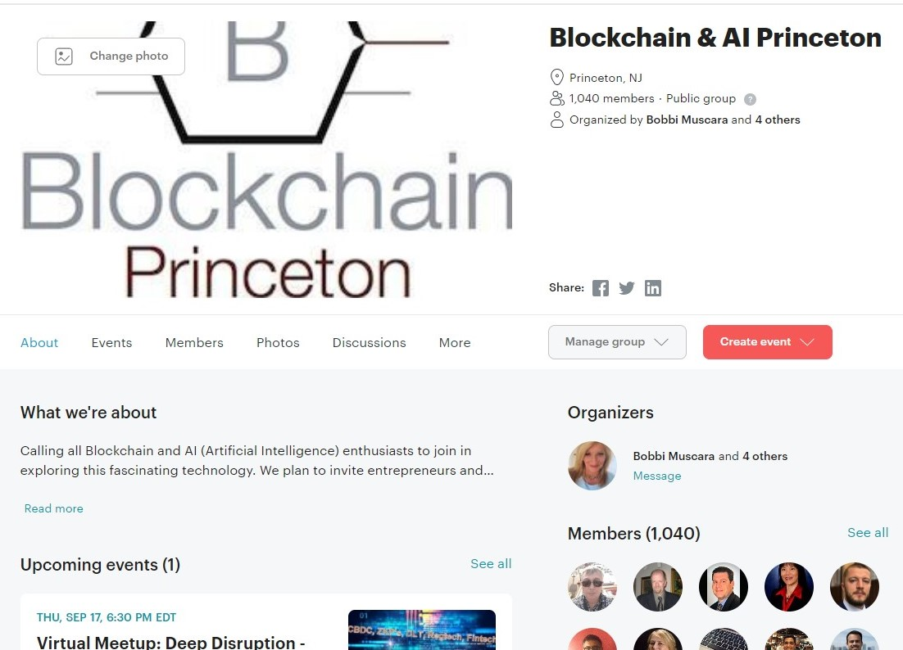
Ledger Academy
Bobbi Muscara
Ledger Academy
Blockchain Training Center
Tiger Labs
252 Nassau Street
Princeton, NJ
Classes Available
www.LedgerAcademy.com
Customized Training program
Freelance Technical Writer
Community Builder
Current Projects
LedgerCG
www.LedgerCG.com
Enterprise Blockchain Consulting Group
Identity Management Solutions

Slide 5

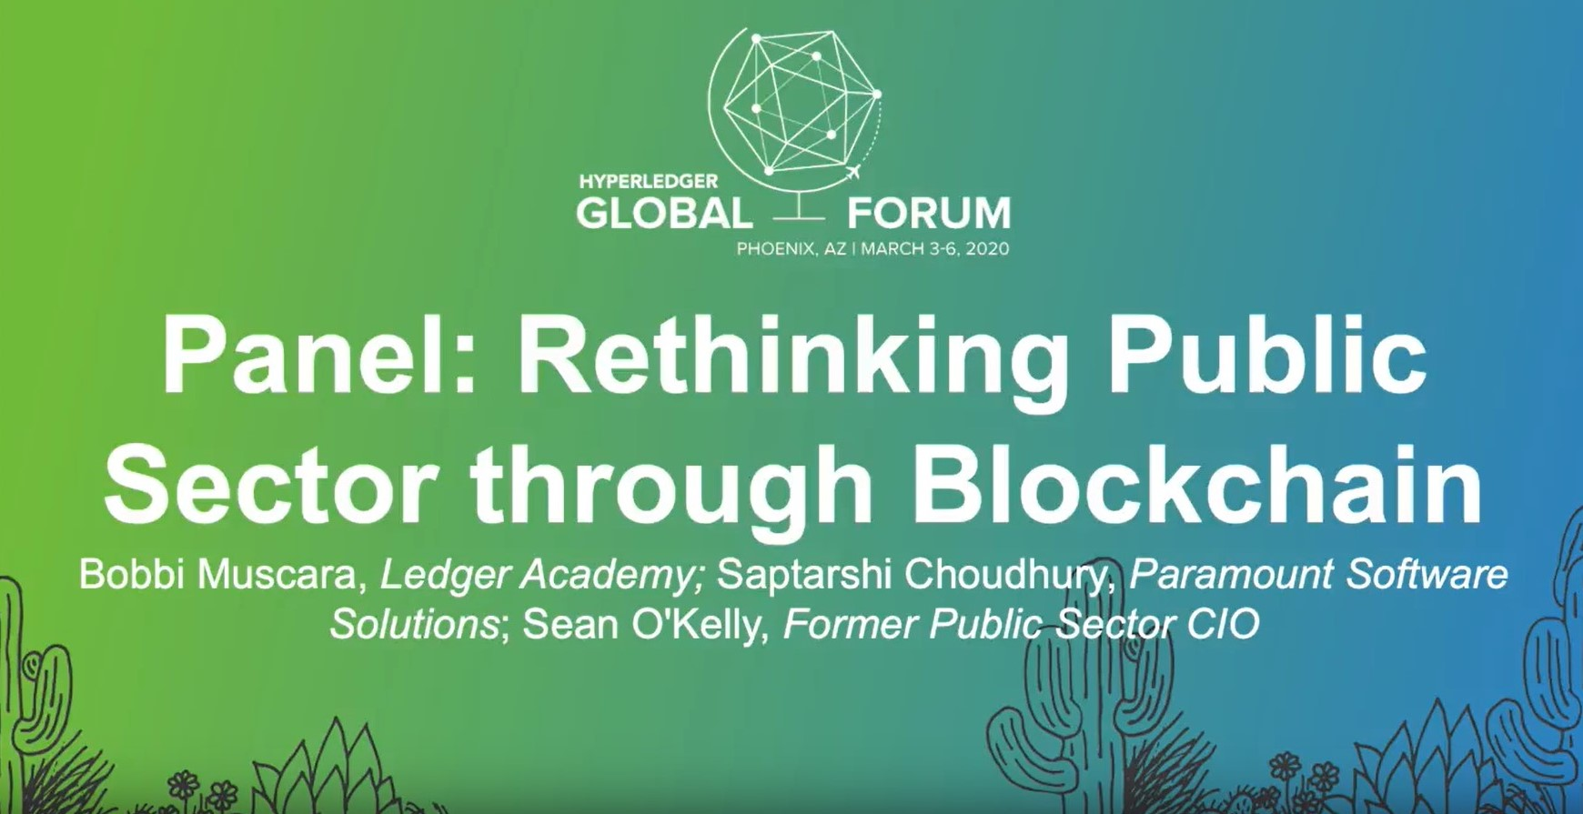
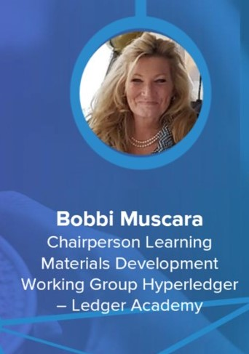
Bobbi Muscara
Ledger Academy
Join Hyperledger Social Impact Working Group December, 2018

Slide 6
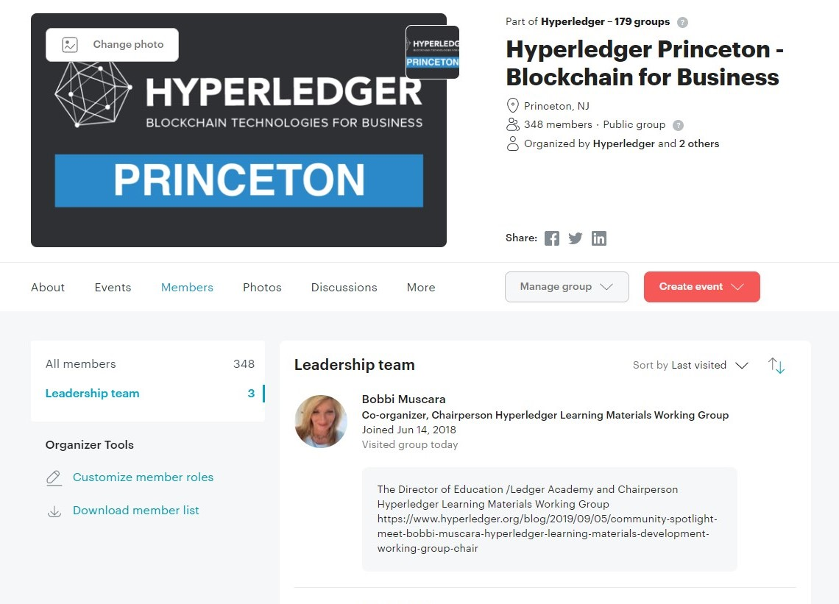
Hyperledger Meetup Groups

Slide 7
How to build a Social Impact Project
Introduction
What are Blockchain Social impact Projects
How to create a Social Impact Project
What is the Government Blockchain Association
Conclusion / Questions

Slide 8
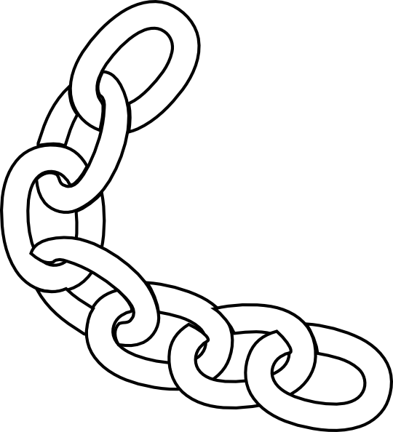
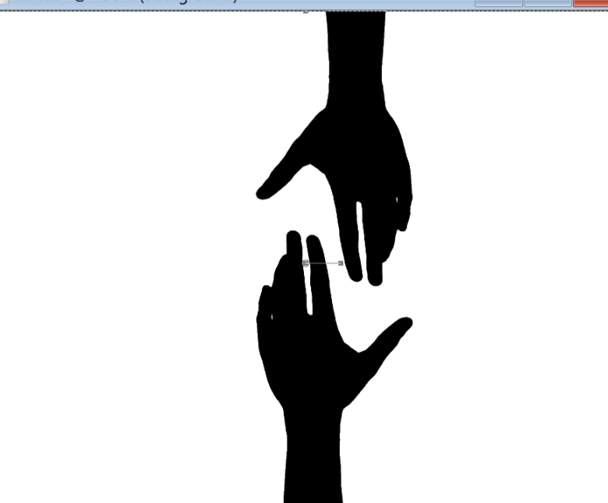
Blockchain and Social Responsibility
    Philanthropy and remittances : Donation traceability, aid transparency, digital currencies in aid and development, governance and accountability
    Financial empowerment: Financial inclusion, microfinancing, microinsurance
    Identity and land rights: Refugee assistance, land ownership documentation
    Governance and democracy : Fighting censorship and fake news, voting rights and protections, election integrity
    Supply chain and environmental protections : Sustainable supply chain, fair trade, ethical soucing, fair labor practices.
Notes:
Philanthropy and remittances (donation traceability, aid transparency, digital currencies in aid and development, governance and accountability)
Financial empowerment (financial inclusion, microfinance, microinsurance)
Identity and land rights (refugee assistance, land ownership documentation)
Governance and democracy (fighting censorship and fake news, voting rights and protections, election integrity)
Supply chain and environmental protections (sustainable supply chain, fair trade, ethical sourcing, fair labor practices

Slide 9
How to build a Social Impact Project
Introduction
What are Blockchain Social impact Projects
How to create a Social Impact Project
What is the Government Blockchain Association
Conclusion / Questions
Notes:
SOCIAL IMPACT CONTRIBUTION
•
Checkpoints
•
Checkpoints are meant to guide
you to
think through your
own solution prototype
,
stay
on track
, and
ultimately
formulate your own
Blockchain / White Paper /
Projects
.

Slide 10
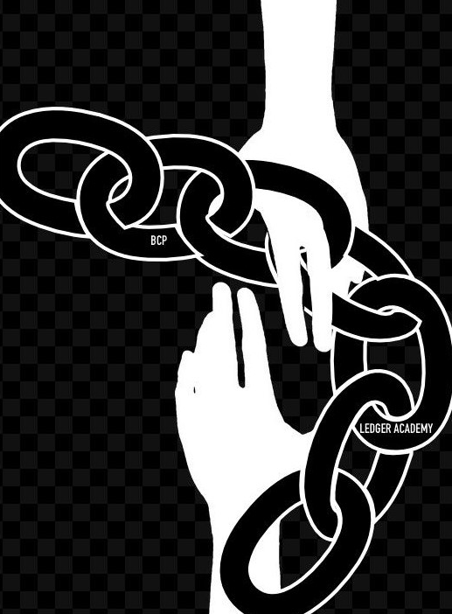
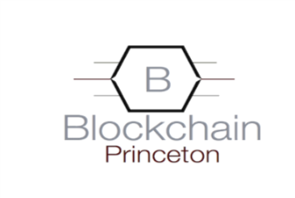
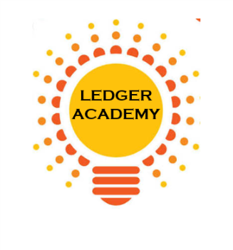
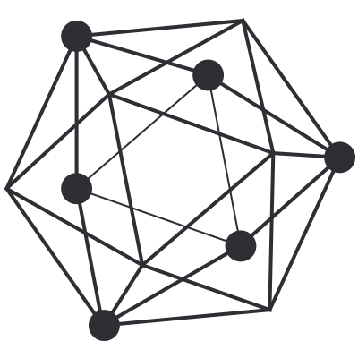
Team
BCPrinceton
  Blockchain Princeton
  www.BCPrinceton.com
Princeton’s Blockchain and AI
Ledger Academy
Hyperledger Princeton
Notes:
BC Princeton represents the combined efforts of the three local Princeton Blockchain Meetup Groups.
The Princeton blockchain meetup groups consist of a diverse group of people who have dedicated countless hours this summer to form a team to change Local Charity Giving.
By creating the Giving Chain we hope to create a working blockchain project to have a positive impact in our area this summer

Slide 11
Process
  BCPrinceton Checkpoints
Checkpoint 1: Impact Opportunity
Checkpoint 2: Business Model Validation
Checkpoint 3: Technical Architecture
Checkpoint 4: Business Development
Checkpoint 5: Product Development
Checkpoint 6: Final Project Delivery
“The Giving Chain”
The New Model for Charity Giving
Notes:
SOCIAL IMPACT CONTRIBUTION
•
Checkpoints
•
Checkpoints are meant to guide
you to
think through your
own solution prototype
,
stay
on track
, and
ultimately
formulate your own
Blockchain / White Paper /
Projects
.

Slide 12
Checkpoint 1: Impact Opportunity
Checkpoint Questions
Define Project and team members.
Define the scope of problem you are addressing.
Why is blockchain needed to solve this problem?
What is the size of the market? What demographics will you serve?
What are some current solutions to the problem you identified? Do they work effectively?
Who are the stakeholders involved? How are they thinking/feeling/acting currently?
What are the geopolitical, cultural-social-economic factors that must be taken into consideration? What are some nuances and complexities that must be addressed?

Slide 13
Checkpoint 1
Solution
Develop an agile & transparent network for connecting surplus foods & supplies to communities in need
impact the current Local Charity Giving model
Create a decentralized system that collect excess farm produce (and other resources) from local residence and distributes these resources to food insecure individuals / Community Centers in local communities
Initiate a supply chain Blockchain to initiate, track and deliver excess food supplies. The above model has many unknown individuals who do not need to form a relationship with the parties at the other end of the supply chain.

Slide 14
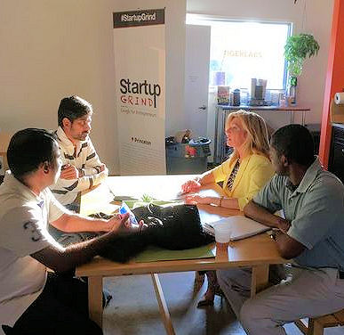
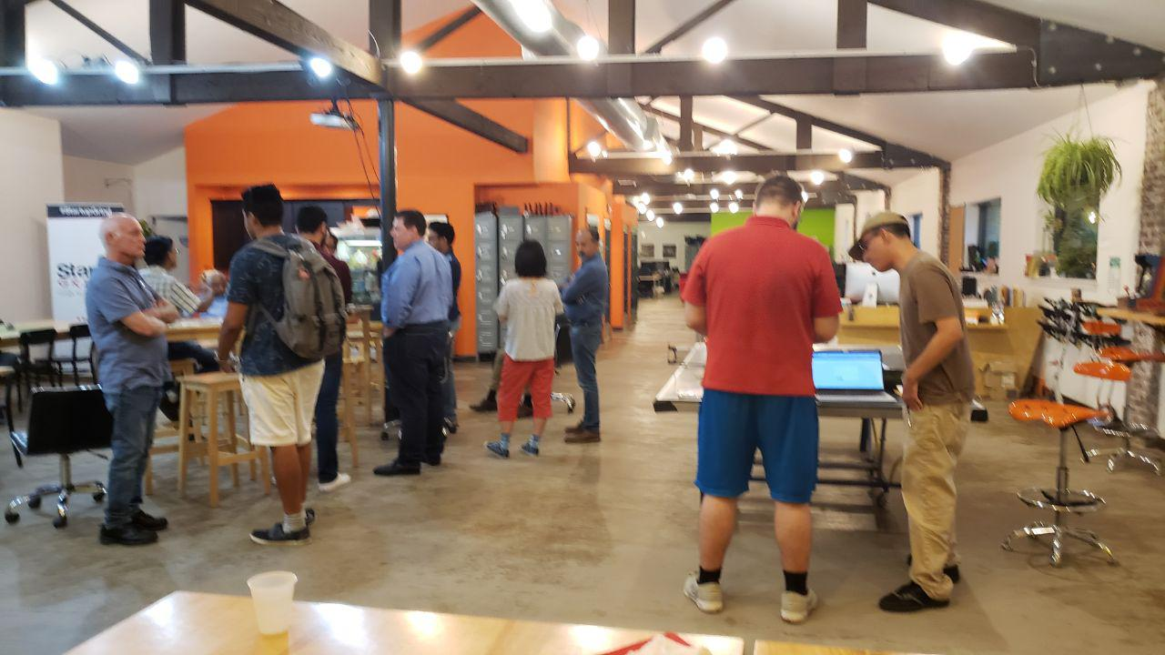
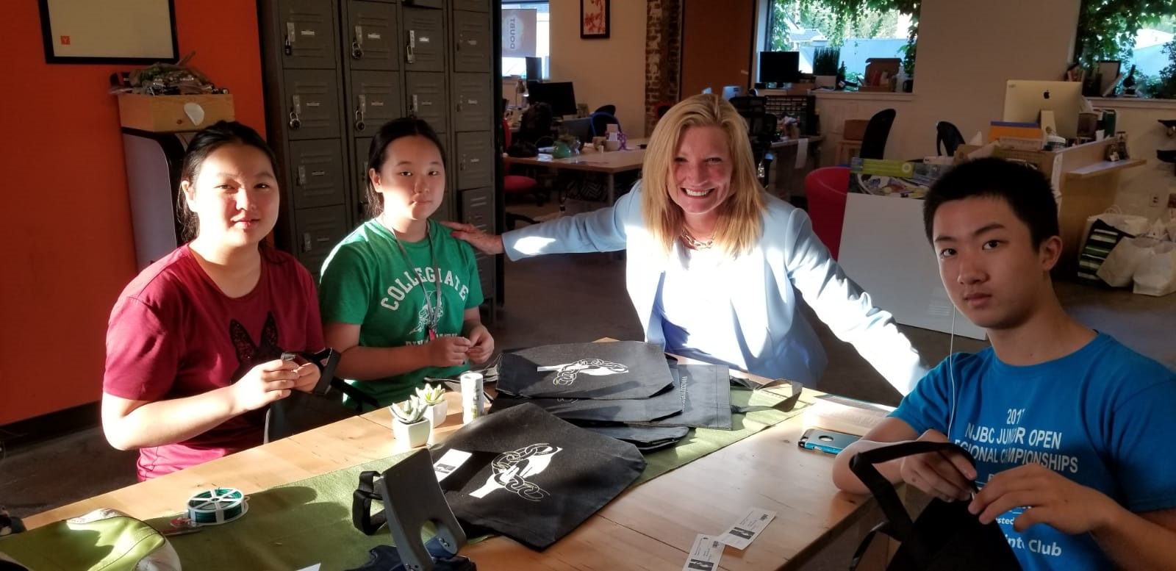
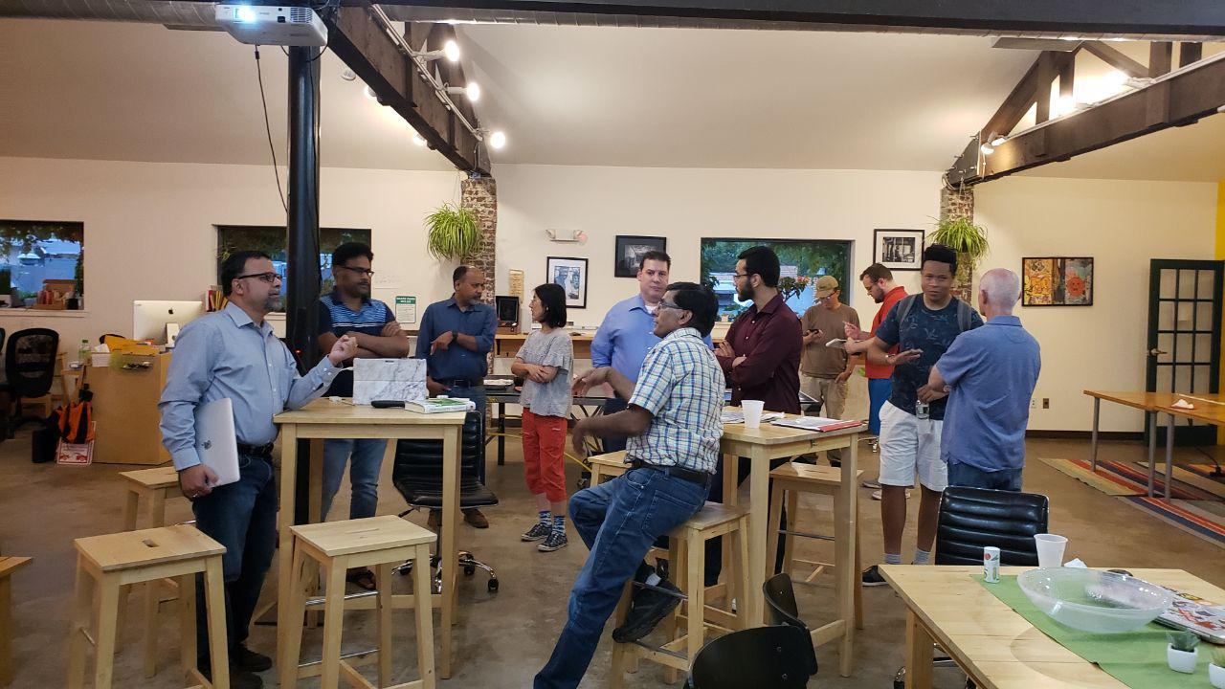
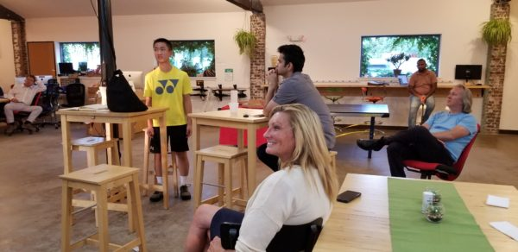
Meetups: Weekly ALL SUMMER

Slide 15
Checkpoint 2: Business Model
Checkpoint Questions
Who are your clients/users? Sketch out the persona of your user.
What are their pain points? How does your solution solve them? Indicate your unique value proposition.
Does your solution depend on context? Can it be scaled?
What is your go-to-market strategy? Who can you partner with?
How will your product generate revenue / benefit ? Will it be financially sustainable in the long-term?
What are the implicit and explicit assumptions being made in your business and financial model (user-profiles, partnerships, costs, etc.)? How do you plan on validating them?
What is the vision for your product? Can it significantly change the current state?

Slide 16
Checkpoint 2: The Giving Chain
Solutions
The industry we are attempting to impact is the Local Charity Giving by creating a system where unknown parties can easily on-board and contribute. Also create a system that can adapt to various giving initiatives
For our POC we will limit the size of the volunteer pool and we will determine the best spot to deliver. Current discussion revolves around local food banks, shelters, and Veterans connections
Local Farmers with excess food are more than excited to be a part of the project. Transporters might prove a challenge The food insecure people who receive a donation should be handled with privacy and dignity and the system develop should reflect this.
Some Challenges / Factors are SUSTANABILITY, food spoilage, timing of transportation as well as dignified deliver systems
  Potential for food spoilage / Product liability associated with being a supplier of food
  Developing a Community of volunteers
  Sufficient pipeline to get foods from Donor to Recipients, able to continue without central authority.

Slide 17
Checkpoint 2: Giving Chain
Business Model
Donors
Farmers
Individuals
Community / Church Groups
Volunteers / Drivers
Pickup / Deliver:
Local volunteers
Community / Groups Transport
Recipients
Food Banks
Houses of Worship
Social Services Offices
Individuals (off the grid)

Slide 18






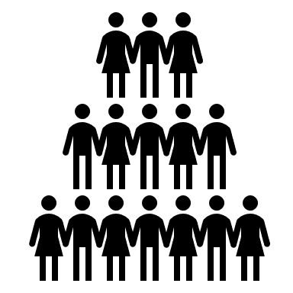
Checkpoint 2 : BUSINESS MODEL
Donation Tag
Giving Chain D2R app for Donor
Initiate P/U
Notification for P/U
Giving Chain D2R app for Drivers
Giving Chain D2R app for Recipient
Recipient Tag
Transporters Tag
Delivery Information

Slide 19
Checkpoint 3: Technical Architecture
Checkpoint Questions
Define the technical specifications of your system's architecture. Include a description of system requirements, processes, business logic, technology stack, user flows, attack factors and any other technical specifications. Attach some visuals as bonus.
Define your Minimum Viable Product (MVP) testing approach.
Product Tests: Sketches, Wireframes, Mockups, Interactive, Prototype, Wizard of Oz, Concierge, Live Product
Outline a development roadmap with a realistic timeline that takes into account your product vision, market readiness, team capabilities, functional upgrades and testing plans. What are your goals for each phase? How will your product evolve? Will you integrate other technologies?

Slide 20

Checkpoint 3: Technical Architecture
Proof of Concept D2R app.
Sawtooth Technology Explained
Is available as an instance of Sawtooth chain on a single node (Dev) with the ability to:
  create key-pairs
  create assets
  Transfer assets ( accept or reject the asset)
  Explorer: a view-able tracking of the current holder of the asset from the current front-end interface.

Slide 21
Checkpoint 4: Business Development
Checkpoint Questions
What is the impact goal of your solution? How do you ensure to capture needs of those who are traditionally underserved within your category?
What are the tools needed to collect and track goods?
How will recipients be selected?
How will Data Points be collected?
What are some obstacles you may face on the ground?

Slide 22
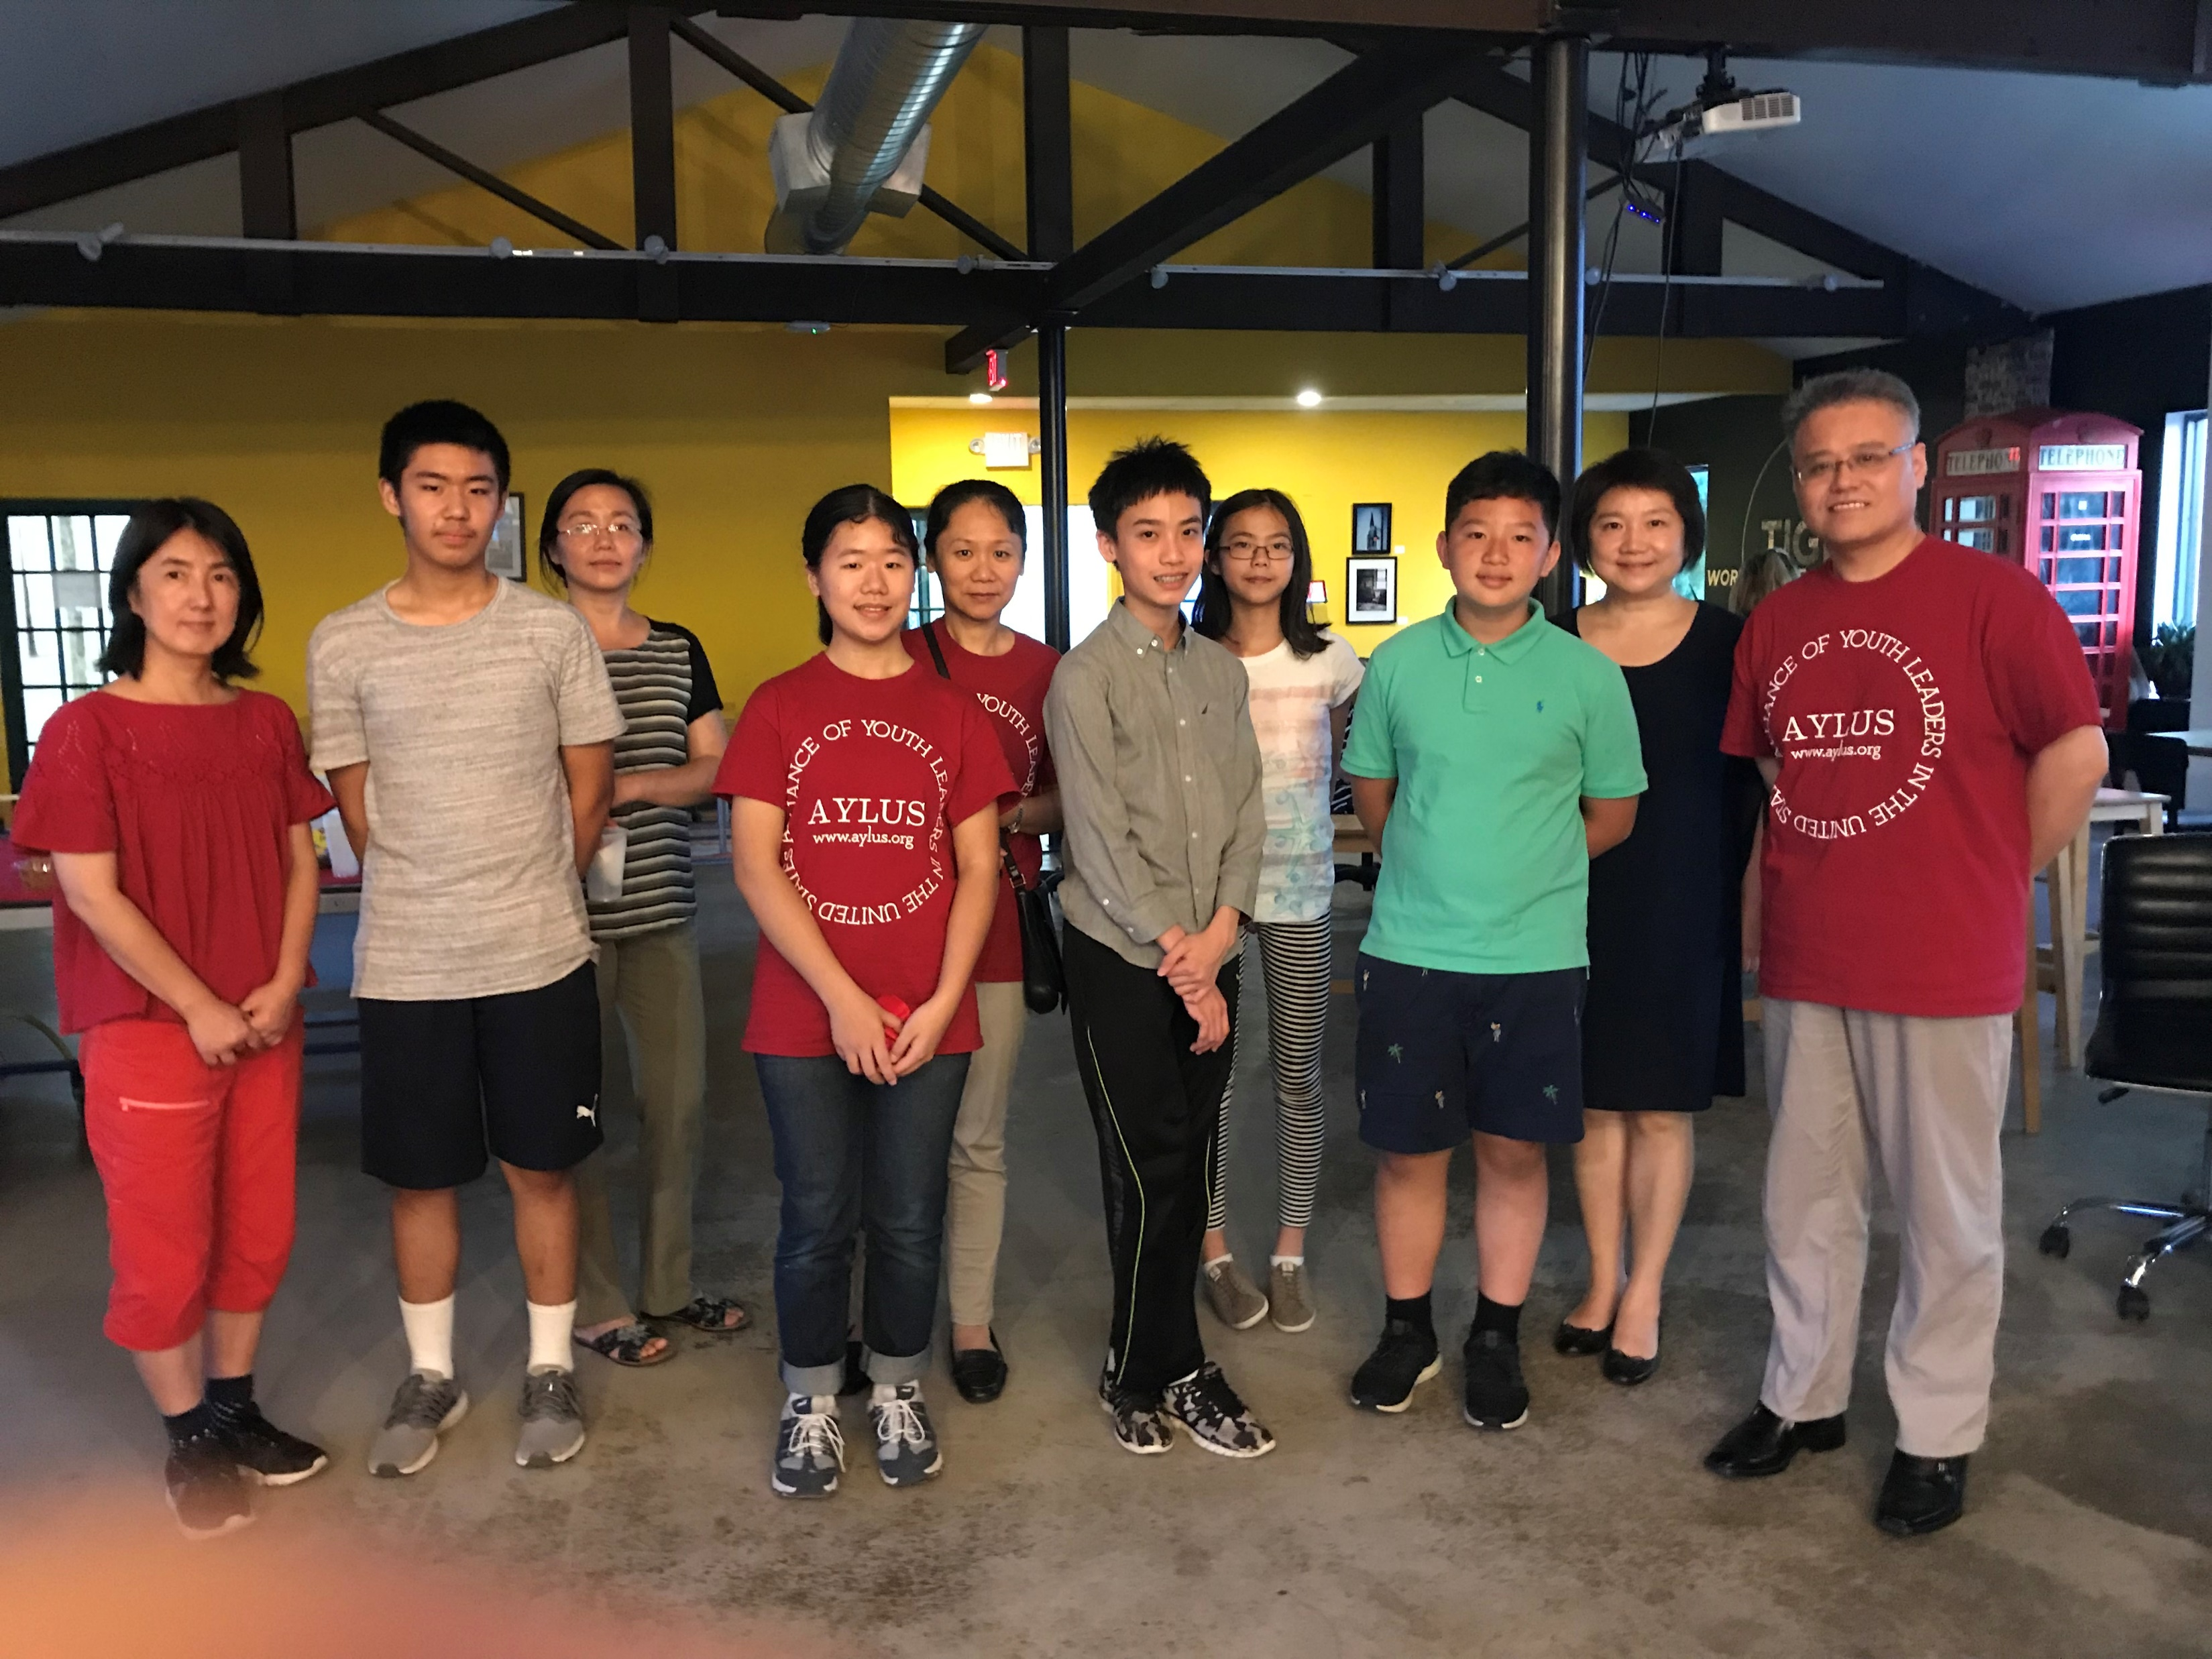
Checkpoint 4: Business Development
Solutions
AYLUS –Local youth group of volunteers
www.aylus.org
Collection items will be gathered in GIVING CHAIN BAGS that will have a bar code attached
Project Logo and Logo of Sponsors will be on Giving Chain bags to be given to local farmers, individuals, and giving organizations who want to help
100 GIVING CHAIN BAGS will be delivered to drop off locations on agreed upon date
Bags delivered to Local Food Bank.

Slide 23
Checkpoint 5: Product Development
Checkpoint Questions
Solutions
Working Code
Technology Decisions
Minimal Viable Product
Technology Stack: Google maps API, database management systems, public-private keys (cryptography), excel
Tracking on an instance of Sawtooth blockchain on a single node (Dev).

Slide 24
Checkpoint 5: Product Development
Minimal Viable Product
MVP
A Donor, Volunteer and Recipient (Actor) logins or interfaces
Ability for each actor to create their own key pairs pseudonymously
Ability to define assets that are fungible (from bulk donation to granular distribution - Asset name; Unit type and Units (numbers, lbs. etc.)
Ability to assign assets (by donor or self assigned by volunteer) for trace-ability purposes
Ability to track assigned assets with the options of:
  Tracking the assets themselves
  Or tracking the packaging the asset is included into (E.g. bags, crates etc.)
Security and audit-ability from bad actors (theft, diversion etc.)
Traceability to final recipient (final recipient acknowledges receipt).

Slide 25
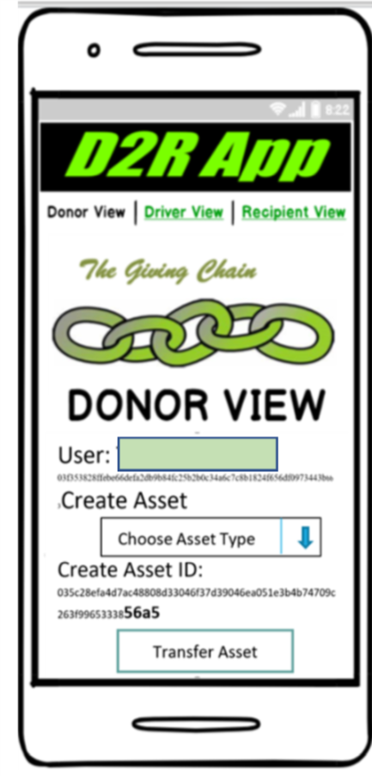
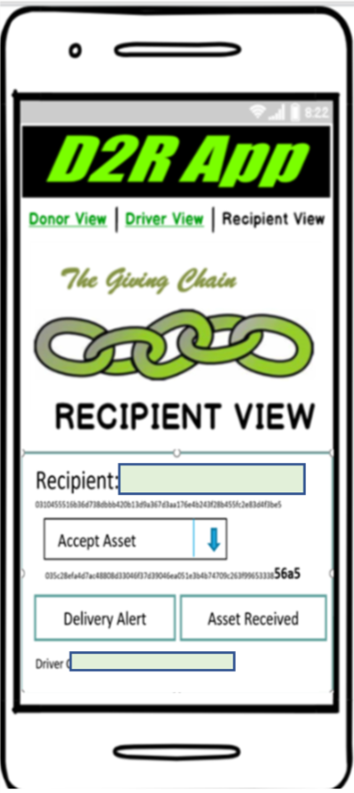
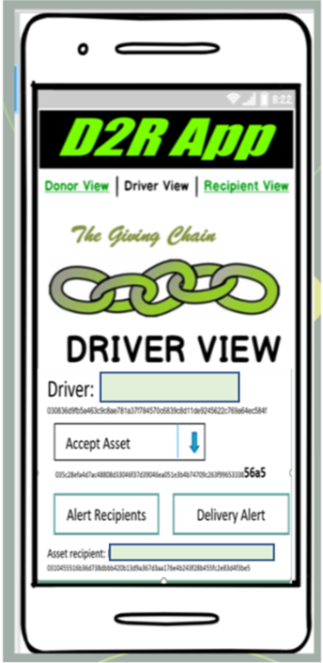
Checkpoint 6: Final Product Delivery
Notes:
In our technical model Donors activate the giving chain with an application a cell phone. They create an asset with a unique tag. The blockchain tracks the ownership of the tag ( donor to driver to recipient) . We will get a closer look at the technology later.

Slide 26
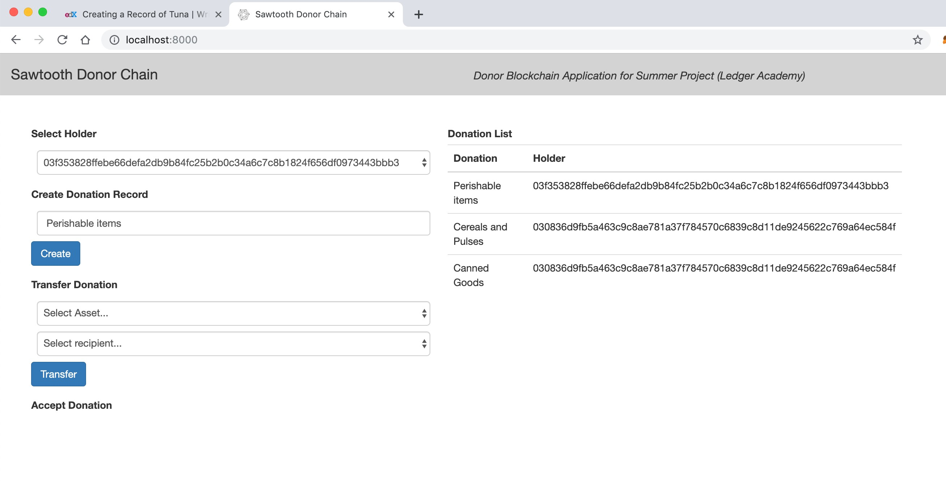
Recipient Blockchain - Change in Holder
donation with Last digits of Hash Tag 56A5 received
Bag 100010

Slide 27
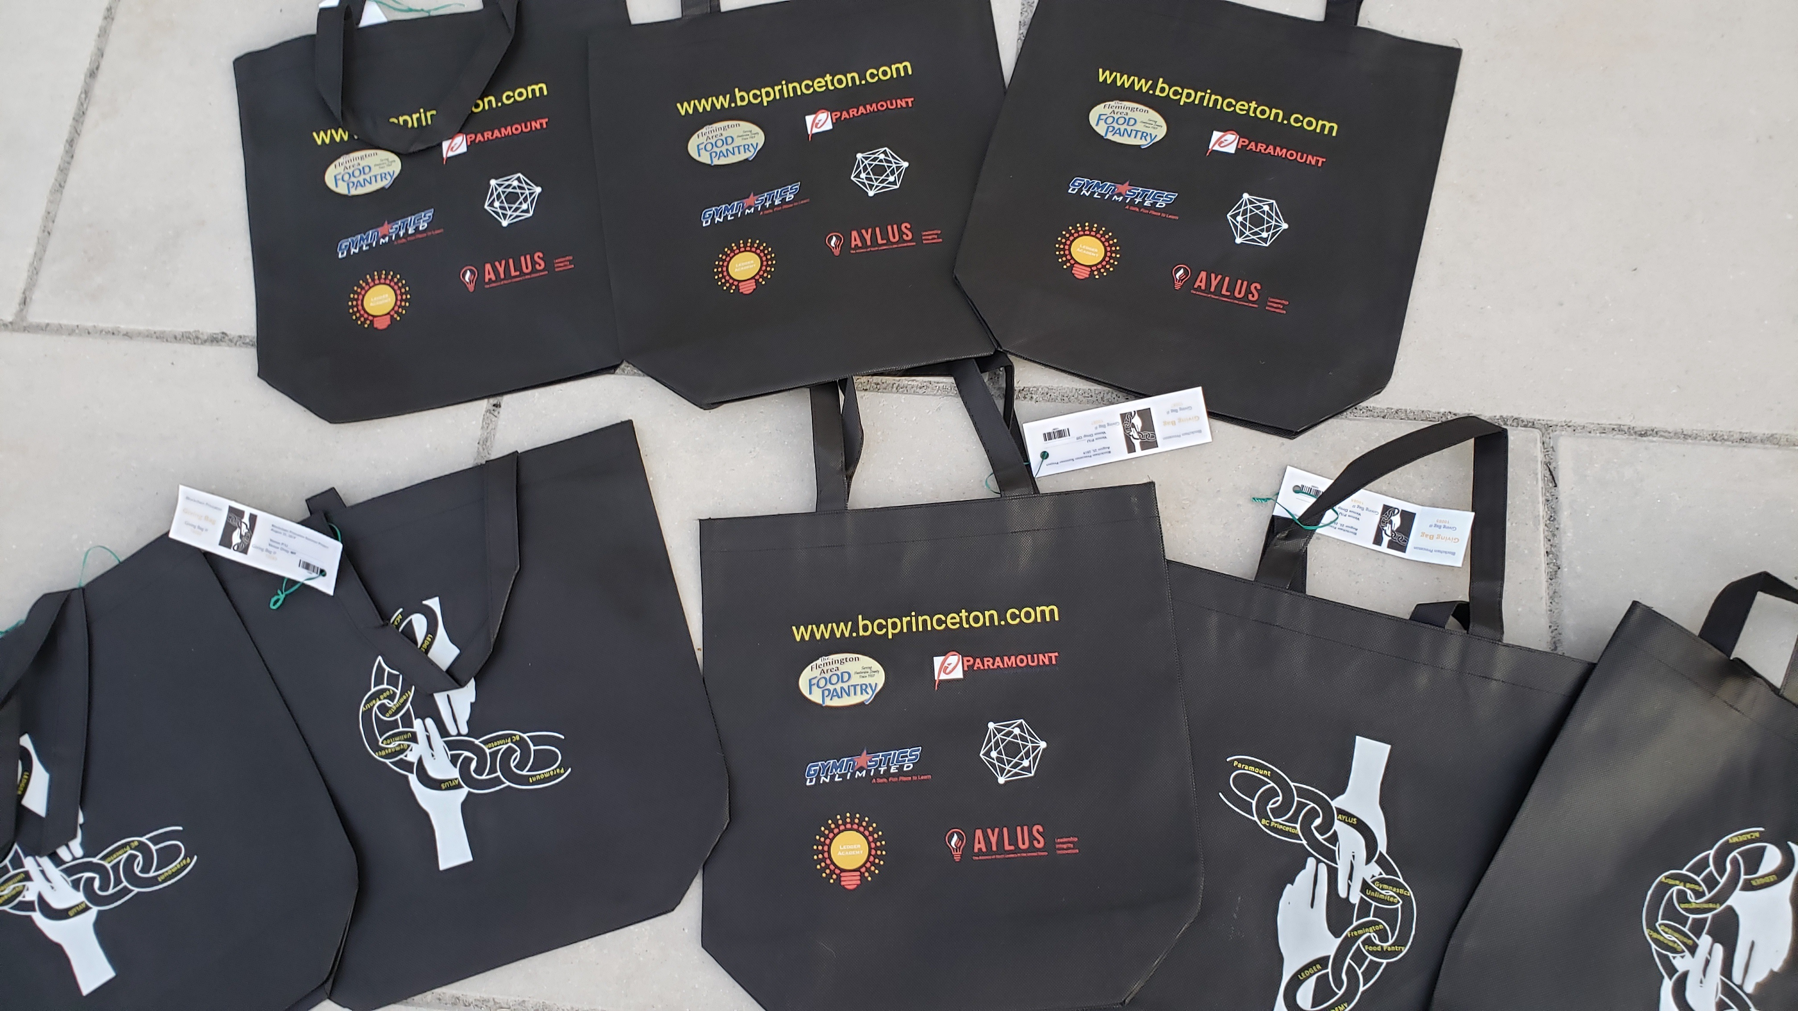
Designing and Ordering Giving Bags
Giving Bags

Slide 28
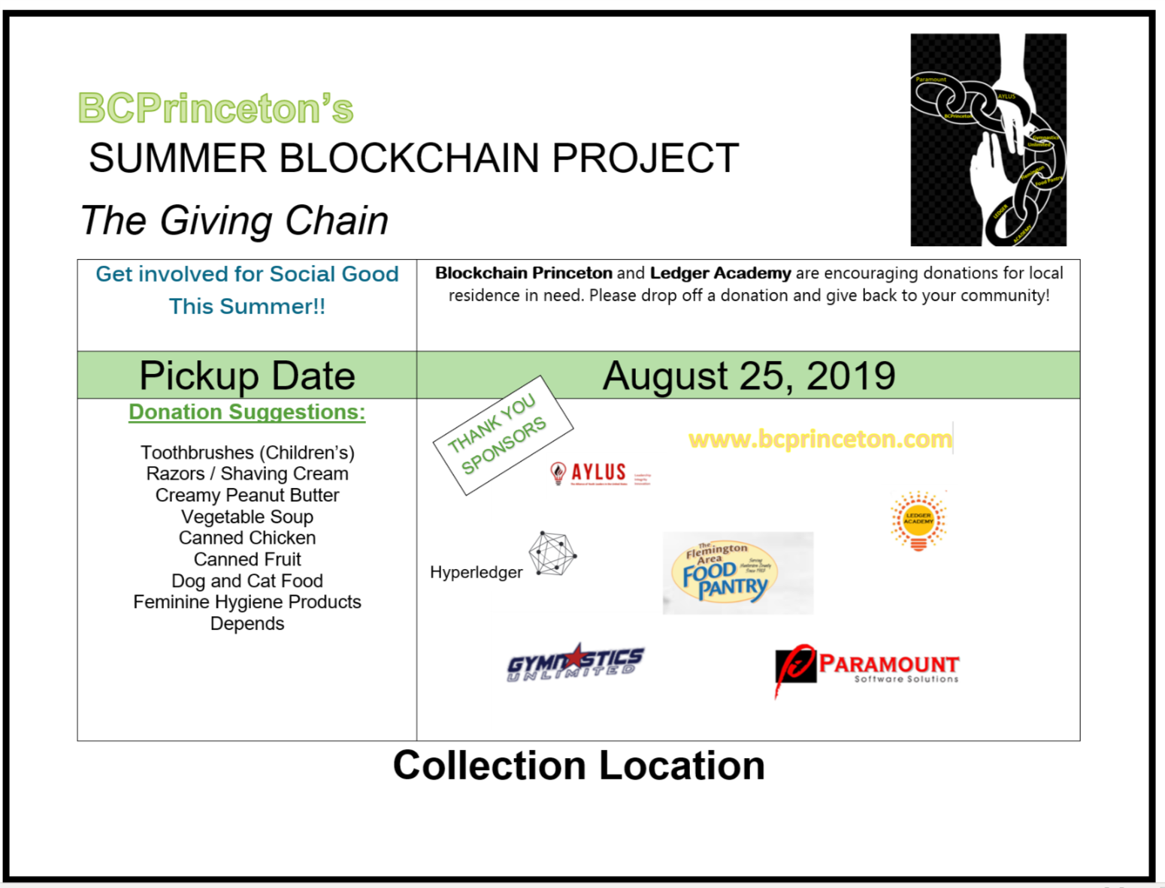
Donation Marketing
Materials
Purpose:
To designate collection location.

Slide 29
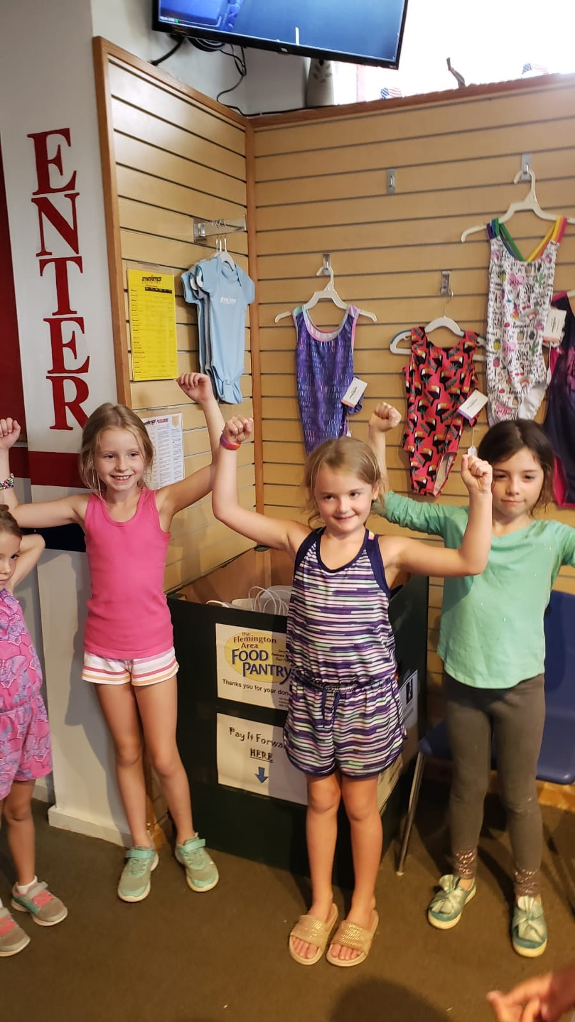
Summer Fund Raising Events: Collection Stations
Gymnastics Unlimited Summer Giving Project
AYLUS –Alliance young leaders – US. Princeton Group www.aylus.org

Slide 30
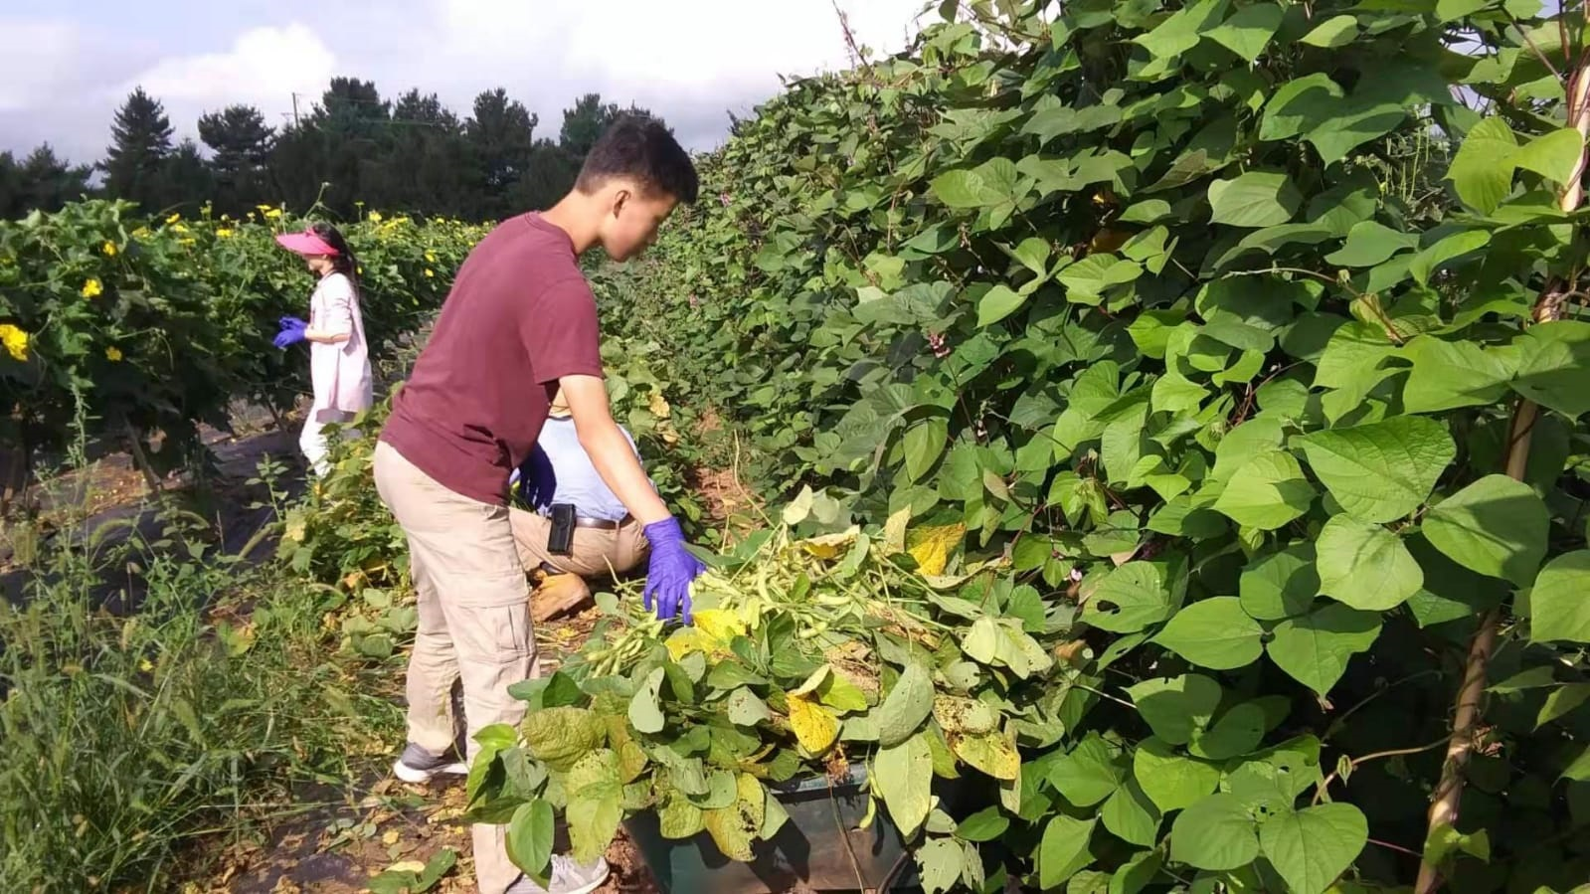
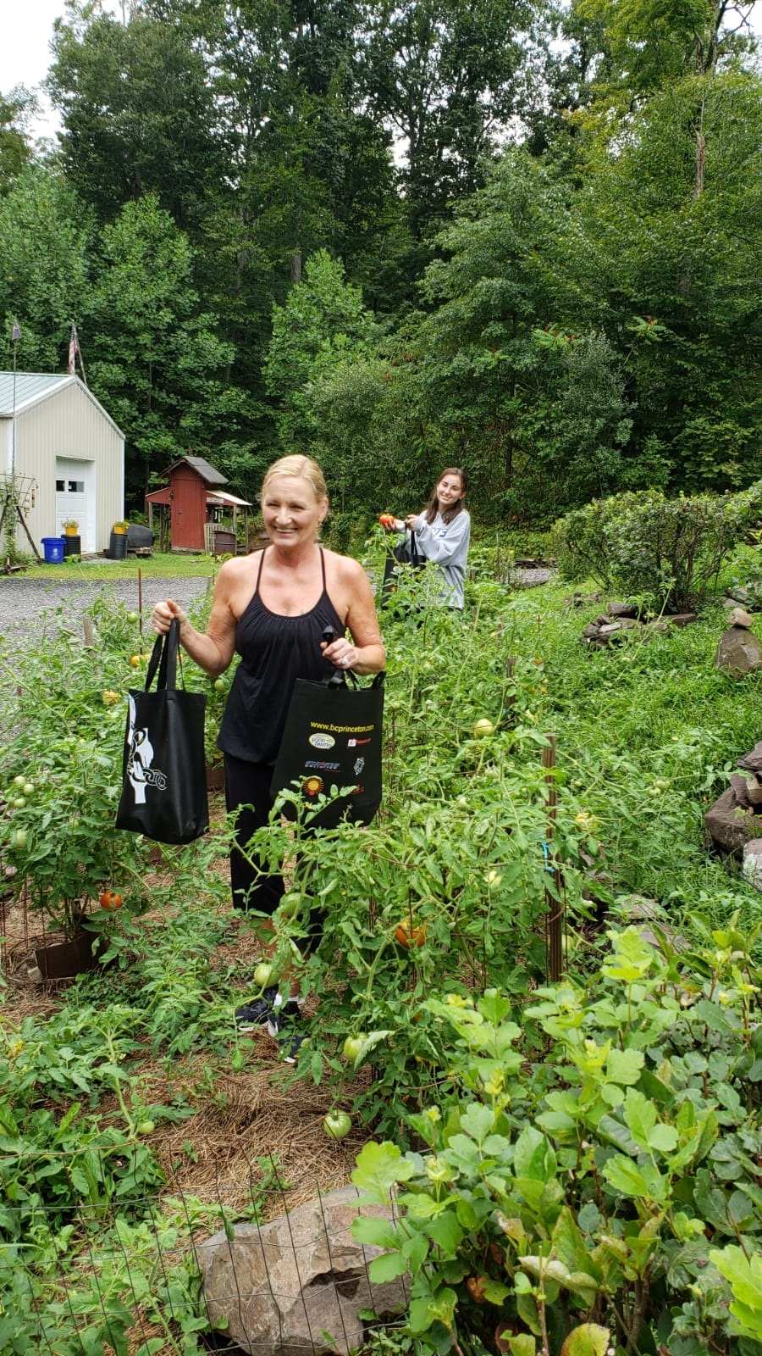
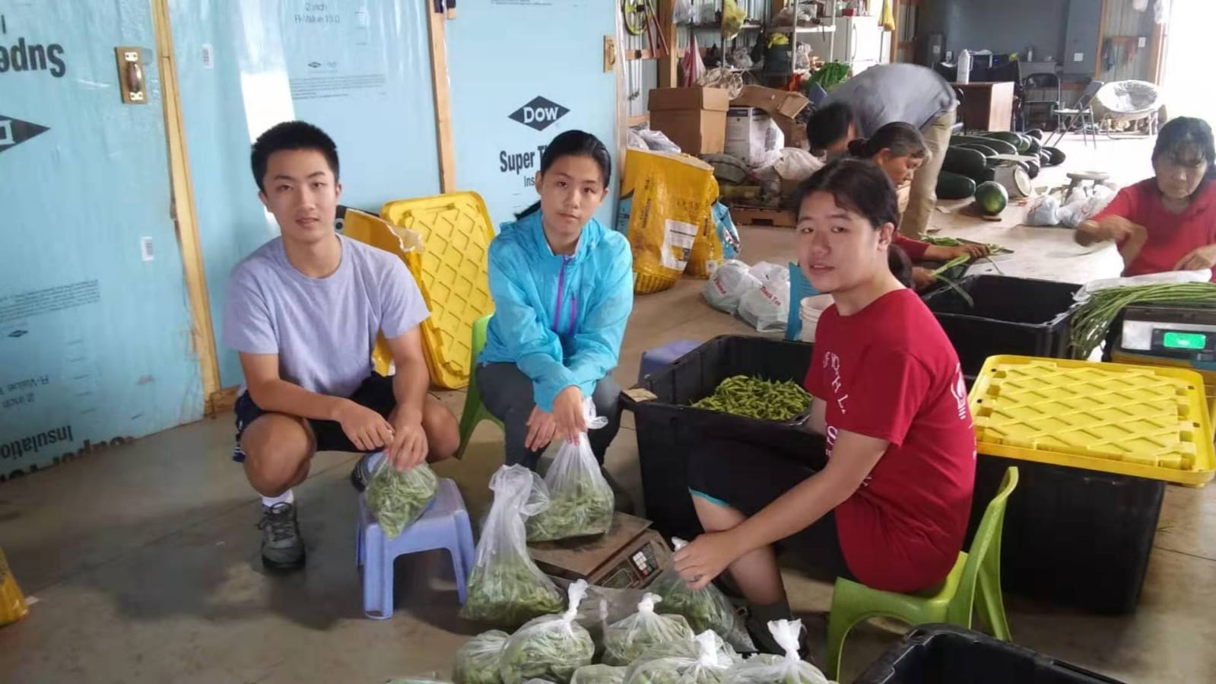
Collection Days

Slide 31
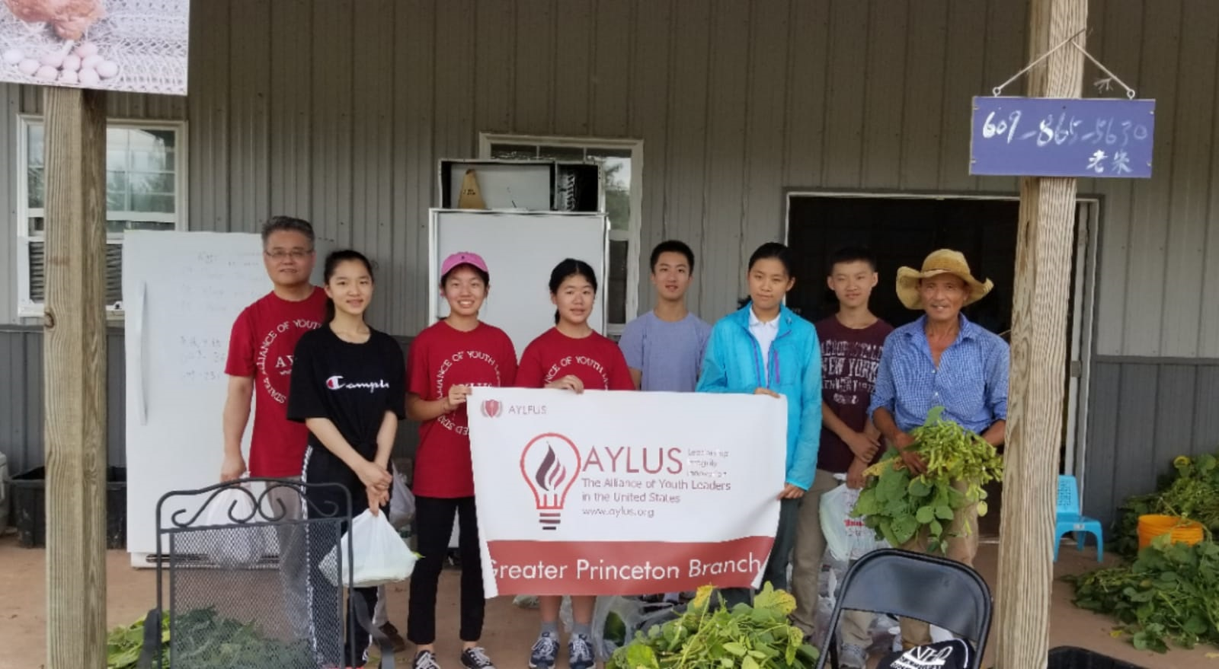

Slide 32
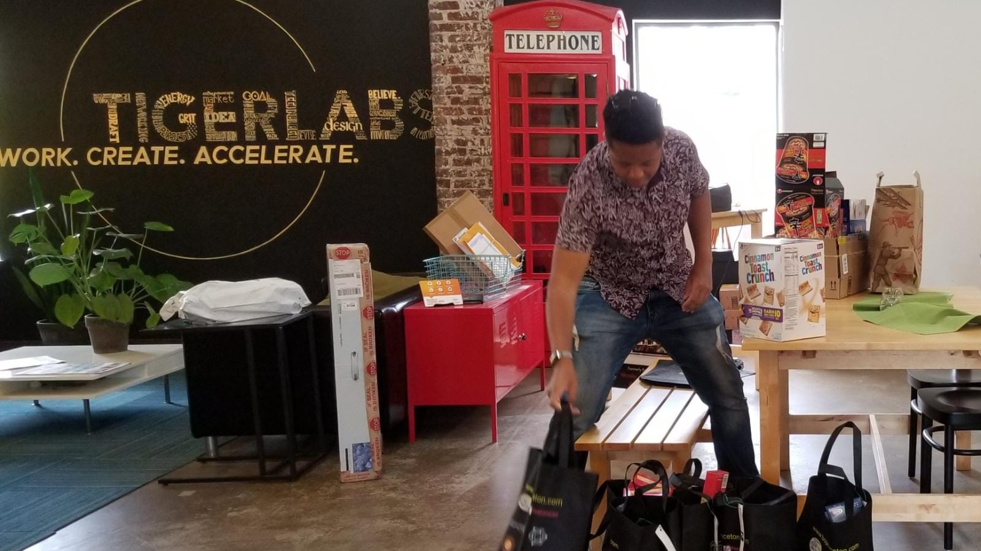

Slide 33
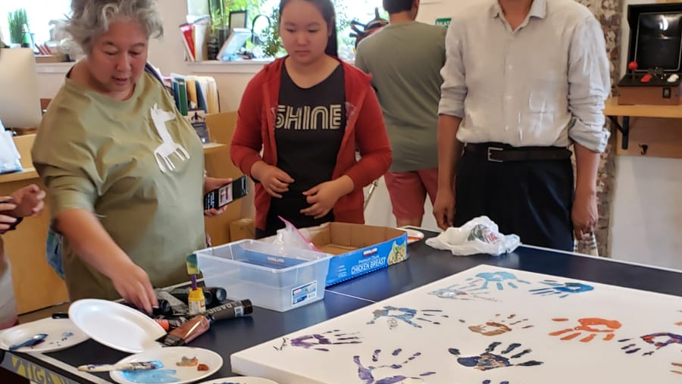

Slide 34
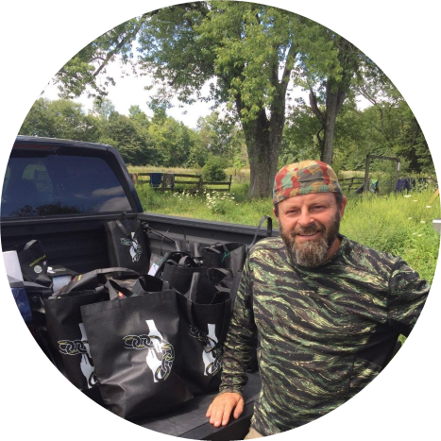

Recipients
Jeannine Gorman
Executive Director

Slide 35
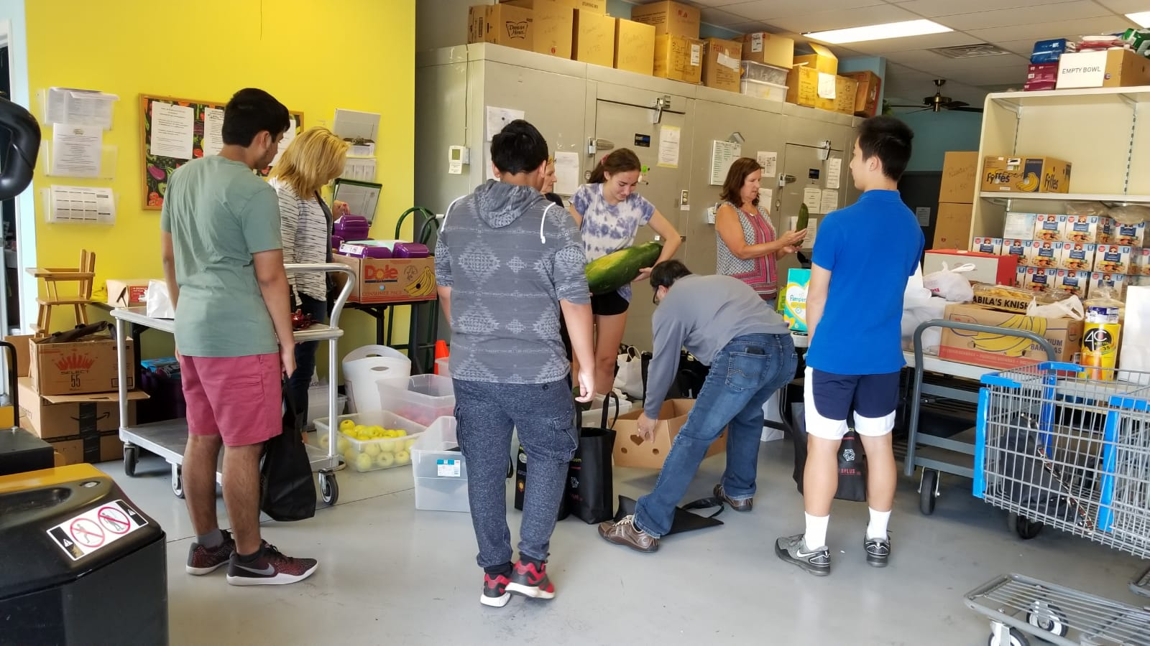

Slide 40
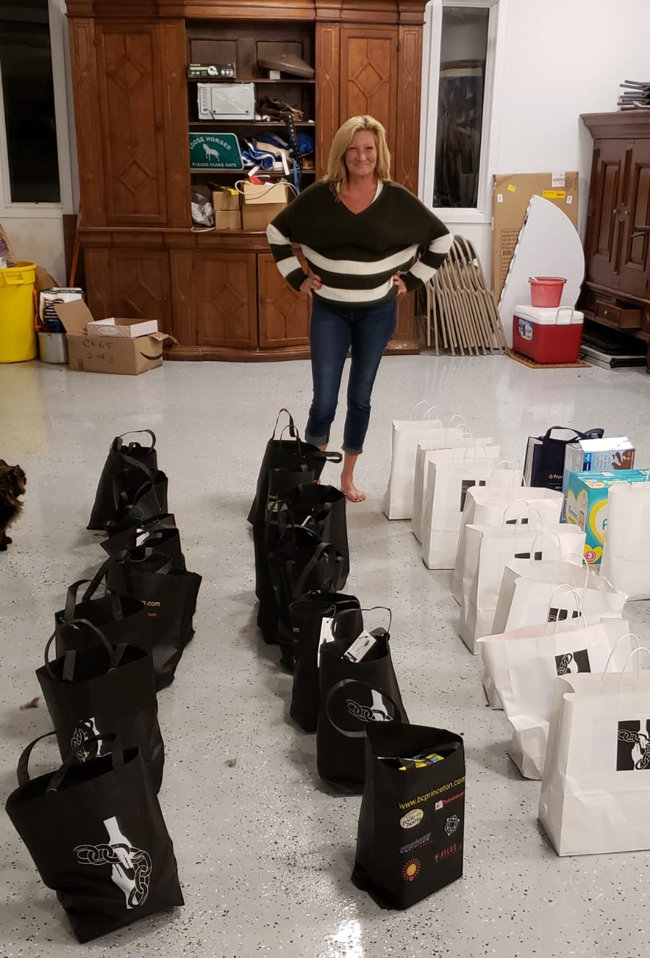

Slide 41
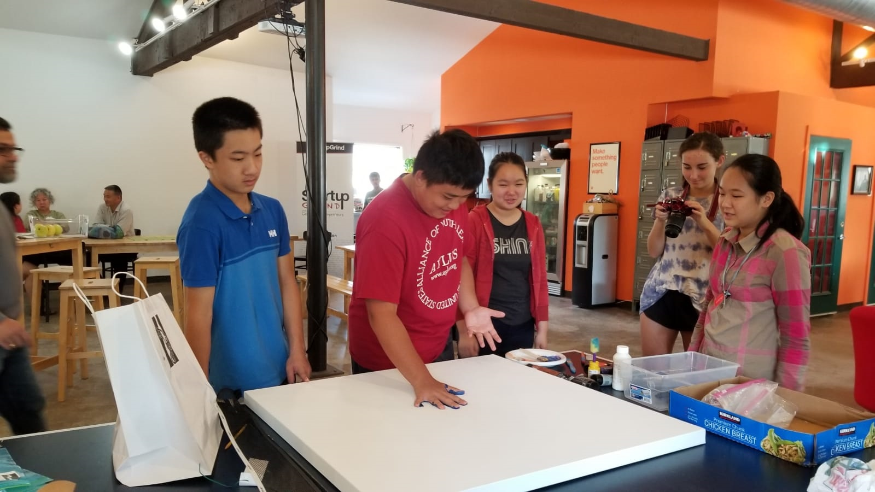

Slide 42


Slide 43


Slide 44
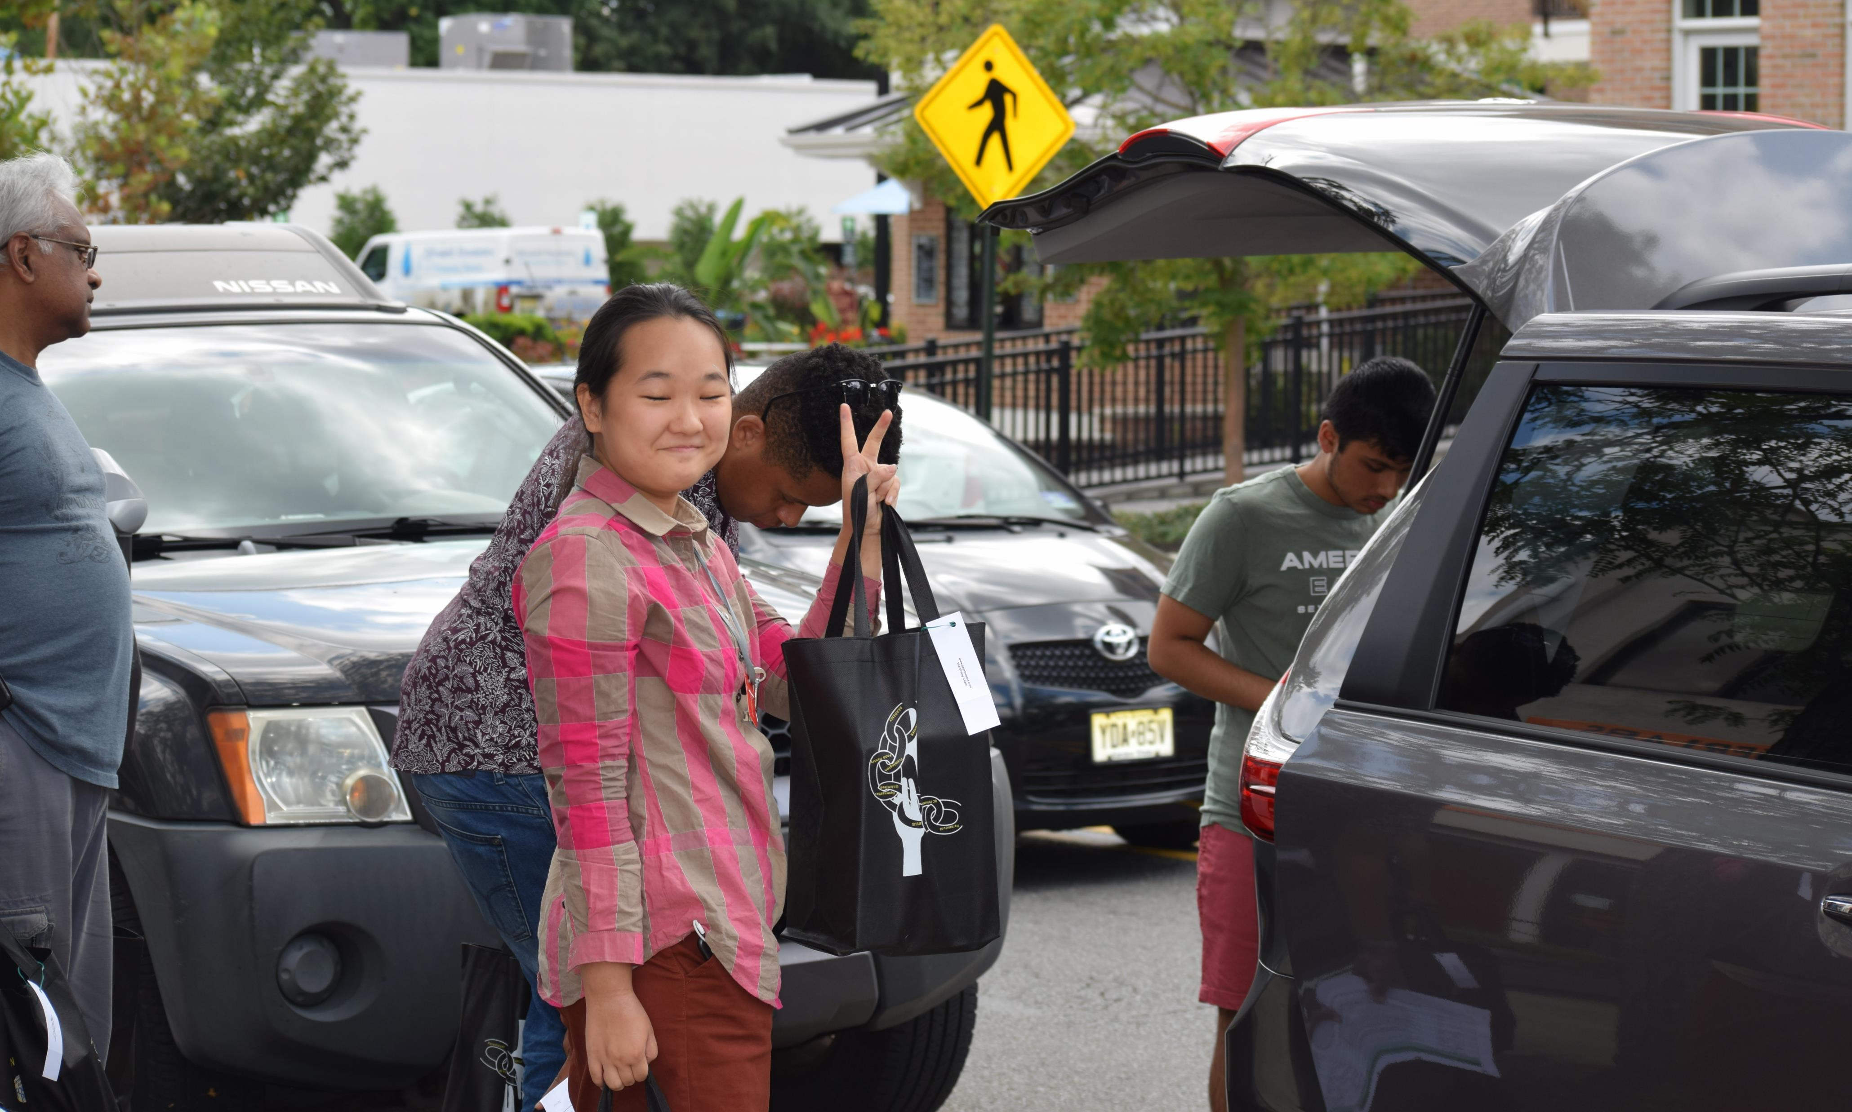

Slide 45
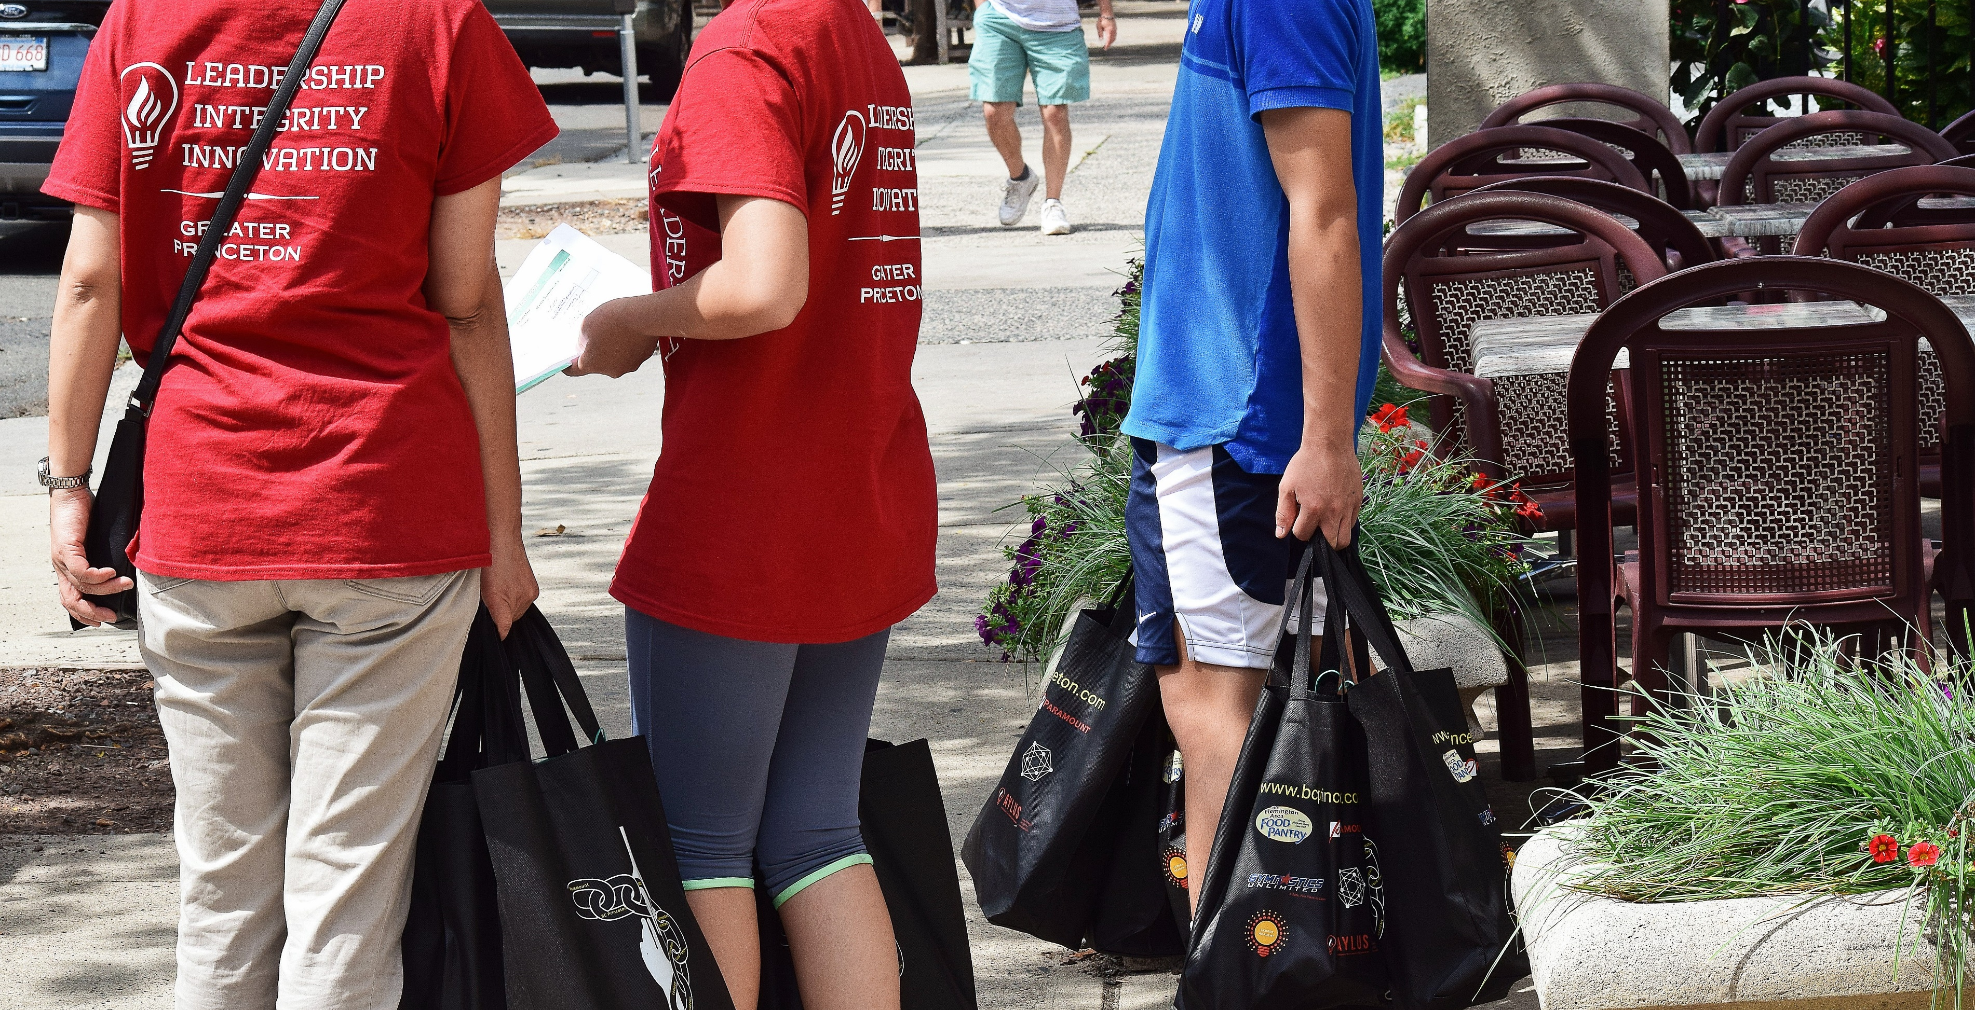

Slide 46
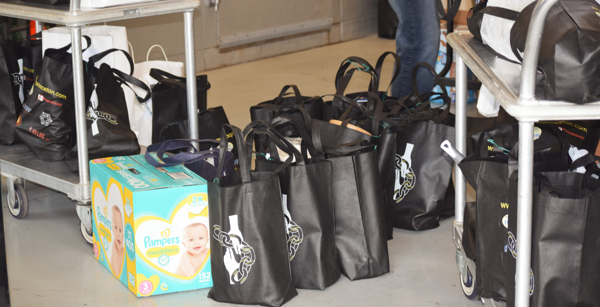

Slide 47
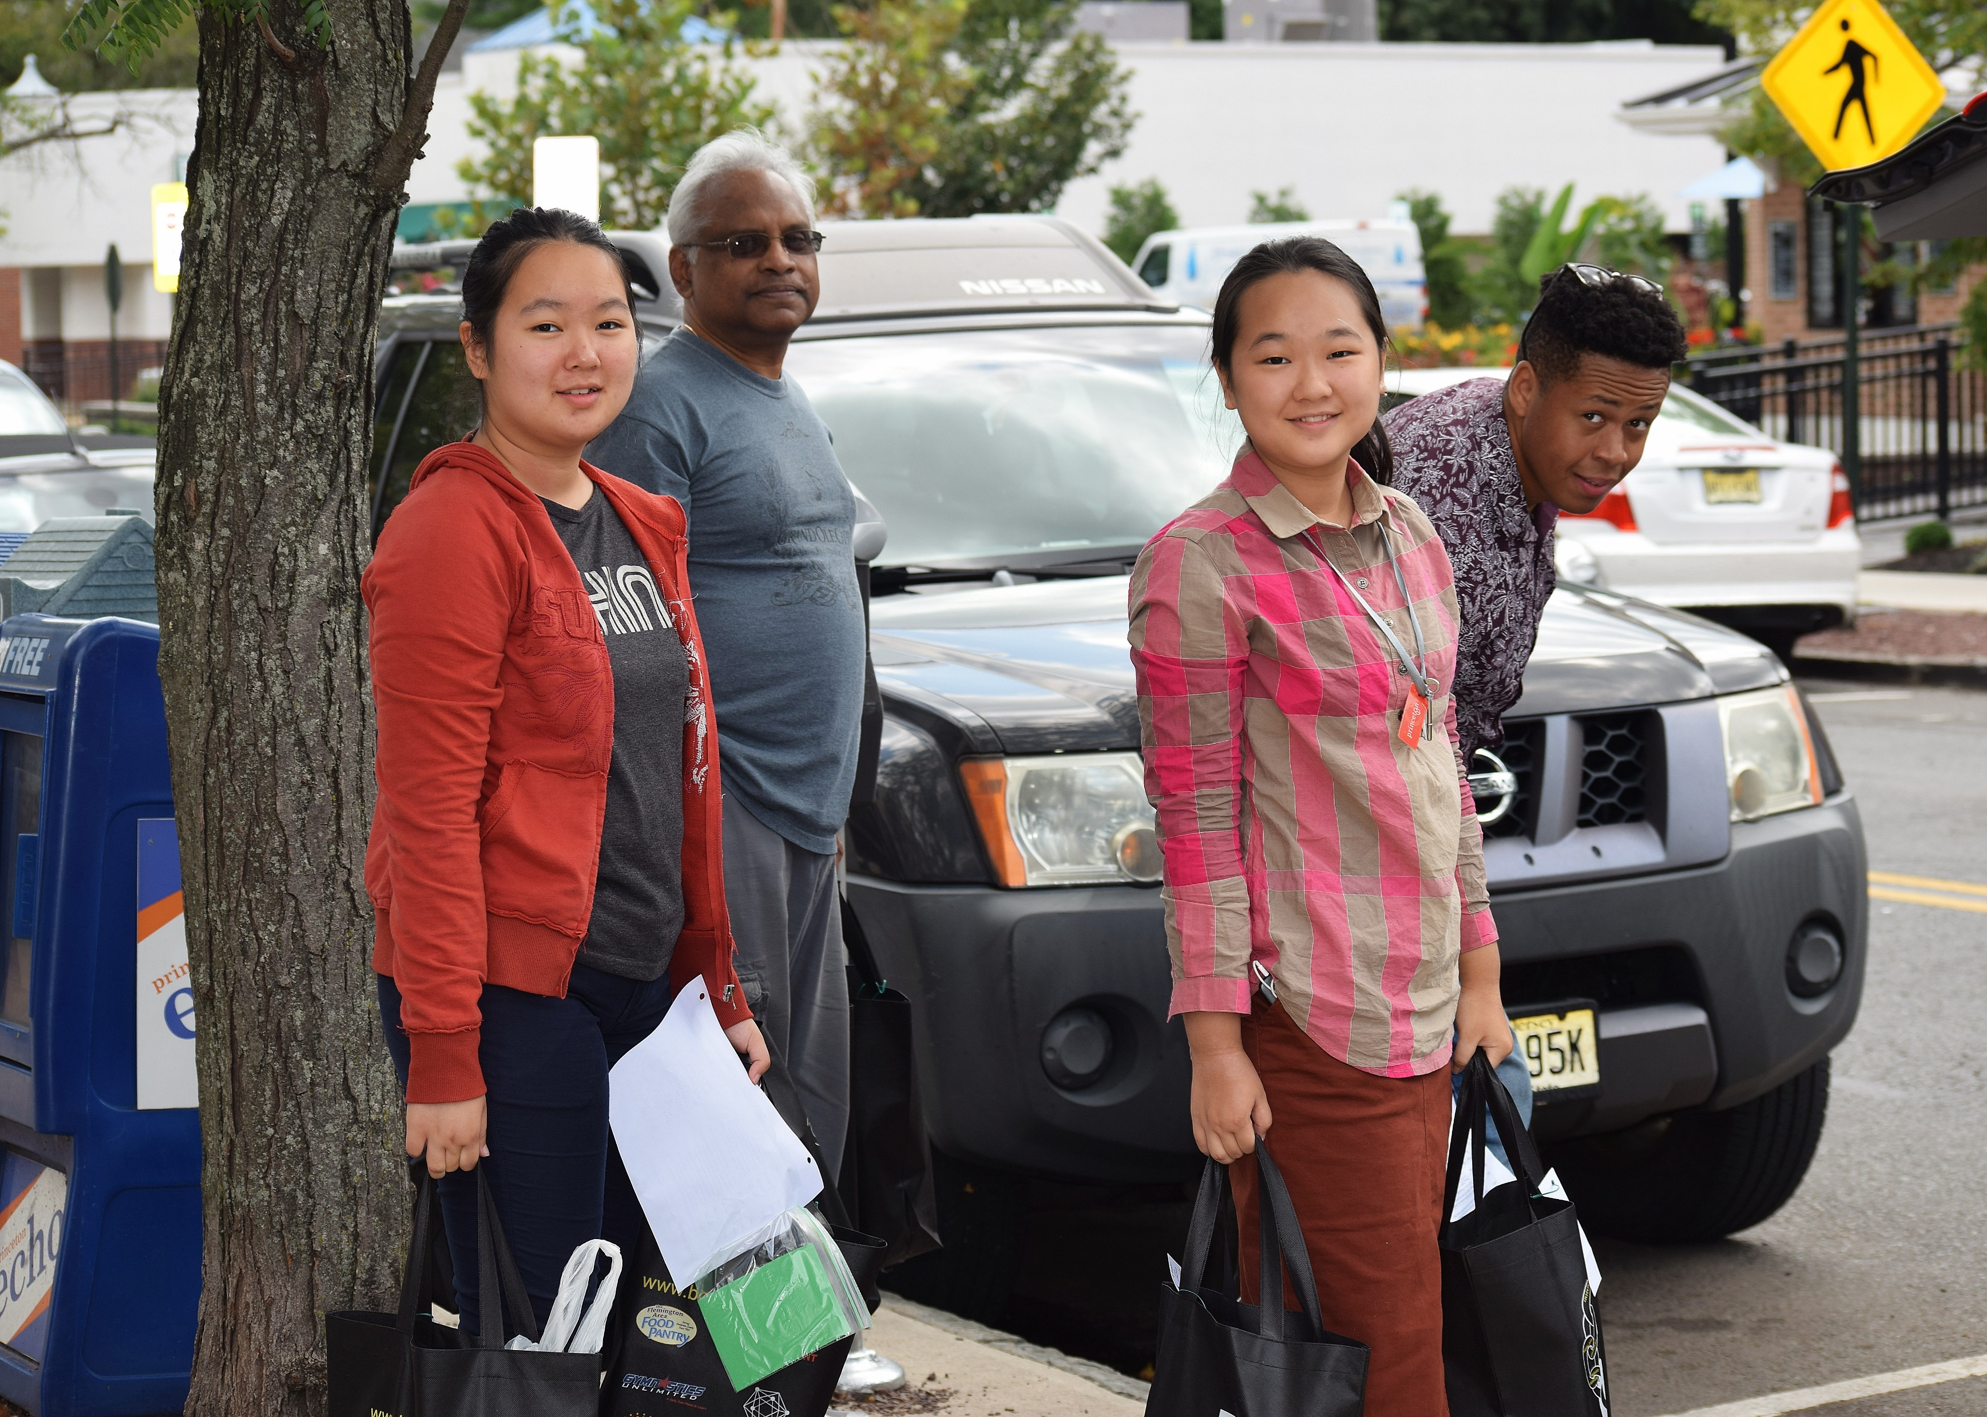

Slide 48
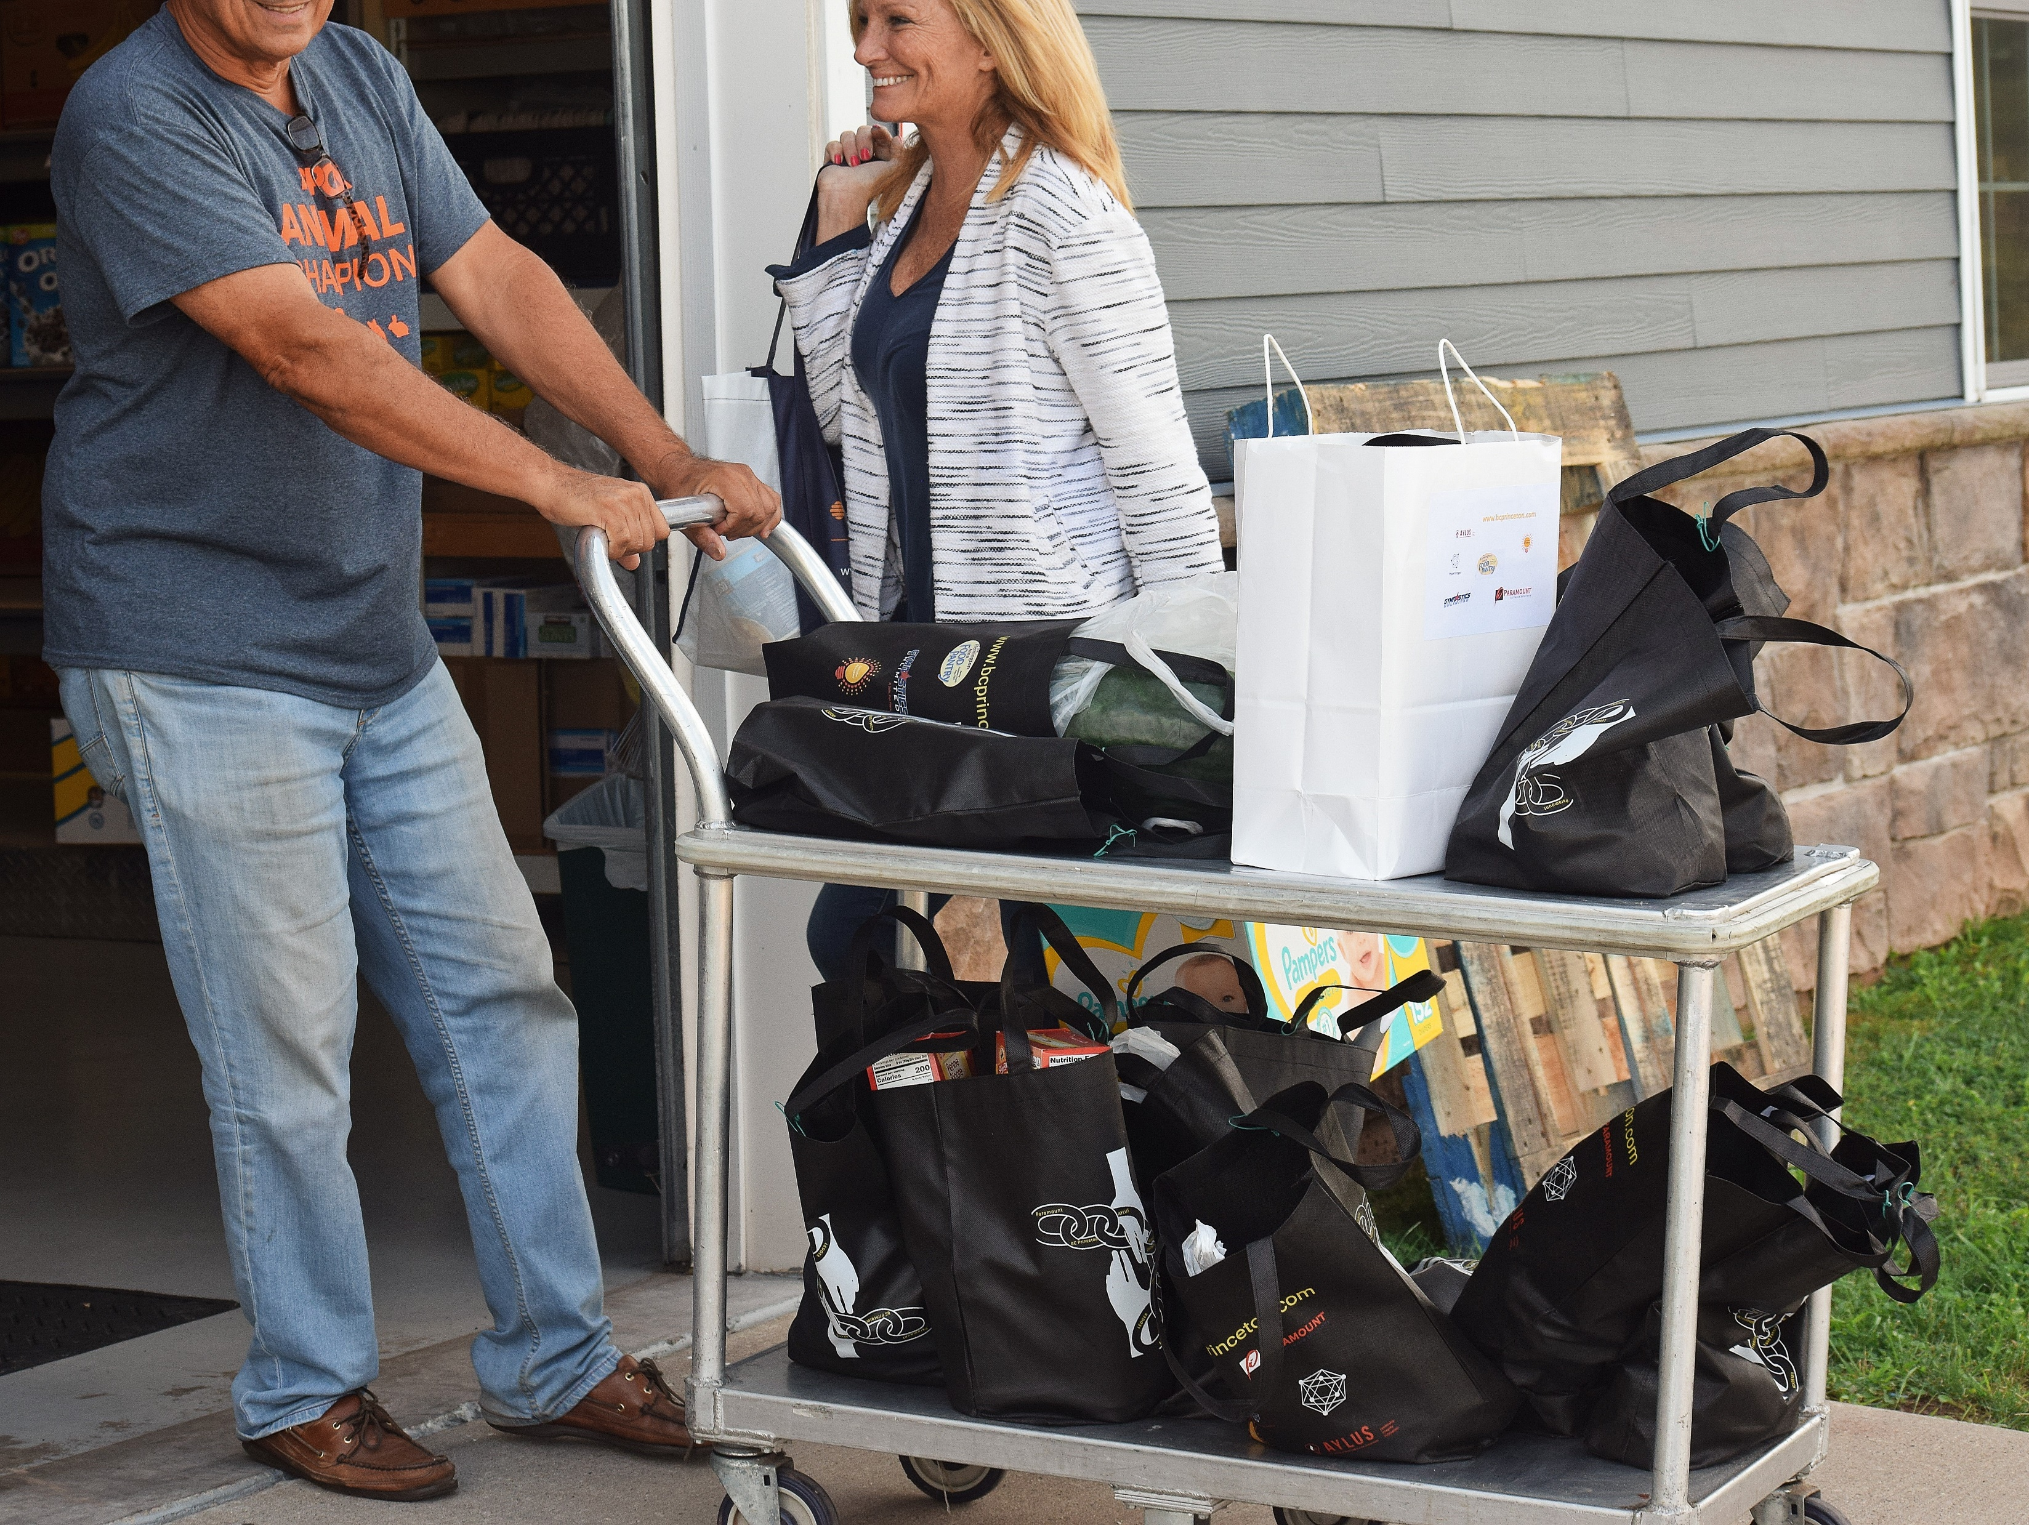

Slide 49
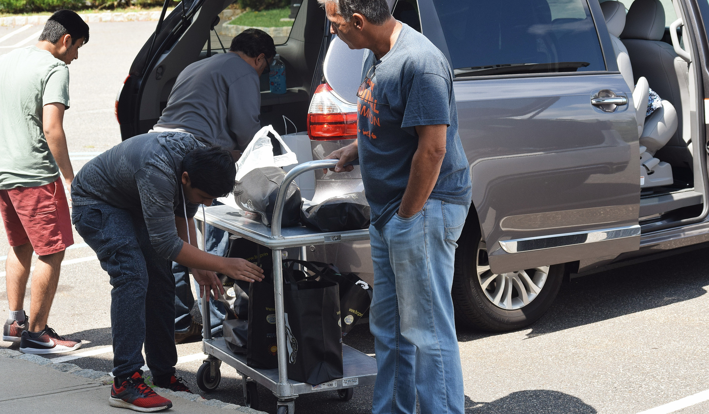

Slide 50
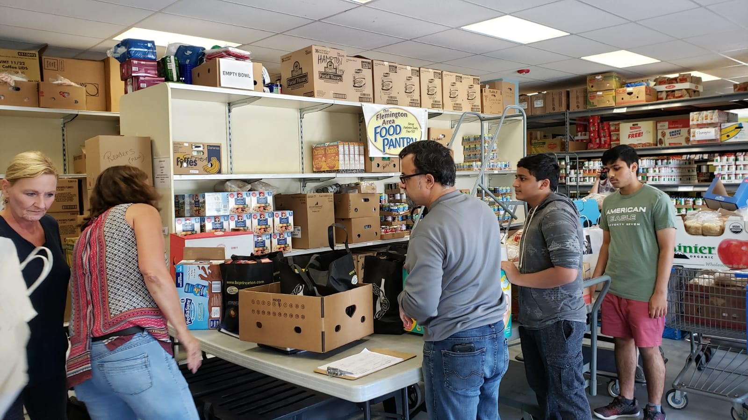

Slide 51
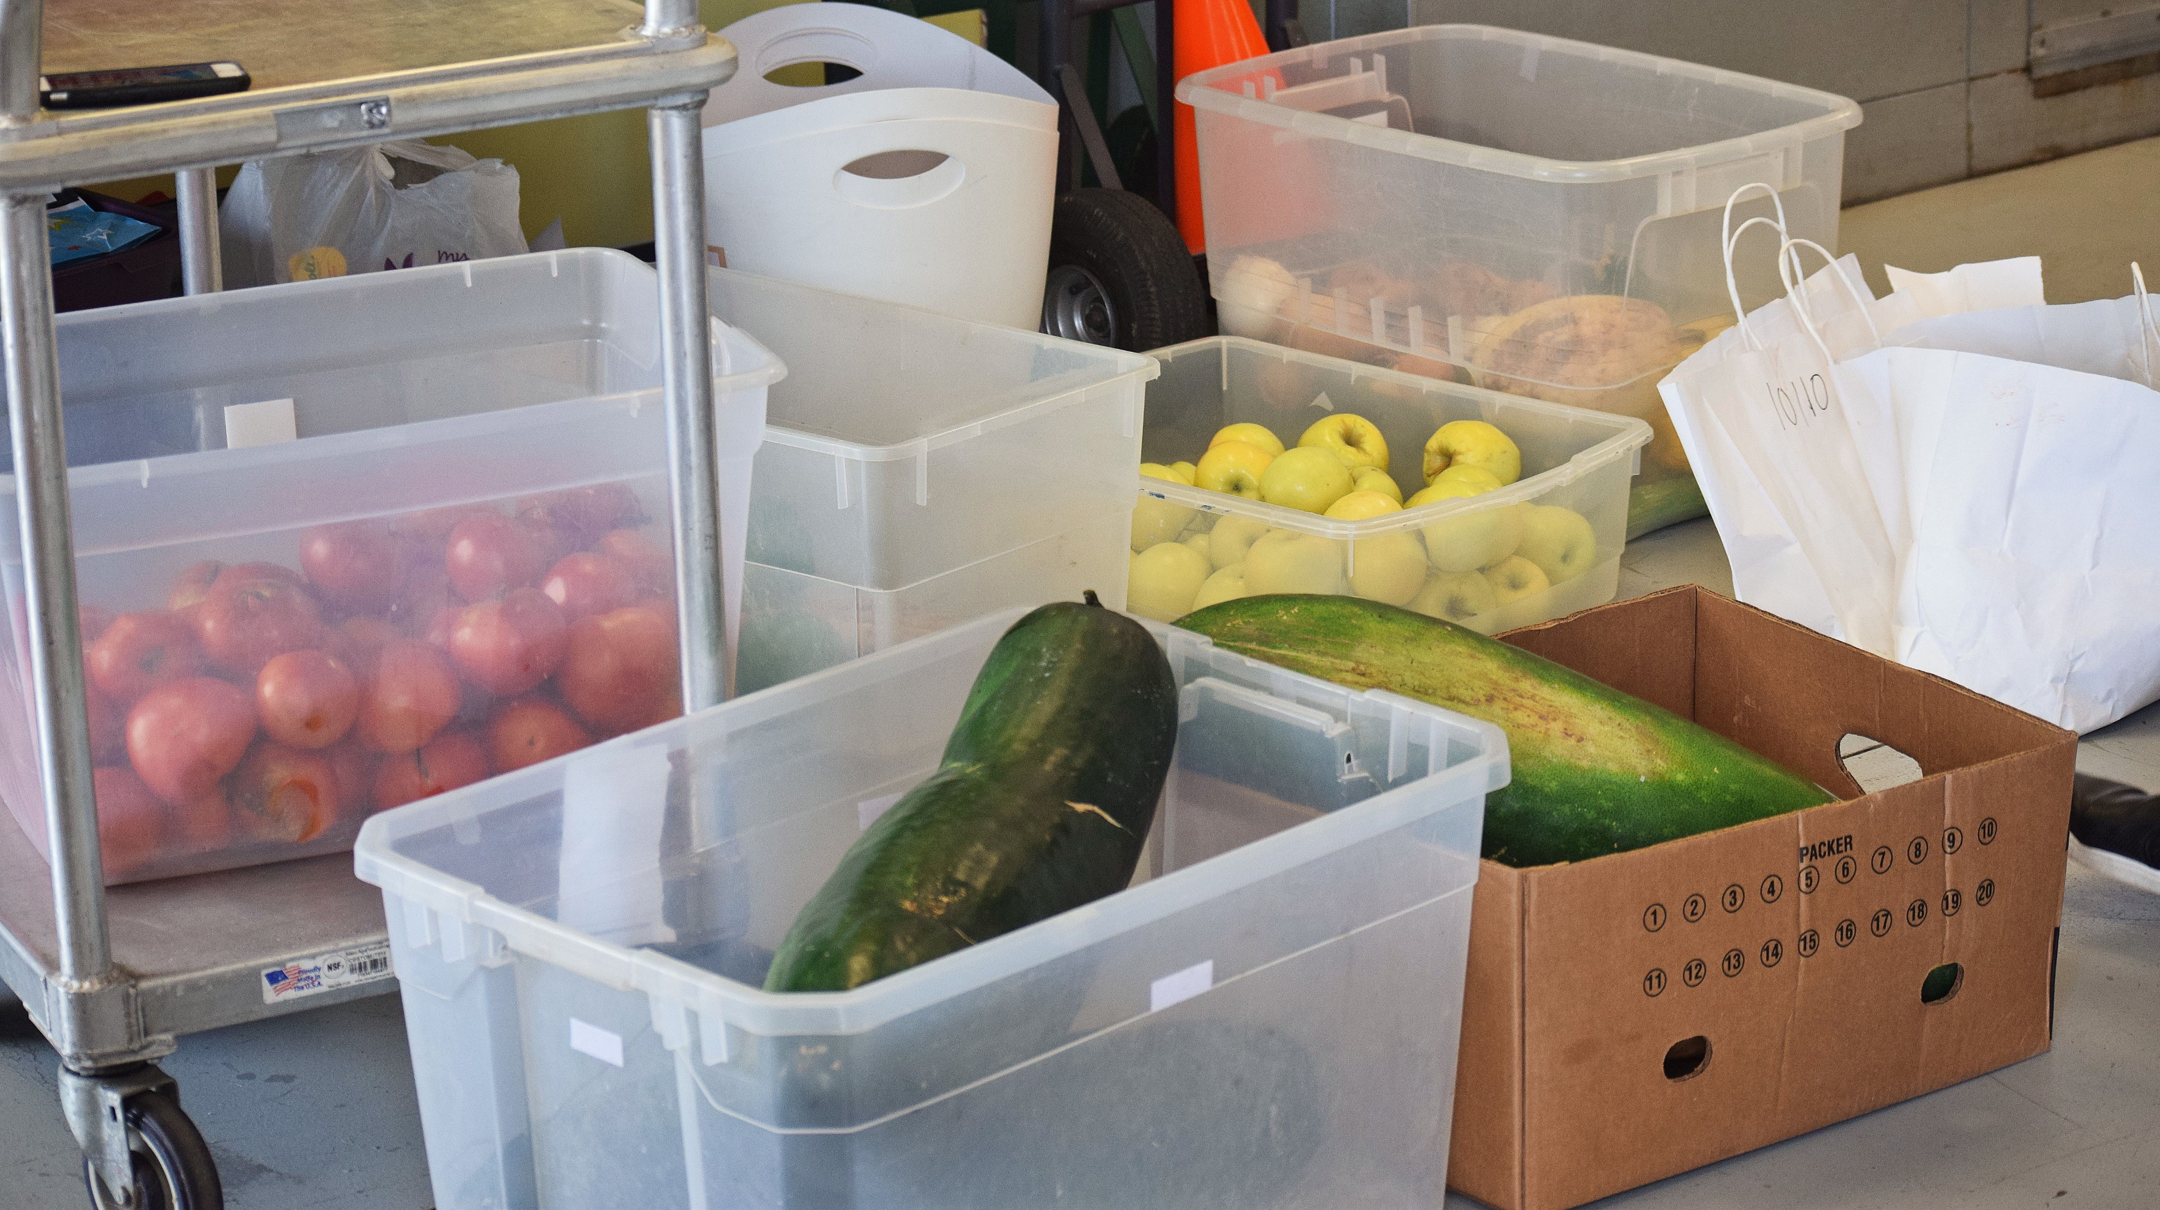

Slide 52
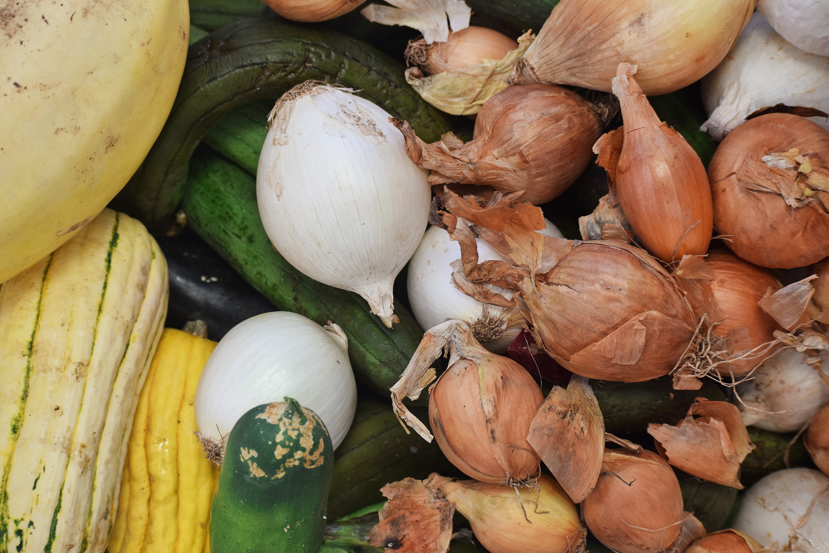

Slide 53
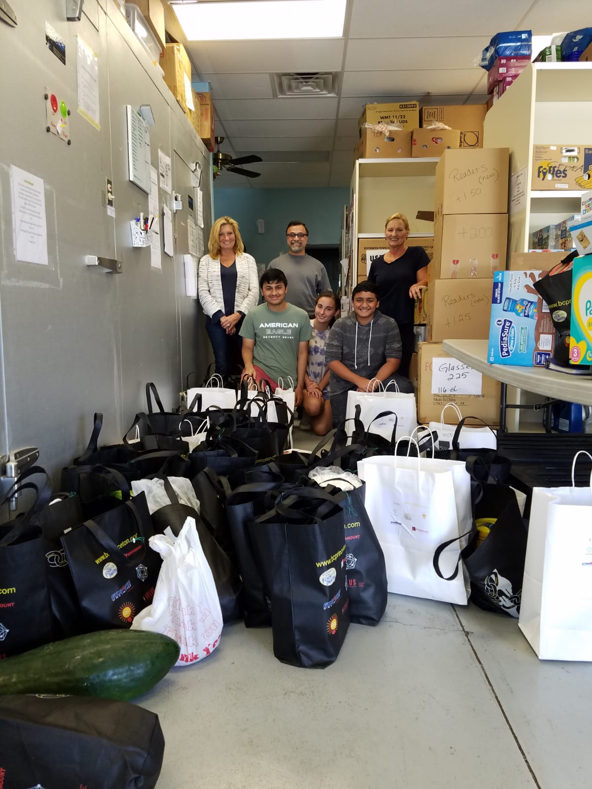

Slide 55
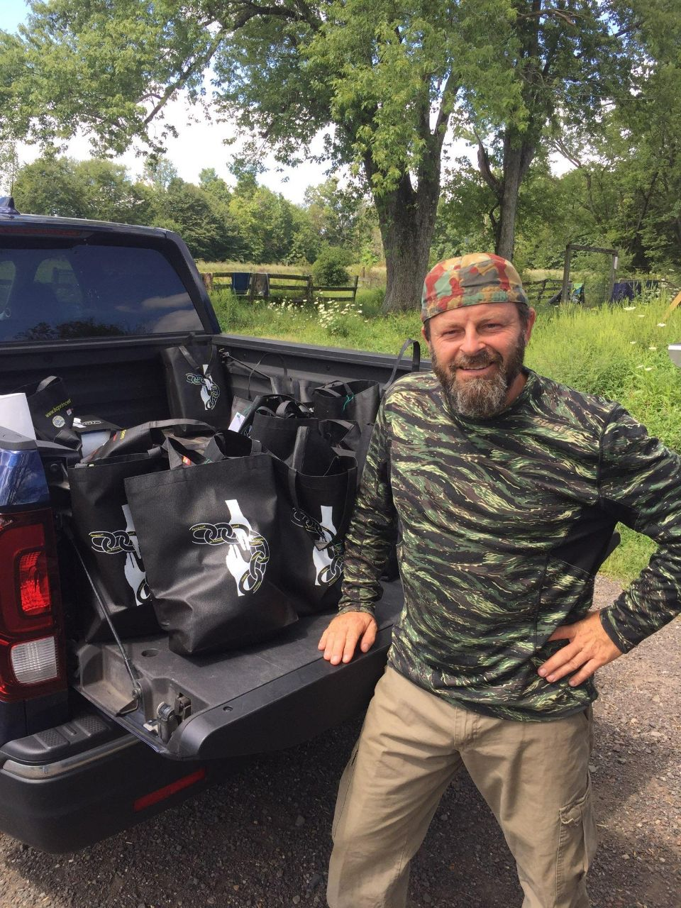

Slide 56
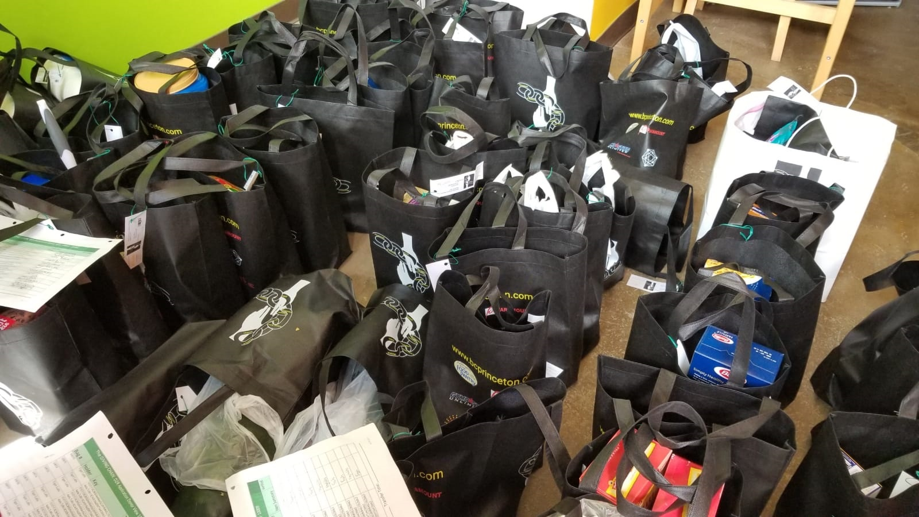

Slide 57
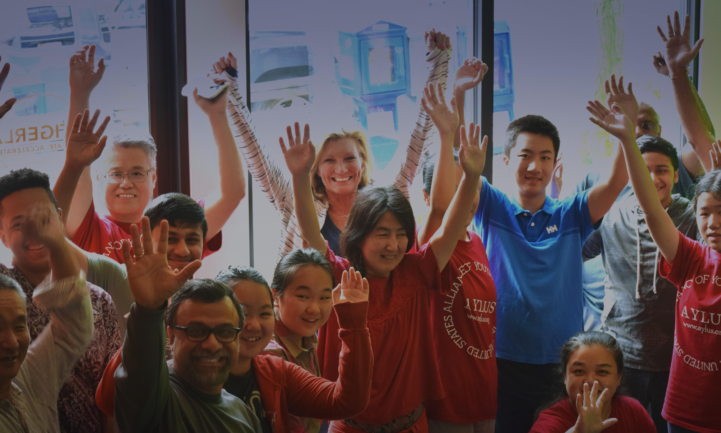

Slide 58
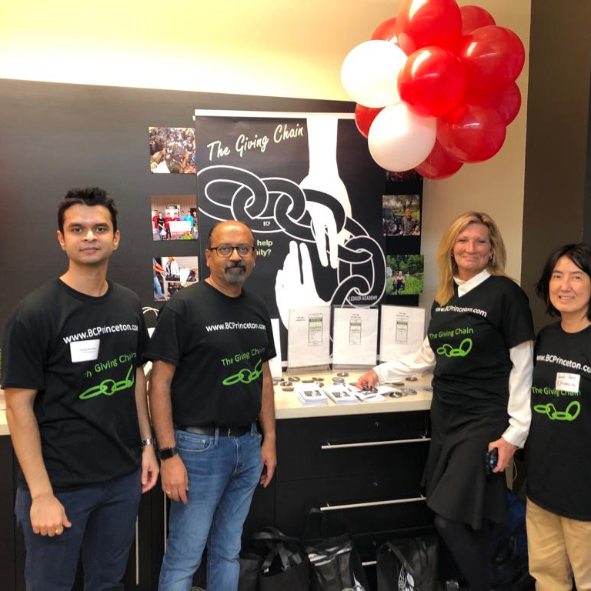
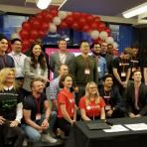
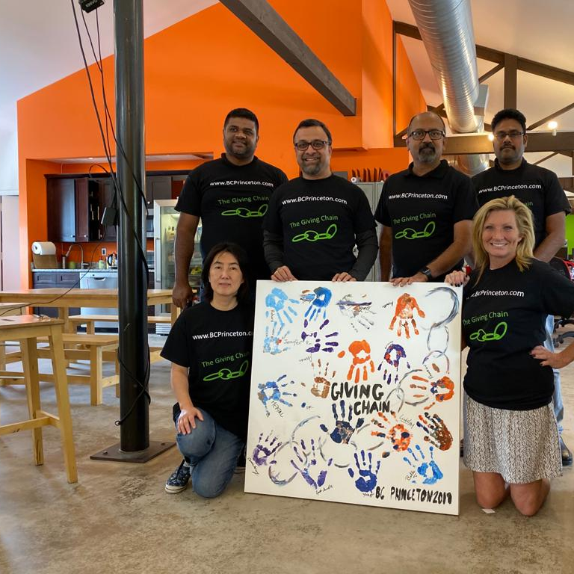
Big Apps Blockchain Challenge
September 2019

Slide 59
How to build a Social Impact Project
Introduction
What are Blockchain Social impact Projects
How to create a Social Impact Project
What is the Government Blockchain Association
Conclusion / Questions

Slide 60

The Government Blockchain Awards
GOVERNMENT BLOCKCHAIN ASSOCIATION
Government Blockchain Association (GBA) promotes blockchain technologies by empowering individuals and organizations to connect, communicate, and collaborate to solve public sector challenges around the world.
https://www.gbaglobal.org/

Slide 61


Slide 62


Slide 63
Leadership is the act of leading a group of people or an organization. This award acknowledges and celebrates exemplary leadership that has a significant and positive impact on advancing the theory and practice of blockchain technology. Leadership requires the ability to create and implement a vision for the team. This award recognizes those who demonstrate leadership within their team that is impactful, affective, motivational, and consistent.
Leaders provide freedom of thought, resources, support, encouragement, and challenge. They have bold goals, get out of the way, and reward people for trying. They are a pioneer of change. They motivate others and have a tangible track record to show it. They lead by example and inspire others to take smart risks and to drive positive change in their professional lives.

Slide 64

Amelia Powers
Gardner
Leadership
Notes:
Bio: Amelia Powers Gardner is the Utah County Clerk/Auditor for Utah County, Utah.
Prior to being elected as the Utah County Clerk/Auditor, Amelia was an account executive for Caterpillar and was a small business consultant. Since being elected, Amelia has received national recognition for her election reforms and innovations in government. In addition to being the only County Clerk in Utah to administer a Ranked Choice election, she also is the first Clerk in the nation to implement mobile voting for overseas and disabled voters and the first to launch a completely online, digital marriage license. Amelia continues to receive local and national attention for improving efficiencies and increasing election security.
Amelia Powers Gardner is a proud mother of six children. She is married to her husband Tobin Gardner and lives in Pleasant Grove, Utah.

Slide 65


Slide 66
Innovation is turning an idea or invention into a product or service that creates value for people and organizations. We are looking for the application of blockchain-related ideas that are novel and useful but also applied and scaled.
These ideas must further satisfy the needs and expectations of users in the public or private sector. An innovative solution has been implemented if it has been introduced, adopted and if it solves a real-world problem.
Innovation is also about staying relevant. In this time of unprecedented change, what may have helped an organization be successful in the past might no longer be effective in the future. We are looking for individuals that adapt and evolve to meet the ever-changing needs of their constituents and stakeholders.

Slide 67


Frank Ricotta Innovation
Notes:
Bio: Frank Ricotta is the CEO and co-founder of BurstIQ, a health-focused global network that connects businesses and people through the power of blockchain. BurstIQ was the first blockchain company to deploy a HIPAA- and GDPR-compliant blockchain solution, the first blockchain company to be listed as a preferred partner with the International Trade Administration, and the first blockchain company to be accepted into the UN Global Compact. Frank’s career achievements span multiple industries, including Defense, Health Care, Cyber Security, AI, and Finance. He holds numerous patents in fields of cyber security and machine intelligence.

Slide 68


Slide 69
Social impact is the effect that an individual or organization’s actions have on the wellbeing of the community, society, or world at large. Social impact must improve the conditions around the current situation and bring a significant, positive change to the problem. It is similar to “social good”, but the change is more drastic. Tackling symptoms of problems remains insufficient, and the phrase “social impact” is often misused to imply even minimalist change.
Social impact must stand for a significant shift in the vision, the trajectory, or the culture of a society. To really make a social impact requires action more than just ideas. However, this significant change takes time. With a clear vision of what could be, one individual or organization can start the process to affect real and lasting social impact.

Slide 70



Bobbi Muscara Social Impact

Slide 71


Slide 72
“Courage is being scared to death but saddling up anyway.”- John Wayne.
Blockchain challenges the traditional paradigms and norms that many hold today. Most people do not understand the impact of this technology. Others may understand it and be threatened by it. There is great potential for opposition, fear, and doubt. Sometimes navigating uncharted waters means taking risks for a vision that no one else sees. True courage is standing for one’s convictions, and not backing down to popular or powerful opinion, even at the risk of great personal loss. Courage is speaking up for what you believe because it must be said, no matter the cost, for not speaking would be cowardice. Courageous people are willing to endure personal sacrifice for the betterment of others and to defend values such as liberty, honesty, and justice.

Slide 73

Carlos Toriello Herrerías Courage
Notes:
Carlos Toriello worked during the national elections of Guatemala on
June 16th 2019 as an officially accredited witness...when it, very
publicly, collapsed. This occurred despite Guatemala being widely
touted around Latin America as one of the most trust worthy elections
in the region. He organized dozens of developers into the Fiscal
Digital movement to volunteer tirelessly in order to produce an audit
that could verify the results quickly. His official accreditation
unmasked him in public and to the authorities, becoming the only
public face of this previously anonymous effort. The movement
persisted and now has an official audience on February 7th, next week,
with election authorities that will incorporate blockchain into the
heart of the national election system, forever ending any future
possibility of election fraud in Guatemala.

Slide 74
How to build a Social Impact Project
Introduction
What are Blockchain Social impact Projects
How to create a Social Impact Project
What is the Government Blockchain Association
Conclusion / Questions

