Slide 1
Hyperledger Overview
August 2019

Slide 2



Introducing Hyperledger
Open source collaborative effort to advance cross-industry blockchain technologies
Hosted by The Linux Foundation, fastest-growing project in LF history
Global collaboration spanning finance, banking, IoT, supply chains, healthcare, manufacturing, technology and more.

Slide 3

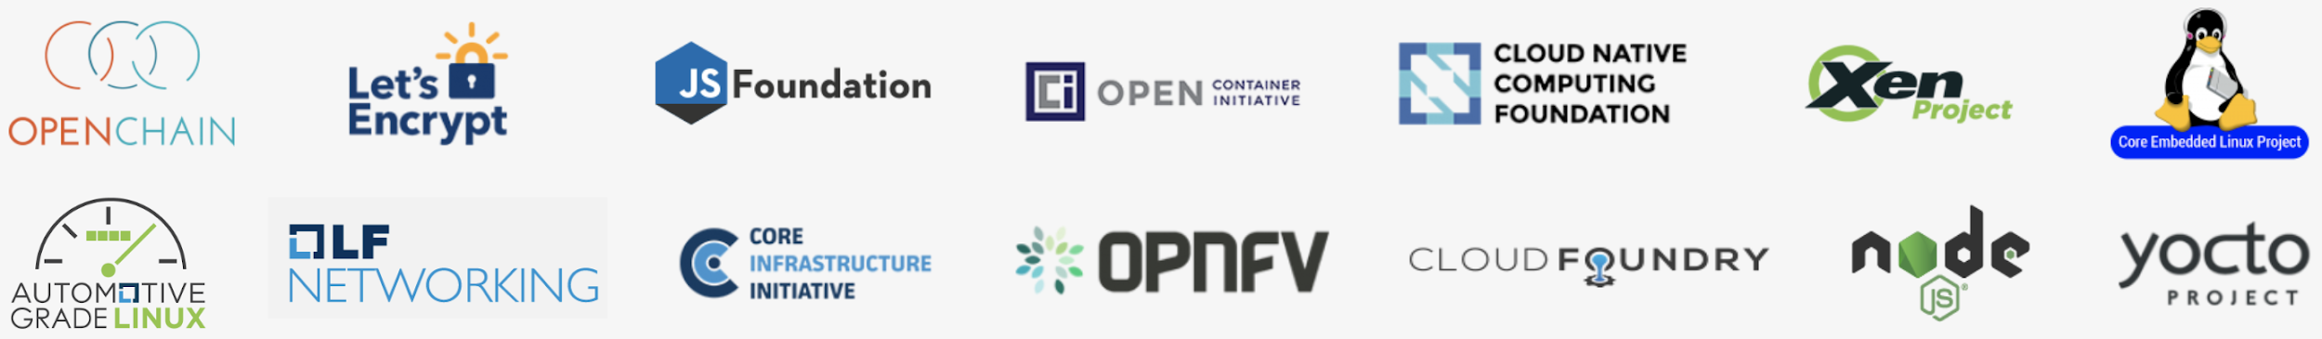
Hosted By The Linux Foundation
For the last 16 years, The Linux Foundation® has provided unparalleled support for open source communities through financial and intellectual resources, governance structure, IT infrastructure, services, events, and training.
Dedicated to building sustainable ecosystems around open source projects, The Linux Foundation is working with the global technology community to solve the world’s hardest problems through open source and creating the largest shared technology investment in history.
The Linux Foundation is the umbrella organization for more than 60 open source projects accelerating open technology development and commercial adoption. Some of the game-changing initiatives hosted by The Linux Foundation include:

Slide 4



Shared Ledger Database
Blockchain allows multiple different parties to securely interact with the same universal source of truth
Finance
Streamlined settlement, improved liquidity, increased transparency and new products/markets
Healthcare
Unite disparate processes, increase data flow and liquidity, reduce costs and improve patient experience and outcomes
Supply Chain
Track parts and service provenance, ensure authenticity of goods, block counterfeits, reduce conflicts

Slide 5




Hyperledger Goals
Where open source teams build diverse approaches for business blockchain technology systems
Create enterprise grade, open source, distributed ledger frameworks &
code bases
to support business transactions
Provide neutral, open, & community-driven infrastructures
supported by technical and business governance
Build technical communities
to develop blockchain and shared ledger POCs, use cases, field trials and deployments
Educate
the public
about the market opportunity for blockchain technology
Promote our community of communities
taking a toolkit approach with many platforms and frameworks

Slide 6
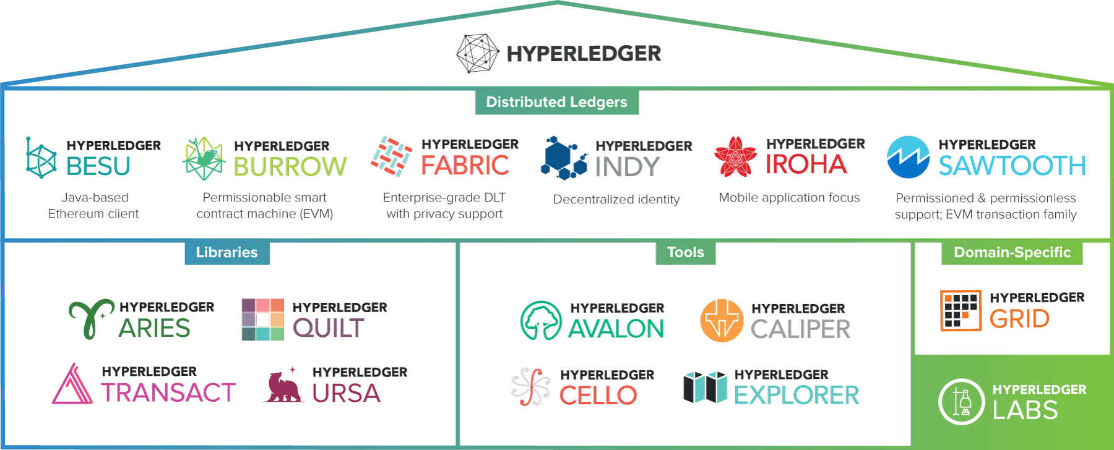
Hyperledger Modular Approach

Slide 7
Hyperledger Technical Scope
Out of Scope
Custom Applications
App Layer
API libraries and GUIs
Specialized consensus algos
Membership policies
Gateway
Operations dashboard
Core APIs
Code execution environment
Ledger data structures
Modular consensus framework
Modular identity services
Network peers
Value Added Systems
In Scope
Core APIs
Shared Ledger

Slide 8

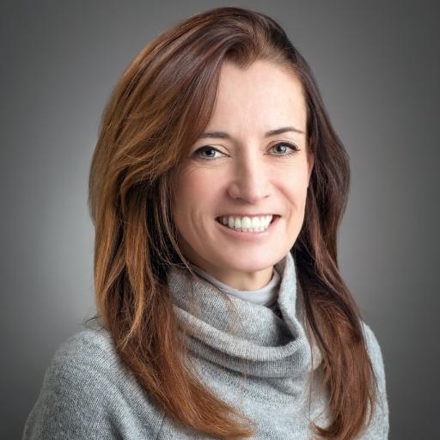
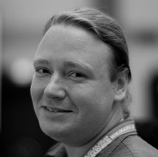
Leadership
“
Brian Behlendorf
Executive Director
2016 was full of growth for the organization and community. Not only did we exceed 100 members, Hyperledger met significant development milestones across our several Umbrella projects, thanks to the community’s hard work. As 2016 was a year of exploration, R&D and prototyping, we’re excited for 2017 to be the year we start to see case studies of Hyperledger Business Blockchain Technologies in production environments.
Apache Web server – Primary developer
Apache Software Foundation – Founding member
Mozilla Foundation – BOD since 2003
Electronic Frontier Foundation – BOD since 2013
CollabNet – Founding CTO
World Economic Forum – CTO
Most recently, managing director at Mithril Capital Management LLC, a global technology investment firm
”

Slide 9
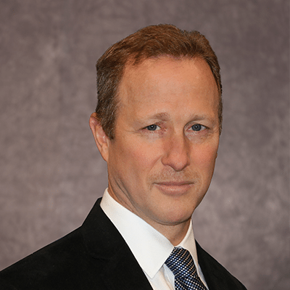
Governing Board
Robert Palatnick
Governing Board Chair
Palatnick previously served as a
Domain Lead in the Application
Development division of IT and was
Chief Administrative Officer of Information
Technology from 2003 to 2007. Palatnick joined Government Securities Clearing Corporation (GSCC), a DTCC subsidiary, in 1993 as Vice President, Information Technology. He became Managing Director and Chief Information Officer of DTCC subsidiaries GSCC (1996), Mortgage-Backed Securities Clearing Corporation (2000) and Fixed Income Clearing Corporation (2003). Prior to that, Palatnick was Vice President, Development and Systems, at Security Pacific Corporation Sequor Software Services. Palatnick received his BS in Electrical Engineering from the University of Buffalo, and is an alumnus of the David Rockefeller fellowship.
Comprised of one voting representative from each Premier Hyperledger member and attended by the TSC and Marketing Committee Chairs, the Governing Board’s responsibilities include:
Approving a budget
Electing a Chair to preside over Governing Board meetings, authorize expenditures approved by the budget and manage any day-to-day operations
Reviewing all project proposals from the TSC and directing the business strategy, development and promotion for projects

Slide 10

Technical Steering Committee
The TSC is the technical governance heart and soul of the project. As new code bases get contributed to the project they get reviewed and approved by this committee.
Committing members appoint and vote the TSC Chair annually.
Meets weekly on Thursday, 10:00 AM to 11:30 AM ET
All are invited to attend these calls and encouraged to join the TSC mailing list for more information:
lists.hyperledger.org/mailman/listinfo/hyperledger-tsc
Arnaud Le Hors
TSC Chair
Arnaud Le Hors is Senior Technical Staff Member (STSM) Open Web Technologies at IBM. He has been working on Open Technologies for over 20 years, involving standards and open source development. Arnaud was a staff member of the W3C and the X Consortium and has represented IBM in several standards and open source organizations for many years. Arnaud was editor of several key Web specifications including HTML and DOM and was involved in high profile open source projects such as Xerces, the Apache XML parser, and the X Window System. Arnaud is currently the main representative for IBM at W3C and the chair of the W3C RDF Data Shapes Working Group.

Slide 11
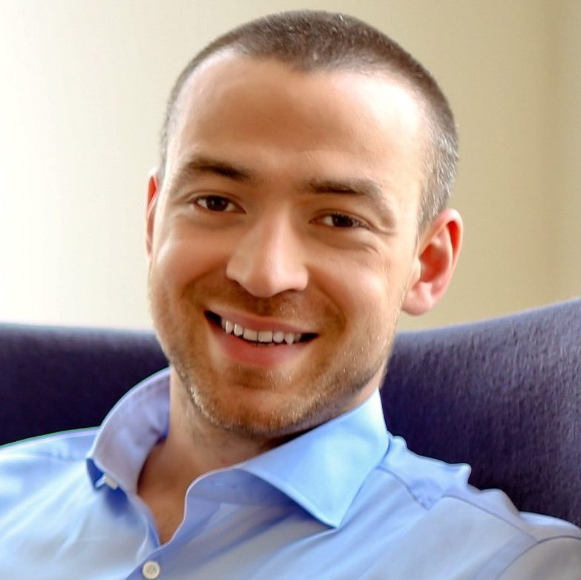
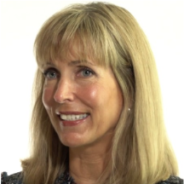
Marketing Committee
The Hyperledger Marketing Committee is open to all Hyperledger members and is charged with defining and executing the marketing and outreach strategy.
MC meets monthly on the second Tuesday at 10:00am PT
Dan O’Prey
Marketing Committee Chair
Alissa Worley
Marketing Committee
Vice Chair
Digital Asset – CMO
Dan was the co-founder and CEO of Hyperledger, a San Francisco-based technology firm that developed an innovative distributed ledger to allow financial institutions to clear and settle transactions in real-time.
Accenture – CEO
Alissa is the Global Marketing Director of Blockchain and DLT at Accenture a Premier founding member of Hyperledger.

Slide 12
Additional Community Working Groups
Working Groups are open to the public
Working Groups
Architecture WG
Diversity, Civility, and Inclusion WG
Identity WG
Learning Materials Development WG
Performance and Scale WG
Smart Contracts WG
Technical WG China
Special Interest Groups
Capital Markets SIG
Healthcare SIG
Public Sector SIG
Social Impact SIG
Supply Chain SIG
Telecom SIG
Trade Finance SIG

Slide 13





Hyperledger Momentum
3
Years Since Launch
14
Projects
3
1.0 Production Releases
275+
Members
(50+ in China)
14
Active Community Working Groups & SIGs
170+
Meetups Worldwide
76K
Meetup Participants

Slide 14
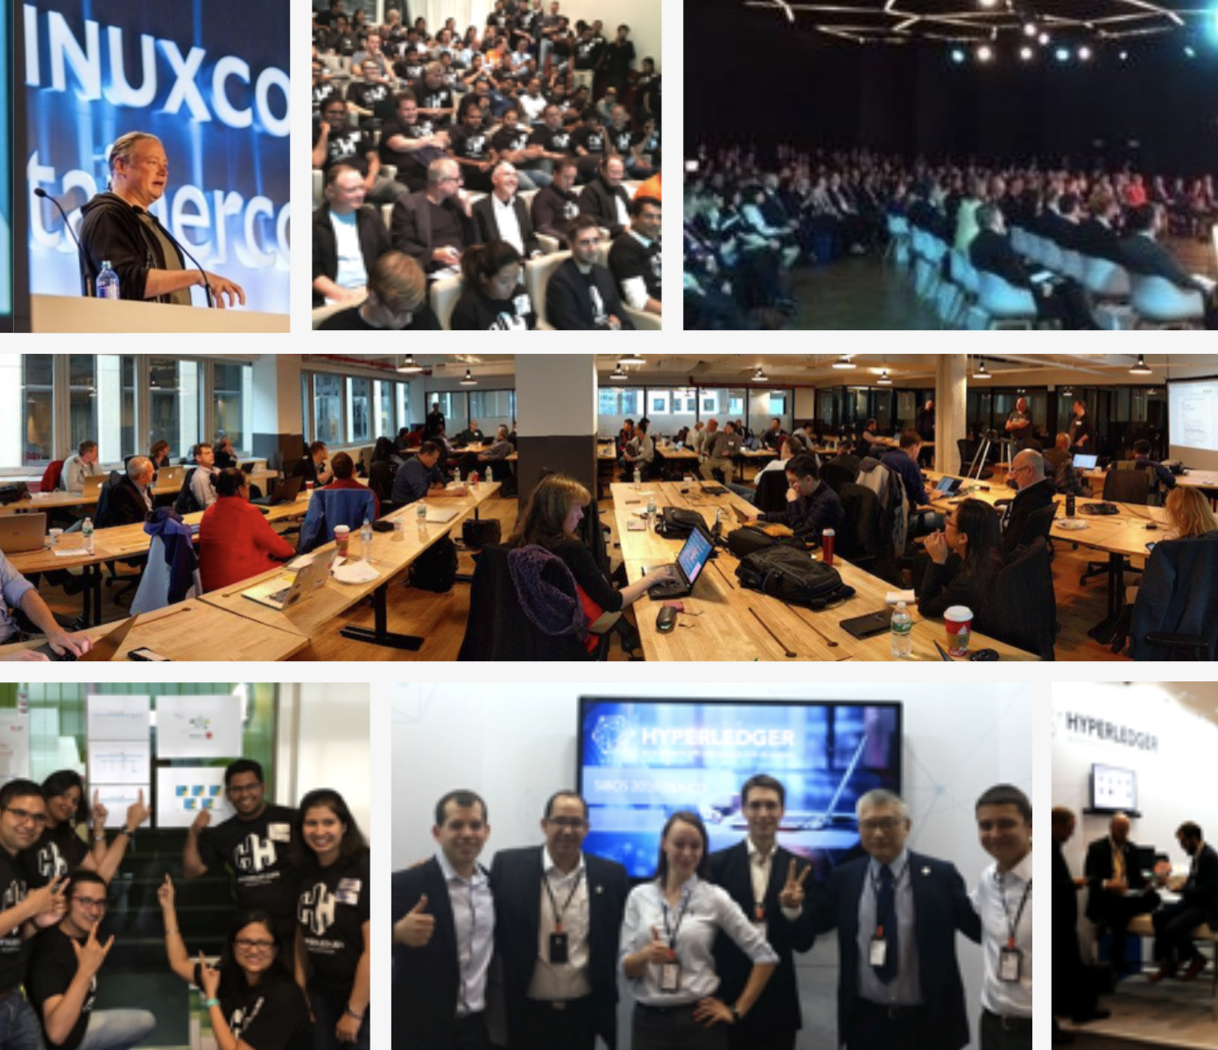
Community and Ecosystem Engagement
Behlendorf is a regular keynoter and Hyperledger exhibits at cross-industry events.
Hyperledger Member Summit and first annual Hyperledger Global Forum.
Active engagement with technology and finance journalists and analysts to continue educating the market on Hyperledger. hyperledger.org/news
Technical Steering Committee hosts regular online and face-to-face hackathons. Join our mailing lists to learn about these and other technical activities. hyperledger.org/community

Slide 15
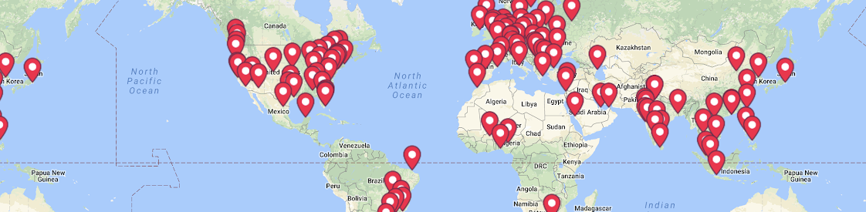
Hyperledger Global Meetups
We are 60K+ members across 170+ Meetups in 76 countries

Slide 16
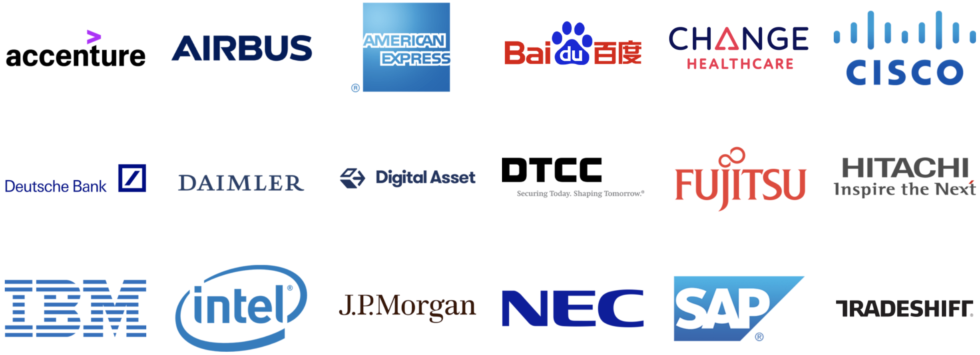
Join Your Industry Peers
Hyperledger Premier Members Serving on the Governing Board.

Slide 17
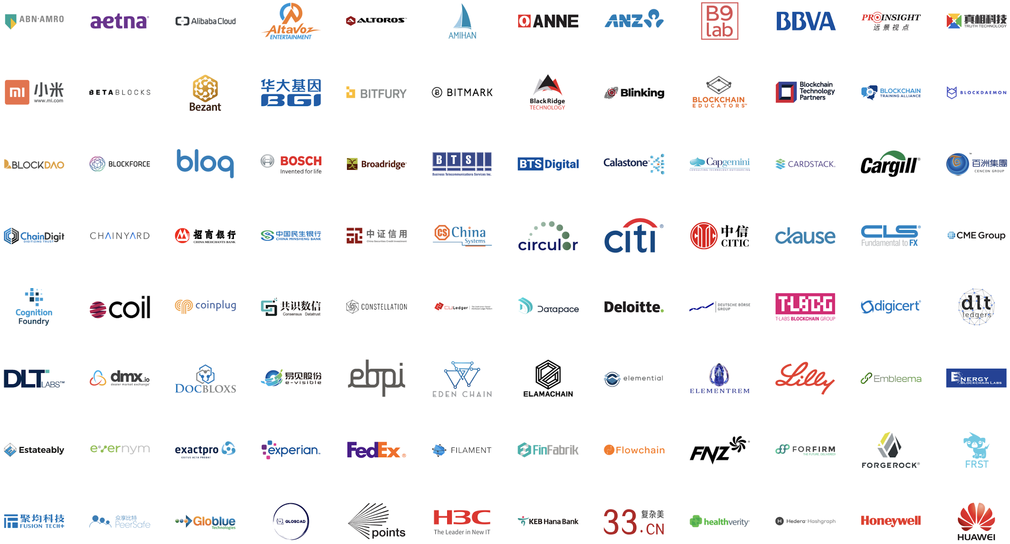
General Members

Slide 18
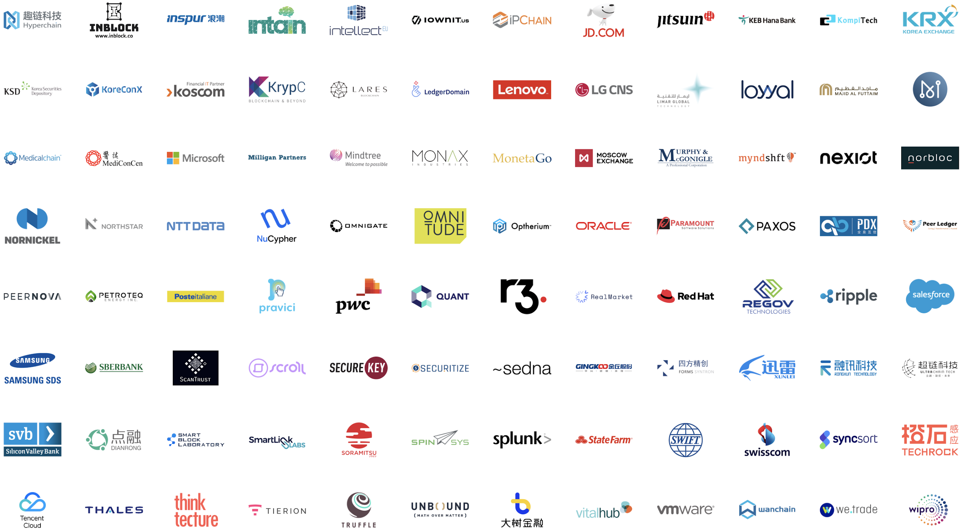

Slide 20

Associate Members

Slide 21

Associates: Academia

Slide 22
Get Involved!
Ensure the strength and longevity of a core technology to your business.
Publicly proclaim your leadership in the blockchain space.
Work with other blockchain leaders to develop and promote Hyperledger blockchain for business technologies.
Visit hyperledger.org/about/join
or email info@hyperledger.org

