Slide 1
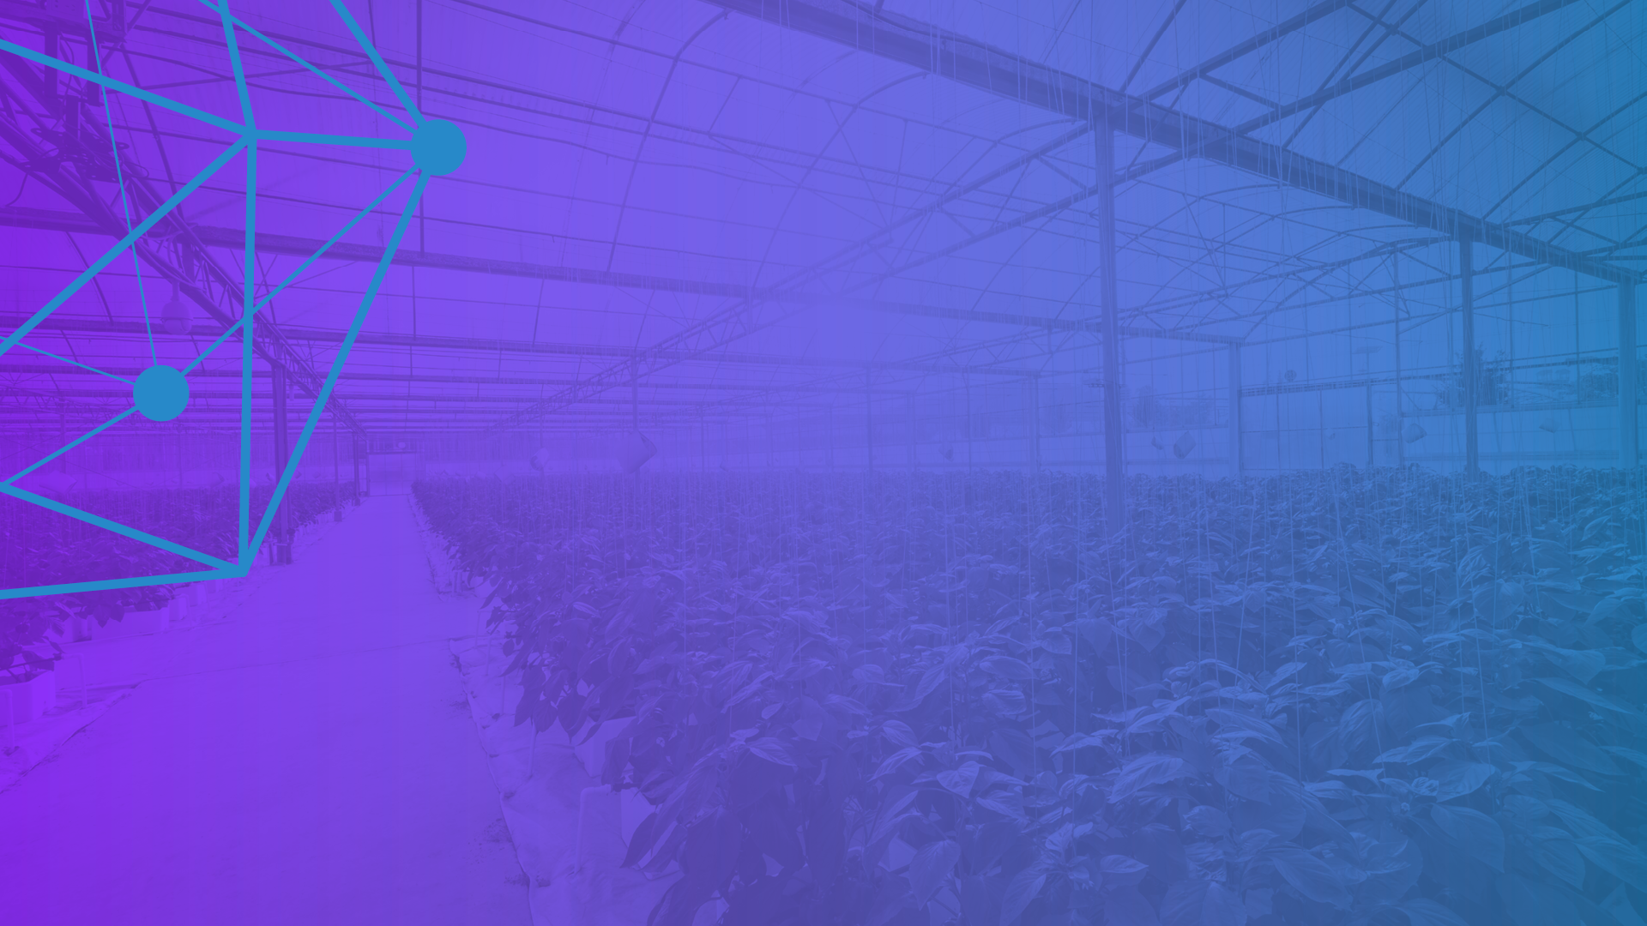


Hyperledger
Overview 2019
www.hyperledger.org
@Hyperledger

Slide 2
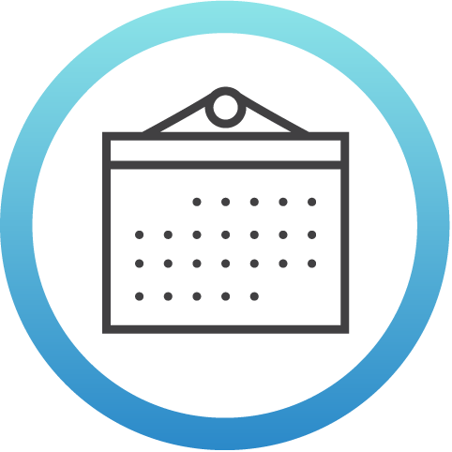

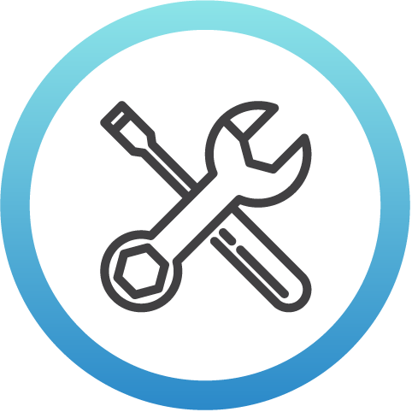
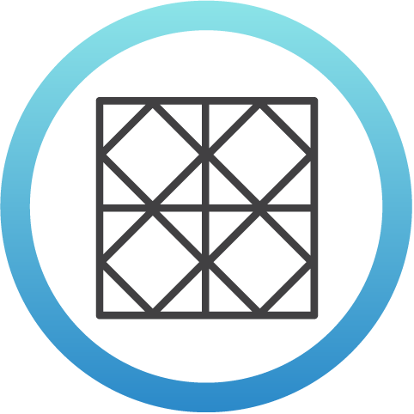
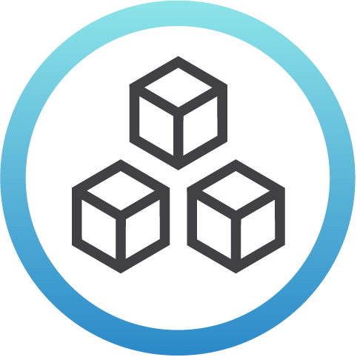
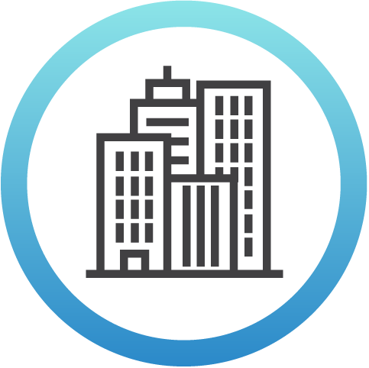
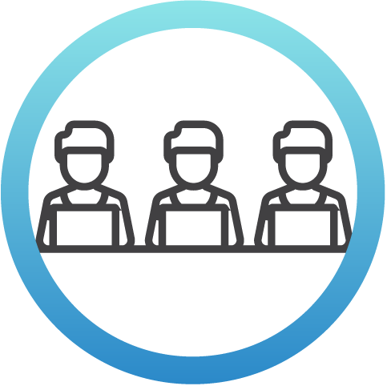

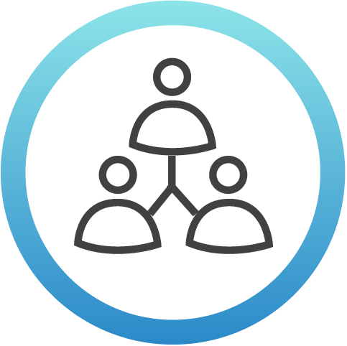

Hyperledger Momentum
3
Years since launch
126K+
Commits
6
Tools
6
Frameworks
2
1.0+ Production Releases
270+
Members
(50+ in AsiaPac)
11
Active Community Working Groups &
Special Interest Groups
165+
Meetups
Worldwide
(65+ countries)
56K+
Meetup
Participants
2,000+
Media Clips Per Month
Notes:
These are statistics covering different aspects of the Hyperledger community that show the growth in activity over time.

Slide 3

Hyperledger has a modular approach to hosting projects. Think of Hyperledger as a greenhouse growing and sustaining business blockchain projects from seed to fruition.
The Linux Foundation and Hyperledger provide the infrastructure for open development to occur among a diverse and thriving community.
Notes:
Under Hyperledger’s umbrella there are frameworks and tools that take different approaches to creating blockchains for business.
There are many benefits to this modular approach since we believe that there isn’t one blockchain solution that will work well for every possible use case.

Slide 4





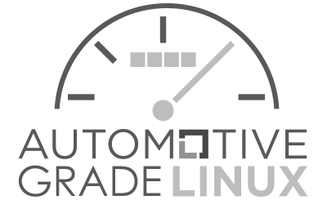
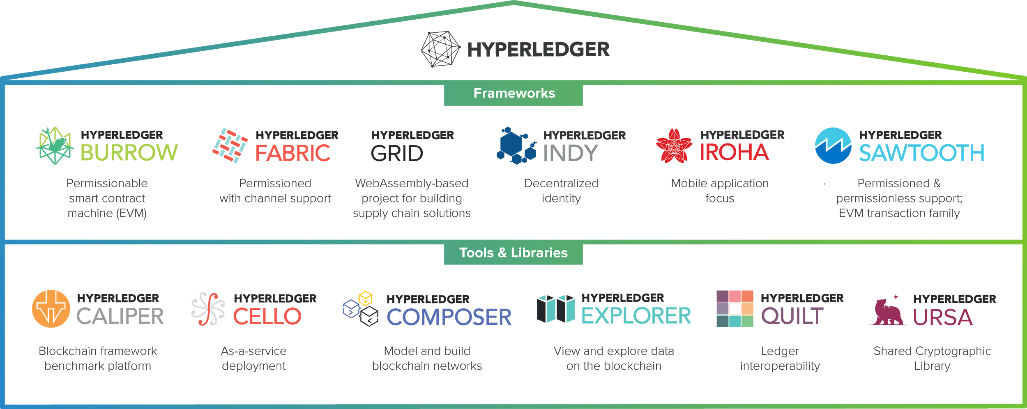
The Hyperledger Greenhouse Architecture
Notes:
This graphic shows how Hyperledger fits within the Linux Foundation’s set of open source projects and how the Hyperledger communities is made up of a number of projects.
Frameworks
Meaningfully differentiated approaches to business blockchain frameworks developed by a growing community of communities
Tools
Typically built for one framework, and through common license and community of communities approach, ported to other frameworks
Similar to the way that The Linux Foundation takes an umbrella approach to the projects that exist under, Hyperledger also has a modular umbrella approach. At the top level, The Linux Foundation and Hyperledger provide the infrastructure for open development to occur. This includes technical, legal, marketing, and organizational aspects.
Under Hyperledger’s umbrella are a number of frameworks that take different approaches to creating business blockchain tools and frameworks -- Fabric, Iroha, Sawtooth, Burrow, and Indy.
Hyperledger’s umbrella also includes a number of modules that were typically built with one framework in mind, but are being expanded and ported to support other frameworks.
Composer - Provides a application development environment that lets you more quickly develop and deploy your blockchain application. Hyperledger Composer allows you to model your business network and integrate existing systems and data with your blockchain applications.
Explorer - provides a User Interface to explore and examine the current state of a Hyperledger blockchain. Similar to bitcoin explorers or crypto-currency explorers, information such as transaction information, network activity, recent blocks, visuals and search are available that allows for information to be quickly found.
Cello - allows us to easily provision a blockchain network, check its status, and maintain the health of the network.

Slide 5



12 total projects to date.
Newest projects:
Hyperledger Ursa: A shared cryptographic library that enables people (and projects) to avoid duplicating security-sensitive cryptographic work and thus can increase security in the process.
Hyperledger Grid: based on demo code already in Sawtooth, will be a library and templates for building supply chain tracing applications.
Q1 2019 Project News
Hyperledger Fabric:
Production 1.4 released January 2019. v1.4 is Fabric’s first long term support release.
Hyperledger Sawtooth: Production 1.1 released in December 2018
More Info: https://wiki.hyperledger.org
Notes:
This slide covers the major project-related news for this time period, including updates to existing projects and the launch of new projects.

Slide 6


2019 Special Interest Group (SIG) News
Newest SIGs:
HYPERLEDGER
Trade Finance Special Interest Group
Focused on applying distributed ledger technology in general, and Hyperledger technologies in particular, to trade finance uses and need. (launched Dec)
HYPERLEDGER
Telecom Special Interest Group
Focused on technical and business-level conversations about appropriate use cases for blockchain technology in the Telecom industry. (launched March)
Current SIG
Healthcare * Public Sector * Social Impact *Telecom * Trade FInance
Current SIG Proposals:
Capital Markets
Supply Chain
Education Architecture
For more information or to get involved, please visit: https://wiki.hyperledger.org/display/HYP/Special+Interest+Groups
Notes:
This slide covers updates with the Special Interest Groups (which of community-led efforts around how Hyperledger is being used in different industries). This include reference to the most recently launched groups and preview of new groups under development.

Slide 7
2019 Technical Working Groups
HYPERLEDGER
Architecture, Identity , Learning Materials, Performance and Scale, and the newest…
Smart Contracts Working Group
The scope is to define concepts regarding smart contracts and to produce material to describe the various aspects and meanings, trying to come up to standards or good practices. The audience for smart contracts is large and spans from researchers, developers, businessmen, decision makers, policy makers, law makers, software users, citizens to governments, banks, financial institutions, insurance providers, etc
For more information or to get involved, please visit:
https://wiki.hyperledger.org/display/SCWG/
Notes:
This slides provides updates about the newest technical working group that was launched during this period.

Slide 8


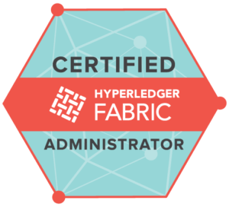
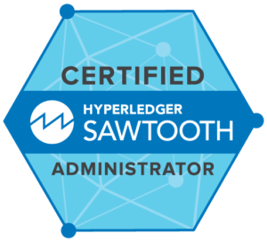

Training and Certifications
Technical training courses and professional certifications to get you up-to-speed on Hyperledger with the highest quality training from The Linux Foundation and Hyperledger Training Partners.
New Professional Certifications!
Certified Hyperledger Sawtooth Administrator (CHSA)
Certified Hyperledger Fabric Administrator (CHFA).
- Blockchain: Understanding Its Uses and Implications
- Introduction to Hyperledger Technologies
- Hyperledger Fabric Fundamentals
- Hyperledger Sawtooth Administration
- Hyperledger Fabric Administration
MOOCs
Visit: https://www.hyperledger.org/resources/training
Notes:
This slides has information about the training and certifications that are available for Hyperledger. For people who want more information, please refer them to the link in the bottom right part of the slide.

Slide 9


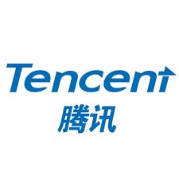



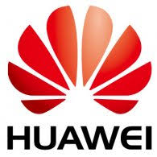




Hyperledger
Now Available Across All Major Clouds
Notes:
This shows the logos for cloud providers who are offering at least one of the Hyperledger projects on their services.

Slide 10
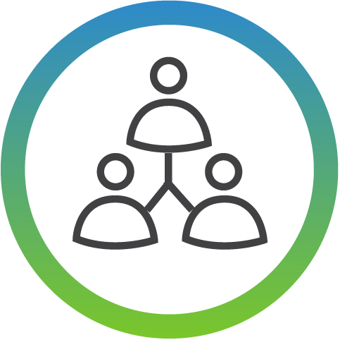
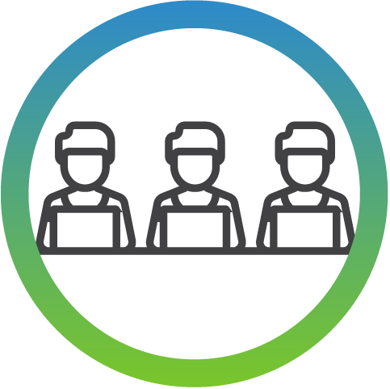

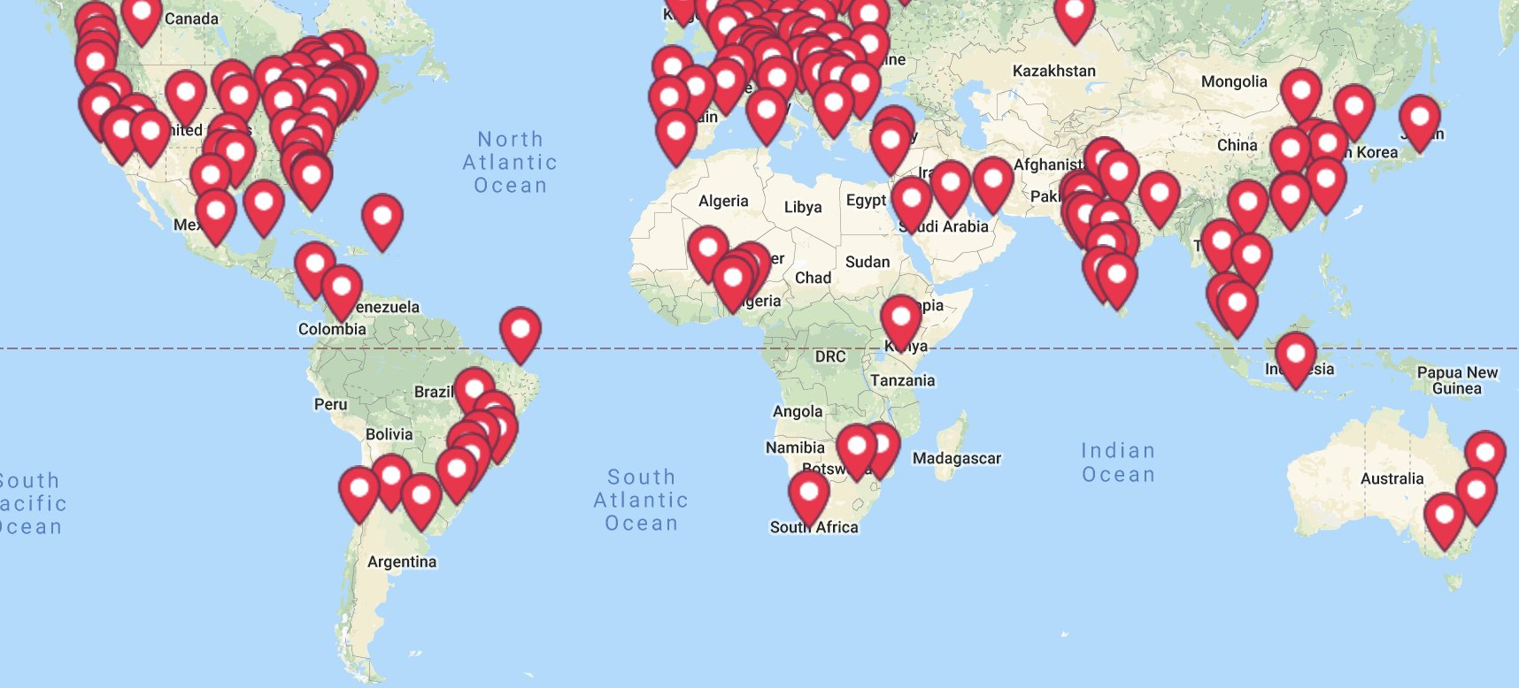
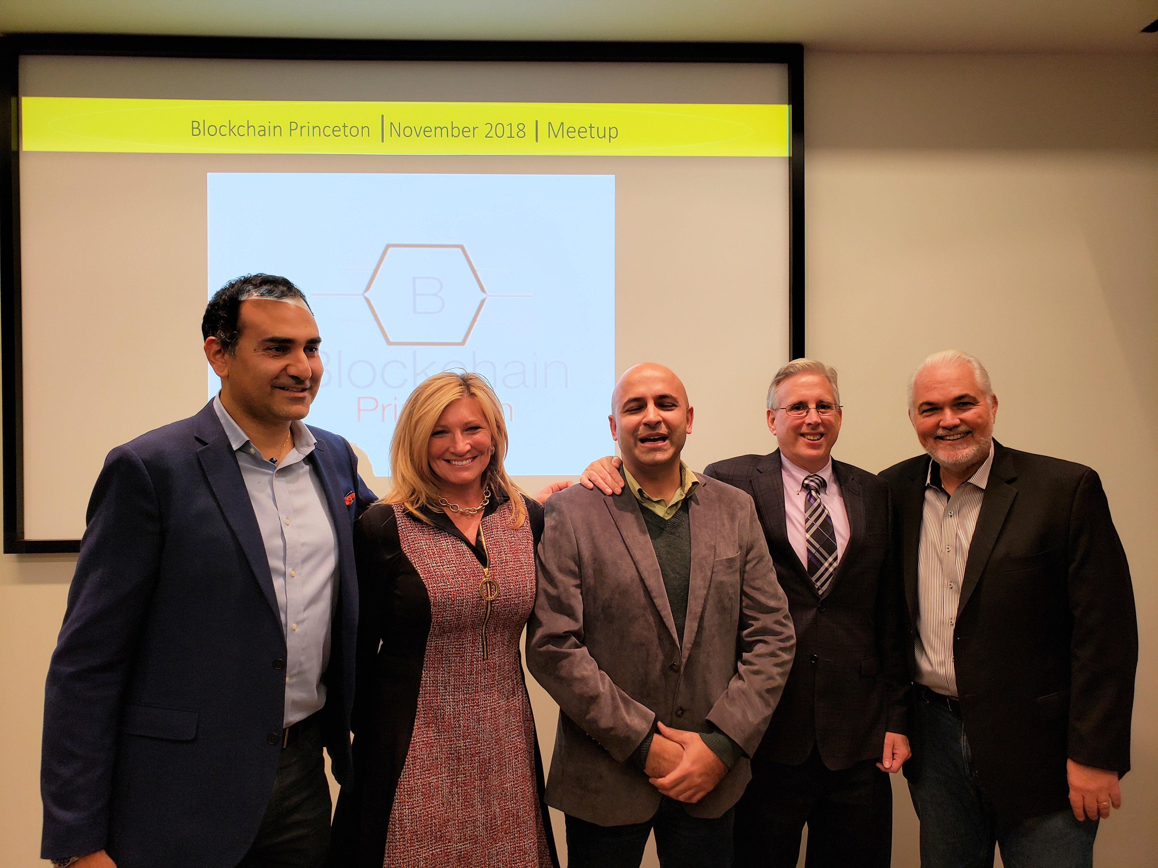
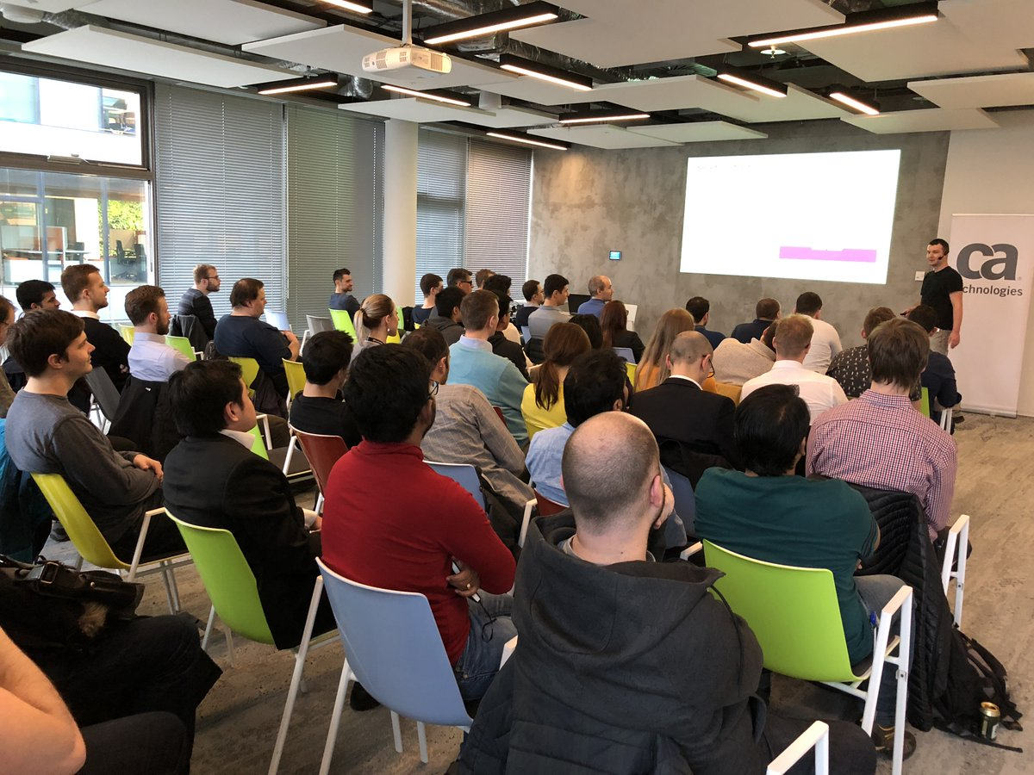
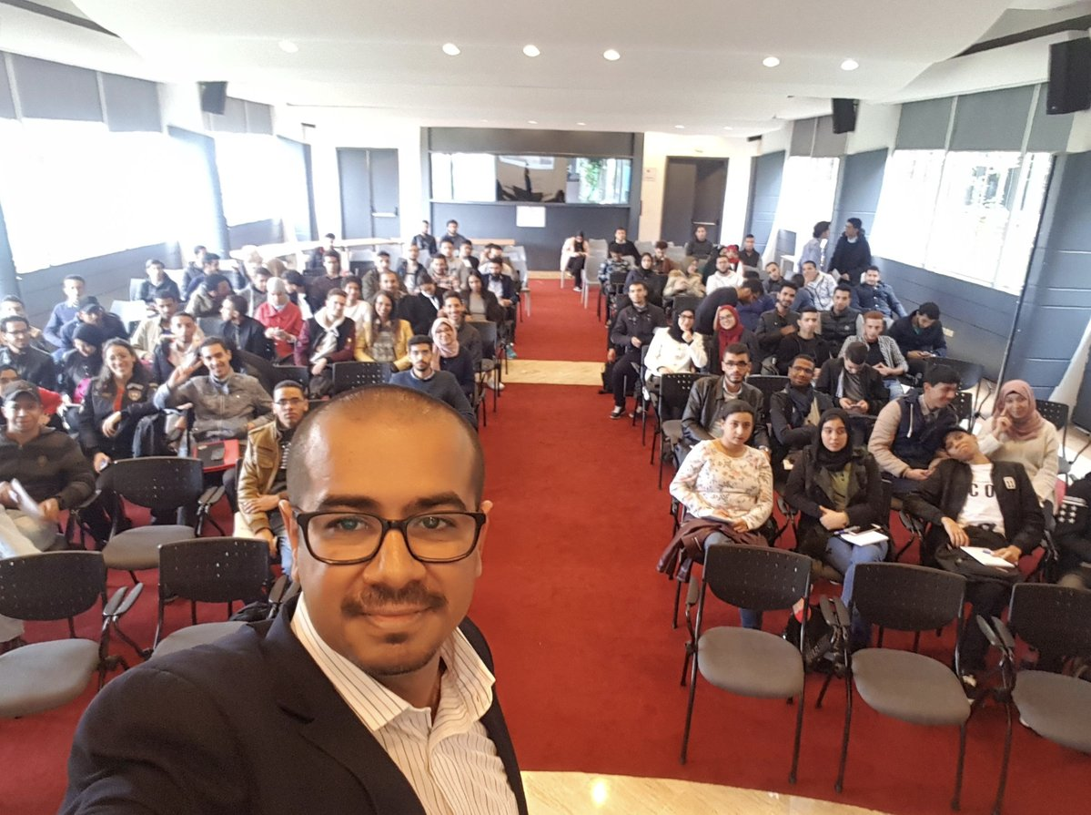
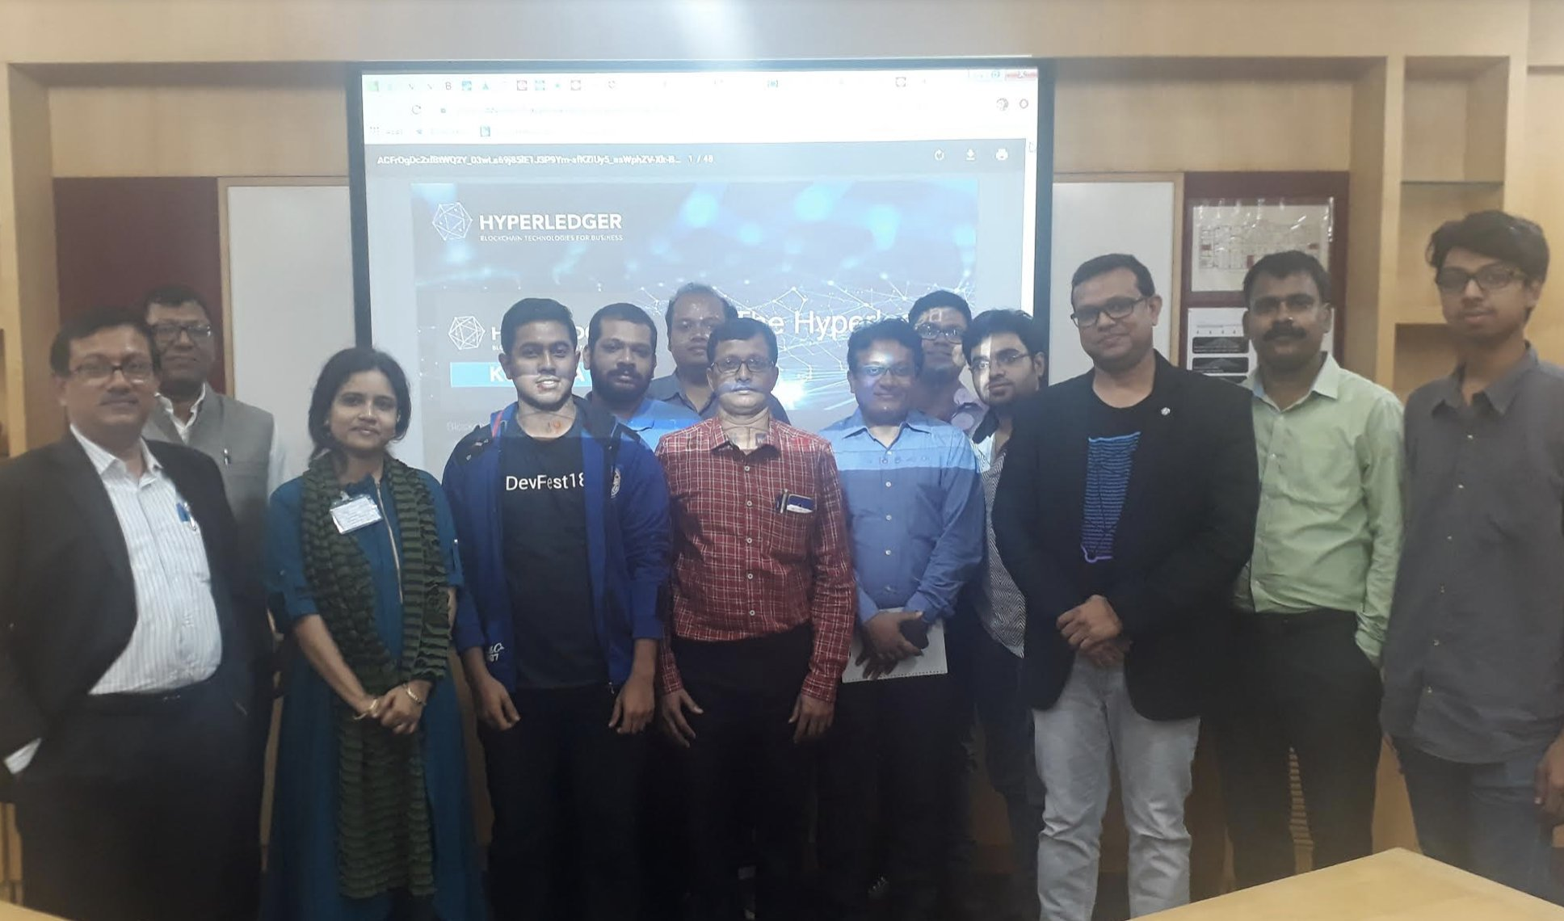
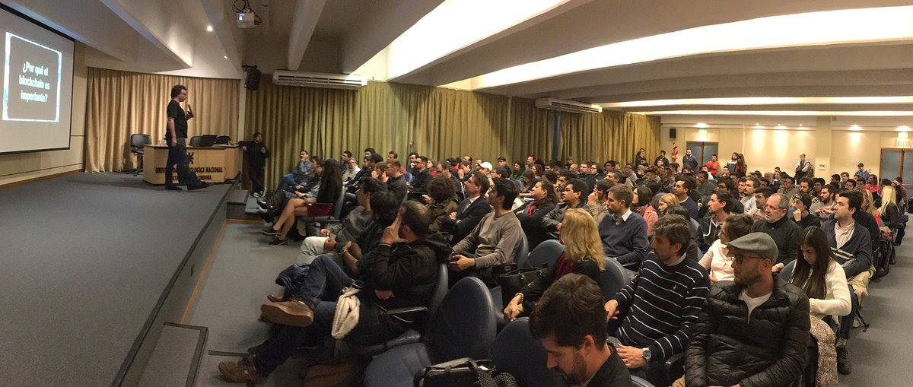
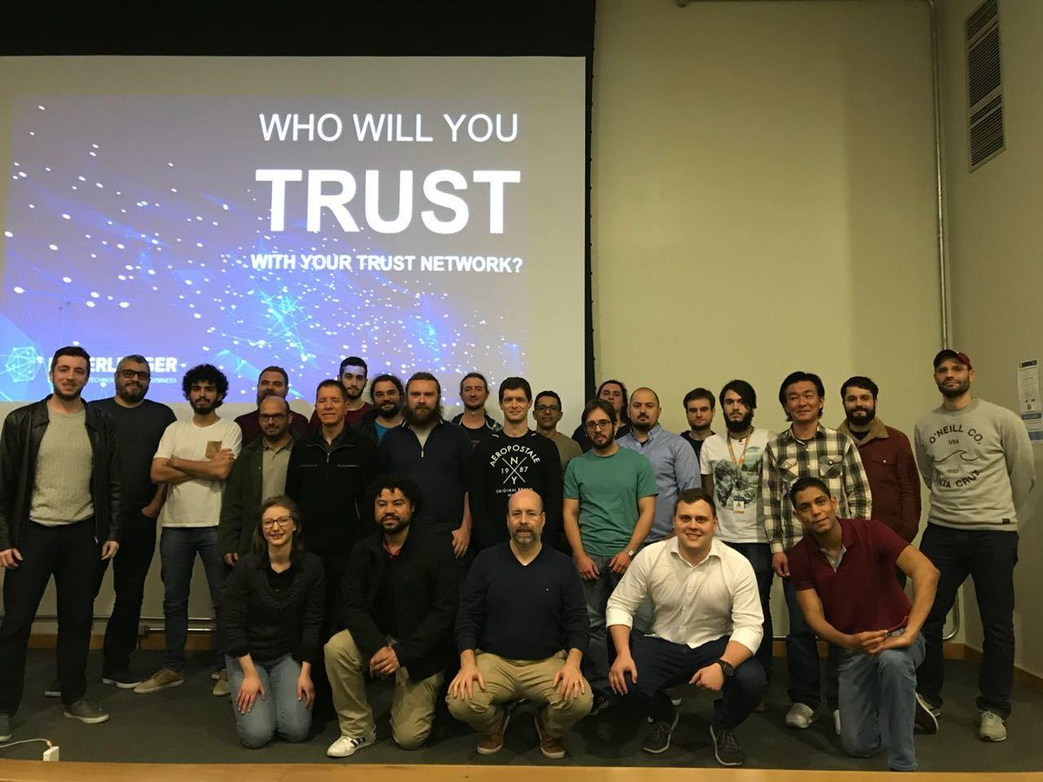
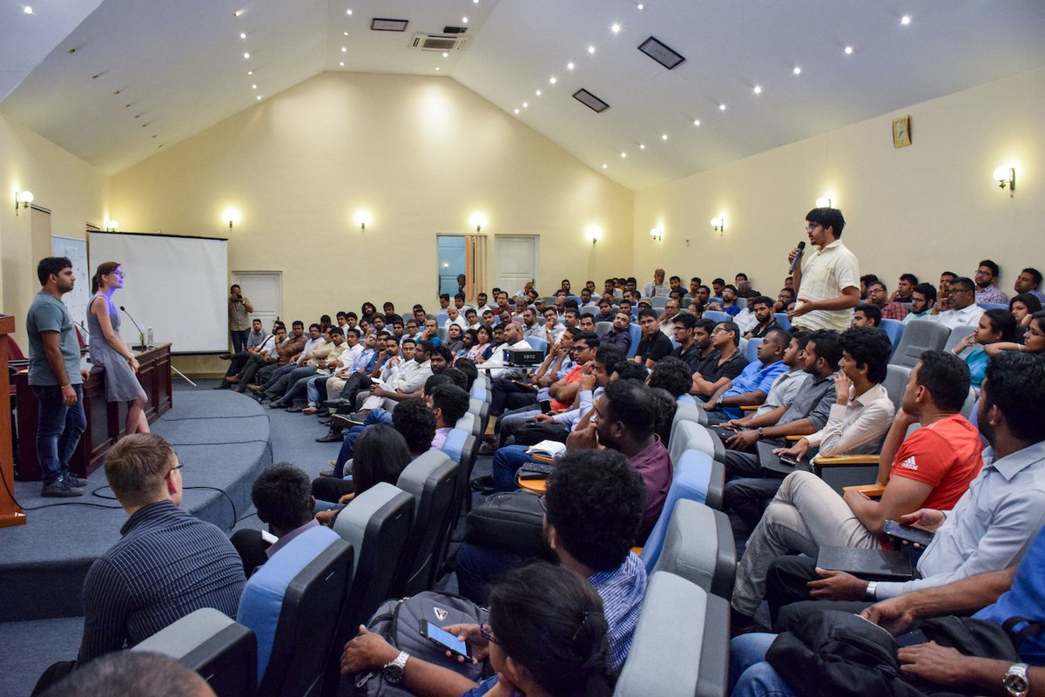
Growing Global Meetup Community
56K+ Members
165+Groups
65+ Countries
Notes:
This page talks about the worldwide group of Hyperledger meetups and includes so relevant statistics, a map and photos from events. For people who want more information, please point them to: https://www.meetup.com/pro/Hyperledger/

Slide 11
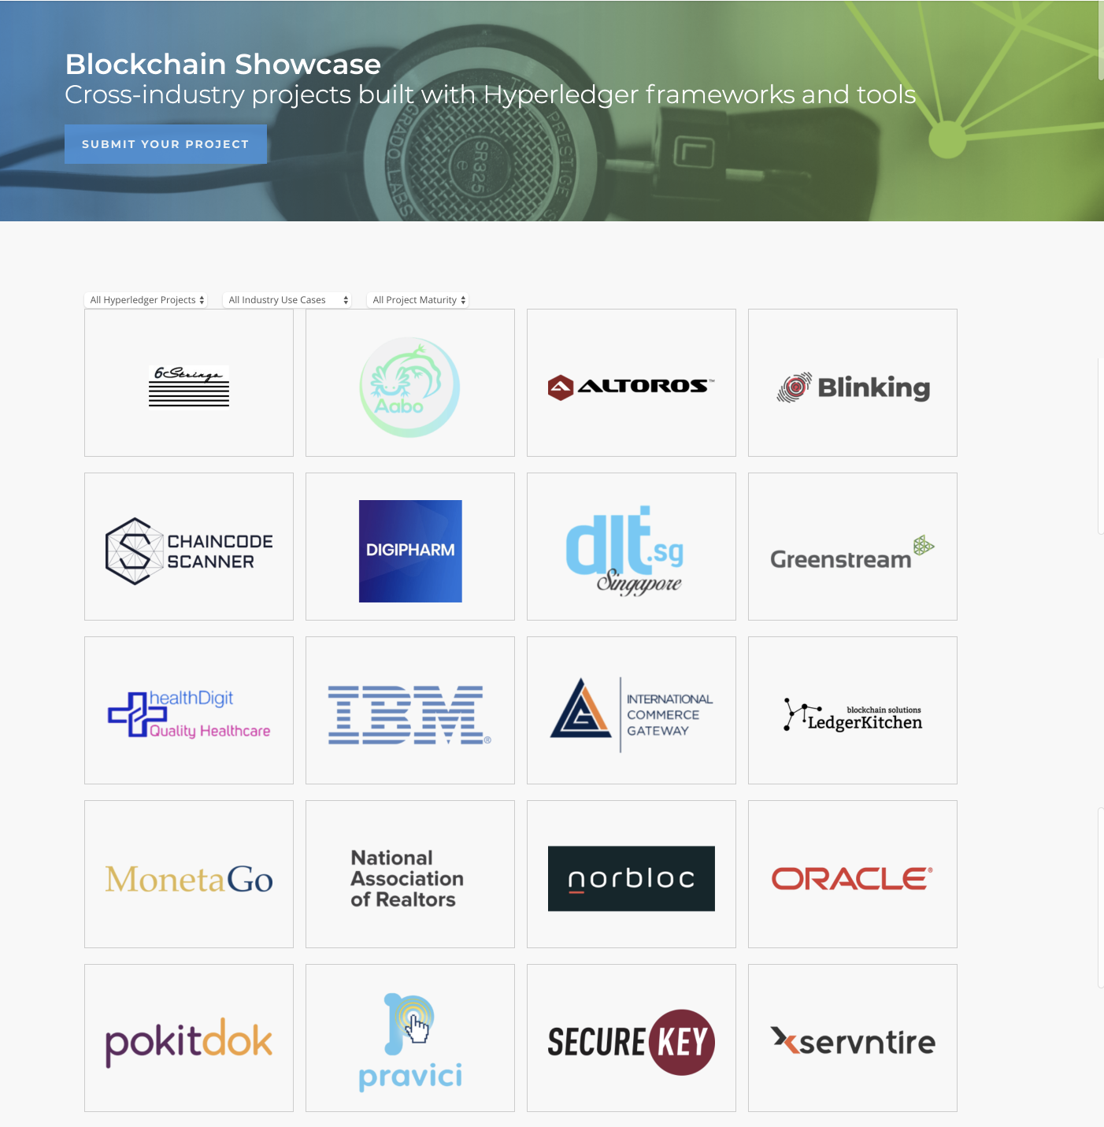

Blockchain Showcase
Cross-industry projects built with Hyperledger frameworks and tools.
65+
Community self submitted projects!
11
Submit your showcase https://www.hyperledger.org/resources/blockchain-showcase
Notes:
This slide talks about the Blockchain Showcase page on the Hyperledger site that has details about the known solutions that organizations have built using Hyperledger. Please point out the link in the bottom right part of the page for people who want to learn more.

Slide 12
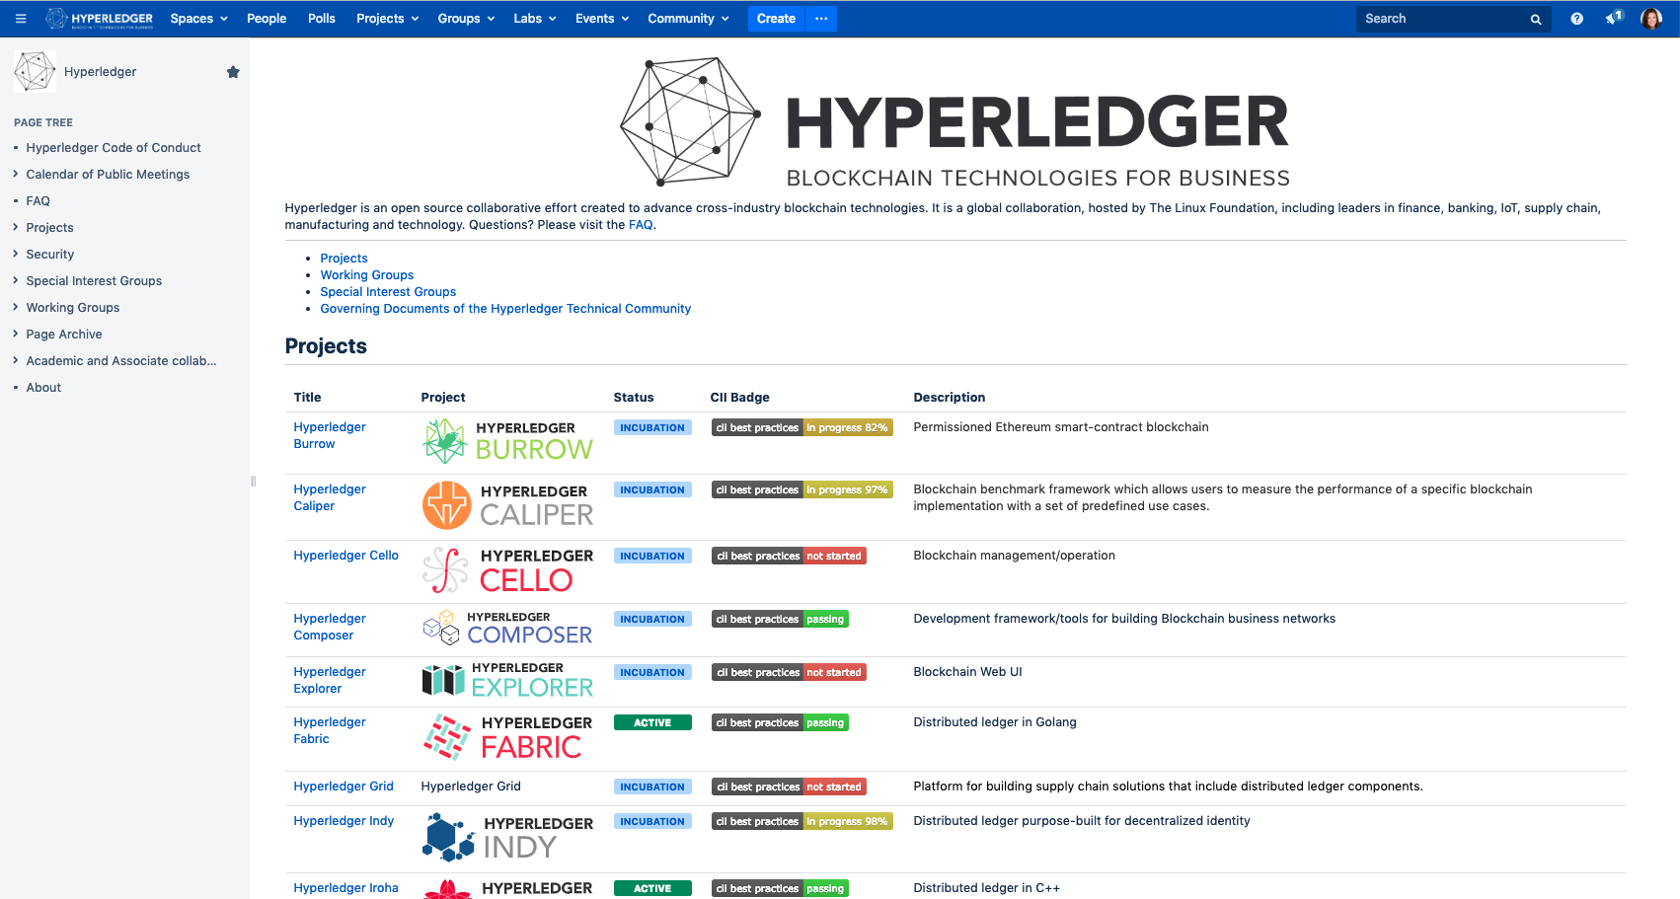
New Wiki (Confluence) : wiki.hyperledger.org
Notes:
This slides shows a screenshot of the new wiki tool that was launched this quarter. You can refer people to the link at the top of the page which will take them to the wiki. There is project and community information there and people are also welcome to edit pages there.

Slide 13

New
Global Use
Cases
Notes:
David

Slide 14


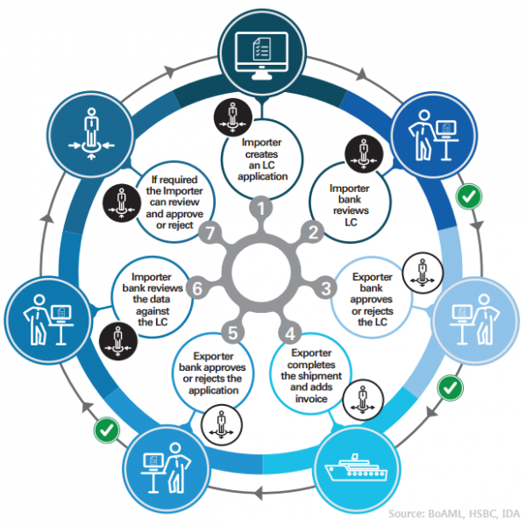
Digital Trade
we.trade
The Challenge
Today, banks live in a competitive world. Small and mid-sized businesses generated 85% of employment growth in Europe in recent years, but only ~50% of them have access to formal credit. The Digital Trade Chain exemplifies how blockchain can bring the required trust and transparency to a new business network and associated business model.
The Collaboration
A consortium of major world banks including: Deutsche Bank, HSBC, KBC, Natixis, Rabobank, Société Générale, Santander, UniCredit and Nordea
The Technology
we.trade is a blockchain-based international trading system that enables accurate trading posture information, order to settlement control, risk coverage, track and trace options
Watch: Rewiring Global Trade Finance Networks: https://www.ibm.com/events/think/watch/replay/120154769/

Slide 15
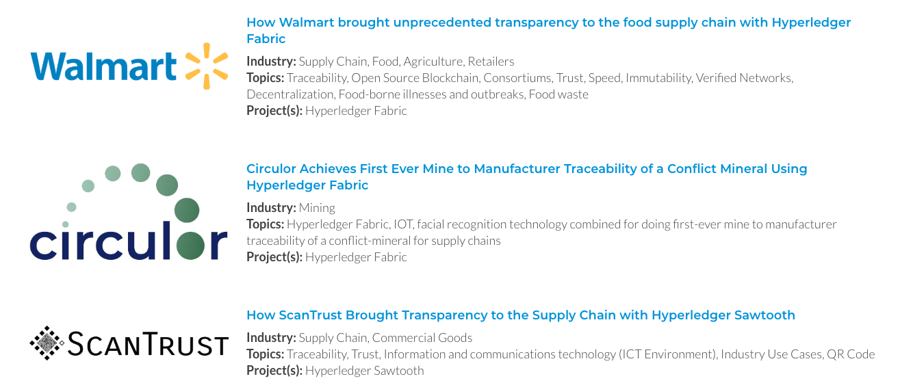
Newest Cross Industry Case Studies
https://www.hyperledger.org/resources/publications#case-studies
Notes:
This slide talks about our case study library -- a collection of long form descriptions of different solutions that have been built with Hyperledger projects. Please refer to the link at the bottom right for people who want to learn more. The following few slides go into more detail about some of these case studies.

Slide 16
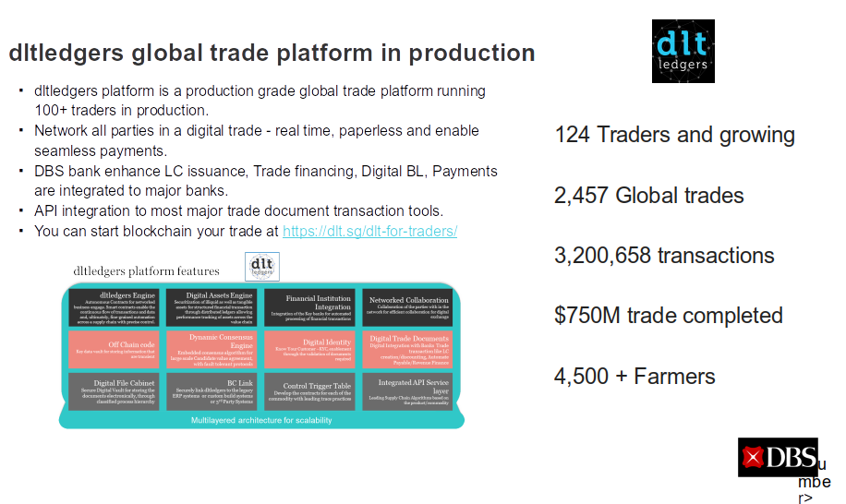
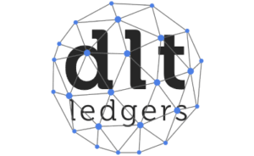

Slide 17

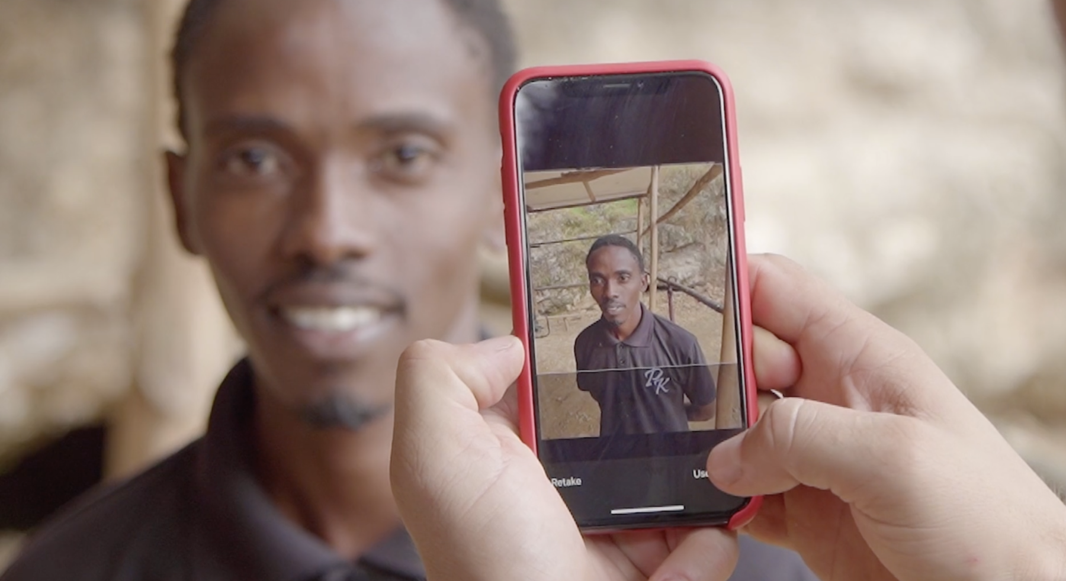
Ethical mining of tantalum and other conflict minerals
Tantalum sold out of Rwanda has a history of being smuggled into the supply chain from the nearby Congo, where it was mined by children or forced labor enslaved by warlords. This led to tantalum being classed as a "conflict material" by the OECD, China, and the U.S. through the Dodd-Frank regulations
Circulor has created a blockchain-based supply chain tracing system to ensure that all tantalum is mined, transported, and processed under OECD-approved conditions
Powered by a private blockchain built on Hyperledger Fabric, the Circulor system uses QR codes attached to bags of ore to provide a world first: complete mine-to-manufacturer traceability of this valuable resource
Read more: https://www.hyperledger.org/resources/publications/tantalum-case-study

Slide 18

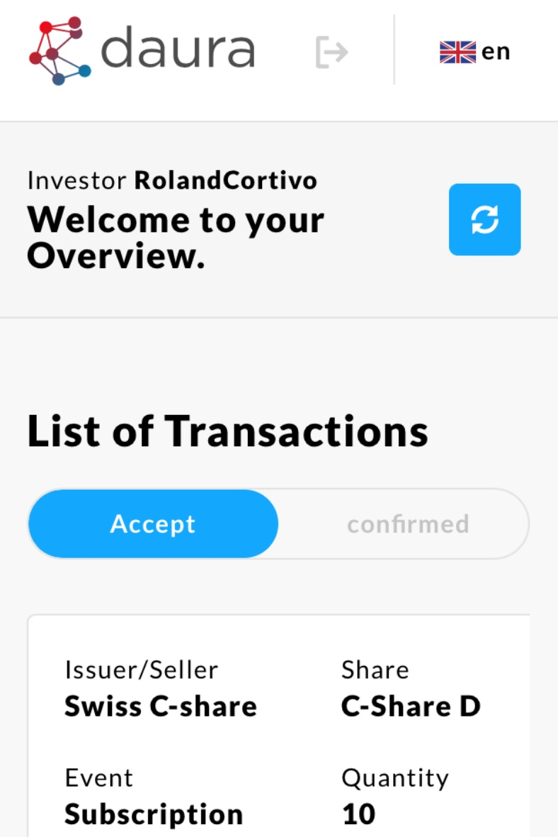
Raising SME capital on the blockchain:
Swisscom - Daura
Capital procurement is complicated, inefficient and costly
Daura is the first regulated Swiss Share Register on a blockchain
Powered by Hyperledger Fabric, it enables a simple, prompt and attractive transfer of Crypto Shares
Swiss C-Shares are registered on the blockchain and securely transferable worldwide
Simplified processes and reduced costs due to a decentralized network
Read more: https://www.swisscom.ch/en/about/news/2018/12/post-swisscom-blockchain-infrastruktur.html

Slide 19
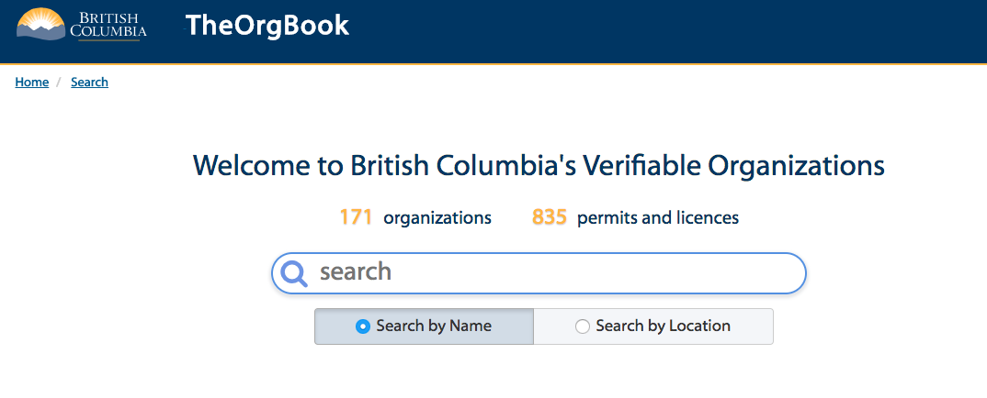

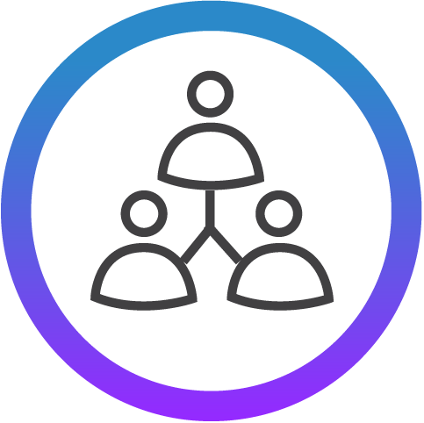
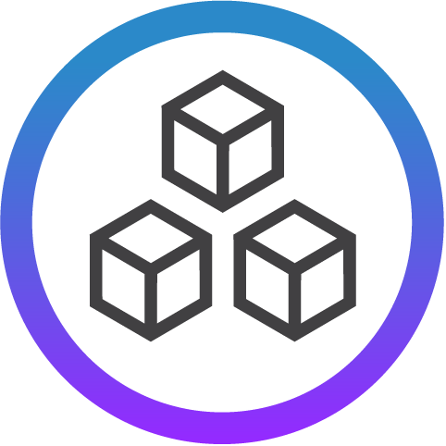
Digital Identity:
The OrgBook
The Challenge
Difficult to find and verify business incorporation documents so a business or a government department can quickly have evidence that a potential partner or supplier is legally incorporated.
The Collaboration
Verifiable Organizations Network (VON), British Columbia Government, Hyperledger Indy, and Sovrin. Ultimately the service hopes to add dozens of other government-issued digital licences and permits to be searched. Perhaps even law societies and professional organizations will also participate so the public can verify the professional credentials of members.
The Technology
Live, public, globally accessible network using the Sovrin Provisional Network built on Hyperledger Indy.
Learn More: https://vonx.io/
Notes:
https://www.itworldcanada.com/article/two-upcoming-government-digital-projects-show-future-for-digital-id-in-canada/406600
https://von.pathfinder.gov.bc.ca/aboutvon/
Von presentation https://docs.google.com/presentation/d/1WbTcnMpXh9vjMJrfNCDg2Kk-t7tT2wKhJE2-e8TYnJ4/edit?usp=sharing

Slide 20






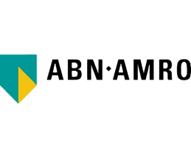
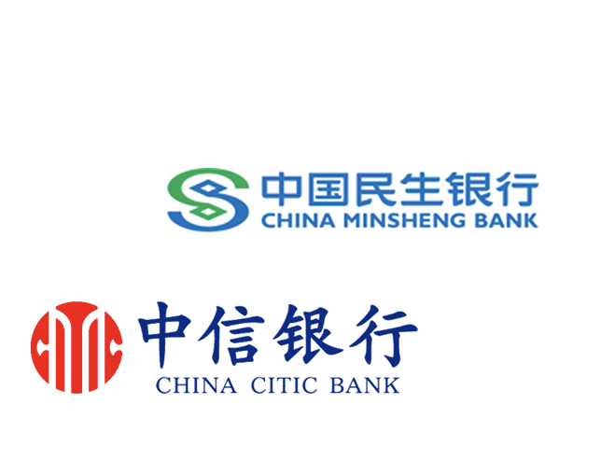


Other Notable Production Deployments
Notes:
This slide provides logos of organizations that have also built solutions using Hyperledger but haven’t been featured in a case study yet.

Slide 21
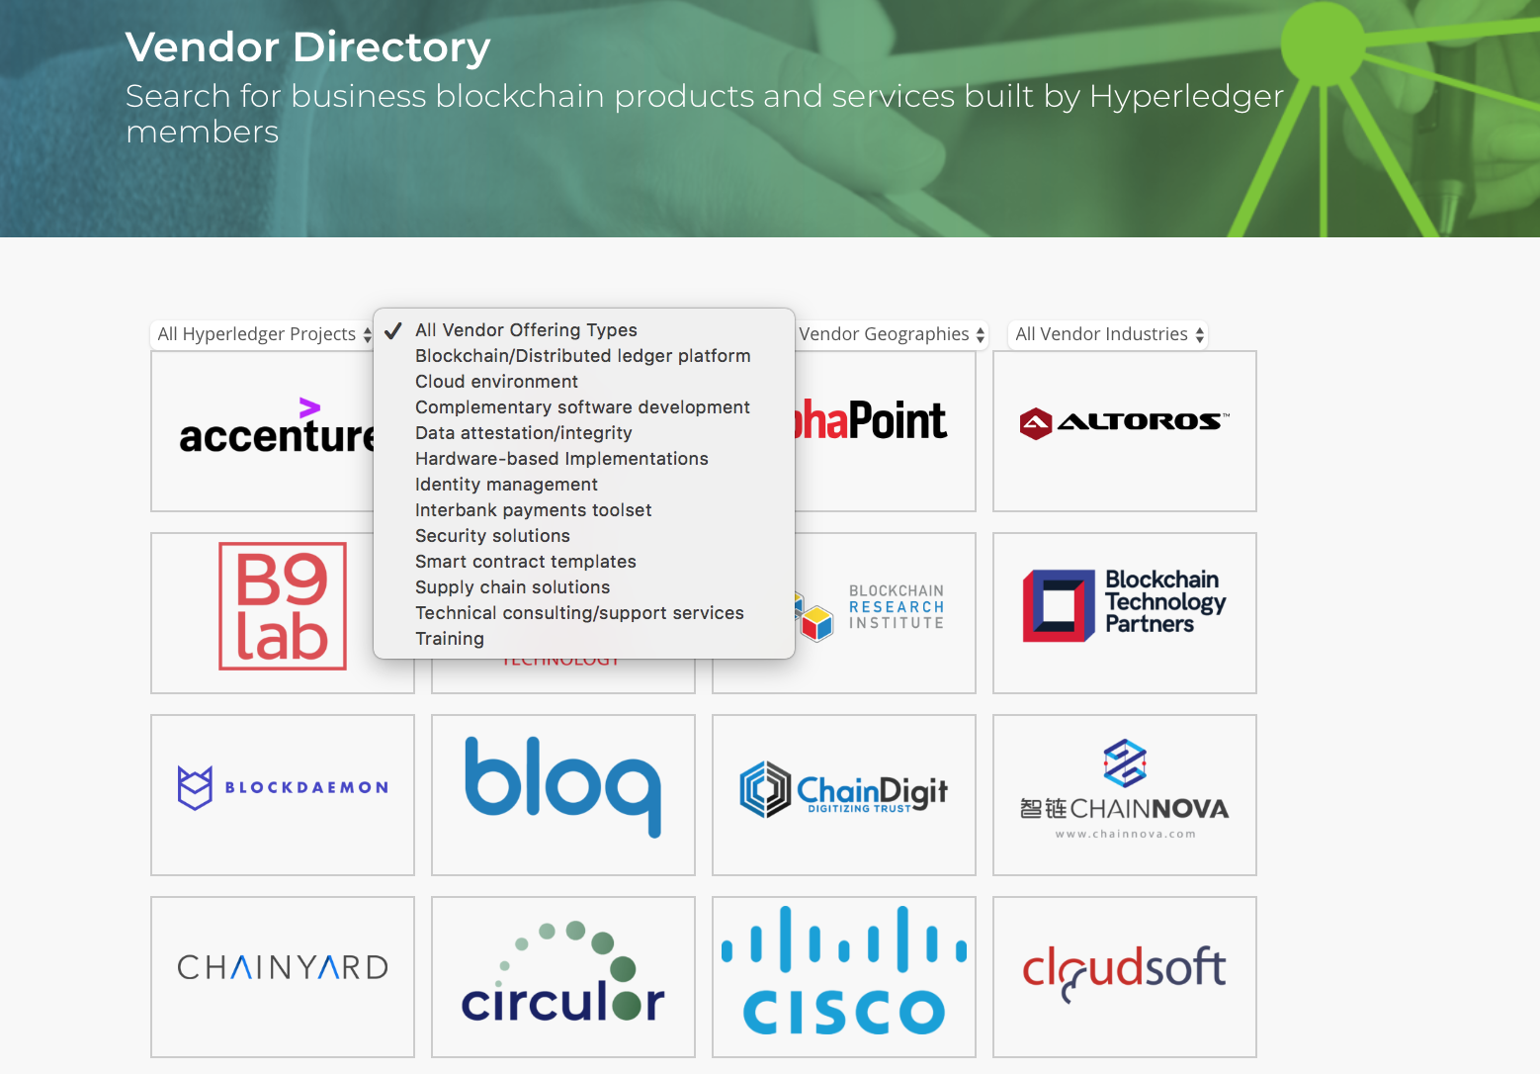
Building a Global Commercial Ecosystem
85+
Global
Vendors across multiple service types, products and industries
21
Notes:
This slide is showing a screenshot from the Vendor Directory on the Hyperledger site which shows the different services being offered by organization in the community, such as training or technical support. People can see this page at: https://www.hyperledger.org/resources/vendor-directory

Slide 22
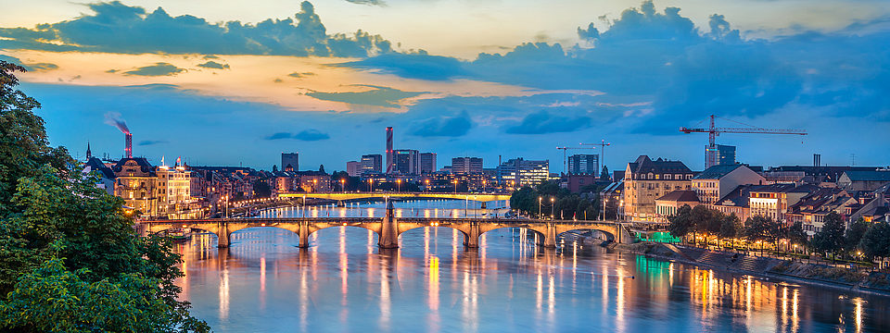
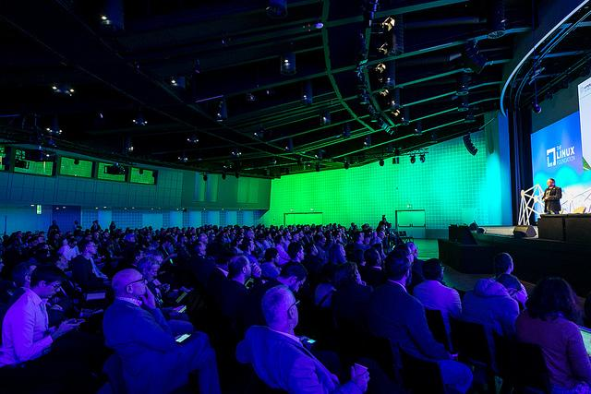

2018 Hyperledger
Global Forum Highlights
Over 730+ attendees
100+ sessions, including demos, technical how-to’s and workshops
20+ Industry Analysts and Media in attendance w/ 30+ press articles, 13MM Twitter impressions and 28K LinkedIn impressions
All keynotes and session videos, available on Hyperledger YouTube channel
All speaker bios and presentations available publicly on SCHED
Browse pictures from this 4 day global event!
NEXT HGF EARLY 2020!!
Notes:
This slide has details about the Hyperledger Global Forum event that was held in December 2018 in Basel, Switerzerland. The next Global Forum event will be in early 2020.

Slide 23

Hyperledger Blockchain Frameworks
Notes:
The following slides have more details about the different Hyperledger platforms.

Slide 24

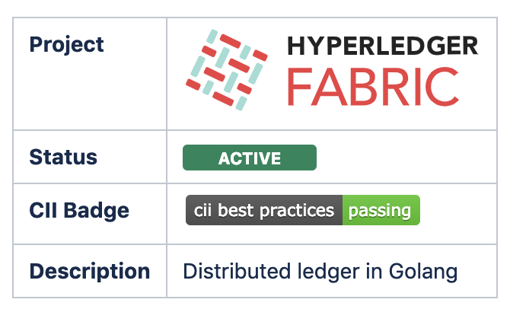
A foundation for developing applications or solutions with a modular architecture, Hyperledger Fabric allows components, such as consensus and membership services, to be plug-and-play. 1.4 released January 2019. 200+ devs across 100+ companies contributing.
500+ customer PoCs, pilots and production.

Slide 25
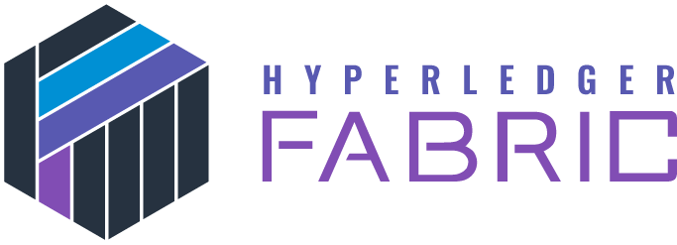
Wiki
https://wiki.hyperledger.org/display/fabric/Hyperledger+Fabric
A modular architecture allowing pluggable implementations of various functions. It features powerful container technology to host any mainstream language for smart contracts development.
Key Characteristics
High-performance, secure, permissioned blockchain network. Code written in Go, chaincode (smart contracts) in Go, Javascript, or Java, SDKs in Node.js, Java, Go, REST and Python.
Roadmap
Current Documentation
1.4 released January 2019 Version v1.4.1
UNRELEASED Start: 09/Jan/19
Release: 31/Mar/19
Release Notes
https://hyperledger-fabric.readthedocs.io/en/latest/

Slide 26
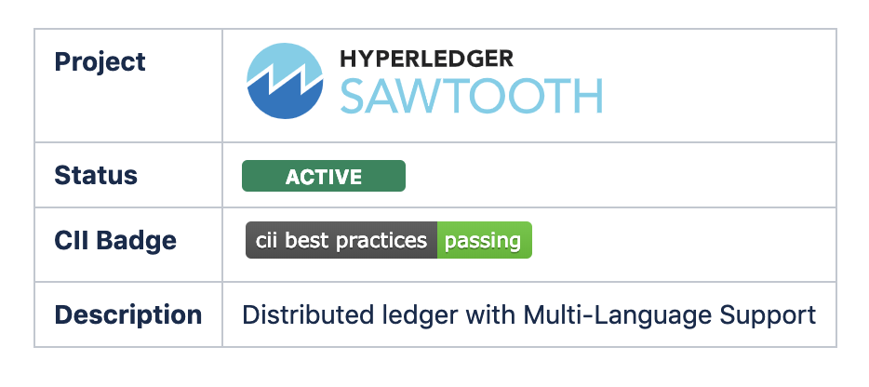
A modular platform for building, deploying, and running distributed ledgers. Hyperledger Sawtooth includes a novel consensus algorithm, Proof of Elapsed Time (PoET), which targets large distributed validator populations with minimal resource consumption. Hyperledger’s second project, released as 1.0 in January 2018 and 1.1 in Dec 2018. Supports Solidity/EVM smart contracts by linking with Hyperledger Burrow.

Slide 27

Wiki
https://wiki.hyperledger.org/display/sawtooth
Originally contributed by Intel, Sawtooth is a blockchain suite designed for versatility and scalability. Sawtooth supports both permissioned and permission- less deployments
Key Characteristics
Pluggable consensus algorithms (Change consensus on the fly by transaction)
Includes Proof of Elapsed Time (PoET) consensus
Write smart contracts in almost any language
Ethereum contract support via Hyperledger Burrow integration
Supply Chain example out of the box
Parallel transaction execution for added throughput
Roadmap
Current Documentation
https://sawtooth.hyperledger.org/docs/core/releases/latest/app_developers_guide.html
Released as 1.0 in January 2018 and 1.1 in Dec 2018

Slide 28

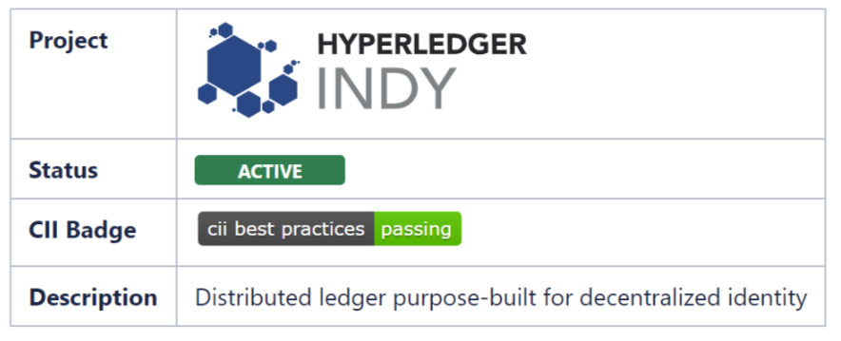
Tools, libraries, and reusable components for providing digital identities rooted on blockchains or other distributed ledgers so that they are interoperable across administrative domains, applications, and any other silo. Utilizes zero-knowledge proofs to provide verifiable claims
These verifiable claims can be used to prove something about the identity without providing access to the underlying data

Slide 29

Wiki
https://wiki.hyperledger.org/display/indy/Hyperledger+Indy
Key Characteristics
Distributed ledger purpose-built for decentralized identity
Correlation-resistant by design
DIDs (Decentralized Identifiers) that are globally unique and resolvable (via a ledger) without requiring any centralized resolution authority
Pairwise Identifiers create secure, 1:1 relationships between any two entities
Verifiable Claims are interoperable format for exchange of digital identity attributes and relationships currently in the standardization pipeline at the W3C
Zero Knowledge Proofs which prove that some or all of the data in a set of Claims is true without revealing any additional information, including the identity of the Prover
Roadmap
Current Documentation
Approved by the TSC on 2017-03-30 as a project
Approved moved to ACTIVE STATUS by the TSC on 2019-03-28
https://indy.readthedocs.io/en/latest/

Slide 30
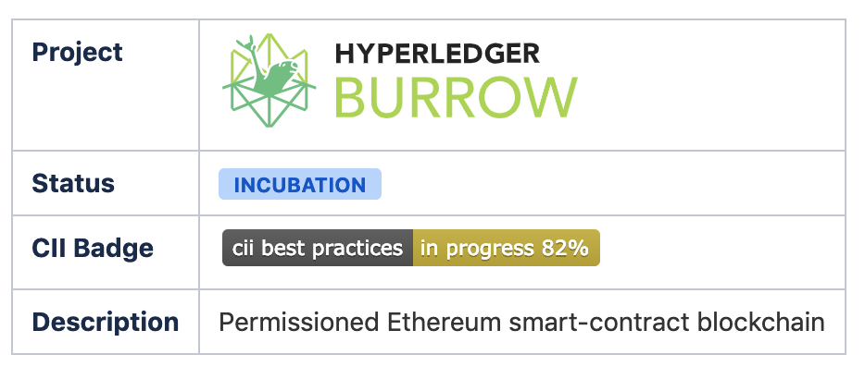
Burrow is a permissioned Ethereum smart-contract blockchain node. It executes Ethereum smart contract code on a permissioned virtual machine. Burrow provides transaction finality and high transaction throughput on a proof-of-stake Tendermint consensus engine. but has also been ported to Sawtooth, and experimental support exists for Fabric

Slide 31

Wiki
https://wiki.hyperledger.org/display/burrow
Burrow is a permissively licensed (Apache 2.0) EVM smart contract machine and Byzantine Fault Tolerant permissioned ledger that uses Tendermint consensus and implements some novel extensions to the EVM whilst remaining EVM-compliant.
It provides EVM execution within the Ethereum account model and an internal token to meter computation in the permissioned setting with transactions finality.
Key Characteristics
To be a fast, light, lean single-process full Tendermint/EVM permissioned ledger with transaction finality
To provide a practical base for EVM extensions in a many-chain world
Current Documentation
Roadmap
https://github.com/hyperledger/burrow
82% completed in incubation, Mostly work geared towards making Burrow operate as a public/semi-public upgradeable side-chain.

Slide 32
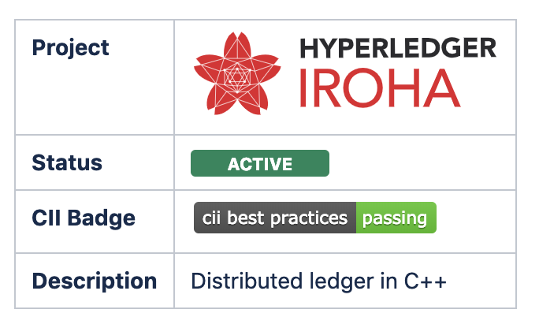
A business blockchain framework designed to be simple and easy to incorporate into infrastructural projects requiring distributed ledger technology. Hyperledger Iroha is written in C++ incorporating unique chain-based Byzantine Fault Tolerant consensus algorithm, called Yet Another Consensus and the BFT ordering service.

Slide 33

Wiki
Iroha is a distributed ledger project, that aims to provide a development environment where C++ and mobile application developers could contribute to Hyperledger.
The project seeks to complement Fabric, Sawtooth, and other potential projects, being a framework with pre-defined set of commands, permissions and queries that can be used with various client libraries to easily create applications for desktop and mobile platforms.
Key Characteristics
Permissioned network; written in C++; Client libraries in Java, Python, JS, Swift; BFT consensus algorithm YetAnotherConsensus (YAC); ready-to-use set of commands and queries, Multi-signature transactions.
Roadmap
Current Documentation
https://iroha.readthedocs.io/en/latest/
Approved by the TSC on October 13, 2016
Moved out of Incubation on May 18, 2017

Slide 34

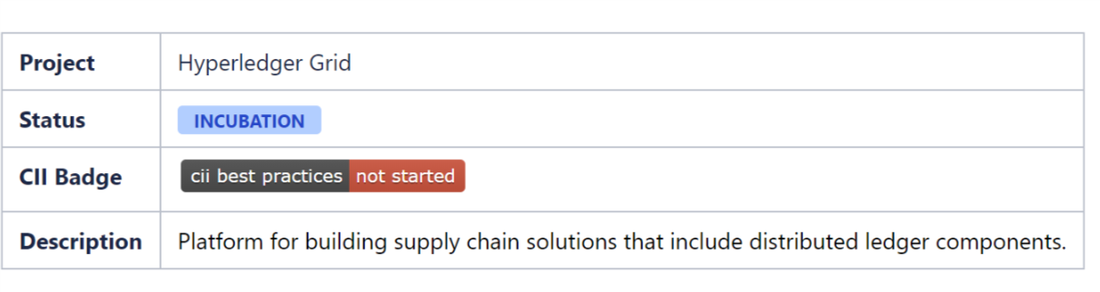
GRID
Hyperledger Grid is a platform for building supply chain solutions that include distributed ledger components. It includes a set of libraries, data models, and SDK to accelerate development for supply chain smart contracts and client interfaces. This project will accelerate the development of blockchain-based solutions to cross-industry supply chain problems

Slide 35
Wiki
GRID
The Grid Track and Trace transaction family allows users to track goods as they move through a supply chain. Records for goods include a history of ownership and custodianship, as well as histories for a variety of properties such as temperature and location. These properties are managed through a user-specifiable system of record types.
Roadmap
Current Documentation
https://grid.hyperledger.org/docs/grid/nightly/master//
Proposed by David Cecchi, Cargill, Shawn Amundson, Bitwise IO, and Dan Middleton, Intel
Approved by the TSC December 6, 2018

Slide 36


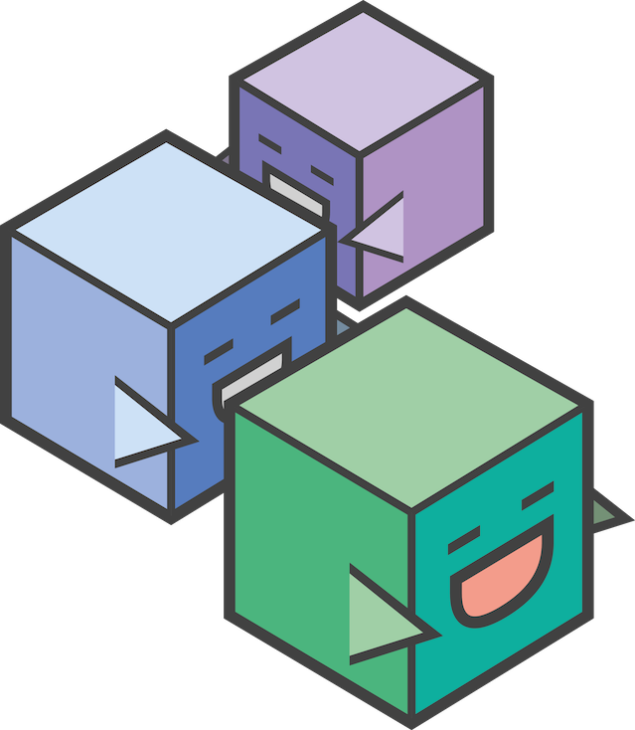

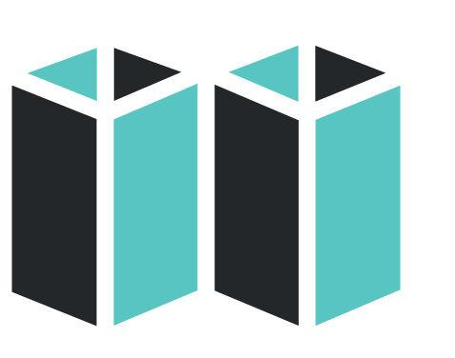

Hyperledger Tools
Caliper
A tool which allows users to measure performance of a specific blockchain implementation with a set of pre-defined use cases.
Cello
Deployment model to simplify creating, managing and terminating blockchains.
Composer
A collaborative tool for building blockchain business networks.
Explorer
A Web-enabled user interface to gain insight into your blockchain.
Quilt
Interoperability between ledger systems by using ILP, a payment protocol to distribute value.

Slide 37

Hyperledger Caliper
A blockchain benchmark framework which allows users to measure the performance of a specific blockchain implementation with a set of predefined use cases.
A tool that provides performance evaluations for different blockchain solutions based on a set of neutral and commonly accepted rules.
The Performance & Scalability Working Group (PSWG) are responsible for the Caliper project definitions, metrics and terminology.
Caliper will produce reports containing a number of performance indicators:
  TPS (Transactions Per Second)
  transaction latency
  resource utilization
Caliper results should be used as a reference in supporting the choice of a blockchain implementation suitable for the users specific use-cases.
Caliper is not intended to be an authoritative performance assessment or to be used for simple comparative purposes (e.g. Blue blockchain is 5 TPS, Red Blockchain is 10 TPS. So b is better).

Slide 38
Hyperledger Caliper
Key Characteristics
Adaptor Layer: provide a common layer to integrate with major existing blockchain framework/platforms, so that the same benchmarks can be run for different blockchain systems.
Benchmark test environments will be provided to help different clients run tests under the same environment.
Users can use their existing environment and configure Caliper to run the test in that environment.
Caliper Documentation:
https://wiki.hyperledger.org/projects/caliper#caliper

Slide 39

Hyperledger Cello
Cello is a blockchain module toolkit which helps people use and manage blockchains in a more efficient way.
Cello creates a Blockchain as a Service (BaaS) platform to provision customizable blockchain networks easier and faster.
Cello’s Blockchain as a Service helps to build deployment model blockchain platforms quickly from scratch that are provisional and customizable.
Cello helps mitigate the operational cost for blockchain users and application developers by reducing the effort required for creating, managing and terminating blockchains.

Slide 40
Hyperledger Cello
.
Key Feature Cello- Analytics:
CMajor features
  Written in Python, Cello will help manage the lifecycle of blockchains (e.g., create / start/ stop/ delete/ keep health) automatically.
  Check the system status, adjust the chain numbers, scale resources etc., through dashboards
  Manage the lifecycle of blockchain networks automatically, (e.g., create/start/stop/delete/keep health)
Collect logs/events from blockchains
    Parse those logs/events automatically with statistic results in interactive graphs
Cello Documentation:
      https://cello.readthedocs.io/en/latest/
      https://docs.google.com/presentation/
      d/1sq4hnTRpH9qaPJe96f6Egx9LclbCC5KcQjnBmv2LO68/
      edit#slide=id.p12
IO9OKL

Slide 41
Hyperledger Composer
Composer is an application development framework (ADF) for building blockchain business networks using Hyperledger Fabric framework.
Hyperledger Composer is a set of collaboration tools for building blockchain business networks that make it simple and fast to create smart contracts and blockchain applications to solve business problems.
It enables business owners and the developers to create smart contracts and blockchain applications to solve business problems by:
  Supplying an example to model business networks, including assets and transactions management.
  Integrating existing systems and data with the blockchain applications.

Slide 42
Composer Playground
Key Characteristics
  Quickly model your business blockchain network.
  Quickly generate REST APIs for interacting with your blockchain network.
  Quickly generate application.
Emphasis on business-centric vocabulary for quick solution creation. Helps create Business Network Definitions .
Composer Documentation
https://hyperledger.github.io/composer/latest/introduction/introduction.htm
https://drive.google.com/file/d/1Xxmu3lHsVcLVDz4TuPRQQvCUOM1tUUoG/view

Slide 43

Hyperledger Explorer
Explorer is designed to create a user-friendly Web application to let you view information about a blockchain.
Hyperledger Explorer can view, invoke, deploy or query :
  Blocks
  Transactions
  associated data
  network information (name, status, list of nodes)
  chaincode deployment
  transaction families
  any other relevant information stored in the ledger.

Slide 44
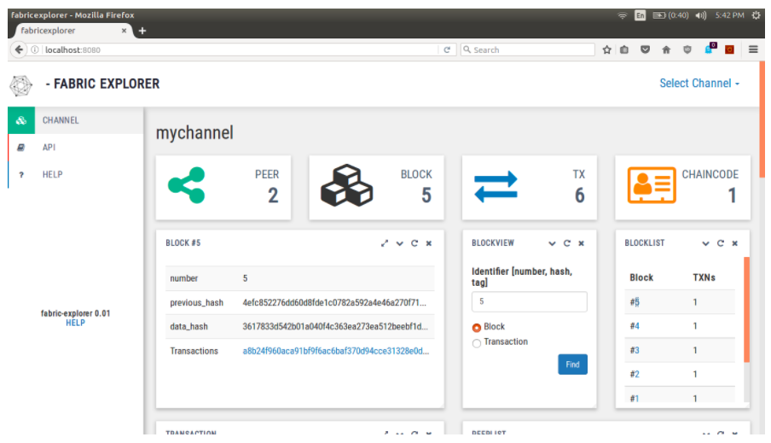

Slide 45
Hyperledger Explorer
Supports the REST APIs for getting access to some of the following information:
  Block information (by block hash block number)
  Transaction
  Peer status
  Channel information,
  List of chaincode installed and represented on specific channels
  Block count on specific channel
  Create and update channel
  Explorer Documentation:
      https://docs.google.com/document/d/1GuVNHZ5Jqq-gTVKflnZ1YiJfEoozvugqenC6QEQFQj4/edit
      https://docs.google.com/presentation/d/e/2PACX-1vQlhbtxwgCOTJ22bacHqY5GpXR_Ucl9EJZKov2RzxlGYZXmi889X6yMW4Hzh6Rjzu4bh0qyYKYTZSF5/pub?start=false&loop=false&delayms=3000&slide=id.gc6f90357f_0_0

Slide 46

Hyperledger Quilt
Quilt promotes interoperability between Blockchain networks by assisting in transferring value across different Blockchain networks.
A user registered with one Blockchain network can securely transfer the value to another user registered with another Blockchain network.
Hyperledger Quilt is build based on the Interledger Protocol ( ILP) provides for routing payments across different digital asset ledgers while isolating senders and receivers from the risk of intermediary failures.

Slide 47
Hyperledger Quilt
Key Characteristics
ILP is primarily a payment protocol and is designed to transfer value across distributed ledgers and non-distributed ledgers.
Provides atomic swaps between ledgers (even non-blockchain or distributed ledgers).
Provides a single account namespace for accounts within each ledger.
Quilt now hosts both the Java (Quilt) and JavaScript (Interledger.js) .
The Interledger protocol is intentionally limited in scope to provide the functions necessary to deliver a payment from a source to a destination over an interconnected system of ledgers.
It includes minimal requirements for underlying ledgers and it does not include public key infrastructure, identity, liquidity management, or other services commonly found in payment protocols.
Quilt Documentation:
  https://github.com/hyperledger/quilt
  https://s3-ap-southeast-1.amazonaws.com/mredmundto-others/Hyperledger+Quilt+and+Interledger+Protocol+.pdf

Slide 48
Thanks!

