Slide 1

Welcome to
Hyperledger princeton hosted by
Ledger Academy
January 21, 2019

Slide 2
AGENDA
Blockchain and Next Gen Battlefields
You're going!
Blockchain and Next Gen Battlefields
You're going!
Housekeeping
Princeton Blockchain Community /Events and Announcement
Presentation
  Bobbi Muscara
  James Waugh
Networking
Notes:
David

Slide 3
Housekeeping
Tiger Labs:
Co-working Space in Princeton New Jersey
Current Home to Ledger Academy
Meetup space for blockchain groups.

Slide 4
Princeton Blockchain Community
Housekeeping
Summer Blockchain Project
Discussion
Moving Forward
HYPERLEDGER PRINCETON
Hosted by Linux Foundation, is comprised of people interested in learning and developing projects using the Hyperledger solutions.
BLOCKCHAIN FUNDEMENTALS / Ledger Academy
  Blockchain Courseware and Meetups focused on Education.
PRINCETON BLOCKCHAIN AND AI
  Princeton Blockchain and AI is focused on COMMUNITY. Discussions are developed by meetup participants.
Notes:
David

Slide 5
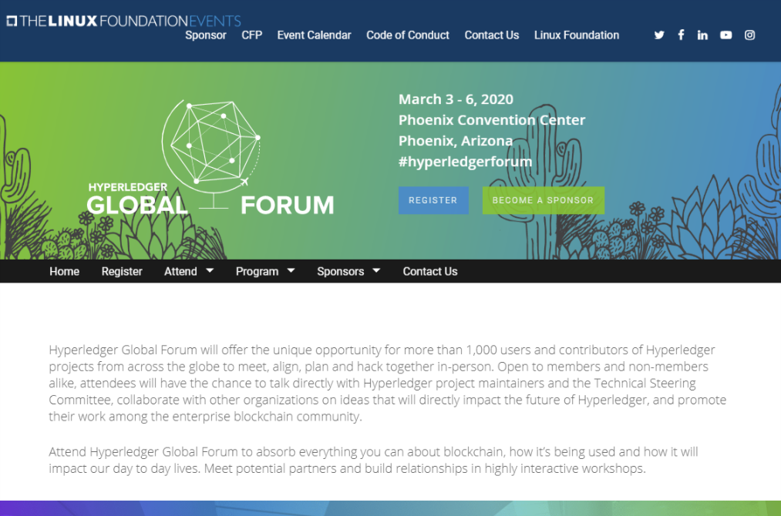
HYPERLEDGER PRINCETON

Slide 6

PRINCETON Blockchain & AI
Rutgersblockchain.io

Slide 7
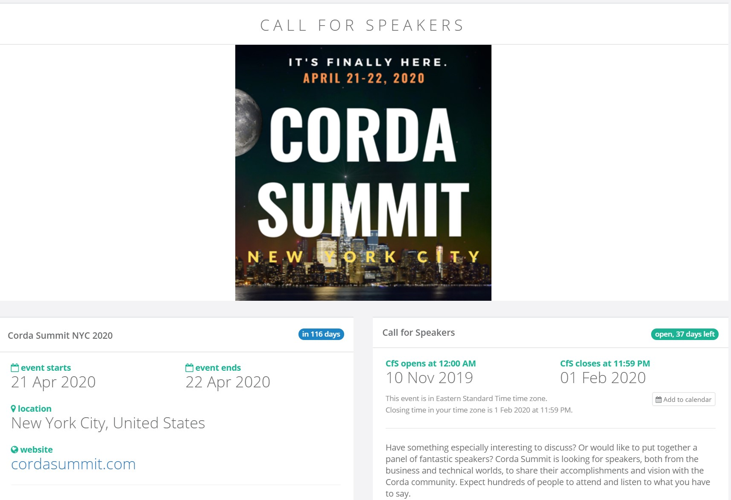
PRINCETON Blockchain & AI

Slide 8

Ledger Academy / Blockchain Fundamentals

Slide 9

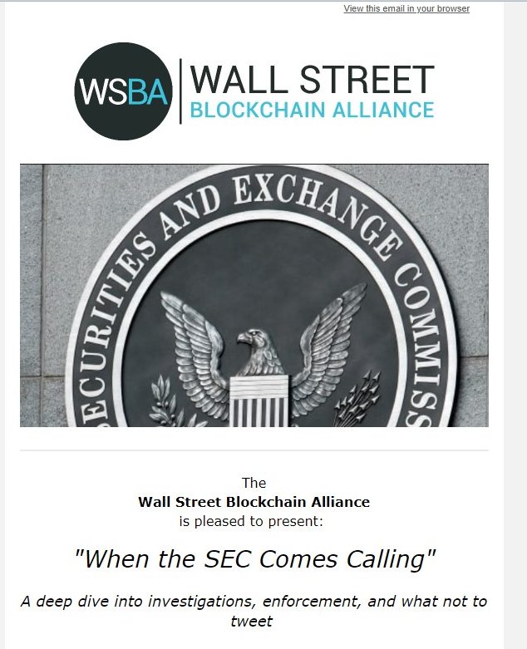

Slide 10

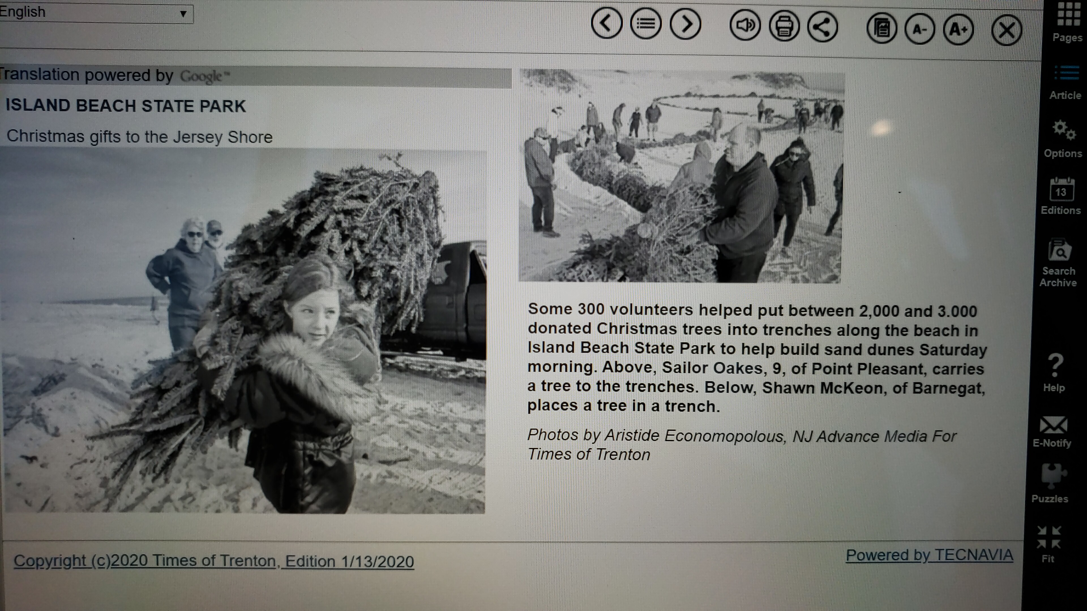
Ledger Academy / Blockchain Fundamentals

Slide 11
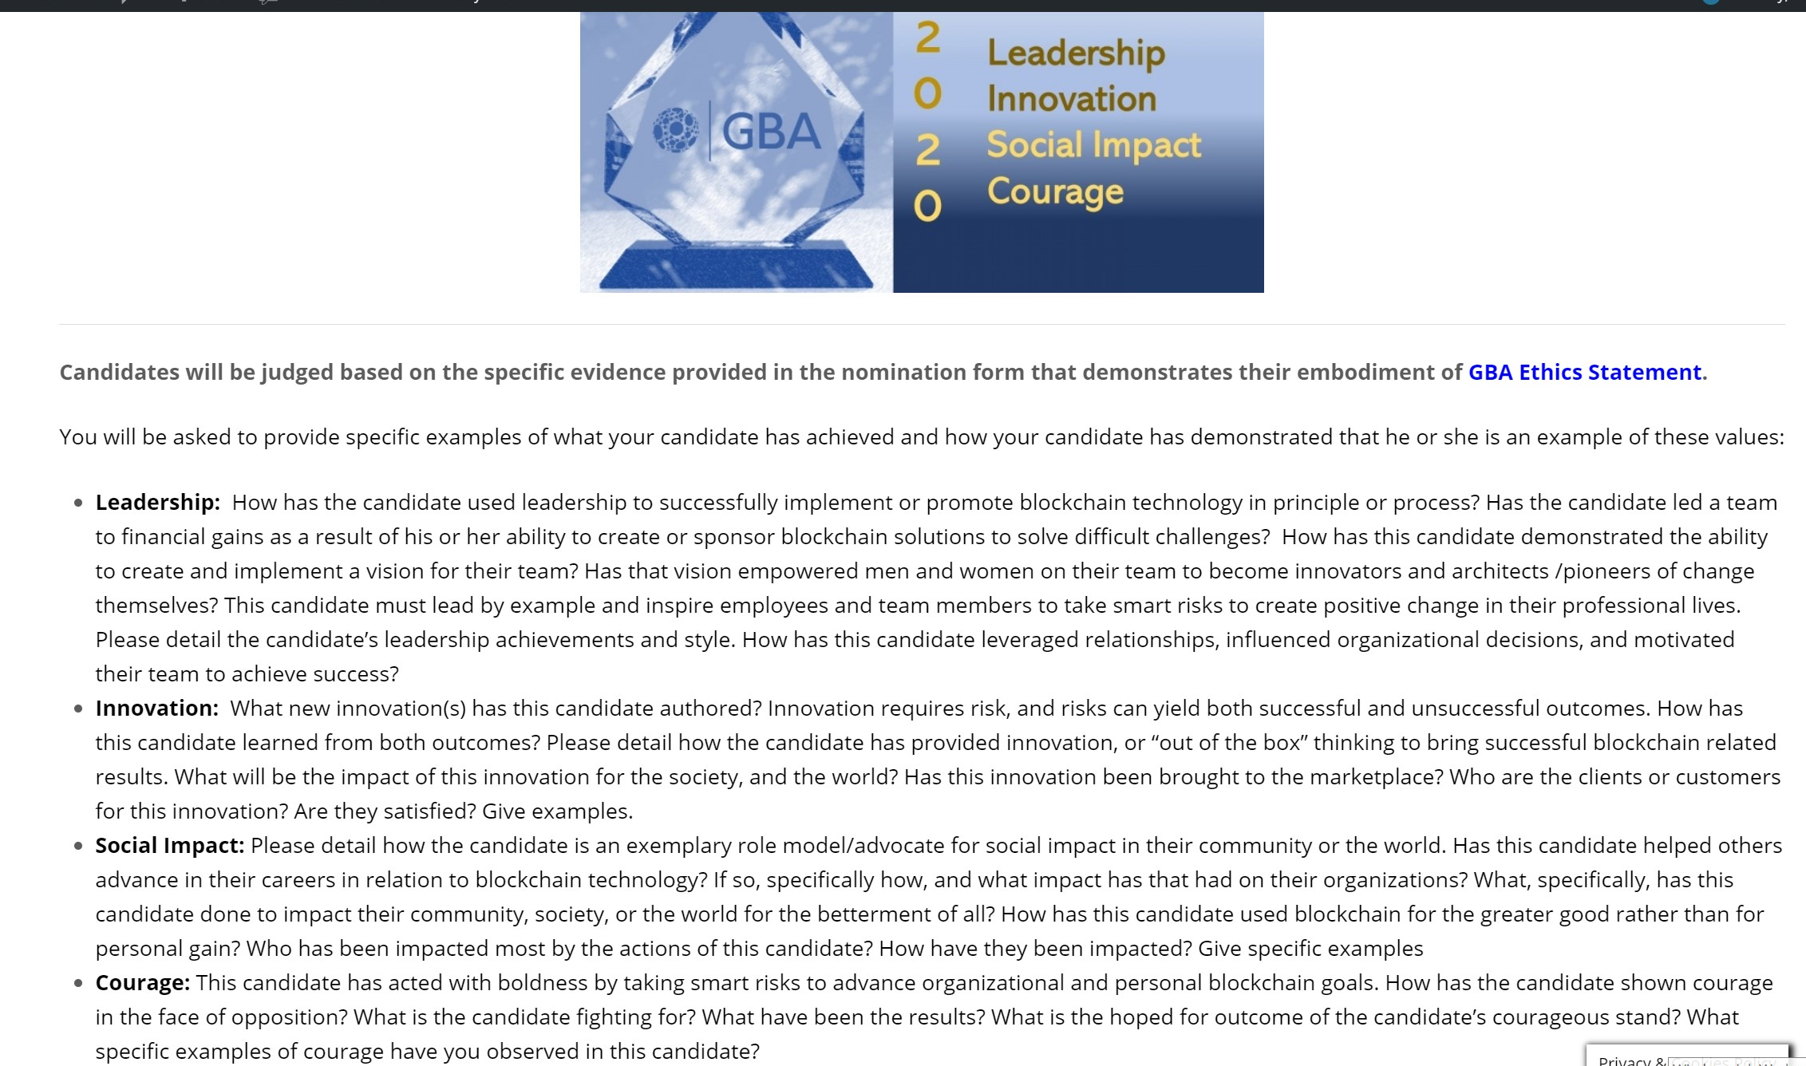
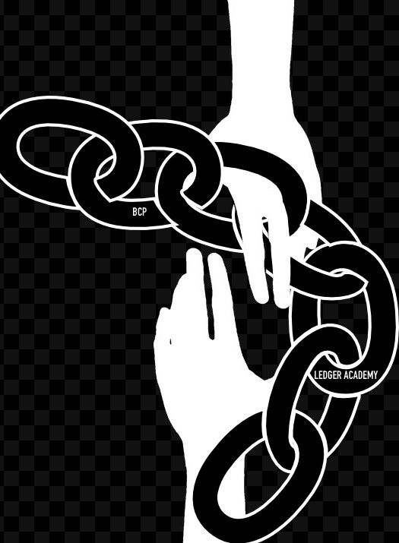
Ledger Academy / Blockchain Fundamentals
GBA Members Get Recognized
Bobbi I just wanted to remind you that January 15th is the last day to nominate anyone for the GBA Annual Achievement Award. The awards will be handed out at the US Capitol on January 31st. For more information, please go to www.gbaglobal.org/gba-aaa. Have a great day, Gerard Dache Executive Director Government Blockchain Association gerard.dache@GBAglobal.org
Copyright © 2020 Government Blockchain Association, All rights reserved. You are receiving this message as a member of GBA after signing up at www.governmentblockchain.org Our mailing address is: Government Blockchain Association4728 Pickett Road Fairfax, Virginia 22032-2028 Add us to your address book Want to change how you receive these emails? You can update your preferences or unsubscribe from this list.

Slide 12
Presentations
Hyperledger Community
Hyperledger Greenhouse
Use Case Identity
How to get involved

Slide 13
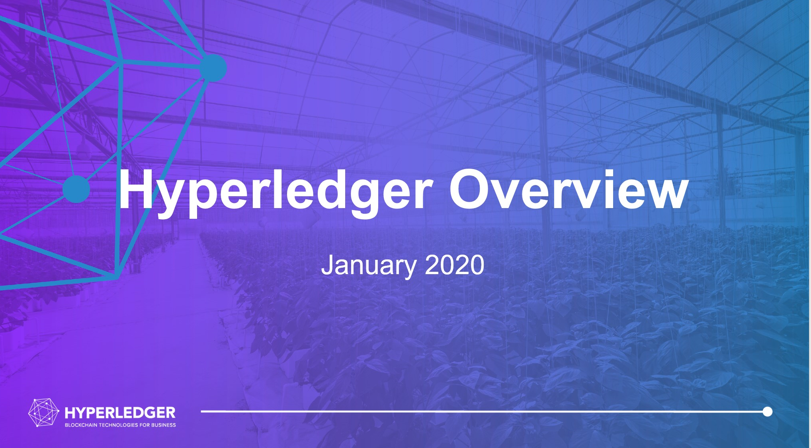
Hyperledger Overview
January 2020

Slide 14



Introducing Hyperledger
Open source collaborative effort to advance cross-industry blockchain technologies
Hosted by The Linux Foundation, fastest-growing project in LF history
Global collaboration spanning finance, banking, IoT, supply chains, healthcare, manufacturing, technology and more.

Slide 15

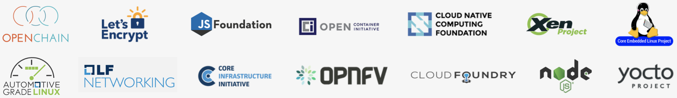
Hosted By The Linux Foundation
For the last 16 years, The Linux Foundation® has provided unparalleled support for open source communities through financial and intellectual resources, governance structure, IT infrastructure, services, events, and training.
Dedicated to building sustainable ecosystems around open source projects, The Linux Foundation is working with the global technology community to solve the world’s hardest problems through open source and creating the largest shared technology investment in history.
The Linux Foundation is the umbrella organization for more than 60 open source projects accelerating open technology development and commercial adoption. Some of the game-changing initiatives hosted by The Linux Foundation include:

Slide 16



Shared Ledger Database
Blockchain allows multiple different parties to securely interact with the same universal source of truth
Finance
Streamlined settlement, improved liquidity, increased transparency and new products/markets
Healthcare
Unite disparate processes, increase data flow and liquidity, reduce costs and improve patient experience and outcomes
Supply Chain
Track parts and service provenance, ensure authenticity of goods, block counterfeits, reduce conflicts

Slide 17




Hyperledger Goals
Where open source teams build diverse approaches for business blockchain technology systems
Create enterprise grade, open source, distributed ledger frameworks &
code bases
to support business transactions
Provide neutral, open, & community-driven infrastructures
supported by technical and business governance
Build technical communities
to develop blockchain and shared ledger POCs, use cases, field trials and deployments
Educate
the public
about the market opportunity for blockchain technology
Promote our community of communities
taking a toolkit approach with many platforms and frameworks

Slide 18
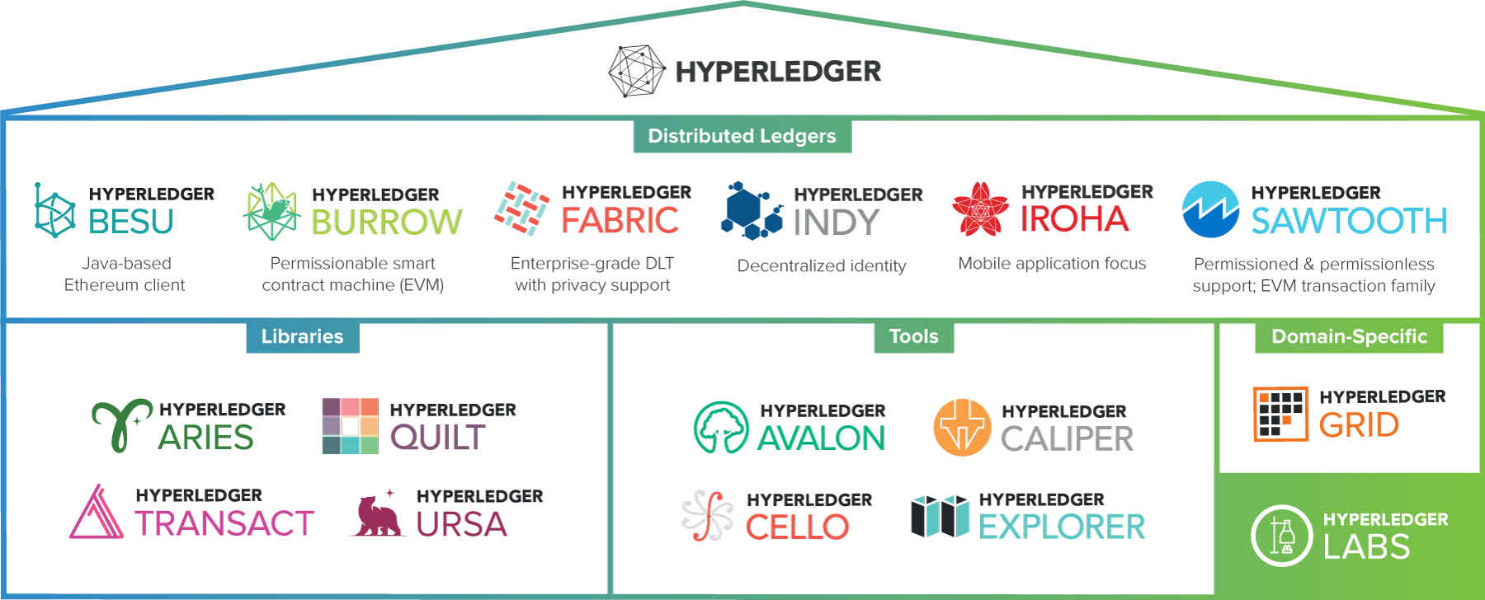
Hyperledger Modular Approach

Slide 19


A permissionable smart contract machine. The first of its kind when released in December, 2014, Burrow provides a modular blockchain client with a permissioned smart contract interpreter built in part to the specification of the Ethereum Virtual Machine (EVM).
Notes:
Internet at the time was much more decentralized than it is today, and built primarily with open source. The technology was young and ripe with promise.
Today, there are clear examples of blockchain efforts that have seen widespread adoption and scale. There are commercial blockchain stacks running in production, clear momentum around Hyperledger frameworks. Yet, by no means is this a mature industry – we seek better consensus mechanisms for both permissioned and permissionless chains, a better range of choices for smart contract platforms and the right identity models.
In 1994, no fonts, background colors. Internet at the time was much more decentralized than it is today. Websites lived everywhere. The move to the cloud was a recentralization of that. Tech themselves were predominantly open source. This is how the internet was built at the time. To validate email, wrote the code and share it with others. To make incremental improvement, why not share it? Early days were very generative. Easy to set up a website. Taking print and turn it to black and white. It’s a return to that decentralization as a first principle?

Slide 20

Intended as a foundation for developing applications or solutions with a modular architecture, Hyperledger Fabric allows components, such as consensus and membership services, to be plug-and-play.
Notes:
Internet at the time was much more decentralized than it is today, and built primarily with open source. The technology was young and ripe with promise.
Today, there are clear examples of blockchain efforts that have seen widespread adoption and scale. There are commercial blockchain stacks running in production, clear momentum around Hyperledger frameworks. Yet, by no means is this a mature industry – we seek better consensus mechanisms for both permissioned and permissionless chains, a better range of choices for smart contract platforms and the right identity models.
In 1994, no fonts, background colors. Internet at the time was much more decentralized than it is today. Websites lived everywhere. The move to the cloud was a recentralization of that. Tech themselves were predominantly open source. This is how the internet was built at the time. To validate email, wrote the code and share it with others. To make incremental improvement, why not share it? Early days were very generative. Easy to set up a website. Taking print and turn it to black and white. It’s a return to that decentralization as a first principle?

Slide 21

A business blockchain framework designed to be simple and easy to incorporate into infrastructural projects requiring distributed ledger technology.
Notes:
Internet at the time was much more decentralized than it is today, and built primarily with open source. The technology was young and ripe with promise.
Today, there are clear examples of blockchain efforts that have seen widespread adoption and scale. There are commercial blockchain stacks running in production, clear momentum around Hyperledger frameworks. Yet, by no means is this a mature industry – we seek better consensus mechanisms for both permissioned and permissionless chains, a better range of choices for smart contract platforms and the right identity models.
In 1994, no fonts, background colors. Internet at the time was much more decentralized than it is today. Websites lived everywhere. The move to the cloud was a recentralization of that. Tech themselves were predominantly open source. This is how the internet was built at the time. To validate email, wrote the code and share it with others. To make incremental improvement, why not share it? Early days were very generative. Easy to set up a website. Taking print and turn it to black and white. It’s a return to that decentralization as a first principle?

Slide 22

A modular platform for building, deploying, and running distributed ledgers. Hyperledger Sawtooth includes a novel consensus algorithm, Proof of Elapsed Time (PoET), which targets large distributed validator populations with minimal resource consumption.
Notes:
Internet at the time was much more decentralized than it is today, and built primarily with open source. The technology was young and ripe with promise.
Today, there are clear examples of blockchain efforts that have seen widespread adoption and scale. There are commercial blockchain stacks running in production, clear momentum around Hyperledger frameworks. Yet, by no means is this a mature industry – we seek better consensus mechanisms for both permissioned and permissionless chains, a better range of choices for smart contract platforms and the right identity models.
In 1994, no fonts, background colors. Internet at the time was much more decentralized than it is today. Websites lived everywhere. The move to the cloud was a recentralization of that. Tech themselves were predominantly open source. This is how the internet was built at the time. To validate email, wrote the code and share it with others. To make incremental improvement, why not share it? Early days were very generative. Easy to set up a website. Taking print and turn it to black and white. It’s a return to that decentralization as a first principle?

Slide 23

Hyperledger Grid is a supply chain focused solution that provides reference implementations of supply chain-centric data types, data models, and smart contract based business logic. Second it showcases how to combine components from the Hyperledger stack into a single, effective business solution.
Notes:
Internet at the time was much more decentralized than it is today, and built primarily with open source. The technology was young and ripe with promise.
Today, there are clear examples of blockchain efforts that have seen widespread adoption and scale. There are commercial blockchain stacks running in production, clear momentum around Hyperledger frameworks. Yet, by no means is this a mature industry – we seek better consensus mechanisms for both permissioned and permissionless chains, a better range of choices for smart contract platforms and the right identity models.
In 1994, no fonts, background colors. Internet at the time was much more decentralized than it is today. Websites lived everywhere. The move to the cloud was a recentralization of that. Tech themselves were predominantly open source. This is how the internet was built at the time. To validate email, wrote the code and share it with others. To make incremental improvement, why not share it? Early days were very generative. Easy to set up a website. Taking print and turn it to black and white. It’s a return to that decentralization as a first principle?

Slide 24

Besu is an Ethereum client that runs on the Ethereum public network, private networks, and test networks such as Rinkeby, Ropsten, and Görli.
Notes:
Internet at the time was much more decentralized than it is today, and built primarily with open source. The technology was young and ripe with promise.
Today, there are clear examples of blockchain efforts that have seen widespread adoption and scale. There are commercial blockchain stacks running in production, clear momentum around Hyperledger frameworks. Yet, by no means is this a mature industry – we seek better consensus mechanisms for both permissioned and permissionless chains, a better range of choices for smart contract platforms and the right identity models.
In 1994, no fonts, background colors. Internet at the time was much more decentralized than it is today. Websites lived everywhere. The move to the cloud was a recentralization of that. Tech themselves were predominantly open source. This is how the internet was built at the time. To validate email, wrote the code and share it with others. To make incremental improvement, why not share it? Early days were very generative. Easy to set up a website. Taking print and turn it to black and white. It’s a return to that decentralization as a first principle?

Slide 25

Tools, libraries, and reusable components for providing digital identities rooted on blockchains or other distributed ledgers so that they are interoperable across administrative domains, applications, and any other silo.
Notes:
Internet at the time was much more decentralized than it is today, and built primarily with open source. The technology was young and ripe with promise.
Today, there are clear examples of blockchain efforts that have seen widespread adoption and scale. There are commercial blockchain stacks running in production, clear momentum around Hyperledger frameworks. Yet, by no means is this a mature industry – we seek better consensus mechanisms for both permissioned and permissionless chains, a better range of choices for smart contract platforms and the right identity models.
In 1994, no fonts, background colors. Internet at the time was much more decentralized than it is today. Websites lived everywhere. The move to the cloud was a recentralization of that. Tech themselves were predominantly open source. This is how the internet was built at the time. To validate email, wrote the code and share it with others. To make incremental improvement, why not share it? Early days were very generative. Easy to set up a website. Taking print and turn it to black and white. It’s a return to that decentralization as a first principle?

Slide 26
Insert section about Identity
Indy
Ursa
Aries

Slide 27
How To Get Involved
With the Hyperledger Community

Slide 28


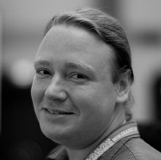
Leadership
“
Brian Behlendorf
Executive Director
2016 was full of growth for the organization and community. Not only did we exceed 100 members, Hyperledger met significant development milestones across our several Umbrella projects, thanks to the community’s hard work. As 2016 was a year of exploration, R&D and prototyping, we’re excited for 2017 to be the year we start to see case studies of Hyperledger Business Blockchain Technologies in production environments.
Apache Web server – Primary developer
Apache Software Foundation – Founding member
Mozilla Foundation – BOD since 2003
Electronic Frontier Foundation – BOD since 2013
CollabNet – Founding CTO
World Economic Forum – CTO
Most recently, managing director at Mithril Capital Management LLC, a global technology investment firm
”

Slide 29
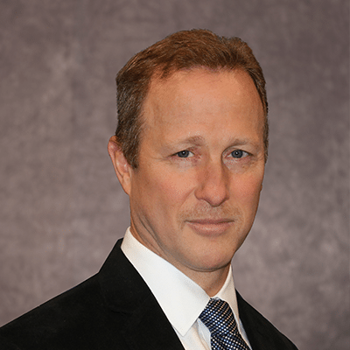
Governing Board
Robert Palatnick
Governing Board Chair
Palatnick previously served as a
Domain Lead in the Application
Development division of IT and was
Chief Administrative Officer of Information
Technology from 2003 to 2007. Palatnick joined Government Securities Clearing Corporation (GSCC), a DTCC subsidiary, in 1993 as Vice President, Information Technology. He became Managing Director and Chief Information Officer of DTCC subsidiaries GSCC (1996), Mortgage-Backed Securities Clearing Corporation (2000) and Fixed Income Clearing Corporation (2003). Prior to that, Palatnick was Vice President, Development and Systems, at Security Pacific Corporation Sequor Software Services. Palatnick received his BS in Electrical Engineering from the University of Buffalo, and is an alumnus of the David Rockefeller fellowship.
Comprised of one voting representative from each Premier Hyperledger member and attended by the TSC and Marketing Committee Chairs, the Governing Board’s responsibilities include:
Approving a budget
Electing a Chair to preside over Governing Board meetings, authorize expenditures approved by the budget and manage any day-to-day operations
Reviewing all project proposals from the TSC and directing the business strategy, development and promotion for projects

Slide 30

Technical Steering Committee
The TSC is the technical governance heart and soul of the project. As new code bases get contributed to the project they get reviewed and approved by this committee.
Committing members appoint and vote the TSC Chair annually.
Meets weekly on Thursday, 10:00 AM to 11:30 AM ET
All are invited to attend these calls and encouraged to join the TSC mailing list for more information:
lists.hyperledger.org/mailman/listinfo/hyperledger-tsc
Arnaud Le Hors
TSC Chair
Arnaud Le Hors is Senior Technical Staff Member (STSM) Open Web Technologies at IBM. He has been working on Open Technologies for over 20 years, involving standards and open source development. Arnaud was a staff member of the W3C and the X Consortium and has represented IBM in several standards and open source organizations for many years. Arnaud was editor of several key Web specifications including HTML and DOM and was involved in high profile open source projects such as Xerces, the Apache XML parser, and the X Window System. Arnaud is currently the main representative for IBM at W3C and the chair of the W3C RDF Data Shapes Working Group.

Slide 31
Additional Community Working Groups
Working Groups are open to the public
Working Groups
Architecture WG
Diversity, Civility, and Inclusion WG
Identity WG
Learning Materials Development WG
Performance and Scale WG
Smart Contracts WG
Technical WG China
Special Interest Groups
Capital Markets SIG
Healthcare SIG
Public Sector SIG
Social Impact SIG
Supply Chain SIG
Telecom SIG
Trade Finance SIG

Slide 32
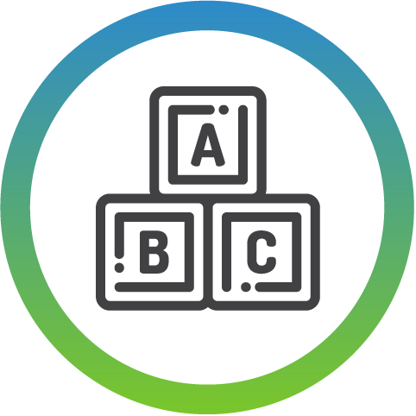


hyperledger.org/community
Learn the Basics
about Hyperledger projects
Start or join a Hyperledger meetup
Spread the word about Hyperledger
Notes:
David

Slide 33



hyperledger.org/community
Improve our documentation and training material
Get involved with coding
Take part in the Ambassador program
Notes:
Tracy - Advanced contribution opportunities include improving our documentation and training material, getting involved with coding, and taking part in the Ambassador program. Let's dive into how you can get involved with each of these opportunities

Slide 34







Collaboration Tools
Account
Sign up for a Linux Foundation account
Chat
Join the discussion on chat
Mailing Lists
Participate on the Hyperledger Mailing Lists
Github
Check out our code repositories
Wiki
Get the latest development updates from the wiki
Bug Reporting
Search for open bugs, or report a new one, in our bug database

Slide 35
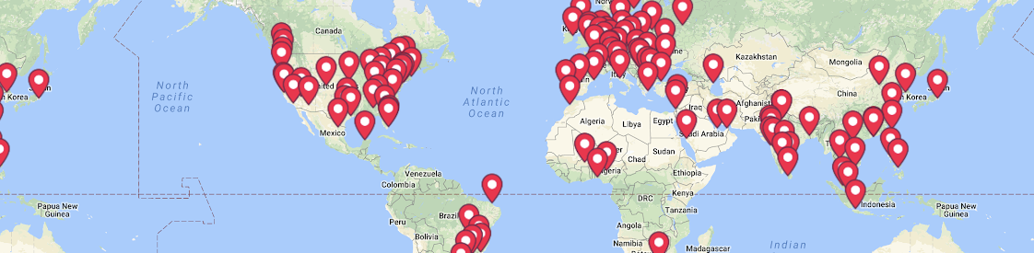
Hyperledger Global Meetups
We are 60K+ members across 170+ Meetups in 76 countries

Slide 36
Get Involved!
Ensure the strength and longevity of a core technology to your business.
Publicly proclaim your leadership in the blockchain space.
Work with other blockchain leaders to develop and promote Hyperledger blockchain for business technologies.
Visit hyperledger.org/about/join
or email info@hyperledger.org

Slide 37
Insert section about Identity

Slide 38
Leadership
“
Brian Behlendorf
Executive Director
2016 was full of growth for the organization and community. Not only did we exceed 100 members, Hyperledger met significant development milestones across our several Umbrella projects, thanks to the community’s hard work. As 2016 was a year of exploration, R&D and prototyping, we’re excited for 2017 to be the year we start to see case studies of Hyperledger Business Blockchain Technologies in production environments.
Apache Web server – Primary developer
Apache Software Foundation – Founding member
Mozilla Foundation – BOD since 2003
Electronic Frontier Foundation – BOD since 2013
CollabNet – Founding CTO
World Economic Forum – CTO
Most recently, managing director at Mithril Capital Management LLC, a global technology investment firm
”

Slide 39
Governing Board
Robert Palatnick
Governing Board Chair
Palatnick previously served as a
Domain Lead in the Application
Development division of IT and was
Chief Administrative Officer of Information
Technology from 2003 to 2007. Palatnick joined Government Securities Clearing Corporation (GSCC), a DTCC subsidiary, in 1993 as Vice President, Information Technology. He became Managing Director and Chief Information Officer of DTCC subsidiaries GSCC (1996), Mortgage-Backed Securities Clearing Corporation (2000) and Fixed Income Clearing Corporation (2003). Prior to that, Palatnick was Vice President, Development and Systems, at Security Pacific Corporation Sequor Software Services. Palatnick received his BS in Electrical Engineering from the University of Buffalo, and is an alumnus of the David Rockefeller fellowship.
Comprised of one voting representative from each Premier Hyperledger member and attended by the TSC and Marketing Committee Chairs, the Governing Board’s responsibilities include:
Approving a budget
Electing a Chair to preside over Governing Board meetings, authorize expenditures approved by the budget and manage any day-to-day operations
Reviewing all project proposals from the TSC and directing the business strategy, development and promotion for projects

Slide 40
Technical Steering Committee
The TSC is the technical governance heart and soul of the project. As new code bases get contributed to the project they get reviewed and approved by this committee.
Committing members appoint and vote the TSC Chair annually.
Meets weekly on Thursday, 10:00 AM to 11:30 AM ET
All are invited to attend these calls and encouraged to join the TSC mailing list for more information:
lists.hyperledger.org/mailman/listinfo/hyperledger-tsc
Arnaud Le Hors
TSC Chair
Arnaud Le Hors is Senior Technical Staff Member (STSM) Open Web Technologies at IBM. He has been working on Open Technologies for over 20 years, involving standards and open source development. Arnaud was a staff member of the W3C and the X Consortium and has represented IBM in several standards and open source organizations for many years. Arnaud was editor of several key Web specifications including HTML and DOM and was involved in high profile open source projects such as Xerces, the Apache XML parser, and the X Window System. Arnaud is currently the main representative for IBM at W3C and the chair of the W3C RDF Data Shapes Working Group.

Slide 41
Additional Community Working Groups
Working Groups are open to the public
Working Groups
Architecture WG
Diversity, Civility, and Inclusion WG
Identity WG
Learning Materials Development WG
Performance and Scale WG
Smart Contracts WG
Technical WG China
Special Interest Groups
Capital Markets SIG
Healthcare SIG
Public Sector SIG
Social Impact SIG
Supply Chain SIG
Telecom SIG
Trade Finance SIG

Slide 42
hyperledger.org/community
Learn the Basics
about Hyperledger projects
Start or join a Hyperledger meetup
Spread the word about Hyperledger
Notes:
David

Slide 43
hyperledger.org/community
Improve our documentation and training material
Get involved with coding
Take part in the Ambassador program
Notes:
Tracy - Advanced contribution opportunities include improving our documentation and training material, getting involved with coding, and taking part in the Ambassador program. Let's dive into how you can get involved with each of these opportunities

Slide 44
Collaboration Tools
Account
Sign up for a Linux Foundation account
Chat
Join the discussion on chat
Mailing Lists
Participate on the Hyperledger Mailing Lists
Github
Check out our code repositories
Wiki
Get the latest development updates from the wiki
Bug Reporting
Search for open bugs, or report a new one, in our bug database

Slide 45
Hyperledger Global Meetups
We are 60K+ members across 170+ Meetups in 76 countries

Slide 46
Get Involved!
Ensure the strength and longevity of a core technology to your business.
Publicly proclaim your leadership in the blockchain space.
Work with other blockchain leaders to develop and promote Hyperledger blockchain for business technologies.
Visit hyperledger.org/about/join
or email info@hyperledger.org

Slide 47
THANK YOU
Notes:
David

