Slide 1
HYPERLEDGER
Getting Involved in an Open-Source Community
Bobbi Muscara / Ledger Academy
Notes:
Today we are going to talk about how to get involved in an open-source community. Weather you are looking to further your career or enhance your business processes , spend some time in our community pages. Feel free to join our project calls or join a group , your level of involvement is up to you.

Slide 2

Hyperledger has a modular approach to hosting projects. Think of Hyperledger as a greenhouse growing and sustaining business blockchain projects from seed to fruition.
The Linux Foundation and Hyperledger provide the infrastructure for open development to occur among a diverse and thriving community.
Notes:
Under Hyperledger’s umbrella there are frameworks and tools that take different approaches to creating blockchains for business.
There are many benefits to this modular approach since we believe that there isn’t one blockchain solution that will work well for every possible use case.

Slide 3
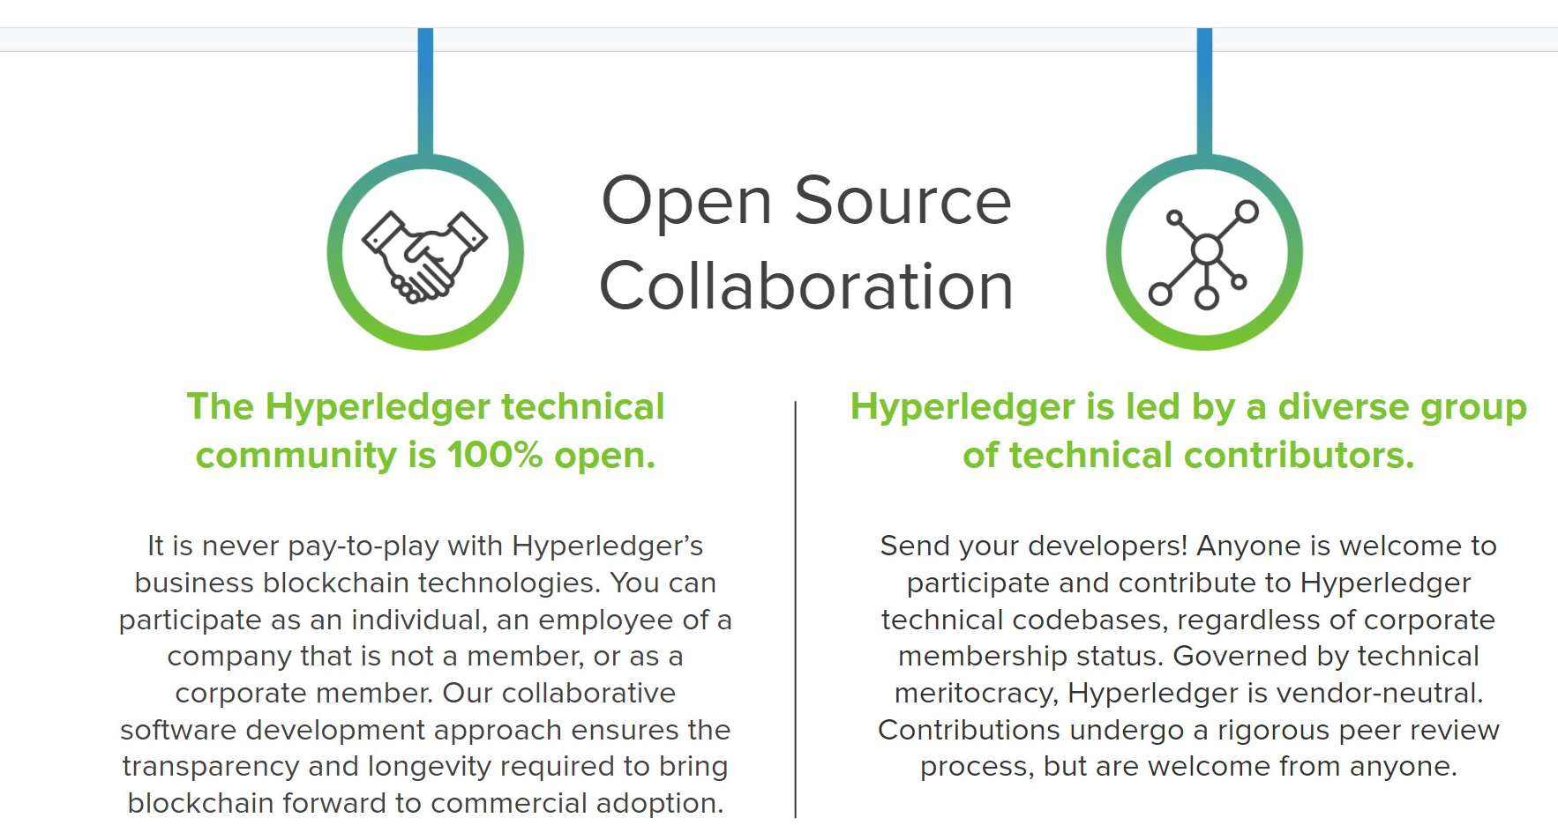

Slide 5
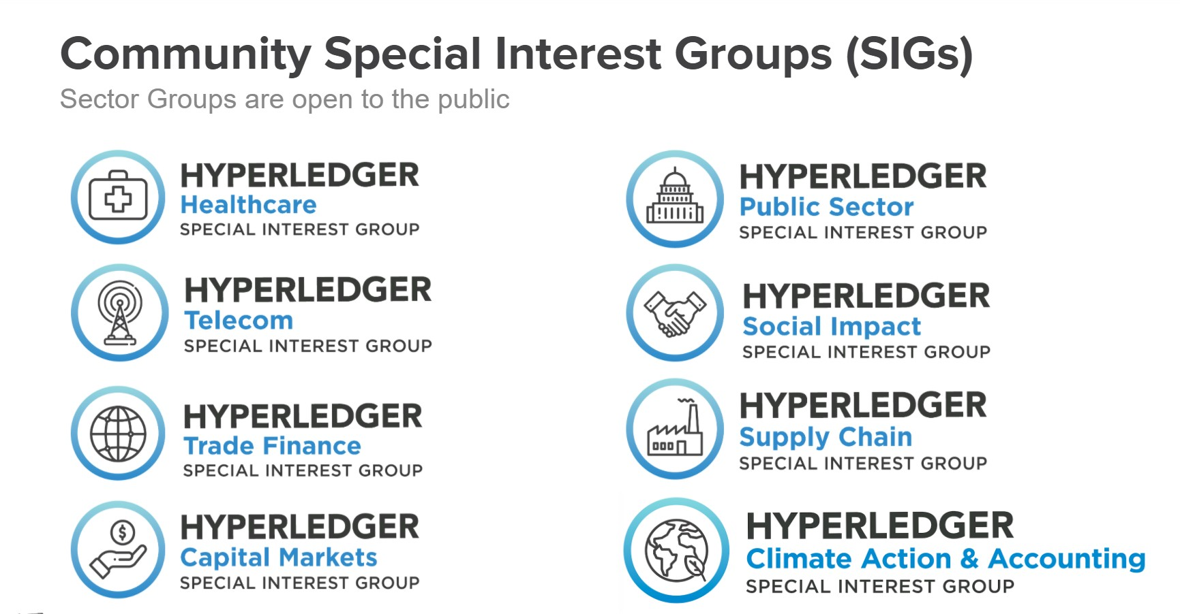
https://wiki.hyperledger.org/display/HYP/Special+Interest+Groups

Slide 6
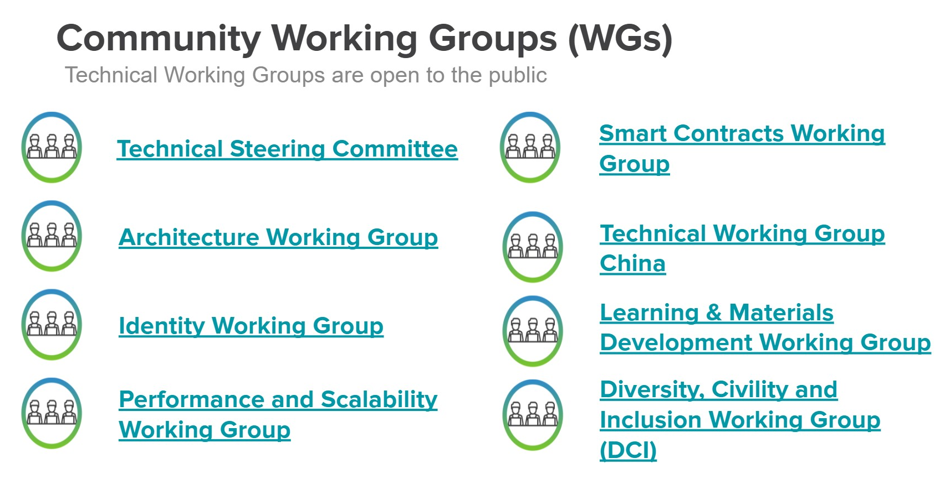

Slide 7
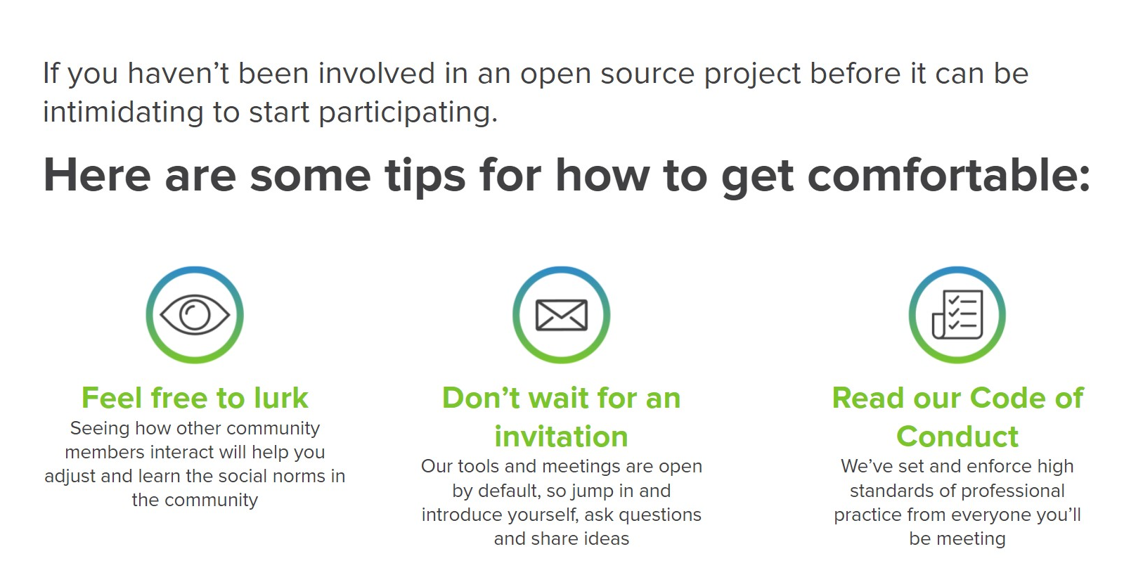

Slide 8
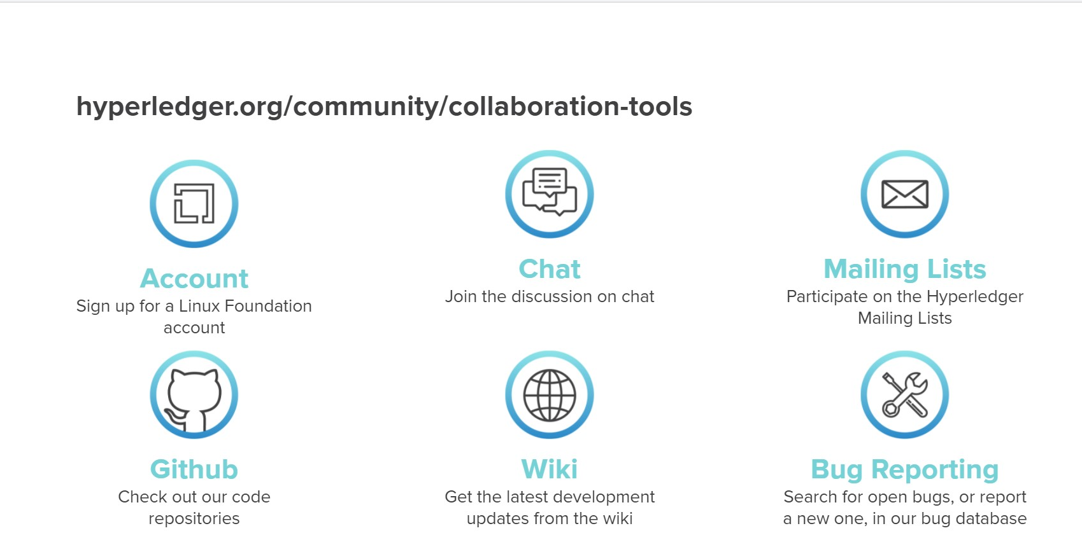

Slide 9

The Wiki
Wiki.hyperledger.org
4 Steps in Getting Involved

Slide 10

To becoming a Community Member
Getting a Linux Login
Edit a Wiki Page ( Edit Mode)
Join the calls
How to Get Involved: Join a Group
Notes:
These step that I am going to describe hold true weather your joining a wg sig or project

Slide 11
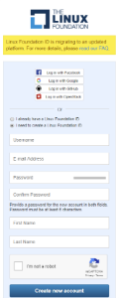
Getting a Linux Login
Getting a Login
https://identity.linuxfoundation.org/
Verifying your email
Login into a Hyperledger Wiki Page
Notes:
Just verify your email.

Slide 12
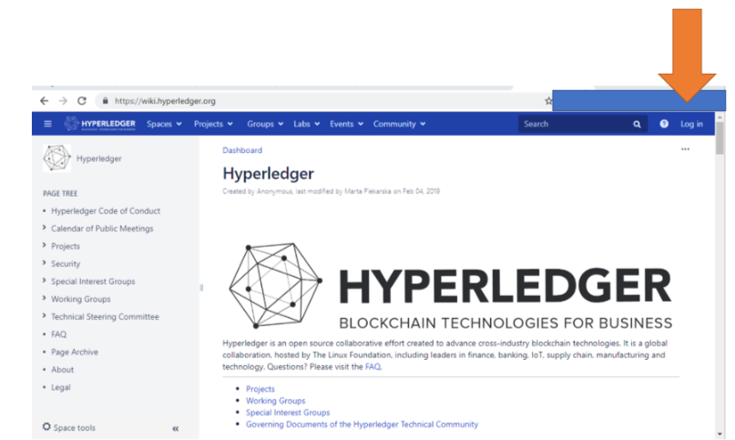
Getting a Linux Login
Login into a Hyperledger Wiki Page
Notes:
Just verify your email. Then you will have the ability to log into the wiki.hyperledger community pages.

Slide 13
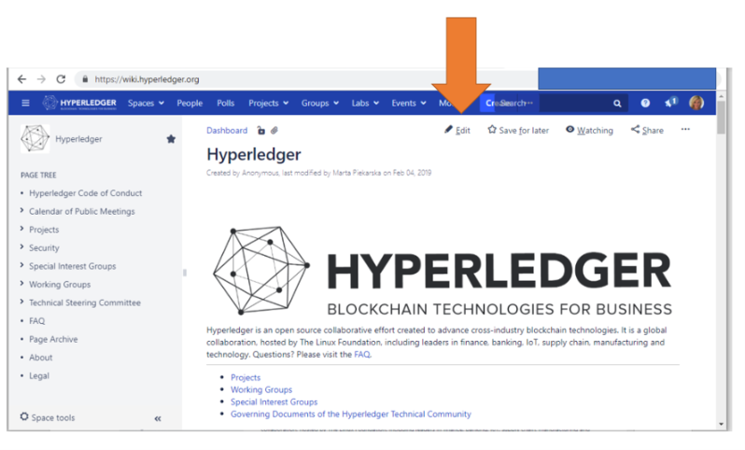
Getting a Linux Login
Ability to Edit a Hyperledger Wiki Page
Notes:
Your login gives you the ability to edit the community pages.

Slide 14
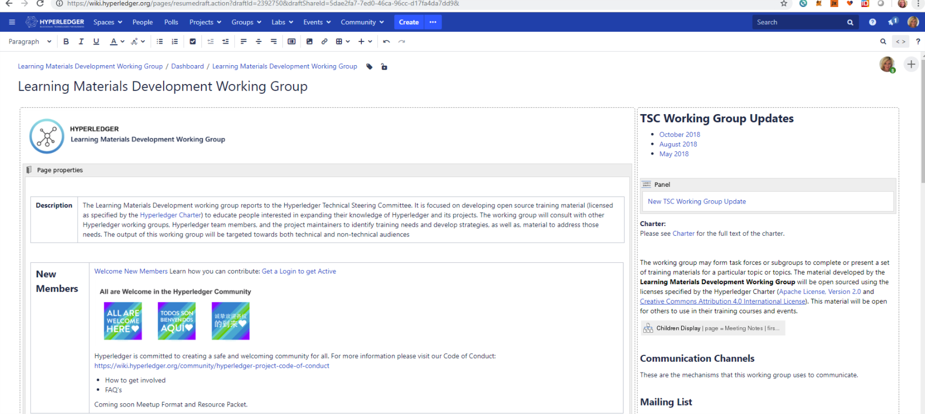
Edit a Wiki Page ( Edit Mode)
Notes:
The edit menu works like the common word processor

Slide 15
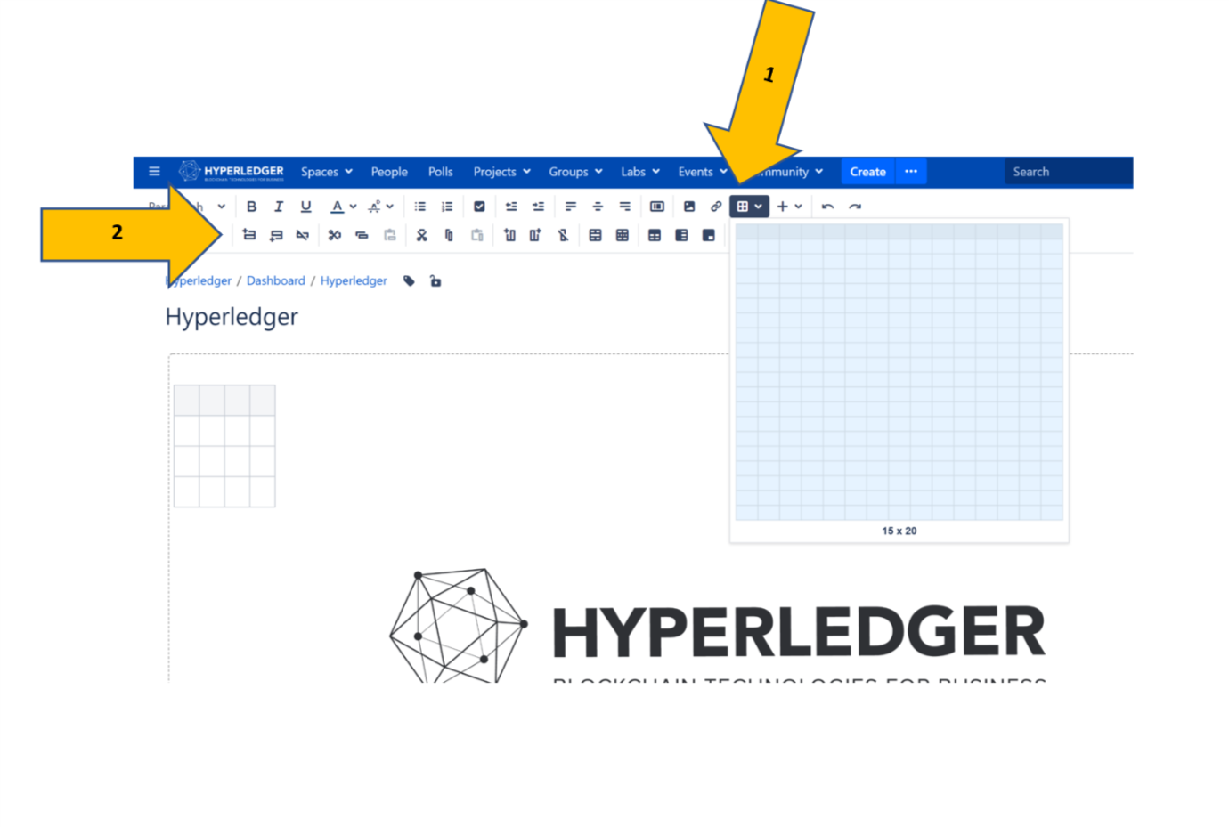
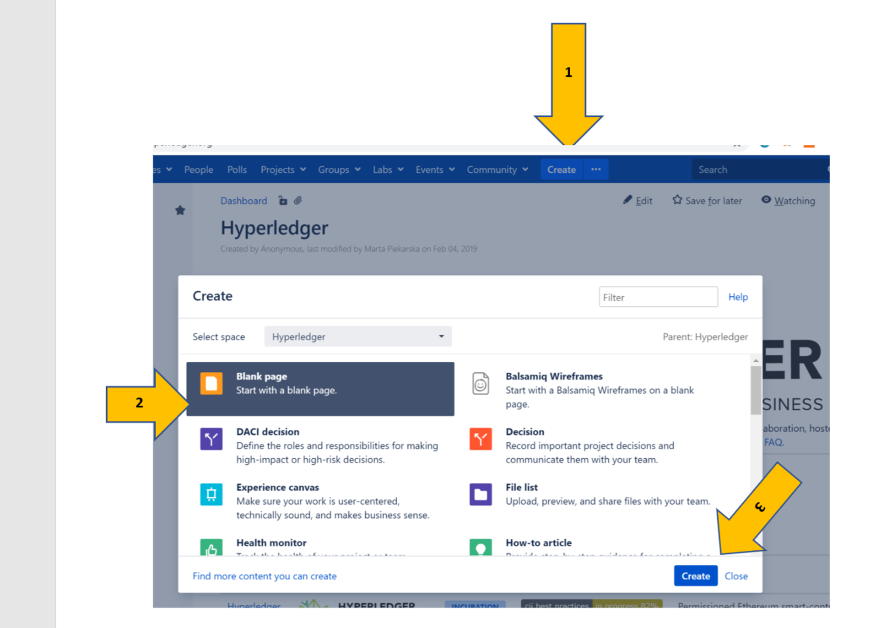
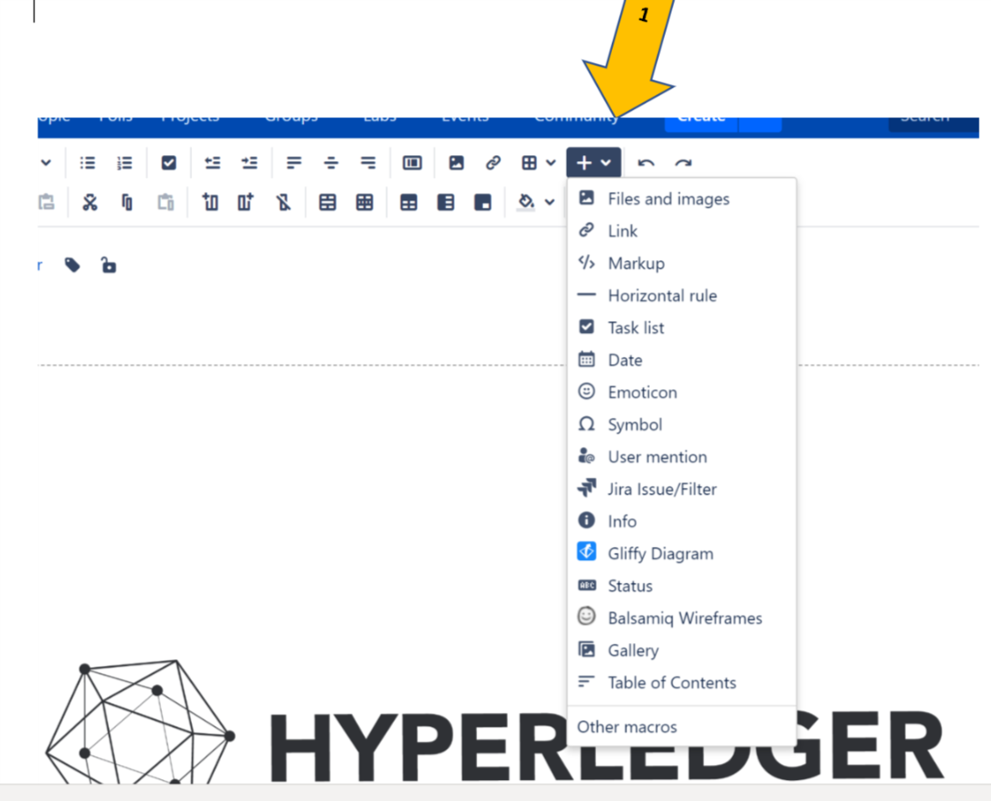
Create Tables
Create New Pages
Insert Objects
Notes:
Word processing, / web page editor. You can insert tables , files and even new pages.

Slide 16
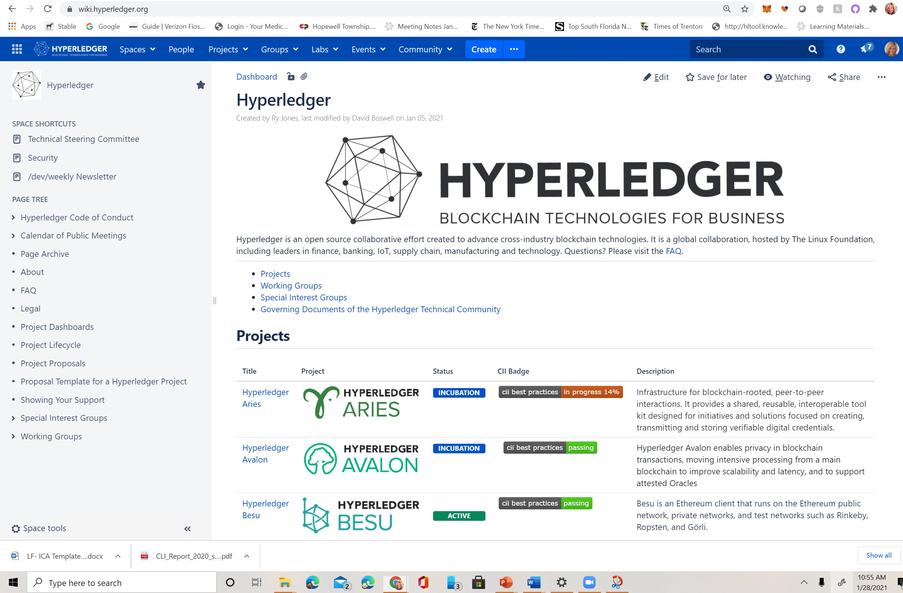
Join the calls CALENDAR
Notes:
Now that you can edit the pages its time to discover where your interest lies. Each project WG and SIG hold weekly / bi-weekly calls that are open to everyone.

Slide 17
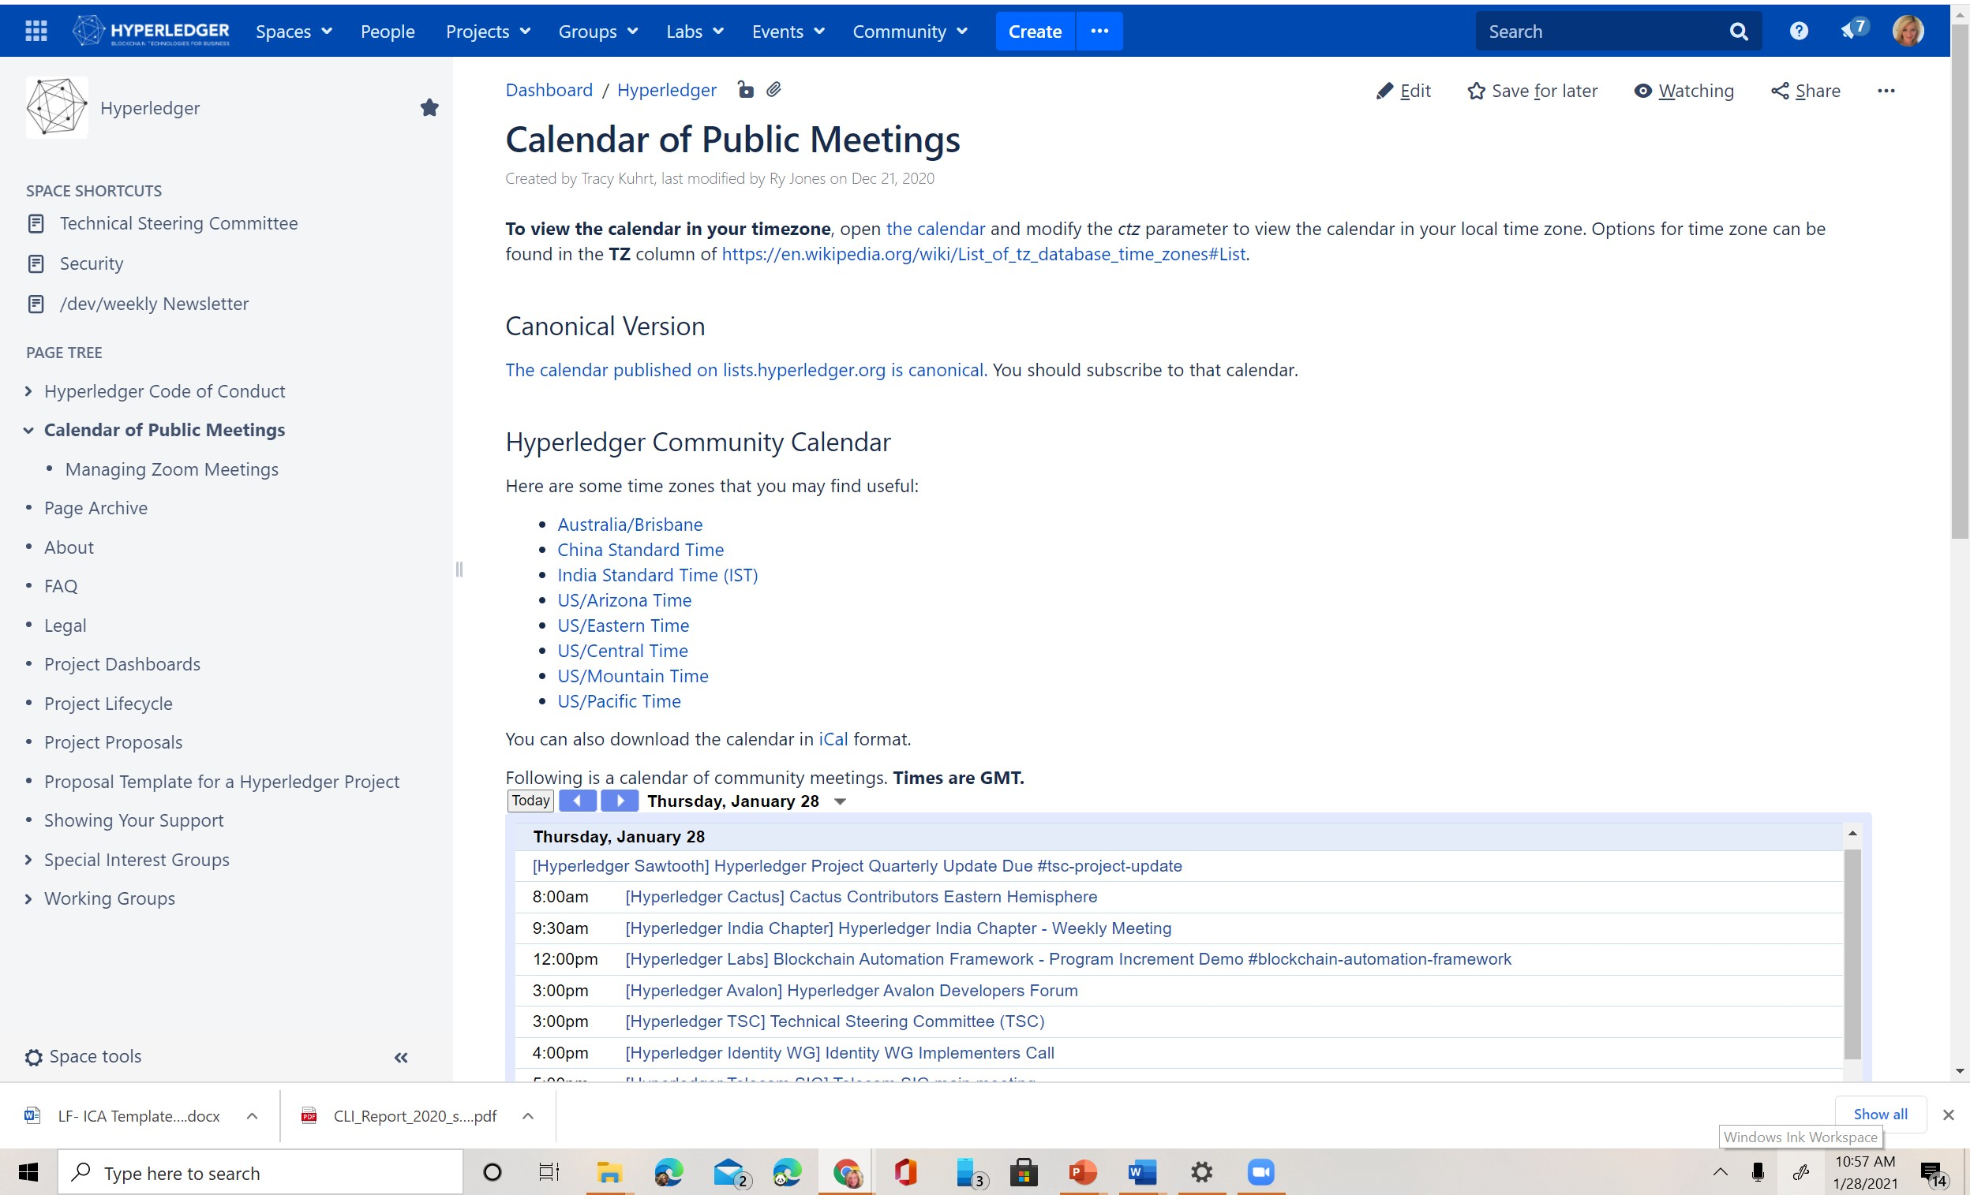
Notes:
Just join a zoom call and introduce yourself and just say you want to learn about the group. Once you find the group you want to contribute to start to get working!

Slide 18
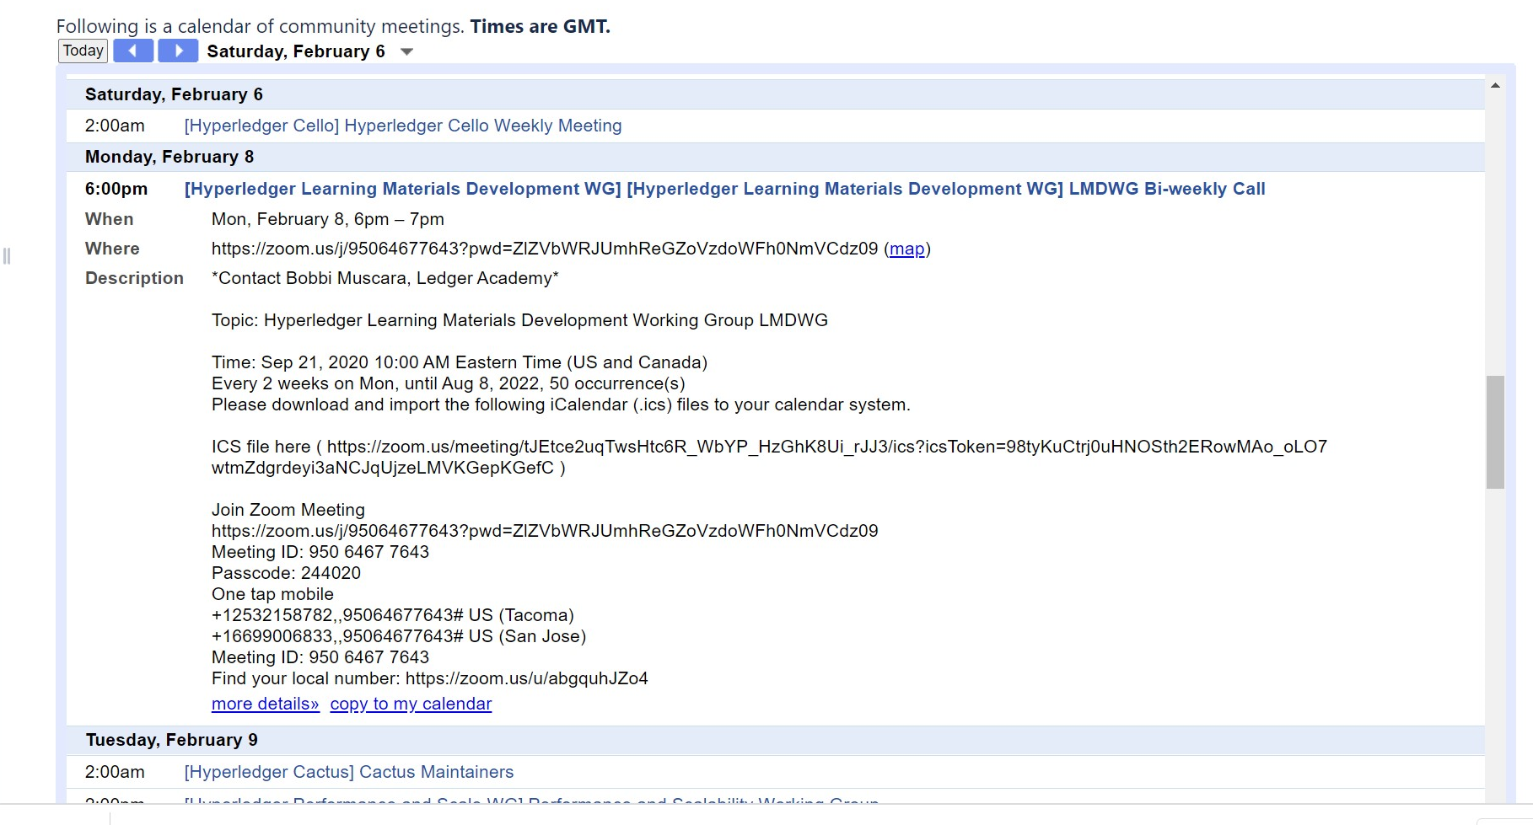
Notes:
All the information is one the community calendar.

Slide 19
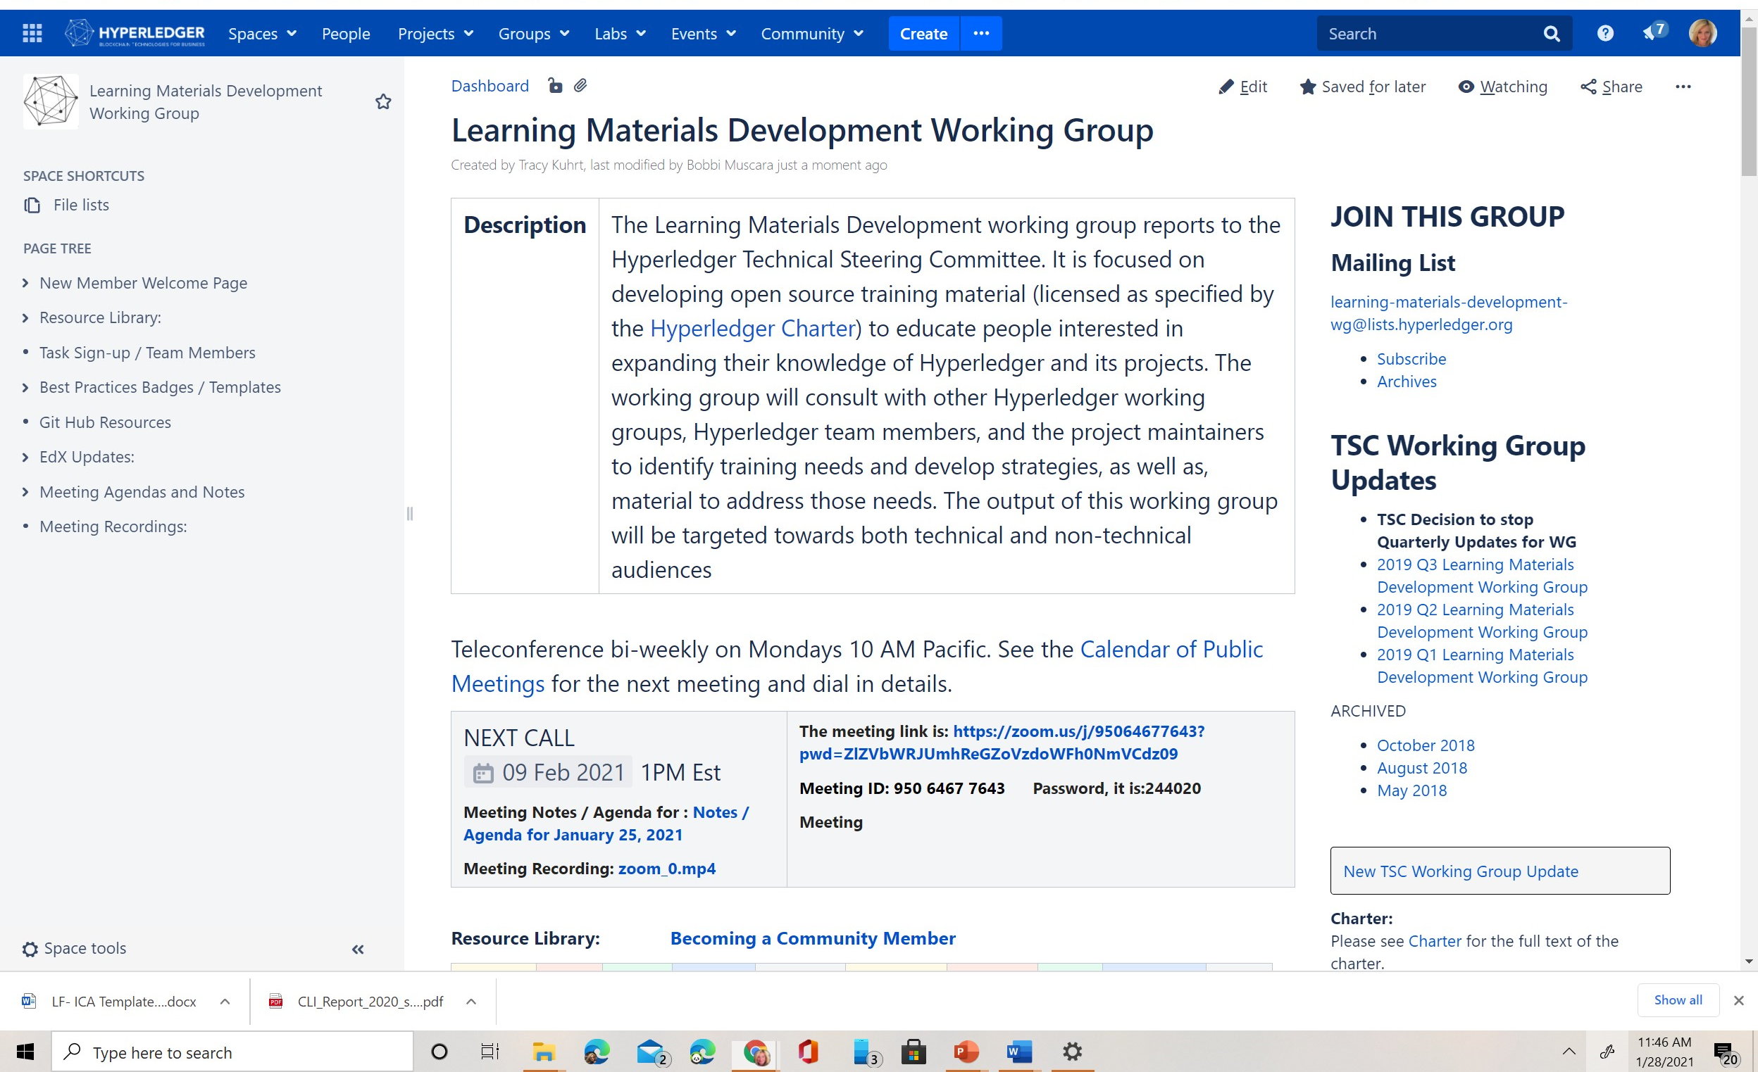
How to Get Involved: Join a Group (LISTS)
Notes:
Now that you know where you want to contribute, its time to JOIN a group and get on the mailing lists. It’s a simple as that. Feel free to roam around the community pages and join as many groups as you feel you can be an important part of this growing community.

Slide 20
Test your Knowledge / Competencies
Obtain a Linux Login
Log in the wiki pages
Navigate to the Learning Materials Working Group
Join the LMDWG
Add your name to the member list
https://identity.linuxfoundation.org/
https://wiki.hyperledger.org/
https://wiki.hyperledger.org/display/LMDWG/Learning+Materials+Development+Working+Group
https://lists.hyperledger.org/g/learning-materials-development-wg
https://wiki.hyperledger.org/pages/viewpage.action?pageId=2394122
Notes:
Its time to test your knowledge. Let's walk through the four steps.

Slide 21
Questions?
Bobbi Muscara / Ledger Academy
Chair Hyperledger Learning Materials Working Group
https://wiki.hyperledger.org/pages/viewpage.action?pageId=2394122

