Slide 1


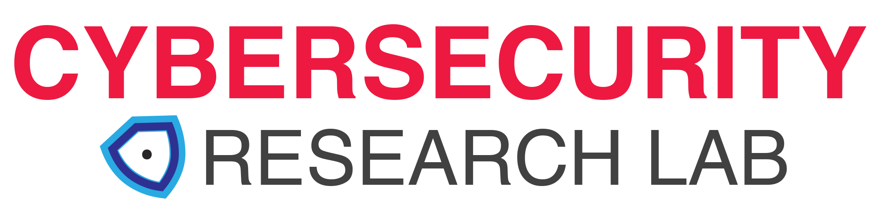
Hyperledger Challenge 2022
Mosaique: Decentralized Workflows

Slide 2

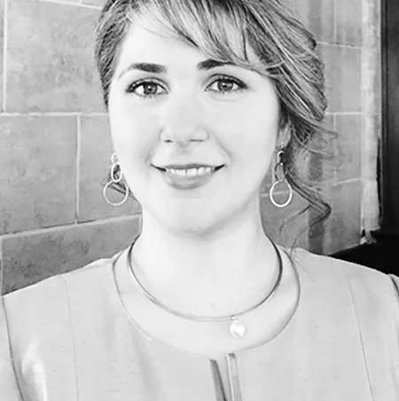
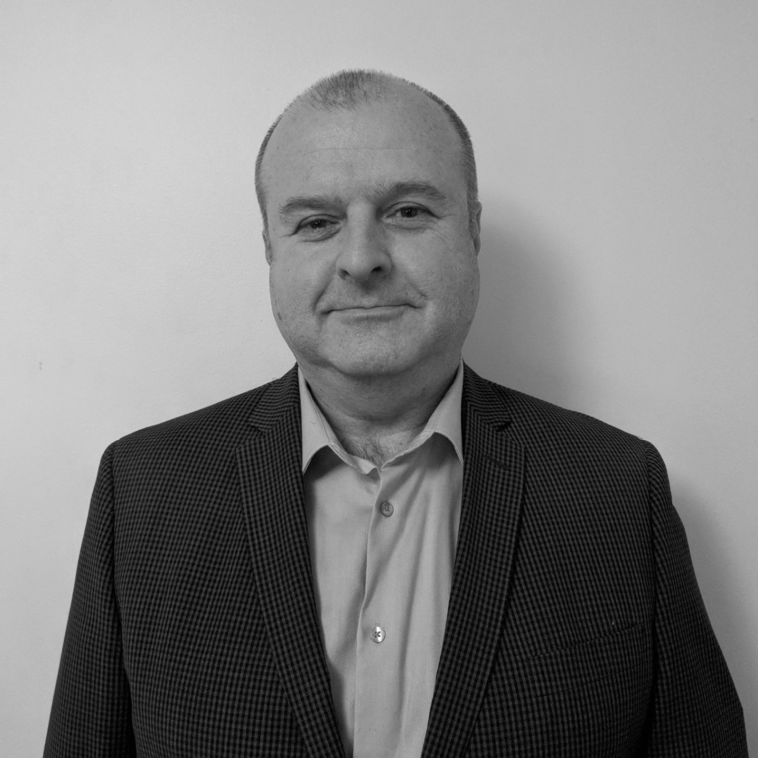
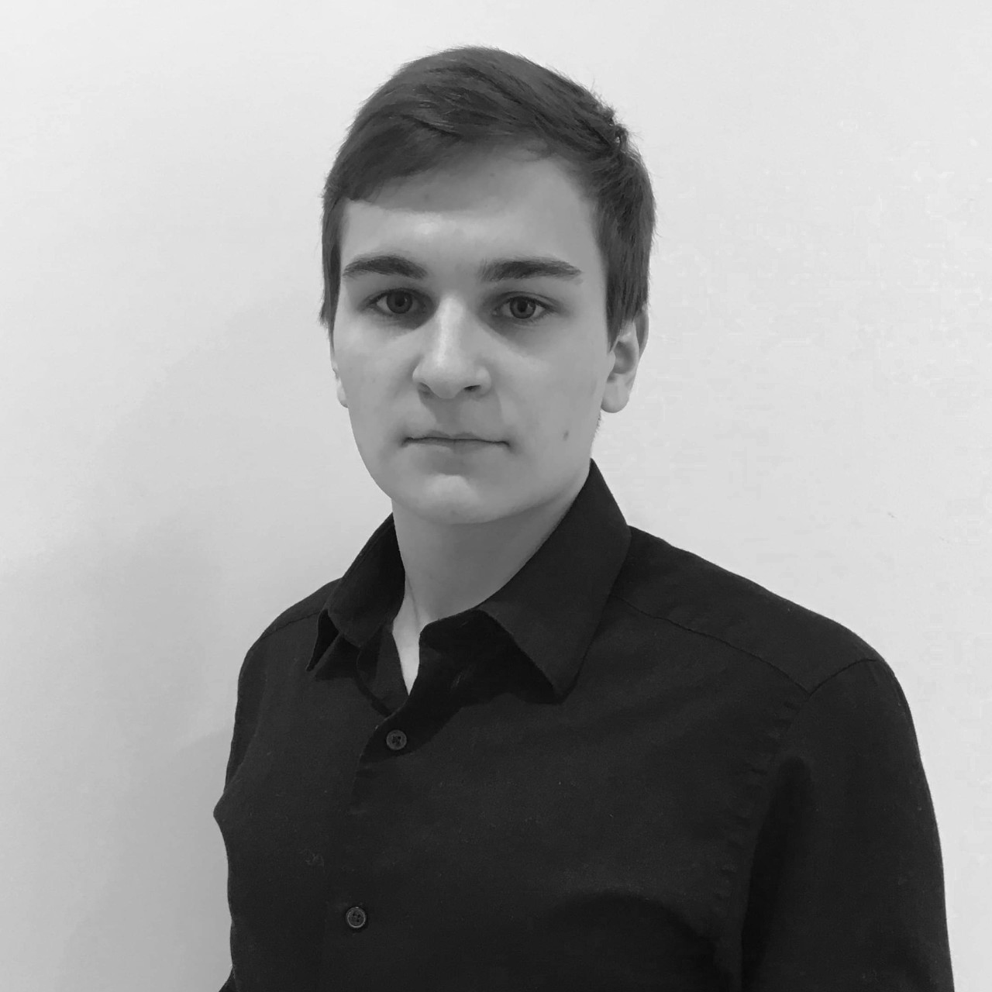
Key Mosaique Team Members
Dr. Atefeh (Atty) Mashatan is the founder and director of the Cybersecurity Research Lab (CRL) at Toronto Metropolitan University and recognized as a leading expert in cryptography, blockchain technology, quantum-resistant solutions, enterprise security architecture and Internet-of-Things (IoT) security.
Dave McKay is the Technical Lead at the Cybersecurity Research Lab (CRL) at Toronto Metropolitan University. Lab. He brings 35 years of software development management to his role with CRL. He is the lead on all development and technical aspects of this research project.
Volodymyr Tanczak is the Lead Developer on this project. Volod has been a Research Assistant at the CRL for over three years. He has recently completed his MSc in Computer Science at Ryerson. Volod has served as the Vice-President of the Linux Users Group @ Toronto Metropolitan University for over two years.

Slide 3
Problem Statement
Blockchain systems were not designed for multi-step workflow process transactions.
Inter-organizational workflows involve multiple prescribed steps, roles, instances, accumulated data, and application interfaces.
How can a decentralized system offer enforced workflows for all participants and instances?

Slide 4
Proposed Solution
Mosaique
A blockchain system that allows for collective development of business processes in a decentralized system.

Slide 5
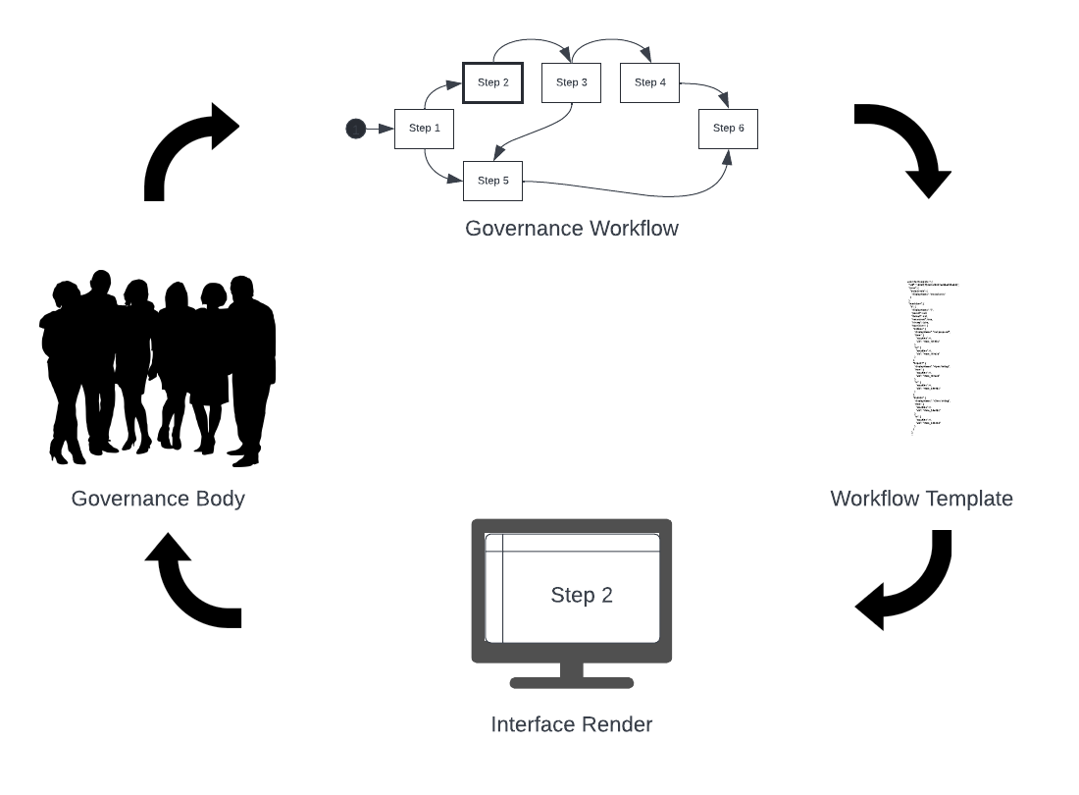
Solution Architecture
State machine as workflow enforcer
Represent the state machine as a template
Template, state, role, and instance are used to render a step in the interface
Governance body can use the system to update the state machine

Slide 6
Solution Benefits
Consistent workflows
Reduced development
Easily integrated
Encourages participation
Treats stakeholders equitably

Slide 7
Solution Uniqueness/Novelty
Data-driven low-code
Integrates into existing applications without recoding for changes
Self-referential system

Slide 8
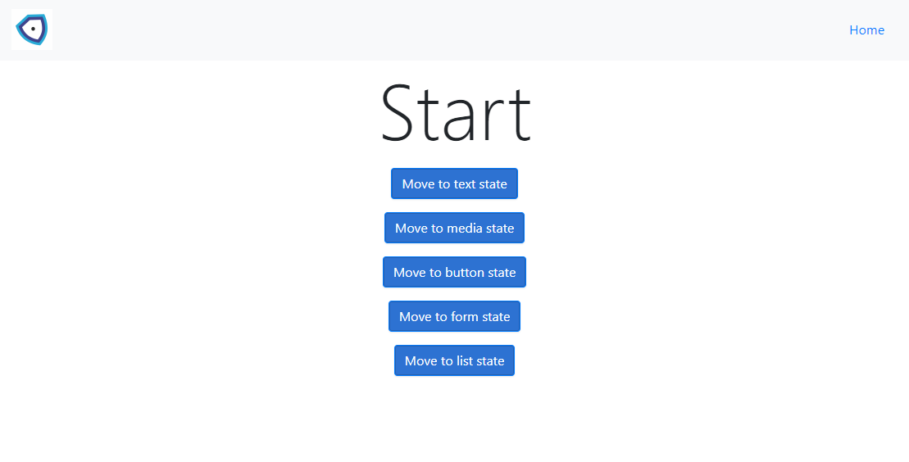
Demo

Slide 9
Roadmap/Next Steps
Visual template editor
Move parser to chaincode on Hyperledger Fabric
Move templates, context, instance to CouchDB in Fabric
First version governance template
For Launch Challenge

Slide 10

Thank You

