Slide 1
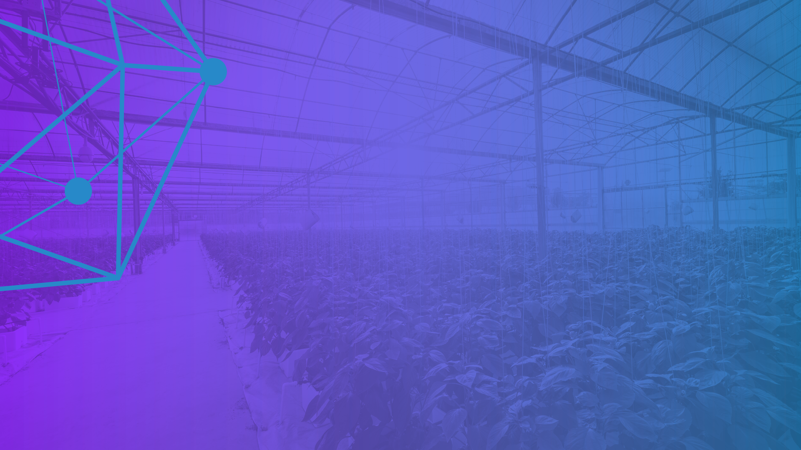


Hyperledger Trade Finance
Special Interest Group
September 29, 2021
www.hyperledger.org
@Hyperledger

Slide 2
AGENDA
Introduction
      1.Presentation
      The Giving Chain
      2.Panel Discussion

Slide 3
Antitrust Policy Antitrust Policy Notice: link: https://www.linuxfoundation.org/antitrust-policy/
Linux Foundation meetings involve participation by industry competitors, and it is the intention of the Linux Foundation to conduct all of its activities in accordance with applicable antitrust and competition laws. It is therefore extremely important that attendees adhere to meeting agendas, and be aware of, and not participate in, any activities that are prohibited under applicable US state, federal or foreign antitrust and competition laws. Examples of types of actions that are prohibited at Linux Foundation meetings and in connection with Linux Foundation activities are described in the Linux Foundation Antitrust Policy available at http://www.linuxfoundation.org/antitrust-policy. If you have questions about these matters, please contact your company counsel, or if you are a member of the Linux Foundation, feel free to contact Andrew Updegrove of the firm of Gesmer Updegrove LLP, which provides legal counsel to the Linux Foundation.
Code of Conduct Code of conduct link: Hyperledger Code of Conduct

Slide 4



Hyperledger Trade Finance
Special Interest Group Presents
The Giving Chain
A Linux Foundation sponsored
2021 Mentorship Project.
The Giving Chain is a Blockchain Social Impact Project to support charitable efforts by creating a donation supply chain tracking platform. The Giving Chain platform creates an immutable record of a donation by tracking items as they go from Donor, Transporter to Recipient.
Hyperledger Trade Finance
Special Interest Group
Notes:
Remind Attendees that All Are Welcome in Hyperledger Community and that they must abide by the code of conduct

Slide 5
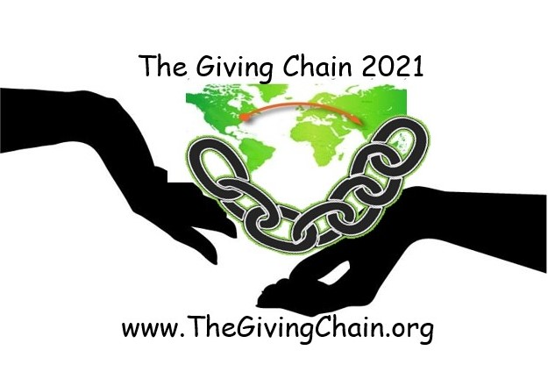
Presentation
      Introduction
      The Giving Chain 2019
      Checkpoints
      Hyperledger Mentorship Program
      The Giving Chain 2021
      Checkpoints
Business Team
Technical Team
4. Next Steps

Slide 6
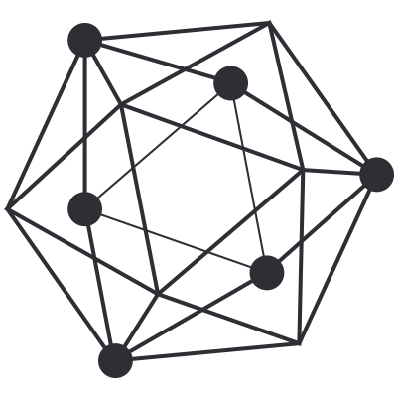

Introduction
Bobbi Muscara
Project Manager – Hyperledger Giving Chain
Director Education at Ledger Academy
Author of Linux Foundation Blockchain Courses for LFS171
Hyperledger TSC Member
Chair OF THE Learning Materials Working Group
Project Team
Hardik Gupta
Project Manager – Hyperledger Giving Chain
Member OF THE Learning Materials Working Group
The Giving Chain
Mentee / Project Management / Technical Lead
Madhu Bhatia
Project Manager – Hyperledger Giving Chain
DLT Talent program of Frankfurt School of Finance and Management Blockchain Center
2021 LiFT Scholarship Women in open-source
Research Scholar /Trainer
Mona Rassouli –
Developer/ Marketing(social media)/Documentation/ Articles or Blogs
mr1241@scarletmail.rutgers.edu
Technology Lead
Project
The Giving Chain
&
The D2R Application

Slide 7
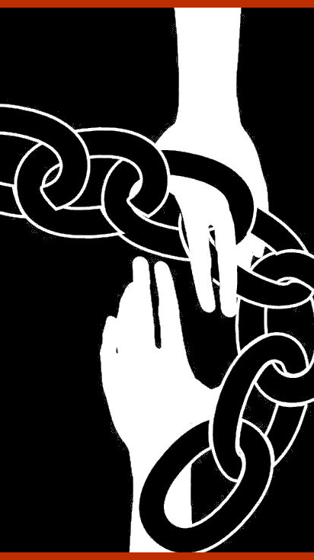
Social Impact
Blockchain
Project
Checkpoint 1: Impact Opportunity
Checkpoint 2: Business Model Validation
Checkpoint 3: Technical Architecture
Checkpoint 4: Impact Measurement
Checkpoint 5: Code
Checkpoint 6: Final Submissions Due
Notes:
2019 Grass roots effort of the Blockchain Princeton Meetup Groups. Worked through the checkpoints to create an important community project.

Slide 8
Checkpoint 1: Impact Opportunity
  Select your challenge.
Develop an agile & transparent network for connecting surplus foods & supplies to communities in need.
To create a decentralized system that collect excess food supplies from local resources and distribute these resources to local area facilities in need.
  Define the scope of problem.
For our summer project, we are limiting the POC to a single collection date in August. Donations from local farmers and community food drives, to be picked up by transportation volunteers who will bring donations to agreed upon drop off point.

Slide 9
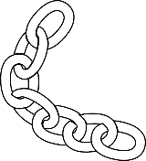
Checkpoint 2: Model Validation
Business Flow
Donors
Farmers
Individuals
Community / Church Groups
Volunteers / Drivers
Pickup / Deliver:
Local volunteers
Community / Groups Transport
Recipients
Food Banks
NGO’s
Social Services Offices
Individuals (off the grid)

Slide 10
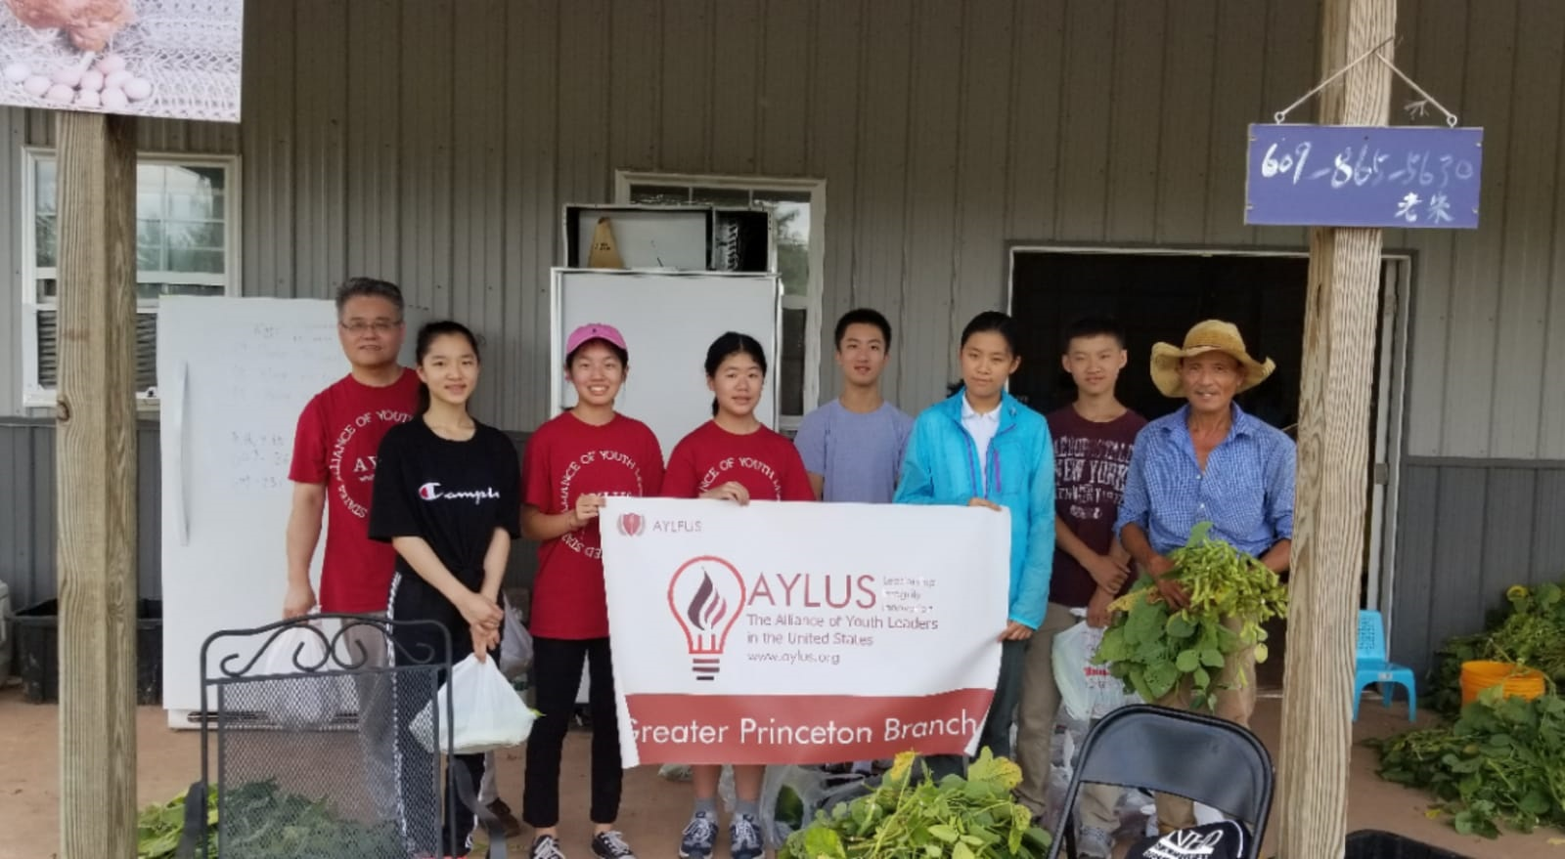
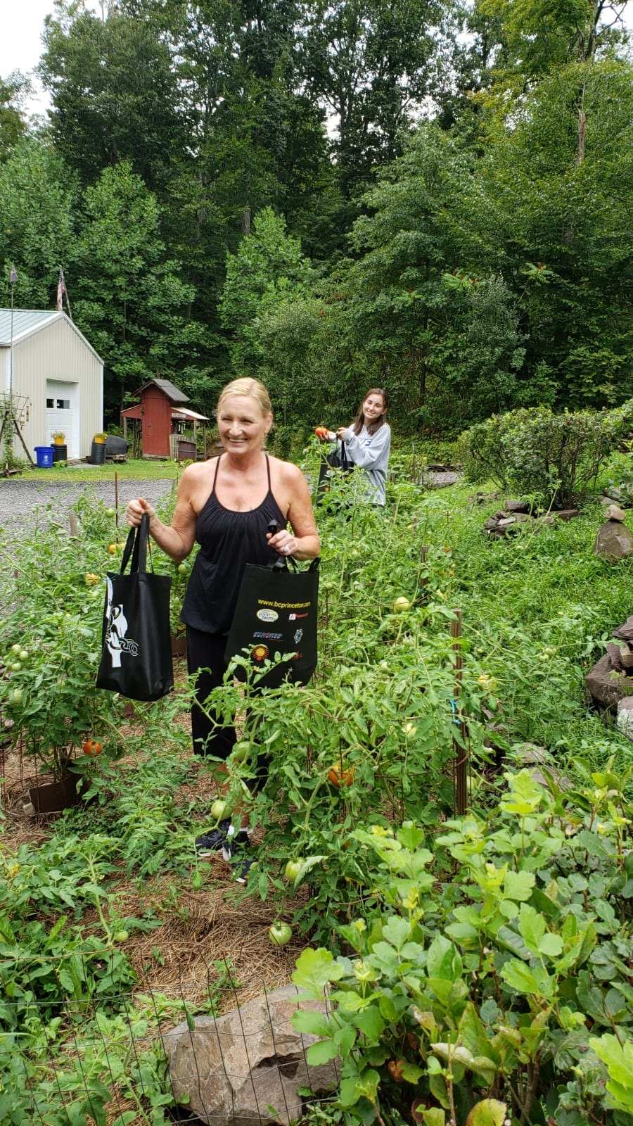
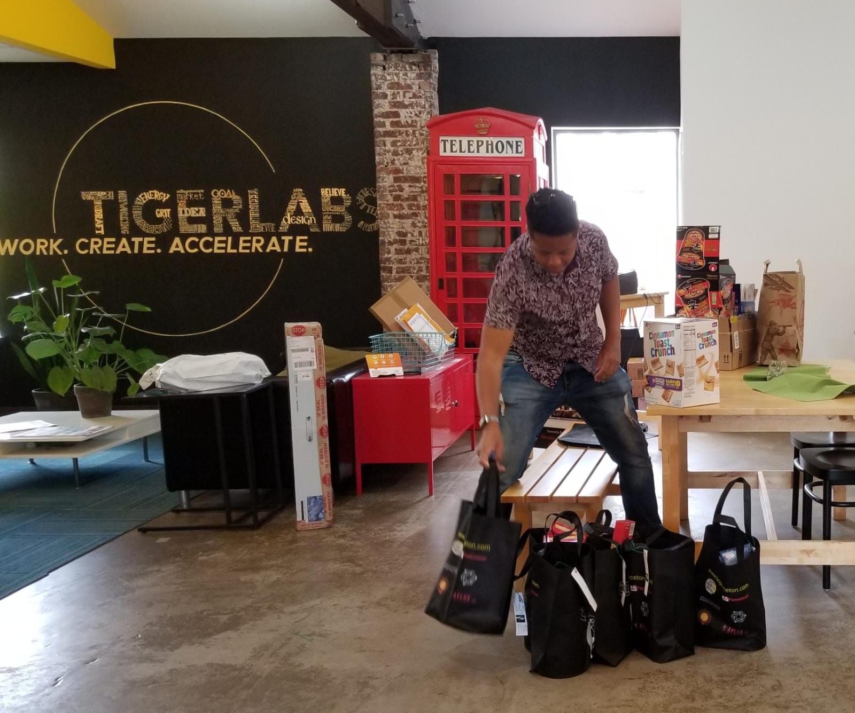
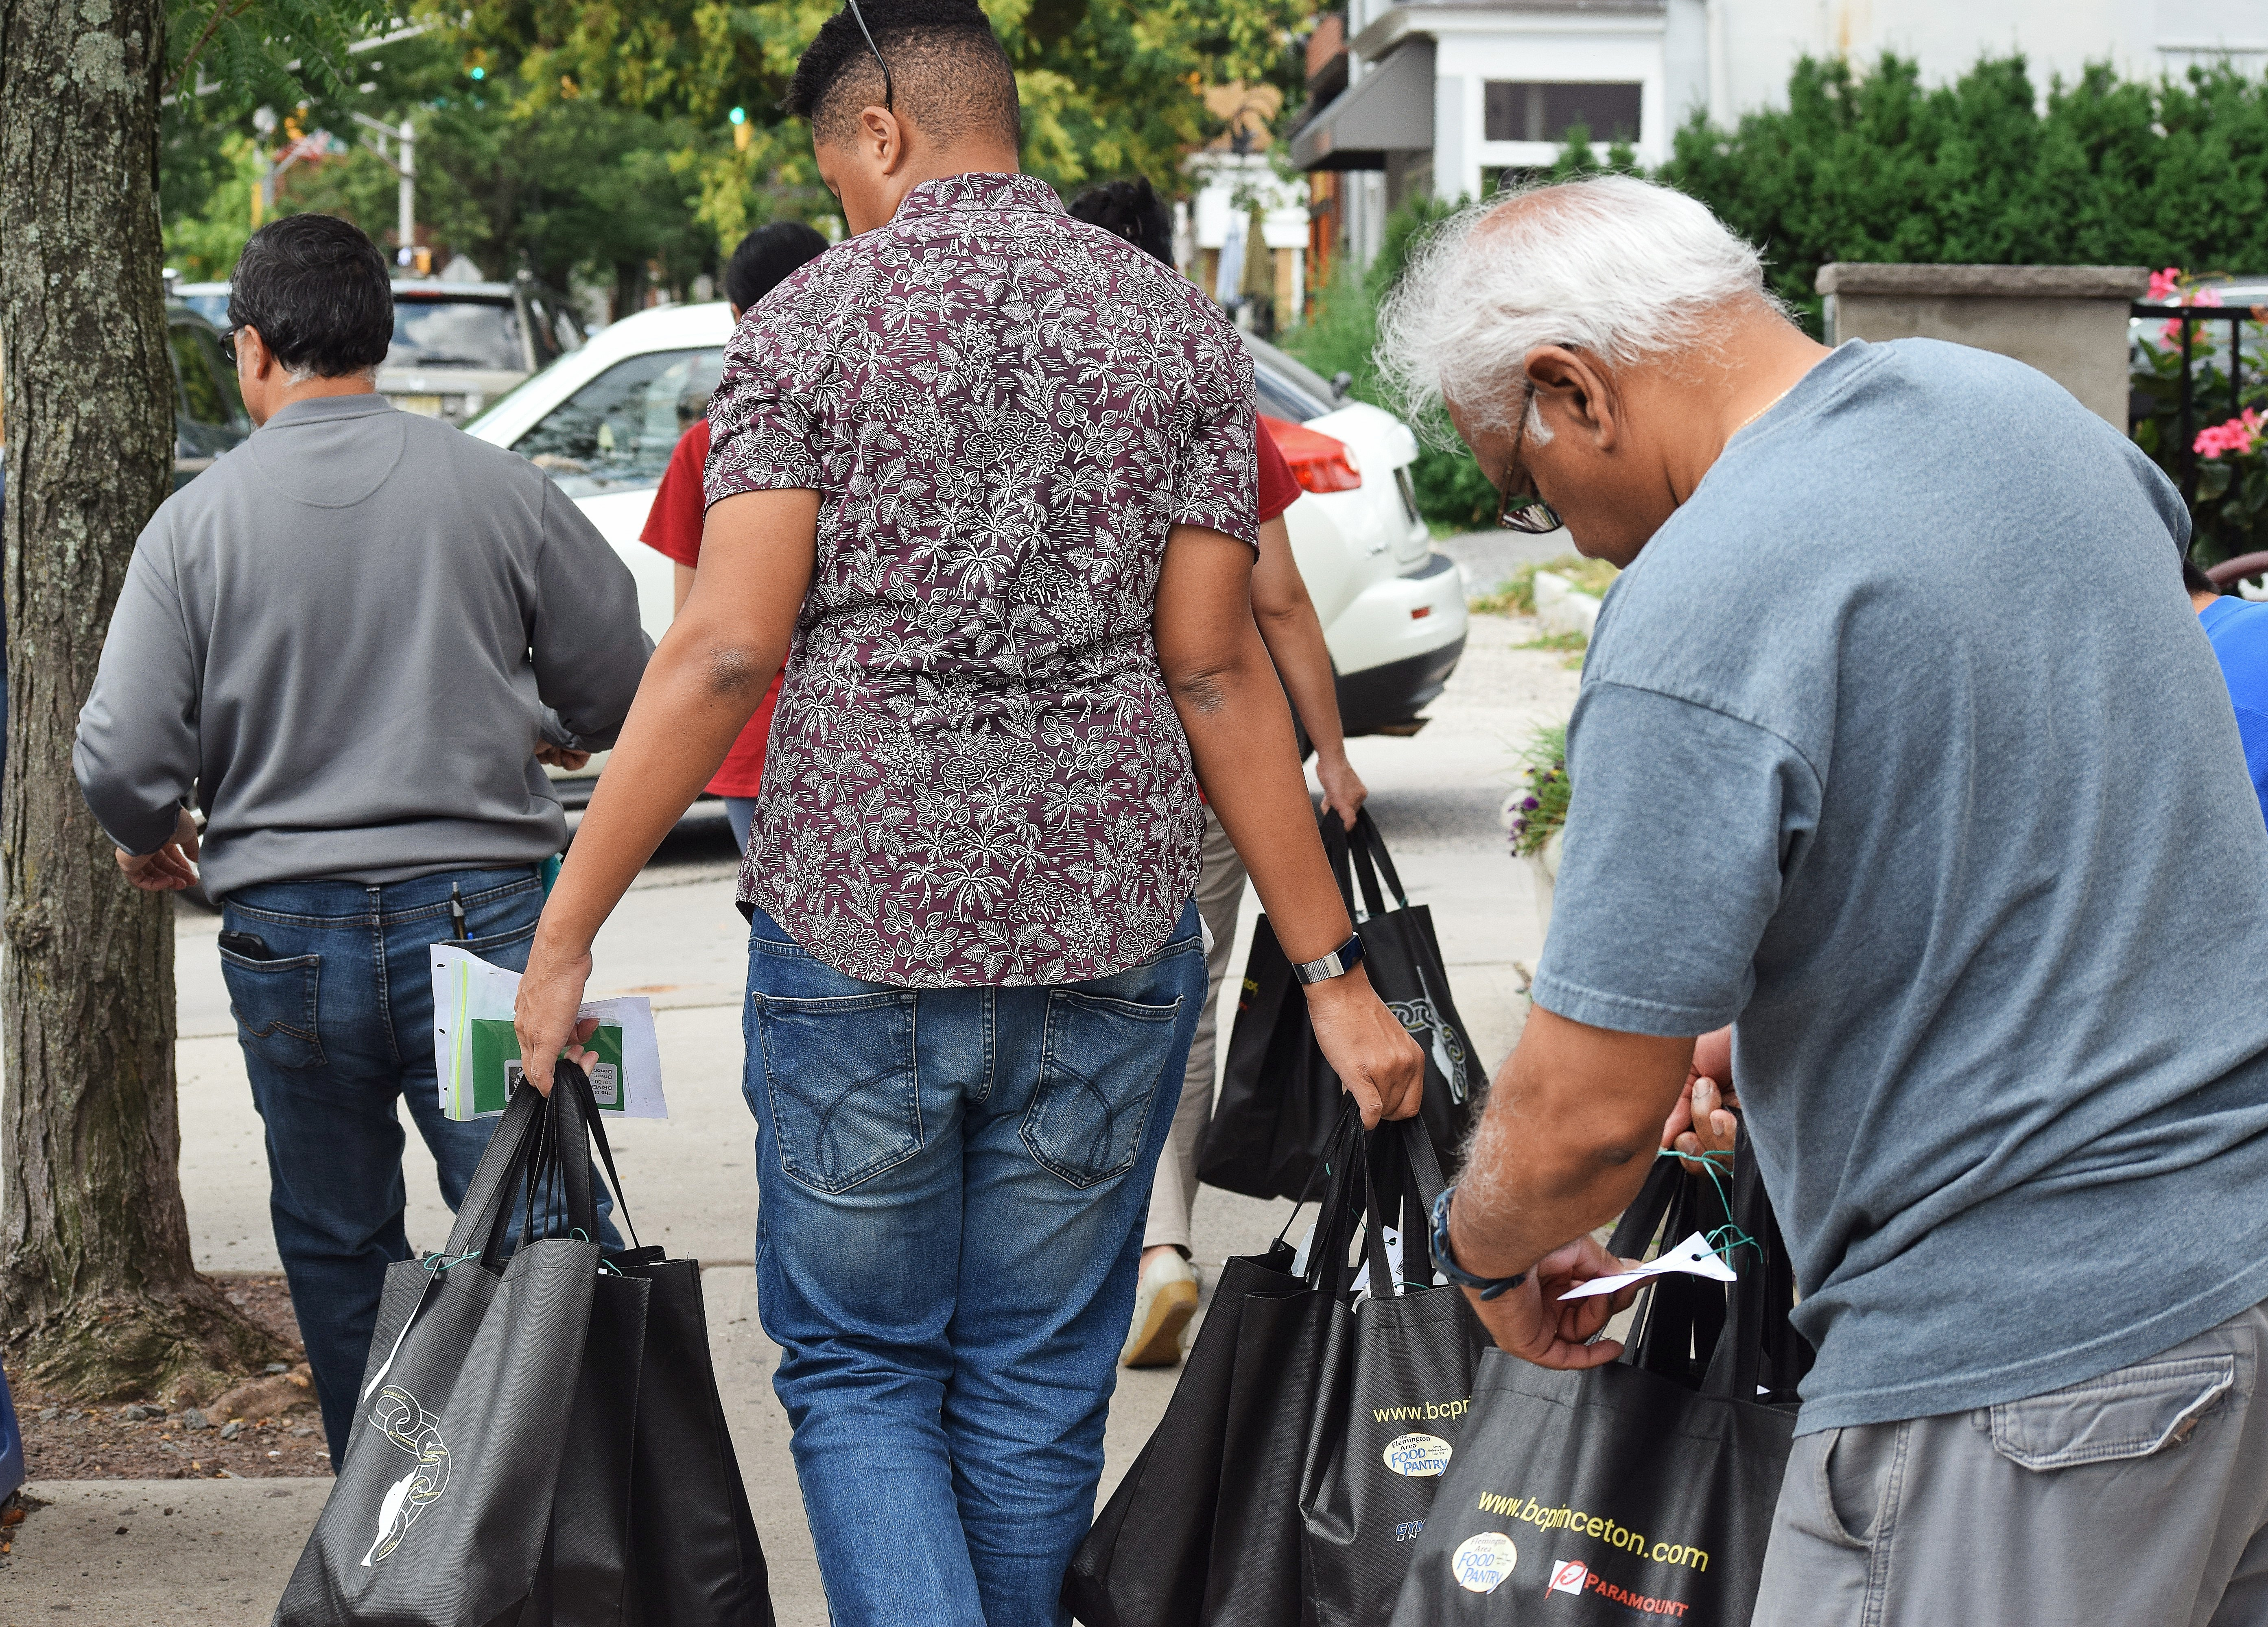
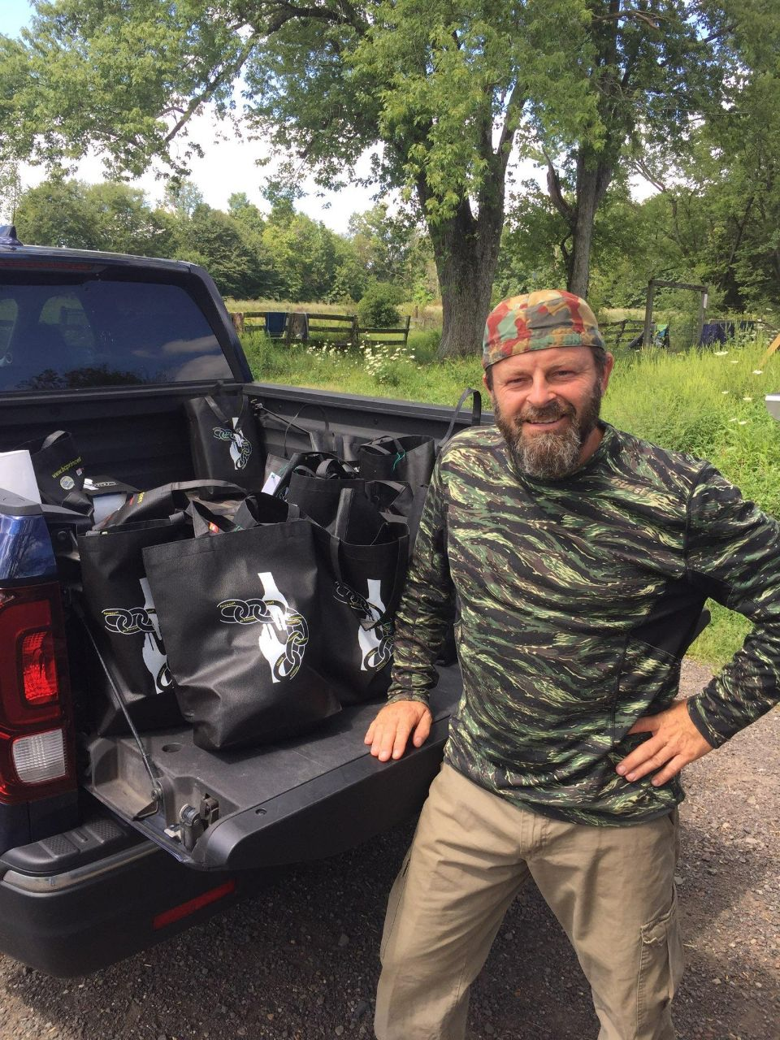
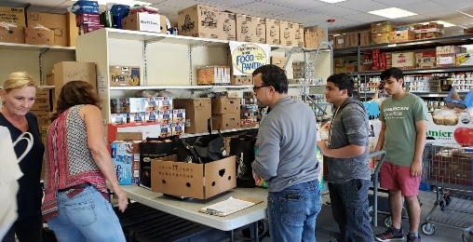
Checkpoint 2: Model Validation
Who are your clients/users? Sketch your user.
What are their pain points? How does your solution solve them?
        Can it be scaled?
Donors
Volunteers / Drivers
Recipients
Notes:
Include Details:
Donors Who they are for each project
Driver – Project Managers choice , Long term Vetted Orgs
Recipients
NGO, Social Services Offices
Schools/College Girls
Underprivileged
Village Women/girls
Marginalized and lower middle-class populace

Slide 11

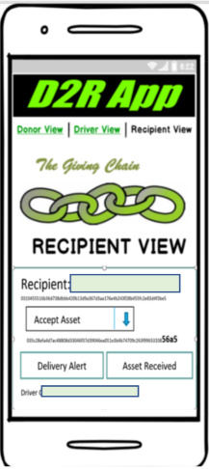

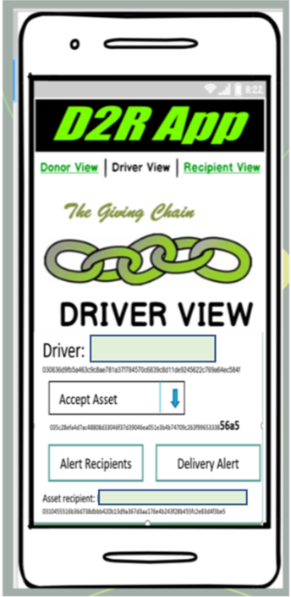




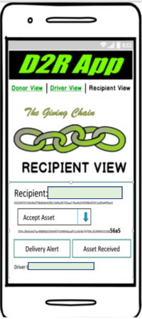
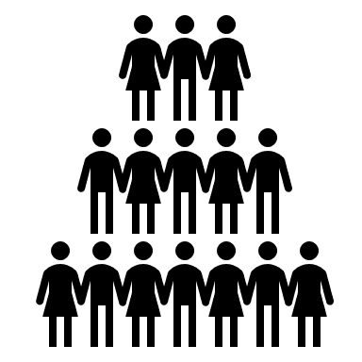
Checkpoint 3: Technical Modeling
Create Asset for Pick upP/U
Recipient Tag
Transporters Tag
Notes:
In our technical model Donors activate the giving chain with an application a cell phone. They create an asset with a unique tag. The blockchain tracks the ownership of the tag ( donor to driver to recipient) . We will get a closer look at the technology later.

Slide 12
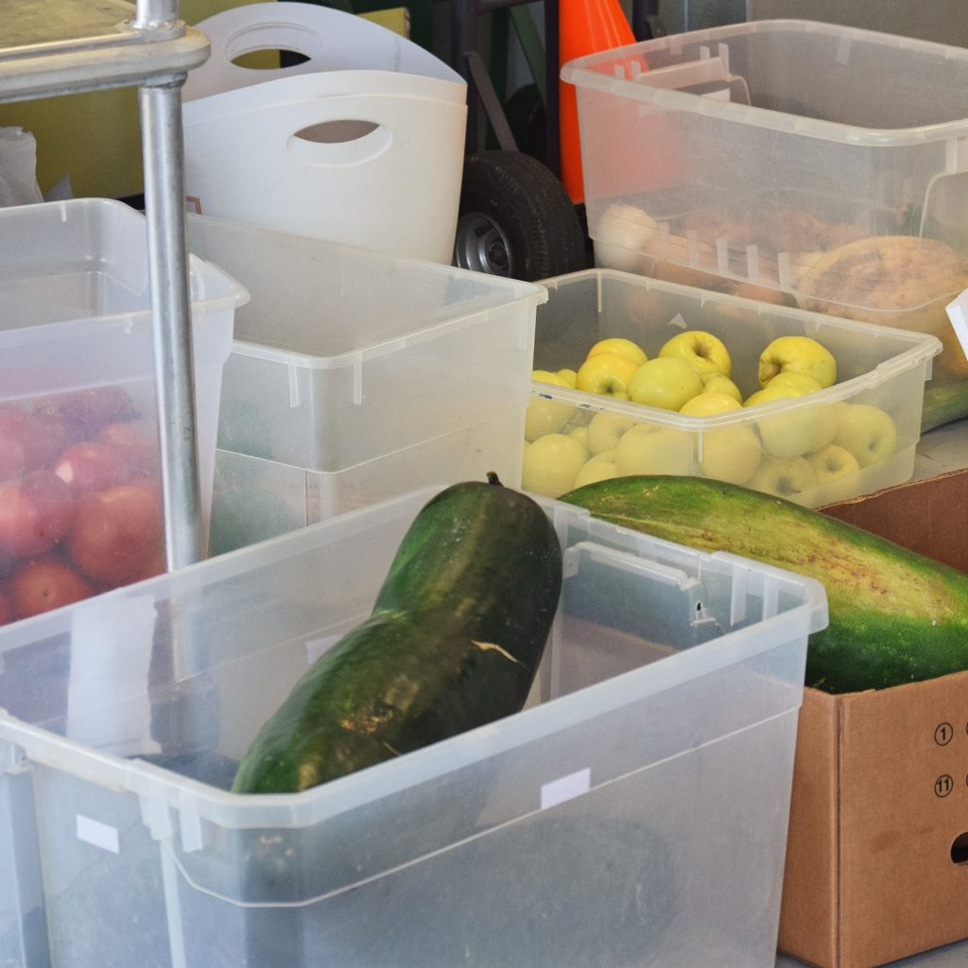
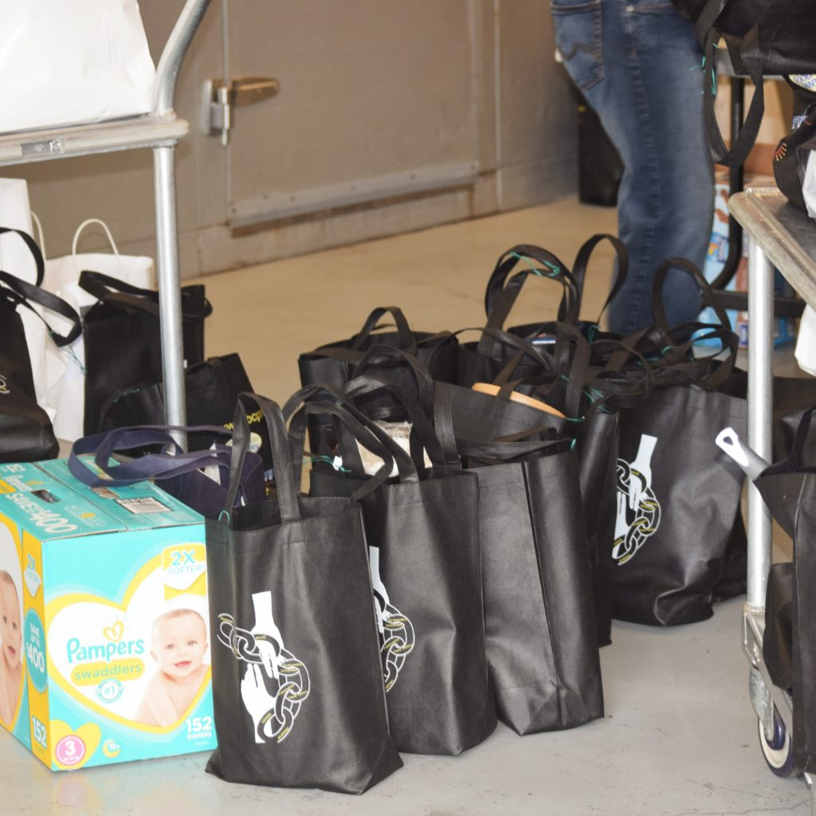
Checkpoint 4 : Impact Measurement
650 Lbs. of Food to Local Food Banks
55 “Giving Bags to Homeless Veterans
Notes:
In our technical model Donors activate the giving chain with an application a cell phone. They create an asset with a unique tag. The blockchain tracks the ownership of the tag ( donor to driver to recipient) . We will get a closer look at the technology later.

Slide 13
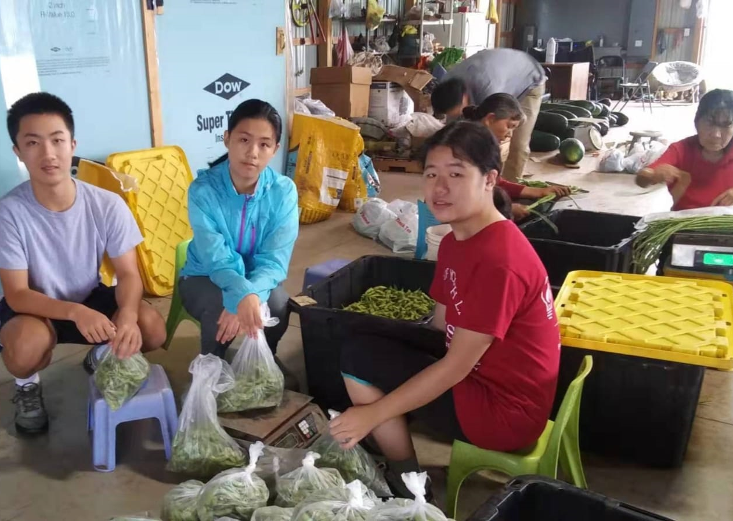
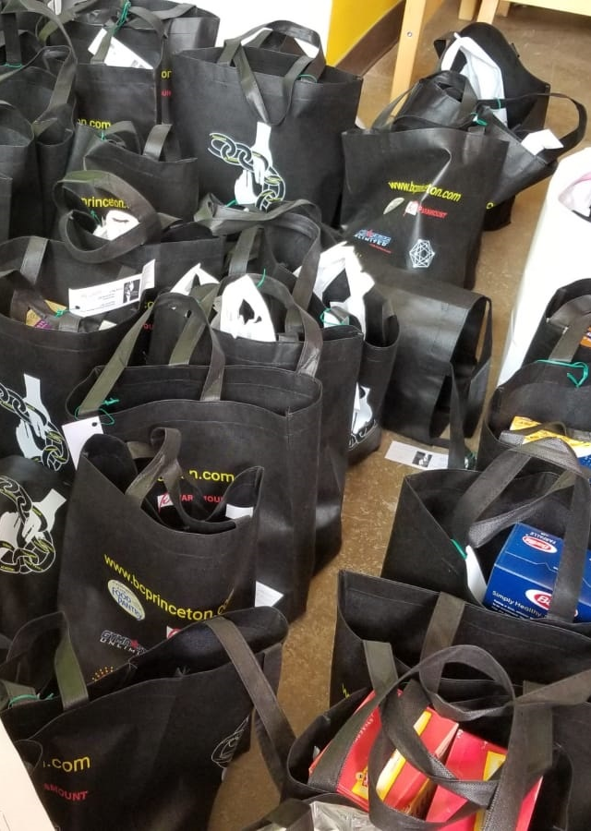

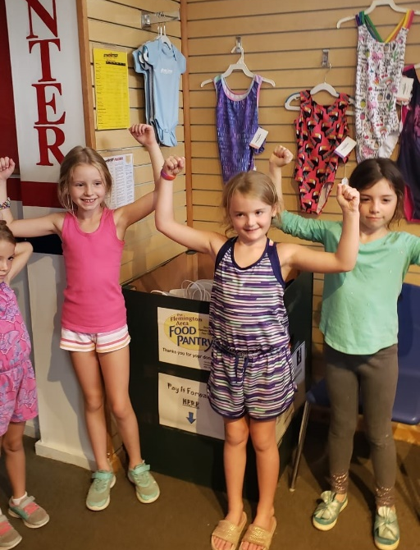
Project Day Collection 8/2019

Slide 14

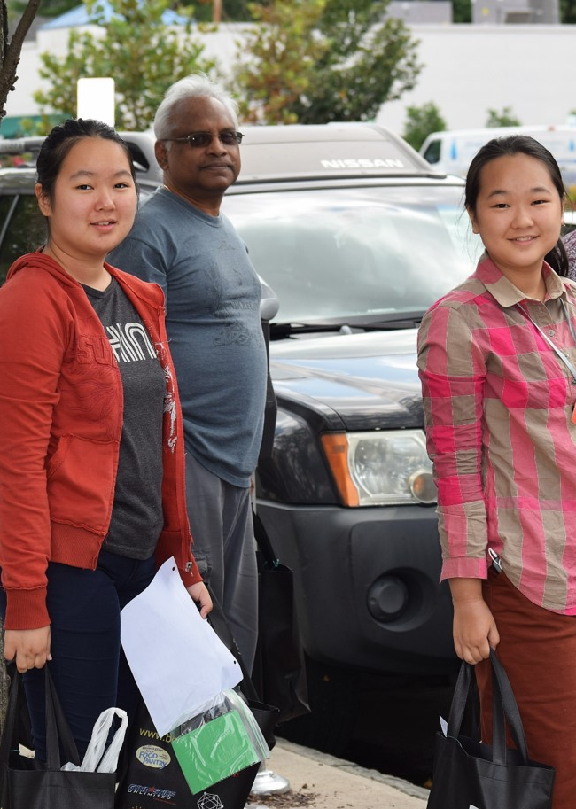
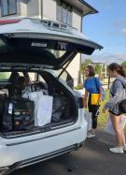
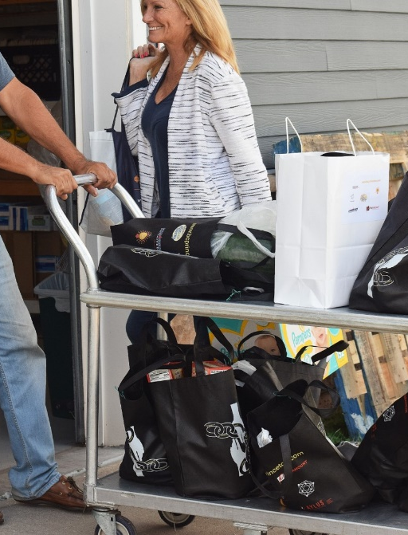
Project Day Transportation 8/2019

Slide 15
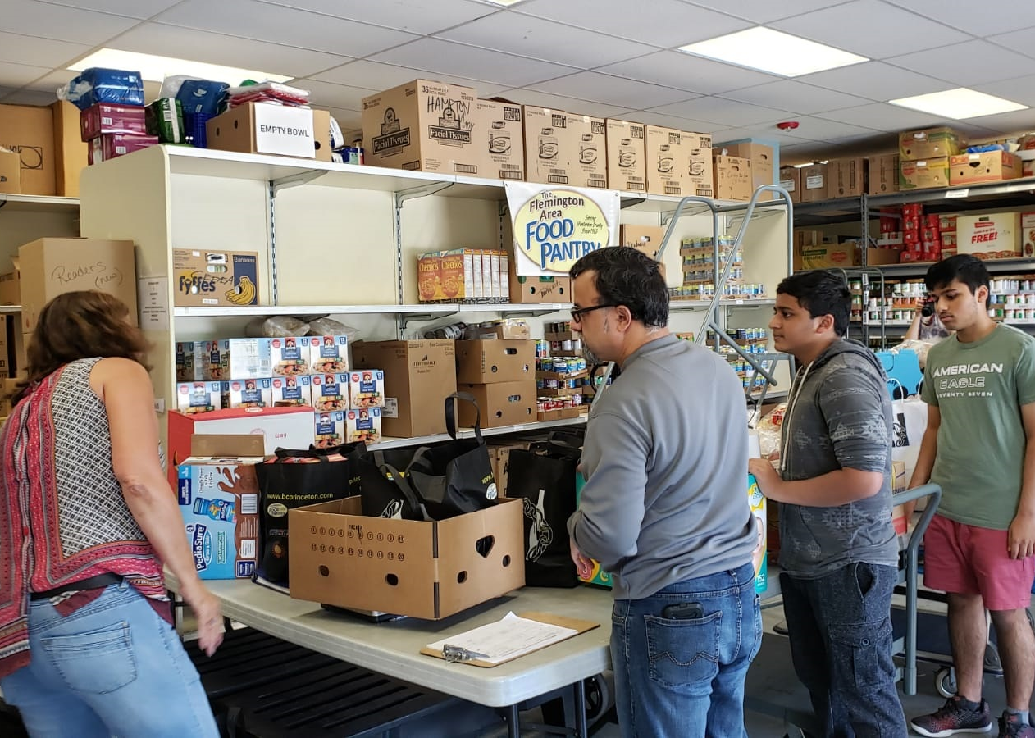
Project Day Delivery 8/2019

Slide 16

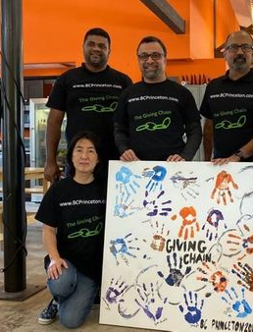
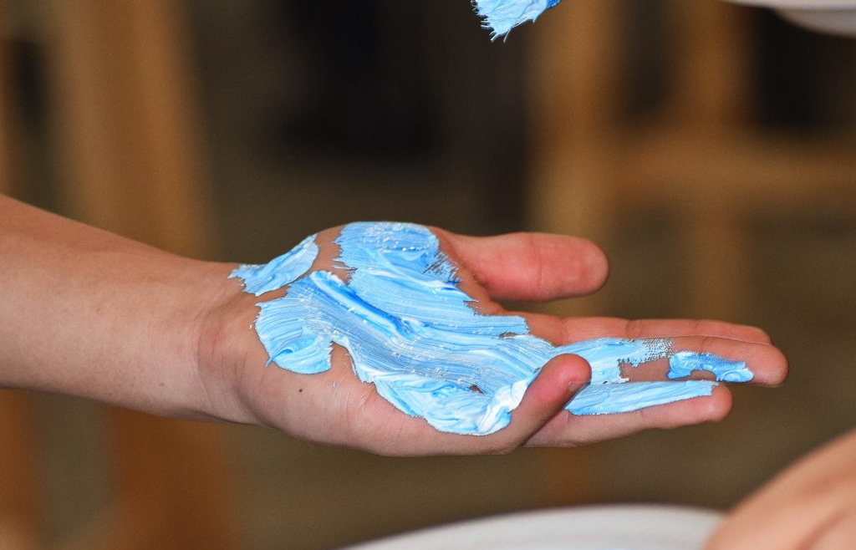

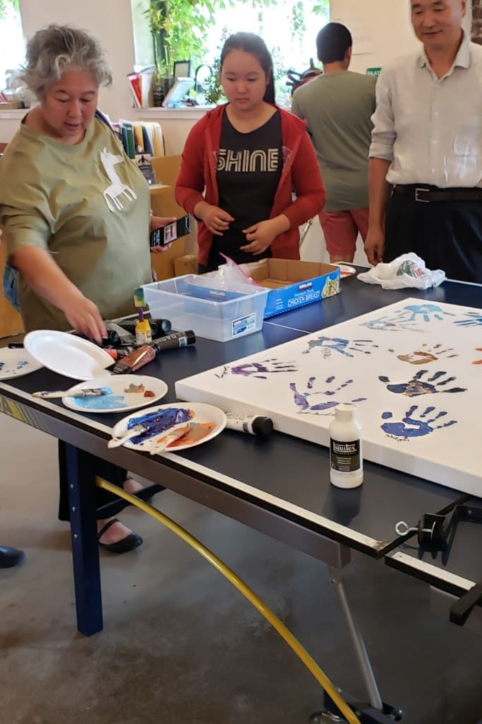
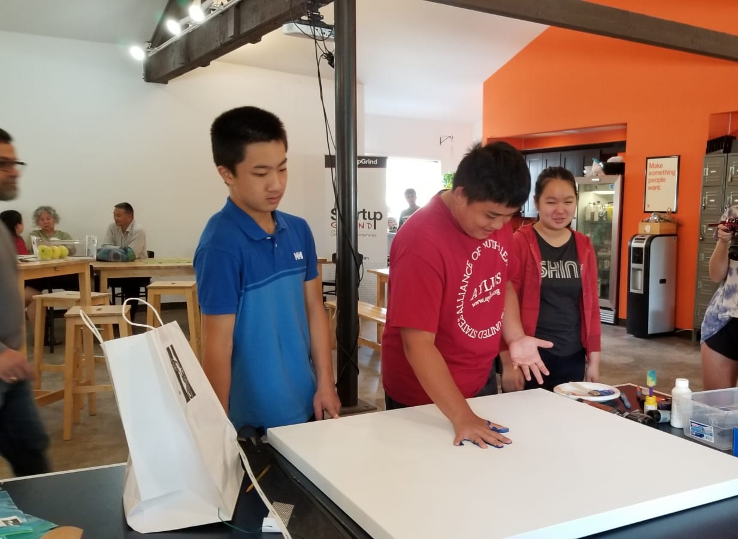
Project Day 8/2019

Slide 17
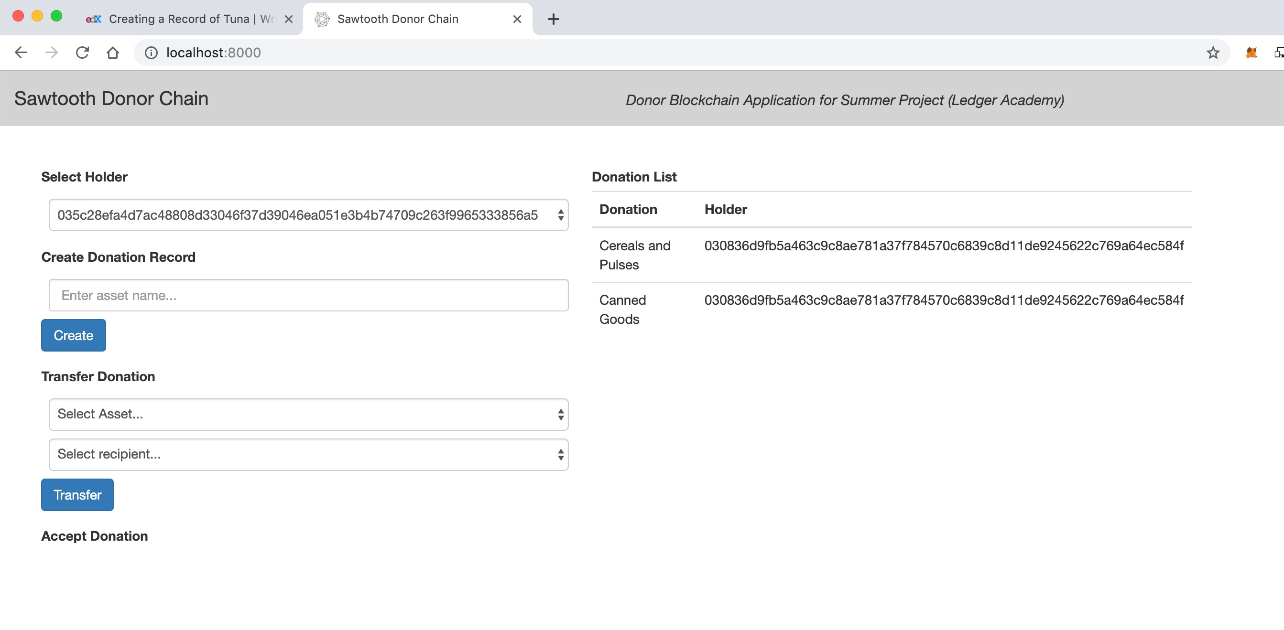
Checkpoint 5 : Code
Notes:
In our technical model Donors activate the giving chain with an application a cell phone. They create an asset with a unique tag. The blockchain tracks the ownership of the tag ( donor to driver to recipient) . We will get a closer look at the technology later.

Slide 18
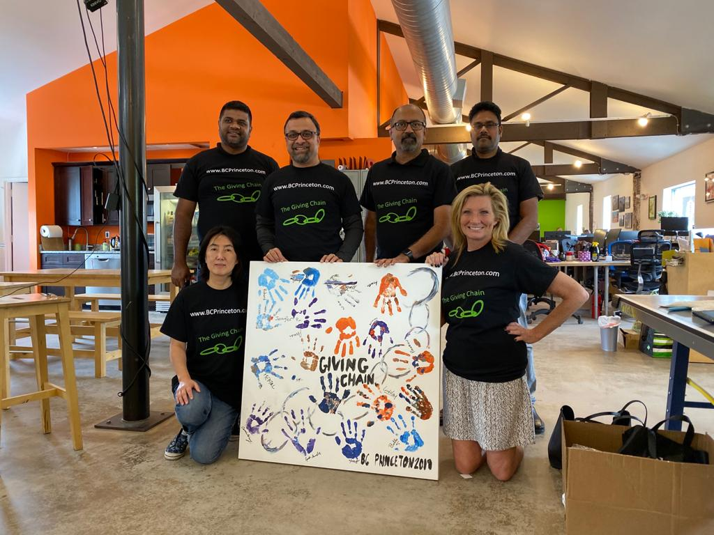
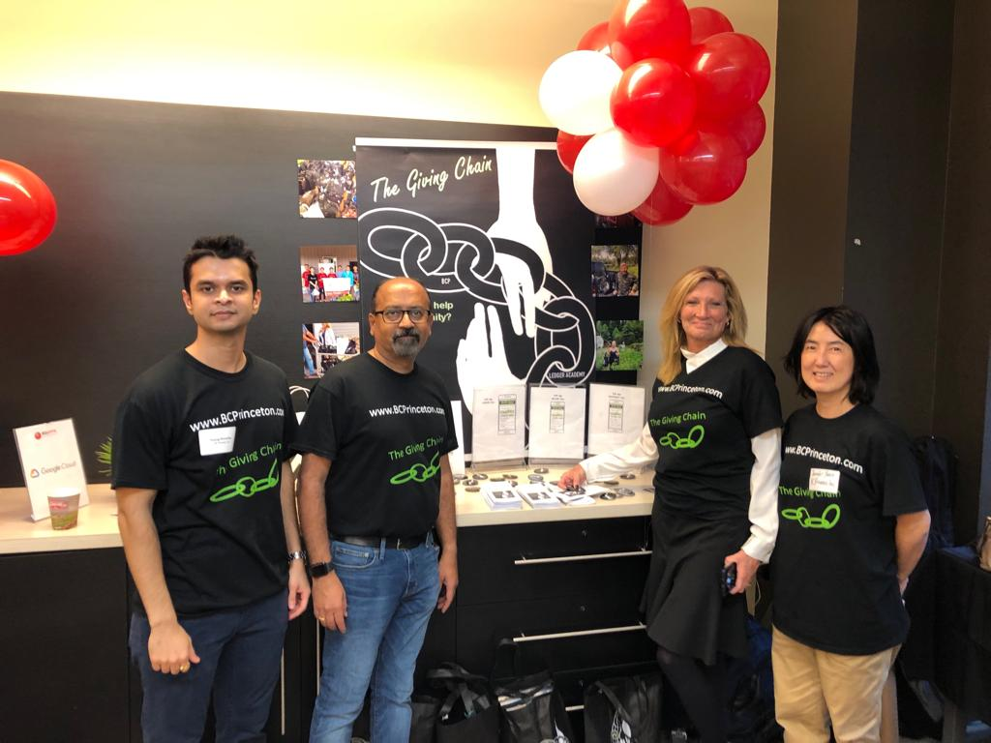
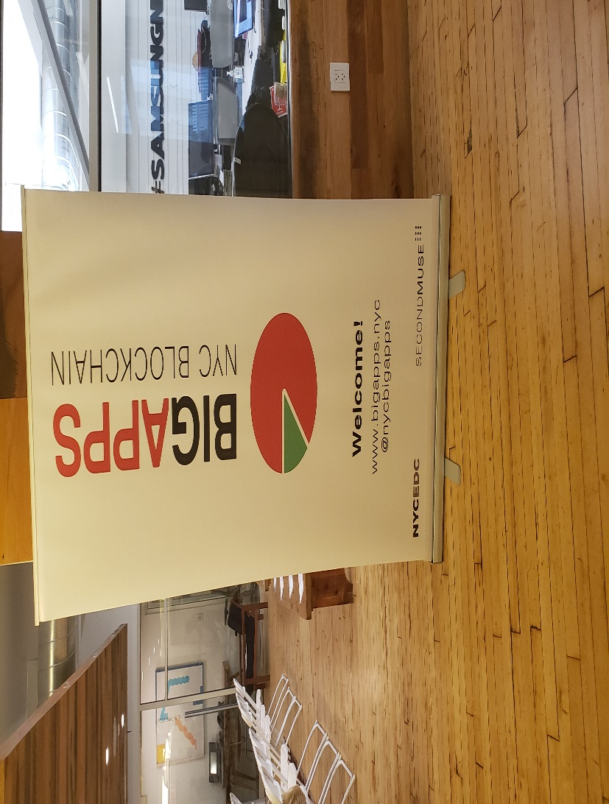
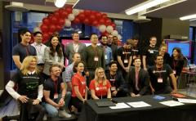
Checkpoint 6 : Final Submission

Slide 19
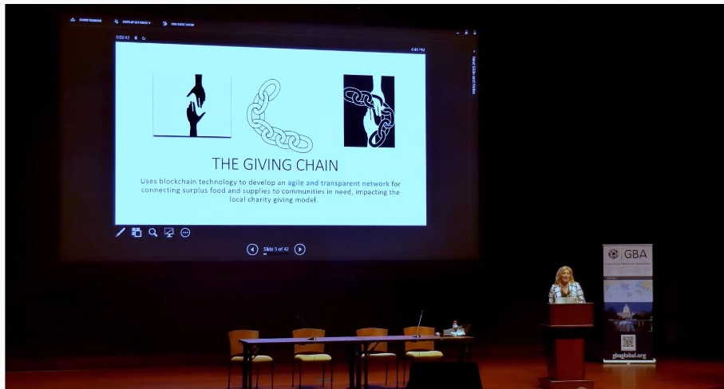
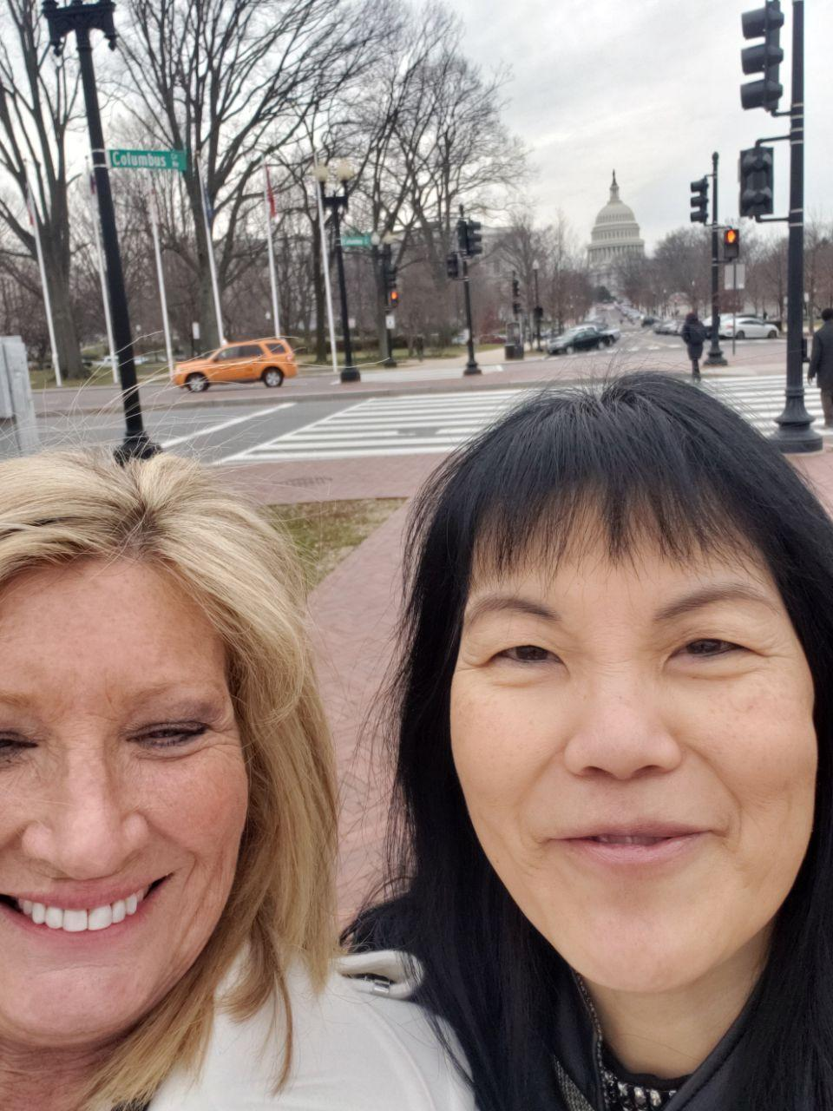
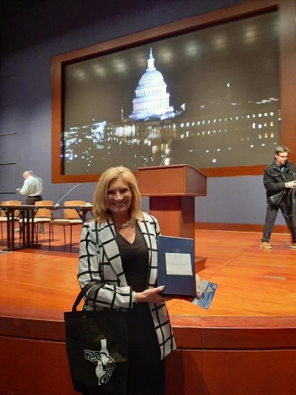
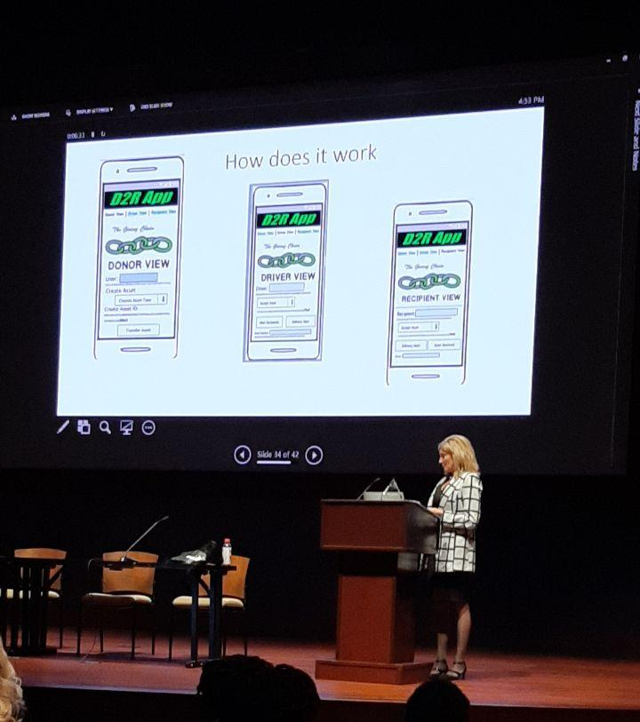
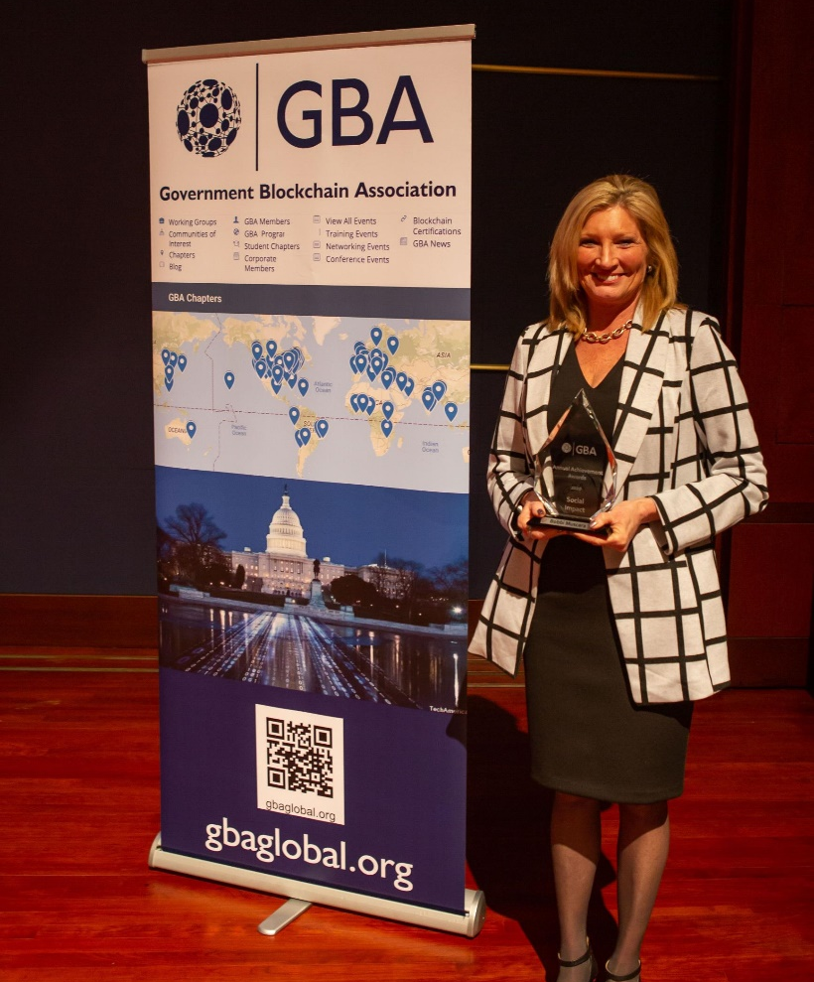
GBA Awards 2020 Government Blockchain Award for Social Impact

Slide 20
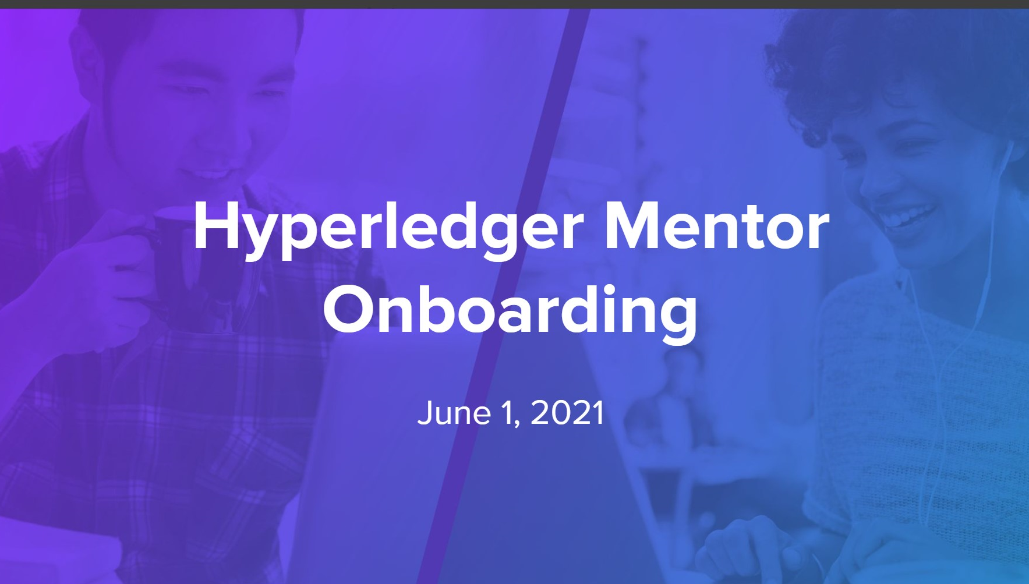
Hyperledger 2021 Mentorship Program
Sponsor: Linux Foundation

Slide 21
Mentorship Program Goals
● To connect new developers eager to learn with experienced developers interested in teaching/coaching
● To provide structured guided hands-on learning opportunities for new open-source developers and researchers
● To help mentees learn and enhance their technical skills, and to inspire them to become long-term active contributors
● To create a pipeline to a diverse, well-educated developer pool and to strength Hyperledger projects and community
●To coach how to participate effectively in open-source community (collaborative culture, tooling, infra, etc.)
●To gain valuable insight into new developer onboarding processes and how to lower the barriers to entry.

Slide 22
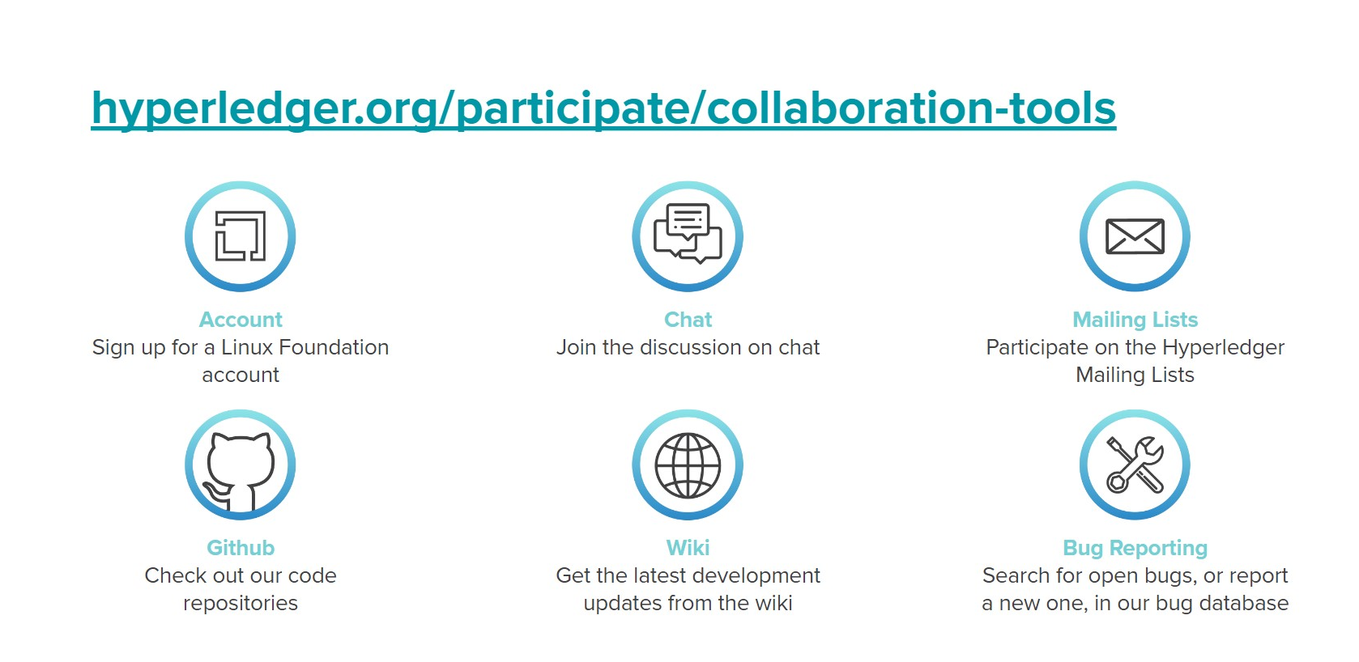

Slide 23
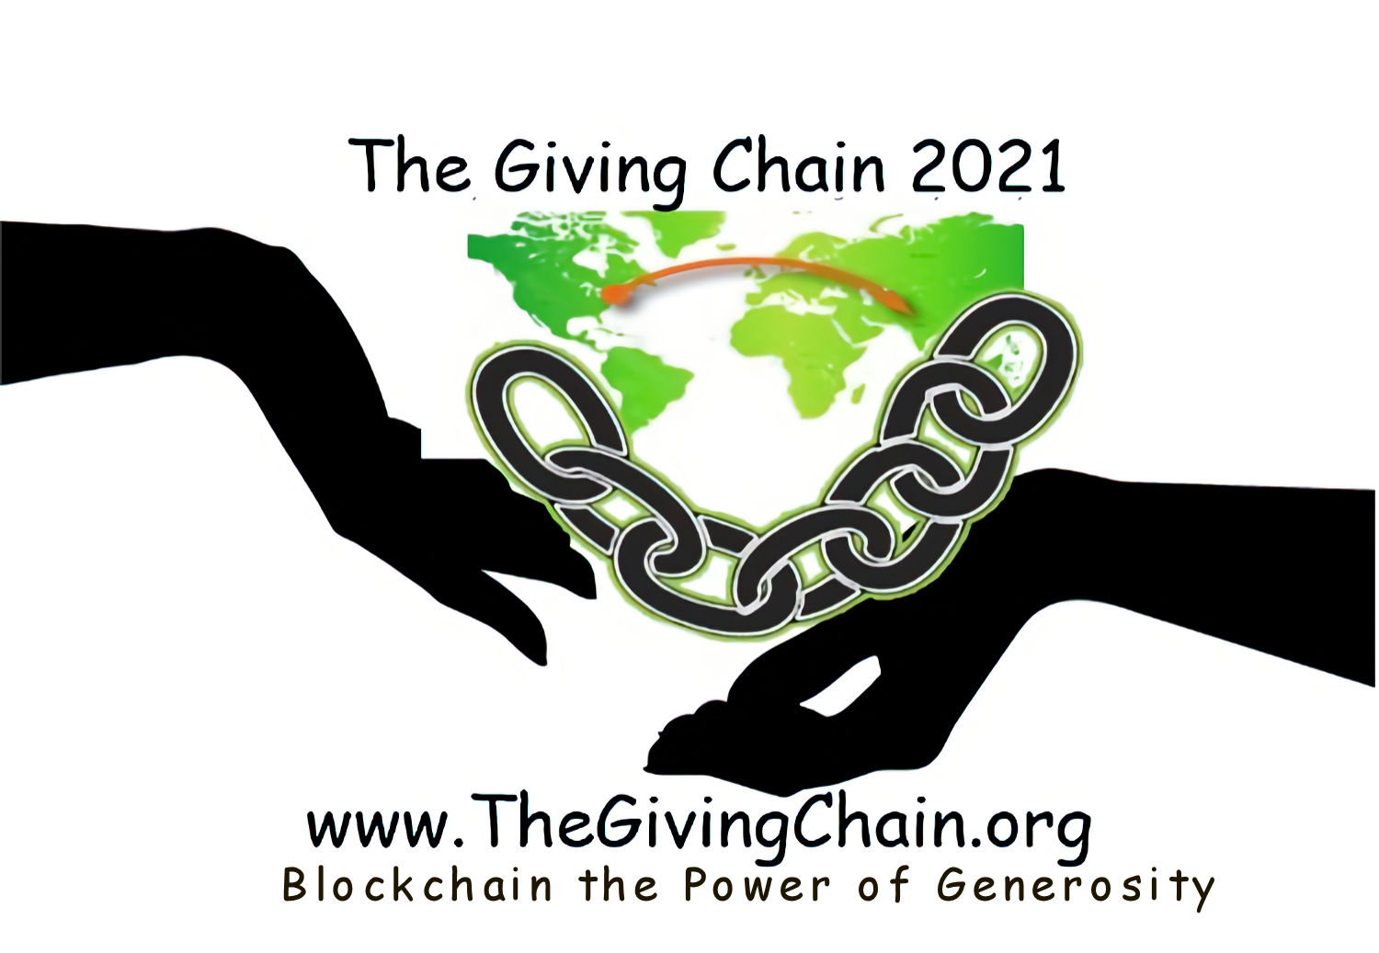
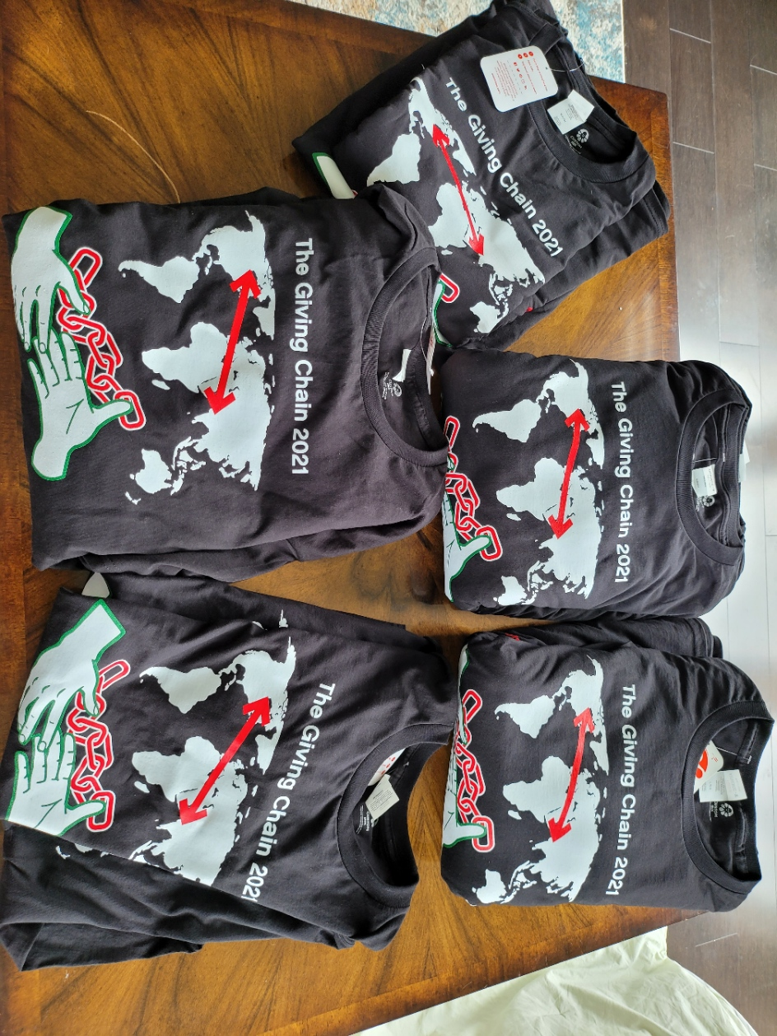
2021 Linux Foundation Hyperledger Giving Chain Mentee’s
Hardik Gupta
Project Manager – Hyperledger Giving Chain
Member OF THE Learning Materials Working Group
The Giving Chain
Mentee / Project Management / Technical Lead
Madhu Bhatia
Project Manager – Hyperledger Giving Chain
DLT Talent program of Frankfurt School of Finance and Management Blockchain Center
2021 LiFT Scholarship Women in open-source
Research Scholar /Trainer
Mona Rassouli
Developer/ Marketing(social media)/Documentation/ Articles or Blogs
mr1241@scarletmail.rutgers.edu
Technology Lead

Slide 24

The Giving Chain
2021
Introduction
  2021 Project Checkpoints
  Speakers:
    Hardik
    Madhu
    Cover the two new projects:
    1. Madhu India Women

Slide 25
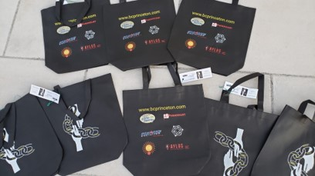
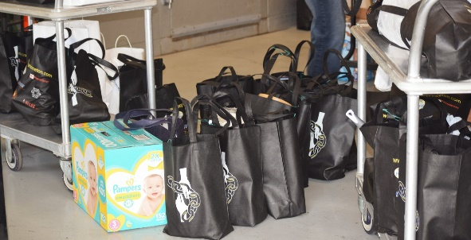
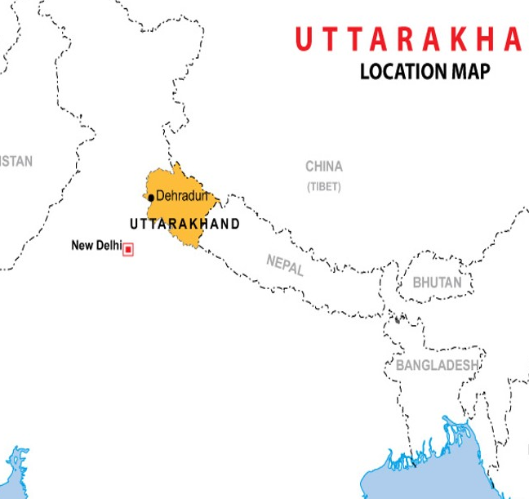
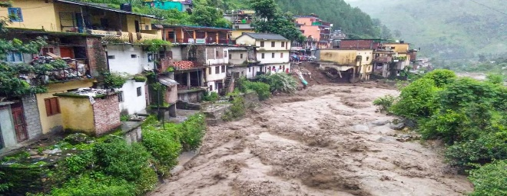
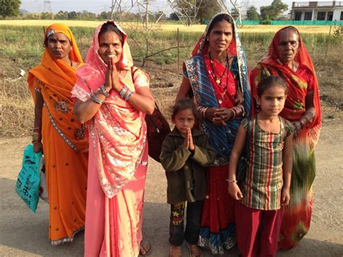
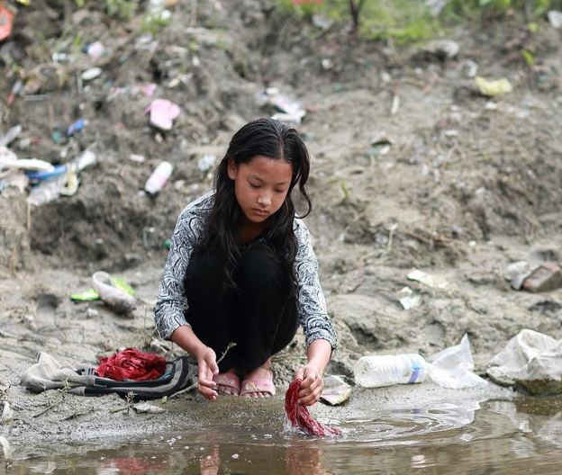
Project 2021
Checkpoint 1
Giving Chain Princeton
Giving Chain India / Uttarakhand
Giving Chain India Women
Notes:
An estimated 355 million Indian women and girls must find ways to cope with monthly menstrual hygiene. Most o A majority of rural women in India employ clothes and rags for feminine hygiene. These materials might predispose women to reproductive tract infections since it may be difficult for them to keep their used napkins clean and free of harmful bacteria. Washing reusable feminine products with soap and drying them in sunlight may be difficult due to lack of water, private facilities, and cultural taboos associated with menstruation.

Slide 26
Giving Chain need a PM
Each project needs to start with a project manager who has dual roles as the manager of the business flow and as the administrator for the technical registration.

Slide 27
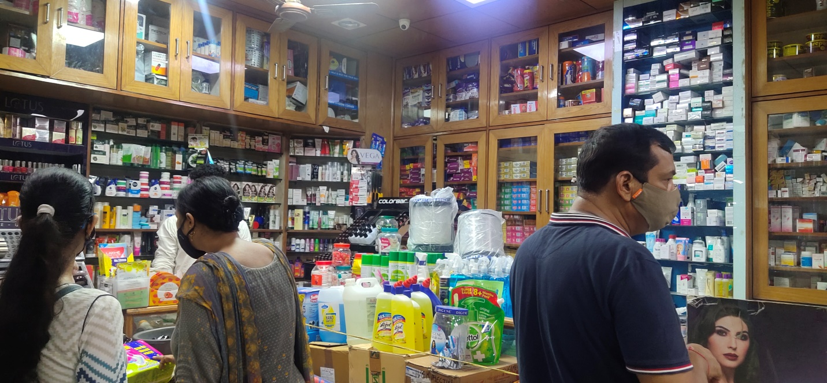
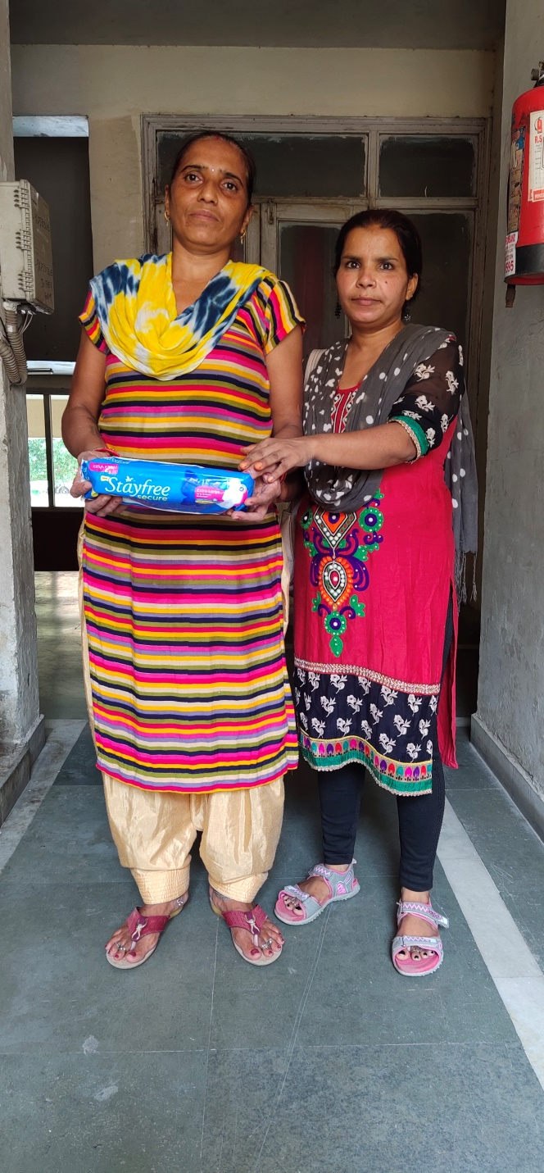
Giving Chain India Women

Slide 28


Checkpoint 2: Model Validation
Who are your clients/users? Sketch your user.
What are their pain points? How does your solution solve them?
        Can it be scaled?
Donors
Volunteers / Drivers
Recipients
Notes:
Include Details:
Donors Who they are for each project
Driver – Project Managers choice , Long term Vetted Orgs
Recipients
NGO, Social Services Offices
Schools/College Girls
Underprivileged
Village Women/girls
Marginalized and lower middle-class populace

Slide 29
Checkpoint 2: Model Validation
Business Flow
Donors
Farmers
Individuals
Community / Church Groups
Volunteers / Drivers
Pickup / Deliver:
Local volunteers
Community / Groups Transport
Recipients
Food Banks
NGO’s
Social Services Offices
Individuals (off the grid)

Slide 30


Checkpoint 3: Technical Modeling
Platform Managers
Project Manger acts as Administrator making enrollment decisions.
Role
1. Project Manager
2. Donor
3. Transporter
4. Recipient
Registration Process
Notes:
In our technical model Donors activate the giving chain with an application a cell phone. They create an asset with a unique tag. The blockchain tracks the ownership of the tag ( donor to driver to recipient) . We will get a closer look at the technology later.

Slide 31


Checkpoint 3: Technical Modeling
Donors
NFT
Picture of Donation
Picture into Smart QR Code
Description and Alert
Hash
Notes:
In our technical model Donors activate the giving chain with an application a cell phone. They create an asset with a unique tag. The blockchain tracks the ownership of the tag ( donor to driver to recipient) . We will get a closer look at the technology later.

Slide 32

Checkpoint 3: Technical Modeling
Transporters
Respond to Alert
Pick up Donation
NFT
Get Location and Deliver
Digital picture added to QR Code
Hash
Notes:
In our technical model Donors activate the giving chain with an application a cell phone. They create an asset with a unique tag. The blockchain tracks the ownership of the tag ( donor to driver to recipient) . We will get a closer look at the technology later.

Slide 33

Checkpoint 3: Technical Modeling
NFT
Recipient
Receives Alert / Accepts
Hash
NFT becomes Immutable Record of Donation!!!
Accepts donation / Smart QR Code and picture.
Accepts Donation / Takes Digital Picture
Takes Digital Picture / NFT
Notes:
In our technical model Donors activate the giving chain with an application a cell phone. They create an asset with a unique tag. The blockchain tracks the ownership of the tag ( donor to driver to recipient) . We will get a closer look at the technology later.

Slide 34
Checkpoint 4 : Impact Measurement
Notes:
In our technical model Donors activate the giving chain with an application a cell phone. They create an asset with a unique tag. The blockchain tracks the ownership of the tag ( donor to driver to recipient) . We will get a closer look at the technology later.

Slide 35

Checkpoint 5 : Code
Notes:
In our technical model Donors activate the giving chain with an application a cell phone. They create an asset with a unique tag. The blockchain tracks the ownership of the tag ( donor to driver to recipient) . We will get a closer look at the technology later.

Slide 36


Slide 37
Checkpoint 6 : Final Submission
November 17thTrade Finance Update presentation

Slide 38
Define Project and team members.
The Giving Chain
Business Team
Technical Team
Create Social Media
Create a Git Hub Repo
Develop Code
Run Projects
Research Platforms
Raise Funds for Project and Platform
Notes:
Looking at the project it was decided to break out into to teams Business and Technical. Most people who attended the meetings were on both teams, The teams can run through several sub projects and individuals can be om many teams.

Slide 39



Business Development
Web Site and Donations
Donate to Project
https://gofund.me/b0840750
Tee-shirt Sales
Institutional Investors
Corporate Funding (For the project development): https://crowdfunding.lfx.linuxfoundation.org/projects/hyperledger-the-giving-chain
General Funding (For the use of buying goods): https://crowdfunding.lfx.linuxfoundation.org/initiative/fabcd0b5-cecb-452b-a7e1-55bf31065c4a
The General Funds will be distributed on Project Day.

Slide 40




Business Development
Date for Project Labor Day weekend September 3, 4 and 5, 2021
Social Media (Advertise The Project)
  Be a Social Media pioneer
  https://www.facebook.com/TheGivingChain
  https://www.instagram.com/thegivingchain/
  https://t.me/BCPrinceton
  https://twitter.com/bc_princeton
  LinkedIn Group: ​https://www.linkedin.com/groups/9055378/https://wiki.hyperledger.org/pages/viewpage.action?pageId=51613841
To Do:
  Fund raiser events
  Tee Shirt Sales and Distribution
  Marketing Materials

Slide 41




The Giving Chain
Test Run, Princeton
August 28th

Slide 42



Food Drive September 5th

Slide 43




Slide 44


shop from where the sanitary napkins are purchased.
Location is Ghaziabad, U.P, India

Slide 45


Recipient:- The sanitary napkins are distributed to the labour workers.
Location Ghaziabad, U.P, India

Slide 46
Firefly Setup (Mac/Linux)
These were my steps and how I got the CLI to run.
These are my steps for Mac and for Linux VM using virtual box. Should also work for windows, but I have not tried it on windows.
1. Open terminal
2. Run ‘go version’ to check whether you have installed go
3. If not please install the latest version which is 1.17 now
4. un ‘go version’again after install to double check installation success
5. Install Docker: https://docs.docker.com/get-docker/
6. To install CLI as per Firefly docs run: go install github.com/hyperledger-labs/firefly-cli/ff@latest
7. To double check install run ls ~/go/pkg/mod/github.com/hyperledger-labs/
8. It should return firefly-cli@v0.0.29
9. For mac the default path for go install was my desktop. It may be in another location depending on your system. Either way from cd into the go directory. cd go
10. From within this directly you should see bin and pkg directories. ‘ff’ should be present within the bin. cd bin
11. This next part is key. You must run the following to declare the path to Go and the bin within it. On both Linux/Mac it did not pickup the binary command ‘ff’ for me otherwise. These are to be copy and pasted directly into terminal: export GOPATH="$HOME/go" PATH="$GOPATH/bin:$PATH"
12. Now from desktop/go/bin directory run the following for firefly cli to launch: ff -h
13. Now we can begin running firefly commands.
Resources:
https://www.youtube.com/watch?v=Ft1A9B9GPhU
https://wiki.hyperledger.org/display/labs/FireFly
https://github.com/hyperledger-labs/firefly-cli https://labs.hyperledger.org/firefly/gettingstarted/setup_env.htm
The Giving Chain 2021

Slide 47
Checkpoint 1: Impact Opportunity
India - Uttarakhand
  Select your challenge.
Develop an agile & transparent network for connecting supplies and aid to flood damaged communities in need. To create a decentralized system that collect needed supplies from local resources and crowdfunding efforts and distributes these resources to flood victims.
  Define the scope of problem
For our summer project, we are limiting the POC to Uttarakhand flood victims . Supplies collected and purchased to be picked up by transportation volunteers who will transport food supplies to agreed upon drop off point .
  Why is blockchain needed to solve this problem
A supply chain model has been determined to be the best way to initiate, track and deliver supplies.
Notes:
We asked ourselves the question with what we know about blockchain and social impact projects, what can we do to have an impact in our community
Philanthropy and remittances (donation traceability, aid transparency, digital currencies in aid and development, governance and accountability)
Financial empowerment (financial inclusion, microfinance, microinsurance)
Identity and land rights (refugee assistance, land ownership documentation)
Governance and democracy (fighting censorship and fake news, voting rights and protections, election integrity)
Supply chain and environmental protections (sustainable supply chain, fair trade, ethical sourcing, fair labor practices
Introduction: Project and Team
The Giving Chain 2019
Hyperledger Mentorship Program
Project Overview
Teams (Expectations) (Focus)
Introduction from Members on Call

Slide 48
Checkpoint 1: Impact Opportunity
India - Women
  Select your challenge.
Develop an agile & transparent network for connecting supplies for the women in crisis in India. Create a dignified distribution system for hygiene products to women by crowdfunding, purchasing and distributing these resources to women in rural areas in India.
  Define the scope of problem
For our summer project, we are limiting the POC to Rural area in India. Supplies purchased will be e picked up by transportation volunteers who will transport hygiene supplies to drop off point in rural areas.
  Why is blockchain needed to solve this problem
A supply chain model has been determined to be the best way to initiate, track and deliver supplies.
Notes:
We asked ourselves the question with what we know about blockchain and social impact projects, what can we do to have an impact in our community
Philanthropy and remittances (donation traceability, aid transparency, digital currencies in aid and development, governance and accountability)
Financial empowerment (financial inclusion, microfinance, microinsurance)
Identity and land rights (refugee assistance, land ownership documentation)
Governance and democracy (fighting censorship and fake news, voting rights and protections, election integrity)
Supply chain and environmental protections (sustainable supply chain, fair trade, ethical sourcing, fair labor practices
Introduction: Project and Team
The Giving Chain 2019
Hyperledger Mentorship Program
Project Overview
Teams (Expectations) (Focus)
Introduction from Members on Call

Slide 49
Checkpoint 2: Model Validation (questions)
Who are your clients/users? Sketch your user.
What are their pain points? How does your solution solve them?
        Can it be scaled?
Donors
Volunteers / Drivers
Recipients

Slide 50

Checkpoints 2 Model Validation
Princeton
Donors
Farmers
Individuals
Volunteers / Drivers
Pickup / Deliver
Local Transporters
Recipients
Food Banks

Slide 51
Checkpoints 2 Model Validation
India - Uttarakhand
Donors
Farmers
Restaurants
Individuals
Volunteers / Drivers
Pickup / Deliver
Local Transporters
Recipients
Flood Victims
Food Banks

Slide 52

Checkpoints 2 Model Validation
India - Women
Donors
CROWDFUNDING EFFORTS
Individuals
Community Group
Volunteers / Drivers
Pickup / Deliver
Local Volunteers
Community / Groups Transport
Shippers
Recipients
NGO, Social Services Offices
Schools/College Girls
Underprivileged
Village Women/girls
Marginalized and lower middle-class populace
Notes:
SWaCH, a self-governing organization that provides waste management services to citizens of Pune in west India, recently brought attention to the issue of waste pickers' exposure to infections and other health hazards due to handling feminine hygiene discards. They highlighted the lack of disposable bags for each used sanitary pad, making its disposal hazardous to both those who handle waste and the environment. Disposable sanitary napkins are seen littering dry riverbeds, roadsides, and streets.

Slide 53

Checkpoint 3 Business and Technical Modeling
Princeton: Business Model
Donors
Farmers
Individuals
Community / Church Groups
Volunteers / Drivers
Pickup / Deliver:
Local volunteers
Community / Groups Transport
Recipients
Food Banks
Social Services Offices
Individuals (off the grid)
Notes:
To connect donors with receipts
Capture and verify the quantity and transfer of donations
Track where donations are located at any time
Track where donation origin and destination but do not reveal their identity to the system.
The business model we defined created a dignified system that matches local individuals who want to donate with recipient in need. In our use case we match local New Jersey farmers who have excess produce in August with food insecure Veterans and local area food banks.

Slide 54

Checkpoint 3 Business and Technical Modeling
Princeton: Business Model
India - Uttarakhand
Donors
Farmers
Individuals
Community / Church Groups
Volunteers / Drivers
Pickup / Deliver:
Local volunteers
Community / Groups Transport
Recipients
Food Banks
Notes:
To connect donors with receipts
Capture and verify the quantity and transfer of donations
Track where donations are located at any time
Track where donation origin and destination but do not reveal their identity to the system.
The business model we defined created a dignified system that matches local individuals who want to donate with recipient in need. In our use case we match local New Jersey farmers who have excess produce in August with food insecure Veterans and local area food banks.

Slide 55
Checkpoint 3 Business and Technical Modeling
India - Women
Donors
Crowdfunding efforts
Individuals
Organizations
Church Groups
Volunteers
Pickup / Deliver:
Shipping Companies
Transporters
Recipients
NGO, Social Services Offices
Schools/College Girls
Notes:
To connect donors with receipts
Capture and verify the quantity and transfer of donations
Track where donations are located at any time
Track where donation origin and destination but do not reveal their identity to the system.
The business model we defined created a dignified system that matches local individuals who want to donate with recipient in need. In our use case we match local New Jersey farmers who have excess produce in August with food insecure Veterans and local area food banks.

Slide 56

Princeton and Uttarakhand : Technical Model
Create Asset for Pick upP/U
Recipient Tag
Transporters Tag
Notes:
In our technical model Donors activate the giving chain with an application a cell phone. They create an asset with a unique tag. The blockchain tracks the ownership of the tag ( donor to driver to recipient) . We will get a closer look at the technology later.

Slide 57


Checkpoint 3 Business and Technical Modeling
Princeton: Technical Business Model
Project India Women

