Slide 1

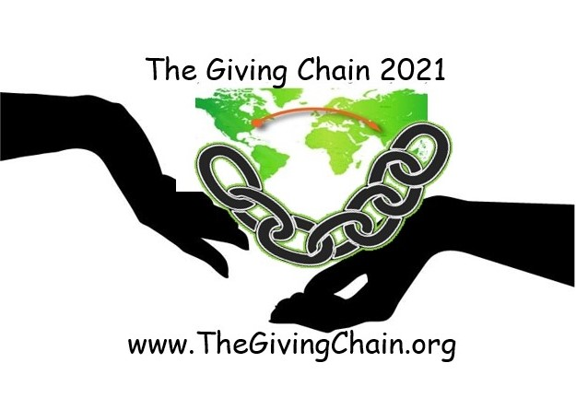
Welcome to The giving chain

Slide 2

AGENDA
Introduction
Recap Project
  Current Projects and Checkpoints
Business Team Updates
Technical Team Update
Getting Involved
Start a contribution EVENT !!!
Join Working Group call

Slide 3
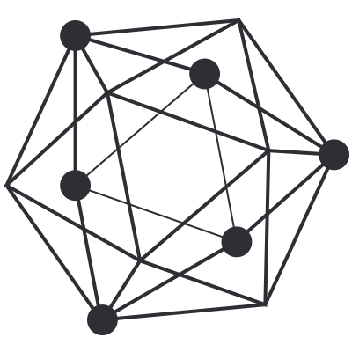

Introduction
Project Management Team
Bobbi Muscara
Project Manager – Hyperledger Giving Chain
Director Education Ledger Academy
Author of Linux Foundation Blockchain Courses for LFS171
Hyperledger TSC Member
Chair OF THE Learning Materials Working Group
Project
The Giving Chain
&
The D2R Application
Hardik Gupta
Project Manager – Hyperledger Giving Chain
Member OF THE Learning Materials Working Group
The Giving Chain
Mentee / Project Management / Technical Lead
Madhu Bhatia
Project Manager – Hyperledger Giving Chain
DLT Talent program of Frankfurt School of Finance and Management Blockchain Center
2021 LiFT Scholarship Women in open-source
Research Scholar /Trainer

Slide 4
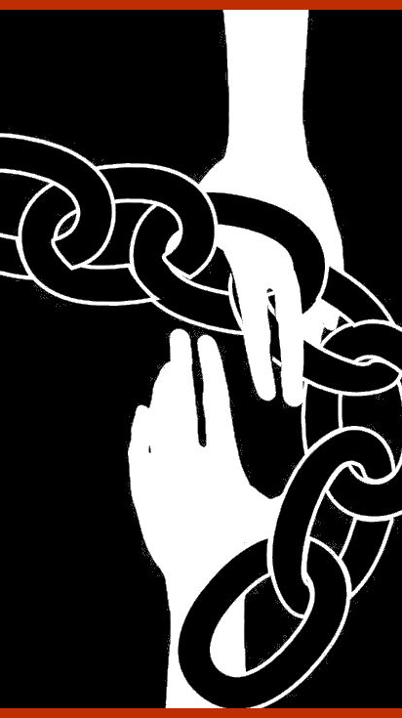
Social Impact
Blockchain
Project
Checkpoint 1: Impact Opportunity
Checkpoint 2: Business Model Validation
Checkpoint 3: Technical Architecture
Checkpoint 4: Impact Measurement
Checkpoint 5: Code
Checkpoint 6: Final Submissions Due

Slide 5
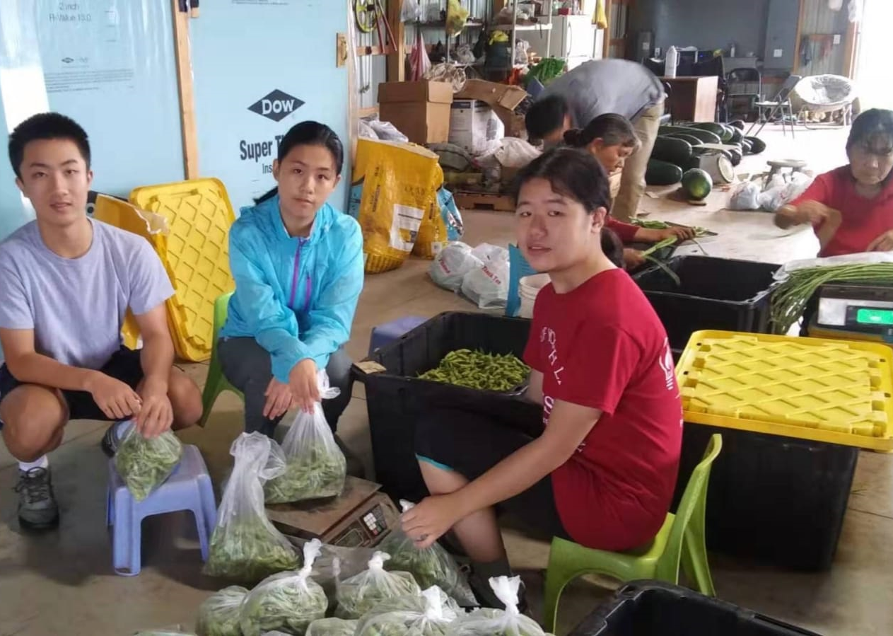
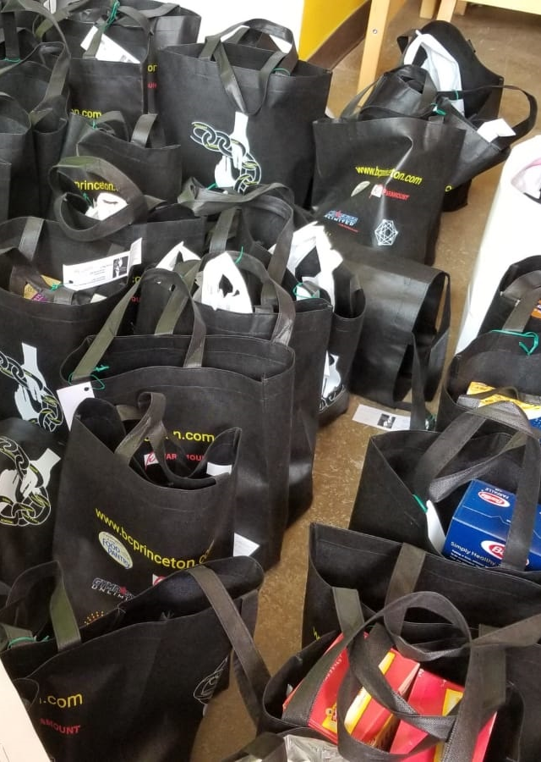
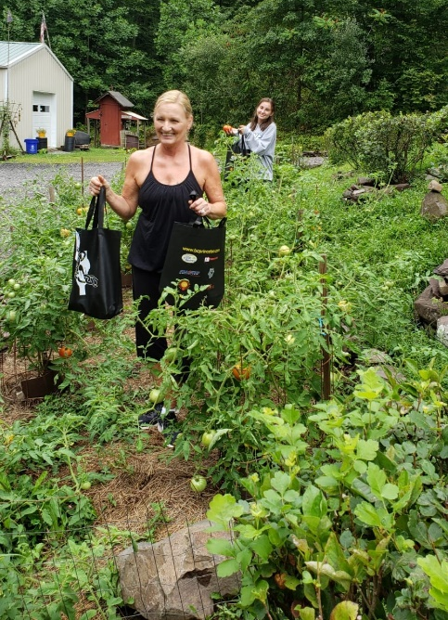
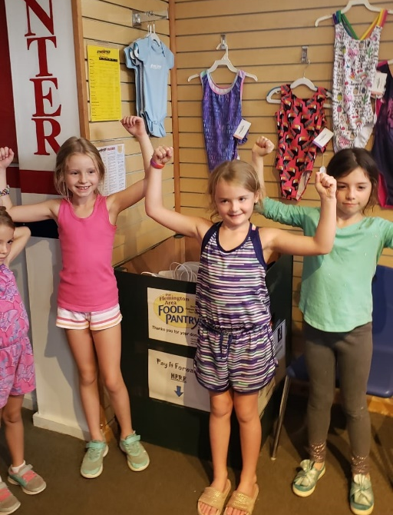
Project Day Collection 8/2019

Slide 6
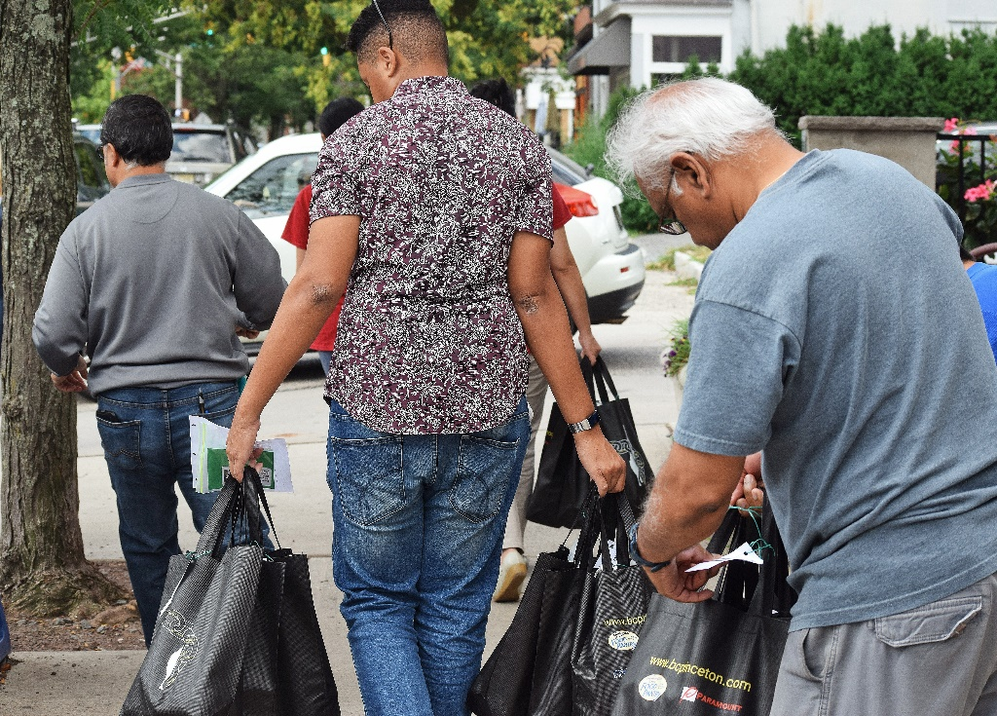
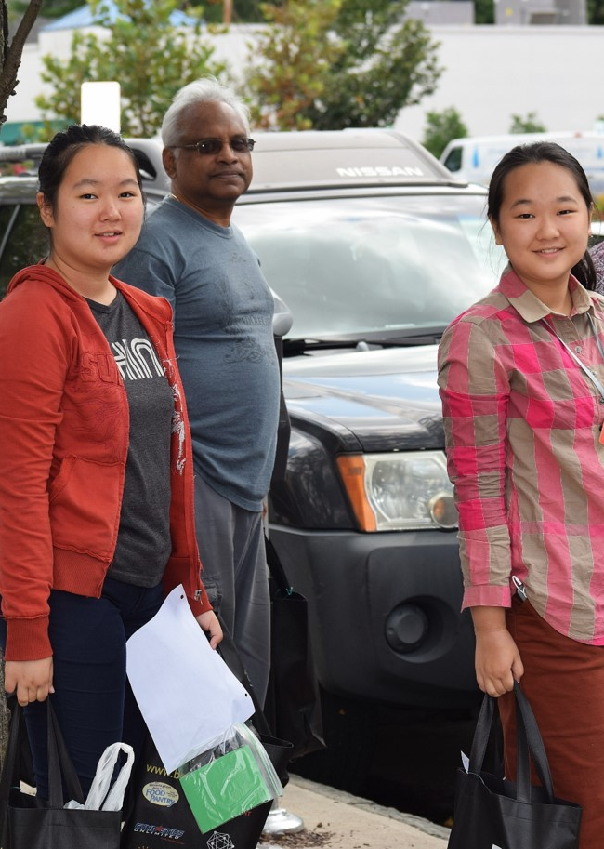
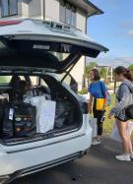
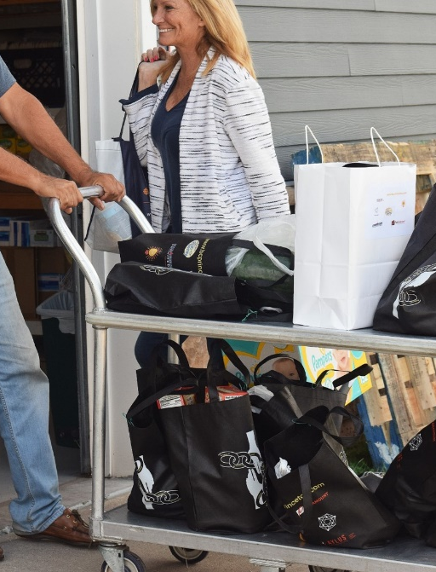
Project Day Transportation 8/2019

Slide 7
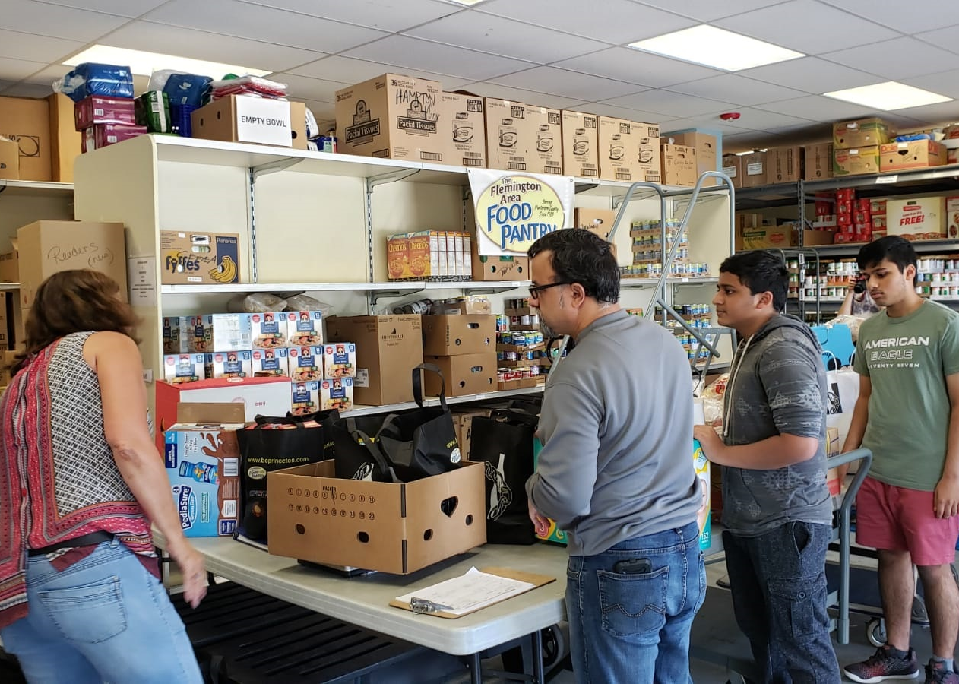
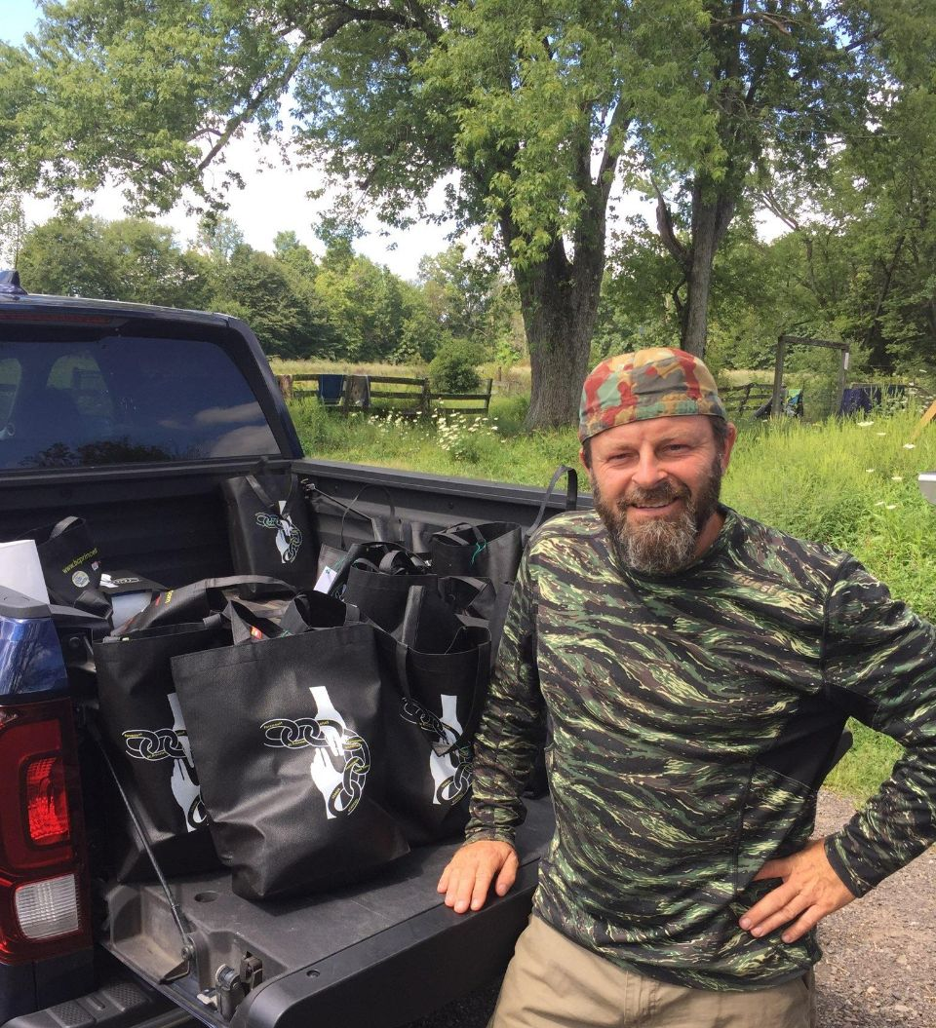
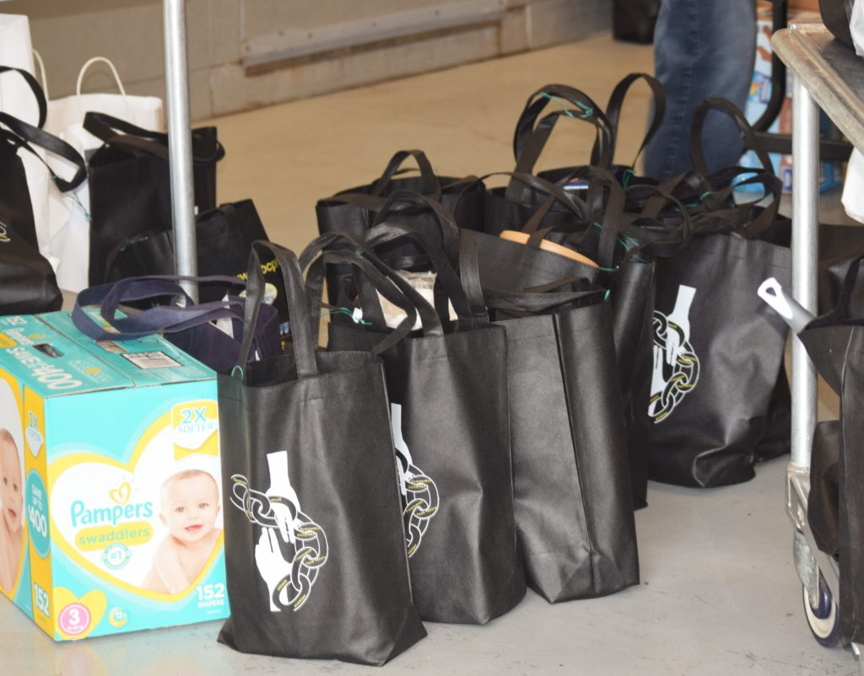
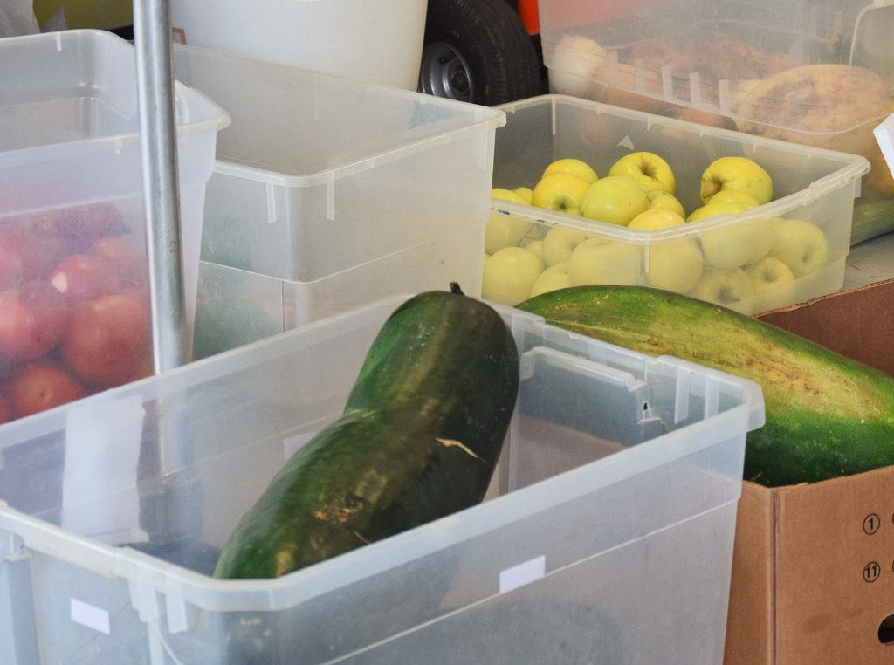
Project Day Delivery 8/2019

Slide 8
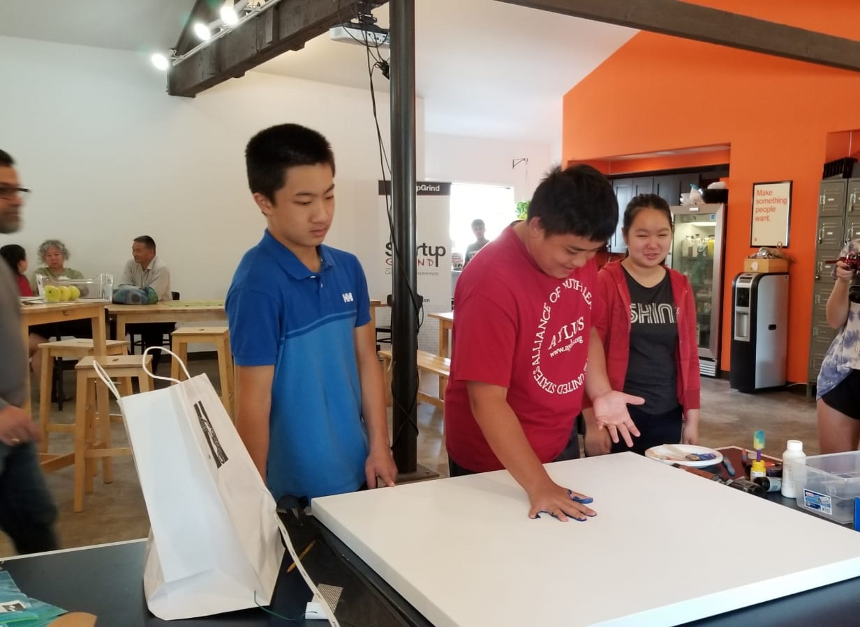
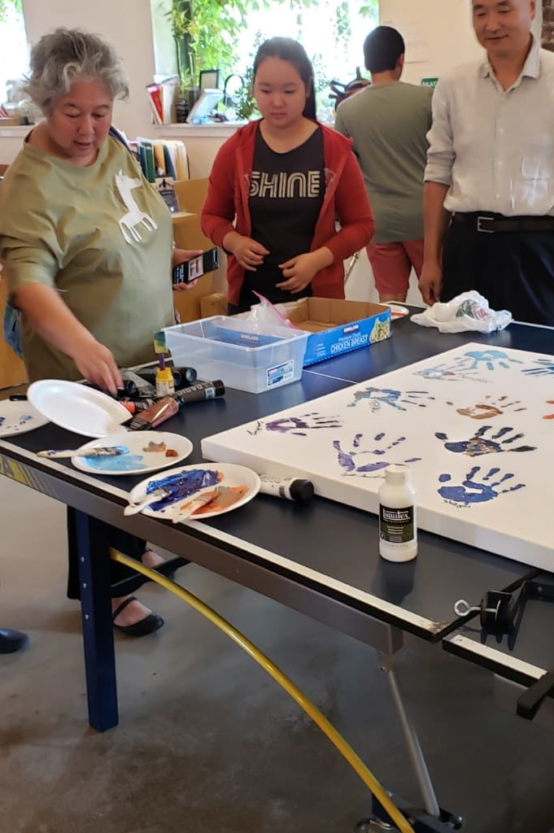
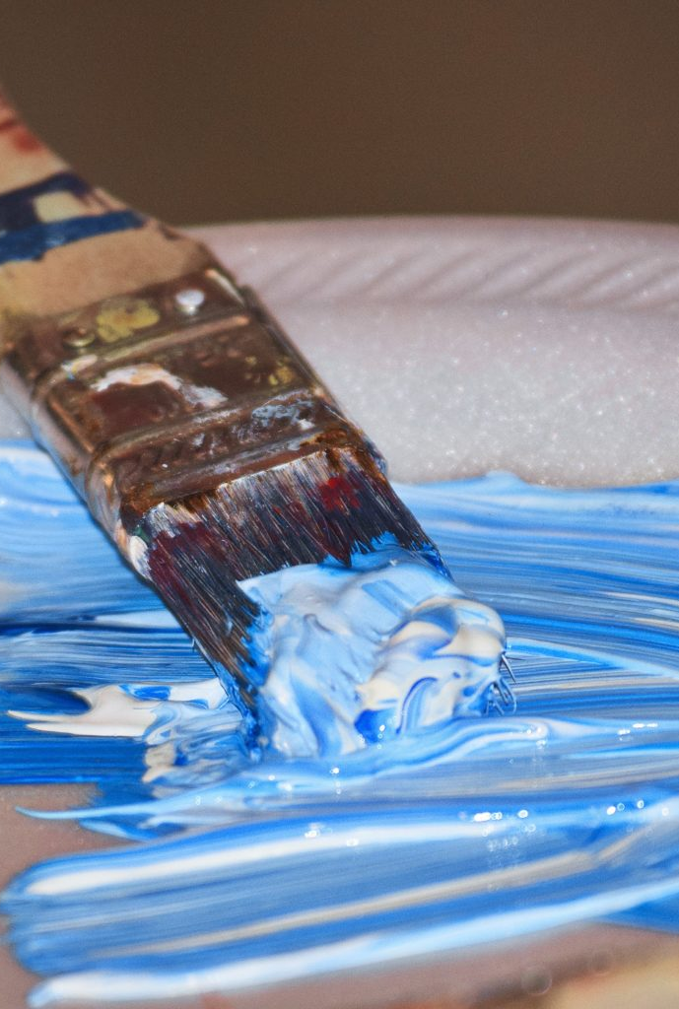
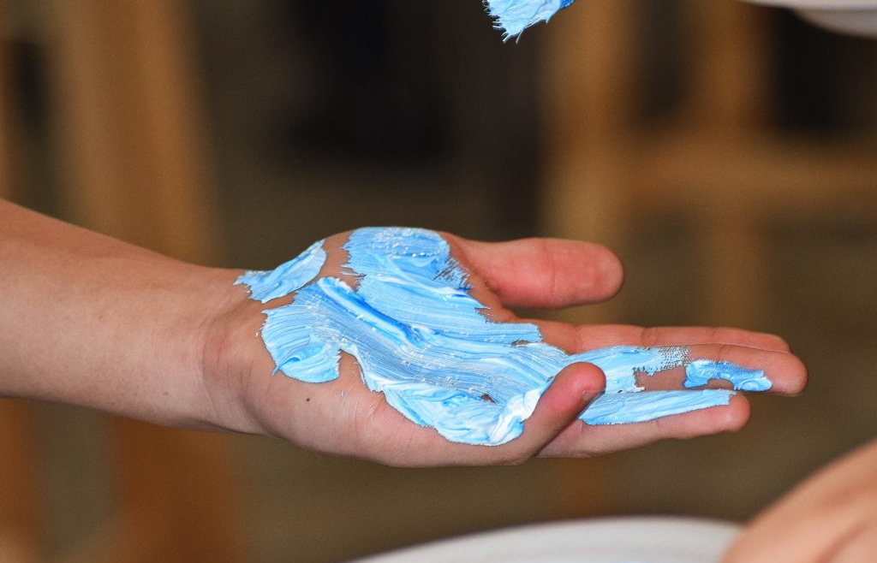
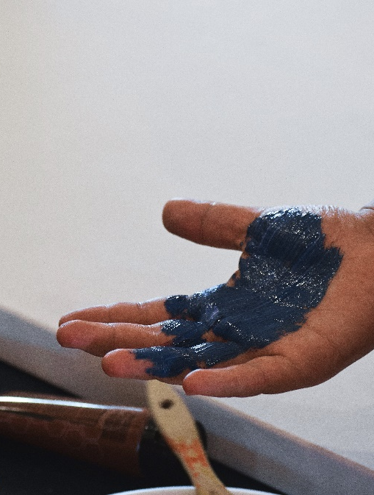
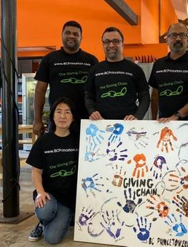
Project Day 8/2019

Slide 9
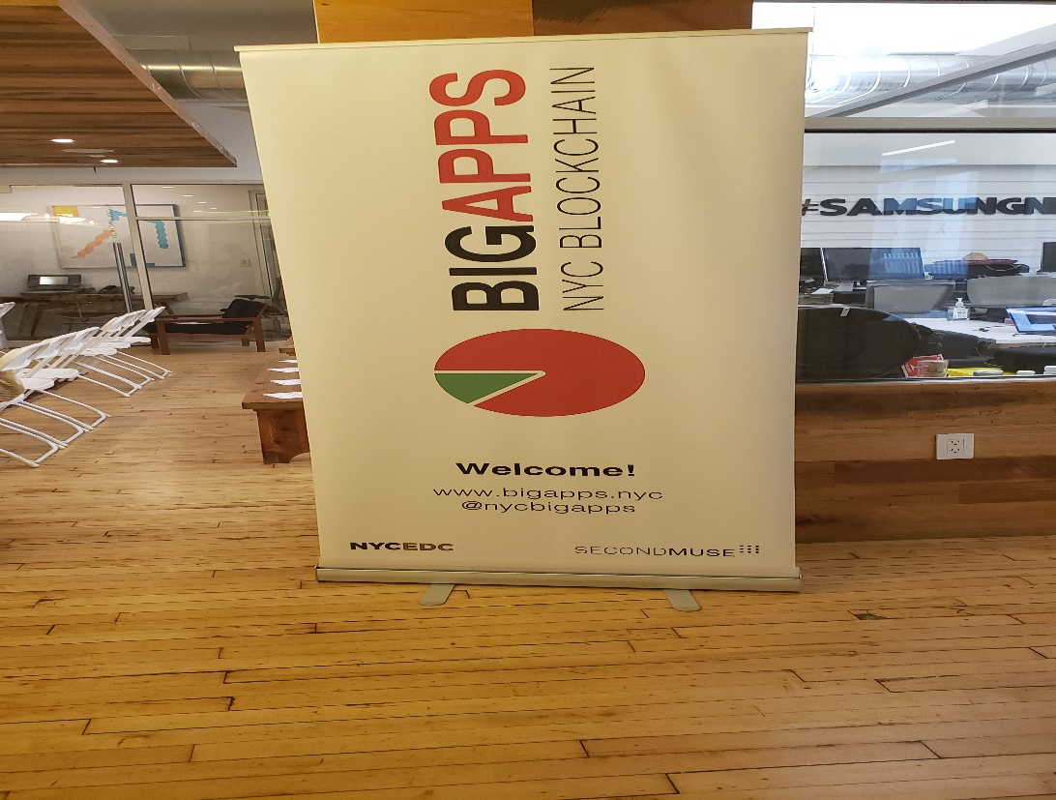
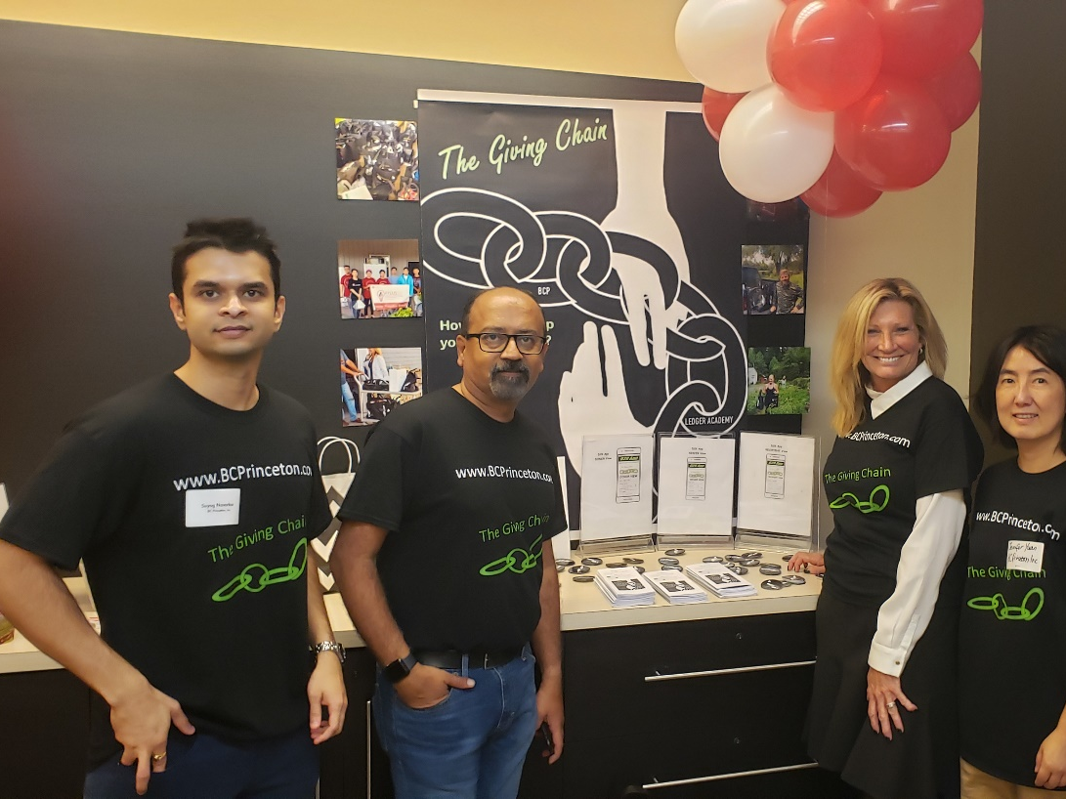
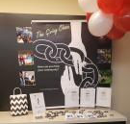
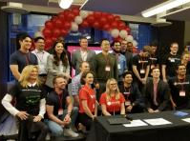
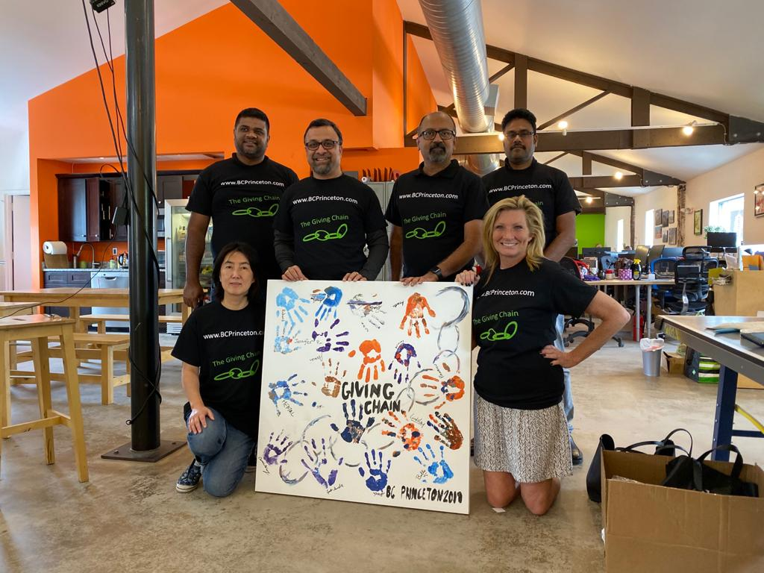
Big Apps Blockchain Challenge
Honorable Mention 9/2019

Slide 10
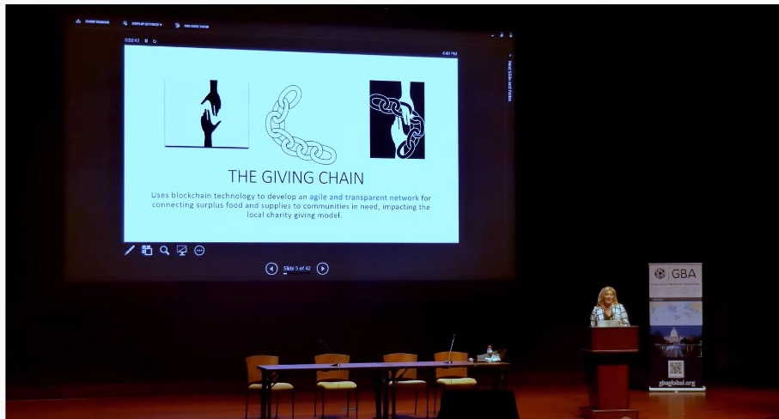
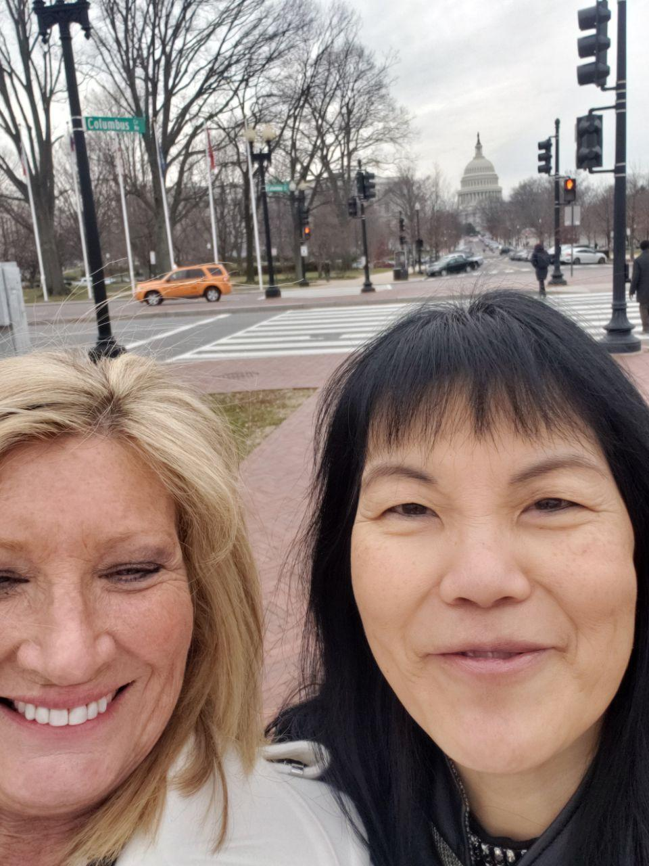
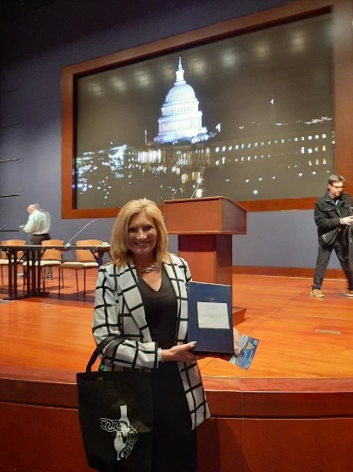
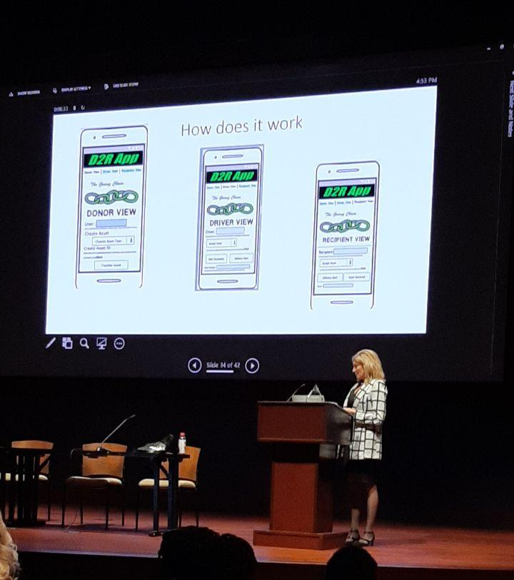
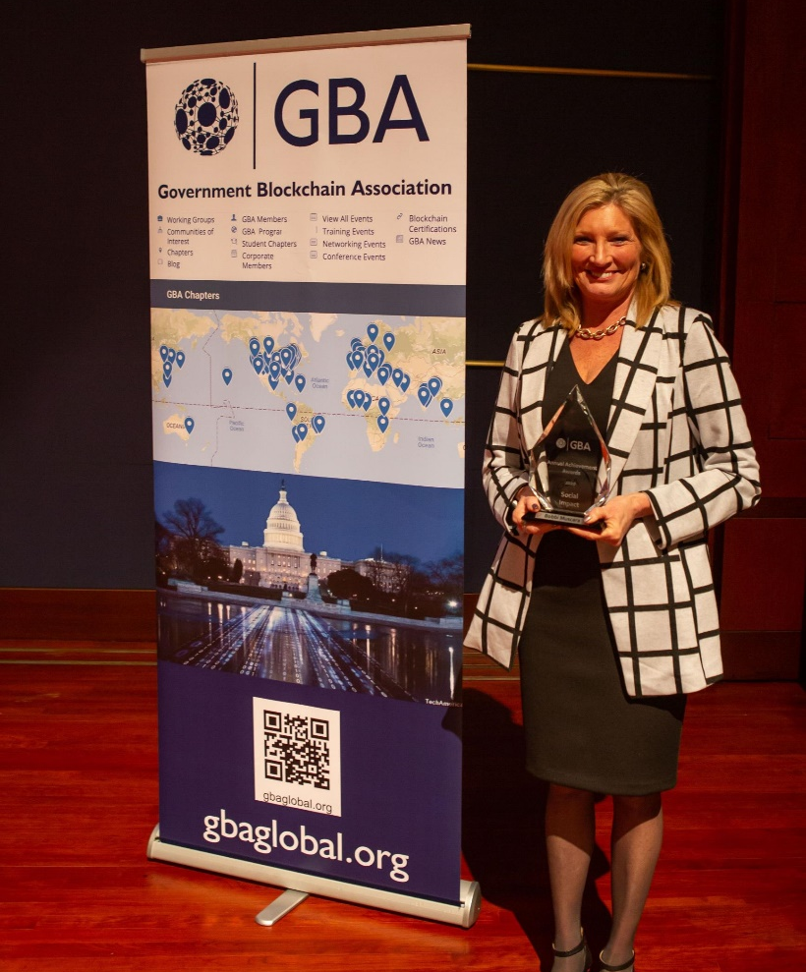
GBA Awards 2020 Government Blockchain Award for Social Impact

Slide 11
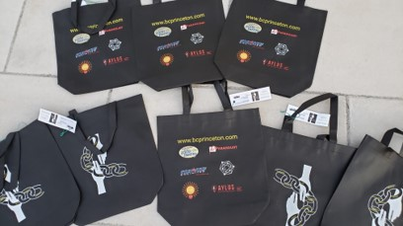
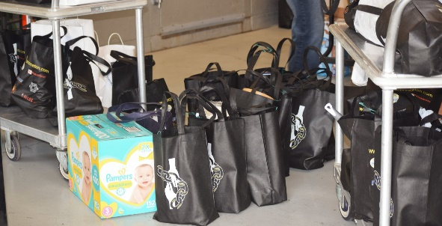
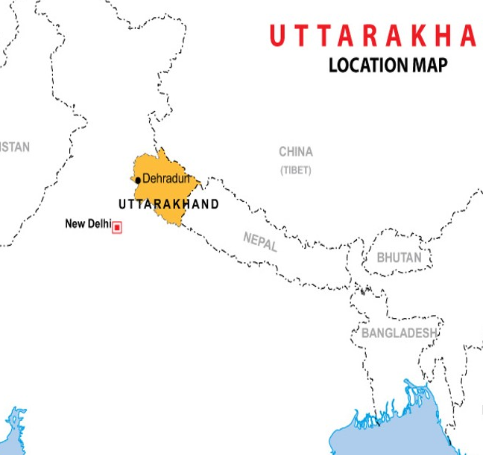
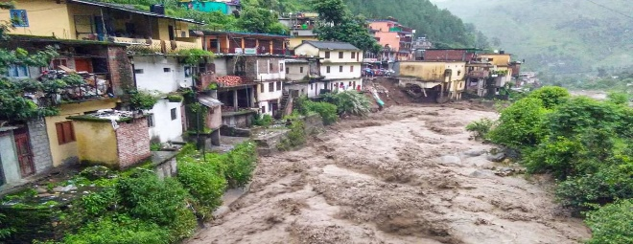
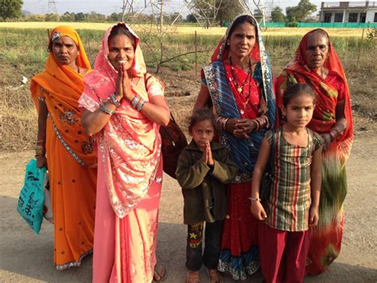
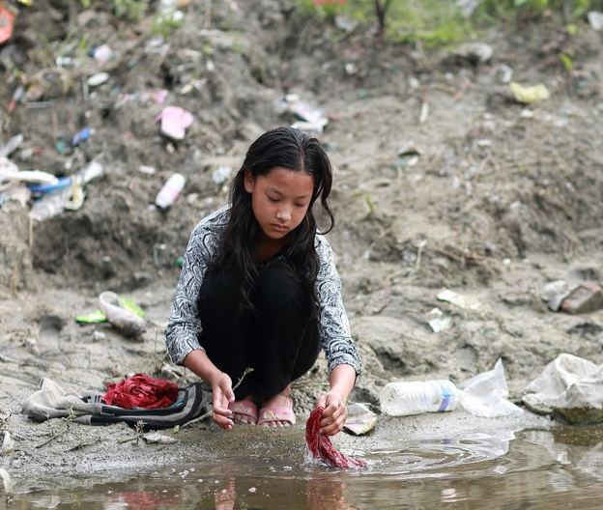
Project 2021
Giving Chain Princeton
Giving Chain India / Uttarakhand
Giving Chain India Women
Notes:
An estimated 355 million Indian women and girls must find ways to cope with monthly menstrual hygiene. Most o A majority of rural women in India employ clothes and rags for feminine hygiene. These materials might predispose women to reproductive tract infections since it may be difficult for them to keep their used napkins clean and free of harmful bacteria. Washing reusable feminine products with soap and drying them in sunlight may be difficult due to lack of water, private facilities, and cultural taboos associated with menstruation.

Slide 12
Checkpoint 1: Impact Opportunity
Princeton
  Select your challenge.
Develop an agile & transparent network for connecting surplus foods & supplies to communities in need.
To create a decentralized system that collect excess food supplies from local resources and distribute these resources to local area facilities in need.
  Define the scope of problem
For our summer project, we are limiting the POC to a small number of local farmers with excess food supplies (pick up dates September 3, 4 and 5) to be picked up by transportation volunteers who will bring donations to agreed upon drop off point .
India – Women ,
we are limiting the POC to Rural area in India. Supplies purchased will be picked up by transportation volunteers who will transport hygiene supplies to drop off point in rural areas.

Slide 13
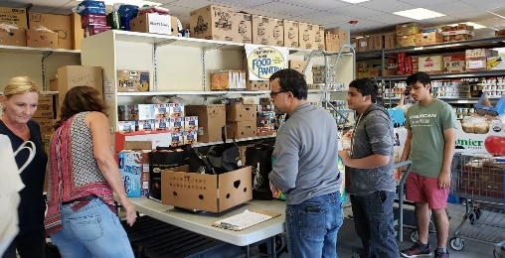
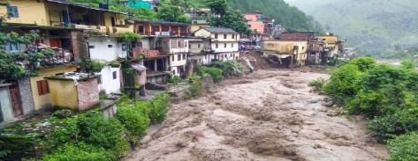
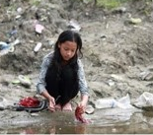
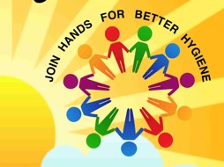
Checkpoint 2: Model Validation
Who are your clients/users? Sketch your user.
What are their pain points? How does your solution solve them?
        Can it be scaled?
Donors
Volunteers / Drivers
Recipients
Notes:
Include Details:
Donors Who they are for each project
Driver – Project Managers choice , Long term Vetted Orgs
Recipients
NGO, Social Services Offices
Schools/College Girls
Underprivileged
Village Women/girls
Marginalized and lower middle-class populace

Slide 14
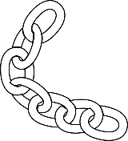
Giving Chain
Business Model
Donors
Farmers
Individuals
Community / Church Groups
Volunteers / Drivers
Pickup / Deliver:
Local volunteers
Community / Groups Transport
Recipients
Food Banks
Houses of Worship
Social Services Offices
Individuals (off the grid)

Slide 15

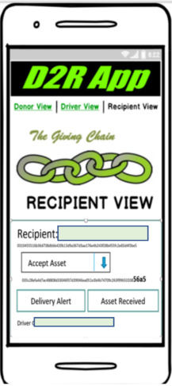

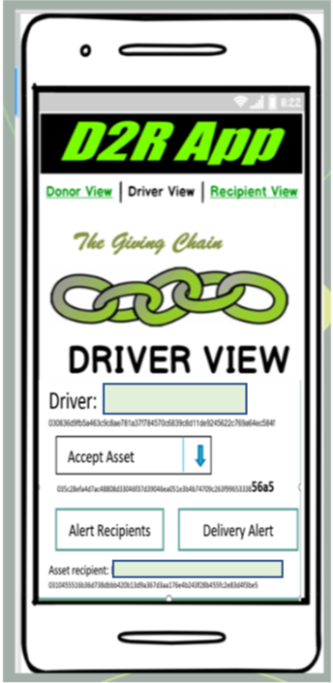




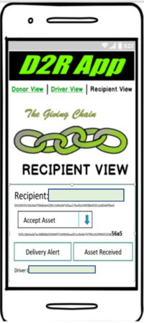
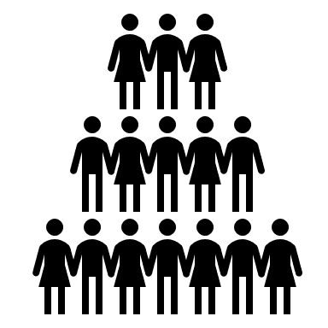
Giving Chain Technical Model
The D2R app
Princeton and Uttarakhand : Technical Model
Create Asset for Pick upP/U
Recipient Tag
Transporters Tag
Notes:
In our technical model Donors activate the giving chain with an application a cell phone. They create an asset with a unique tag. The blockchain tracks the ownership of the tag ( donor to driver to recipient) . We will get a closer look at the technology later.

Slide 16
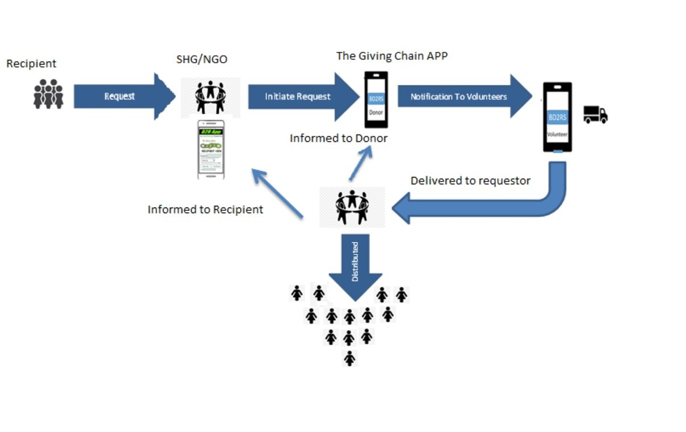
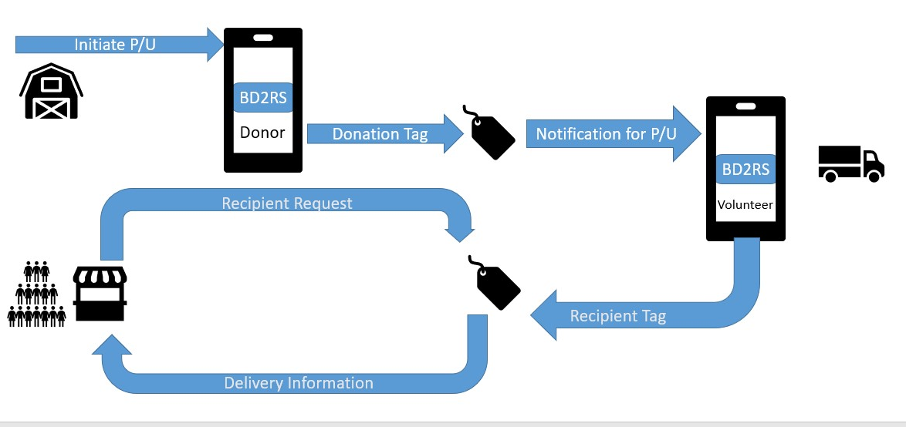
Checkpoint 3 Business and Technical Modeling
Princeton: Technical Business Model
Project India Women

Slide 17
Define Project and team members.
The Giving Chain
Business Team
Technical Team
RAISE FUNDs
Tee shirt Sales
Secure Donors
Create a Git Hub Repo
Research Platforms
Develop Code
Create Social Media
Notes:
Looking at the project it was decided to break out into to teams Business and Technical. Most people who attended the meetings were on both teams, The teams can run through several sub projects and individuals can be om many teams.

Slide 18
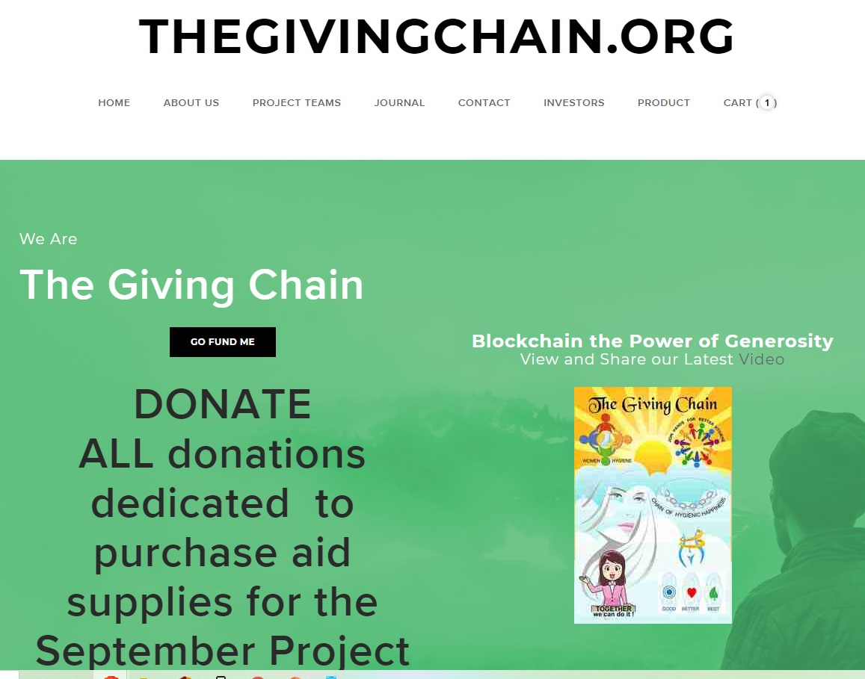
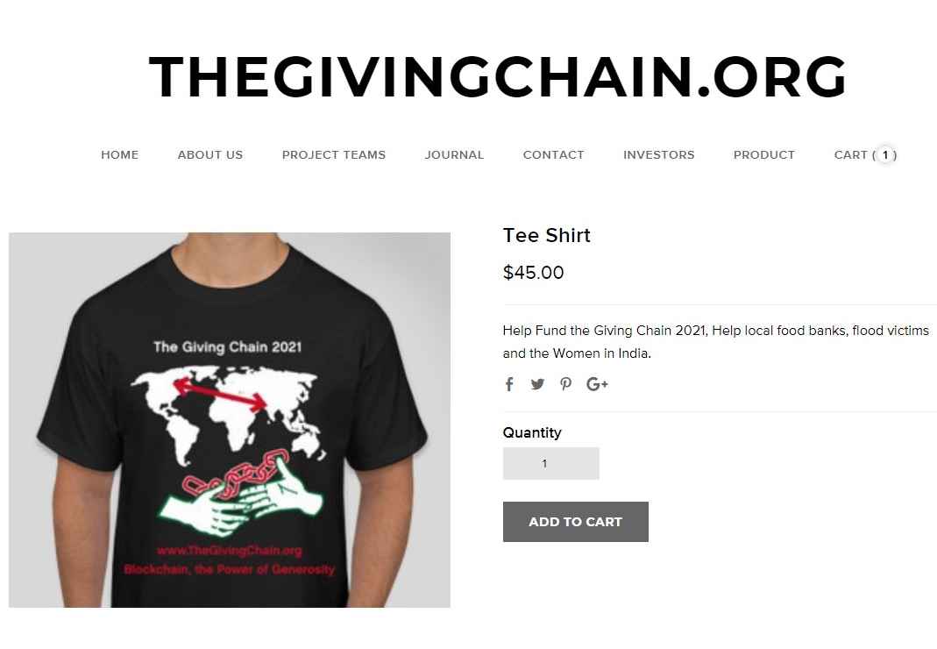
Business Development
Web Site and Donations
Donate to Project
https://gofund.me/b0840750
Tee-shirt Sales
General Funding (For the use of buying goods): https://crowdfunding.lfx.linuxfoundation.org/initiative/fabcd0b5-cecb-452b-a7e1-55bf31065c4a
The General Funds will be distributed on Project Day.

Slide 19

GoFundMe Individual Donations
https://gofund.me/b0840750

Slide 20


Corporate Funding
Corporate Funding (For the project development): https://crowdfunding.lfx.linuxfoundation.org/projects/hyperledger-the-giving-chain

Slide 21
Business Development
Date for Project Labor Day weekend September 3, 4 and 5, 2021
Social Media (Advertise The Project)
  Be a Social Media pioneer
  https://www.facebook.com/TheGivingChain
  https://www.instagram.com/thegivingchain/
  https://t.me/BCPrinceton
  https://twitter.com/bc_princeton
  LinkedIn Group: ​https://www.linkedin.com/groups/9055378/https://wiki.hyperledger.org/pages/viewpage.action?pageId=51613841
To Do:
  Fund raiser events
  Tee Shirt Sales and Distribution
  Marketing Materials

Slide 22


Business Development
Marketing Material
Power Point
Farm Produce Collection Days Posters
Printed GoFundMe Pages

Slide 23



Collection Days

Slide 24
NFT Tracking and Creation
Name/ Role:_________________________
Date and Time:_______________________
Location (GEO) _______________________
Name/ Role:_________________________
Date and Time:_______________________
Location (GEO) _______________________
Name/ Role:_________________________
Date and Time:_______________________
Location (GEO) _______________________

Slide 25

NFT Tracking and Creation
Name/ Role:__Bobbi M / Donor _________
Date and Time:__Thur. 9/2/2021________
Location (GEO) ____Pennington, NJ______

Slide 26



The Giving Chain
Test Run, Princeton
Web App- user upload image, we upload to IPFS and we get back Hash (represents URL , Mona ☺

Slide 27
Technical Team Steps
Decide on a platform:
Hyperledger Sawtooth
Distributed Ledger Platform we Used in 2019
Hyperledger Firefly
Potential Blockchain As A Service
Making The Giving Chain a Hyperledger Lab

Slide 28






Prototype The R2D Application
  Analog prototype / Mock-ups
  .
R2D
App

Slide 29
D2RA - Hyperledger Sawtooth Chain - MVP
Sl. No. | Things to be accomplished | Description of work and any constraints to be overcome | Assigned to (please include your name based on your time and skills) | Comments / Remarks
1 | Multiple nodes | Create multiple nodes of Sawtooth chain and demonstrate workability of the chain - Sawtooth chain needs to be brought up inside docker (or any other container) and should run on all instances; should be able to connect with each node |  | Can be on multiple instances in cloud (Eg: AWS EC2) or multiple macs Hemal Panji has done some research
2 | Define Transaction Processor | Be able to create transaction families and define Transactions on the chain (not the front end) - business logic on the server and able to bundle transactions into a block for validation |  | Transaction processor node(s) within Sawtooth
3 | Define Validator | Be able to assign validator nodes and / or create validators that will take the transaction families for validating and creating a block |  | Validator node(s) in Sawtooth
4 | Define any REST API | Be able to connect the client (Front end interface) to the chain |  | Connectors to chain from front end client (HTML, JSON etc.)
5 | Create Donor, Volunteer interfaces / logins | Provide the ability for Donors and volunteers to interact with the chain to login, create assets, transfer assets etc. |  | Current single screen from POC may need to be split into multiple with respective functionalities
6 | Create assets | Define what an asset attributes need to be (Asset name, asset type, unit type, unit measure etc.) Master template for assets (minimum values to be picked while defining assets that answers questions like - What am I donating, how much and if it can be picked up by multiple volunteers - one donor to many volunteers) |  | Solve for Fungibility of assets - Lindsley Medlin can articulate / elaborate.
7 | Tracking assets in the supply chain | How does the asset get tracked - Bar code, Mobile phone (Suyog Navarkar can elaborate), individual asset being tracked or the bag / crate. |  | Cost effective tracking mechanisms - pls remember that this is a social impact project and not a commercial one

Slide 30
  Working code
Create blockchain and implement
  Tech Stack and Wireframes

Slide 31
GitHub
Working code
Enter Into Lab – Needed Space for Tech Team to work.
GitHub is a web-based version-control and collaboration platform for software developers.
Hyperledger Labs aims to provide a channel suitable for innovation and testing of ideas where work can easily be started without the creation of a formal Hyperledger project. It will allow teams to experiment with new frameworks and new modules without the promise of stable code.
Notes:
Determined not ready as we haven’t decided on code

Slide 32

Government Blockchain Association

Slide 33

Artist Needed
Government Blockchain Association
The GBA will be hosting a digital (online) Art Show during Government Blockchain Week, Sept 27- Oct 2, 2021
‘What I Hope to See Blockchain Achieve in My Lifetime’

Slide 34

2021 GBA Art Show Submission

Slide 35


Slide 36

Lanchel Brutus

Slide 37
Thank You from www.thegivingchain.org

