Slide 1
Welcome to The giving chain
2021

Slide 2
AGENDA
Housekeeping
Introduction: Project and Team
The Giving Chain 2019
Hyperledger Mentorship Program
Project Overview
Teams (Expectations) (Focus)
Introduction from Members on Call
Questions and Answers

Slide 3
Housekeeping
Linux Foundation Sponsored Event
Antitrust Policy Antitrust Policy Notice: link: https://www.linuxfoundation.org/antitrust-policy/
Linux Foundation meetings involve participation by industry competitors, and it is the intention of the Linux Foundation to conduct all of its activities in accordance with applicable antitrust and competition laws. It is therefore extremely important that attendees adhere to meeting agendas, and be aware of, and not participate in, any activities that are prohibited under applicable US state, federal or foreign antitrust and competition laws. Examples of types of actions that are prohibited at Linux Foundation meetings and in connection with Linux Foundation activities are described in the Linux Foundation Antitrust Policy available at http://www.linuxfoundation.org/antitrust-policy. If you have questions about these matters, please contact your company counsel, or if you are a member of the Linux Foundation, feel free to contact Andrew Updegrove of the firm of Gesmer Updegrove LLP, which provides legal counsel to the Linux Foundation.
Code of conduct link: https://wiki.hyperledger.org/display/HYP/Hyperledger+Code+of+Conduct

Slide 4
Introduction
Project
Team
Hyperledger, Ledger Academy and
BC Princeton Presents
The Giving Chain
&
The D2R Application
Bobbi Muscara
Hardik Gupta

Slide 5
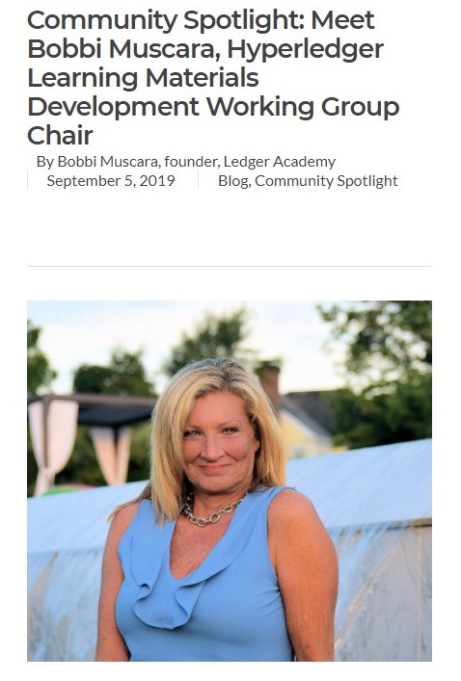
Bobbi Muscara
Director Education Ledger Academy
  Author of Linux Foundation Blockchain Courses for LFS171
Hyperledger
TSC Member
Chair OF THE Learning Materials Working Group
The Giving Chain
Mentor / Project Management
BCEmploy
Navigating the Blockchain Job
Market

Slide 6

Hardik Gupta
Hyperledger
Member OF THE Learning Materials Working Group
The Giving Chain
Mentee / Project Management / Technical Lead

Slide 7
Blockchain and Social Responsibility
    Philanthropy and remittances
    Financial empowerment
    Identity and land rights
    Governance and democracy
    Supply chain and environmental protections
Notes:
We asked ourselves the question with what we know about blockchain and social impact projects, what can we do to have an impact in our community
Philanthropy and remittances (donation traceability, aid transparency, digital currencies in aid and development, governance and accountability)
Financial empowerment (financial inclusion, microfinance, microinsurance)
Identity and land rights (refugee assistance, land ownership documentation)
Governance and democracy (fighting censorship and fake news, voting rights and protections, election integrity)
Supply chain and environmental protections (sustainable supply chain, fair trade, ethical sourcing, fair labor practices

Slide 8
How We Did It
  BCPrinceton Checkpoints
Checkpoint 1: Impact Opportunity
Checkpoint 2: Business Model Validation
Checkpoint 3: Technical Architecture
Checkpoint 4: Business Development
Checkpoint 5: Product Development
Checkpoint 6: Final Project Delivery
“The Giving Chain”
The New Model for Charity Giving
Notes:
By Working thru 6 checkpoints we designed a project / prototype / proof of concept that had a positive impact on our local society. Addressing the needs of the community. The result was a project called The Giving Chain and the Hyperledger based D2R application.

Slide 9
The Giving Chain
Uses blockchain technology to develop an agile and transparent network for connecting surplus food and supplies to communities in need, impacting the local charity giving model.
Notes:
We designed a logo that represented the idea that thru blockchain anonymous decentralized charity giving can happen on a community level . We chose the hands reaching out joined by a chain to represent this.

Slide 10
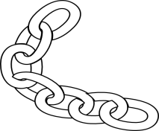
Giving Chain
Business Model
Donors
Farmers
Individuals
Community / Church Groups
Volunteers / Drivers
Pickup / Deliver:
Local volunteers
Community / Groups Transport
Recipients
Food Banks
Social Services Offices
Individuals (off the grid)
Notes:
The business model we defined created a dignified system that matches local individuals who want to donate with recipient in need. In our use case we match local New Jersey farmers who have excess produce in August with food insecure Veterans and local area food banks.

Slide 11
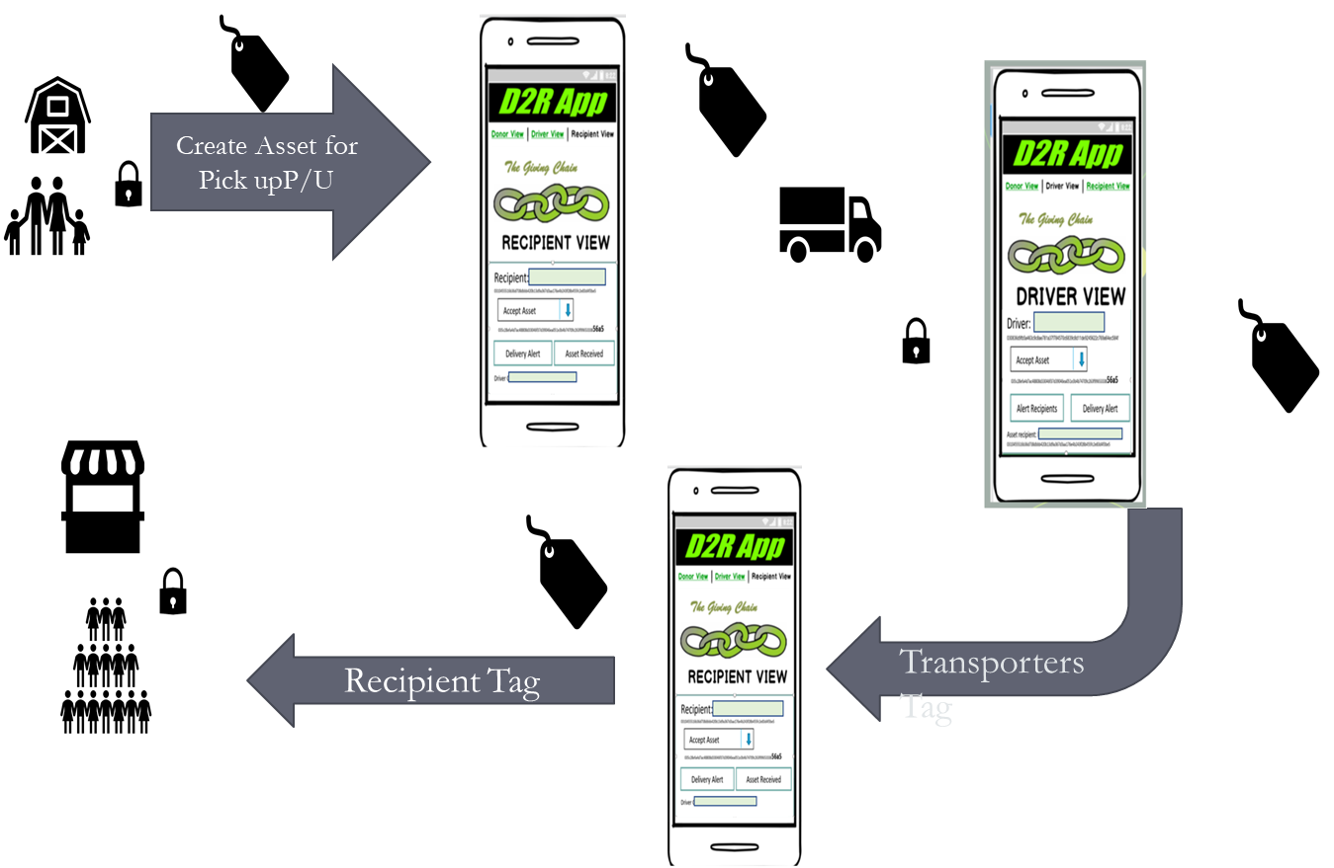
Giving Chain Technical Model
The D2R app
Notes:
In our technical model Donors activate the giving chain with an application a cell phone. They create an asset with a unique tag. The blockchain tracks the ownership of the tag ( donor to driver to recipient) . We will get a closer look at the technology later.

Slide 12
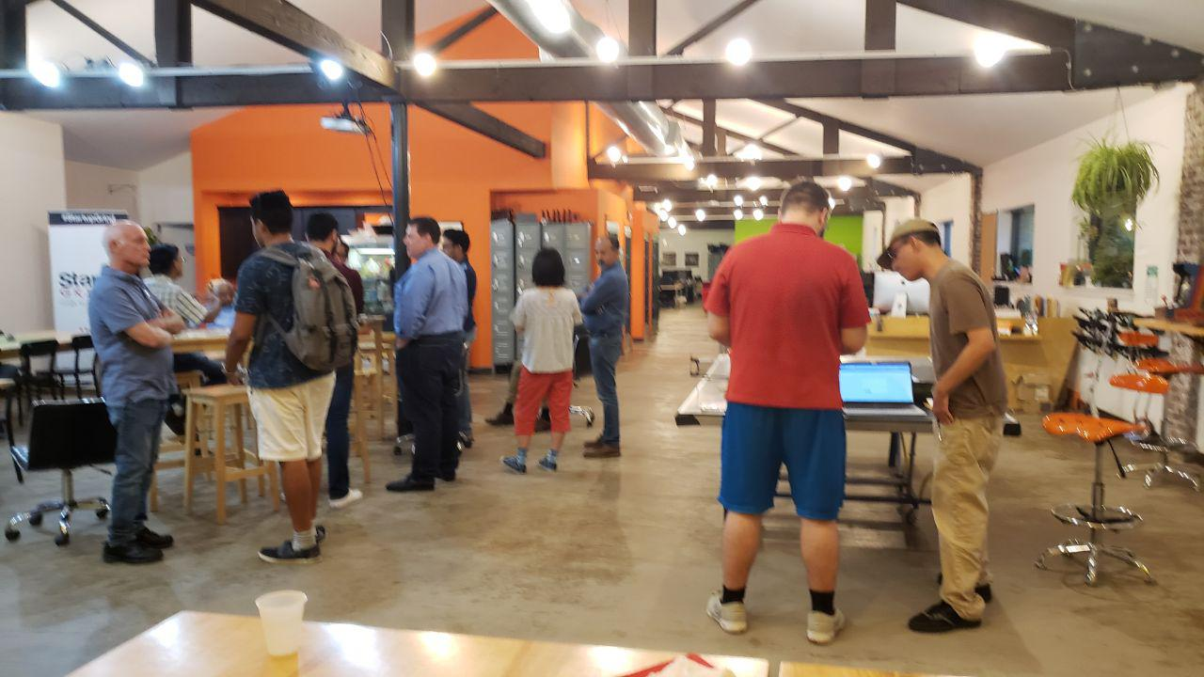
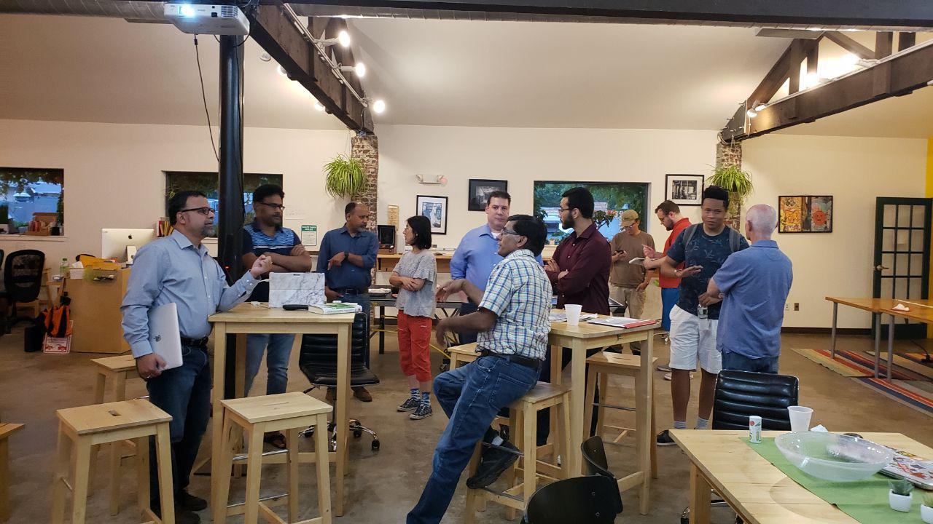
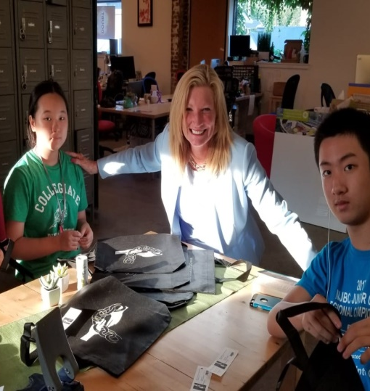
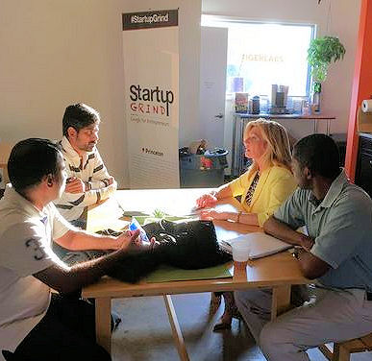
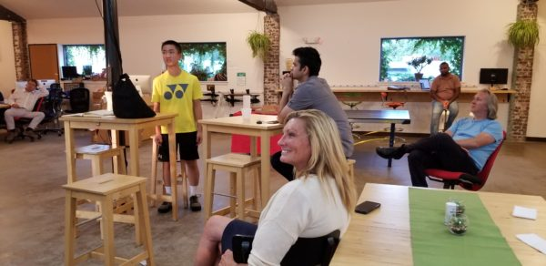
Team Meetings
Notes:
So how did it turn out….. We spent countless hours meeting and developing the relationships we would need. Our local meetup participants gave up their time and expertise to build this project.

Slide 13
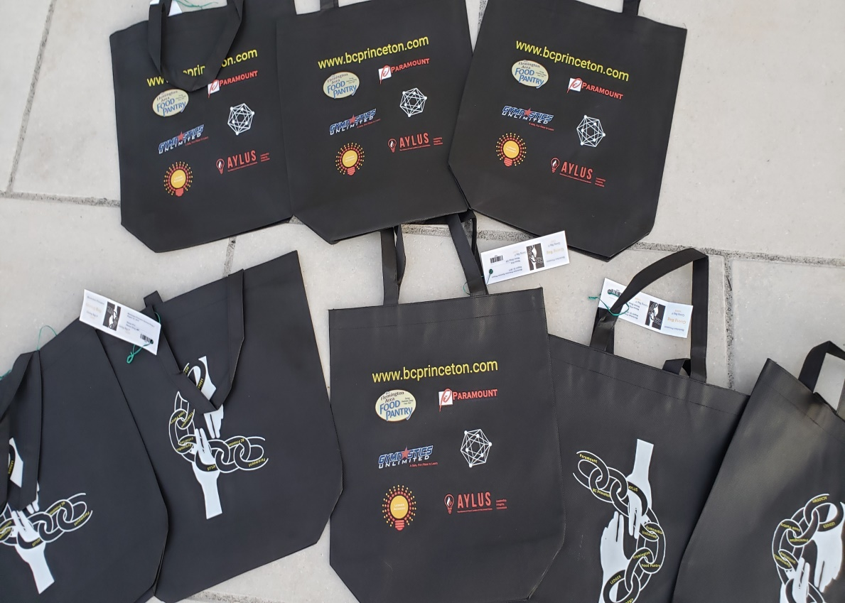
Designing and Ordering Giving Bags
Notes:
To ordering giving bag that included the names of everyone involved in the project, as well as our cool logo.

Slide 14
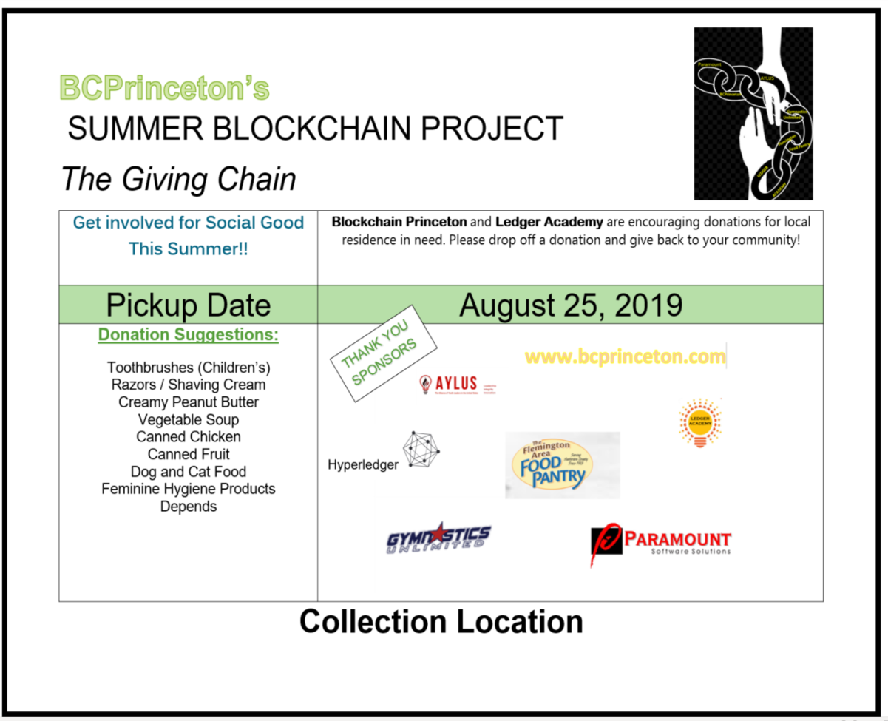
Donation Marketing
Materials
Purpose:
To designate collection location.
Notes:
To organizing collection Loccations

Slide 15
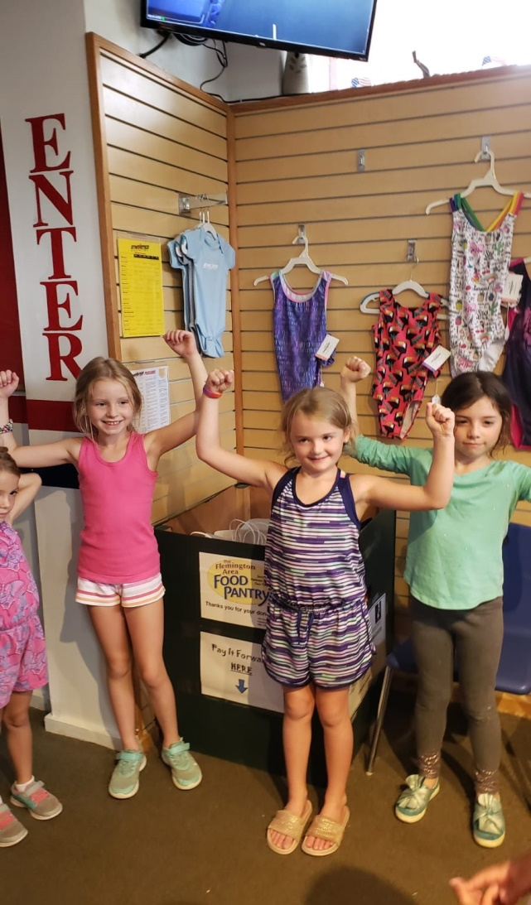
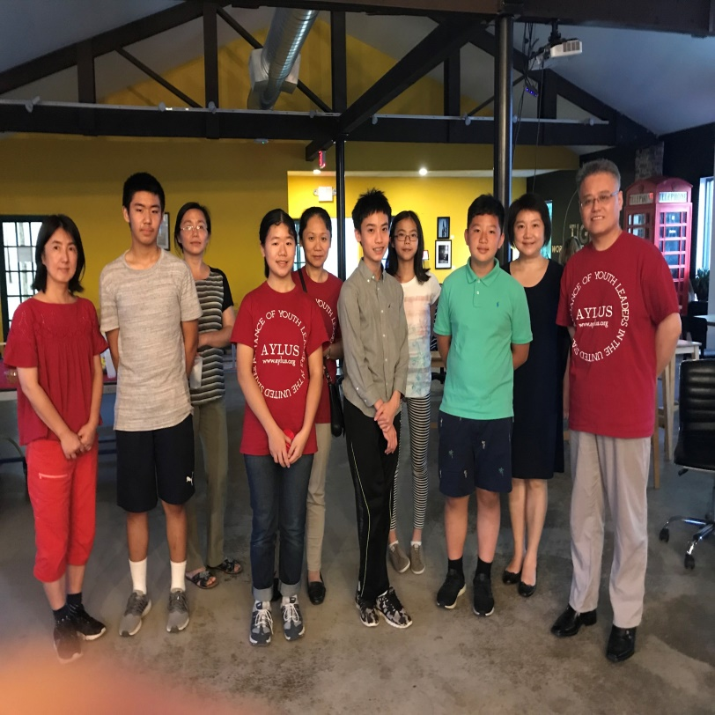
Summer Fund Raising Events: Collection Stations
AYLUS –Alliance young leaders of the United State Princeton Chapter www.aylus.org
Gymnastics Unlimited Summer Giving Project
Notes:
And enlisting local area youth organization to get involved in helping those in the community who need assistance

Slide 16
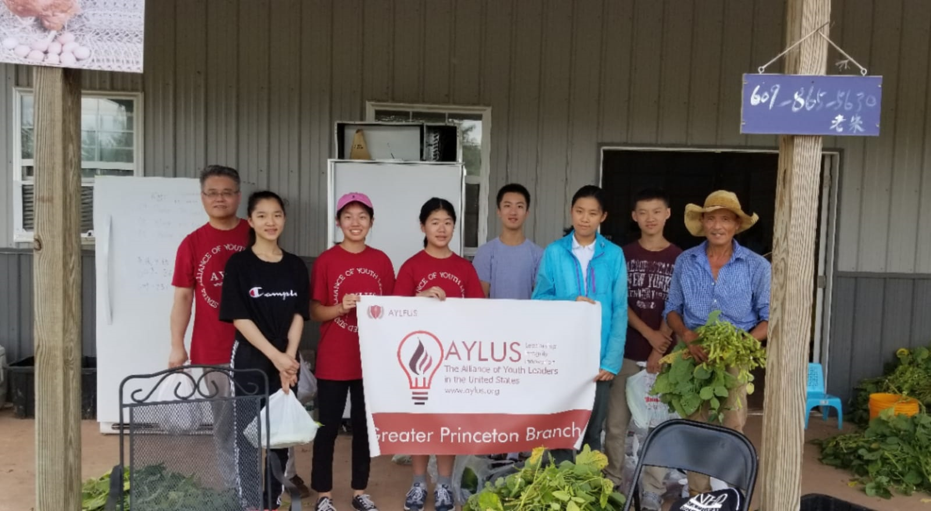

Slide 17
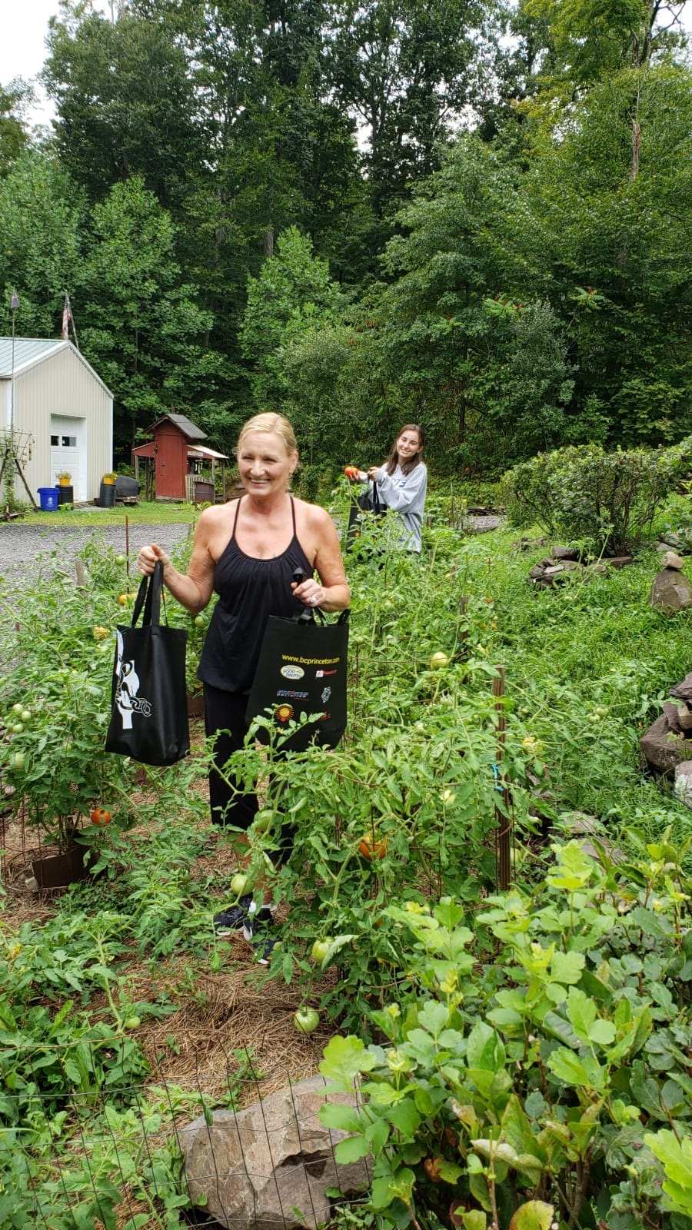
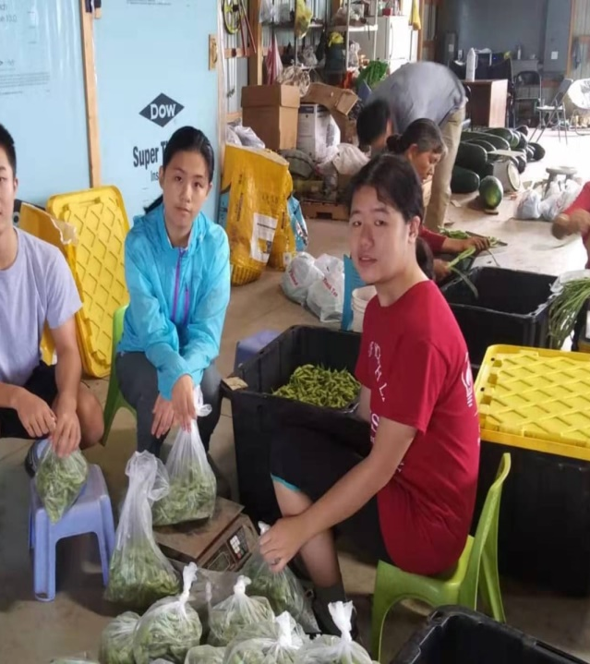
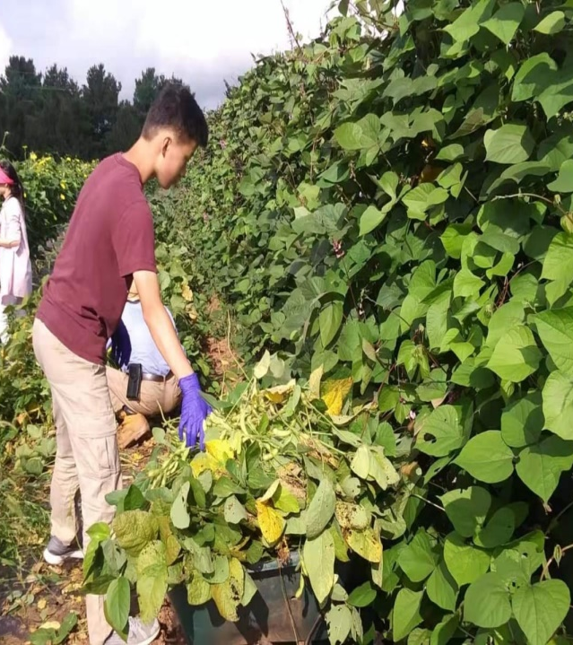
Collection Days
Notes:
And we cant forgot local farmer who donated fresh farm produce

Slide 18
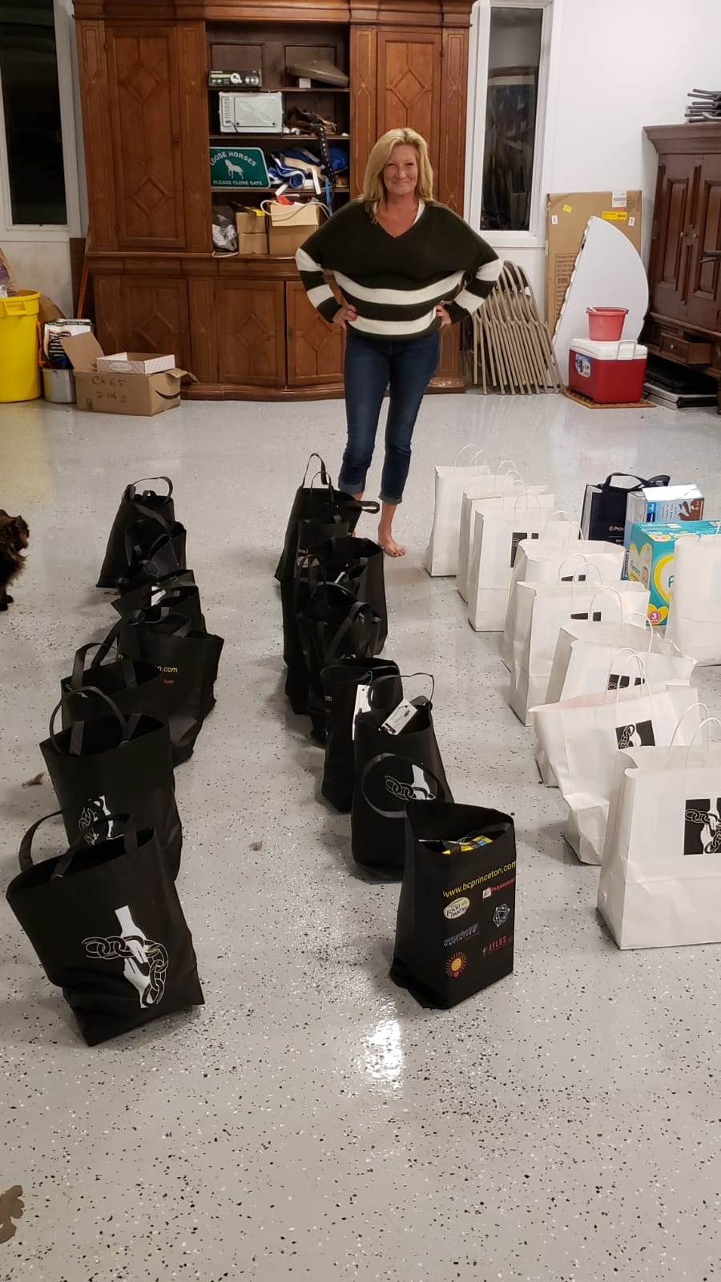
Notes:
To our surprise we wound up with more donations that would fit in 100 bags

Slide 19
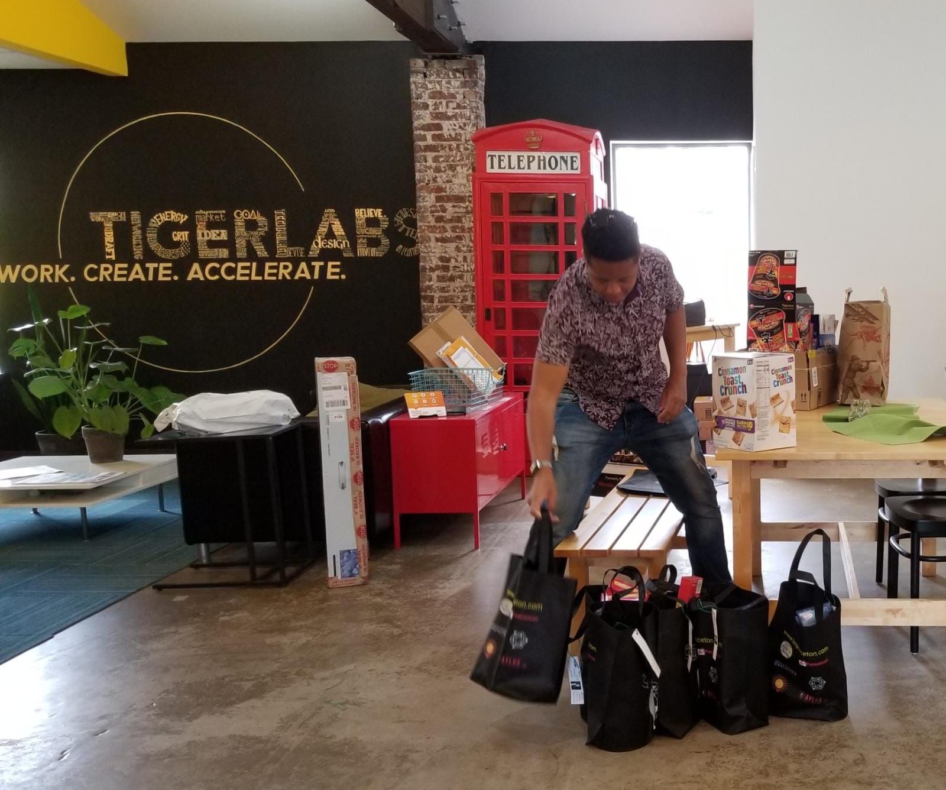
Notes:
Project days, All the collected items were brought to Tiger Labs.

Slide 20
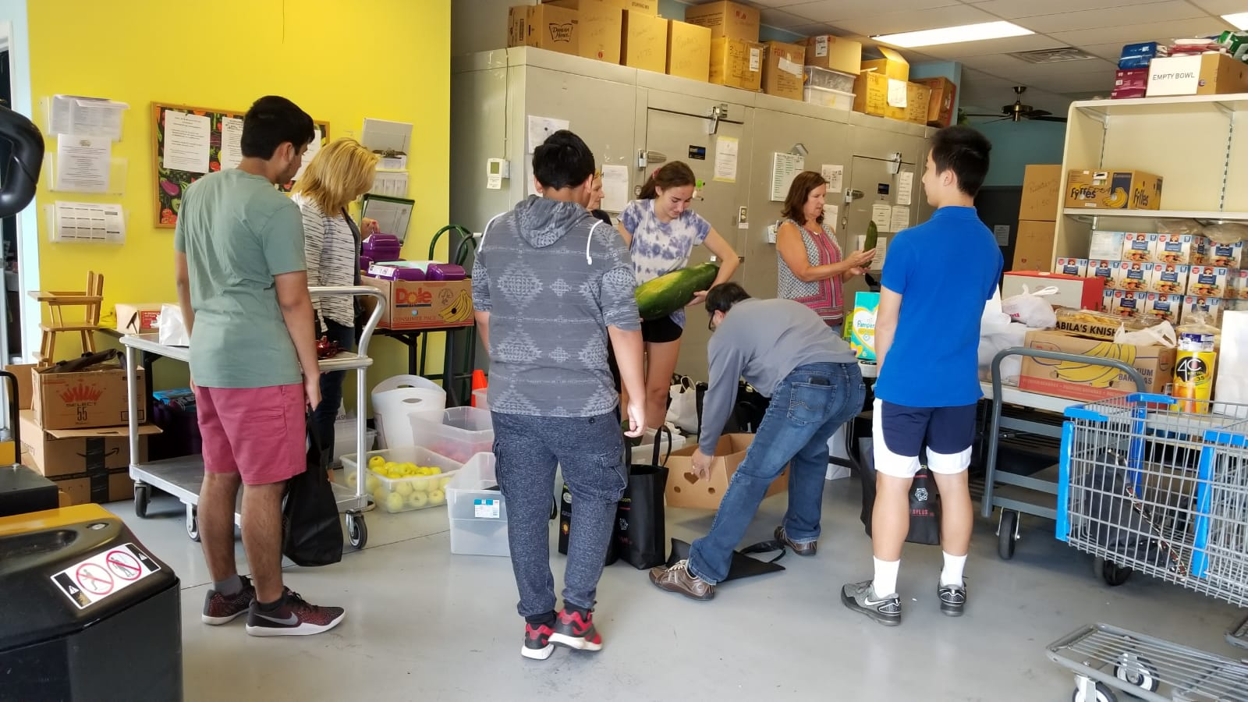

Slide 21
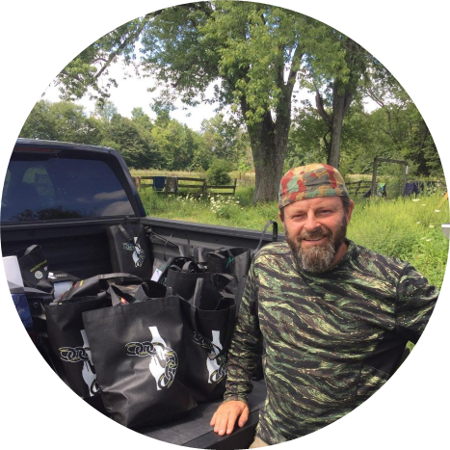

Jeannine Gorman
Executive Director
Rooster Featherstone US Veteran
Recipients

Slide 22
Hyperledger Mentorship
Hyperledger recognized the project and accepted The Giving Chain into the mentorship project
Hardik Gupta, Mentee / Project Manager, and Technical Lead.
Checkpoints are meant to guide you to think through your own solution prototype, stay on track, and ultimately formulate your own Blockchain / White Paper / Projects.

Slide 23
Weekly Checkpoints
Week 1: Impact Opportunity
Week 2: Business Model Validation
Week 3: Technical Architecture
Week 4: Impact Measurement
Week 5: Code
Week 6: Final Submissions Due

Slide 24
Week 1: Impact Opportunity (questions)
Define Project and team members.
Select your challenge requirements.
Define the scope of problem you are addressing.
Why is block chain needed to solve this problem?
What is the size of the market? What demographics will you serve? Which industries will you impact? Any concurrent trends?
What are some current solutions to the problem you identified? Do they work effectively?
Who are the stakeholders involved? How are they thinking/feeling/acting currently?
What are the geopolitical, cultural-social-economic factors that must be taken into consideration? What are some nuances and complexities that must be addressed?

Slide 25
Introduction To Member
Let us start with an introduction of all the members present here
Please add your name, email and area of interest / talents to our team page:
https://wiki.hyperledger.org/display/INTERN/Team+Information
Work will be completed in Hyperledger Wiki Pages
https://wiki.hyperledger.org/display/INTERN/Project+Plan+Giving+Chain

Slide 26
Teams
Business – Map out the Project (Works on developing and refining the project idea), Make Connections, Track Project, Funding and Project financials.
Technical – Define Tech requirements, Develop Prototype, Plan and Implement the Project, Determine and Deploy the environment.
Community – Handle the Social media platforms and help with the communications. Work on the documentation.

Slide 27
Defining The Project
The Purpose of the project is to decentralize local charity giving by creating the Giving Chain and the R2D application.
This project should implement a blockchain social service solution that by just redefining the donors, recipients, and the transportation method can be used at different geographical locations.

Slide 28
Defining The Project
Donors
Farmers
Restaurants
Wholesalers
Individuals
Volunteers / Drivers
Pickup / Deliver
Local Transporters
Recipients
Food Banks
NGO
Social Services Offices

Slide 29
Questions and Answers
We asked ourselves the question with what we know about blockchain and social impact projects, what can we do to have an impact in our community
We need to define the scope of problem
Need to see the size of the market
Select between tokenizing and creating a digital picture for tracking
Do we know any social community / project that may help us

Slide 30
Finally
Next Meeting Friday July 9th
To Do: Bring Ideas For Social projects that could work with giving chain r2d application
Like and comment in Social Media
https://www.facebook.com/TheGivingChain
https://www.instagram.com/thegivingchain/
https://t.me/BCPrinceton
https://twitter.com/bc_princeton
LinkedIn Group: ​https://www.linkedin.com/groups/9055378/

Slide 31
Thank You

