Slide 1
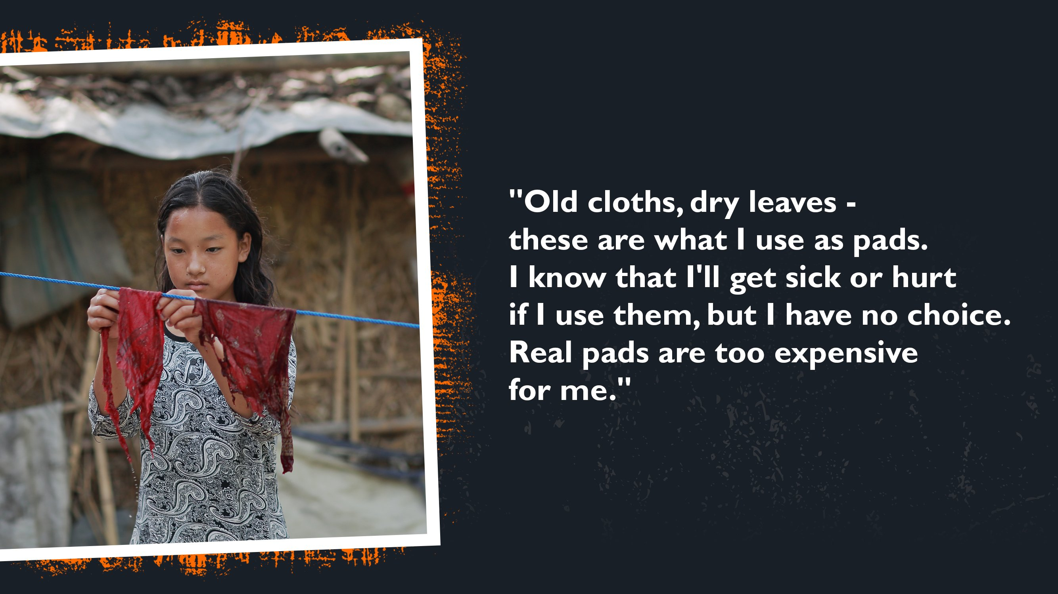
Examples of Impact Opportunity

Slide 2
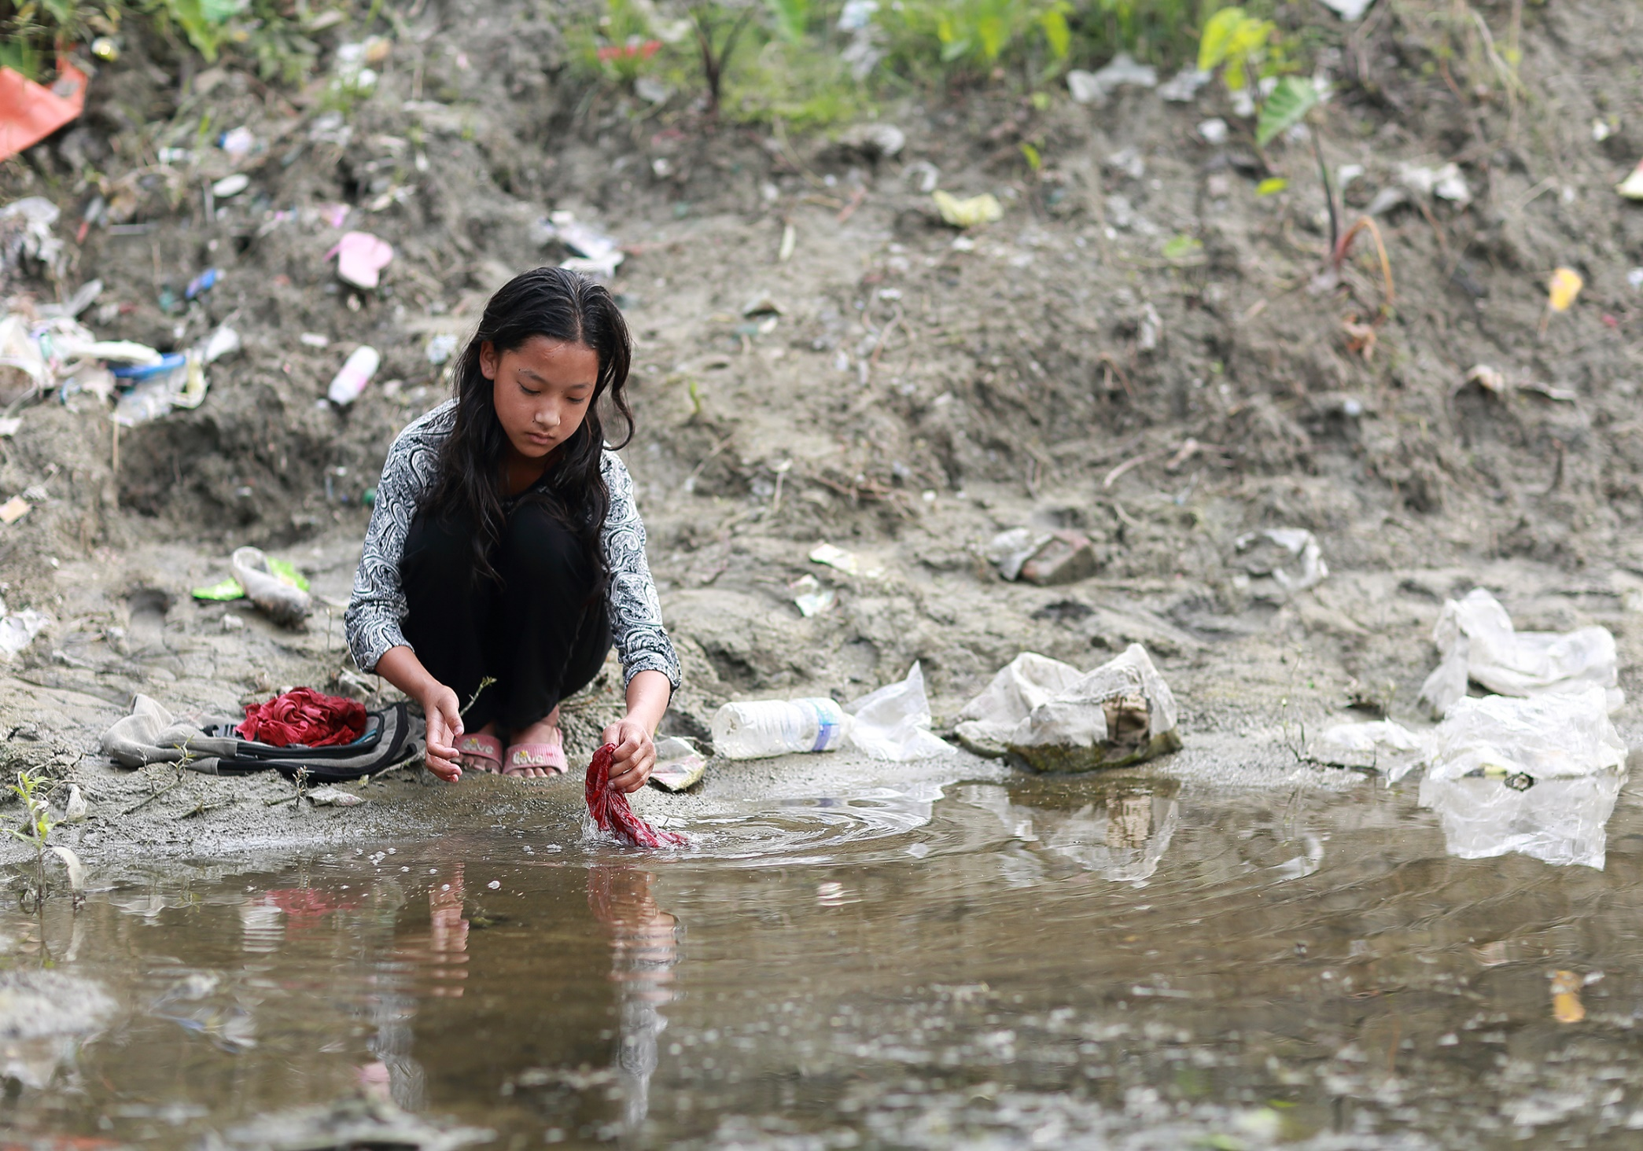

Slide 3

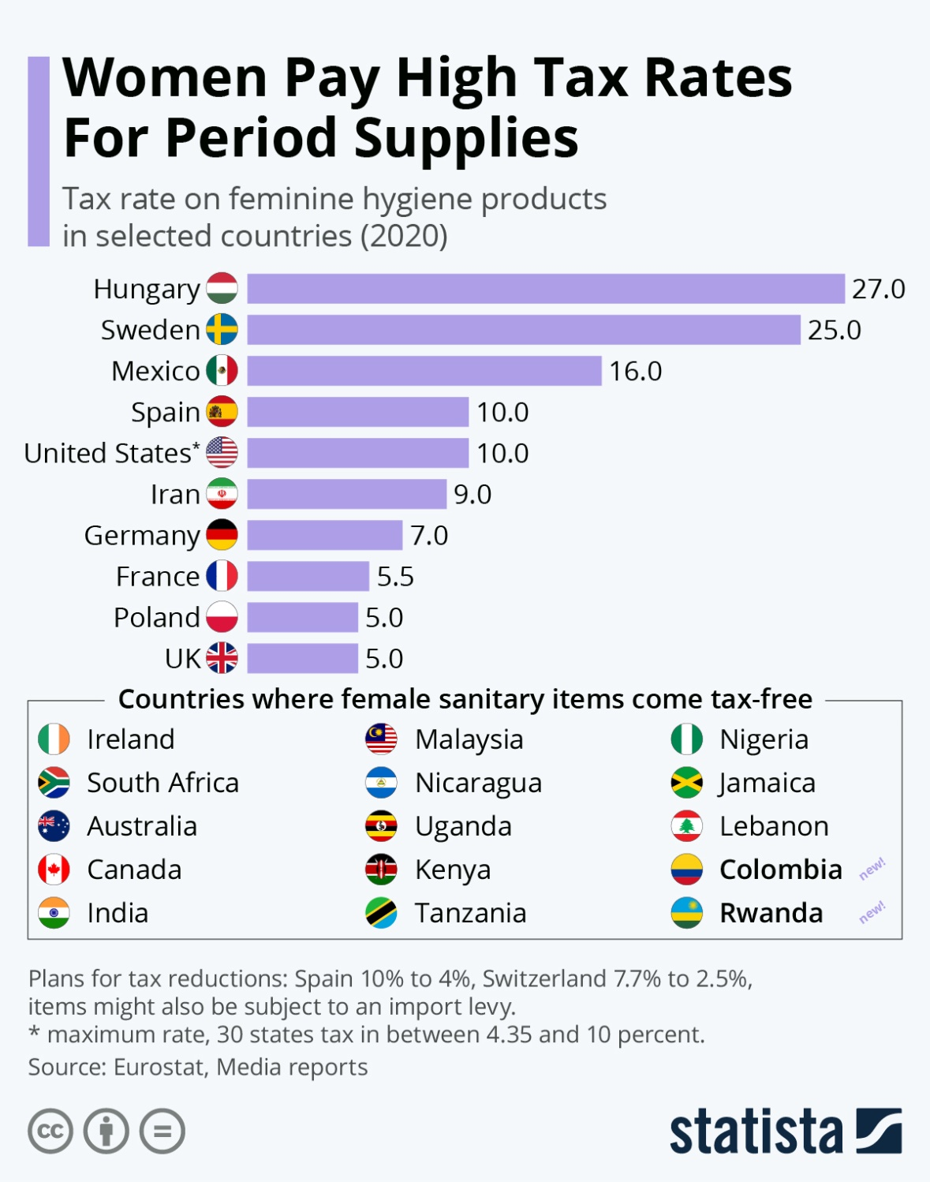
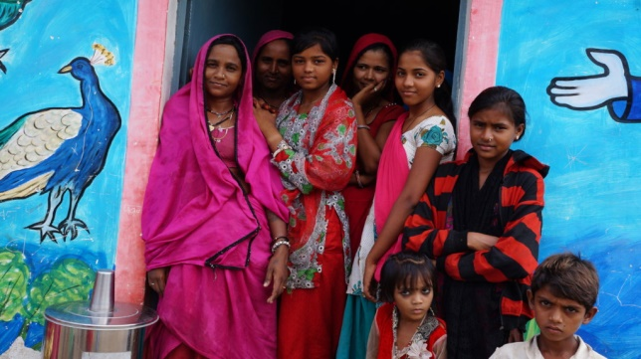

Slide 4

Giving Chain
Business Model
Donors
Farmers
Individuals
Community / Church Groups
Volunteers / Drivers
Pickup / Deliver:
Local volunteers
Community / Groups Transport
Recipients
Food Banks
Social Services Offices
Individuals (off the grid)

Slide 5
Giving Hygiene Project
Donors
Wholesalers
Individuals
Community
Group
Volunteers / Drivers
Pickup / Deliver
Local Volunteers
Community / Groups Transport
Recipients
NGO, Social Services Offices
Schools/College Girls
Underprivileged
Village Women/girls
Marginalized and lower middle class populace

Slide 6
Examples of Impact Opportunity
  Define Project and team members.
  Select your challenge requirements.
  Define the scope of problem you are addressing.
  Why is blockchain needed to solve this problem?
  What is the size of the market? What demographics will you serve?
  Which industries will you impact? Any concurrent trends?
  What are some current solutions to the problem you identified? Do they work effectively?
  Who are the stakeholders involved? How are they thinking/feeling/acting currently?
  What are the geopolitical, cultural-social-economic factors that must be taken into consideration? What are some nuances and complexities that must be addressed?

