Slide 1
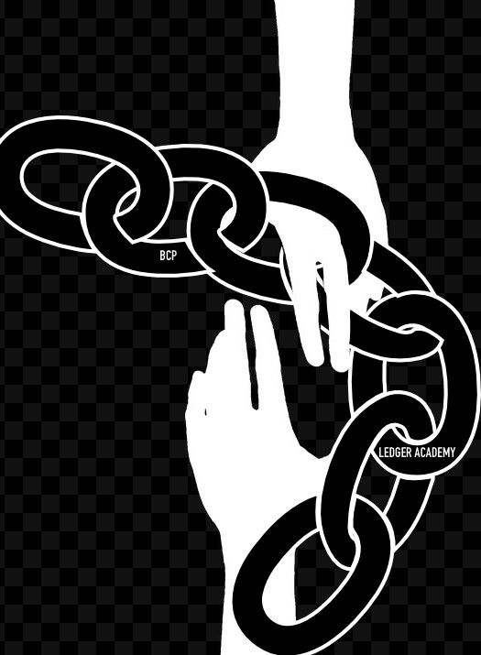
The Giving Chain
2021 Linux Foundation Mentorship Program
Technology Fact Finding: SAWTOOTH
August 6,2021

Slide 2
Introduction
Team
Bobbi Muscara
Project Manager – Hyperledger Giving Chain
Director Education Ledger Academy
Author of Linux Foundation Blockchain Courses for LFS171
Hyperledger TSC Member
Chair OF THE Learning Materials Working Group
Project
Hyperledger, Ledger Academy
The Giving Chain
&
The D2R Application
Hardik Gupta
Project Manager – Hyperledger Giving Chain
Member OF THE Learning Materials Working Group
The Giving Chain
Mentee / Project Management / Technical Lead
Madhu Bhatia
Project Manager – Hyperledger Giving Chain
DLT Talent program of Frankfurt School of Finance and Management
Blockchain Center
2021 LiFT Scholarship Women in open-source
Research Scholar /Trainer
Check out our website for funding opportunities
www.TheGivingChain.org

Slide 3
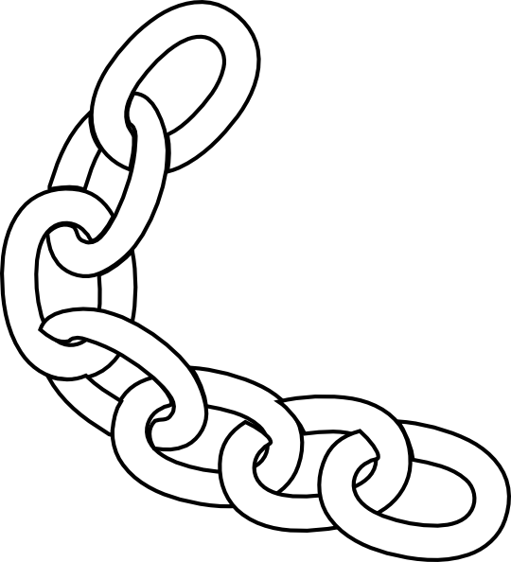
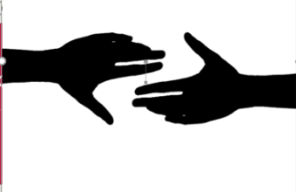
Blockchain and Social Responsibility
    Philanthropy and remittances
    Financial empowerment
    Identity and land rights
    Governance and democracy
    Supply chain and environmental protections
Notes:
We asked ourselves the question with what we know about blockchain and social impact projects, what can we do to have an impact in our community
Philanthropy and remittances (donation traceability, aid transparency, digital currencies in aid and development, governance and accountability)
Financial empowerment (financial inclusion, microfinance, microinsurance)
Identity and land rights (refugee assistance, land ownership documentation)
Governance and democracy (fighting censorship and fake news, voting rights and protections, election integrity)
Supply chain and environmental protections (sustainable supply chain, fair trade, ethical sourcing, fair labor practices

Slide 4
How We Did It
“The Giving Chain”
The New Model for Charity Giving
  BCPrinceton Checkpoints
Checkpoint 1: Impact Opportunity
Checkpoint 2: Business Model Validation
Checkpoint 3: Technical Architecture
Checkpoint 4: Business Development
Checkpoint 5: Product Development
Checkpoint 6: Final Project Delivery
Notes:
By Working thru 6 checkpoints we designed a project / prototype / proof of concept that had a positive impact on our local society. Addressing the needs of the community. The result was a project called The Giving Chain and the Hyperledger based D2R application.

Slide 5

The Giving Chain
Uses blockchain technology to develop an agile and transparent network for connecting surplus food and supplies to communities in need, impacting the local charity giving model.
Notes:
We designed a logo that represented the idea that thru blockchain anonymous decentralized charity giving can happen on a community level . We chose the hands reaching out joined by a chain to represent this.

Slide 6
Giving Chain
Business Model
Donors
Farmers
Individuals
Community / Church Groups
Volunteers / Drivers
Pickup / Deliver:
Local volunteers
Community / Groups Transport
Recipients
Food Banks
Social Services Offices
Individuals (off the grid)
Notes:
The business model we defined created a dignified system that matches local individuals who want to donate with recipient in need. In our use case we match local New Jersey farmers who have excess produce in August with food insecure Veterans and local area food banks.

Slide 7
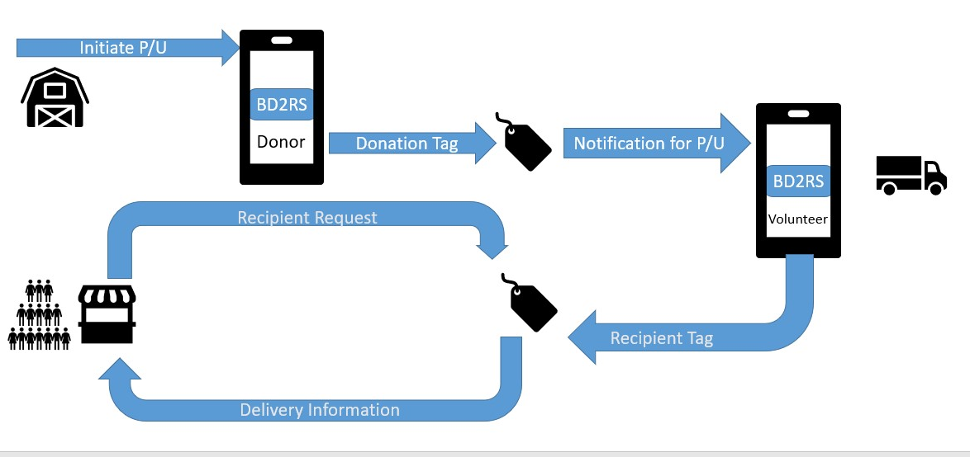
Technical Modeling

Slide 8
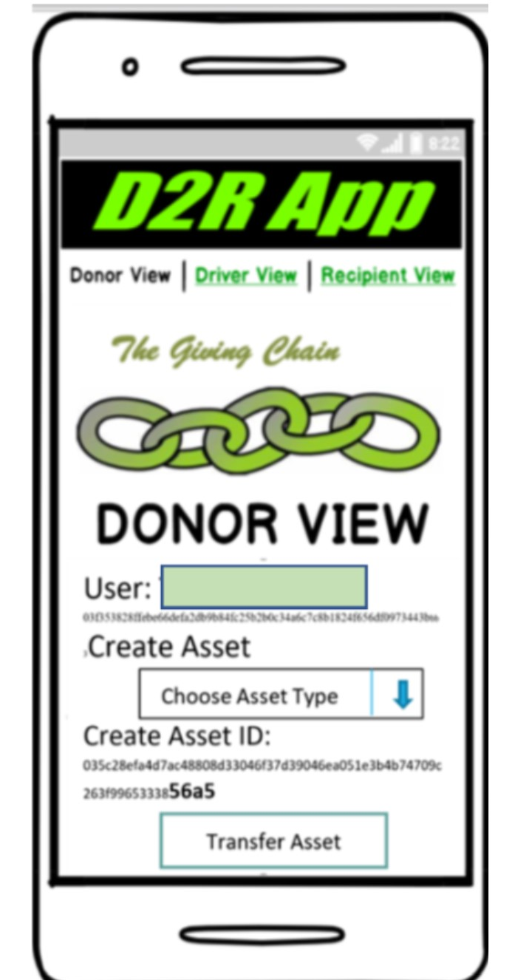
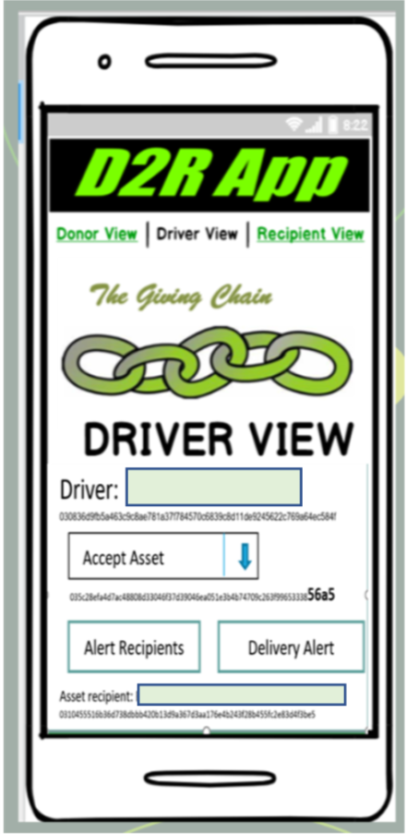
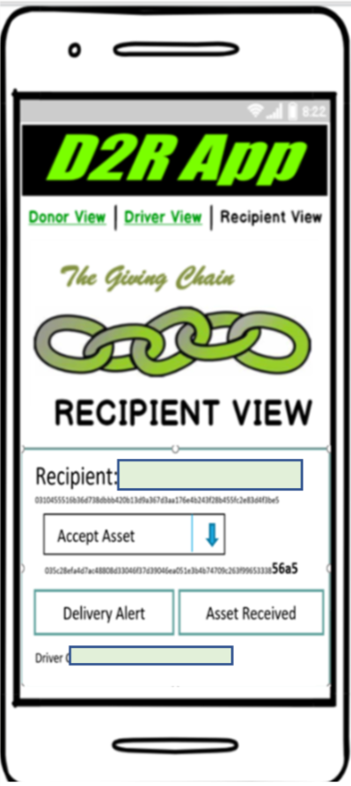
How does it work
Notes:
The project relies on the D2R application built on an instance of Hyperledger Sawtooth. Comprised of three interface to interact with the blockchain, the DONOR VIEW the DRIVER VIEW and the RECIPENT VIEW.

Slide 9
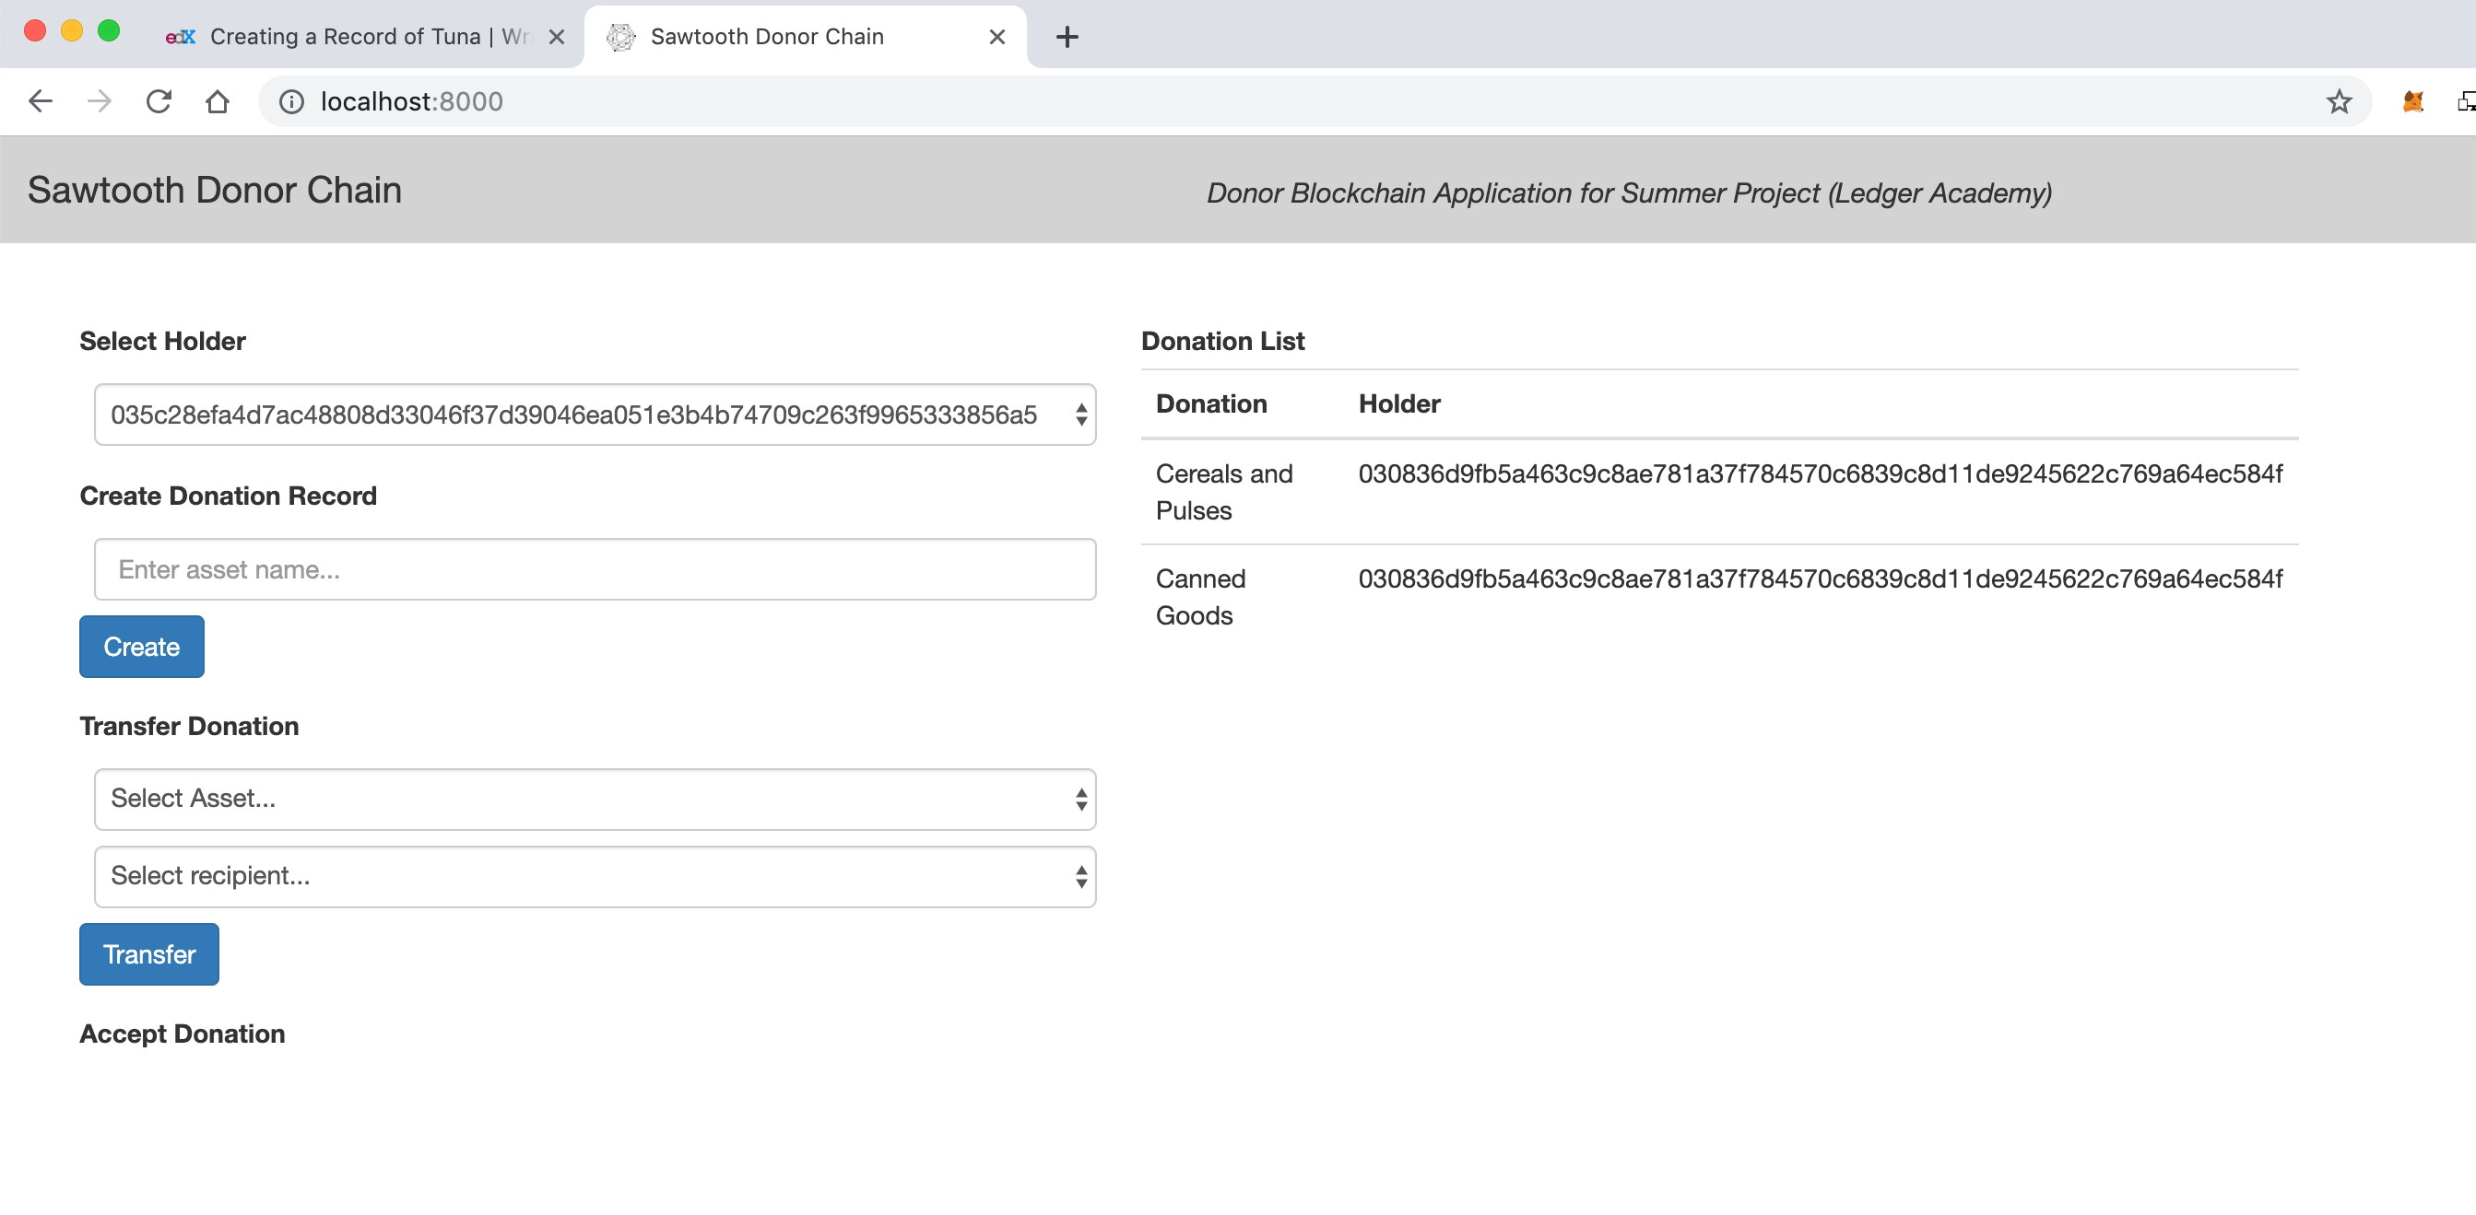
Donor Blockchain - View
Unique Identifier for the Donor/holder who creates the asset. (****56a5)
Donation is given a name with a unique identifier for the asset.

Slide 10
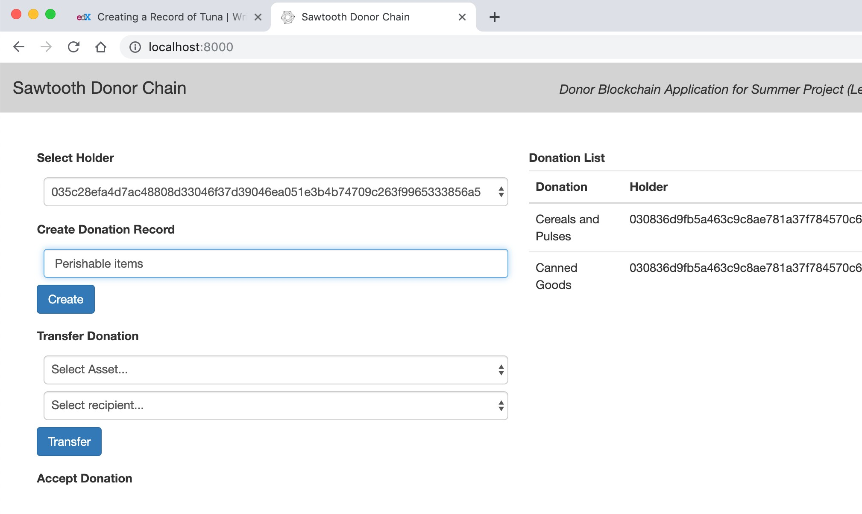
Donor Blockchain - Donation record
Donor named asset Perishable items
System associates a unique identifier ****l282.
System alerts Driver of the asset (****l282)
086d9fb5a3c9c8ae781a37f784570c6839c8d11de9245622c769agc5tdrl282

Slide 11
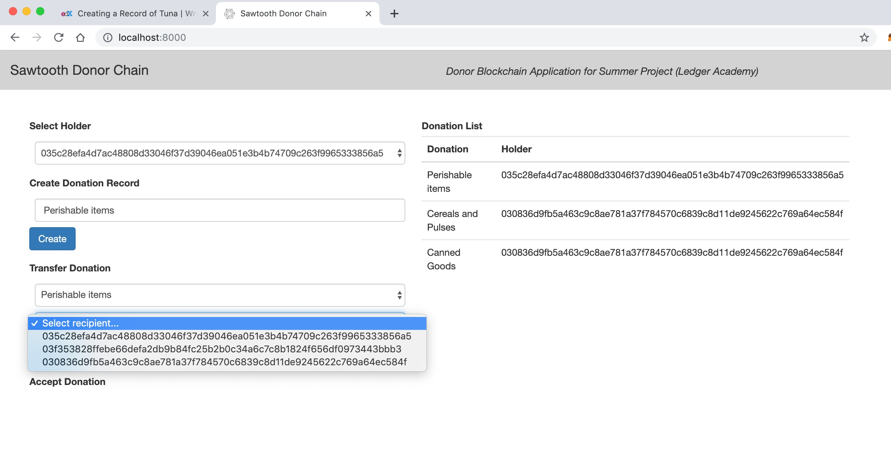
Driver Blockchain - Transfer
Perishable Item 086d9fb5a3c9c8ae781a37f784570c6839c8d11de9245622c769agc5tdrl282
Drivers are alerted asset Perishable items ( ****l282)

Slide 12
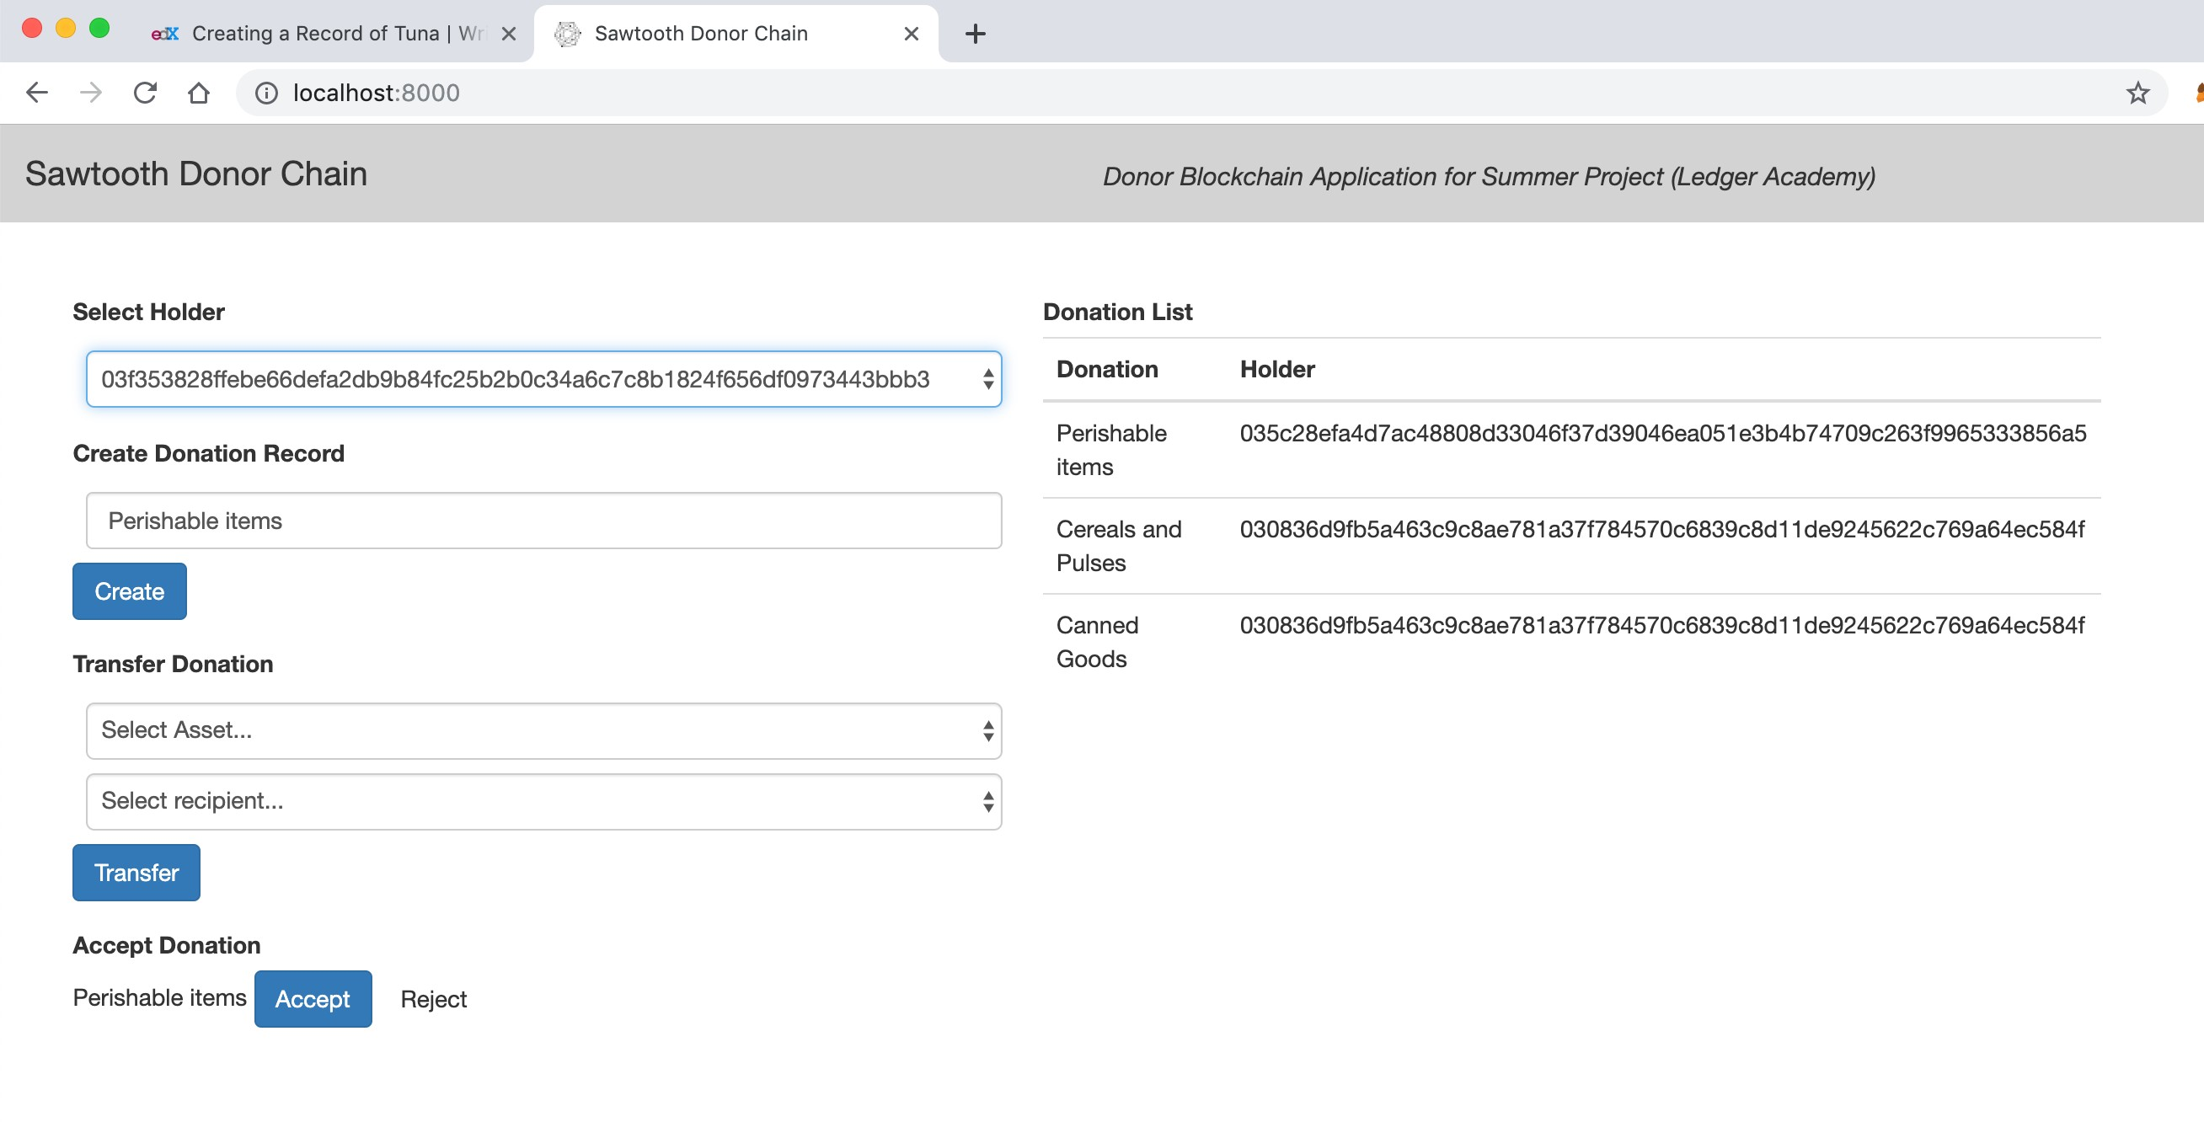
Driver Blockchain - Transfer
Unique Identifier for the Driver who accepts the donation
System alerts Recipients of the asset Perishable Items (****l282)
086d9fb5a3c9c8ae781a37f784570c6839c8d11de9245622c769agc5tdrl282

Slide 13
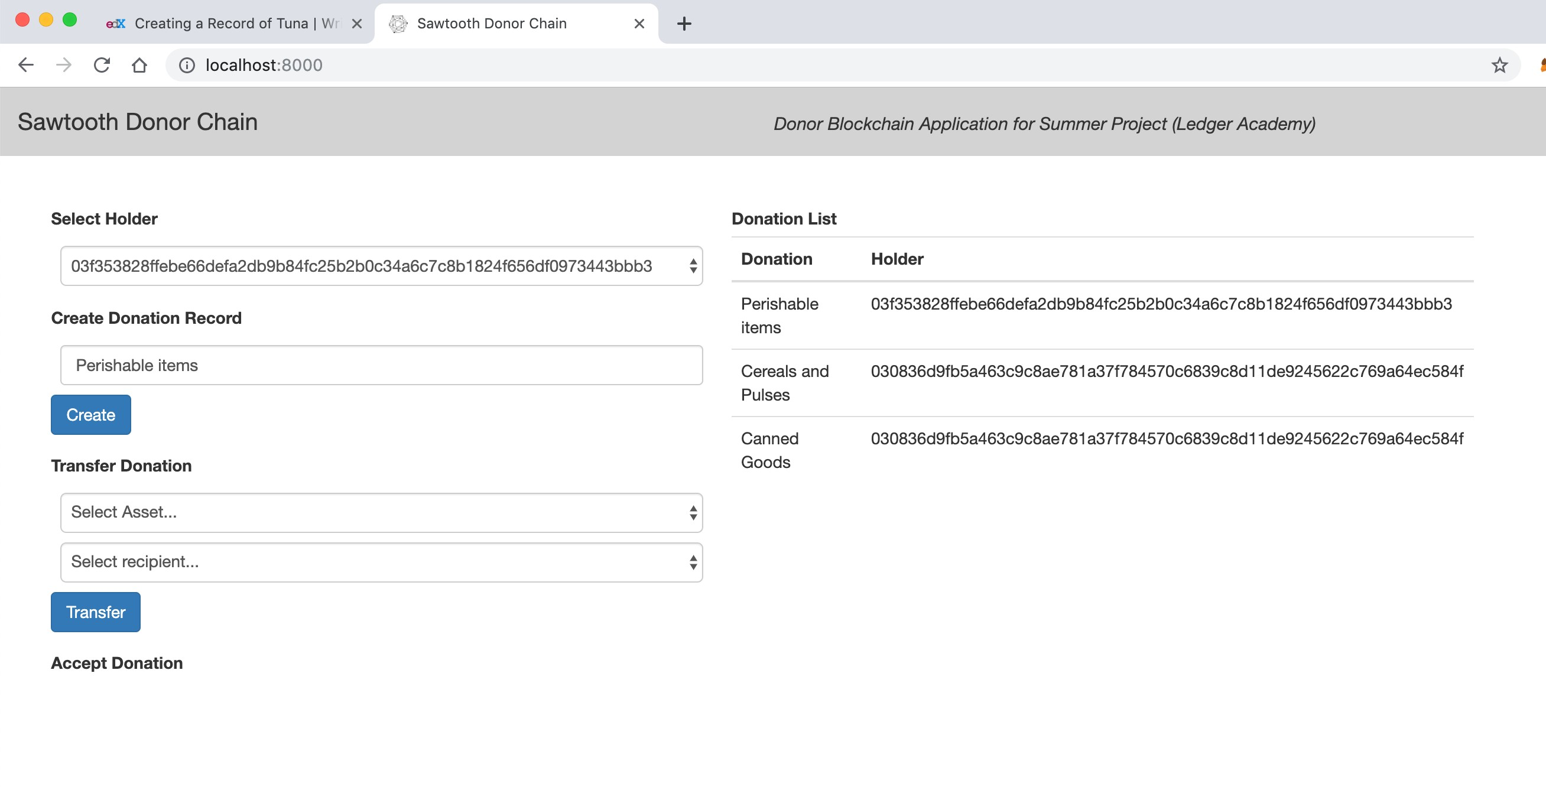
Recipient Blockchain - Change in Holder
086d9fb5a3c9c8ae781a37f784570c6839c8d11de9245622c769agc5tdrl282
System alerts Recipients of the asset ( Perishable Items ****l282), first recipient to accept initiates driver's delivery.

Slide 14
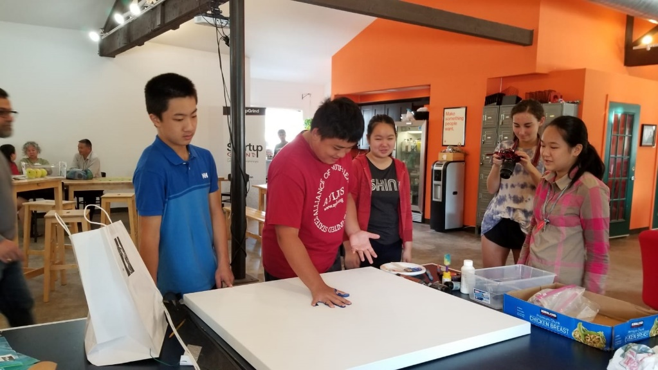

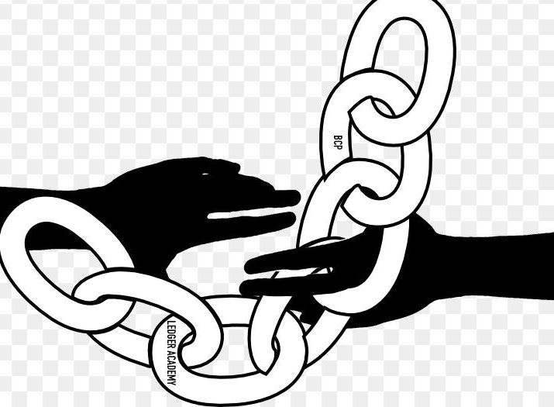
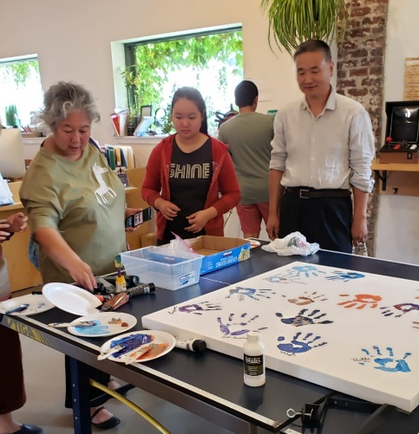


Slide 15

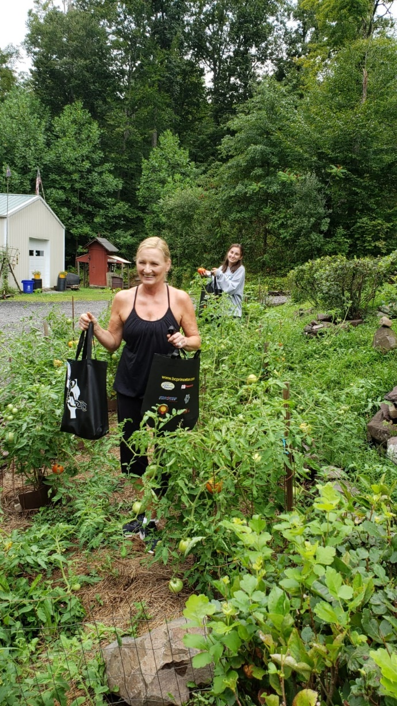
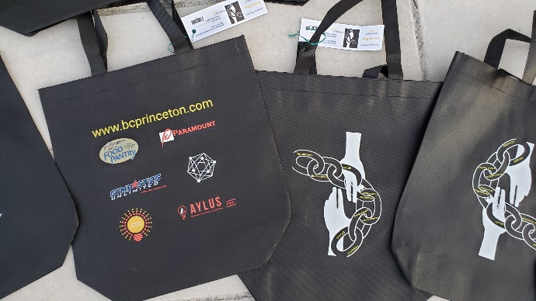
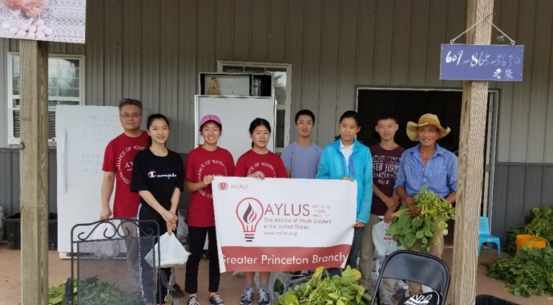
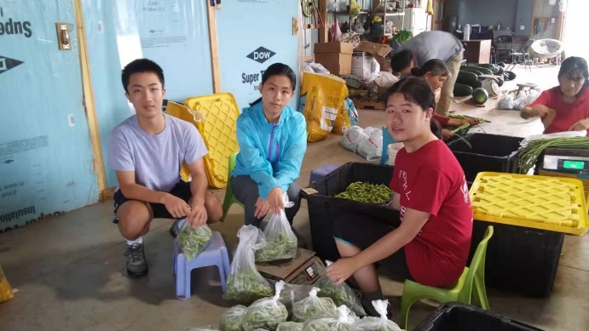

Slide 16
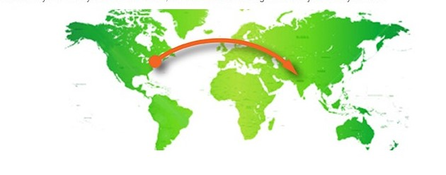
2021

Slide 17

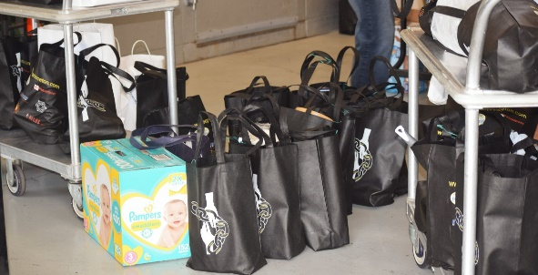
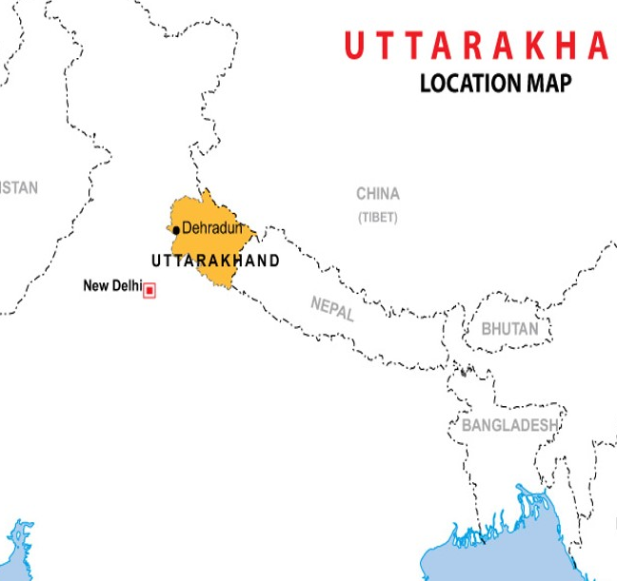
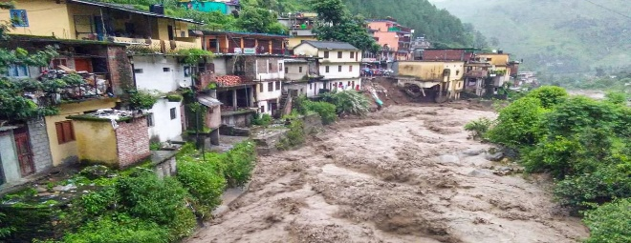

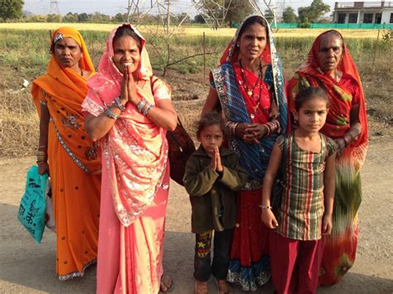
Giving Chain Projects 2021
Giving Chain
Princeton
Giving Chain
India / Uttarakhand
Giving Chain
India Women
Notes:
An estimated 355 million Indian women and girls must find ways to cope with monthly menstrual hygiene. Most o A majority of rural women in India employ clothes and rags for feminine hygiene. These materials might predispose women to reproductive tract infections since it may be difficult for them to keep their used napkins clean and free of harmful bacteria. Washing reusable feminine products with soap and drying them in sunlight may be difficult due to lack of water, private facilities, and cultural taboos associated with menstruation.

Slide 18
Checkpoint 1: Impact Opportunity
Princeton
  Select your challenge.
Develop an agile & transparent network for connecting surplus foods & supplies to communities in need.
To create a decentralized system that collect excess food supplies from local resources and distributes these resources to local food insecure individuals.
  Define the scope of problem
For our summer project, we are limiting the POC to a small number of local farmers with excess food supplies (two pick up dates TBD ) to be picked up by transportation volunteers who will transport food supplies to agreed upon drop off point .
  Why is blockchain needed to solve this problem
A supply chain model has been determined to be the best way to initiate, track and deliver excess food supplies. The above model has many unknown individuals who do not need to form a relationship with the parties at the other end of the supply chain.

Slide 19
Checkpoint 1: Impact Opportunity
India - Uttarakhand
  Select your challenge.
Develop an agile & transparent network for connecting supplies and aid to flood damaged communities in need. To create a decentralized system that collect needed supplies from local resources and crowdfunding efforts and distributes these resources to flood victims.
  Define the scope of problem
For our summer project, we are limiting the POC to Uttarakhand flood victims . Supplies collected and purchased to be picked up by transportation volunteers who will transport food supplies to agreed upon drop off point .
  Why is blockchain needed to solve this problem
A supply chain model has been determined to be the best way to initiate, track and deliver supplies.
Notes:
We asked ourselves the question with what we know about blockchain and social impact projects, what can we do to have an impact in our community
Philanthropy and remittances (donation traceability, aid transparency, digital currencies in aid and development, governance and accountability)
Financial empowerment (financial inclusion, microfinance, microinsurance)
Identity and land rights (refugee assistance, land ownership documentation)
Governance and democracy (fighting censorship and fake news, voting rights and protections, election integrity)
Supply chain and environmental protections (sustainable supply chain, fair trade, ethical sourcing, fair labor practices
Introduction: Project and Team
The Giving Chain 2019
Hyperledger Mentorship Program
Project Overview
Teams (Expectations) (Focus)
Introduction from Members on Call

Slide 20
Checkpoint 1: Impact Opportunity
India - Women
  Select your challenge.
Develop an agile & transparent network for connecting supplies for the women in crisis in India. Create a dignified distribution system for hygiene products to women by crowdfunding, purchasing and distributing these resources to women in rural areas in India.
  Define the scope of problem
For our summer project, we are limiting the POC to Rural area in India. Supplies purchased will be e picked up by transportation volunteers who will transport hygiene supplies to drop off point in rural areas.
  Why is blockchain needed to solve this problem
A supply chain model has been determined to be the best way to initiate, track and deliver supplies.
Notes:
We asked ourselves the question with what we know about blockchain and social impact projects, what can we do to have an impact in our community
Philanthropy and remittances (donation traceability, aid transparency, digital currencies in aid and development, governance and accountability)
Financial empowerment (financial inclusion, microfinance, microinsurance)
Identity and land rights (refugee assistance, land ownership documentation)
Governance and democracy (fighting censorship and fake news, voting rights and protections, election integrity)
Supply chain and environmental protections (sustainable supply chain, fair trade, ethical sourcing, fair labor practices
Introduction: Project and Team
The Giving Chain 2019
Hyperledger Mentorship Program
Project Overview
Teams (Expectations) (Focus)
Introduction from Members on Call

Slide 21
Checkpoint 2: Model Validation (questions)
Who are your clients/users? Sketch your user.
What are their pain points? How does your solution solve them?
        Can it be scaled?
Donors
Volunteers / Drivers
Recipients

Slide 22
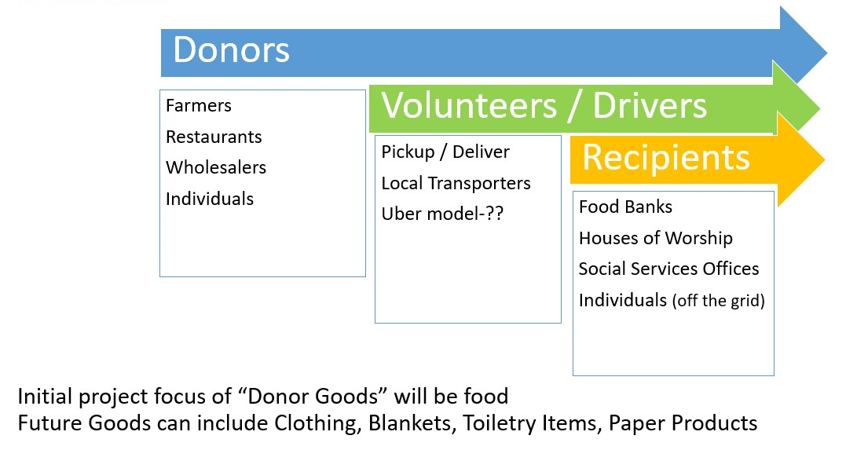
Checkpoints 2 Model Validation
Princeton

Slide 23
Checkpoints 2 Model Validation
India - Uttarakhand
Donors
Farmers
Restaurants
Wholesalers
Individuals
Volunteers / Drivers
Pickup / Deliver
Local Transporters
Recipients
Food Banks
NGO
Schools

Slide 24
Checkpoints 2 Model Validation
India - Women
Donors
Wholesalers
Individuals
Community
Group
Volunteers / Drivers
Pickup / Deliver
Local Volunteers
Community / Groups Transport
Recipients
NGO, Social Services Offices
Schools/College Girls
Underprivileged
Village Women/girls
Marginalized and lower middle class populace
Notes:
SWaCH, a self-governing organization that provides waste management services to citizens of Pune in west India, recently brought attention to the issue of waste pickers' exposure to infections and other health hazards due to handling feminine hygiene discards. They highlighted the lack of disposable bags for each used sanitary pad, making its disposal hazardous to both those who handle waste and the environment. Disposable sanitary napkins are seen littering dry riverbeds, roadsides, and streets.

Slide 25
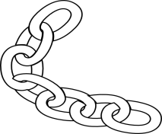
Checkpoint 3 Business and Technical Modeling
Princeton: Business Model
Donors
Farmers
Individuals
Community / Church Groups
Volunteers / Drivers
Pickup / Deliver:
Local volunteers
Community / Groups Transport
Recipients
Food Banks
Social Services Offices
Individuals (off the grid)
Notes:
To connect donors with receipts
Capture and verify the quantity and transfer of donations
Track where donations are located at any time
Track where donation origin and destination but do not reveal their identity to the system.
The business model we defined created a dignified system that matches local individuals who want to donate with recipient in need. In our use case we match local New Jersey farmers who have excess produce in August with food insecure Veterans and local area food banks.

Slide 26
Checkpoint 3 Business and Technical Modeling
Princeton: Technical Business Model

Slide 27
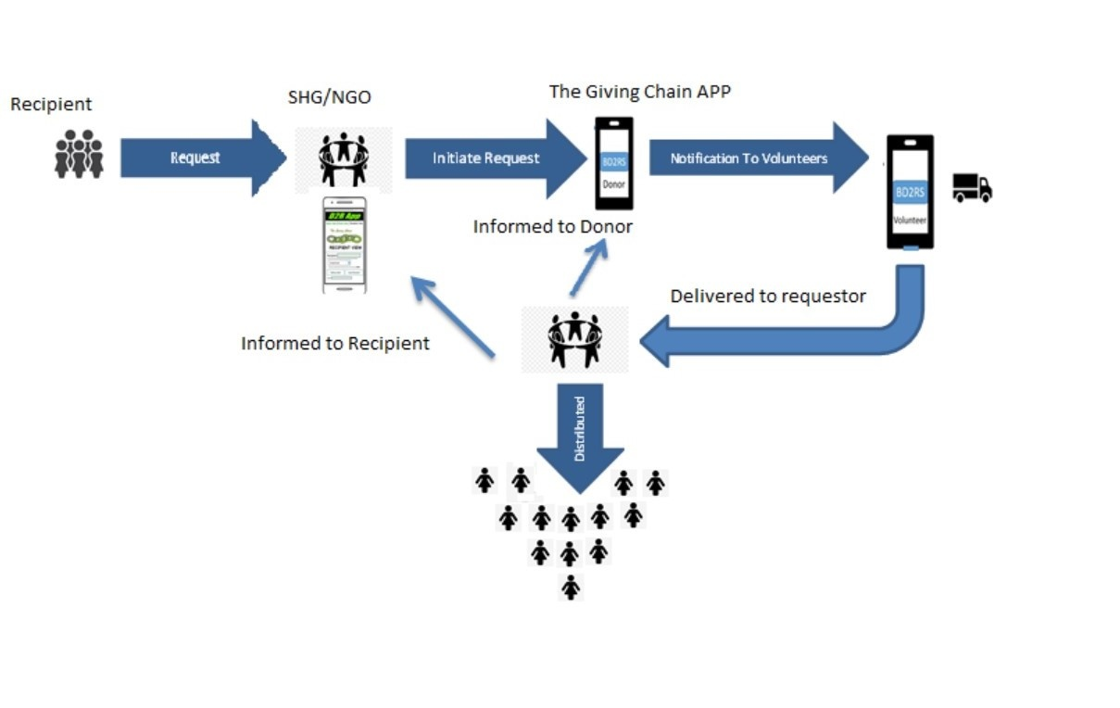
Giving Chain – India Women

Slide 28
TRANSACTIONS IN OUR WORKFLOW:
*help to identify the implicit transactions and features to be supported by this blockchain application solution via business network APIs.
Identify an initial list of Donors who will donate. List will expand with additional Donors.
Identify the location of the Donors. Locations will expand with additional Donors.
Identify an initial list of Transporters - an initial list which will expand as additional Donors volunteer their services.
Identify the location of Transporters. Locations will expand with additional Donors.
Identify attributes of Donors, Donors, Transporters that will help with identification and communication to ensure supply pipeline efficiency.
Donor provides notification that they have a food supply ready for pickup by Transporters for delivery to Consumers.
The Donor indicates the available quantity of food they are supplying.
Transporter monitors the blockchain to determine when food is available for pickup.
Transporter matches the Donor supply with specific Consumers (whose daily needs have not been filled) to whom they can deliver this food supply.
Transporter volunteers to pickup the available supplies and deliver to specific Consumers (criteria may be location proximity).
Transporter picks up the available food supply from the Donor.
Transporter delivers the available food supply to the Consumers.
Transporter records that they have provided this service.
The Donor's quantity of food supply available for transport is decremented.
The Consumer is checked-off as having had their daily needs filled.
If additional quantities of food is still available from this Donor, the Donor notification remains active else it is closed.
Application metrics are updated (e.g., quantify the amount of food delivered, the cost of delivered food, etc.) for analytics.
At the end of day, all pending transactions are closed to reset for a new day of deliveries.

Slide 29
Technology Development
Define Technology requirements
Plan out project Specifications
Develop prototype
Steps
Enter Hyperledger Lab - Space for Tech Team To work
Decide on blockchain ( can it scale as we add features?)

Slide 30
Issues from First Project
Questions for Sawtooth

Slide 31
Business Development
Date for Project Labor Day weekend
September 3,4 and 5, 2021
  Ads
  Social Media
  Tee Shirts

Slide 32
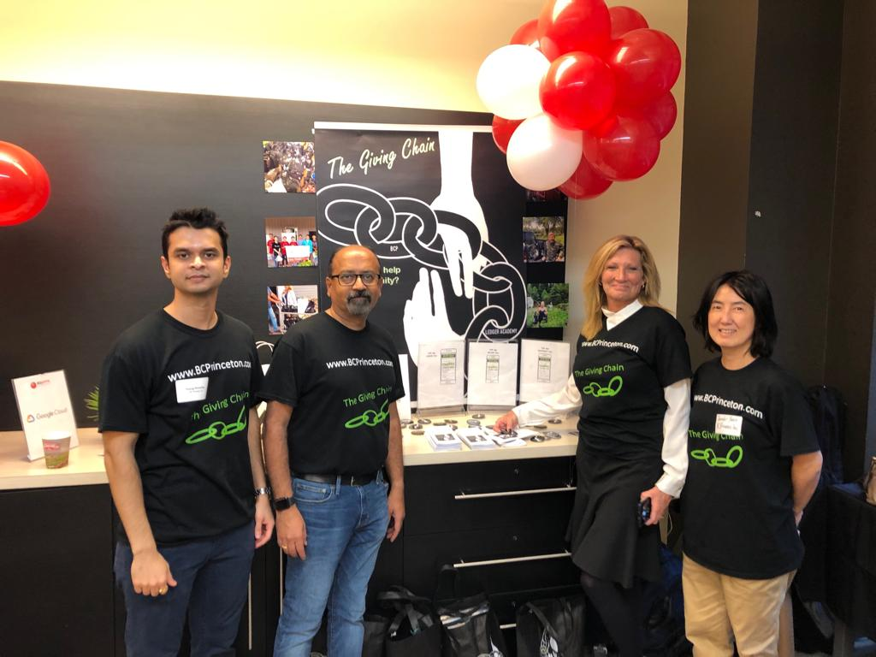
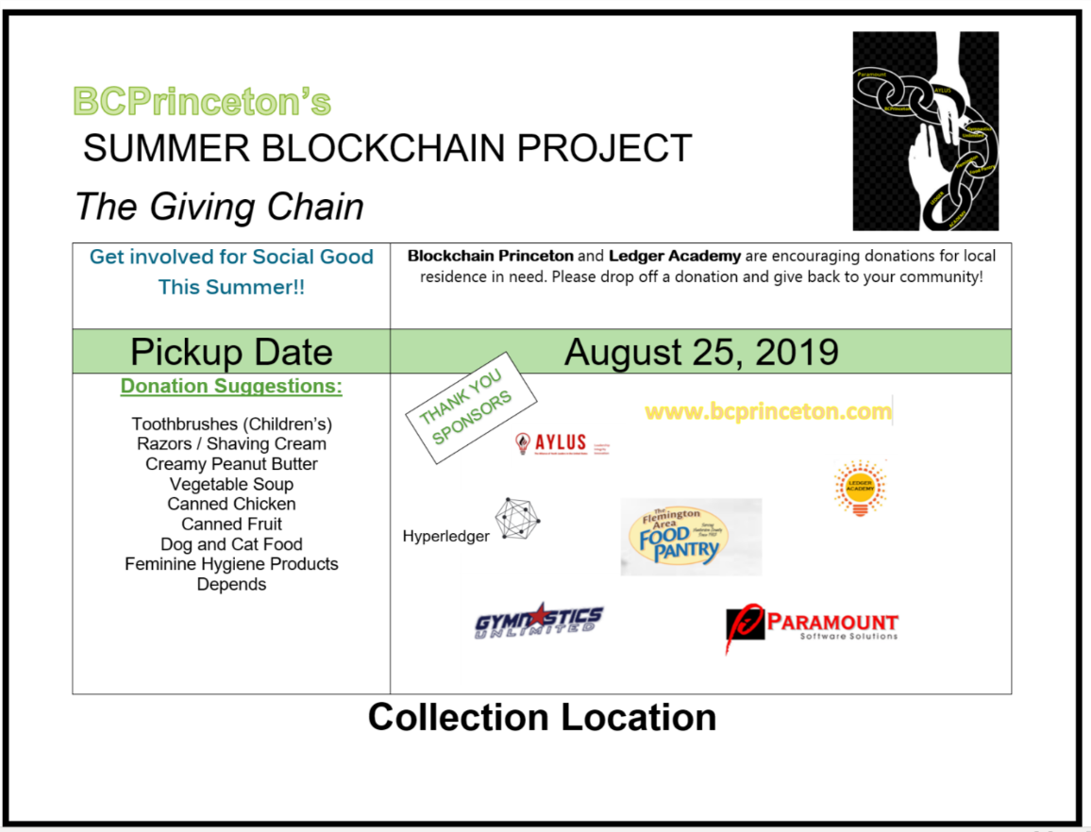
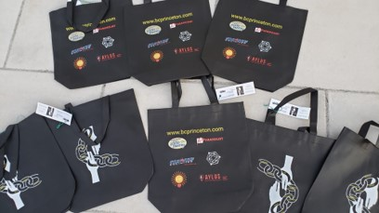

Slide 33
Business Development
Web Site www.thegivingchain.org
Organize meetups ( invite and presentations)
https://www.meetup.com/Blockchain-Princeton/events/279568123/
Update Wiki Page
https://wiki.hyperledger.org/display/INTERN/Project+Pages+and+Resources
Be a Social Media pioneer
https://www.facebook.com/TheGivingChain
https://www.instagram.com/thegivingchain/
https://t.me/BCPrinceton
https://twitter.com/bc_princeton
LinkedIn Group: ​https://www.linkedin.com/groups/9055378/https://wiki.hyperledger.org/pages/viewpage.action?pageId=51613841
To Do:
Design Tee shirts and Marketing Materials
Presentation - for fund raising Elevator slides

Slide 34
Tech Team Steps
Decide on Platform – We decided on Sawtooth
Make space to work on our version of the sawtooth platform (hence referred to as the Giving Chain )
Explain Github – What it is ( working space for developer.) How it works ( fork or copy code to your new directory ( )
Previous code from 2019
Working this week on merging old code with new sawtooth and collected data refence points.

Slide 35
Sawtooth
Originally contributed by Intel, Sawtooth is a blockchain suite designed for versatility and scalability. Distributed Ledger Technology has potential in many fields with use cases from IoT to Financials. This architecture recognizes the diversity of requirements across that spectrum. Sawtooth supports both permissioned and permissionless deployments. It includes a novel consensus algorithm, Proof of Elapsed Time (PoET). PoET targets large distributed validator populations with minimal resource consumption. Transaction business logic is decoupled from the consensus layer into Transaction Families that allow for restricted or unfettered semantics.

Slide 36
Key Characteristics
Pluggable consensus algorithms (Change consensus on the fly by transaction)
Includes Proof of Elapsed Time (PoET) consensus
Write smart contracts in almost any language
Ethereum contract support via Hyperledger Burrow integration
Supply Chain example out of the box
Parallel transaction execution for added throughput

Slide 37
Separation Between the Application Level and the Core System
Sawtooth makes it easy to develop and deploy an application by providing a clear separation between the application level and the core system level. Sawtooth provides smart contract abstraction that allows application developers to write contract logic in a language of their choice.
core system level
application level
native business logic or a smart contract virtual machine
design decisions to be made in the transaction-processing layer, which allows multiple types of applications to exist in the same instance of the blockchain network.

Slide 38
Ethereum Contract Compatibility with Seth
The Sawtooth-Ethereum integration project, Seth, extends the interoperability of the Sawtooth platform to Ethereum. EVM (Ethereum Virtual Machine) smart contracts can be deployed to Sawtooth using the Seth transaction family.
Dynamic Consensus
In a blockchain, consensus is the process of building agreement among a group of participants in a network. Algorithms for achieving consensus with arbitrary faults generally require some form of voting among a known set of participants. General approaches include Nakamoto-style consensus, which elects a leader through some form of lottery, and variants of the traditional Byzantine Fault Tolerance (BFT) algorithms, which use multiple rounds of explicit votes to achieve consensus.

Slide 39
Private Networks with the Sawtooth Permissioning Features
Sawtooth is built to solve the challenges of permissioned (private) networks. Clusters of Sawtooth nodes can be easily deployed with separate permissioning. There is no centralized service that could potentially leak transaction patterns or other confidential information.
The blockchain stores the settings that specify the permissions, such as roles and identities, so that all participants in the network can access this information.
Parallel Transaction Execution
Most blockchains require serial transaction execution in order to guarantee consistent ordering at each node on the network. Sawtooth includes an advanced parallel scheduler that splits transactions into parallel flows. Based on the locations in state which are accessed by a transaction, Sawtooth isolates the execution of transactions from one another while maintaining contextual changes.
When possible, transactions are executed in parallel, while preventing double-spending even with multiple modifications to the same state. Parallel scheduling provides a substantial potential increase in performance over serial execution.
Event System
Hyperledger Sawtooth supports creating and broadcasting events. This allows applications to:
Subscribe to events that occur related to the blockchain, such as a new block being committed or switching to a new fork.
Subscribe to application specific events defined by a transaction family.
Relay information about the execution of a transaction back to clients without storing that data in state.

Slide 40
The Sawtooth consensus API supports a wide variety of consensus algorithms on a network. Sawtooth currently includes consensus engines for these algorithms:
Sawtooth PBFT (Practical Byzantine Fault Tolerance) is a voting-based consensus algorithm that provides Byzantine fault tolerance with finality. Sawtooth PBFT extends the original PBFT algorithm with features such as dynamic network membership, regular view changes, and a block catch-up procedure. A Sawtooth network with PBFT consensus requires four or more nodes.
PoET (Proof of Elapsed Time) is a Nakamoto-style consensus algorithm that is designed to be a production-grade protocol capable of supporting large network populations. PoET relies on secure instruction execution to achieve the scaling benefits of a Nakamoto-style consensus algorithm without the power consumption drawbacks of the Proof of Work algorithm. A Sawtooth network with PoET consensus requires at least three nodes.
Sawtooth includes two versions of PoET consensus:
  PoET-SGX relies on a Trusted Execution Environment (TEE), such as Intel® Software Guard Extensions (SGX), to implement a leader-election lottery system. PoET-SGX is sometimes called “PoET/BFT” because it is Byzantine fault tolerant.
  PoET simulator provides PoET-style consensus on any type of hardware, including a virtualized cloud environment. PoET simulator is also called “PoET/CFT” because it is crash fault tolerant, not Byzantine fault tolerant.
Sawtooth Raft is a leader-based consensus algorithm that provides crash fault tolerance for a small network with restricted membership.
Devmode (short for “developer mode”) is a simplified random-leader algorithm that is useful for developing and testing a transaction processor. Devmode is not recommended for multi-node networks and should not be used for production

Slide 41
Sawtooth Supply Chain: Demonstrates how to trace the provenance and other contextual information of any asset. Supply Chain provides an example application with a transaction processor, custom REST API, and web app. This example application also demonstrates a decentralized solution for in-browser transaction signing and illustrates how to synchronize the blockchain state to a local database for complex queries. For more information, see the sawtooth-supply-chain repository on GitHub.

Slide 42
Transaction Family Overview
Sawtooth separates the application level from the core system level with transaction families, which allows application developers to write in the languages of their choice. Each application defines the custom transaction families for its unique requirements.
A transaction family includes these components:
A transaction processor to define the business logic for your application
A data model to record and store data
A client to handle the client logic for your application
See Transaction Family Specifications for a list of example transaction families. Sawtooth provides these examples to serve as models for low-level functions (such as maintaining chain-wide settings and storing on-chain permissions) and for specific applications such as performance analysis and storing block information.

Slide 43
Sawtooth Supply Chain: Demonstrates how to trace the provenance and other contextual information of any asset. Supply Chain provides an example application with a transaction processor, custom REST API, and web app. This example application also demonstrates a decentralized solution for in-browser transaction signing, and illustrates how to synchronize the blockchain state to a local database for complex queries. For more information, see the sawtooth-supply-chain repository on GitHub.

Slide 44
Try Hyperledger Sawtooth
The Sawtooth documentation explains how to set up a local validator for demonstrating Sawtooth functionality and testing an application.
Once running, you will be able to submit new transactions and fetch the resulting state and block data from the blockchain using HTTP and the Sawtooth REST API.
These methods apply to the included example transaction families, as well as to any transaction families you might write yourself.

Slide 45
Get the Sawtooth Software
The Sawtooth software is distributed as source code with an Apache license. You can get the code to start building your own distributed ledger.
sawtooth-core: Contains fundamental classes used throughout the Sawtooth project, as well as the following items:
  The implementation of the validator process which runs on each node
  SDKs for writing transaction processing or validation logic in a variety of languages
  Dockerfiles to support development or launching a network of validators
  Source files for this documentation
Sawtooth PBFT: Use PBFT consensus with Sawtooth
Sawtooth Sabre: Run on-chain smart contracts executed in a WebAssembly virtual machine
Sawtooth Seth: Deploy Ethereum Virtual Machine (EVM) smart contracts to Sawtooth
Sawtooth Marketplace: Exchange customized “assets” with other users on the blockchain
Sawtooth Supply Chain: Trace the provenance and other contextual information of any asset
Join the Sawtooth Community

Slide 46
Sawtooth can be run from a pre-built Docker container, from a Kubernetes cluster inside a virtual machine on your computer, or on a native Ubuntu installation.

Slide 47
About Sawtooth Networks
Using Docker for a Sawtooth Test Network
  About the Docker Sawtooth Network Environment
  Prerequisites
  Step 1: Download the Docker Compose File
  Step 2: Start the Sawtooth Network
  Step 3: Check the REST API Process
  Step 4: Confirm Network Functionality
  Step 5. Configure the Allowed Transaction Types (Optional)
  Step 6: Stop the Sawtooth Network (Optional)
Using Kubernetes for a Sawtooth Test Network
  About the Kubernetes Sawtooth Network Environment
  Prerequisites
  Step 1: Install kubectl and minikube
  Step 2: Start Minikube
  Step 3: Download the Sawtooth Configuration File
  Step 4: (PBFT Only) Configure Keys for the Kubernetes Pods
  Step 5: Start the Sawtooth Cluster
  Step 6: Confirm Network and Blockchain Functionality
  Step 7. Configure the Allowed Transaction Types (Optional)
  Step 8: Stop the Sawtooth Kubernetes Cluster
Using Ubuntu for a Sawtooth Test Network
  About the Ubuntu Sawtooth Network Environment
  Prerequisites
  Step 1: Install Sawtooth on All Nodes
  Step 2: Create User and Validator Keys
  Step 3: Create the Genesis Block on the First Node
  Step 4. (PBFT Only) Configure Peers in Off-Chain Settings
  Step 5. Start Sawtooth on the First Node
  Step 6. Test the First Node
  Step 7: Start the Other Nodes
  Step 8: Confirm Network Functionality
  Step 9. (Optional) Configure the Allowed Transaction Types
Next Previous

Slide 48
Transaction Family Overview
Sawtooth separates the application level from the core system level with transaction families, which allows application developers to write in the languages of their choice. Each application defines the custom transaction families for its unique requirements.
A transaction family includes these components:
  A transaction processor to define the business logic for your application
  A data model to record and store data
  A client to handle the client logic for your application
See Transaction Family Specifications for a list of example transaction families. Sawtooth provides these examples to serve as models for low-level functions (such as maintaining chain-wide settings and storing on-chain permissions) and for specific applications such as performance analysis and storing block information.

Slide 49
Setting Up a Sawtooth Node for Testing
Before you can start developing for the Hyperledger Sawtooth platform, you’ll need to set up a local Sawtooth node to test your application against.
Once the node is running, you will be able to submit new transactions and fetch the resulting state and block data from the blockchain using HTTP and the Sawtooth REST API.
The methods explained in this section apply to the example transaction processors, IntegerKey and XO, as well as any transaction processors you might write yourself.

Slide 50
Using Docker for a Single Sawtooth Node
This procedure explains how to set up Hyperledger Sawtooth for application development using a multi-container Docker environment.
It shows you how to start Sawtooth and connect to the necessary Docker containers, then walks you through the following tasks:
  Checking the status of Sawtooth components
  Using Sawtooth commands to submit transactions, display block data, and view global state
  Examining Sawtooth logs
  Stopping Sawtooth and resetting the Docker environment
After completing this tutorial, you will have the application development environment that is required for the other tutorials in this guide. The next tutorial introduces the XO transaction family by using the xo client commands to play a game of tic-tac-toe. The final set of tutorials describe how to use an SDK to create a transaction family that implements your application’s business logic.

Slide 51
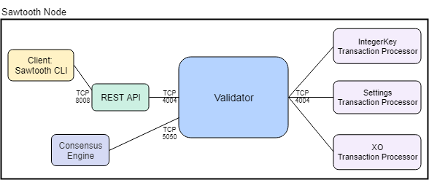
About the Docker Test Node Environment
This Docker environment is a single Sawtooth node that is running a validator, a REST API, the Devmode consensus engine, and three transaction processors. The environment uses Devmode consensus and parallel transaction processing.

Slide 52
This environment introduces basic Sawtooth functionality with the IntegerKey and Settings transaction processors for the business logic and Sawtooth commands as a client.
It also includes the XO transaction processor, which is used in later tutorials. The IntegerKey and XO families are simple examples of a transaction family, but Settings is a reference implementation.
In a production environment, you should always run a transaction processor that supports the Settings transaction family.
Note
The Docker environment includes a Docker Compose file that handles environment setup steps such as generating keys and creating a genesis block. To learn how the typical startup process works, see Using Ubuntu for a Single Sawtooth Node.

Slide 53
Step 1: Download the Sawtooth Docker Compose File
Download the Docker Compose file for the Sawtooth environment, sawtooth-default.yaml.
This example Compose file defines the process for constructing a simple Sawtooth environment with following containers:
  A single validator using Devmode consensus
  A REST API connected to the validator
  The Settings transaction processor (sawtooth-settings)
  The IntegerKey transaction processor (intkey-tp-python)
  The XO transaction processor (xo-tp-python)
A client (shell) container for running Sawtooth commands
The Compose file also specifies the container images to download from Docker Hub and the network settings needed for all the containers to communicate correctly.
After completing the tutorials in this guide, you can use this Compose file as the basis for your own multi-container Sawtooth development environment or application.

Slide 54
Step 2: Configure Proxy Settings (Optional)
To configure Docker to work with an HTTP or HTTPS proxy server, follow the instructions for proxy configuration in the documentation for your operating system:
Windows - See “Get Started with Docker for Windows”.
macOS - See “Get Started with Docker for Mac”.
Linux - See “Control and configure Docker with Systemd”.

Slide 55
Joining the Teams as a Project Manager
Technical Track (Define Tech requirements, Develop Prototype, Plan and Implement the Project, Determine and Deploy the environment.): https://wiki.hyperledger.org/display/INTERN/Technical+Track
Business Track (Map out the Project (Works on developing and refining the project idea), Make Connections, Track Project, Funding and Project financials.): https://wiki.hyperledger.org/display/INTERN/Business+Track
Add “Project Manager” in the Talent column.

Slide 56
Introduction To Member
Let us start with an introduction of all the members present here
Please add your name, email and area of interest / talents to our team page:
https://wiki.hyperledger.org/display/INTERN/Team+Information
Work will be completed in Hyperledger Wiki Pages
https://wiki.hyperledger.org/display/INTERN/Project+Plan+Giving+Chain

Slide 57
Crowd Funding
Both the links are present at: https://thegivingchain.org/
Corporate Funding (For the project development): https://crowdfunding.lfx.linuxfoundation.org/projects/hyperledger-the-giving-chain
General Funding (For the use of buying goods): https://crowdfunding.lfx.linuxfoundation.org/initiative/fabcd0b5-cecb-452b-a7e1-55bf31065c4a
The General Funds will be fairly distributed among the Project Mangers and will be exhausted at the end of the project.

Slide 58
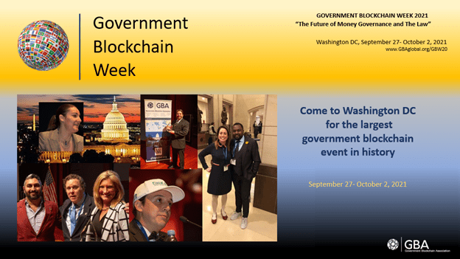
Government Blockchain Association

Slide 59
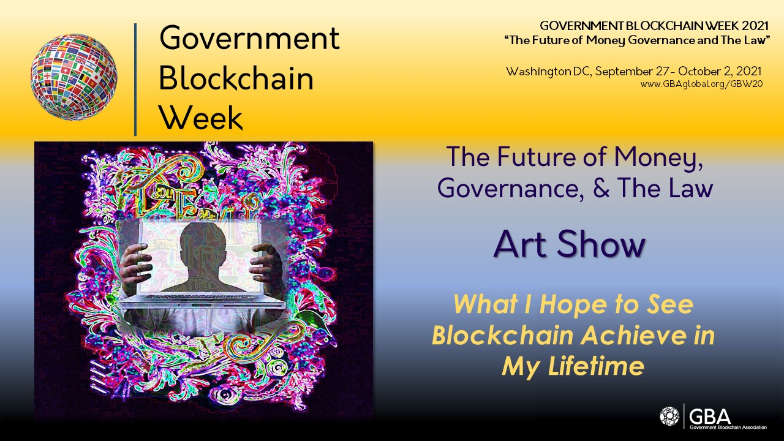
Artist Needed
Government Blockchain Association
The GBA will be hosting a digital (online) Art Show during Government Blockchain Week, Sept 27- Oct 2, 2021
‘What I Hope to See Blockchain Achieve in My Lifetime’

Slide 60
The GBA is creating NFTs out of selected pieces that will be for sale at this event. Artists. All artwork in this show will be printed into a brochure with the artist’s name, contact information, and a paragraph about their piece. Additionally, the entire show will be posted digitally for our members around the globe to see.
Submissions will be judged on 5 categories:
1) Creativity/Originality. How insightful and innovative is this idea?
2) Practicality. Could this idea work? Is it even remotely possible?
3) Helpful/ Humanity. Does this idea help anyone? Who? How?
4) Involvement. Is the artist involved in the deployment of this project? How? To what extent?
5) Visual appeal. How pleasing is the image to behold?
The call for entries is open now and we will be taking submissions until August 15, 2021.
This contest is open to anyone.

Slide 61
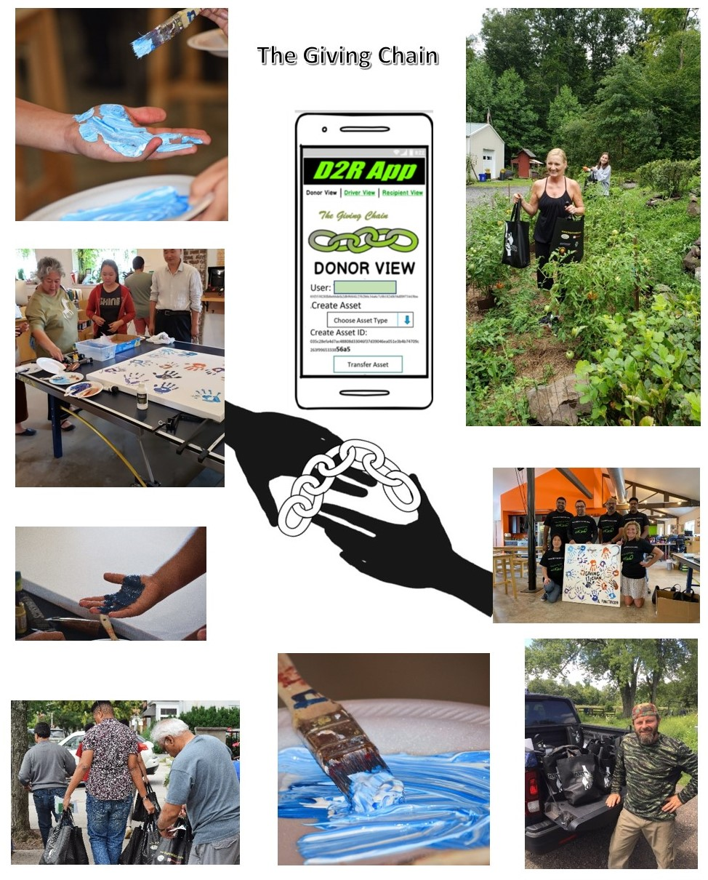
2021 GBA Art Show Submission

Slide 62


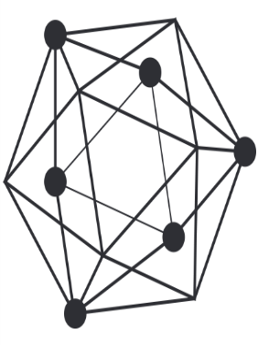

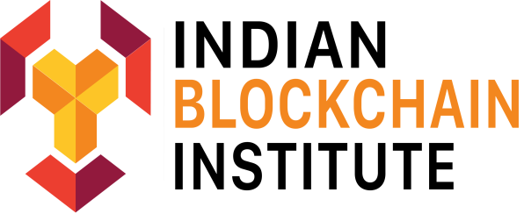
BCEmploy
Session Three Princeton Meetup 8/12/2021
Session Four JOB FAIR 8/24/2021
bcemploy.com

Slide 63
Finally
MONDAY WORKING GROUP August 2ly 26th
Please join the LMDWG call at 1pm EDT Monday, Working Groups Immediately after (2pm EDT start)
Next Meeting Friday July 30th
To Do: Bring Ideas For Business Model Validation that could work with giving chain r2d application
Like and comment in Social Media
https://www.facebook.com/TheGivingChain
https://www.instagram.com/thegivingchain/
https://t.me/BCPrinceton
https://twitter.com/bc_princeton
LinkedIn Group: ​https://www.linkedin.com/groups/9055378/

Slide 64
Thank You

Slide 65
https://sawtooth.hyperledger.org/docs/core/releases/latest/

