Slide 1

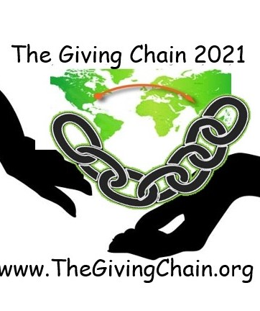
Welcome to The giving chain
Technology Discussion

Slide 2

AGENDA
Introduction
Recap Project
  Technical Team Update

Slide 3
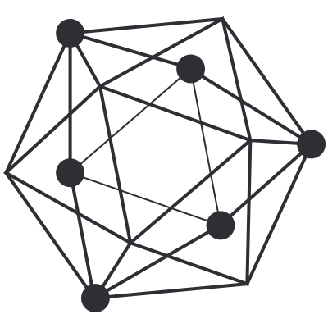

Introduction
Project Team
Bobbi Muscara
Project Manager – Hyperledger Giving Chain
Director Education Ledger Academy
Author of Linux Foundation Blockchain Courses for LFS171
Hyperledger TSC Member
Chair OF THE Learning Materials Working Group
Project
Hardik Gupta
The Giving Chain
&
The D2R Application
Project Manager – Hyperledger Giving Chain
Member OF THE Learning Materials Working Group
The Giving Chain
Mentee / Project Management / Technical Lead
Madhu Bhatia
Project Manager – Hyperledger Giving Chain
DLT Talent program of Frankfurt School of Finance and Management Blockchain Center
2021 LiFT Scholarship Women in open-source
Research Scholar /Trainer
Mona Rassouli –
Developer/ Marketing(social media)/Documentation/ Articles or Blogs
mr1241@scarletmail.rutgers.edu
Technology Lead

Slide 4
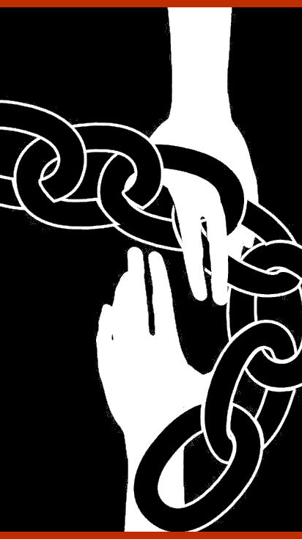
Social Impact
Blockchain
Project
Checkpoint 1: Impact Opportunity
Checkpoint 2: Business Model Validation
Checkpoint 3: Technical Architecture
Checkpoint 4: Impact Measurement
Checkpoint 5: Code
Checkpoint 6: Final Submissions Due

Slide 5
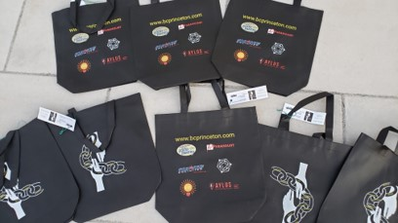
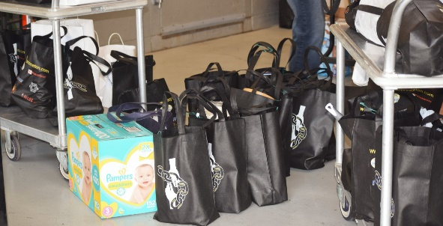
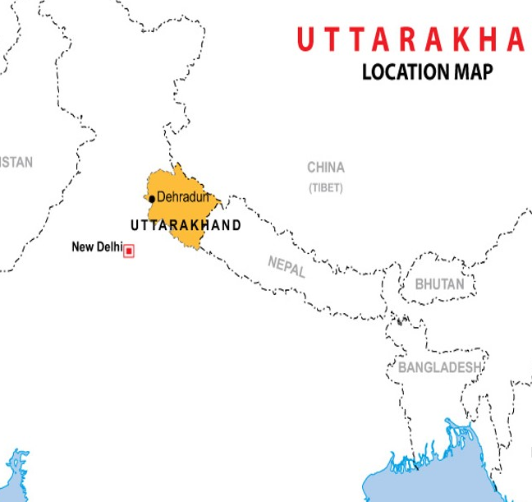
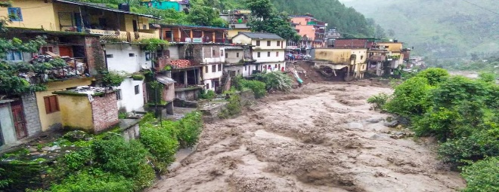
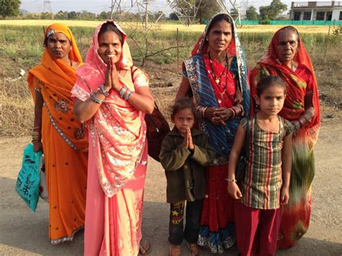
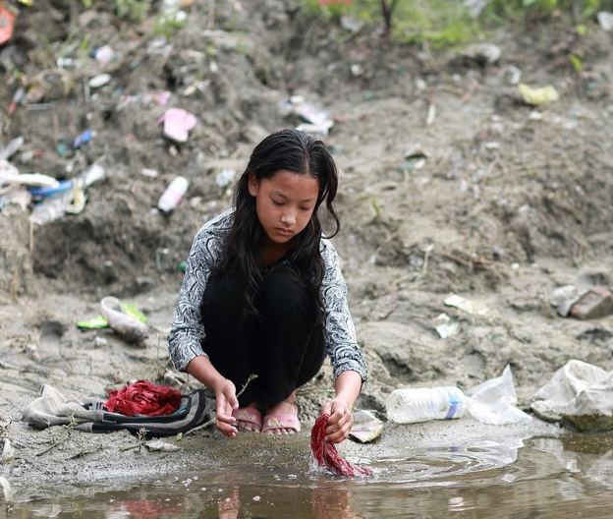
Project 2021
Giving Chain Princeton
Giving Chain India / Uttarakhand
Giving Chain India Women
Notes:
An estimated 355 million Indian women and girls must find ways to cope with monthly menstrual hygiene. Most o A majority of rural women in India employ clothes and rags for feminine hygiene. These materials might predispose women to reproductive tract infections since it may be difficult for them to keep their used napkins clean and free of harmful bacteria. Washing reusable feminine products with soap and drying them in sunlight may be difficult due to lack of water, private facilities, and cultural taboos associated with menstruation.

Slide 6
Checkpoint 1: Impact Opportunity
  Select your challenge.
Develop an agile & transparent network for connecting surplus foods & supplies to communities in need.
To create a decentralized system that collect excess food supplies from local resources and distribute these resources to local area facilities in need.
  Define the scope of problem
For our summer project, we are limiting the POC to a small number of local farmers with excess food supplies (pick up dates September 3, 4 and 5) to be picked up by transportation volunteers who will bring donations to agreed upon drop off point .
India – Women ,
we are limiting the POC to Rural area in India. Supplies purchased will be picked up by transportation volunteers who will transport hygiene supplies to drop off point in rural areas.

Slide 7
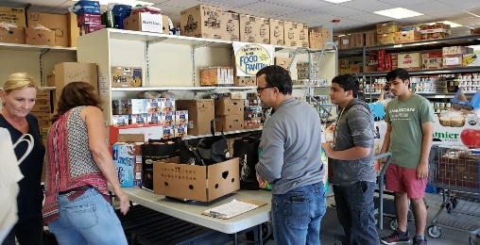
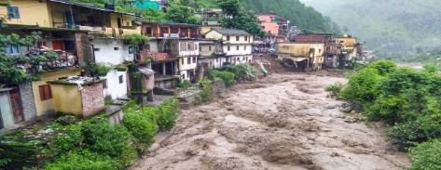


Checkpoint 2: Model Validation
Who are your clients/users? Sketch your user.
What are their pain points? How does your solution solve them?
        Can it be scaled?
Donors
Volunteers / Drivers
Recipients
Notes:
Include Details:
Donors Who they are for each project
Driver – Project Managers choice , Long term Vetted Orgs
Recipients
NGO, Social Services Offices
Schools/College Girls
Underprivileged
Village Women/girls
Marginalized and lower middle-class populace

Slide 8
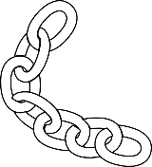
Checkpoint 2: Model Validation
Business Flow
Donors
Farmers
Individuals
Community / Church Groups
Volunteers / Drivers
Pickup / Deliver:
Local volunteers
Community / Groups Transport
Recipients
Food Banks
NGO’s
Social Services Offices
Individuals (off the grid)

Slide 9


Checkpoint 3: Technical Modeling /Registration
Project Manger acts as Administrator making enrollment decisions.
Role
1. Project Manager
2. Donor
3. Transporter
4. Recipient
Registration Process
Notes:
In our technical model Donors activate the giving chain with an application a cell phone. They create an asset with a unique tag. The blockchain tracks the ownership of the tag ( donor to driver to recipient) . We will get a closer look at the technology later.

Slide 10
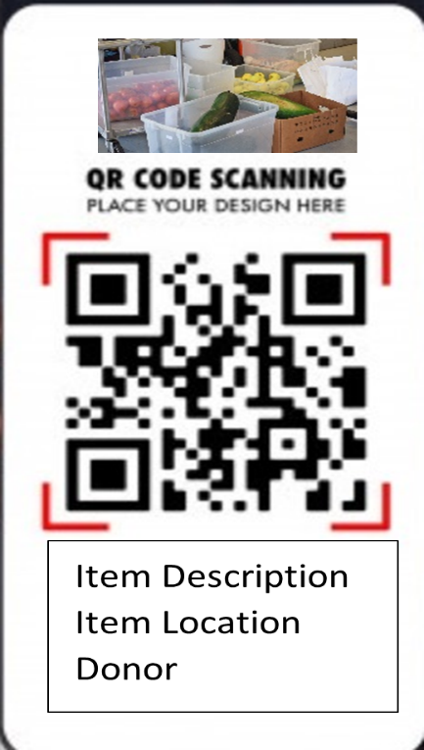

Checkpoint 3: Technical Modeling
Donors
NFT
Picture of Donation
Picture into Smart QR Code
Hash
Description and Alert
Notes:
In our technical model Donors activate the giving chain with an application a cell phone. They create an asset with a unique tag. The blockchain tracks the ownership of the tag ( donor to driver to recipient) . We will get a closer look at the technology later.

Slide 11
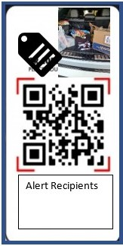
Checkpoint 3: Technical Modeling
Transporters
Respond to Alert
Pick up Donation
NFT
Get Location and Deliver
Digital picture added to QR Code
Hash
Notes:
In our technical model Donors activate the giving chain with an application a cell phone. They create an asset with a unique tag. The blockchain tracks the ownership of the tag ( donor to driver to recipient) . We will get a closer look at the technology later.

Slide 12
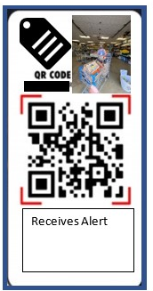
Checkpoint 3: Technical Modeling
NFT
Recipient
Receives Alert / Accepts
Hash
Accepts Donation / Takes Digital Picture
Accepts donation / Smart QR Code and picture.
Takes Digital Picture / NFT
Notes:
In our technical model Donors activate the giving chain with an application a cell phone. They create an asset with a unique tag. The blockchain tracks the ownership of the tag ( donor to driver to recipient) . We will get a closer look at the technology later.

Slide 13
Technical Team Steps
Decide on a platform:
Hyperledger Firefly
Potential Blockchain As A Service
Making The Giving Chain a Hyperledger Lab

Slide 14
Firefly Setup (Mac/Linux)
These were my steps and how I got the CLI to run.
These are my steps for Mac and for Linux VM using virtual box. Should also work for windows, but I have not tried it on windows.
1. Open terminal
2. Run ‘go version’ to check whether you have installed go
3. If not please install the latest version which is 1.17 now
4. un ‘go version’again after install to double check installation success
5. Install Docker: https://docs.docker.com/get-docker/
6. To install CLI as per Firefly docs run: go install github.com/hyperledger-labs/firefly-cli/ff@latest
7. To double check install run ls ~/go/pkg/mod/github.com/hyperledger-labs/
8. It should return firefly-cli@v0.0.29
9. For mac the default path for go install was my desktop. It may be in another location depending on your system. Either way from cd into the go directory. cd go
10. From within this directly you should see bin and pkg directories. ‘ff’ should be present within the bin. cd bin
11. This next part is key. You must run the following to declare the path to Go and the bin within it. On both Linux/Mac it did not pickup the binary command ‘ff’ for me otherwise. These are to be copy and pasted directly into terminal: export GOPATH="$HOME/go" PATH="$GOPATH/bin:$PATH"
12. Now from desktop/go/bin directory run the following for firefly cli to launch: ff -h
13. Now we can begin running firefly commands.
Resources:
https://www.youtube.com/watch?v=Ft1A9B9GPhU
https://wiki.hyperledger.org/display/labs/FireFly
https://github.com/hyperledger-labs/firefly-cli https://labs.hyperledger.org/firefly/gettingstarted/setup_env.htm

Slide 15
Thank You from www.thegivingchain.org

