Slide 1

Hyperledger Mentorship Project Presentation
November 2021

Slide 2
The Giving Chain
Introduction
  Name: Hardik Gupta
  Location: Dehradun, India
  University: Graphic Era Hill University
  Mentor(s): Bobbi Muscara
  Hyperledger Project: Hyperledger FireFly

Slide 3
The Giving Chain
Project Description: The Purpose of the project is to decentralize local charity giving by creating the Giving Chain. The Giving Chain is a Blockchain Social Impact Project to support charitable efforts by creating a donation supply chain tracking platform. The Giving Chain platform creates an immutable record of a donation by tracking items as they go from Donor, Transporter to Recipient.
Technologies: Hyperledger FireFly, React, Node and Express JS.
Donors
Farmers
Individuals
Community / Church Groups
Volunteers / Drivers
Pickup / Deliver:
Local volunteers
Community / Groups Transport
Recipients
Food Banks
NGO’s
Social Services Offices
Individuals (off the grid)

Slide 4
The Giving Chain
Project Objectives:
  Obj 1: Complete and Answer the checkpoints for the Social impact blockchain project.
                Checkpoint 1: Impact Opportunity
            Checkpoint 2: Business Model Validation
            Checkpoint 3: Technical Architecture
            Checkpoint 4: Impact Measurement
            Checkpoint 5: Code
            Checkpoint 6: Final Submissions Due
  Obj 2: Improve and Solve the problem faced with the Giving Chain 2019.
  Obj 3: Scale the Project.

Slide 5
The Giving Chain
Project Deliverables:
  Deliverable 1: Build a business model for the project.
  Deliverable 2: Code and Develop an agile & transparent network.
  Deliverable 3: Documentation
  Deliverable 4: Presenting the Project to Social Impact and Trade Finance
  Special Interest Group.

Slide 6
The Giving Chain
Project Execution & Accomplishments:
    Accomplished: A business model with working prototype.
  Not accomplished: Documentation and Implementation of NFTs in our project.
  Most proud thing: Presenting the Project to Social Impact and Trade Finance
  Special Interest Group and Collecting funds for the projects.
  Most challenging thing: To pick a framework for our project.

Slide 7
The Giving Chain
Recommendations for future work:
Implementation of the NTFs to the project for transferring ownership.
Documentation of the project.
Registration option for the Project Manager.
Abstracting the whole project for Project Managers.
Scaling the project.
Get the project to Hyperledger labs.

Slide 8
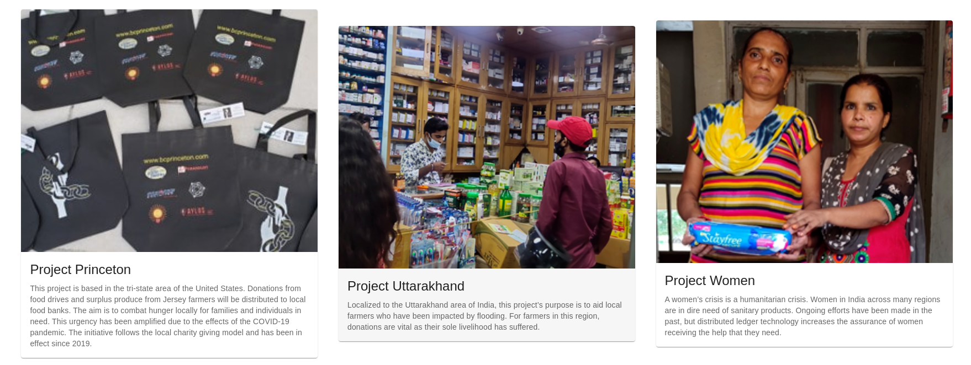
The Giving Chain
Project Output or Results:
The link to FireFly CLI: https://github.com/hyperledger/firefly-cli
All the code is being uploaded at our Github: https://github.com/DecoratedWings/GivingChain-ui

Slide 9
The Giving Chain
Insights Gained:
Learned the workflow of working on opensource project.
Worked on both business and technical aspects of the project.
Improved my presentation and management skills.
Gained knowledge of many Hyperledger projects.

Slide 10
THANK YOU!

