Slide 1



Digital Negotiable Instruments (DNI) Initiative
16 March 2021
Prepared by André Casterman,
Managing Director, Casterman Advisory
Legal Reforms Steering Group, ICC UK
Fintech Committee, ITFA
Alternative Finance Learning Lab, WOA
acasterman@c-advisory.eu

Slide 2
The DNI Initiative helps incumbents and alternative funders position themselves for the future
The aim of the DNI Initiative is to bring bills of exchange (B/E) and promissory notes (PN) into the digital world. We achieve this with advanced DLT-based document technology which brings the highest levels of security and certainty of enforceability, as well as regulatory advocacy.
Market dynamics
What’s in it for banks
Market evolution
New technology proposition
Client needs
New scalable market practice
The differentiation opportunity
The
business
opportunity
Digital trade
DLT-based document technology
Paperless negotiable instruments
Digital bills of exchange and promissory notes
Enhanced security and certainty of enforceability
Increased origination
DNI Initiative

Slide 3
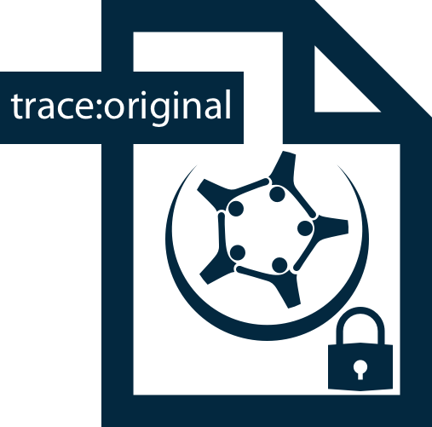
DLT offers new opportunities for digital original documents across institutions and platforms
Centralised model - platforms
Banks and clients sign up to a common document platform to exchange originals
A digital original is only valid
within the chosen platform
Document ownership and transfer of ownership
managed by the chosen platform
Distributed model - DLT
Negotiable instruments and guarantees are produced, owned and secured digitally by banks
The digital originals are valid across institutions and platforms
Document ownership and transfer of ownership performed digitally via any electronic channel
Platform
1
Platform
2
Platform
3
P
P
Evolution
Financial institutions and clients
Digital originals tracked on the digital notary
P
Platforms
DLT-based digital notary

Slide 4
DNI Initiative – the technology solution is non-invasive and integrates with any transport infrastructure
The digital original document technology
Compatibility with existing infrastructure
Digital
Container
Electronic
signatures & seals
Digital
Notary
Digital
Courier
Digital Document Processors
What
Ricardian contract & cryptography & JSON schema
(stores business data)
E-signing software
(Signicat, DocuSign…)
Distributed Ledger Technology
(only stores cryptographic references & signatures )
Existing Trade Networks / Ecosystems
(SWIFT, EBICS, FTP, platforms…)
Existing Trade Applications
How
Document content management
Document authenticity, legality
& identification
Document lifecycle tracking & verification (originality, integrity, ownership)
Document delivery
Document presentation & processing
Why
Existing and reusable infrastructure

Slide 5
Digital originals rely on e-signatures and DLT to enable digital possession and transfer of ownership
Level of digitisation
CONTROL OF SIGNATURE
+ CONTROL OF OWNERSHIP
+ LIFE CYCLE TRACEABILITY
e-signed e-original
Digital Medium
(YML)
Business data in secured file
Public hash in public DLT
Signed original
Paper Medium
e-signed document
Digital Medium
(ex. PDF)
Who owns the digital original and is eligible to digitally transfer possession?
What does the document contain
and who signed it?
Who owns the paper original
in a legal way?
Technical features
E-SIGNATURE
PAPER ORIGINAL
DIGITAL ORIGINAL
Negotiable instruments
e-signature

Slide 6
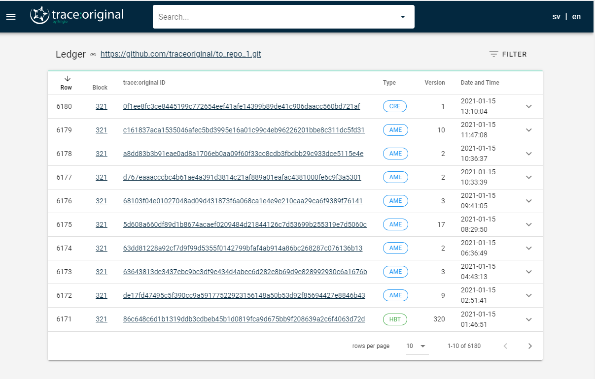
Enigio’s trace:original - the public DLT is used as a Notary Service
Private Data on a file
-> Security and ease of integration
Public DLT as notary service --> Power and transparency

Slide 7
DNI Initiative – value of use cases for ITFA membership
Value for ITFA membership
Irrevocable, unconditional, transferrable payment undertakings (IPUs)
Changing the law to fully recognise NIs in electronic form
Full recognition of electronic Negotiable Instruments
Highest
High
Adding enforceability / negotiability under contract law
ePUs as contractual instruments
Medium
dDOC guidelines for Trade Documents
Digitally native trade documents and irrevocable payment undertakings
1
2
3
Authenticated, secured and traceable documents
Enforceable instruments under contract law
Electronic Negotiable Instruments recognised in law
Use Cases

Slide 8


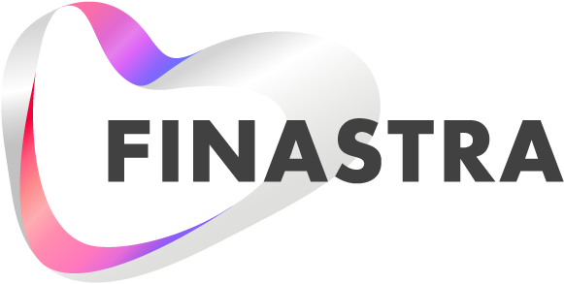

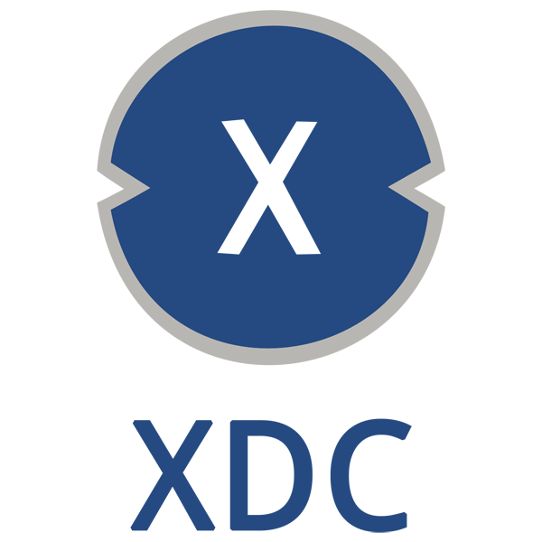
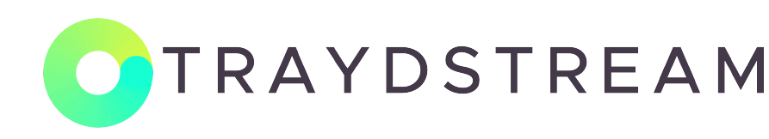
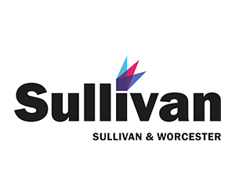

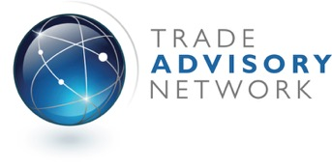
DNI Initiative – collaboration amongst fintechs and advisors
Electronic Signatures
Original Document Technology
Core TF Technologies
Document Processing Solutions
Tokenisation Infrastructure
Advisors

Slide 9

Example of integration between Enigio, China Systems and Traydstream
Public DLT – Industry-wide lifecycle tracking of negotiable instruments
Clients
Bank’s own (internal or cloud-based) transaction processing systems
Channels to correspondent banks and clients
e-Banking
TF application
Middle-ware
Network
Interface
Payments application
Payment Screening
FileAct
Trade Document Compliance & Processing

Slide 10
Use cases of Enigio trace:original documents exchanged on SWIFT
Digital original document technology and DLT-based notary service
trace:original documents on
SWIFT MT 798 / FileAct
trace:original documents
on SWIFT MT 798 / FileAct
FileAct
FileAct
FileAct
trace:original documents exchanged via SWIFT FileAct in the inter-bank space
trace:original is Enigio’s patented
invention to create and handle
authoritative digital original
documents

Slide 11
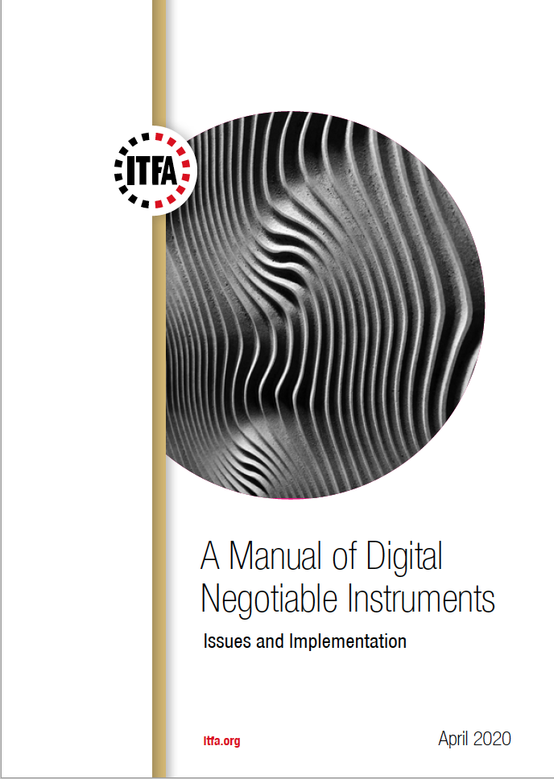
More information
The ITFA Manual on Digital Negotiable Instruments (version of April 2020) is available from the ITFA web site Member Area:
https://itfa.org/member-area/

Slide 12
DNI Initiative
Want to join ITFA? Consult www.itfa.org
Want to join WOA? Consult www.woa.community
Need more info? Want to engage? Email acasterman@c-advisory.eu

Slide 13
How to bring hybrid blockchain to bills of exchange and promissory notes
Gunnar Collin, Head of Sales & Marketing, Enigio
March, 2021

Slide 14

The Digital Original Document, solving the unsolved
Original vs Copy
Possession
Transferability
Presentability
Immutability
Traceability
Data Privacy

Slide 15
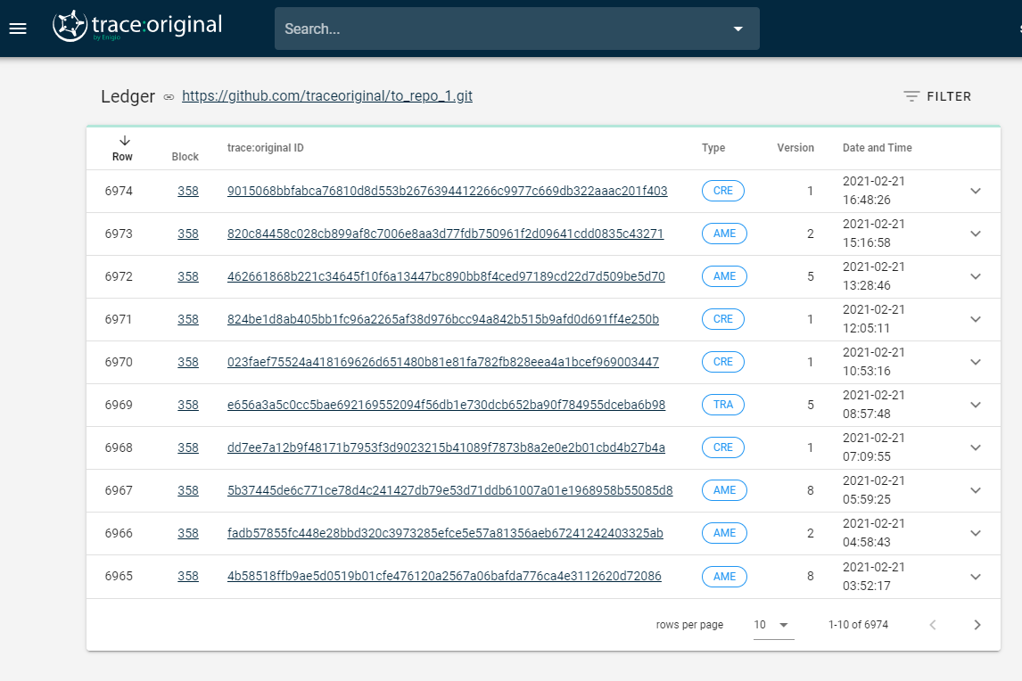
The Notary Service – a public ledger
trace:original public DLT

Slide 16















trace:original; how it works
Manage document
Add wet ink = asset
Store physically
Read scrutinize, feel, verify and hold
Paper
Add content
Manage and transport physically
Dual documents
Dual processes
Cost x 2
Data mismatch
A physical
document
Process and manage scanned image
Scan original
OCR and AI
SHA-256, defined data container
Add e-sign =
digital asset
File
Add content
View, read, validate, verify and hold. AI
e-storage
Transfer, store and manage digitally. SWIFT e-mail or platform
#
#
#
#@¤
#
#@¤
#@¤
Digital original documents created and evidenced with a DLT based Notary Service

Slide 17

About
  Who we are
  Our Vision
  Enigio is a Stockholm-based technology company aiming to become the global technology provider of a standardised solution for digitised, authoritative original documents, a digital original distinguishable from any copy
  Our patent-protected solutions leverage blockchain components and distributed ledger technology (DLT), allowing businesses to create and manage Digital Original Documents that are transferable, fraud safe and verifiable at any time..
  To become the global technology provider of a standardised solution for digitised, authoritative original documents.
  Our Mission
  To provide innovative solutions that ensure consistency, integrity and traceability of digital information at any time.

Slide 18
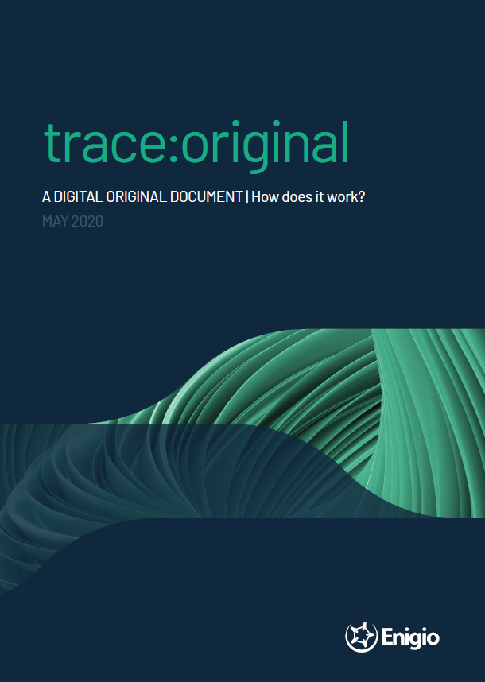
trace:original is ready to use by anyone at anytime. Once a trace:original document is created it can be received stored managed by anyone, anywhere who has access to a computer and internet.
Want to try? Get in touch!
Enigio Time AB, Drottningholmsvägen 10, 5tr, 112 42 Stockholm, www.enigio.com
Gunnar Collin: gunnar.collin@enigio.com +46 761 139 500
Lars Hansén: lars.hansen@enigio.com, +46 730 898 780

