Slide 1

Documentation and Use Cases for Climate Action
November 2021

Slide 2
Documentation and Use Cases for Climate Action
Introduction
  Name: Dounia Marbouh
  Location: Abu Dhabi, UAE
  University: Khalifa University
  Mentor(s): Si Chen and Sherwood Moore
  Hyperledger Project: Documentation and Use Cases for Climate Action

Slide 3
Documentation and Use Cases for Climate Action
Project Description: The voluntary carbon offsets market is currently highly fragmented, unstandardized, with poor transparency, and questionable quality. Therefore, the aim of this project was to define the structure and dynamics of this market. Through interviews with key stakeholders, we tried to achieve the following:
Understanding the characteristics of the market
Analyzing the findings
Identify how blockchain could be used to improve the VCO Market

Slide 4
Documentation and Use Cases for Climate Action
Project Objectives: Interview stakeholders and draft a paper on how to improve voluntary carbon offsets market transparency and quality using a robust solution.
  Obj 1: Map out the ecosystem of the market and its key participants
  Obj 2: Find, reach out, and interview several market stakeholders (Developers, buyers, brokers, standards, and government entities).
  Obj 3: Identify the key challenges confronting the market
  Obj 4: Analyze the findings
  Obj 5: Draft a paper

Slide 5
Documentation and Use Cases for Climate Action
Project Deliverables:
  Deliverable 1: Conduct a literature review about the background of voluntary carbon offsets market with citations.
  Deliverable 2: Interview stakeholders of the ecosystem.
  Deliverable 3: Provide the architecture for voluntary carbon offsets directory based on interviews, ecosystem mapping, and literature review.
  Deliverable 4: Wrap-up the paper covering the voluntary carbon offsets directory.
  Deliverable 5: Submit the paper to a reputable journal for publication.

Slide 6
Documentation and Use Cases for Climate Action
Project Execution & Accomplishments
What was accomplished: The final paper draft is ready for the public review.
Deliverables that were not completed: Submitting the paper for publication.
The challenges:
Scarcity of literature
Collection of data
Getting responses from stakeholders
Analyzing qualitative data

Slide 7
Documentation and Use Cases for Climate Action
Project Output or Results: Our market research on the Voluntary Carbon Offsets Market is now completed. Here is the link to the paper’s draft:
https://wiki.hyperledger.org/display/CASIG/Voluntary+Carbon+Offsets+Directory+Research+Project
We will appreciate your participation in giving insights about the paper.

Slide 8
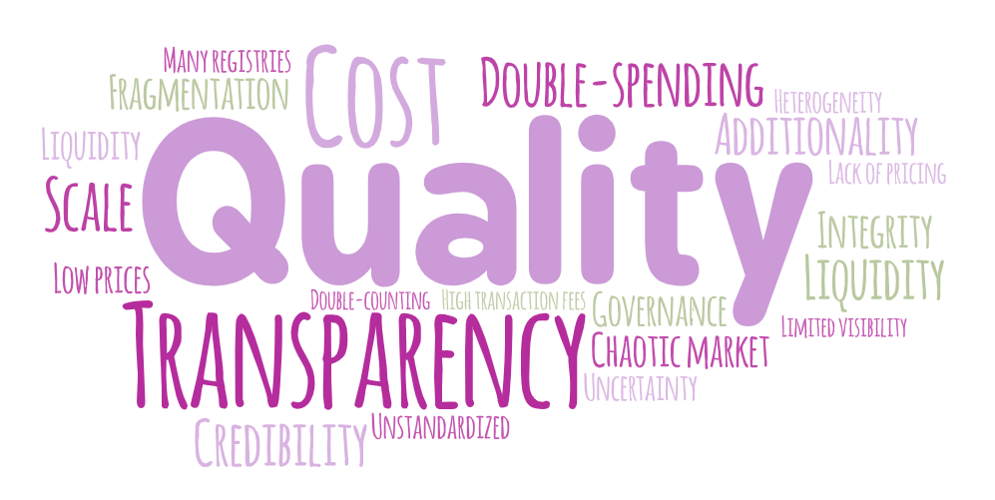
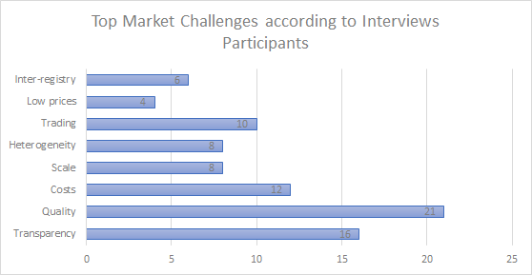
Documentation and Use Cases for Climate Action
Project Output or Results:
Figure 1. Word cloud from our interviews
Figure 2. Top challenges surfaced in our interviews

Slide 9
Documentation and Use Cases for Climate Action
Project Output or Results:
Conclusion: Create more rigorous systems of establishing reputation for the stakeholders in the offsets market. For example, a system which tracks the success of offsets projects back to both the developers and buyers of the offsets could help create incentives for both groups to focus on the quality of the offsets.
 | Type of interviewees
 |  | Developer | Standards | Broker/Marketplace | Buyer | Government
Challenge Type | Quality | 100% | 40% | 63% | 100% | 20%
 | Transparency | 50% | 40% | 38% | 60% | 80%
 | Cost | 50% | 80% | 25% | 40% | 20%
 | Scale | 25% | 80% | 13% | 20% | 0%
 | Heterogeneity | 13% | 40% | 25% | 20% | 40%
 | Low prices | 38% | 0% | 0% | 0 | 20%
 | Inter-registry | 13% | 0% | 38% | 20% | 20%
 | Trading | 50% | 40% | 38% | 0% | 0%

Slide 10
Documentation and Use Cases for Climate Action
Recommendations for future work:
Increase the number of interviews as the current one is barely sufficient to make very firm and revealing conclusions from this study.
Conduct a follow up study to include more participants and test different approaches for them to work together to improve quality of the offsets while reducing costs of validation and verification.
Design a blockchain-based system to build the necessary reputation system for the market.

Slide 11
Documentation and Use Cases for Climate Action
Insights Gained:
Valuable insights from my mentors
Several interactions with experts in the field
Learnt how to drive an interview to get the best out of the interviewee
Piece of advice:
Use this opportunity to grow your professional network and learn as much as possible from the experience of your mentors.
Have a clear plan of deliverables and objectives
Reach out for help when needed

Slide 12
THANK YOU!

