Slide 1


BAFT DLPC - Distributed Ledger Payment commitment
A Primer on DLPC: A New Financial Asset and Standard for Global Trade
Where did it come from?
The LEGAL FRAMEWORK
How is it useD?

Slide 2
BAFT DLPC working group leadership and today’s presenters
  Whitman E Knapp – Chairman, GTBInsights LLC – Outreach - wknapp@gtbinsights.com
  John Taylor – Professor of Law, Centre for Commercial Law Studies, Queen Mary University of London – Legal framework - johnlachlantaylor@gmail.com
  Rebecca Liao – Co-Founder and COO, Skuchain – Co-Chair of the DLPC Working Group – Use in Transactions - rebecca@skuchain.com
.

Slide 3
IN ADDITION, a significant number of technical, Legal and banking experts contributed to the development of the BAFT DLPC
Additional DLPC contributors:
* Nancy Amert – CGI * Tariq Korejo – Citi * Michael Beispel - Formerly with Standard Chartered * Eric Marcus - Arnold & Porter Kaye Scholer (retired) * Kitt Carswell - CGI * Alisa DiCaprio - R3 * Norm Powell - Young Conaway Stargatt & Taylor * Stacey Facter – BAFT * Frank Schultz - Surecomp * Hector Fuenzalida - CGI * Edwin Smith - Morgan, Lewis & Bockius * Andy Garner - Wells Fargo * Ranga Krishnan - Formerly with Skuchain * Alex Thompson - Wells Fargo * Janna Webskowski – WG Co-Chair - US Bank * Raymond Zenkich - Formerly with Red Chalk Group * Samantha Pelosi – BAFT

Slide 4
Where did it come from? Why BAFT developed the DLPC?
A New Financial Asset and Standard for Global Trade
Why BAFT?
    BAFT is an international financial services industry association whose membership includes nearly 300 financial institutions and solution providers throughout the global community. As a worldwide forum for analysis, discussion, and advocacy in international financial services, BAFT provides support to members that are active in trade finance and payments globally.
The Problem:
Addressing the digital transformation of trade – an historically paper-based line of business.
BAFT’s initiative to meet the problem:
Creation of a working group in 2016 to analyze and create answers to the problems posed by the digital transformation of trade.
BAFT’s solutions – The Distributed Ledger Payment Commitment – DLPC
Documentation published in the August 2020:
Initial Release Version 1.1 BAFT DLPB Best Business Practices
Initial Release Version 1.1 BAFT DLPC Best Technical Practices
.

Slide 5
The DLPC Legal Framework
A payment commitment
In digital form
For use in any trade finance transaction
Open Source and Interoperable on any DLT platform
Within a legal framework ensuring that the commitment, although in digital form, is legally binding, enforceable, and is negotiable

Slide 6
The DLPC Legal Framework
The whitepaper “Code is Not Law” authored jointly by BAFT, R3, and Shearman & Sterling informed the development of the DLPC. See https://baft.org/code-is-not-law.pdf
DLPC operates within a legal framework that provides a legally binding and enforceable payment obligation and a negotiable instrument.
In particular, the DLPC is a digital “Note” (an unconditional promise to pay) and it is recommended that the parties choose Delaware law that expressly confers on obligors (and holders i.e. those having control of the Note) the same rights and defenses as if the Note were in writing. If needed, dispute settlement is before Delaware courts.
Parties to a DLPC are permitted to choose other laws (or courts) to govern the DLPC if they wish but are cautioned to seek legal advice when doing so.
A DLPC is recorded on a DL in 13 simple data fields, or codes, that:
  Identify the payment commitment and the parties
  Link the commitment to an identified transaction
  Show the status of the transaction
  Provide rules governing the DLPC

Slide 7
How Is It Used? Commercial use of the DLPC
The DLPC can be used in any trade transaction. How is it used? A look at actual transactions.
The four ways for a Buyer to originate a DLPC asset:
A Buyer could attach a DLPC to a Purchase Order (+ a Bill of Materials for deep-tier financing) and associate a set of smart contract governed conditions that trigger the commitment.
Once a Buyer approves an invoice with a Tier 1 Supplier, this approval can be turned into a DLPC on the blockchain that provides a liquidity pool for the deep-tier.
A Buyer could provide a Take or Pay contractual guarantee that will backstop a specific purchasing line, turning all its POs for that line into DLPCs.
A Buyer can ask its bank to issue a DLPC in lieu of a traditional Letter of Credit.

Slide 8

DLPC as an alternative to an LC
Buyer
Buyer Bank
Seller
Issue PO
Initially
DLPC is contingent.
It is irrevocable
Has risk of buyer non-acceptance which is mitigated by ownership of underlying commodity
Issue Contingent DLPC / Connect to bank account
E Presentation of docs
Ship Goods
Change DLPC to Effective within 5 days of document presentation
Smart contract trigger
On buyer acceptance of documents
DLPC is effective.
It is irrevocable
Buyer’s bank will execute draft as per trade terms
Platform issues draft to bank on behalf of Seller
Debit Account
Make Payment at draft maturity
Discharge DLPC
A DLPC can also be combined with a guarantee as an alternative to an LC.

Slide 9
Bank issuance of a dlpc in place of an LC
Buyer
Middle Office
Back Office
Supplier
Issue PO
Issue Contingent DLPC / Upload Application (BB)
Pass application
Book Contingent DLPC*
Issue DLPC (SS)
E Presentation of docs
Ship Goods
This is a sample flow for transactions in which the supplier would still like a bank to back the buyer’s obligation.
Effective DLPC and Payment Instructions
Effective DLPC
Upload Application for Loan
Discharge DLPC
Payment*
Discharge DLPC (SS)

Slide 10







Deep tier financing for pos and invoices
3
Ship
$500 / 45 day terms
1
Ship
$1000 / 60 day terms
Deep Tier Financing
DLPC
0
Tier 2
Tier 1
Skuchain EC3 Blockchain Platform
Bank or SPV
$
PO
PO
5
4
T1 accepts T2 invoice
EDIBUS
Make early payment
of $450 (90%) from Liquidity Pool.
Buyer
Buyer
Tier 2
Inditex Brand
Tier 1
Field encrypted EDI Docs,
POs, Invoices, ASN’s etc.
PO Financing / Working Capital
2
Buyer accepts T1 invoice
Bank
Create a
Liquidity Pool
$900 (90%)
Deep-Tier Invoice Factoring

Slide 11





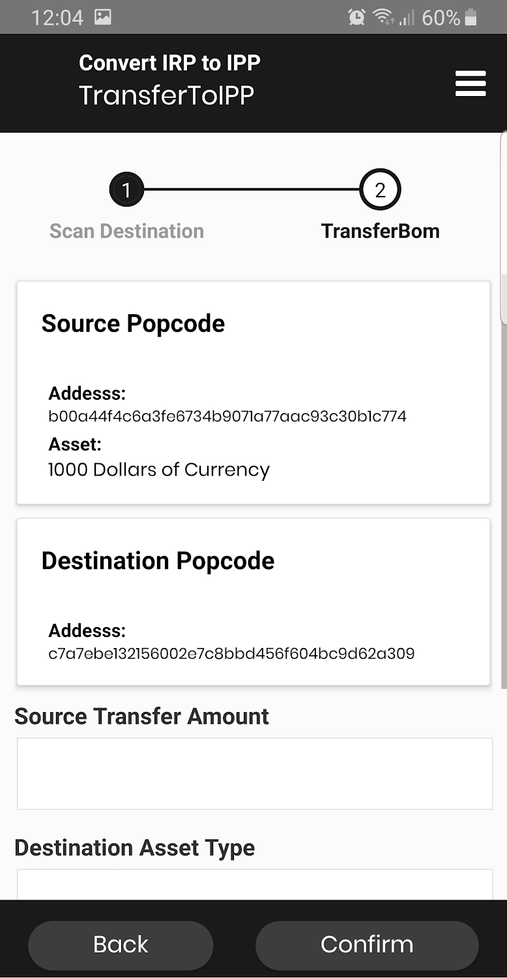
Inventory Financing
Face value: $100 Net 60
After financing at 12% p.a.: $98.00 Net 0
Inventory Ownership
After 60 days,
Purchase price: $100
Inv
Shipment
Shipment
Tier 1 Supplier
In transit / Hub
Buyer
Payment $
CoC at 4% p.a.: $.86
Fee: $.20
Skuchain Inventory Tracker
Face value: $100 Net 60
IMT financed at 4% p.a. + splitting gains with Buyer: $98.56 Net 0
DLPC/Payment $
DLPC/Payment $
After 60 days,
Purchase price: $99.42
Inv
Inventory Control
Skuchain SPV
Shipment
Shipment
Gain: $.57
Tier 2 Supplier
In transit / Hub
Buyer
Gain: $.57

Slide 12
BAFT REFERENCE MATERIALS
  Code Is Not Law: The Legal Background for Trade Finance Using Blockchain
  https://www.r3.com/wp-content/uploads/2018/09/Code_Is_Not_Law_R3.pdf
  BAFT DLPC Distributed Ledger Payment Commitment Business Best Practices Initial Release Version 1.1 https://www.baft.org/docs/default-source/2020/08/baft-dlpc-business-bps-v1-1.pdf?sfvrsn=5e2b23e1_14
  BAFT DLPC Distributed Ledger Payment Commitment Technical Best Practices Initial Release Version 1.1 https://www.baft.org/docs/default-source/2020/08/baft-dlpc-technical-bps-v1-1.pdf?sfvrsn=5b2b23e1_16

