Slide 1
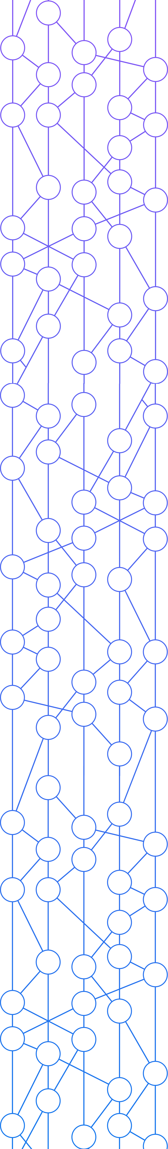


Donald Thibeau
donald@hedera.com
Director, Product Management

Slide 2












The
Hedera
Governing Council
Building the future
together.
All trademarks and company names are the property of their respective owners. All rights in the Deutsche Telekom mark are protected by Deutsche Telekom AG. All rights reserved. Hedera uses the third party marks with permission

Slide 3





The Hedera Mainnet
NETWORK SERVICES
Cryptocurrency
Smart
Contract
File
Service
Consensus
Service
Hedera
GOVERNING
Council
Hashgraph Consensus

Slide 4














End users
Individuals
Real Estate
health
financial
media
Social causes
Enterprises
3rd party Applications
Governments
Devices
Communications
Gaming
Legal
logistics
Private DLT
NETWORK SERVICES
Cryptocurrency
Smart
Contract
File
Service
Consensus
Service
Hashgraph Consensus

Slide 5
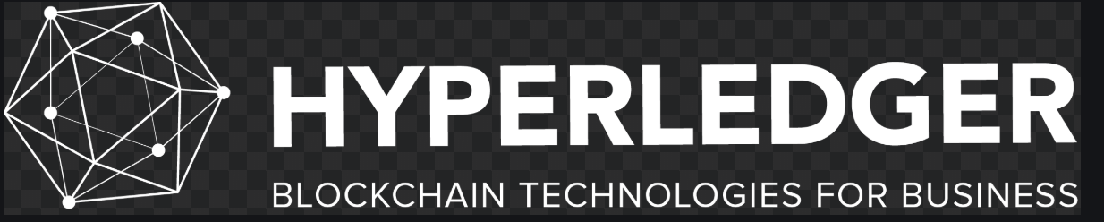


End users
Individuals
Real Estate
health
financial
media
Social causes
Enterprises
3rd party Applications
Governments
Devices
Communications
Gaming
Legal
logistics
Private DLT
NETWORK SERVICES
Cryptocurrency
Smart
Contract
File
Service
Consensus
Service
Hashgraph Consensus

Slide 6
Hedera mainnet
Hedera mirrornet
HCS Message Submission
Message
TopicID
Submitting Account
Hedera
Notes:
In September of 2019, Hedera launched it global public network – the mainnet. A network that everyone in the world can leverage. A public ledger where the nodes operate at the highest known level of trust - – Asynchronous Byzantine Fault Tolerence – or ABFT for short. Attack resistant and able to come to consensus independently in a matter of seconds. Since the launch of the network - anyone anywhere has been able to create accounts and build decentralized applications.
CLICK
Importantly, unlike other networks, Hedera does not store state. Data does not reside on the network for more than a few minutes. Therefore Hedera - and several third parties – have launched mirror nodes so that transaction history can be managed. While Mirror nodes do not participate in consensus, mirror nodes can provide a public record of transactions and the state. In addition, mirror nodes offer flexibility for the owner to choose what to store and for how long. So the mirror node is a means for storing and retrieving transaction history long after the record has ceased to exist on the Hedera mainnet.
CLICK
And finally we have the concept of an application network – or appnet for short. An appnet is simply software that is executed collectively across Hedera’s global public network. These applications interact in order to achieve a specific common goal or task – settlement between airlines for example, or payments between two organizations or individuals. Importantly, the party’s that interact do not need to trust one another as they inherit the trust from Hedera. Trust in the order of transactions, the time they happen and proof that they occurred.

Slide 7
Hedera mainnet
Hedera mirrornet
HCS Message Response
Consensus Timestamp
Sequence Number
Running Hash
Hedera
Notes:
In September of 2019, Hedera launched it global public network – the mainnet. A network that everyone in the world can leverage. A public ledger where the nodes operate at the highest known level of trust - – Asynchronous Byzantine Fault Tolerence – or ABFT for short. Attack resistant and able to come to consensus independently in a matter of seconds. Since the launch of the network - anyone anywhere has been able to create accounts and build decentralized applications.
CLICK
Importantly, unlike other networks, Hedera does not store state. Data does not reside on the network for more than a few minutes. Therefore Hedera - and several third parties – have launched mirror nodes so that transaction history can be managed. While Mirror nodes do not participate in consensus, mirror nodes can provide a public record of transactions and the state. In addition, mirror nodes offer flexibility for the owner to choose what to store and for how long. So the mirror node is a means for storing and retrieving transaction history long after the record has ceased to exist on the Hedera mainnet.
CLICK
And finally we have the concept of an application network – or appnet for short. An appnet is simply software that is executed collectively across Hedera’s global public network. These applications interact in order to achieve a specific common goal or task – settlement between airlines for example, or payments between two organizations or individuals. Importantly, the party’s that interact do not need to trust one another as they inherit the trust from Hedera. Trust in the order of transactions, the time they happen and proof that they occurred.

Slide 8



Fabric Network
Consensus Service
Endorsed transactions
Ordered transactions
PRIVACY
TRUST
CUSTOMIZATION
TRANSPARENCY

Slide 9
HCS Hyperledger Fabric Architecture
Client Application
Run by Fabric network members
Run by Council / public
1
Submits transaction proposal to Fabric peers of choice and collects response with endorsements
4
Submit message to consensus service on mainnet (message + topicID)
Mainnet Node
Mainnet Node
Fabric Peers
Mainnet Nodes
Fabric Peers
Fabric Peers
2
Client Application broadcasts transactions to their orderer (common or 1 per organization)
5
Gossip of events between nodes with mainnet and mirror nodes calculating consensus timestamp & generating state-proofs.
Ordered transactions delivered to peers
3
Transaction fragmented into messages and associated with topicID
8
Fabric Orderer
Fabric Orderer
Mirror Node
Mirror Node
Fabric Plugin
Mirror Nodes
7
Transaction reassembled and put into a block
SDK Interface
6
Notify of consensus (ordered) messages - message + topicID + timestamp + sequenceNumber + running hash + optional state proof
Notes:
Peer to orderer is really two APIs for sending and receiving the ordered transactions. It could be as simple as having Peer communicate with the Mainnet. Orderer write access and control. Fail fast, start kicking the tires.

Slide 10
HCS-based Orderer
Broadcast Transactions to Orderer
Deliver Ordered Blocks
Orderer
Common
AtomicBroadcast
Config handling
Channel Mgmt
Common TX handling
Block Cutter
HCS Plugin
Consenter
Chain
Config handling
Channel Mgmt
TX handling
Hedera SDK
Submit messages to mainnet for consensus
Notify of consensus messages from mirrornet
Notes:
Interfaces: AtomicBroadcast, Consenter, Chain

Slide 11
Configuration Changes
Channel related common configuration
  configtx.yaml
  configtxgen reads in configtx.yaml and generates genesis block / channel config update request tx for orderers to consume
  example config items
    ConsensusType – decides which plugin to use for a channel
    list of kafka broker addresses for kafka plugin
Per orderer configuration
  orderer.yaml
  the orderer executable reads orderer.yaml during bootstrapping
  example config items:
    tls cert / private key
    retry config for kafka plugin

Slide 12
Configuration Changes – configtx.yaml
new ConsensusType – hcs
channel id <-> HCS topic id

Slide 13
Configuration Changes – orderer.yaml
mainnet node id / node addresses
associated account / key for message submission to topics
mirror node address

Slide 14
Configuration Changes - HCS Admin Tool
Out-of-band
CRUD HCS topics for fabric channels
  create HCS topic with corresponding admin key(s) and submit key(s)
  update HCS topic, e.g., add/remove admin / submit key(s), renew topic
  delete HCS topic

Slide 15
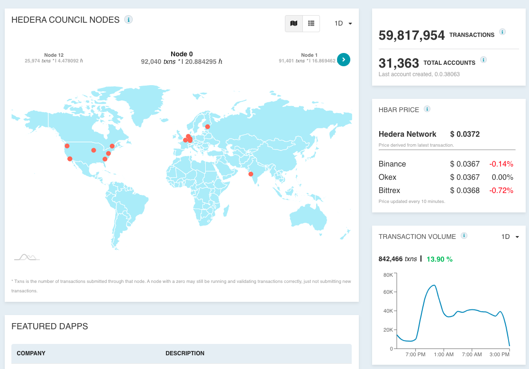
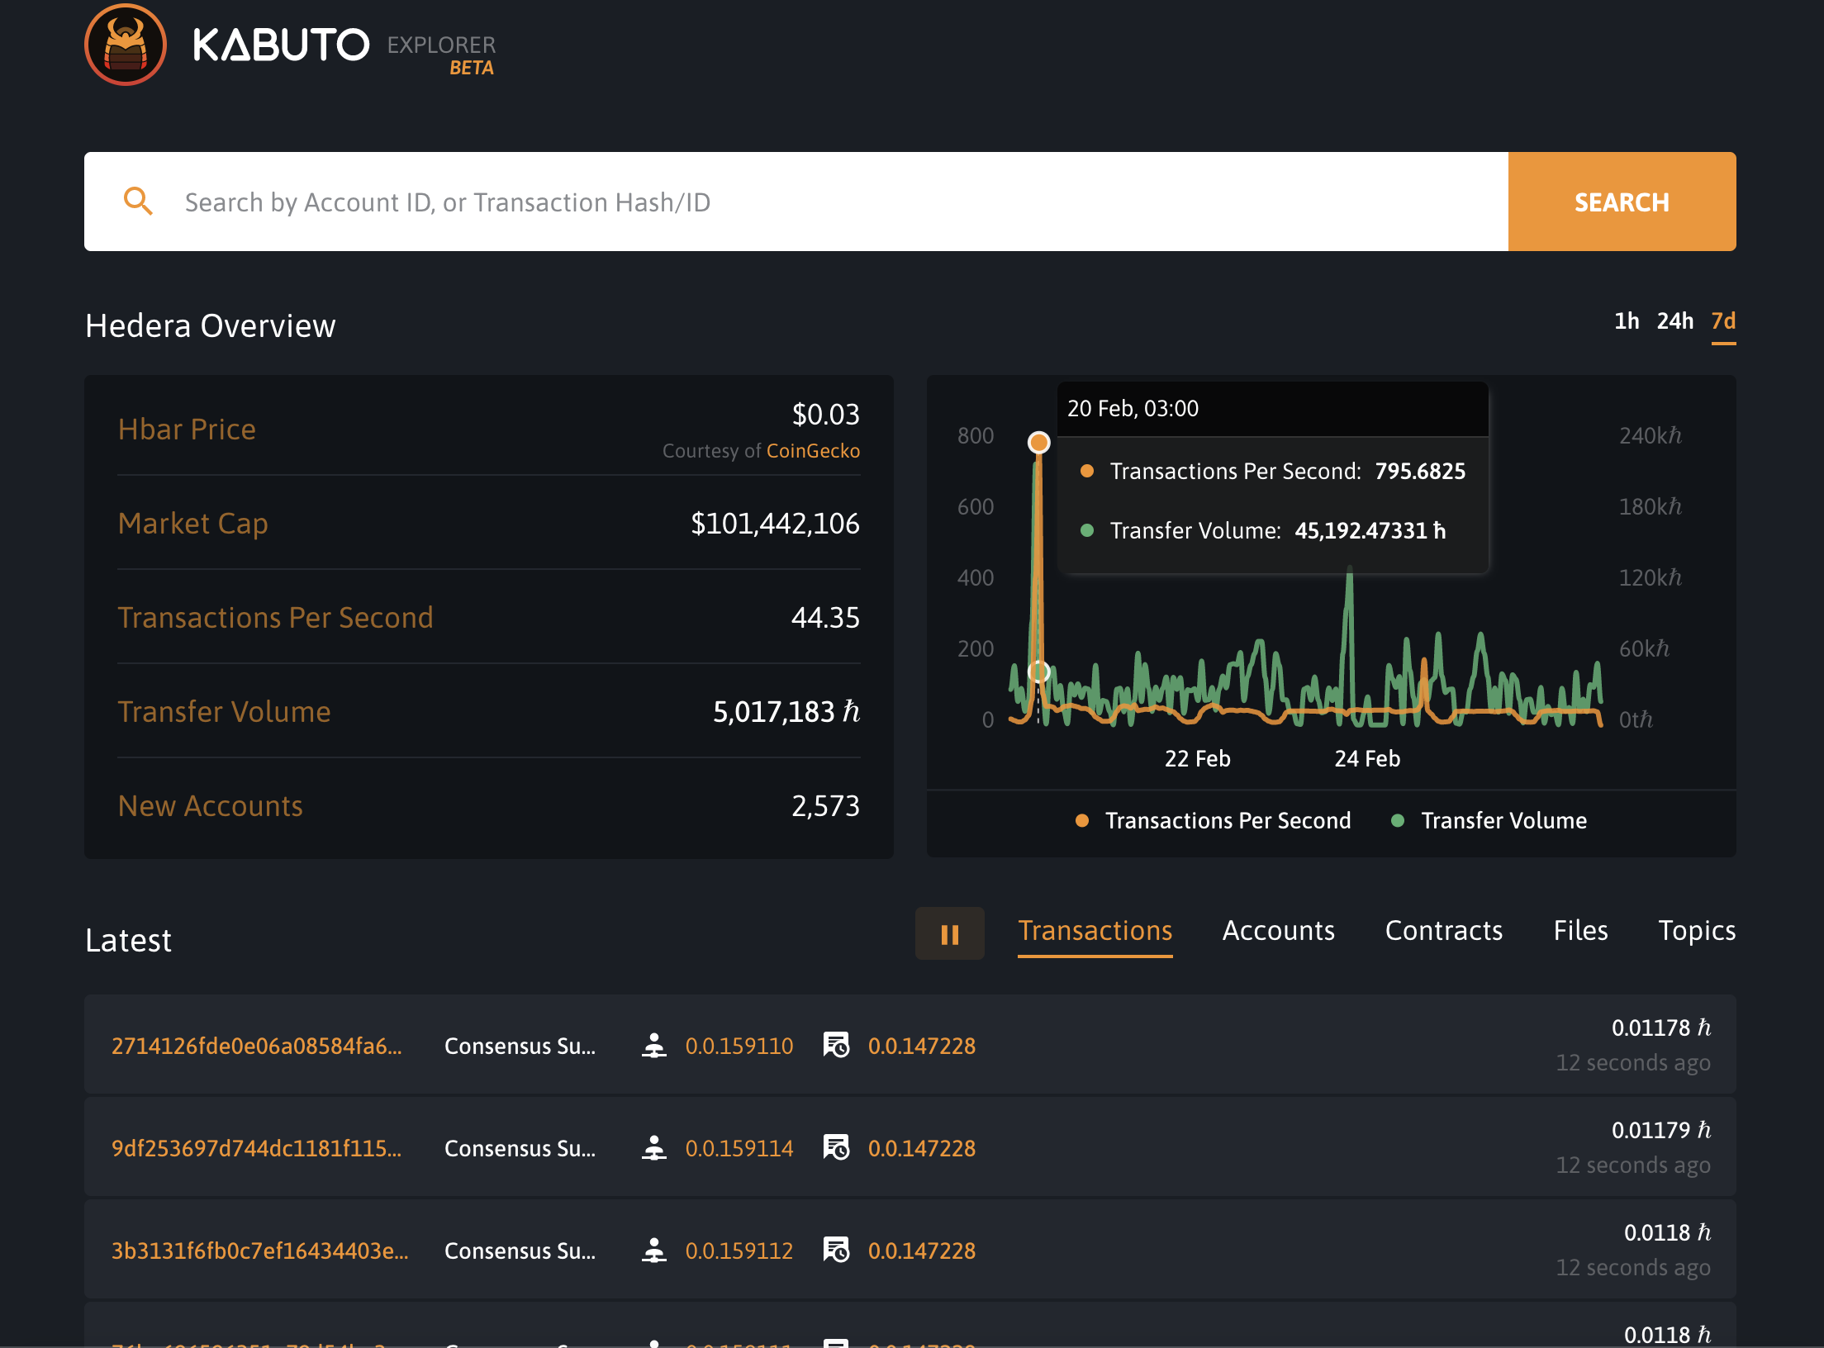
Adoption to Date

Slide 16


Adoption to Date
Decentralized Network Ordering & Interconnectivity
Audit Logging

Slide 17
Adoption to Date
Decentralized Network Ordering & Interconnectivity
Audit Logging
Scalable consensus on a shared infrastructure.
Irrevocable log of messages ordered between applications.
Resolves complexity of deploying and managing a centralized service.
Remove third party infrastructure to order and audit messages.
Examples:
Examples:
Supply chain tracking
Payment messaging
Regulated token issuance
Business event tracking
Financial markets and insurance
Content right management and credentialing
Proof of Deletion (CCPA/GDPR)

Slide 18
Enterprise Adoption – Real Commercial Opportunities
Global Brand | Use Case | Challenge | Why Hedera
Law Firm | Asset Tokenization Platform | Building an enterprise-grade tokenization platform with the proper technical benefits (aligned to client business objectives) | Fair timestamping, security, stability, transaction finality, scalability
Commercial Real Estate Developer | Utility Token & Loyalty Platform | Building an enterprise-grade platform with the proper technical benefits (aligned to client business objectives) | Fair timestamping, security, stability, transaction finality, scalability
Beverage Bottler | Supply Chain – Trusted & Frictionless | Securely connecting “less trusted” organizations to the private blockchain network | Distributed fair ordering service, audit capabilities, and greater security (for entities outside immediate partner network)
Global Communications Firm | Call Fraud | Eliminate fraudulent spam calls | Create a public registry of untrusted or fraudulent call sources
Steel Manufacturer | Supply Chain – Traceability & Provenance | Verifying provenance without a secure audit log | Transaction ordering and audit of messages between partners across the supply chain

