Slide 1

Digital Finance
“Blockchain & Its Disruption
of the Financial Industry”
Speaker: Baxter Hines
Hyperledger Capital Markets
Special Interest Group
October 2020

Slide 2


Speaker Biography
Baxter Hines
Baxter Hines, CFA, is managing partner and Chief Investment Officer with Honeycomb Digital Investments. He founded the firm in 2020 to provide income producing solutions for clients. His firm manages portfolios consisting of traditional assets, security tokens and digital assets.
Mr. Hines was a managing director, portfolio manager and co-lead for several internationally focused value strategies during his 12 years with NFJ Investment Group, a wholly owned subsidiary of Allianz Global Investors. Prior to his time with NFJ, he was an analyst with the Teacher Retirement Systems of Texas and worked as financial systems specialist for Reuters. He holds a Bachelor's Degree in economics from the University of Virginia and an MBA in finance from the University of Texas. His investment philosophy and market outlook have been profiled in several financial publications including Barron's and The Wall Street Journal. Mr. Hines holds the Chartered Financial Analyst designation and is a member of the CFA Society of Dallas.
Mr. Hines is a current board member and former chairman of Camp Summit, a charity providing outdoor camping experiences to persons with disabilities. He lives with his wife and two children in Dallas, Texas.
Notes:
Good to have team upfront. I like quick intro of personnel here with more detailed bios in the back. Perhaps picture should be on this slide. Just put CFA next to names.

Slide 3
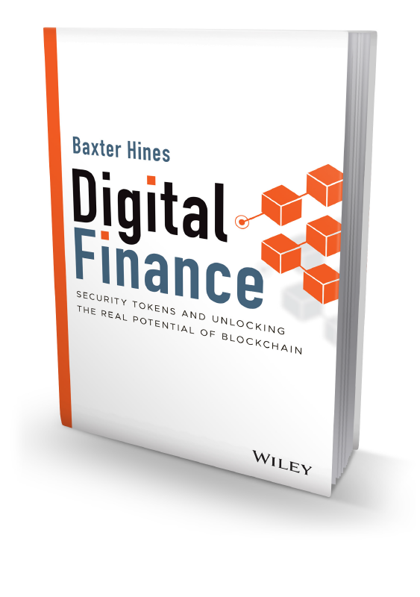
Additional Resource
Digital Finance: Security Tokens and Unlocking the Real Potential of Blockchain by Baxter Hines (published by John Wiley & Sons, Inc. and releases November 2020)
Available for pre-order at Amazon, Barnes & Noble and other fine retailers
3

Slide 4



“Through this initial application of blockchain technology, we begin a process that could revolutionize the core of capital market infrastructure systems.”
Financial services
are rapidly evolving
to embrace
digitalization.
– Bob Greifeld
Former Nasdaq CEO
4

Slide 5
Private Equity
Private Real Estate
Digital securities are financial instruments whose issuance is recorded on the blockchain.
Because of their programmable nature, digital
securities include features to automate servicing,
embed compliance and enforce contractual obligations.
These characteristics of blockchain technology are likely to have widespread ramifications on traditional assets such as stocks, real estate, bonds, and alternative investments.
Security tokenization is the process of materializing the ownership in a security through the issuance of a “token” through blockchain infrastructure. The result is a tokenized security that can represent equity, a bond, or anything of value.
Infrastructure
Alternative Investments
Alternative
Credit
Intellectual
Property
Investment Funds
Hybrid Securities
5

Slide 6
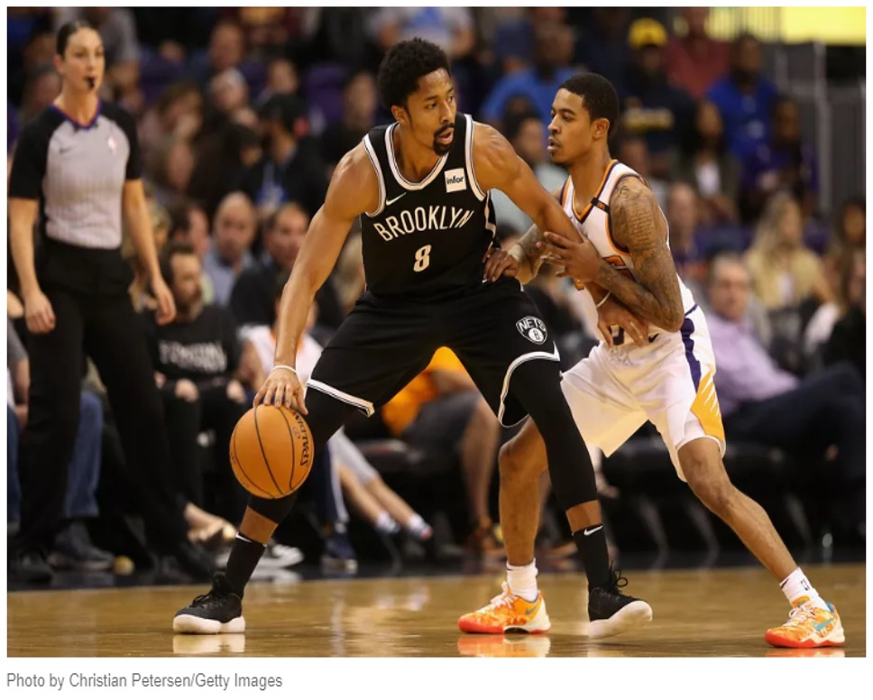


Tokenization allows for the trading, tracking and monitoring of
an asset with the agility
and speed of blockchain.
For example, NBA player Spencer Dinwiddie has tokenized a portion of his three-year guaranteed $34 million contract and issued the “SD26 Tokens” at $150,000 each under Reg D.
The SD26 Tokens represent general obligation bonds on the Brooklyn Nets forward’s creditworthiness. These digitally traded Ethereum ERC-20 tokens are structured to pay investors an approximately 5% annual yield.
Paxos Trust, as custodian, maintains the tokens and disburses all payments to investors.

Slide 7

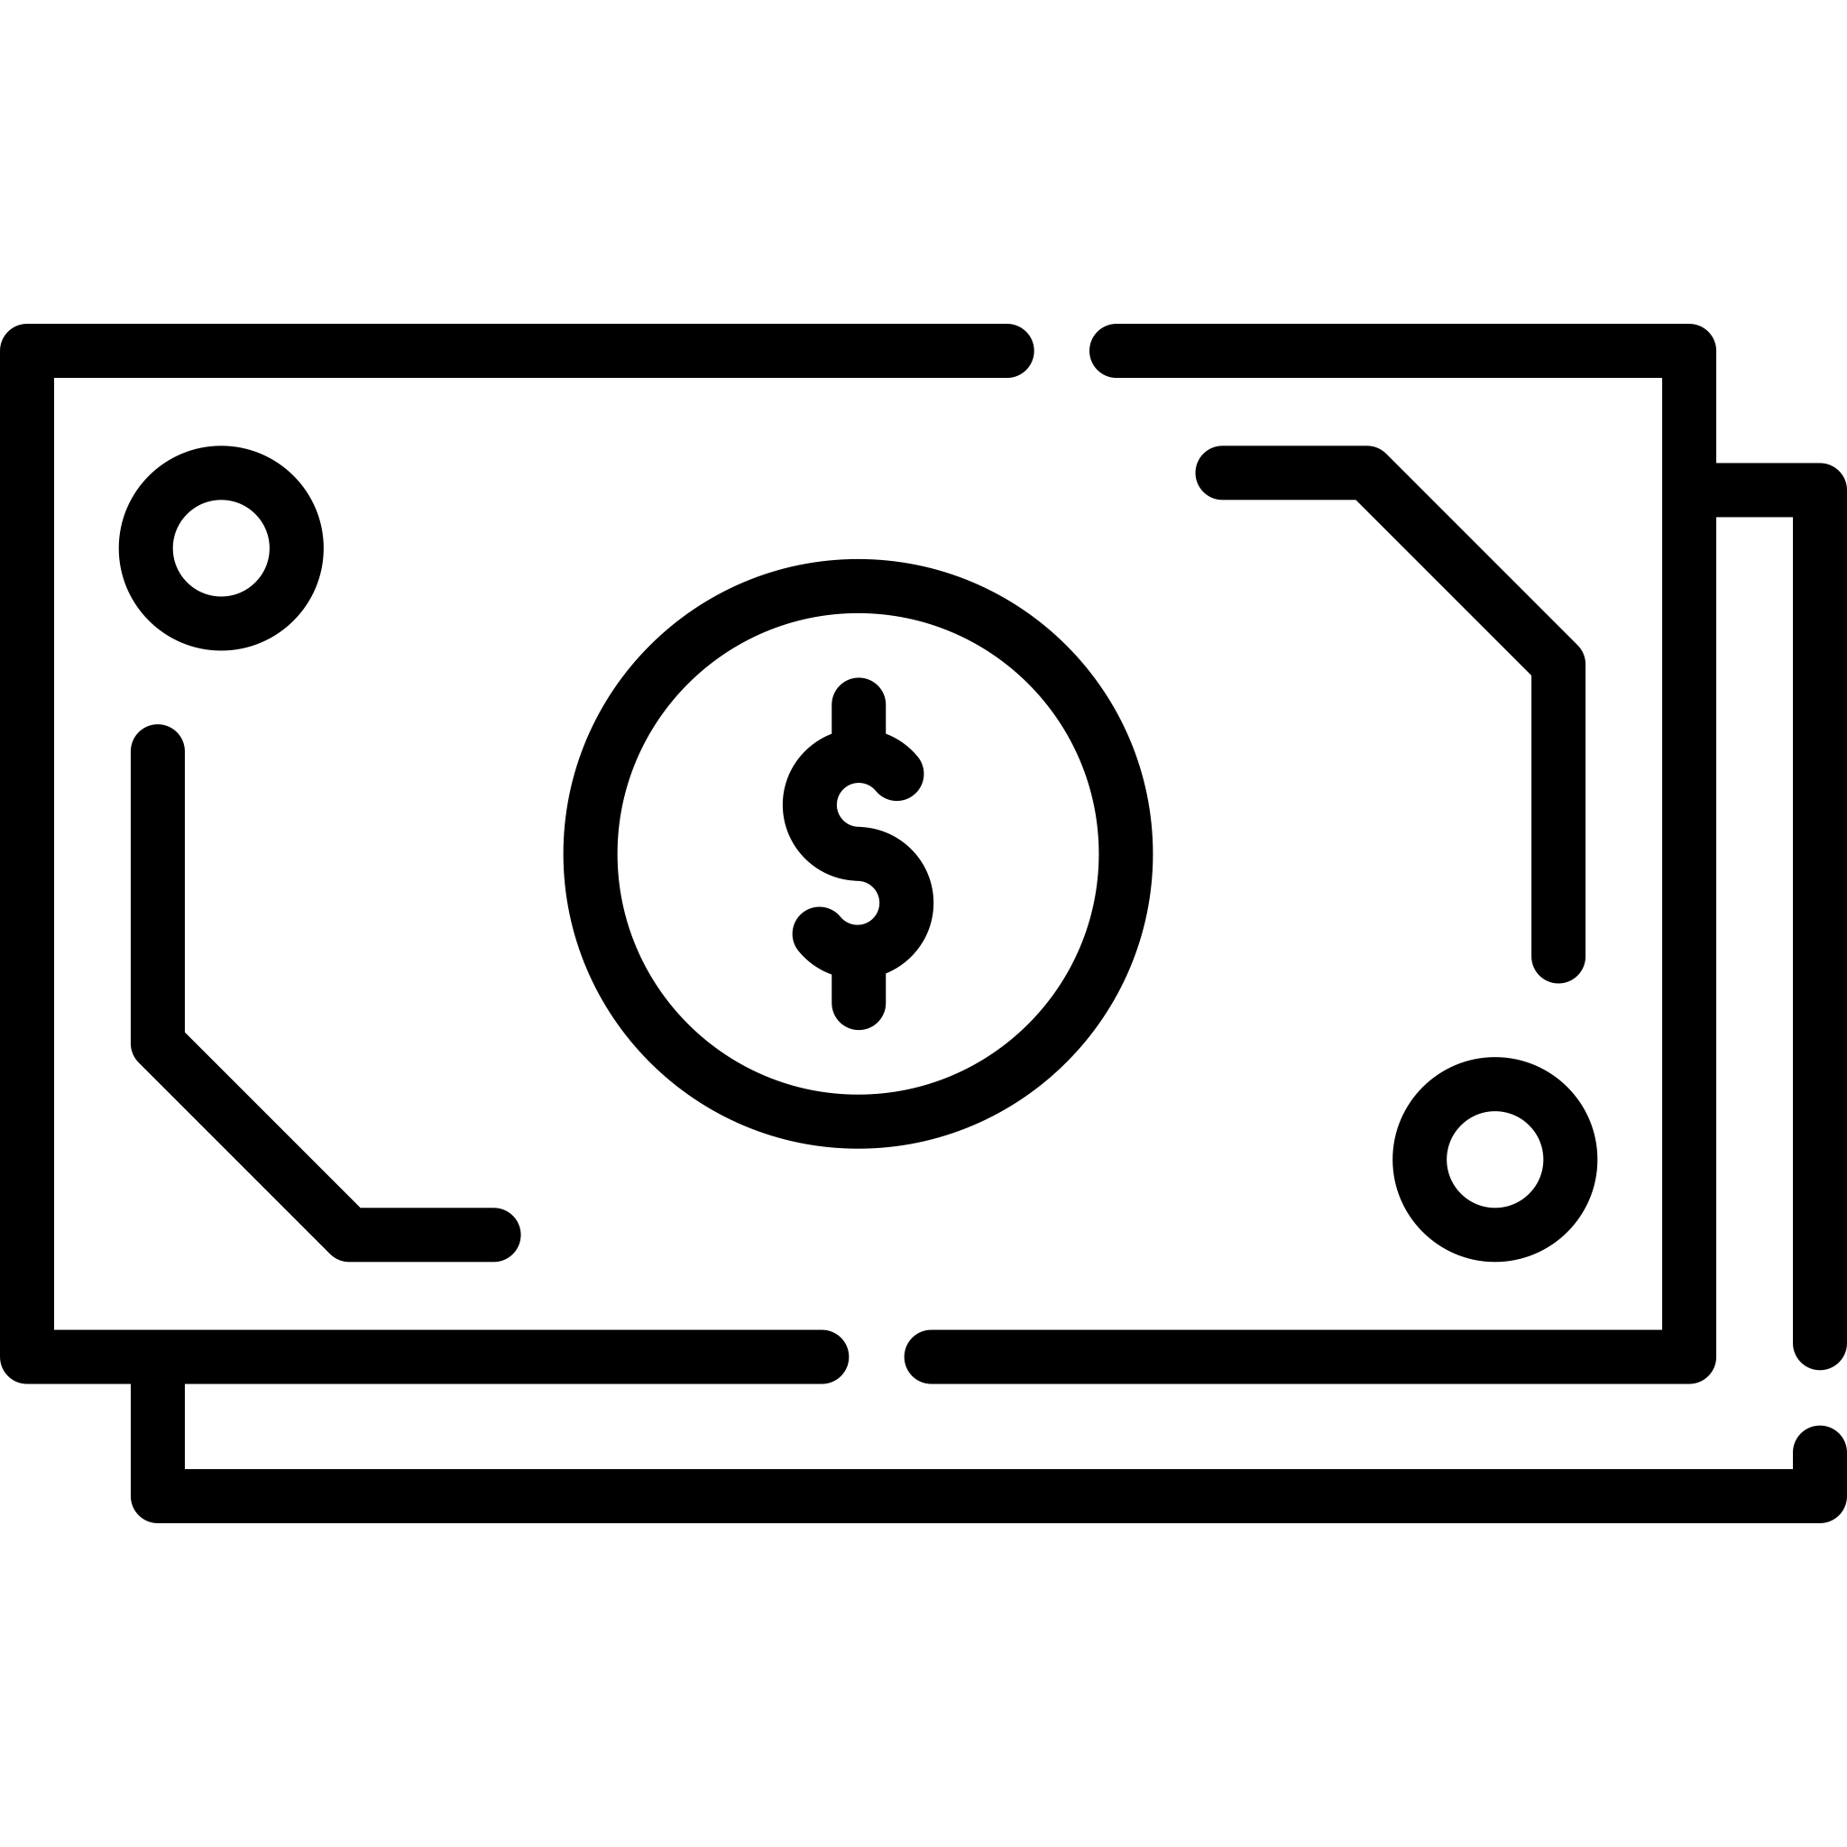


Tokenization is easily customizable to create a wide range of new & innovative financial products.
It is operationally efficient, with lower costs and faster settlement than traditional securities.
And its enhanced liquidity increases tradability and market depth.
With a lower cost of capital, tokenization removes certain middlemen, increases transparency and provides enforceable governance mechanisms.
Tokenized securities are more accessible than traditional securities with lower minimum investments which may diversify the investor base.
With the ability to automate processes that simplify monitoring & auditing, tokenization allows for better record keeping.
Tokenization
Payments
Web 3.0
Store of Value

Slide 8
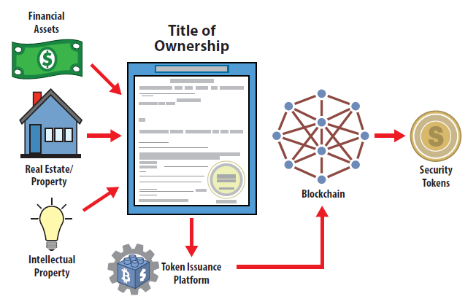

Tokenization of Assets on the Blockchain

Slide 9
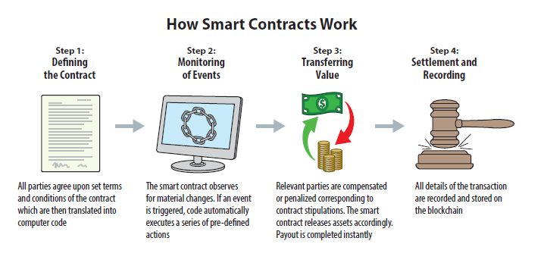
Smart Contracts & Automation via Blockchain….

Slide 10
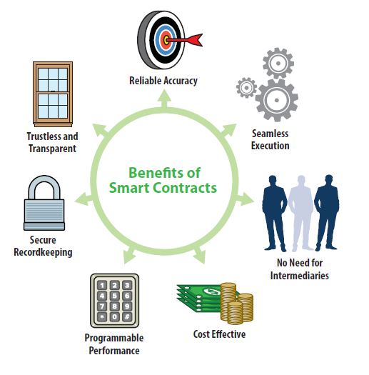
Advantages of Smart Contracts

Slide 11






Advantages of Digital Securities
Easily Customizable
Create a wide range of new & innovative financial products
Operationally Efficient
Lower costs and faster settlement than
traditional securities
Enhanced Liquidity
Increase tradability
and market depth
Lower Cost of Capital
Remove middlemen, increase transparency and program enforceable governance mechanisms
Improve Accessibility
Lower minimum investments & diversify investors bases
Better Recordkeeping
Automate processes to simplify monitoring & auditing

Slide 12
We expect trillions of dollars
are coming to the blockchain.
More of the economy’s growth is coming from private markets and that’s unlikely to change.
Already the number of privately owned corporates has well surpassed publicly listed securities.
Operators and asset owners need liquidity for sustaining IRRs and returning capital to early LPs.
Private Market AUM expected to grow at 10% annually through 2023.
8,000
7,000
5,000
6,000
4,000
3,000
2,000
1,000
0
7,596
6,917
US Listed Companies
4.336
US Private
Equity-Owned
Companies
1,572
2000
2005
2010
2015
Source: Morgan Stanley Research 2019

Slide 13
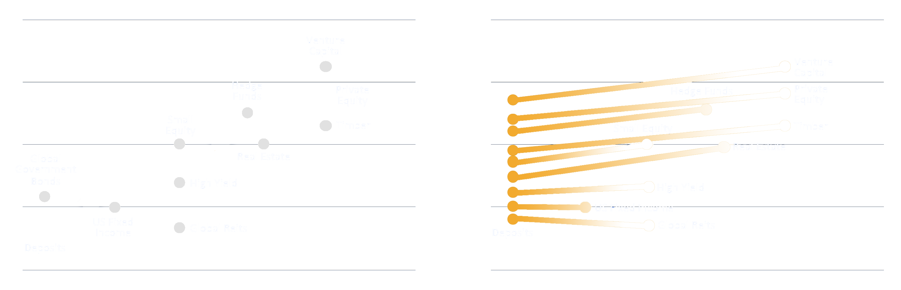
Unlocking the Potential for Digital Assets
Adding Liquidity to Traditionally Illiquid Assets
Expected Asset Class Returns VS. Liquidity
Leveling the Liquidity Playing Field
19
15
11
7
3
19
15
11
7
3
Compound Annual Returns (%)
Compound Annual Returns (%)
1
2
3
4
5
6
1
2
3
4
5
6
HIGHER
LIQUIDITY ESTIMATES
LOWER
HIGHER
LIQUIDITY ESTIMATES
LOWER
Tokenized Investment
Traditional Investment
Source: Honeycomb Digital Investments estimates

Slide 14


We believe we are in the early stages of a digital revolution built on blockchain technology.
Digital assets are still in the early stages of adoption and opportunities are likely to remain mispriced while an uptick in participants will drive demand higher. An expanded user base
of these new financial instruments leads to virtuous cycles and network effects.
Tools such as smart contracts and distributed ledger technology are likely to become major underpinnings of our new financial system.
Cryptocurrencies and utility tokens are now widely discussed as viable alternatives to fixed-supply instruments such as gold.

Slide 15
Major Trends Already in Motion
1. Adoption is on the Rise
2. Digital Infrastructure is Improving
3. Regulatory Environment is Being Defined

Slide 16
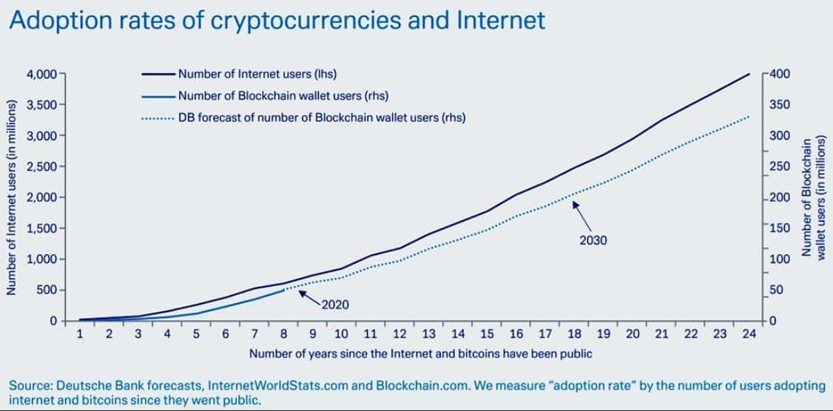
Similar Growth Trajectory to the Internet….

Slide 17

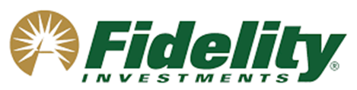
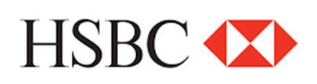


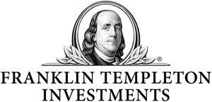
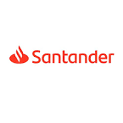

Digital Finance Continues to be Adopted by Established Market Participants at an Increasingly Rapid Pace.²
Announced plans to rate debt issued on blockchains, and completed review of two token projects
Developed institutional grade custody services for digital assets
Replacing records with a blockchain-based “Digital Vault” tracking $10 billion in private investments
Raised $1 billion line of credit for blockchain-based mortgages
Created partnership platform to support the issuance, trading, settlement and custody of digital assets
Launched first end-to-end tokenized bond ($20 million)
Filed preliminary prospectus to tokenize money market fund shares
Japan’s largest financial group will lead a 22-member security token research consortia
And the list continues to grow….

Slide 18
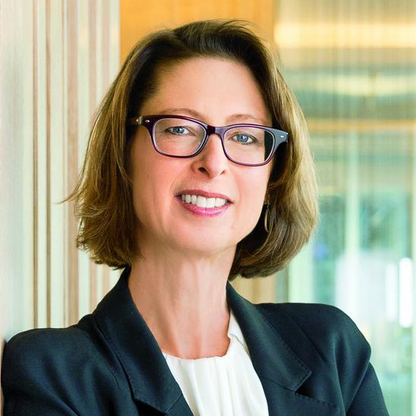

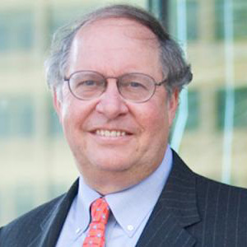
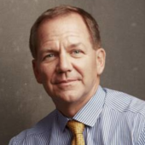
Established Investors and Financial Services Leaders
are Active in the Digital Asset Space.³
Abigail P. Johnson
Chairman & CEO
Fidelity Investments
Jack Dorsey
Chairman, CEO
& Co-Founder
Square & Twitter
Bill Miller
Former Chairman & CIO Legg Mason Capital
Paul Tudor Jones
Founder
Tudor Investment Corporation
18

Slide 19
Simulated Portfolio Performance – With Daily Rebalancing of Targeted Allocation
7 years of simulated performance: December 31, 2012 through December 31, 2019
PORTFOLIO | 60/40 Portfolio | 59/40 Portfolio +1% Bitcoin | 57/40 Portfolio +3% Bitcoin | 55/40 Portfolio +5% Bitcoin
Cumulative Total Return (%) | 93.5 | 109.4 | 144.9 | 185.7
Annualized Return (%pa) | 9.9 | 11.1 | 13.7 | 16.2
Annualized Risk (%Std Dev) | 7.44 | 7.37 | 7.52 | 8.07
Sharpe Ratio | 1.23 | 1.41 | 1.71 | 1.91
Change in Abs Return (%) |  | +16.9 | +51.4 | +92.2
Change in Risk (%) |  | (0.07) | +0.08 | +0.63
Sharpe Improvement (%) |  | +15 | +39 | +55
Benefits of Digital Assets
Benefits of
Digital Assets
Combination of Digital and Traditional Assets
Basic 60/40 portfolio composition: 60% S&P500 Total Return Index, 40% US Treasury Total Return Bond Index
Source: Federal Reserve Bank, CoinDesk 2020
The simulated performance information included herein does not reflect Fund performance. Fees and expenses of the Funds, which are not reflected herein, reduce Fund performance.
Past performance of the simulated portfolio is not indicative of future results.

Slide 20
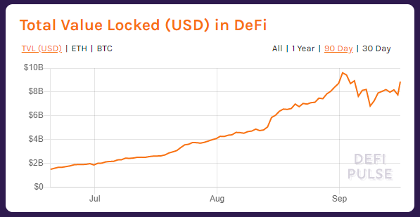
Hockey Stick Growth Profiles….
Source: defipulse.com; September 16, 2020

Slide 21



It’s Only Just Beginning….
Digital Assets & Cryptocurrency are Young
Bitcoin was first introduced in 2009 but began to gain widespread acceptance as an asset class in less than five years. Other digital assets are where Bitcoin was just a few years ago.
Digital Assets & Crypto Are a Fraction of Other Markets
The total market cap of digital assets is currently less than 1% of the world’s money and markets.
Regulators and Legislators Are Paying Attention
International and domestic legislators and regulators are methodically working to understand digital assets, their ramifications on the economy and how best to regulate all parties in the digital asset ecosystem.

Slide 22
Approximately a third of large institutional investors own digital assets now and more than 60% believe they have a place in portfolios.
– 36% across US and Europe; 27% of US institutions (pension funds, family offices, investment advisers, hedge funds) & 45% in Europe. It was 22% in US a year earlier
Increasing momentum in digital asset investment and interest across all investor segments we believe results from the following:
  Adoption and usage of underlying networks
  Recovery in digital asset returns relative
  to 2018 lows
  Launch of institutional grade infrastructure
  Introduction of sophisticated products
  Growth of talent and services providers
  focused on the space
Source: Fidelity Digital Assets, June 2020 Institutional Investors Digital Asset Survey.
22

Slide 23
Appendix
23

Slide 24
Case Study – St Regis Aspen
A portion of the St Regis Aspen Hotel was tokenized and formed as a single asset REIT. The iconic Colorado property was tax-efficiently structured as a Reg D 506(c) offering with the capability and simplicity of an asset on the blockchain.
The sponsor has since announced that it is launching an additional $1 billion of real estate investment offerings on the Tezos blockchain.
24

Slide 25

Case Study – Figure Technologies
Blockchain lending startup Figure Technologies is using its Provenance blockchain to more efficiently originate, finance and securitize loans for HELOCs, mortgage refinancing and student loan refinancing. Use of blockchain and distributed ledger technology allows Figure to dramatically cut costs, time and risk from the loan origination process.
Provenance has already issued over $1 billion in loan originations and estimates an increase in its margins of 1.25%.
In March 2020 Figure announced the issuance of the first ever securitization backed by loans originated, serviced, financed and sold on blockchain. Parties in the transaction included Jeffries Group and Nomura Securities.
25

Slide 26







How a Blockchain Mortgage Works
Adam is preapproved for a home loan, has fallen in love with a property, and wants to apply for formal approval.
1
The property and land title is transferred to Adam and the block added to the chain, providing a record of the transaction on the network
8
2
His application is represented online as a “block”.
The loan funds are transferred to Adam and the block is added to the chain, providing a record of the transaction on the network
7
Adam becomes a homeowner in 5 days instead of 42.
3
The block is broadcast to every “third party” involved in the home buying process including the bank, conveyancers, the credit reporting agency and land registry.
6
4
Through data-sharing on the blockchain network, Adam’s identity, bank account details, credit history and other personal details required for his application are verified.
A loan officer contract is generated, and Adam can sign the loan offer with a private key
5
$
A formal valuation may still need to take place depending on the nature of the property.
26

Slide 27
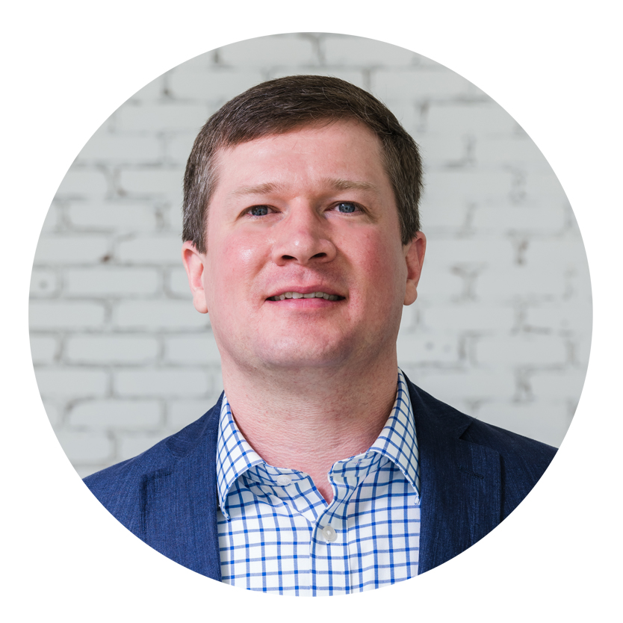
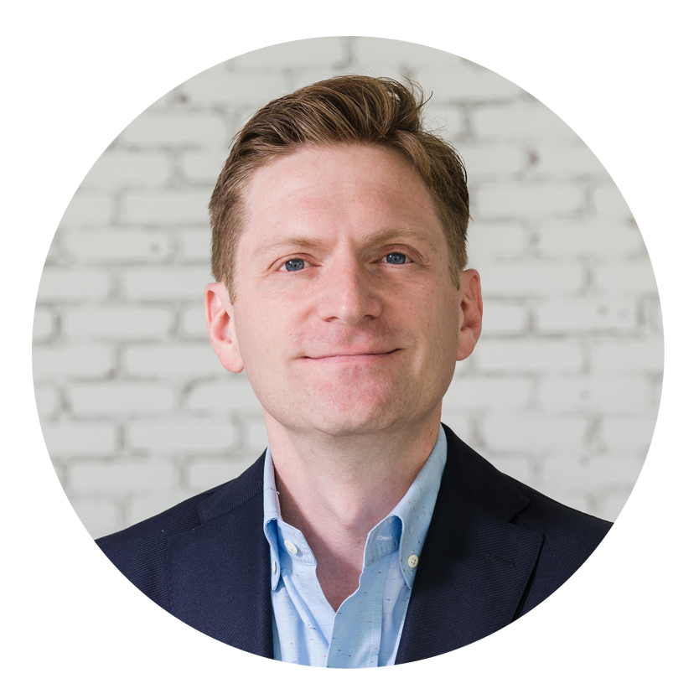
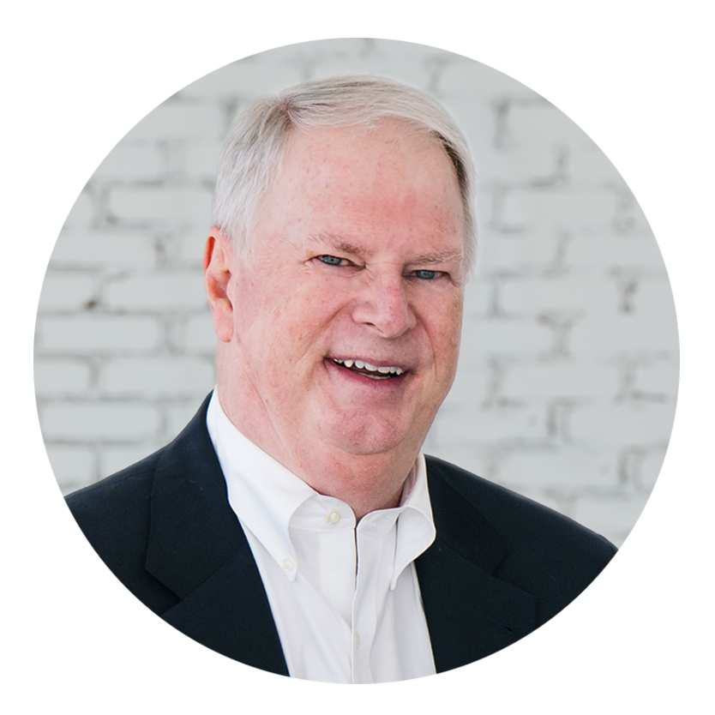
Honeycomb Digital Leadership and Investment Professionals
Team of Capital Markets, Asset Management, and Private Equity Veterans
Baxter Hines, CFA
CIO
Baxter holds a Bachelor's Degree in economics from the University of Virginia and an MBA in finance from the University of Texas. Baxter holds the Chartered Financial Analyst designation and is a member of the CFA Society of Dallas. Baxter is a current board member and former chairman of Camp Summit.
Baxter lives with his wife and two children in Dallas, Texas.
David Beran
COO
Dave is a graduate of Wake Forest University and the University of Arkansas School of Law, summa cum laude. Dave is a board member of The Lamplighter School in Dallas, an adjunct professor at the University of Arkansas School of Law and an active cyclist.
Dave lives with his wife and three children in Dallas, Texas.
Gregory Swank, CFA
CFO
Greg holds a Bachelor of Science Degree and an MBA from The Ohio State University with majors in finance. Greg holds the Chartered Financial Analyst designation and is a member of the CFA Society of Dallas.
Greg lives with his wife in Southlake, Texas.

Slide 28
Endnotes
Slide 4 – Bob Greifeld: https://bravenewcoin.com/insights/nasdaq-planning-a-tokenized-securities-platform
Slide 17 – Morningstar: https://www.forbes.com/sites/michaeldelcastillo/2020/03/08/morningstar-rates-ﬁrst-ethereum-debt-security-in-40-million-fatburger-deal/#5d071b8b2abd; Fidelity: https://www.ﬁdelitydigitalassets.com/about-us; HSBC: https://venturebeat.com/2019/11/28/hsbc-to-shift-20-billion-worth-of-assets-to-blockchain-based-digital-vault/; Jefferies: https://www.housingwire.com/articles/49009-ﬁgure-technologies-lands-1-billion-blockchain-investment-to-revolutionize-heloc-lending; Nasdaq: https://www.coindesk.com/nasdaq-r3-corda-digital-assets; Santander: https://www.santander.com/en/press-room/press-releases/santander-launches-the-ﬁrst-end-to-end-blockchain-bond%C2%A0; Templeton: https://www.ledgerinsights.com/franklin-templeton-blockchain-mutual-fund-stellar/; MUFG: https://www.ﬁnancemagnates.com/cryptocurrency/news/mufg-to-lead-22-member-consortium-for-security-token-research/
Slide 18 – Abigail Johnson: https://www.bostonglobe.com/business/2017/05/23/johnson-talks-bitcoin-her-ﬁrst-major-speech-ﬁdelity-chairman/HYE8mo5Q5hABggIuD2y5kJ/story.html; Jack Dorsey: https://www.forbes.com/sites/billybambrough/2020/01/27/update-twitters-jack-dorsey-is-making-bitcoin-as-common-as-cash/#604e3c706ac3; Bill Miller: https://cointelegraph.com/news/report-bill-miller-hedge-fund-surges-46-thanks-to-bitcoin-amazon; Paul Tudor Jones: https://www.cnbc.com/2020/05/11/paul-tudor-jones-calls-bitcoin-a-great-speculation-says-he-has-almost-2percent-of-his-assets-in-it.html
29

Slide 29
Disclaimer
This presentation and the information contained herein is provided for informational purposes only and does not constitute investment advice, investment recommendations or an offer or solicitation to buy or sell an interest in any funds (each a "Fund" and collectively, the “Funds”) sponsored or managed by Honeycomb Digital Investments, LLC (the “Investment Manager”) or any other security. An investment in a Fund is speculative and involves substantial risks, including the risk of loss of the investment. Investment products such as the Funds are designed only for sophisticated investors who are able to sustain the loss of their investment. Accordingly, such investment products are not suitable for all investors. Additional information regarding the Funds including fees, expenses and risks of investment, may be contained in a confidential offering memorandum for each Fund and related documents and should be carefully reviewed. This Presentation does not constitute or form part of an offer to issue or sell, or of a solicitation of an offer to subscribe or buy, any securities or other financial instruments, nor does it constitute a financial promotion, investment advice or an inducement or incitement to participate in any product, offering or investment. Any offer or solicitation of an investment in a Fund will only be made to accredited investors pursuant to a confidential private placement memorandum and associated documents. Interests in the Funds can only be purchased by investors meeting all the requirements of such Fund. There can be no guarantee that the Funds will achieve their investment objectives. The information contained in this material does not purport to be complete, is only current as of the date indicated, and may be superseded by subsequent market events or for other reasons. Unless otherwise noted, all information contained herein is presented as of October 2020. No securities commission or regulatory authority in the United States or in any other country has in any way passed upon the merits of an investment in a Fund or the accuracy or adequacy of the information or material contained herein or otherwise. This information is not, and under no circumstances is to be construed as, a prospectus, a public offering, or an offering memorandum as defined under applicable securities legislation. Funds are not registered under the Investment Company Act of 1940, as amended, in reliance on an exception thereunder. Interests in the Funds have not been registered under the Securities Act of 1933, as amended, or the securities laws of any state and will only be offered and sold in reliance on exemptions from the registration requirements of said Act and such laws. These securities shall not be offered or sold in any jurisdiction in which such offer, solicitation or sale would be unlawful until the requirements of the laws of such jurisdiction have been satisfied. Investors in the Funds have a limited right to redeem or transfer interests in the Funds. In addition, interests will not be listed on an exchange and it is not expected that there will be a secondary market for interests. Prospective investors are advised to consult with their own independent advisors, including tax advisors, regarding a potential investment in a Fund. This presentation and accompanying document are not intended to provide, and should not be relied on for, accounting, legal, or tax advice, or investment recommendations.
Certain information contained in this Presentation has been obtained from third-party sources. While such information is believed to be reliable for the purposes used herein, the Investment Manager has not independently verified such information, and the Investment Manager makes no representation or warranty, express or implied, as to the accuracy or completeness of the information contained herein. Certain economic and market conditions contained herein have been obtained from published sources and/or prepared by third-parties and in certain cases have not been updated through the date hereof.
Investors should bear in mind that targeted investment characteristics and terms may not be indicative of actual or future investment characteristics and terms, and there can be no assurance that the Funds will have comparable investment characteristics or terms or that target investment characteristics will be achieved.
Certain information contained in this material constitutes “forward-looking statements,” which can be identified by the use of forward looking terminology such as “may,” “will,” “should,” “expect,” “anticipate,” “objective,” “strategy,” “plan,” “project,” “estimate,” “intend,” “continue” or “believe” or the negatives of those terms or other variations of them or by comparable terminology. Due to various risks and uncertainties, actual events or results or the actual performance of the Funds may differ materially from those reflected or contemplated in such forward-looking statements. No person or entity should rely on these forward-looking statements when making any investment decision. There is no obligation for the Investment Manager to update or alter any forward-looking statements, whether as a result of new information, future events or otherwise. All forward-looking statements contained herein are qualified in their entirety by the foregoing cautionary statements.
Estimates contained herein are inherently uncertain and subject to change.
Past performance is no guarantee of future results. ©2020 Honeycomb Digital Investments, LLC. All rights reserved. This material may not be reproduced, displayed, modified or distributed without the express prior written permission of the copyright holder.
29

Slide 30
Contact
David R. Beran
Chief Operating Officer
dave@honeycombdigital.io
214.708.2137

