Slide 1

HYPERLEDGER ITALIAN CHAPTER MANIFESTO
Hyperledger Italian Chapter is
Responsible for developing the Hyperledger community in Italy, promoting cross functional projects based on Hyperledger frameworks.
Providing a platform for collaboration, mentoring and support of the Italian community.
The chapter aims to showcase the broad range of Hyperledger projects and initiatives to the Italian market favoring business and technological interactions for cross functional DLT projects.
Please join us on our global community

Slide 2





ITALIAN CHAPTER ACTIVITY MAP
BUSINESS MEETINGS & USE CASES
INTENTS
ORGANIZATIONS, CONSORTIA & REGULATORS
EDUCATIONAL
ACADEMY & RESEARCH
LAB

Slide 3
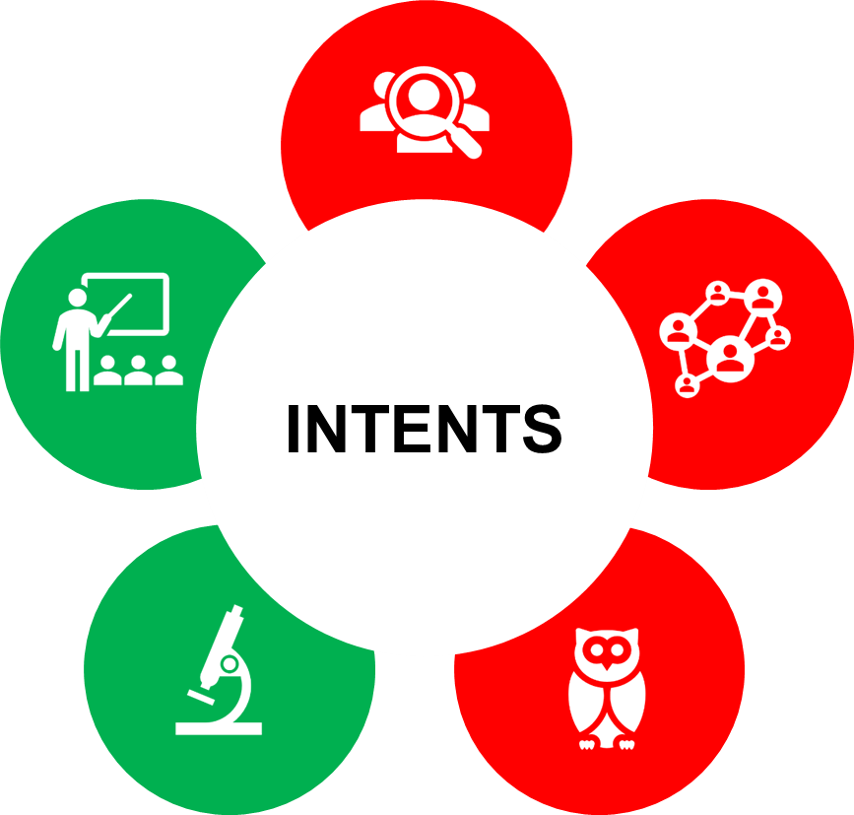
Educational
Educate the Italian Community on Hyperledger Projects (ie. Indy, Besu, Aries, etc.) and Assets (Cactus, etc.)
Share roadmaps, features and release, strategies and related support.
Increase local awareness, support developers and users
Collaborate with Universities and Research Centers

Slide 4
Lab
Experimenting blockchain according to the Technology Trends (ie IoT, Edge Computing, etc.) and Use Case (ie DID, Tokenized Phisycal Asset, Supply Chain, Financial Services Infrastructures, etc.).
Organize Technical Deep Dive and Hackathons.
Coordinate technical meet-ups.

Slide 5
Business meetings
Collaborate (Companies, Enterprise, Public Services) to consolidate use cases and fields of application.
Coordinate specific business meet ups in order to share business related experiences, feedbacks and challenging in adoption phase.

Slide 6
Use cases
Suggesting areas:
  Finance;
    (CBDC, asset securitization, trade),
  Machinery, fashion, agrifood, energy, healthcare, energy shipping industry
    (supply chain digitization and finance)
  Administrations and Institutions
    (sovereign identity, settlement disputes, IP management)

Slide 7

ORGANIZATIONS, CONSORTIA & REGULATORS
Collaborate with Public and Private Organizations in order to establish guidelines and policies for adoption and growth.
National level (AGI, MISE)
International level (ISO, WEF, ICC,WHO)

Slide 8
ACADEMY & RESEARCH
Engage and Collaborate with Universities and Research Centers, in order to share Areas of Interest, Roadmaps and Fields of Application.

Slide 9
Agenda
Hyperledger Italian Chapter Proposal introduction by Eugenio Reggianini and discussion - Trade Finance & Capital Market SIG member
Hyperledger Trade Finance Special Interest Group focus by Andrea Frosinini - Chair at Hyperledger Trade Finance SIG
Sharing experiences on DLT challenges and potentials for the italian market: (provisional list)
Mattia Ozzello - SIA
Others
For everyone interested please join the event at the following page.
When: 25th November 6.30-8.30 CET
Hosted by Carlo Ferrarini - IBM Italia

