Slide 1

Hyperledger DCI Survey
Final Results
July 2020

Slide 2
Executive Summary
Limited responses from underrepresented groups. Received 98 responses of which men consisted of 85% of responses and woman, 13%. More than half of respondents were Caucasian, Asian at 30% , and only 9% percent were made up of black and Hispanic respondents.
While majority of respondents across all demographic profiles experience civility and inclusion within the Hyperledger community overall, diversity (particularly gender) is not experienced by majority of respondents. Additionally, Hyperledger events and meetings are not always inclusive or diverse with variation in responses by demographic profile.
Respondents appear to be engaged with majority contributing to code and communicating with the chat and emails. However, challenges were citied around finding the agenda/meeting information and the right chat channel (40-45% of respondents).
Hyperledger community members are roughly concentrated across three major time zone clusters: Americas (largely US) (42%), Europe (25%), and India (21%). Likely one of the reasons why majority of respondents cited difficulties with meeting times.
Notes:
According to respondents, events are less diverse and inclusive, following by meetings. Although only 46% of respondents attended a hyperledger sponsored event.

Slide 3
Q1. Global diversity experiences lead the way, followed by racial and gender diversity. Overall, gender diversity occurred 41% of the time and 38%* of the time for woman respondents. Racial/ethnic diversity occurred 58% of time, but for other underrepresented groups (e.g. black and Hispanic), this was experienced 33%* of the time.
N= 97 overall
*See appendix for slice by gender and race/ethnicity for underrepresented groups. N=13 for woman and N= 9 for Hispanics/blacks
**Majority of respondents were unsure about disability and LGBTQIA diversity. One contributing factor is that these diverse profiles can be hidden(e.g. hidden disabilities such as colleagues on spectrum).
Notes:
**Majority of respondents were unsure about disability and LGBTQIA diversity. One contributing factor is that these diverse profiles can be hidden(e.g. hidden disabilities such as colleagues on spectrum) or not reported.

Slide 4
Q2. Eighty percent of respondents usually or always experienced civility within the Hyperledger community, while 73% of respondents experienced inclusion (this past year). Woman respondents usually or always experienced civility 77% of the time but inclusion 61% of the time. Other underrepresented groups (e.g. black and Hispanic), experienced C&I 70% of the time.
Civility, N=88*
Inclusion, N=96*
*2 respondents skipped this question and 8 did not answer for civility.
Notes:
Civility slightly exceeds inclusive experiences, but high overall.

Slide 5
Q3. Leading Hyperledger engagement included mailing lists, followed by channels and community meetings.
N=97, 1 respondent skipped
Notes:
With the exception of events, the majority of respondents have engaged across a variety of modalities with the community. Attendance in sponsored events has been shy of 50% but this could increase given the push for more virtual conferences or events (or hybrid of sorts going forward)

Slide 6
Q4. Sixty-three percent of respondents agree or strongly agree that Hyperledger events are inclusive and diverse. Fifty-four percent of woman respondents and 44% of underrepresented groups (Blacks/Hispanics) agree or strongly agree
N=98
See slide 16 for woman/underrepresented groups
Notes:
% of not attending hyperledger event is lower in this question that the previous. But it could be from observation of agendas or speaker report outs from events or varying interpretation of what consists of a hyperledger event.

Slide 7
Q5. Majority of respondents (62% for all, 77% for women) cited community meeting times as difficult (either sometimes, usually, or always). Forty-five percent found it difficult to find the agenda or meeting information and 15% cited technical difficulties. Thirty-eight percent of woman respondents did not find meetings to be inclusive for new participants (either sometimes, usually, or always) compared to 27% of respondents overall.
N=98*
N=13
Please note that the number of respondents who did not attend a community event is not reported here. There were inconsistencies in the responses with people applying the rating system (always, sometimes, etc), as well as ‘not applicable’ for the question. N/A responses across the board represent 44 or 49% of responses. This figure may indicate the number of respondents who did not attend.
33% of underrepresented groups (blacks/Hispanics) indicated that meetings are not inclusive for new participants (wither sometimes, usually, or always)
* 98 answered part of the question whereas 96 responded to 3 out of 4 of the statements and 95 for the remaining statement.
Notes:
Perhaps room to simplify the wiki UI or messaging in communications ahead of meetings.

Slide 8
Q6. More than half cited (61%) that the asynchronous nature of Hyperledger chat allows them to participate (always or usually). Eighty-seven percent of respondents did not find chat recipients to be rude or unwelcoming; Fifty-two percent did not have challenges finding the right channel although 40% found it challenging usually or sometimes. Eighty-one percent indicated that questions were quickly answered (usually or sometimes).
N=98*
N=13
*While no respondents skipped the entire question, 95 responded to one of the statements, 97 responded to two of the statements, and 98 to one of the statements.
46% of woman respondents indicated that the asynchronous nature of Hyperledger chat allowed them to participate (70 % for blacks/Hispanics). 92% did not find participants to be rude or unwelcoming (100% for black/Hispanics). 69% indicated that questions were quickly answered (usually or sometimes). Fifty-three percent did no have challenges finding the right channel was difficult (40% for blacks/Hispanics) but 46% found it challenging usually or sometimes (60% for blacks and Hispanics).
Notes:
Perhaps room to simplify wiki UI

Slide 9
Q7. Majority of respondents are from North America (55%), followed by APAC (25%), and Europe (18%)
N=97
*One respondent skipped the question.

Slide 10
Q8. Majority of respondents are from the 25-34 (34%) age group range, followed by 35-44 age group (23%), and 45-54 age group (22%).
Q11. Over half of respondents are Caucasian (54%), followed by Asians (30%). Hispanic/Latin/Spanish race/ethnicities account for 9% of respondents.
N=98

Slide 11
Q9/Q10. Men accounted for 85% of respondents and 90% of respondents identified as heterosexual.
N=98

Slide 12
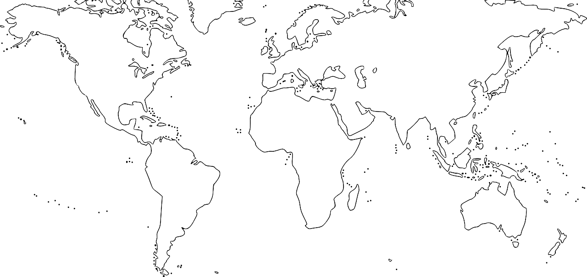
Q12. Time zones
 | IST
5 | 05:30 | 6
6% | 9% | 6%
Alaska | PST | MST | CST | EST
-9 | -8 | -7 | -6 | -5 | -4
 | 10% | 13% | 3% | 9% | 7%
UTC | CET | EET | MSK
0 | +1 | +2 | +3
3% | 14% | 2% | 6%
ACT |  | AEST
+8 | +9 | +10 | +11 | +12
5% | 5% | 2% |  | 1%
Hyperledger community members are concentrated in three major time zone clusters: Americas (42%), Europe (25%), and India (21%).
US-based respondents have clearly dominated (49%) the Hyperledger Inclusion and Diversity survey. Most of them work in Western (23%) and Eastern (16%) states.
Western- and Central Europe-based respondents are strongly focused in CET time zone (UTC +1).
Western US and India struggle to cooperate as their respective time zones (PST, MST, and IST) are approximately 12 hours apart.
Notes:
The reporting of time zones were a bit messy as they were open responses and lacked some standardization but this is the rough breakdown

Slide 13



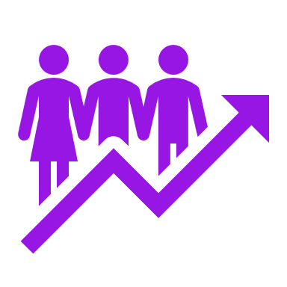
Q13. Open responses garnered mixed reactions about DCI
Desire for more convenient meeting times
For others, not always an inclusive and welcoming community
Several respondents stated challenges with inconvenient meetings times with requests for more asynchronous times at different time zones to enhance inclusion and diversity globally.
A few respondents cited issues with civility within TSC (not as welcoming), treatment with maintainers by HL staff and general perception that the community can be hard to break into.
Diversity not reflective of general population
For some, the community is inclusive.
Desire for more resources and training
Some acknowledged room to improve diversity (e.g. challenges with pipeline) by reaching out to underrepresented communities (e.g. PyLadies to learn about best practices).
Some respondents felt welcome and included by the community and indicated that the leadership team does a good job to enable DCI.
Stated need to train maintainers on expectations to help uphold community accountability as well as develop more central resources and support to help technical folks build solutions.
See appendix slides for detailed list of responses
N=37
Notes:
Only 37 out of 98 (nearly 40%) provided completed the open responses section.
Opportunity for partnerships to support and foster a more diverse pipeline of candidates

Slide 14
Appendix

Slide 15
Q1. In the past year, did you experience the following types of diversity within the Hyperledger community?
N=13
N=9
*Majority of respondents were unsure about disability and LGBTQIA diversity. One contributing factor is that these diverse profiles can be hidden(e.g. hidden disabilities such as colleagues on spectrum).

Slide 16
Q2. In the past year, did you experience civility and inclusion within the Hyperledger community?
Civility, N=9
Inclusion, N=9
Civility, N=13
Inclusion, N=13

Slide 17
Q4. Hyperledger events are inclusive and diverse
N=13
N=9

Slide 18
Q5. Provide your feedback on the Hyperledger community meetings (women respondents)
N=13

Slide 19
Q5. Provide your feedback on the Hyperledger community meetings (Black and Latin/Hispanic/Spanish)
N=9

Slide 20
Q6. Provide your feedback on Hyperledger chat channels (woman respondents)
N=13

Slide 21
Q6. Provide your feedback on Hyperledger chat channels (Black/Latin/Hispanic respondents)
N=9;

Slide 22
Q13.
Please provide any thoughts or comments that you have on diversity, civility, and inclusion in the Hyperledger community including sharing past experiences that you feel may be relevant and useful for us to be aware of and/or suggestions and ideas of what you think could be done to expand, grow, and improve diversity, civility, and inclusion in the Hyperledger community.
“I am new to the community and have felt completely welcome to participate in any ways I felt comfortable.”
“The community is very inclusive.”
“Diversity, civility, and inclusion in the Hyperledger community is generally a given. Leaders set good examples. As the community expands its global footprint, a perfect world cannot be expected, standards are best set by example. Also allow some wriggle room for mistakes and learning. i.e. many with Big Tech background are in political cultures where diversity, civility, and inclusion are more important than technical ability. This is not the case in smaller companies and global companies outside the west. So while setting DCI examples, also tolerate and teach how to deal with differences.”
“Non-developer community calls I've been on assume a US time zone. The events also are focused on the US - that makes it hard for folks to join in.”
“The TSC come across as unwelcoming and uncivil/impolite. opening an item for discussion the chair will first state their opinion on the matter and then steer discussion to support their opinion. It comes across as a challenge to defy him, and on a few occasions he has chided the TSC members for not falling into consensus with his view. At least one other TSC member will yell and occasionally swear in frustration at other members when they don't get their way. This is not safe and welcoming behavior.”

Slide 23
Q13. Continued..
“More than diversity is the lack of responsiveness on rocket chat and other channels. Also, find "real-world" code examples beyond 2 orgs is hard, as is having a working substitute for composer that actually let's people worth through POCs -- or a viable narrative to bootstrap that one can actually use to build working POCs -- you appear to have it working well for the community from a diversity perspective, now can you please work on something we can actually use to modify your samples so we can spin up quickly?”
“The open source software community is not diverse by default. To get to diversity will take a concerted effort. Civility is fine but if diversity is a goal we need to do more than a survey.
“Reach out to groups that are not highly represented in the Hyperledger community”
“Special focus should be given to small island developing states that have little resources and developers scattered across different time zones and languages, like the Caribbean.”
“I would like to see follow through if there is action to be taken”
“I have found the community welcoming and becoming more inclusive.”
“In general, I think Hyperledger does an excellent job of being inclusive of everyone.”
“In the past maintainers concerns have been ignored or even made fun of by hyperledger staff. This makes it hard for those of us working hard on our projects to want to put the effort into working with the staff.”
“Effective representativeness of population in political systems.”
“Almost all meetings are early morning. 6-9am. Too early for me to be awake and productive.”

Slide 24
Q13. Continued..
“I am teaching myself more advanced software platforms and concepts. In moving beyond a tactical macro play set to something more formal but still attainable such as this, I am behind the curve on the small things that can hold my progress. I cannot expect people to hand hold me but I do have use/business cases for this platform that I think no one else is contemplating. It would be helpful if the disparate knowledge of the questions and responses was collected on this topic. As it is, I get as more help from StackOver and sometimes the research on it actually references Sawtooth as the platform involved. It is kind of a big request to attempt managing knowledge sharing through a chat forum and it depends on whether you are looking to support hackers such as myself.”
“Connecting in the call has a lot of technical difficulties. Time of Hyperledger calls falls in odd hours in my time zone.”
“I see a lot of people struggling with making use of technologies in their solutions. More and more examples assisted with the tech stack would be of immense help.”
“Please don't fall in this fucking bullshit of "diversity, civility, and inclusion." Don't make engineering world worse. Just accept everyone, do not put them in a special individuality.”
“In the communities I've participated, the vibe of the community seems to be welcoming, but we have far from a diverse community. It is very much dominated by white males. Creating a more diverse community organically seems to be difficult. It's a tough challenge.”

Slide 25
Q13. Continued..
“It's well diverse community and welcome all participants as Equal”
“HL is very welcoming but it would be great to have more ladies in the community. Maybe, contact communities like PyLadies and invite them to share their experience.”
“It comes down to companies hiring diverse people to work on this stuff”
“Just a clarification regarding 1. There is usually diversity, e.g., regarding gender or ethnicity, but obviously not in overall representative proportion. But it's certainly not worse than in the field in general ....”
“I like the fact that the Hyperledger leadership team itself seems diverse- it makes for a good model.”
“We need to help train maintainers on expectations and hold each other accountable to a high standard of respect and cordiality. Always with a clear message that good faith contributions and differing perspectives are welcomed and appreciated.”
“Without a pipeline, difficult to get gender diversity. Usually women participate from the BD, Community and other soft sides; rarely technical. Civility is a matter of taste, need to know how to disagree politely. Listening is a skill that might help.”

Slide 26
Q13. Continued..
“I am saddened by the "rumblings" I hear of some claiming that some Hyperledger Communities are not as accepting of diversity as I would like them to be and fully support any efforts to correct that anomaly. (Like this survey, Thanks!)”
“Asynchronous meetings should be promoted for people in different time zones to participate. This will increase diversity. Simplification of UI of Hyperledger Wiki for non technical people to easily navigate and understand. This will promote inclusion.”
“Having more localised events help.”
“Hyperledger can be difficult for anyone to break into as a community. While I don't have personal experience with this, I can imagine that this difficulty is amplified for some underrepresented groups. Making this easier would probably boost diversity and total participation.”
“Almost all meetings are early morning. 6-9am. Too early for me to be awake and productive.”
“Pacific time zone is hard to attend meetings”
“Hyperledger projects and community to better than any other organization to be inclusive and diverse. I do think rocketchat is the best way to have productive, asynch conversations etc the wiki is also very useful including the meeting recordings / notes and presentations. the github repos are a big help to download code etc JIRA is very helpful to see product roadmaps, story, defect status etc the meetings calendar is great to find groups / meetings that are relevant linking to related content, videos useful when needed.”

