Slide 1

Ledger Academy
Covid-19 Initiatives
April 27

Slide 2
AGENDA
Current Covid-19 Initiatives
US Government Public Health Emergency BARDA
CCI
Identity Working Group
IBM Call For Code
Government Blockchain Assoc
New Jersey Initiative
The Giving Chain
Wrap up
Notes:
David

Slide 3
AGENDA
US Government Public Health Emergency BARDA
CCI
Identity Working Group
IBM Call For Code
Government Blockchain Assoc
New Jersey Initiative
The Giving Chain
Wrap up
Notes:
David

Slide 4
US Government
Public Health Emergency
BARDA
US Government Public Health Emergency BARDA
(Biomedical Advanced Research and Development Authority
https://www.phe.gov/emergency/events/COVID19/Pages/business-barda.aspx

Slide 5

US Government Public Health Emergency BARDA
BARDA is continuing to work with its partners to identify promising medical countermeasures and technologies to combat the 2019 novel coronavirus

Slide 6

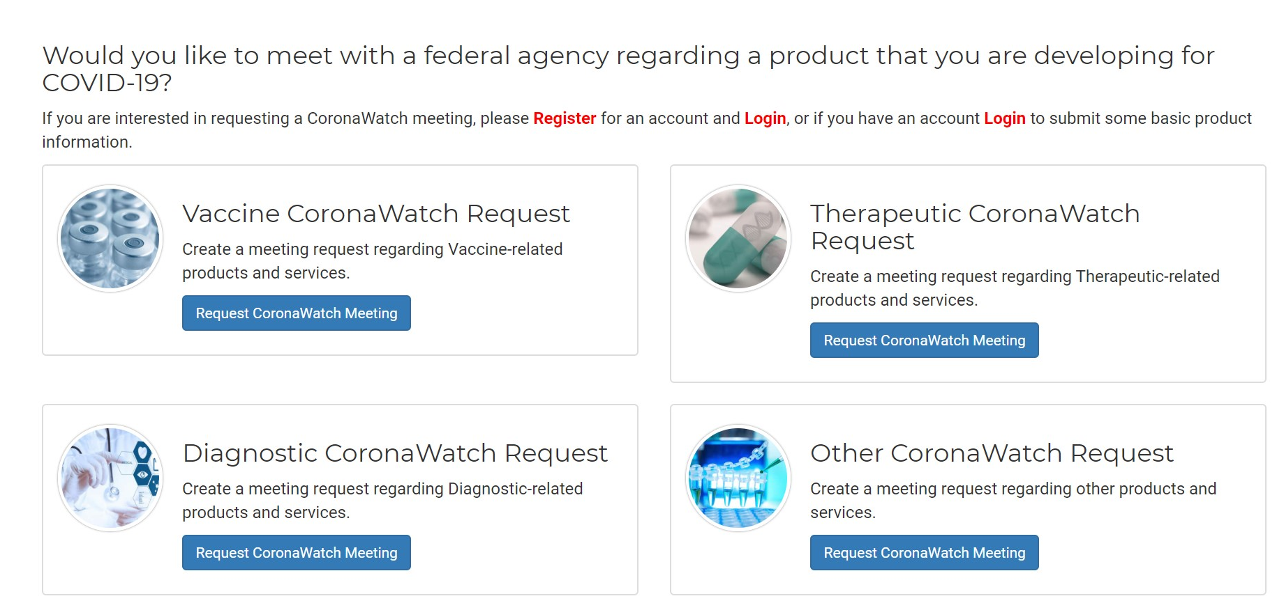

Slide 7
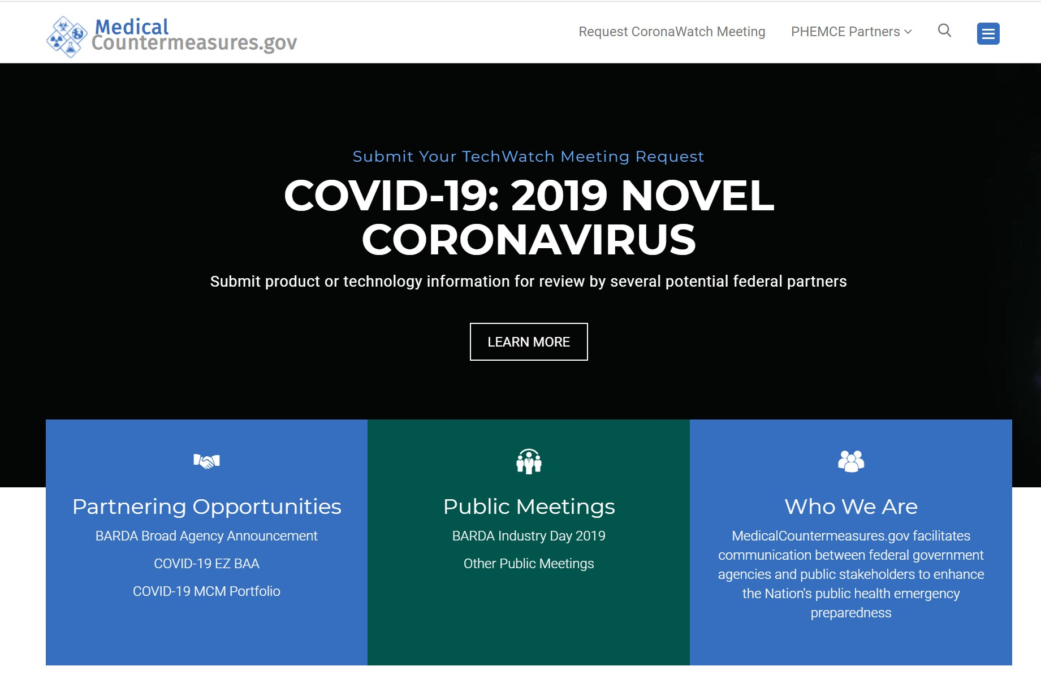

Slide 8
AGENDA
US Government Public Health Emergency BARDA
CCI
Identity Working Group
IBM Call For Code
Government Blockchain Assoc
New Jersey Initiative
The Giving Chain
Wrap up
Notes:
David

Slide 9

About the initiative
The COVID-19 Credentials Initiative (CCI) is a collaboration of more than 60 organizations working to deploy verifiable credential solutions to help stop the spread of COVID-19. Our goal is simple, we want to enable society to return to ‘normal’ in a controlled, measurable, and privacy-preserving way.
The initiative is a direct response to the many calls for an ‘immunity passport,’ a digital certificate that lets individuals prove (and request proof from others) that they’ve recovered after testing negative, have tested positive for antibodies, or have received a vaccination, once one is available

Slide 10
Workstream #1: Use Cases
Mission: Deliver Covid-19 credentials use cases that are validated by domain experts and can be implemented by the Covid-19 Credentials Initiative
Scope: Identify and prioritize the key use cases for Covid-19 Credentials. Validate them for adoption and business value. Elaborate them for implementation.
Deliverables: Use case summary. Use case narrative. Use case diagrams (optional).
Subgroups: (a) Healthcare Speciality, (b) SSI Speciality, (c) Value/GtM Speciality
Headcount: ~70 members (names are on meeting page link below)
Calls: Two so far; weekly - Tuesday 17:00-18:00 CEST
Call attendance: ~40 members
To join, send email to: usecasesCCI+subscribe@groups.io
Meeting page: https://docs.google.com/document/d/1dbWvs1m8uziTsbhUQv_nPofTXAyDSkxI5CZtoo1SlRY/edit?usp=sharing
Workstream Co-Leads: Oskar van Deventer (oskar.vandeventer@tno.nl / NL) & Gurvinder Ahluwalia (guri@digitaltwinlabs.com / US)

Slide 11

Workstream #2
CCI Rules (Governance Framework) Workstream

Slide 12

Progress and Achievements
Draft Credentials Governance Framework (GF) due by 13 May.
Final Credentials GF due around 1 June.
Shell of draft has been created - based on SGF.
Draft of User Stories for COVID-19 Credentials Use Cases has been started.
Governance Framework approach for potential use across any ecosystem discussed - Possible that GF will primarily align with ToIP initiative.

Slide 13

Key Challenges/Roadblocks/Support Needed
Develop a Governance Framework to be deployed at speed.
Develop user understanding of the credential or data exchange layer.
Not get sidetracked with specific regulatory concerns, ie HIPPA, GDPR met by Indy/Ursa/Aries.
Make recommendations about limitations of liability.
Address priorities of Use Case and Tools Workstreams.
Keep guidance simple for users to understand, interpret.

Slide 14

Plan for the Upcoming Weeks
Definition of Credential Registry. Decentralized credential and holding by the owner. Where does the registry come in?
Develop a compact, extensible, easy to use, Credential Governance Framework draft designed to discover and facilitate any C-19 related credentials.
Discuss credential issuers. Practical approach. Guide for usable framework that can be adopted by countries.
Create simple narrative for use case reader understanding of data ownership.

Slide 15
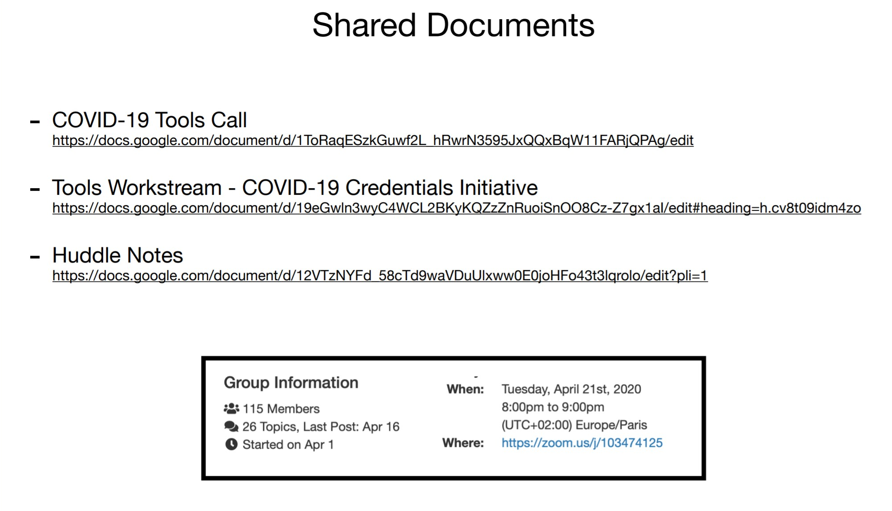
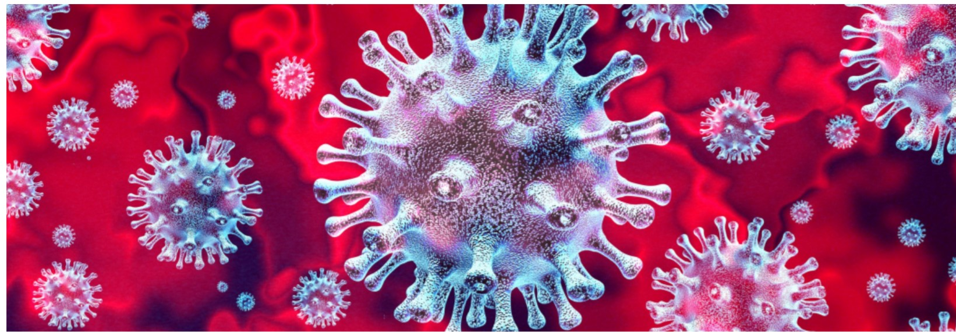
“Tools” workstream
Workstream #3
Date of Next Meeting April 21st @ 12 pm-1 pm US/Mountain // 8 pm - 9 pm Central European

Slide 16
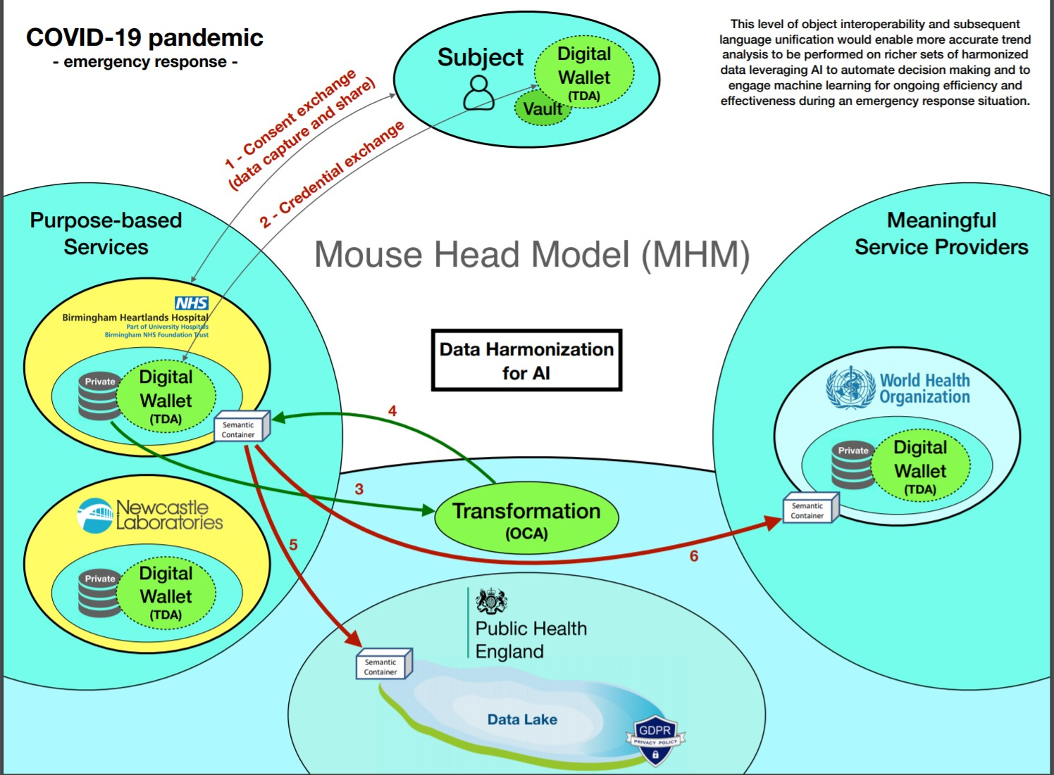

Slide 17
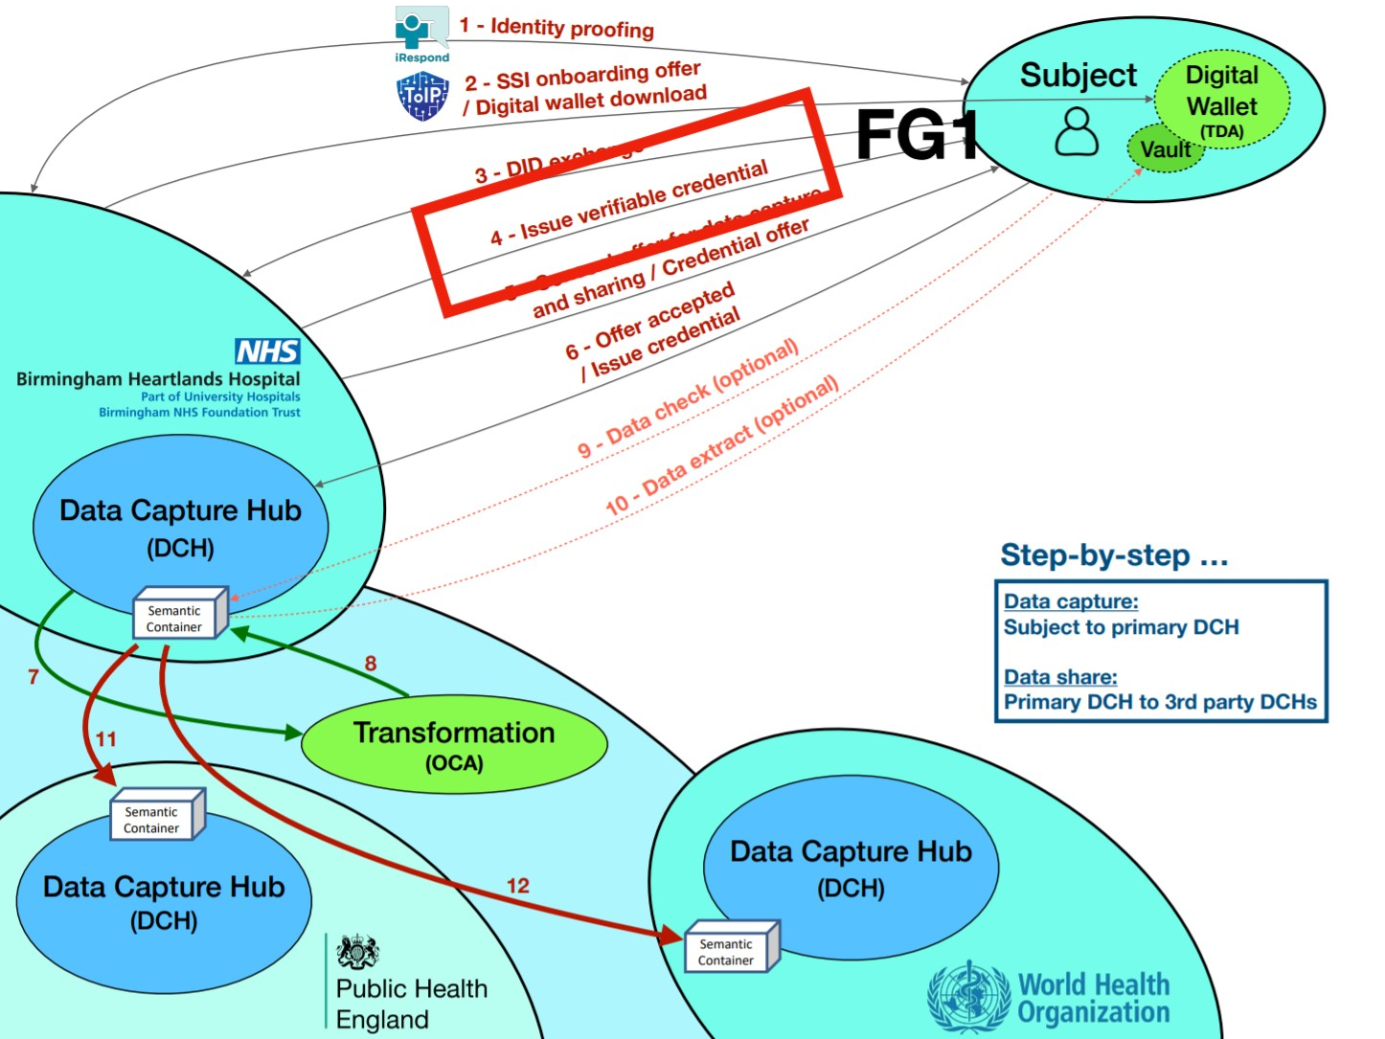

Slide 18
Workstream 4: Coordination & Comms

Slide 19
Mission & Scope
To coordinate projects and share information across the CCI workstreams, handling broad community comms and resource needs.
Internal Comms: Internal communication within the workstream and with other workstreams; internal learning, coordination and knowledge transfer
External Comms (Subgroup co-led by Kaliya & Alex): Develop external messaging; create marketing assets; gain public exposure; conduct public education (public website/social media, PR and media, training)
Partnerships: Work with internal comms team to identify project needs for partners across workstreams; identify and confirm organizations and people to work with in launching solutions successfully
Inclusion (Subgroup co-led by Nicky, Robin & Meredith): Provide guidance & advisory to the entire initiative on important issues such as data protection, privacy, ethics, and inclusion
Workstream members: ~60 ppl (Co-leads: Lucy Yang, Taylor Kendal & John Walker)
Workstream Homepage: https://docs.google.com/document/d/1FRYA-IpHNez7dY2ksDhafztF4u9XHDBWNHZ7P881y5I/edit?ts=5e854319#
Workstream Subscription: Please send an email (no subject line or body text needed) to coordinationCCI+subscribe@groups.io.

Slide 20
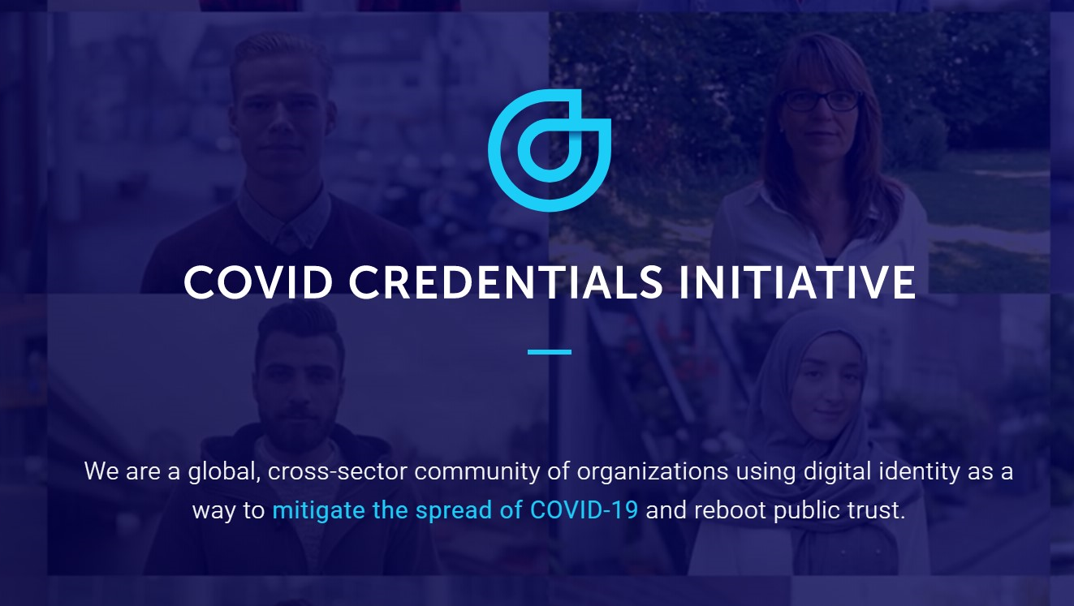
https://www.covidcreds.com/
Using the W3C industry standard called Verifiable Credentials, we have a blueprint to move forward. Yet while the underlying tech and standards are established, the vision for immunity certificates and other related credentials is far bigger than any one organization. To move at the speed and scale required, we need true collaboration across all fronts, and we are extending an open invitation for any organization or individual looking to join this endeavor.

Slide 21
AGENDA
US Government Public Health Emergency BARDA
CCI
Identity Working Group
IBM Call For Code
Government Blockchain Assoc
New Jersey Initiative
The Giving Chain
Wrap up
Notes:
David

Slide 22

Identity WG
COVID-19 Rapid Contact Tracing
Vipin Bharathan
©㊢ 2020

Slide 23
Rapid Contact Tracing
Isolation for everyone vs. fast trace and isolate Privacy concerns with fast trace & isolate
3 Types of people
 | Not Infected Yet
 | Infected Contagious No symptoms yet | Target these individuals by tracing infected people they encounter.
 | Infected Contagious Showing Symptoms | Once detected trace through phone all people they encountered.

Slide 24
AGENDA
US Government Public Health Emergency BARDA
CCI
Identity Working Group
IBM Call For Code
Government Blockchain Assoc
New Jersey Initiative
The Giving Chain
Wrap up
Notes:
David

Slide 25
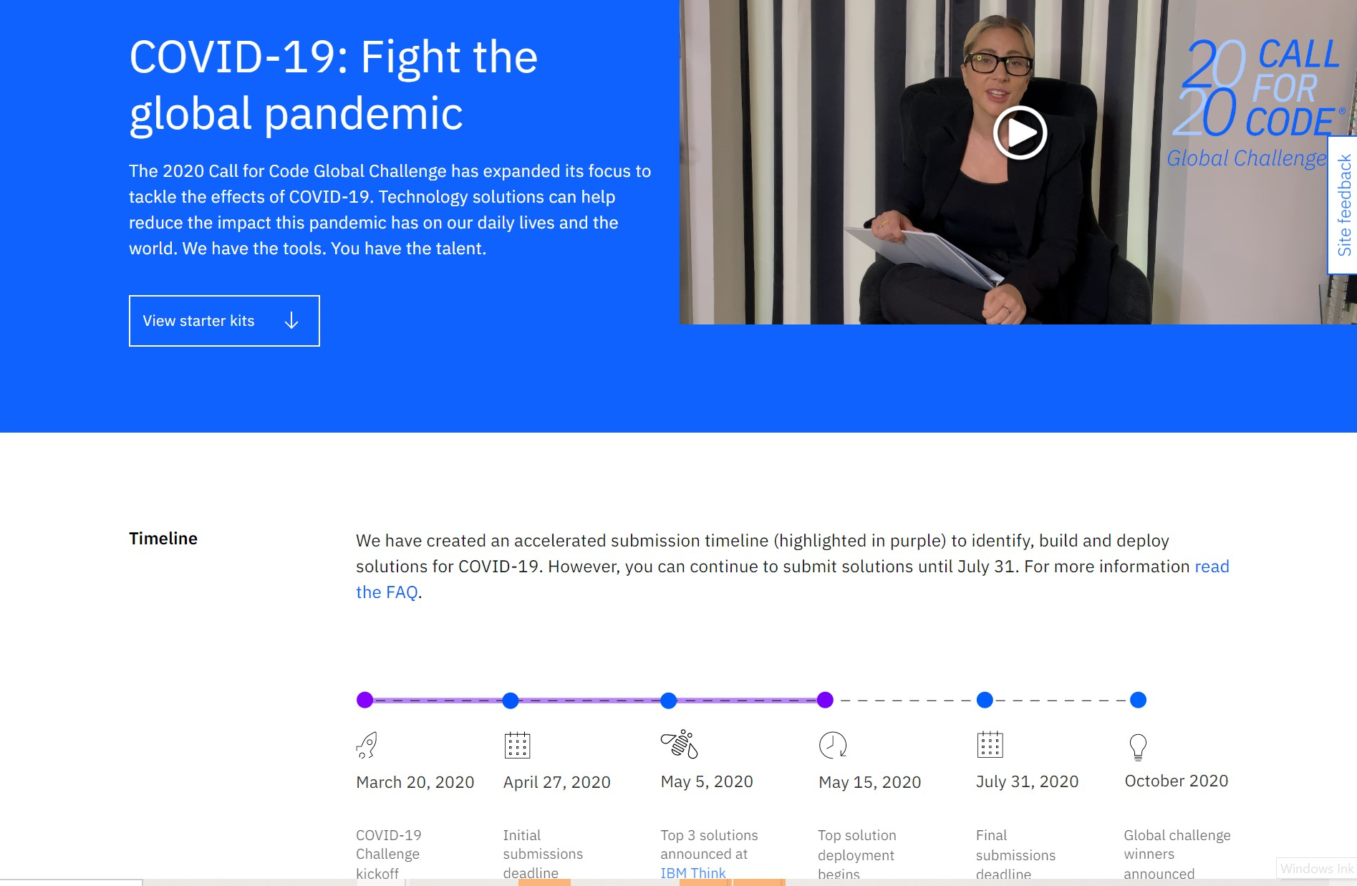
IBM Call for Code

Slide 26
AGENDA
US Government Public Health Emergency BARDA
CCI
Identity Working Group
IBM Call For Code
Government Blockchain Assoc
New Jersey Initiative
The Giving Chain
Wrap up
Notes:
David

Slide 27


Blockchain, Healthcare, and Ethics Online Discussion (Free)
« All Events
Blockchain, Healthcare, and Ethics Online Discussion (Free)
April 27 @ 7:00 pm - 9:00 pm UTC-5
Free
« BC 210 Blockchain for Financial Professionals Specialist (Online)
Going Cashless: The Digital Dollar in the face of COVID-19 »
Join us for a conversation about blockchain, healthcare, and ethics. We will have several speakers followed by questions and answers and discussion. Our ethics panel will be moderated by Dr. Vasiliu Feltes the GBA Chief Ethics Officer and address key ethical challenges in deploying blockchain technology during a crisis, as well as propose possible frameworks for blockchain companies or governments that wish to build a sustainable ethics ecosystem.

Slide 28
AGENDA
US Government Public Health Emergency BARDA
CCI
Identity Working Group
IBM Call For Code
Government Blockchain Assoc
New Jersey Initiative
The Giving Chain
Wrap up
Notes:
David

Slide 29
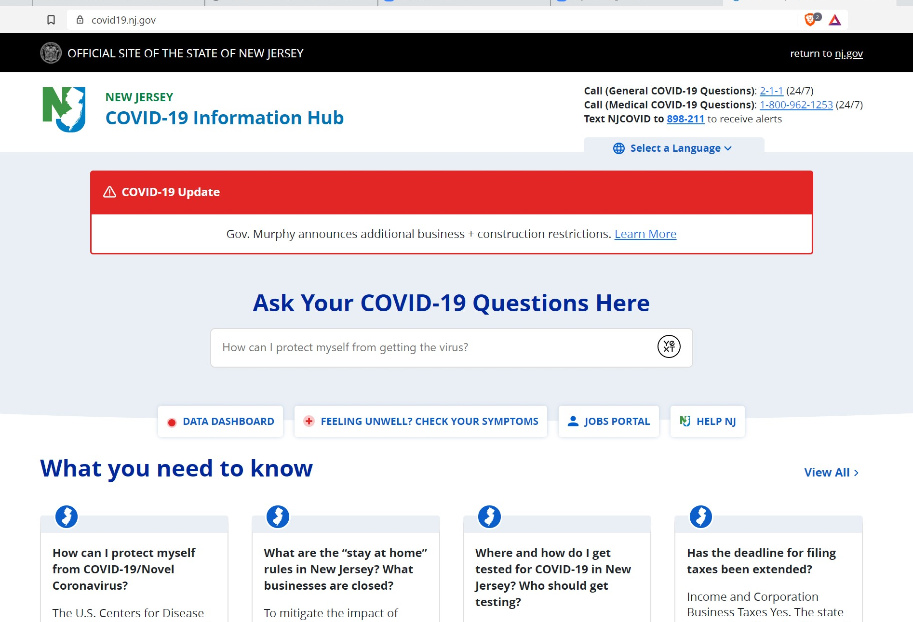
https://covid19.nj.gov/

Slide 30
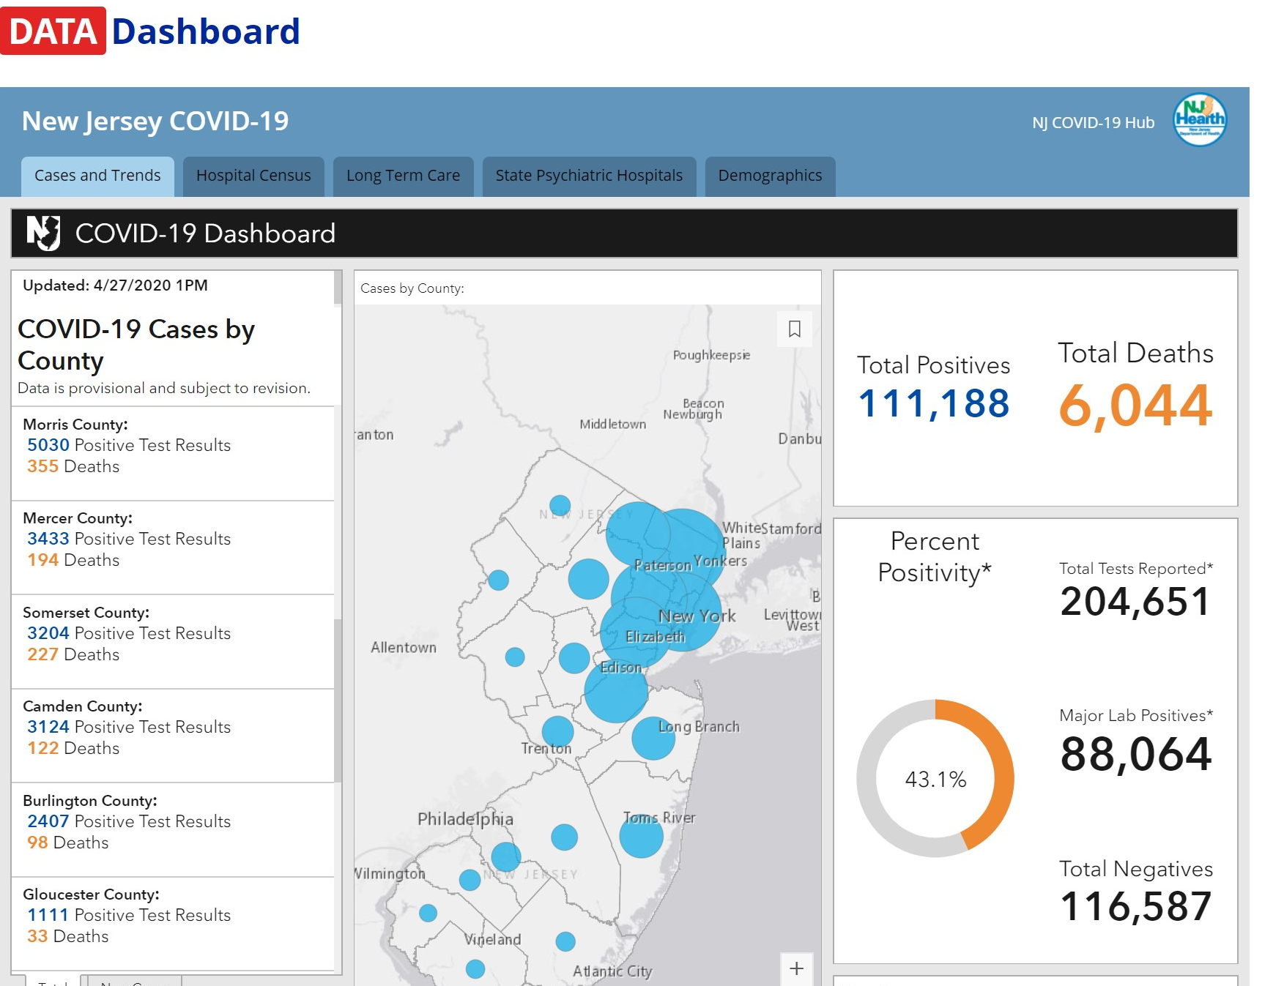
https://covid19.nj.gov/

Slide 31
LIVE UPDATES: Tracking the coronavirus in New Jersey
    New Rutgers saliva test for COVID-19 makes debut in Middlesex County
      BY Brenda Flanagan, Senior Correspondent | April 15, 2020, 4PM EST
a test developed at Rutgers University that can detect the presence of the virus behind COVID-19 in saliva made its public debut Wednesday in Middlesex County.
Far less invasive than the deep nasal or throat swab
Its scalability, quicker turnaround for results, and it can be administered without close contact by a medical worker.
We’re looking at a 24- to 48-hour turnaround time
Notes:
the saliva test headed to RWJBarnabas and University Hospital in Newark by the end of this week New Jersey’s flagship university stepping up to fill the testing gap,” he said. “I am proud of the work at Rutgers and look forward to moving forward with them.”

Slide 32
AGENDA
US Government Public Health Emergency BARDA
CCI
Identity Working Group
IBM Call For Code
Government Blockchain Assoc
New Jersey Initiative
The Giving Chain
Wrap up
Notes:
David

Slide 33
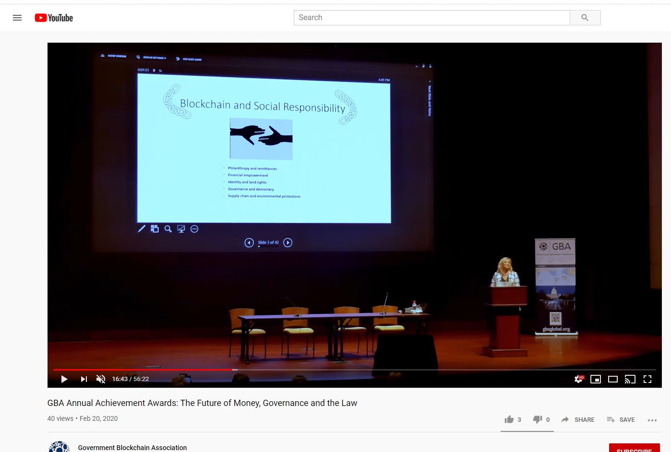
BCPrinceton Update Link to award presentation
https://www.youtube.com/watch?v=41DYKpLSvrs&feature=youtu.be
Ledger Academy / BC Princeton
Update:
Quorum leveraging the Tupelo Blockchain is currently building out THE GIVING CHAIN and we are looking for local project managers. If interested email bobbi@bcprinceton.com

Slide 34
AGENDA
US Government Public Health Emergency BARDA
CCI
Identity Working Group
IBM Call For Code
Government Blockchain Assoc
New Jersey Initiative
The Giving Chain
Wrap up
Notes:
David

Slide 35
IBM Call for Code

Slide 36
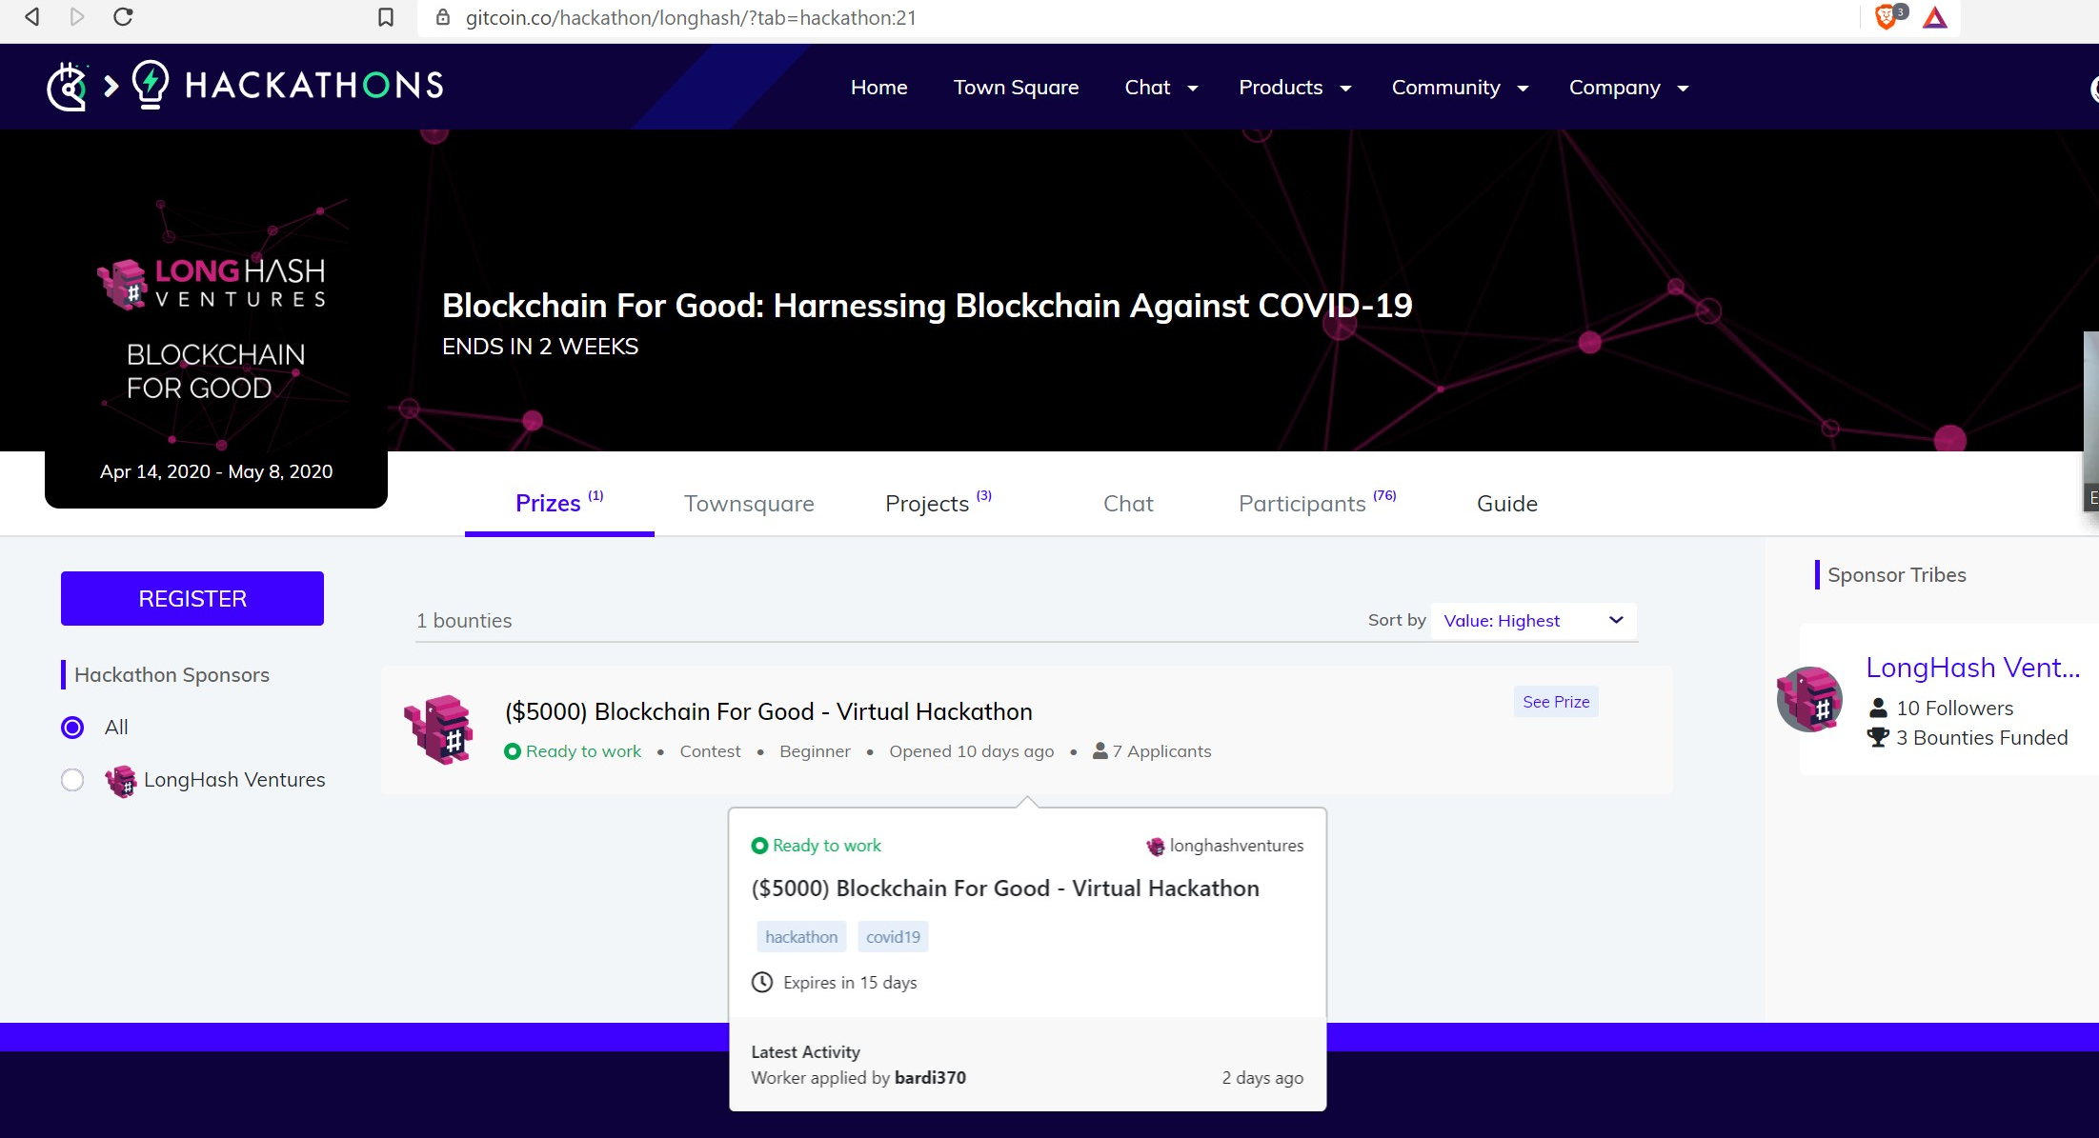
COVID-19 related hackathons
LongHash Ventures' Blockchain for Good Hackathon is going on concurrently, with $5k in prizes. Sign up to hack on the prize explorer. The goal of both events is to build impact solutions for social good and to battle the COVID-19 crisis. Applications for LongHash are being accepted until April 26th, so if you are working on a COVID-19 or public health related project, consider applying to both hackathons!

Slide 37
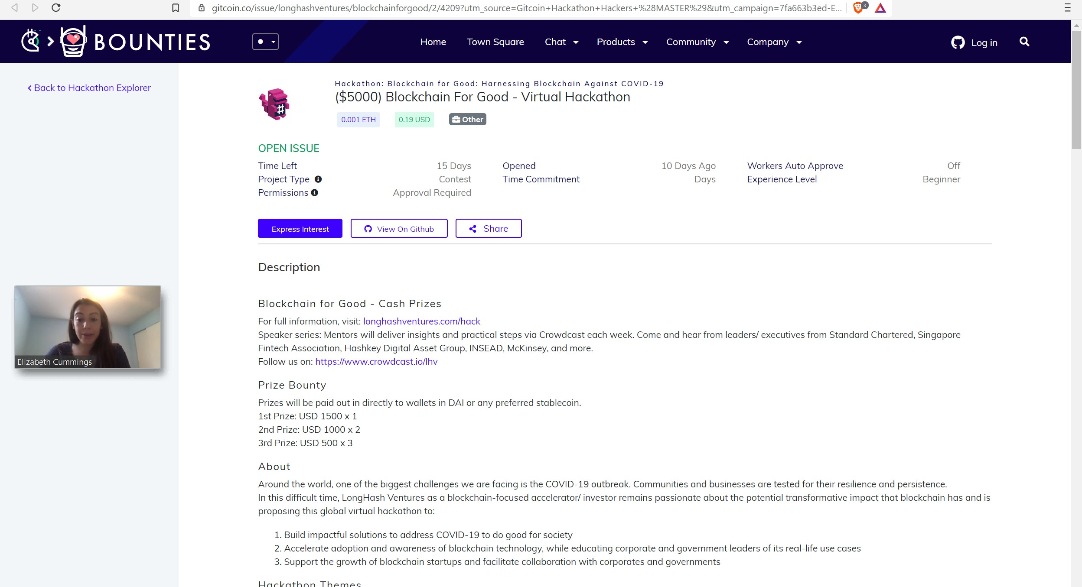
COVID-19 related hackathons

Slide 38
COVID-19 related hackathons
ConsenSys Health's Stop COVID-19 event has $20k in prizes,
Our Mission
In a moment of crisis, we are all faced with hard choices. Every one of us feels the daily, growing impact of COVID-19, and how we choose to act and what we choose to protect will define us moving forward.
The current pandemic presents us with a real, existential crisis. Millions will die if we don’t get it right. Unlike pandemics of the past, today we have new ways to save those lives.
For those who choose to help solve problems, join us to use the best available technology to advance our understanding and build solutions to end this pandemic. We are looking for technology solutions that will help collect, standardize, verify, utilize and optimize the data so that scientists can understand and stop C-19.
Data is the medicine we need. The internet and especially Web3.0 technologies, promise to unleash and contextualize data as never before, providing better understanding, and disseminating life-saving knowledge.
For those who choose to help, the time is now.

Slide 39
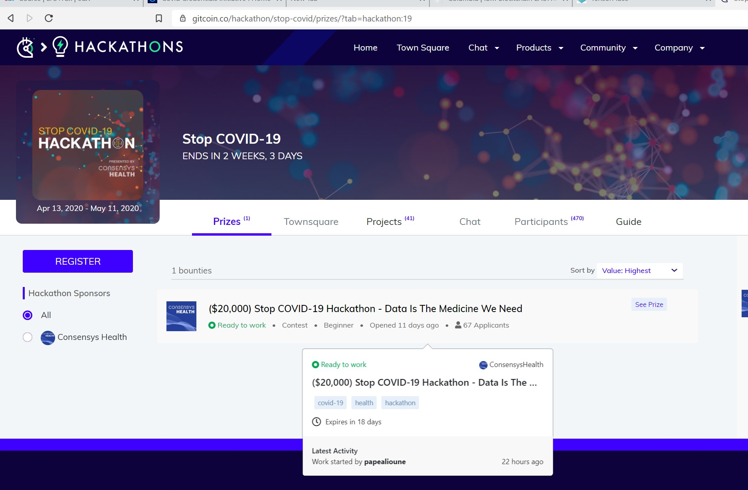
COVID-19 related hackathons
ConsenSys Health's Stop COVID-19 event has $20k in prizes,

Slide 40
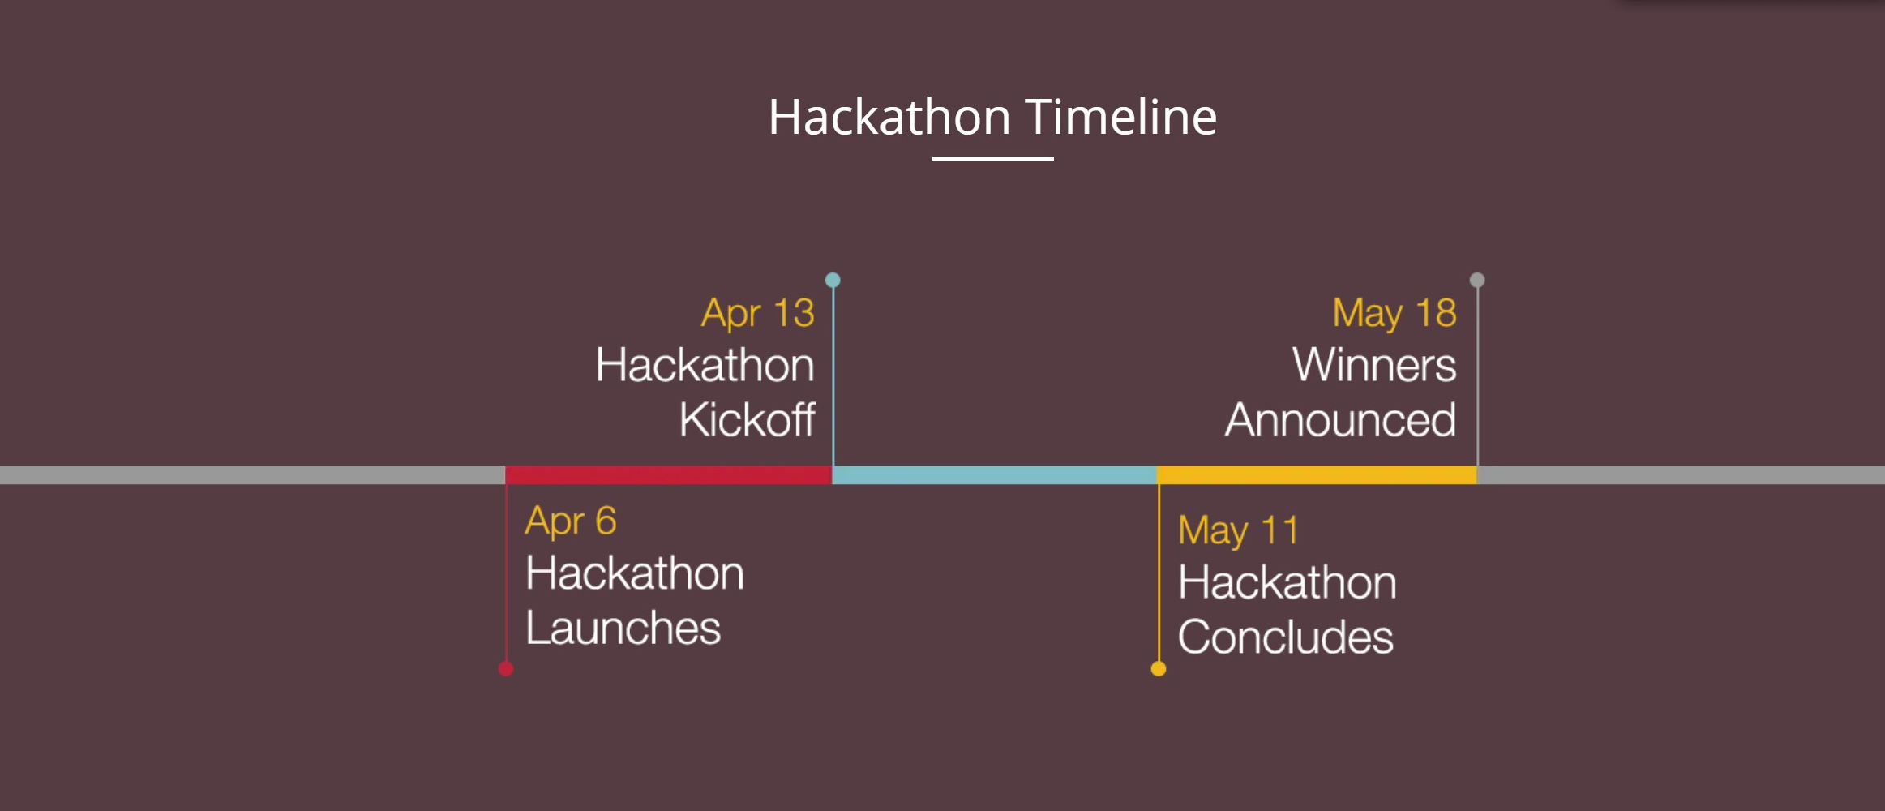
COVID-19 related hackathons
ConsenSys Health's Stop COVID-19 event has $20k in prizes,

Slide 41
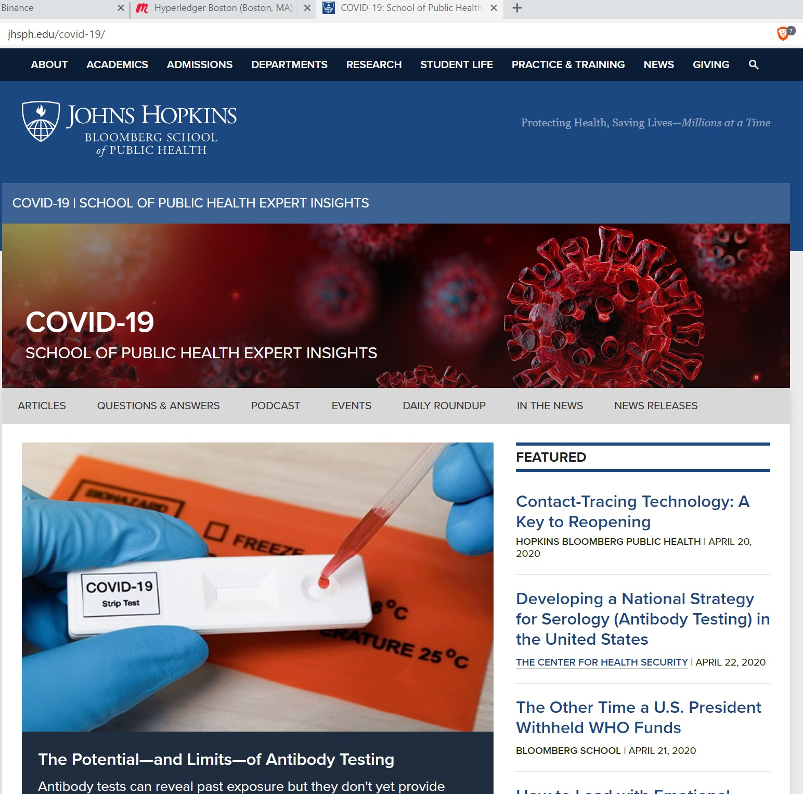
Bloomberg and John Hopkins Initiative ,

Slide 42
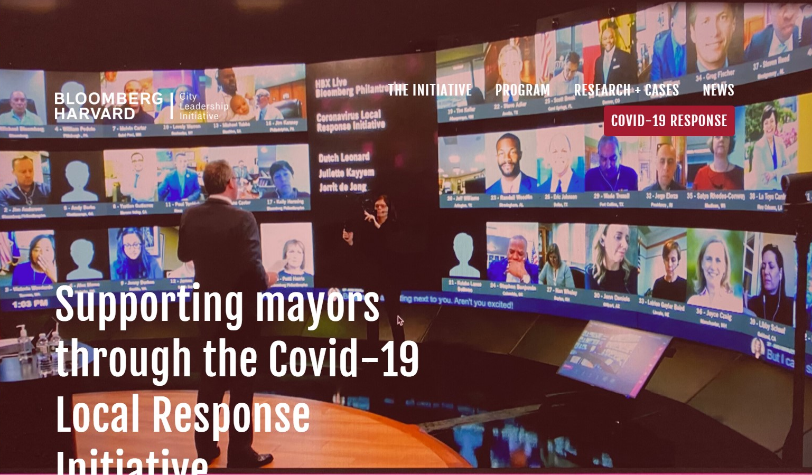

Slide 43
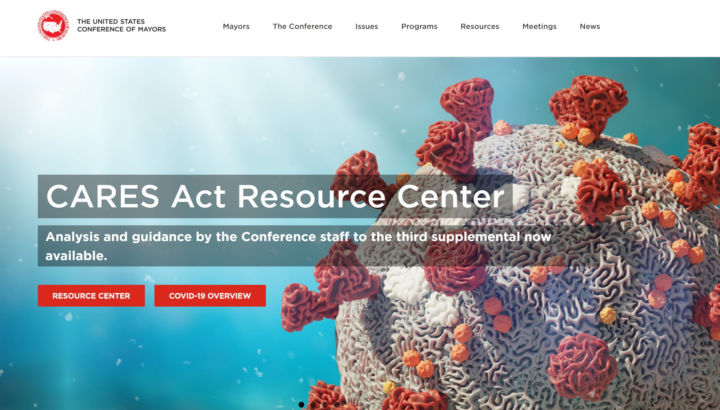

Slide 44
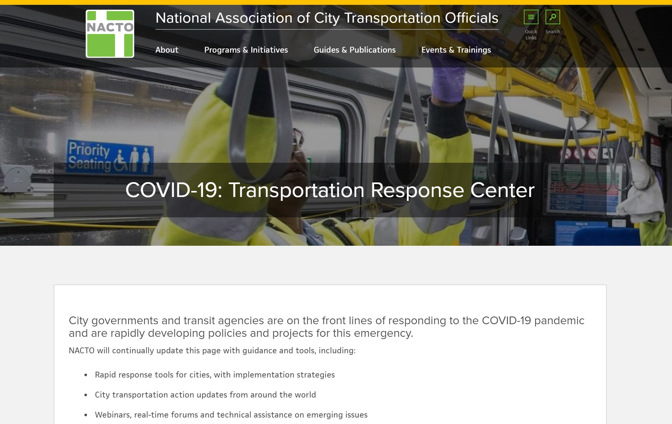

Slide 45
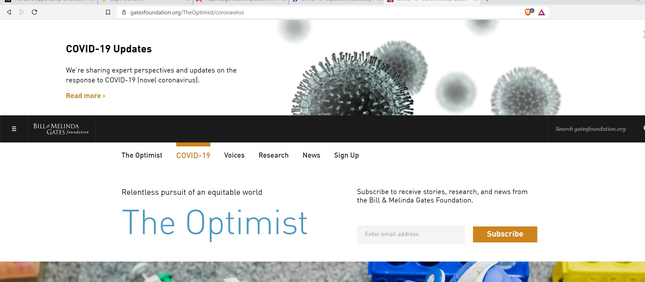

Slide 46

https://consensyshealth.com/covid-19/

Slide 47

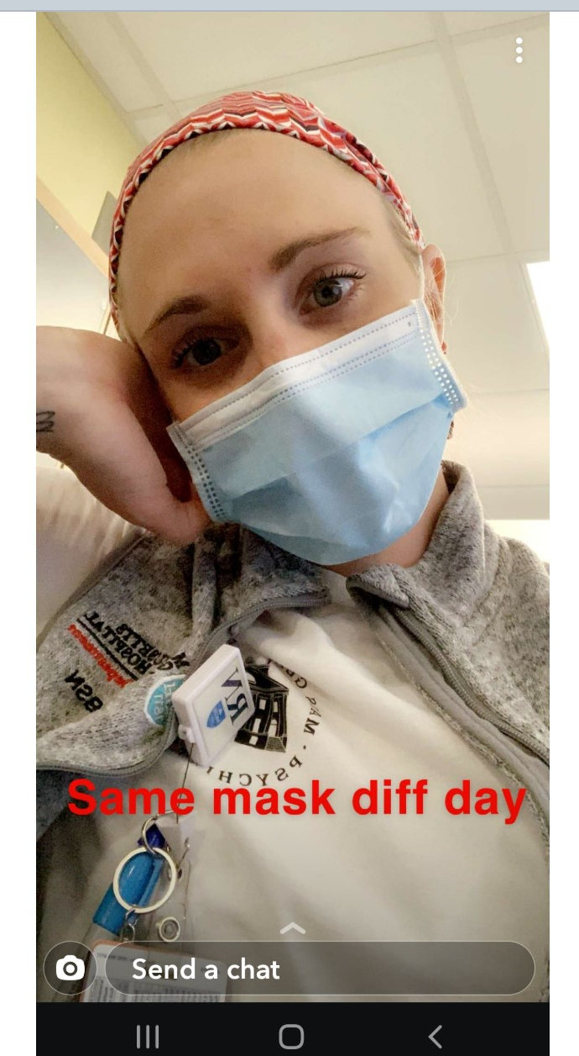

Slide 48

Ledger Academy Announcement
Ledger Academy’s
Blockchain Basics
– Understanding the Power of Blockchains

Slide 49
Princeton Blockchain Community
Housekeeping
Summer Blockchain Project
Discussion
Moving Forward
BLOCKCHAIN FUNDEMENTALS / Ledger Academy
  Blockchain Courseware and Meetups focused on Education.
HYPERLEDGER PRINCETON
  Hosted by Linux Foundation, is comprised of people interested in learning and developing projects using the Hyperledger solutions.
PRINCETON BLOCKCHAIN AND AI
  Princeton Blockchain and AI is focused on COMMUNITY. Discussions are developed by meetup participants.
Notes:
David

