Slide 1

Crypto-Philanthropy: Giving in the Age of Blockchain
Hyperledger SIG, October 2019

Slide 2

Crypto-philanthropy
Definition: “The use of cryptocurrency or Distributed Ledger Technology (DLT) to enhance philanthropic giving, systems, and impact.”
“It seems like somebody absolutely has turned on the light on cryptocurrency giving.”
Eileen Heisman, CEO, National Philanthropic Trust
Image from: https://www.cryptoscoop.news/crypto-philanthropy-how-bitcoin-blockchain-and-charity-coins-affect-giving/
Notes:
Image from: https://www.cryptoscoop.news/crypto-philanthropy-how-bitcoin-blockchain-and-charity-coins-affect-giving/

Slide 3

Transparent
Decentralized and global
Lower transaction costs
Tax incentives
Improved operations (e.g., smart contracts)

Slide 4
Trends
Decreasing crypto donations to NGOs?
Increase in # of NGOs accepting crypto (2% globally)
Crypto-philanthropy project thinning
Crypto giving Market leaders holding fast
Continued innovation
Notes:
Decreasing crypto donations (Fidelity Charitable)
Crypto accepted by 2% of charities globally (Global NGO Technology Report
Cryptocurrency projects thinning
Market leaders holding fast (Ripple, Coinbase, Bitgive Foundation, Binance, Quingsongchou*)
Continued innovation (GiveCrypto, GiveDirectly, UNICEF, Brave Ad Grants program)
*over the past three years, the platform has helped 1.6 million families struggling with medical bills raise more than 20 billion RMB ($2.98 billion).

Slide 5

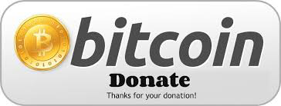

Crypto-Philanthropy Spectrum
More mature
Less mature
Crypto donations | Management Platforms | Distributed Philanthropy
Direct donations Crowdfunding Charity Coins Mining for charity | Donation tracking Impact measurement | Self-governing orgs Tokenized giving

Slide 6



Direct Donations
Over $200 Million in US 2017- 2018
2% of NGOs accept cryptocurrency
Nearly $3 Billion in China (via blockchain-based systems)
Notes:
https://www.qschou.com
600 Million users
*over the past three years, the platform has helped 1.6 million families struggling with medical bills raise more than 20 billion RMB ($2.98 billion).
For Kaiser (#5 in US): KFHP/H supports a wide range of community health activities, partnerships and investments that improve community health, provide care and coverage to low-income individuals, address housing instability, train health professionals and support medical research. In 2018, approximately $2.8 billion was provided to support these community investment programs representing 3.5 percent of operating revenue.

Slide 7

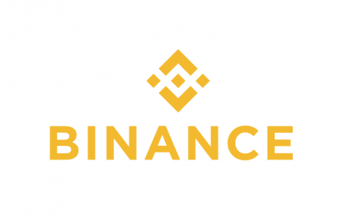

Institutional Giving

Slide 8


Charity Coins + mining
Over $1 Million ICO
$400,000 ICO
Notes:
Fundraising vs. utlity

Slide 9
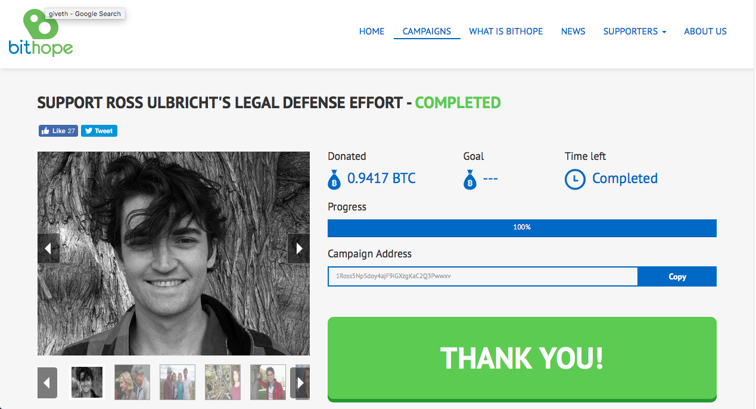
Crypto Crowdfunding

Slide 10
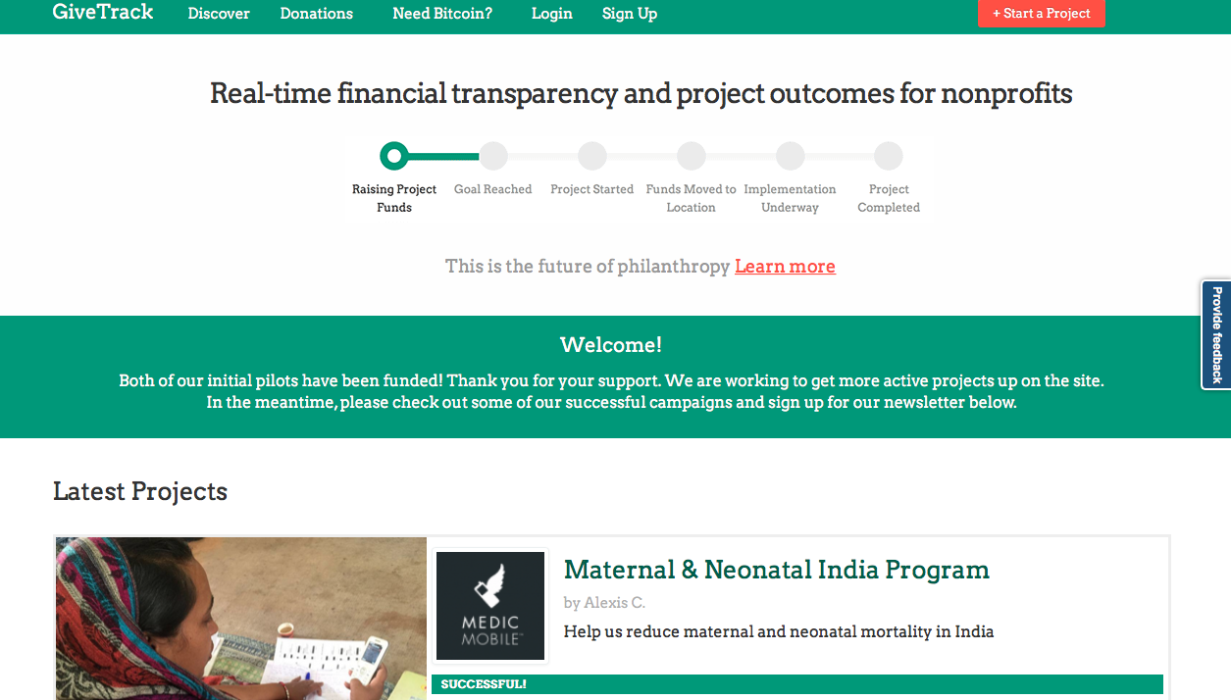
Donation Tracking and Impact Measurement

Slide 11

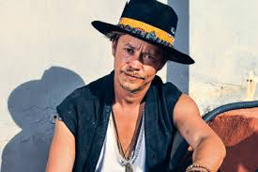
Distributed Philanthropy

Slide 12

Opportunities
New funding streams
New fundraising approaches (ICOs, Libra, etc)
Improved impact tracking and operations (smart contracts)
Innovations (UNICEF crypto fund, Brave Browser ads, etc.)
Philanthropy re-imagined (Distributed Autonomous Foundation)
Notes:
96% of endowments and foundatiions not looking to invest.
https://www.bloomberg.com/news/articles/2018-03-12/crypto-craze-finds-few-fans-at-endowments-maybe-not-for-long

Slide 13

Challenges
Negative association of crypto
Market fluctuations
Legal & regulatory uncertainty
Lack of user friendly systems
Imagination

Slide 14
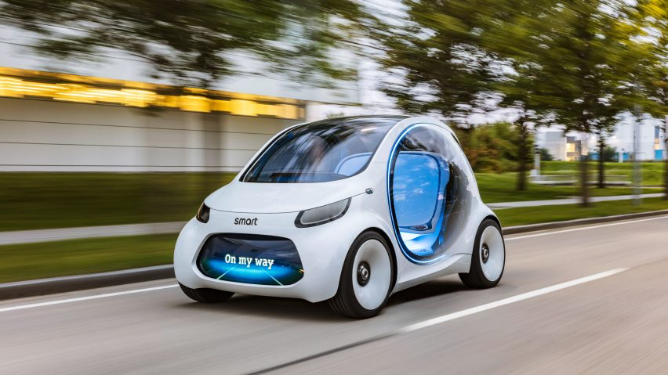
The Future: Charitymobile

Slide 15
Questions
Does crypto-philanthropy have legs?
Where will crypto/blockchain most benefit philanthropy?
Where will crypto/blockchain hinder philanthropy?
Others?

Slide 16
More Info
Resources:
Man on a Mission cryptocurrency and blockchain for Good Resources Listing (https://www.manonamission.biz/cryptocurrency-and-blockchain-for-good.html)
Articles:
Digital Currencies and Blockchain in the Social Sector, Stanford Social Innovation Review, January 2018
Crypto-philanthropy: How Bitcoin and Blockchain are Disrupting the World of Giving, Medium, February 2018

Slide 17

Paul Lamb
Tel: 510-815-6091
Email: paul@manonamission.biz
Website: www.manonamission.biz
Bitcoin Address: qqr5rkwknwyafaudhht4wnn0cw727fg5ygk0eza39j
Ether Address: 0x6eD022a973C6eF5D60b5a2543bf99F4ca7aA257a
Litecoin Address: MCnPPWDcJiBew1jxHCxCo7qSf1dUsPpcnd

