Slide 1
Blockchain and Business
Ledger Academy
10-24-2019

Slide 2
Introduction
Blockchain Technology for Business
Innovation to Computer Science
New way to Interact and Trade
Types of Blockchains
Permission vs Permission-less
Public vs Private
Use Cases
BCPrinceton
Kiva
We-trade
VON Book

Slide 3
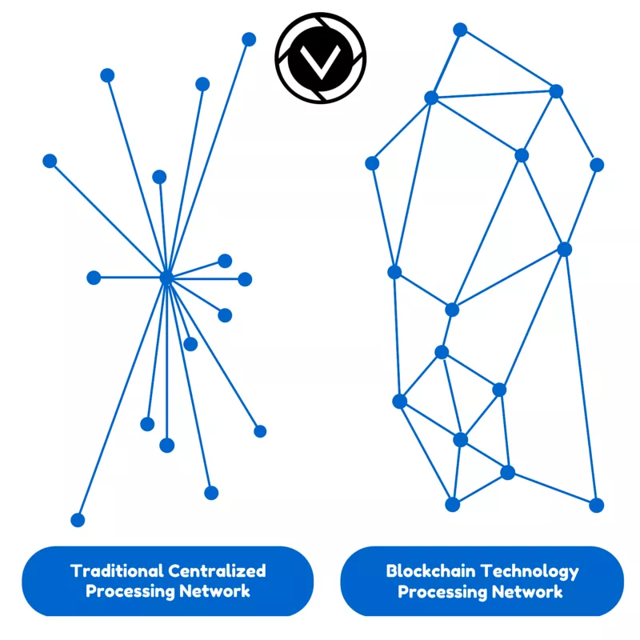
Innovation to Computer Science
Blockchain Technology for Business
Blockchain technology is a shared ledger (DLT) that everyone trusts to be accurate and permanent
Public registry that stores transactions in append only network system that creates a shared reality between non trusting entities
Bitcoin was the first to introduce it to the world.
Cryptoasset – or cryptocurrency or digital asset, Underlying function of a blockchain, Does not have to represent digital cash but digital value.

Slide 4
Blockchain Technology for Business
Immutability of Data
his immutability, or 'unchanging over time' feature makes the blockchain useful for accounting, financial transactions, identity management, and asset ownership, management and transfer, just to name a few examples. Once a transaction is written onto the blockchain, no one can change it, or, at least, it would be extremely difficult to change it.

Slide 5
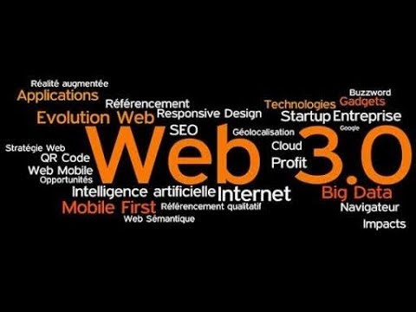
WEB 3.0
Blockchain Technology for Business
Web 3.0 browsers: New browsers are being built that help you manage your cryptocurrency, keys, passwords, blockchain, identity, permissions, etc. In general, they will use the familiar web front-end toolkits: JavaScript, AJAX, HTML, etc.
Blockchains
Smart Contracts
D Apps
Artificial Intelligence
Data Mining
Cloud Storage
Tokenization of Value
Commercial Internet Service Providers Web 1.0
Internet of Information Web 2.0
Internet Value Web 3.0.
Notes:
Just as email was the first big app for the interent of information. Bitcoin is the first killer app for the interne5t of value.
It also allows us to create an instantaneous single source of truth.

Slide 6
Types of Blockchains
Anonymity of Validators
Permissioned
Permission-less
Public
Public
Proof of Work
Proof of Stake
Permission-less
Permissioned
Private
Private
Byzantine Fault Tolerant / Multi Signature
Trust Validators

Slide 7
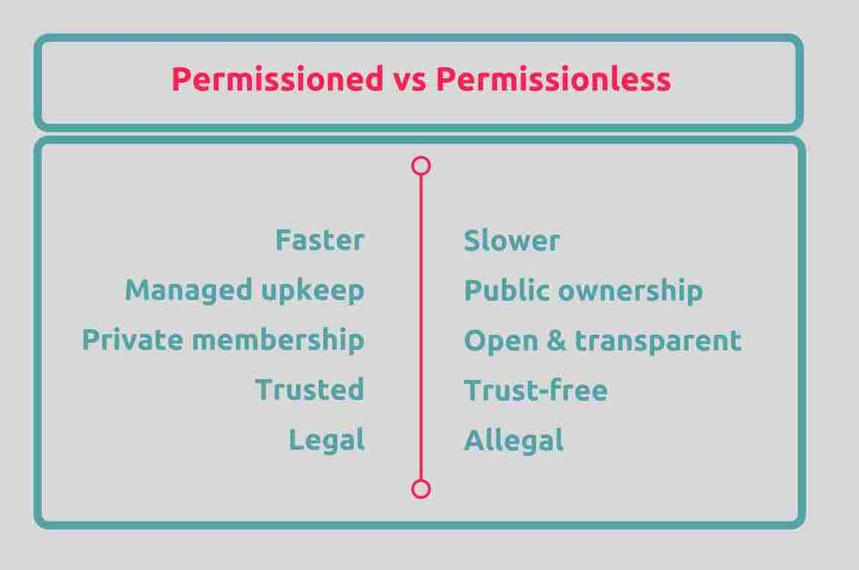
Comparison
Types of Blockchains

Slide 8
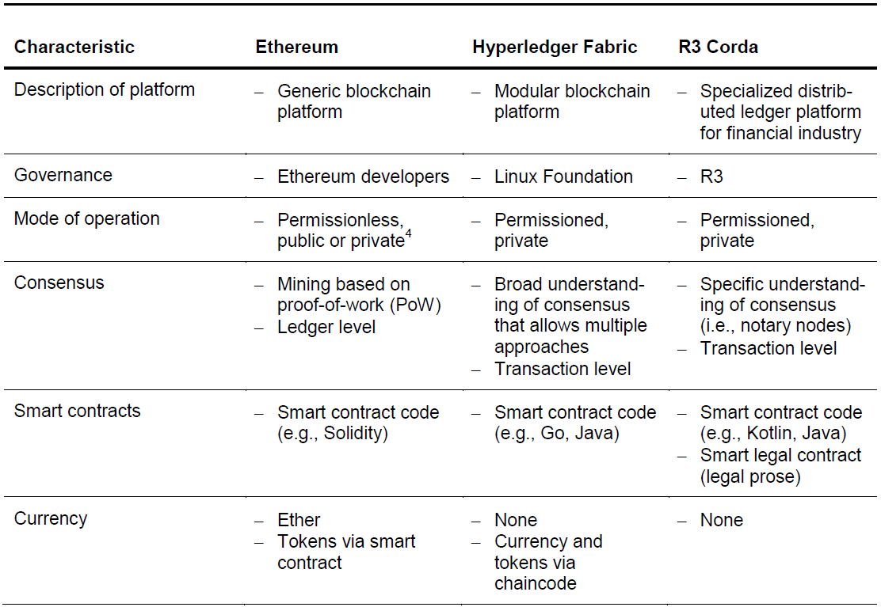
Types of Blockchains
Permissioned versus Permission less

Slide 9
Ethereum
An open-source virtual machine that allows programmers to build dapps using blockchain. Includes ETH, its own native currency
Types of Blockchains
The EVM
With Ethereum, servers and clouds are replaced by thousands of so-called "nodes" run by volunteers from across the globe (thus forming a "world computer").
The vision is that Ethereum would enable this same functionality to people anywhere around the world, enabling them to compete to offer services on top of this infrastructure.

Slide 10
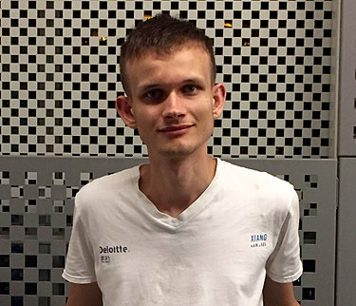
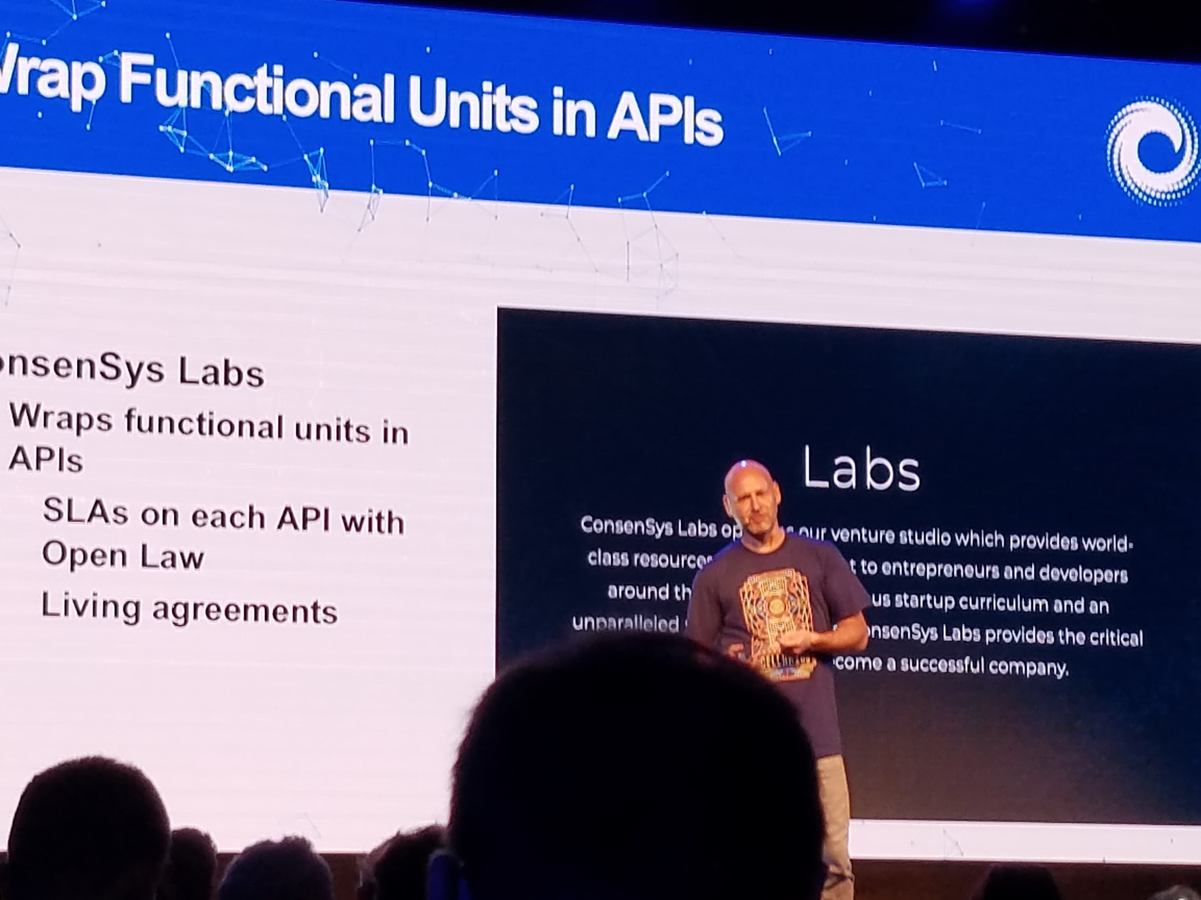
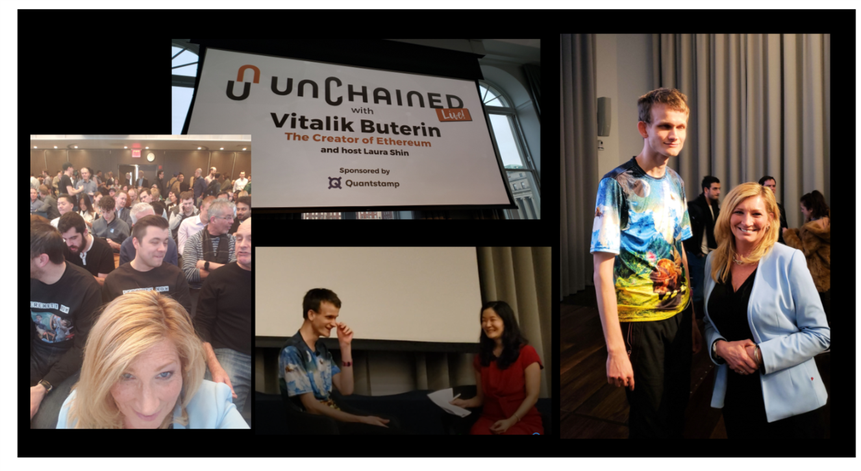
Vitalik Buterin
Types of Blockchains
Ethereum
Ethereum, which was first described in a white paper in 2013, is the operating system that adds programming to blockchains, effectively turning the network of “miners” into the world’s largest computer.
Ethereum can be programmed just like any general-purpose computer, and apps built on Ethereum can grow to any size, are incredibly secure, preserve anonymity, are auditable, and provide the same service at the same scale for less than 1% of the centralized price
The Ethereum Virtual Machine or EVM is the virtual machine in which all the smart contracts function in Ethereum.
It is a simple yet powerful Turing Complete 256-bit virtual machine. Turing Complete means that given the resources and memory, any program executed in the EVM can solve any problem.
Because it has the ability to build platforms, its both a cryptoasset and a cryptocurrency
Notes:
father gave him the blockchain code and he developed Ethereum with Joe Lubin

Slide 11
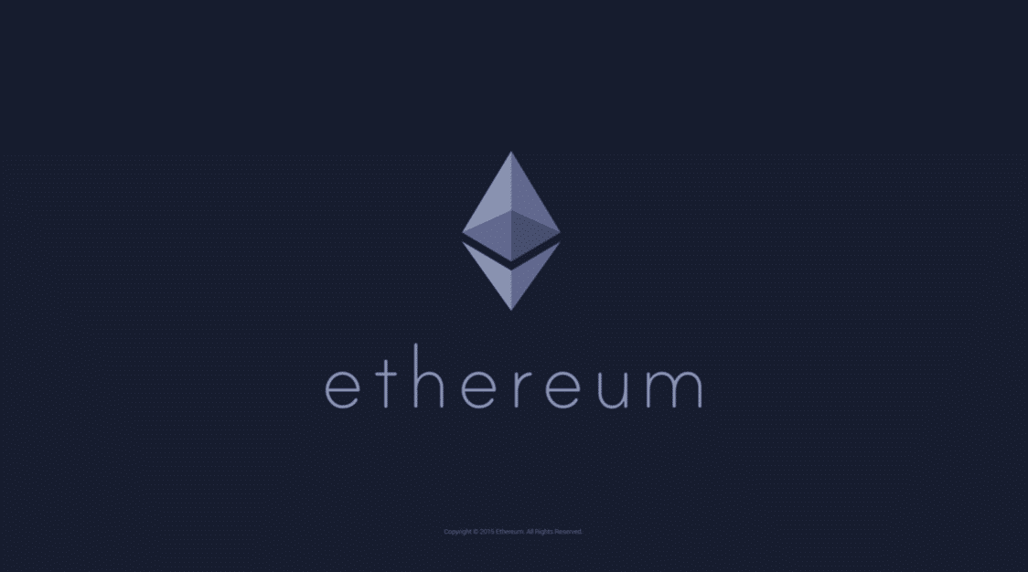
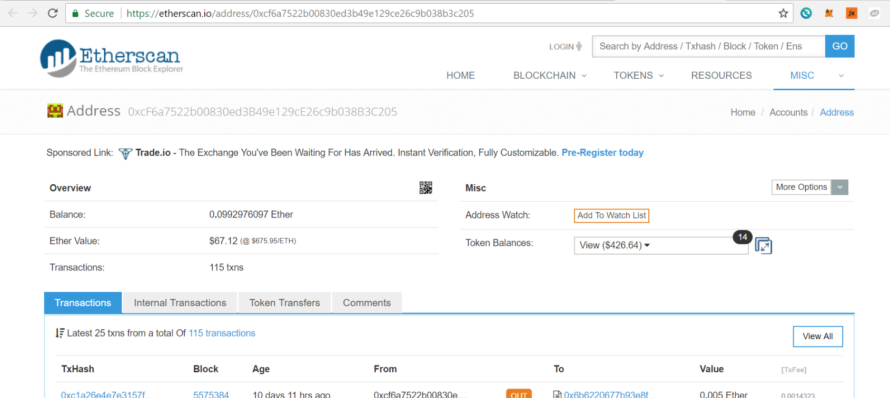
Ethereum
Types of Blockchains
“Ethereum is a decentralized platform that runs smart contracts: applications that run exactly as programmed without any possibility of downtime, censorship, fraud or third-party interference. These apps run on a custom built blockchain, an enormously powerful shared global infrastructure that can move value around and represent the ownership of property.”

Slide 12
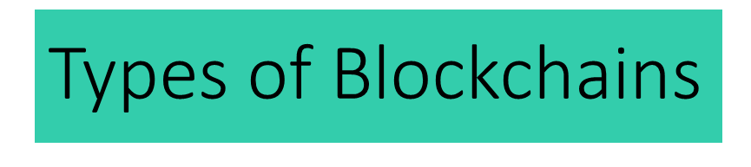
Smart Contracts
a smart contract within the blockchain may allow automatic execution of transactions upon meeting predefined criteria
The Enterprise Ethereum Architecture Stack will serve as a guidepost for corporations, providing infrastructure tools and frameworks designed to empower the next generation of Enterprise Ethereum applications. The new EEA specifications have been under development by the EEA's technical committee, in partnership with member companies, for the past year and a half.

Slide 13
Dapps
Types of Blockchains
Dapps: Distributed apps - applications that use blockchain storage and computing power through Ethereum. Generally, dapps look and feel like existing apps you know and use every day
Gas: The small amount of money you pay for each transaction that rewards nodes for providing their computing power
Web 3.0 browsers: New browsers are being built that help you manage your cryptocurrency, keys, passwords, blockchain, identity, permissions, etc. In general, they will use the familiar web front-end toolkits: JavaScript, AJAX, HTML, etc.

Slide 14
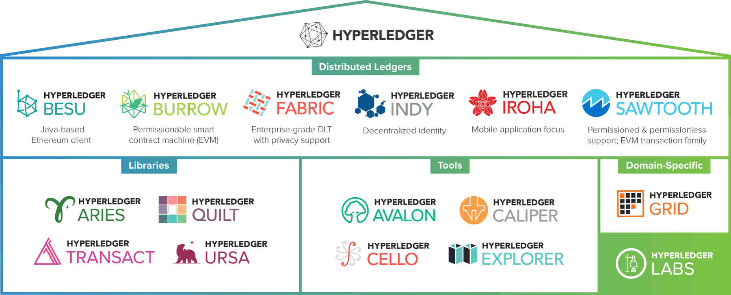
The Hyperledger Greenhouse

Slide 15
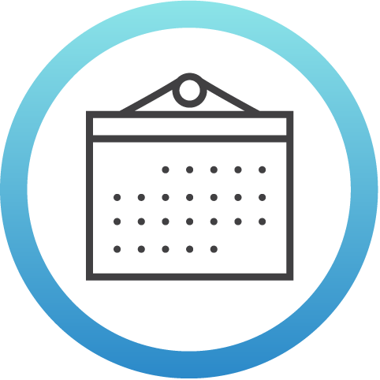
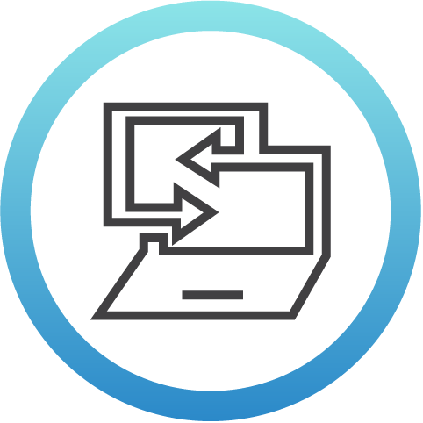
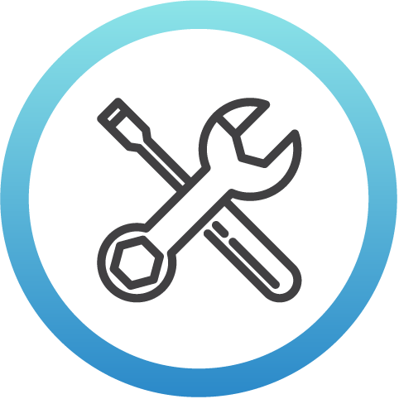
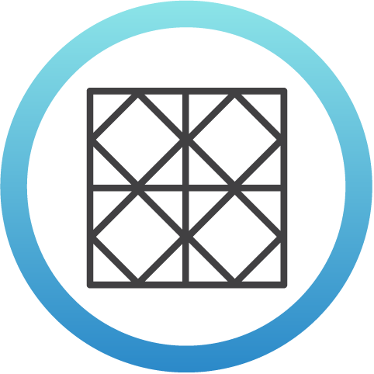
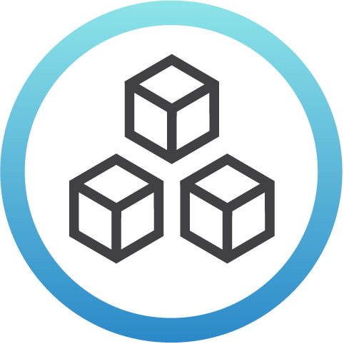
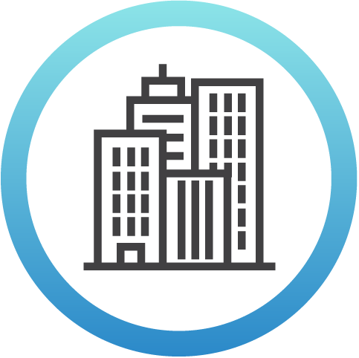
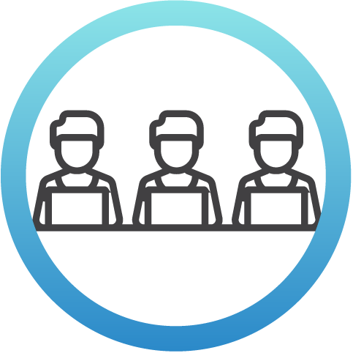
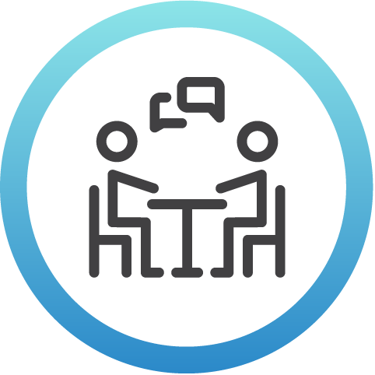
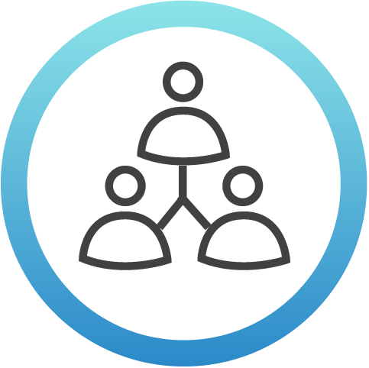
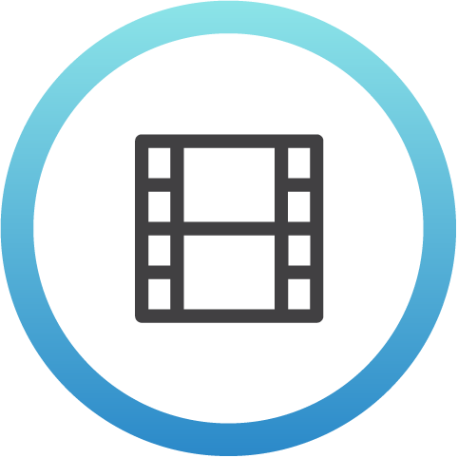
Hyperledger Momentum
3.5
Years since launch
4
Libraries
4
Tools
5
Distributed Ledgers
3
1.0+ Production Releases
275+
Members
(50+ in AsiaPac)
14
Active Community Working Groups &
Special Interest Groups
175+
Meetups
Worldwide
(75+ countries)
62K+
Meetup
Participants
2,000+
Media Clips Per Month
Notes:
These are statistics covering different aspects of the Hyperledger community that show the growth in activity over time.

Slide 16
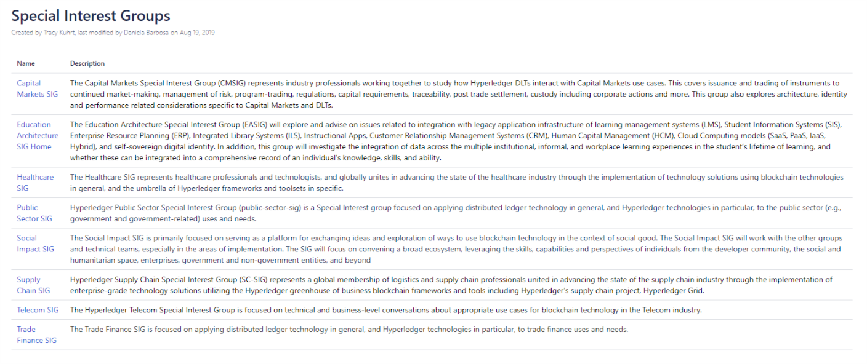
Types of Blockchains
Special Interest Groups (SIG)
Notes:
This slide covers updates with the Special Interest Groups (which of community-led efforts around how Hyperledger is being used in different industries). This include reference to the most recently launched groups and preview of new groups under development.

Slide 17
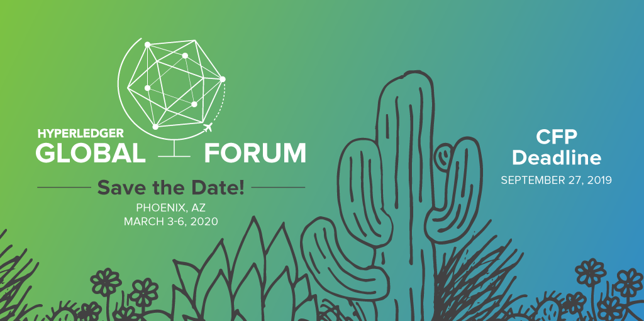
Hyperledger Global Forum 2020
More than 1,000 users and contributors of Hyperledger projects from across the globe to meet, align, plan and hack together in-person. Phoenix, AZ, March 3-6, 2020
Registration is now open! individual, academic, Govt rates available.
We encourage you to submit a talk by Sept 27!
Please help us promote the event on your channels using #HyperledgerForum

Slide 18
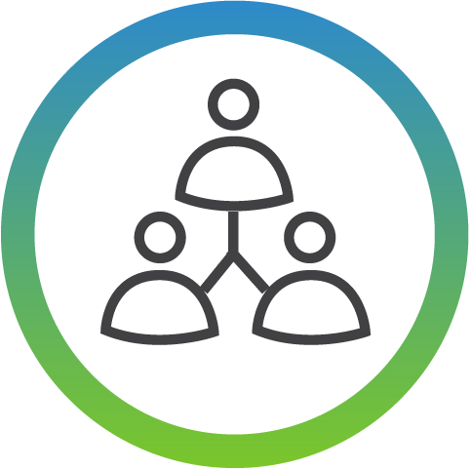
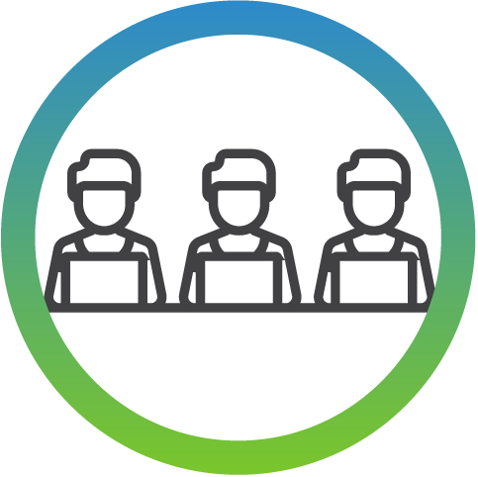

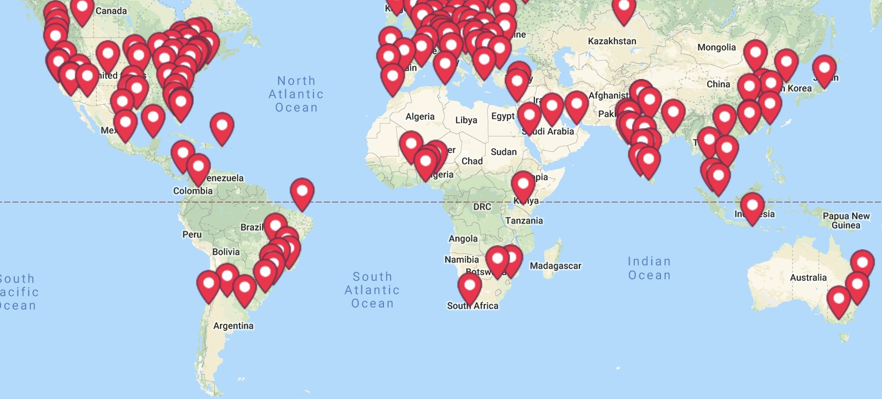
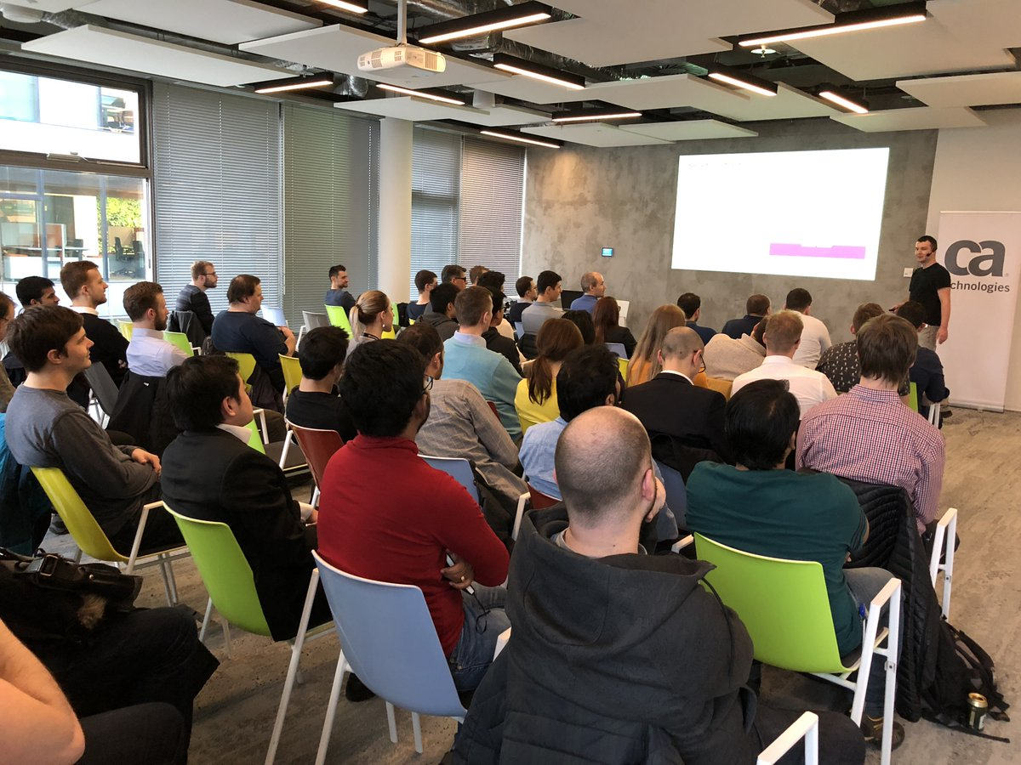
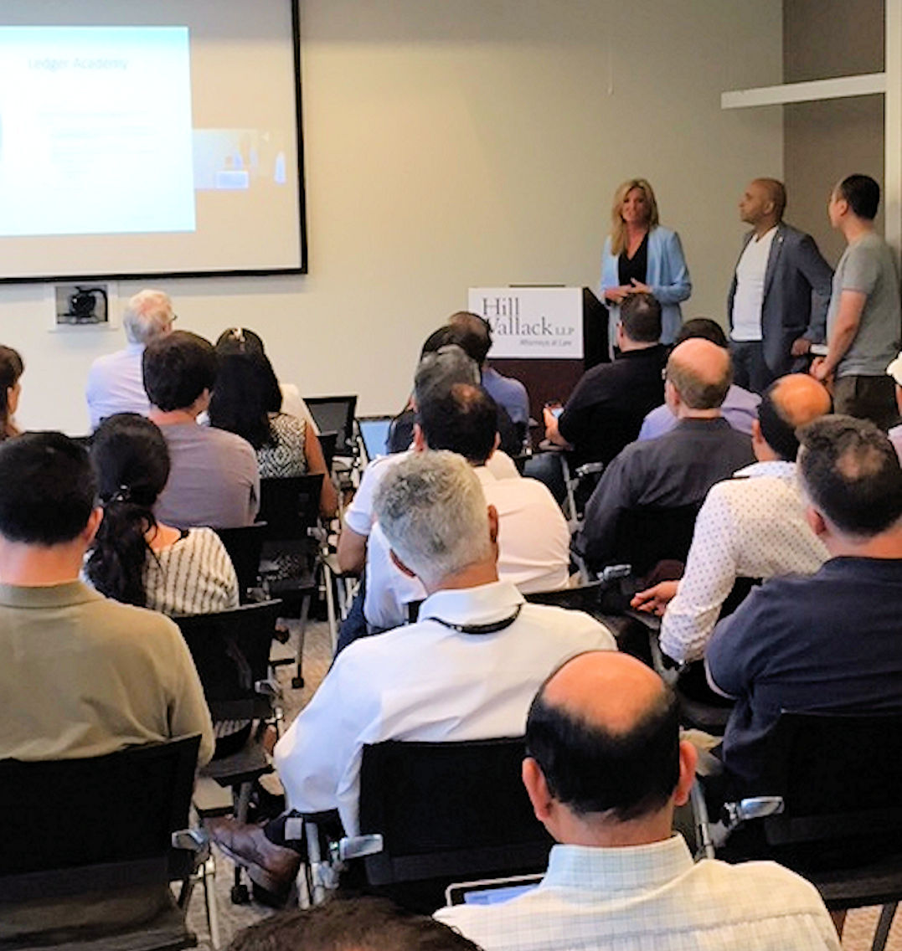
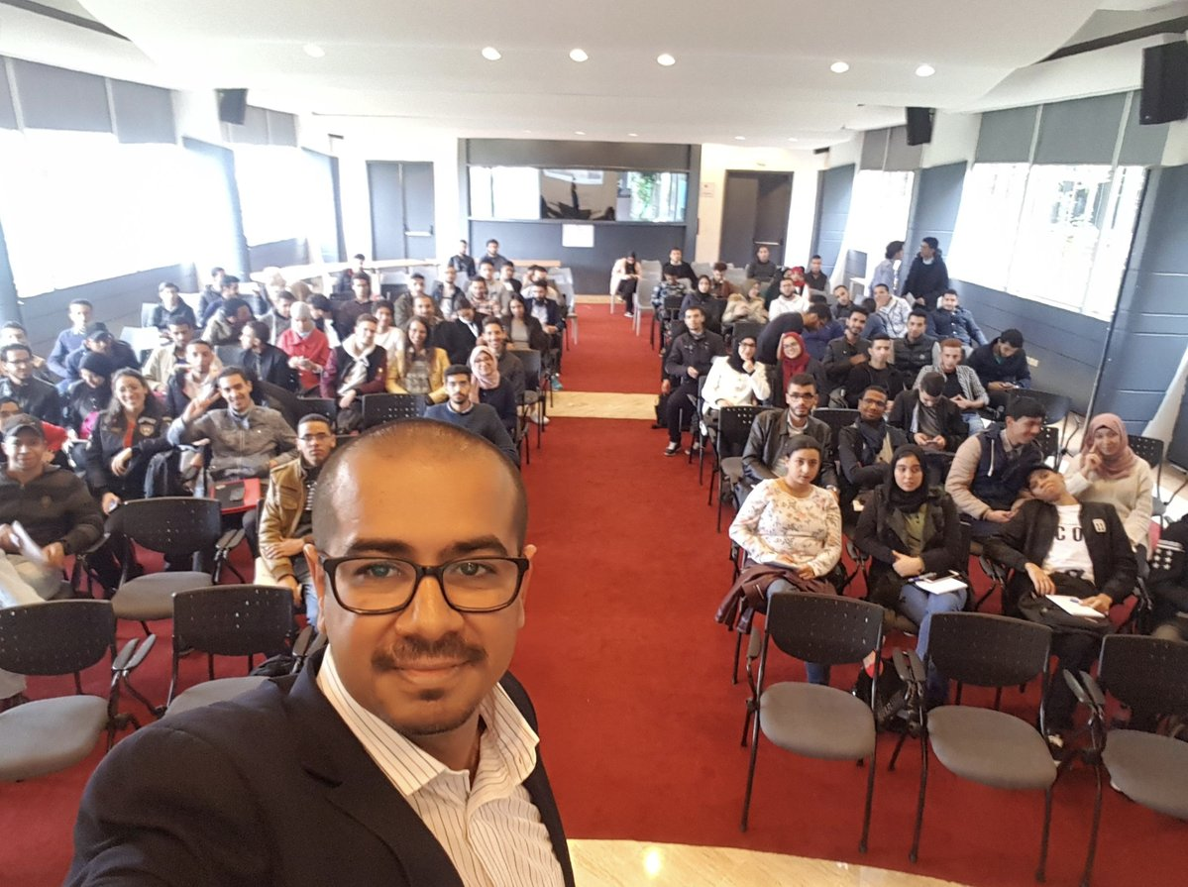
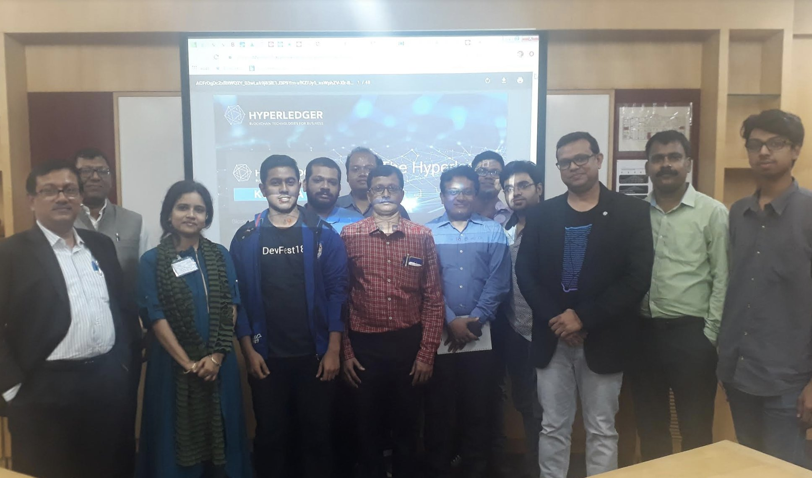
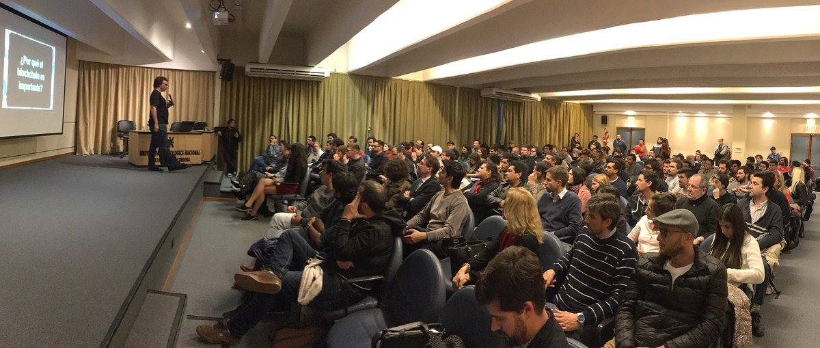
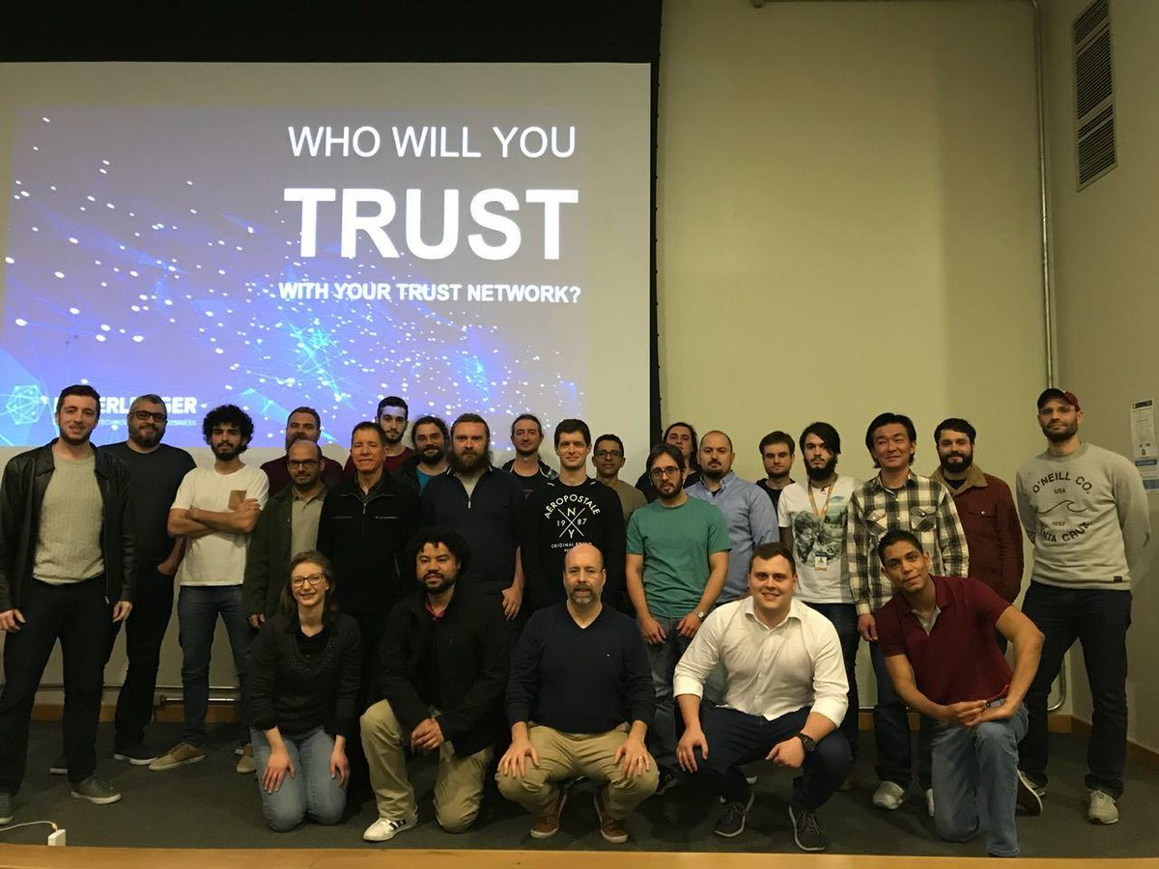
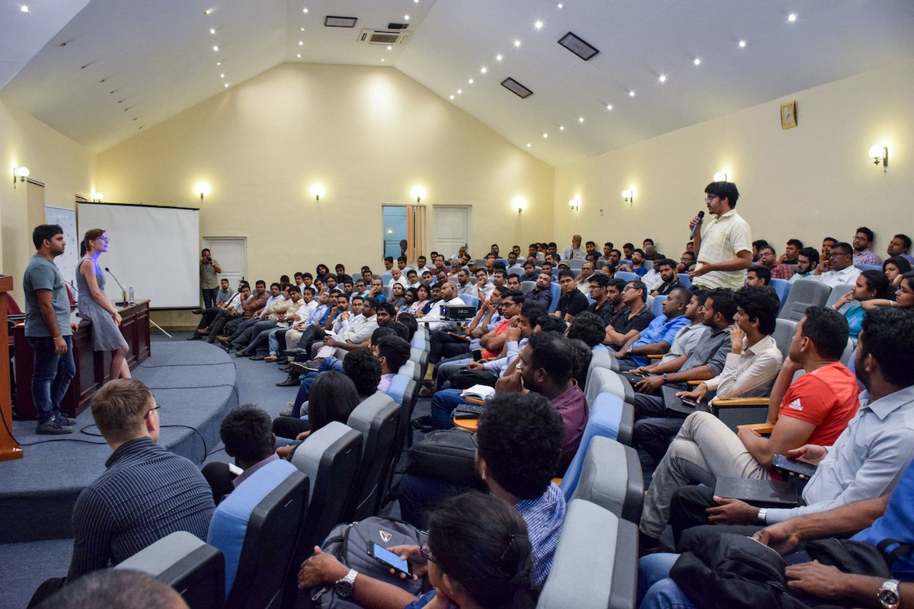
Growing Global Meetup Community
62,000+ Members
175+ Groups
75+ Countries
Notes:
This page talks about the worldwide group of Hyperledger meetups and includes so relevant statistics, a map and photos from events. For people who want more information, please point them to: https://www.meetup.com/pro/Hyperledger/

Slide 19
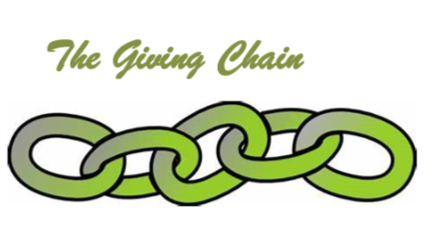
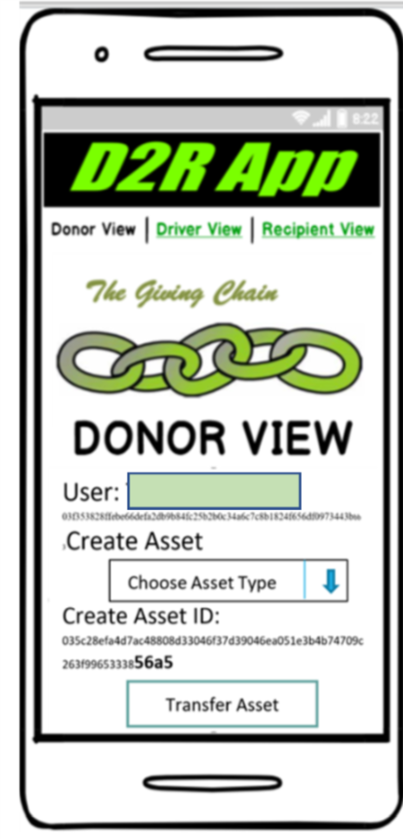
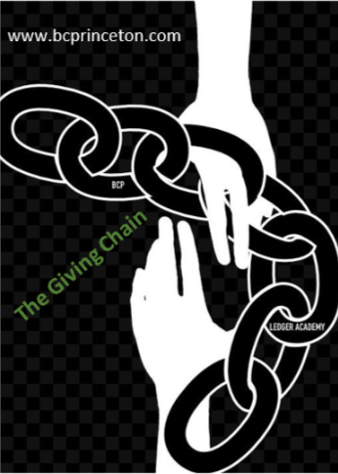
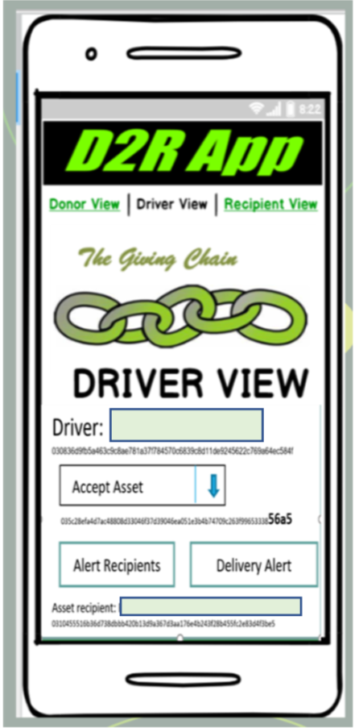
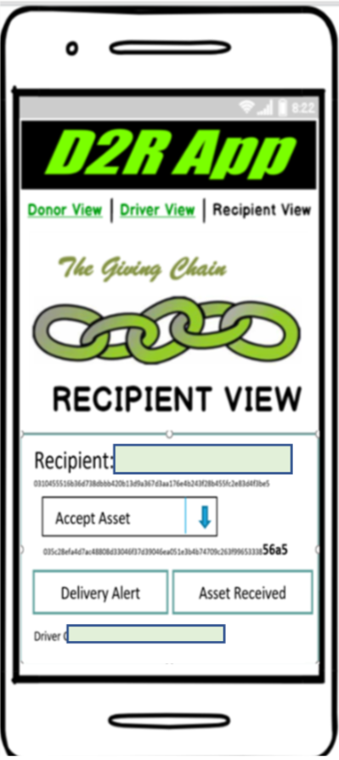
BLOCKCHAIN FUNDEMENTALS / Ledger Academy
D2R Application

Slide 20
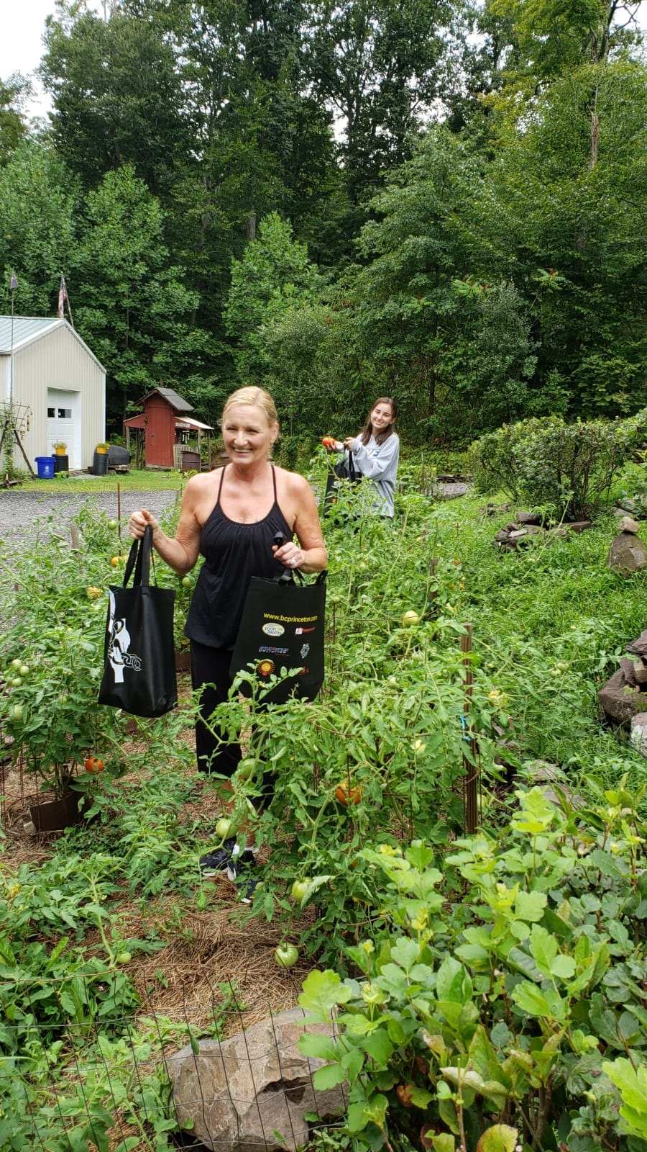
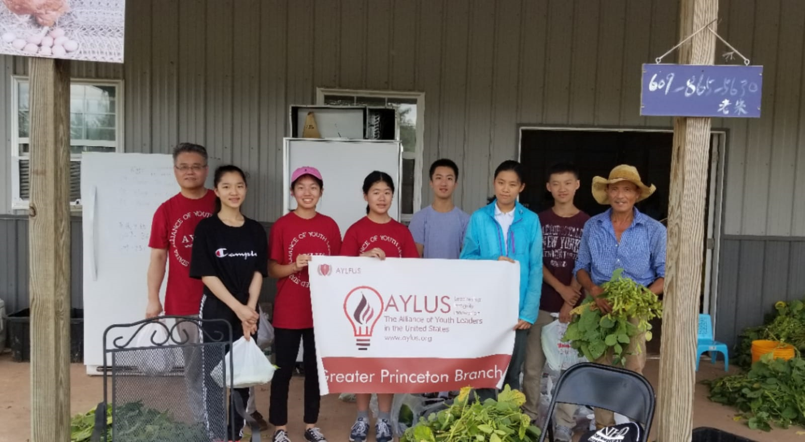
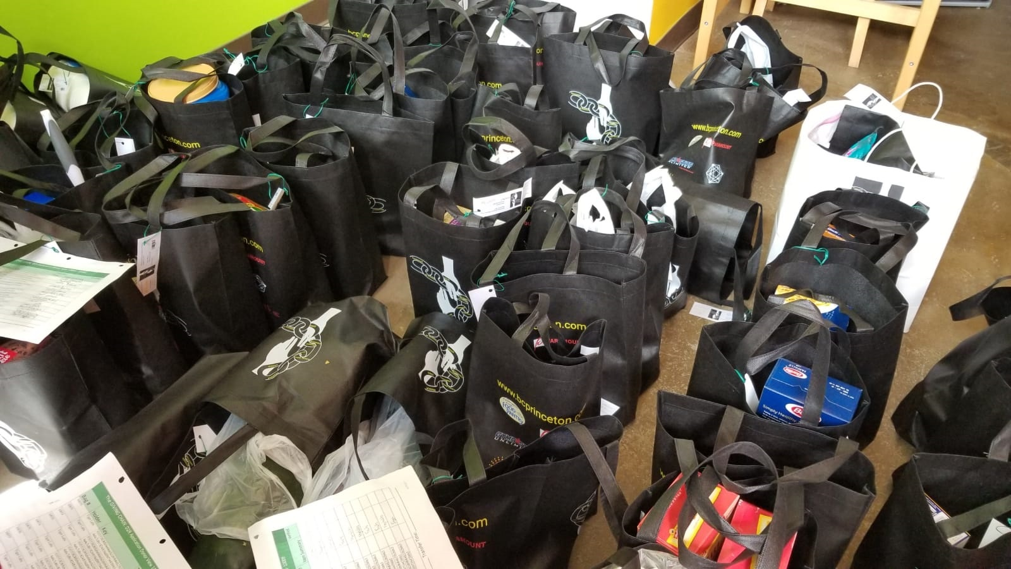
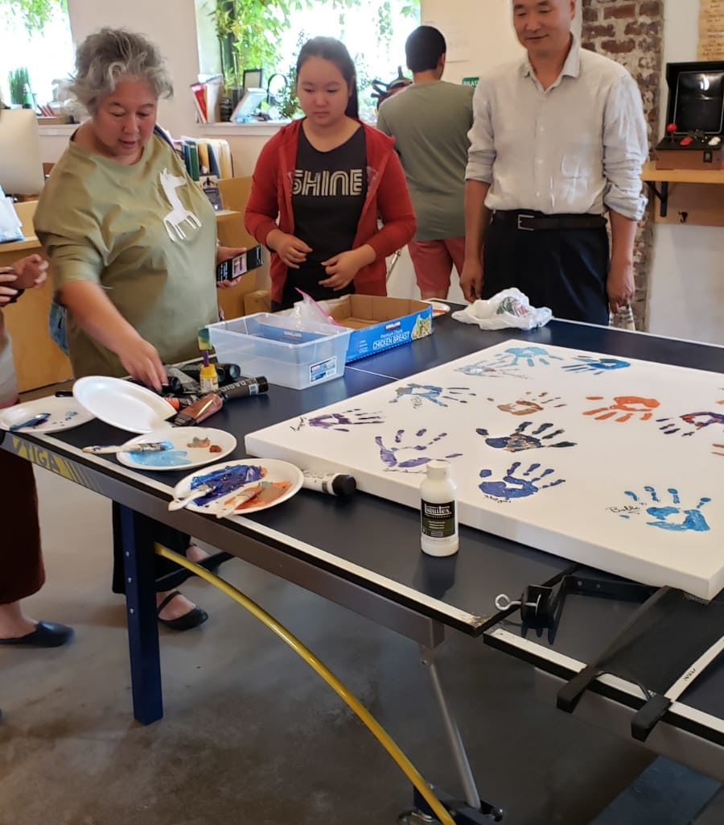
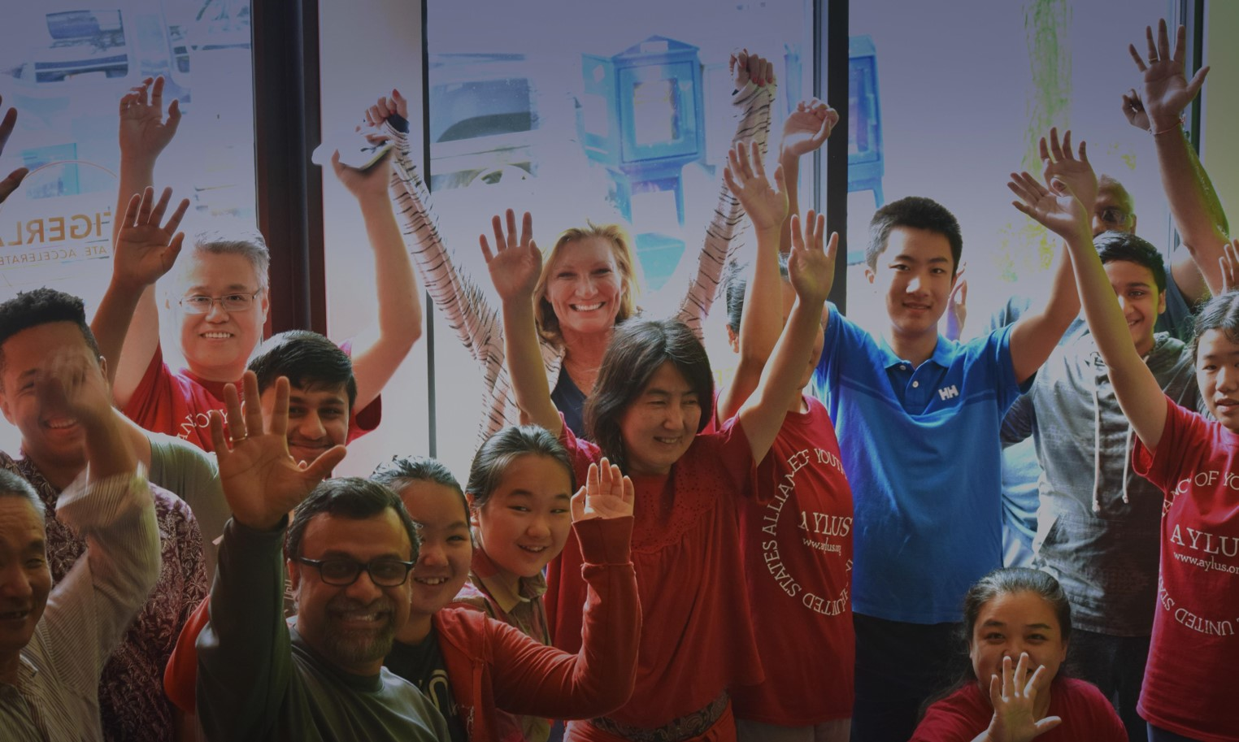
BCPrinceton’s The Giving Chain

Slide 21
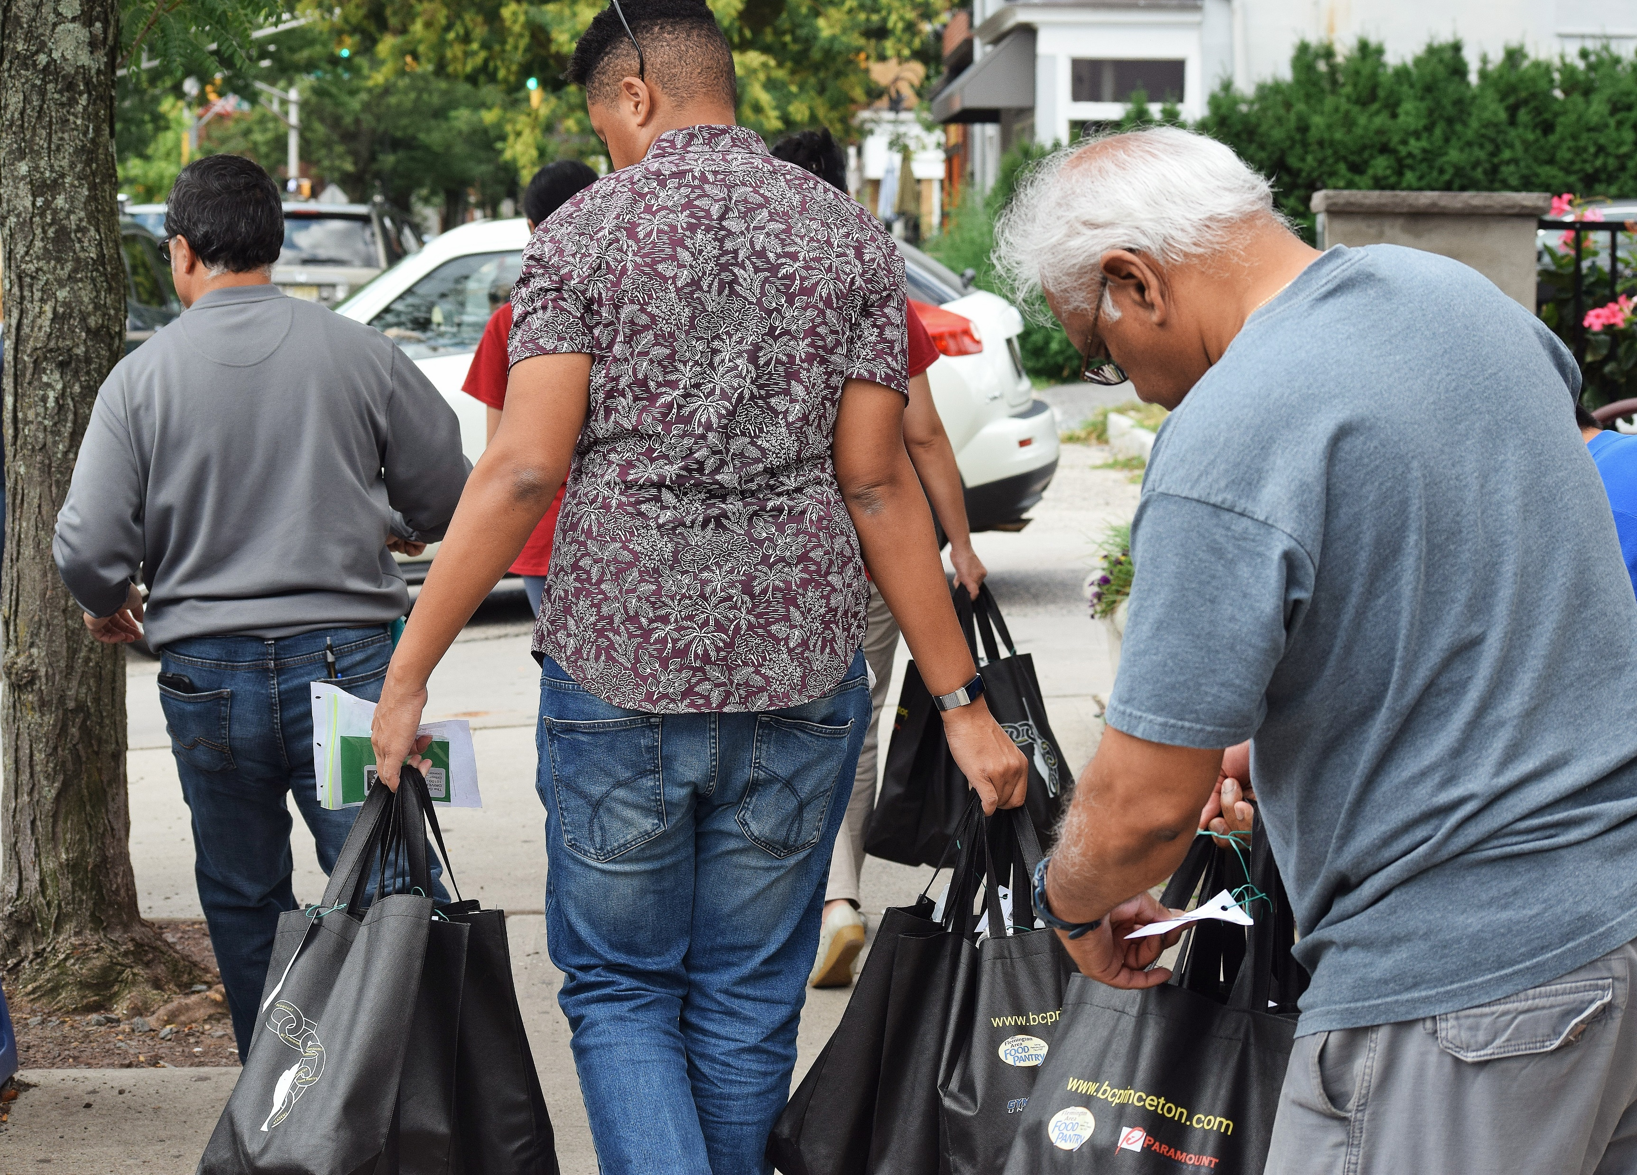

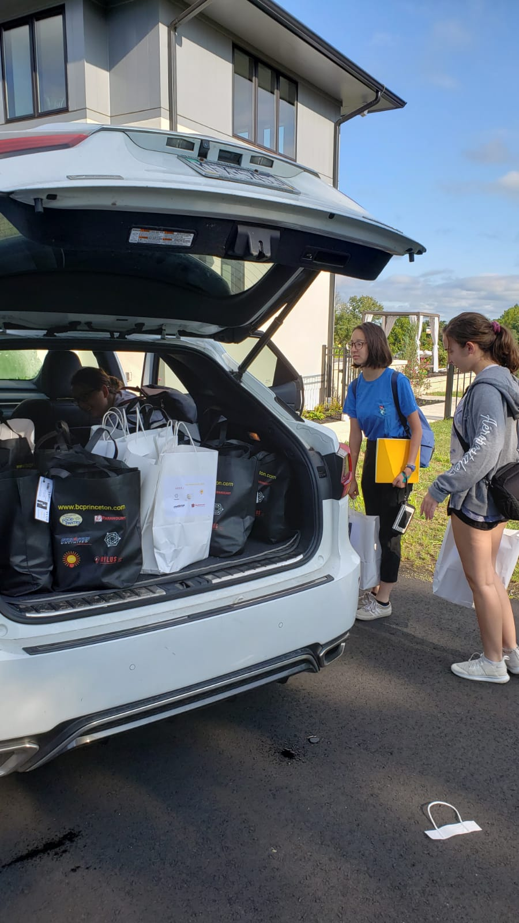
BCPrinceton’ The Giving Chain

Slide 22
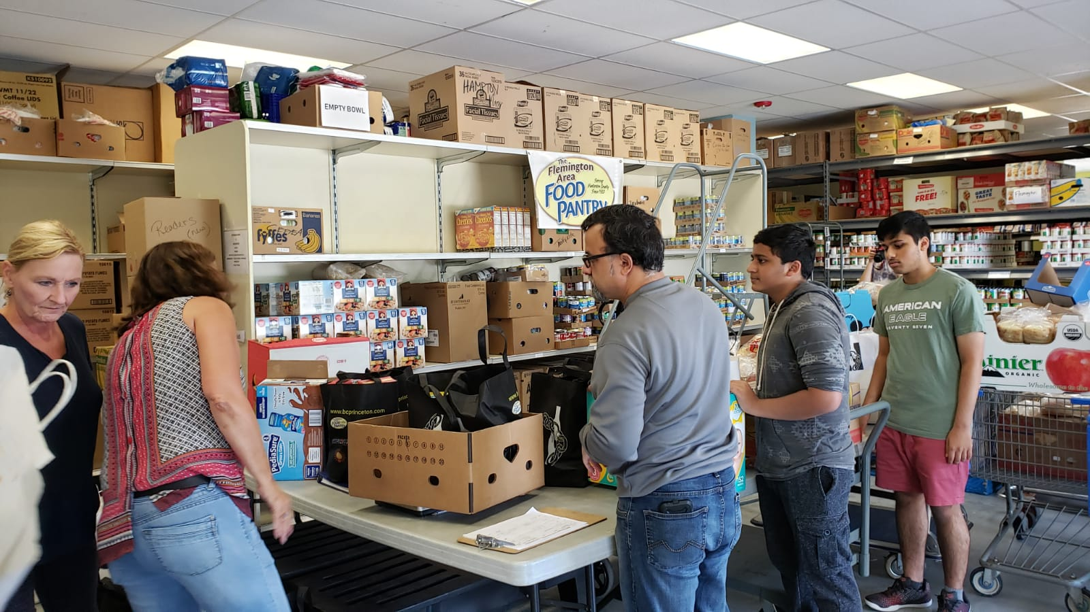

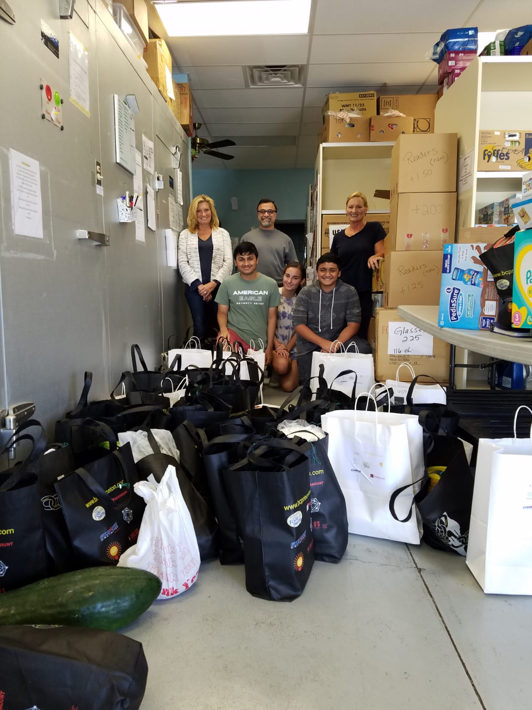
BCPrinceton’s The Giving Chain

Slide 23
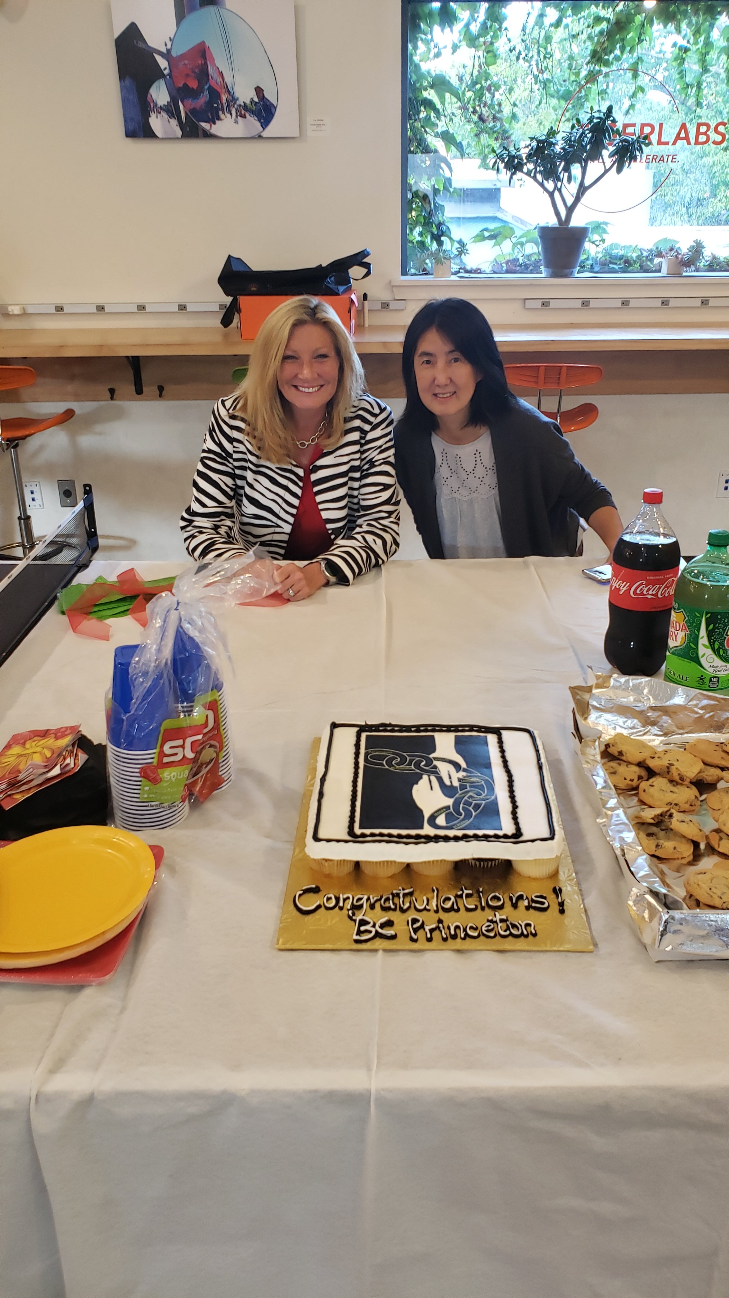
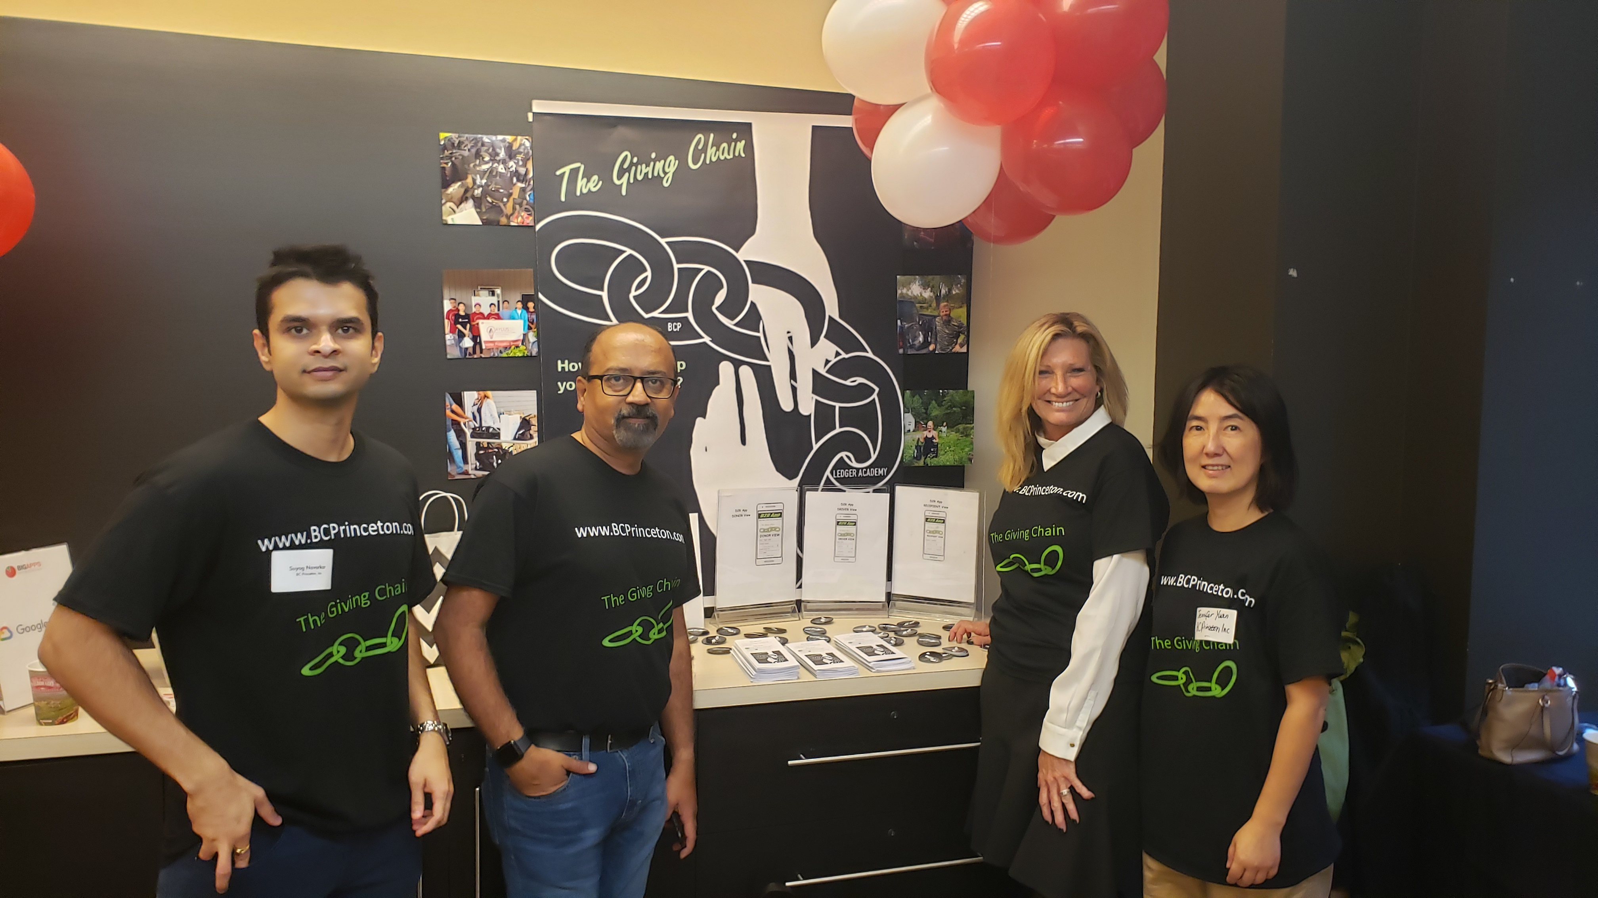
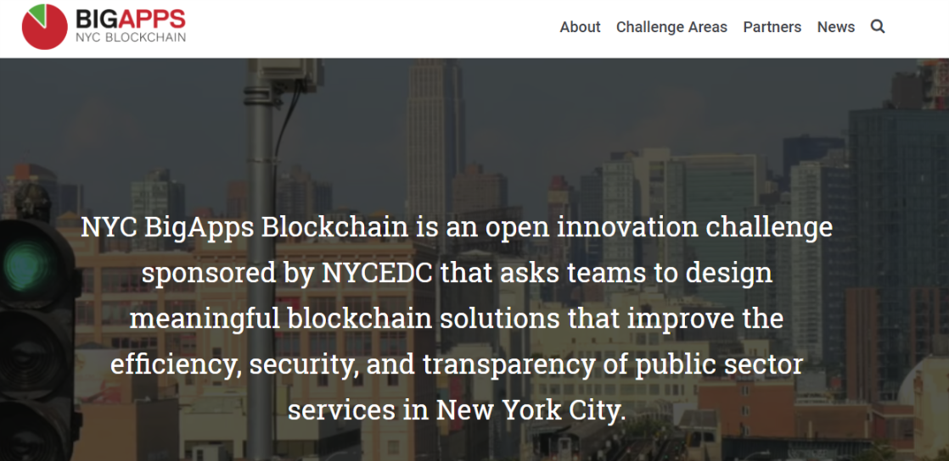


Slide 24

Kiva: Implementing SSI and a privacy-first credit bureau for Sierra Leone
Challenge:
There is no effective digital identity system or credit bureau for SL’s 7.5M citizens
As a result, Kiva’s lending rates are 30%, much higher than in other countries and a blocker to financial participation.
Solution:
2019-Q2 NCRA (SL government ID agency) will issue credentials on a Hyperledger-Indy based network.
2019-Q4 BSL (central bank) will use Hyperledger Fabric for a shared, decentralized credit reporting bureau.
Partnership between Kiva, SL government, UNDP and UNCDF.
Social Impact SIG presentation: https://wiki.hyperledger.org/display/SISIG/2019-08-06+Meeting+notes

Slide 25


Trade Finance: we.trade
we.trade is a blockchain-based international trading system for a consortium of major world banks including:
HSBC, Deutsche Bank, KBC, Natixis, Rabobank, Société Générale, Santander, UniCredit and Nordea
SMEs generate 85% of employment growth in Europe, but only ~50% of them have access to formal credit.
Went into production July 2018 conducting seven live trade transactions by ten companies via four partner banks
Enables accurate trading position information, order to settlement control, risk coverage, track and trace options
Near-real time exchange of information on a secure platform that digitizes transactional financing
Continual business and compliance readiness in any relevant regulatory environment
Scalability that allows for rapid international expansion as business, regulatory, and security opportunities converge
https://we-trade.com/
Notes:
we.trade is a blockchain-based international trading system for a consortium of major world banks including:
Deutsche Bank, HSBC, KBC, Natixis, Rabobank, Société Générale, Santander, UniCredit and Nordea
Enables accurate trading posture information, order to settlement control, risk coverage, track and trace options
Near-real time exchange of information on a secure platform that digitizes transactional financing and other complex processes
Continual business and compliance readiness in any regulatory environment
Scalability that allows for rapid international expansion as business, regulatory, and security opportunities converge
https://www.finextra.com/newsarticle/32342/wetrade-blockchain-platform-goes-into-live-production/wholesale
https://www.ibm.com/blogs/insights-on-business/banking/digital-trade-chain-consortiums-trade-finance-project-underscores-important-new-use-cases-blockchain/
▪ we.trade is a blockchain-based international trading system for a consortium of major world banks including: HSBC, Deutsche Bank, KBC, Natixis, Rabobank, Société Générale, Santander, UniCredit and Nordea ▪ Enables accurate trading posture information, order to settlement control, risk coverage, track and trace options ▪ Near-real time exchange of information on a secure platform that digitizes transactional financing and other complex processes ▪ Continual business and compliance readiness in any relevant regulatory environment ▪ Scalability that allows for rapid international expansion as business, regulatory, and security opportunities converge
The Technology
we.trade is a blockchain-based international trading system that enables accurate trading posture information, order to settlement control, risk coverage, track and trace options
The Challenge
Today, banks live in a competitive world. Small and mid-sized businesses generated 85% of employment growth in Europe in recent years, but only ~50% of them have access to formal credit. The Digital Trade Chain exemplifies how blockchain can bring the required trust and transparency to a new business network and associated business model.

Slide 26


Digital Identity: The OrgBook
The OrgBook serves as a trusted digital network of verifiable data about organizations which is globally connected, interoperable, secure, and easy to join
Why? So business/government can quickly access evidence of that a potential partner is legally incorporated
The new enrollment experience is more convenient and use an open global blockchain registry
Reduced single point of failure for database, reduced fraud from counterfeit IDs, reduces bottlenecks, and improves privacy which a complex verification system can expose
As more businesses establish their Self-Sovereign Identity, more Services will become Self-Sovereign Identity-aware
Live, public, globally accessible network using the Sovrin Provisional Network built on Hyperledger Indy.
https://www.hyperledger.org/resources/publications/orgbook-case-study
Notes:
https://von.pathfinder.gov.bc.ca/aboutvon/
https://www.itworldcanada.com/article/two-upcoming-government-digital-projects-show-future-for-digital-id-in-canada/406600
https://docs.google.com/document/d/1wNnXdQKUtWnx--xw3VQ9Fr2TDa0kUNIBSMmFGR4uoMg/edit#heading=h.hb1zjewyrm4
Interaction Diagram: Enrollment via Verifiable Claim from TheOrgBook - BC
A business person is interacting with the Supplier Registry (SRI) site to enroll their organization as a supplier. In doing that, information is needed about the organization that is available as a Verifiable Claim from BC Registries via TheOrgBook - BC. When that data is needed, and the user has identified the Organization sufficiently, send a Proof Request to TheOrgBook, which will use the Claims about the Organization to respond to the Proof Request. SRI will verify the claim, including checking for revocations, and if all is correct, use the claim to populate the data required for enrollment.
Organizations could be a “Verifiable Organizations” in a particular context … for example … within the tax realm if they have been issued a Business Number (in Canada) or within the Government of Canada procurement realm if they are a registered supplier. It is up to each realm to determine what the necessary evidence is for it to consider an organization to be verified. One realm could certainly rely on another. For example, the supplier may need to be a legal entity of a certain type (corporation) and therefore need to have a Verifiable Claim attesting to such a fact.

Slide 27

Thank You

