Slide 1


Connecting Emerging Tech Communities Worldwide

Slide 2

The Opportunity - Access to capital
Emerging tech ecosystems outside of the USA and Western Europe are on the rise showing record levels of startup VC investments in 2018 alone.
Asia is close to eclipsing US as world’s biggest VC market with total funding of $70.8bn last year to America’s $71.9bn [1]
South East Asia alone has risen to $3.16 billion over the first eight months of 2018, up 16 percent from 2017 [2]
The MENA region experienced a rise of 31% on investments from 2017 [3]
The first half of 2018 was a record-breaking semester for Latin America with US$780m across 145 deals [4]
Africa has now 51 ‘viable’ Africa-focused VC funds [5]

Slide 3
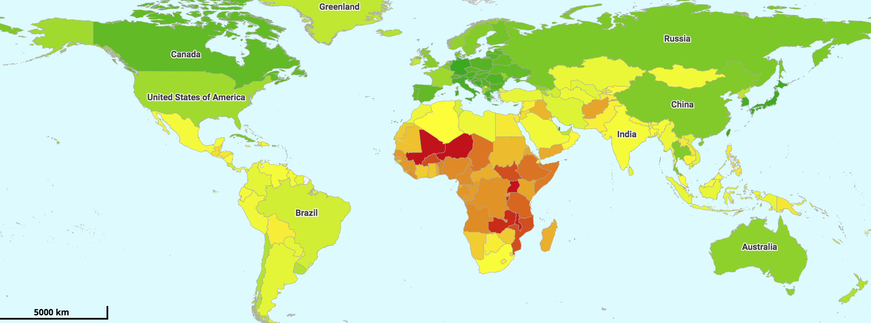
The Opportunity - Younger Countries
More than nine-in-ten Millennials or 92% own smartphones, and the vast majority 85% use social media, 97% say they use the internet, and 28% of them are smartphone-only internet users. Emerging Markets account for 90% of the Global Population Aged Under 30 [6].

Slide 4
The Opportunity - The Leapfrog Effect
Leapfrogging bypasses the lack of existing infrastructure by skipping stages in development, often with the help of smartphones. And this is happening faster in emerging markets [7] than anywhere else, thanks to low production costs, rise of GDP, cheaper data among other factors [8].
Technologies like the Blockchain and Artificial intelligence will provide huge opportunities like alternative sources of funding, employment, and alleviating poverty. Alternatively they will bring huge disruption in the labor markets especially in the emerging world. [9].

Slide 5
The Problem
Despite all these opportunities, most of these thriving technology ecosystems in emerging markets have big problems in terms of:
Technology startup founders lack a global mindset
Not enough technical, product, distribution and marketing talent available
Funding gaps for series A and beyond
Lack of mentors and opportunities to partner with key global technology companies and global institutions
Lack of awareness of other emerging tech communities
Poor regulatory and legal frameworks for startup founders and investors

Slide 6
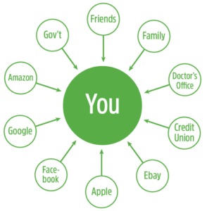


The Solution
A Real Global Community + Decentralized Identity System + Crypto Token
Decentralized Identity System
(Hyperledger Indy)
GST is a global tech community of 10,000+ covering almost 50 cities in 39 countries and has organized 90+ tech meetups around the world
Crypto Token
ERC20

Slide 7

The Solution
The Crypto token will provide concrete incentives to make more connections happen
Mapping out GST community and built reputation through the decentralized identity system
Decentralized Identity
Real Community
GST Token buyers can be anyone who needs to explore further with emerging tech communities
More details on the GST Token white paper http://

Slide 8

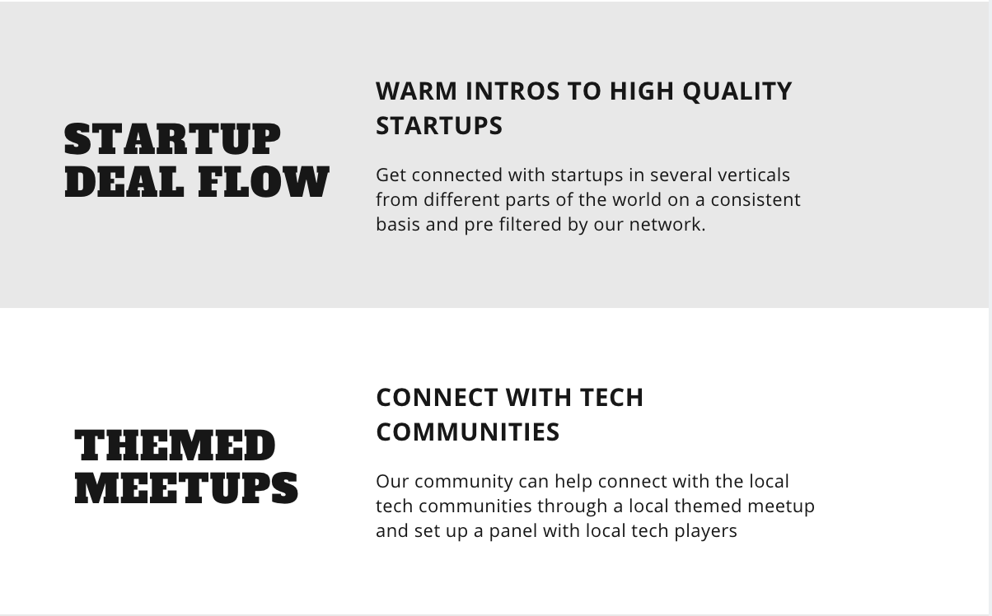
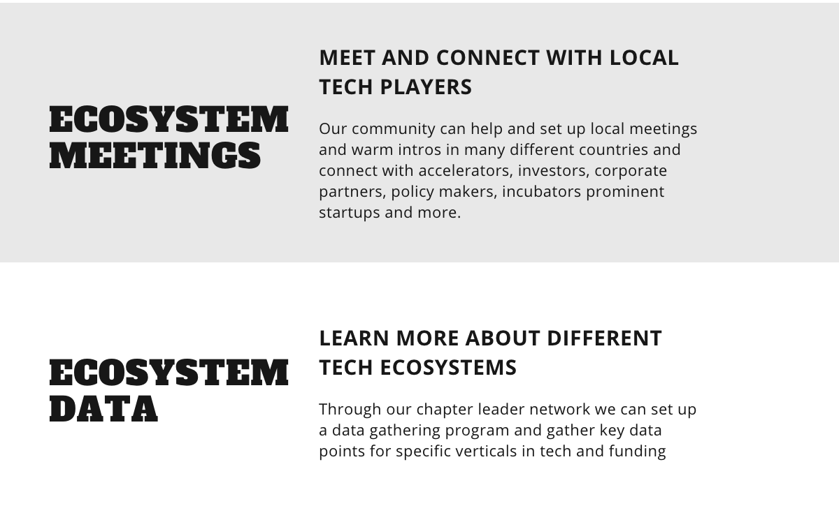

Slide 9

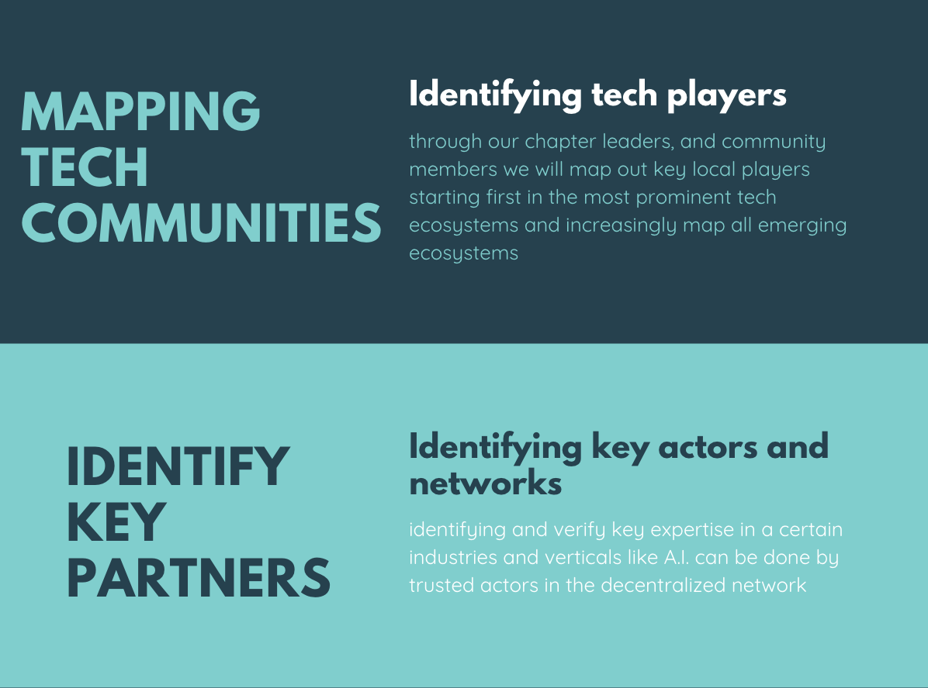
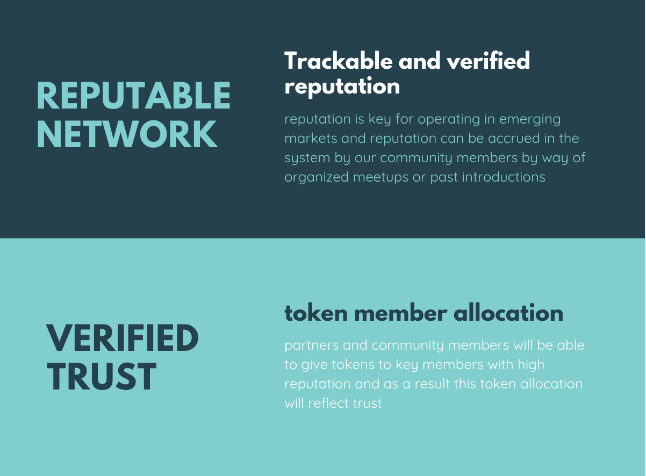

Slide 10
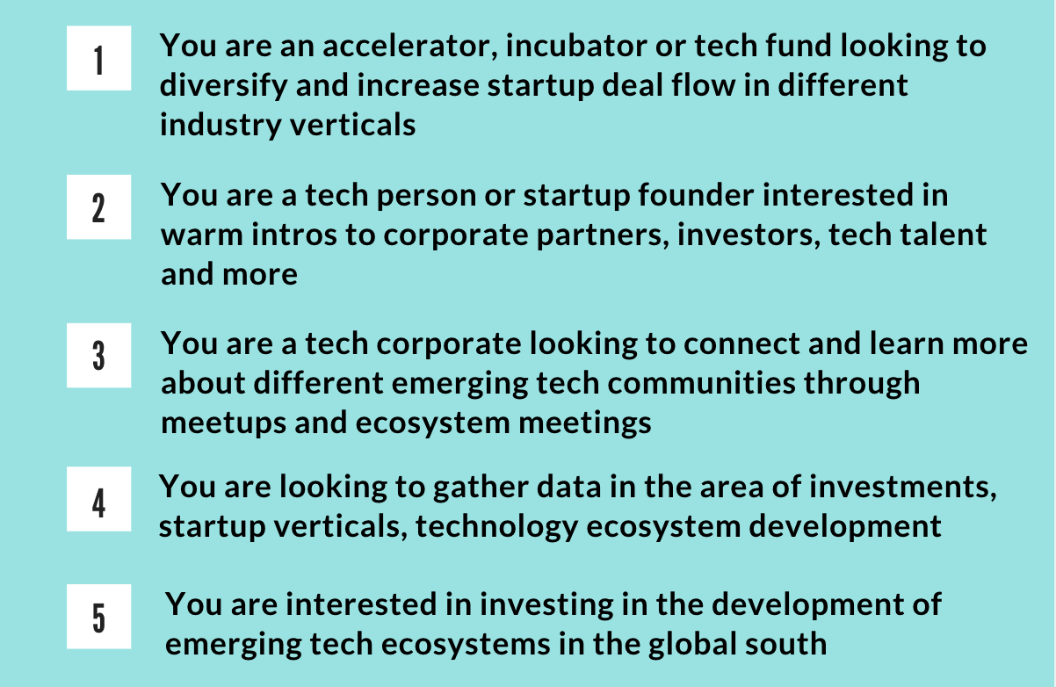
Why should you acquire the GST Token?

