Slide 1
Blockchain Basics
Ledger Academy
10-28-2019

Slide 2
Agenda
Housekeeping
Introduction to Blockchain
Blockchains and Enterprise Solutions
Use Cases
Discussion

Slide 3
Agenda
Housekeeping
Introduction to Blockchain
Blockchains and Enterprise Solutions
Use Cases
Identity and the Blockchain
Discussion

Slide 4

Housekeeping
Tiger Labs:
Co-working Space in Princeton New Jersey
Current Home to Ledger Academy
Meetup space for blockchain groups.

Slide 5
Princeton Blockchain Community
Housekeeping
Summer Blockchain Project
Discussion
Moving Forward
HYPERLEDGER PRINCETON
Hosted by Linux Foundation, is comprised of people interested in learning and developing projects using the Hyperledger solutions.
BLOCKCHAIN FUNDEMENTALS / Ledger Academy
  Meetups focused on Education
PRINCETON BLOCKCHAIN AND AI
  Princeton Blockchain and AI is focused on COMMUNITY. Discussions are developed by meetup participants.
Notes:
David

Slide 6
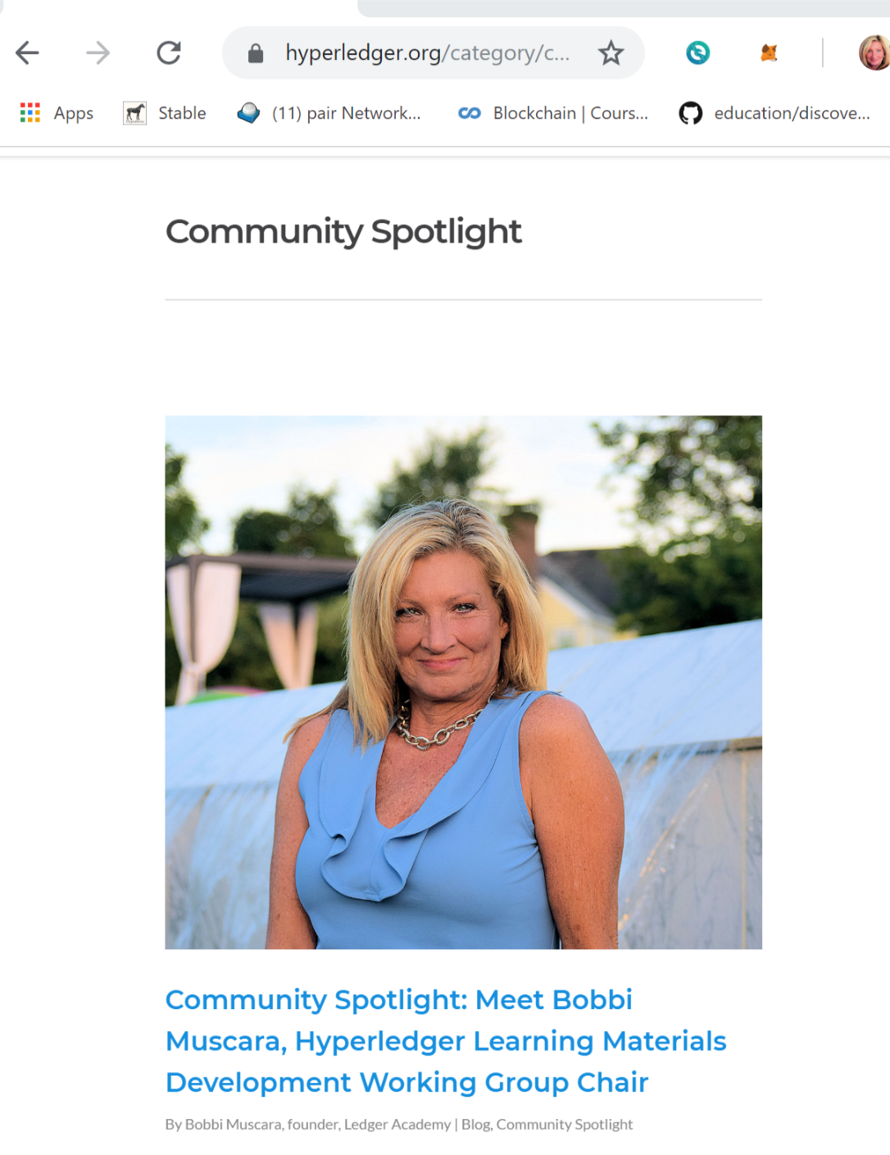
HYPERLEDGER PRINCETON
https://www.slideshare.net/Evernym/what-is-selfsovereign-identity-ssi

Slide 7
Agenda
Housekeeping
Introduction to Blockchain
Blockchains and Enterprise Solutions
Use Cases
Discussion

Slide 8
Introduction
What Is Blockchain Technology
  Innovation to Computer Science
  New way to interact Trade
History of the Internet
History Of Bitcoin
Bitcoin The System
How It works

Slide 9
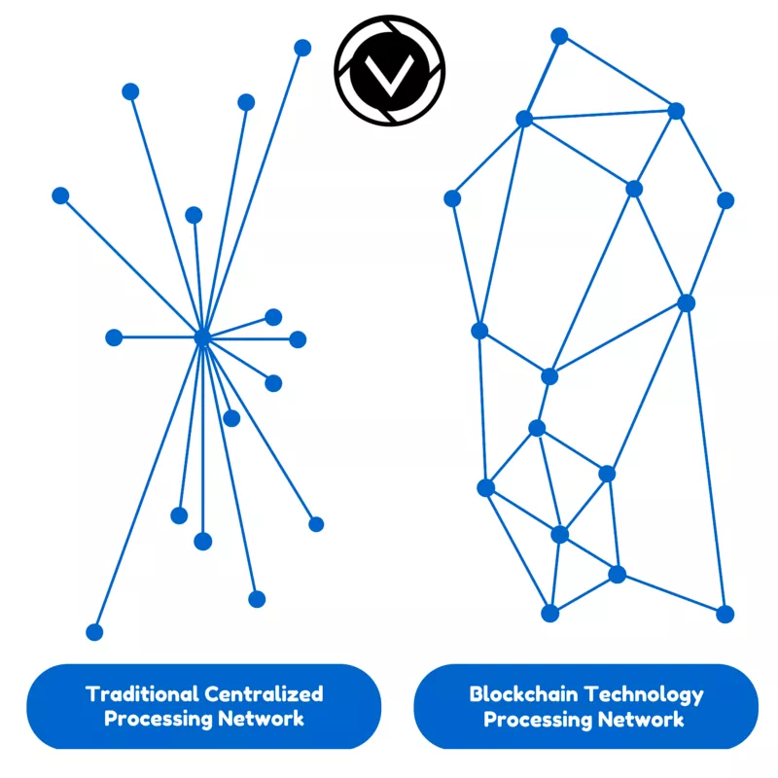
Innovation to Computer Science
Blockchain technology is a shared ledger (DLT) that everyone trusts to be accurate and permanent
Public registry that stores transactions in append only network system that creates a shared reality between non trusting entities
Bitcoin was the first to introduce it to the world.
Cryptoasset – or cryptocurrency or digital asset, Underlying function of a blockchain, Does not have to represent digital cash but digital value.

Slide 10
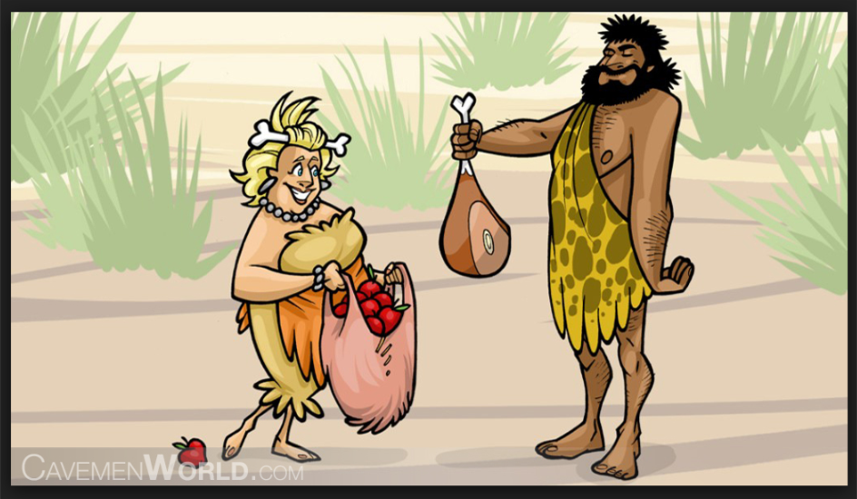
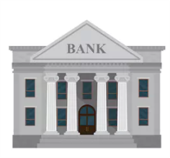
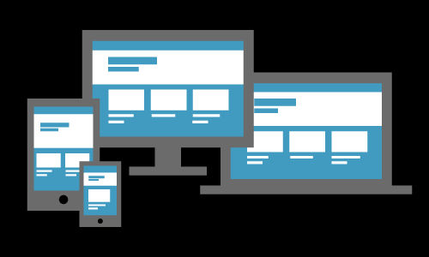
Distributed Ledger Technology
Trade:
First form was bartering , informal rules.
CURRENCY
Purpose of Currency
1. Medium For Exchange.
2. Store of value over time
3. Accepted as a measure of worth.
Fiat currency –Backed by Government ( because I said so) .
Online transactions. Centralized ledgers Single point of control.
CRYPTOCURRENCY
Because we can prove it.
Notes:
Problems with bartering, coincidence of wants, commodity pricinga middle agent , currency. solved with a currency but this introduces a need for a trust mechanism.
Store of value refers to the liquidity, scarcity, distributable

Slide 11

Distributed Ledger Technology

Slide 12


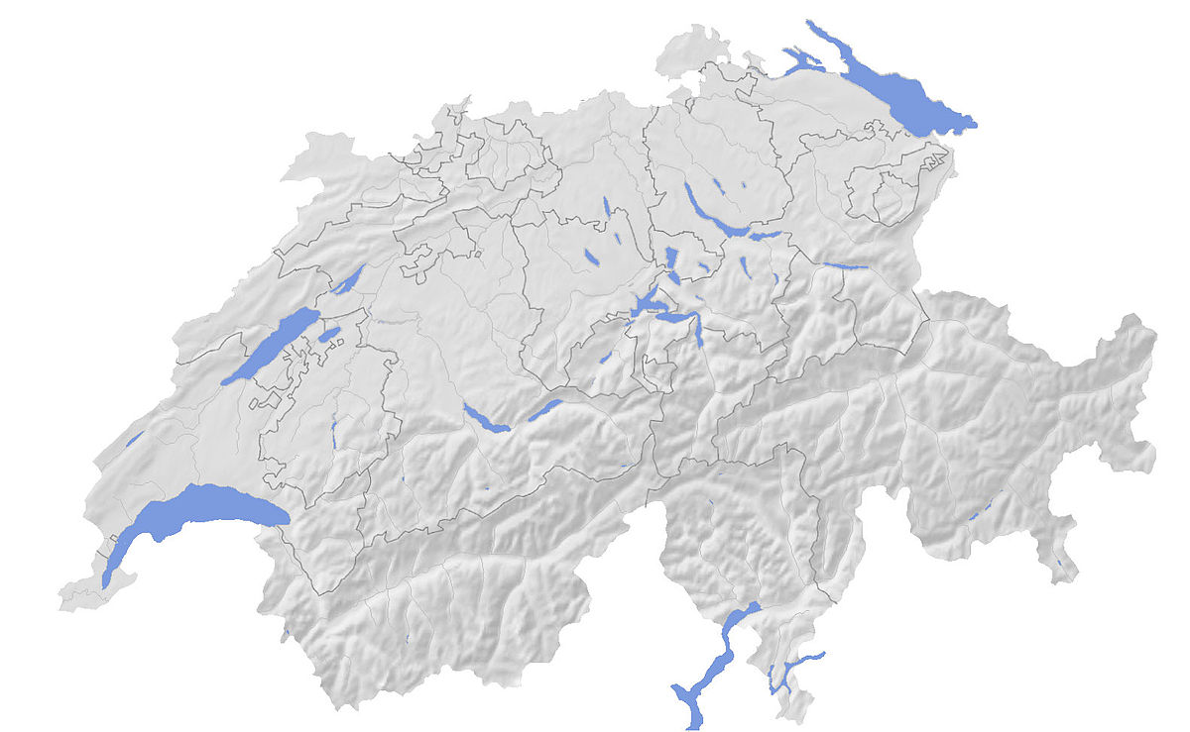
Origin of Internet
WWW
  Electronic computers in the 1950s
  1960 DARPA attempt to create a decentralized computer system
  in 1969 The first message was sent over the ARPANET, the defense departments first attempt at a WIDE AREA NETWORK, from a laboratory at UCLA to the second network node at Stanford Research Institute.
    Packet switching, communication protocols were being developed.
  1970s The INTERNET PROTOCOL SUITE (TCP/IP) was developed by R. Kahn and V. Cerf and became the standard networking protocol.
  1980s -1990’s,CERN in Switzerland, British computer scientist Tim Berners-Lee inventing the World Wide Web and in doing so the first web server, and the first web browser, resulted in a database called the WORLD WIDE WEB that used linking hypertext documents into an information system, accessible from any node on the network.
Notes:
The www is the meta application to leverage the underlying fiber of the internet.
The indexed web contains 4.7 billion pages
Did we expect nothing to come out of sharing information. GOOD IDEAS.

Slide 13


WEB 1.0
  Late 1980s, Commercial Internet Service Providers (ISPs) began to emerge.
  The 1989 implementation of Tim Berners-Lee's Hypertext Transfer Protocol (HTTP) on top of the base-layer Transmission Control and Internet protocols (TCP/IP) paved the way for web-based applications
  1993 Marc Andreessen’s MOSAIC which we know as NETSCAPE gave us the Commercial BROWSER
  Information Revolution, email, messaging, video calls, discussion forums.
Content From Administrator
Notes:
The 1989 implementation of Tim Berners-Lee's Hypertext Transfer Protocol (HTTP) on top of the base-layer Transmission Control and Internet protocols (TCP/IP) paved the way for Marc Andreessen's Mosaic Netscape browser in 1994. That then gave rise to a host of web-based applications, which ultimately fostered all the online services that now form part of everyday life.

Slide 14
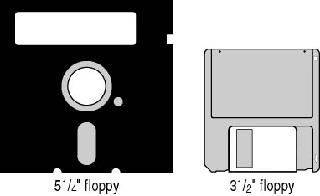
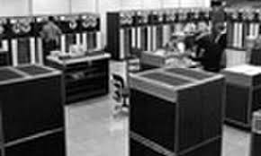
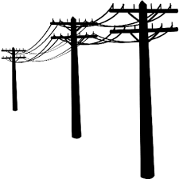
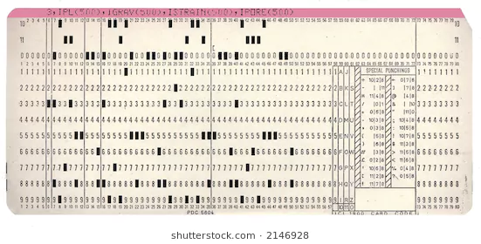
WEB 2.0
First used in 1999
Marked household adoption: computers and items for connect became necessities
Technology advancements : computer storage, data access speeds, hard drives instead of floppies MB turned in GB that turned into TB.
Internet Speeds (ethernet technology that allows for TCP/IP) common speeds of kilobits to tens of megabits per second, to gigabits per second.
RAM grew from hundreds of kilobytes to gigabytes as typical amounts on a system.
Dot. Com Bubble
Notes:
Most people don’t need to know this information as they will not need to know the inner workings of a blockchain.
WORLD WIDE WEB was !st Killer App. To leverage the internet
DOT>COM Bubble WEB 2.0 brought together unrelated buyers and sellers in seamless and low-cost ways.
Entrepreneurs around the world developed new business models, and ran to their nearest VC
Little business experience, just people with ideas, and did not manage the capital influx prudently.
Business plans were predicated on the assumption that by using the Internet, they would bypass the distribution channels of existing businesses and therefore not have to compete with them;
when the established businesses with strong existing brands developed their own Internet presence, these hopes were shattered, and the newcomers were left attempting to break into markets dominated by larger, more established businesses. Many did not have the ability to do so.

Slide 15









WEB 2.0
Collaboration
The emergence of social media and interactive websites
Instagram, Twitter, Facebook, Wikipedia, Google
Web sites generated content and encouraged sharing and online commerce.
Website with user generated content.
Content User Generated/ Apps
Notes:
Didn’t know how to share properly. Napster, Bit torrent

Slide 16
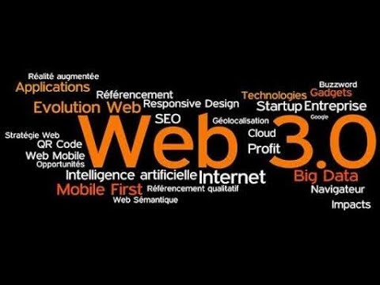
WEB 3.0
Blockchains
Smart Contracts
D Apps
Artificial Intelligence
Data Mining
Cloud Storage
Tokenization of Value
Internet of Information Web 2.0
Internet Value Web 3.0.
Content Generated by Community
Notes:
Just as email was the first big app for the interent of information. Bitcoin is the first killer app for the interne5t of value.
It also allows us to create an instantaneous single source of truth.

Slide 17
History Of Bitcoin
In 1983, David Chaum introduced the idea of digital cash. In 1990, he founded DigiCash, an electronic payment system. Chaum wrote a paper describing the technological of public and private key generation order to create this Blind Signature Technology. Chaum's Blind Signature Technology was designed to ensure the complete privacy of users who conduct online transactions.
1990 Dot Com bubble and business mis-management discouraged digital cash mechanisms
In 1998, Wei Dai / Nick Szabo created (bitgold) electronic currency system which required users to complete a proof of work function with solutions being cryptographically put together and published.
A currency system based on a proof of work was later created by Hal Finney who followed the work of Dai and Szabo(smart contract 1996).
Satoshi Nakamoto, the unknown inventor of Bitcoin, never intended to invent a currency. In his announcement of Bitcoin in late 2008, Satoshi said she developed “A Peer-to-Peer Electronic Cash System.“
Notes:
DOT com bubble occurred when the internet opened up avenues of trade that weren’t there before and people rushed in with excellent ideas, no business background or understanding of this new technology. When the ideas hit the pavement the infra structures weren’t there to support these new company *( actual trade routes, shipping deliverables)
David Caum business decisions
Bitcoin is the first 'killer application' of decentralized computing

Slide 18
Bitcoin: A Peer-to-Peer Electronic Cash System Satoshi Nakamoto. A purely peer-to-peer version of electronic cash would allow online payments to be sent directly from one party to another without going through a financial institution. Digital signatures provide part of the solution, but the main benefits are lost if a trusted third party is still required to prevent double-spending. We propose a solution to the double-spending problem using a peer-to-peer network. The network timestamps transactions by hashing them into an ongoing chain of hash-based proof-of-work, forming a record that cannot be changed without redoing the proof-of-work. The longest chain not only serves as proof of the sequence of events witnessed, but proof that it came from the largest pool of CPU power. As long as a majority of CPU power is controlled by nodes that are not cooperating to attack the network, they'll generate the longest chain and outpace attackers. The network itself requires minimal structure. Messages are broadcast on a best effort basis, and nodes can leave and rejoin the network at will, accepting the longest proof-of-work chain as proof of what happened while they were gone.

Slide 19

The White Paper
Introduced to a Crypto Mailing list by publishing the White Paper “ Bitcoin: A Peer-to-Peer Electronic Cash System ”, and released as open-source software in 2009.
The system is peer-to-peer, and transactions take place between users directly, without an intermediary.
These transactions are verified by network nodes and recorded in a public distributed ledger called the blockchain , which uses bitcoin as its native currency.
Bitcoins are created as a reward in a competition in which users offer their computing power to verify and record bitcoin transactions into the blockchain. This activity is referred to as mining and successful miners are rewarded with transaction fees and newly created bitcoins.
Bitcoin can be exchanged for other currencies. products, and services. When sending bitcoins, users can pay an optional transaction fee to the miners. This may expedite the transaction being confirmed.
Notes:
How that native currency is to perform is detailed I paper.
For you, down load protocols get money into the system , start trading, step it up and become a miner.

Slide 20
BITCOIN ECOSYSTEM
bitcoin the Unit: the denominations of bitcoin
Bitcoin (capitalized B) : associated with Bitcoin the protocol and payment network. The uppercase form, “Bitcoin,” is also often used to refer to as the ecosystem as a whole. Using Bitcoin with a capital “B” is the common way of referencing Bitcoin when writing about it in general terms.
bitcoin. lowercase “b” written as “bitcoin” is usually associated with bitcoin as the currency
Bitcoin the Network: the network is connected by independent nodes. Network is secure from from attacks (such as DDoS) but not 51% Attack.
Bitcoin Improvement Proposals (BIPs): ​a BIP is the basic process of submitting, evaluating, and implementing updates to the system. BIP Reviews are posted in Github and community votes on the ­ Bitcoin Improvement Proposals
Notes:
INDEPENDENT
Transactions are processed (blood flow), Blocks are added Heart Beat)
Miners receive transactions requests, compete to solve the hash, (the worked needed to solve the calculations fuel)
51% attack

Slide 21
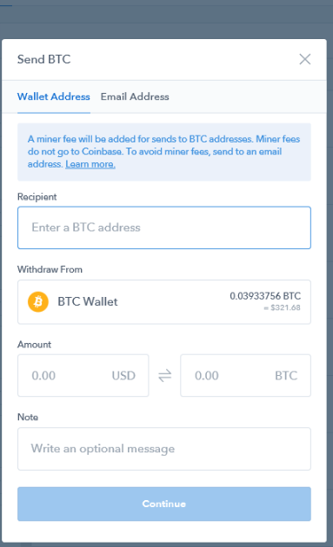
How it works
User Makes Request of system:
  New to system, set up account, returning user, open blockchain and login
  Fill out Ticket
  Request goes to the system
  Verification and consensus process by miners (or other mechanism)
  Value gets transferred and confirmed.

Slide 22
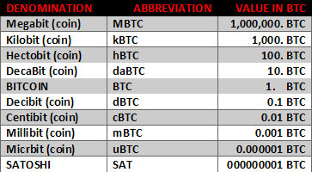
Denominations of Bitcoin
.012 BTC = $ 100.
Satoshi, which is the name of the creator of bitcoin, is also the smallest denomination available at 0.00000001 BTC.

Slide 23
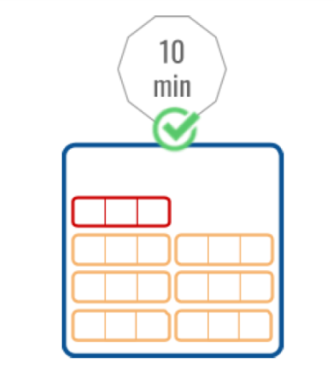
How It works
Parts of a Bitcoin blockchain:
  Header (Version, Previous Block Hash, Merkle Root, Timestamp, Difficulty Target, Nonce)
Description
  Version number to track software/protocol upgrades
HASH
  A reference to the hash of the previous (parent) block in the chain
  Merkle Root A hash of the root of the Merkle tree of this block’s transactions
  Timestamp The approximate creation time of this block
  Difficulty Target The proof-of-work algorithm difficulty target for this block (Nonce A counter used for the proof-of-work algorithm)
  # of transactions in the block.

Slide 24
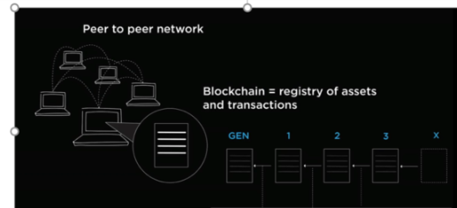
Bitcoins Blockchain System
Technologies:
  Cryptography
  Mathematical Hashing
  Consensus Algorithms
  Public / Private Keys

Slide 25
Consensus
Consensus is a process whereby the peers synchronize the data on the blockchain.
There are a number of consensus mechanisms or algorithms.
Proof of Work, Proof of Stake, Proof of Elapsed Time, Byzantine Fault Tolerance.
Bitcoin uses Proof of Work, while Ethereum uses Proof of Work currently, but is moving towards Proof of Stake.
The Hyperledger Sawtooth uses Proof of Elapsed Time.
Fabric – Plug and Play consensus model (BFT)

Slide 26
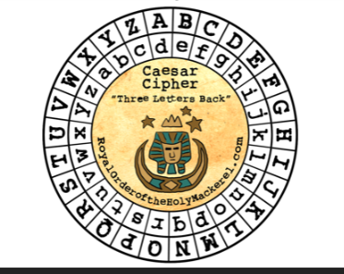
Cryptography DIGITAL SECRETS
Cryptography has a key role to play both in the security, as well as in the immutability
For blockchain technologies, cryptography is used in 2 ways:
  to prove that a transaction was created by the right person.
  It is used to link transactions into a block in a tamper-proof way, as well as create the links between blocks, to form a blockchain.
Hash: Cryptographic hash functions are mathematical operations run on digital data. (SHA 256) Elliptic Curves Cryptography
  Proof-of-Work
Notes:
History: Caesar / WWII

Slide 27
Immutability of Data
his immutability, or 'unchanging over time' feature makes the blockchain useful for accounting, financial transactions, identity management, and asset ownership, management and transfer, just to name a few examples. Once a transaction is written onto the blockchain, no one can change it, or, at least, it would be extremely difficult to change it.

Slide 28
Public Keys and Private Keys Address
Bitcoin Address: To keep information secure, these keys are crypto secure.
PRIVATE KEY
The private key is crucial to keeping your bitcoins safe. This is unique to you, and only you should know your private key. It takes the form of a string that signs a digital communication once hashed with your public key.
PUBLIC KEY
A public key is a bitcoin address, the information of which is accessible to all. When hashed with a private key it secures a digital communication.
Public / Private Keys / Wallets
Passphrase-Encrypted Wallets (AKA BIP38)
Multisig

Slide 29
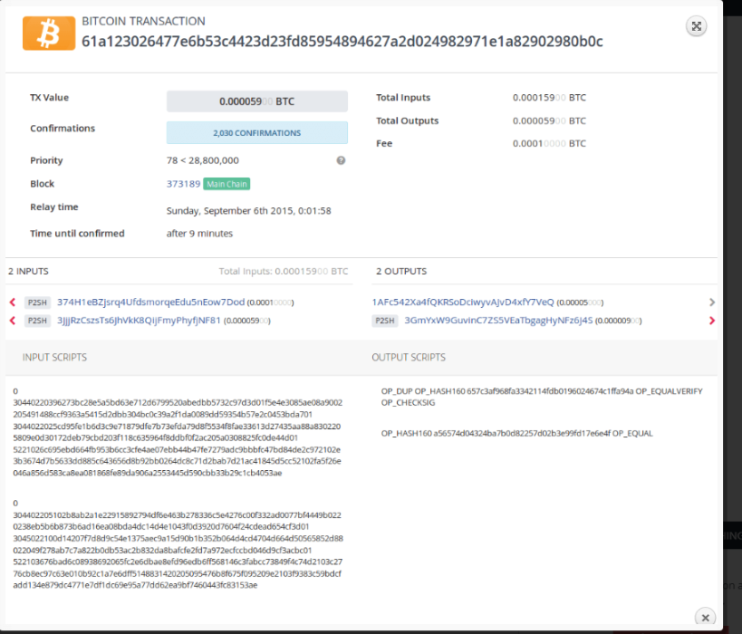
Stored on the blockchain

Slide 30
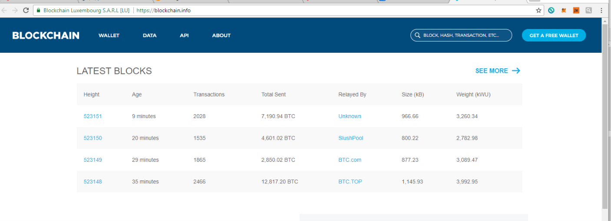

Slide 31
Agenda
Housekeeping
Introduction to Blockchain
Blockchains and Enterprise Solutions
Use Cases
Discussion

Slide 32
Types of Blockchains
Anonymity of Validators
Permissioned
Permission-less
Public
Public
Proof of Work
Proof of Stake
Permission-less
Permissioned
Private
Private
Byzantine Fault Tolerant / Multi Signature
Trust Validators

Slide 33
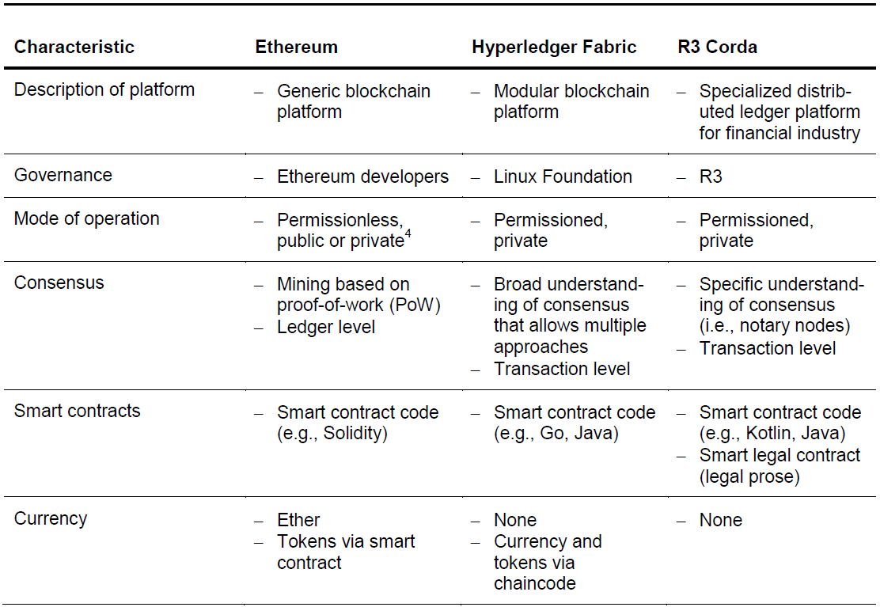
Types of Blockchains
Permissioned versus Permission less

Slide 34
Types of Blockchains
Ethereum
An open-source virtual machine that allows programmers to build dapps using blockchain. Includes ETH, its own native currency
The EVM
With Ethereum, servers and clouds are replaced by thousands of so-called "nodes" run by volunteers from across the globe (thus forming a "world computer").
The vision is that Ethereum would enable this same functionality to people anywhere around the world, enabling them to compete to offer services on top of this infrastructure.

Slide 35
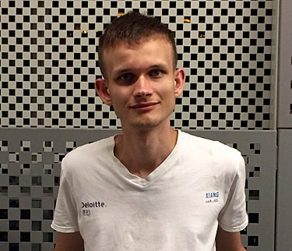
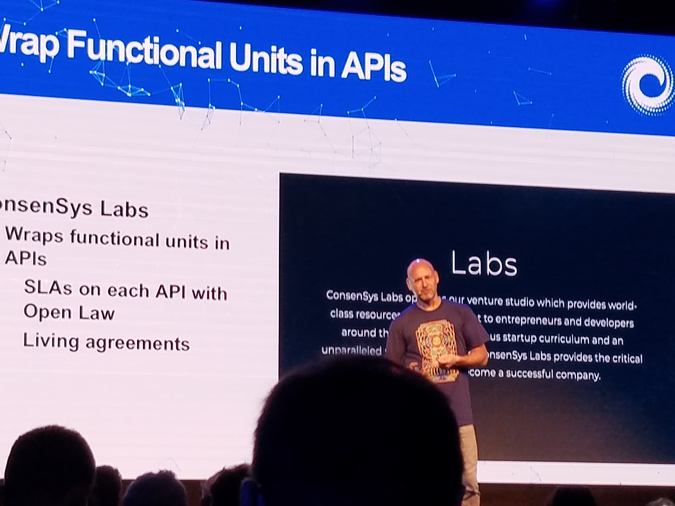
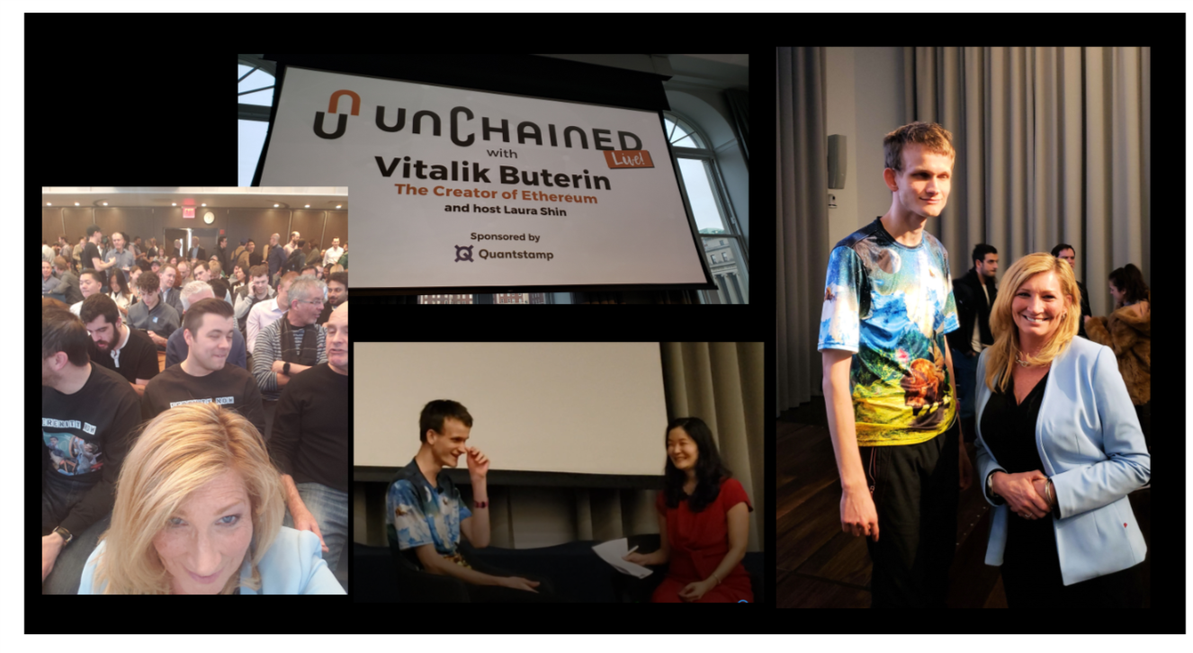
Vitalik Buterin
Types of Blockchains
Ethereum
Ethereum, which was first described in a white paper in 2013, is the operating system that adds programming to blockchains, effectively turning the network of “miners” into the world’s largest computer.
Ethereum can be programmed just like any general-purpose computer, and apps built on Ethereum can grow to any size, are incredibly secure, preserve anonymity, are auditable, and provide the same service at the same scale for less than 1% of the centralized price
The Ethereum Virtual Machine or EVM is the virtual machine in which all the smart contracts function in Ethereum.
It is a simple yet powerful Turing Complete 256-bit virtual machine. Turing Complete means that given the resources and memory, any program executed in the EVM can solve any problem.
Because it has the ability to build platforms, its both a cryptoasset and a cryptocurrency
Notes:
father gave him the blockchain code and he developed Ethereum with Joe Lubin

Slide 36
Dapps
Types of Blockchains
Dapps: Distributed apps - applications that use blockchain storage and computing power through Ethereum. Generally, dapps look and feel like existing apps you know and use every day
Gas: The small amount of money you pay for each transaction that rewards nodes for providing their computing power
Web 3.0 browsers: New browsers are being built that help you manage your cryptocurrency, keys, passwords, blockchain, identity, permissions, etc. In general, they will use the familiar web front-end toolkits: JavaScript, AJAX, HTML, etc.

Slide 37
ICO and Tokens
Staking
Security
Locking
Tokens: represent value inside various systems. tokens will bridge systems, interoperable.
https://youtu.be/rIMKNkF6d28
Unit of value that an organization creates to
  Self govern business model
  Empower users to interact with product/service
  Facilitates sharing of rewards to ecosystem
Burning
ERC20
Utility
Payment
Airdrop

Slide 38
Token Values:
Each token represents some value for the company:
Who will use it
How will they use it
What will it cost
What is the benefit
What's the value
Can it be exchanged
Tokens create private economies

Slide 39
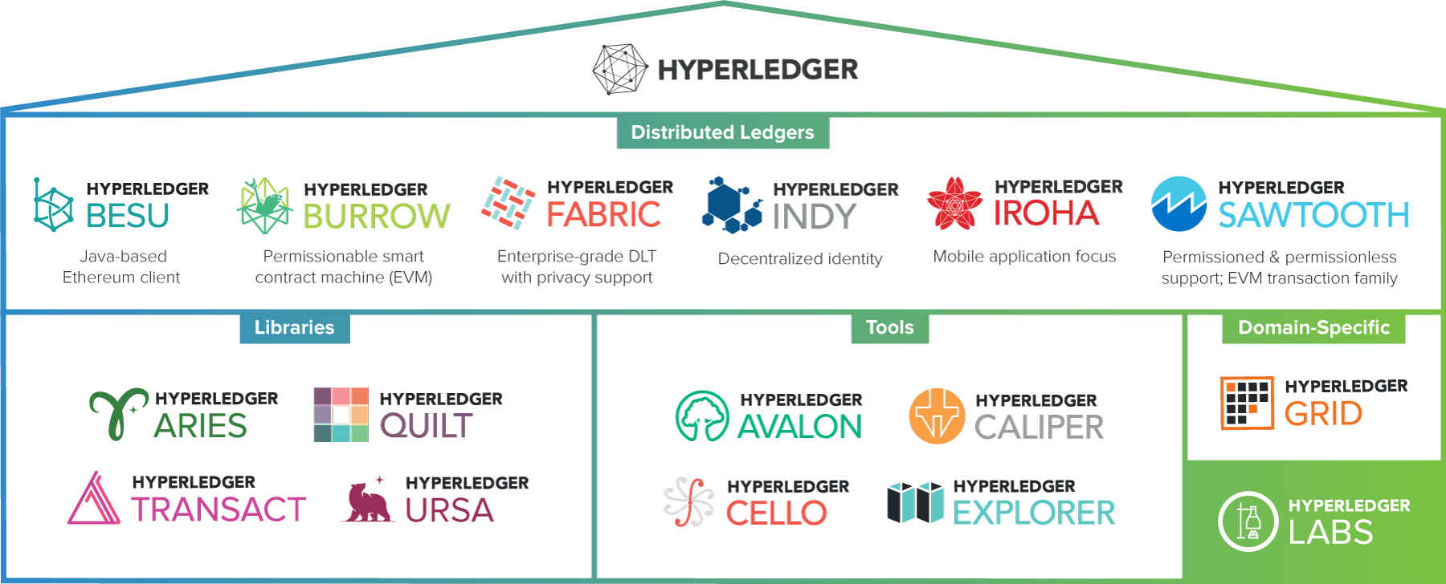
The Hyperledger Greenhouse
Types of Blockchains

Slide 40
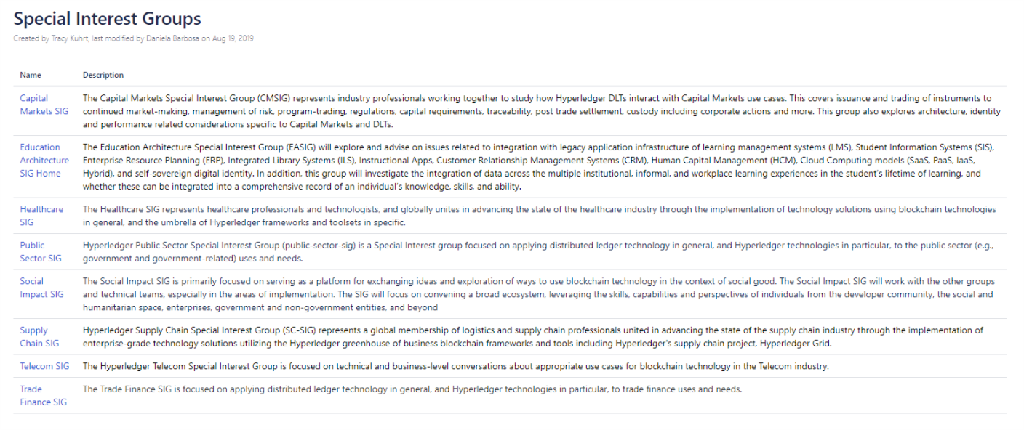
Special Interest Groups (SIG)
Notes:
This slide covers updates with the Special Interest Groups (which of community-led efforts around how Hyperledger is being used in different industries). This include reference to the most recently launched groups and preview of new groups under development.

Slide 41


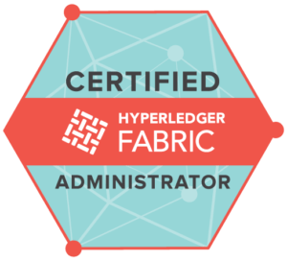


Training and Certifications
Technical training courses and professional certifications to get you up-to-speed on Hyperledger with the highest quality training from The Linux Foundation and Hyperledger Training Partners.
New Professional Certifications!
Certified Hyperledger Sawtooth Administrator (CHSA)
Certified Hyperledger Fabric Administrator (CHFA).
Certified Hyperledger Fabric Developer (CHFD) (coming soon Q1 2020!)
- Blockchain: Understanding Its Uses and Implications
- Introduction to Hyperledger Technologies
- Hyperledger Fabric Fundamentals
- Hyperledger Sawtooth Administration
- Hyperledger Fabric Administration
MOOCs
Visit: https://www.hyperledger.org/resources/training
Notes:
This slides has information about the training and certifications that are available for Hyperledger. For people who want more information, please refer them to the link in the bottom right part of the slide.

Slide 42
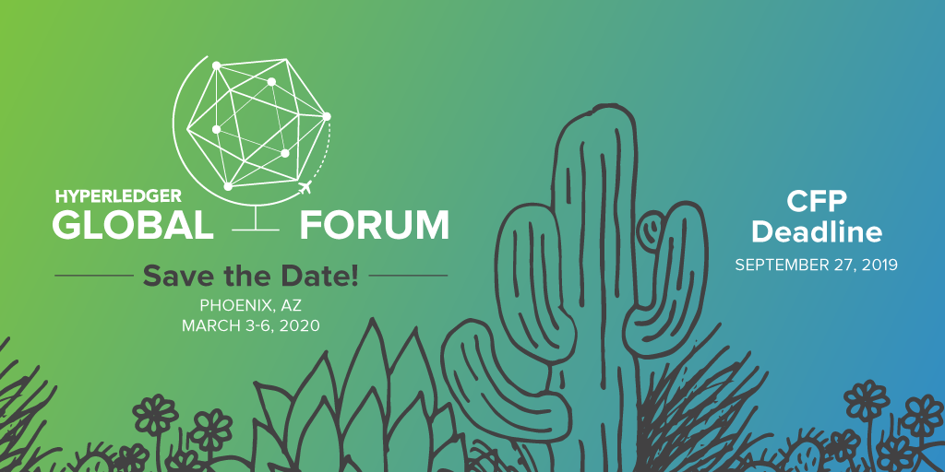
Hyperledger Global Forum 2020
More than 1,000 users and contributors of Hyperledger projects from across the globe to meet, align, plan and hack together in-person. Phoenix, AZ, March 3-6, 2020
Registration is now open! individual, academic, Govt rates available.
Please help us promote the event on your channels using #HyperledgerForum

Slide 43

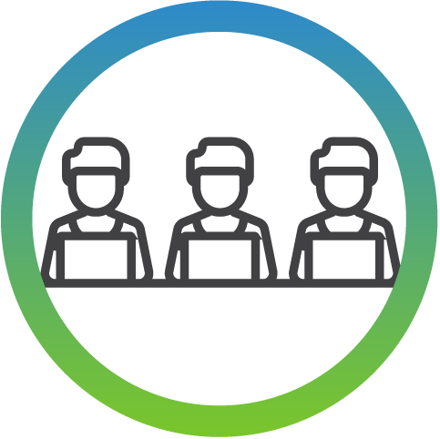

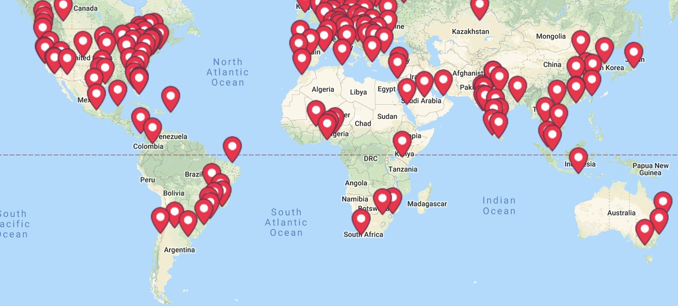
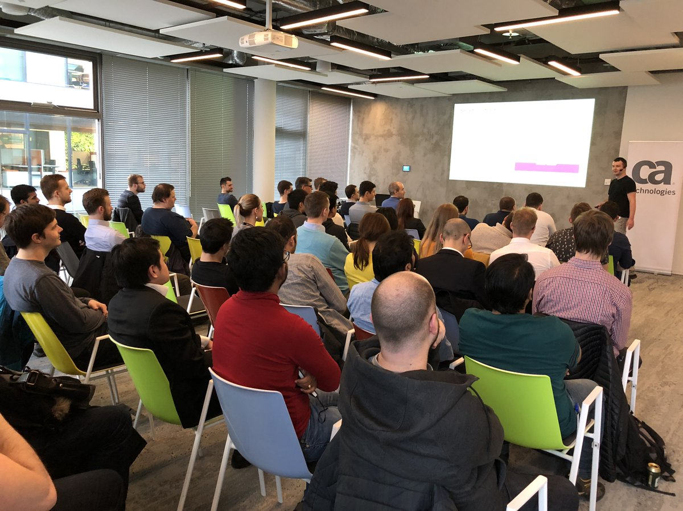
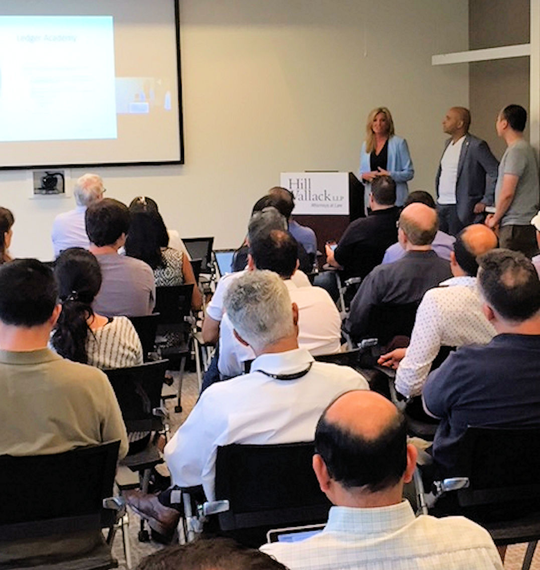
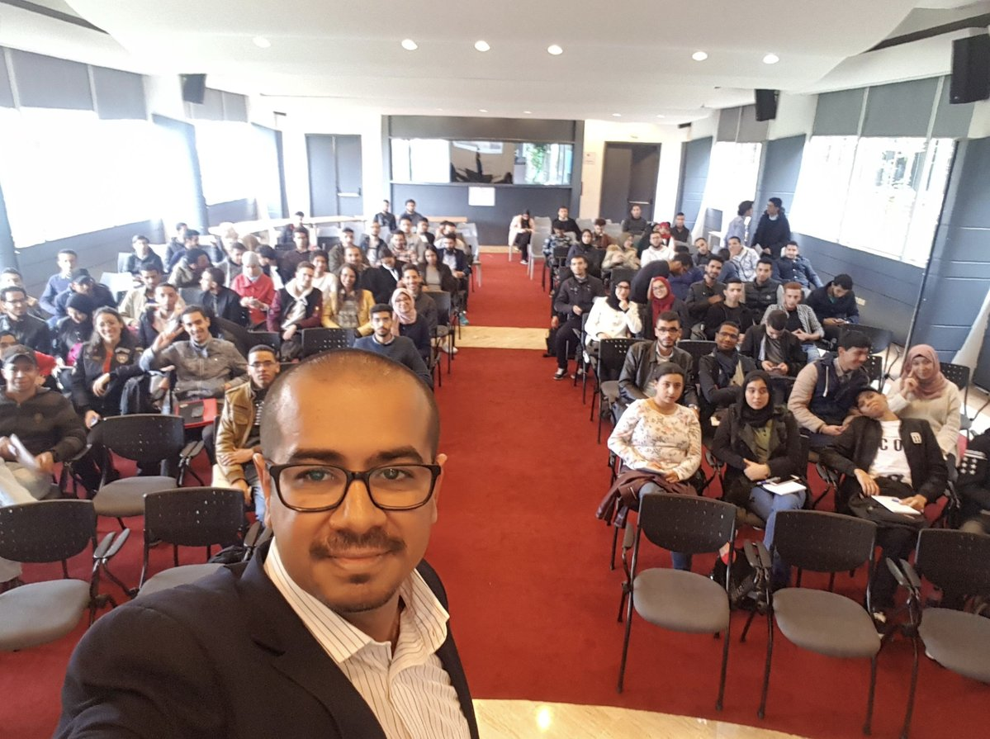
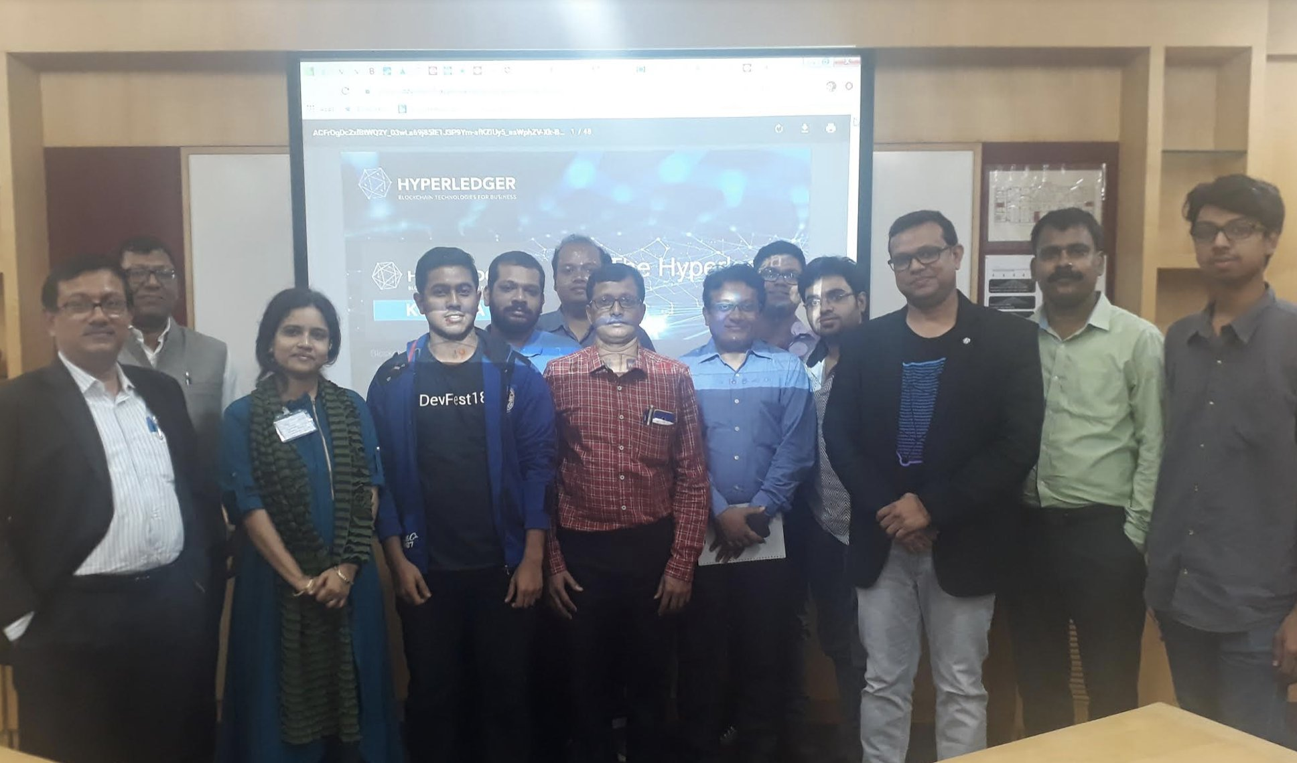
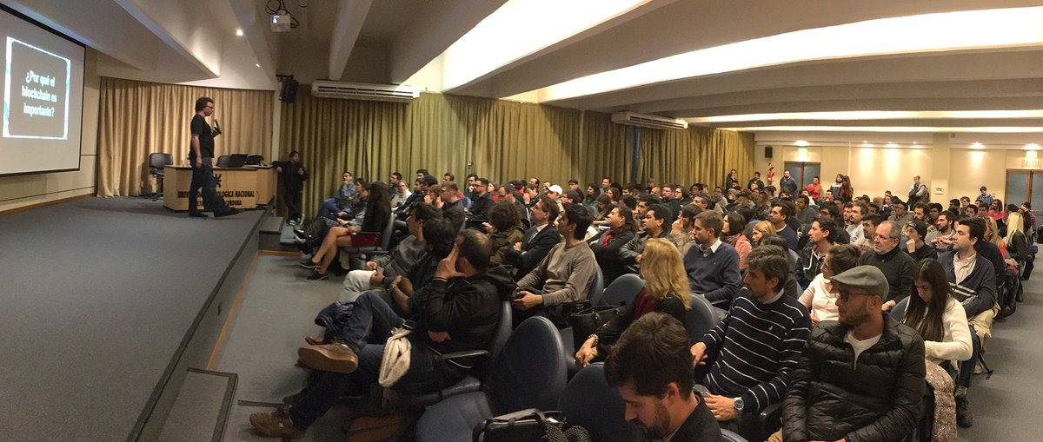
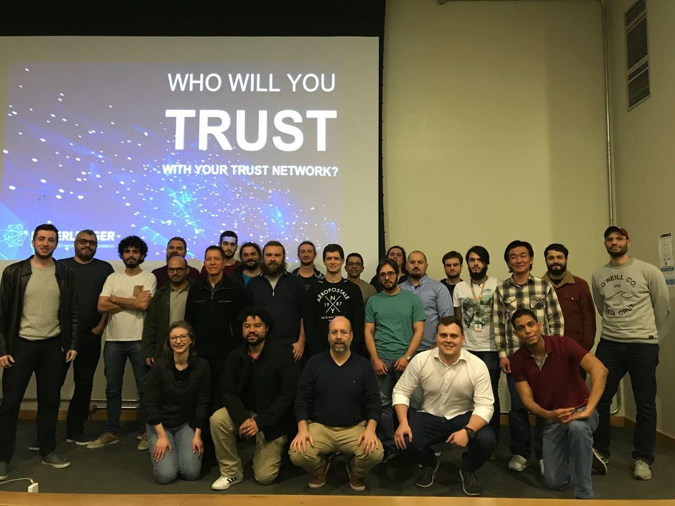
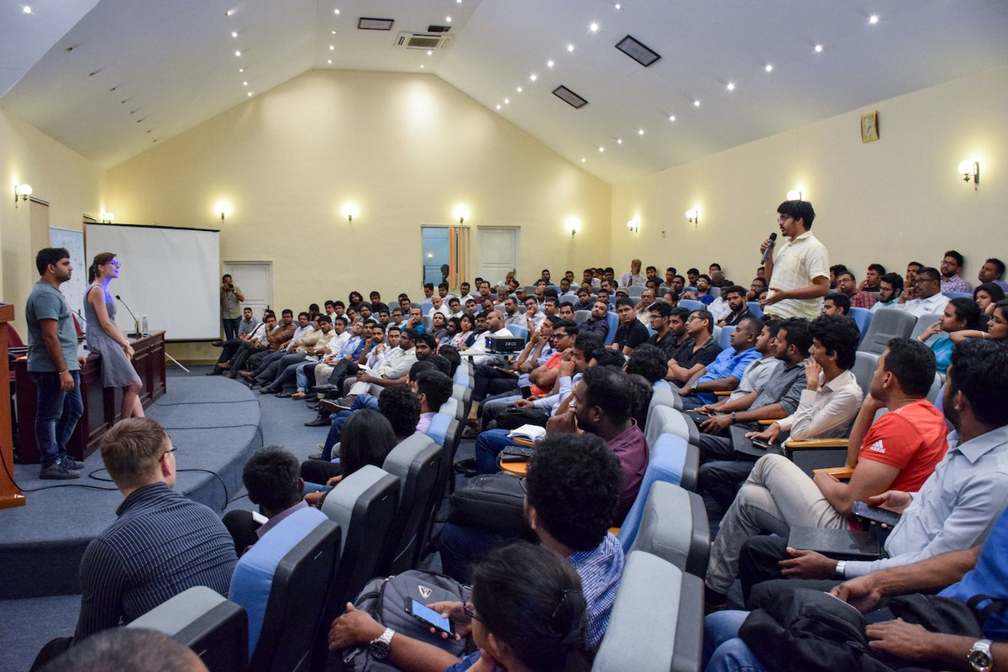
Growing Global Meetup Community
62,000+ Members
175+ Groups
75+ Countries
Notes:
This page talks about the worldwide group of Hyperledger meetups and includes so relevant statistics, a map and photos from events. For people who want more information, please point them to: https://www.meetup.com/pro/Hyperledger/

Slide 44
Agenda
Housekeeping
Introduction to Blockchain
Blockchains and Enterprise Solutions
Use Cases
Discussion

Slide 45
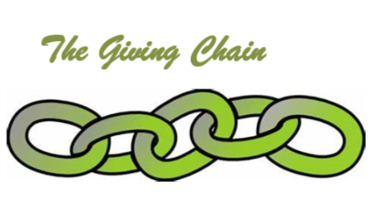
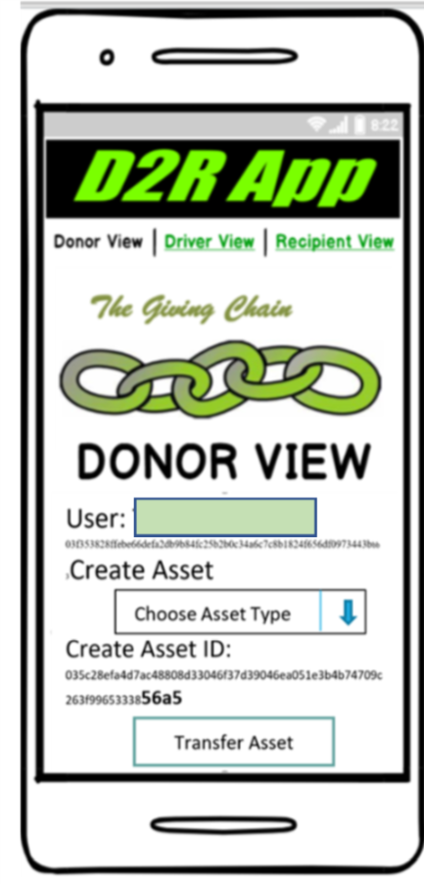
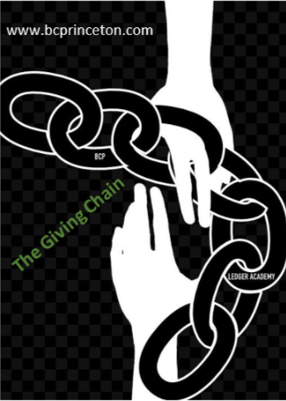
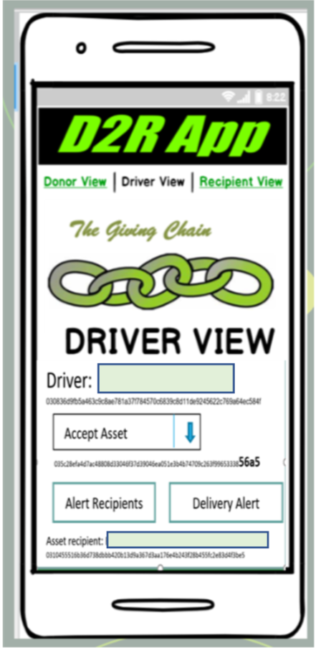
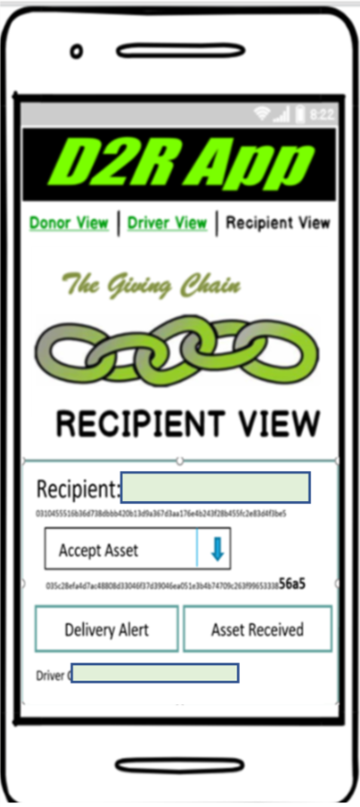
BLOCKCHAIN FUNDEMENTALS / Ledger Academy
D2R Application

Slide 46
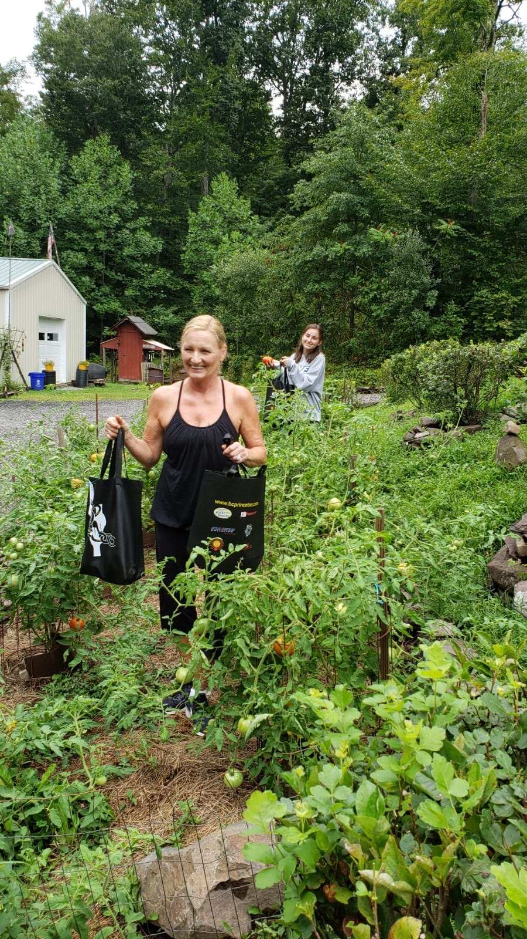
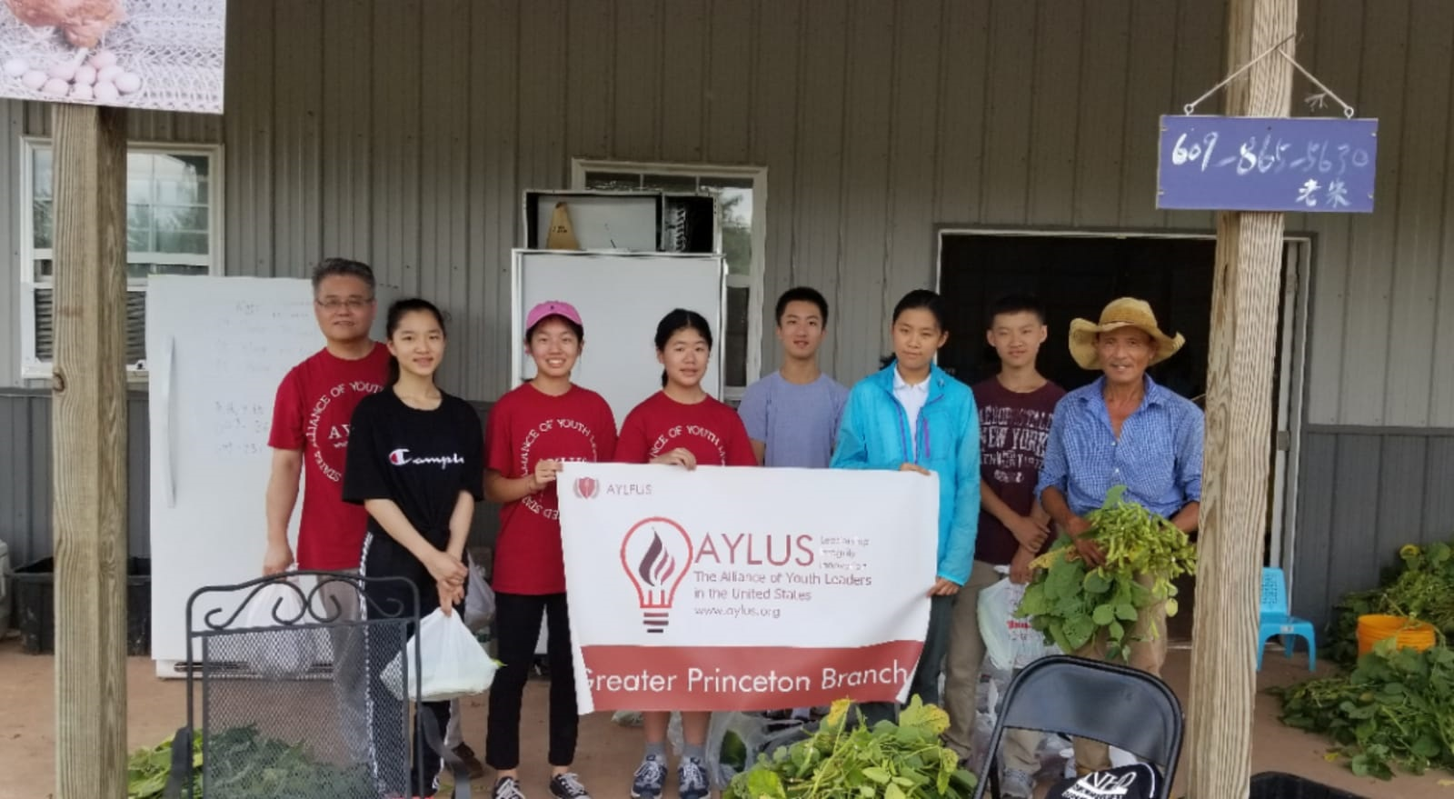
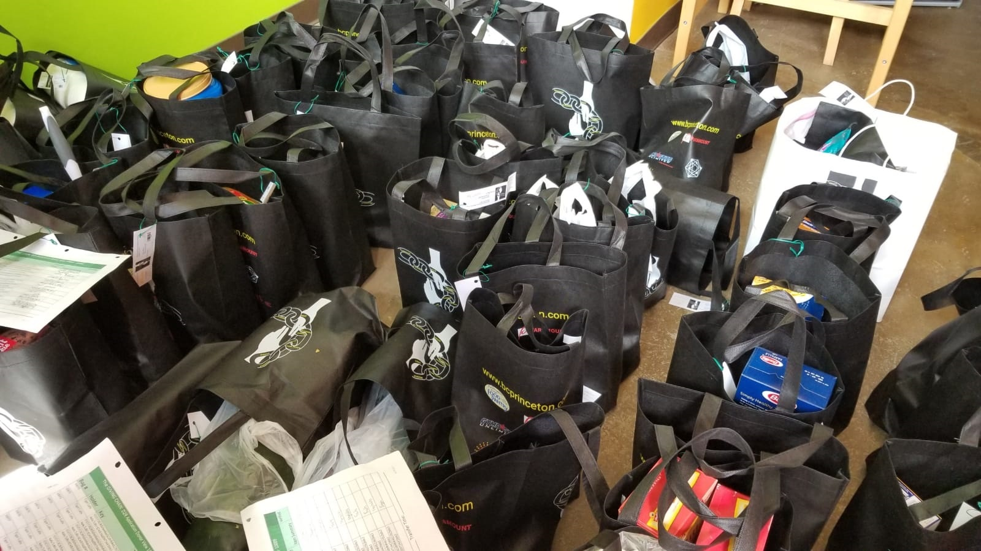
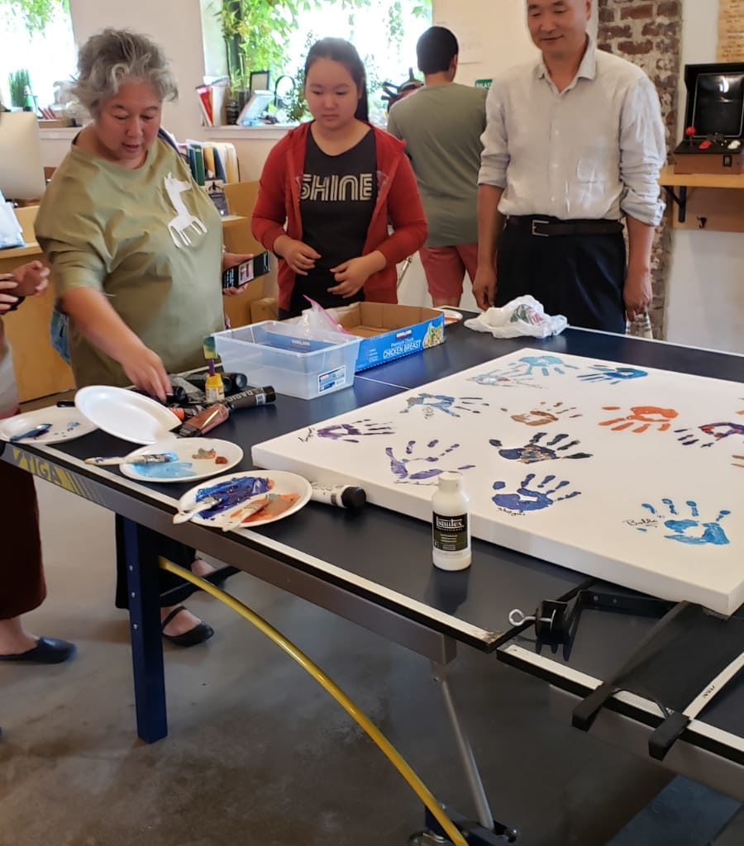
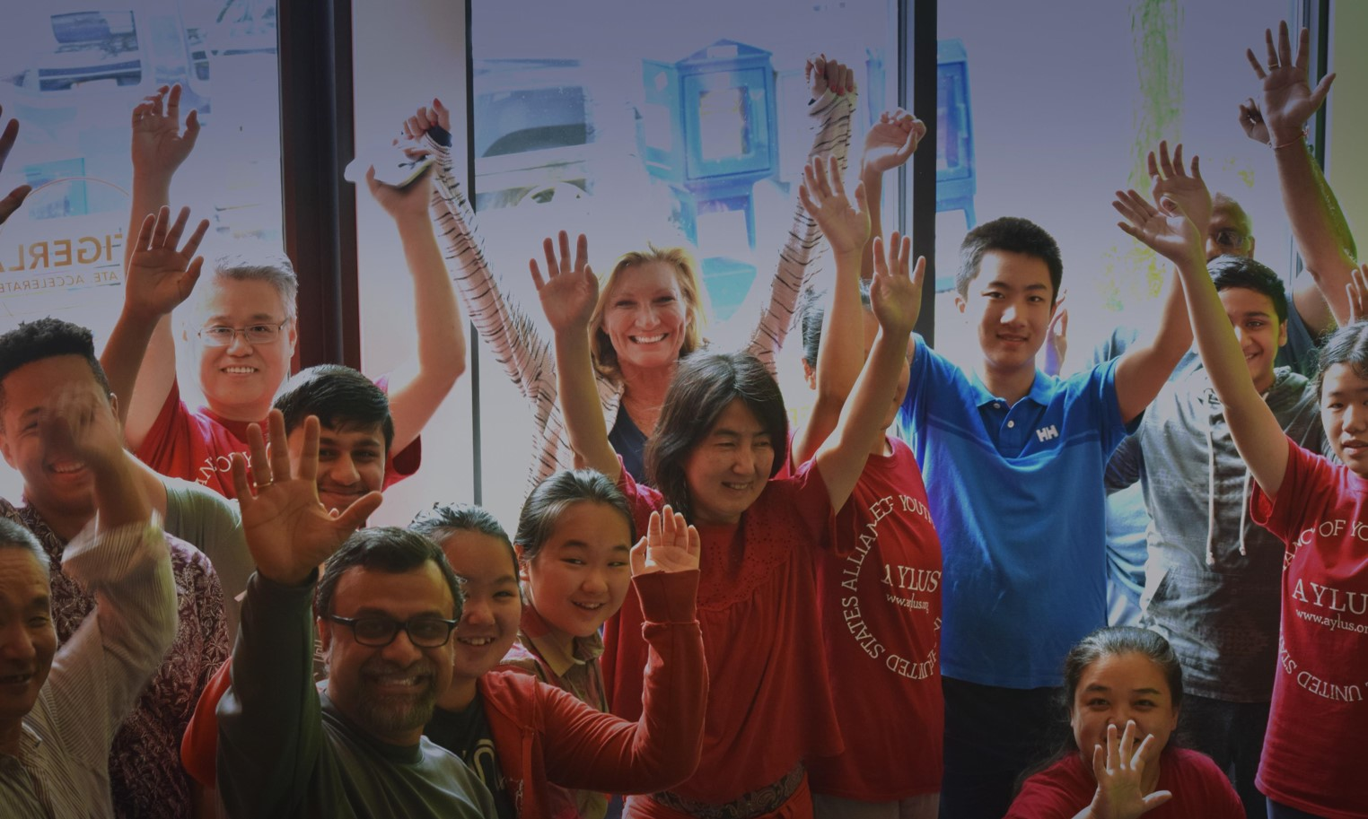
BCPrinceton’s The Giving Chain

Slide 47
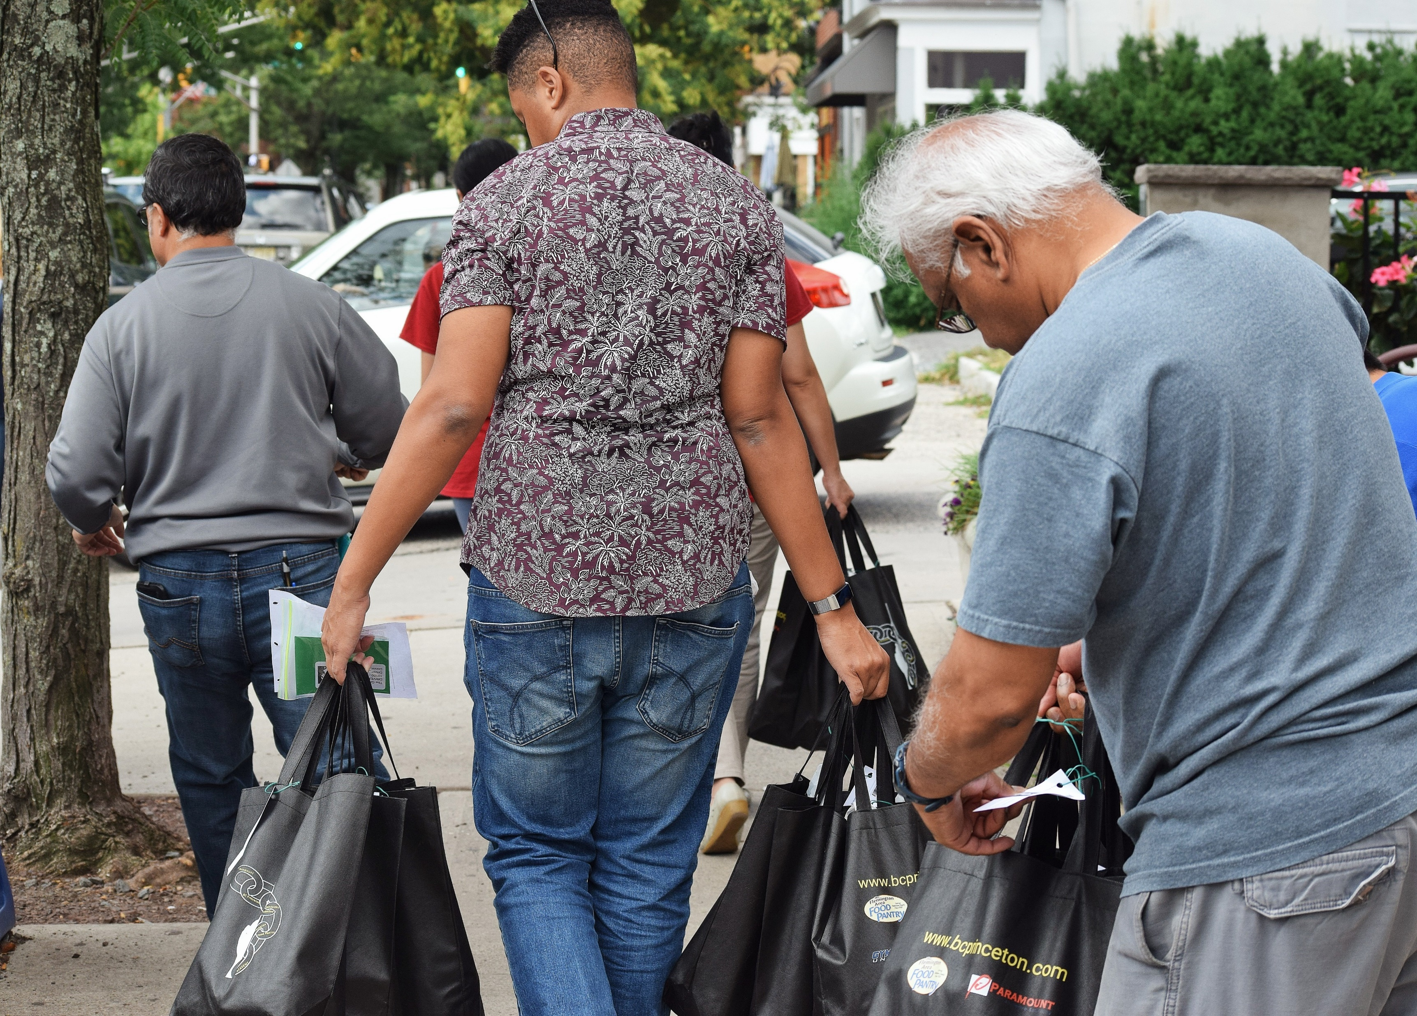

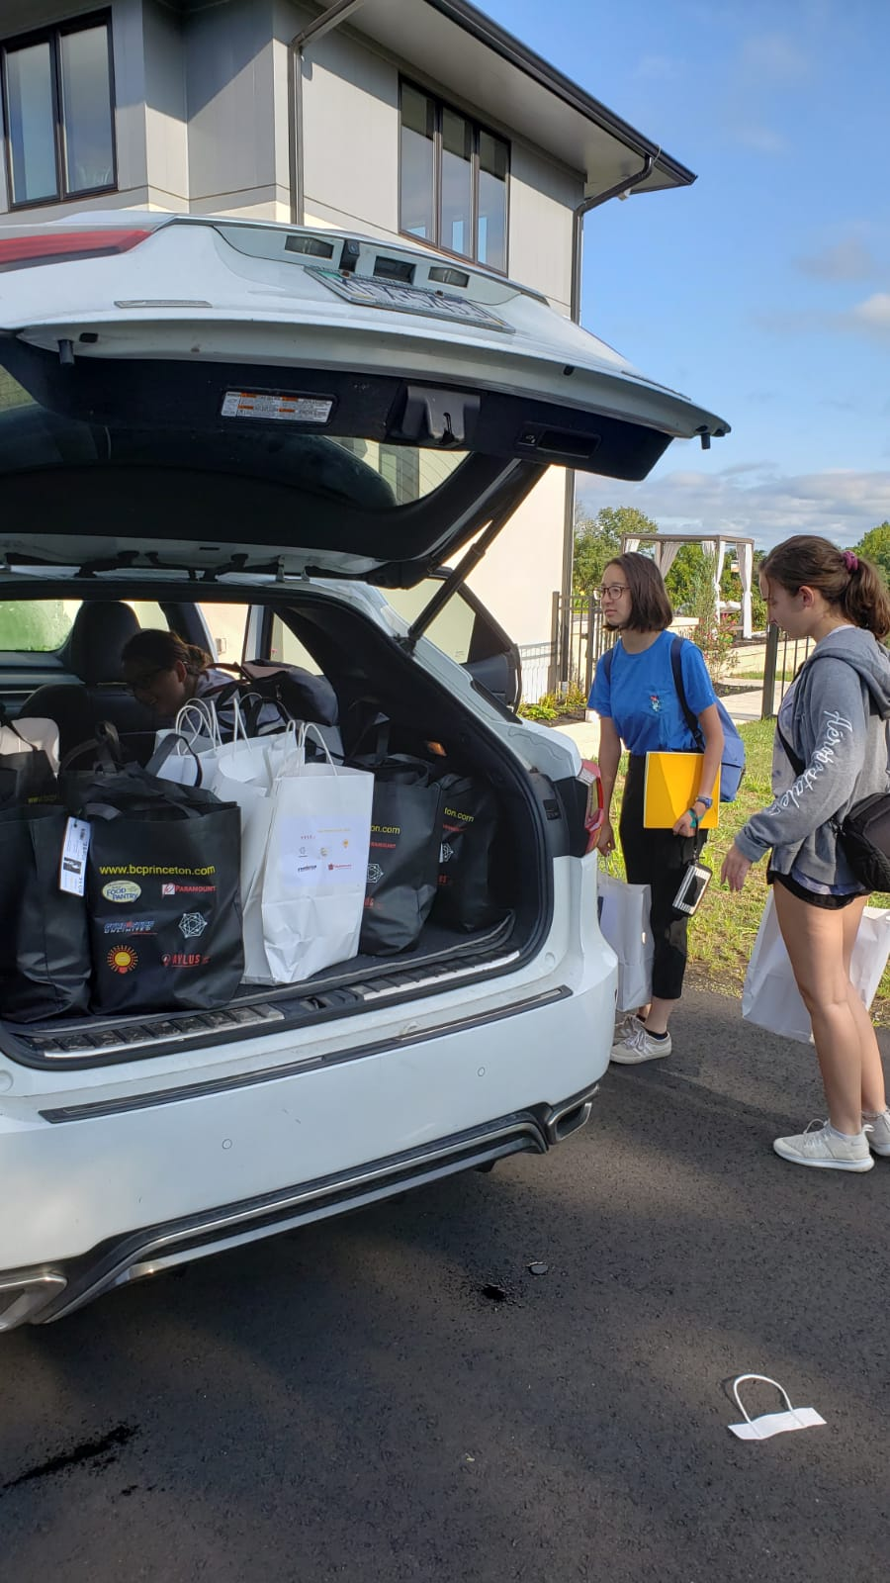
BCPrinceton’ The Giving Chain

Slide 48
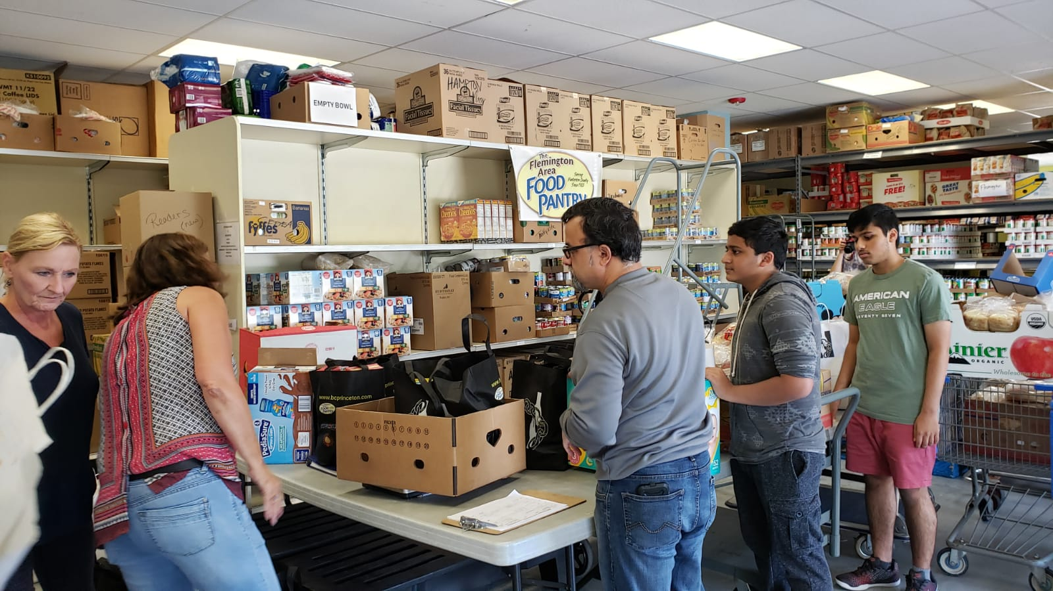

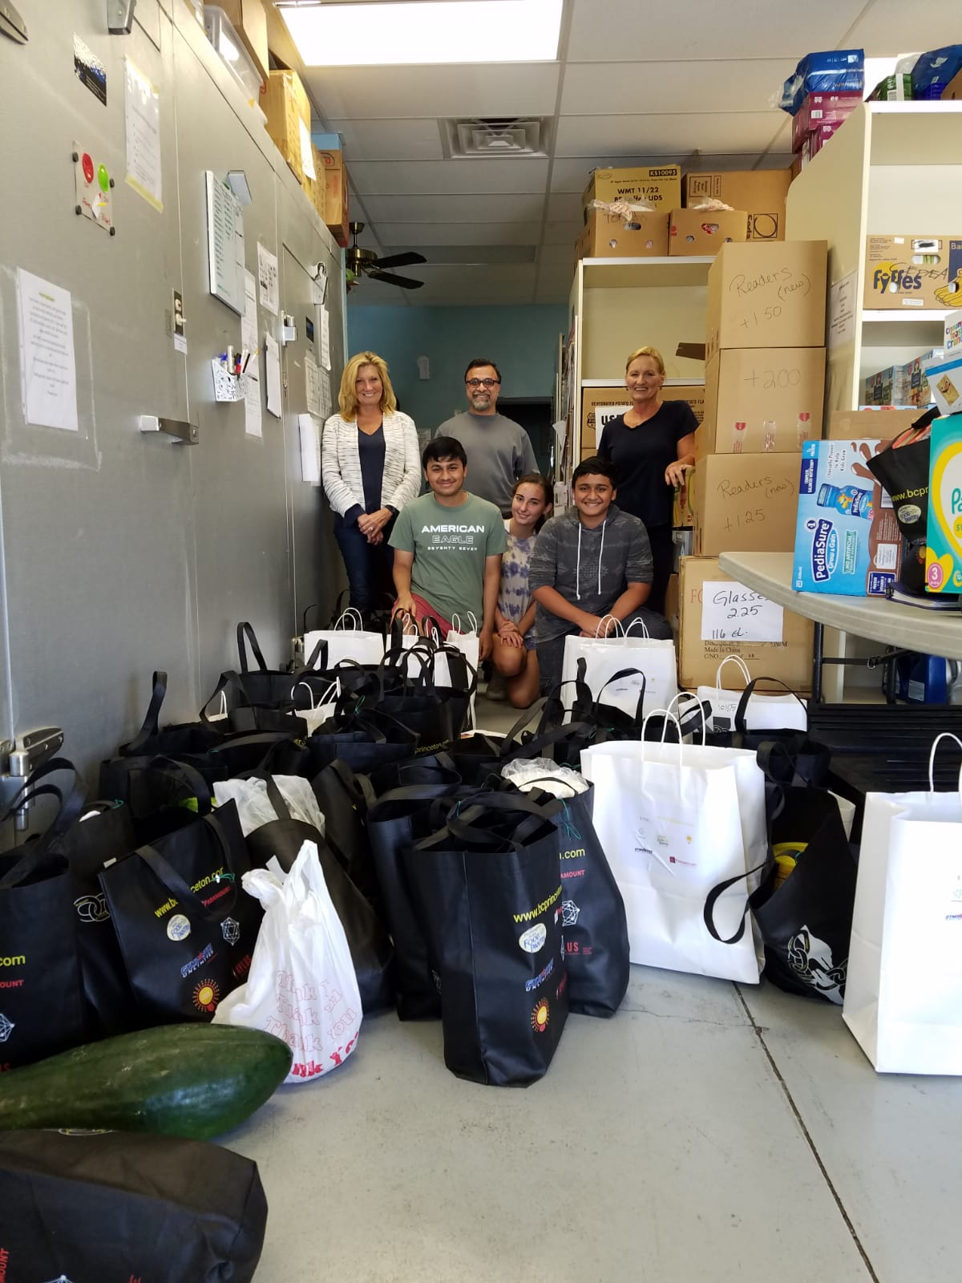
BCPrinceton’s The Giving Chain

Slide 49
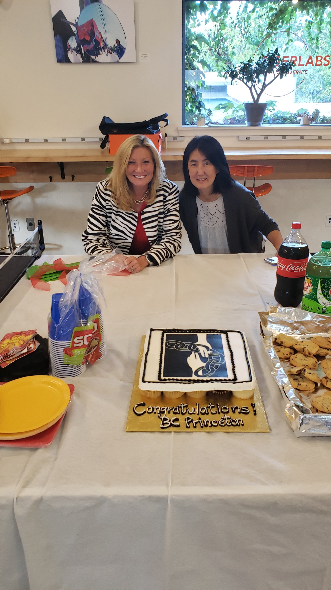




Slide 50

Kiva: Implementing SSI and a privacy-first credit bureau for Sierra Leone
Challenge:
There is no effective digital identity system or credit bureau for SL’s 7.5M citizens
As a result, Kiva’s lending rates are 30%, much higher than in other countries and a blocker to financial participation.
Solution:
2019-Q2 NCRA (SL government ID agency) will issue credentials on a Hyperledger-Indy based network.
2019-Q4 BSL (central bank) will use Hyperledger Fabric for a shared, decentralized credit reporting bureau.
Partnership between Kiva, SL government, UNDP and UNCDF.
Social Impact SIG presentation: https://wiki.hyperledger.org/display/SISIG/2019-08-06+Meeting+notes

Slide 51


Trade Finance: we.trade
we.trade is a blockchain-based international trading system for a consortium of major world banks including:
HSBC, Deutsche Bank, KBC, Natixis, Rabobank, Société Générale, Santander, UniCredit and Nordea
SMEs generate 85% of employment growth in Europe, but only ~50% of them have access to formal credit.
Went into production July 2018 conducting seven live trade transactions by ten companies via four partner banks
Enables accurate trading position information, order to settlement control, risk coverage, track and trace options
Near-real time exchange of information on a secure platform that digitizes transactional financing
Continual business and compliance readiness in any relevant regulatory environment
Scalability that allows for rapid international expansion as business, regulatory, and security opportunities converge
https://we-trade.com/
Notes:
we.trade is a blockchain-based international trading system for a consortium of major world banks including:
Deutsche Bank, HSBC, KBC, Natixis, Rabobank, Société Générale, Santander, UniCredit and Nordea
Enables accurate trading posture information, order to settlement control, risk coverage, track and trace options
Near-real time exchange of information on a secure platform that digitizes transactional financing and other complex processes
Continual business and compliance readiness in any regulatory environment
Scalability that allows for rapid international expansion as business, regulatory, and security opportunities converge
https://www.finextra.com/newsarticle/32342/wetrade-blockchain-platform-goes-into-live-production/wholesale
https://www.ibm.com/blogs/insights-on-business/banking/digital-trade-chain-consortiums-trade-finance-project-underscores-important-new-use-cases-blockchain/
▪ we.trade is a blockchain-based international trading system for a consortium of major world banks including: HSBC, Deutsche Bank, KBC, Natixis, Rabobank, Société Générale, Santander, UniCredit and Nordea ▪ Enables accurate trading posture information, order to settlement control, risk coverage, track and trace options ▪ Near-real time exchange of information on a secure platform that digitizes transactional financing and other complex processes ▪ Continual business and compliance readiness in any relevant regulatory environment ▪ Scalability that allows for rapid international expansion as business, regulatory, and security opportunities converge
The Technology
we.trade is a blockchain-based international trading system that enables accurate trading posture information, order to settlement control, risk coverage, track and trace options
The Challenge
Today, banks live in a competitive world. Small and mid-sized businesses generated 85% of employment growth in Europe in recent years, but only ~50% of them have access to formal credit. The Digital Trade Chain exemplifies how blockchain can bring the required trust and transparency to a new business network and associated business model.

Slide 52


Digital Identity: The OrgBook
The OrgBook serves as a trusted digital network of verifiable data about organizations which is globally connected, interoperable, secure, and easy to join
Why? So business/government can quickly access evidence of that a potential partner is legally incorporated
The new enrollment experience is more convenient and use an open global blockchain registry
Reduced single point of failure for database, reduced fraud from counterfeit IDs, reduces bottlenecks, and improves privacy which a complex verification system can expose
As more businesses establish their Self-Sovereign Identity, more Services will become Self-Sovereign Identity-aware
Live, public, globally accessible network using the Sovrin Provisional Network built on Hyperledger Indy.
https://www.hyperledger.org/resources/publications/orgbook-case-study
Notes:
https://von.pathfinder.gov.bc.ca/aboutvon/
https://www.itworldcanada.com/article/two-upcoming-government-digital-projects-show-future-for-digital-id-in-canada/406600
https://docs.google.com/document/d/1wNnXdQKUtWnx--xw3VQ9Fr2TDa0kUNIBSMmFGR4uoMg/edit#heading=h.hb1zjewyrm4
Interaction Diagram: Enrollment via Verifiable Claim from TheOrgBook - BC
A business person is interacting with the Supplier Registry (SRI) site to enroll their organization as a supplier. In doing that, information is needed about the organization that is available as a Verifiable Claim from BC Registries via TheOrgBook - BC. When that data is needed, and the user has identified the Organization sufficiently, send a Proof Request to TheOrgBook, which will use the Claims about the Organization to respond to the Proof Request. SRI will verify the claim, including checking for revocations, and if all is correct, use the claim to populate the data required for enrollment.
Organizations could be a “Verifiable Organizations” in a particular context … for example … within the tax realm if they have been issued a Business Number (in Canada) or within the Government of Canada procurement realm if they are a registered supplier. It is up to each realm to determine what the necessary evidence is for it to consider an organization to be verified. One realm could certainly rely on another. For example, the supplier may need to be a legal entity of a certain type (corporation) and therefore need to have a Verifiable Claim attesting to such a fact.

Slide 53
Agenda
Housekeeping
Introduction to Blockchain
Blockchains and Enterprise Solutions
Use Cases
Discussion

Slide 54
Thank You
Thank You
www.LedgerAcademy.com
Bobbi @LedgerAcademy.com
#LedgerAcademy
@LedgerAcademy

