Slide 1

Hyperledger’s Supply Chain Project
david_cecchi@cargill.com

Slide 2
Introducing Hyperledger Grid
The Problem
Lack of frameworks, components, etc in Hyperledger to rapidly build Supply Chain solutions
The Solution – Hyperledger Grid
Higher level abstractions than conventionally provided by the lower-level blockchain platforms
Distributed problems related to multi-party interactions, i.e. not as a replacement for internal company systems
Compositions of features required by supply chain usages

Slide 3
So it’s an Application?
Grid is an ecosystem of technologies, frameworks, and libraries that work together, letting application developers make the choice as to which components are most appropriate for their industry or market model.
It’s not a blockchain. It uses a blockchain.
It’s not an application. Developers would use Grid frameworks to build applications.

Slide 4
The Stack
Grid Applications
Track and Trace
Settlement
Product Catalog
Asset Ownership / Exchange
…
Hyperledger Grid
Universal Client
Smart Permissioning (Pike)
Sample Applications
…
Domain Models
Smart Contracts
Enabling Technologies
Blockchain Platform(s)
Smart Contract Engine
(Sabre)
Identity Framework(s)
…

Slide 5
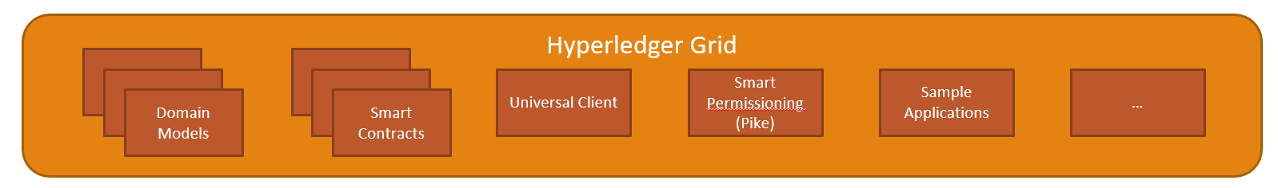
Domain Models
Define the “what”
Standards based
  GS1
  Open Data Initiative
  BITA
  etc
Early priorities
  Identity (who)
  Product (what)
  Location (where)
  Certification (sustainability, safety, etc)
Protobuf implementations

Slide 6






GS1 Product
The Grid Product implementation is designed for sharing product master data between participants. It is also useful to use product information as auxiliary data in other supply chain solutions. Therefore, Product becomes a reusable and important component within Grid.
https://github.com/hyperledger/grid-rfcs/pull/5

Slide 7
Business Logic
Define the “how”
Prebuilt business logic, which ultimately represent various business transactions
Early priorities
  Product catalog
  Product transformation
  Batch / lot behavior
    Location
    Ownership
  And more!
Coded in Sabre smart contracts

Slide 8
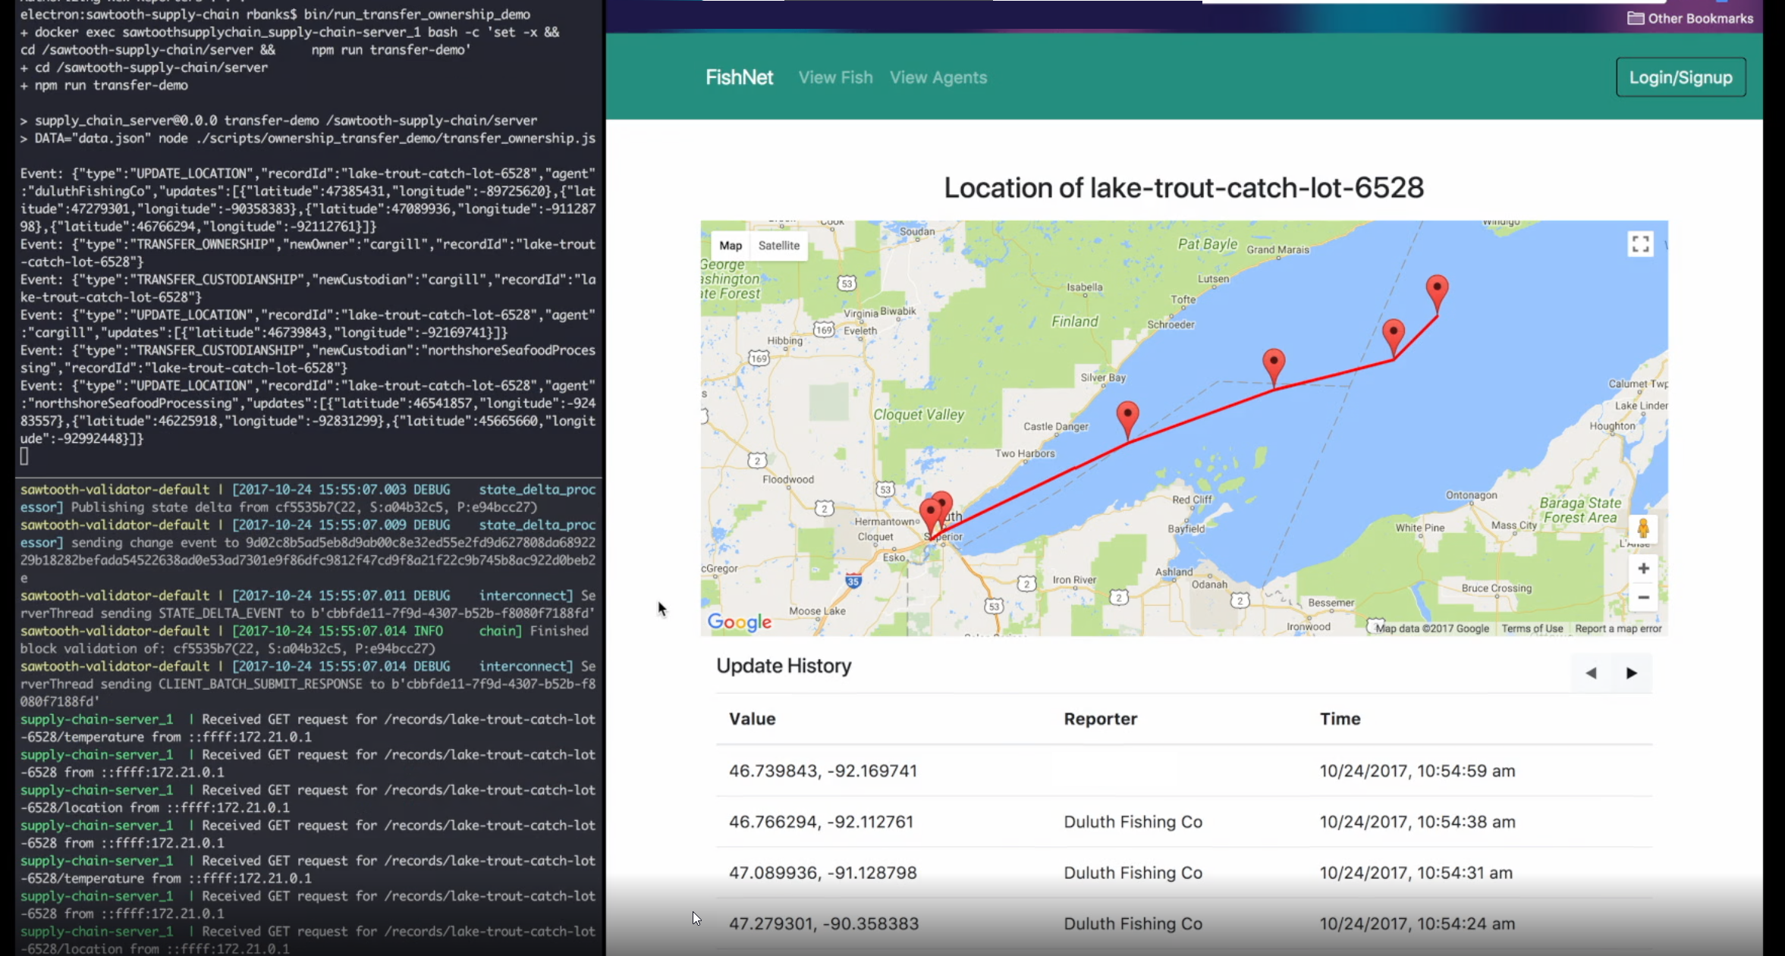
Sample Applications
Apps that showcase Grid components being assembled into an application
Track and Trace is first up

Slide 9
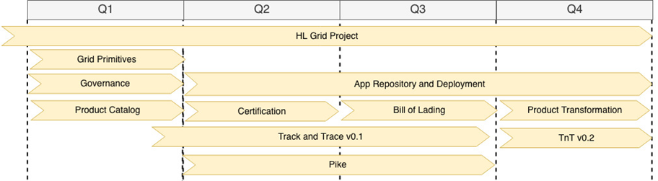
Roadmap

Slide 10
Look at All These Links!
Website - https://grid.hyperledger.org/
Grid Repo - https://github.com/hyperledger/grid
Grid Website Repo - https://github.com/hyperledger/grid-website
Grid RFC Repo - https://github.com/hyperledger/grid-rfcs/
Grid Contrib Repo - https://github.com/hyperledger/grid-contrib/
Jira - https://jira.hyperledger.org/projects/GRID/issues/
Mailing List - https://lists.hyperledger.org/g/grid/topics
Chat - https://chat.hyperledger.org/channel/grid
Project Page - https://www.hyperledger.org/projects/grid

Slide 11
Thanks

