Slide 1
Hyperledger Meetups Toronto
May 2020 Updates
Notes:
Event Recording:
Vimeo: https://vimeo.com/418181692
YouTube:

Slide 2

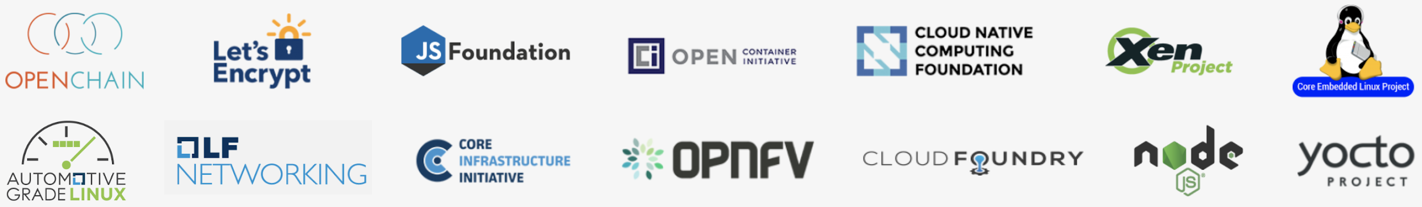
Hosted By The Linux Foundation
For the last 16 years, The Linux Foundation® has provided unparalleled support for open source communities through financial and intellectual resources, governance structure, IT infrastructure, services, events, and training.
Dedicated to building sustainable ecosystems around open source projects, The Linux Foundation is working with the global technology community to solve the world’s hardest problems through open source and creating the largest shared technology investment in history.
The Linux Foundation is the umbrella organization for more than 60 open source projects accelerating open technology development and commercial adoption. Some of the game-changing initiatives hosted by The Linux Foundation include:
Notes:
Today's event stems from the results of Toronto's local survey sent out earlier this year, which indicated an interest for more content incorporating Hyperledger Sawtooth.
As such, we are privileged to have Duncan Johnston-Watt as our guest speaker today to fulfill that request.
Now, for some the interest was in introductory-level content, while others desired more in-depth technical coverage. The Hyperledger event on May 20th will appeal to those seeking the latter - link: https://www.hyperledger.org/event/hyperledger-member-webinar-delivering-the-tel-aviv-stock-exchange-securities-lending-platform-on-hyperledger-sawtooth
For today, as the title suggests, Duncan will provide an overview of Sawtooth, highlighting points such as pluggable consensus and how Sawtooth supports smart contract languages. He will also be open for Q&A afterwards.
We hope that this event and the one on May 20th can complement each other in a way that our guests can gain value from.

Slide 3




Hyperledger Community
4
Years Since Launch
14
Active Community Working Groups & SIGs
67K
Meetup Participants
170+
Meetups Worldwide
Notes:
Before getting started, a couple updates for the Meetups community.
First is that as some of you might have been noticing, a number of online events hosted by Hyperledger groups worldwide have been cross-posted between groups.
For example, some of you may be here via Hyperledger Dubai, Washington DC, or Nigeria
The ability to cross-invite of course, primarily results from conditions imposed by the COVID situation. Which - as it has with many other things - brought all our meetup endeavors to the virtual space.

Slide 4
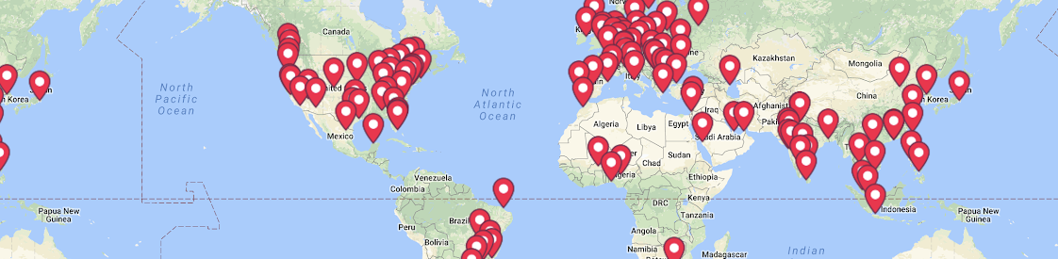
Bringing Hyperledger Global Meetups Online
https://www.meetup.com/pro/hyperledger
We are 67K+ members across 170+ Meetups in 76 countries
Notes:
There are 178 meetup groups currently under Hyperledger.
Online events hosted by all groups are open to anyone and everyone interested, so feel free to RSVP.
So far the majority of them have been in English, and of course, more to come.
List of Hyperledger Meetup Communities:https://www.meetup.com/pro/hyperledger
Virtual HL Meetups Master List:https://wiki.hyperledger.org/display/events/Virtual+Hyperledger+Meetups
Going online has also opened up the chance for groups to reach out to experts outside of their localities. So, if you have suggestions
on topics you'd like to see curated at your local group’s page, or
speakers you might want to see present,
please reach out to your local organizer and let us know.

Slide 5




Community Engagement in Virtual Spaces
Co-organizers are currently working on an online community space
Built on Confluence
aims include:
  serve as a hub for event notifications & post-event resources
  place to connect and network virtually in a flavor similar to traditional meetups
Provide neutral, open, & community-driven infrastructures
supported by technical and business governance
Build technical communities
to develop blockchain and shared ledger POCs, use cases, field trials and deployments
Educate the public
about the market opportunity for blockchain technology
Promote our community of communities
taking a toolkit approach with many platforms and frameworks
Notes:
Second item: is that the Meetup organizer group is currently working on a forum-style environment that we hope to roll out to you in the very near future.
Wiki Improvement Sub-Group: https://wiki.hyperledger.org/display/events/Wiki+Improvement+Sub-Group
Its aim is:
to serve as the central hub for post-event resources such as slides, recordings, and so on. Sort of a 'one stop' resource for those items to be archived.
to have it as a place for members to connect and network virtually in a flavor we hope will be similar to traditional meetups, or at least fill that void when necessary.
A positive is that networking in this flavor can cover a broader geographic scale, so something to consider.
Again, suggestions on what you want to see, or on how the layout can improve once it's rolled out, are welcome: feel free to shoot a message to your local organizer.

Slide 6
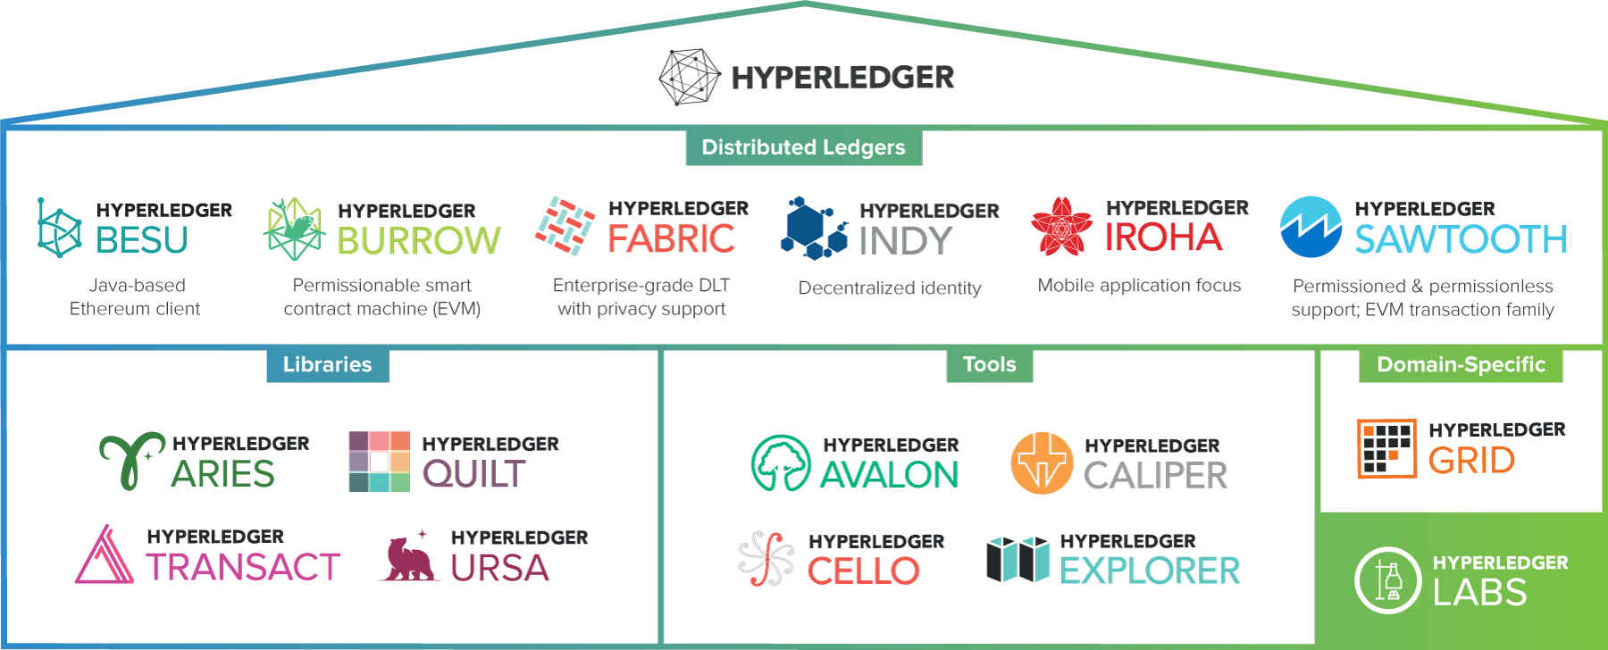
Hyperledger Modular Approach
Notes:
Formally introduce our guest speaker, Duncan Johnston-Watt:
Duncan is CEO of Blockchain Technology Partners, or BTP.
He's been involved heavily in the open source community for over a decade.
Prior to being the CEO of BTP, he was also the founder and CEO of Cloudsoft, who created the cloud apps manager Apache Brooklyn.
In May 20th's event, he will be discussing the background of how BTP worked with the Tel Aviv Stock Exchange on the decision to develop a new securities lending platform underpinned by Hyperledger Sawtooth.
Duncan is also on Hyperledger’s Marketing Committee.
Blockchain Technololgy Partners:
https://blockchaintp.com/
twitter: @duncanjw
email: duncan@blockchaintp.com

Slide 7
Hyperledger Sawtooth
Duncan Johnston-Watt
CEO & Co-founder, BTP
@duncanjw

Slide 8








Brief History
2014 – Begins as Sawtooth Lake - a research project within Intel Labs
2016 – Intel contributes Sawtooth to Hyperledger
2017 – Sawtooth graduates to active status
2018 – Sawtooth achieves 1.0 milestone status
2019 – Sawtooth 1.2 released

Slide 9
Key Features
Open source and industry agnostic
Scalable, highly modular architecture
Clear separation between network and application layers
First class support for smart contract languages
Pluggable consensus mechanism
Strong governance model

Slide 10
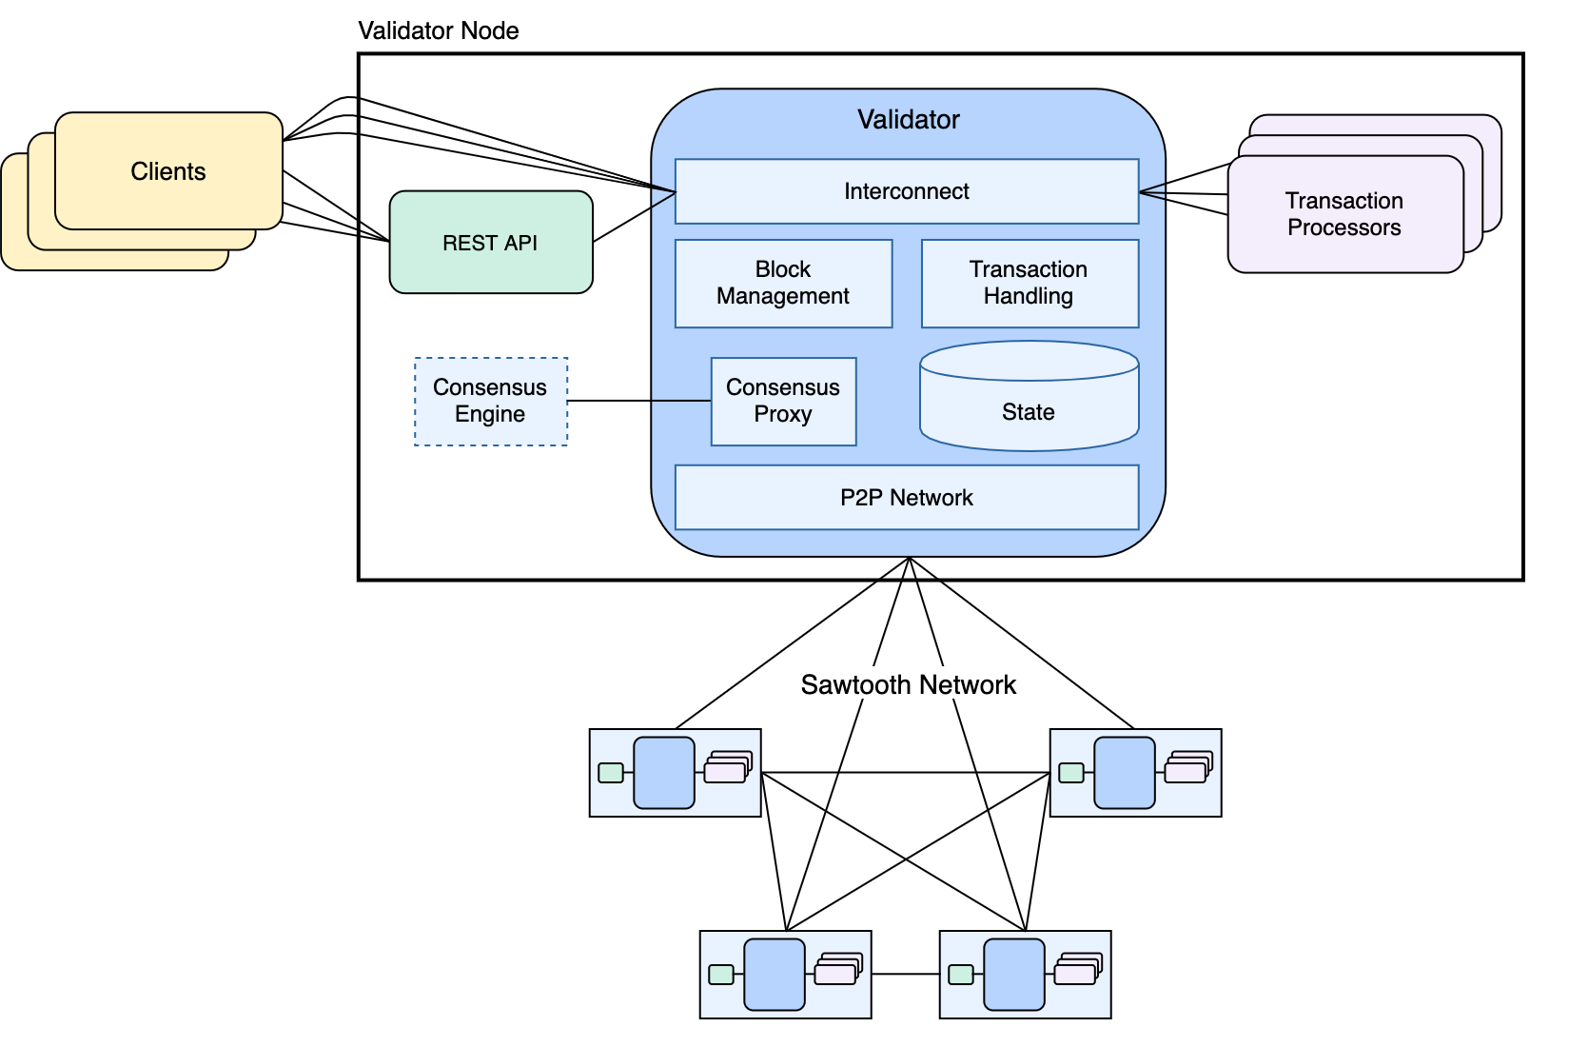
Architecture
Source: https://sawtooth.hyperledger.org/docs/core/releases/latest/architecture.html

Slide 11
Pluggable Consensus
Raft
Non-forking, Crash Fault Tolerant (CFT)
PBFT
Non-forking, Byzantine Fault Tolerant (BFT)
PoET/PoET-SGX
Forking, CFT/BFT respectively
Source: https://medium.com/blockchaintp/hyperledger-sawtooth-not-just-sgx-anymore-5ff47d267fa7

Slide 12
PBFT by the numbers
Quorum
Requires (n - f) nodes where n is size of network
Computing f
f = floor ((n - 1) / 3) where f is number of faulty nodes
Local & global resilience
n = 3 r + 1 where r ≥ 4 is the number of regions/independent clusters
Source: https://www.hyperledger.org/blog/2019/02/13/introduction-to-sawtooth-pbft

Slide 13
Smart Contract Languages
Solidity
Sawtooth Seth, Leverages Burrow EVM
WASM
Sawtooth Sabre
DAML
DAML-on-Sawtooth
Source: https://blog.daml.com/daml-driven/the-world-of-smart-contracts-using-daml-solidity

Slide 14

Key Features
Open source smart contract language
Initially developed by Digital Asset
Focused on interoperability
Productive
Intuitive
Trusted and widely used
Source: https://daml.com/

Slide 15
We chose Sawtooth because of its performance in terms of its scalability.
The network needs to integrate seamlessly with Salesforce and Sawtooth stood out because of the power of its engagement layer
Adam Caplan, SVP Emerging Technologies, Salesforce

Slide 16
Introducing BTP Paralos
A freely available, enterprise-grade distribution of Hyperledger Sawtooth built, tested and maintained by BTP
Resource: https://tinyurl.com/btp-paralos-press-release

Slide 17

Introducing BTP Sextant
A platform, delivered as software, that automates the deployment and management of blockchain infrastructure on Kubernetes
Resource: https://blockchaintp.com/sextant/sawtooth/

Slide 18
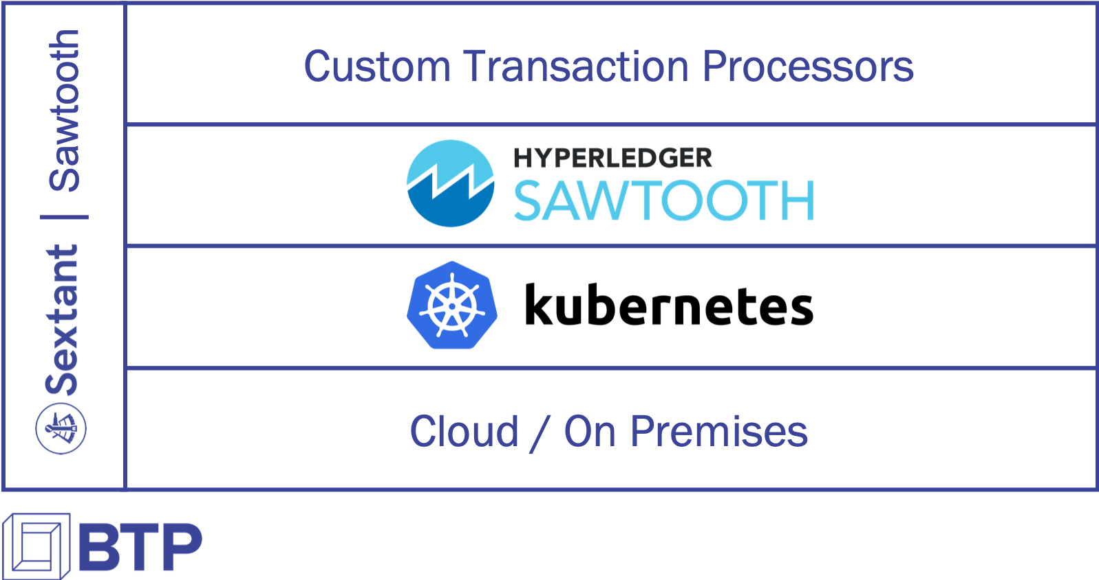

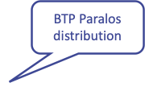
Sextant for Sawtooth

Slide 19

Demo
Notes:
name: consensource-processor
image: target/consensource-processor:latest
command: bash -c
arguments: consensource-processor -v -C tcp://localhost:4004

Slide 20

References
Hyperledger Sawtooth: https://www.hyperledger.org/use/sawtooth
Hyperledger Sawtooth: https://tinyurl.com/sawtooth-is-more-than-sgx
PBFT: https://www.hyperledger.org/blog/2019/02/13/introduction-to-sawtooth-pbft
BTP Paralos: https://tinyurl.com/btp-paralos-press-release
BTP Sextant: https://blockchaintp.com/sextant/sawtooth/
DAML: https://daml.com/

