Slide 1
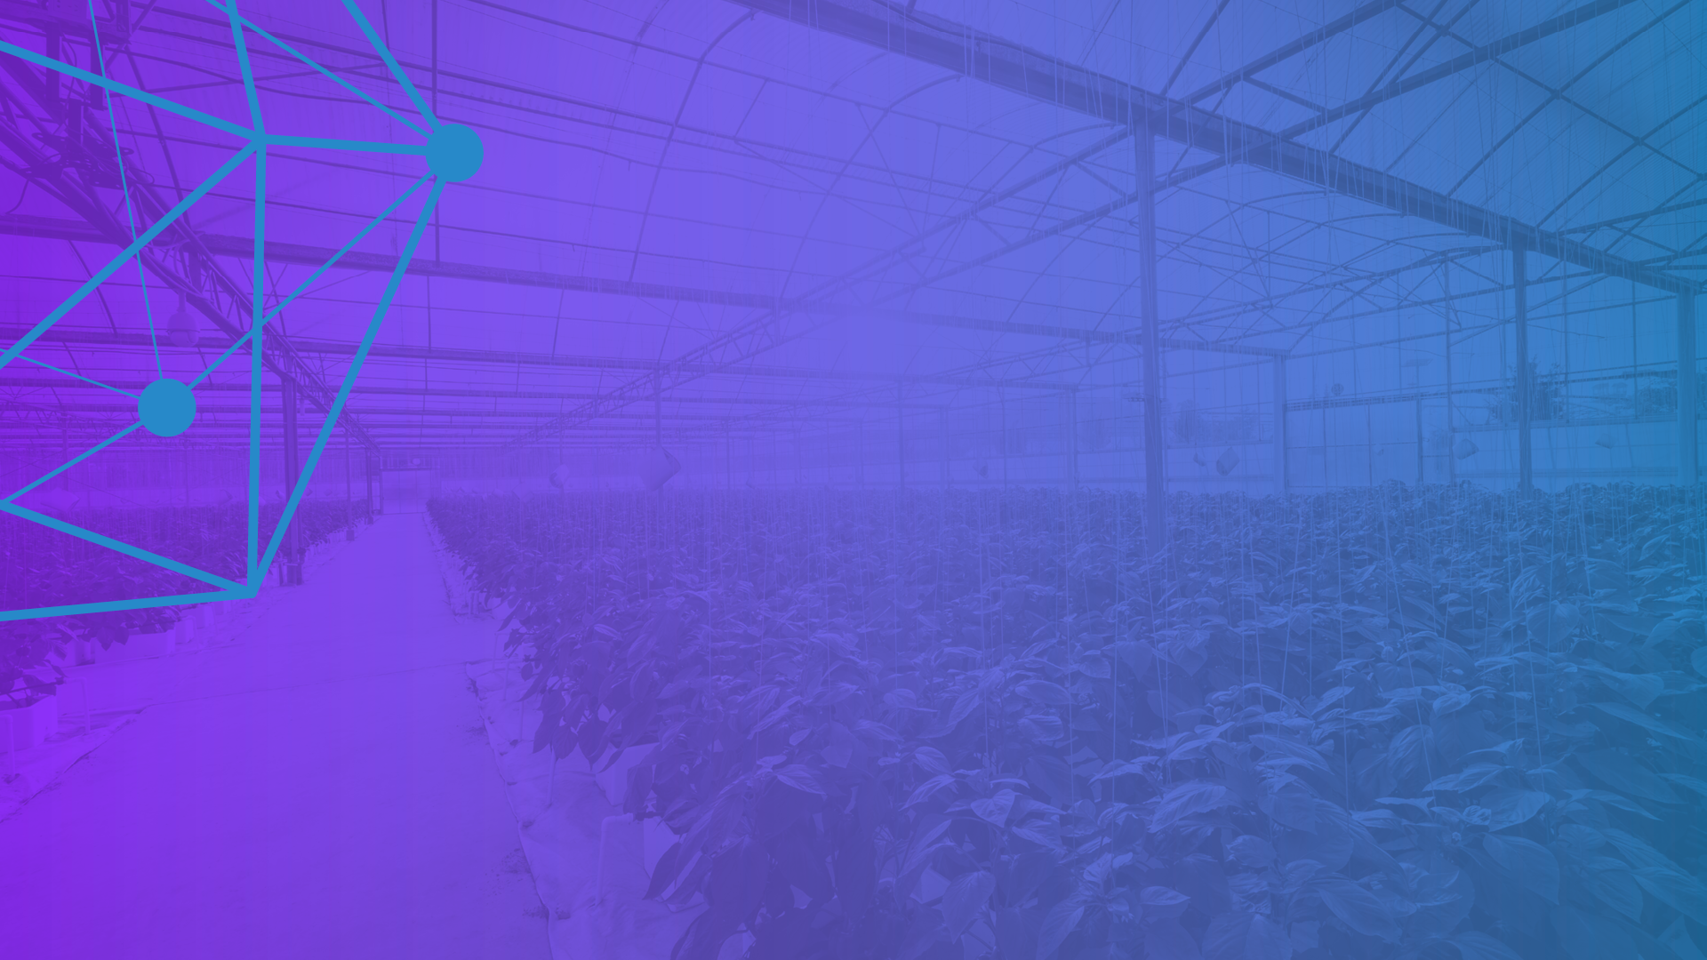


Hyperledger Trade Finance
Special Interest Group
September 29, 2021
www.hyperledger.org
@Hyperledger

Slide 2
AGENDA
Introduction
      1. Presentation
      The Giving Chain
      2. Questions Comments and Discussion

Slide 3

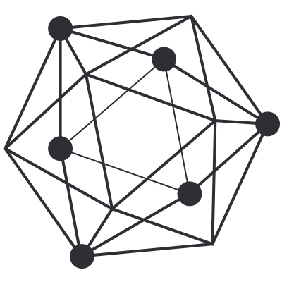
Meeting is being recorded !
Antitrust Policy Antitrust Policy Notice: link: https://www.linuxfoundation.org/antitrust-policy/
Linux Foundation meetings involve participation by industry competitors, and it is the intention of the Linux Foundation to conduct all of its activities in accordance with applicable antitrust and competition laws. It is therefore extremely important that attendees adhere to meeting agendas, and be aware of, and not participate in, any activities that are prohibited under applicable US state, federal or foreign antitrust and competition laws. Examples of types of actions that are prohibited at Linux Foundation meetings and in connection with Linux Foundation activities are described in the Linux Foundation Antitrust Policy available at http://www.linuxfoundation.org/antitrust-policy. If you have questions about these matters, please contact your company counsel, or if you are a member of the Linux Foundation, feel free to contact Andrew Updegrove of the firm of Gesmer Updegrove LLP, which provides legal counsel to the Linux Foundation.
Code of Conduct Code of conduct link: Hyperledger Code of Conduct

Slide 4



Hyperledger Trade Finance
Special Interest Group Presents
The Giving Chain
A Linux Foundation sponsored
2021 Mentorship Project.
The Giving Chain is a Blockchain Social Impact Project to support charitable efforts by creating a donation tracking, supply chain blockchain platform. The Giving Chain platform creates an immutable record of a donation by tracking items as they go from Donor, Transporter to Recipient.
Hyperledger Trade Finance
Special Interest Group
Notes:
Remind Attendees that All Are Welcome in Hyperledger Community and that they must abide by the code of conduct

Slide 5
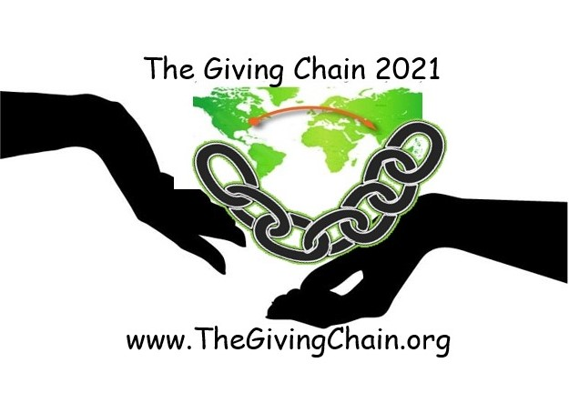
Presentation
      Introduction
      The Giving Chain 2019
      Checkpoints
      Hyperledger Mentorship Program
      The Giving Chain 2021
      Checkpoints
Business Team
Technical Team
4. Next Steps

Slide 6

Introduction
Bobbi Muscara
Project Manager – Hyperledger Giving Chain
Director Education at Ledger Academy
Author of Linux Foundation Blockchain Courses for LFS171
Hyperledger TSC Member
Chair OF THE Learning Materials Working Group
Project Team
Hardik Gupta
Project Manager – Hyperledger Giving Chain
Member OF THE Learning Materials Working Group
The Giving Chain
Mentee / Project Management / Technical Lead
Madhu Bhatia
Project Manager – Hyperledger Giving Chain
DLT Talent program of Frankfurt School of Finance and Management Blockchain Center
2021 LiFT Scholarship Women in open-source
Research Scholar /Trainer
Mona Rassouli –
Developer/ Marketing(social media)/Documentation/ Articles or Blogs
mr1241@scarletmail.rutgers.edu
Technology Lead
Project
The Giving Chain
&
The D2R Application

Slide 7
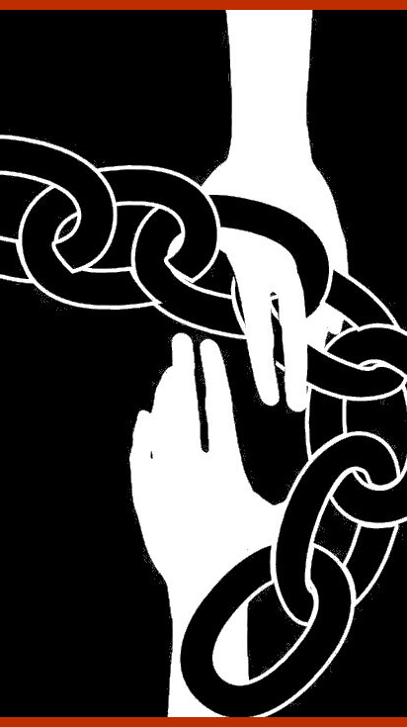
Social Impact
Blockchain
Project
Checkpoint 1: Impact Opportunity
Checkpoint 2: Business Model Validation
Checkpoint 3: Technical Architecture
Checkpoint 4: Impact Measurement
Checkpoint 5: Code
Checkpoint 6: Final Submissions Due
Notes:
2019 Grass roots effort of the Blockchain Princeton Meetup Groups. Worked through the checkpoints to create an important community project.

Slide 8
Checkpoint 1: Impact Opportunity
  Select your challenge.
Develop an agile & transparent network for connecting surplus foods & supplies to communities in need.
To create a decentralized system that collect excess food supplies from local resources and distribute these resources to local area facilities in need.
  Define the scope of problem.
For our summer project, we limited the POC to a single collection date in August. Donations from local farmers and community food drives were picked up by transportation volunteers who brought donations to agreed upon drop off point.

Slide 9
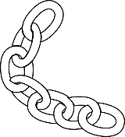
Checkpoint 2: Model Validation
Business Flow
Donors
Farmers
Individuals
Community / Church Groups
Volunteers / Drivers
Pickup / Deliver:
Local volunteers
Community / Groups Transport
Recipients
Food Banks
NGO’s
Social Services Offices
Individuals (off the grid)

Slide 10
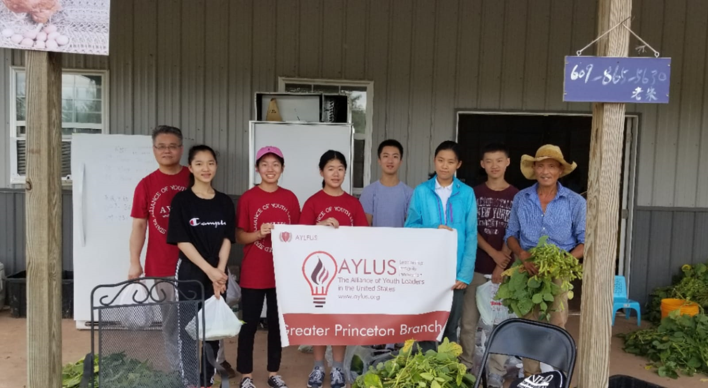
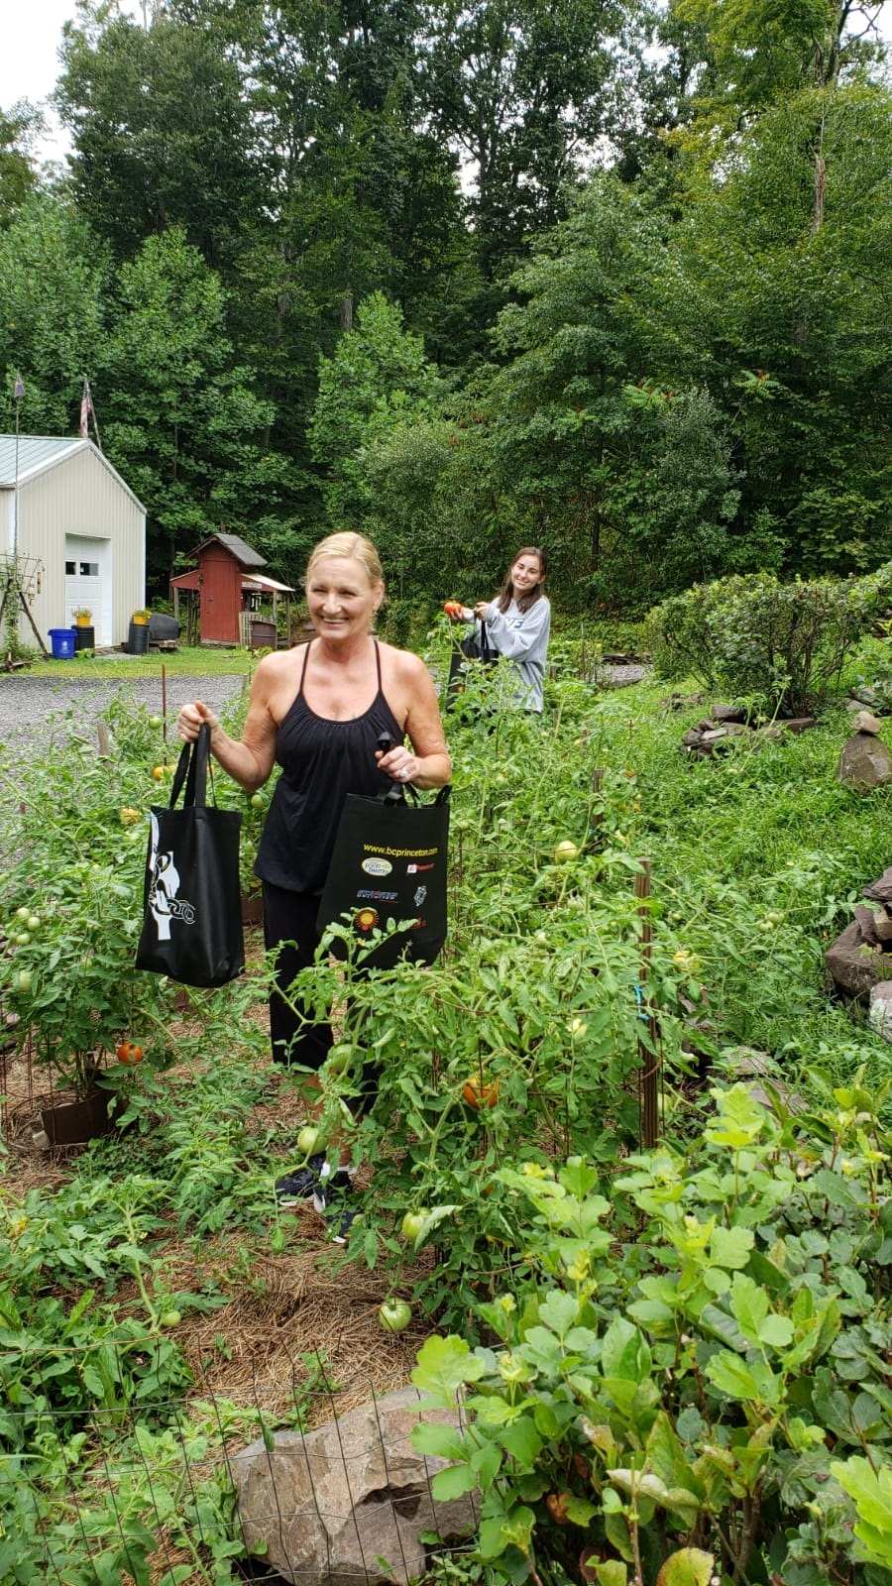
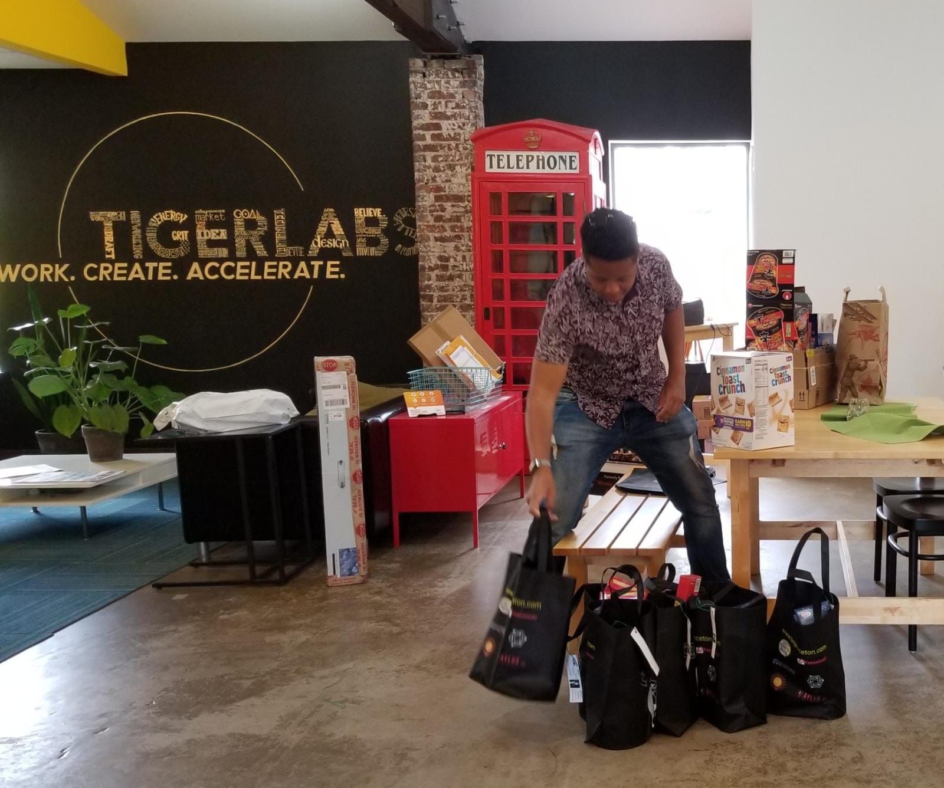
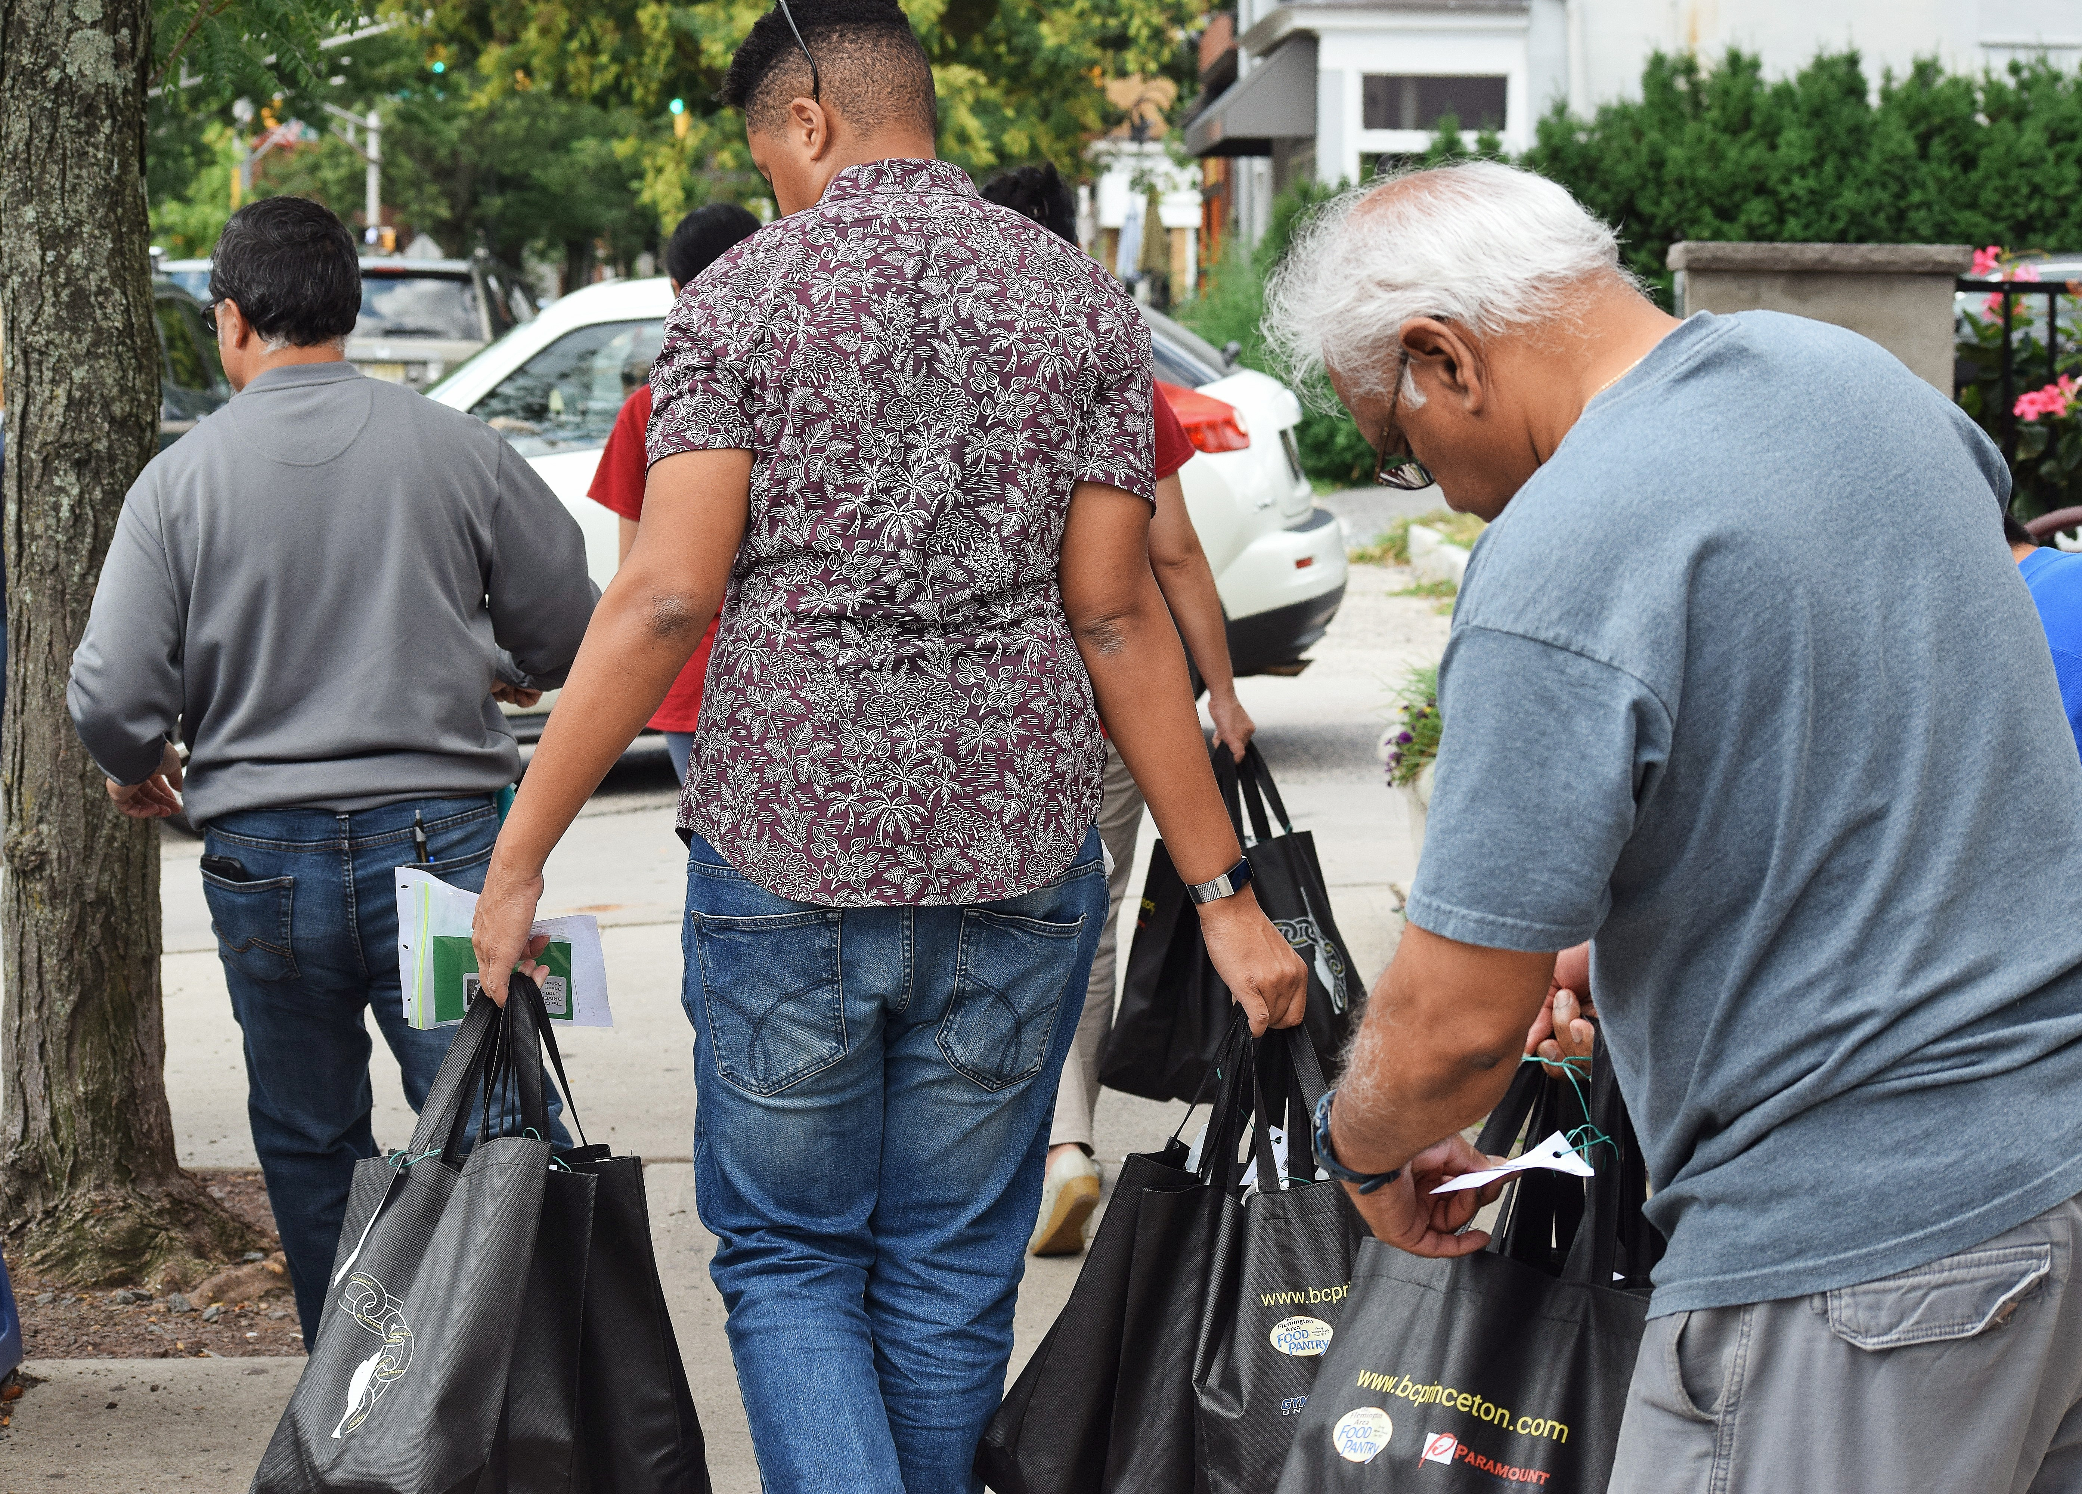
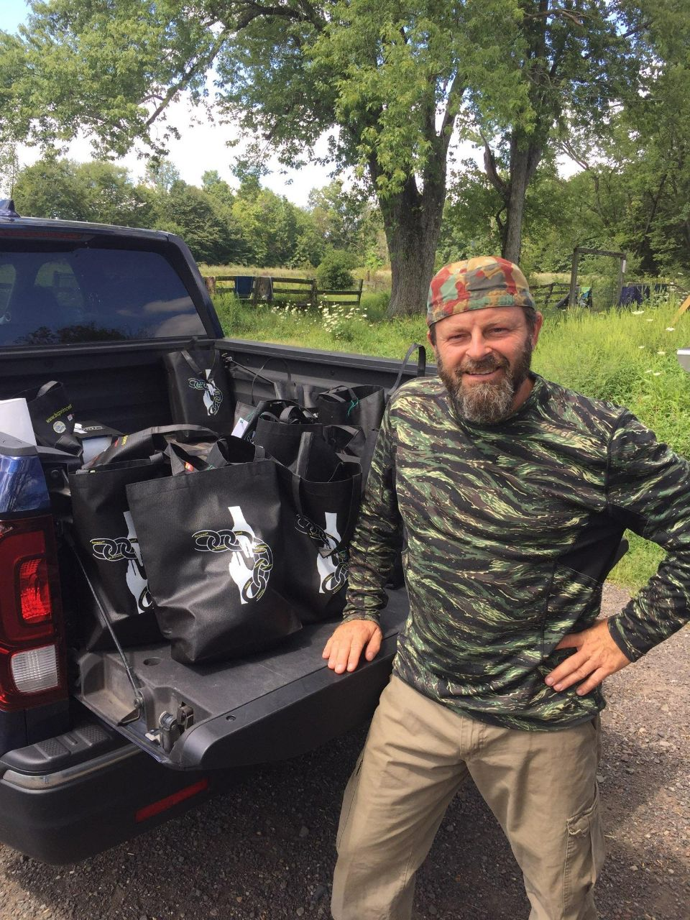
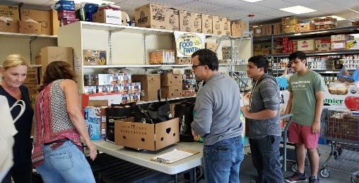
Checkpoint 2: Model Validation
Who are your clients/users? Sketch your user.
What are their pain points? How does your solution solve them?
        Can it be scaled?
Donors
Volunteers / Drivers
Recipients
Notes:
Include Details:
Donors Who they are for each project
Driver – Project Managers choice , Long term Vetted Orgs
Recipients
NGO, Social Services Offices
Schools/College Girls
Underprivileged
Village Women/girls
Marginalized and lower middle-class populace

Slide 11

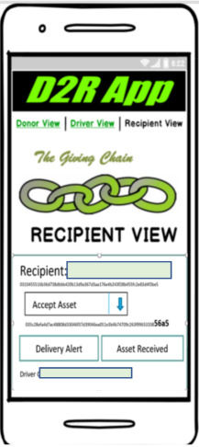

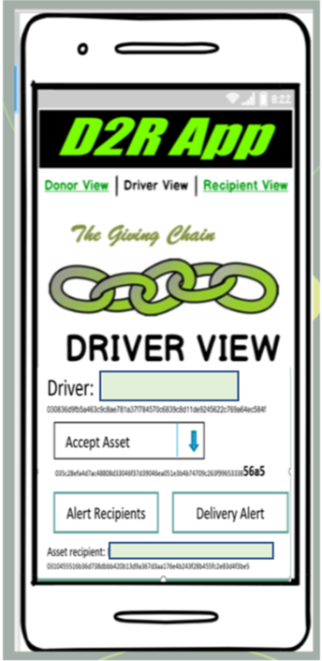




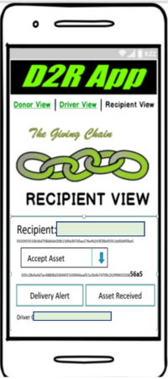
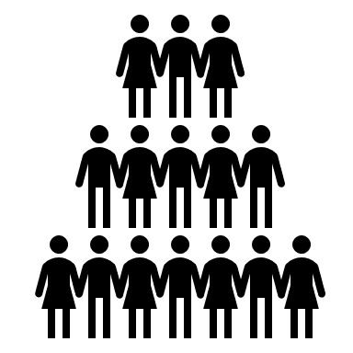
Checkpoint 3: Technical Modeling
Create Asset for Pick upP/U
Recipient Tag
Transporters Tag
Notes:
In our technical model Donors activate the giving chain with an application a cell phone. They create an asset with a unique tag. The blockchain tracks the ownership of the tag ( donor to driver to recipient) . We will get a closer look at the technology later.

Slide 12
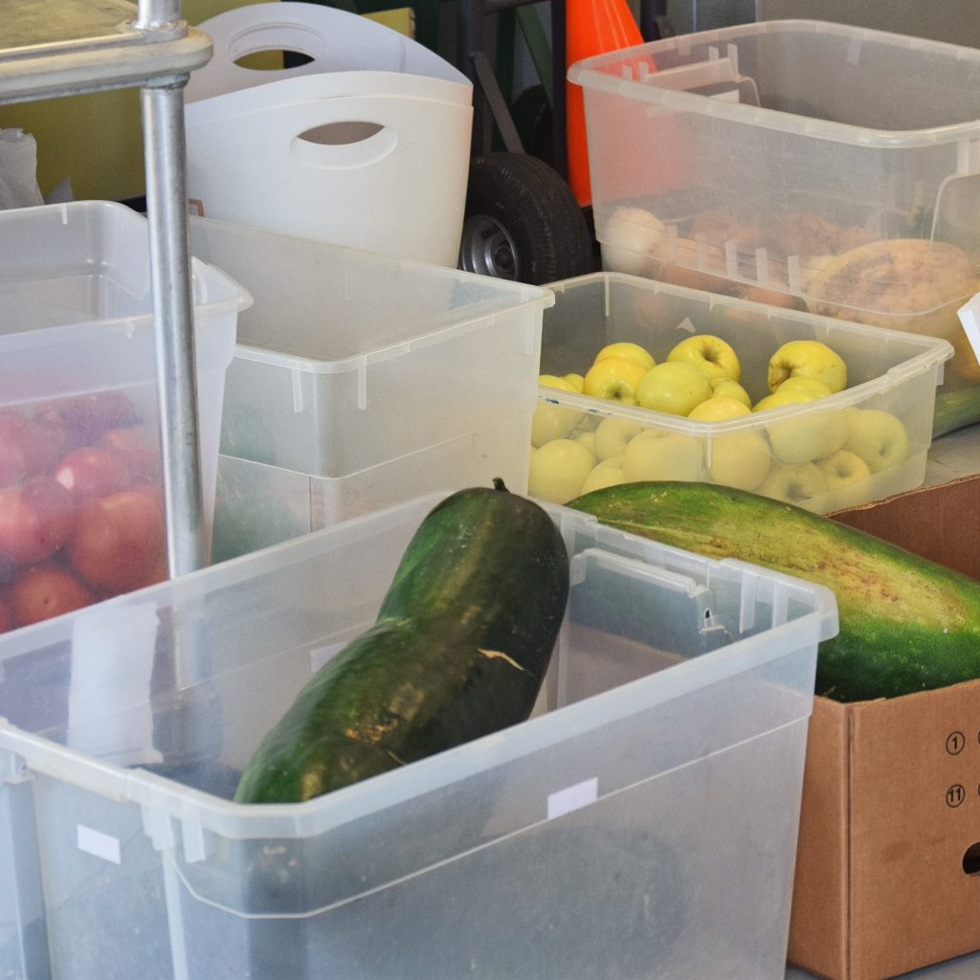

Checkpoint 4 : Impact Measurement
650 Lbs. of Food to Local Food Banks
55 “Giving Bags to Homeless Veterans
Notes:
In our technical model Donors activate the giving chain with an application a cell phone. They create an asset with a unique tag. The blockchain tracks the ownership of the tag ( donor to driver to recipient) . We will get a closer look at the technology later.

Slide 13
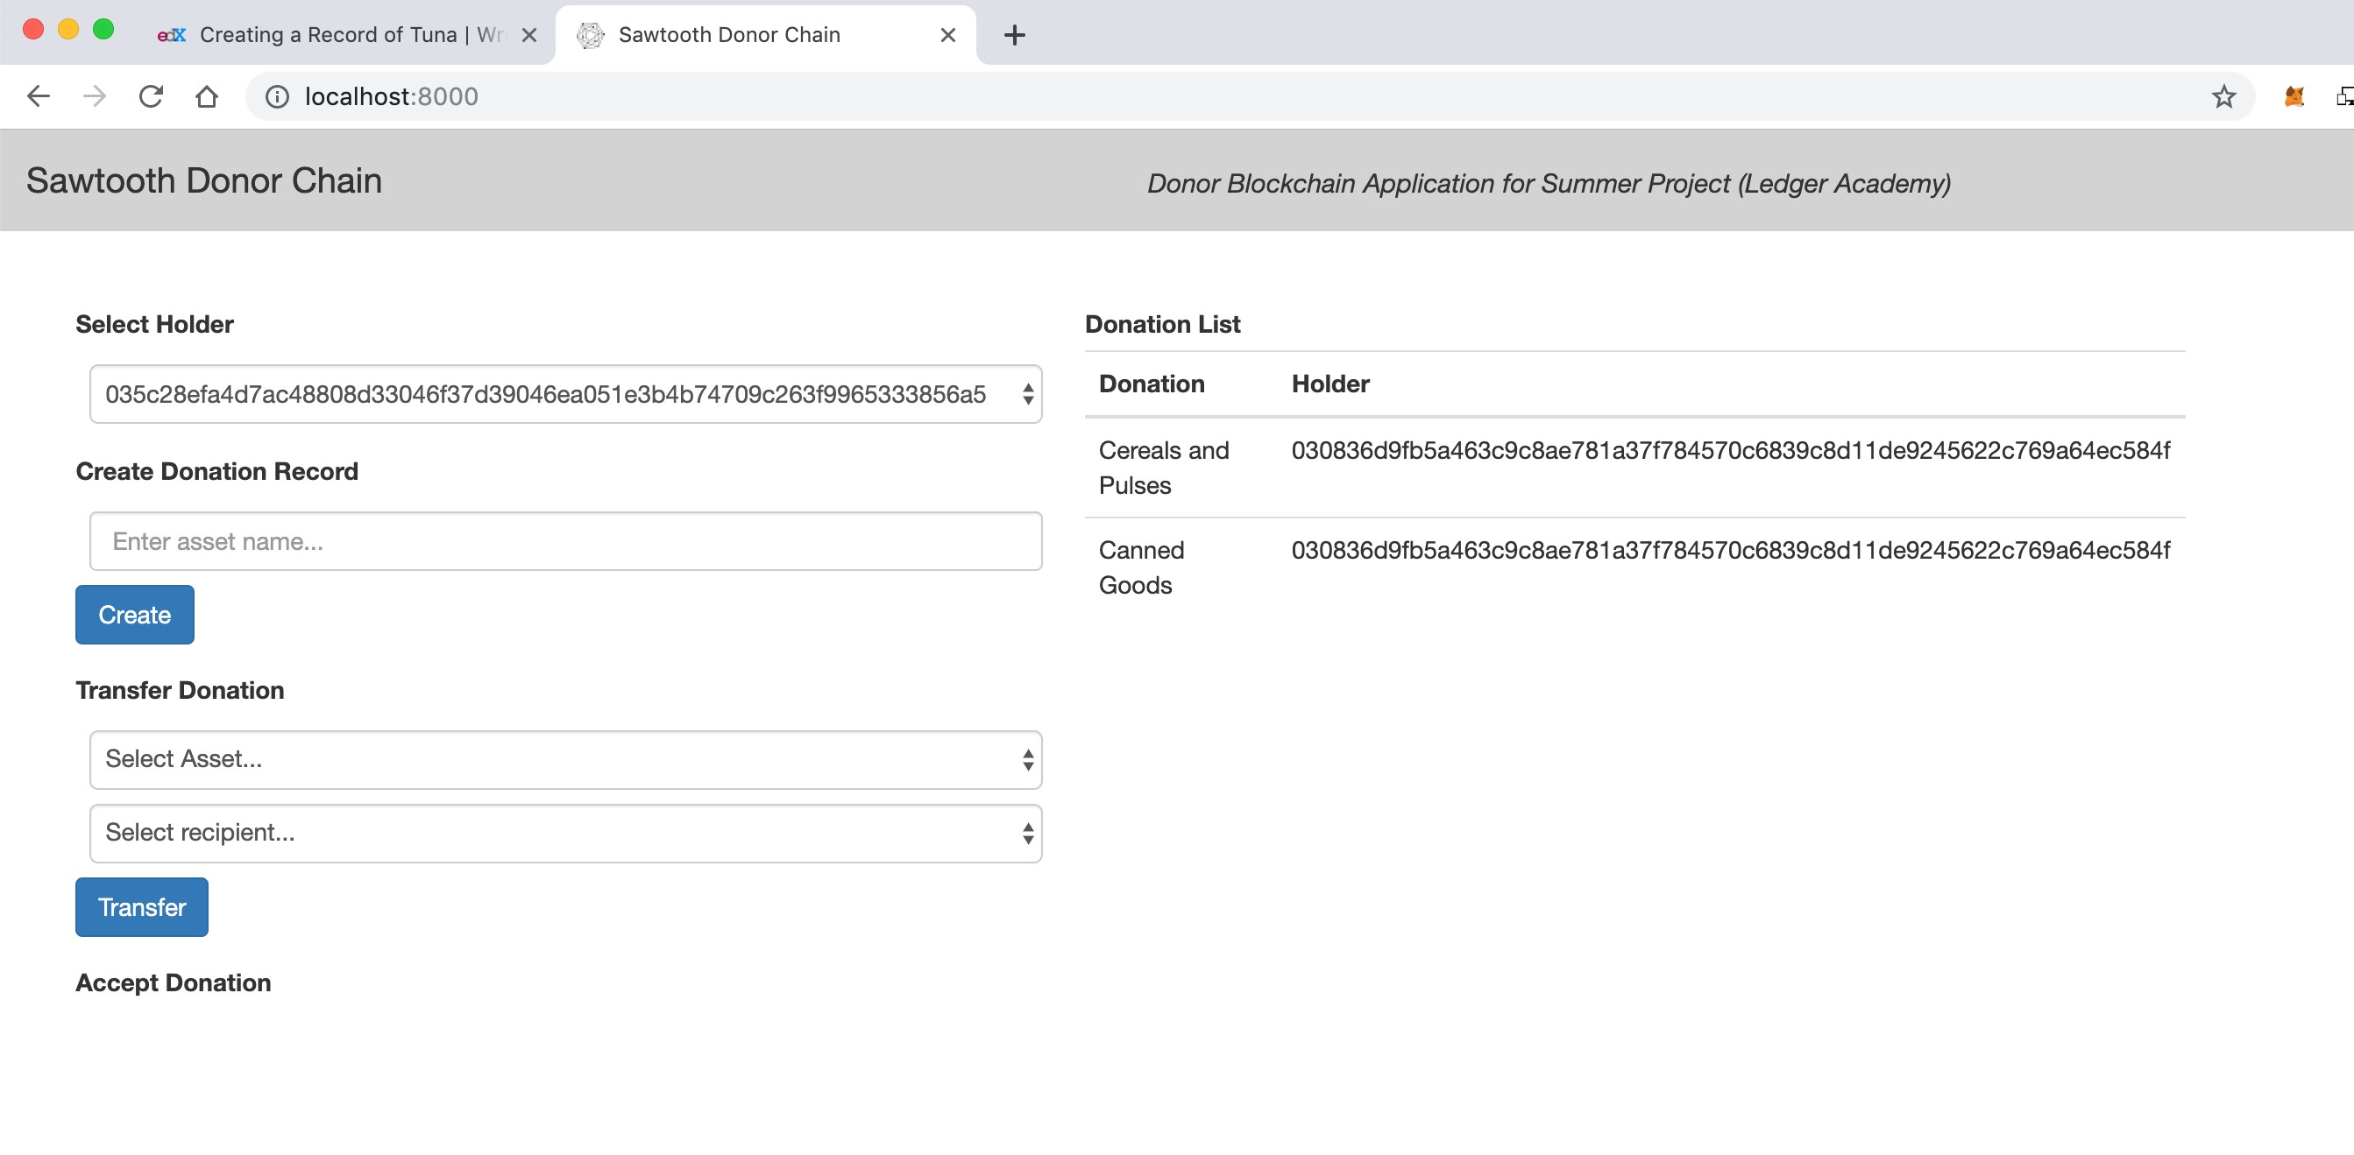
Checkpoint 5 : Code
Notes:
In our technical model Donors activate the giving chain with an application a cell phone. They create an asset with a unique tag. The blockchain tracks the ownership of the tag ( donor to driver to recipient) . We will get a closer look at the technology later.

Slide 14
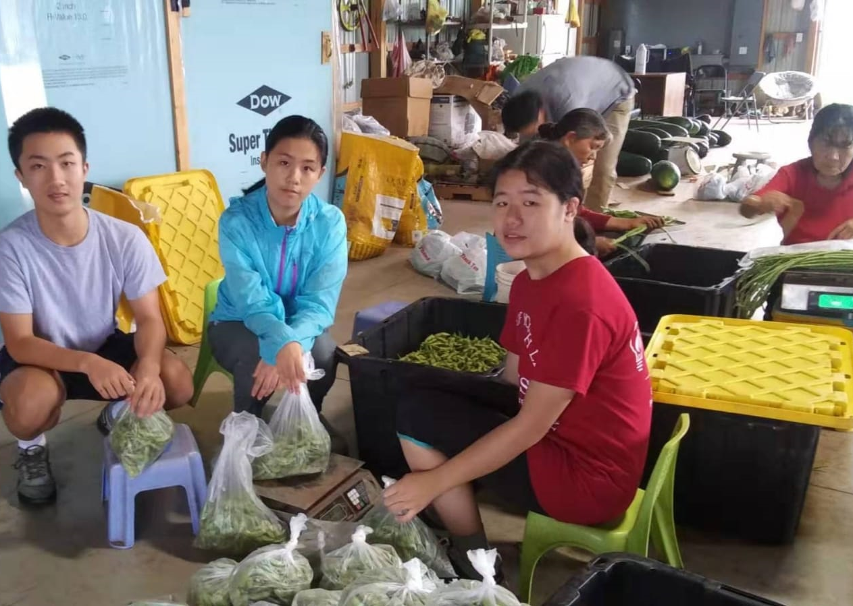
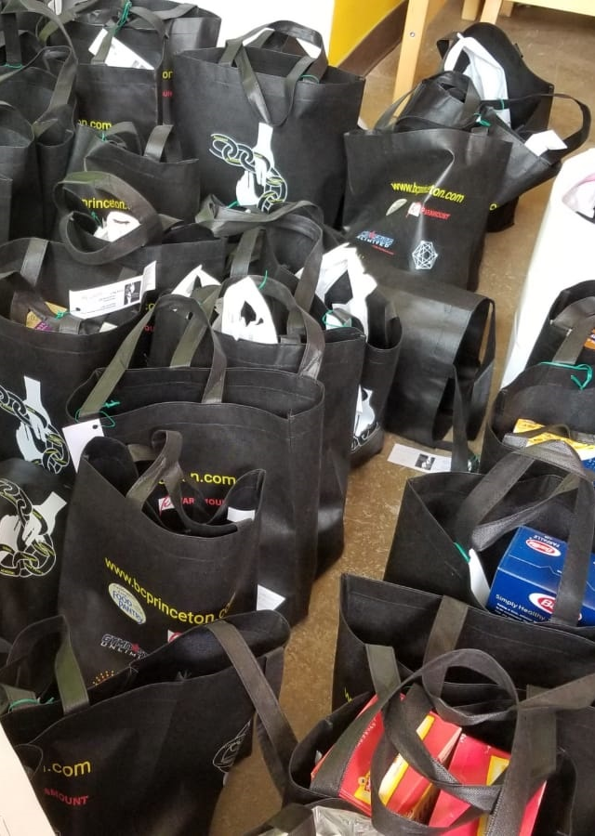

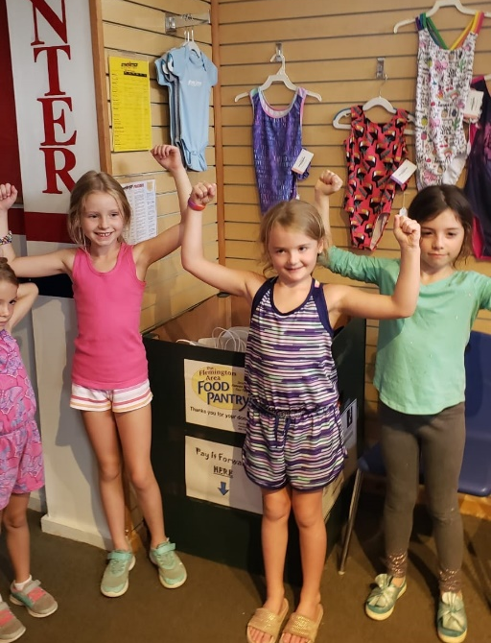
Project Day Collection 8/2019

Slide 15

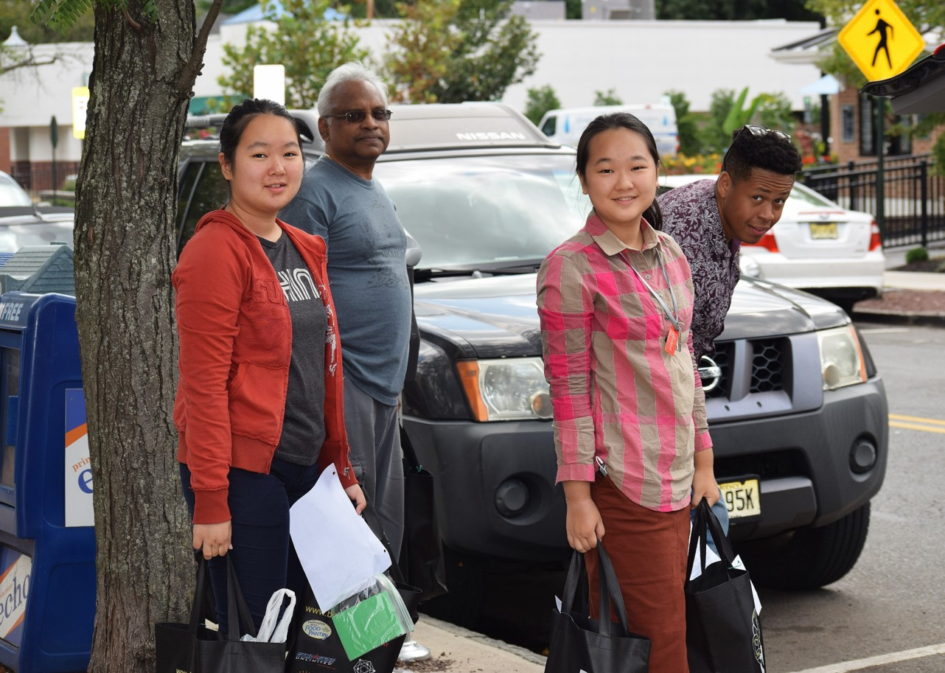
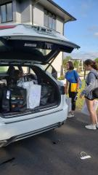
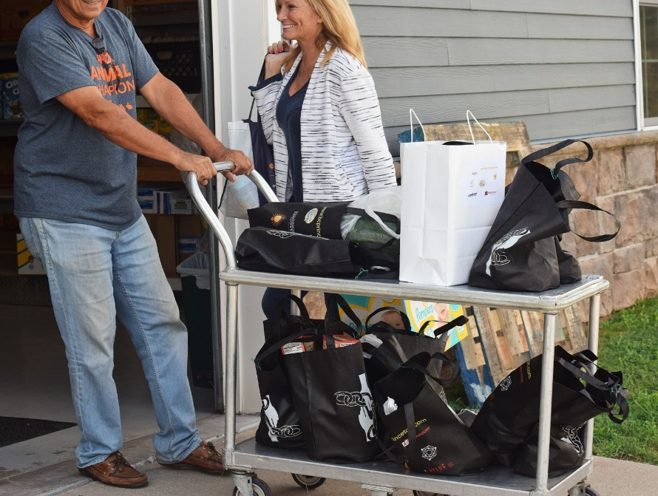
Project Day Transportation 8/2019

Slide 16
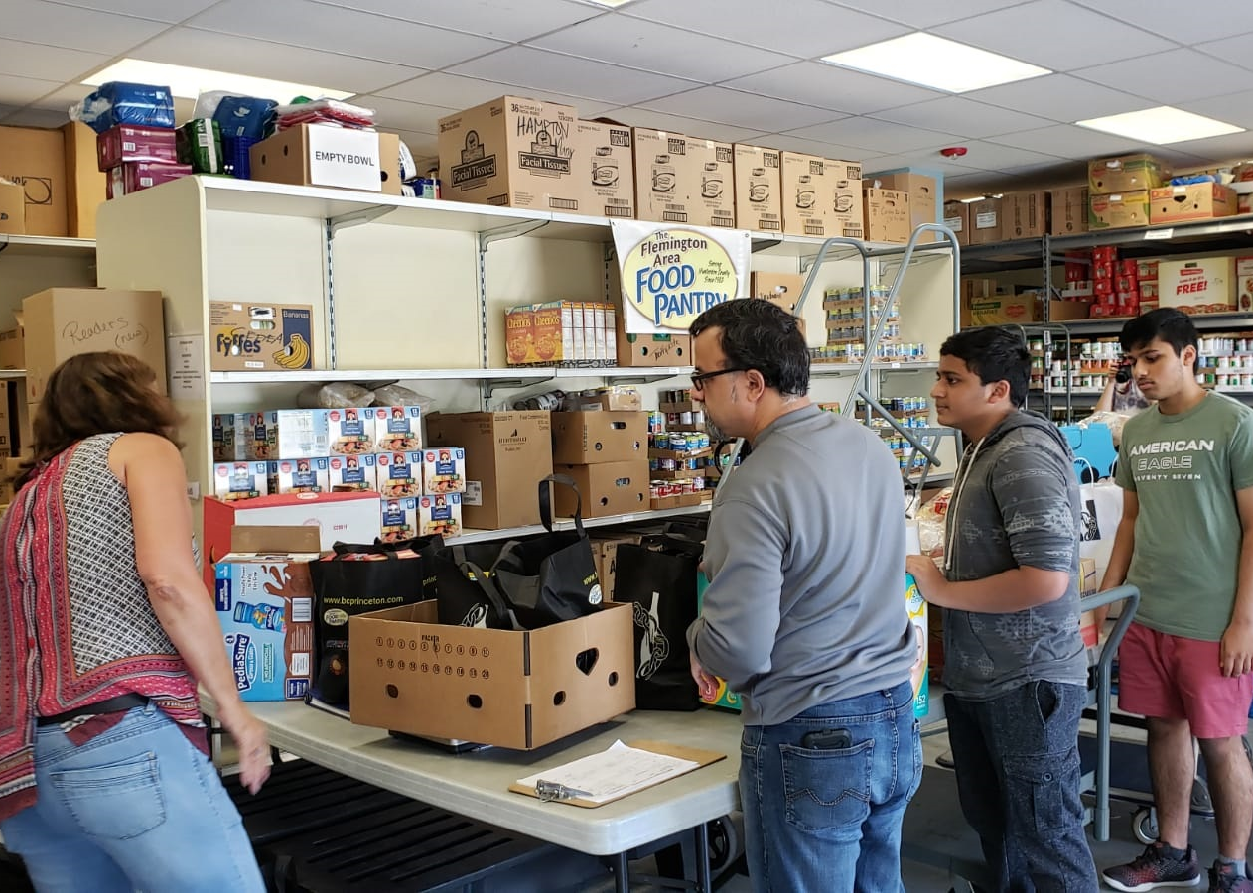
Project Day Delivery 8/2019

Slide 17

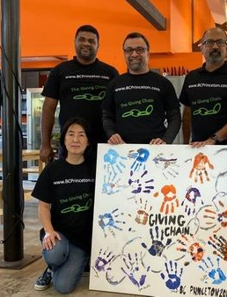
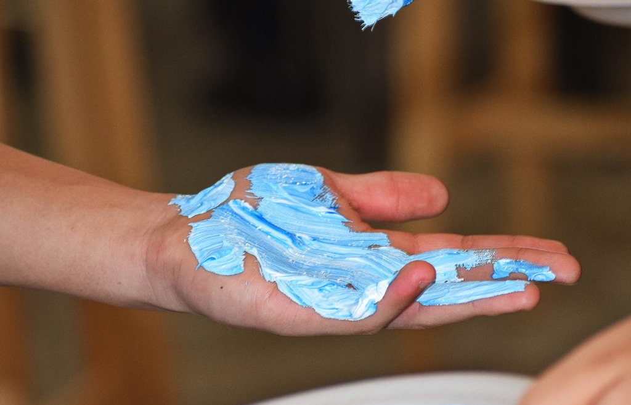

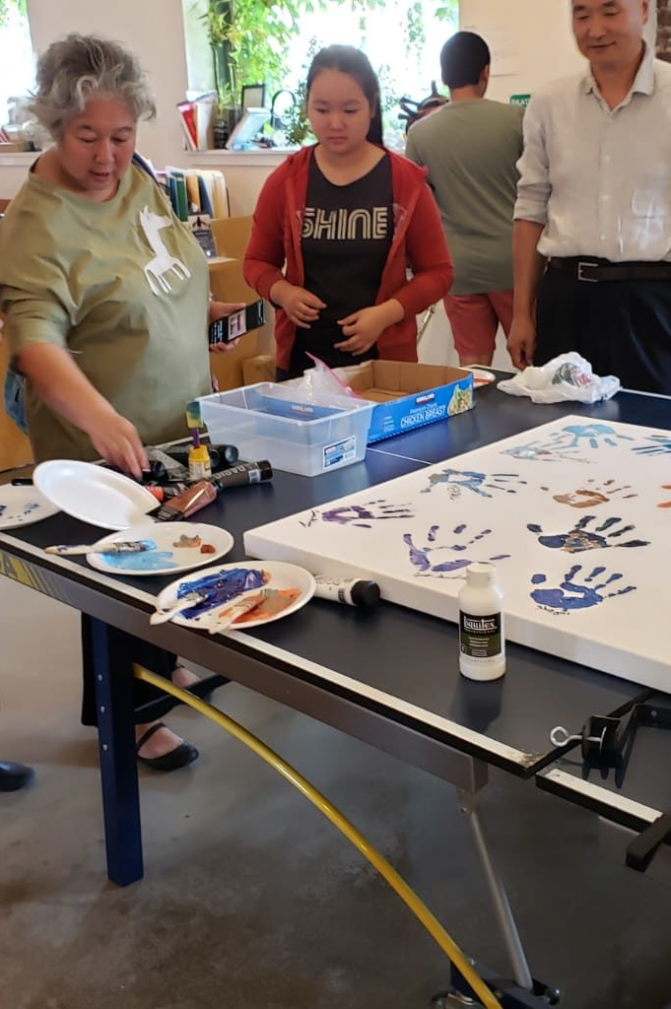
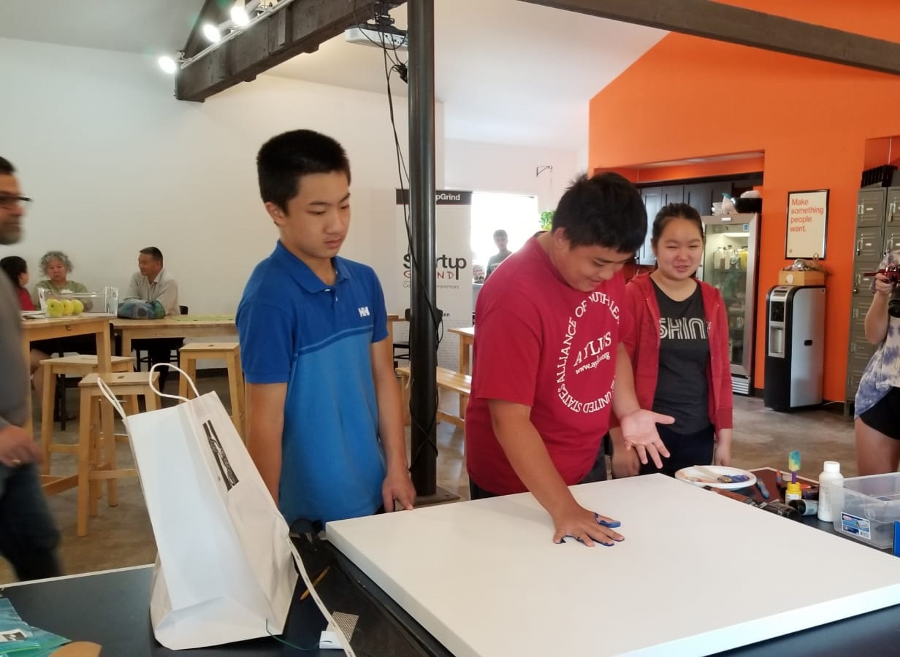
Project Day 8/2019

Slide 18
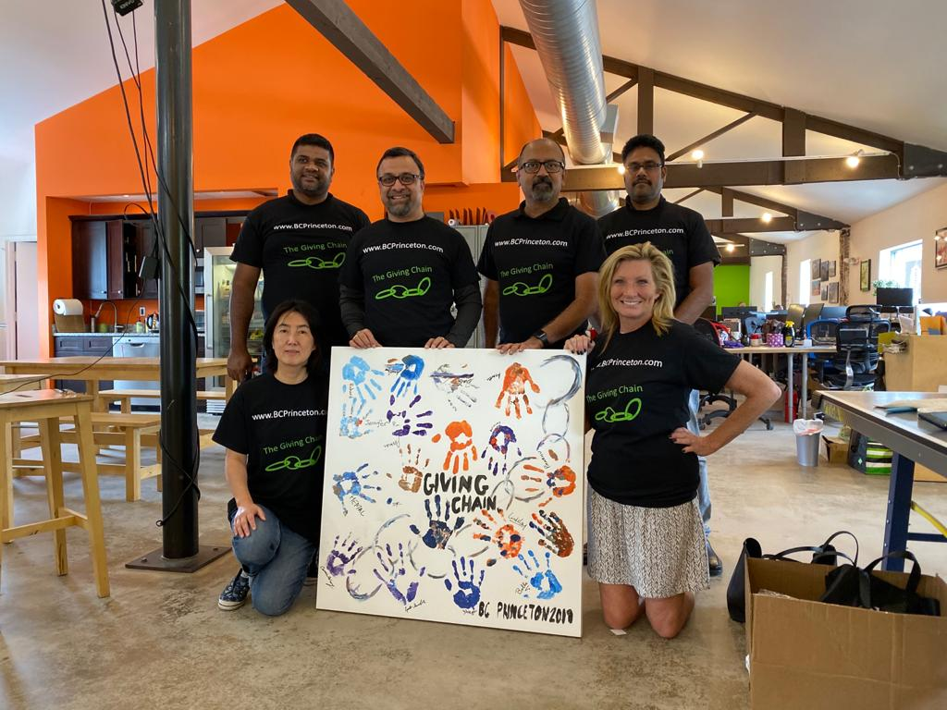
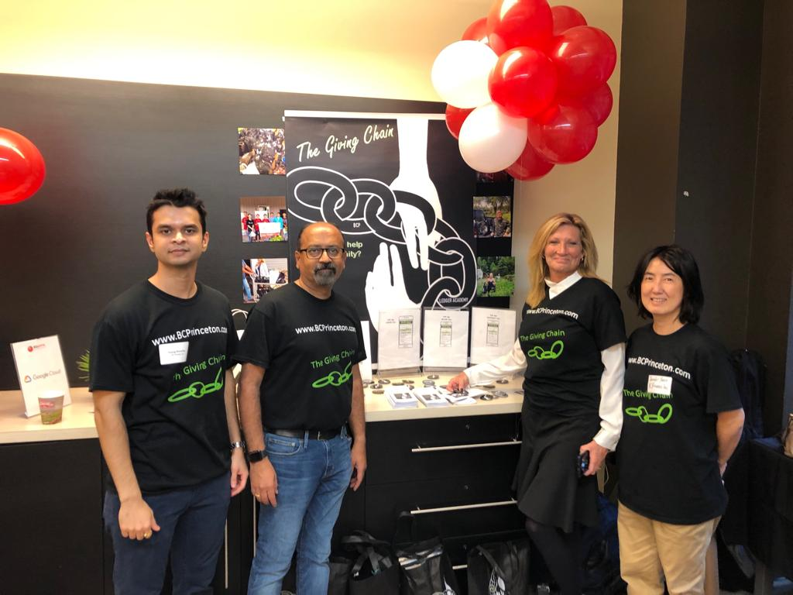
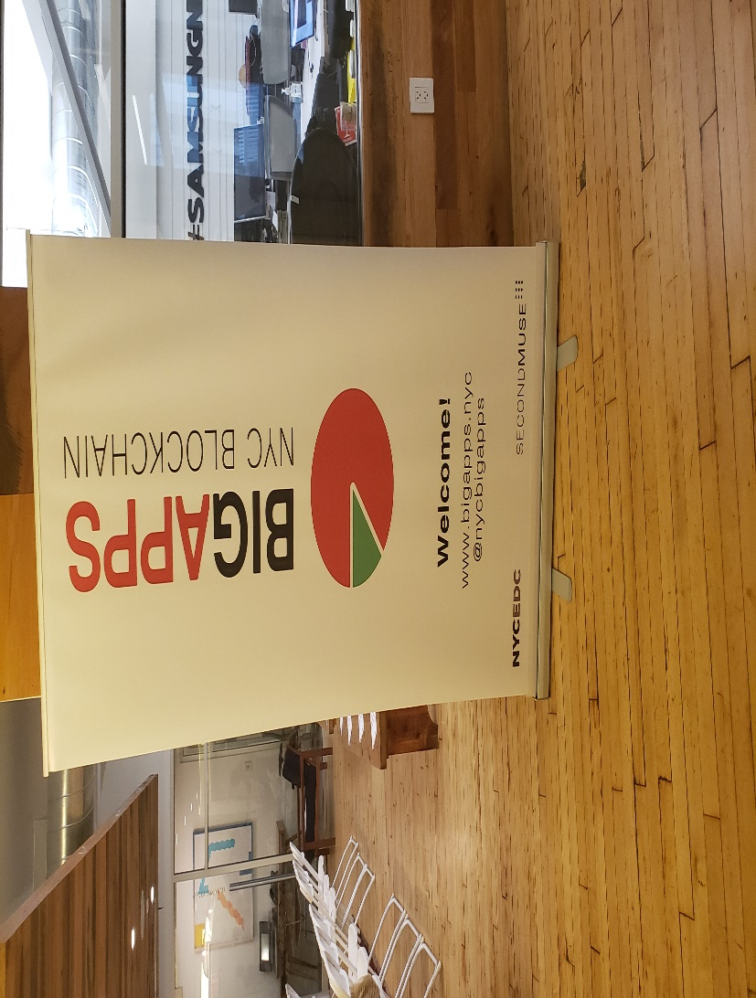
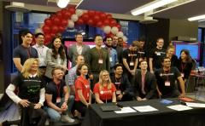
Checkpoint 6 : Final Submission

Slide 19
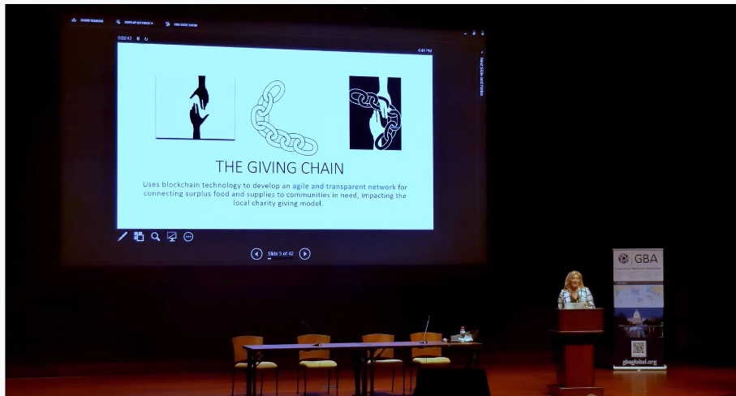
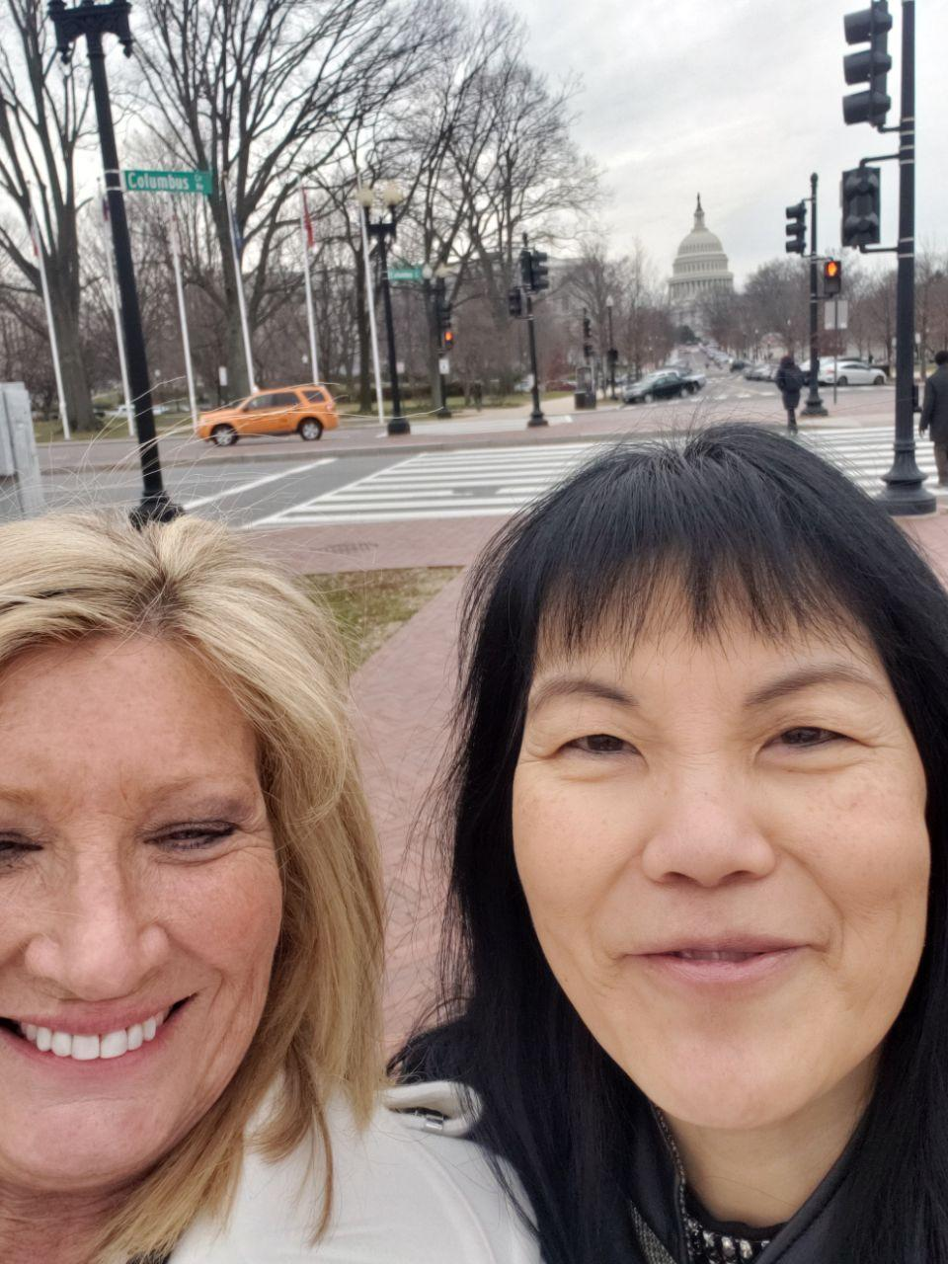
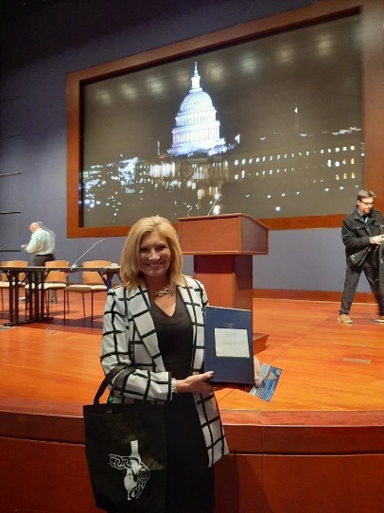
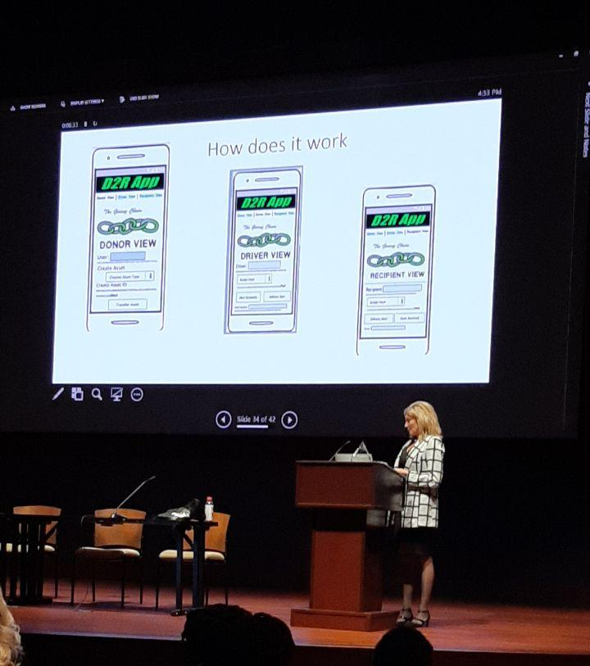
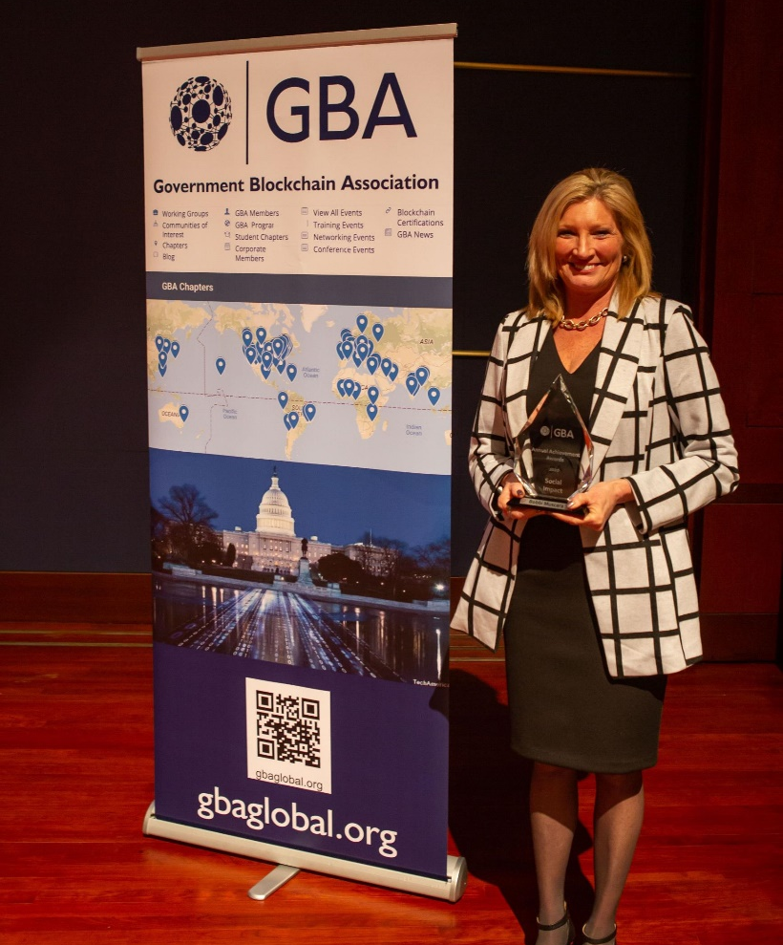
GBA Awards 2020 Government Blockchain Award for Social Impact

Slide 20
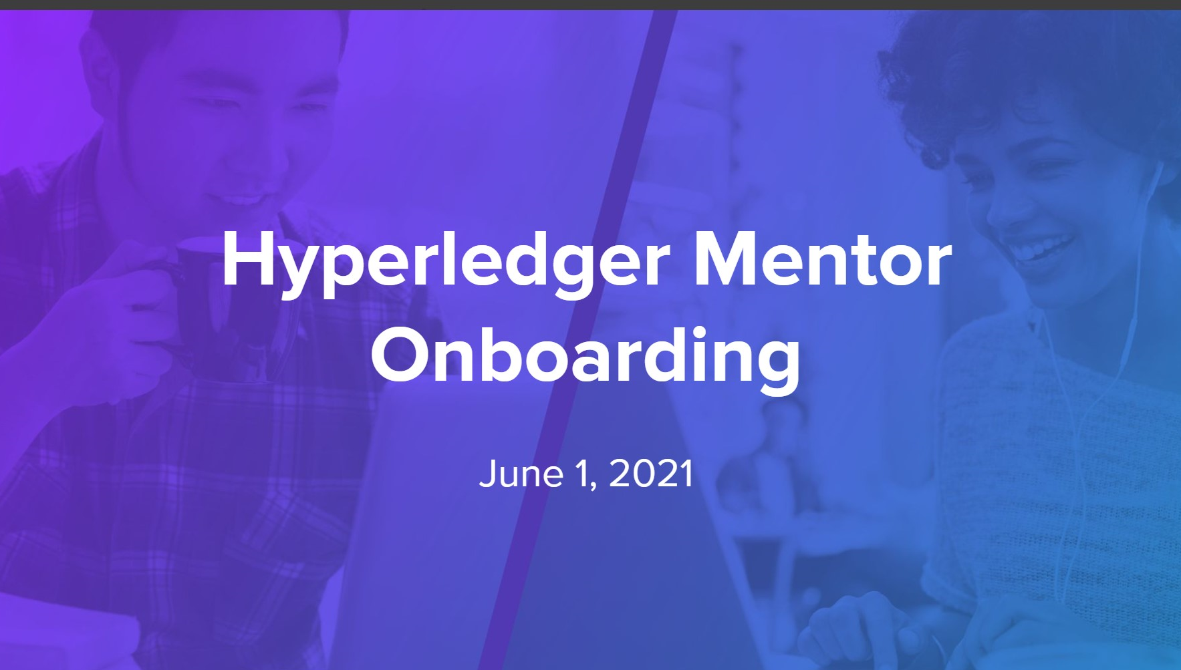
Hyperledger 2021 Mentorship Program
Sponsor: Linux Foundation

Slide 21
Mentorship Program Goals
● To connect new developers eager to learn with experienced developers interested in teaching/coaching
● To provide structured guided hands-on learning opportunities for new open-source developers and researchers
● To help mentees learn and enhance their technical skills, and to inspire them to become long-term active contributors
● To create a pipeline to a diverse, well-educated developer pool and to strength Hyperledger projects and community
●To coach how to participate effectively in open-source community (collaborative culture, tooling, infra, etc.)
●To gain valuable insight into new developer onboarding processes and how to lower the barriers to entry.

Slide 22
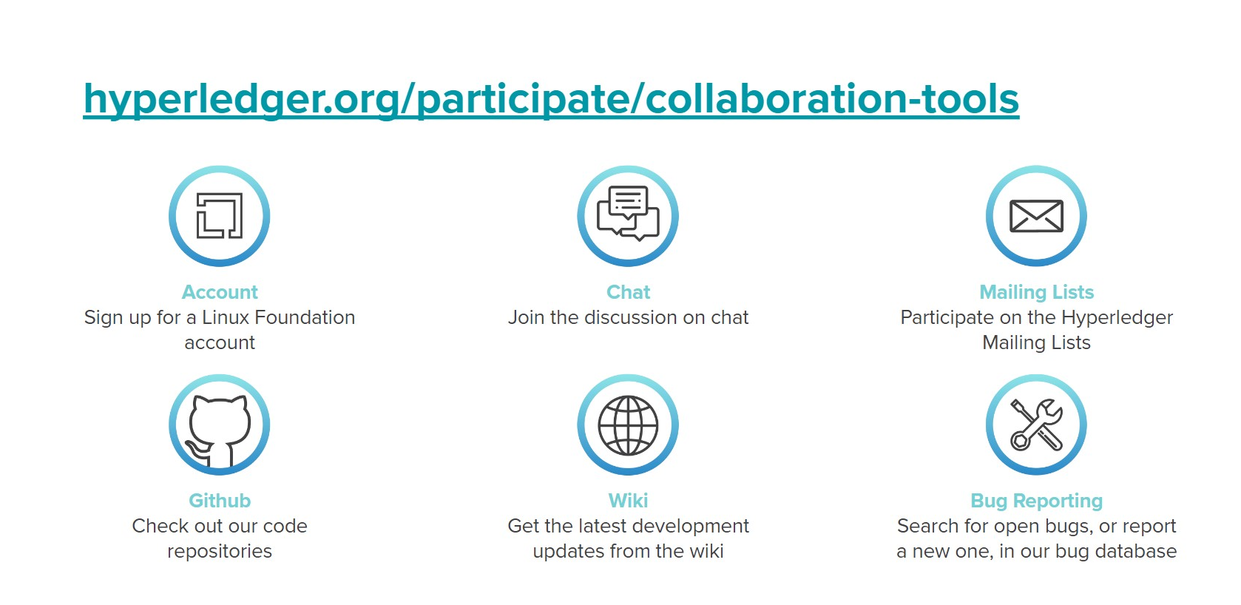
Notes:
Wrote blogs, build business relationships.

Slide 23

The Giving Chain
2021
  AGENDA
  Introduction
Cover the two new projects
  2021 Project Checkpoints

Slide 24
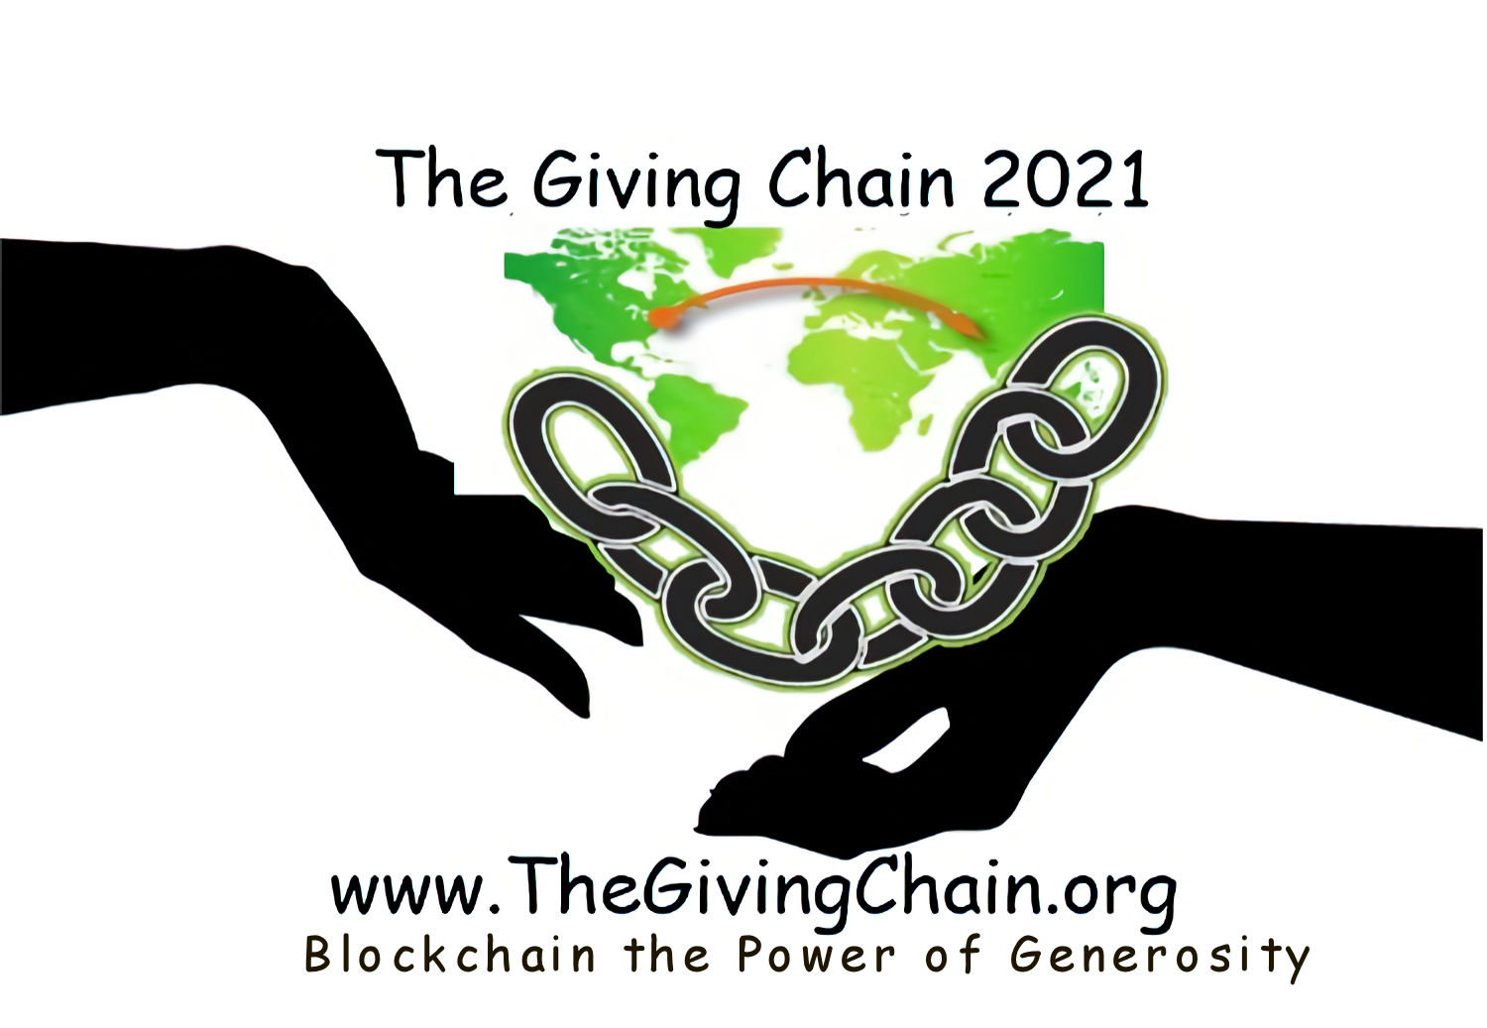
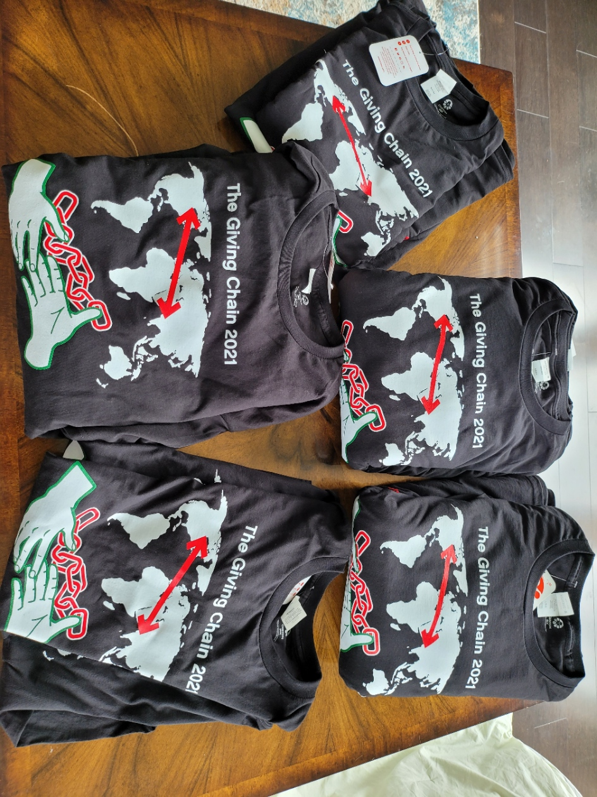
2021 Linux Foundation Hyperledger Giving Chain Mentee’s
Hardik Gupta
Project Manager – Hyperledger Giving Chain
Member OF THE Learning Materials Working Group
The Giving Chain
Mentee / Project Management / Technical Lead
Madhu Bhatia
Project Manager – Hyperledger Giving Chain
DLT Talent program of Frankfurt School of Finance and Management Blockchain Center
2021 LiFT Scholarship Women in open-source
Research Scholar /Trainer
Mona Rassouli
Developer/ Marketing(social media)/Documentation/ Articles or Blogs
mr1241@scarletmail.rutgers.edu
Technology Lead

Slide 25
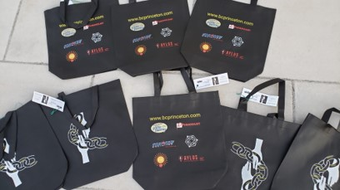
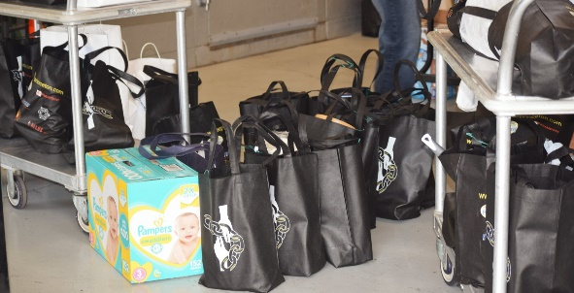
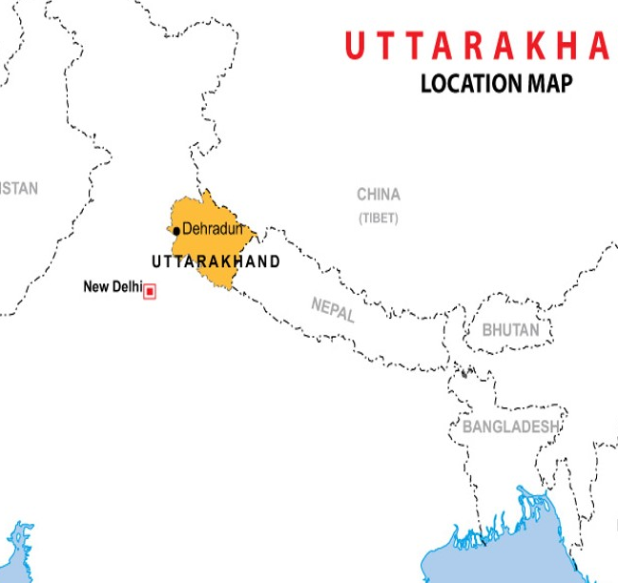
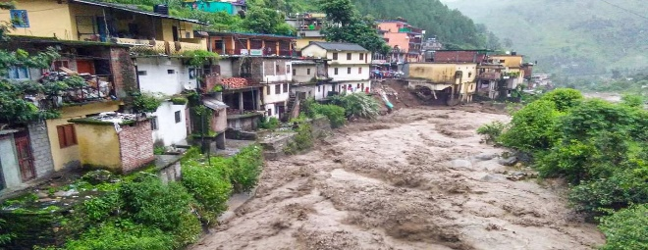
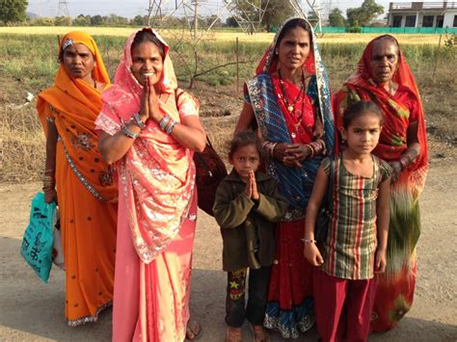
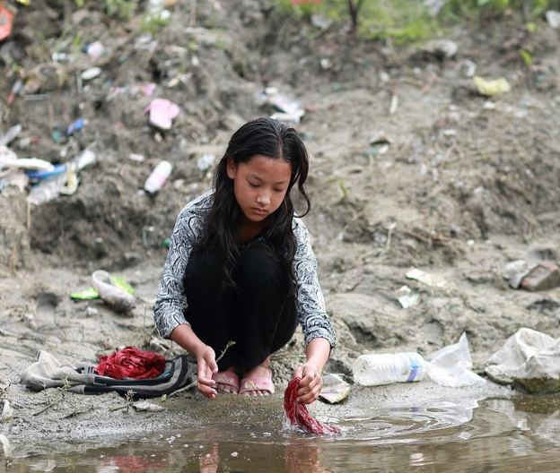
Project 2021
Checkpoint 1
Giving Chain Princeton
Giving Chain India / Uttarakhand
Giving Chain India Women
Notes:
An estimated 355 million Indian women and girls must find ways to cope with monthly menstrual hygiene. Most o A majority of rural women in India employ clothes and rags for feminine hygiene. These materials might predispose women to reproductive tract infections since it may be difficult for them to keep their used napkins clean and free of harmful bacteria. Washing reusable feminine products with soap and drying them in sunlight may be difficult due to lack of water, private facilities, and cultural taboos associated with menstruation.

Slide 26
Checkpoint 1: Impact Opportunity
Giving Chain - Uttarakhand
  Select your challenge.
Develop an agile & transparent network for connecting supplies and aid to flood damaged communities in need. To create a decentralized system that collect needed supplies from local resources and crowd funding efforts and distributes these resources to flood victims.
  Define the scope of problem
For our summer project, we are limiting the POC to Uttarakhand flood victims .Supplies collected and purchased to be picked up by transportation volunteers who will transport food supplies to agreed upon drop off point .
  Why is blockchain needed to solve this problem
A supply chain model has been determined to be the best way to initiate, track and deliver supplies.
Notes:
We asked ourselves the question with what we know about blockchain and social impact projects, what can we do to have an impact in our community
Philanthropy and remittances (donation traceability, aid transparency, digital currencies in aid and development, governance and accountability)
Financial empowerment (financial inclusion, microfinance, microinsurance)
Identity and land rights (refugee assistance, land ownership documentation)
Governance and democracy (fighting censorship and fake news, voting rights and protections, election integrity)
Supply chain and environmental protections (sustainable supply chain, fair trade, ethical sourcing, fair labor practices
Introduction: Project and Team
The Giving Chain 2019
Hyperledger Mentorship Program
Project Overview
Teams (Expectations) (Focus)
Introduction from Members on Call

Slide 27
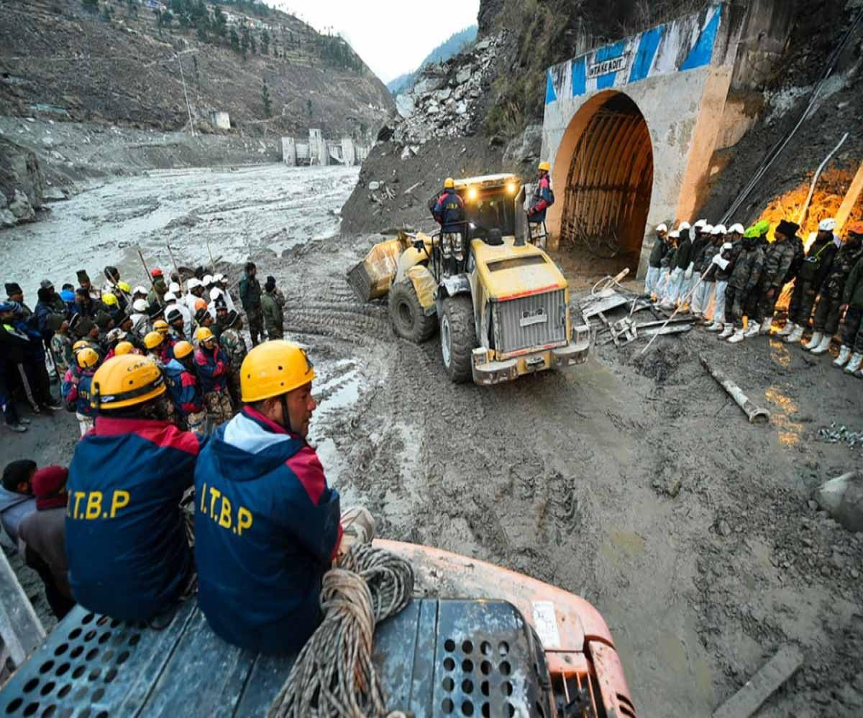
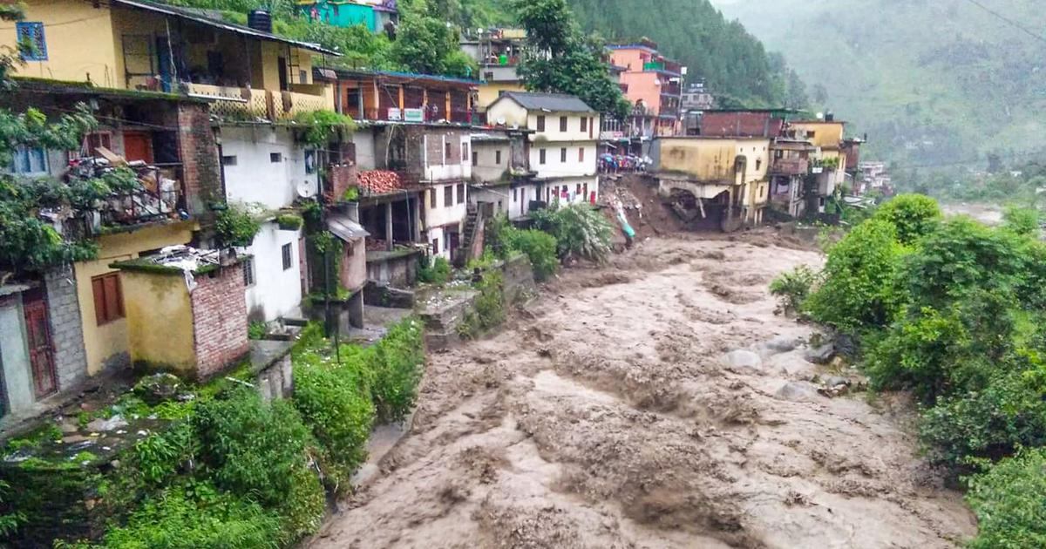
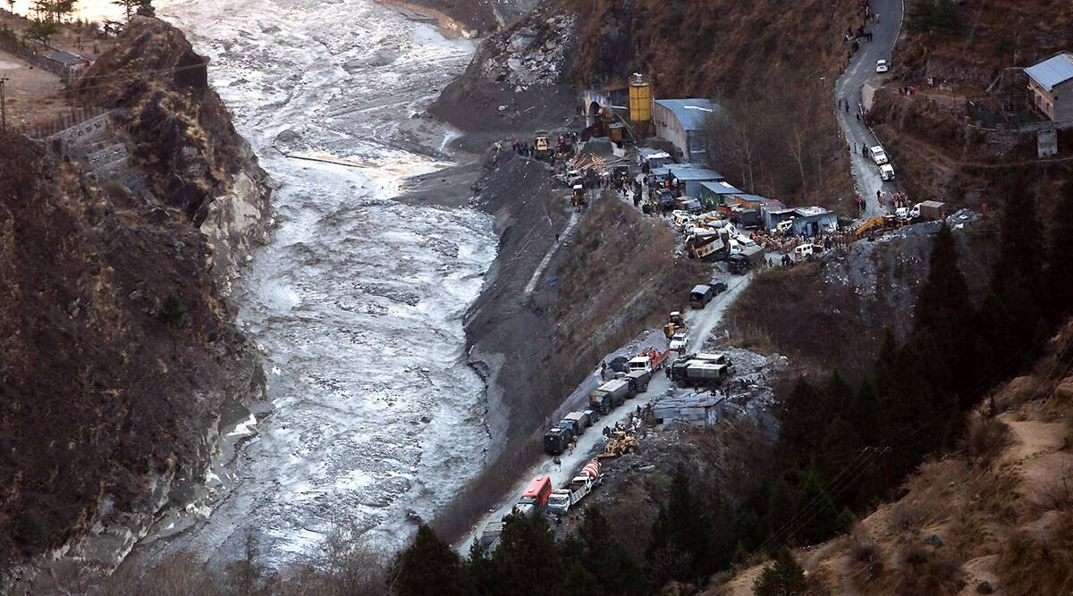
Impact Opportunity

Slide 28





Checkpoint 1: Impact Opportunity
Giving Chain - India Women
Notes:
We asked ourselves the question with what we know about blockchain and social impact projects, what can we do to have an impact in our community
Philanthropy and remittances (donation traceability, aid transparency, digital currencies in aid and development, governance and accountability)
Financial empowerment (financial inclusion, microfinance, microinsurance)
Identity and land rights (refugee assistance, land ownership documentation)
Governance and democracy (fighting censorship and fake news, voting rights and protections, election integrity)
Supply chain and environmental protections (sustainable supply chain, fair trade, ethical sourcing, fair labor practices
Introduction: Project and Team
The Giving Chain 2019
Hyperledger Mentorship Program
Project Overview
Teams (Expectations) (Focus)
Introduction from Members on Call

Slide 29
Giving Chain need a PM (Project Manager)
Each project needs to start with a project manager who has dual roles as the manager of the business flow and as the administrator for the technical registration.
What is a project manager do?
In the broadest sense, project managers (PMs) are responsible for
Planning
Organizing the registrations
and directing the completion of specific projects.

Slide 30



Checkpoint 2: Model Validation
Who are your clients/users? Sketch your user.
What are their pain points? How does your solution solve them?
Can it be scaled?
Donors
Volunteers / Drivers
Recipients
Notes:
Include Details:
Donors Who they are for each project
Driver – Project Managers choice , Long term Vetted Orgs
Recipients
NGO, Social Services Offices
Schools/College Girls
Underprivileged
Village Women/girls
Marginalized and lower middle-class populace

Slide 31
Checkpoint 2: Model Validation
Business Flow
Donors
Farmers
Individuals
Community / Church Groups
Volunteers / Drivers
Pickup / Deliver:
Local volunteers
Community / Groups Transport
Recipients
Food Banks
NGO’s
Social Services Offices
Individuals (off the grid)

Slide 32


Checkpoint 3: Technical Modeling
Platform Managers
Project Manger acts as Administrator making enrollment decisions.
Role
1. Project Manager
2. Donor
3. Transporter
4. Recipient
Registration Process
Notes:
In our technical model Donors activate the giving chain with an application a cell phone. They create an asset with a unique tag. The blockchain tracks the ownership of the tag ( donor to driver to recipient) . We will get a closer look at the technology later.

Slide 33


Checkpoint 3: Technical Modeling
Donors
NFT
Picture of Donation
Picture into Smart QR Code
Description and Alert
Hash
Notes:
In our technical model Donors activate the giving chain with an application a cell phone. They create an asset with a unique tag. The blockchain tracks the ownership of the tag ( donor to driver to recipient) . We will get a closer look at the technology later.

Slide 34

Checkpoint 3: Technical Modeling
Transporters
Respond to Alert
Pick up Donation
NFT
Get Location and Deliver
Digital picture added to QR Code
Hash
Notes:
In our technical model Donors activate the giving chain with an application a cell phone. They create an asset with a unique tag. The blockchain tracks the ownership of the tag ( donor to driver to recipient) . We will get a closer look at the technology later.

Slide 35

Checkpoint 3: Technical Modeling
NFT
Recipient
Receives Alert / Accepts
Hash
NFT becomes Immutable Record of Donation!!!
Accepts donation / Smart QR Code and picture.
Accepts Donation / Takes Digital Picture
Takes Digital Picture / NFT
Notes:
In our technical model Donors activate the giving chain with an application a cell phone. They create an asset with a unique tag. The blockchain tracks the ownership of the tag ( donor to driver to recipient) . We will get a closer look at the technology later.

Slide 36

Data Flow Diagram

Slide 37




Checkpoint 4 : Impact Measurement
The Giving Chain
Test Run, Princeton
August 28th

Slide 38


Checkpoint 4 : Impact Measurement
The Giving Chain
Test Run, India
August 29th

Slide 39

Checkpoint 5 : Code
Notes:
In our technical model Donors activate the giving chain with an application a cell phone. They create an asset with a unique tag. The blockchain tracks the ownership of the tag ( donor to driver to recipient) . We will get a closer look at the technology later.

Slide 40
Checkpoint 6 : Final Submission
October 26th Social Impacts SIG
November 12th Closing ceremonies of the Mentorship program
November 17th Trade Finance Update presentation.

Slide 41
Define Project and team members.
The Giving Chain
Business Team
Technical Team
Create Social Media
Create a Git Hub Repo
Develop Code
Run Projects
Research Platforms
Raise Funds for Project and Platform
Notes:
Looking at the project it was decided to break out into to teams Business and Technical. Most people who attended the meetings were on both teams, The teams can run through several sub projects and individuals can be om many teams.

Slide 42



Business Development
Web Site and Donations
Donate to Project
https://gofund.me/b0840750
Tee-shirt Sales
Institutional Investors
Corporate Funding (For the project development): https://crowdfunding.lfx.linuxfoundation.org/projects/hyperledger-the-giving-chain
General Funding (For the use of buying goods): https://crowdfunding.lfx.linuxfoundation.org/initiative/fabcd0b5-cecb-452b-a7e1-55bf31065c4a
The General Funds will be distributed on Project Day.

Slide 43

Tech Teamwork
Work on creating an Open-Source project using FireFly.
The link to FireFly CLI: https://github.com/hyperledger/firefly-cli
All the code is being uploaded at our Github: https://github.com/DecoratedWings/GivingChain-ui

Slide 44
Question, Comments, and Discussion
Thank you from the Giving Chain Project Team

