Slide 1
Welcome to
HYPERLEDGER

Slide 2

AGENDA
Housekeeping
What is Hyperledger
Hyperledger Umbrella Products
  Frameworks
  Tools
Hyperledger Community
  Getting Involved
Notes:
David

Slide 3
Housekeeping

Slide 4
Name
Bio
Notes:
Location and Speaker Information

Slide 5
What is Hyperledger

Slide 6

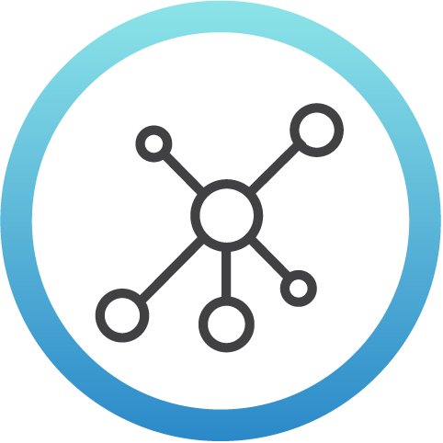



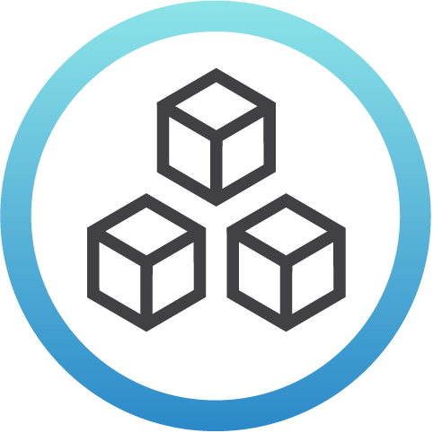


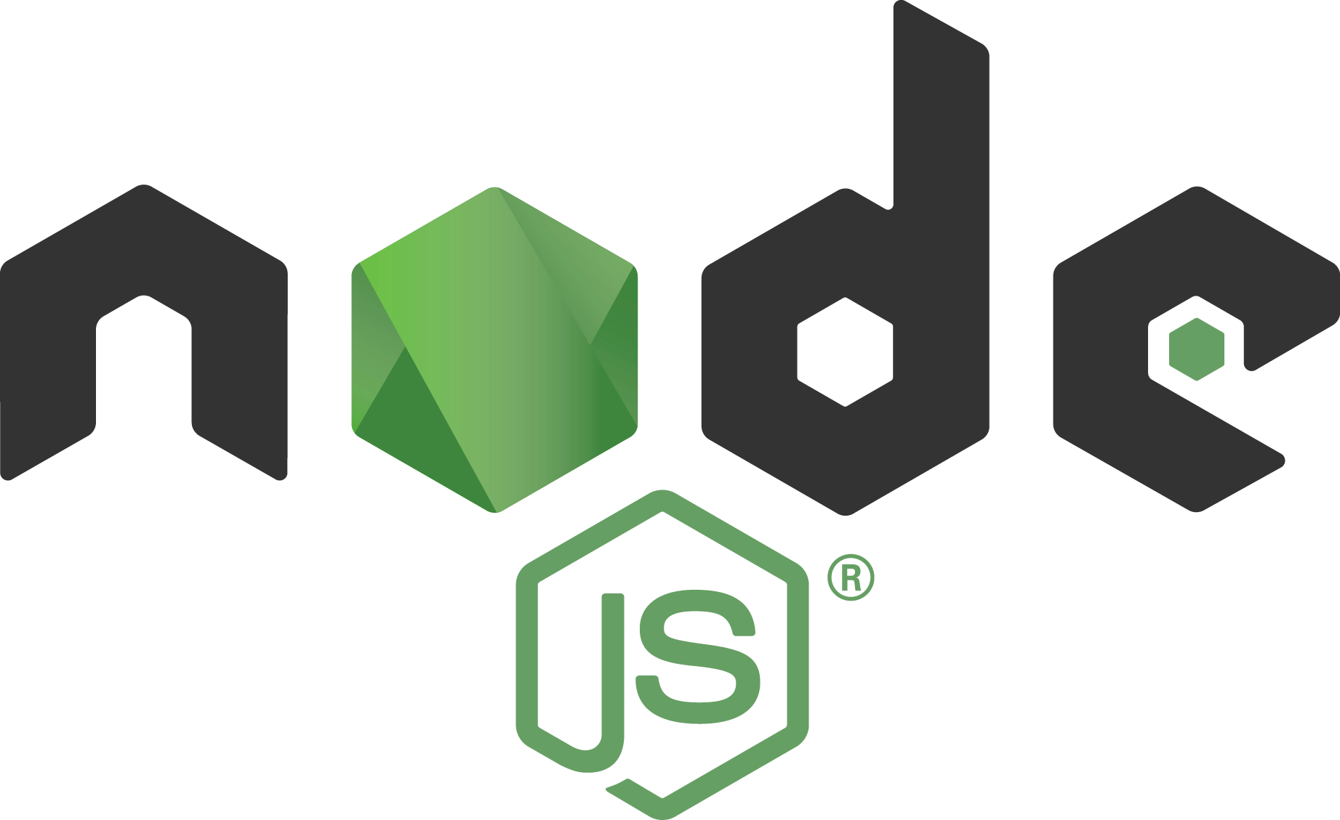



Security
We are helping global privacy and security through a program to encrypt the entire internet.
Networking
We are creating ecosystems around networking to improve agility in the evolving software-defined datacenter.
Cloud
We are creating a portability layer for the cloud, driving de facto standards and developing the orchestration layer for all clouds.
Automotive
We are creating the platform for infotainment in the auto industry that can be expanded into instrument clusters and telematics systems.
Web
We are providing the application development framework for next generation web, mobile, serverless, and IoT applications.
Blockchain
We are creating a permanent, secure distributed ledger that makes it easier to create cost-efficient, decentralized business networks.
We are regularly adding projects; for the most up-to-date listing of all projects visit tlfprojects.org
Notes:
The Linux Foundation fosters innovation in every layer of the software stack. The Linux Foundation hosts over 50 projects spanning enterprise IT, embedded systems, consumer electronics, cloud, networking, and more.
You can see a few of these projects listed here.
Let's Encrypt is a free, automated, and open certificate authority
Open Network Automation Platform project (ONAP) allows for real-time, policy-driven software automation of virtual network functions
Kubernetes, is a Cloud Native Computing Foundation project that provides production-grade container orchestration
Automotive Grade Linux provides a platform for automotive applications
the Node.JS Foundation is building and supporting the Node.js platform
and of course, Hyperledger the reason we are here today.

Slide 7
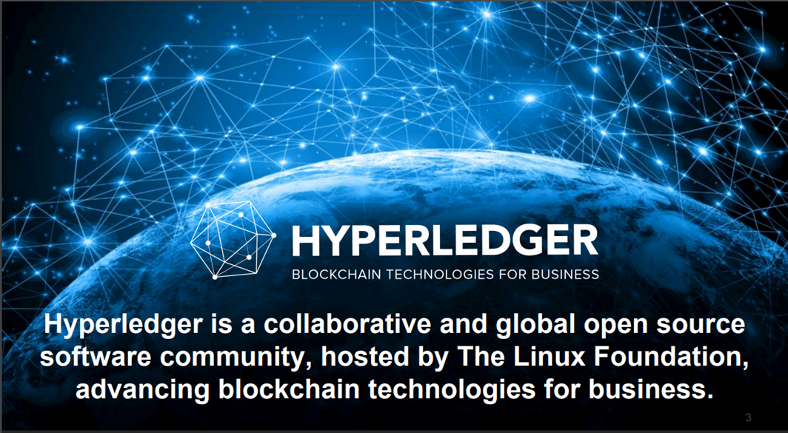

Slide 8


Open source collaborative effort
to advance cross-
industry blockchain technologies, Permissioned, that all participants have their roles clearly defined.
Hyperledger blockchains allows multiple parties to securely interact with the same version of the truth, as a shared reality becomes the basis for trusted interaction between non trusting individuals.
Global collaboration spanning finance, banking, IoT, supply chains, manufacturing and technology
Notes:
Hyperledger now has more than 230 members. The project was first announced with 30 members in February of 2016. Hyperledger members exist in 25 different countries

Slide 9

Similar to The Linux Foundation, Hyperledger also has a modular approach to hosting projects. Think of Hyperledger as a greenhouse for developing business blockchain projects from Hyperledger Labs (seed) to stable code ready for production (fruition). All are invited to contribute to the greenhouse; collectively advancing industry goals of distributed ledger and smart contracts.
Notes:
The Linux Foundation and Hyperledger provide the infrastructure for open development to occur among a diverse and thriving community.

Slide 10
Hyperledger Umbrella Products
Frameworks and Tools

Slide 11
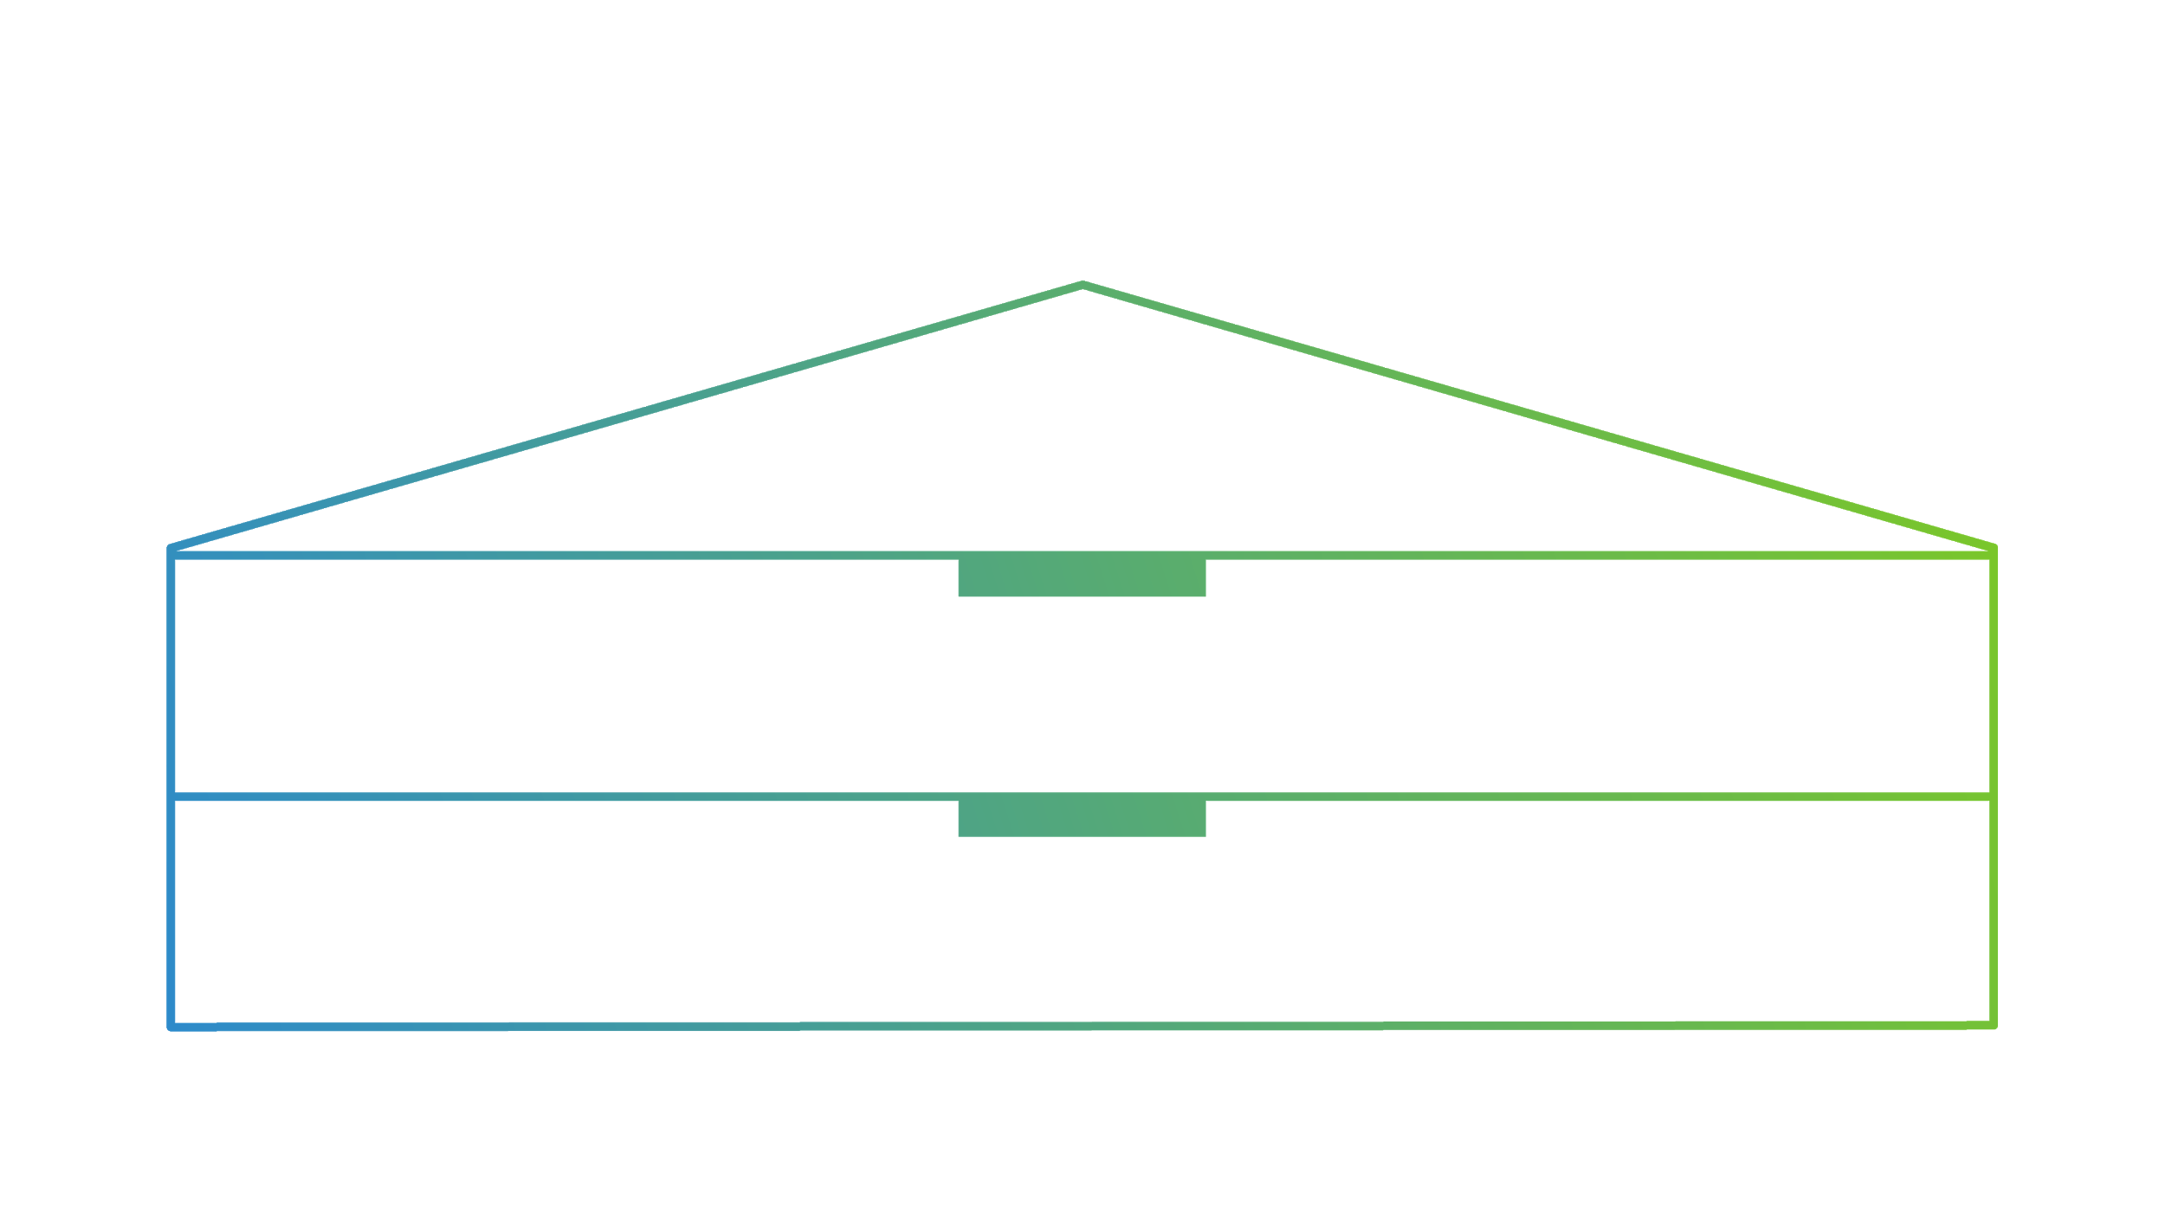

















Community Stewardship and Technical, Legal, Marketing, Organizational Infrastructure
Frameworks
Permissionable smart contract machine (EVM)
Permissioned with
channel support
Decentralized identity
Mobile application focus
Permissioned & permissionless support; EVM transaction family
Tools
Tools
Blockchain framework benchmark platform
As-a-service deployment
Model and build
blockchain networks
View and explore data on the blockchain
Ledger interoperability
Notes:
Infrastructure
Technical, Legal, Marketing, Organizational
Ecosystems that accelerate open development and commercial adoption
Frameworks
Meaningfully differentiated approaches to business blockchain frameworks developed by a growing community of communities
Tools
Typically built for one framework, and through common license and community of communities approach, ported to other frameworks
Similar to the way that The Linux Foundation takes an umbrella approach to the projects that exist under, Hyperledger also has a modular umbrella approach. At the top level, The Linux Foundation and Hyperledger provide the infrastructure for open development to occur. This includes technical, legal, marketing, and organizational aspects.
Under Hyperledger’s umbrella are a number of frameworks that take different approaches to creating business blockchain tools and frameworks -- Fabric, Iroha, Sawtooth, Burrow, and Indy.
Hyperledger’s umbrella also includes a number of modules that were typically built with one framework in mind, but are being expanded and ported to support other frameworks.
Composer - Provides a application development environment that lets you more quickly develop and deploy your blockchain application. Hyperledger Composer allows you to model your business network and integrate existing systems and data with your blockchain applications.
Explorer - provides a User Interface to explore and examine the current state of a Hyperledger blockchain. Similar to bitcoin explorers or crypto-currency explorers, information such as transaction information, network activity, recent blocks, visuals and search are available that allows for information to be quickly found.
Cello - allows us to easily provision a blockchain network, check its status, and maintain the health of the network.

Slide 12

Hyperledger Blockchain Frameworks
Notes:
Today, there are clear examples of blockchain efforts that have seen widespread adoption and scale. There are commercial blockchain stacks running in production, clear momentum around Hyperledger frameworks. Yet, by no means is this a mature industry – we seek better consensus mechanisms for both permissioned and permissionless chains, a better range of choices for smart contract platforms and the right identity models.

Slide 13

Intended as a foundation for developing applications or solutions with a modular architecture, Hyperledger Fabric allows components, such as consensus and membership services, to be plug-and-play.

Slide 14

Fabric allows the code or any complex program stored and executed on a blockchain. Smart contracts (the logic component of the systems) are called chaincode and run inside a secure DOCKER containers. Container technology hosts any mainstream language for smart contract development.
Notes:
Building one layer above distributed ledger technologies, you have smart contracts. Since distributed databases allow for multiparty, shared database use, distributed ledgers can be equipped with multi-party business logic, which is more commonly referred to as ‘smart contracts. These are a way to publish scripts and write programs in a language particular to a given chain, have them live on the shared network, and be able to execute on all those different nodes simultaneously.

Slide 15


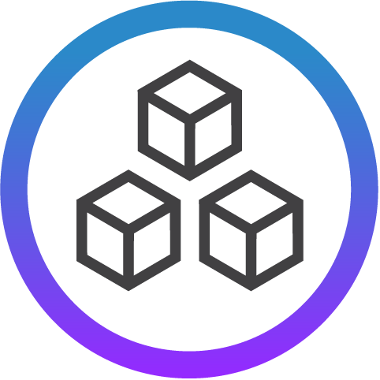
Hyperledger Fabric
Channels
A feature in Fabric that ensure that only the participants involved in a transaction see the transaction.0
Channels are a private subnetwork of communications between 2 or more network participants (peers or nodes) for private transactions.
Roles of Network Nodes
Committing Peer
Endorsing Peer
Orderer
Notes:
Associate Hyperledger Member State of Illinois has implemented a pilot program in collaboration with General member Hashed Health using Hyperledger Fabric to reduce complexity of interstate medical licensing, as well as to improve the veracity of provider directories and claims adjudication processes.
The Hyperledger Fabric pilot program will identify opportunities to improve the efficiency and accuracy of the medical credentialing process in the state of Illinois. The concept will utilize a blockchain-based registry to streamline the sharing of smart contracts and medical credential data to automate workflow associated with interstate and multistate licensure.
In the short-term they anticipate this pilot will show how distributed ledger technology can help reduce the complexity of interstate licensing processes in Illinois. In the long-term, they see this as a secure, privacy-enhancing way in which state licensure boards can efficiently manage credentialing at national scale, while also presenting health payers and provider networks a ‘single source-of-truth’ to improve the veracity of provider directories and claims adjudication processes.

Slide 16
Hyperledger Fabric Documentation:
  https://hyperledger-fabric.readthedocs.io/en/latest/index.html

Slide 17
A modular platform for building, deploying, and running distributed ledgers. Hyperledger Sawtooth includes a novel consensus algorithm, Proof of Elapsed Time (PoET), which targets large distributed validator populations with minimal resource consumption.
Notes:
Internet at the time was much more decentralized than it is today, and built primarily with open source. The technology was young and ripe with promise.
Today, there are clear examples of blockchain efforts that have seen widespread adoption and scale. There are commercial blockchain stacks running in production, clear momentum around Hyperledger frameworks. Yet, by no means is this a mature industry – we seek better consensus mechanisms for both permissioned and permissionless chains, a better range of choices for smart contract platforms and the right identity models.
In 1994, no fonts, background colors. Internet at the time was much more decentralized than it is today. Websites lived everywhere. The move to the cloud was a recentralization of that. Tech themselves were predominantly open source. This is how the internet was built at the time. To validate email, wrote the code and share it with others. To make incremental improvement, why not share it? Early days were very generative. Easy to set up a website. Taking print and turn it to black and white. It’s a return to that decentralization as a first principle?

Slide 18
Hyperledger Sawtooth
A blockchain suite designed for versatility and scalability. Sawtooth supports both permissioned and permission-less deployments.
Sawtooth includes a novel consensus algorithm, Proof of Elapsed Time (PoET). PoET’s aim is to achieve distributed consensus as efficiently as possible. Targets large distributed validator populations with minimal resource consumption.
The Seth transaction family provides support for the Ethereum Virtual Machine (EVM).
Notes:
Uses the secure enclave on an Intel chip to provide random wait timer for each of the validators (Peers) on the network. First validator whose timer expires generates the next block.

Slide 19
Hyperledger Sawtooth
Pluggable consensus algorithms (Change consensus on the fly by transaction)
Write smart contracts in almost any language, Ethereum smart contract support via Hyperledger Burrow integration
Supply Chain example out of the box

Slide 20
Hyperledger Sawtooth Documentation
    https://sawtooth.hyperledger.org/docs/

Slide 21
A permissionable smart contract machine. The first of its kind when released in December, 2014, Burrow provides a modular blockchain client with a permissioned smart contract interpreter built in part to the specification of the Ethereum Virtual Machine (EVM).

Slide 22

Hyperledger Burrow
A permissioned Ethereum smart-contract blockchain framework that executes smart contract code (written in Solidity) on a permissioned virtual machine. Burrow is built for a multi-chain universe.
Burrow is constructed out of three main components:
The consensus engine
The permissioned Ethereum virtual machine
The gateway

Slide 23
Hyperledger Burrow
Consensus Engine: Transactions are ordered and finalized with the Byzantine fault-tolerant Tendermint protocol. The Tendermint protocol provides high transaction throughput over a set of known validators and prevents the blockchain from forking.
Application Blockchain Interface (ABCI): The smart contract application interfaces with the consensus engine over the ABCI. The ABCI allows for the consensus engine to remain agnostic from the smart contract application.

Slide 24
Hyperledger Burrow
Smart Contract Application
Transactions are validated and applied to the application state in the order that the consensus engine has finalized them. The application state consists of all accounts, the validator set and the name registry.
Accounts in Burrow have permissions and either contain smart contract code or correspond to a public-private key pair.
A transaction that calls on the smart contract code in a given account will activate the execution of that account’s code in a permissioned virtual machine.

Slide 25
Hyperledger Burrow
Permissioned Ethereum Virtual Machine:
This virtual machine is built to observe the Ethereum operation code specification and additionally asserts the correct permissions have been granted.
Permissioning is enforced through secure native functions and all smart contract code. An arbitrary but finite amount of gas is handed out for every execution to ensure a finite execution duration .
Notes:
You don't need money to play when you have permission to play.

Slide 26
Hyperledger Burrow
Application Binary Interface (ABI)
Transactions need to be formulated in a binary format that can be processed by the blockchain node.
Current tooling provides functionality to compile, deploy and link solidity smart contracts and formulate transactions to call smart contracts on the chain.
API Gateway
Burrow exposes REST API and JSON-RPC endpoints to interact with the blockchain network and the application state through broadcasting transactions, or querying the current state of the application.
Burrow Documentation
https://github.com/hyperledger/burrow/blob/master/README.md

Slide 27

Hyperledger Iroha
Iroha is a distributed ledger project that provides a development environment where C++ and mobile application developers can contribute to the Hyperledger Project.
Iroha allows reusable components. Users can perform common functions, such as creating and transferring digital assets, by using prebuilt commands that are in the system.
No need to write cumbersome and hard to test smart contracts, developers can use tested solutions to complete simple tasks faster and with less risk.

Slide 28
A business blockchain framework designed to be simple and easy to incorporate into infrastructural projects requiring distributed ledger technology.

Slide 29
Hyperledger Iroha
Key Characteristics
Simple deployment and maintenance
Variety of libraries for developers
Role-based access control
Modular design, driven by command–query separation principle
Assets and identity management
A new Byzantine Fault Tolerance Consensus Algorithm called YAC
Permissioned network
Written in C++, Java chaincode.
Special transactions types libraries for asset creation without chaincode.

Slide 30
Hyperledger Iroha
Iroha is an additive to existing projects that will foster robust libraries that can be selected and used freely by those running distributed ledgers on Hyperledger technology.
Iroha supports JavaScript Libraries that provide both Android and IOS system design Kits.
Iroha Documentation:
IROHA Code on Github
Setting up IROHA Development Environment
Technical Guide

Slide 31
Tools, libraries, and reusable components for providing digital identities rooted on blockchains or other distributed ledgers so that they are interoperable across administrative domains, applications, and any other silo.

Slide 32

Hyperledger Indy
Indy provides tools, libraries, and reusable components for providing Digital Identities rooted on blockchains.
Indy strives to make this data on the blockchain or other distributed ledgers so that they are interoperable across administrative domains, applications, and any other silo.

Slide 33
Hyperledger Indy
Key Characteristics
Distributed ledger purpose-built for decentralized identity
Zero Knowledge Proofs which prove that some or all of the data in a set of Claims is true without revealing any additional information, including the identity of the Prover.
Provides tools , libraries and reusable components for providing digital identities on the blockchain. These verifiable claims can be used to prove something about the identity without providing access to the underlying data.
Indy Documentation: https://wiki.hyperledger.org/projects/indy/documentation

Slide 34

HYPERLEDGER TOOLS
Notes:
David

Slide 35


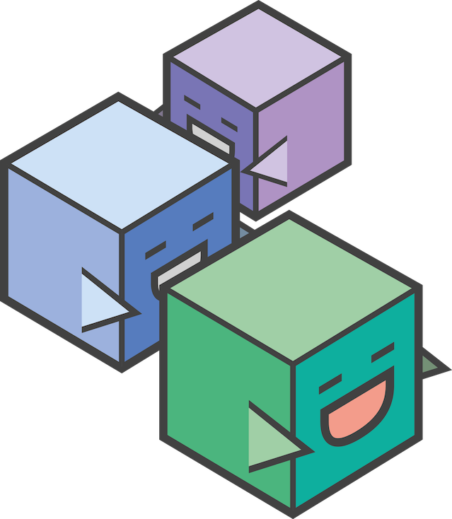

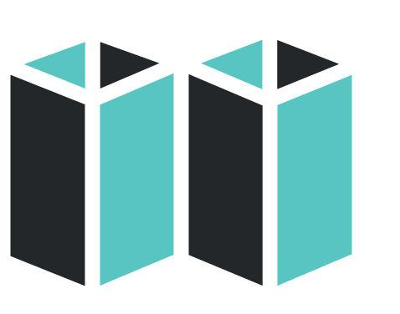

Hyperledger Tools
Caliper
A tool which allows users to measure performance of a specific blockchain implementation with a set of pre-defined use cases.
Cello
Deployment model to simplify creating, managing and terminating blockchains.
Composer
A collaborative tool for building blockchain business networks.
Explorer
A Web-enabled user interface to gain insight into your blockchain.
Quilt
Interoperability between ledger systems by using ILP, a payment protocol to distribute value.

Slide 36

Hyperledger Caliper
A blockchain benchmark framework which allows users to measure the performance of a specific blockchain implementation with a set of predefined use cases.
A tool that provides performance evaluations for different blockchain solutions based on a set of neutral and commonly accepted rules.
The Performance & Scalability Working Group (PSWG) are responsible for the Caliper project definitions, metrics and terminology.

Slide 37
Hyperledger Caliper
Caliper will produce reports containing a number of performance indicators:
  TPS (Transactions Per Second)
  transaction latency
  resource utilization
Caliper results should be used as a reference in supporting the choice of a blockchain implementation suitable for the users specific use-cases.
Caliper is not intended to be an authoritative performance assessment or to be used for simple comparative purposes (e.g. Blue blockchain is 5 TPS, Red Blockchain is 10 TPS. So b is better).

Slide 38
Hyperledger Caliper
Key Characteristics
Adaptor Layer: provide a common layer to integrate with major existing blockchain framework/platforms, so that the same benchmarks can be run for different blockchain systems.
Benchmark test environments will be provided to help different clients run tests under the same environment.
Users can use their existing environment and configure Caliper to run the test in that environment.

Slide 39
Hyperledger Caliper
The goal of Caliper includes providing a set of easily understandable benchmark cases so that each blockchain solution can be compared in various scenarios.
Caliper Documentation:
https://wiki.hyperledger.org/projects/caliper#caliper
Hyperledger Caliper is not intended to make judgments and will not publish benchmark results.
  .
  Hyperledger Caliper will provide benchmark tools for users based on performance

Slide 40

Hyperledger Cello
Cello is a blockchain module toolkit which helps people use and manage blockchains in a more efficient way.
Cello creates a Blockchain as a Service (BaaS) platform to provision customizable blockchain networks easier and faster.
Cello’s Blockchain as a Service helps to build deployment model blockchain platforms quickly from scratch that are provisional and customizable.
Cello helps mitigate the operational cost for blockchain users and application developers by reducing the effort required for creating, managing and terminating blockchains.

Slide 41
Hyperledger Cello
CMajor features
  Written in Python, Cello will help manage the lifecycle of blockchains (e.g., create / start/ stop/ delete/ keep health) automatically.
  Check the system status, adjust the chain numbers, scale resources etc., through dashboards
  Manage the lifecycle of blockchain networks automatically, (e.g., create/start/stop/delete/keep health) .
  Support customized blockchain network config, (e.g., network size, consensus type).
  Support multiple underlying infrastructures including bare-metal, virtual machine, vSphere, native Docker host, swarm and Kubernetes.

Slide 42
Hyperledger Cello
.
Key Feature Cello- Analytics:
    Collect logs/events from blockchains
    Parse those logs/events automatically with statistic results in interactive graphs
    Provides deep analytics to explore potential abnormality and root cause.
    Schedule resources among various resource pools including servers and container clouds
Cello Documentation:
      https://cello.readthedocs.io/en/latest/
      https://docs.google.com/presentation/d/1sq4hnTRpH9qaPJe96f6Egx9LclbCC5KcQjnBmv2LO68/edit#slide=id.p12

Slide 43
Hyperledger Composer
Composer is an application development framework (ADF) for building blockchain business networks using Hyperledger Fabric framework.
Hyperledger Composer is a set of collaboration tools for building blockchain business networks that make it simple and fast to create smart contracts and blockchain applications to solve business problems.
Built with JavaScript and leveraging modern tools including node.js and popular editors, Composer offers business-based abstractions, sample apps with easy to test processes, to create robust blockchain solutions.
It enables business owners and the developers to create smart contracts and blockchain applications to solve business problems by:
  Supplying an example to model business networks, including assets and transactions management.
  Integrating existing systems and data with the blockchain applications.

Slide 44
Composer Playground
Key Characteristics
  Quickly model your business blockchain network.
  Quickly generate REST APIs for interacting with your blockchain network.
  Quickly generate an Angular application.
Emphasis on business-centric vocabulary for quick solution creation. Helps create Business Network Definitions .
Composer Documentation
https://hyperledger.github.io/composer/latest/introduction/introduction.htm
https://drive.google.com/file/d/1Xxmu3lHsVcLVDz4TuPRQQvCUOM1tUUoG/view

Slide 45
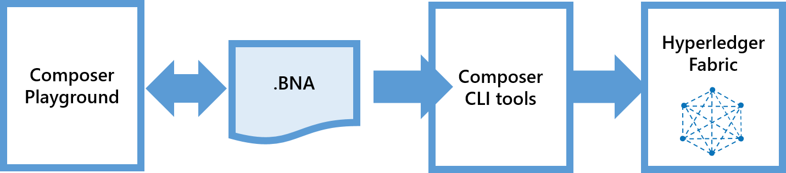
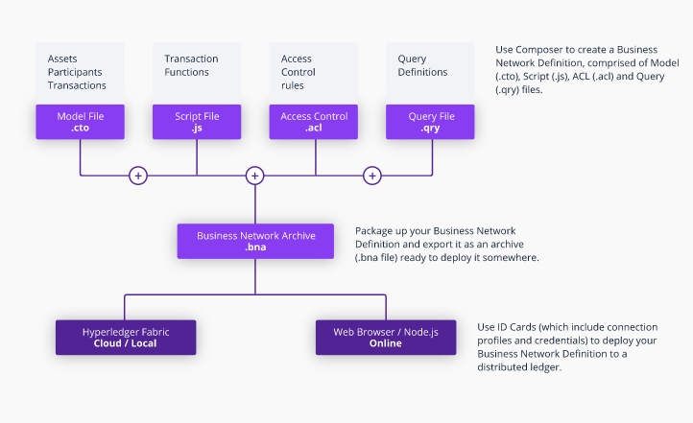

Slide 46
Hyperledger Explorer
Explorer is designed to create a user-friendly Web application to let you view information about a blockchain.
Hyperledger Explorer can view, invoke, deploy or query :
  Blocks
  Transactions
  associated data
  network information (name, status, list of nodes)
  chaincode deployment
  transaction families
  any other relevant information stored in the ledger.

Slide 47
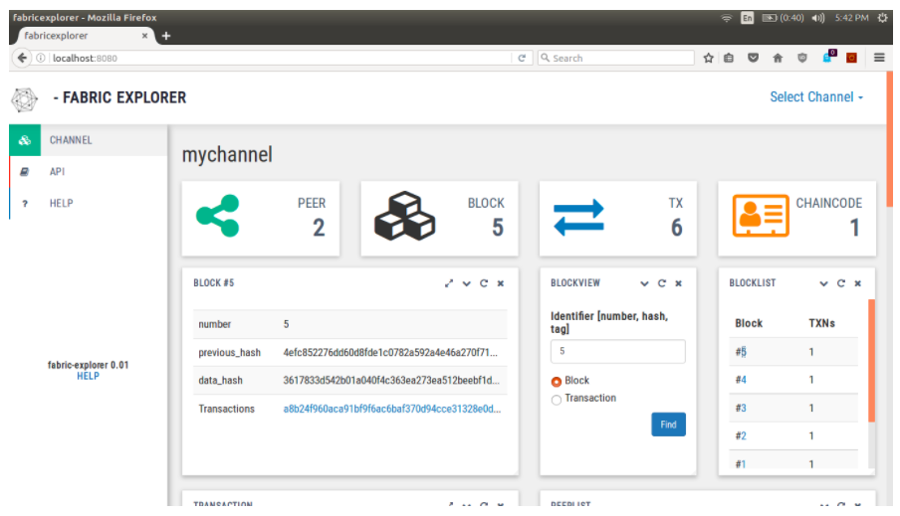

Slide 48
Hyperledger Explorer
Supports the REST APIs for getting access to some of the following information:
  Block information (by block hash block number)
  Transaction
  Peer status
  Channel information,
  List of chaincode installed and represented on specific channels
  Block count on specific channel
  Create and update channel

Slide 49
Hyperledger Explorer
  Explorer Documentation:
      https://docs.google.com/document/d/1GuVNHZ5Jqq-gTVKflnZ1YiJfEoozvugqenC6QEQFQj4/edit
      https://docs.google.com/presentation/d/e/2PACX-1vQlhbtxwgCOTJ22bacHqY5GpXR_Ucl9EJZKov2RzxlGYZXmi889X6yMW4Hzh6Rjzu4bh0qyYKYTZSF5/pub?start=false&loop=false&delayms=3000&slide=id.gc6f90357f_0_0

Slide 50

Hyperledger Quilt
Quilt promotes interoperability between Blockchain networks by assisting in transferring value across different Blockchain networks.
A user registered with one Blockchain network can securely transfer the value to another user registered with another Blockchain network.
Hyperledger Quilt is build based on the Interledger Protocol ( ILP) provides for routing payments across different digital asset ledgers while isolating senders and receivers from the risk of intermediary failures.

Slide 51
Hyperledger Quilt
Key Characteristics
ILP is primarily a payment protocol and is designed to transfer value across distributed ledgers and non-distributed ledgers.
Provides atomic swaps between ledgers (even non-blockchain or distributed ledgers).
Provides a single account namespace for accounts within each ledger.
Quilt now hosts both the Java (Quilt) and JavaScript (Interledger.js) .
The Interledger protocol is intentionally limited in scope to provide the functions necessary to deliver a payment from a source to a destination over an interconnected system of ledgers.
It includes minimal requirements for underlying ledgers and it does not include public key infrastructure, identity, liquidity management, or other services commonly found in payment protocols.

Slide 52
Hyperledger Quilt
Quilt Documentation:
  https://github.com/hyperledger/quilt
  https://s3-ap-southeast-1.amazonaws.com/mredmundto-others/Hyperledger+Quilt+and+Interledger+Protocol+.pdf

Slide 53
Getting Involved: Hyperledger Community
Notes:
David

Slide 54

Get Involved!
How to get started with Hyperledger projects
Tracy Kuhrt
Community Architect, Hyperledger
The Linux Foundation
David Boswell
Director of Ecosystem, Hyperledger The Linux Foundation
Notes:
Emily

Slide 55
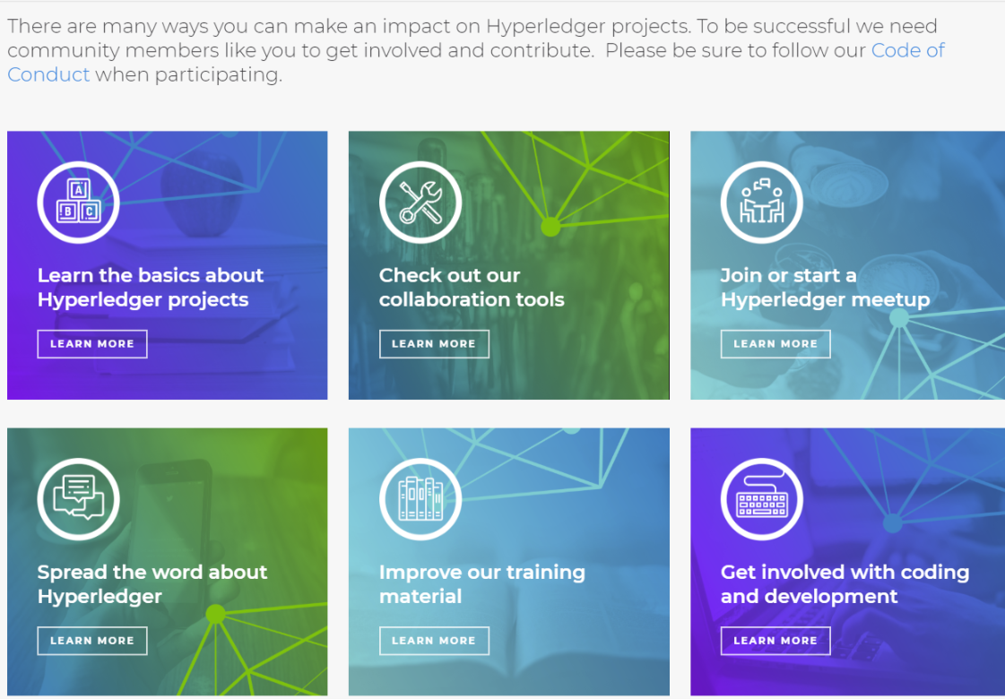
WEBPAGE
WWW.HYPERLEDGER.ORG/COMMUNITY

Slide 56
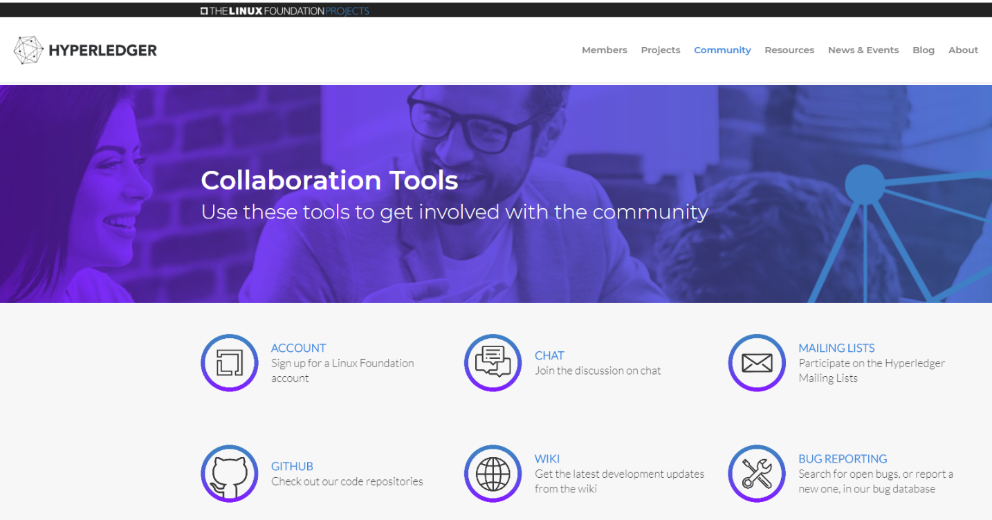
Hyperledger Web Page
https://www.hyperledger.org/community/collaboration-tools
Sign up

Slide 57
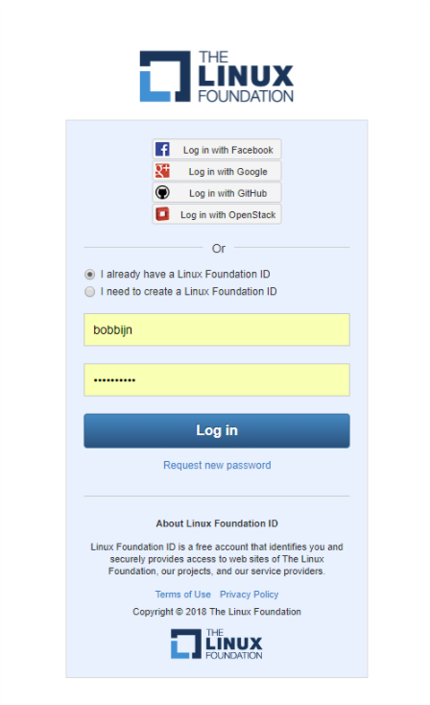
Hyperledger
Linux Login

Slide 58
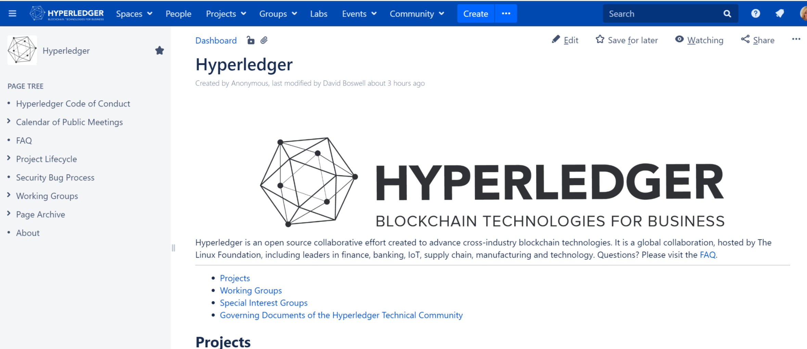
Hyperledger Wiki https://wiki2.hyperledger.org/

Slide 59
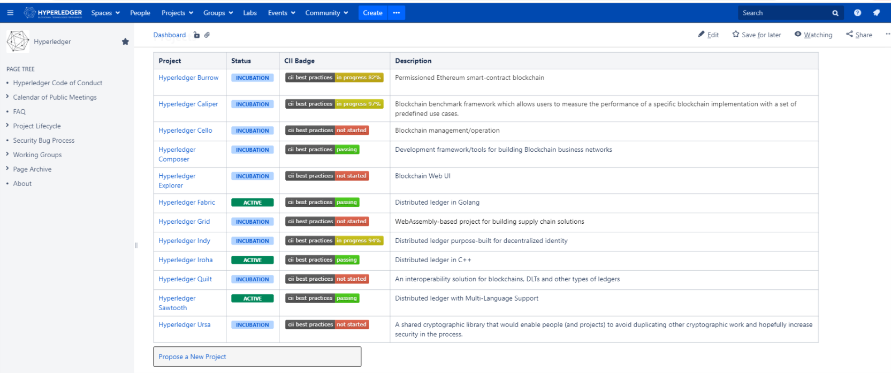
Hyperledger Projects

Slide 60
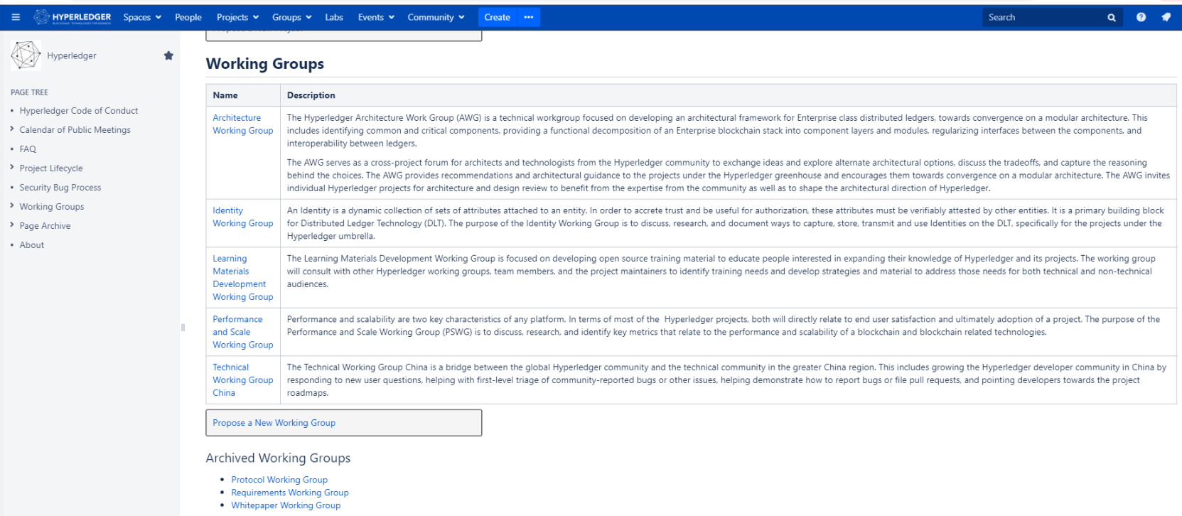
Hyperledger Working Groups

Slide 61
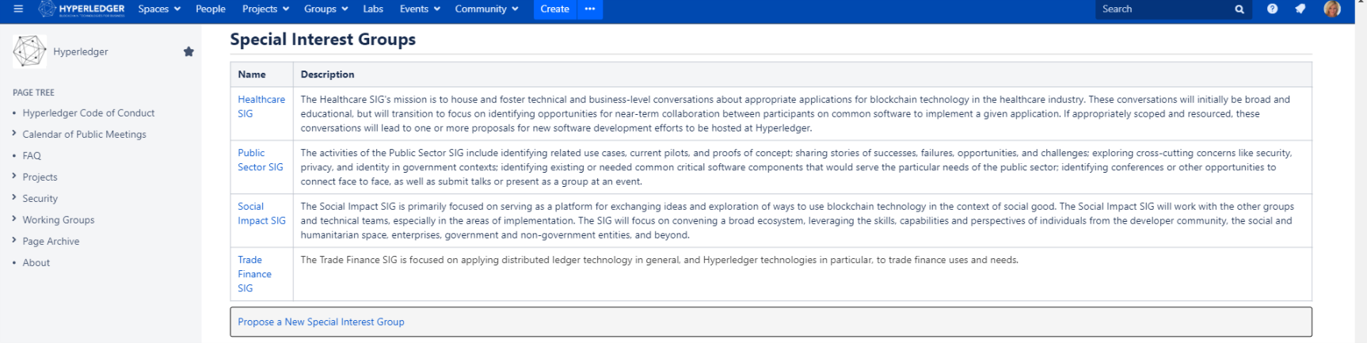
Hyperledger Special Interest Groups

Slide 62
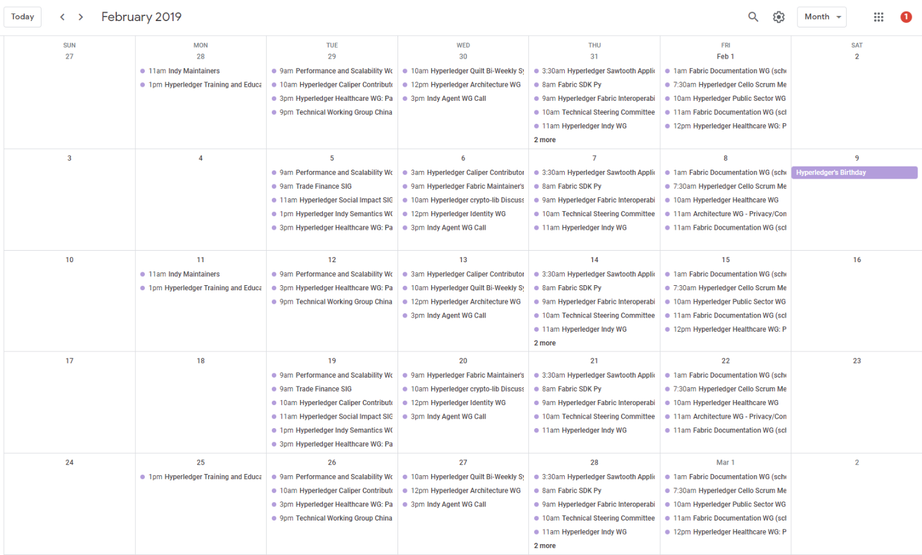
Hyperledger Community Meeting Schedule

Slide 63

Participating in the Community
All Hyperledger working groups (specs) and projects (code) do their work in the open, with the code and discussions published publicly.
All code is forkable from GitHub.
Committers use Gerrit or GitHub to submit and accept changes.
Bugs in current code should be submitted to JIRA.
Projects use mailing lists for all technical discussions and announcements; you are free to join.
Many working groups hold regular public meetings where anyone can participate.
Live discussions happen in RocketChat channels (instead of Slack).
Projects at Hyperledger have a lifecycle from incubation to production products.
Notes:
David

Slide 64
Thank You!

