Slide 1
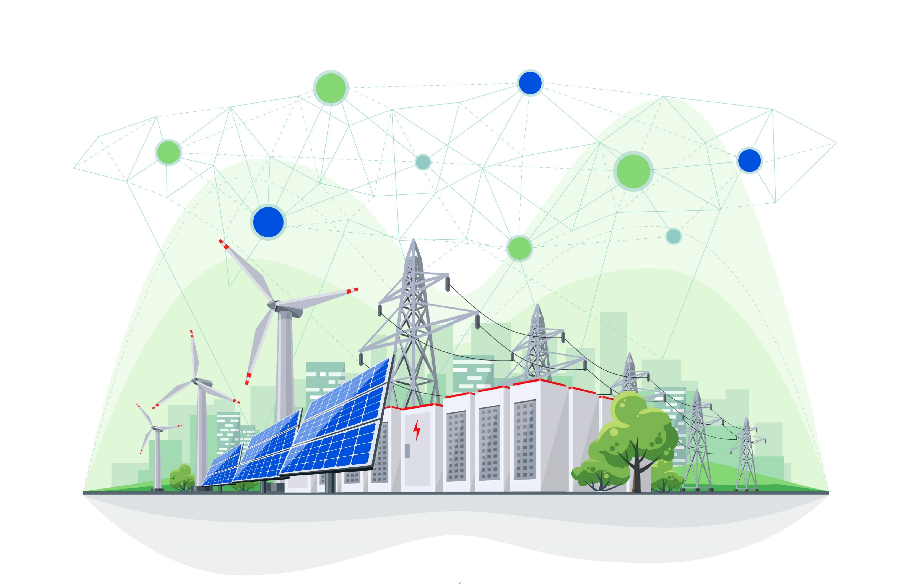
EnerBlock
UNLOCKING DISTRIBUTED POTENTIAL
Blockchain-Enabled Virtual Power Plant
for Distributed Energy Resources
Dr. David M. King Founder, EnerBlock LLC

Slide 2
EnerBlock Vision: Power Grid Resilience from Renewable Electricity produced and stored at the Grid Edge
1-5 Years:
Rate Structure Optimization; Solar + Storage Observability; Residential DR; Enhanced Weather Derivatives
5-10 Years:
P2G Residential Demand-Response for Peaker Retirement and Grid Services; Vehicle-to-Grid Designs for Fast Charging
10-20 Years:
Autonomous P2P Transactions using Real-Time-Pricing; Majority Renewables

Slide 3
EnerBlock Technology: Multi-Token Strategy for the Autonomous Home
“Nearly half of utilities globally exploring Distributed Energy Resource Management Systems (DERMS)” PV Magazine, April 2019
There are over 2 Million PV installations in the US without storage... 4 Million by 2023
  Leading Residential PV installation cost driver is Customer Acquisition;
  EnerBlock retrofittable storage + blockchain module would have a built-in market base
New York Public Service Commission: Eliminating the top 100 hours of peak demand would save $1.2-1.7 Billion per year.
  Most PV installers are evaluating/offering solar + storage installations (DC-coupled batteries)
  Blockchain allows self-prescribed Demand-Response Management without requiring a third-party
EV charging will add around 2,000 TWh of electricity demand by 2040, 9% of total demand by 2050 Bloomberg New Energy Outloook 2018
  Tariffs / Time-of-Use (TOU) / Real-Time-Pricing models necessary to manage demand
Blockchain provides trustworthy mechanism for utility to purchase power for grid services from Behind-the-Meter (BTM); maintains privacy for the autonomous home

Slide 4
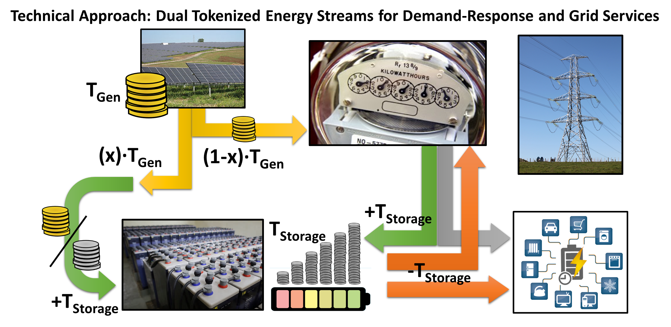
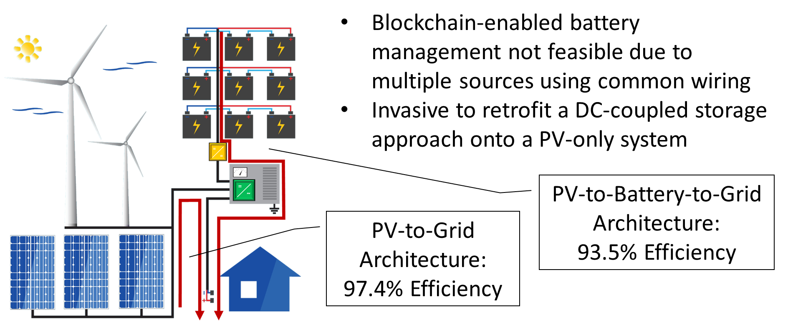
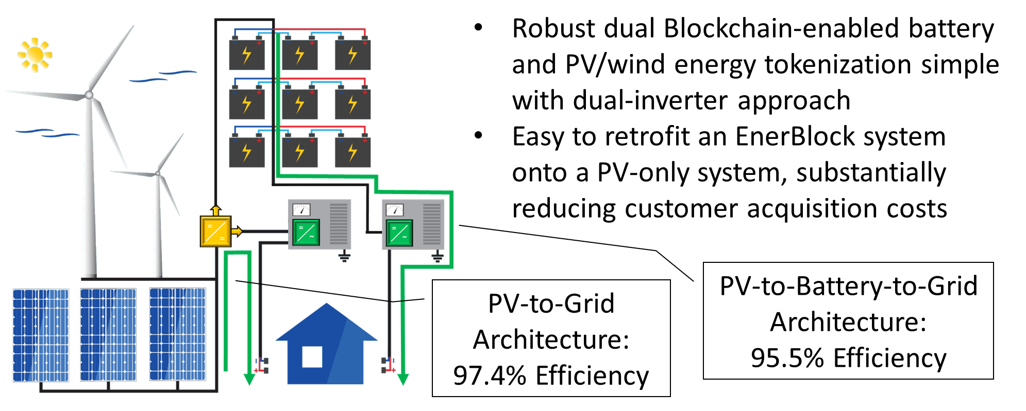
EnerBlock: Dual blockchain for independent auditing of energy generation + storage in a hybrid power electronics architecture
Asset Blockchain: Tokenized Energy
  Value of kWh, market-based $ for transaction
  Utility buying tokens corresponds to discharging batteries
Separate tokenization of generated vs. stored energy provides enhanced observability
Utility can see/trust exact energy available to request from Grid Edge assets
Dual Blockchain / Dual Inverter technology: simple retrofit, non-disruptive, highest efficiency/flexibility

Slide 5
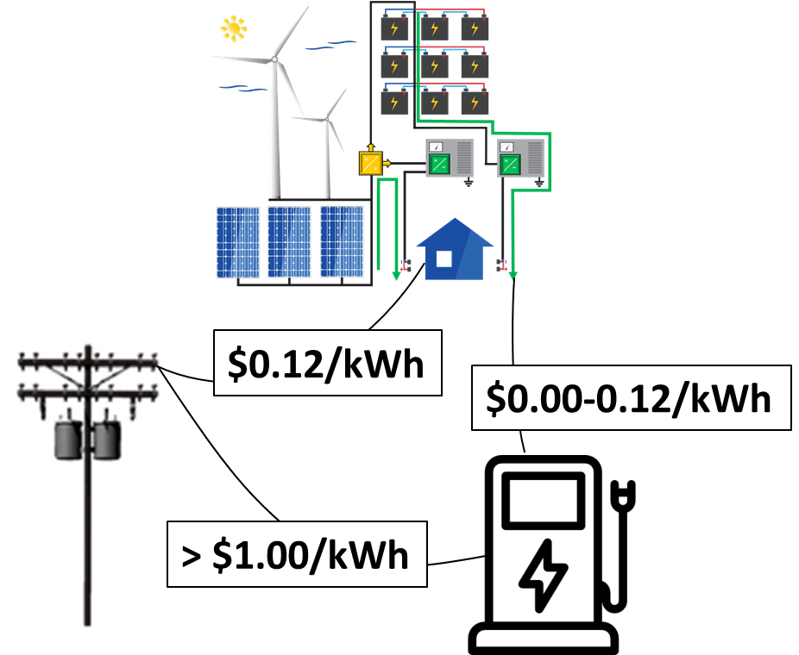
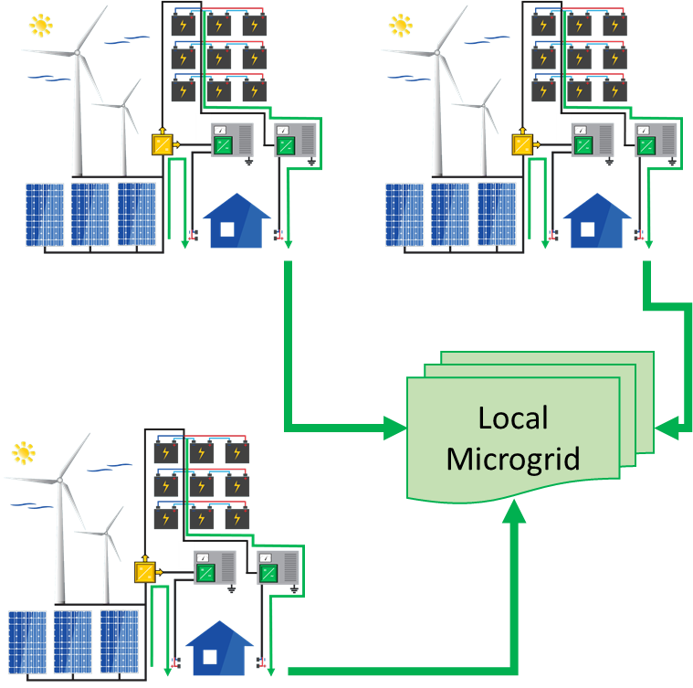
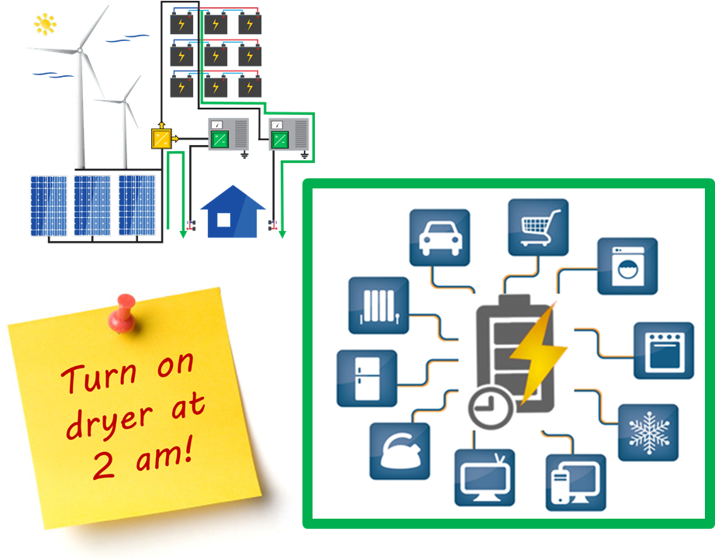
EnerBlock Technology: Additional Benefits
Parallel PV + Blockchain / Storage + Blockchain facilitates building-assisted Extreme Fast Charging (< 10 minute) without incurring high demand charges
Aggregated Storage + Blockchain via 2nd inverter provides back-up power to nano-grid / micro-grid upon centralized grid failure without risking safety
Maximizes IoT interoperability
Battery on a Blockchain™ provides data analytics of real use patterns for battery lifecycle
  Optimizes 1st life warranty costs
  Provides 2nd life certification (proof of remaining life)
  Tracking of battery chemistry facilitates end-of-life recycling efforts

Slide 6
Top Opportunities for Blockchain-Enabled Transactive Energy
Autonomous Residential, C&I DR Management while Maintaining Privacy, Cybersecurity
Provide Grid Operator with Full DER Asset Observability to Enhance Grid Resilience, Reduce Costs, Increase Margins of Weather Derivatives Product Offerings
Capture Benefits of Real-Time Pricing without Costly Regulatory Studies
Peer-to-Peer, Peer-to-Grid, Vehicle-to-grid Marketplaces; Prepare for EV Fast Charging

Slide 7
