Slide 1
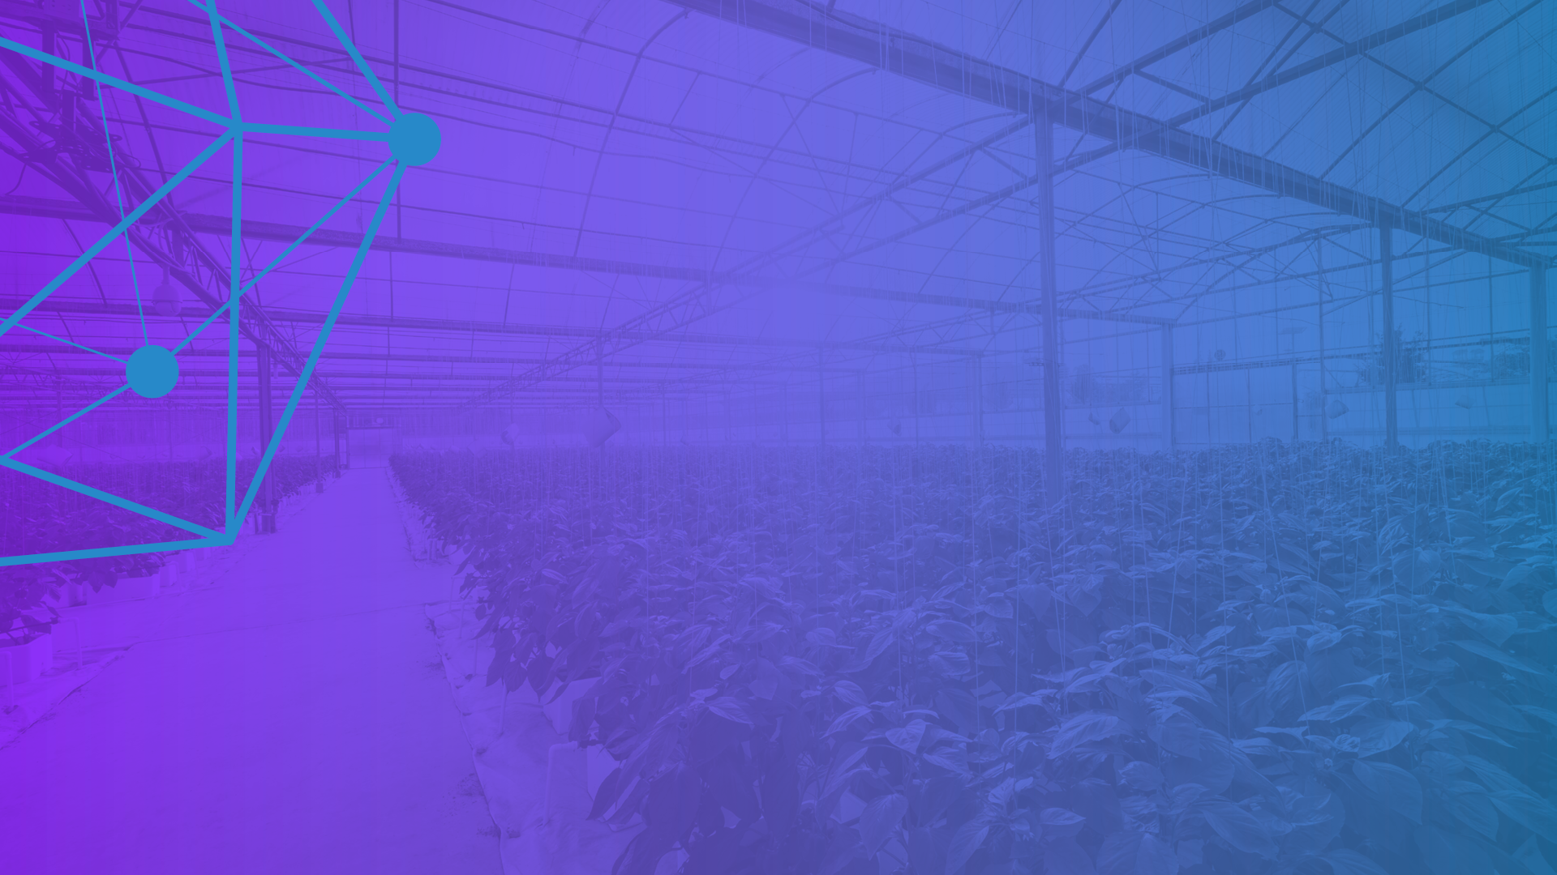


Mid-Year 2019
Hyperledger Update
www.hyperledger.org
@Hyperledger

Slide 2
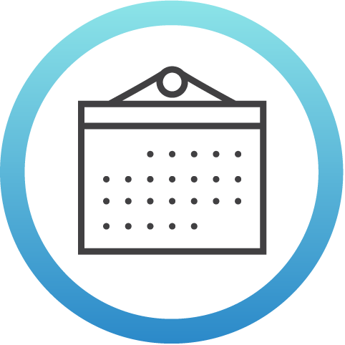

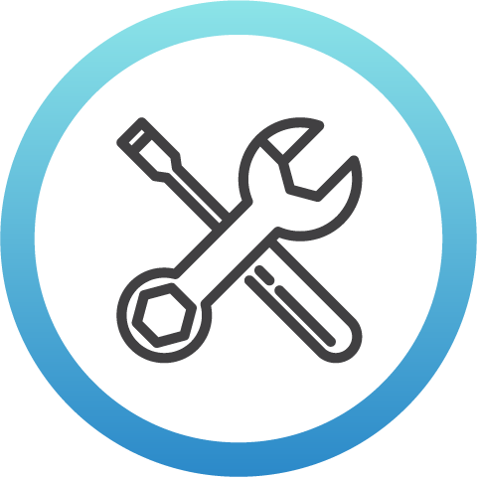
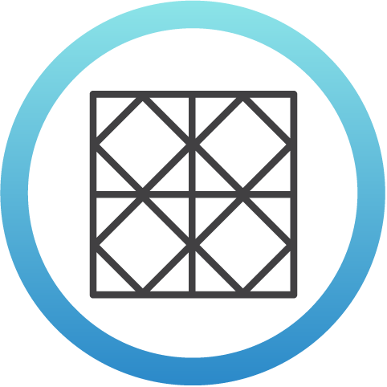
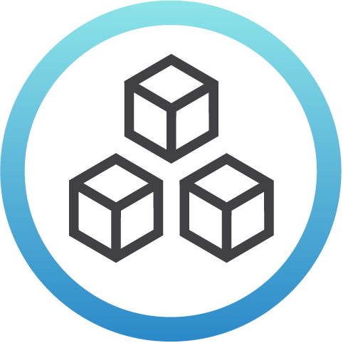

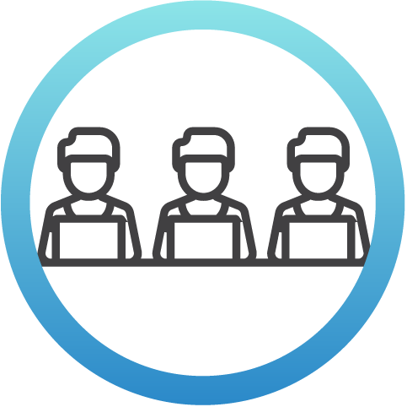
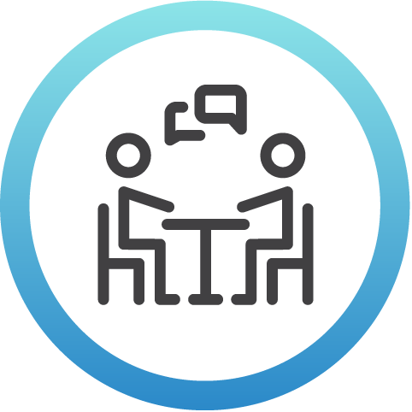
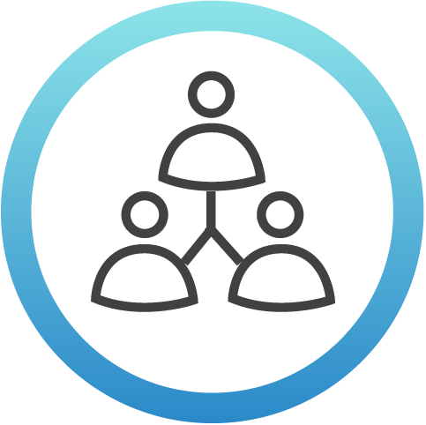

Hyperledger Momentum
3.5
Years since launch
4
Libraries
4
Tools
5
Distributed Ledgers
3
1.0+ Production Releases
275+
Members
(50+ in AsiaPac)
14
Active Community Working Groups &
Special Interest Groups
175+
Meetups
Worldwide
(75+ countries)
62K+
Meetup
Participants
2,000+
Media Clips Per Month
Notes:
These are statistics covering different aspects of the Hyperledger community that show the growth in activity over time.

Slide 3

Hyperledger has a modular approach to hosting projects. Think of Hyperledger as a greenhouse growing and sustaining business blockchain projects from seed to fruition.
The Linux Foundation and Hyperledger provide the infrastructure for open development to occur among a diverse and thriving community.
Notes:
Under Hyperledger’s umbrella there are frameworks and tools that take different approaches to creating blockchains for business.
There are many benefits to this modular approach since we believe that there isn’t one blockchain solution that will work well for every possible use case.

Slide 5


Major Project Releases
The Alpha release of Hyperledger Fabric v2.0 allows users to try out the new support for decentralized governance of smart contracts.
The Iroha 1.0 release happened in May and included YAC Consensus, Fully Operational Multisignature, updated client libraries and Windows support
Notes:
This slide covers the major project-related news for this time period, including updates to existing projects and the launch of new projects.

Slide 6


Our Newest Projects
Infrastructure for blockchain-rooted, peer-to-peer interactions. Includes a shared cryptographic wallet (the secure storage tech, not a UI) + a protocol for off-ledger interaction between clients.
Hyperledger Transact will reduce the development effort for writing distributed ledger software by providing a standard interface for executing smart contracts that is separate from the distributed ledger implementation. A shared software library handles all aspects of scheduling, transaction dispatch, and state management.
Notes:
This slide covers the major project-related news for this time period, including updates to existing projects and the launch of new projects.

Slide 7

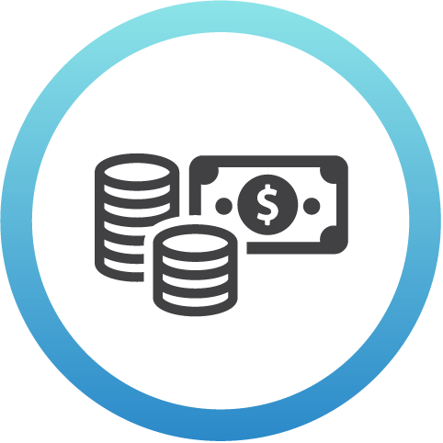
Special Interest Groups (SIG)
Newest SIGs:
HYPERLEDGER
Supply Chain Special Interest Group
Focused on the implementation of enterprise-grade solutions utilizing the Hyperledger greenhouse of business blockchain frameworks and tools (launched May)
HYPERLEDGER
Capital Markets Special Interest Group
Focused on studying how Hyperledger DLTs interact with Capital Markets use cases and exploring architecture, identity and performance related considerations (launched July)
Current SIG Proposals:
Education Architecture
For more information or to get involved, please visit: https://wiki.hyperledger.org/display/HYP/Special+Interest+Groups
Notes:
This slide covers updates with the Special Interest Groups (which of community-led efforts around how Hyperledger is being used in different industries). This include reference to the most recently launched groups and preview of new groups under development.

Slide 8
New Technical Working Groups
HYPERLEDGER
Diversity, Civility and Inclusion Working Group
This group is focused on measuring and improving the health of our open source community. We seek to provide constructive recommendations to the TSC, projects, and working groups. All are welcome to join us and help Hyperledger continue to grow in a diverse, civil, and inclusive way.
For more information or to get involved, please visit:
https://wiki.hyperledger.org/display/DCI/
Notes:
This slides provides updates about the newest technical working group that was launched during this period.

Slide 9


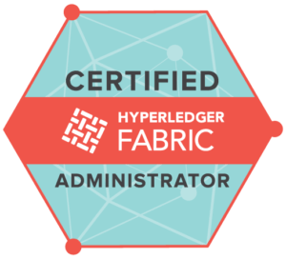
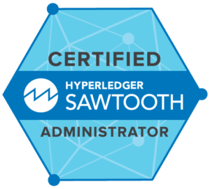

Training and Certifications
Technical training courses and professional certifications to get you up-to-speed on Hyperledger with the highest quality training from The Linux Foundation and Hyperledger Training Partners.
New Professional Certifications!
Certified Hyperledger Sawtooth Administrator (CHSA)
Certified Hyperledger Fabric Administrator (CHFA).
Certified Hyperledger Fabric Developer (CHFD) (coming soon Q1 2020!)
- Blockchain: Understanding Its Uses and Implications
- Introduction to Hyperledger Technologies
- Hyperledger Fabric Fundamentals
- Hyperledger Sawtooth Administration
- Hyperledger Fabric Administration
MOOCs
Visit: https://www.hyperledger.org/resources/training
Notes:
This slides has information about the training and certifications that are available for Hyperledger. For people who want more information, please refer them to the link in the bottom right part of the slide.

Slide 10


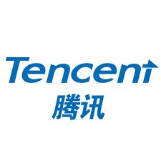

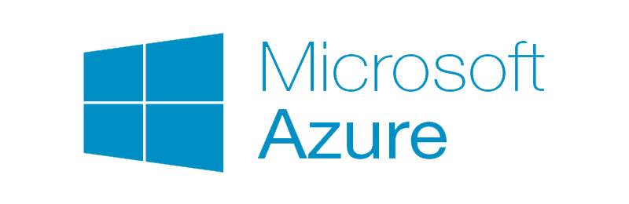

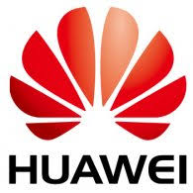




Hyperledger
Now Available Across All Major Clouds
Notes:
This shows the logos for cloud providers who are offering at least one of the Hyperledger projects on their services.

Slide 11
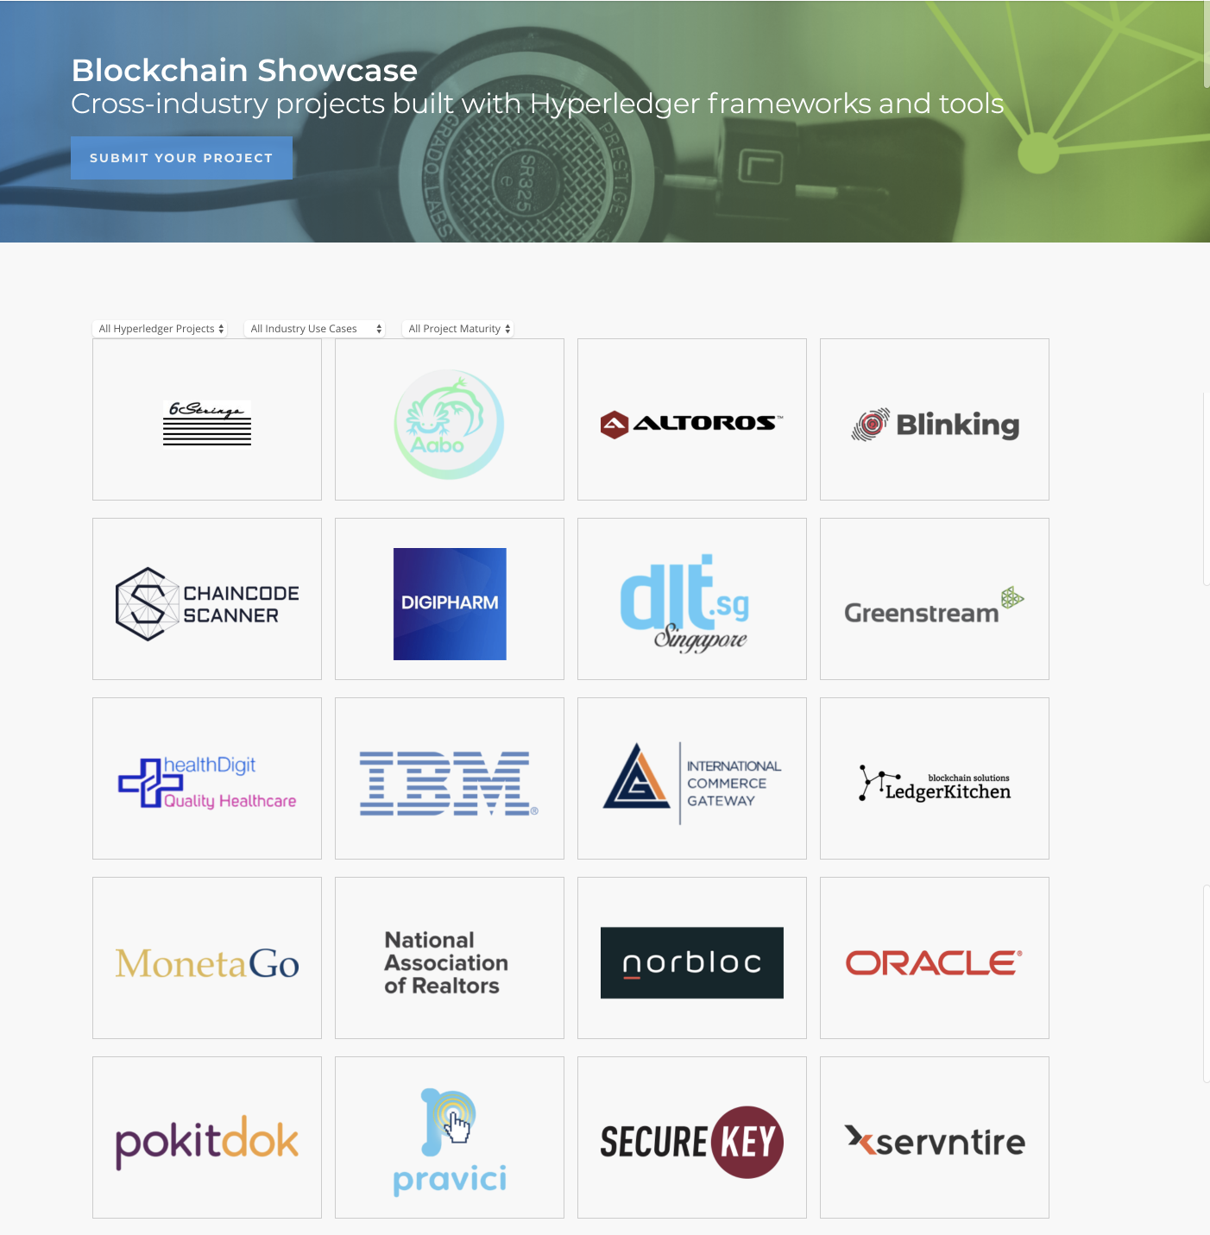

Blockchain Showcase
Cross-industry projects built with Hyperledger frameworks and tools.
65+
Community self submitted projects!
11
Submit your showcase https://www.hyperledger.org/resources/blockchain-showcase
Notes:
This slide talks about the Blockchain Showcase page on the Hyperledger site that has details about the known solutions that organizations have built using Hyperledger. Please point out the link in the bottom right part of the page for people who want to learn more.

Slide 12

Events Update

Slide 13

Hyperledger Global Forum 2020
More than 1,000 users and contributors of Hyperledger projects from across the globe to meet, align, plan and hack together in-person. Phoenix, AZ, March 3-6, 2020
Registration is now open! individual, academic, Govt rates available.
We encourage you to submit a talk by Sept 27!
Please help us promote the event on your channels using #HyperledgerForum

Slide 14
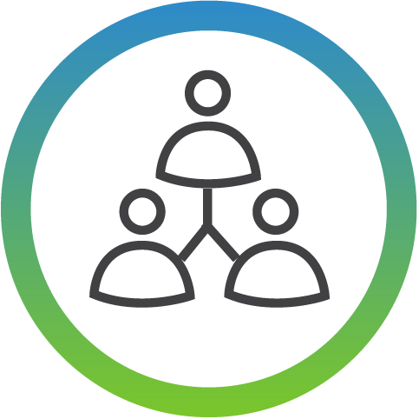
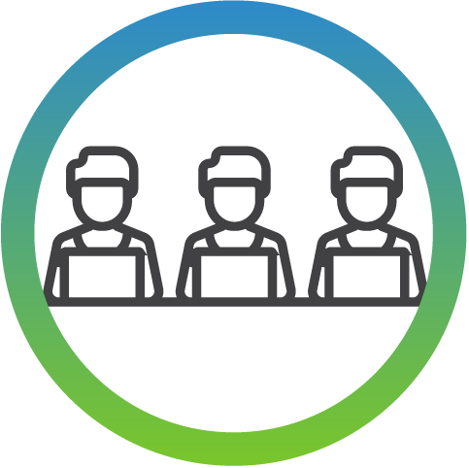

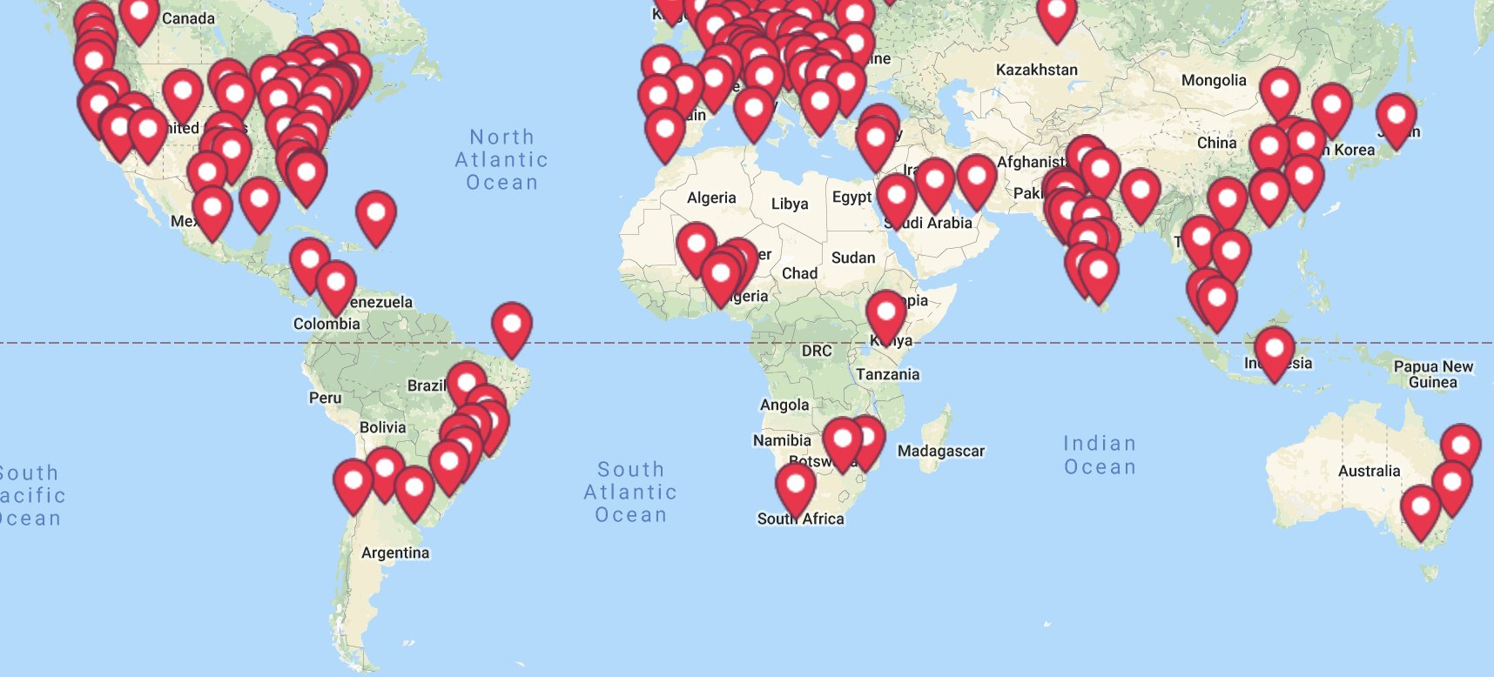
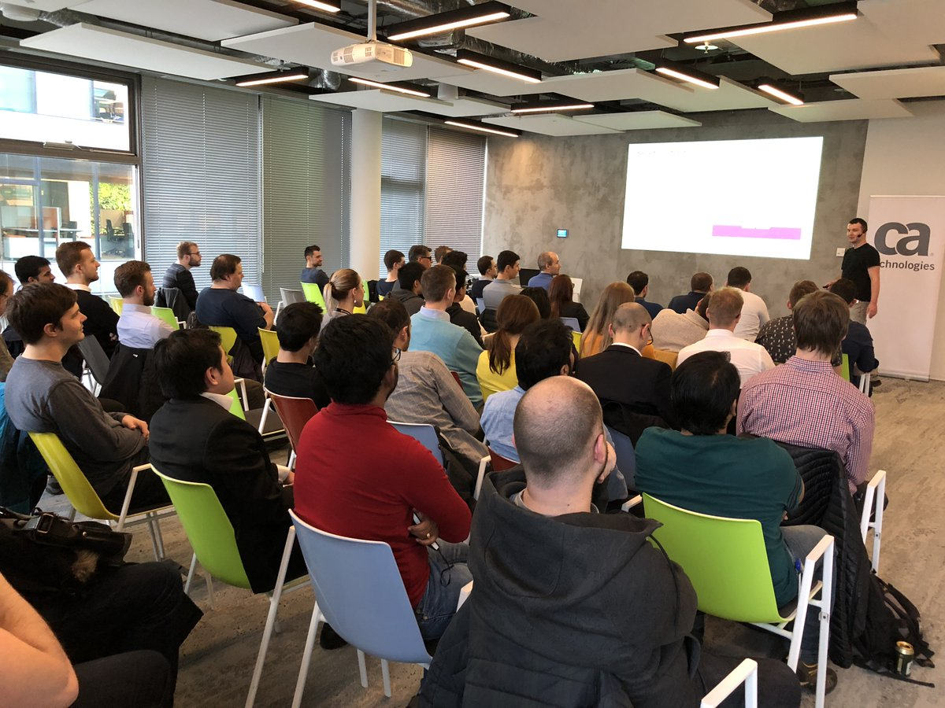
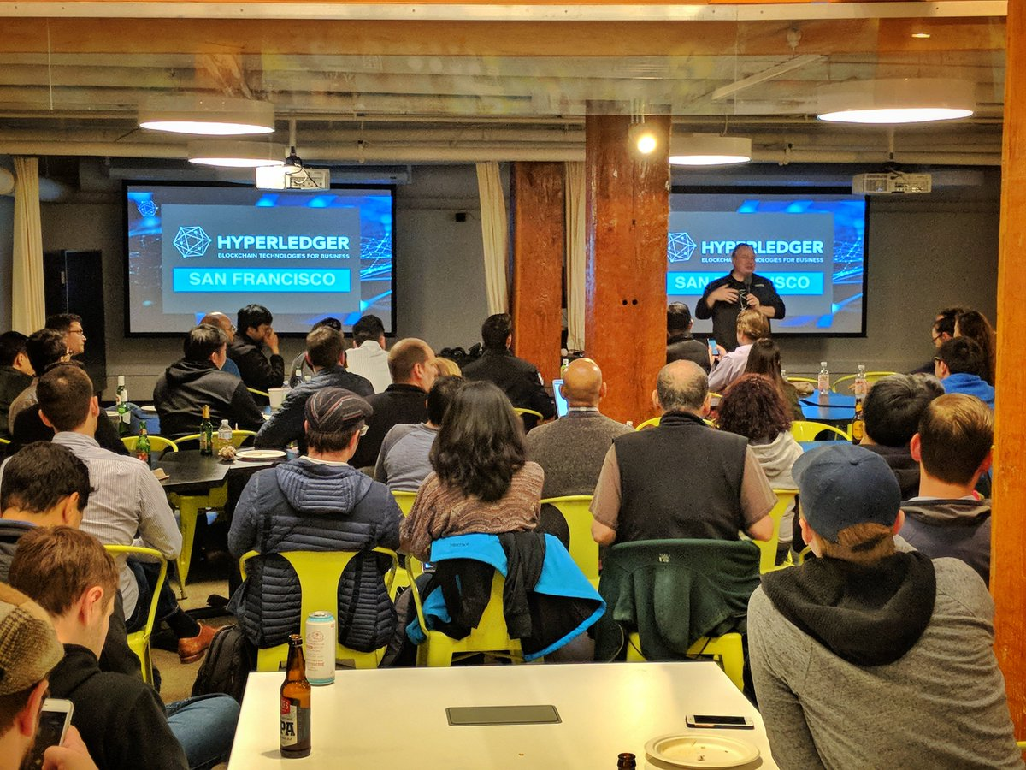
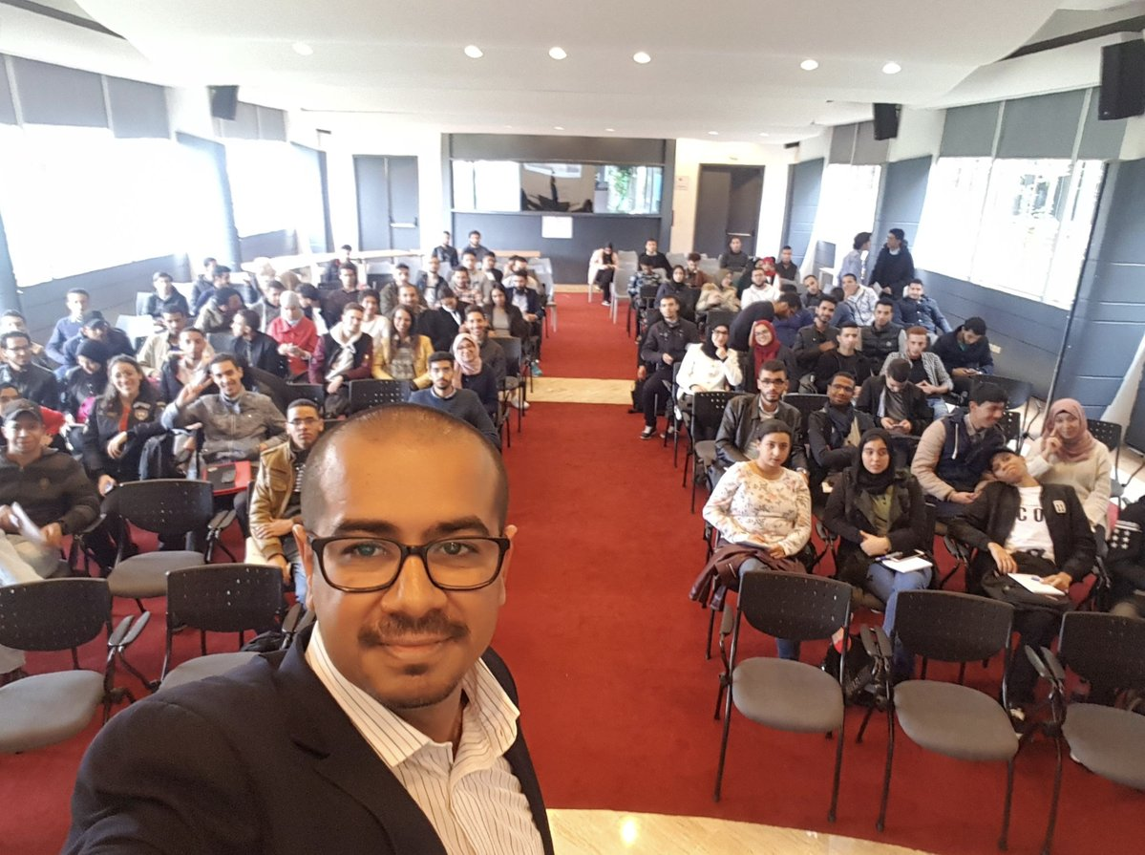
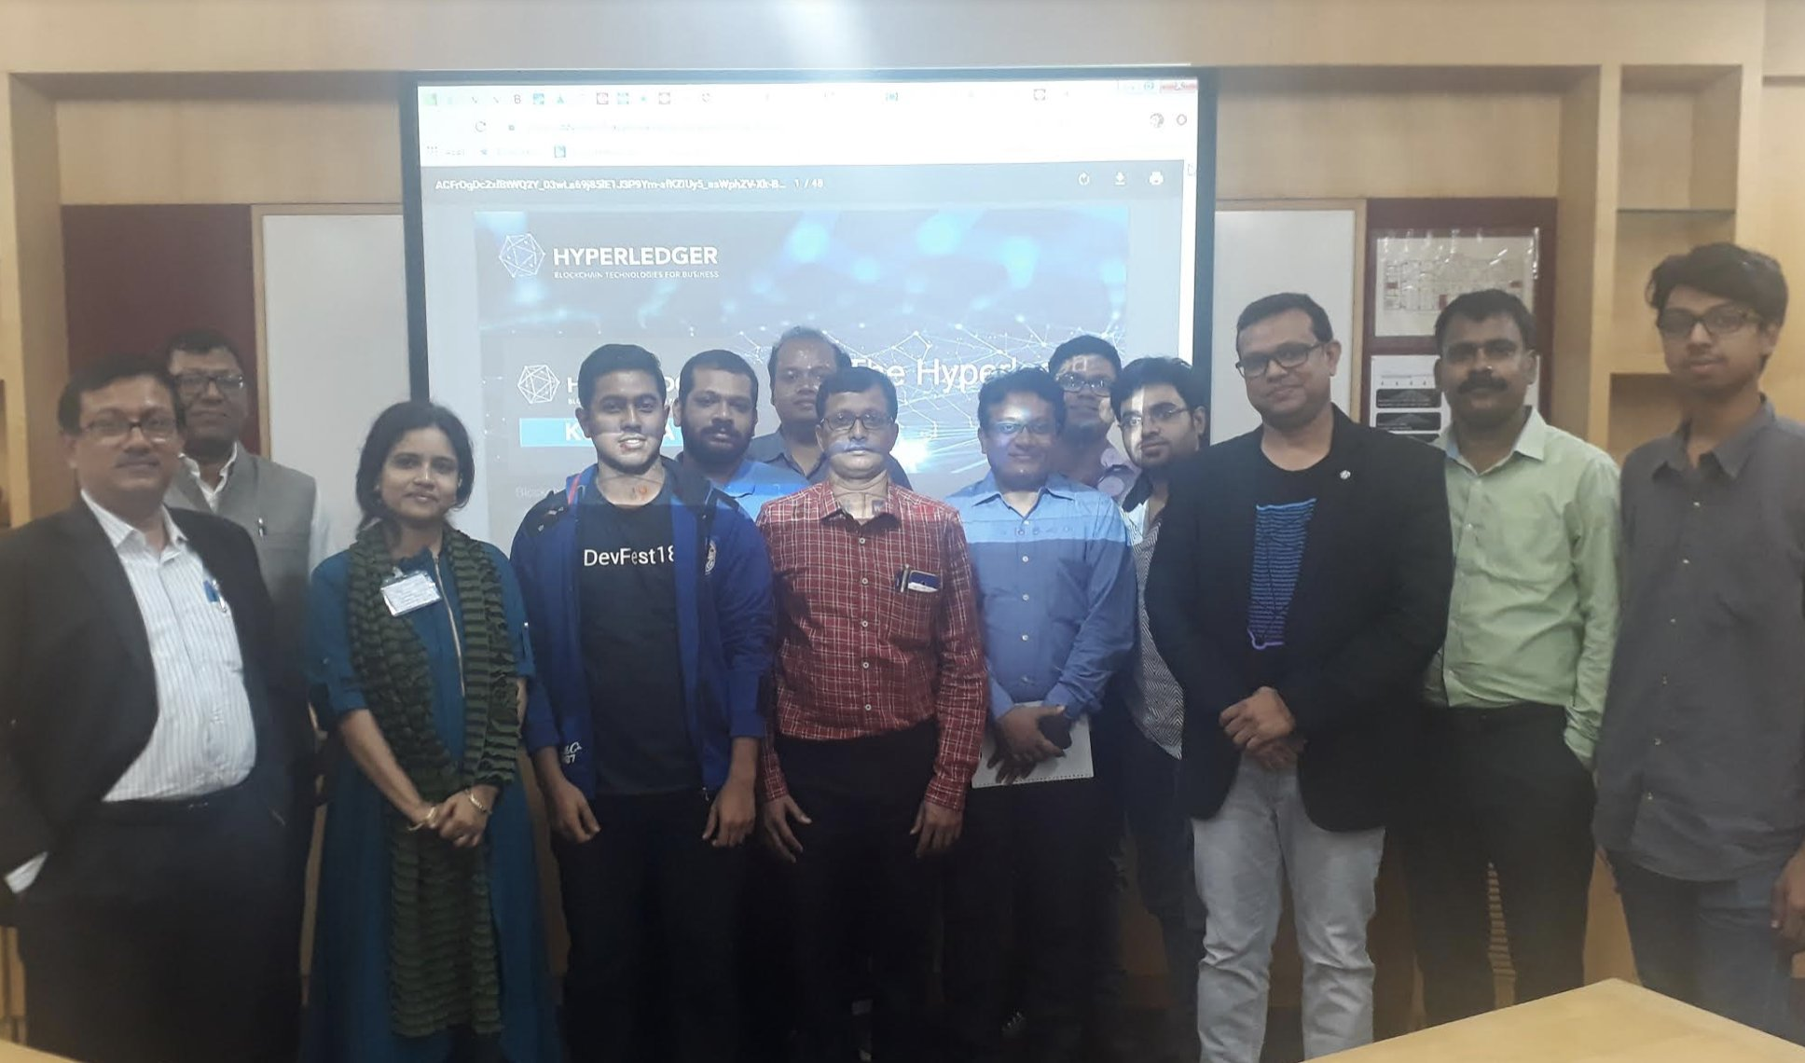
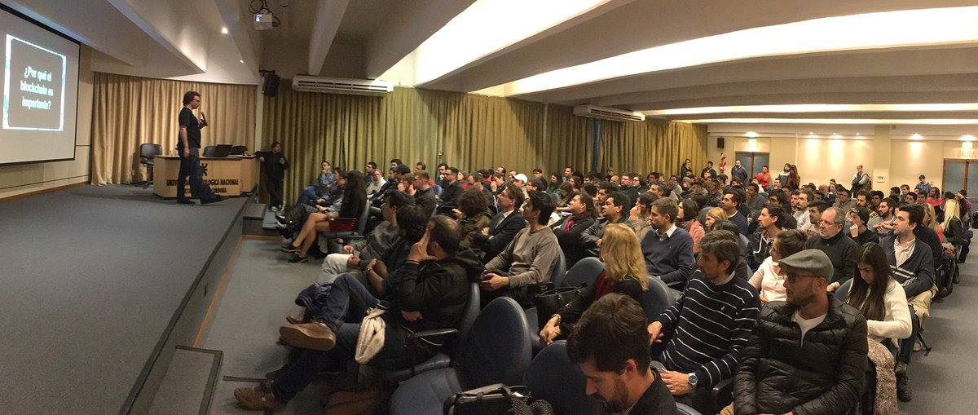
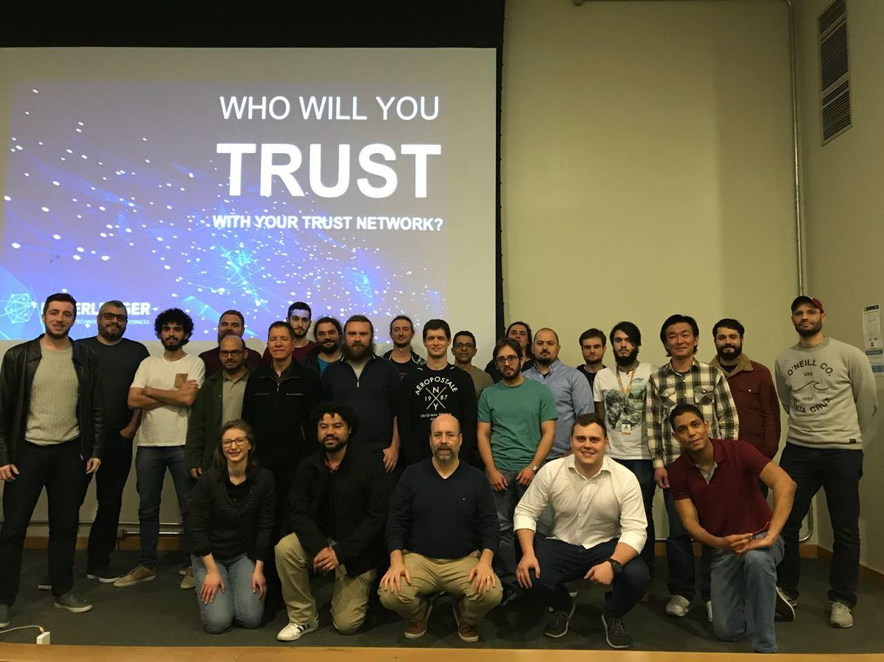
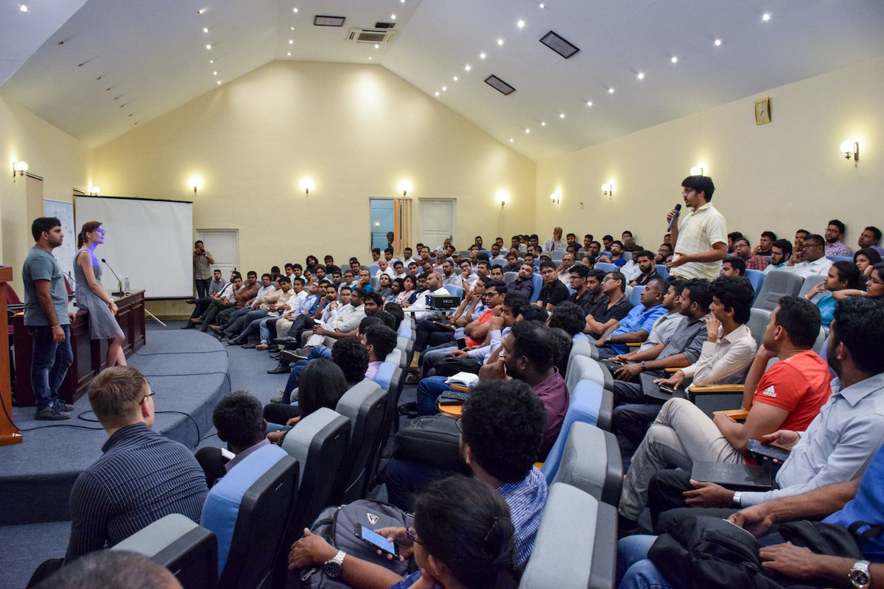
Growing Global Meetup Community
62,000+ Members
175+ Groups
75+ Countries
Notes:
This page talks about the worldwide group of Hyperledger meetups and includes so relevant statistics, a map and photos from events. For people who want more information, please point them to: https://www.meetup.com/pro/Hyperledger/

Slide 15

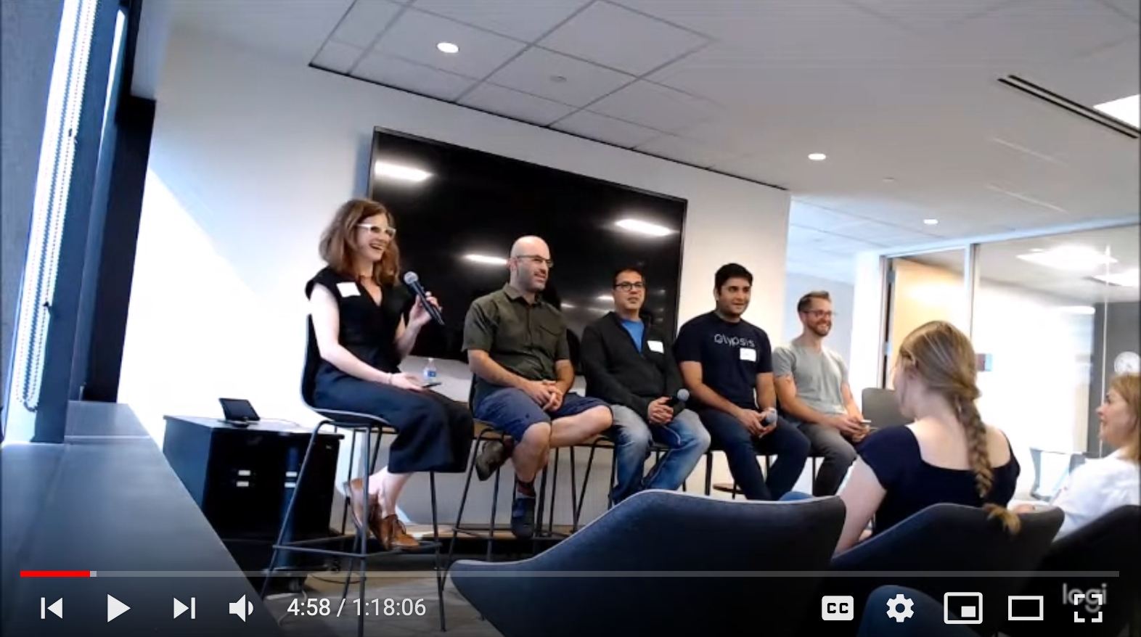
Meetup Highlights
India Chapter ran a nation wide meetup that included several local groups across India holding events at the same time and streaming presentations to each location and online. This is a great template for other regional groups to consider doing.
There are now over 25 recorded talks from Hyperledger meetups around the world on the Hyperledger YouTube channel. Thanks to Hyperledger Seattle for recording and sharing each of their meetups. If you record your meetup and would like it posted, please reach out to meetup@hyperledger.org.
15
Notes:
This slide talks about the Blockchain Showcase page on the Hyperledger site that has details about the known solutions that organizations have built using Hyperledger. Please point out the link in the bottom right part of the page for people who want to learn more.

Slide 16
Share Your Meetup Highlights
Let us know about your meetup highlights so we can share the great things you are doing with the rest of the Hyperledger community.
Send updates, photos, tips and ideas to the Meetup mailing list to get in touch with all of the meetup organizers. You can find out how to post to that at:
https://lists.hyperledger.org/g/meetups/
When we hear about what active meetup groups are doing we can support you by posting about your group on the Hyperledger Twitter account, send you free swag to give away, help you find speakers for upcoming events and more.
16
Notes:
This slide talks about the Blockchain Showcase page on the Hyperledger site that has details about the known solutions that organizations have built using Hyperledger. Please point out the link in the bottom right part of the page for people who want to learn more.

Slide 17
Hyperledger Bootcamps
An event where we help get community members up to speed on how to contribute
For existing community members this is the ideal place to recruit more help for your project, lab, or group
Bootcamps were held in Hong Kong and São Paulo earlier this year
The next Bootcamp is in Moscow on October 14 and 15
If your local community is interested in hosting a Bootcamp, look more about the next steps at:
https://wiki.hyperledger.org/display/events/Bootcamps
17
Notes:
This slide talks about the Blockchain Showcase page on the Hyperledger site that has details about the known solutions that organizations have built using Hyperledger. Please point out the link in the bottom right part of the page for people who want to learn more.

Slide 18
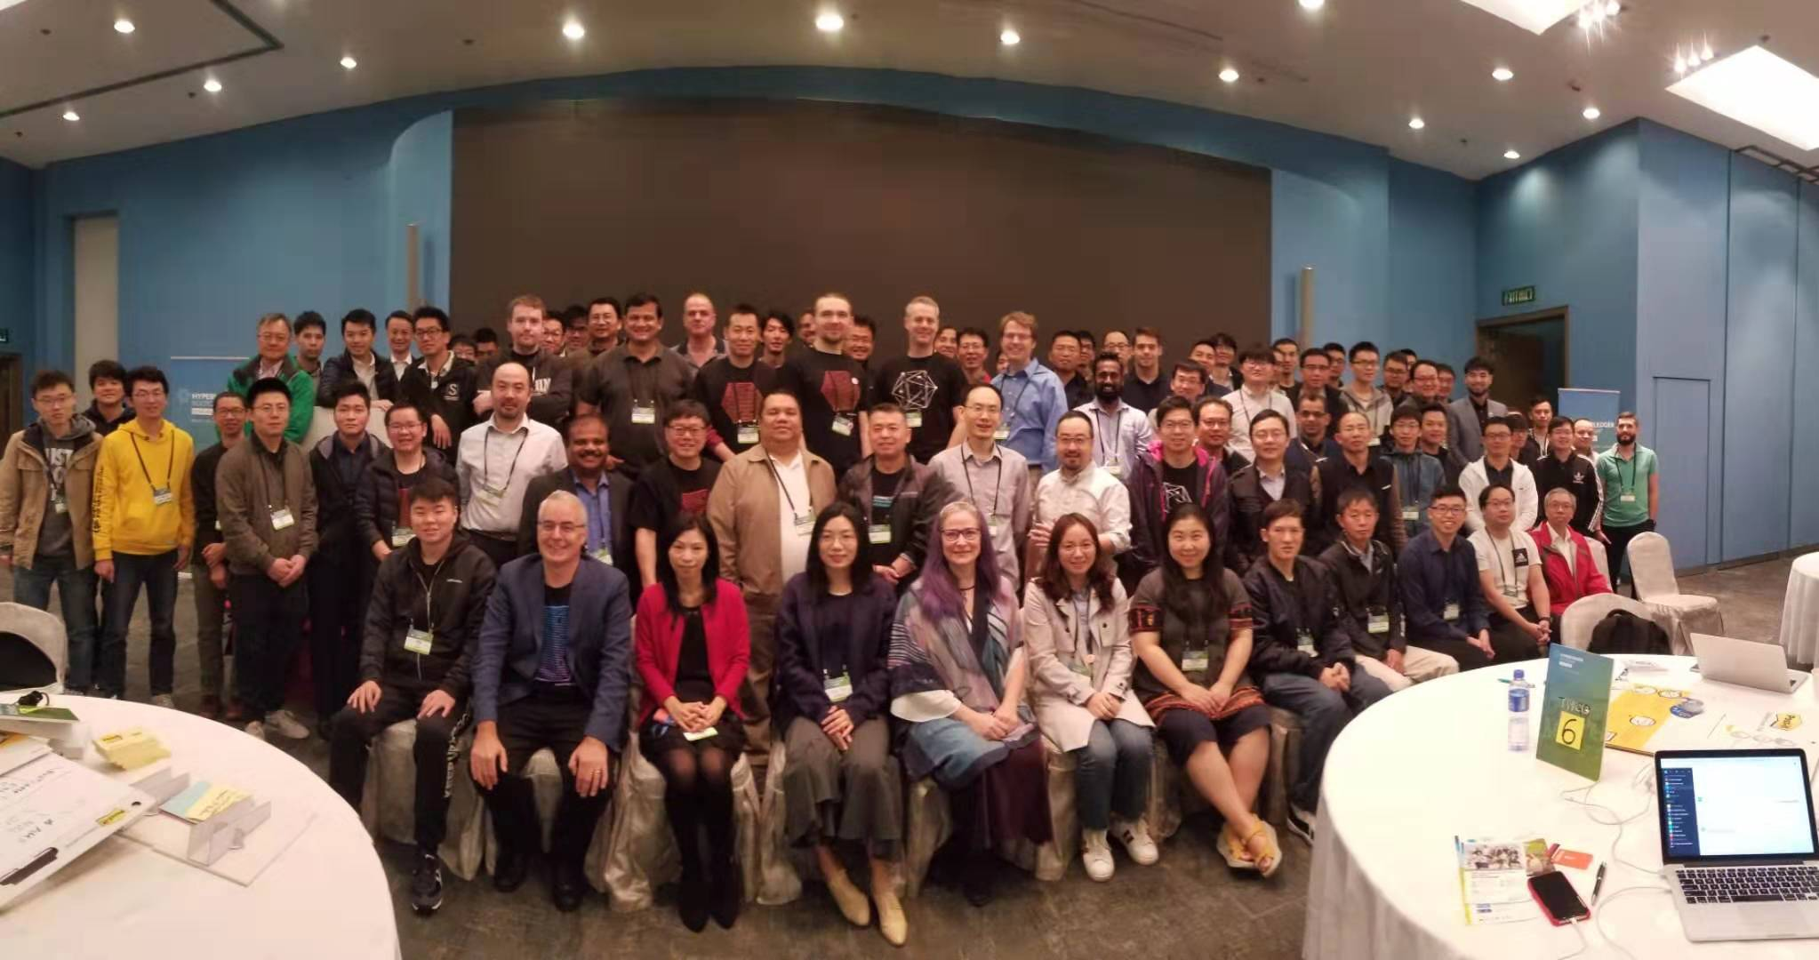
Hyperledger Hong Kong Bootcamp - March 7th - 8th

Slide 19
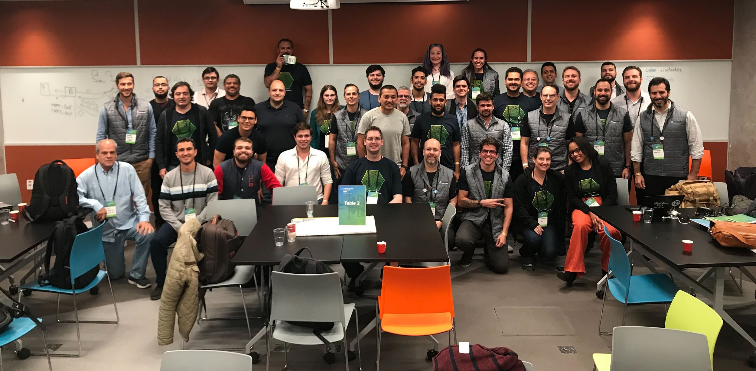
Hyperledger São Paulo Brazil Bootcamp June 24-25

Slide 20
Other Upcoming Events
Hyperledger will be active at the following upcoming events. If you will be attending any of these events, we are looking forward to meeting you there.
Conference | Focus | Location | Dates
Sibos 2019 | FinTech | London | Sept. 23-26
Devcon | OSS | Osaka, Japan | Oct 8-11
All Things Open | OSS | Raleigh, NC | Oct. 13-15
Singapore FinTech | APAC FinTech | Singapore | Nov. 11-15
Blockchain World Series NA | Enterprise Blockchain | Santa Clara | Nov. 12 - 13
Open FinTech | OSS, DLT | New York | Dec. 9
Mobile World Congress | Telecom, OS | Barcelona | Feb. 24 - 27

Slide 21

New
Global Use
Cases
Notes:
David

Slide 22

Hyperledger embraces the full spectrum of industry use cases, especially enterprise scenarios with widely varied requirements for decentralization, trust, continuity and confirmation times. Each represents a potentially unique optimization point for the technology.
Notes:
Distributed ledgers for different use cases can have vastly different requirements.
Here you will find industry-specific use cases to illustrate how blockchain technologies can and are being implemented to bring more trust across industries and the world today.
Every problem is not a nail. There is more than just sprinkling blockchain on it.

Slide 23
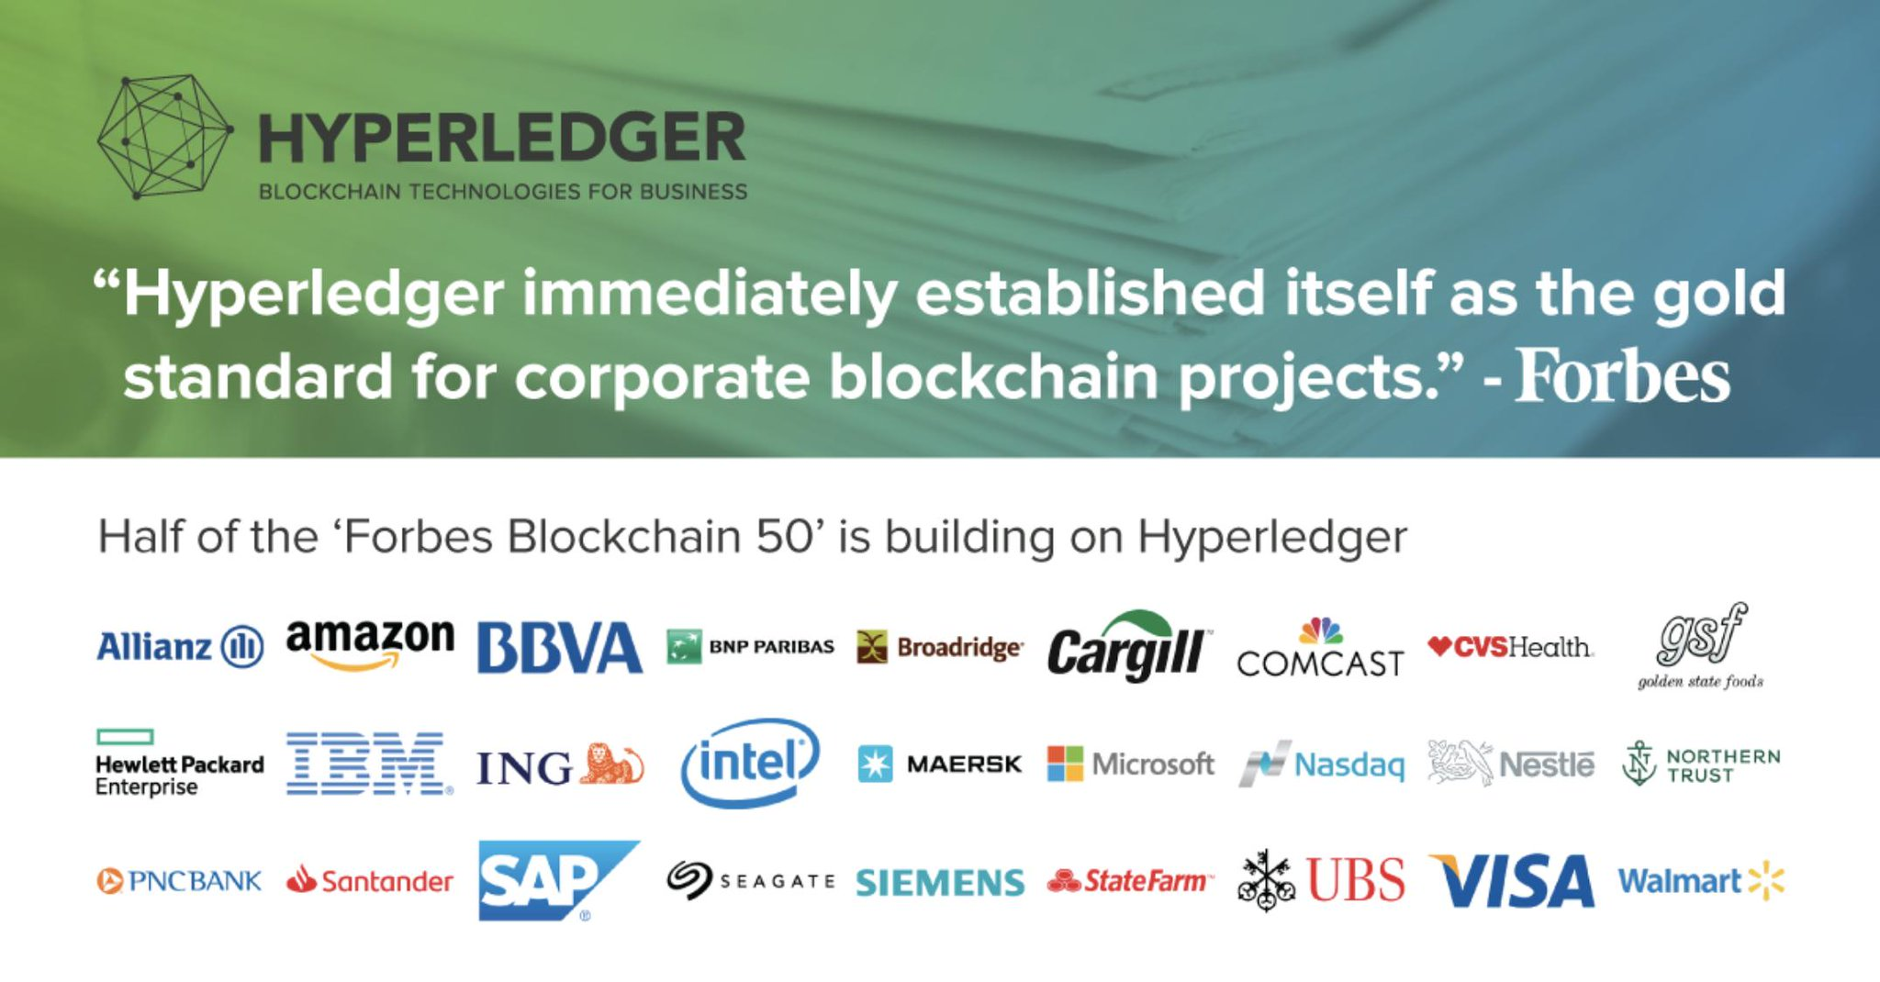
https://www.forbes.com/sites/michaeldelcastillo/2019/04/16/blockchain-50-billion-dollar-babies/

Slide 24
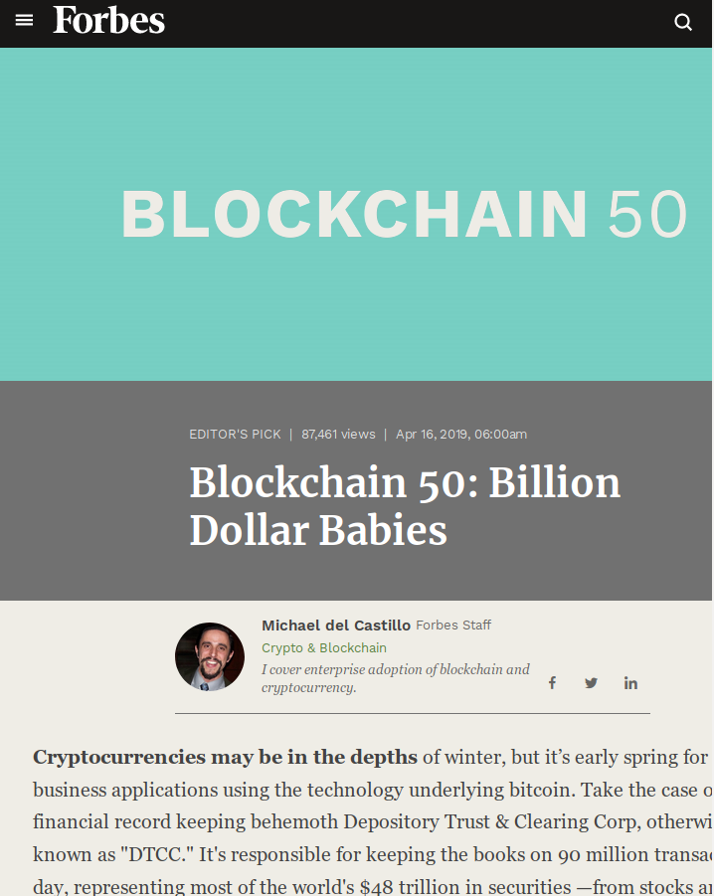
So who’s using what?
Of the Forbes Blockchain 50:
23 HL Fabric
  +5 IBM Blockchain
  +2 DTCC & Google
  +1 Oracle Blockchain
  +1 Samsung Nexledger
21 (Public?) Ethereum
13 Corda
12 Quorum
3 HL Indy
3 HL Sawtooth
https://www.forbes.com/sites/michaeldelcastillo/2019/04/16/blockchain-50-billion-dollar-babies/

Slide 25



Newest Cross Industry Case Studies
Change Healthcare using Hyperledger Fabric to improve claims lifecycle throughput and transparency
Industry: Healthcare
Topics: Hyperledger Fabric, Healthcare, Blockchain
Project(s): Hyperledger Fabric
When Hyperledger Sawtooth Met Kubernetes – Simplifying Enterprise Blockchain Adoption
Industry: Blockchain, Cloud Computing, Technology, IT Services
Topics: Hyperledger Sawtooth, Kubernetes, Blockchain, Containers, Cloud computing
Project(s): Hyperledger Sawtooth
BC aims to cut government red tape with Hyperledger Indy
Industry: Blockchain, Tech, Small Business, Government
Topics: Blockchain, Open Source, Digital Identity, Self Sovereign Identity, Bureaucracy, Small Businesses, Business Development, Government
Project(s): Hyperledger Indy
Notes:
we.trade is a blockchain-based international trading system for a consortium of major world banks including:
Deutsche Bank, HSBC, KBC, Natixis, Rabobank, Société Générale, Santander, UniCredit and Nordea
Enables accurate trading posture information, order to settlement control, risk coverage, track and trace options
Near-real time exchange of information on a secure platform that digitizes transactional financing and other complex processes
Continual business and compliance readiness in any regulatory environment
Scalability that allows for rapid international expansion as business, regulatory, and security opportunities converge
https://www.finextra.com/newsarticle/32342/wetrade-blockchain-platform-goes-into-live-production/wholesale
https://www.ibm.com/blogs/insights-on-business/banking/digital-trade-chain-consortiums-trade-finance-project-underscores-important-new-use-cases-blockchain/
▪ we.trade is a blockchain-based international trading system for a consortium of major world banks including: HSBC, Deutsche Bank, KBC, Natixis, Rabobank, Société Générale, Santander, UniCredit and Nordea ▪ Enables accurate trading posture information, order to settlement control, risk coverage, track and trace options ▪ Near-real time exchange of information on a secure platform that digitizes transactional financing and other complex processes ▪ Continual business and compliance readiness in any relevant regulatory environment ▪ Scalability that allows for rapid international expansion as business, regulatory, and security opportunities converge
The Technology
we.trade is a blockchain-based international trading system that enables accurate trading posture information, order to settlement control, risk coverage, track and trace options
The Challenge
Today, banks live in a competitive world. Small and mid-sized businesses generated 85% of employment growth in Europe in recent years, but only ~50% of them have access to formal credit. The Digital Trade Chain exemplifies how blockchain can bring the required trust and transparency to a new business network and associated business model.

Slide 26
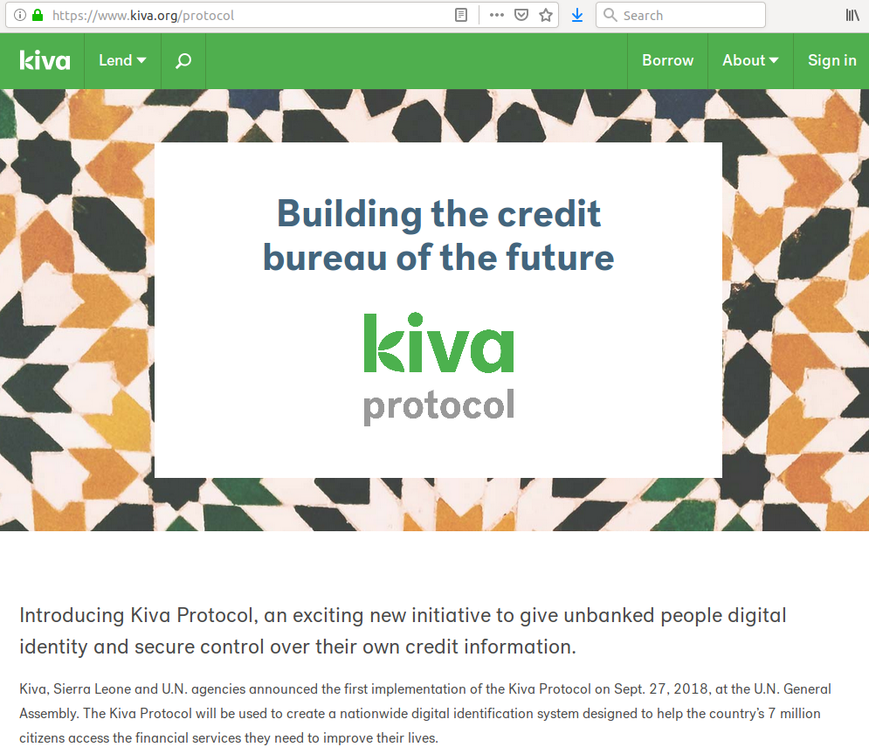
Kiva: Implementing SSI and a privacy-first credit bureau for Sierra Leone
Challenge:
There is no effective digital identity system or credit bureau for SL’s 7.5M citizens
As a result, Kiva’s lending rates are 30%, much higher than in other countries and a blocker to financial participation.
Solution:
2019-Q2 NCRA (SL government ID agency) will issue credentials on a Hyperledger-Indy based network.
2019-Q4 BSL (central bank) will use Hyperledger Fabric for a shared, decentralized credit reporting bureau.
Partnership between Kiva, SL government, UNDP and UNCDF.
Social Impact SIG presentation: https://wiki.hyperledger.org/display/SISIG/2019-08-06+Meeting+notes

Slide 27

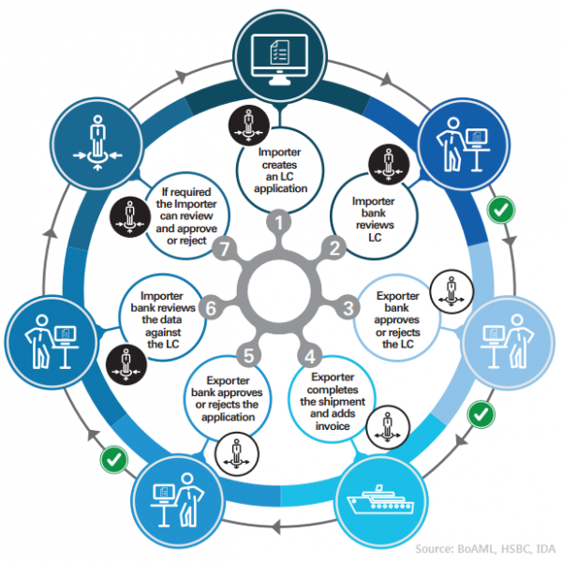
Trade Finance: we.trade
we.trade is a blockchain-based international trading system for a consortium of major world banks including:
HSBC, Deutsche Bank, KBC, Natixis, Rabobank, Société Générale, Santander, UniCredit and Nordea
SMEs generate 85% of employment growth in Europe, but only ~50% of them have access to formal credit.
Went into production July 2018 conducting seven live trade transactions by ten companies via four partner banks
Enables accurate trading position information, order to settlement control, risk coverage, track and trace options
Near-real time exchange of information on a secure platform that digitizes transactional financing
Continual business and compliance readiness in any relevant regulatory environment
Scalability that allows for rapid international expansion as business, regulatory, and security opportunities converge
https://we-trade.com/
Notes:
we.trade is a blockchain-based international trading system for a consortium of major world banks including:
Deutsche Bank, HSBC, KBC, Natixis, Rabobank, Société Générale, Santander, UniCredit and Nordea
Enables accurate trading posture information, order to settlement control, risk coverage, track and trace options
Near-real time exchange of information on a secure platform that digitizes transactional financing and other complex processes
Continual business and compliance readiness in any regulatory environment
Scalability that allows for rapid international expansion as business, regulatory, and security opportunities converge
https://www.finextra.com/newsarticle/32342/wetrade-blockchain-platform-goes-into-live-production/wholesale
https://www.ibm.com/blogs/insights-on-business/banking/digital-trade-chain-consortiums-trade-finance-project-underscores-important-new-use-cases-blockchain/
▪ we.trade is a blockchain-based international trading system for a consortium of major world banks including: HSBC, Deutsche Bank, KBC, Natixis, Rabobank, Société Générale, Santander, UniCredit and Nordea ▪ Enables accurate trading posture information, order to settlement control, risk coverage, track and trace options ▪ Near-real time exchange of information on a secure platform that digitizes transactional financing and other complex processes ▪ Continual business and compliance readiness in any relevant regulatory environment ▪ Scalability that allows for rapid international expansion as business, regulatory, and security opportunities converge
The Technology
we.trade is a blockchain-based international trading system that enables accurate trading posture information, order to settlement control, risk coverage, track and trace options
The Challenge
Today, banks live in a competitive world. Small and mid-sized businesses generated 85% of employment growth in Europe in recent years, but only ~50% of them have access to formal credit. The Digital Trade Chain exemplifies how blockchain can bring the required trust and transparency to a new business network and associated business model.

Slide 28


Government Procurement: GSA
Today's procurement processes take upto 35 days even when the requirements are very clear.
The General Services Administration designed a FASt Lane process for IT Schedule 70 contracts.
Blockchain-based software layer over the agency’s existing infrastructure that aims to make the GSA Schedules review process transparent and automate financial reviews and processes, creating savings in fixed costs.
Vendors' financial information is analyzed through a “smart contract” that compares their financial ratios to the average of companies with the same NAICS code.
Agency estimates that the blockchain pilot will save a financial analyst 10 to 15 days when it comes to reviewing each proposal. Lowering the OpEx costs by 80-90%.

Slide 29

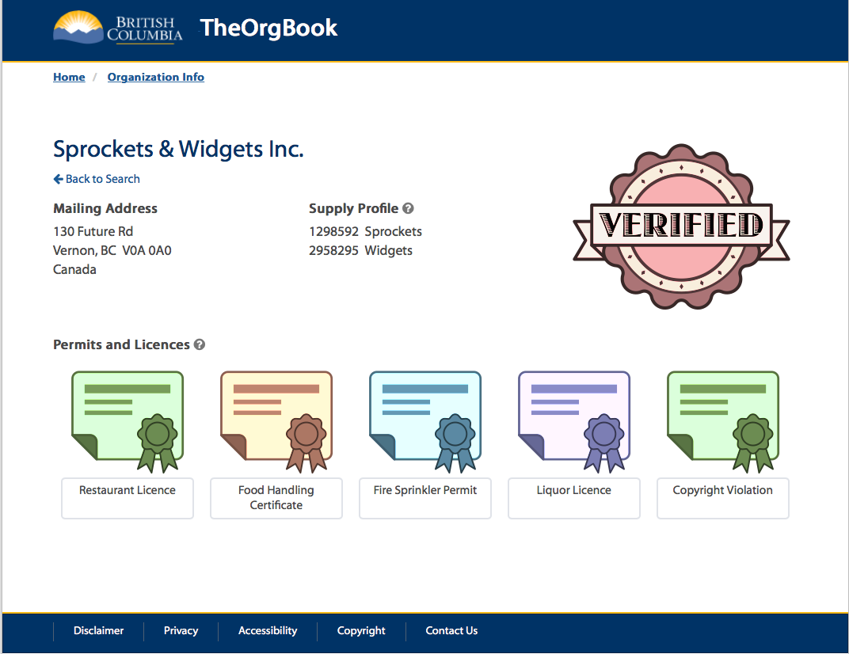
Digital Identity: The OrgBook
The OrgBook serves as a trusted digital network of verifiable data about organizations which is globally connected, interoperable, secure, and easy to join
Why? So business/government can quickly access evidence of that a potential partner is legally incorporated
The new enrollment experience is more convenient and use an open global blockchain registry
Reduced single point of failure for database, reduced fraud from counterfeit IDs, reduces bottlenecks, and improves privacy which a complex verification system can expose
As more businesses establish their Self-Sovereign Identity, more Services will become Self-Sovereign Identity-aware
Live, public, globally accessible network using the Sovrin Provisional Network built on Hyperledger Indy.
https://www.hyperledger.org/resources/publications/orgbook-case-study
Notes:
https://von.pathfinder.gov.bc.ca/aboutvon/
https://www.itworldcanada.com/article/two-upcoming-government-digital-projects-show-future-for-digital-id-in-canada/406600
https://docs.google.com/document/d/1wNnXdQKUtWnx--xw3VQ9Fr2TDa0kUNIBSMmFGR4uoMg/edit#heading=h.hb1zjewyrm4
Interaction Diagram: Enrollment via Verifiable Claim from TheOrgBook - BC
A business person is interacting with the Supplier Registry (SRI) site to enroll their organization as a supplier. In doing that, information is needed about the organization that is available as a Verifiable Claim from BC Registries via TheOrgBook - BC. When that data is needed, and the user has identified the Organization sufficiently, send a Proof Request to TheOrgBook, which will use the Claims about the Organization to respond to the Proof Request. SRI will verify the claim, including checking for revocations, and if all is correct, use the claim to populate the data required for enrollment.
Organizations could be a “Verifiable Organizations” in a particular context … for example … within the tax realm if they have been issued a Business Number (in Canada) or within the Government of Canada procurement realm if they are a registered supplier. It is up to each realm to determine what the necessary evidence is for it to consider an organization to be verified. One realm could certainly rely on another. For example, the supplier may need to be a legal entity of a certain type (corporation) and therefore need to have a Verifiable Claim attesting to such a fact.

Slide 30

Hyperledger Blockchain Frameworks
Notes:
The following slides have more details about the different Hyperledger platforms.

Slide 31

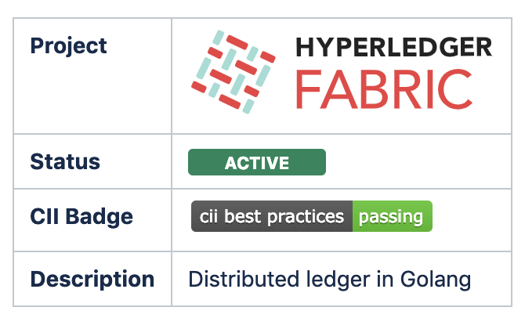
Hyperledger Fabric is an enterprise-grade permissioned distributed ledger framework for developing solutions and applications.
Its modular and versatile design satisfies a broad range of industry use cases.
It offers a unique approach to consensus that enables performance at scale while preserving privacy.
Fabric v1.4.3 is the current long-term support (LTS) release, which includes RAFT consensus.
2.0-alpha was released in April with support for decentralized governance of smart contracts.
200+ devs across 100+ companies contributing.
Hundreds of pilot and production networks deployed.
Learn more at: https://wiki.hyperledger.org/display/fabric/Hyperledger+Fabric

Slide 32
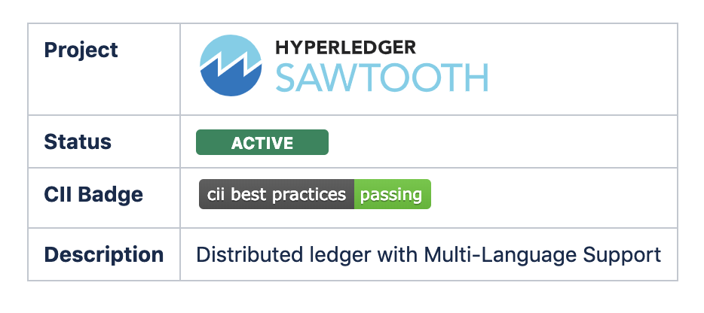
A modular platform for building, deploying, and running distributed ledgers. Hyperledger Sawtooth includes a novel consensus algorithm, Proof of Elapsed Time (PoET), which targets large distributed validator populations with minimal resource consumption. Hyperledger’s second project, released as 1.0 in January 2018 and 1.1 in Dec 2018.
Supports Solidity/EVM smart contracts by linking with HL Burrow.
Learn more at: https://wiki.hyperledger.org/display/sawtooth/Hyperledger+Sawtooth

Slide 33
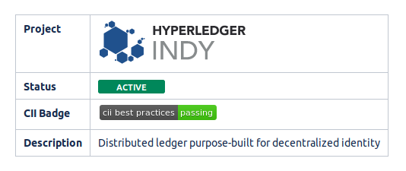
Tools, libraries, and reusable components for providing digital identities rooted on blockchains or other distributed ledgers so that they are interoperable across administrative domains, applications, and any other silo. Utilizes zero-knowledge proofs to provide verifiable claims
which can be used to prove something about the identity without providing access to the underlying data
Learn more at: https://wiki.hyperledger.org/display/indy/Hyperledger+Indy

Slide 34
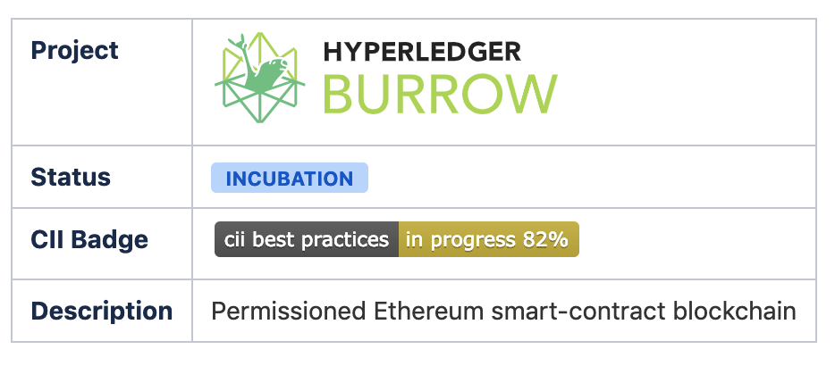
Burrow provides a modular blockchain client with a permissioned smart contract interpreter built in part to the specification of the Ethereum Virtual Machine (EVM). It is the only Apache-licensed EVM. Uses Tendermint as its default consensus mechanism, but has also been ported to Fabric and Sawtooth.
Learn more at: https://wiki.hyperledger.org/display/burrow/Hyperledger+Burrow

Slide 35
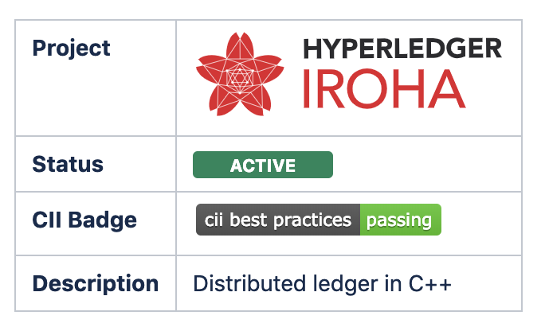
1.0 release in May. A business blockchain framework designed to be simple and easy to incorporate into infrastructural projects requiring distributed ledger technology. Written in C++ incorporating unique chain-based Byzantine Fault Tolerant consensus. Mobile SDKs. Multisig support for transactions.
Learn more at: https://wiki.hyperledger.org/display/iroha/Hyperledger+Iroha

