Slide 1

Kultur-Token
Jakob Hackel
Research Institute for Cryptoeconomics, WU
jakob.hackel@wu.ac.at
wu.ac.at/cryptoeconomics

Slide 2
Our Mission
Interdisciplinary research in technology, economics, business & law
Cooperation with partners from industry
Collaboration with other national & international Research Institutions
Technology
Economics
Business
Law

Slide 3
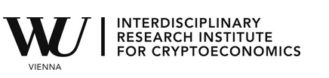
Interdisciplinarity
Information Systems
& Operations
Economics
Public Law &
Tax Law
Finance,
Accounting
& Statistics
Business, Employment
& Social Security Law
Strategy &
Innovation
Global Business
& Trade
Marketing

Slide 4

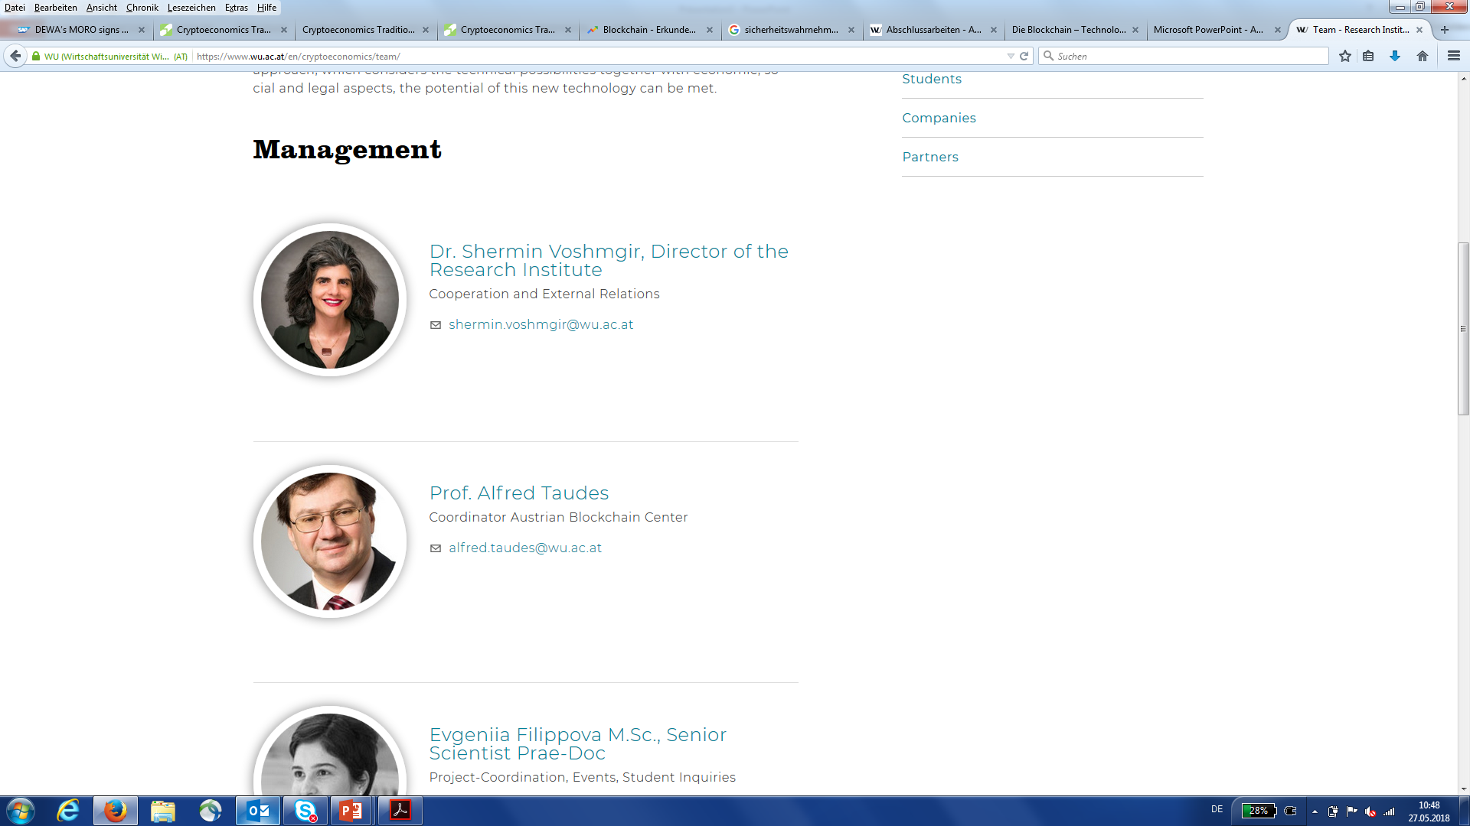
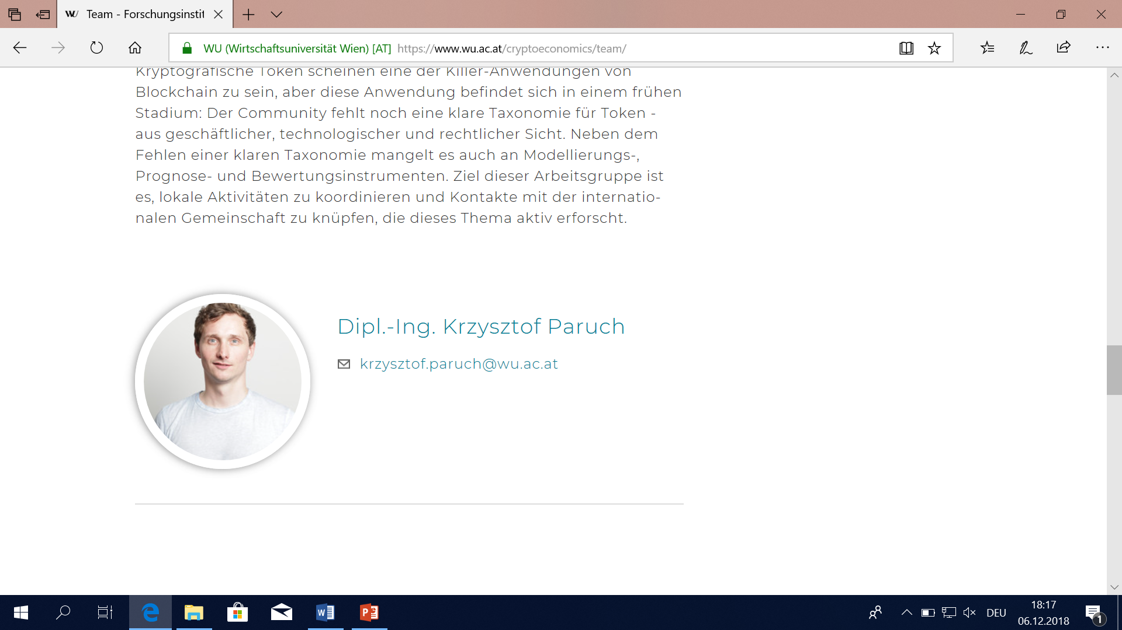




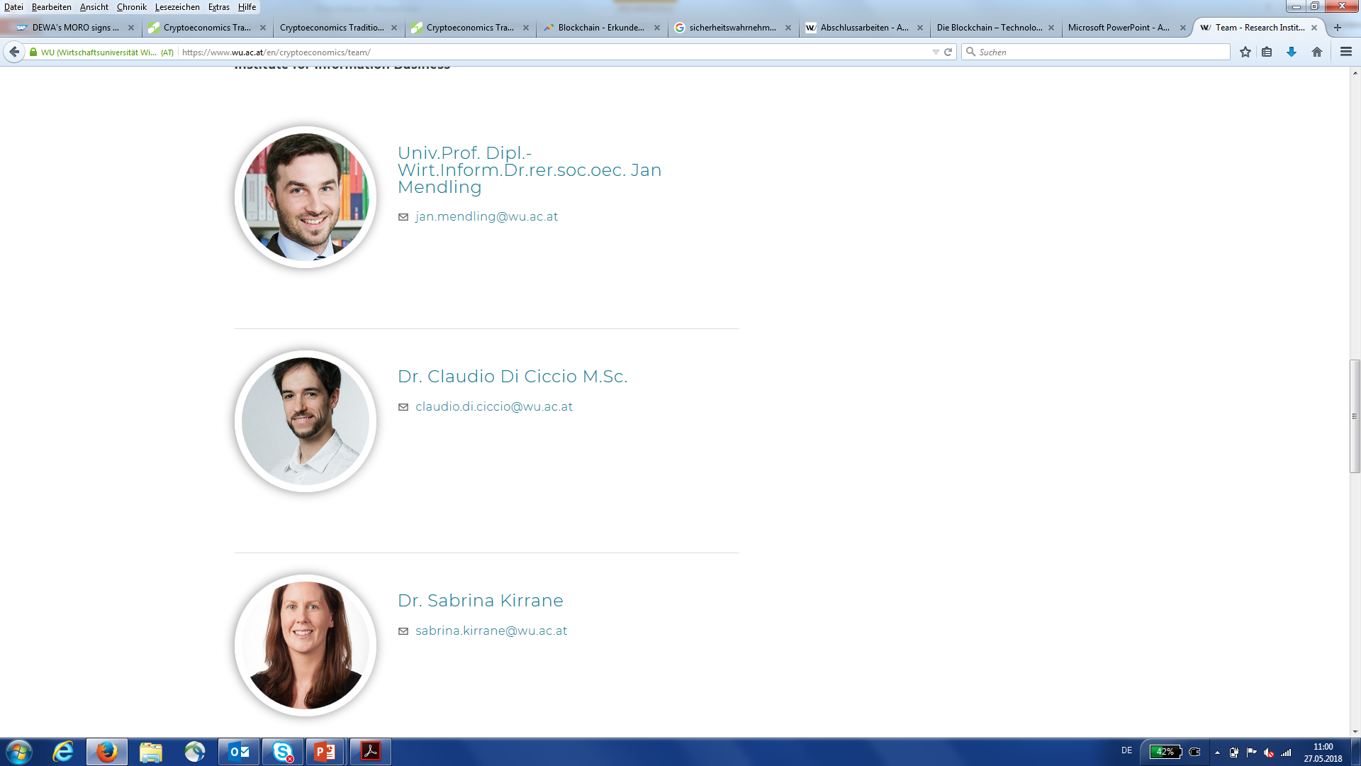
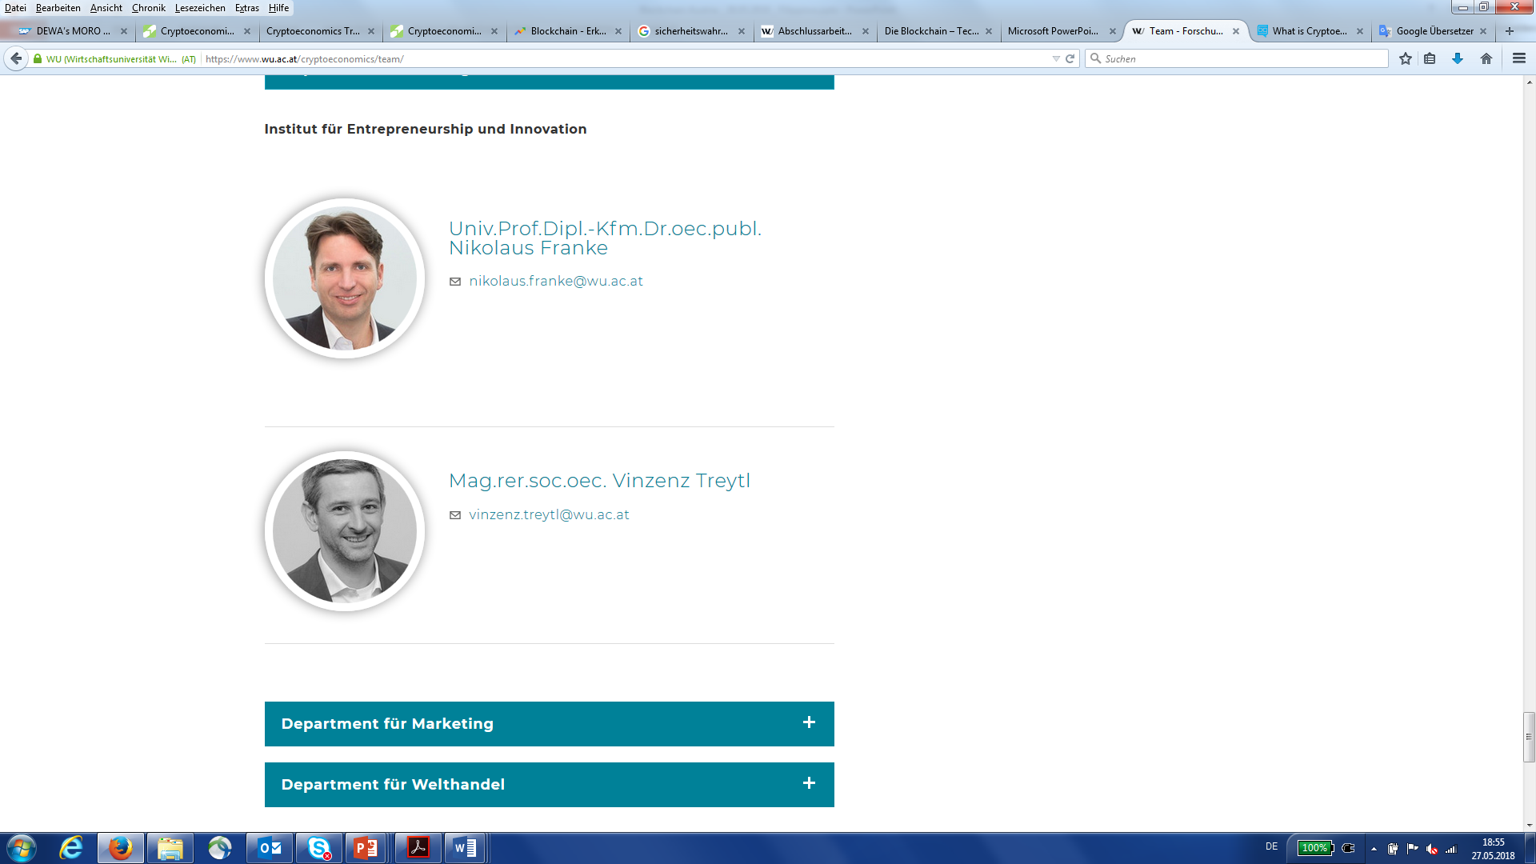
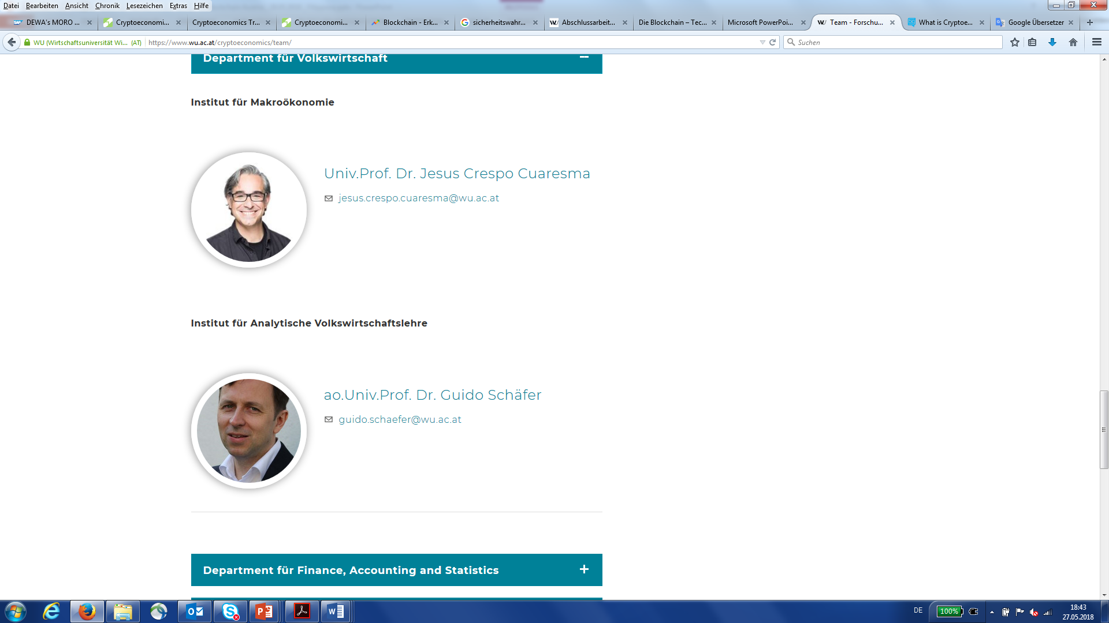
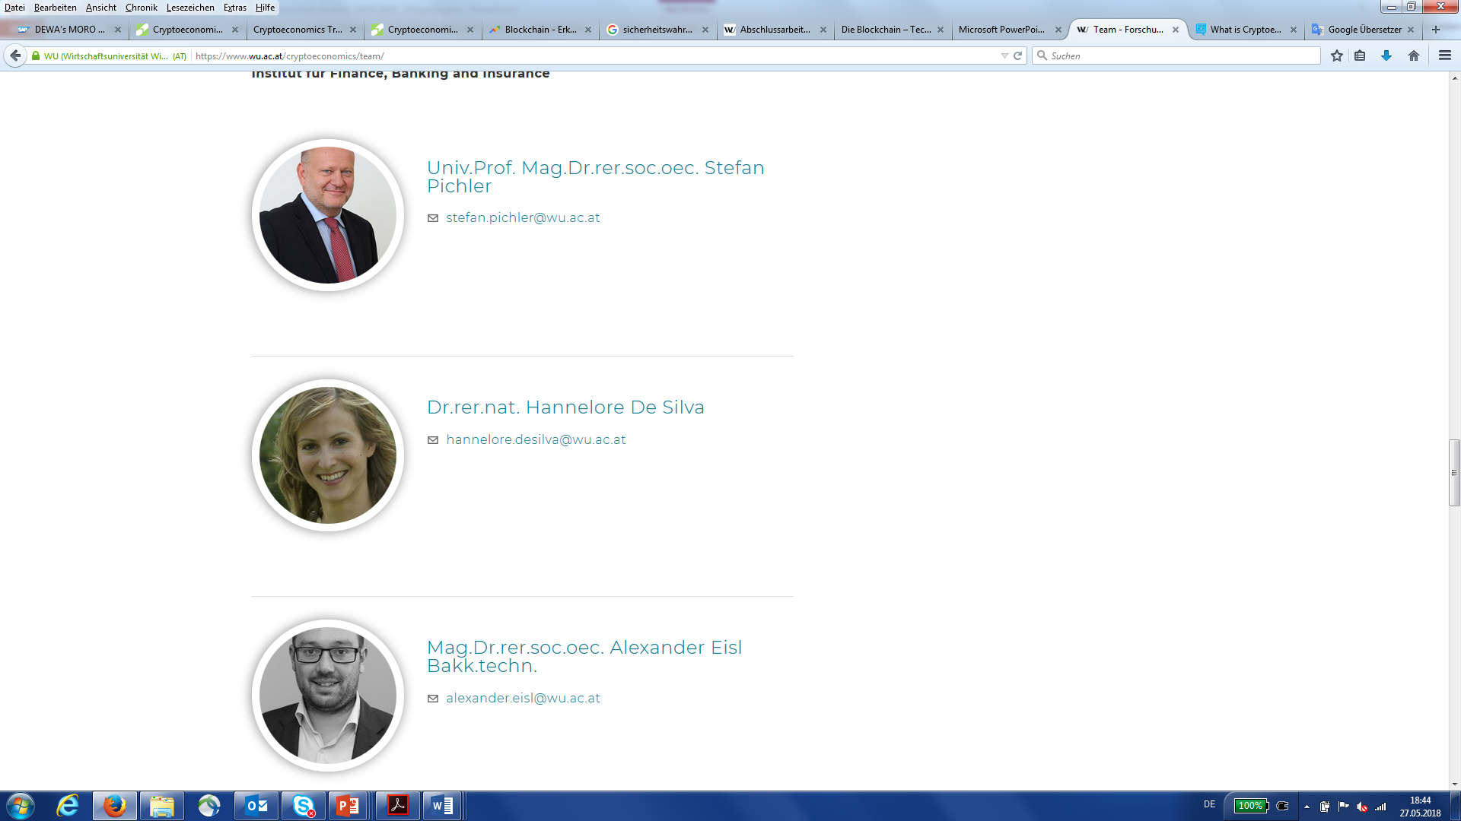
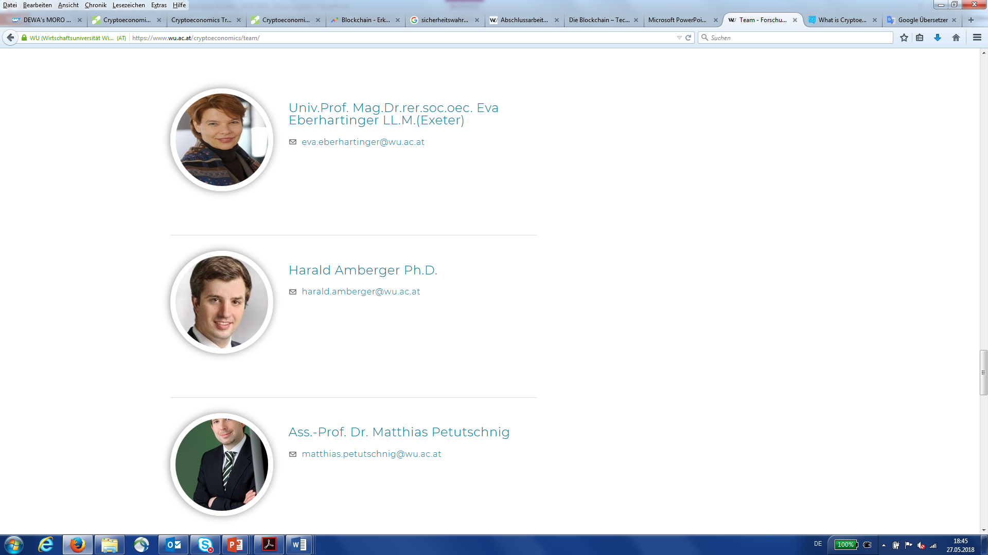
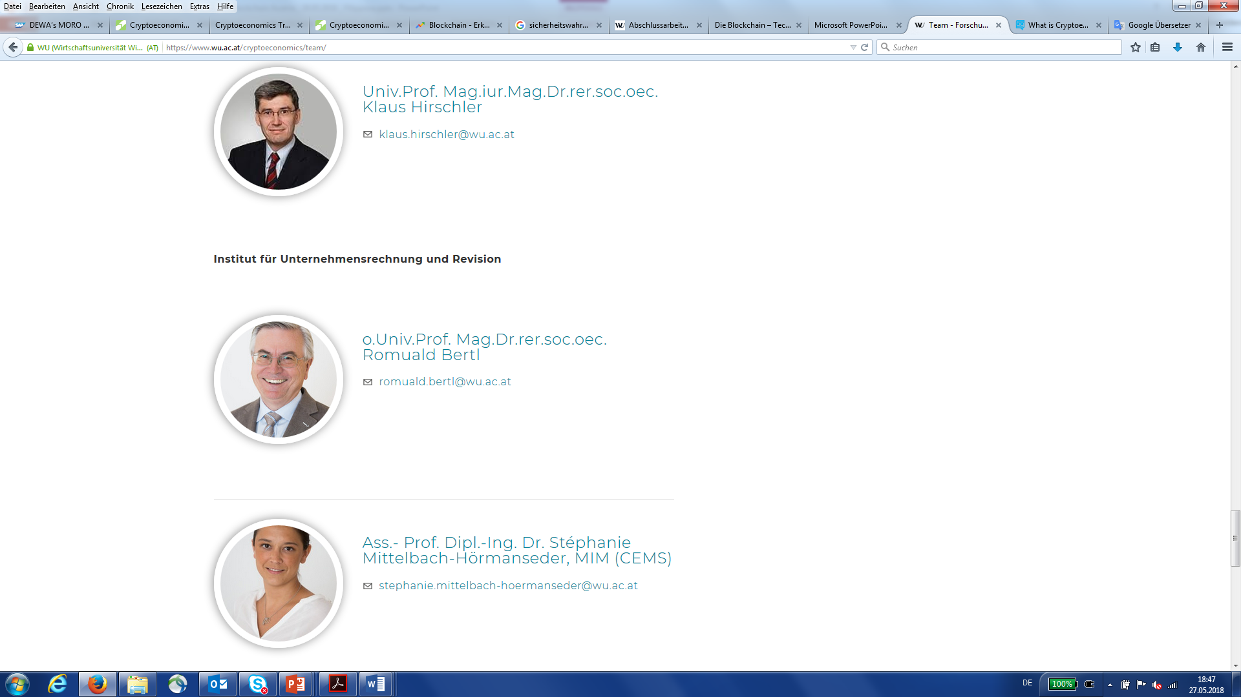
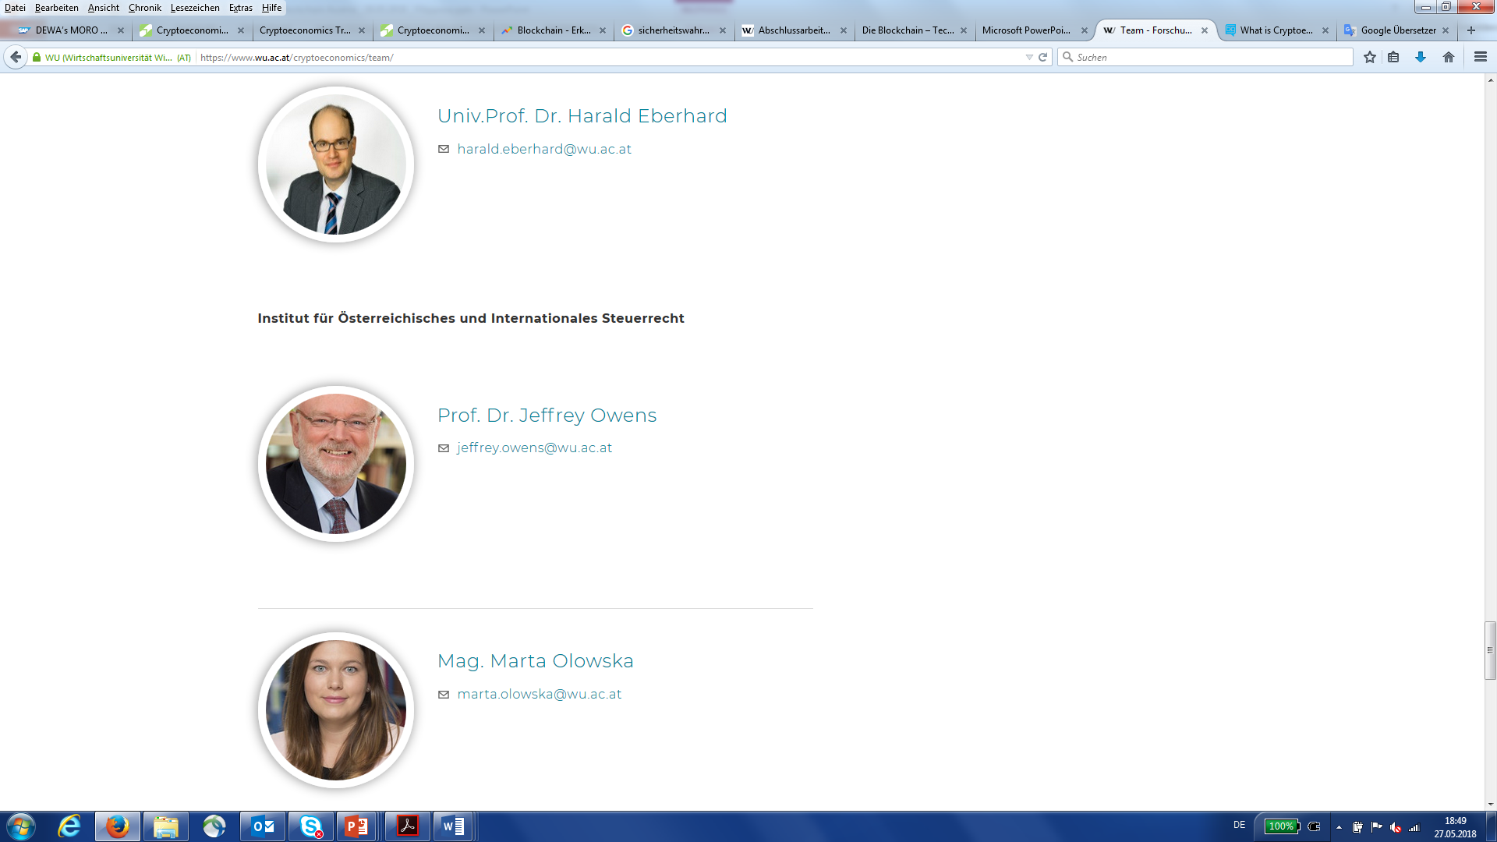
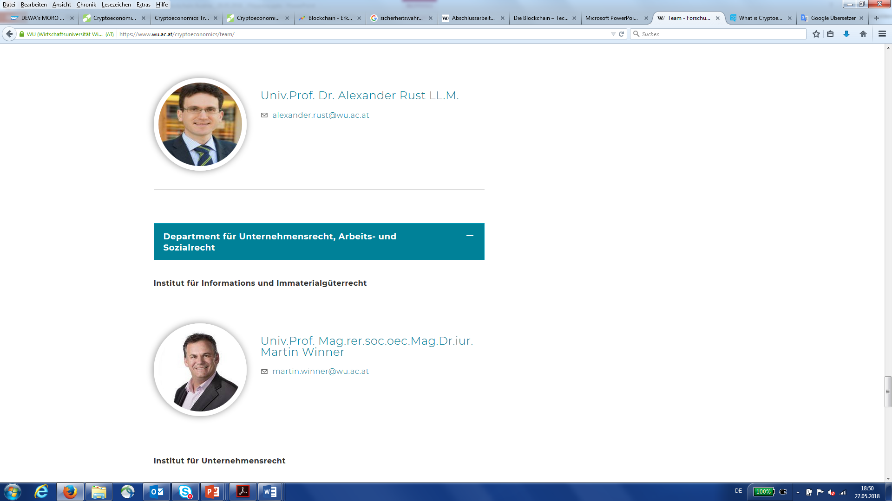
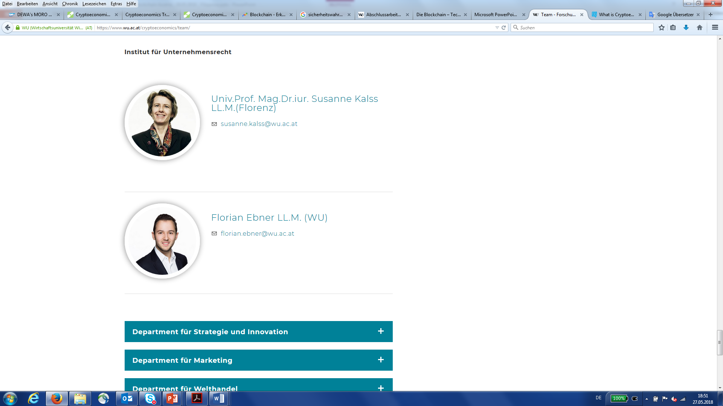
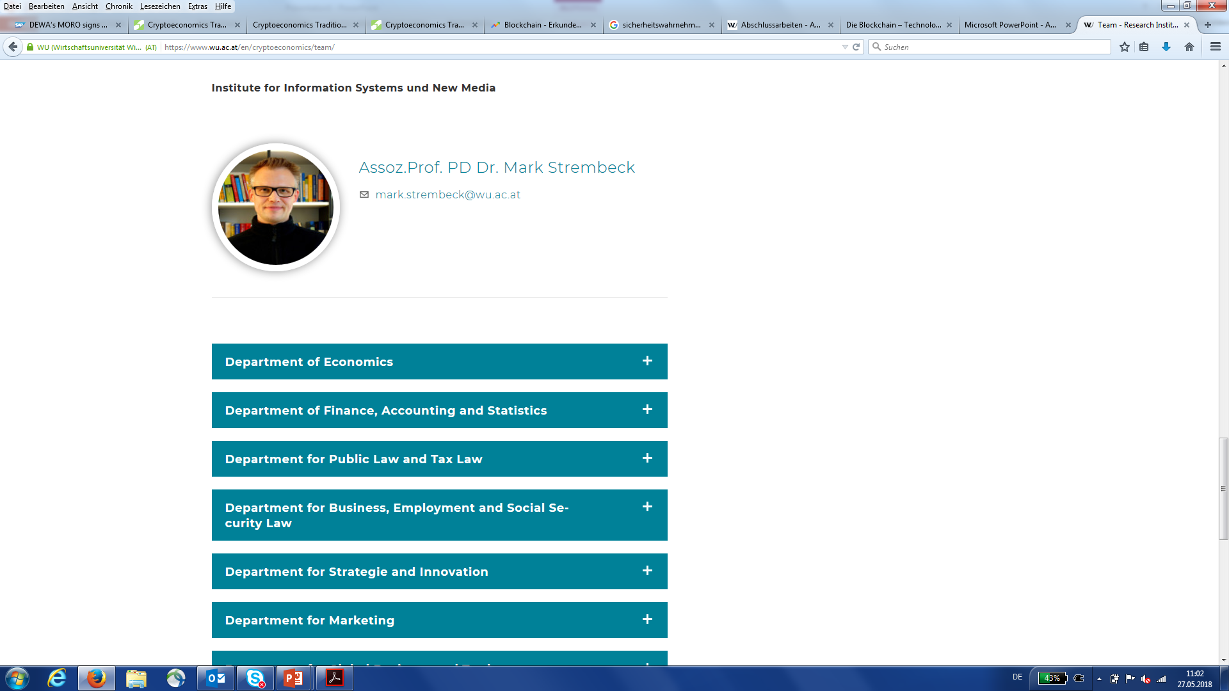
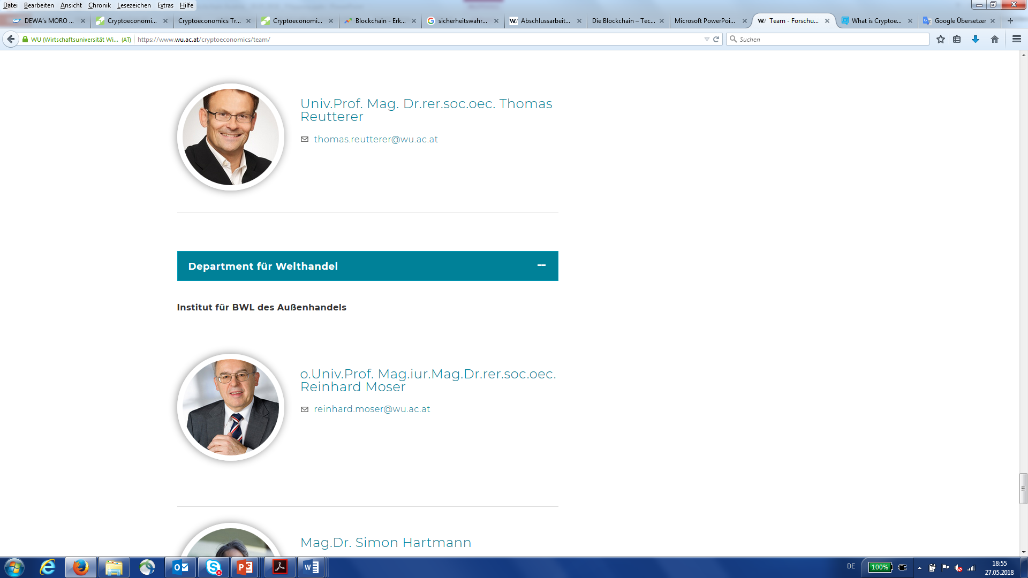
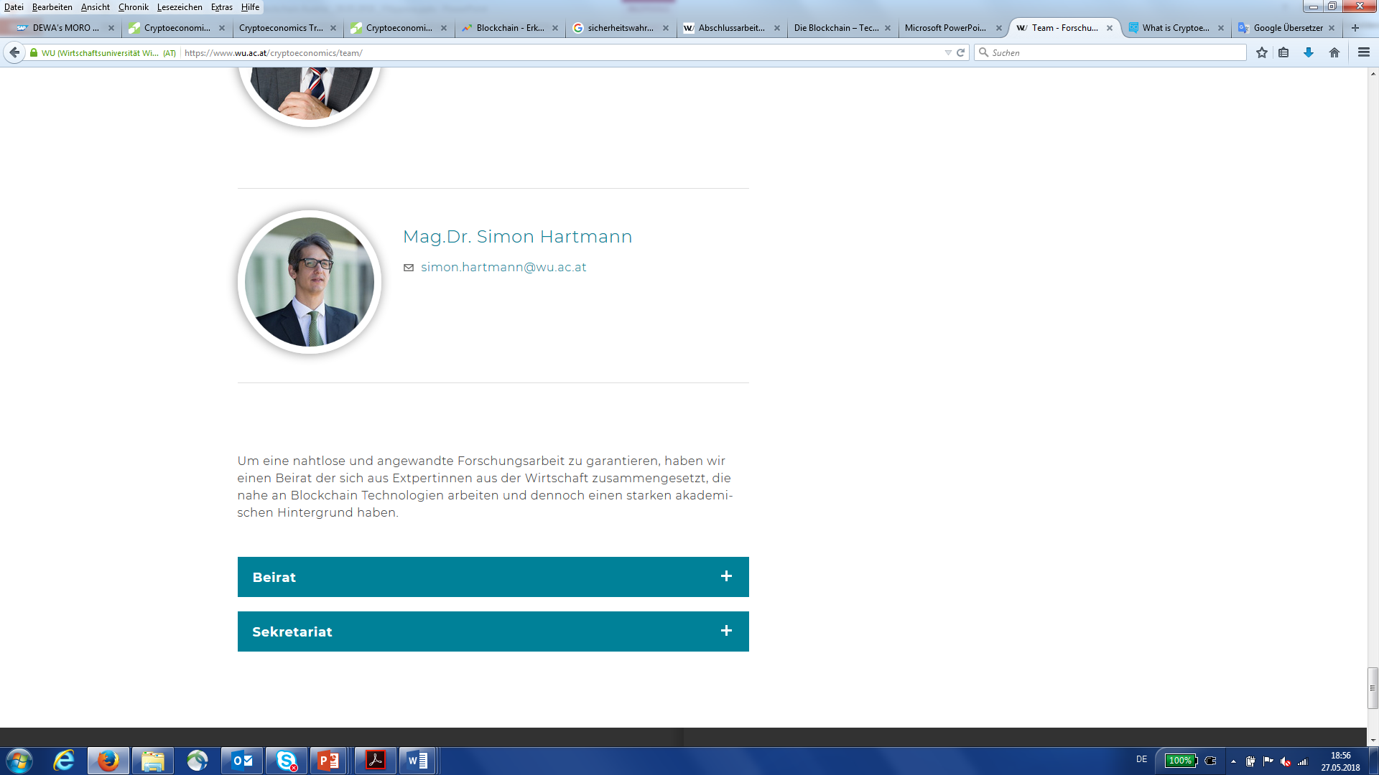
Team
Researchers
Associated Researchers

Slide 5

Token Project - Vienna
The City of Vienna’s pilot project Culture-Token:
Pilot project with scientific supervision and evaluation.
Gamification: mobile app encourages people to cut CO2 emissions while enjoying art & culture. Digital credits can be spent in various art & culture facilities.
Pilot initiative for a digital incentive system to increase the presence of
art & culture in people’s daily lives while contributing to a sustainable city.
Pilot project to gain experience for the potential roll-out of a more encompassing Vienna Token system.

Slide 6
Kultur-Token App:
mobility patterns:
car
bicycle
walking
public transport
Users are awarded Kultur-Token for any distance not traveled by car
Token can be exchanged for admissions to participating cultural institutions
→ aligns with Vienna’s goals to promote sustainable mobility choices, while enabling access to cultural institutions

Slide 7
Token Project - Vienna
City of Vienna
Administrative Group for Cultural Affairs and Science
Office of the CIO of the City of Vienna
Municipal Department 01 – Information Technology
Upstream – next level Mobility GmbH
in cooperation with (amongst many more)
Institute for Cryptoeconomics, Vienna University of Economics and Business
Binder Grösswang Rechtsanwälte GmbH
Institute for Higher Studies
University Koblenz-Landau
Frau Isa (Street Artist)

Slide 8
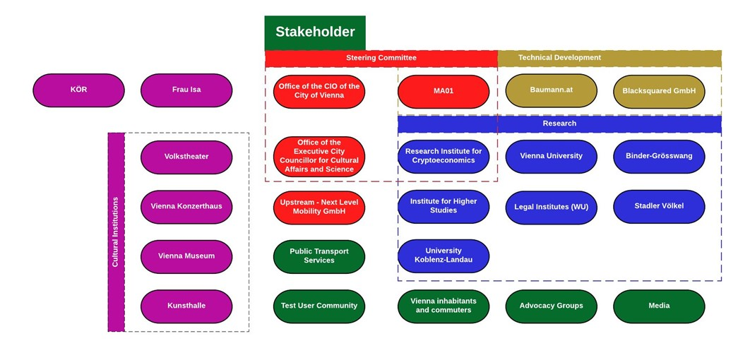

Slide 9
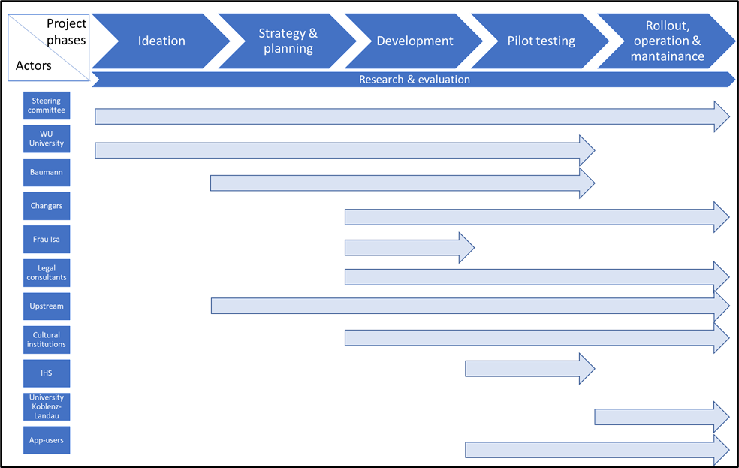

Slide 10
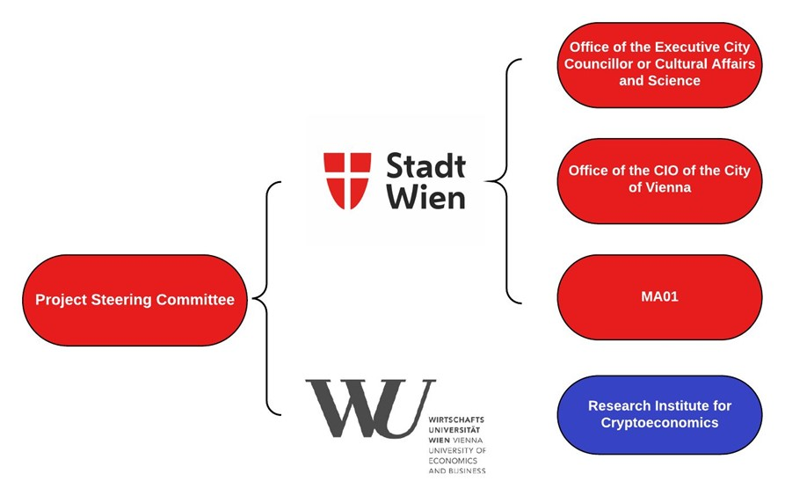

Slide 11
Kultur-Token App:
→ Tracking mobility patterns:
car
bicycle
walking
public transport
GPS location data gathered by user‘s smartphone sensor (speed of travel, acceleration, …) calculates route traveled (time + distance) and start-stop patterns to discover most likely used mode of transport
Users are awarded Kultur-Token for any distance not traveled by car
CO₂-emissions saved: 20kg = 1 KT
Token can be exchanged for admissions to participating cultural institutions
→ aligns with Vienna’s goals to promote sustainable mobility choices, reducing energy consumption and pollution related to transport and reducing traffic-related CO₂.
→ facilitate access to and enjoyment of artistic and cultural institutions

Slide 12
Applied Research project
Research role in an applied project
  Behavioral Economics
  Sustainability
→ Kultur-Token Business model developed based on Strongly Sustainable Business Ontology + Flourishing Business Canvas
  Digital Ecosystems

Slide 13

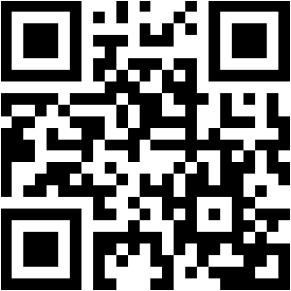
Applied Research project

Slide 14
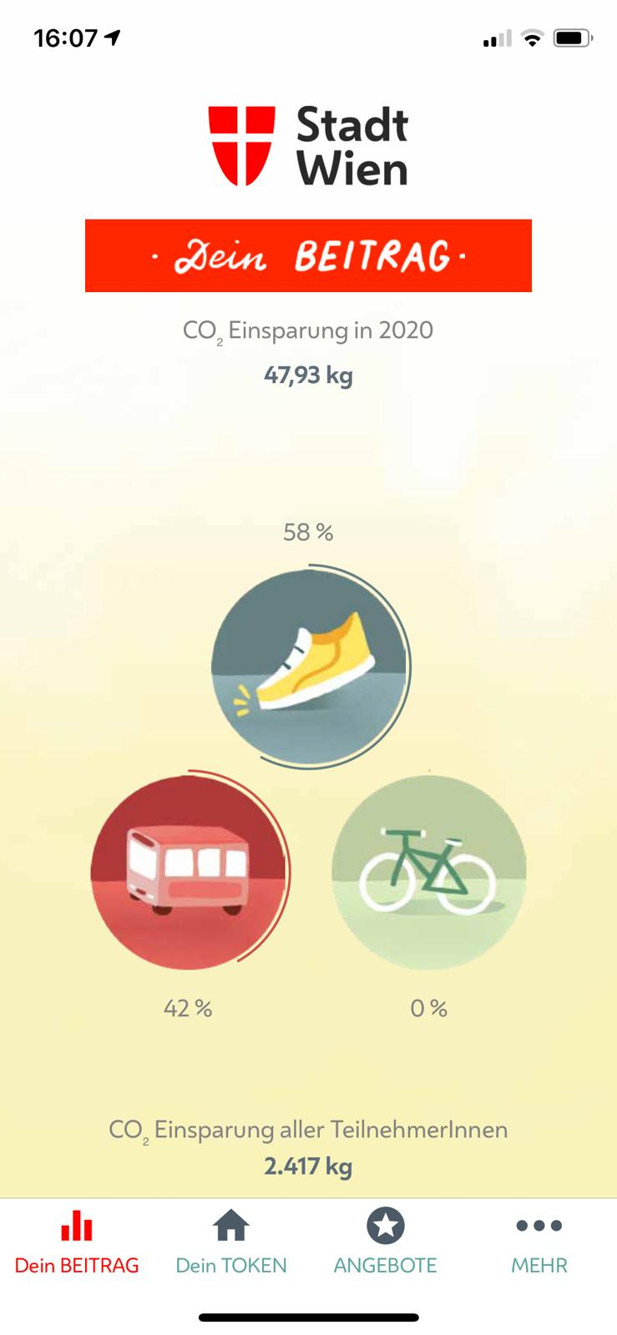
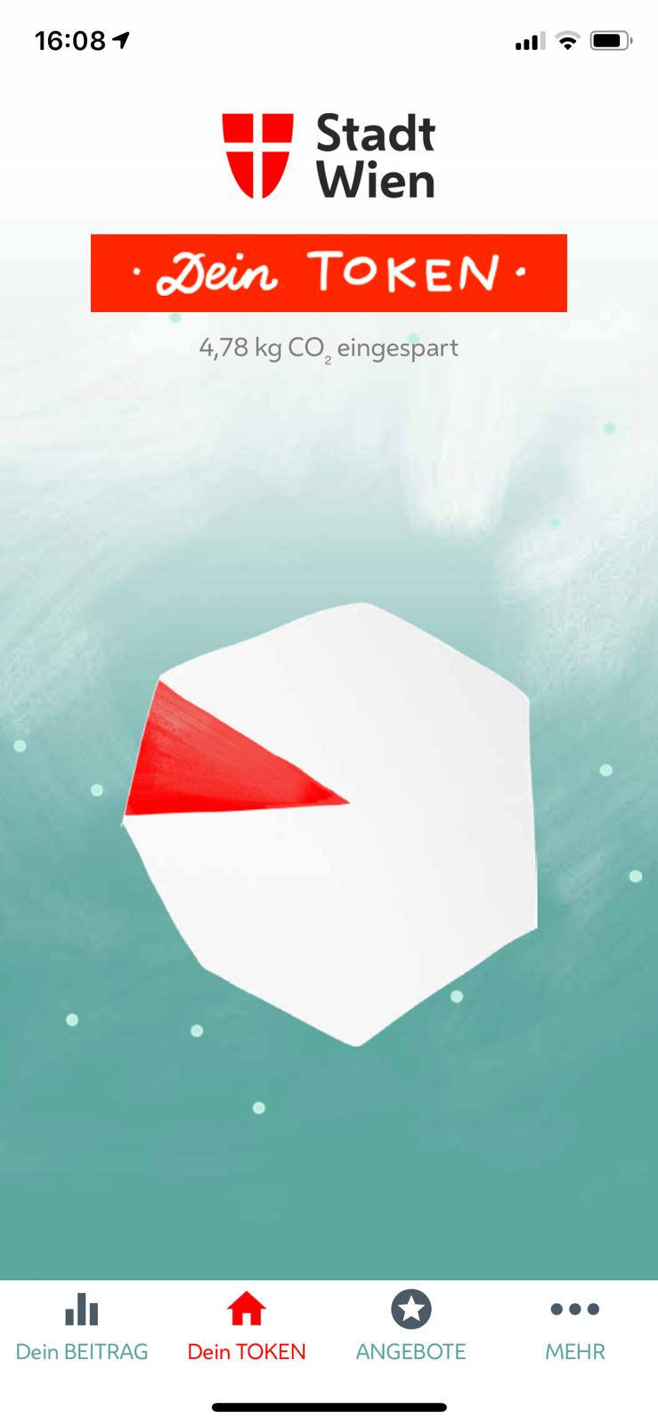
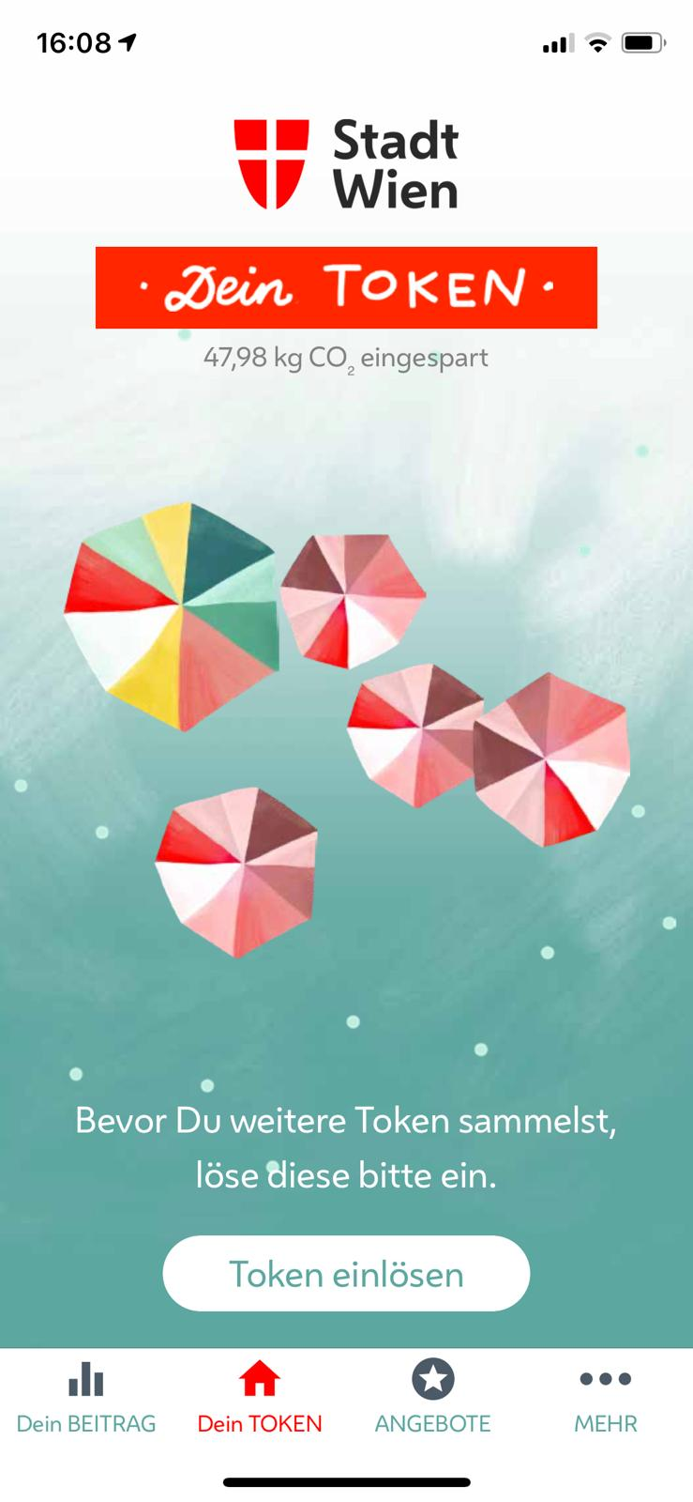

Slide 15
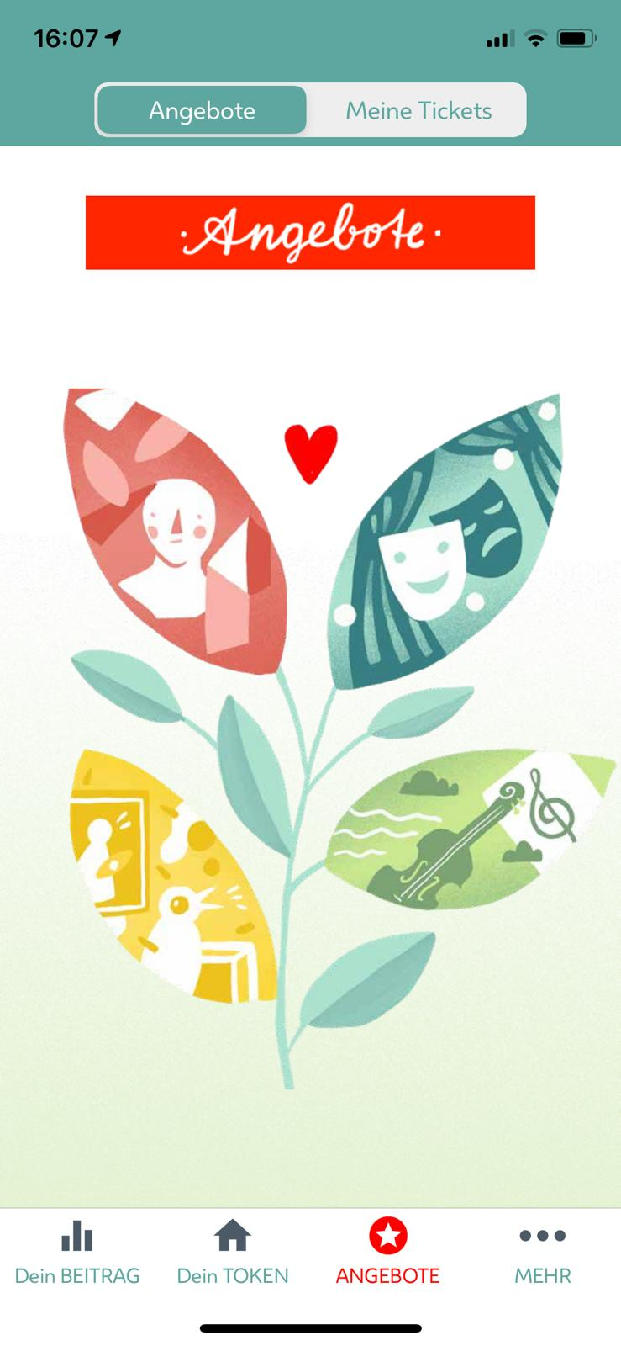
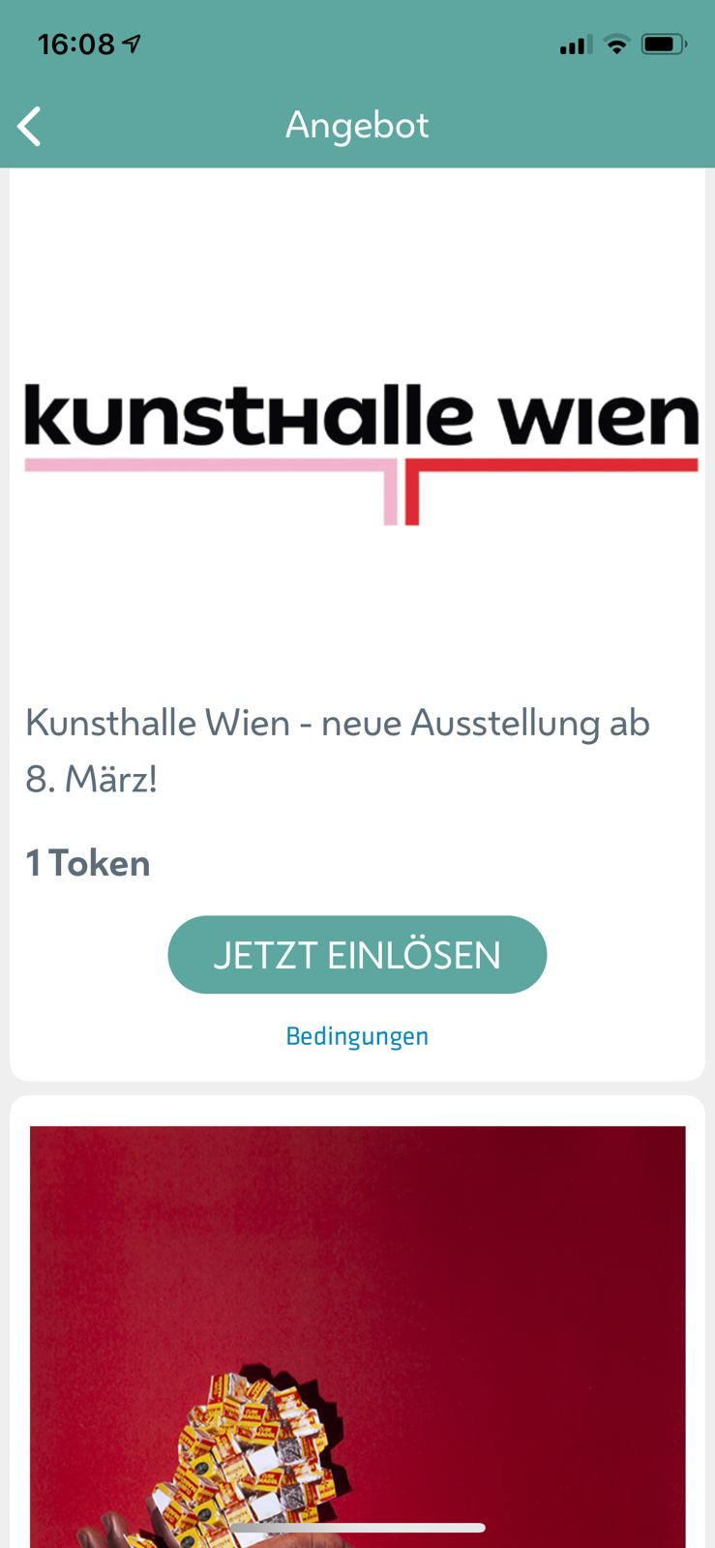

Slide 16
Contact
Website: http://wu.ac.at/cryptoeconomics
Twitter: @crypto3conomics
Linkedin: @crypto3conomics
Facebook: @crypto3conomics
Medium: @crypto3conomics

