Slide 1
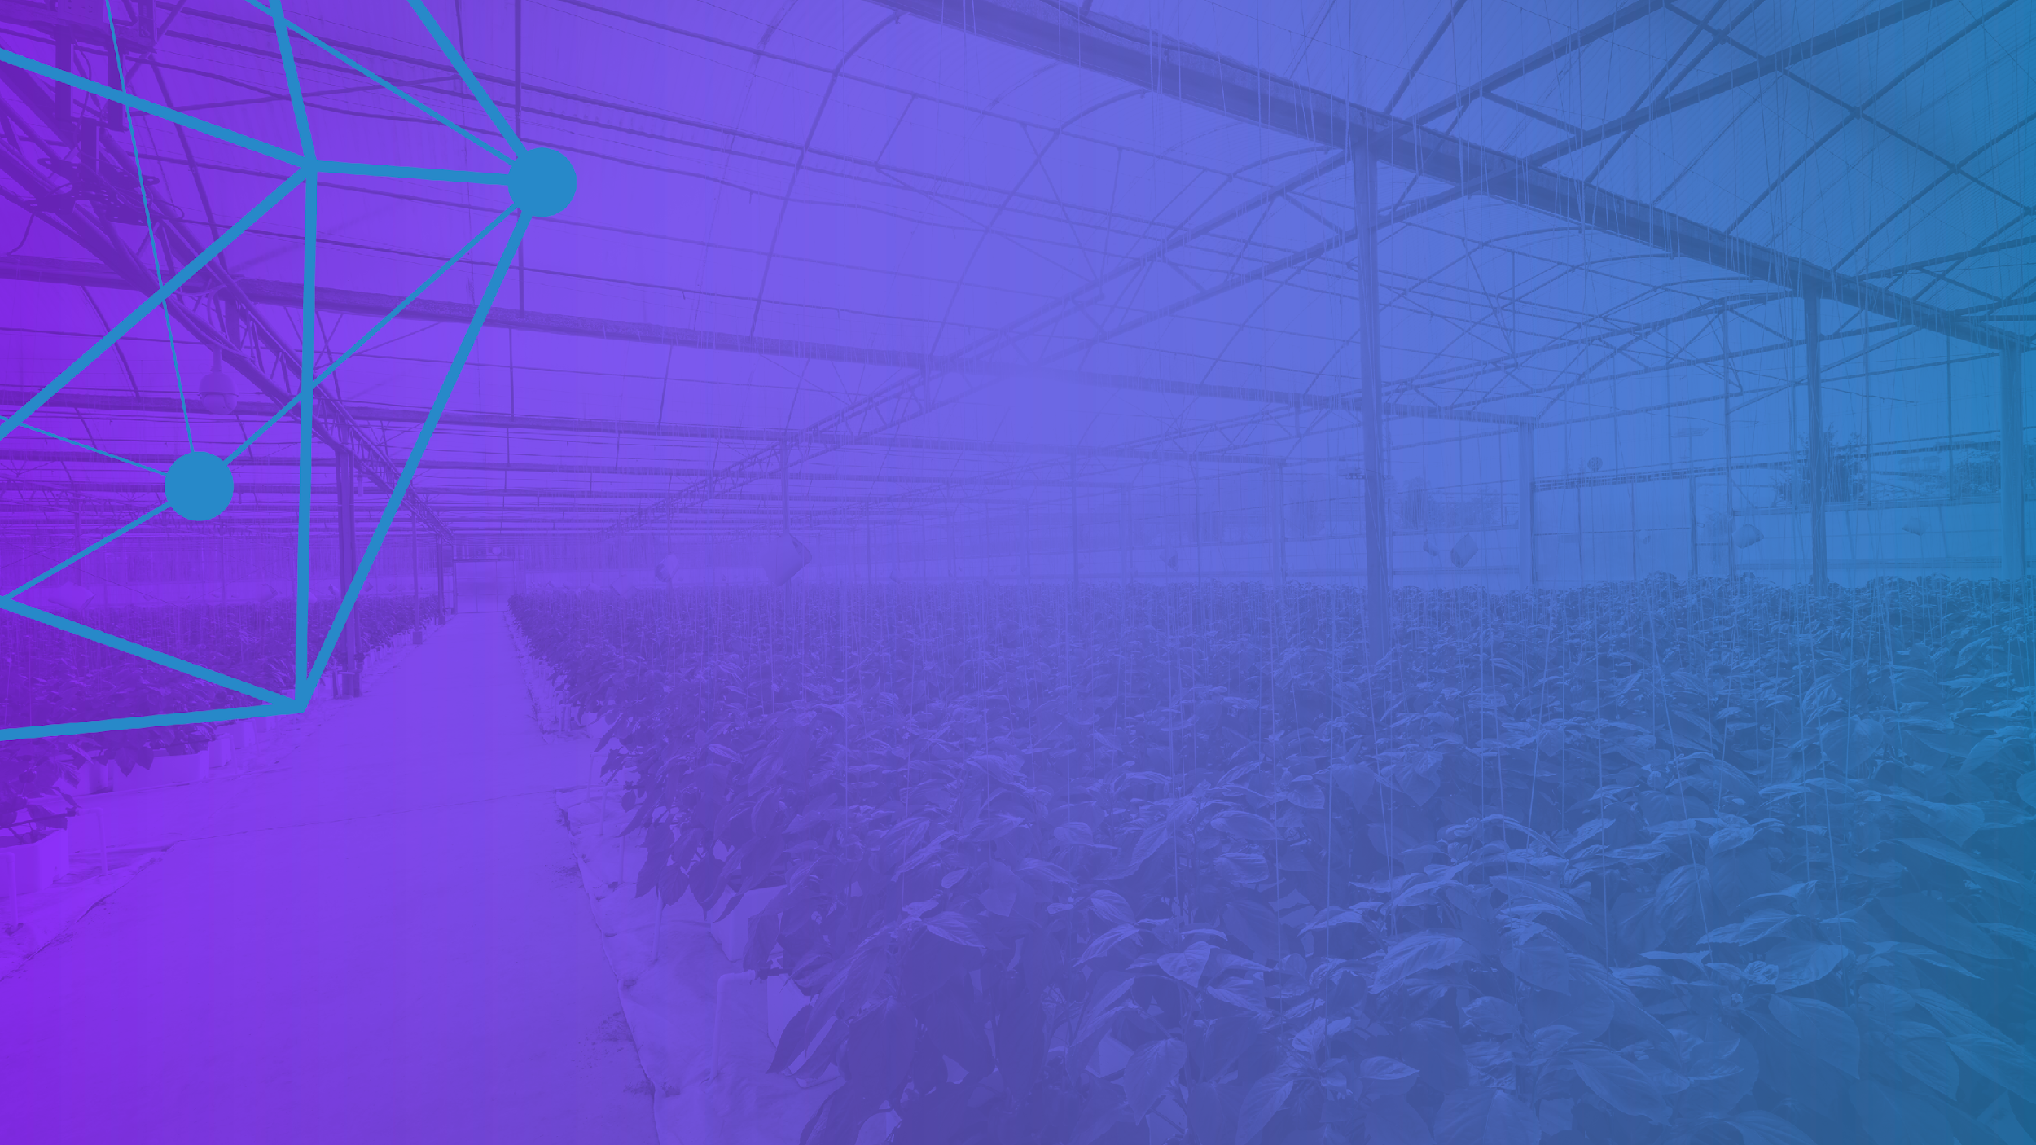
The Hyperledger
Vision
January 2020

Slide 2

Blockchain 101

Slide 3

What are Blockchain Technologies?

Slide 4

Encompasses both distributed ledgers and smart contracts.

Slide 5

What is a
Distributed Ledger?

Slide 6

An append-only system
of record or log of transactions.
Notes:
Blockchains can be used to record promises, trades, transactions or simply items we never want to disappear. Mirrored exactly across all nodes in a given network, it allows everyone in an ecosystem to keep a copy of the common system of record. Nothing can ever be erased or edited.
A distributed ledger is a multi-party database with no central trusted authority. The differentiating nuance is that when transactions are processed in blocks according to the ordering of a blockchain, the result is a distributed ledger.

Slide 7

Cryptography for Integrity & Privacy

Slide 8

Software standards keep everyone in the shared ecosystem in sync.
Notes:
A hash-based data structure is essential to know that each entry in the ledger is in a certain order and is cryptographically connected to the prior entries. The exact order of those entries is transparent and verifiable by all the participants, safeguarding the entries from manipulation or dispute.

Slide 9

Distributed Ledgers
in Action

Slide 10

All businesses participating in a commercial ecosystem need a ledger to contain a record of transactions. It is vitally important to know that your copy of the ledger is identical to others’ in the network.

Slide 11

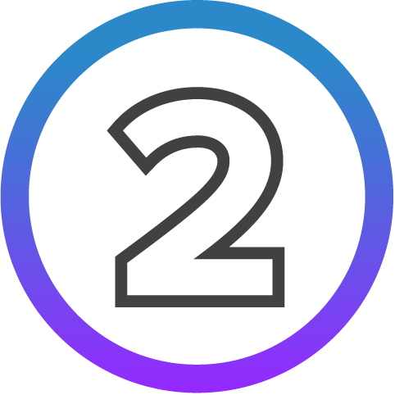
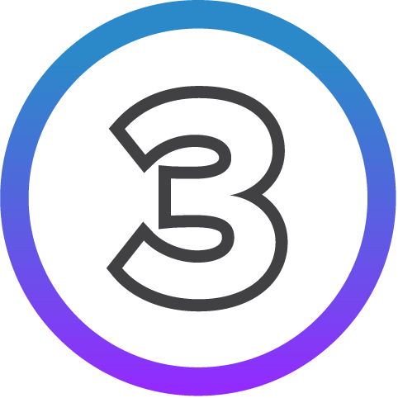



Example Scenario
Everyone in a room has a book with the instructions to write down entries as they get called out.
Someone calls out item number one and everyone writes it down.
Then two people call out item number two at the same time, but the item number differs.
There needs to be a process for who wins, and the loser gets to try to call out item number three.
When all agree on the outcome of an entry, the next link in that ledger can be written.
Whether this happens in a small scale or the size of the internet, that is the spectrum for how a distributed ledger can work.

Slide 12

What is a Smart Contract?

Slide 13

The code or any complex program stored and executed on a blockchain.
Notes:
Building one layer above distributed ledger technologies, you have smart contracts. Since distributed databases allow for multiparty, shared database use, distributed ledgers can be equipped with multi-party business logic, which is more commonly referred to as ‘smart contracts. These are a way to publish scripts and write programs in a language particular to a given chain, have them live on the shared network, and be able to execute on all those different nodes simultaneously.

Slide 14

Smart Contracts in Action

Slide 15

Imagine a farmer based in Sacramento, California buys an insurance agreement that protects them from extreme weather condition. If temperatures reach more than 100 degrees for 100 days, they get reimbursed 10,000 USD.

Slide 16
With manually-triggered contracts/ledgers widely operated today, the insurer might find a way to back out of, procrastinate or dispute this agreement.

Slide 17
If a Smart Contract is in place, the script in the ledger would rule that on that 100th day of 100+ degrees, the 10,000 USD would be automatically withdrawn. With an automated process, like it or not, the insurer cannot back out.

Slide 18

Myth Debunked: Blockchain ≠ Cryptocurrency

Slide 19

Cryptocurrency is an application that sits on top of blockchain.
Not the other way around.
Notes:
Blockchain and cryptocurrencies are often discussed in similar contexts, but they are not one in the same. Distributed ledgers do not require a cryptocurrency to work.
Cryptocurrency encompasses an anonymous record of who owns what tokens. Token exchanges create new entries on the ledger. Blockchains prevent the same token from being spent twice.
Many open source blockchain efforts implement cryptocurrency as a means to fund mining and participation in consensus. However, the most popular existing blockchains like Bitcoin [Nak08] and Ethereum [But13] utilize completely trustless networks and permissionless chains.
Permisionless networks present tremendous challenges and not all of them technical as debates rise over the roles these platforms should play in society and who should govern them.

Slide 20

Why Business
Blockchain Technologies

Slide 21

All over the global market there are ledgers that organizations and individuals alike must trust.
Notes:
Permissioned blockchains differ from what you’ll find in Bitcoin or Ethereum.
Most enterprise blockchain applications rely upon real world trust relationships, wherein the goal is to set up a set of participants in an ecosystem with the needed insurance that the boundaries are flexible enough to bring in more participants in the future. Participants on a permissioned network are known to one another, and therefore have an intrinsic interest in participating in the consensus making process. This community of participants want to share data with a greater degree of security. Without needing to run proof of work mechanisms, they can resolve more immediate problems than on a public cryptocurrency blockchain.
This is why you’re seeing every financial business looking to get involved in business blockchain technologies.

Slide 22



Early Adopter Industries
Financial Services
Supply Chain
Healthcare
Notes:
Financial Services
The most immediate business opportunities are to use business blockchains to track and trade stocks and bonds with reduced risk and time, and increased transparency.
Supply Chain
Blockchain technologies will lead to greater efficiency, as well as safer and more ethical standards through the ability to prove the veracity of transactions to all stakeholders.
Healthcare
Business blockchains are giving the healthcare industry a chance to reinvent what historically has been a thorny problem: sharing patient data records between organizations.

Slide 23

TRUST:
The Deciding Factor
in Whether a Society Can Function

Slide 24

The Need for Trust
The 2018 Edelman Trust Barometer, an annual survey of 33k people in 28 countries, reveals that the trust in key institutions continues to decline. For blockchain, 2019 needs to be the year of scale done well.
Notes:
And to sustain trust in the promise of blockchain technologies, 2018 needs to be the year of incremental scale done well, bringing PoCs into production-class environments.
Globalization and technological change are further eroding trust in institutions, which people believe have failed to protect them from the negative effects of these forces.
Ten of 28 surveyed countries combined an above-average lack of belief that the system is working with multiple societal fears – the same hotspots of recent populist actions: France, Italy, Mexico, South Africa, Spain, Brazil, Columbia, the U.K., Australia and the U.S.

Slide 25
Without trust, the system fails. The onus is on businesses to prove that it is possible to act in the interest of shareholders and society alike and show that free markets can succeed for all if businesses work with the people.

Slide 26
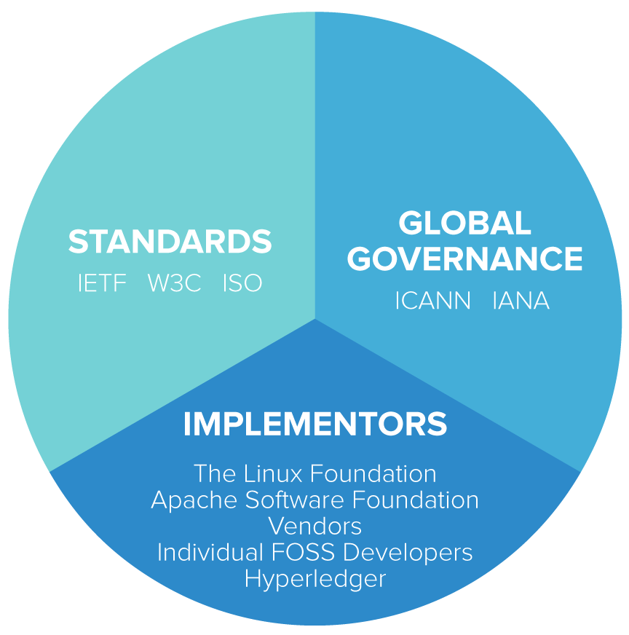
The Trust Protocol
The way internet technologies tend to get developed is a partnership between three organizations: standards, global governance and implementors, like Hyperledger.
Notes:
If Hyperledger could help not only forge common ground between different software development efforts, but also encourage a gradual detachment between standards, implementations, and global governance (whether that’s around currencies or other use cases), then we will also accelerate adoption of blockchain technologies widely and further reduce needlessly duplicated engineering and hardening efforts.

Slide 27



Slide 28

Introducing Hyperledger
A global, cross-industry consortium of communities advancing business blockchain technologies.
Notes:
Hyperledger is promoting enterprise grade, open source business blockchain technologies, including distributed ledgers, smart contract engines, client libraries, graphical interfaces, utility libraries, and sample applications.
Hyperledger provides the underlying open source software, on top of which anyone can set up apps to meet business needs.
Built under technical governance and open collaboration, individual developers, service and solution providers, government associations, corporate members and end users are all invited to participate in the development and promotion of these game-changing technologies.

Slide 29


Hosted by

Slide 30

Dedicated to building sustainable ecosystems around open source projects, The Linux Foundation is working with the global technology community to solve the world’s hardest problems through open source and creating the largest shared technology investment in history.
Notes:
For the last 16 years, The Linux Foundation® has provided unparalleled support for open source communities through financial and intellectual resources, governance structure, IT infrastructure, services, events, and training.

Slide 31








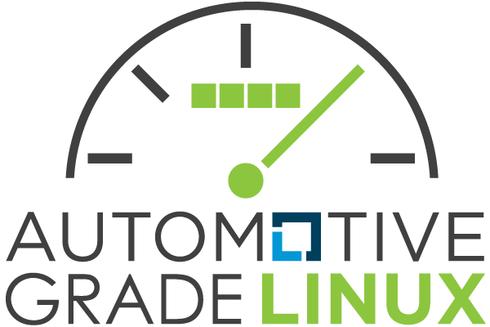





Some of the game-changing initiatives hosted by The Linux Foundation include:
Notes:
The Linux Foundation is the umbrella organization for more than 60 open source projects accelerating open technology development and commercial adoption.

Slide 32

The Hyperledger Genesis

Slide 33

This technology is young.
It is still early days.
Notes:
Hyperledger was initially seeded with various blockchain-supporting commercial members, some of whom had interesting internal or nascent open source efforts that needed the kind of home that The Linux Foundation could provide. They saw a need within the enterprise market for a flat, distributed, multi-party database ledger and Smart Contract system separate from cryptocurrencies, and through open source collaboration began building blockchain technology building blocks to enable these types of systems.

Slide 34

Hyperledger Momentum

Slide 35
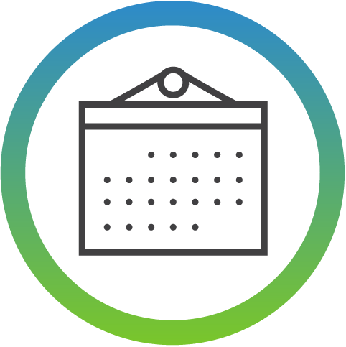
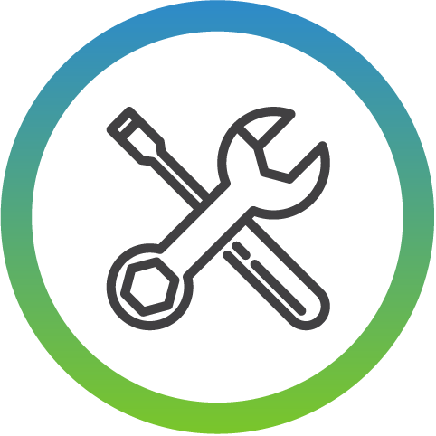
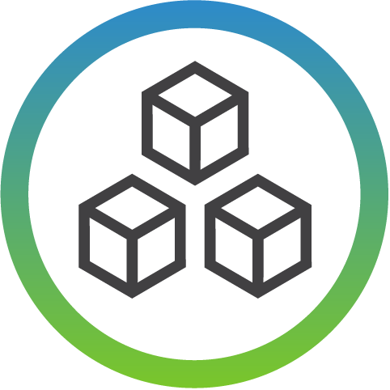



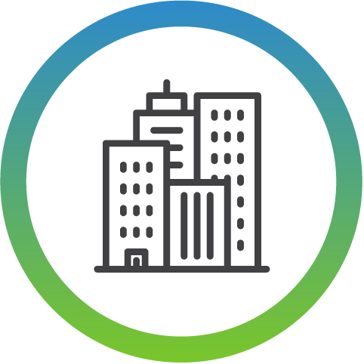
4
Years Since Launch
15
Projects
3
1.0 Production Releases
1
2.0 Production Releases
14
Active Community Working Groups & SIGs
170+
Meetups Worldwide
67K
Meetup Participants
250+
Members
(50+ in China)

Slide 36
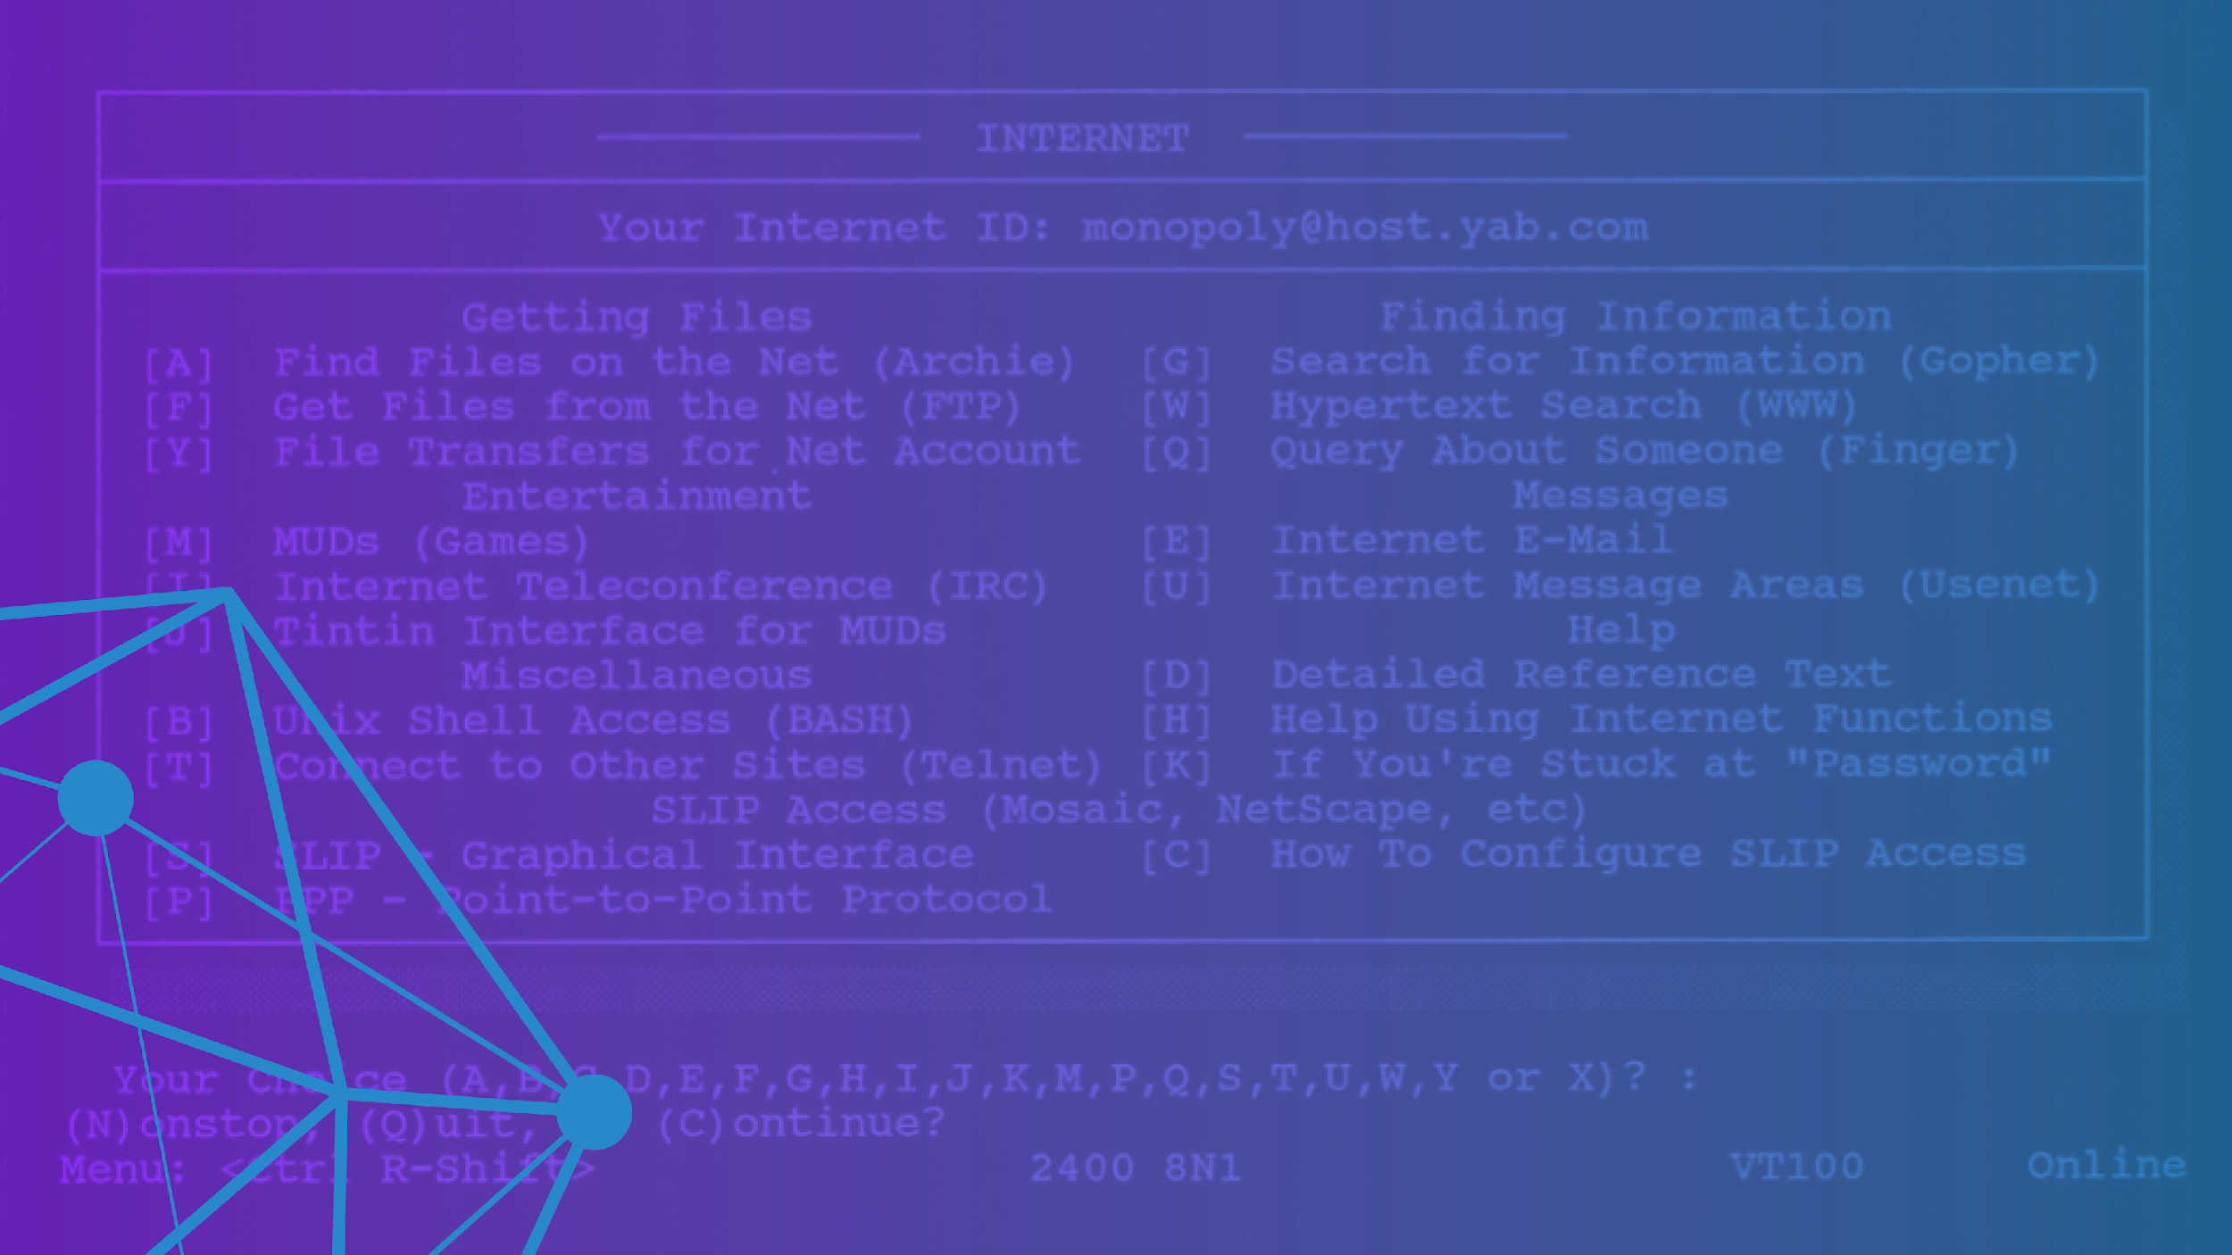
Parallels With the
Early Web

Slide 37

Blockchain technologies are in the early stages of a 20-year, if not a 50-year, adoption and maturation cycle. Many compare blockchain today with 1995 and the Web.
Notes:
Internet at the time was much more decentralized than it is today, and built primarily with open source. The technology was young and ripe with promise.
Today, there are clear examples of blockchain efforts that have seen widespread adoption and scale. There are commercial blockchain stacks running in production, clear momentum around Hyperledger frameworks. Yet, by no means is this a mature industry – we seek better consensus mechanisms for both permissioned and permissionless chains, a better range of choices for smart contract platforms and the right identity models.
In 1994, no fonts, background colors. Internet at the time was much more decentralized than it is today. Websites lived everywhere. The move to the cloud was a recentralization of that. Tech themselves were predominantly open source. This is how the internet was built at the time. To validate email, wrote the code and share it with others. To make incremental improvement, why not share it? Early days were very generative. Easy to set up a website. Taking print and turn it to black and white. It’s a return to that decentralization as a first principle?

Slide 38

The Hyperledger
Vision

Slide 39

Blockchain promises to change the way business is conducted and transactions are executed across industries. Precisely how, and the pace at which, each of these industries adopts blockchain will surely vary.
There will never be one global chain-of-all chains that all industries convert to.
Notes:
Ultimately, there will be many public chains and millions of private chain distributed ledger systems designed for specific marketplaces. They will interoperate over standards and ideally each use a common base of technology, much like how the Linux community uses the common Kernel operating system. Potentially, each will have a different consensus mechanism, preferred smart contract language, and other unique characteristics.
In this environment, the most valuable role that Hyperledger can play is to serve as a trusted source of innovative, quality-driven open source software development community, creating modular, open source components and platforms. The optimal focus of Hyperledger is to advance industry goals of distributed ledger and smart contracts.
Hyperledger is forging a brand to be seen widely as the accepted default, “safe” deployment platform for enterprise teams, and as a great home for active collaboration around new technologies.

Slide 40

Similar to The Linux Foundation, Hyperledger also has a modular approach to hosting projects. Think of Hyperledger as a greenhouse for developing business blockchain projects from Hyperledger Labs (seed) to stable code ready for production (fruition). All are invited to contribute to the greenhouse; collectively advancing industry goals of distributed ledger and smart contracts.
Notes:
The Linux Foundation and Hyperledger provide the infrastructure for open development to occur among a diverse and thriving community.
Under Hyperledger’s umbrella are frameworks and tools that take different approaches to creating blockchains for business.
There are many benefits to this modular approach.

Slide 41

Hyperledger
Modular Approach Benefits

Slide 42
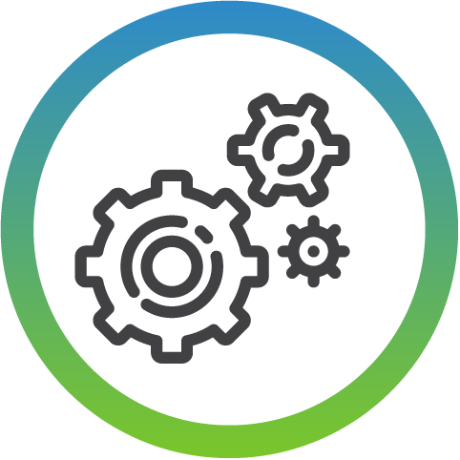
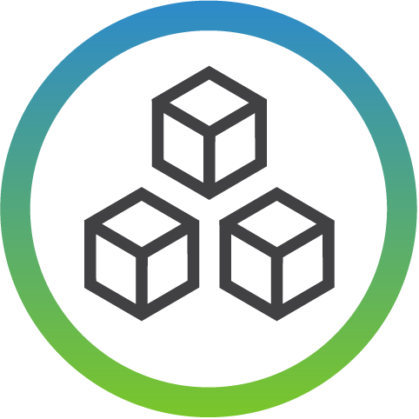


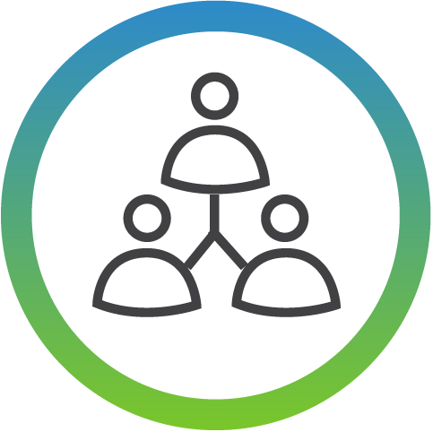
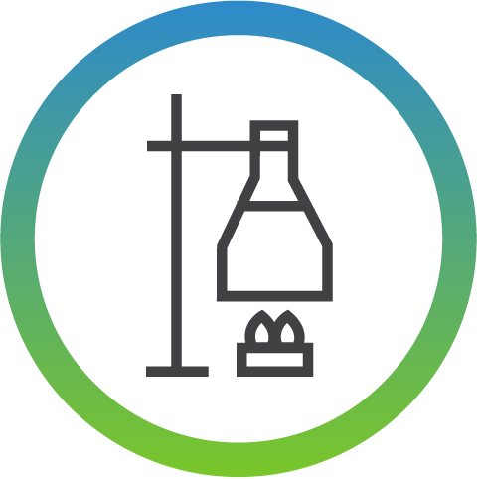
Flexible Modification
of Any Component
Common Functional Modules and Defined Interfaces
Re-use of Common Building Blocks
Extensible Codebases
Diverse Developer Community
Rapid Experimentation

Slide 43
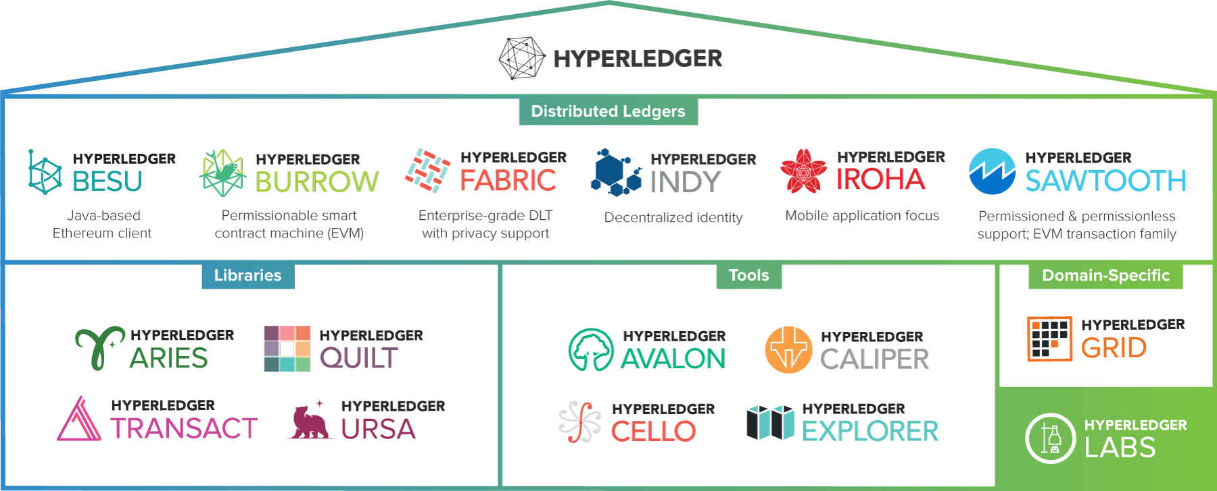
Hyperledger Modular Approach
Notes:
Infrastructure
Technical, Legal, Marketing, Organizational
Ecosystems that accelerate open development and commercial adoption
Frameworks
Meaningfully differentiated approaches to business blockchain frameworks developed by a growing community of communities
Tools
Typically built for one framework, and through common license and community of communities approach, ported to other frameworks
Similar to the way that The Linux Foundation takes an umbrella approach to the projects that exist under, Hyperledger also has a modular umbrella approach. At the top level, The Linux Foundation and Hyperledger provide the infrastructure for open development to occur. This includes technical, legal, marketing, and organizational aspects.
Under Hyperledger’s umbrella are a number of frameworks that take different approaches to creating business blockchain tools and frameworks -- Fabric, Iroha, Sawtooth, Burrow, and Indy.
Hyperledger’s umbrella also includes a number of modules that were typically built with one framework in mind, but are being expanded and ported to support other frameworks.
Composer - Provides a application development environment that lets you more quickly develop and deploy your blockchain application. Hyperledger Composer allows you to model your business network and integrate existing systems and data with your blockchain applications.
Explorer - provides a User Interface to explore and examine the current state of a Hyperledger blockchain. Similar to bitcoin explorers or crypto-currency explorers, information such as transaction information, network activity, recent blocks, visuals and search are available that allows for information to be quickly found.
Cello - allows us to easily provision a blockchain network, check its status, and maintain the health of the network.

Slide 44

Hyperledger Blockchain Frameworks

Slide 45


A permissionable smart contract machine. The first of its kind when released in December, 2014, Burrow provides a modular blockchain client with a permissioned smart contract interpreter built in part to the specification of the Ethereum Virtual Machine (EVM).
Notes:
Internet at the time was much more decentralized than it is today, and built primarily with open source. The technology was young and ripe with promise.
Today, there are clear examples of blockchain efforts that have seen widespread adoption and scale. There are commercial blockchain stacks running in production, clear momentum around Hyperledger frameworks. Yet, by no means is this a mature industry – we seek better consensus mechanisms for both permissioned and permissionless chains, a better range of choices for smart contract platforms and the right identity models.
In 1994, no fonts, background colors. Internet at the time was much more decentralized than it is today. Websites lived everywhere. The move to the cloud was a recentralization of that. Tech themselves were predominantly open source. This is how the internet was built at the time. To validate email, wrote the code and share it with others. To make incremental improvement, why not share it? Early days were very generative. Easy to set up a website. Taking print and turn it to black and white. It’s a return to that decentralization as a first principle?

Slide 46

Intended as a foundation for developing applications or solutions with a modular architecture, Hyperledger Fabric allows components, such as consensus and membership services, to be plug-and-play.
Notes:
Internet at the time was much more decentralized than it is today, and built primarily with open source. The technology was young and ripe with promise.
Today, there are clear examples of blockchain efforts that have seen widespread adoption and scale. There are commercial blockchain stacks running in production, clear momentum around Hyperledger frameworks. Yet, by no means is this a mature industry – we seek better consensus mechanisms for both permissioned and permissionless chains, a better range of choices for smart contract platforms and the right identity models.
In 1994, no fonts, background colors. Internet at the time was much more decentralized than it is today. Websites lived everywhere. The move to the cloud was a recentralization of that. Tech themselves were predominantly open source. This is how the internet was built at the time. To validate email, wrote the code and share it with others. To make incremental improvement, why not share it? Early days were very generative. Easy to set up a website. Taking print and turn it to black and white. It’s a return to that decentralization as a first principle?

Slide 47

Tools, libraries, and reusable components for providing digital identities rooted on blockchains or other distributed ledgers so that they are interoperable across administrative domains, applications, and any other silo.
Notes:
Internet at the time was much more decentralized than it is today, and built primarily with open source. The technology was young and ripe with promise.
Today, there are clear examples of blockchain efforts that have seen widespread adoption and scale. There are commercial blockchain stacks running in production, clear momentum around Hyperledger frameworks. Yet, by no means is this a mature industry – we seek better consensus mechanisms for both permissioned and permissionless chains, a better range of choices for smart contract platforms and the right identity models.
In 1994, no fonts, background colors. Internet at the time was much more decentralized than it is today. Websites lived everywhere. The move to the cloud was a recentralization of that. Tech themselves were predominantly open source. This is how the internet was built at the time. To validate email, wrote the code and share it with others. To make incremental improvement, why not share it? Early days were very generative. Easy to set up a website. Taking print and turn it to black and white. It’s a return to that decentralization as a first principle?

Slide 48

A business blockchain framework designed to be simple and easy to incorporate into infrastructural projects requiring distributed ledger technology.
Notes:
Internet at the time was much more decentralized than it is today, and built primarily with open source. The technology was young and ripe with promise.
Today, there are clear examples of blockchain efforts that have seen widespread adoption and scale. There are commercial blockchain stacks running in production, clear momentum around Hyperledger frameworks. Yet, by no means is this a mature industry – we seek better consensus mechanisms for both permissioned and permissionless chains, a better range of choices for smart contract platforms and the right identity models.
In 1994, no fonts, background colors. Internet at the time was much more decentralized than it is today. Websites lived everywhere. The move to the cloud was a recentralization of that. Tech themselves were predominantly open source. This is how the internet was built at the time. To validate email, wrote the code and share it with others. To make incremental improvement, why not share it? Early days were very generative. Easy to set up a website. Taking print and turn it to black and white. It’s a return to that decentralization as a first principle?

Slide 49

A modular platform for building, deploying, and running distributed ledgers. Hyperledger Sawtooth includes a novel consensus algorithm, Proof of Elapsed Time (PoET), which targets large distributed validator populations with minimal resource consumption.
Notes:
Internet at the time was much more decentralized than it is today, and built primarily with open source. The technology was young and ripe with promise.
Today, there are clear examples of blockchain efforts that have seen widespread adoption and scale. There are commercial blockchain stacks running in production, clear momentum around Hyperledger frameworks. Yet, by no means is this a mature industry – we seek better consensus mechanisms for both permissioned and permissionless chains, a better range of choices for smart contract platforms and the right identity models.
In 1994, no fonts, background colors. Internet at the time was much more decentralized than it is today. Websites lived everywhere. The move to the cloud was a recentralization of that. Tech themselves were predominantly open source. This is how the internet was built at the time. To validate email, wrote the code and share it with others. To make incremental improvement, why not share it? Early days were very generative. Easy to set up a website. Taking print and turn it to black and white. It’s a return to that decentralization as a first principle?

Slide 50

Hyperledger Grid is a supply chain focused solution that provides reference implementations of supply chain-centric data types, data models, and smart contract based business logic. Second it showcases how to combine components from the Hyperledger stack into a single, effective business solution.
Notes:
Internet at the time was much more decentralized than it is today, and built primarily with open source. The technology was young and ripe with promise.
Today, there are clear examples of blockchain efforts that have seen widespread adoption and scale. There are commercial blockchain stacks running in production, clear momentum around Hyperledger frameworks. Yet, by no means is this a mature industry – we seek better consensus mechanisms for both permissioned and permissionless chains, a better range of choices for smart contract platforms and the right identity models.
In 1994, no fonts, background colors. Internet at the time was much more decentralized than it is today. Websites lived everywhere. The move to the cloud was a recentralization of that. Tech themselves were predominantly open source. This is how the internet was built at the time. To validate email, wrote the code and share it with others. To make incremental improvement, why not share it? Early days were very generative. Easy to set up a website. Taking print and turn it to black and white. It’s a return to that decentralization as a first principle?

Slide 51

Architecture of Hyperledger Projects

Slide 52
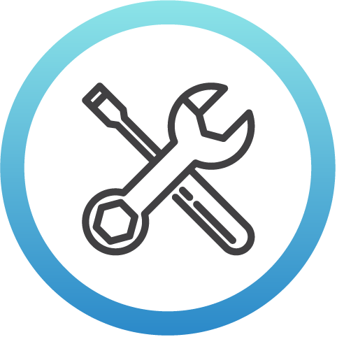
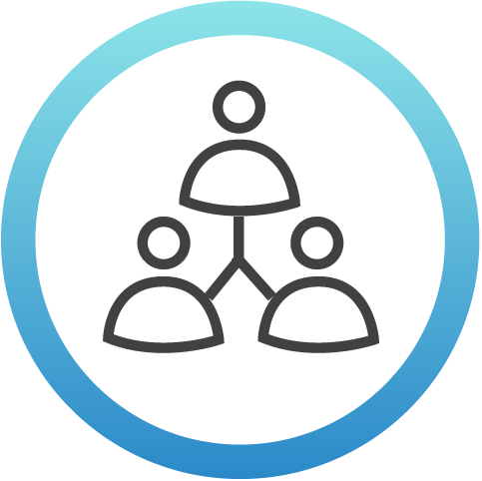

Architecture of Hyperledger Projects
Available Tools
Common software license: Apache v2
Common IP framework: the Developer Certificate of Origin
Collaboration tools (Gerrit, Jira, Chat, email)
Promotion and branding
Security processes and practices for bugs
A Team of Developer Volunteers
Build code in the open
Manage individual roadmaps and release schedules
Responsible for following Hyperledger policies and requirements
Align modular code with other projects
Infrastructure from
The Linux Foundation
Executive Director
Business Operations
Technical Staff for Security, Ecosystem and Community Development
Communications Staff for Marketing, PR and Events
Legal Counsel
Membership Sales
Notes:
(Slack removed from list of tools) Rocket.Chat → Chat

Slide 53

Hyperledger
Goals

Slide 54



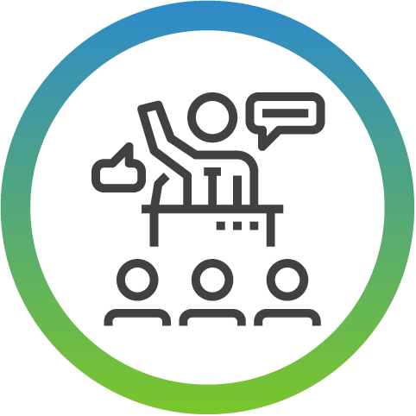
Create enterprise grade software
open source, distributed ledger frameworks & code bases
to support business transactions
Provide community-driven infrastructures
that are open, neutral and supported by technical and business governance
Build technical communities
to develop blockchain and shared ledger POCs, use cases, field trials and deployments
Educate the public
about the market opportunity for blockchain technology
Promote our communities
taking a toolkit approach with many platforms and frameworks
Notes:
Under Hyperledger’s umbrella are frameworks and tools that take different approaches to creating blockchains for business.
There are many benefits to this modular approach.

Slide 55

Industry
Use Cases

Slide 56

Hyperledger embraces the full spectrum of industry use cases, especially enterprise scenarios with widely varied requirements for decentralization, trust, continuity and confirmation times. Each represents a potentially unique optimization point for the technology.
Notes:
Distributed ledgers for different use cases can have vastly different requirements.
Here you will find industry-specific use cases to illustrate how blockchain technologies can and are being implemented to bring more trust across industries and the world today.

Slide 57

Cross-Border Payments

Slide 58

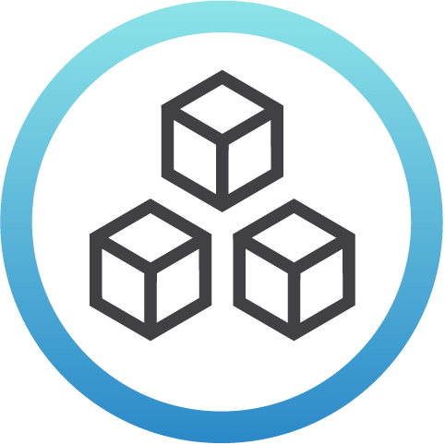
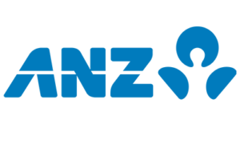


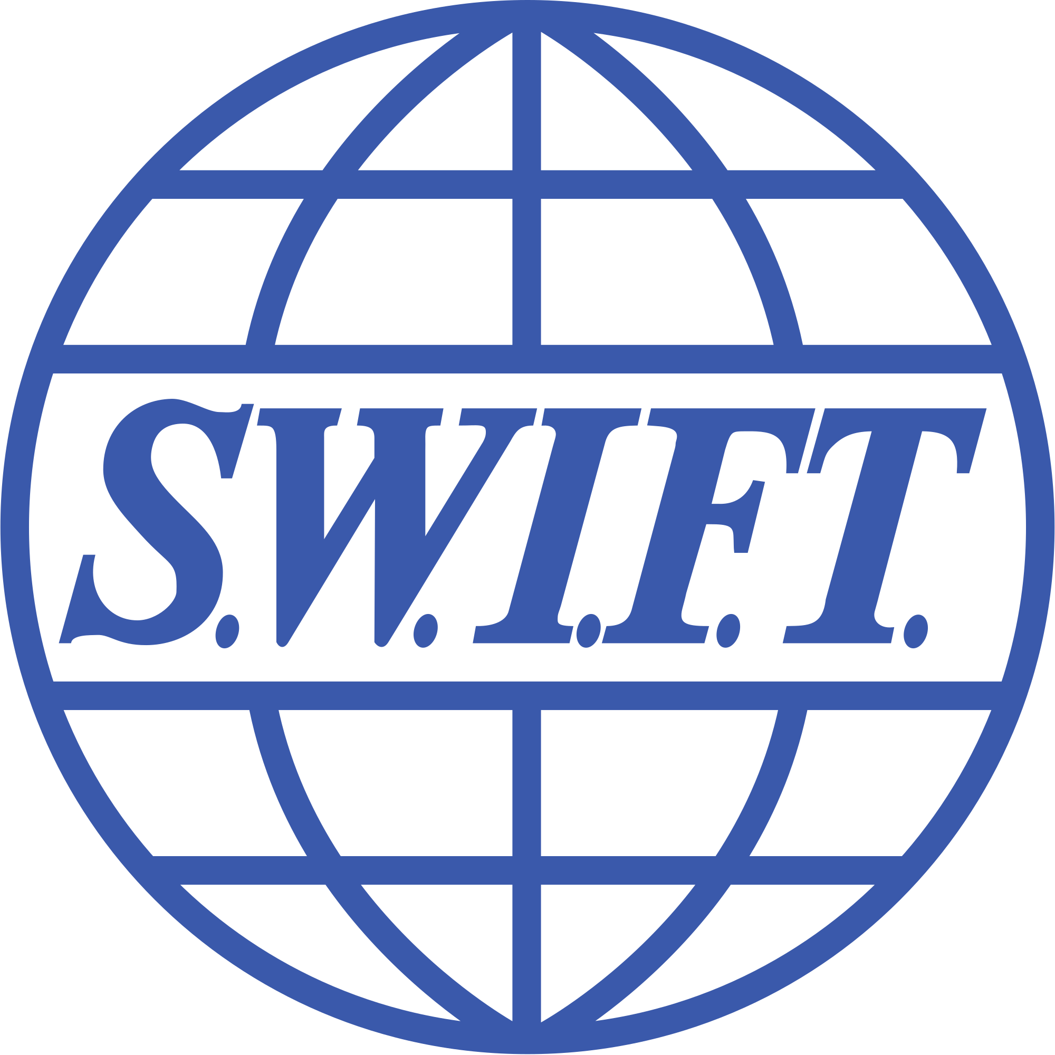

Cross-Border Payments
The Challenge
Transferring money across international borders is still complicated, time consuming and expensive.
The Collaboration
A global team of developers from Hyperledger members SWIFT, ANZ, BNP Paribas, BNY Mellon and Wells Fargo create a cross-border POC. built with Hyperledger Fabric.
The Technology
The blockchain trial was built on Hyperledger Fabric and is now ready for its next phase of testing.
Notes:
Transferring money across international borders is still complicated, time consuming and expensive. Payments routed abroad can take several days to get settled. Existing money transfer systems suffer furthermore from long lines, exchange rate losses, counter-party risks, bureaucracy and extensive paperwork. Cross-border payments have become a critical part of millions of lives as we moved towards a more globalized world and multicultural societies.
After months of work, a global team of developers have completed a cross-border POC built with Hyperledger Fabric. Designed to test whether moving member bank accounts to a distributed ledger could help the inter-bank payments platform Swift reconcile in real time, the blockchain trial is now ready for its next phase of testing with General members ANZ, BNP Paribas, BNY Mellon and Wells Fargo.
Hyperledger Fabric enables real-time visibility on the liquidity of Nostro accounts, easing reconciliation and allowing liquidity savings while meeting key industry requirements such as governance, data privacy, standardisation, and identity.

Slide 59

Healthcare
Records

Slide 60




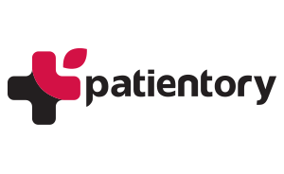

Healthcare Records
The Challenge
Blockchain could be used to provide patients' with more control over their healthcare information and who it is shared with.
The Collaboration
Members like Change Healthcare, Gem, Hashed Health, Patientory and Kaiser Permanente are leading the open Hyperledger Healthcare Working Group to bring commercial blockchain adoption to the healthcare industry.
The Technology
Hyperledger Composer offers a set
of APIs, a modeling language and a programming model to quickly define and deploy business networks and applications that allow participants to send transactions that exchange assets.
Notes:
Blockchain may offer a way to get the healthcare industry to commit to an information sharing platform in which pointers to personal health data could be stored on a secure, permissioned chain and shared back and forth quickly like email.
Hyperledger Composer offers a set of APIs, a modeling language and a programming model to quickly define and deploy business networks and applications that allow participants to send transactions that exchange assets.
Say, for example, a patient’s x-ray sits on a cloud site and insurers can request the password to access it. Password requests get stored on a chain, and a set of smart contracts allow the doctor to share the pointers to the x-ray with the insurance company. The patient has a wallet noting which chains their records are stored on. When those pointers are shared, they’re recorded as auditable events in the healthcare system, allowing patients to have complete visibility into their data and ultimately the ability to mediate and approve who their records are shared with.

Slide 61

Interstate
Medical Licensing

Slide 62

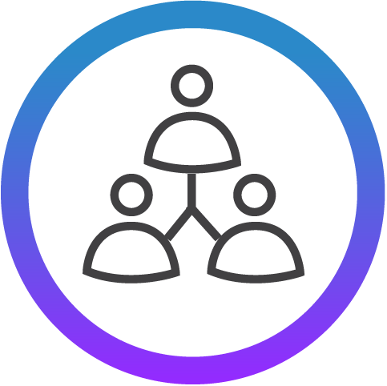
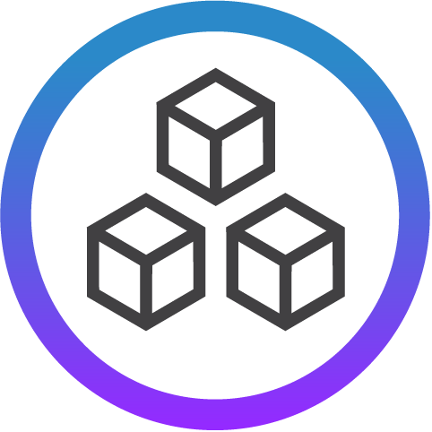
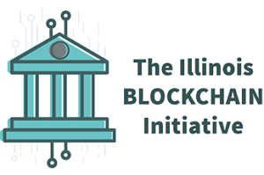
Interstate Medical Licensing
The Challenge
Interstate medical licensing is complex, and the provider directories and claims adjudication processes need increased trust and transparency.
The Collaboration
Hyperledger members Hashed Health and the State of Illinois have implemented a pilot program to identify opportunities to improve the efficiency and accuracy of these processes in Illinois.
The Technology
A blockchain-based registry, built using Hyperledger Fabric, streamlines the sharing of smart contracts and medical credential data to automate workflow associated with interstate and multistate licensure.
Notes:
Associate Hyperledger Member State of Illinois has implemented a pilot program in collaboration with General member Hashed Health using Hyperledger Fabric to reduce complexity of interstate medical licensing, as well as to improve the veracity of provider directories and claims adjudication processes.
The Hyperledger Fabric pilot program will identify opportunities to improve the efficiency and accuracy of the medical credentialing process in the state of Illinois. The concept will utilize a blockchain-based registry to streamline the sharing of smart contracts and medical credential data to automate workflow associated with interstate and multistate licensure.
In the short-term they anticipate this pilot will show how distributed ledger technology can help reduce the complexity of interstate licensing processes in Illinois. In the long-term, they see this as a secure, privacy-enhancing way in which state licensure boards can efficiently manage credentialing at national scale, while also presenting health payers and provider networks a ‘single source-of-truth’ to improve the veracity of provider directories and claims adjudication processes.

Slide 63

Seafood Supply
Chain Traceability

Slide 64
Seafood Supply Chain Traceability
The Challenge
Blockchain technologies are being used in the fishing industry to drive fish catch towards more ethical practices.
The Collaboration
Hyperledger member Intel is collaborating with the broader community to implement a modern approach to seafood traceability.
The Technology
Leveraging Hyperledger Sawtooth, IoT sensors attached to any object (like fish) can trace ownership, possession, and telemetry parameters to record the seafood journey from ocean to table.
Notes:
Blockchain technologies are being used in the fishing industry to drive fish catch towards more ethical practices, obstructing pirate fisherman and fish that are caught outside of legal fishing areas from being sold.
Hyperledger Premier member Intel is collaborating with the Hyperledger community to implement a modern approach to seafood traceability. Leveraging the Hyperledger Sawtooth framework, the seafood journey can now be recorded from ocean to table.
IoT sensors can be attached to any object (like fish) that is entrusted to someone else for transport, with trackable ownership, possession, and telemetry parameters such as location, temperature, humidity, motion, shock and title. The final buyer can access a complete record of information and trust that the information is accurate and complete. Revolutionizing the seafood supply chain is just one example of the many ways Hyperledger Sawtooth can have real world benefits.

Slide 65

Diamond
Supply Chain

Slide 66



Diamond Supply Chain
The Challenge
The Kimberley Process Certification Scheme established in 2003 to prevent conflict diamonds is a long, paperwork-heavy process with a history of fraud from missing documents.
The Collaboration
Hyperledger members SAP Ariba and IBM are collaborating with Everledger on a pilot to prevent blood diamonds from entering the supply chain.
The Technology
The distributed ledger diamond track and trace system using Hyperledger Fabric v1.0 allows everyone in the industry to write to it, from miners, distributors and retailers, using the light pattern that is unique to every diamond to create an ID.
Notes:
In 2003, the Kimberley Process Certification Scheme (KPCS) was established to prevent conflict diamonds. Purchased diamonds now come with a certificate to prove the distributor did not obtain the diamond from rebels, that the mine has been audited, etc. The idea is that paperwork can confirm provenance; however, the process is lengthy and there is a history of fraud from missing paperwork.
To keep blood diamonds from entering the supply chain Hyperledger Premier members SAP Ariba and IBM are collaborating with Everledger to pilot a distributed ledger diamond track and trace system using Hyperledger Fabric v1.0 that everyone in the industry can write to from miners, to distributors, to retailers.
Holding a diamond to light creates a unique pattern that may be used to create an ID. When a bag of diamonds changes hands in the supply chain, it forms two entries in the chain: the diamond IDs present upon sending and receipt. Once a diamond ID number is inside the system it provides integrity as any stakeholder can then query and instantaneously verify a diamond’s provenance.

Slide 67

Digital
Identity

Slide 68

Digital Identity
The Challenge
As of 2017, only 44% of Filipinos were utilizing bank accounts, hampered by inefficient "Know Your Customer" laws.
The Collaboration
The Bankers Association of Philippines (BAP), in partnership with Hyperledger member Amihan and a coalition of major banks, undertook a POC to test a nation-wide self-sovereign ID system.
The Technology
The POC used Hyperledger Indy to develop a platform that streamlines new account onboarding, allowing consumers to enter information once
in a digital and privacy-preserving way.
Notes:
As of 2017, only 44% of Filipinos were utilizing bank accounts, a metric that is
quickly increasing thanks to rapid economic growth in the Philippines, but is still
hampered by inefficient mechanisms for checking the identity and history of new
account applicants. “Know Your Customer” laws require asking for the same data
over and over, much of which is not available in digital or verifiable form.
To solve this, the Bankers Association of the Philippines (BAP) in partnership with
Hyperledger member and technology consulting company Amihan, and a coalition of
major banks undertook a proof-of-concept exercise to build a prototype that implements self-sovereign identity using Hyperledger Indy.
The platform streamlines onboarding of new accounts, by allowing consumers to
enter information once in a privacy-preserving way, and re-use that data for new
account opening. The bank can trust that the history of that data is solid. If
successful, this could serve as a test for a nation-wide self-sovereign ID system.

Slide 69
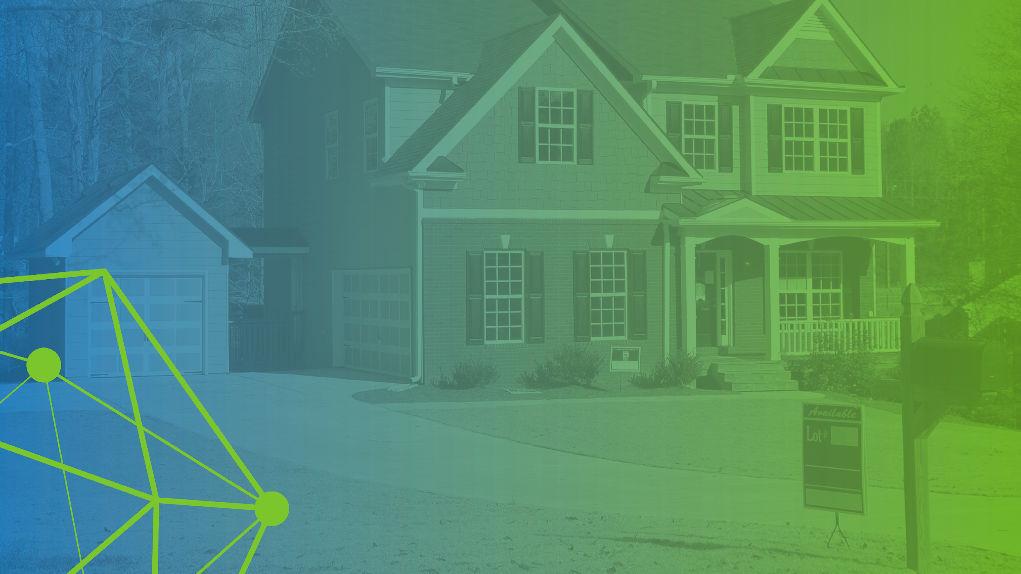
Real Estate Transactions

Slide 70
Real Estate Transactions
The Challenge
In some cases of corruption, the move to government-owned centralized databases backfired, and digital histories of land titles were eradicated, properties seized and handed over to oil companies.
The Collaboration
The winning team at the Consensus 2017: Building Blocks Hackathon, built an online property banking and acquisition game utilizing Hyperledger Fabric with IBM Bluemix.
The Technology
HyperProperty shows that Hyperledger Fabric can be used to guarantee who owns what properties. Decentralizing databases and turning to DLTs track land titles could keep governments accountable and create a more trustworthy system, even in instances where the individual actors may not be trusted.
Notes:
In the 1990s and 2000s, many international organizations put pressure on emerging countries to digitize land titles to guarantee citizens’ legal rights to their properties. In some cases of corruption, the move to government-owned centralized databases backfired, and digital histories of land titles were eradicated, properties seized and handed over to oil companies.
Decentralizing databases and turning to distributed ledger technologies to keep track of land titles could keep governments accountable and create a more trustworthy system, even in instances where the individual actors may not be trusted.
Every transaction such as when a property is sold from one party to another or when a loan is taken out against a property, would be recorded on the public ledger. Financial firms would reference the distributed ledger to decide whether or not to extend the loan to someone looking to buy a property. This permissioned-based, shared system of record will increase trust overall and protect homeowners.

Slide 71

Music and Media Rights

Slide 72

Music and Media Rights
The Challenge
Dot Blockchain Media (dotBC) is building a music content rights registry that will help musicians express their rights and wishes for commercializing their art in an interoperable file format.
The Collaboration
Although not a member of Hyperledger, dotBC is able to leverage the open source Hyperledger Sawtooth platform for recording its content rights registry for the media industries.
The Technology
Data is maintained across a distributed network that utilizes Hyperledger Sawtooth. dotBC's blockchain implementation is a foundation for music and media rights expression into the works themselves.
Notes:
Dot Blockchain Media (dotBC) is building a music content rights registry that will help musicians express their rights and wishes for commercializing their art in an interoperable file format. Data is maintained across a distributed network that utilizes Hyperledger Sawtooth.
dotBC's blockchain implementation is a foundation for music and media rights expression into the works themselves. It creates a fair and transparent method for music composers, artists, publishers and rights holders to express their rights and wishes for commercializing their art into a modern and interoperable file format. dotBC maintains partnerships and connections in the music and wider media industries to enable seamless data exchanges between more than 63 million globally recorded works from independent and major label artists and the dotBC ecosystem.
“Hyperledger Sawtooth will enable us to scale rapidly and customize transaction processors specifically for ingesting rights data. We look forward to delivering a strong and lasting solution, anchored on a sophisticated and secure blockchain foundation, for the music and media industries with Intel.”
– Benji Rogers, dotBC CEO

Slide 73

Green Assets Management

Slide 74


Green Assets Management
The Challenge
Generating carbon assets more efficiently, helping to build a green, low-carbon and environmentally-
friendly future in China.
The Collaboration
General Hyperledger member Energy Blockchain Labs partnered with Premier member IBM on the world’s first blockchain-based green assets management platform. based on Hyperledger Fabric.
The Technology
Blockchain technology, like the use of Hyperledger Fabric here, is expected to become an important means for effective control of carbon emissions in China, the world's largest source of carbon emissions. Carbon asset development, is one of the most popular ways of encouraging enterprises to decrease emissions and use low carbon emission technology.
Notes:
General Hyperledger member Energy Blockchain Labs partnered with Premier member IBM on the world’s first blockchain-based green assets management platform based on Hyperledger Fabric. In production use by the carbon asset market in China, it allows enterprises to generate carbon assets more efficiently, helping to build a green, low-carbon and environmentally-friendly future in China.
Blockchain technology is expected to become an important means for effective control of carbon emissions, which is of great significance to China, the world's largest source of carbon emissions. Carbon asset development, also known as CER (Carbon Emission Reduction) quota issuing, is one of the most popular ways of encouraging enterprises to decrease emissions and use low carbon emission technology.
The platform is estimated to significantly shorten the carbon assets development cycle and reduce the cost of carbon assets development by 20-30 percent just in the pilot stage of the platform, enabling cost-effective development of a large number of carbon assets.

Slide 75

Letters of
Credit

Slide 76
Letters of Credit
The Challenge
The LOC process is a difficult one to automate due to the sheer number of network participants involved.
The Collaboration
Institutions in Singapore, including Monetary Authority of Singapore, several banks and Standard Chartered, as well as China CITIC Bank and Minsheng bank have come together to use blockchain to create a LOC system. One of the first transactions of this kind in China saw a 100 million letter of credit transaction be completed without a hitch.
The Technology
Asian markets have been deploying and developing various solutions for LOC based on Hyperledger Fabric. Blockchain provides a common ledger for LOC and presents a modernized opportunity; the LOC is stored on the blockchain, and once spent, is marked as such so that the value of the letter cannot be spent again.
Notes:
Letters of credit (LOC) is a centuries old process (actually started in medieval times with the Knights Templar who required a way to allow pilgrims to travel to Jerusalem without the danger of carrying money around). The LOC process is a difficult one to automate due to the sheer number of network participants involved. In this example, Bank A and Bank B are used to represent a complicated network.
This use case also allows for innovative methods of payment using IoT devices. Smart contracts could implement rules that prevent/allow/increase/reduce payment if certain conditions hold (e.g., if it gets too hot/cold/humid/dry, or if the goods are a certain percentage of the way to the destination).
Example) Bank handling LOC wants to offer them to a wider range of clients. Currently constrained by costs and time to execute. Blockchain provides a common ledger for LOC. Blockchain presents a modernized opportunity; the LOC is stored on the blockchain, and once spent, is marked as such so that the value of the letter cannot be spent again. Blockchain allows all counter-parties to have the same validated record of transaction and fulfillment, with increased execution speed and significantly reduced costs.
http://www.fintechist.com/chinese-banks-unveil-blockchain-based-letter-credit-system/
https://www.gtreview.com/news/asia/ibm-experiments-with-blockchain-for-trade-finance/

Slide 77

Food Trust

Slide 78
Food Trust
The Challenge
The food network is a complex distribution and processing ecosystem involving farms, distributors, retailers and consumers, which make it difficult to assure food provenance.
The Collaboration
Walmart, and a group of retailers and food companies such as Unilever, Nestlé and Dole, have teamed up with IBM to explore how to apply blockchain technology like Hyperledger Fabric to their food supply chain.
The Technology
By making a shared ledger accessible to each party in the supply chain, all food processing steps can be recorded and stored on the blockchain, including digital compliance documentation, test results and audit certificates to improve transparency and efficiency across the food network.
Notes:
Blockchain technologies can provide a trusted source of information and traceability across the food network, a complex distribution and processing ecosystem involving farms, distributors, retailers and consumers, which make it difficult to assure food provenance.
By making a shared ledger accessible to each party in the supply chain, all food processing steps can be recorded and stored on the blockchain, including digital compliance documentation, test results and audit certificates to improve transparency and efficiency across the food network.
The result is a reduced impact of food recalls through instant access to end-to-end traceability data to verify history in the food network and supply chain, which can help address the 1 in 10 people sickened every year from food-born illness.

Slide 79

Digital Trade
Chain

Slide 80

Digital Trade Chain
The Challenge
Today, banks live in a competitive world. Small and mid-sized businesses generated 85% of employment growth in Europe in recent years, but only ~50% of them have access to formal credit. The Digital Trade Chain exemplifies how blockchain can bring the required trust and transparency to a new business network and associated business model.
The Collaboration
A consortium of major world banks including: Deutsche Bank, HSBC, KBC, Natixis, Rabobank, Société Générale, Santander, UniCredit and Nordea
The Technology
we.trade is a blockchain-based international trading system that enables accurate trading posture information, order to settlement control, risk coverage, track and trace options
Notes:
we.trade is a blockchain-based international trading system for a consortium of major world banks including:
Deutsche Bank, HSBC, KBC, Natixis, Rabobank, Société Générale, Santander, UniCredit and Nordea
Enables accurate trading posture information, order to settlement control, risk coverage, track and trace options
Near-real time exchange of information on a secure platform that digitizes transactional financing and other complex processes
Continual business and compliance readiness in any regulatory environment
Scalability that allows for rapid international expansion as business, regulatory, and security opportunities converge
https://www.ibm.com/blogs/insights-on-business/banking/digital-trade-chain-consortiums-trade-finance-project-underscores-important-new-use-cases-blockchain/

Slide 81
Introductory Contribution Opportunities
Notes:
David

Slide 82
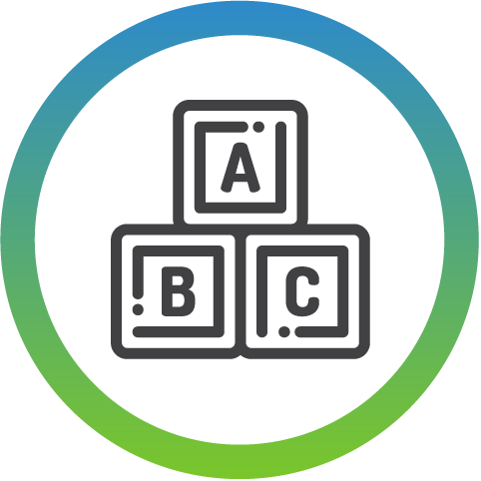


hyperledger.org/community
Learn the Basics
about Hyperledger projects
Start or join a Hyperledger meetup
Spread the word about Hyperledger
Notes:
David

Slide 83

Advanced
Contribution Opportunities
Notes:
Tracy - Now we are going to explore some more advanced contribution opportunities.

Slide 84


hyperledger.org/community
Improve our documentation and training material
Get involved with coding
Take part in the Ambassador program
Notes:
Tracy - Advanced contribution opportunities include improving our documentation and training material, getting involved with coding, and taking part in the Ambassador program. Let's dive into how you can get involved with each of these opportunities

Slide 85







Collaboration Tools
Account
Sign up for a Linux Foundation account
Chat
Join the discussion on chat
Mailing Lists
Participate on the Hyperledger Mailing Lists
Github
Check out our code repositories
Wiki
Get the latest development updates from the wiki
Bug Reporting
Search for open bugs, or report a new one, in our bug database

Slide 86

Appendix

Slide 87
Business Blockchain Components Glossary
Consensus Layer
Responsible for generating an agreement on the order and confirming the correctness of the set
of transactions that constitute a block.
Smart Contract Layer
Responsible for processing transaction requests and determining if transactions are valid by executing business logic.
Communication Layer
Responsible for peer-to-peer message transport between the nodes that participate in a shared ledger instance.
Data Store Abstraction
Allows different data-stores to be used by other modules.
Crypto Abstraction
Allows different crypto algorithms or modules to be swapped out without affecting other modules.
Identity Services
Enables the establishment of a root of trust during setup of a blockchain instance, the enrollment and registration of identities or system entities during network operation, and the management of changes like drops, adds, and revocations. Also, provides authentication and authorization.
Policy Services
Responsible for policy management of various policies specified in the system, such as the endorsement policy, consensus policy, or group management policy. It interfaces and depends on other modules to enforce the various policies.
APIs
Enables clients and applications to interfere to blockchains.
Interoperation
Supports the interoperation between different blockchain instances.

