Slide 1

Blockchain Employ
Fall 2021
Matching Qualified Applicants with Blockchain Opportunities

Slide 2
Antitrust Policy Notice
Linux Foundation meetings involve participation by industry competitors, and it is the intention of the Linux Foundation to conduct all its activities in accordance with applicable antitrust and competition laws. It is therefore extremely important that attendees adhere to meeting agendas, and be aware of, and not participate in, any activities that are prohibited under applicable US state, federal or foreign antitrust and competition laws.
Examples of types of actions that are prohibited at Linux Foundation meetings and in connection with Linux Foundation activities are described in the Linux Foundation Antitrust Policy available at http://www.linuxfoundation.org/antitrust-policy. If you have questions about these matters, please contact your company counsel, or if you are a member of the Linux Foundation, feel free to contact Andrew Updegrove of the firm of Gesmer Updegrove LLP, which provides legal counsel to the Linux Foundation.

Slide 3





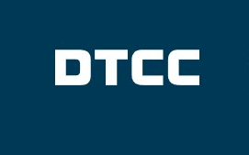


1
Denver Meetup 10/14/2021
What’s Happening in the Blockchain Career Department
2
Boston Meetup
11/4/2021
Who is hiring for Blockchain Positions
3
Princeton Meetup 11/18/2021
Are you ready for What’s Happening in the Blockchain Career Department
4
Hyperledger
Career Fair
12/2/2021
Meetup Schedule
Denver Meetup 10/14/2021
What’s Happening in the Blockchain Career Department
John Carpenter Hosts Blockchain Hiring Experts for an engaging Q&A
Notes:
Depository Trust & Clearing Corporation

Slide 4

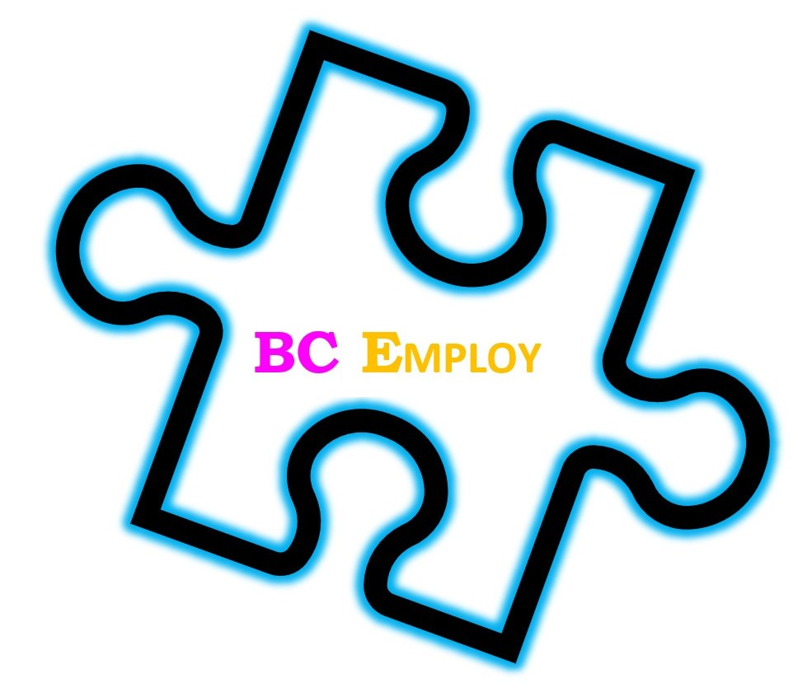
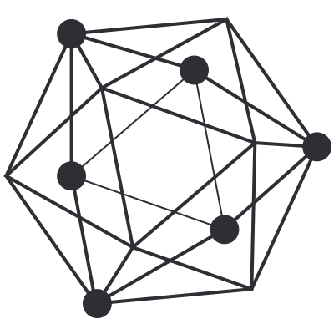

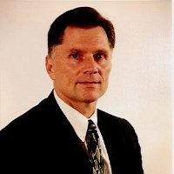

Hosts
Bobbi Muscara
Princeton
Jim Mason
Boston
John Carpenter
Denver
Ledger Academy
The Giving Chain
BC Employ
Hyperledger TSC
Blockchain Practice Leader
Paramount Software
Solutions, Inc
Chair Hyperledger
Public Sector
Global Blockchain Summit
Hyperledger Co-Chair Learning Materials Working Group Denver Meetup Organizer

Slide 5
Blockchain
Announcements
Blockchain Events, Bobbi Muscara
Matching Qualified Applicants with Blockchain Opportunities

Slide 6
Events Announcements
Blockchain Employment Series
Session One Denver Meetup Date 10/14/2021
Session Two Boston Meetup 11/4/2021
Session Three Princeton Meetup 11/18/2021
Session Four JOB FAIR 12/2/2021

Slide 7
Hyperledger Happenings
TSC Election
TSC Elections 2021 Nomination Statements
TSC Elections should have received a Ballot, Voting is OPEN, This year's Hyperledger Technical Steering Committee (TSC) election will happen from October 1 to 15, 2021.
The election will include active contributors who have been nominated to run as candidates. If you have any questions about the election process, please feel free to write to election@lists.hyperledger.org
New Leadership
Brian passes leadership to Daniela
In his farewell post, Brian Behlendorf announces Daniela Barbosa as the new Executive Director of Hyperledger. "She knows perhaps better than anyone else on the planet the potential in (and the challenges to) the use of blockchain and DLT in the enterprise." https://lnkd.in/dtiK3KJJ

Slide 8
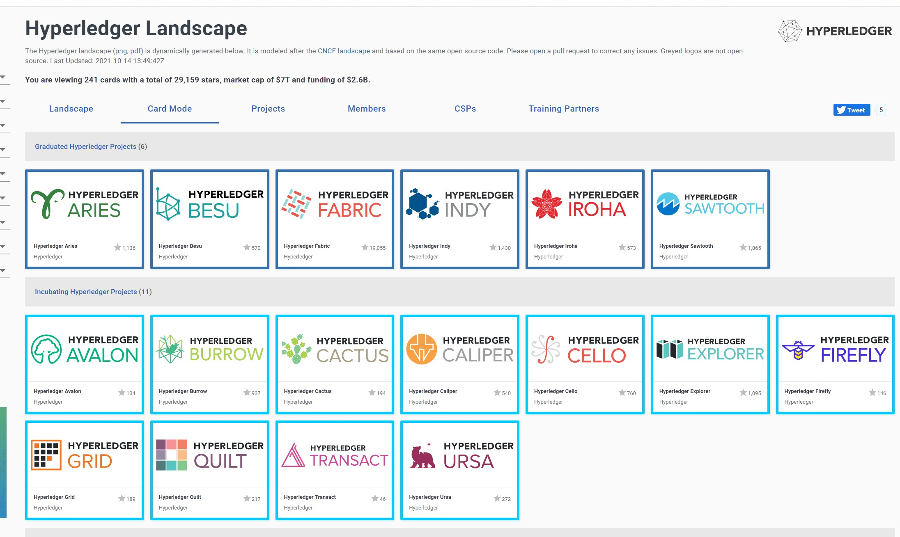
New View of Hyperledger https://landscape.hyperledger.org/projects

Slide 9
Hyperledger Happenings
Tuesday, October 19th 11 am EDT the Climate Action and Accounting SIG
Hosts a speaker from Hedera Hashgroup for a discussion about scaling carbon markets with public DLTs. This will cover open standards, the advantages of ledgers and real-world examples of use cases in Carbon Emissions & Offsets.
This is a virtual call, so anyone anywhere is welcome to attend. Please feel free to join if this sounds interesting and please also help us spread the word about the event.
Date and time: Tuesday, October 19 at 8 AM Pacific
Dial-in link:
https://zoom.us/j/4034983298?pwd=STZQd0xMZU9xRVVOVnpQM3JNQ2dqZz09
Event page:
https://wiki.hyperledger.org/display/CASIG/CA2+SIG+-+Meeting+October+19
October 15
Cactus - Pair Programming Session
The Giving Chain Meeting
Cello Weekly Meeting

Slide 10
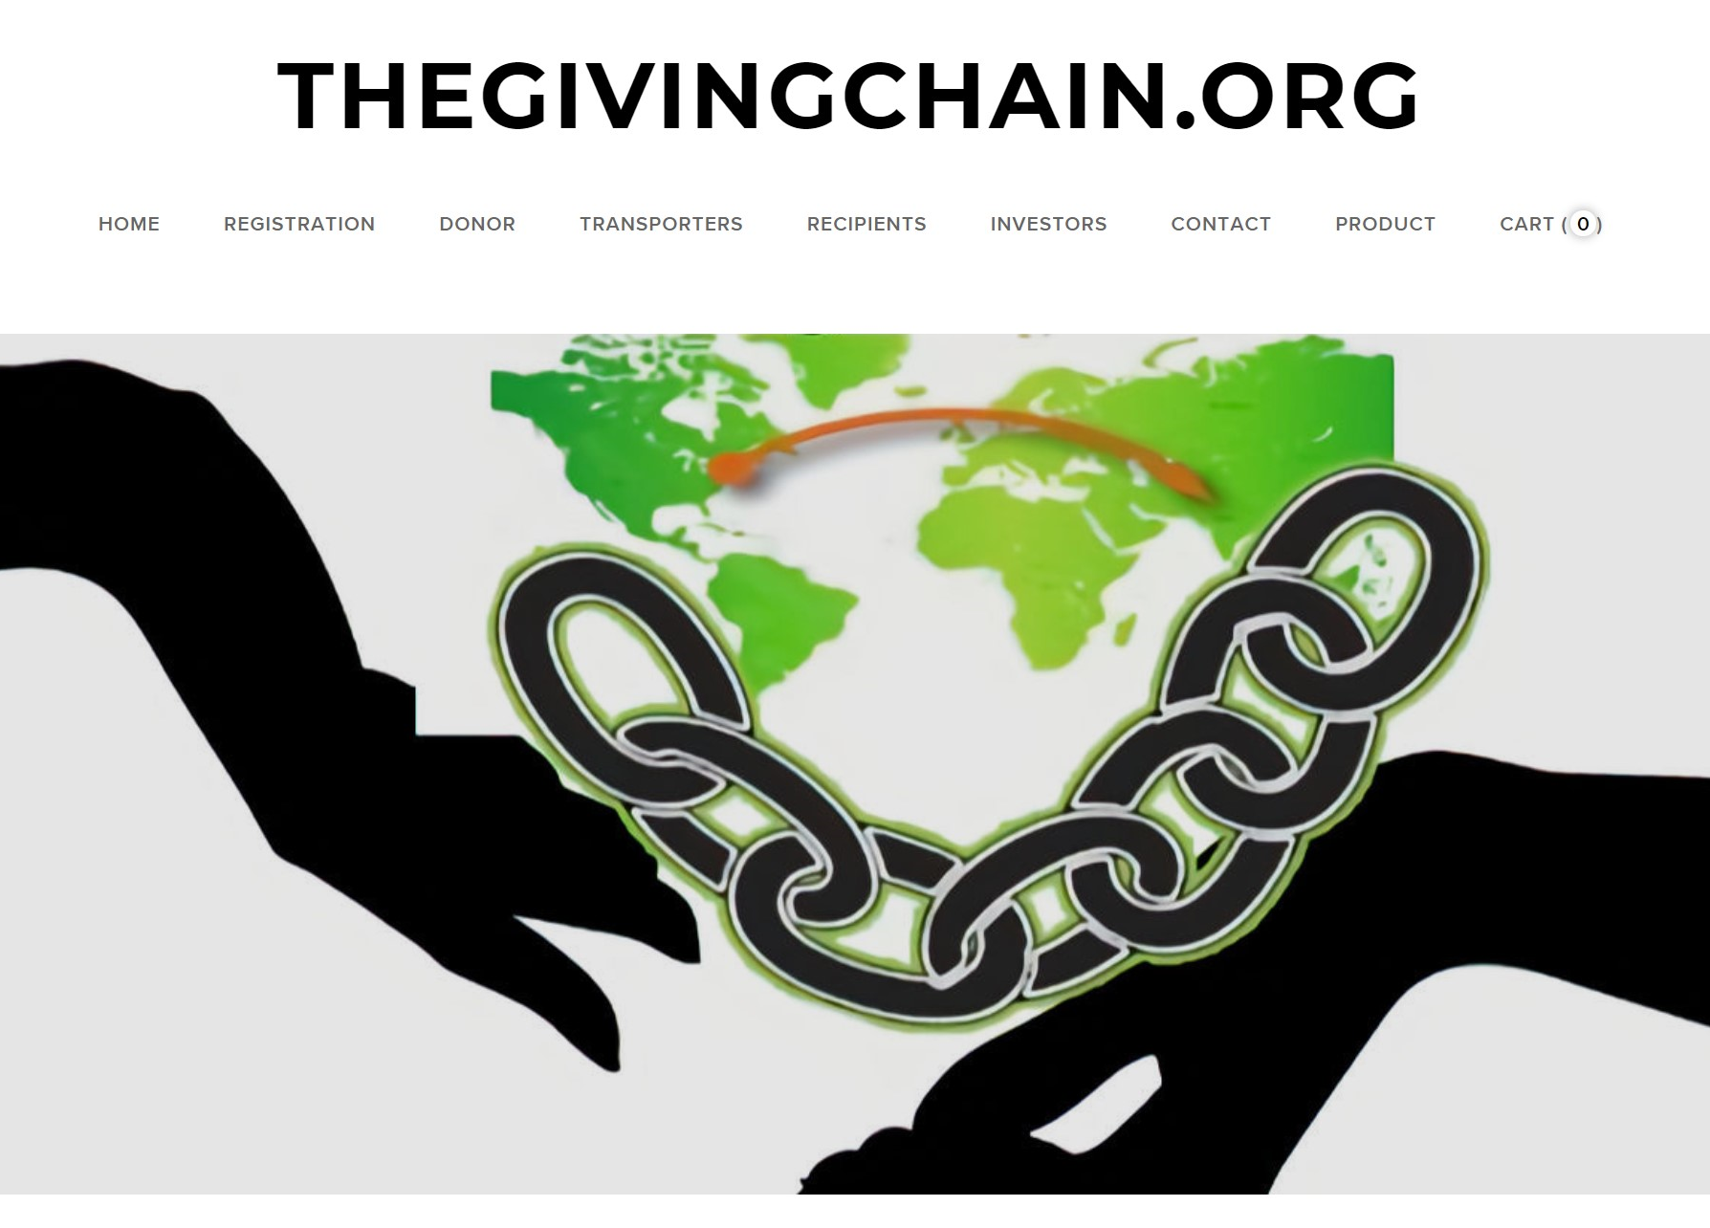
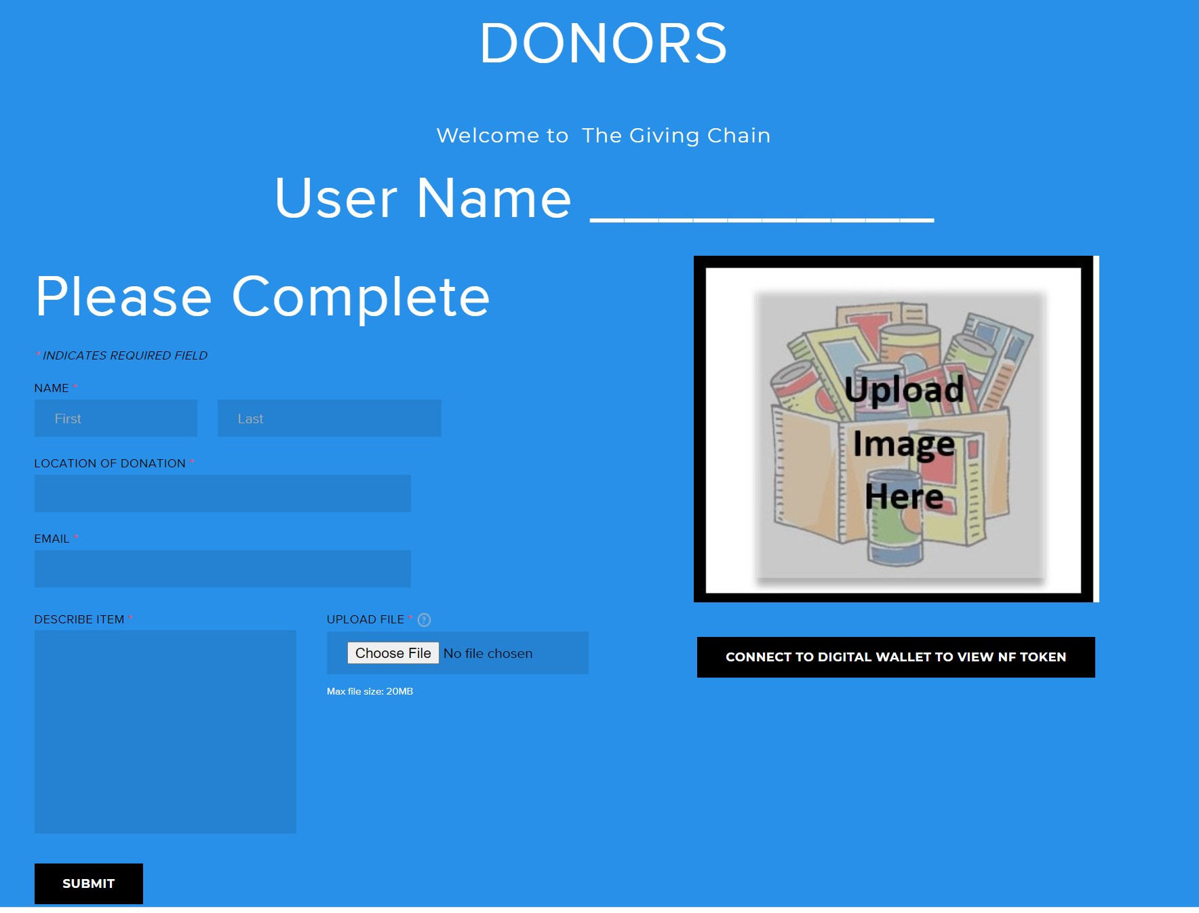

Technical Working Group Meetings
12 PM EDT
Friday 10/15/21
PRESENTATION SCHEDULE
October 26th
Mentorship November 12th
Trade Finance November 17th.
Next General Meeting
MONDAY October 18TH 1:00 PM EDT
On Public Calendar
wiki.hyperledger.org

Slide 11
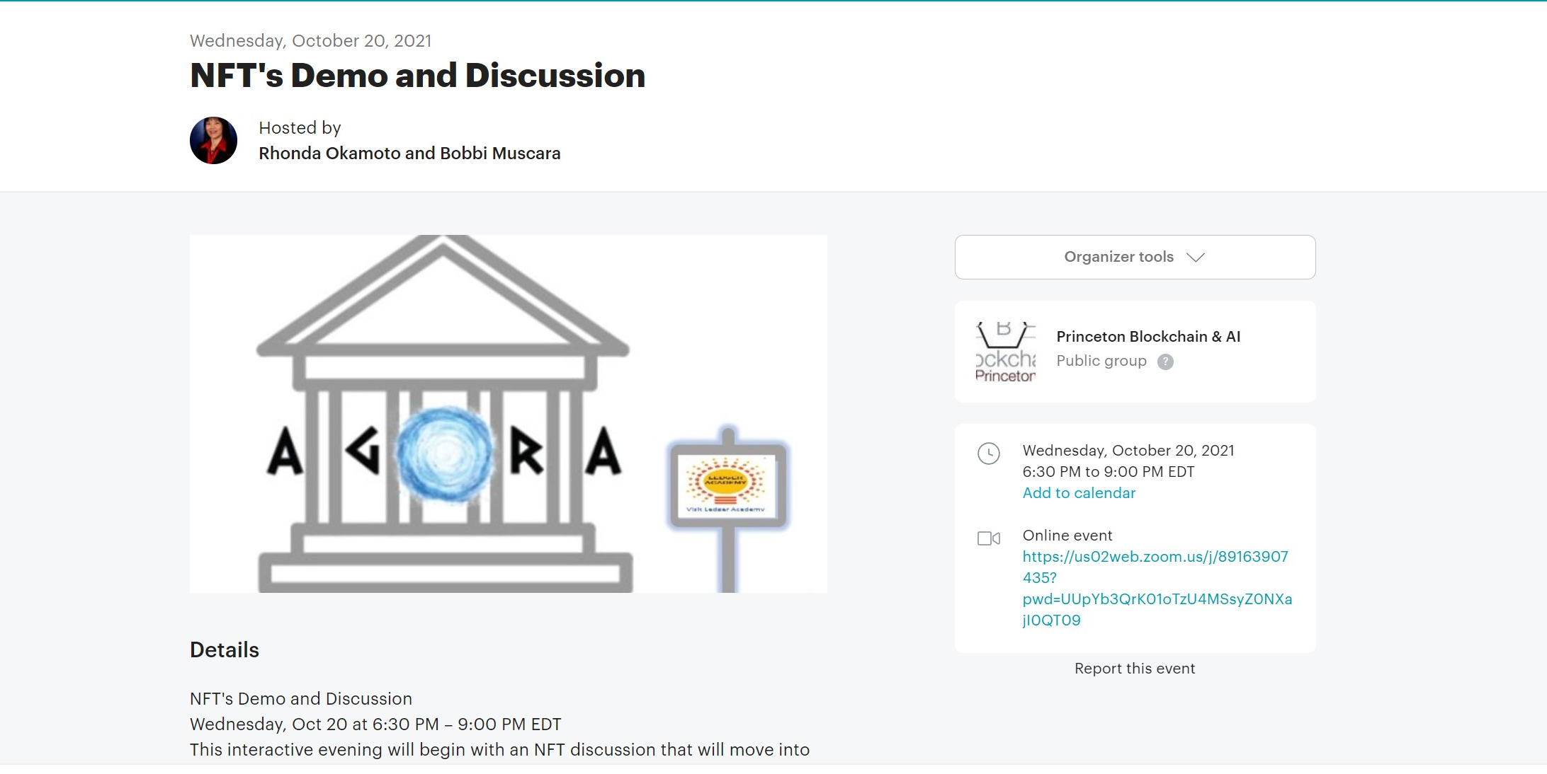
Princeton Meetup October 20th
https://www.meetup.com/Blockchain-Princeton/

Slide 12
Blockchain
Environment
Blockchain Environment Events, Bobbi Muscara
Matching Qualified Applicants with Blockchain Opportunities

Slide 13
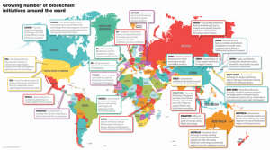
Global Blockchain Adoption
https://irishtechnews.ie/global-blockchain-adoption-which-countries-are-leading-the-charge/
Notes:
The global blockchain market size is expected to grow from USD 3.0 billion in 2020 to USD 39.7 billion by 2025

Slide 14
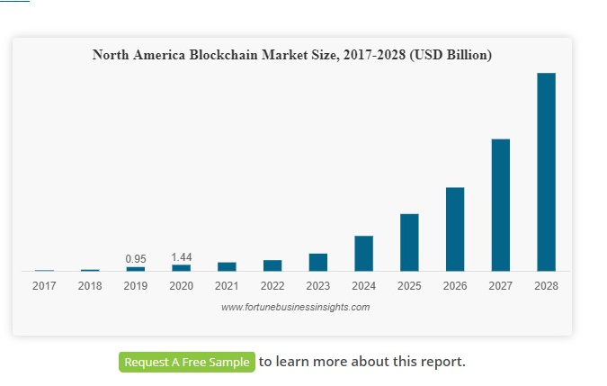
The Blockchain Job Markets
https://www.fortunebusinessinsights.com/industry-reports/blockchain-market-100072

Slide 15
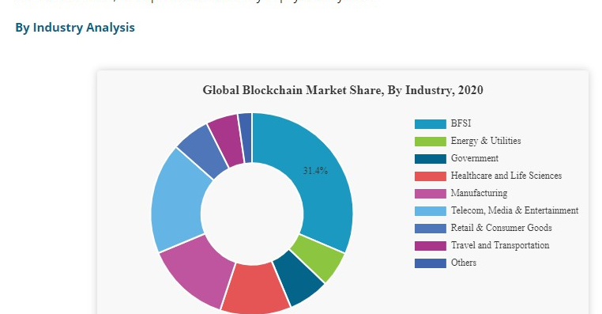
Blockchain INDUSRTY ADOPTION 2021

Slide 16

Employment website Indeed — cited — as of mid-July 2021, the overall share of crypto and blockchain job postings on the platform has grown 118% compared with early September 2020.
Blockchain-related roles tend toward a higher salary range than other technology posts as they demand a strong knowledge of cryptography combined with expertise in ledger economics and object-oriented programming, among other areas.
https://cointelegraph.com/news/crypto-and-blockchain-jobs-share-grew-118-in-ten-months-new-data-shows

Slide 17
What are the roles and positions are needed?
Blockchain Careers
Blockchain Developer
Blockchain Administrator
Blockchain Architect
Blockchain Consultant
Blockchain Engineer
Notes:
LFS171 Documentation

Slide 18


Blockchain Consultant
Blockchain Consultants
Blockchain consults companies and blockchain consultants are tasked with advising companies on designing and implementing blockchain solutions. This includes the documentation and maintenance of solutions, as well as their initial implementations, Assessing and managing risks. Usually, possess industry knowledge as well as blockchain prowess.
Notes:
There are different kinds of blockchain jobs in the field of blockchain consultant. You can opt for the one which matches your skillset the most. Keep in mind that intrinsic knowledge about the blockchain technology is required for every job.
blockchain legal consultant is

Slide 19

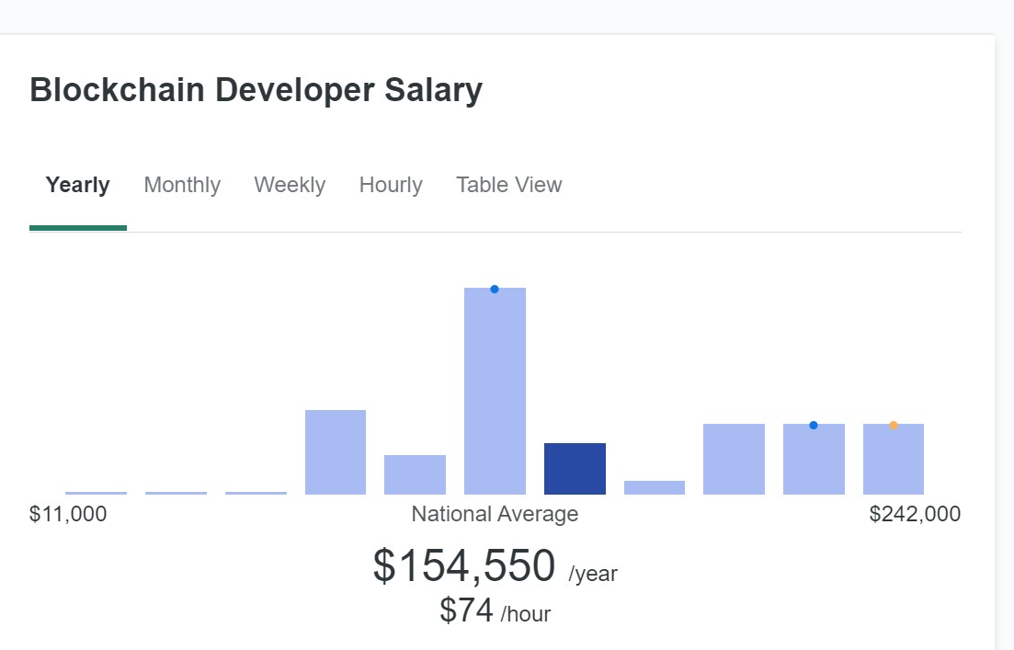

Blockchain Developer
Developers create blockchain platforms and design, write and upload smart contracts to the blockchain. Developer design workflows that operate with blockchains and smart contracts. Responsibilities can include project design, smart contract development and implementation, front end applications design and application deployment
Blockchain Developer
Notes:
)two types: program blockchain platforms as well as the apps residing on these platforms
Platforms Developers Their role is to develop, maintain, and update the source code powering the blockchain’s functionality as C++, Java, and Python.
app developers are involved mainly in programming the apps hosted on the blockchain networks
blockchain. blockchain-specific languages popular for smart contract development. The most common among these is Solidity, a de-facto language of choice for smart contract development on Ethereum.
cryptography and the architecture of decentralized ledger systems.

Slide 20

Blockchain Architect
For a blockchain solution to be functional, it first needs to exist. The blockchain architect is the person or group who designs and implements the backend code of the blockchain. The blockchain architect works with blockchain engineers and technical leaders to identify the blockchain structure for specific use cases. Architects understand infrastructure of blockchain networks, application consensus mechanisms, cryptography systems, key management techniques and smart contract management.
Blockchain Architect
Notes:
how various parts of this technology interact.
While architects are not expected to be familiar with blockchain code, they need to thoroughly understand blockchain cryptography, transaction verification models, cross-chain interoperability, tokenization, and other key areas required for a functional blockchain network or app.
Go, Java, Javascript, or any modern programming language plus project management skills.

Slide 21

Blockchain Administrator
Blockchain Administrators are responsible for operations or the moving parts in a blockchain infrastructure. They help create, develop, and maintaining the blockchain network. Work with the blockchain teams to manage the talent. Knowledge of Blockchain Protocols, Linux, Containers, and an in-depth understanding and expertise in networking infrastructure
Notes:
sought after entry-level blockchain jobs with the requirement of promising skills. Candidates aspiring for the role of blockchain administrator should have comprehensive fluency in the working of Bitcoin protocol, knowledge of high-level programming languages, and proficiency in using Linux/UNIX in coordination. In addition, blockchain administrators need an, virtualization, and networking services and protocols.

Slide 22

.
Blockchain Engineer
Blockchain Quality Engineer
This position is responsible for ensuring quality in all areas of blockchain development, such as automation frameworks and tests, manual testing and dashboards to support mobile, web and platform engineering. A quality engineer will need to research and advise on blockchain tools and develop quality assurance (QA) automated test standards, as well as define, write and implement test automation strategies for load performance tests. Applicants may also need an engineering management MBA degree.
Notes:
The chief responsibility of a blockchain engineer includes creating an application that reflects the technological aspects of a company.
economic aspect of blockchain engineering. It includes the understanding of concepts like supply and demand, incentivization, etc.
The most desired skill that is looked for in this blockchain jobs is the mindset to constantly learn and adapt to new things

Slide 23
Entry Level and Internship Positions
Mentorship programs and internships include assisting in the designing and developing blockchain distributed ledgers based on both public and private or permissioned blockchains. With open-source, development and success depend on an active community, Working Groups and Hackathons are available for the newcomer. Skills include basic blockchain knowledge and some familiarity with basic programming languages.
Blockchain Data Scientists
Blockchain Web Designer
NFT Graphics Designer
Data Storage and Processing Managers
Blockchain Project Managers

Slide 24
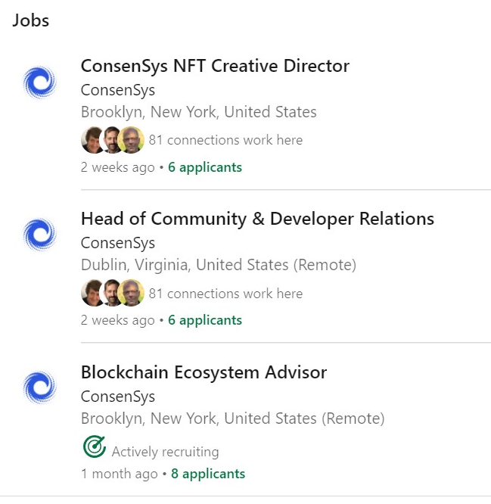
Blockchain jobs Today 10/14/2021

Slide 25
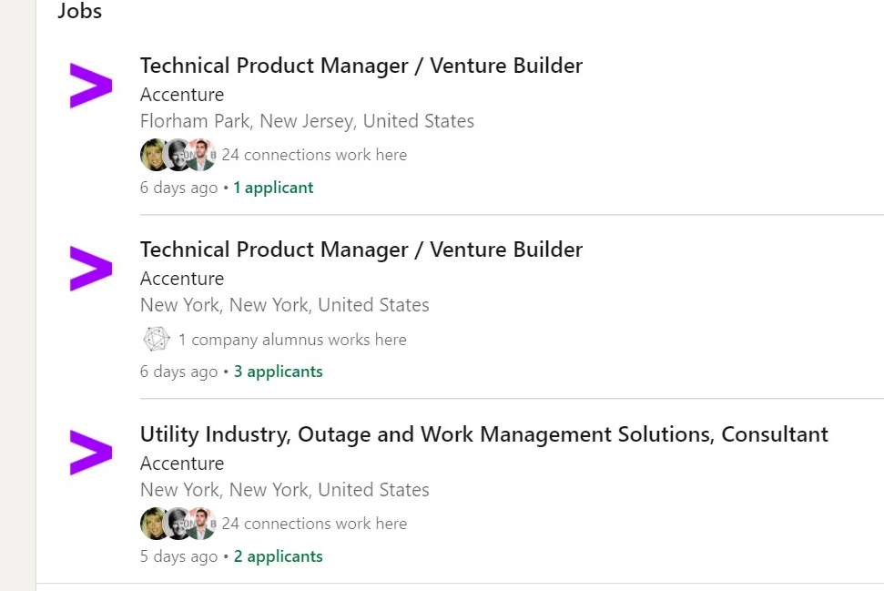
Blockchain jobs Today 10/14/2021

Slide 26
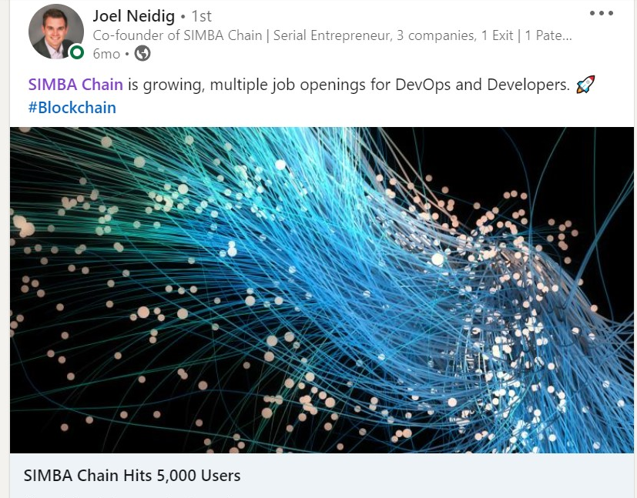
Blockchain jobs TODAy 10/14/2021

Slide 27
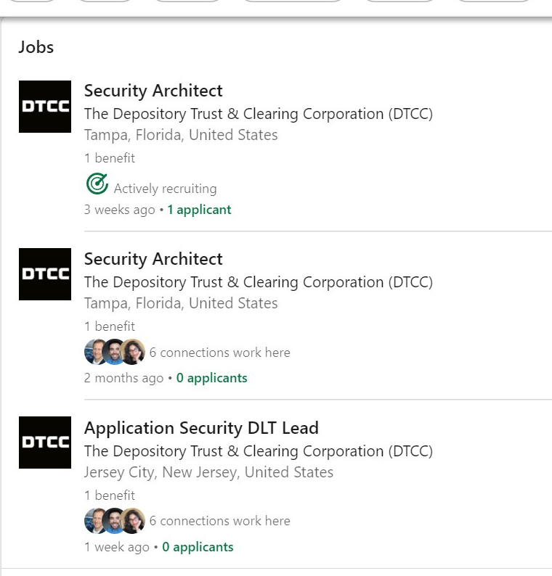
Blockchain jobs Today 10/14/2021

Slide 28


Educational Opportunities
EdX / LF Courses for Hyperledger
Test fee, get a 50% discount for all certifications from Linux Foundation. Use code HGF2021 at checkout
LFX 170 Blockchain Understanding its Uses and Implication LINK
  LFX171 Hyperledger Technologies for Business LINK
  LFS272 Hyperledger Fabric Administrator 2.2 LINK
  LFD272 Hyperledger Fabric Developer 2.2 LINK
  LFS 172 Hyperledger Sovereign Identity Blockchain Solutions ( Indy Aries Ursa) LINK
  LFS173 Becoming A Hyperledger Aries Developer LINK
  LFS 174 Hyperledger Sawtooth Application Developer LINK
  LFS176x Hyperledger Besu Essentials: Creating a Private Blockchain Network LINK

Slide 29
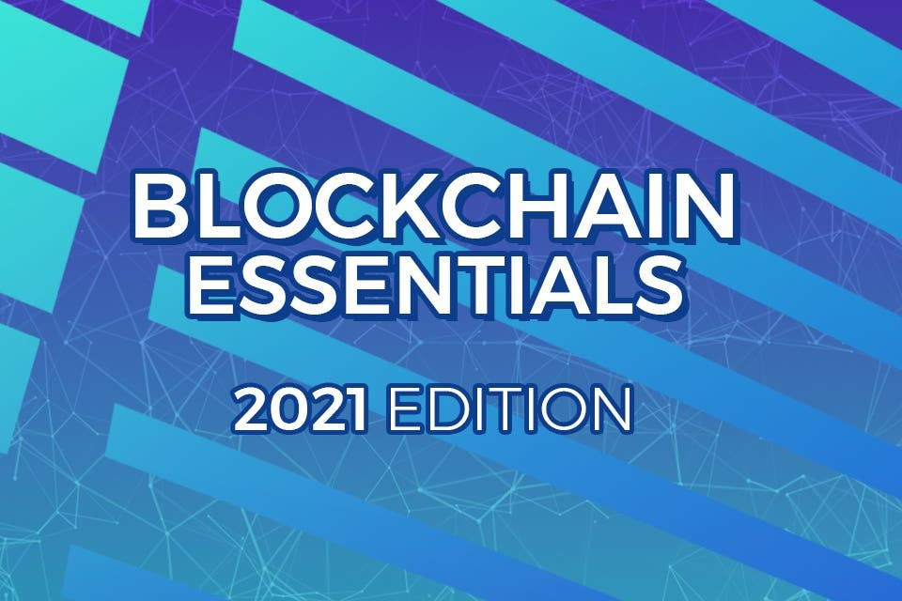
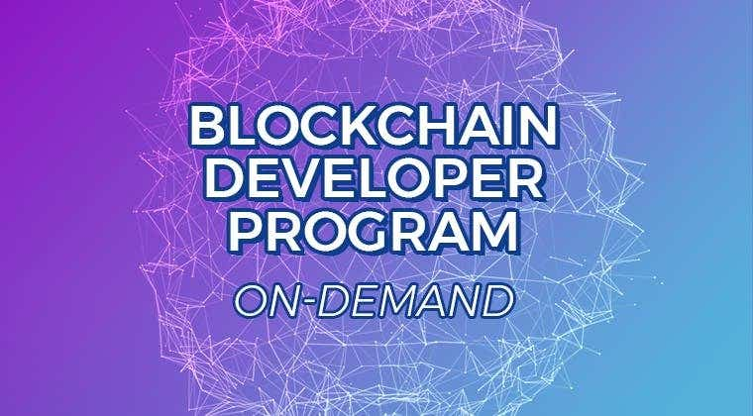


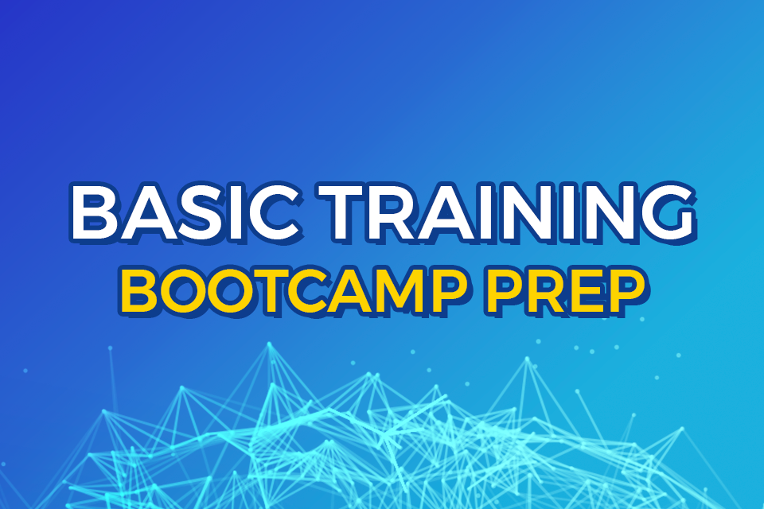
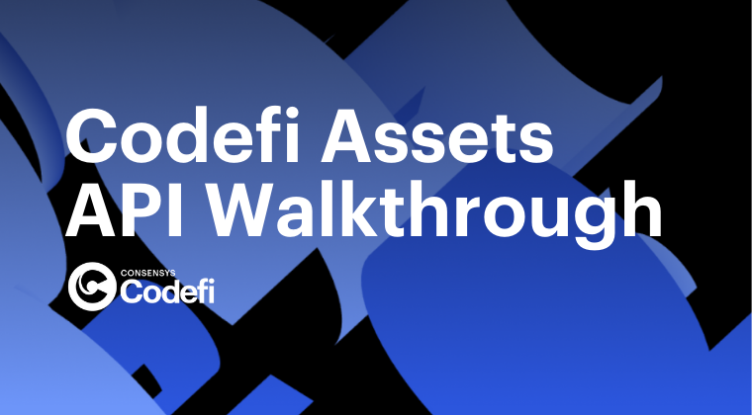
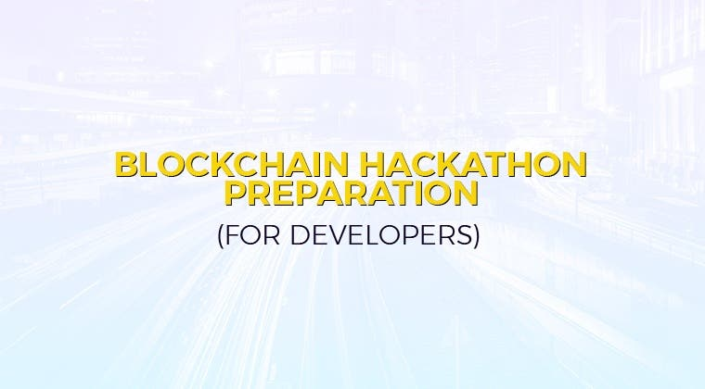

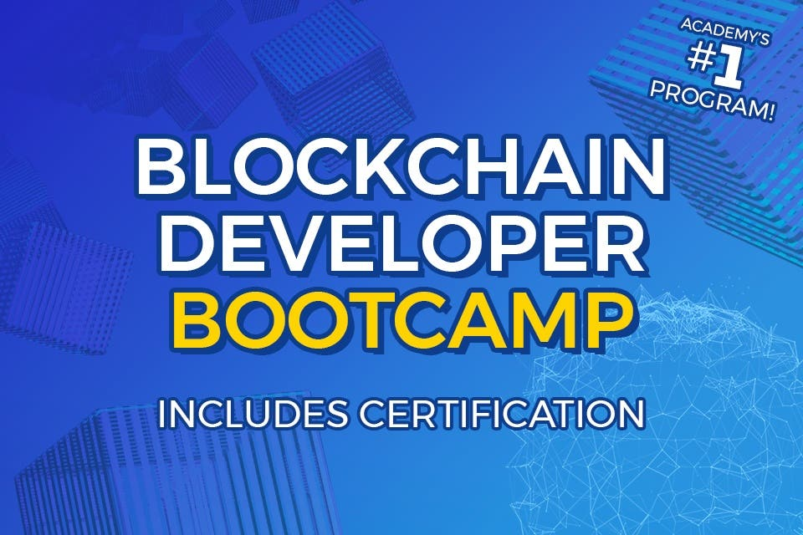
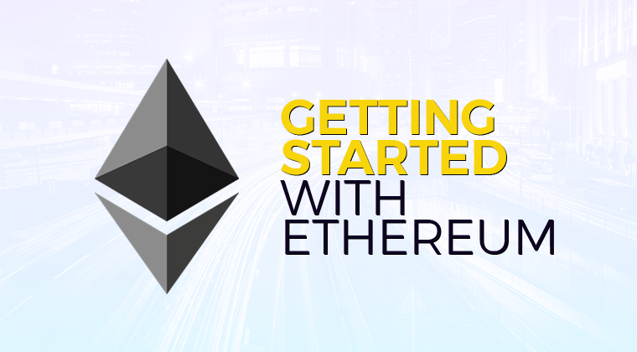
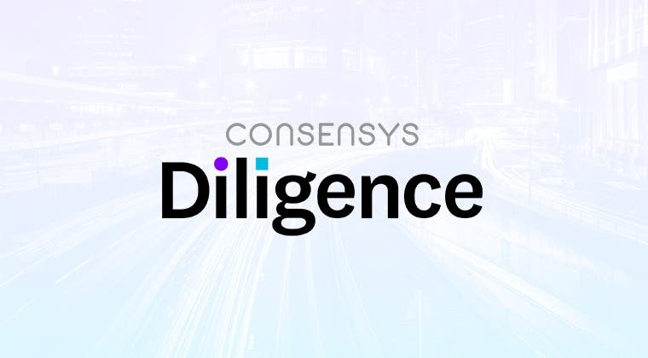

CONSENSYS ACADEMY Basics for Developers
Notes:
Intro to Blockchain
Basic Training Build your own Ethereum API with INFURA and COMPOUND
Develops bootcamp includes certification

Slide 30

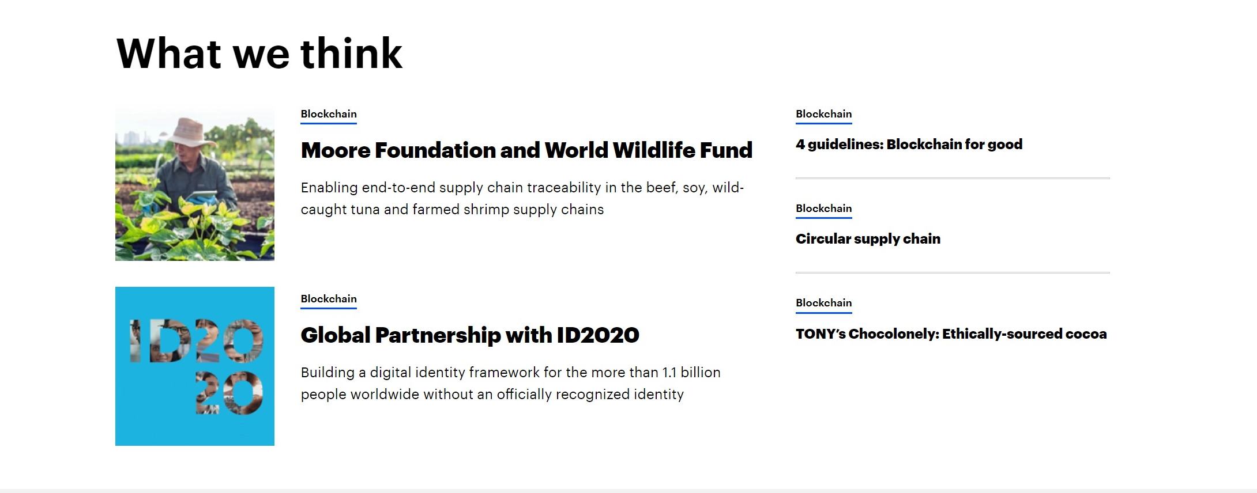

Slide 31
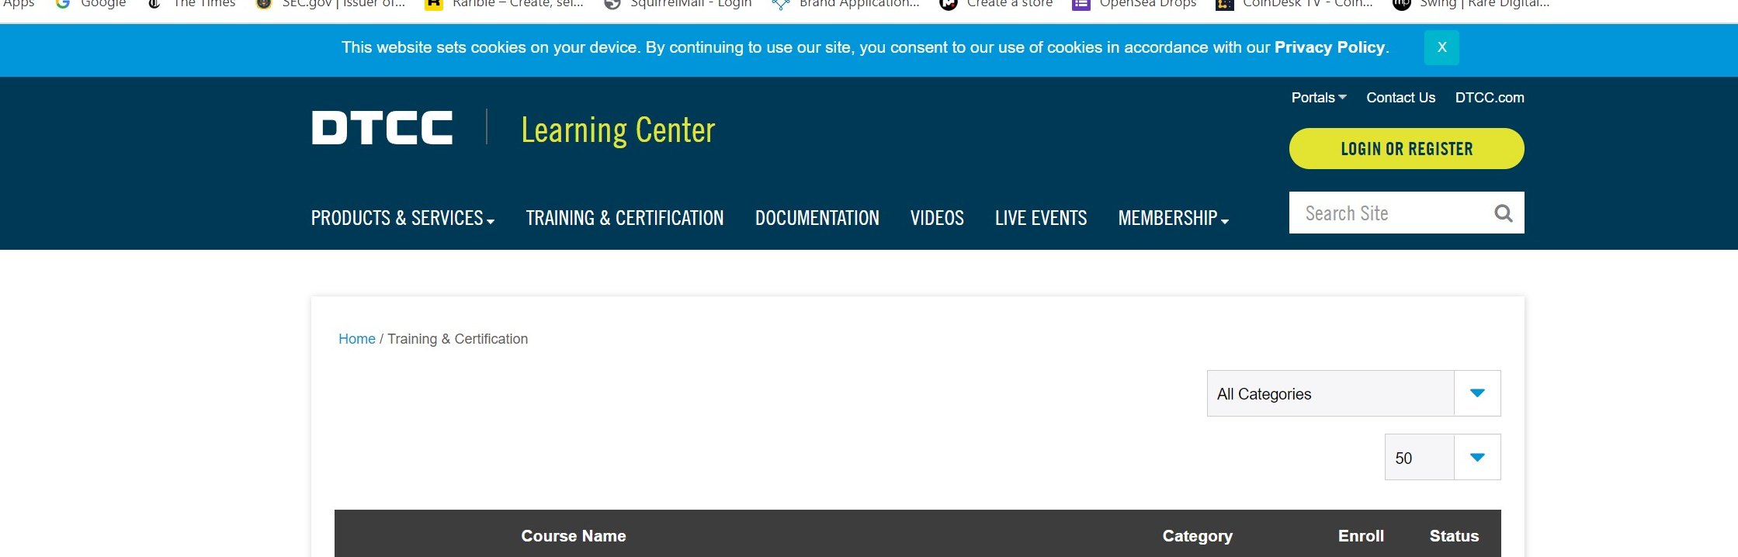
Depository Trust & Clearing Corporation

Slide 32
Panel Discussion
Host: John Carpenter
Jyoti Ponnapalli
William Lipovsky - ConsenSys
Arslan Khalid - Accenture
David Wasson -SIMBA Chain

Slide 33
Topics
What was your personal journey around blockchain that led to you joining your company?
What is your company's projection for new hires in 2021/2022 around blockchain technology?
What are the skills that are most in need for these new hires. This could include any specific knowledge around Hyperledger, Ethereum, Identity, CBDC's, Trade Finance, etc.? It could also include non-blockchain related skills.
What internship/mentorship opportunities exist within your company around blockchain?
What is the best way to contact your company for job applicants that have the relevant skill sets?

Slide 34
Thank you to our Panel.
Next up:
Blockchain Environment
Jim Mason
Future Events /Questions
  11/4 - Welcome Employers
  11/18 - Opportunity Seeker
  12/2- Career Fair

Slide 35
Blockchain
Employ
Boston Meetup
11/4/2021
Who is hiring for Blockchain Positions
Next Session , Jim Mason
Matching Qualified Applicants with Blockchain Opportunities

Slide 36
Questions and Answers

Slide 37
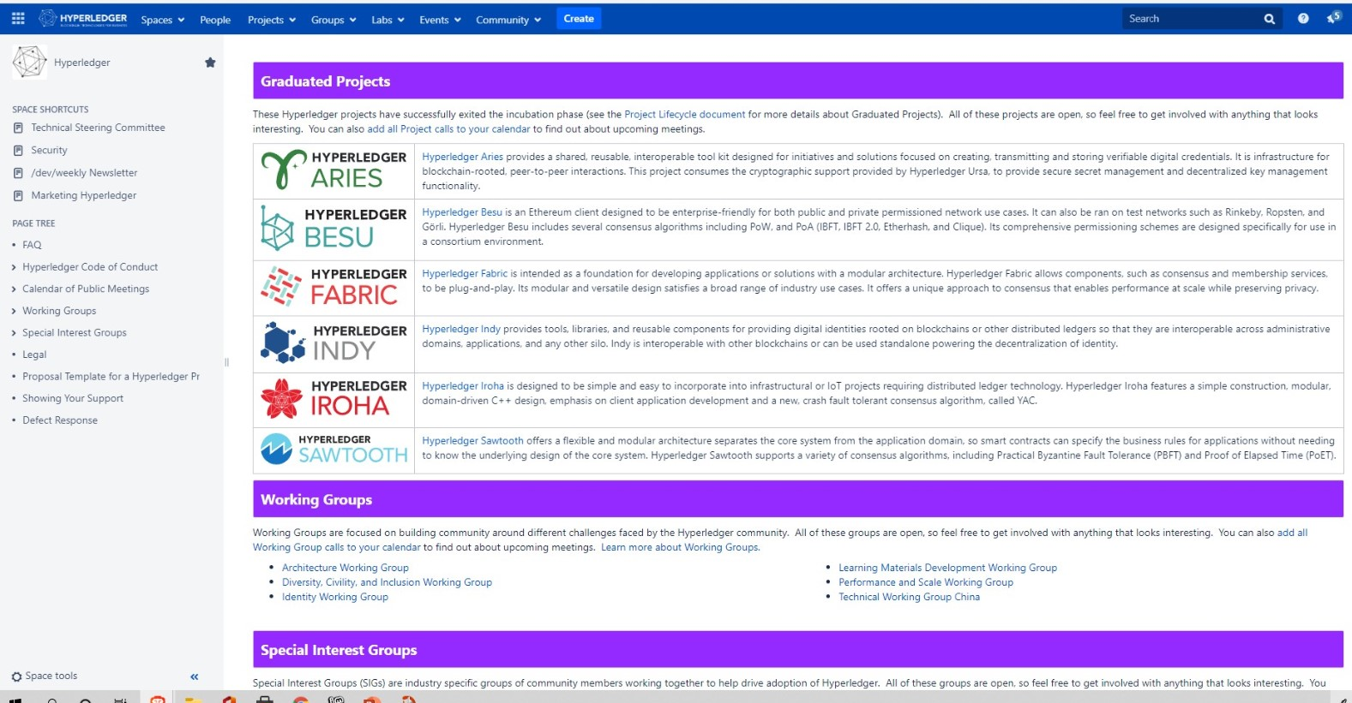
Getting Involved in The Community wiki.hyperledger.org

Slide 38
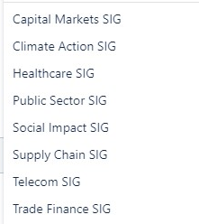
Hyperledger Special Interest Groups
NEW RESOURCE
Special Interest and Working Groups Video Library https://www.youtube.com/c/Hyperledger/playlists

Slide 39
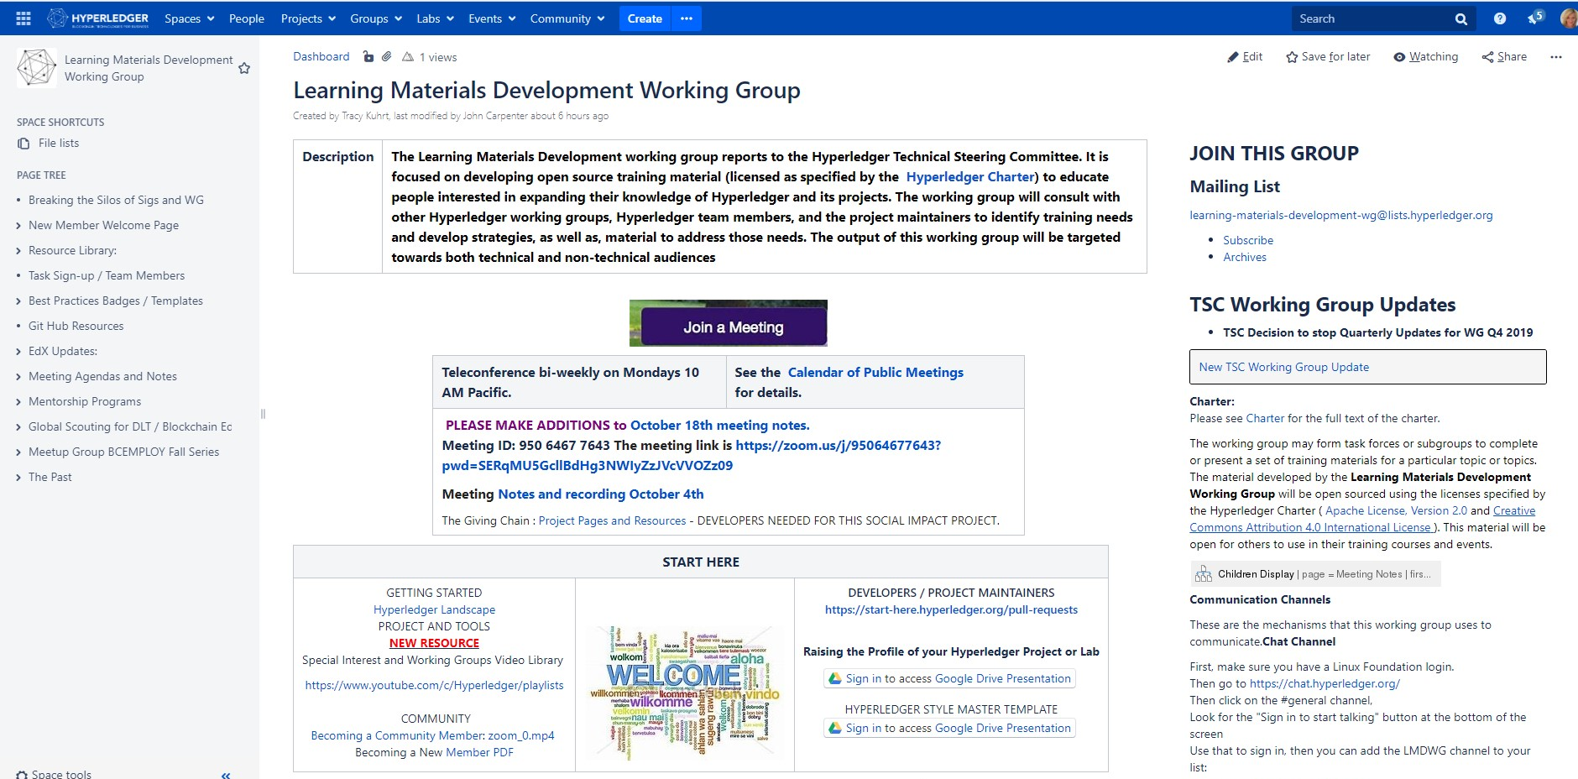
Hyperledger Working Groups

