Slide 1

Re-Thinking Public Sector through Blockchain
Sean O’Kelly
Bobbi Muscara
Saptarshi Choudhury

Slide 2
Abstract*
"Governments' and other public sector entities core function is to act on behalf of society to create the laws and rules that must be followed, and to ensure that they are being followed. It is foundationally necessary for governments to have access to accurate, relevant, and complete information in order to fulfill these responsibilities.
To this end governments possess legal, regulatory, and judicial mechanisms to compel the truth from all societal participants. This authority uniquely positions governments' as validators of truth and custodians of trusted information.
Blockchain will be among the most consequential, technology for Public Sector because of its specific role as a facilitator, validator, and custodian of trusted information. This technology promises to enable governments' and other public sector entities to interact with societal participants within a larger ecosystem, which will break down traditional public-private silos and provide completely new approaches toward governance.
The key components of this ecosystem are a) identity b) regulated interactions c) regulatory compliance d) governance

Slide 3
Re-Thinking Public Sector through Blockchain
Core Function of Government and the Public Sector
How can Blockchain Change the Environment
Key Components of a Public Sector

Slide 4
Hyperledger Public Sector White Paper
1. Introduction
1.1 What is Hyperledger
1.2 Public Sector:
1.3 IMPACT STATEMENT:
2. Public Sector Environment
2.1 Identity management for Governments
2.2 Interactions (Highly Regulated Transactions)
2.3. Regulations
2.4 Governance
3. Public Sector Mapping
4. Use cases
4.1 Predatory Bank Loans
4.2 Energy Sector Management
4.3 Land Registry / Land Markets
4.4 Grants Management
5. Conclusions
6. Recommendations
7. Glossary
7. Acknowledgement

Slide 5
Definitions
Public sector organisations are businesses set up with the aim of providing a public service rather than making a profit., existing in all three layers of government ( Federal. State Local)
Public Sector is usually comprised of organizations that are owned and operated by the government and exist to provide services for its citizens, instead of working toward the goal of collecting a profit, public sector entities seek to provide services, regulate activities and enforce laws.
Funding for public services are usually raised through a variety of methods, including taxes, fees, and through financial transfers from other levels of government
  Examples of organizations in the public sector include:
    Education (Schools, Libraries)
    Electricity
    Emergency Services
    Fire Service
    Gas and Oil
    Healthcare
    Infrastructure
    Law Enforcement
    Police Services
    Postal Service
    Public Transit
    Social Services
    Waste Management

Slide 6
1. Introduction
Purpose of This Paper
Government has served an important function, to maintain trusted information for member of its society. Blockchain technology can revolutions how agents collect and process information. We believe the future will involve a world with many interconnected distributed databases and blockchains, each of which will be specialized to suit the purposes of its users, In this interconnected world, it is the role of the Public Sector to define and facilitate these relationships.
The purpose of this paper is to derive pathways for the Public Sector when discovering the benefits of Blockchain Technology

Slide 7
When discussing Blockchain thru a Public Sector lens, (3) important segments need addressing:
(1) Identity Management for Public Sector
(2) The Interaction
(3) Compliance, as seen though government transaction ,and/or viewed thru the Highly regulated transaction, and (4) Governance . These areas we see the most benefits blockchain can effect.
We will describe Use cases to show how blockchains are being utilized to improve the public sector. How tools can help across governments Worldwide efforts. This whitepaper will tackle the issues by looking at the problem facing the Public Sector and what is being done today and what will our recommendation for government when adopting blockchain in the public sector.
Intended Audience
Across Governments [state the intended audience as precisely as possible. For most white papers, this will be a technical audience, not a business audience. Does their level of technical understanding matter? Are there some matters they should already understand before they can get anything from the current document? Can we point them to this kind of prerequisite information? Does it matter which framework(s) they are using: Fabric, Indy, Sawtooth, etc? Does it matter what issue they are trying to understand: security, interoperability, etc?]

Slide 8
IMPACT STATEMENT:
Blockchain technology is relatively new technology and is in its very early stages of adoption. Questions need to be answered as to how the Public Sector and related industries can leverage blockchain technology in various verticals. While there is a great hype and interest in the technology it is critical to ensure that initial deployments consider right use cases to demonstrate the effective use of technology.
The intent of this document is to help shape the role blockchain technology can have in optimizing what government can do for its citizens. By delving into three areas (Identity, Compliance issues and Governance ) we will draw conclusions as to how to structure blockchains, develop programs, and run these new system to best aid citizens the derive the optimal success. If we understand how current use cases are leveraging this technology we can devise standards and guidelines for governments on all levels to implement.
1 Identity Management in Government
2. Interactions
3. Compliance
4. Governance

Slide 9
Public Sector
Public Services
Government
Public Adminstration
Community
Land / Territory

Slide 10
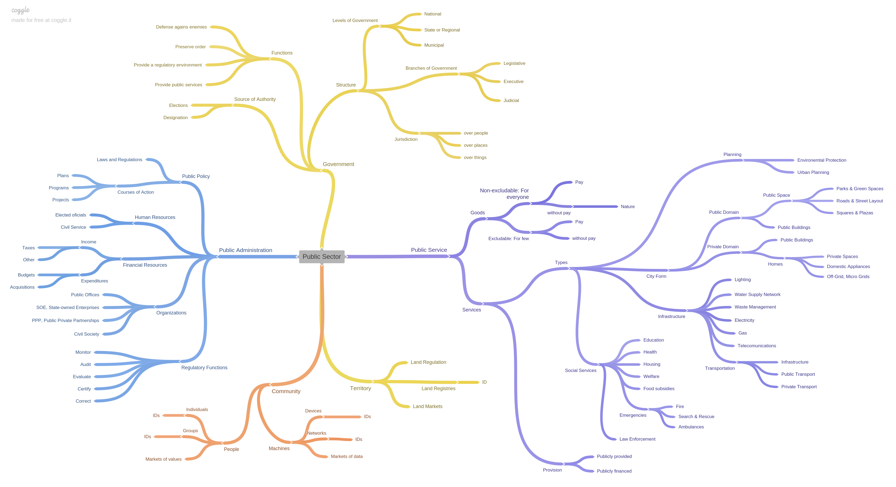

Slide 11
Public Sector
Public Services
Government
Community
Land / Territory

Slide 12
Public Services
Goods
Services
City Forms
Infrastructure
For Everyone
Selective
Social Services
City Planning
Public Sector
Public Services
Government
Community
Land / Territory

Slide 13
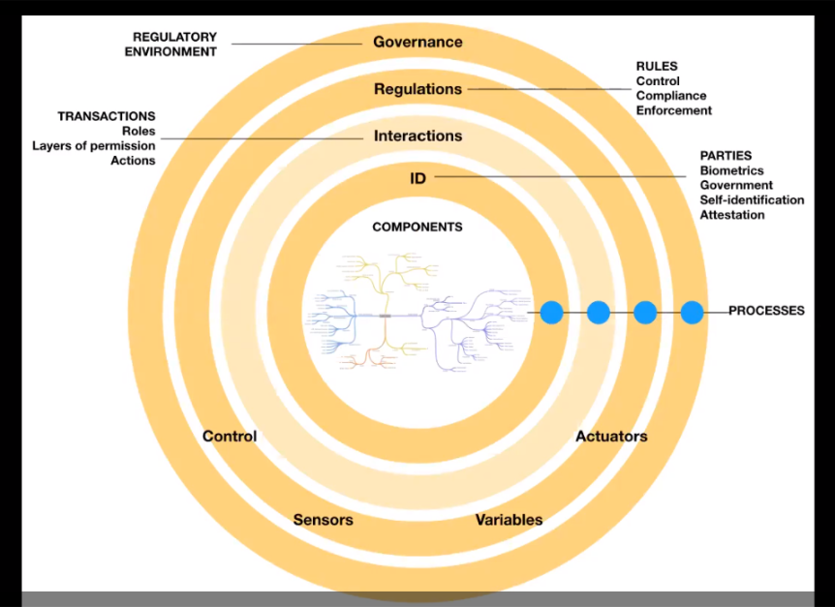

Slide 14
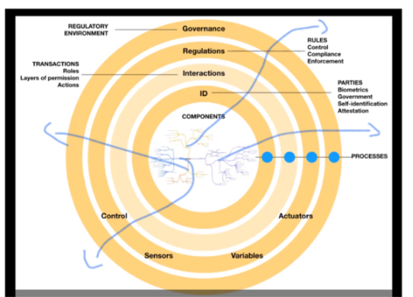

Slide 15
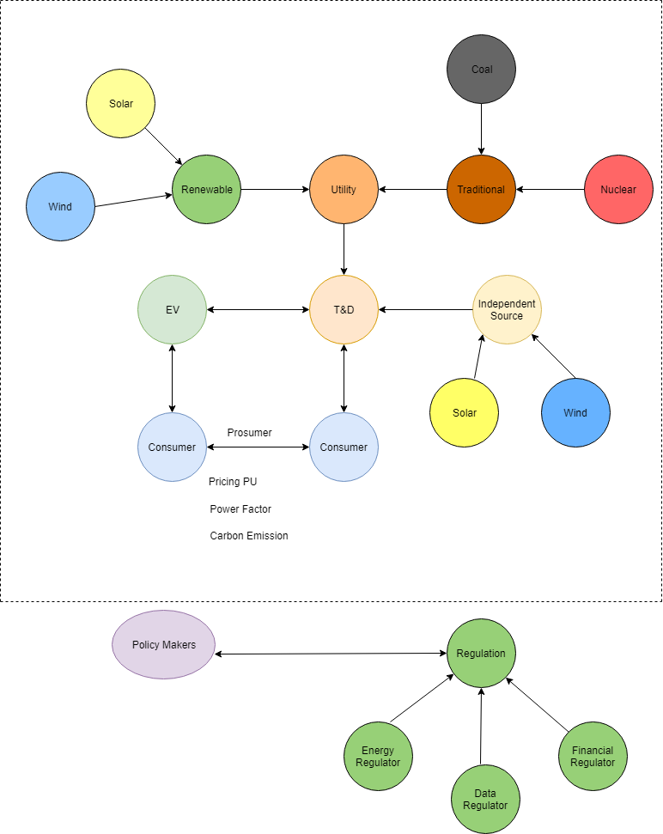
#) Energy Market Ecosystem
General Description

Slide 16
#) Need for Blockchain
1) Legitimate Connection
2) Flexibility & Affordability
3) Quality of Power Supply
5) Visibility in Energy Transactions
#) Use Cases for Blockchain
1) Project Finance
2) Energy Trade
3) Supply Chain Visibility
4) Bill Reconciliation
5) ID Management of Contract Workers
#)
All Stakeholders
1) Consumers
i) Consumer 1
ii) Consumer 2
iii) Electric Vehicles
2) Policy Makers
3) Regulators
i) Energy Regulator
A) Power Quality
B) Tariff Rate(Pricing)
C) Physical Infrastructure
D) Environment & Safety
E) Control & Communication Network
ii) Financial Regulator
iii) Data Privacy & Security

Slide 17
4) Generators
i) Utility
A) Traditional
B) Renewable
ii) Independent Source
5) Physical Infrastructure
i) Design
ii) Laying Cables
iii) Equipment Installation
iv) Maintenance
6) Financial Institution
i) Banks (Project Finance)
ii) Financial Services (Payments)
iii) General Insurance (Hazard Insurance)
#) Identity Management of Stakeholders
#) Interaction between Stakeholders
1) Roles of Stakeholders
2) Energy Transactions
#) Governance
1) Core Elements of Governance
i) Equity
ii) Trust
iii) Interoperability
2) Execution
3) Assessment & Update

Slide 18
Overview Land Rights
Land Market Ecosystem
  General description
Parties
  Stakeholders
    Buyers
    Sellers
    Local Authorities
    Registrars
    Financial Institutions
    Real Estate Agents
    Developers
Interactions
  Roles of stakeholders
  Actions of stakeholders
    Urban Planning
    Market Transactions
    Real Estate Financing
    Real Estate Development
  Contracts & Information
    Data
    Functions
Laws and Regulations
  Land Ownership
    Types of properties
    Land rights
    Registries
      Cadastral
      Register of Deeds
  Land Taxes
  Land Use
    Urban Planning Regulations
      Zoning
      Densities
      Intensity of use
  Land Value
    Types of land values
    Land value capture
  Land Finance
    Financial Institutions
    Financial Instruments
      Traditional
      Innovative
Governance of Regulatory Environment

Slide 19
4.4 Public Enterprise : Grants Management
4.4.1 Description of Environment (brief)
Grantors and Applicants research and address significant challenges in society. Collaboration is time-consuming; whether in identifying funding needs of researchers, resourcing potential requests for proposals/applications (RFP/RFA), or reporting progress and results. International and in-country organizations spend too much time locating potential grantors and those grantors spend too much time administering grants when they yearn to link with the research community in innovation rather than a maintenance role. All parties prioritize researching, analyzing, and disseminating; however, the business burden of grants compliance overshadows the incredible potential of significant adoption of grants-related research.
4.4.2 Use Case
Name
The Grant Lifecycle
Description
Identification, Application, Implementation, and Dissemination phases of the grant lifecycle complement blockchain strength in identity, provenance, and security.
Primary Actors
Grantor and Applicants
Supporting Actors
Multiple stakeholders in Grantor and Applicant organizations, external researchers, and grants participants
Use Case
Securing and Connecting Grants

Slide 20
Description
High-Level Summary The grant process follows a linear lifecycle that includes creating the funding opportunity, applying, making award decisions, and successfully implementing the award. These phases are grouped as:
Pre-Award Phase - funding opportunities and application review
Award Phase - award decisions and notifications
Post Award Phase - implementation, reporting, and closeout
Low-level Summary

Slide 21
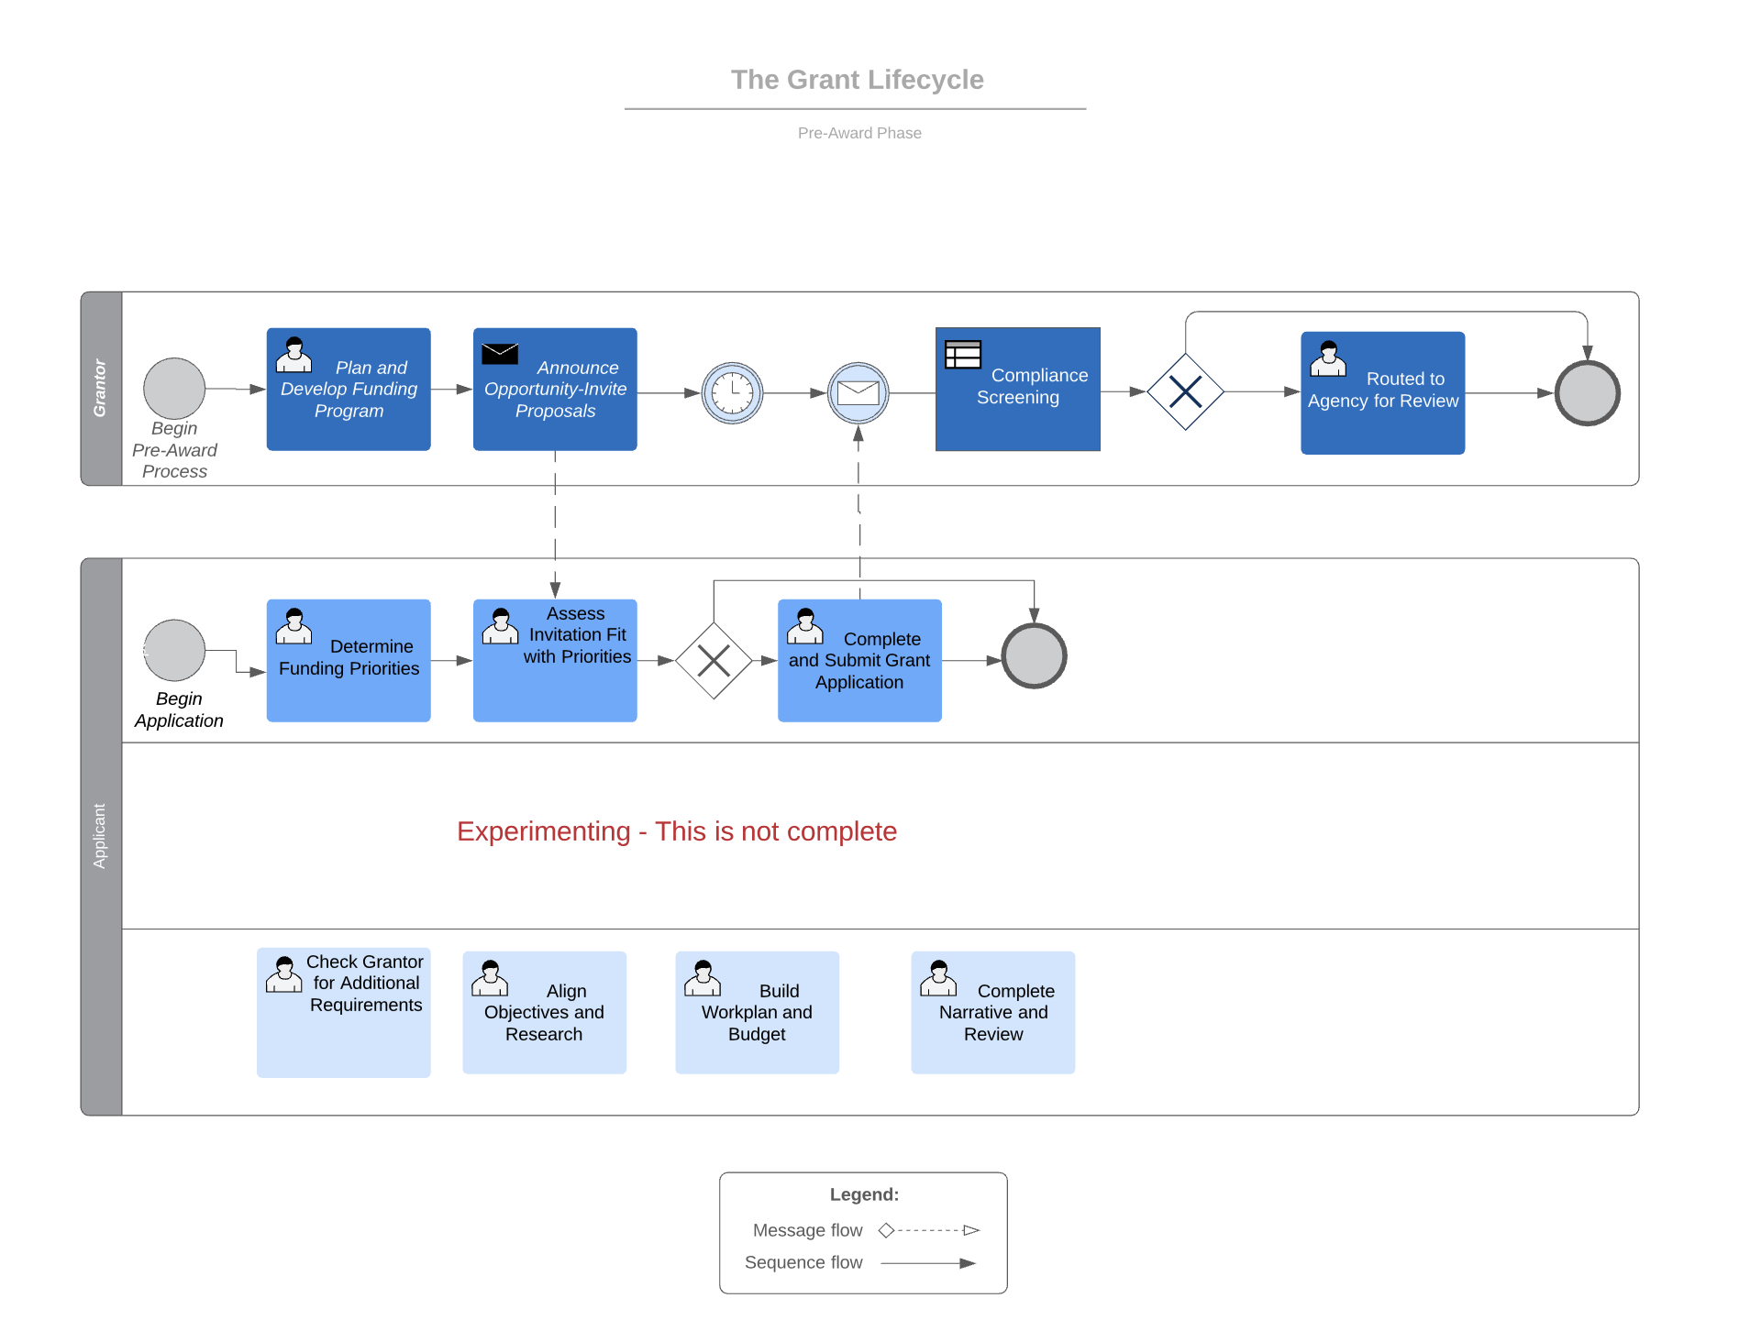

Slide 22
Primary Actor
Grantors and Applicants
Grantors:
Review process
Inter- and Intra-departmental share among agencies
Track applications and avoid duplication
Notify member agencies
Fund projects
Support informed decision making by federal grant-making entities
Integrate with grant-making and grant recipient entities’ systems used to manage day-to-day grants management operations
Improve ability to detect fraud, waste, and abuse
Improve ability to efficiently conduct audits
Applicants:
Reduce redundant reporting
Control of access to and protection of personally identifiable information (PII) and sensitive/proprietary information
Integrate federal and non-federal grants management processes
Improve payment efficiency for second- and third-tier grant recipients
Notify RFA and RFP based on selected topics

