Slide 1

Sponsorship Proposal
Startup Weekend Blockchain for Good 2019
San Francisco, Bay Area
October 25 - 27, 2019
#SWB4G

Slide 2
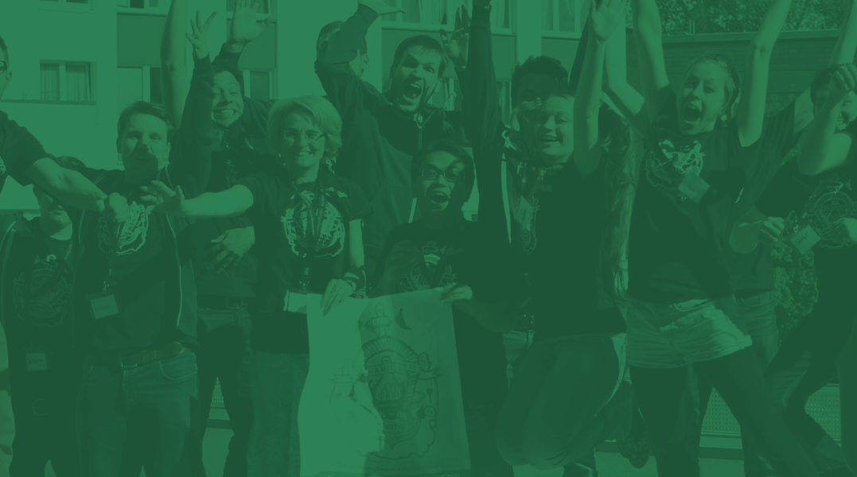
Learn, Network, Startup
Techstars Startup Weekend is the world’s starting point for entrepreneurship.
Our 54-hour event is where designers, developers, marketers, and startup enthusiasts come together to share ideas, form teams, and launch startups. We are organizers dedicated to fostering local entrepreneurship to strengthen our community.

Slide 3

Techstars is the Worldwide Network
that helps entrepreneurs succeed.

Slide 4
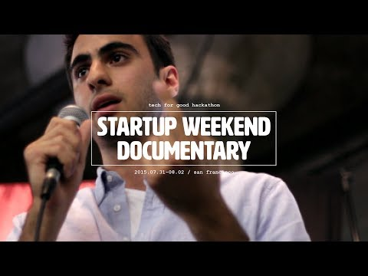

Slide 5
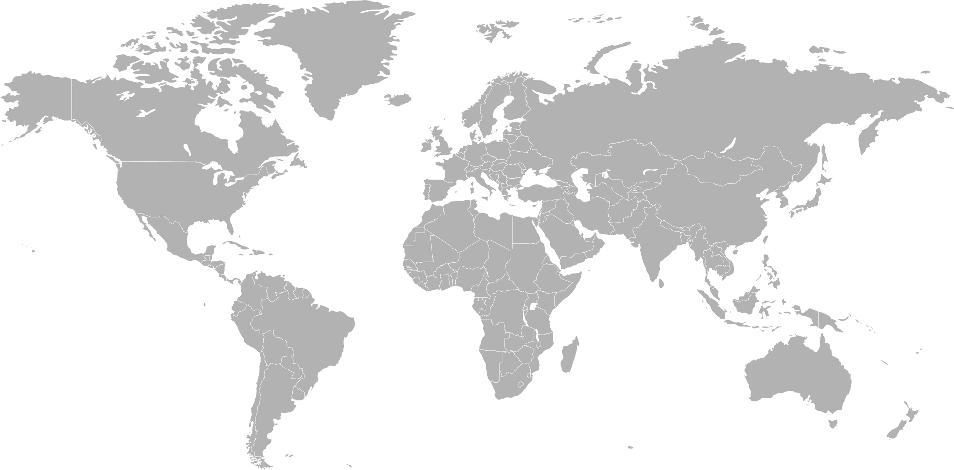
Techstars Startup Weekend
by the numbers, since 2009:
150+
1,200+
240,000+
5,000+
Countries
(That’s more than Starbucks!)
Cities
Global participants
Startup Weekend events to date, globally.

Slide 6
Why Sponsor Techstars Startup Weekend?
Techstars Startup Weekend is easily the biggest entry point for entrepreneurs to create a startup. These events are all organized by the local community. Sponsoring a Startup Weekend is one of the best ways to support a your local community while engaging early stage businesses. Whether they’re developers, designers, or business focused, attendees build close relationships with the companies that sponsor.

Slide 7
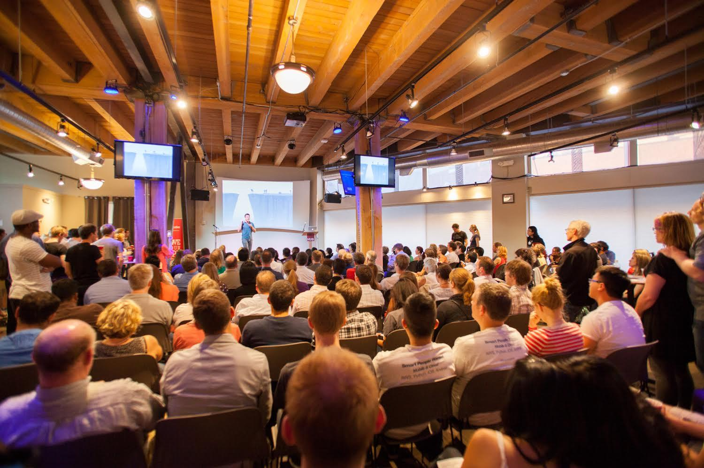
Sponsoring
Provides
An immersive weekend to engage with entrepreneurs and users (great for market research and user testing).
A channel to hire and find new employees.
Exposure and marketing to early stage companies and entrepreneurs.
A platform to share API’s or relevant tools for entrepreneurs.

Slide 8


The Schedule: Here’s what happens during a Techstars Startup Weekend
Pre-Startup Weekend: B4SJ Incubator
In collaboration with Blockchain for Social Justice, we are partnering to offer a day long incubator program for aspiring founders who want to learn more about use case design, platform development and more. Incubator participants may also participate for the San Francisco Blockchain Week Hackathon in addition to the Techstars Startup Weekend
Notes:
All Startup Weekend events follow the same basic model: on Friday night anyone is welcome to pitch their idea for a startup. Teams form around the top ideas (as determined by popular vote) and embark on a three-day frenzy of business model creation, coding, designing, and market validation.

Slide 9


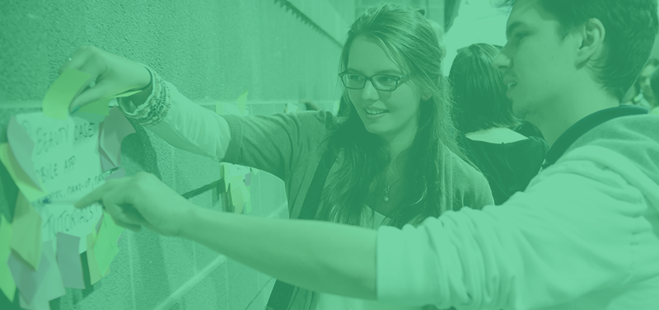
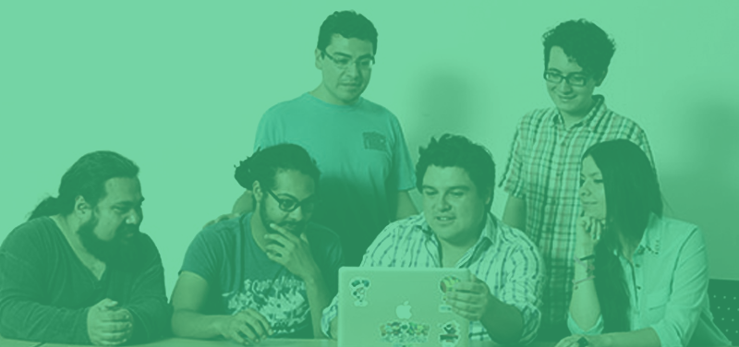
Day 1: Meet, Pitch & Team Up
Dinner & Networking
Get to know your new friends. Meet the people you'll be working with.
60 Seconds
to Pitch
Got an idea? You’ve got 1 minute to pitch in front of the group.
Choose Your Project
From the top
projects – Choose which one you'll work on over the weekend.
Build a Team
Whether it's your idea or someone else’s, you'll create a cross-functional team to work with over the weekend.
Notes:
All Startup Weekend events follow the same basic model: on Friday night anyone is welcome to pitch their idea for a startup. Teams form around the top ideas (as determined by popular vote) and embark on a three-day frenzy of business model creation, coding, designing, and market validation.

Slide 10

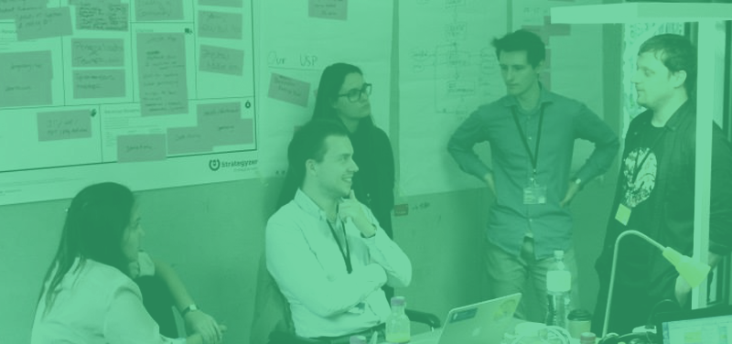
The Schedule: Here’s what happens during a Techstars Startup Weekend
Day 2: Learn & Work
Learn from the Best
Local mentors will be coming in throughout the event to coach you through the hard problems.
Get to Work
We've got the resources and support in place to make things happen in a short period of time. You'll be responsible for everything from finding customers to building your product. We'll be here to help when you need it.
Notes:
All Startup Weekend events follow the same basic model: on Friday night anyone is welcome to pitch their idea for a startup. Teams form around the top ideas (as determined by popular vote) and embark on a three-day frenzy of business model creation, coding, designing, and market validation.

Slide 11

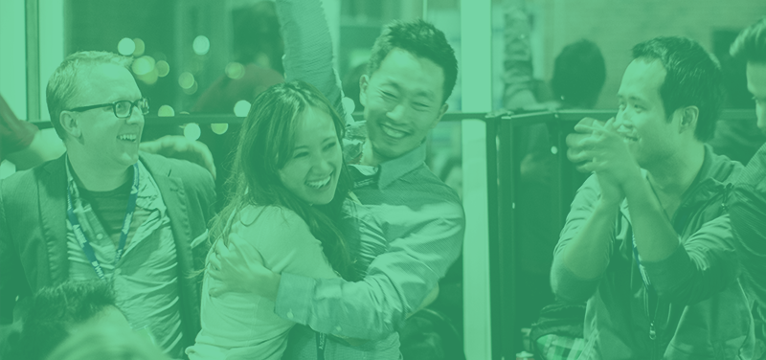
The Schedule: Here’s what happens during a Techstars Startup Weekend
Day 3: Present & Choose
Present in Front of Panel Judges
The culmination of the weekend. You'll have 5 minutes to present the product or service you built to the crowd and a panel of experts.
Celebrate
Watch the other teams present and celebrate all the work you’ve done. Get the opportunity to talk to judges and mingle with mentors.
Notes:
All Startup Weekend events follow the same basic model: on Friday night anyone is welcome to pitch their idea for a startup. Teams form around the top ideas (as determined by popular vote) and embark on a three-day frenzy of business model creation, coding, designing, and market validation.

Slide 12
Why should participants attend Techstars Startup Weekend?
CONNECT | DISCOVER | LEARN | START
Connect with people driven to build something new. Rich and diverse talent is a Startup Weekend staple. Participants will mix, mingle and work with new people who could be their next cofounder, friend, mentor, or investor. | Participants will discover where they are on the Entrepreneur's Journey. They will be introduced to new resources available near them and will leave knowing the next steps they need to take on their road to success. | Participants will learn what it really takes to start a company. No book, panel, speaker, or blog post will teach them what you need to know. The only way to learn is the experience of trying. | It’s that simple. Startup Weekend is designed to get you going, FAST. Local Organizers will set up the ideal environment for participants to be successful and learn as much as possible in just 54 hours.

Slide 13

Blockchain for Good
We believe entrepreneurship is the single greatest force in making the world a better place.
We’re encouraging entrepreneurs from all corners of Silicon Valley to come out, participate, and create ideas and opportunities that drive impact.

Slide 14
What we offer
SIGNATURE
$10,000+
PLATINUM
$5,000
GOLD
$2,500
SILVER
$1,000
Branding Exposure
Company name/logo listed on the event website
Opportunity to display a sign or banner at the event
Handout materials, swag and/or related to materials
User Acquisition
Sampling and/or product placement at the event
Promotional codes to attendees
Opportunity to provide class/workshop
Event Presence
Mentioned and Thank You Message by the Facilitator at event
Brochure and/or swag giveaway
Booth or Table at the event
Impact
Receive a post-event report with statistics about technology used,
number of teams, product descriptions, etc.
Employee Engagement
Tickets to attend
4
3
2
2
Possibility to Mentor at event

Slide 15
Thank You

