Slide 1

Blockchain Use Cases in Healthcare
HYPERLEDGER COLUMBIA MEETUP
JULY 16, 2019

Slide 2

Healthcare and Blockchain
Has anyone started or is planning to start an effort to pilot/POC using blockchain?

Slide 3
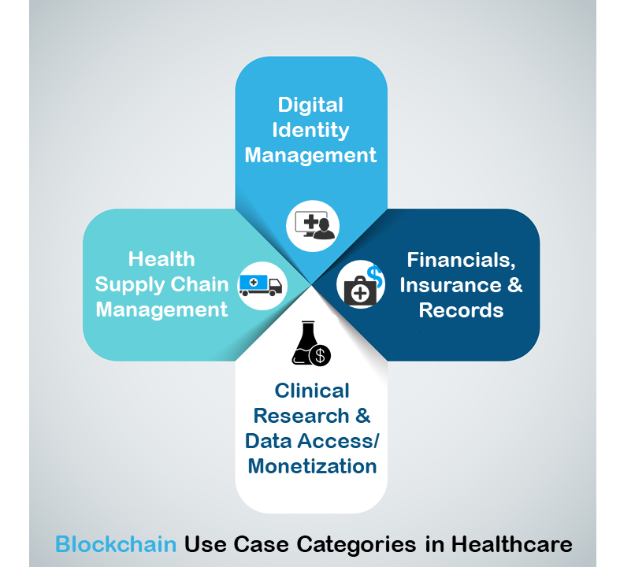
Use Cases in HealthCare
Blockchain healthcare use cases are being discovered by the day, and with them the entire healthcare system can be completely overhauled.
Source: himss.com

Slide 4
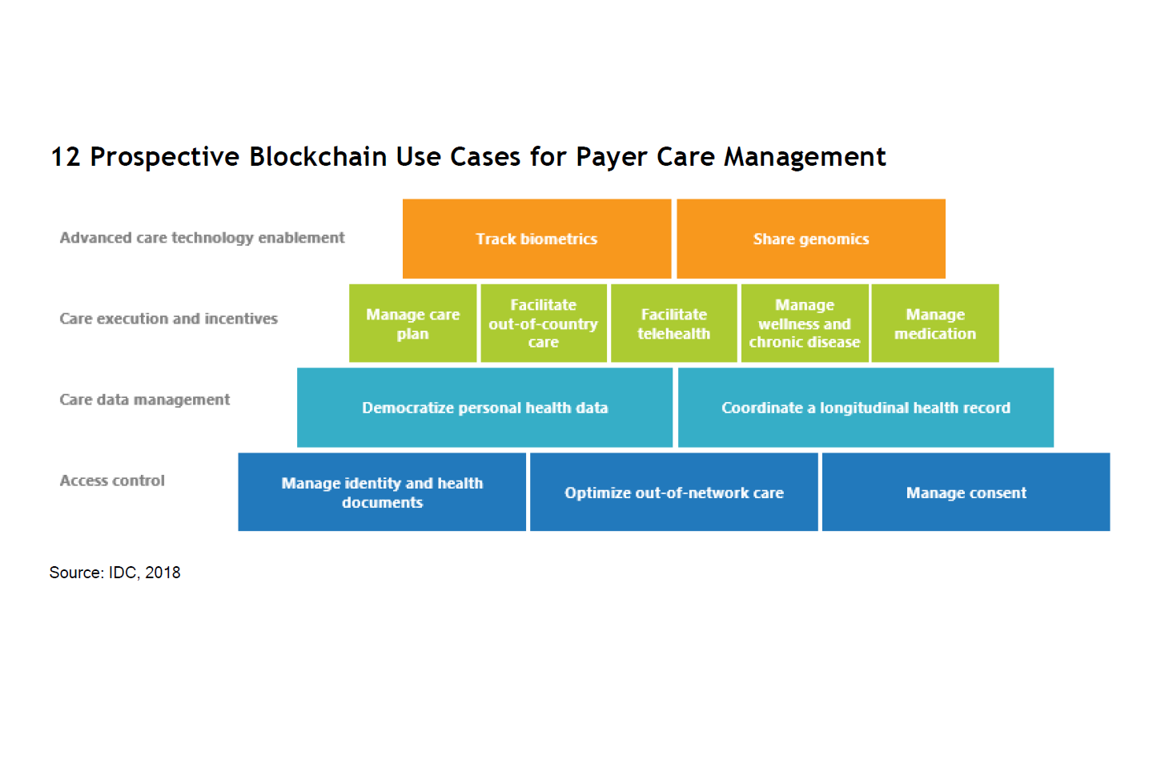
Use cases in Care Management
Care Management Use Cases
There are use cases from Healthcare Payers and Provider that can benefit from blockchain technology

Slide 5

Provider Data
Management
Optum and UnitedHealthcare
Pilot program applying blockchain technology to improve data quality and reduce administrative costs associated with changes to health care provider demographic data, a critical, complex and difficult issue facing organizations across the health care system.

Slide 6
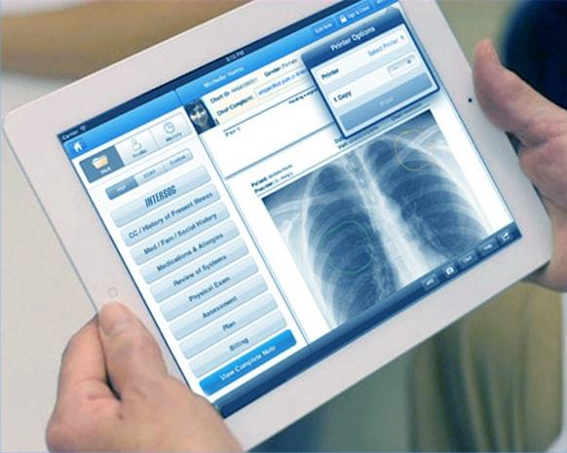
Sharing health record
Sharing data across health care organizations on blockchain technology is a significant use case that can improve data accuracy, streamline administration and improve access to care.

Slide 7

Out of Network Claims
"Parametric insurance" coverage is typically used
in property insurance for difficult-to-insure risks; this concept is beginning to leak into health insurance.
Vitana product pilot offers gestational diabetes insurance to expecting mothers in Singapore.

Slide 8
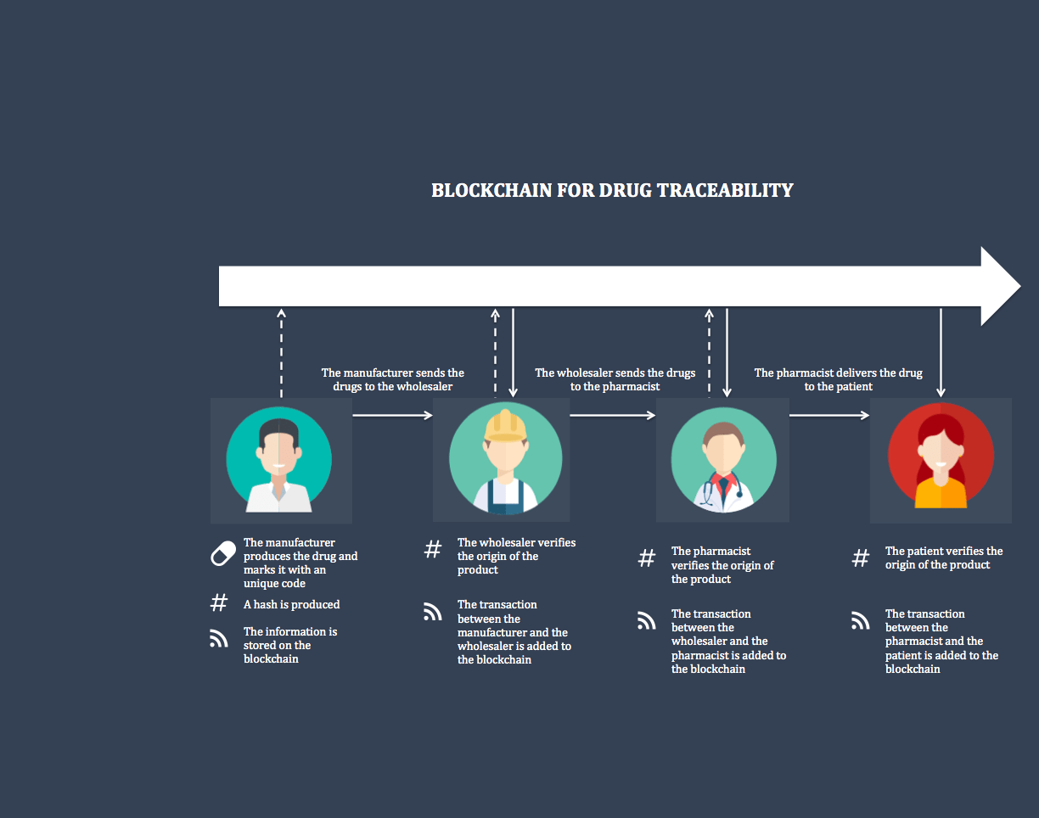
Drug Traceability
The main characteristic of blockchain technology that is useful in drug traceability is security. Each new transaction added to a block is immutable and timestamped, making it easy to track a product and make sure the information cannot be altered.

Slide 9

Manage Consent
Allow for more tailored consent provisions and ensure that requests for information withholding are properly recorded and available. In addition, patients can add consent statements at any point in their care journey.

Slide 10

Out of Country Care
CareX is a blockchain platform with a token currency (CARE) to be used on the Ethereum network for the purchase and sale of healthcare services.
CARE tokens help facilitate medical tourism by changing the paradigm of healthcare payment.

Slide 11

Tracking
Clinical Trials
Good clinical practice requires as much transparency as possible regarding where and when data was entered, and by whom—as well as other information such as who has permission to access what data. Audit trails provide this insight, and blockchain can take it to the next level by improving privacy, security, and transparency.

Slide 12

Prescriptions
Ability to make prescription data easily accessible to patients, pharmacies and giving patients control on who they can share the information with and where they can get the service.

Slide 13

Managing Bundled Payments
Bundled payments are single fixed price based on the services by 2+ providers, also considered as episode based where care has to be coordinated and payment is released after the service is performed and can be managed effectively with Smart Contracts.

Slide 14
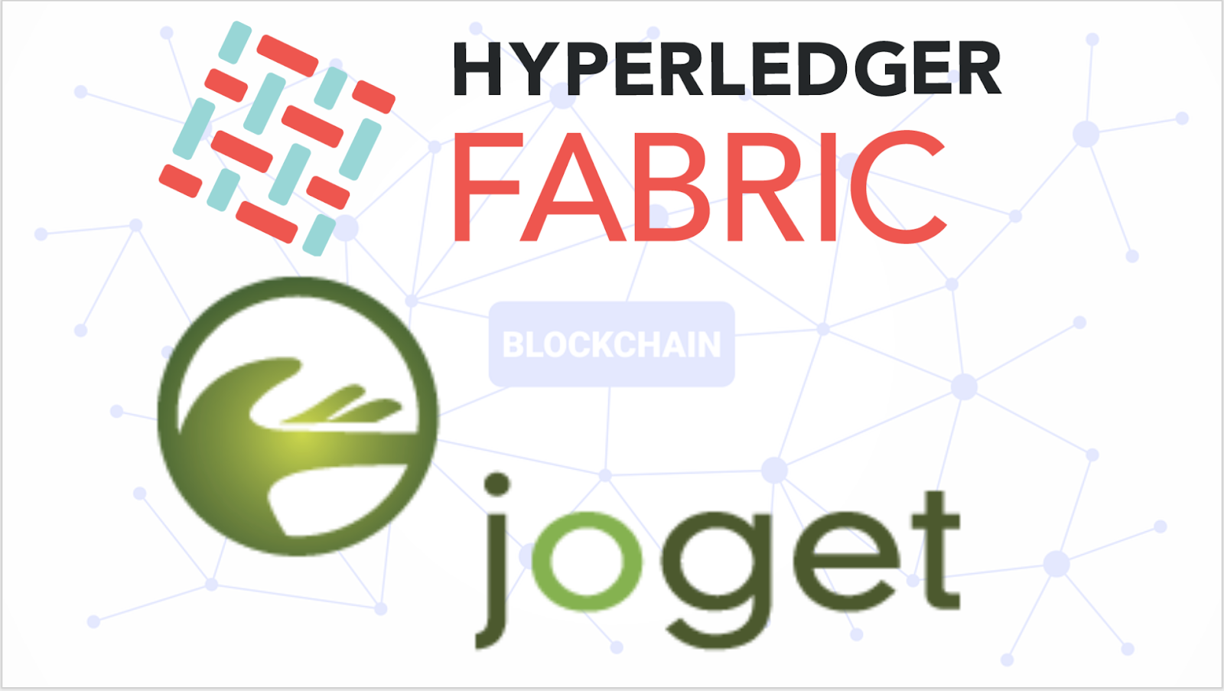
Blockchain Made Simple
No-Code Apps with Hyperledger Fabric and Joget
Its easier than you think
A number of companies have already started exploring, piloting and experimenting blockchain use cases.
We as part of the Hyperledger HealthCare Payer SIG are inviting any organization that wants to start a pilot / POC. Payer SIG will help support the POC.
https://blog.joget.org/2019/01/blockchain-made-simple-no-code-apps.html

Slide 15
THANK YOU
Consider joining HealthCare Payer SIG
Meets every other Tuesdays from
3:00 PM to 4:00 PM

Slide 16

Spotlight
Yuxiang Liu (David)
CTO of Mediconcen
Yuxiang (David) is CTO of Mediconcen, where he leads the company’s innovation, IT application architecture and new technologies. As a member of Hyperledger, Mediconcen aims to establish a decentralized governed medical network consortium connected with enterprise blockchain.
He is now Hyperledger Technical Ambassador and actively involved in Hyperledger TWGC, Hyperledger HK meetup event organizing.

