Slide 1
Healthcare Working Group
Meeting 3
October 31, 2017

Slide 2
General Information
Agenda: Distributed Health recap
Insights from Debbie Bucci
What makes a good framework for Hyperledger?
HCWG Surveys
Open mic

Slide 3
Distributed Health Meetup
Use cases:
A registry of patient reported data
A registry of disease encounters, public health
A registry of disaster recovery assets
Patient consent management for data sharing
Track changes to business associate agreements
Data provenance for prescription fulfillment
Real-time first responder event network
Interoperability: FHIR, HL-7, openEHR, etc.

Slide 4
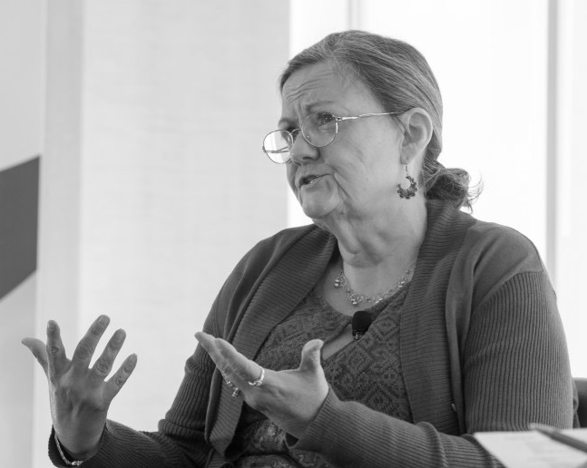

Debbie Bucci
Office for Standards and Interoperability
Office for the National Coordination for Health IT, HHS

Slide 5

What makes a good Hyperledger framework?

Slide 6
Health Care Working Group Surveys
Member Survey #2 sent out in August
Submissions of startups, speakers, or projects you want to hear from during these meetups
Use case voting from Distributed Health
Submit open source software / resources

Slide 7
Next Meeting: September 19th

