Slide 1


Blockchain Made Simple: No-Code Apps with Hyperledger Fabric and Joget
Hyperledger Fabric and Joget
Making it easy to create blockchain application using Hyperledger Fabric and Joget
Notes:
Joget Introduction
Logos
Modern Development Platforms
Industry Outlook - Need in the Market
Joget - Capabilities
Open and Plugin Architecture
Applications Screens
Workflows
User Views
Mobile Ready
Progressive
Performance Analyzer
Embedded APM Features
AI
Block-chain
Easy to learn
Typical - Adoption Model
Enterprise Adoption Program
Case Studies

Slide 2


Blockchain Adoption
Is Blockchain adoption a technical problem or business problem?

Slide 3

Blockchain Adoption Barriers
While blockchain is a great technology, it has its own challenges for adoption across any industry
Usage complications
Resistance to change
Absence of regulation
Engagement of multiple parties
Perception of immaturity
SLOW ADOPTION
Lack of ability to demonstrate and creating business Proof of Concepts
BLOCHAIN ADOPTION BARRIERS

Slide 4

Acceptance/Adoption of new capabilities and concepts are directly proportional to your ability to demonstrate via Proof of Concept.
CREATE SOMETHING TO SHOW IN ACTION
INNOVATION
UNDERSTANDING HOW PEOPLE INNOVATE IS CRITICAL

Slide 5


What is the #1 factor
CRITICAL TO ENABLE YOUR TEAMS TO
CONSISTENTLY DELIVER AND BE INNOVATIVE

Slide 6

#1
Joget DX
Your Digital Transformation Platform
Coming Soon…
Empowerment is your key to success
All new technologies working towards empowering
end-users to leverage technology to accomplish and deliver results
Empower Your Teams
This Photo by Unknown Author is licensed under CC BY-SA-NC

Slide 7
What is a No-Code/Low-Code Platform
No-Code/Low-Code Platforms are platforms that minimize or eliminate the need to code by empowering non-coders or coders by providing visually intuitive buildout capabilities including creating screens and workflow and other views of application.
Build complete and full-fledged apps, not just processes
Increased efficiency and productivity across enterprises
Speed to Market with our simple-to-learn platform
Easy to-change and maintain based on enterprise needs
Deploy and customize ready-made apps from marketplace
Improved process control and visibility with SLAs and deadlines
Web-based, drag-and-drop, wizard-style approach to build apps
Reduced Total Cost of Ownership with resources and technology

Slide 8




No-Code/Low-Code for building blockchain applications
Four major capabilities to build Applications
FORM BUILDER
​Drag and drop to visually build and configure forms
PROCESS BUILDER
Drag and drop to visually build and configure process workflows
REPORT/DATA VIEW BUILDER
​Drag and drop to visually build tabular lists and reports
USERVIEW BUILDER
Drag and drop to build user navigation menu interfaces and app themes

Slide 9

Blockchain Made Simple
No Code Apps with Hyperledger Fabric and Joget
This Photo by Unknown Author is licensed under CC BY-NC-ND

Slide 10

Visually build Blockchain applications with Hyperledger Fabric and Joget
Originally contributed by IBM, Fabric is emerging as the de-facto standard for enterprise blockchain platforms, with commercial implementations and support from major vendors including IBM, Oracle and SAP.
BLOCKCHAIN
Download Plugin
GET STARTED WITH BLOCKCHAIN APPLICATIONS
https://dev.joget.org/community/display/KBv6/Blockchain+Hyperledger+Fabric+Plugins
Hyperledger Fabric plugin accelerates the integration with Hyperledger Network

Slide 11
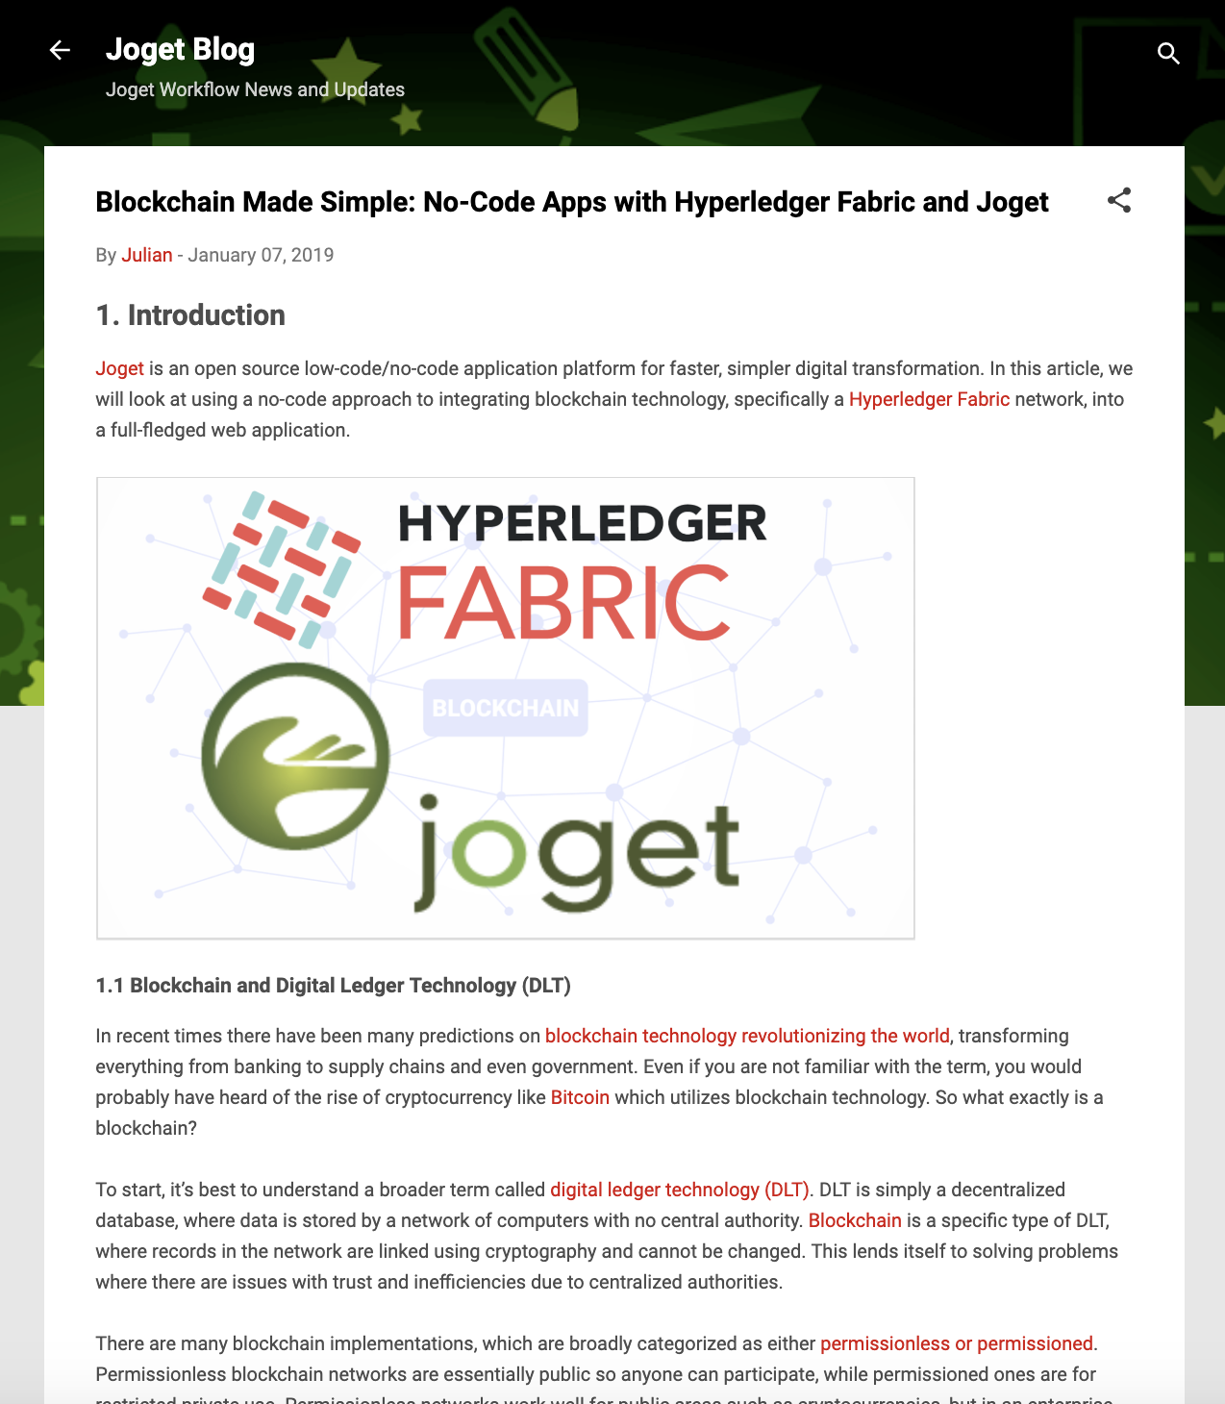
Simple steps to Try Yourself
Visually build with Hyperledger Ledger and Joget
Ensure that a Hyperledger Fabric network is up and running
Ensure that an instance of Joget Enterprise Edition is up and running
Download the Hyperledger Fabric Plugins JAR file, and upload the downloaded jar file through Manage Plugins under System Settings
Example -- Download the Joget jwa app and import it
Configure the fabric_host environment variable to point to the appropriate IP/hostname
Publish the app and access it from the App Center
Detailed Article
https://blog.joget.org/2019/01/blockchain-made-simple-no-code-apps.html

Slide 12
Plugin Configuration

Slide 13
Plugin Configuration

Slide 14
Application View

Slide 15
Demo
Plugin and App Demo
This Photo by Unknown Author is licensed under CC BY-NC-ND

Slide 16

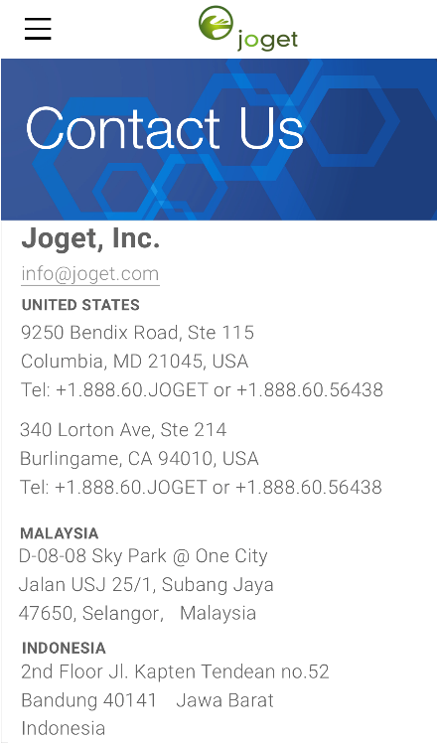
Contact Us
Get in touch with us
Want to try out Joget there are plenty of ways to do it
Download and try on your premise
Cloud
AWS Marketplace
RedHat OpenShift online
Azure – Coming Soon
DOWNLOAD
If you want to try it out On-Premise
Try Online
On our On-Demand for free

Slide 17

We are here to support
THANKS

