Slide 1
Welcome to
Blockchain Summer Project hosted by:
Hyperledger Princeton * Blockchain Princeton *
Blockchain Fundamentals * Ledger Academy
June 18, 2019

Slide 2
Blockchain Summer project

Slide 3
AGENDA
Housekeeping
Princeton Blockchain Community
Project Re-Cap Summer Blockchain Project
Discussion
Moving Forward
Notes:
David

Slide 4
Housekeeping
Housekeeping
Princeton Blockchain Community
Re-Cap Project Kickoff Meeting
Summer Blockchain Project
Discussion
Moving Forward
Notes:
David

Slide 5

HOUSEKEEPING
Tiger Labs:
Co-working Space in Princeton New Jersey
Current Home to Ledger Academy
Bobbi Muscara, Chair of Hyperledger Learning Materials Working Group.
Location for Princeton Meetups
Incubator space for start ups.

Slide 6
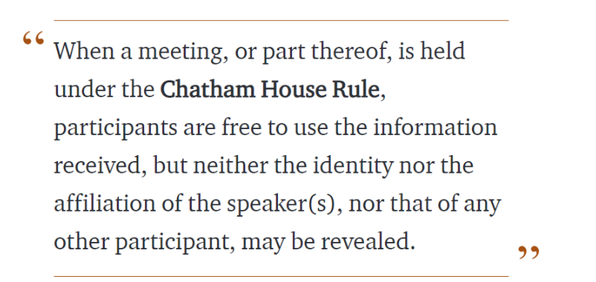
Chatham House Rule
Antitrust Policy Antitrust Policy Notice
Meetings involve participation by industry competitors, and it is the intention of the Ledger Academy to conduct all of its activities in accordance with applicable antitrust and competition laws. It is therefore extremely important that attendees adhere to meeting agendas, and be aware of, and not participate in, any activities that are prohibited under applicable US state, federal or foreign antitrust and competition laws. If you have questions about these matters, please contact your company counsel, or if you are a member of the Linux Foundation, feel free to contact Andrew Updegrove of the firm of Gesmer Updegrove LLP, which provides legal counsel to the Linux Foundation.

Slide 7
Princeton Blockchain Community
Housekeeping
Princeton Blockchain Community
Re-Cap Project Kickoff Meeting
Summer Blockchain Project
Discussion
Moving Forward
Notes:
David

Slide 8
meetups
HYPERLEDGER PRINCETON
  Hosted by Linux Foundation, is comprised of people interested in learning and developing projects using the Hyperledger solutions.
PRINCETON BLOCKCHAIN AND AI
  Princeton Blockchain and AI is focused on COMMUNITY. Discussions are developed by meetup participants.
BLOCKCHAIN FUNDEMENTALS / Ledger Academy
  Meetups focused on Education.

Slide 9
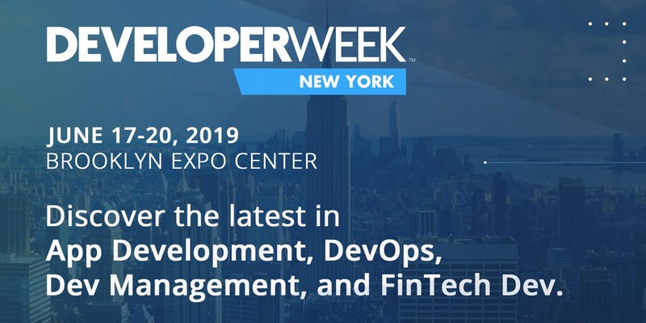
Princeton Blockchain and AI
25 Free OPEN Passes to DeveloperWeek New York,
Did anyone attend and could you report on event?
25 Free OPEN Passes to DeveloperWeek New York,
Did anyone attend and could you report on event?
Call for Speakers for the September Meetup
New Meetup https://www.meetup.com/Princeton-School-of-AI/

Slide 10
Hyperledger Meetup Group
New Graphic still being debated conversation has moved to product life cycle and when should project make the graphic.
Fabric 1.4 Performance report
Hyperledger Learning Materials documentation Working group needs members. (Edx Editor)

Slide 11
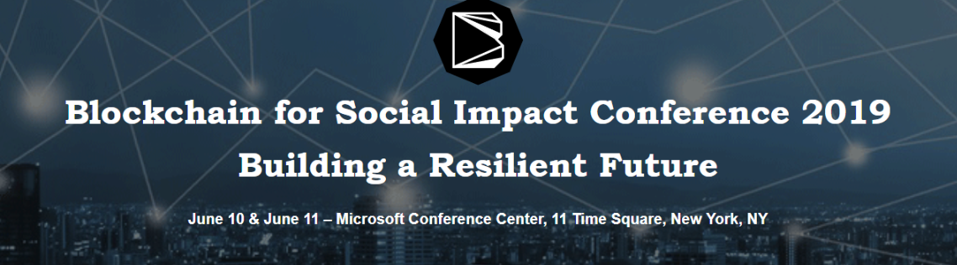
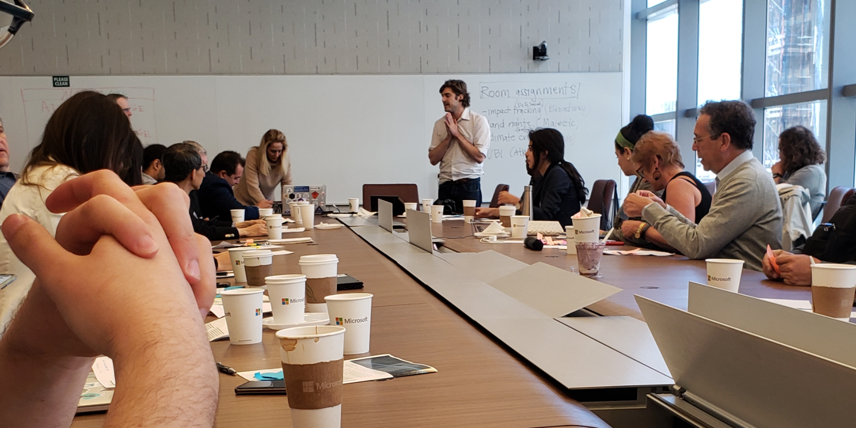
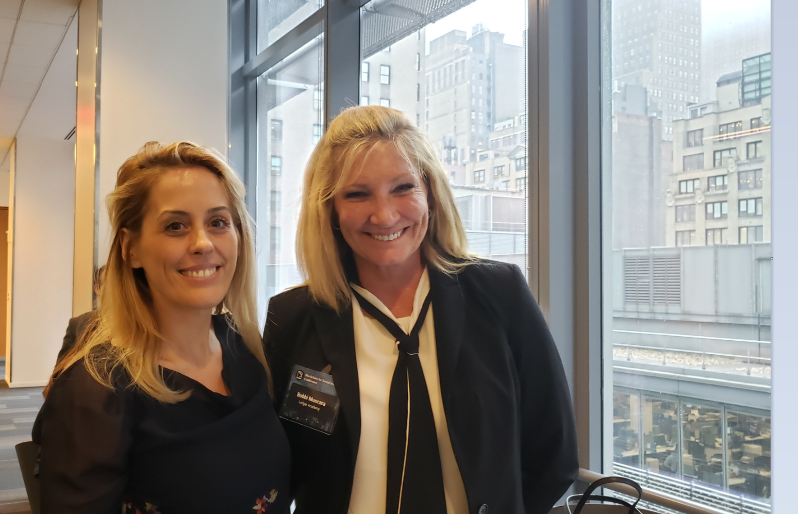
Ledger Academy
Working Groups Forming Now (must be member)
Decentralized Social Finance
Land Rights
Climate Crisis
Universal Basic Income

Slide 12
Re-Cap Project Kick off Meeting
Blockchain for Social Imapct
Housekeeping
Princeton Blockchain Community
Re-Cap Project Kickoff Meeting
Summer Blockchain Project
Discussion
Moving Forward
Notes:
David

Slide 13

Blockchain and social responsibility
    Philanthropy and remittances (donation traceability, aid transparency, digital currencies in aid and development, governance and accountability)
    Financial empowerment (financial inclusion, microfinance, microinsurance)
    Identity and land rights (refugee assistance, land ownership documentation)
    Governance and democracy (fighting censorship and fake news, voting rights and protections, election integrity)
    Supply chain and environmental protections (sustainable supply chain, fair trade, ethical sourcing, fair labor practices)

Slide 14
Summer Project Goals
following a project from idea to production.
create a working blockchain project
have a positive impact in our area this summer.
Work with a team using the latest collaboration tools
solve a problem.

Slide 15
SOCIAL IMPACT CONTRIBUTION
Checkpoints
Checkpoints are meant to guide you to think through your own solution prototype, stay on track, and ultimately formulate your own Blockchain / White Paper / Projects.
Scorecard / Recap
Each checkpoint is designed to address a particular set of questions corresponding to a section of a tally sheet.
Notes:
scorecard.

Slide 16
Summer Blockchain Project
Housekeeping
Princeton Blockchain Community
Re-Cap Project Kickoff Meeting
Summer Blockchain Project
Discussion
Moving Forward
Notes:
Hyperledger Quilt
Business Blockchain Tool
● Contributed by NTT Data and Ripple
● Java implementation of the Interledger protocol
● Interledger protocol provides:
○ atomic swaps between ledgers (even non-blockchain or distributed ledgers)
○ a single account namespace for accounts within each ledger

Slide 17
Weekly Checkpoints
Week 1: Impact Opportunity
Week 2: Business Model Validation
Week 3: Technical Architecture
Week 4: Impact Measurement
Week 5: Code
Week 6: Final Submissions Due

Slide 18
Week 1: Impact Opportunity (questions)
Define Project and team members.
Select your challenge requirements.
Define the scope of problem you are addressing.
Why is blockchain needed to solve this problem?
What is the size of the market? What demographics will you serve? Which industries will you impact? Any concurrent trends?
What are some current solutions to the problem you identified? Do they work effectively?
Who are the stakeholders involved? How are they thinking/feeling/acting currently?
What are the geopolitical, cultural-social-economic factors that must be taken into consideration? What are some nuances and complexities that must be addressed?

Slide 19
Princeton Blockchain Summer 2019
Social Impact Project
Goal: Create a simple app utilizing Blockchain to seamlessly connect donors to recipients
BD2RA = Blockchain Donor to Recipient App

Slide 20
Revision Log
Date | Edits / Additions Made By | Edits / Additions
6/14/19 | Scott Schneider | Original Working Project Draft Presentation
6/14/19 | Colin Pinto | Expanded High Level Project Vision
6/18/19 | Bobbi Muscara | Complied Information collected from group

Slide 21
Weekly Checkpoints
Week 1: Impact Opportunity
Week 2: Business Model Validation
Week 3: Technical Architecture
Week 4: Impact Measurement
Week 5: Code
Week 6: Final Submissions Due

Slide 22
Week 1: Impact Opportunity (questions)
Define Project and team members.
Select your challenge..
Define the scope of problem you are addressing.
Why is blockchain needed to solve this problem?
What is the size of the market? What demographics will you serve? Which industries will you impact? Any concurrent trends?
What are some current solutions to the problem you identified? Do they work effectively?
Who are the stakeholders involved? How are they thinking/feeling/acting currently?
What are the geopolitical, cultural-social-economic factors that must be taken into consideration? What are some nuances and complexities that must be addressed?

Slide 23
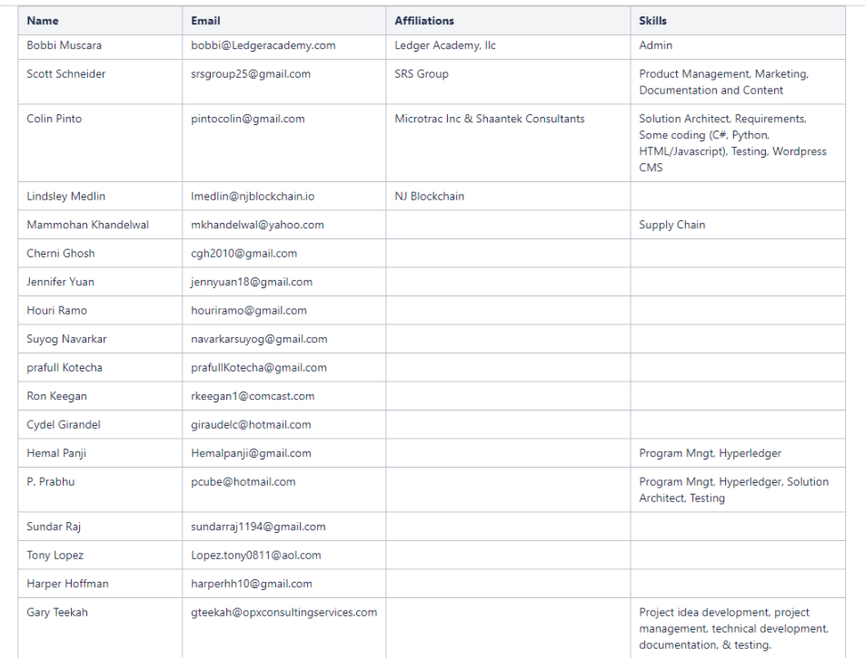
Impact Opportunity : Team Members
https://wiki.hyperledger.org/display/LMDWG/SUMMER+PROJECT+IDEAS
Hyperledger Wiki / LMDWG / Resource Page/ Meetups / Summer Project

Slide 24
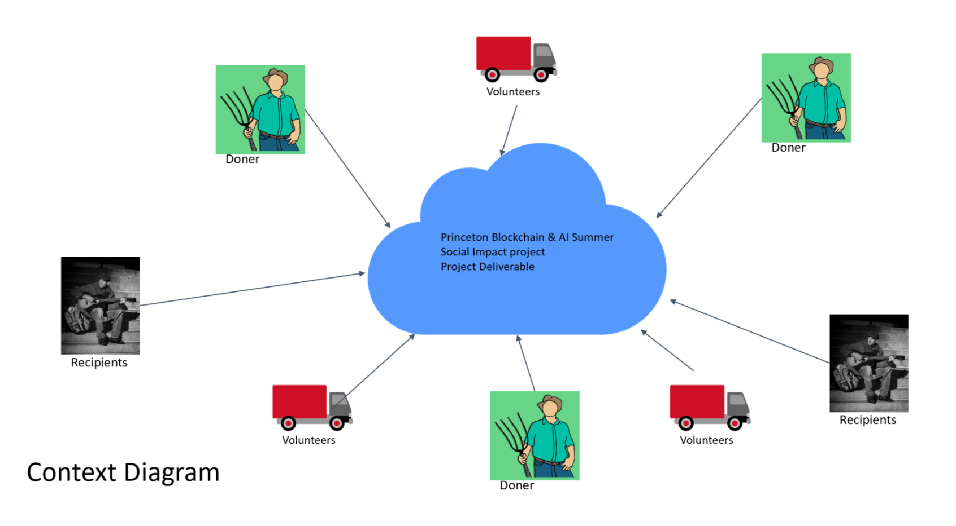
Impact Opportunity
Project Description: “Seamlessly connecting donors to recipients”
“
Donors are becoming more results- and impact-focused, and trust in the recipient organization is crucial to their decision-making.
A study by Stanford University
This transparency goal will spur new donors which will result in a larger impact.
Colin Pinto

Slide 25
Impact Opportunity Project Statement & attributes (- project pillars)
Develop an agile & transparent network for connecting surplus foods & supplies to communities in need.
Agility:
An agile supply chain for humanitarian aid has to be flexible & dynamic.
Observations: – Humanitarian supply chains have similarities with business supply chains, but there are significant differences. Many humanitarian distribution systems have a short and unstable existence with an inadequate link between donors & consumers.
Potential Impact: Efficient utilization of limited donated goods.
Transparency:
Anyone with access to the network can view a history of transactions in real time. Potential impact: The donnation trail can be tracked and monitored more accurately. Donors can in near real-time see the impact their donations are having

Slide 26
Impact Opportunity Team Description
Project Idea Team. Works on developing and refining the project idea, clarifying scope, funding, project financials, exploring which activities are worth pursuing in the interest of project success, Definition of Done, etc.
Project Management/Governance Team: Tasks, deadlines, timeline management, risks, assumptions, issues, dependencies, next-steps, etc.
Development Team: Confirm permissioned v. permissionless blockchain. Determine whether Hyperleger Fabric solution. Setup development environment, design network, bootstrap channel, install tools & utilities, ledger setup, client application development, chaincode development, etc.
Communication/Documentation Team: Project documentation and internal/external communications. Wiki/Spaces structure, documentation guidance, etc.
Requirements & Testing Team: Work with Project Idea Team & Documentation Team to validate requirements/user stories. Test and certify the solution.
Notes:
Need Further clarification before next working Group

Slide 27
Impact Opportunity
Define Project
This project implements a blockchain social service solution that provides food daily to the population of veterans in the Princeton area who are unable to acquire daily meals. This solution matches donor organizations (farmers, restauranteurs, kitchens, etc.) with these needy veterans in the community, so that excess food supplies can be delivered to them instead of being discarded as daily food waste.
This blockchain solution can be used also for other social services by redefining the donors, recipients, and the transportation method. If transportation is available, this solution can be used despite the geographical location of the donors and recipients.
Implementation of this solution can provide an annual cost savings of US$420,000 (this is just an example - actual figures to be determined) to the Princeton community:
GaryT
Population of Veterans | Daily Food Cost per Vet | Total Daily Cost | Total Annual Cost
1000 | US $35.00 | $35,000.00 | $420,000.00
Cost of providing this service to veterans |  | $0.00 | $0.00
Total benefit to Princeton Community |  | $35,000.00 | $420,000.00

Slide 28
Initial project focus of “Donor Goods” will be food
Future Goods can include: Clothing, Blankets, Toiletry Items, Paper Products
Impact Opportunity
Donors
Farmers
Restaurants
Wholesalers
Individuals
Volunteers / Drivers
Pickup / Deliver
Local Transporters
Uber model-??
Recipients
Food Banks
Houses of Worship
Social Services Offices
Individuals (off the grid)

Slide 29
Impact Opportunity High Level Project Vision
Easy to use Blockchain app on phone
  BD2RA = Blockchain Donor to Recipient App
No single point of control. Volunteer/s matches supply with demand or demand with supply => Agility
Donor post availability of food
  Type of food, Quantity, Location, ‘Shelf-life’ for perishables/or pick-up-by-date, Contact information,…
  Auto-generated Donation-tag is created
Volunteers can check donors / food available for pickup
Volunteers can check recipients in need
Volunteer picks up food from Donor on a first-come, first-serve basis
Volunteers adopts a Just-in-Time delivery model to eliminate the need for refrigeration and special handling of perishables
Volunteers is responsible for the transportation including transportation capacity
Activity is recorded at each stage. => Transparency
  Donation-tag, Recipient-tag & Geo-location from smart phone, event time-stamp
  [Stretch goal for summer2019] Donors and Volunteers can get BD2R “tokens” for recognition, community service, etc.

Slide 30



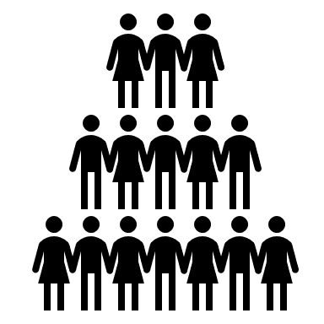

Impact Opportunity System Design
Initiate P/U
BD2RS
Donation Tag
Notification for P/U
Donor
BD2RS
Recipient Request
Volunteer
Recipient Tag
Delivery Information

Slide 31
Why is blockchain needed to solve this problem?
Impact Opportunity: Why Blockchain
How Blockchain will benefit this Social Impact project.
To connect donors with receipts
Capture and verify the quantity and handover of food & supplies
Track where food & supplies are located at any time
Understand where food & supplies are sourced from and who the recipients are
Technical solution rationalization
Blockchain enables a digitized, verifiable, decentralized technology that’s used to capture and verify transactions between mulitple parties in a provable and permanent way.
Due to its decentralized nature, multiple stakeholders use the blockchain to efficiently record, report on and track verified interactions.
This makes it easier to track and manage the sourcing, storage, transfer and distribution of food donations.

Slide 32
Impact Opportunity
Scope
  Must be contained for success within project time constraint.
  Scope includes a working prototype of the Blockchain application.
<<GaryT>>

Slide 33
Impact Opportunity
        Zeroing-in on achievable scope, consider
          Donors: List suggested Donors (e.g., Farmers, Restaurants, Individuals, etc.). Rank Donors in order of greatest chance of collaboration for project success. Agree on final target Donor.
          Consumers: List suggested Consumers (e.g., Veterans, Families, etc.). Rank Consumers in order of greatest chance of collaboration for project success. Agree on final target Consumer.
          Location: Decide on a target location guided by decision on Donor and Consumer.
          Organizations that may be able to assist with identification of Consumer and Location: Churches, Food Banks, Social Services. Target consumers may congregate in locations where social services providers are located.
          Transporters: Same comments as above.

Slide 34
Impact Opportunity
Donors
Volunteers
Recipients
Farmers, Restaurants, Individuals, etc.
Wants
Needs
Challenges
Transporters, Pick/up Facility / Location
Wants
Needs
Challenges
Veterans, Food Banks, Families, etc
Wants
Needs
Challenges

Slide 35
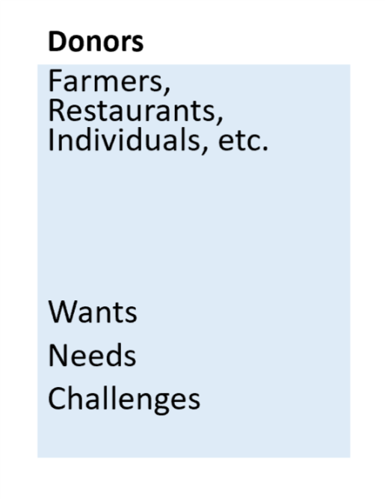
Impact Opportunity

Slide 36
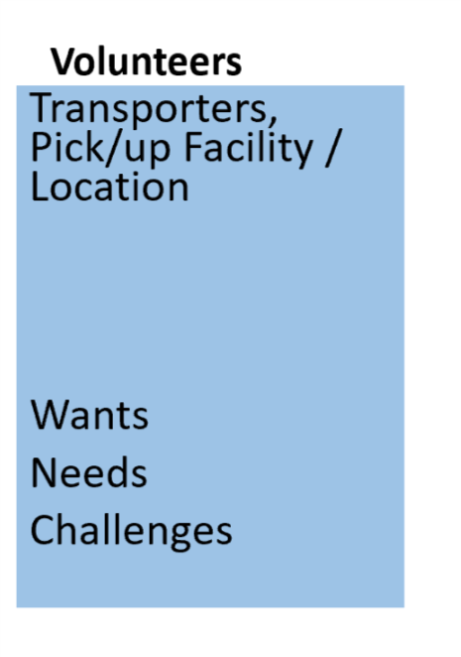
Impact Opportunity

Slide 37
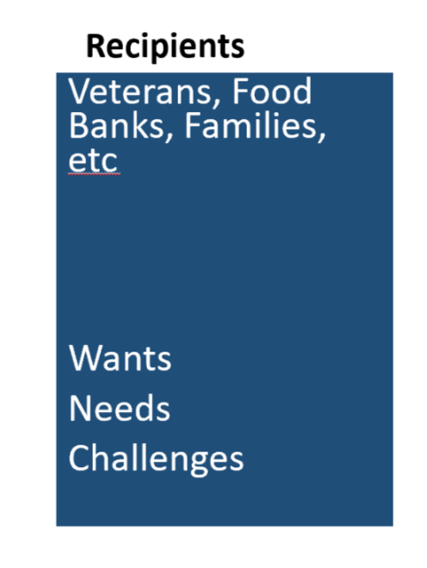
Impact Opportunity

Slide 38
Impact Opportunity
NJ Food Bank Organizations – partial list
Community Foodbank of NJ https://www.cfbnj.org/ 908-355-3663 Hillside
609-383-8843 Egg Harbor Township
Feeding America https://www.feedingamerica.org/find-your-local-foodbank/community-foodbank-of-new-jersey
Foodbank of South Jersey https://foodbanksj.org/ 856-662-4884, Pennsauken
Food Pantries.org https://www.foodpantries.org/st/new_jersey
Fulfill 732-918-5600 Neptune City
Need Help Paying Bills https://www.needhelppayingbills.com/html/new_jersey_food_banks.html
NJ Department of Agriculture https://www.nj.gov/agriculture/news/press/2018/approved/press181113.html
Facebook page https://www.facebook.com/communityfoodbankofnj/

Slide 39
Introduction
Rooster Featherstone United States Veterans and Local Farmers
6/5 Spoke with R.F. over the phone.
Pick /up : He supplies produce from farm, local farmers have expressed an interest in supporting his effort. He feels they would be open to an app on their phone that lets the system know they have a pick up. Currently R.F picks up produce in his truck.
Up to date the produce has not been in sufficient amount that his truck cant handle it.
Delivery: He has two location for Drop off:
Location One - isn't feasible for our study, the individuals do not have cell phone and distribution can be sketchy at best. The individuals are spread out through affluent Hunterdon and Mercer county with no system to handle the homeless, not we organized
Location Two - Philadelphia. Can establish drop off with facilities and individual who most likely will be carrying cell phone. City has more organized homeless.
R.F. agreed to join by phone at our next meeting.
6/12
R.F. agreed to a phone call tonight after 8pm.
Action Item Ron

Slide 40
Impact Opportunity
What are the geopolitical, cultural-social-economic factors that must be taken into consideration? What are some nuances and complexities that must be addressed?
  Potential for food spoilage.
  Product liability associated with being a supplier of food.
  Supply pipeline to get foods from Donor to Consumer must be efficient enough to avoid complexities 1 and 2.

Slide 41
Impact Opportunity
No experienced blockchain architects/developers were present at the 6/12/19 meeting. Must reach out to the other Meetup members, or external parties, to assist with building-out the solution. Will need participation of technicians who have implemented blockchain solutions before - time constraint does not allow for using this as a learning exercise.
AWS Solution Fabric or Ethereum

Slide 42
TRANSACTIONS IN OUR WORKFLOW:
*help to identify the implicit transactions and features to be supported by this blockchain application solution via business network APIs.
Identify an initial list of Consumers who will require a daily food supply. List will expand with additional Consumers.
Identify the location of the Consumers. Locations will expand with additional locations serviced.
Identify an initial list of Donors who will donate food daily. List will expand with additional Donors.
Identify the location of the Donors. Locations will expand with additional Donors.
Identify an initial list of Transporters - an initial list which will expand as additional Donors volunteer their services.
Identify the location of Transporters. Locations will expand with additional Donors.
Identify attributes of Consumers, Donors, Transporters that will help with identification and communication to ensure supply pipeline efficiency.
Donor provides notification that they have a food supply ready for pickup by Transporters for delivery to Consumers.
The Donor indicates the available quantity of food they are supplying.
Transporter monitors the blockchain to determine when food is available for pickup.
Transporter matches the Donor supply with specific Consumers (whose daily needs have not been filled) to whom they can deliver this food supply.
Transporter volunteers to pickup the available supplies and deliver to specific Consumers (criteria may be location proximity).
Transporter picks up the available food supply from the Donor.
Transporter delivers the available food supply to the Consumers.
Transporter records that they have provided this service.
The Donor's quantity of food supply available for transport is decremented.
The Consumer is checked-off as having had their daily needs filled.
If additional quantities of food is still available from this Donor, the Donor notification remains active else it is closed.
Application metrics are updated (e.g., quantify the amount of food delivered, the cost of delivered food, etc.) for analytics.
At the end of day, all pending transactions are closed to reset for a new day of deliveries.

Slide 43
Impact Opportunity
SUGGESTED IMMEDIATE NEXT-STEPS FOR NEXT MEETUP
  Lock-down scope.
  Agree on Donor, Transporter, Consumer, assets to be transported, and business rules governing interactions amongst these entities.
  Fill-in the the above Week-1 Checkpoint - Impact Opportunity proposal - move closer to full completion. Develop Whitepaper
  Establish Teams - much to do here given that the solution is a working prototype. See Development Team structure & responsibilities above. Need to start now.
  Assign members to agreed teams (see Define Teams - Structure above) and appoint group leaders. They can then help with next-steps.
  Agree on process workflow, participants in business use case, runtime transaction processing flow

Slide 44
Impact Opportunity
Working Groups –Sub categories
Business Development
Marketing
Technology
Define
Connect
Map
Develop Prototype
Decide/develop Blockchain
Interface design
Web Site Mgt
Wiki Development
Meeting Prep

Slide 45
Discussion
Housekeeping
Princeton Blockchain Community
Blockchain and Social Impact Projects
Summer Blockchain Project
Discussion
Moving Forward
Notes:
David

Slide 46
Impact Opportunity
A quantifiable value serving as a proxy for your solutions impact. This can be in number of users, geographic coverage, adoption rate, sales, volume, etc..
Economic Conditions, geopolitical and social/cultural environment, industry trends, current solutions, stakeholders, and other factors should be accounted for in overall plan.

Slide 47
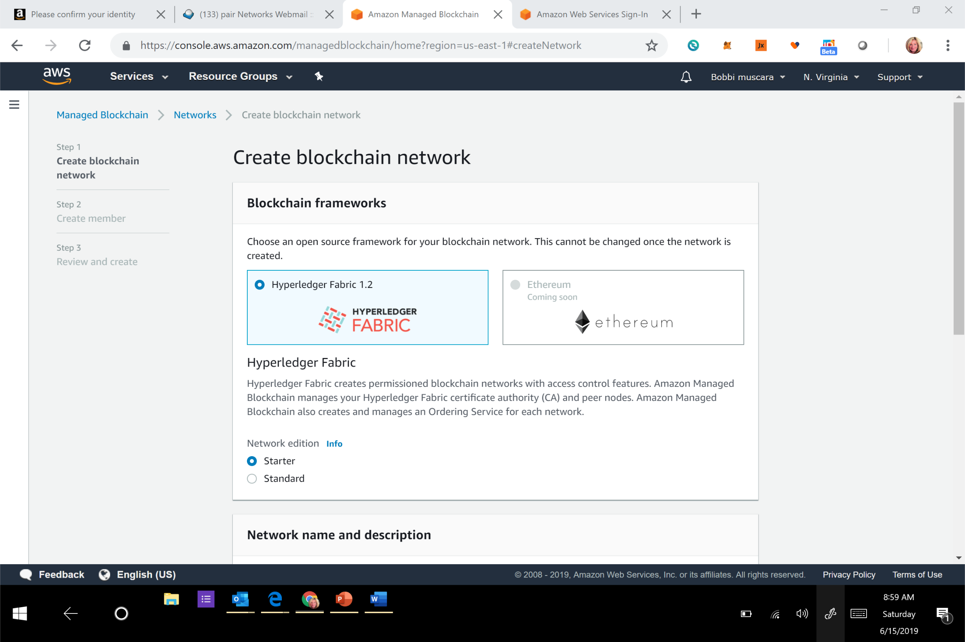
AWS

Slide 48
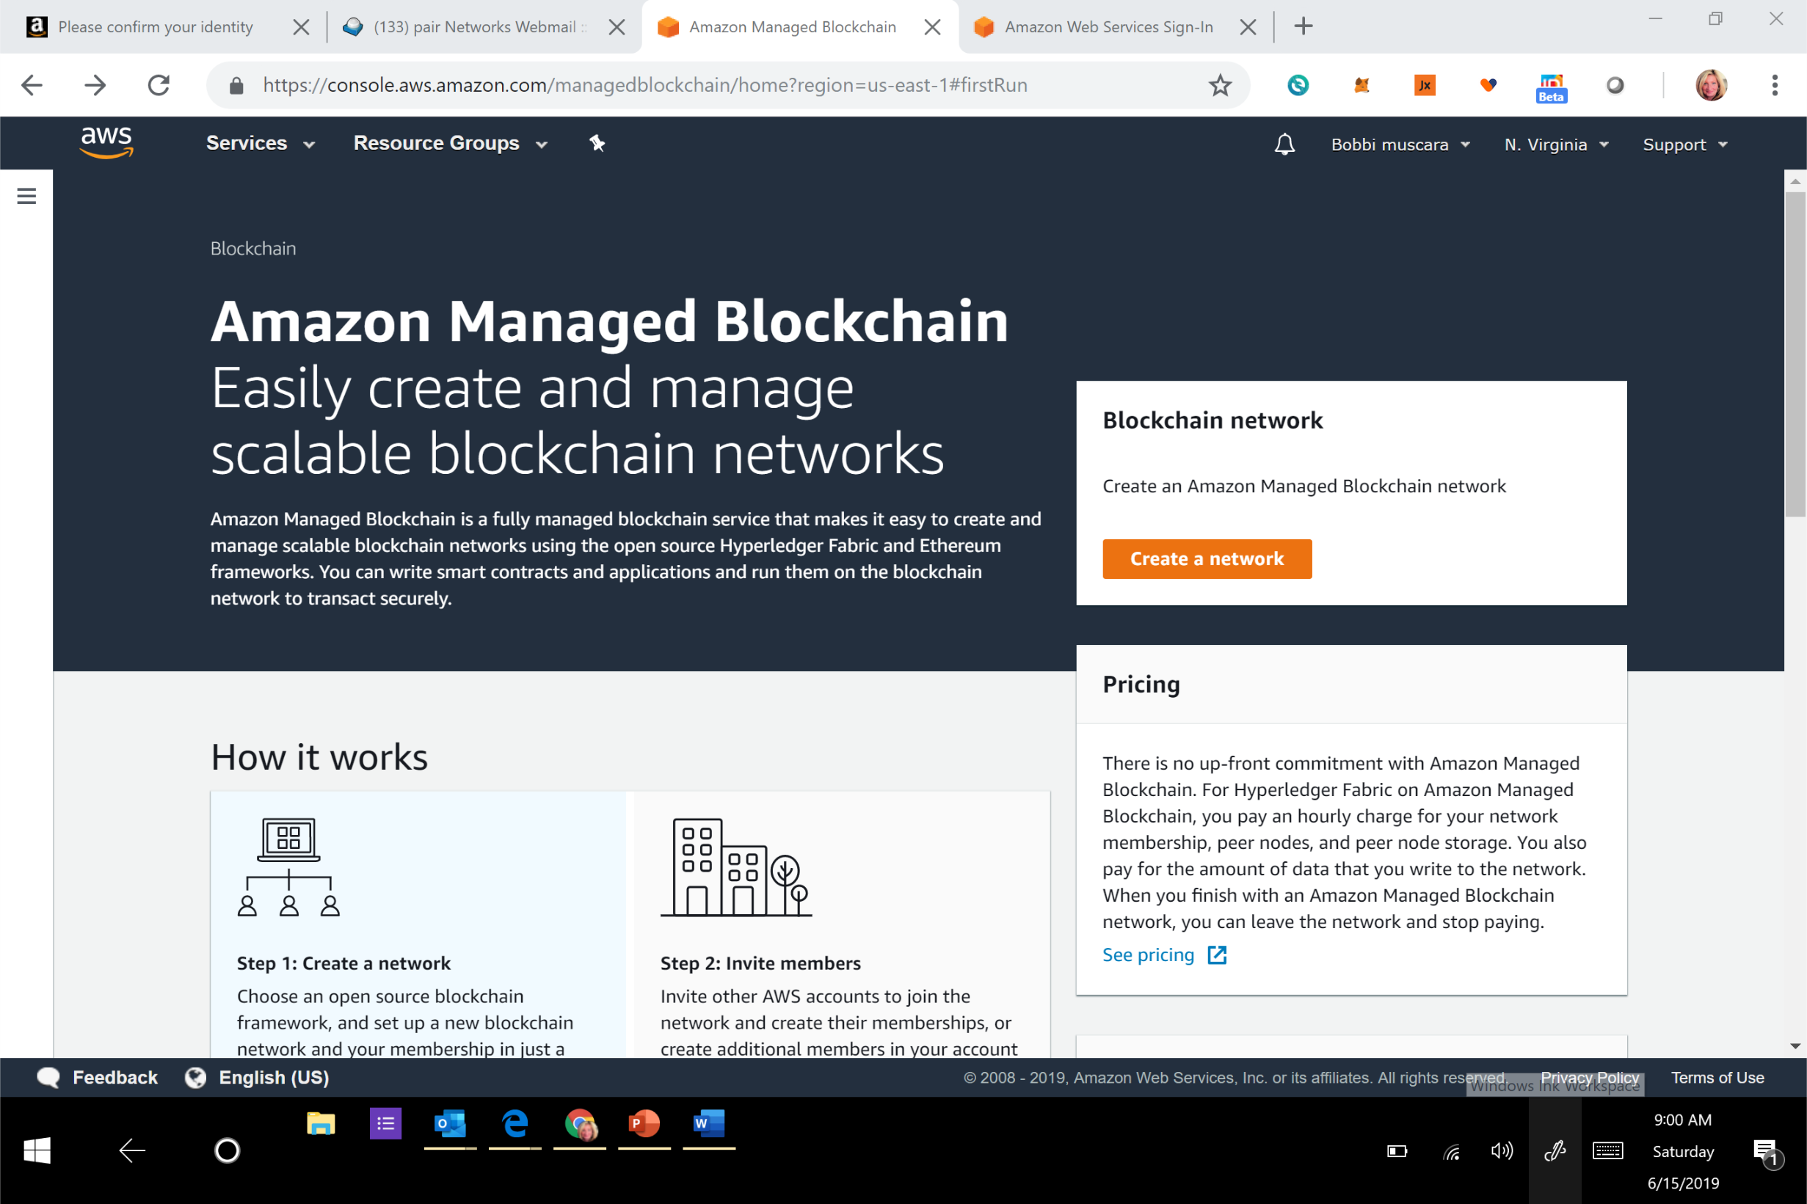

Slide 49
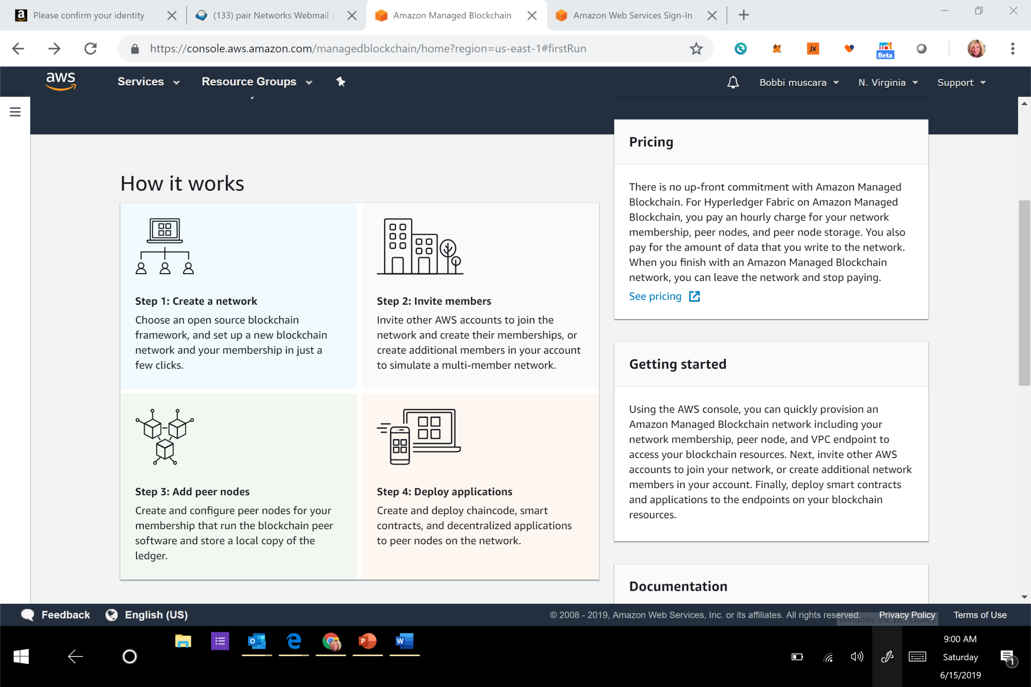

Slide 50
Week 2: Business Model Validation (questions)
Who are your clients/users? Sketch out the persona of your user.
What are their pain points? How does your solution solve them? Indicate your unique value proposition.
Does your solution depend on context? Can it be scaled?
What is your go-to-market strategy? Who can you partner with?
How will your product generate revenue / benefit ? Will it be financially sustainable in the long-term?
What are the implicit and explicit assumptions being made in your business and financial model (user-profiles, partnerships, costs, etc.)? How do you plan on validating them?
What is the vision for your product? Can it significantly change the current state?

Slide 51
Week 3: Technical Architecture (questions)
Define the technical specifications of your system's architecture. Include a description of system requirements, processes, business logic, technology stack, user flows, attack factors and any other technical specifications. Attach some visuals as bonus.
Define your Minimum Viable Product (MVP) testing approach.
  Marketing Tests: Landing Page, Explainer Video, Ad Campaign, A/B Tests, Crowdfunding
  Product Tests: Sketches, Wireframes, Mockups, Interactive, Prototype, Wizard of Oz, Concierge, Live Product
Outline a development roadmap with a realistic timeline that takes into account your product vision, market readiness, team capabilities, functional upgrades and testing plans. What are your goals for each phase? How will your product evolve? Will you integrate other technologies?

Slide 52
Week 4: Impact Measurement (questions)
What is the impact goal of your solution? How do you ensure to capture needs of those who are traditionally underserved within your category?
What are the key indicators that capture your impact goal? Are they compatible with globally recognized standards (e.g. IRIS, SROI, PPI)? Do you have impact measures to add to create a more equal and inclusive solution?
What variables and data points do you need to collect? What are the tools and processes to collect those data? What are some obstacles you may face on the ground? Infrastructure issues, measurement techniquest, etc.
How do you collect feedback? How do you improve your measurement?

Slide 53
Week 5: Code (questions)
Prototype your solution in some manner. Examples include:
Working code
Analog prototype / Mock-ups
Tech Stack and Wireframes
Create blockchain and implement

Slide 54
Week 6: Final Submissions Due (questions)
Integrate information into a White Paper, , White Paper is your chance to incorporate new information after your submissions of weekly checkpoints.
Prepare a 5-min video demo that includes the following:
A description of your early stage idea: The challenge of your choice and the overview of your solution.
An explanation of your business model: How does your solution create value and be financially sustainable?
Prototype / Proof-of-concept: A minimum viable product that captures how your product functions.
Timeline for sustained development: A plan for project's growth beyond the scope of the incubator.
Bonus: Include how you addressed increasing Diversity and Inclusion. How did this goal impact your team, the product, the research methods, the target groups and any other way you came up with. (To qualify for The One World Award you also need to submit a 2 pager. see above)

Slide 55
Final project
White paper
Video demo
presentation

Slide 56
Moving Forward
Housekeeping
Princeton Blockchain Community
Social Impact Projects
Summer Blockchain Project
Discussion
Moving Forward
Notes:
David

Slide 57
PRINCETON BLOCKCHAINFOR SOCIAL IMPACT
June12 , 2019
Schedule: Tiger Labs
Checkpoint 2 Business Model Validation
Next Working Group June 26th
Presentation : July 2nd
Five checkpoints to be presented at meetups:
Impact Opportunity
Business Model Validation
Technical Architecture
Impact Measurement Prototype
Delivery.

Slide 58
THANK YOU
Notes:
David

