Slide 1
Welcome to
Blockchain Summer Project hosted by:
Hyperledger Princeton * Blockchain Princeton *
Blockchain Fundamentals * Ledger Academy
June 26, 2019

Slide 2
Blockchain Summer project

Slide 3
AGENDA
Housekeeping
Princeton Blockchain Community
Project Re-Cap Summer Blockchain Project
Discussion
Moving Forward
Notes:
David

Slide 4
Housekeeping
Housekeeping
Princeton Blockchain Community
Re-Cap Project Kickoff Meeting
Summer Blockchain Project
Discussion
Moving Forward
Notes:
David

Slide 5

HOUSEKEEPING
Tiger Labs:
Co-working Space in Princeton New Jersey
Current Home to Ledger Academy
Bobbi Muscara, Chair of Hyperledger Learning Materials Working Group.
Location for Princeton Meetups
Incubator space for start ups.

Slide 6
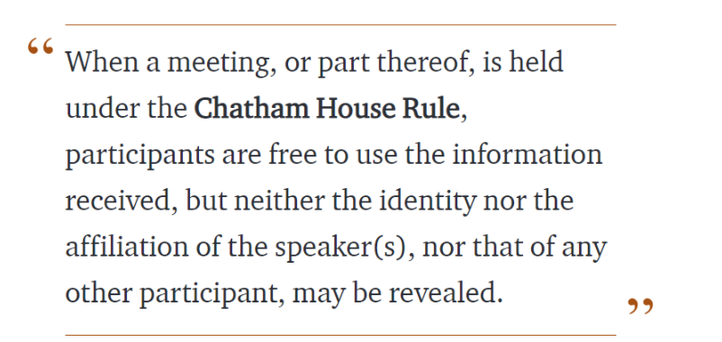
Chatham House Rule
Antitrust Policy Antitrust Policy Notice
Meetings involve participation by industry competitors, and it is the intention of the Ledger Academy to conduct all of its activities in accordance with applicable antitrust and competition laws. It is therefore extremely important that attendees adhere to meeting agendas, and be aware of, and not participate in, any activities that are prohibited under applicable US state, federal or foreign antitrust and competition laws. If you have questions about these matters, please contact your company counsel, or if you are a member of the Linux Foundation, feel free to contact Andrew Updegrove of the firm of Gesmer Updegrove LLP, which provides legal counsel to the Linux Foundation.

Slide 7
Princeton Blockchain Community
Housekeeping
Princeton Blockchain Community
Re-Cap Project Kickoff Meeting
Summer Blockchain Project
Discussion
Moving Forward
Notes:
David

Slide 8
meetups
HYPERLEDGER PRINCETON
  Hosted by Linux Foundation, is comprised of people interested in learning and developing projects using the Hyperledger solutions.
PRINCETON BLOCKCHAIN AND AI
  Princeton Blockchain and AI is focused on COMMUNITY. Discussions are developed by meetup participants.
BLOCKCHAIN FUNDEMENTALS / Ledger Academy
  Meetups focused on Education.

Slide 9
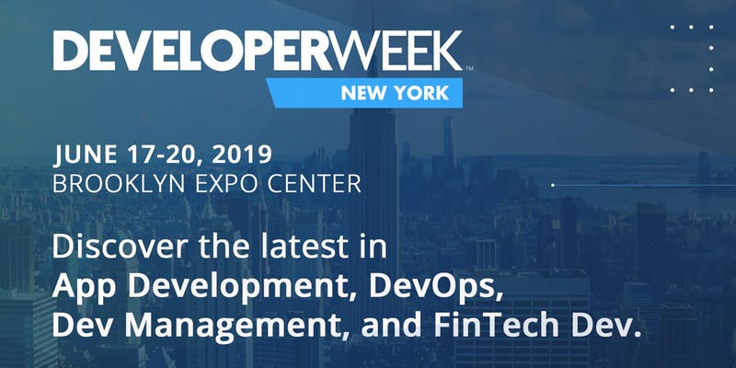
Princeton Blockchain and AI
25 Free OPEN Passes to DeveloperWeek New York,
Did anyone attend and could you report on event?
Call for Speakers for the September Meetup
New Meetup https://www.meetup.com/Princeton-School-of-AI/

Slide 10
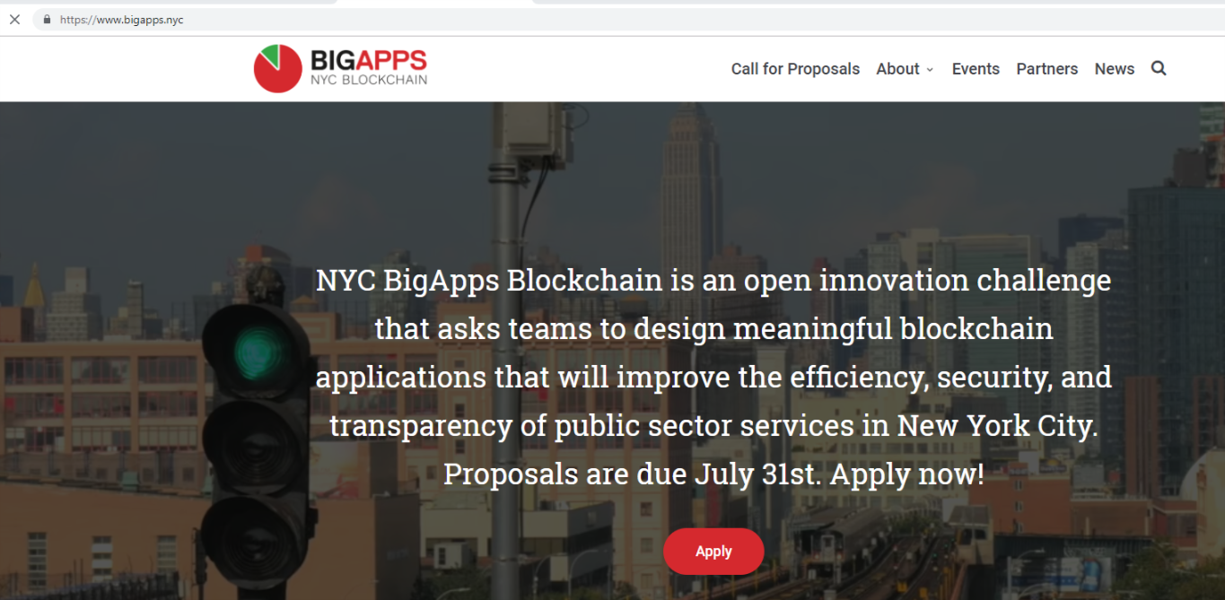

Slide 11
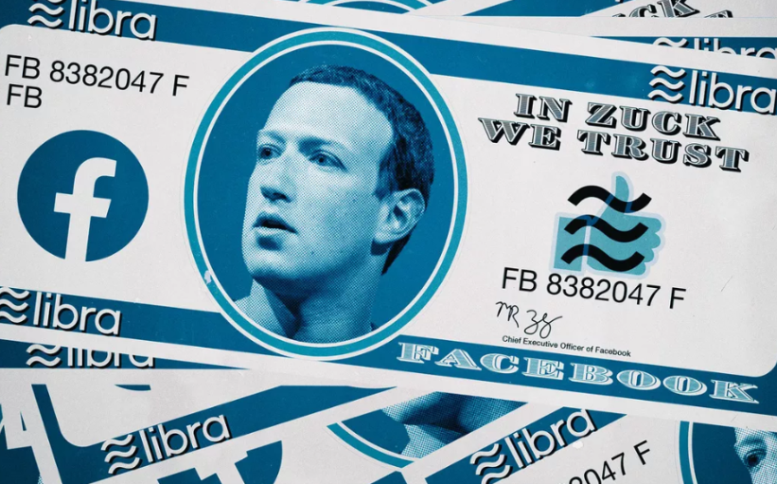
Facebook’s new cryptocurrency.
It’s shady as hell, though. You remember Tyler and Cameron Winklevoss? The twins from whom Mark Zuckerberg ripped the initial idea for Facebook? Yeah, so they have a cryptocurrency exchange called Gemini. As any astrology buff will tell you, both Libra and Gemini are air signs, and Geminis are stereotypically scarier than Libras. Gemini is the sign of twins and is associated with two-faced-ness. Plus, it’s a mutable air sign, which makes it somewhat unstable. Libra, as a cardinal sign, is somewhat more stable. Libra sees both sides; Gemini tries to be both sides

Slide 12
Libra, by contrast, is permissioned, meaning only a few trusted entities can keep track of the ledger. That makes it more like a digital currency rather than a cryptocurrency,
Libra is a stablecoin — kind of! Unfortunately, much like “cryptocurrency,” this is something of a semantic gray area.
Basically, any cryptocurrency pegged to either a fiat currency (say, the US dollar) or some kind of government-backed security (like a bond) counts as a stablecoin. The idea is that there’s more stability — hence the name — and less volatility than in something like bitcoin, which isn’t pegged to anything. Bitcoin is exactly as valuable as people believe bitcoin is, which makes it very, very volatile.

Slide 13
“THE GOAL IS FOR LIBRA TO BE MORE USEFUL THAN ANY NATIONAL CURRENCY, ACCEPTED IN MORE PLACES AND WITH FEWER COMPLICATIONS; PEGGING IT TO A SINGLE NATIONAL CURRENCY WOULD ONLY HOLD IT BACK.”
Unlike most stablecoins, though, Libra isn’t pegged to one specific currency. Libra is pegged to a group of “of low-volatility assets, including bank deposits and government securities” in multiple currencies. While there is a Libra Reserve, Libra doesn’t seem like it’s necessarily pegged to its value. Rather, the reserve functions as a kind of lower bound on Libra’s value.
That means that there’s just one Libra, no matter where you live

Slide 14
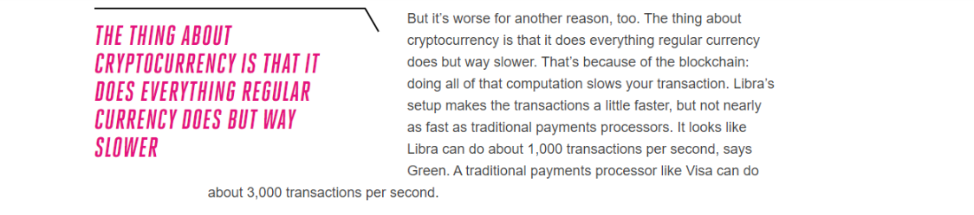

Slide 15
Know Your Customer and Anti-Money Laundering laws,
Since any integration into Facebook Messenger or WhatsApp is under the control of Facebook, Facebook should probably file income tax documents and keep track of the otherwise difficult cost-basis math on behalf of Facebook’s customers, like other investment brokerages do. The IRS needs to remind both Facebook and the public of these implications and requirements. Of course, this would make Libra completely useless in the U.S. by increasing the cost of using it beyond any utility.

Slide 16
Re-Cap Project Kick off Meeting
Blockchain for Social Imapct
Housekeeping
Princeton Blockchain Community
Re-Cap Project Kickoff Meeting
Summer Blockchain Project
Discussion
Moving Forward
Notes:
David

Slide 17

Blockchain and social responsibility
    Philanthropy and remittances (donation traceability, aid transparency, digital currencies in aid and development, governance and accountability)
    Financial empowerment (financial inclusion, microfinance, microinsurance)
    Identity and land rights (refugee assistance, land ownership documentation)
    Governance and democracy (fighting censorship and fake news, voting rights and protections, election integrity)
    Supply chain and environmental protections (sustainable supply chain, fair trade, ethical sourcing, fair labor practices)

Slide 18
Summer Project Goals
following a project from idea to production.
create a working blockchain project
have a positive impact in our area this summer.
Work with a team using the latest collaboration tools
solve a problem.

Slide 19
SOCIAL IMPACT CONTRIBUTION
Checkpoints
Checkpoints are meant to guide you to think through your own solution prototype, stay on track, and ultimately formulate your own Blockchain / White Paper / Projects.
Scorecard / Recap
Each checkpoint is designed to address a particular set of questions corresponding to a section of a tally sheet.
Notes:
scorecard.

Slide 20
Summer Blockchain Project
Housekeeping
Princeton Blockchain Community
Re-Cap Project Kickoff Meeting
Summer Blockchain Project
Discussion
Moving Forward
Notes:
Hyperledger Quilt
Business Blockchain Tool
● Contributed by NTT Data and Ripple
● Java implementation of the Interledger protocol
● Interledger protocol provides:
○ atomic swaps between ledgers (even non-blockchain or distributed ledgers)
○ a single account namespace for accounts within each ledger

Slide 21
Weekly Checkpoints
Week 1: Impact Opportunity
Week 2: Business Model Validation
Week 3: Technical Architecture
Week 4: Impact Measurement
Week 5: Code
Week 6: Final Submissions Due

Slide 22
Week 1: Impact Opportunity
  Select your challenge.
Develop an agile & transparent network for connecting surplus foods & supplies to communities in need.
To create a decentralized system that collect excess food supplies from local resources and distributes these resources to local food insecure individuals.
  Define the scope of problem
For our summer project, we are limiting the POC to a small number of local farmers with excess food supplies (two pick up dates TBD ) to be picked up by transportation volunteers who will transport food supplies to agreed upon drop off point .
  Why is blockchain needed to solve this problem
A supply chain model has been determined to be the best way to initiate, track and deliver excess food supplies. The above model has many unknown individuals who do not need to form a relationship with the parties at the other end of the supply chain.

Slide 23
Week 1: Impact Opportunity
  Why is blockchain needed to solve this problem
A supply chain model has been determined to be the best way to initiate, track and deliver excess food supplies. The above model has many unknown individuals who do not need to form a relationship with the parties at the other end of the supply chain.
  Technical solution rationalization
Blockchain enables a digitized, verifiable, decentralized technology that’s used to capture and verify transactions between mulitple parties in a provable and permanent way.
Due to its decentralized nature, multiple stakeholders use the blockchain to efficiently record, report on and track verified interactions.
This makes it easier to track and manage the sourcing, storage, transfer and distribution of food donations.
To connect donors with receipts
Capture and verify the quantity and handover of food & supplies
Track where food & supplies are located at any time
Understand where food & supplies are sourced from and who the recipients are

Slide 24
Week 1: Impact Opportunity
  What is the size of the market? What demographics will you serve? Which industries will you impact? Any concurrent trends?
For our POC we will limit the size of the volunteer pool and we will determine the best spot to deliver. Current discussion revolves around local food banks, shelters, and R.F Veterans connections. The industry we are attempting to impact is the Local Charity Giving by creating a system where unknown parties can easily on-board and contribute.
  Who are the stakeholders involved? How are they thinking/feeling/acting currently?
Local Farmers with excess food are more than excited to be a part of the project. Transporters might prove a challenge The food insecure people who receive a donation should be handled with privacy and dignity and the system develop should reflect this.
  What are the geopolitical, cultural-social-economic factors that must be taken into consideration? What are some nuances and complexities that must be addressed?
Some factors are SUSTANABILITY, food spoilage , timing of transportation as well as dignified deliver system.
  Potential for food spoilage.
  Product liability associated with being a supplier of food.
  Supply pipeline to get foods from Donor to Consumer must be efficient enough to avoid complexities 1 and 2.

Slide 25
Initial project focus of “Donor Goods” will be food
Future Goods can include: Clothing, Blankets, Toiletry Items, Paper Products
Impact Opportunity
Donors
Farmers
Restaurants
Wholesalers
Individuals
Volunteers / Drivers
Pickup / Deliver
Local Transporters
Uber model-??
Recipients
Food Banks
Houses of Worship
Social Services Offices
Individuals (off the grid)

Slide 26
TRANSACTIONS IN OUR WORKFLOW:
*help to identify the implicit transactions and features to be supported by this blockchain application solution via business network APIs.
Identify an initial list of Consumers who will require a daily food supply. List will expand with additional Consumers.
Identify the location of the Consumers. Locations will expand with additional locations serviced.
Identify an initial list of Donors who will donate food daily. List will expand with additional Donors.
Identify the location of the Donors. Locations will expand with additional Donors.
Identify an initial list of Transporters - an initial list which will expand as additional Donors volunteer their services.
Identify the location of Transporters. Locations will expand with additional Donors.
Identify attributes of Consumers, Donors, Transporters that will help with identification and communication to ensure supply pipeline efficiency.
Donor provides notification that they have a food supply ready for pickup by Transporters for delivery to Consumers.
The Donor indicates the available quantity of food they are supplying.
Transporter monitors the blockchain to determine when food is available for pickup.
Transporter matches the Donor supply with specific Consumers (whose daily needs have not been filled) to whom they can deliver this food supply.
Transporter volunteers to pickup the available supplies and deliver to specific Consumers (criteria may be location proximity).
Transporter picks up the available food supply from the Donor.
Transporter delivers the available food supply to the Consumers.
Transporter records that they have provided this service.
The Donor's quantity of food supply available for transport is decremented.
The Consumer is checked-off as having had their daily needs filled.
If additional quantities of food is still available from this Donor, the Donor notification remains active else it is closed.
Application metrics are updated (e.g., quantify the amount of food delivered, the cost of delivered food, etc.) for analytics.
At the end of day, all pending transactions are closed to reset for a new day of deliveries.

Slide 27
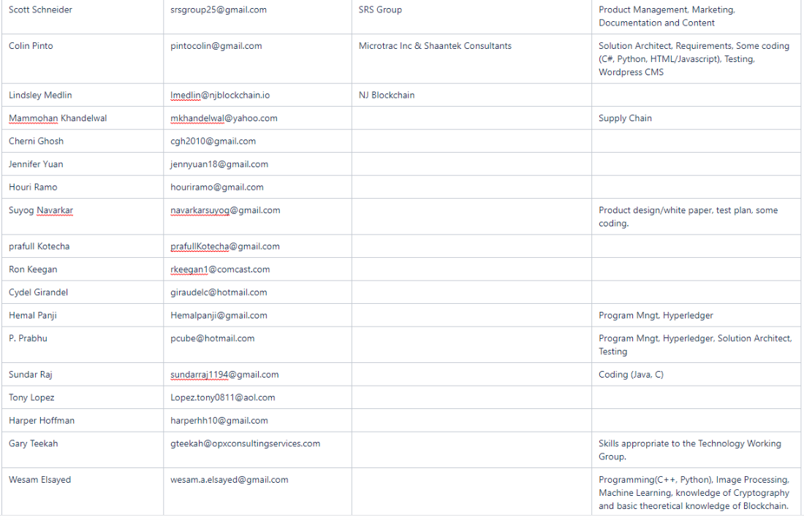
Impact Opportunity : Team Members
https://wiki.hyperledger.org/display/LMDWG/SUMMER+PROJECT+IDEAS
Hyperledger Wiki / LMDWG / Resource Page/ Meetups / Summer Project
Notes:
Added a column to keep track of tasks

Slide 28
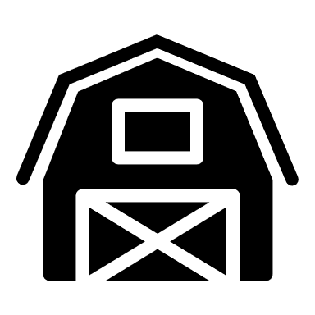


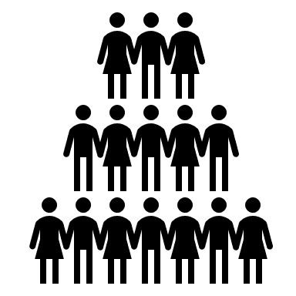

Impact Opportunity System Design
Initiate P/U
BD2RS
Donation Tag
Notification for P/U
Donor
BD2RS
Recipient Request
Volunteer
Recipient Tag
Delivery Information

Slide 29
Project Scope
        Zeroing-in on achievable scope, consider
          Donors: List suggested Donors (e.g., Farmers, Restaurants, Individuals, etc.). Rank Donors in order of greatest chance of collaboration for project success. Agree on final target Donor.
          Consumers: List suggested Consumers (e.g., Veterans, Families, etc.). Rank Consumers in order of greatest chance of collaboration for project success. Agree on final target Consumer.
          Location: Decide on a target location guided by decision on Donor and Consumer.
          Organizations that may be able to assist with identification of Consumer and Location: Churches, Food Banks, Social Services. Target consumers may congregate in locations where social services providers are located.
          Transporters: Same comments as above.

Slide 30
Impact Opportunity
SUGGESTED IMMEDIATE NEXT-STEPS FOR NEXT MEETUP
  Lock-down scope.
  Agree on Donor, Transporter, Consumer, assets to be transported, and business rules governing interactions amongst these entities.
  Fill-in the the above Week-1 Checkpoint - Impact Opportunity proposal - move closer to full completion. Develop Whitepaper
  Establish Teams - much to do here given that the solution is a working prototype. See Development Team structure & responsibilities above. Need to start now.
  Assign members to agreed teams (see Define Teams - Structure above) and appoint group leaders. They can then help with next-steps.
  Agree on process workflow, participants in business use case, runtime transaction processing flow

Slide 31
Impact Opportunity Team Description
Project Idea Team. Works on developing and refining the project idea, clarifying scope, funding, project financials, exploring which activities are worth pursuing in the interest of project success, Definition of Done, etc.
Project Management/Governance Team: Tasks, deadlines, timeline management, risks, assumptions, issues, dependencies, next-steps, etc.
Development Team: Confirm permissioned v. permissionless blockchain. Determine whether Hyperleger Fabric solution. Setup development environment, design network, bootstrap channel, install tools & utilities, ledger setup, client application development, chaincode development, etc.
Communication/Documentation Team: Project documentation and internal/external communications. Wiki/Spaces structure, documentation guidance, etc.
Requirements & Testing Team: Work with Project Idea Team & Documentation Team to validate requirements/user stories. Test and certify the solution.
Notes:
Need Further clarification before next working Group

Slide 32
Impact Opportunity
Working Groups –Sub categories
Business Development
Marketing
Technology
Define
Connect
Map
Develop Prototype
Decide/develop Blockchain
Interface design
Web Site Mgt
Wiki Development
Meeting Prep

Slide 33
Impact Opportunity
Donors
Volunteers
Recipients
Farmers, Restaurants, Individuals, etc.
Wants
Needs
Challenges
Transporters, Pick/up Facility / Location
Wants
Needs
Challenges
Veterans, Food Banks, Families, etc
Wants
Needs
Challenges

Slide 34
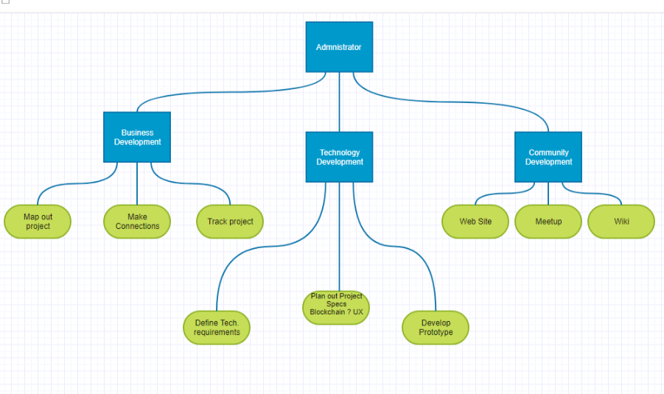

Slide 35
Business Development
Map Out Project (timelines)
Make Connections with participants
Track project

Slide 36
Technology Development
Define Technology requiremnents
Plan out project Specifications
Develop prototype

Slide 37
Hyperledger Summer Project
Sawtooth Set up and requirements
Presented by: Prabhu (pcube@hotmail.com)

Slide 38
Week 2: Business Model Validation (questions)
Who are your clients/users? Sketch out the persona of your user.
What are their pain points? How does your solution solve them? Indicate your unique value proposition.
Does your solution depend on context? Can it be scaled?
What is your go-to-market strategy? Who can you partner with?
How will your product generate revenue / benefit ? Will it be financially sustainable in the long-term?
What are the implicit and explicit assumptions being made in your business and financial model (user-profiles, partnerships, costs, etc.)? How do you plan on validating them?
What is the vision for your product? Can it significantly change the current state?

Slide 39
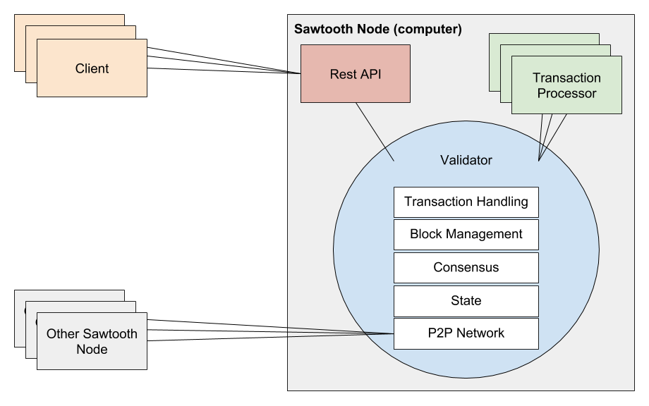
Overview of Sawtooth Architecture
Set up needs:
Clients – these are the users of the system (Mobile app, desktop app etc.)
Validators – these are nodes that are authorized to validate and batch transactions into Sawtooth (mostly work on PoET consensus algorithm) – each Organization runs at least one and receives blocks that are broadcasted
Transaction processor – Server side business logic that operates on assets within the network (Sawtooth separates app layer from consensus and core framework layer) – each node needs one
Node – A peer on the Peer-to-peer Sawtooth network

Slide 40
Set up Sawtooth
Prerequisites:
  Needs set up of cURL, Git, Docker and Docker Compose on your mac (see link for details of set up)
Steps: (For Mac – Terminal)
  Download sawtooth-default.yaml (See Github repository link at the end of this document)
  Start and run Docker (See Docker download instructions separately)
  Run the command below from Terminal (from the location of the .yaml file)
    $ docker-compose -f sawtooth-default.yaml up
    Will download Docker images for Sawtooth, may take a few minutes
  Next log in to the container
      $ docker exec -it sawtooth-shell-default bash
      If successful, you should see something like root@75b380886502:/# (this is the client container)
  Test to see if Validator is up and running and accessible from Client container
    $ curl http://rest-api:8008/blocks
    You should see json object response with “data”, array of batches, header, etc
  Test to confirm connectivity from host computer (run this in a separate terminal window)
    $ curl http://localhost:8008/blocks
    You should see the same json object response with “data”, array of batches, etc.
You will now need to create the Validators, Transaction Processors, etc. - A sample repository is available here:
  $ git clone https://github.com/hyperledger/education.git
  $ cd education/LFS171x/sawtooth-material/sawtooth-tuna
Next step is to set up and run State entries for “Assets” and “Transfers” (More on this later – interested folks can try this independently

Slide 41
Requirements and Limitations - Issues to deal with
Should not have anything else running on port 8008 or port 4004 (I am trying to trouble shoot the port 4004 not accessible docker error)
The instance that is set up needs to run in the terminal window (you use another terminal window to run any commands). To bring this down you need to:
  First press Ctrl+c
  Then run: $ docker-compose -f sawtooth-default.yaml down
  This is one limitation of using this Dev type setup. You will need a machine that runs docker compose to keep the environment live; as any work will be lost once you exit the container (unless you are mounting a host directory into the container – not sure how to do this)
The application and Business logic still needs to be brainstormed and written separately

Slide 42
Other Options / Evaluations
AWS Blockchain is an option – but it appears this is not free for the first 12 months as advertised (need to understand the commercial model, there is a per hour and per gig price besides the 12 month free trial)
Multiple laptops / macs set up in a lab environment
Mounting a host directory into the container

Slide 43
Few useful links
An Introduction to Hyperledger Blockchain Technologies Provided by The Linux Foundation (LinuxFoundationX)
  https://www.edx.org/course/blockchain-for-business-an-introduction-to-hyperledger-technologies
  The above is a free course and you only need to pay if you want to get a verified certificate
Github repository for Sawtooth set up files:
  https://github.com/Git-Prabhu/Hyperledger.git
Docker container download and set up:
  https://docs.docker.com/docker-for-mac/install/

Slide 44
Community Development
Develop Web Site
Organize meetups ( invite and presentations)
Update Wiki Page

Slide 45
Community Development
Wiki Page
  How to use
Web Page
Meetups

Slide 46
Discussion
Housekeeping
Princeton Blockchain Community
Blockchain and Social Impact Projects
Summer Blockchain Project
Discussion
Moving Forward
Notes:
David

Slide 47
Moving Forward
Housekeeping
Princeton Blockchain Community
Social Impact Projects
Summer Blockchain Project
Discussion
Moving Forward
Notes:
David

Slide 49
FAQs
1. What is blockchain?
○ For the purposes of this Challenge, blockchain is any type of digital, distributed
ledger, including both public and private, or permissioned and permissionless
systems. For more information on how to get started with blockchain, check out
our list of educational resources .
2. How do I enter? What constitutes a complete submission?
○ All Applicants must complete the Submission Form at www.bigapps.nyc;
completion of the Submission Form will constitute an official entry into the
challenge. All submissions must be completed by July 31st at 11:59PM ET.
3. Am I eligible to compete?
○ BigApps is open to legal residents, ages 13 or older, of the 50 United States (plus
the District of Columbia). All corporations or other organizations participating
must be legally domiciled in the United States or incorporated in the United
States at the time of entry.
4. We are an organization. Can we enter?
○ Yes, organizations that have not raised more than $500,000 in funding in the last
12 months for this particular Proposal may enter and compete for cash and
in-kind prizes as well as post-challenge support and implementation resources. If
this particular proposal is publicly available, it must not have been in the market
for more than 12 months prior to the time of submission to the Challenge.

Slide 50
5. I’m not a coder. Can I still participate?
○ BigApps is open to everyone, including government employees, engineers,
designers, marketers, content creators, and anyone else interested in improving
New York City.
6. Can I enter the same Proposal in multiple Challenge areas?
○ No. Each Proposal shall only be submitted to one challenge.
7. Is there a limit to how many projects I can submit or participate in?
○ You may submit up to 5 entries. An individual may also participate on behalf of
more than one team, corporation, or nonprofit organization.
8. Is there a limit to how many people I can have on my team?
○ There is no limit to how many people can participate on a single team. If a team
of individuals, or an organization is selected as a prize winner, the Administrator
will issue prize money to the primary team member listed on the submission
form. It will be up to the winning team or organization to allocate the prize money,
if they deem it appropriate.

Slide 51
9. Do I retain intellectual property ownership?
○ Yes, all entrants, regardless of winner status, will retain intellectual property
ownership of their submissions. However, as a condition of entering the BigApps
Challenge, City, Sponsor and Administrator will maintain a royalty-free license to:
a) post the Submissions on BigApps.NYC; b) make the Proposals available for
the course of the Challenge and 12 months after the conclusion of the Challenge;
and c) use the Proposals for noncommercial purposes for a period of 12 months
after the conclusion of the Challenge Submission Period. The BigApps Sponsors
and Administrator will have the right to display and promote your submission to
the public on the NYC BigApps website and partner sites. They will also be
allowed to publicize your name in connection with the submission and the NYC
BigApps Challenge.
10. How else can I get involved with the Challenge?
○ There are many ways to get involved with BigApps besides submitting a
Proposal. You can sponsor the Challenge or Demo Day; contribute data & other
resources; serve as a mentor or volunteer; and help promote BigApps. Please
contact us at info@nycbigapps.com for more information.
11. I have more questions. How do I contact you?
○ Please email your questions to info@nycbigapps.com.

Slide 52
PRINCETON BLOCKCHAINFOR SOCIAL IMPACT
June12 , 2019
Schedule: Tiger Labs
Checkpoint 2 Business Model Validation
^{th}
Presentation : July 2nd
Next Working Group July 10th
Five checkpoints to be presented at meetups:
Impact Opportunity
Business Model Validation
Technical Architecture
Impact Measurement Prototype
Delivery.

Slide 53
THANK YOU
Notes:
David

Slide 54
Impact Opportunity
NJ Food Bank Organizations – partial list
Community Foodbank of NJ https://www.cfbnj.org/ 908-355-3663 Hillside
609-383-8843 Egg Harbor Township
Feeding America https://www.feedingamerica.org/find-your-local-foodbank/community-foodbank-of-new-jersey
Foodbank of South Jersey https://foodbanksj.org/ 856-662-4884, Pennsauken
Food Pantries.org https://www.foodpantries.org/st/new_jersey
Fulfill 732-918-5600 Neptune City
Need Help Paying Bills https://www.needhelppayingbills.com/html/new_jersey_food_banks.html
NJ Department of Agriculture https://www.nj.gov/agriculture/news/press/2018/approved/press181113.html
Facebook page https://www.facebook.com/communityfoodbankofnj/

Slide 55
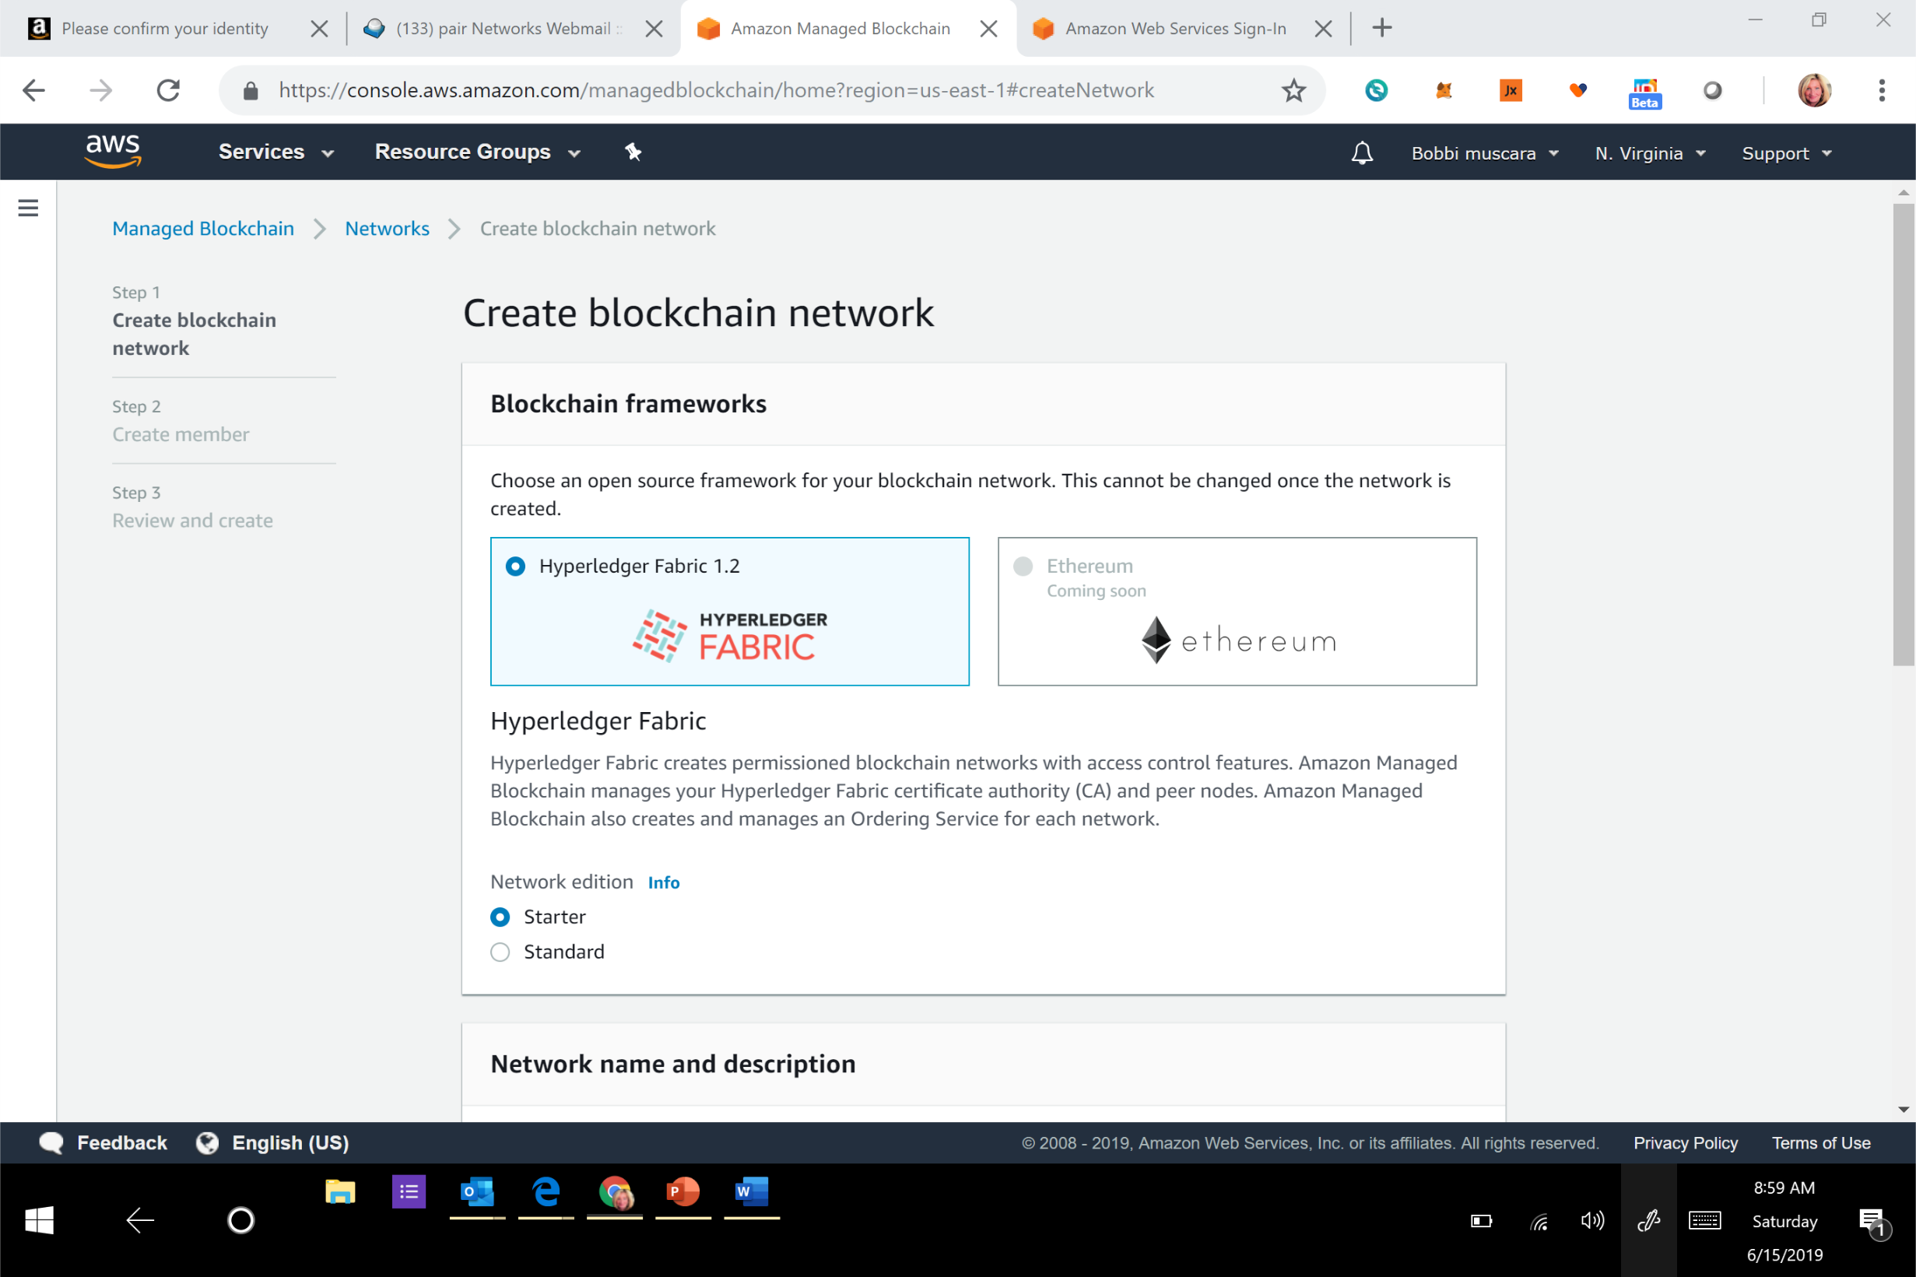
AWS

Slide 56
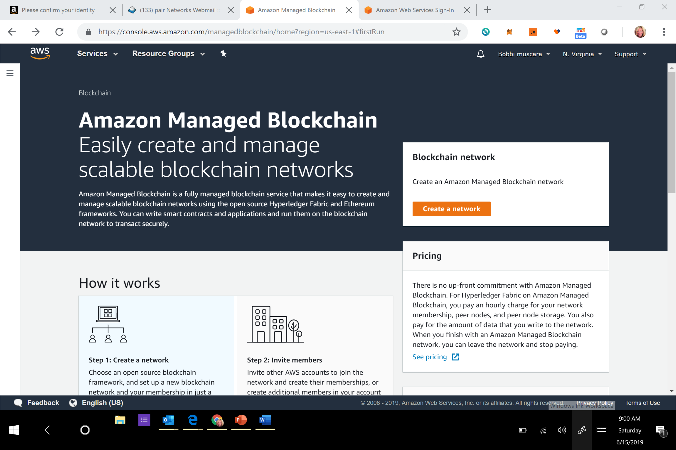

Slide 57
