Slide 1
Welcome to
Blockchain Summer Project hosted by:
Hyperledger Princeton * Blockchain Princeton *
Blockchain Fundamentals * Ledger Academy
June 12, 2019

Slide 2
Blockchain Summer project

Slide 3
AGENDA
Housekeeping
Princeton Blockchain Community
Re-Cap Project Kickoff Meeting
Summer Blockchain Project
Discussion
Moving Forward
Notes:
David

Slide 4
Housekeeping
Housekeeping
Princeton Blockchain Community
Re-Cap Project Kickoff Meeting
Summer Blockchain Project
Discussion
Moving Forward
Notes:
David

Slide 5

HOUSEKEEPING
Tiger Labs:
Co-working Space in Princeton New Jersey
Current Home to Ledger Academy
Bobbi Muscara, Chair of Hyperledger Learning Materials Working Group.
Location for Princeton Meetups
Incubator space for start ups.

Slide 6
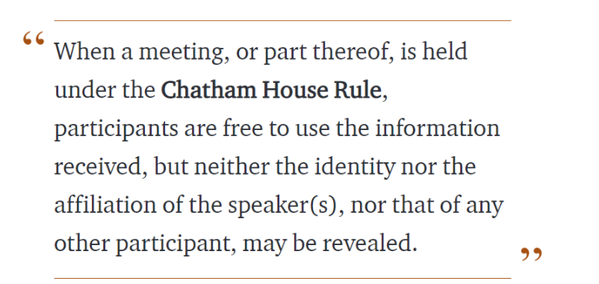
Chatham House Rule
Antitrust Policy Antitrust Policy Notice
Meetings involve participation by industry competitors, and it is the intention of the Ledger Academy to conduct all of its activities in accordance with applicable antitrust and competition laws. It is therefore extremely important that attendees adhere to meeting agendas, and be aware of, and not participate in, any activities that are prohibited under applicable US state, federal or foreign antitrust and competition laws. If you have questions about these matters, please contact your company counsel, or if you are a member of the Linux Foundation, feel free to contact Andrew Updegrove of the firm of Gesmer Updegrove LLP, which provides legal counsel to the Linux Foundation.

Slide 7
Princeton Blockchain Community
Housekeeping
Princeton Blockchain Community
Re-Cap Project Kickoff Meeting
Summer Blockchain Project
Discussion
Moving Forward
Notes:
David

Slide 8
meetups
HYPERLEDGER PRINCETON
  Hosted by Linux Foundation, is comprised of people interested in learning and developing projects using the Hyperledger solutions.
PRINCETON BLOCKCHAIN AND AI
  Princeton Blockchain and AI is focused on COMMUNITY. Discussions are developed by meetup participants.
BLOCKCHAIN FUNDEMENTALS / Ledger Academy
  Meetups focused on Education.

Slide 9
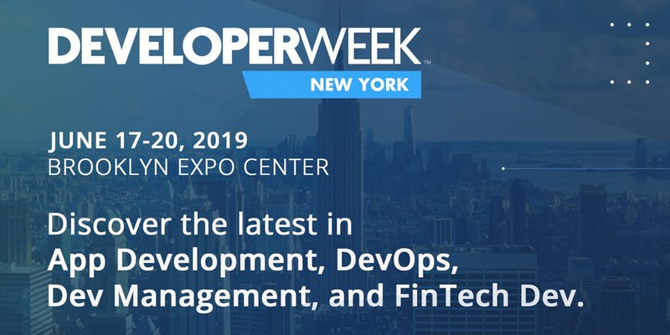
Princeton Blockchain and AI
25 Free OPEN Passes to DeveloperWeek New York, The East Coast's largest developer conference & expo with tracks covering Containers, Kubernetes, Microservices, AI dev, JavaScript, Blockchain, and more. Speakers include leaders from Google, PayPal, Birchbox, Uber, Foursquare, Meetup, Intuit, Vanguard Group and 100+ more.
Register by 11:59 PM on June 14 to get your free OPEN Pass or to SAVE $150 on your PRO Pass.
Call for Speakers for the September Meetup

Slide 10
Hyperledger Meetup Group
New Graphic to Depict “Greenhouse”

Slide 11
The hyperledger Greenhouse Classifications
Distributed Ledgers:
- Burrow
- Fabric
- Iroha
- Sawtooth
Libraries:
- Ursa
- Transact
Specialty:
- Aries - wallet/edge
- Grid - supply chain
- Indy - identity
- Quilt - interop
- Composer
Tools:
- Caliper
- Cello
- Explorer

Slide 12
Ledger Academy
Hyperledger Learning Material Working Group
https://wiki.hyperledger.org/display/LMDWG/Learning+Materials+Development+Working+Group
Planned Work Products
Community Building: increase membership, New Member Onboarding
EdX Updates: assist in proofreading the EDX Basic course and help organize the chapters for the Technical course.
GitHub support: Create a system to support the projects Github learning materials, a system is needed for pull requests.
Developing Standard / Best Practices Badges: So all Learning Materials produced represent the appropriate Hyperledger message.
Organizing current projects documentation into the Learning Materials Resource Library and give guidance to projects towards earning Best Practice Badge
Key Terminology section development
Summer Project - Document the Blockchain Summer Project Meetup in Princeton for other meetups to follow.
Use Cases: Develop Table of Content for indexing, Learning Material working group will collect Hyperledger use cases and organize them for easy access.
Create Survey : Discover why people became inactive, suggestions on time change, format change, leadership change to encourage participation.

Slide 13
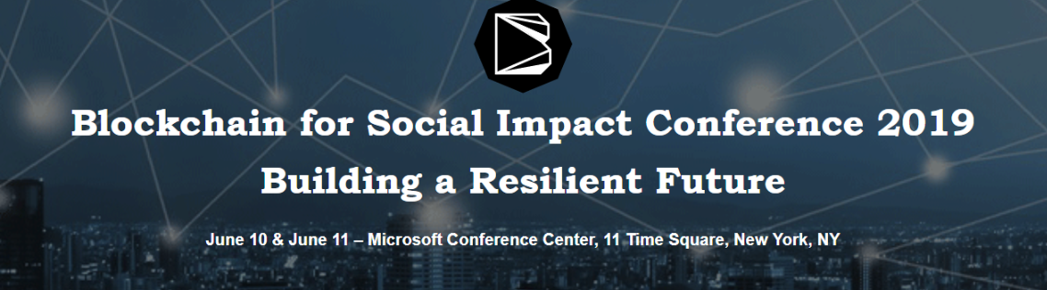
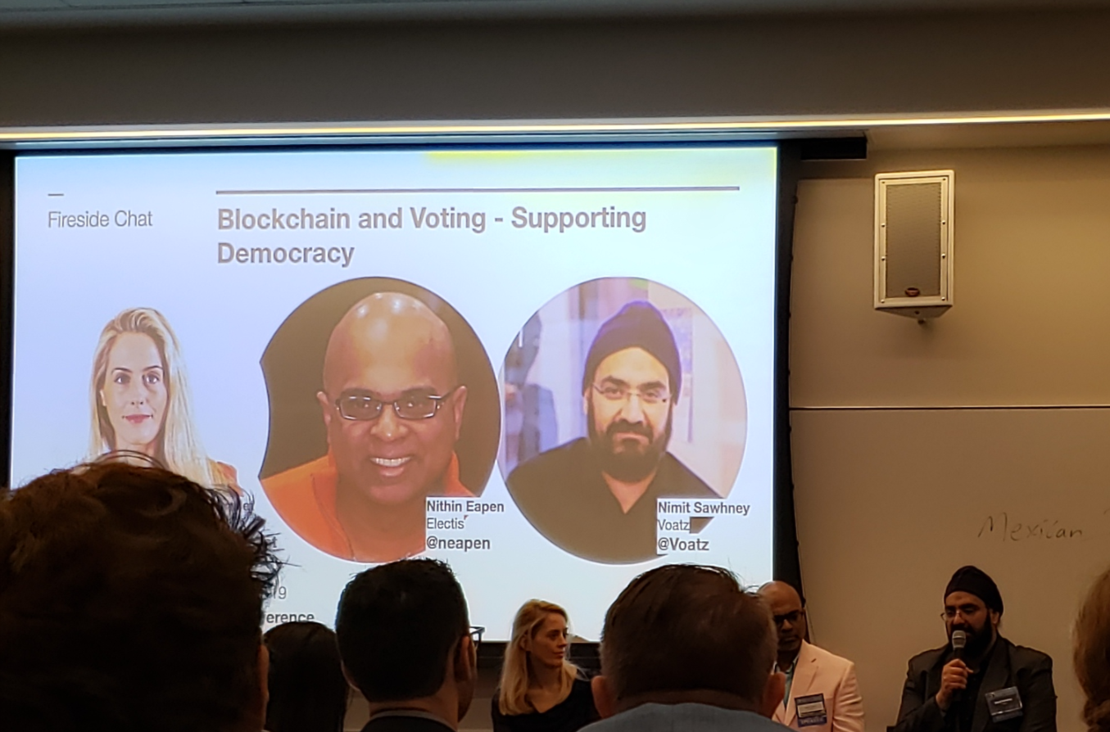
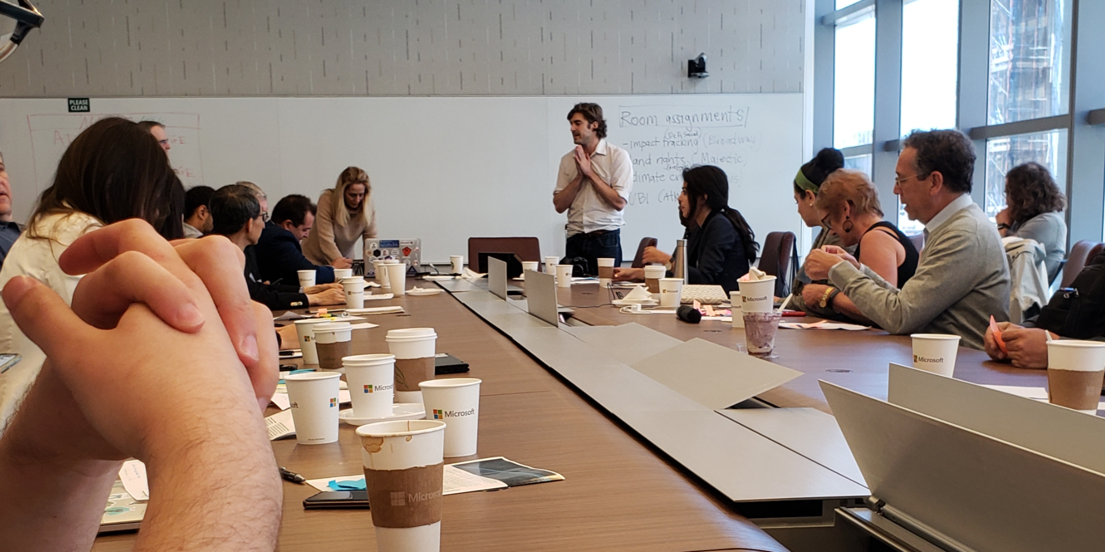
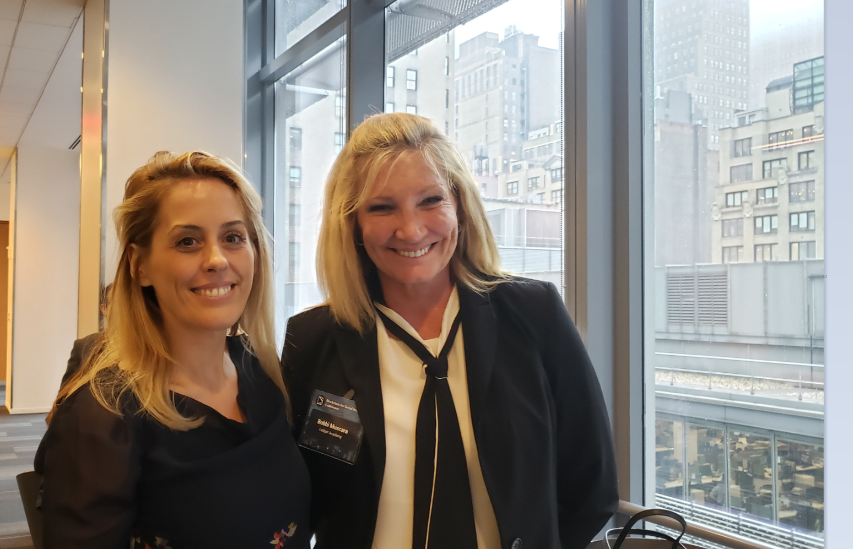

Slide 14
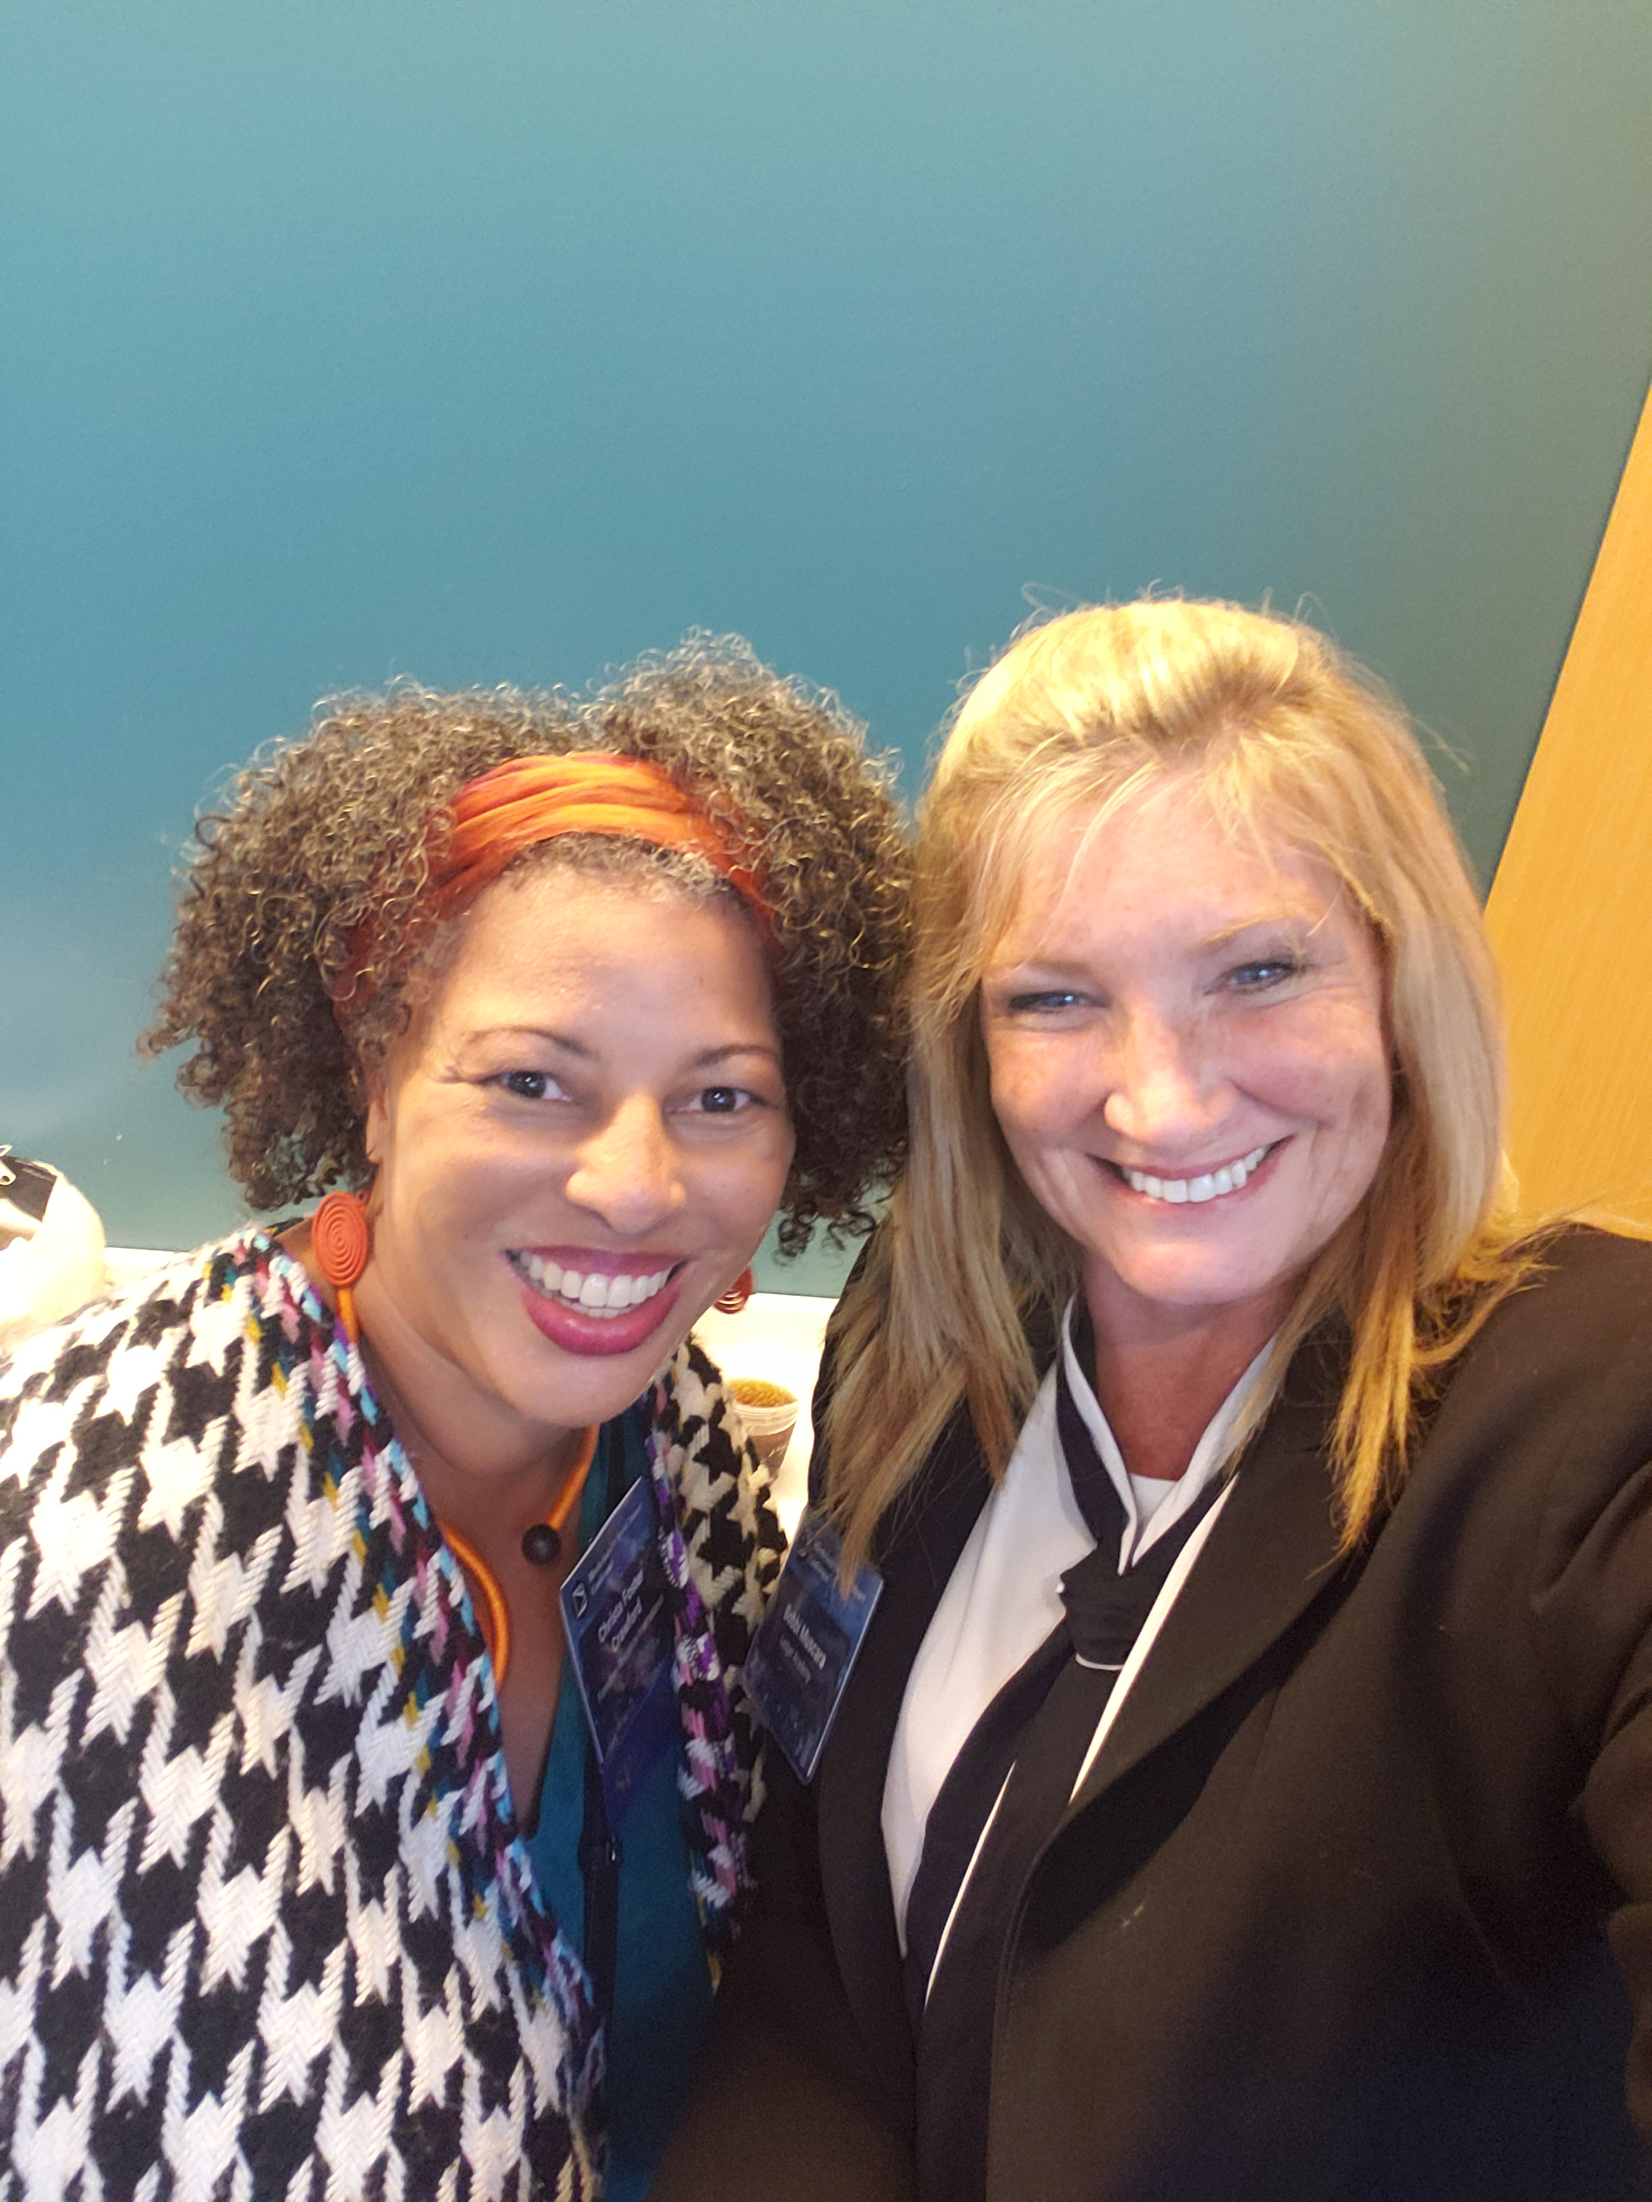
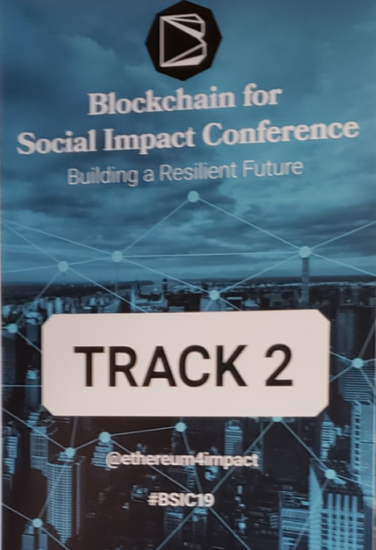
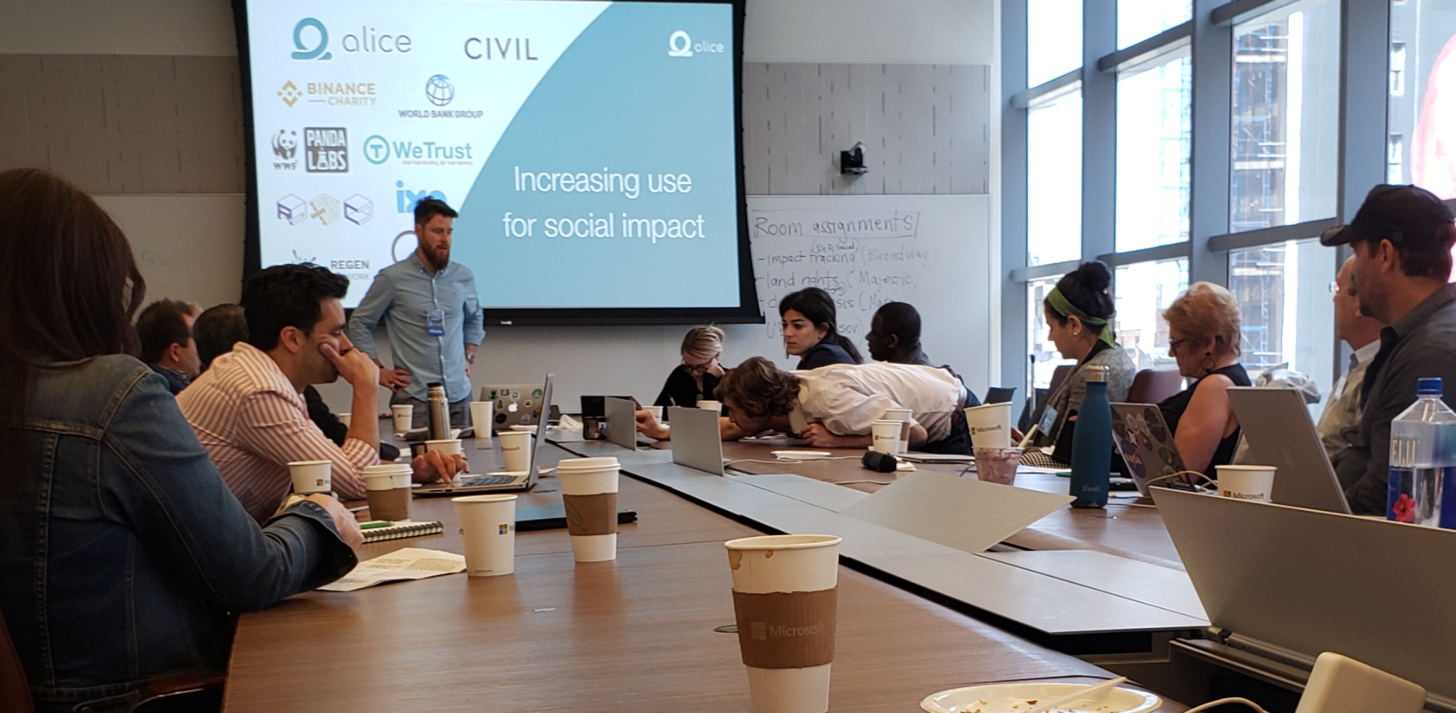
Blockchain for Social Impact Conference
1. Defined a Social Problem / Aim
  Describe 2 Needs
  Describe 2 Challenges
Create Affinity Groups
Create a two Step Action Plan
Decentralized Social Finance
Land Rights
Climate Crisis
Universal Basic Income

Slide 15
Re-Cap Project Kick off Meeting
Blockchain for Social Imapct
Housekeeping
Princeton Blockchain Community
Re-Cap Project Kickoff Meeting
Summer Blockchain Project
Discussion
Moving Forward
Notes:
David

Slide 16

Blockchain and social responsibility
    Philanthropy and remittances (donation traceability, aid transparency, digital currencies in aid and development, governance and accountability)
    Financial empowerment (financial inclusion, microfinance, microinsurance)
    Identity and land rights (refugee assistance, land ownership documentation)
    Governance and democracy (fighting censorship and fake news, voting rights and protections, election integrity)
    Supply chain and environmental protections (sustainable supply chain, fair trade, ethical sourcing, fair labor practices)

Slide 17
Summer Project Goals
following a project from idea to production.
create a working blockchain project
have a positive impact in our area this summer.
Work with a team using the latest collaboration tools
solve a problem.

Slide 18
SOCIAL IMPACT CONTRIBUTION
Checkpoints
Checkpoints are meant to guide you to think through your own solution prototype, stay on track, and ultimately formulate your own Blockchain / White Paper / Projects.
Scorecard / Recap
Each checkpoint is designed to address a particular set of questions corresponding to a section of a tally sheet.
Notes:
scorecard.

Slide 19
Summer Blockchain Project
Housekeeping
Princeton Blockchain Community
Re-Cap Project Kickoff Meeting
Summer Blockchain Project
Discussion
Moving Forward
Notes:
Hyperledger Quilt
Business Blockchain Tool
● Contributed by NTT Data and Ripple
● Java implementation of the Interledger protocol
● Interledger protocol provides:
○ atomic swaps between ledgers (even non-blockchain or distributed ledgers)
○ a single account namespace for accounts within each ledger

Slide 20
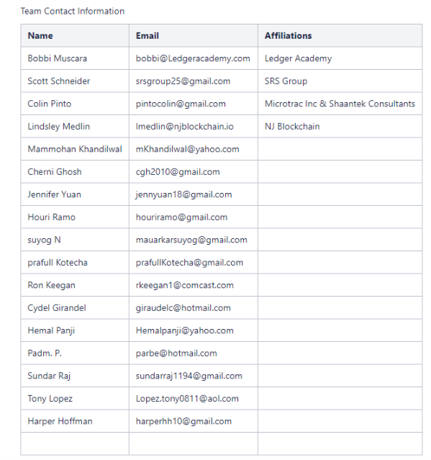
Summer Project Work Space
https://wiki.hyperledger.org/display/LMDWG/SUMMER+PROJECT+IDEAS
Hyperledger Wiki / LMDWG / Resource Page/ Meetups / Summer Project

Slide 21
Introduction
Rooster Featherstone United States Veterans and Local Farmers
6/5 Spoke with R.F. over the phone.
Pick /up : He supplies produce from farm, local farmers have expressed an interest in supporting his effort. He feels they would be open to an app on their phone that lets the system know they have a pick up. Currently R.F picks up produce in his truck.
Up to date the produce has not been in sufficient amount that his truck cant handle it.
Delivery: He has two location for Drop off:
Location One - isn't feasible for our study, the individuals do not have cell phone and distribution can be sketchy at best. The individuals are spread out through affluent Hunterdon and Mercer county with no system to handle the homeless, not we organized
Location Two - Philadelphia. Can establish drop off with facilities and individual who most likely will be carrying cell phone. City has more organized homeless.
R.F. agreed to join by phone at our next meeting.
6/12
R.F. agreed to a phone call tonight after 8pm.

Slide 22
Colin Pinto
"Colin Pinto
pintocolin@gmail.com

Slide 23
Princeton Blockchain & AI Summer Social Impact project
“Seamlessly connecting donors to recipients”

Slide 24

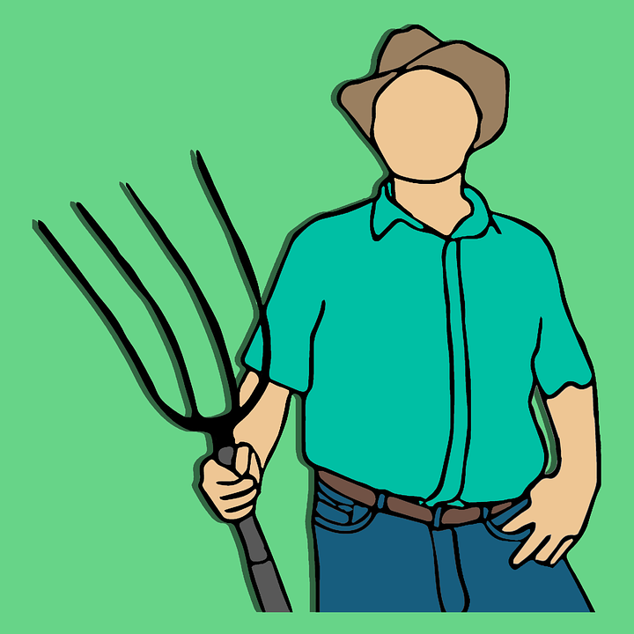

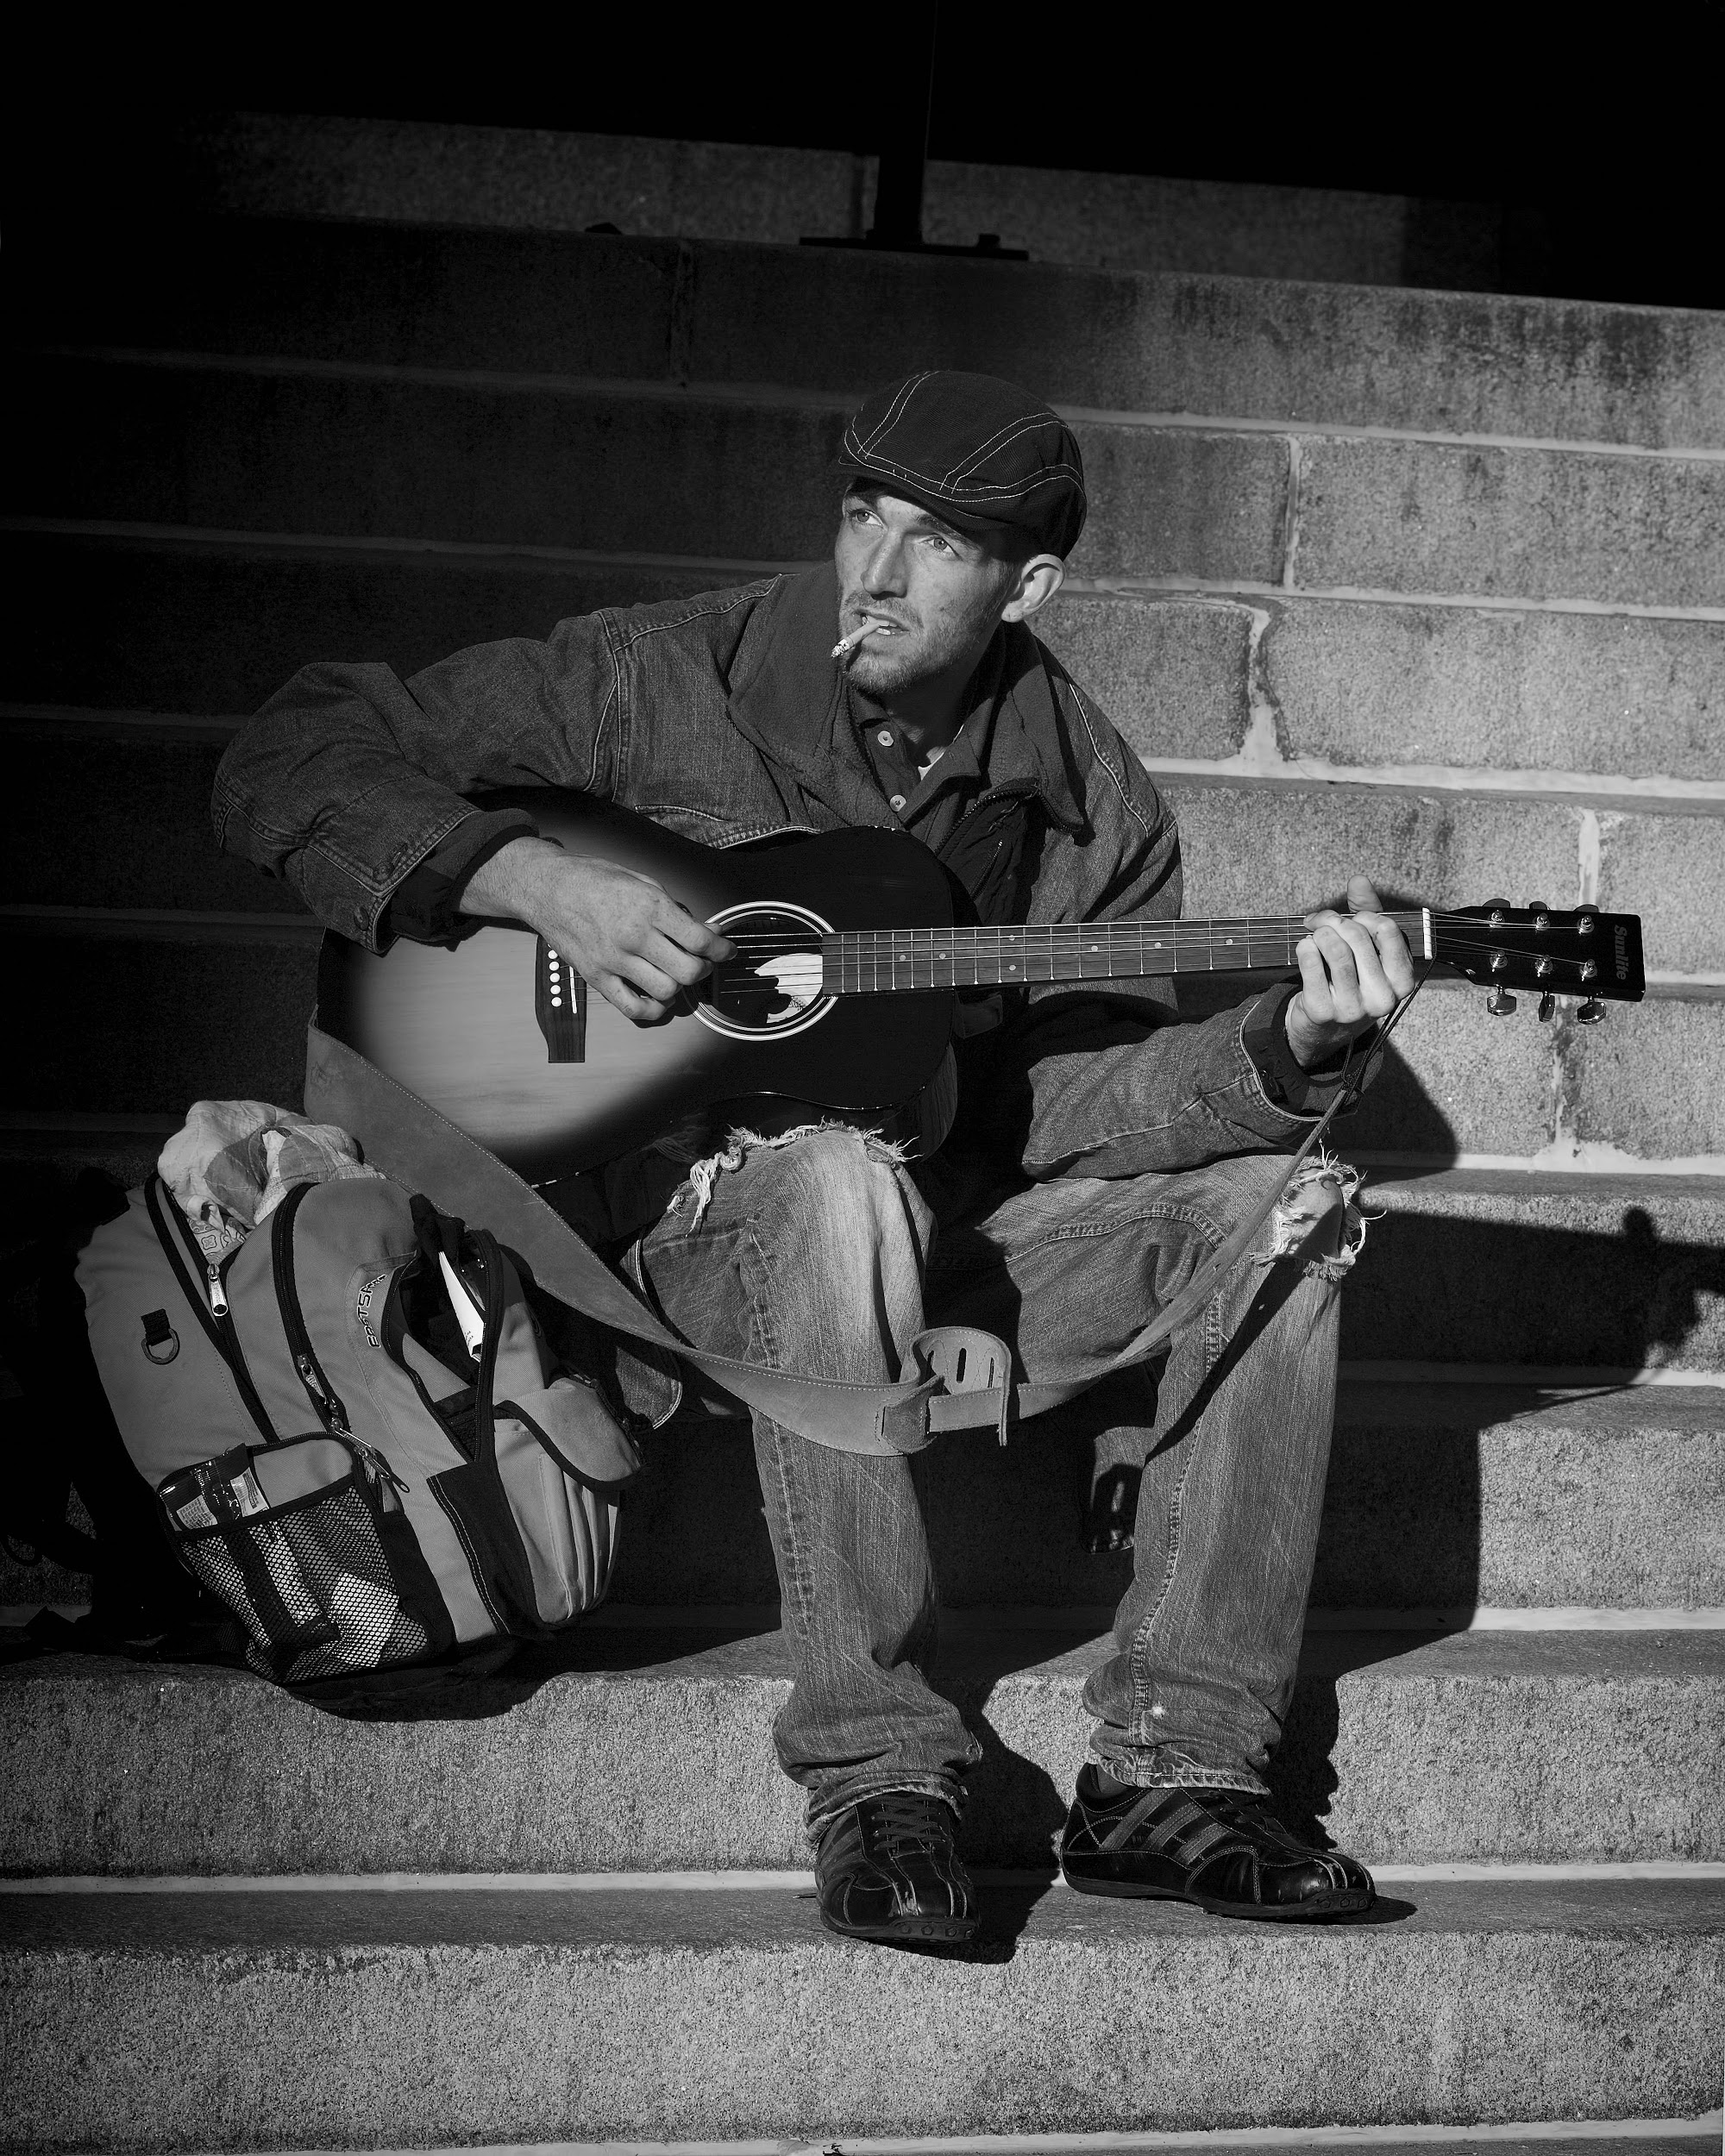
Volunteers
Doner
Doner
Princeton Blockchain & AI Summer Social Impact project
Project Deliverable
Recipients
Recipients
Volunteers
Volunteers
Context Diagram
Doner

Slide 25
Project Statement & attributes (- project pillars)
Develop an agile & transparent network for connecting surplus foods & supplies to communities in need.
Agility:
An agile supply chain for humanitarian aid has to be flexible & dynamic.
Observations: – Humanitarian supply chains have similarities with business supply chains, but there are significant differences. Many humanitarian distribution systems have a short and unstable existence with an inadequate link between donors & consumers.
Potential Impact: Efficient utilization of limited donated goods.
Transparency:
Anyone with access to the network can view a history of transactions in real time. Potential impact: The donnation trail can be tracked and monitored more accurately. Donors can in near real-time see the impact their donations are having

Slide 26

Social Impact
Donors are becoming more results- and impact-focused, and trust in the recipient organization is crucial to their decision-making.
A study by Stanford University
This transparency goal will spur new donors which will result in a larger impact.

Slide 27
Why is blockchain needed to solve this problem?
Technical solution rationalization.
Blockchain enables a digitized, verifiable, decentralized technology that’s used to capture and verify transactions between mulitple parties in a provable and permanent way. Due to its decentralized nature, multiple stakeholders use the blockchain to efficiently record, report on and track verified interactions. This makes it easier to track and manage the sourcing, storage, transfer and distribution of food donations.
How Blockchain will benefit this Social Impact project.
Capture and verify the quantity and handover of food & supplies
Track where food & supplies are located at any time
Understand where food & supplies are sourced from and who the recipients are

Slide 28
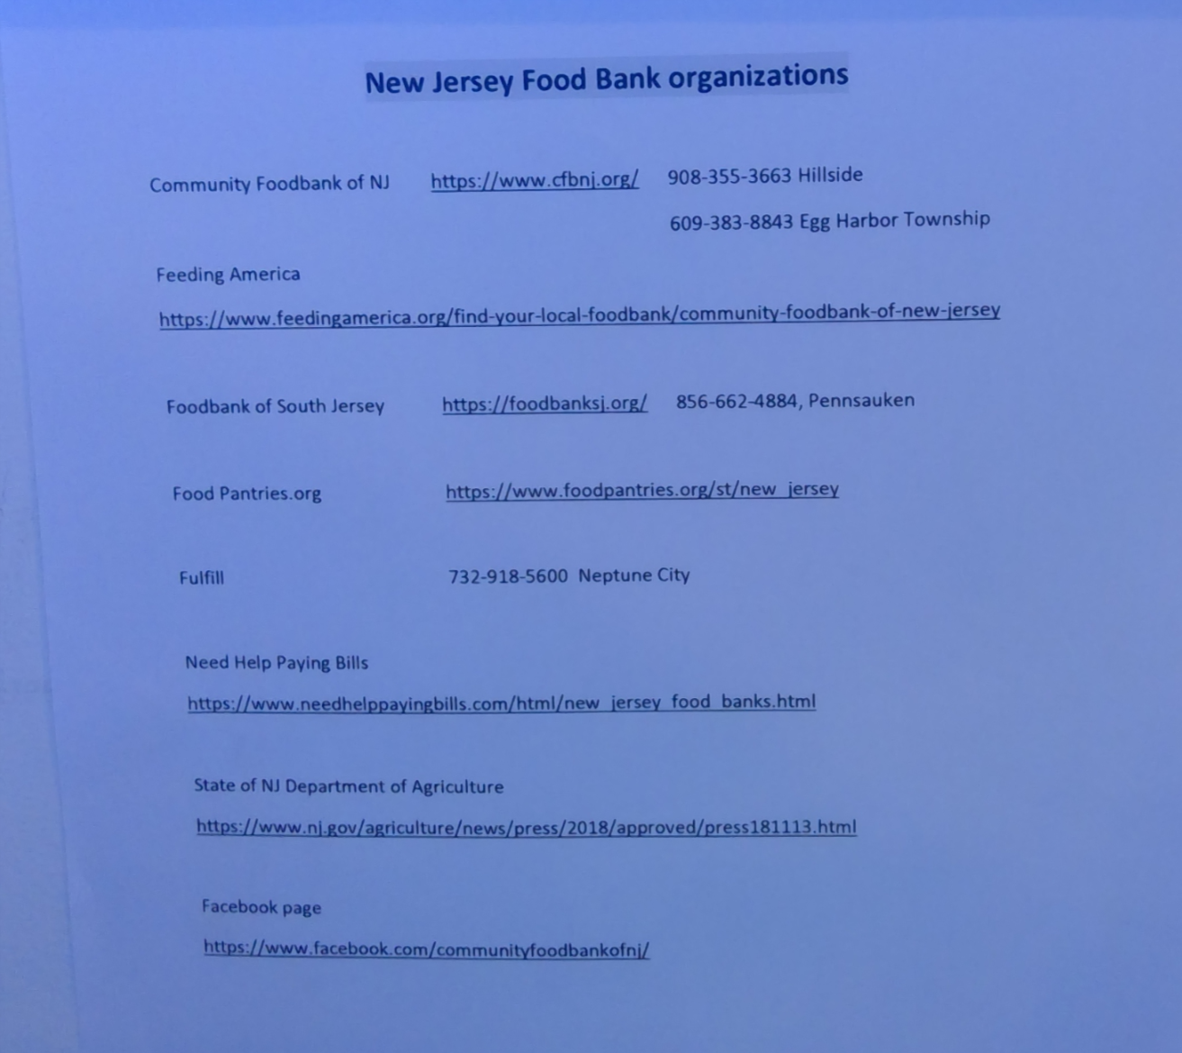
Scott Schneider
- Product Management
- Marketing
Local Food Banks

Slide 29
Project Definition
Idea:
  Supply Chain Blockchain that facilitates the transparent transfer of excess food stocks to food insecure individuals.
  Alternate Idea Discussions
www.slido.com

Slide 30
Checkpoint one
Week 1: Getting Started
  Define Project and team members.
  Select your challenge requirements.
  Define the scope of problem you are addressing.
  Why is blockchain needed to solve this problem?
  What is the size of the market? What demographics will you serve? Which industries will you impact? Any concurrent trends?
  What are some current solutions to the problem you identified? Do they work effectively?
  Who are the stakeholders involved? How are they thinking/feeling/acting currently?
  What are the geopolitical, cultural-social-economic factors that must be taken into consideration? What are some nuances and complexities that must be addressed?
End of Week Deliverable Presentation June18th

Slide 31
Discussion
Housekeeping
Princeton Blockchain Community
Blockchain and Social Impact Projects
Summer Blockchain Project
Discussion
Moving Forward
Notes:
David

Slide 32
Defining The Situation Impact and opportunity
Week 1: Impact Opportunity
  Select your challenge.
  Confirm your team members
  Define the scope of problem
  Why is blockchain needed to solve this problem
  What is the size of the market? What demographics will you serve? Which industries will you impact? Any concurrent trends?
  Who are the stakeholders involved? How are they thinking/feeling/acting currently?
  What are the geopolitical, cultural-social-economic factors that must be taken into consideration? What are some nuances and complexities that must be addressed?

Slide 33
Week One judging criteria
Judging Criteria | Description | Weight Total | 1 | 2 | 3 | 4 | 5
IMPACT OPPORTUNITY |  | Sum 20%
Size | A quantifiable value serving as a proxy for your solutions impact. This can be in number of users, geographic coverage, adoption rate, sales, volume, etc.. | 5% | No identified opportunity | Questionable opportunity | Emerging opportunity | Significant opportunity | Industry Defining opportunity
Human Landscape | Economic Conditions, geopolitical and social/cultural environment, industry trends, current solutions, stakeholders, and other factors should be accounted for in overall plan. | 15% | Very little consideration for human landscape that solution will be deployed in | Partial touch on landscape that solution will be deployed in. | Complete Override Of current landscape/ solution | Complete Override Of current landscape/ solution with industry trends and stakeholder analysis | Complete Override Of current landscape/ solution with industry trends and stakeholder analysis as well as nuances and complexities.

Slide 34
Moving Forward
Housekeeping
Princeton Blockchain Community
Social Impact Projects
Summer Blockchain Project
Discussion
Moving Forward
Notes:
David

Slide 35
PRINCETON BLOCKCHAINFOR SOCIAL IMPACT
June12 , 2019
Schedule: Tiger Labs
Checkpoint 1 Impact Opportunity
Presentation : June 18th
CHECKPOINT 2 Business Model Validation
Next Working Group June 26th
Five checkpoints to be presented at meetups:
Impact Opportunity
Business Model Validation
Technical Architecture
Impact Measurement Prototype
Delivery.

Slide 36
Checkpoint two
Week 2: Business Model Validation
Who are your clients/users? Sketch out the persona of your user.
What are their pain points? How does your solution solve them? Indicate your unique value proposition.
Does your solution depend on context? Can it be scaled?
What is your go-to-market strategy? Who can you partner with?
How will your product generate revenue / benefit ? Will it be financially sustainable in the long-term?
What are the implicit and explicit assumptions being made in your business and financial model (user-profiles, partnerships, costs, etc.)? How do you plan on validating them?
What is the vision for your product? Can it significantly change the current state?
End of Week Deliverable

Slide 37
Checkpoint three
Week 3: Technical Architecture
Define the technical specifications of your system's architecture. Include a description of system requirements, processes, business logic, technology stack, user flows, attack factors and any other technical specifications. Attach some visuals as bonus.
Define your Minimum Viable Product (MVP) testing approach.
  Product Tests: Sketches, Wireframes, Mockups, Interactive, Prototype, Wizard of Oz, Concierge, Live Product, blockchain network, Kubernetes. Programming landuage..
Outline a development roadmap with a realistic timeline that takes into account your product vision, market readiness, team capabilities, functional upgrades and testing plans. What are your goals for each phase? How will your product evolve? Will you integrate other technologies?
End of Week Deliverable

Slide 38
Network Operator develops and runs the blockchain and makes available nodes and portals for the users who play the various roles to interact. This might include periodic upgrades or expansions of the network.
Registrar registers the makers, certifiers and auditors, granting them unique identities and the rights to onboard further agents.
Certifiers certify the makers as to their capacity (how many units of a certain good they can produce), the standards they conform to (FairTrade) etc.
Makers issue goods according to when they become available tagging them according to prior agreement as well as a snapshot.
Conveyors (delivery trucks, ships) Audit the snapshot when taking delivery of goods
Warehouses also function as audit points (snapshot)
Automatic snapshots can be taken if the goods stray beyond some environmental thresholds (too hot, too cold etc.)
Customers can look up the snapshots of the particular item as well as the certification and other data.
Extensions: we can use this scheme to track the goods after purchase, including repair, reviews, recycling etc.
Metric Specific Questions
Other efforts in Hyperledger
Smart Contracts WG is working on a provenance related use case
Grid is working on a supply chain library.
There is a supply chain working group.
Transact is working on a generalized Smart Contract library.
References
Provenance.org whitepaper
Skuchain
GTR-IoT (Tagging and tracking)
The Transparent Supply Chain (tagging)
IBM Pork story

Slide 39
Checkpoint four
Week 4: Impact Measurement and Prototype Viability
What is the impact goal of your solution? How do you ensure to capture needs of those who are traditionally underserved within your category?
What are the tools need to run prototype. Where and who is data collected. Infrastructure issues, measurement techniques, User interface.
How do you improve your prototype
End of Week Deliverable

Slide 40
Checkpoint five
Week 5: Code
Prototype your solution in some manner. Examples include:
  Working code
  Analog prototype / Mock-ups
  Tech Stack and Wireframes
  Create blockchain and implement.
  User Interface
End of Week Deliverable

Slide 41
Checkpoint six
Week 6: Final Submissions Due
Integrate information into a White Paper, , White Paper is your chance to incorporate new information after your submissions of weekly checkpoints.
Prepare a 5-min video demo that includes the following:
  A description of your early stage idea: The challenge of your choice and the overview of your solution.
  An explanation of your business model: How does your solution create value and be financially sustainable?
  Prototype / Proof-of-concept: A minimum viable product that captures how your product functions.
  Timeline for sustained development: A plan for project's growth beyond the scope of the incubator.
  Bonus: Include how you addressed increasing Diversity and Inclusion. How did this goal impact your team, the product, the research methods, the target groups and any other way you came up with. (To qualify for The One World Award you also need to submit a 2 pager. see above)
End of Week Deliverable Video Demo

Slide 42
Final project
White paper
Video demo
presentation

Slide 43
THANK YOU
Notes:
David

