Slide 1
Welcome to
Blockchain Summer Project hosted by:
Hyperledger Princeton * Blockchain Princeton *
Blockchain Fundamentals * Ledger Academy
July 30, 2019

Slide 2
Blockchain Summer project

Slide 3
AGENDA
Housekeeping
Princeton Blockchain Community
Project Re-Cap Summer Blockchain Project
Discussion
Moving Forward
Notes:
David

Slide 4
Housekeeping
Housekeeping
Princeton Blockchain Community
Re-Cap Project Kickoff Meeting
Summer Blockchain Project
Discussion
Moving Forward
Notes:
David

Slide 5

HOUSEKEEPING
Tiger Labs:
Co-working Space in Princeton New Jersey
Current Home to Ledger Academy
Bobbi Muscara, Chair of Hyperledger Learning Materials Working Group
Meetup space for blockchain groups.

Slide 6
Princeton Blockchain Community
Housekeeping
Princeton Blockchain Community
Re-Cap Project Kickoff Meeting
Summer Blockchain Project
Discussion
Moving Forward
Notes:
David

Slide 7
meetups
HYPERLEDGER PRINCETON
  Hosted by Linux Foundation, is comprised of people interested in learning and developing projects using the Hyperledger solutions.
PRINCETON BLOCKCHAIN AND AI
  Princeton Blockchain and AI is focused on COMMUNITY. Discussions are developed by meetup participants.
BLOCKCHAIN FUNDEMENTALS / Ledger Academy
  Meetups focused on Education.

Slide 8
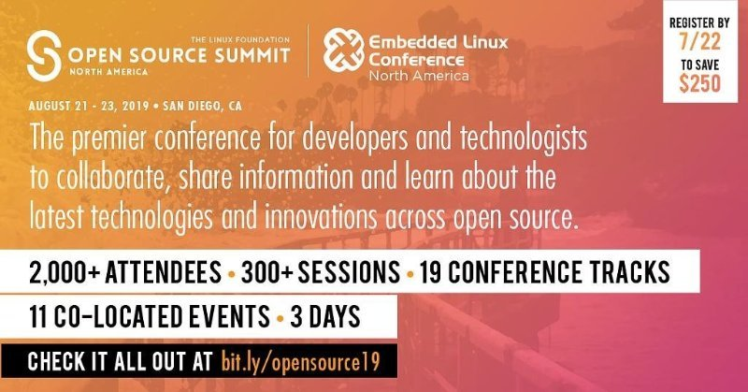
HYPERLEDGER PRINCETON
Open Source Conference

Slide 9
HYPERLEDGER capital markets special interest group
Tomorrow 9am
Mission
The Capital Markets Special Interest Group (CMSIG) represents industry professionals working together to study how Hyperledger DLTs interact with capital markets use cases. Issuance and trading of instruments to continued market-making, management of risk, program-trading, standards, regulations, capital requirements, traceability, post trade settlement, custody including corporate actions for capital markets. This group also explores architecture, identity and performance related considerations specific to capital markets and DLTs. Business and technology professionals from the capital markets world come together in this SIG to discuss, brain storm and learn from each other.
https://wiki.hyperledger.org/display/CMSIG/Capital+Markets+SIG+Charter

Slide 10
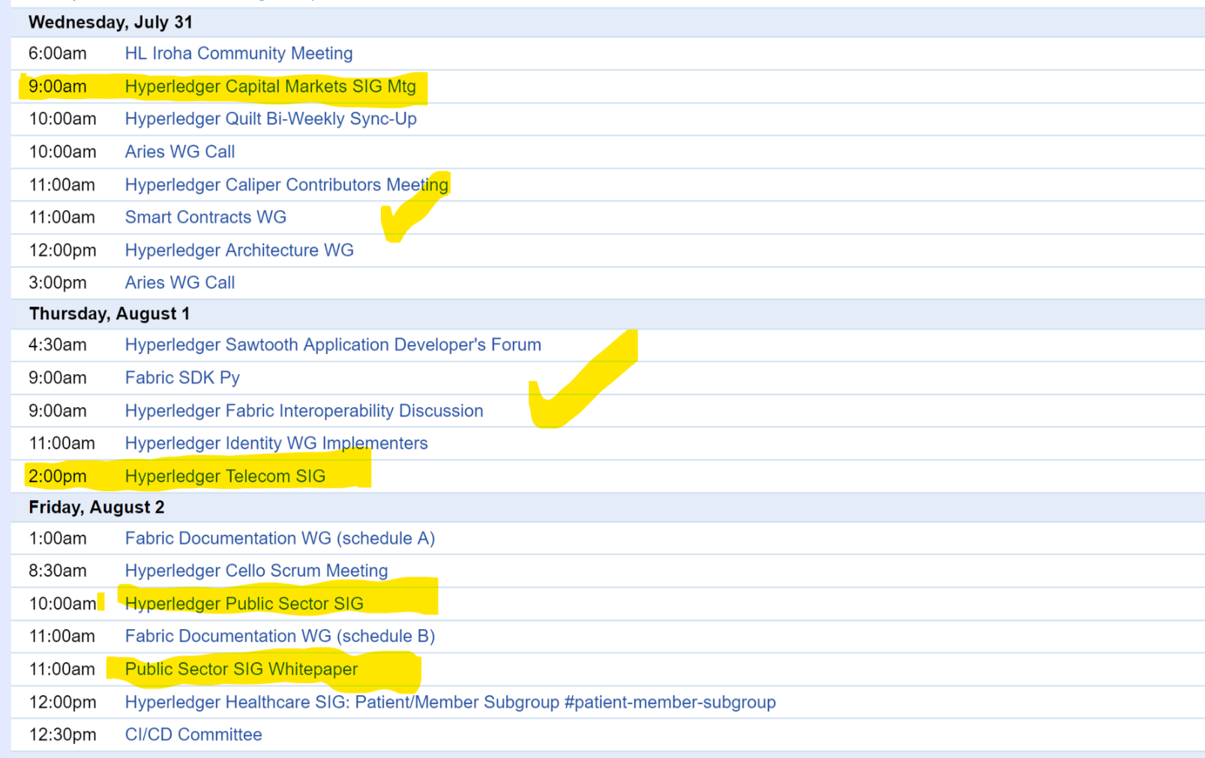
HYPERLEDGER PRINCETON
Zoom Calls
Wednesday: Capital Markets
Thursday: Telecom
Friday: Public Sector / Whitepaper

Slide 11
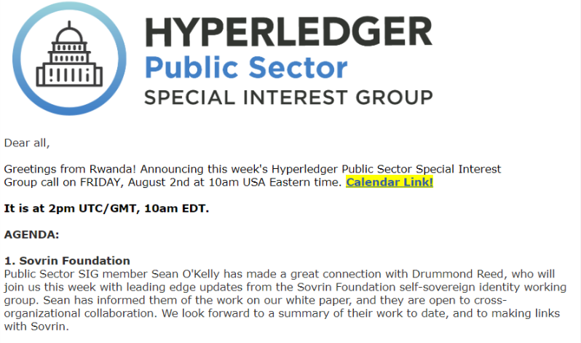
Identity Presentation

Slide 12
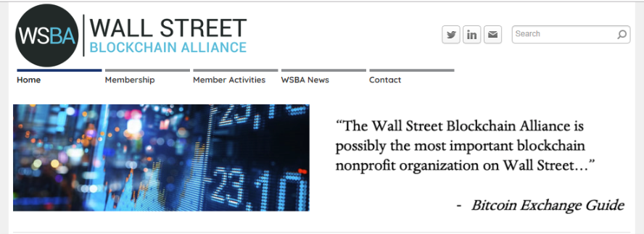
Blockchain Princeton
Wall Street Blockchain Association
Legal Working Group
Monday, August 5th from 11:00 am - 12:00 pm EST
Enterprise Solutions Working Group
Thursday, August 8th from 10:00 am - 11:00 am EST

Slide 13

Ledger Academy
Top 100 Blockchain Influencers
Discover the most important cryptocurrency thought leaders.
https://www.upfolio.com/blockchain-influencers

Slide 14
Re-Cap Project Kick off Meeting
Blockchain for Social Imapct
Housekeeping
Princeton Blockchain Community
Re-Cap Project Kickoff Meeting
Summer Blockchain Project
Discussion
Moving Forward
Notes:
David

Slide 15
Blockchain and social responsibility
    Philanthropy and remittances (donation traceability, aid transparency, digital currencies in aid and development, governance and accountability)
    Financial empowerment (financial inclusion, microfinance, microinsurance)
    Identity and land rights (refugee assistance, land ownership documentation)
    Governance and democracy (fighting censorship and fake news, voting rights and protections, election integrity)
    Supply chain and environmental protections (sustainable supply chain, fair trade, ethical sourcing, fair labor practices)
Blockchain Summer Project Goals
following a project from idea to production
create a working blockchain project
have a positive impact in our area this summer
Work with a team using the latest collaboration tools
Build a project through checkpoints, Working Groups and Recaps.

Slide 16
Summer Blockchain Project
Housekeeping
Princeton Blockchain Community
Re-Cap Project Kickoff Meeting
Summer Blockchain Project
Discussion
Moving Forward
Notes:
Hyperledger Quilt
Business Blockchain Tool
● Contributed by NTT Data and Ripple
● Java implementation of the Interledger protocol
● Interledger protocol provides:
○ atomic swaps between ledgers (even non-blockchain or distributed ledgers)
○ a single account namespace for accounts within each ledger

Slide 17
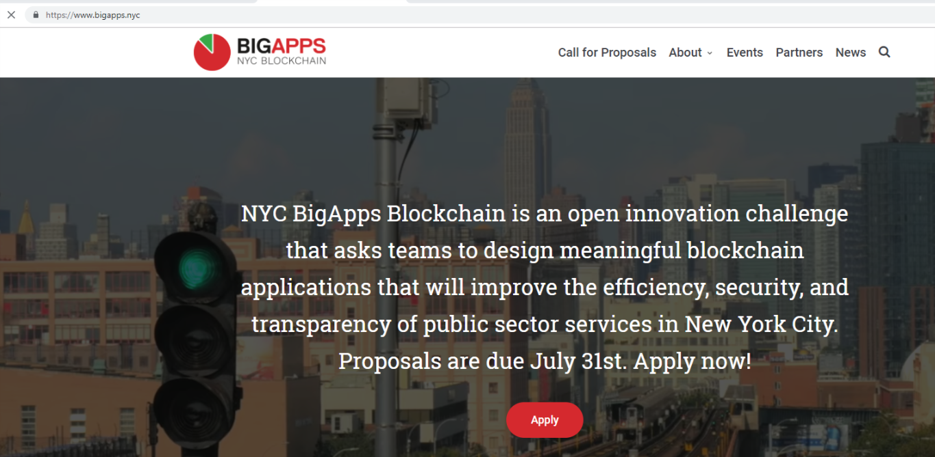
Big Apps Challenge

Slide 18
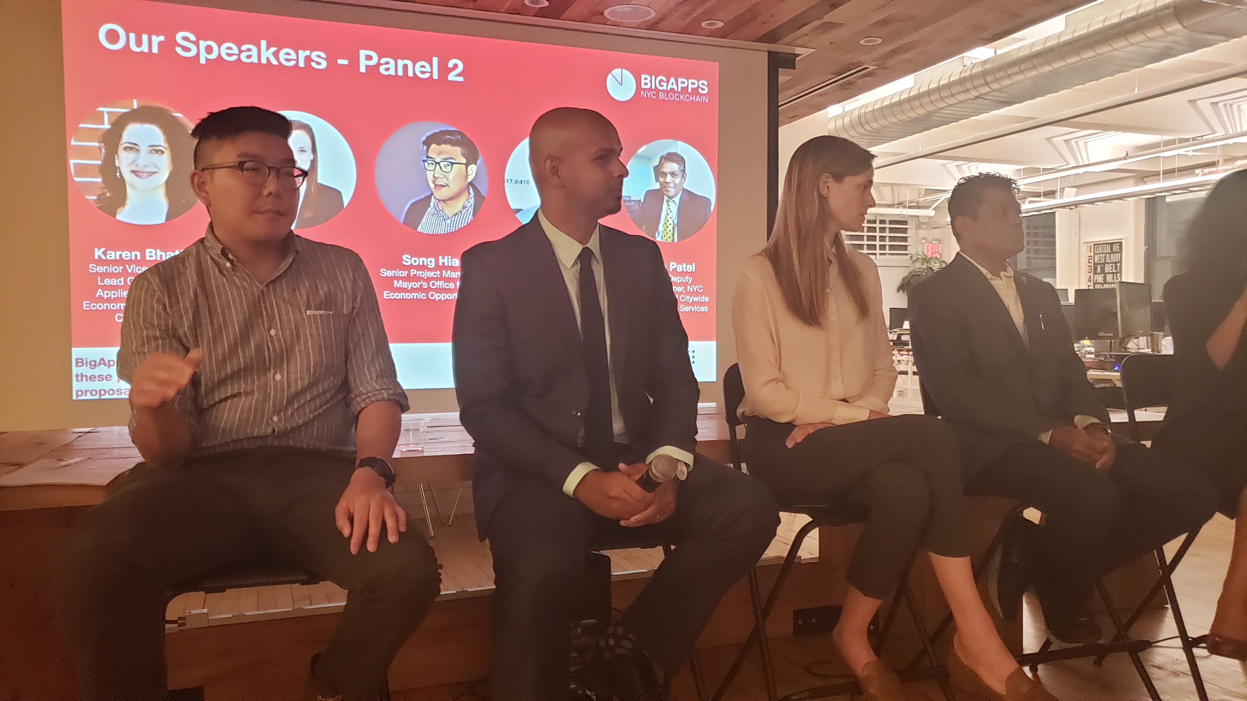
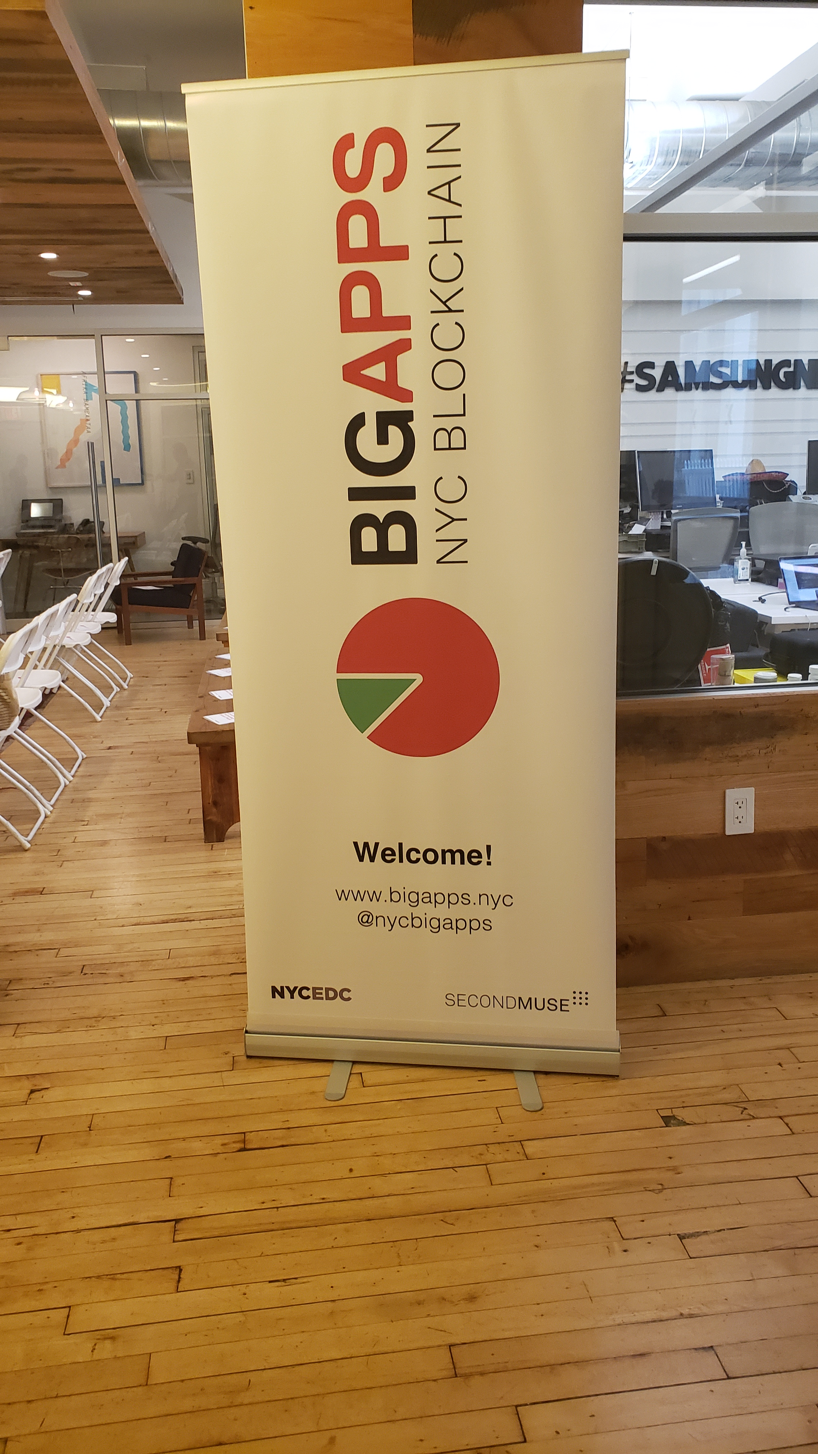
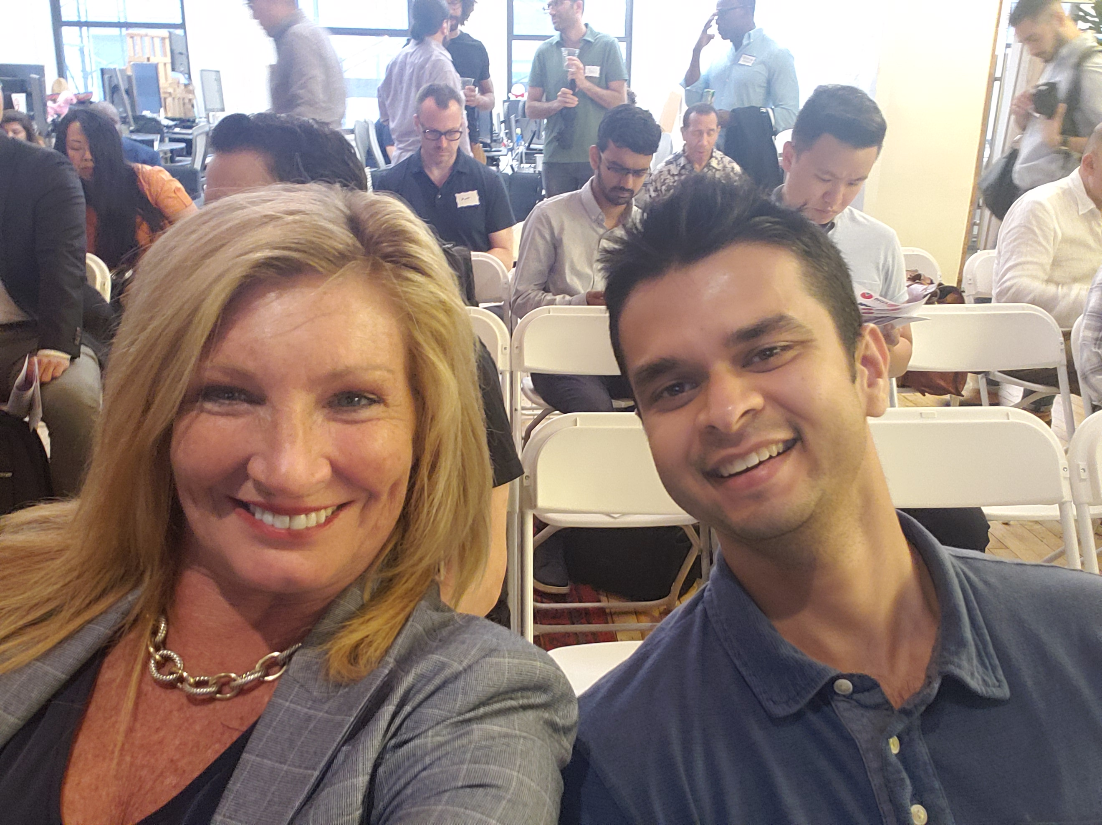
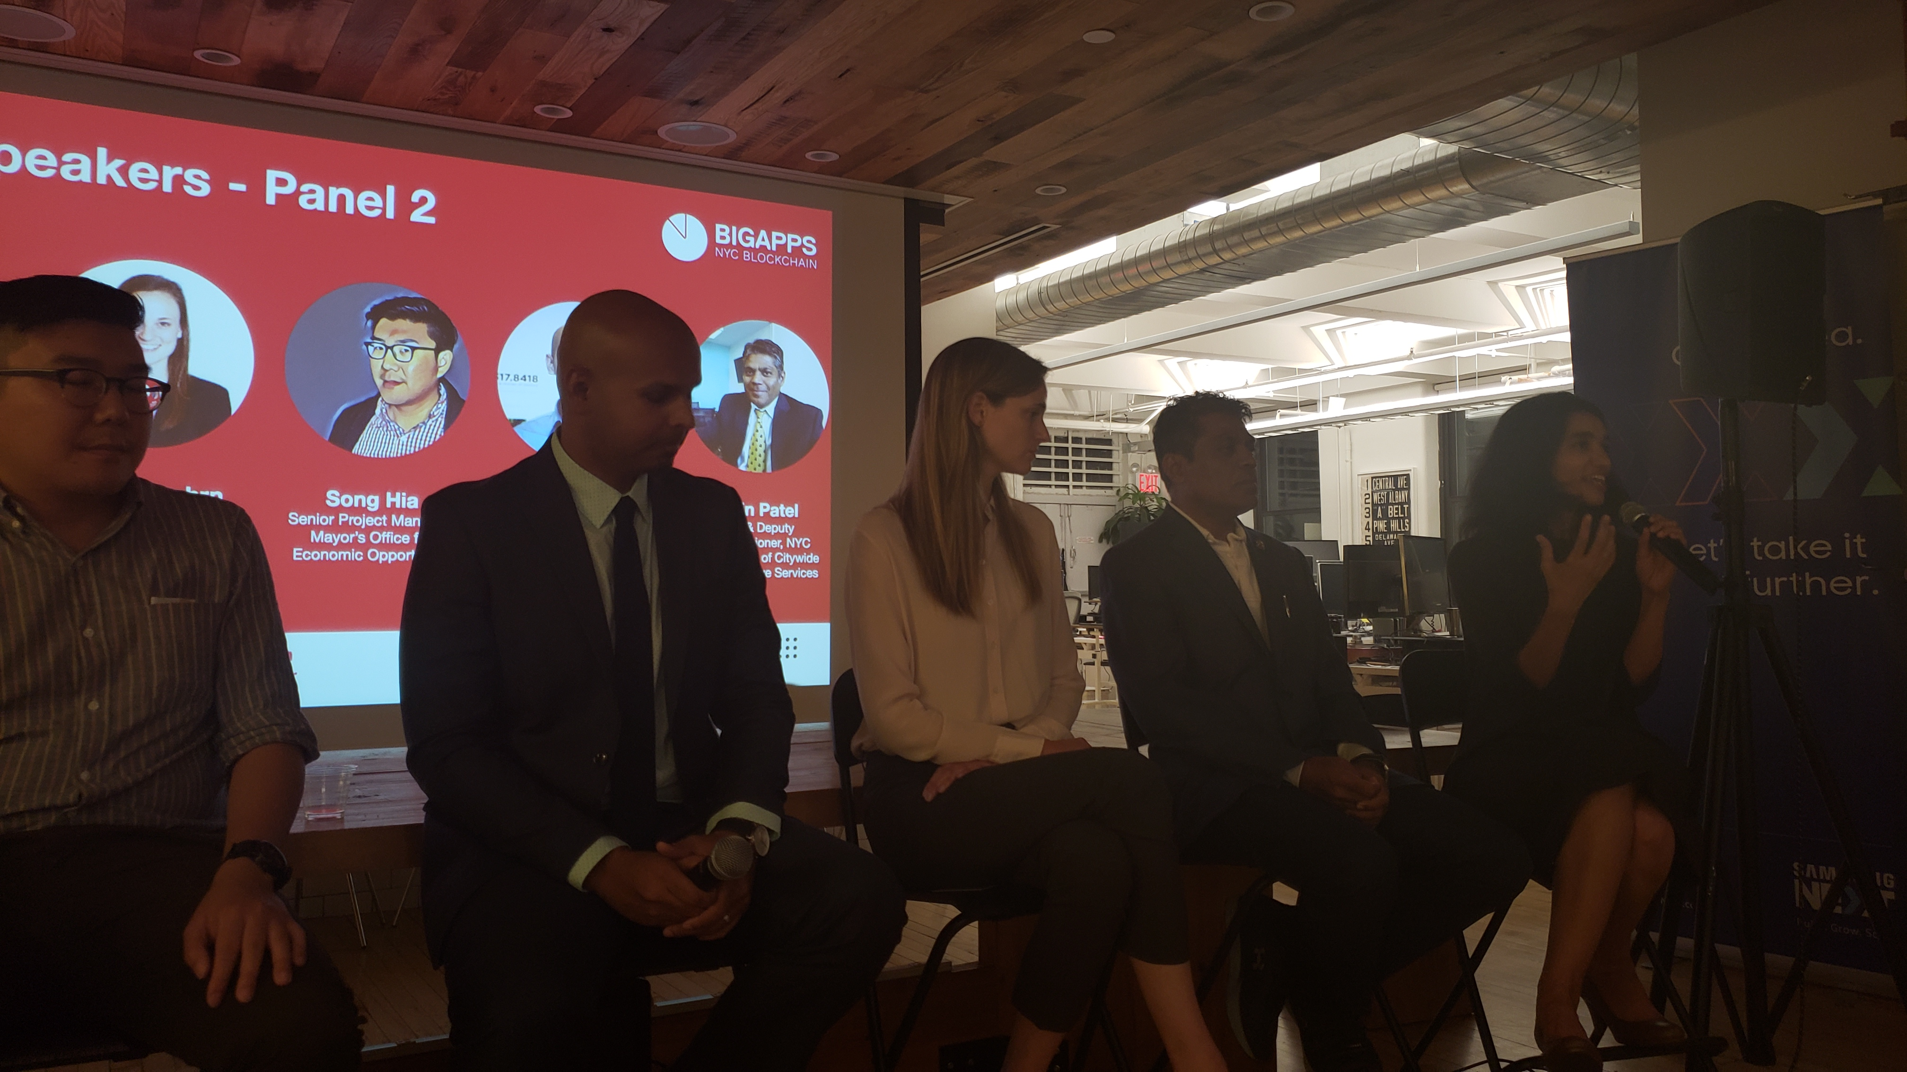

Slide 19
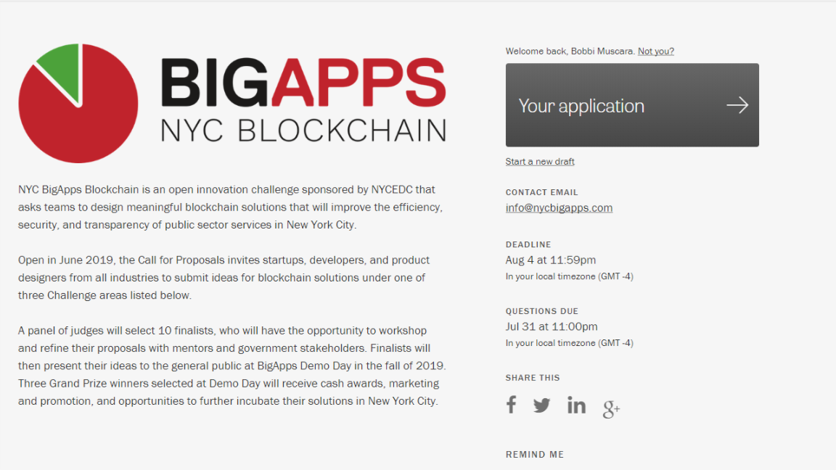

Slide 20
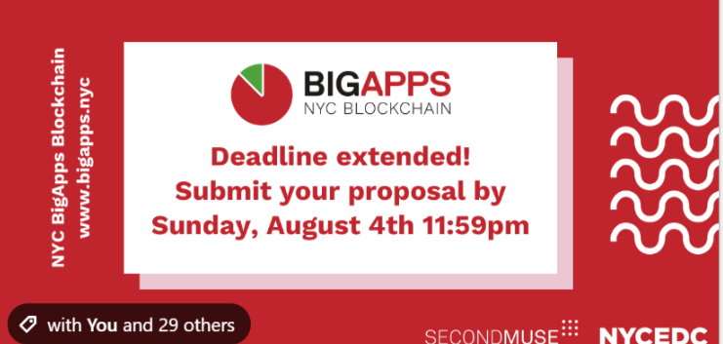

Slide 21

BC Princeton
Presents
Summer Blockchain Project
The Giving Chain

Slide 22
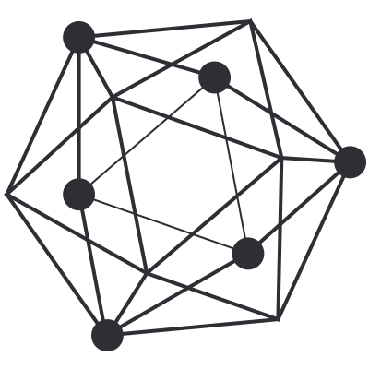

Who We Are
Ledger Academy
  Blockchain Princeton
  BC Princeton represents the combined efforts of the three local Princeton Blockchain Meetup Groups.
  The Princeton blockchain meetup groups consist of a diverse group of people who have dedicated countless hours this summer to form a team to change Local Charity Giving.
  By creating the Giving Chain we hope to create a working blockchain project to have a positive impact in our area this summer
Hyperledger Princeton
Princeton’s Blockchain and AI

Slide 23
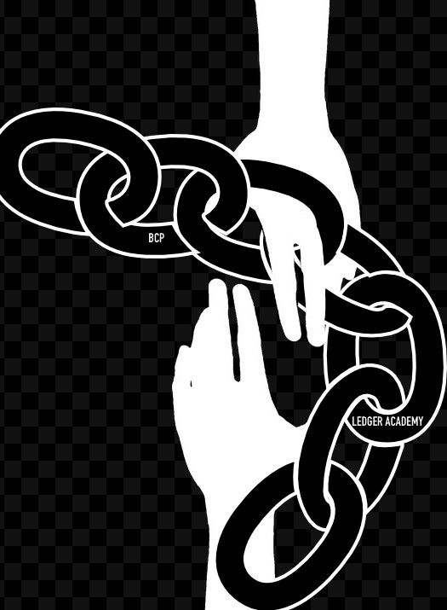
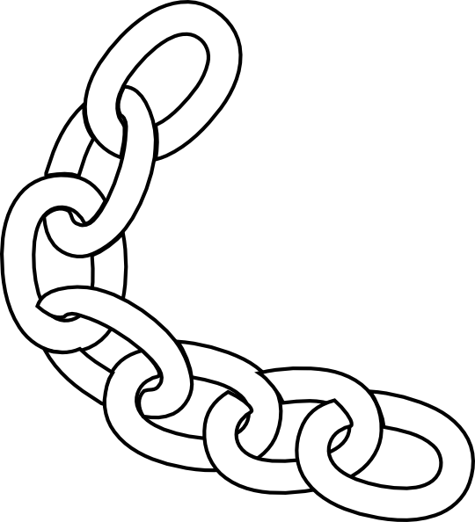

Giving Chain
A new look at local charity giving.

Slide 24
How Are We
  In order to create the giving chain BCPrinceton is working through 6 Checkpoints.
  BCPrinceton Checkpoints
Checkpoint 1: Impact Opportunity
Checkpoint 2: Business Model Validation
Checkpoint 3: Technical Architecture
Checkpoint 4: Business Development
Checkpoint 5: Product Development
Checkpoint 6: Final Project Delivery

Slide 25
Checkpoint 1: Impact Opportunity
Challenge Questions
Define Project and team members.
Define the scope of problem you are addressing.
Why is blockchain needed to solve this problem?
What is the size of the market? What demographics will you serve?
What are some current solutions to the problem you identified? Do they work effectively?
Who are the stakeholders involved? How are they thinking/feeling/acting currently?
What are the geopolitical, cultural-social-economic factors that must be taken into consideration? What are some nuances and complexities that must be addressed?

Slide 26
Checkpoint 1
Solution
Develop an agile & transparent network for connecting surplus foods & supplies to communities in need
impact the current Local Charity Giving model
Create a decentralized system that collect excess farm produce (and other resources) from local residence and distributes these resources to food insecure individuals / Community Centers in Local communities
Initiate a supply chain Blockchain to initiate, track and deliver excess food supplies. The above model has many unknown individuals who do not need to form a relationship with the parties at the other end of the supply chain.

Slide 27
Checkpoint 2: Business Model
Checkpoint Questions
Who are your clients/users? Sketch out the persona of your user.
What are their pain points? How does your solution solve them? Indicate your unique value proposition.
Does your solution depend on context? Can it be scaled?
What is your go-to-market strategy? Who can you partner with?
How will your product generate revenue / benefit ? Will it be financially sustainable in the long-term?
What are the implicit and explicit assumptions being made in your business and financial model (user-profiles, partnerships, costs, etc.)? How do you plan on validating them?
What is the vision for your product? Can it significantly change the current state?

Slide 28
Checkpoint 2: The Giving Chain
Solutions
The industry we are attempting to impact is the Local Charity Giving by creating a system where unknown parties can easily on-board and contribute. Also create a system that can adapt to various giving initiatives
For our POC we will limit the size of the volunteer pool and we will determine the best spot to deliver. Current discussion revolves around local food banks, shelters, and Veterans connections
Local Farmers with excess food are more than excited to be a part of the project. Transporters might prove a challenge The food insecure people who receive a donation should be handled with privacy and dignity and the system develop should reflect this
Some Challenges / Factors are SUSTANABILITY, food spoilage, timing of transportation as well as dignified deliver systems
  Potential for food spoilage. / Product liability associated with being a supplier of food
  Developing a Community of volunteers
  Sufficient pipeline to get foods from Donor to Consumer, able to continue with out central authority.

Slide 29
Checkpoint 2: Giving Chain
Business Model
Donors
Farmers
Individuals
Community / Church Groups
Volunteers / Drivers
Pickup / Deliver:
Local volunteers
Community / Groups Transport
Recipients
Food Banks
Houses of Worship
Social Services Offices
Individuals (off the grid)

Slide 30






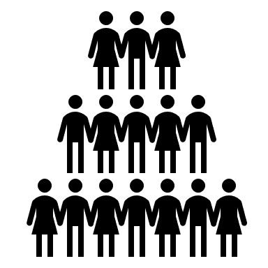
Checkpoint 2 : BUSINESS MODEL
Donation Tag
Giving Chain D2R app for Donor
Initiate P/U
Notification for P/U
Giving Chain D2R app for Drivers
Giving Chain D2R app for Recipient
Recipient Tag
Transporters Tag
Delivery Information

Slide 31
Checkpoint 3: Technical Architecture
Checkpoint Questions
Define the technical specifications of your system's architecture. Include a description of system requirements, processes, business logic, technology stack, user flows, attack factors and any other technical specifications. Attach some visuals as bonus.
Define your Minimum Viable Product (MVP) testing approach.
Product Tests: Sketches, Wireframes, Mockups, Interactive, Prototype, Wizard of Oz, Concierge, Live Product
Outline a development roadmap with a realistic timeline that takes into account your product vision, market readiness, team capabilities, functional upgrades and testing plans. What are your goals for each phase? How will your product evolve? Will you integrate other technologies?

Slide 32

Checkpoint 3: Technical Architecture
Proof of Concept D2R app.
Sawtooth Technology Explained
Is available as an instance of Sawtooth chain on a single node (Dev); with the ability to:
  create key-pairs
  create assets
  Transfer assets ( accept or reject the asset)
  Explorer , a view-able tracking of the current holder of the asset from the current front-end interface.

Slide 33
Checkpoint 4: Business Development
Checkpoint Questions
What is the impact goal of your solution? How do you ensure to capture needs of those who are traditionally underserved within your category
What are the tools needed to collect and track goods.
How will receipiants be selected?
How will Data Points be collected?
What are some obstacles you may face on the ground? Infrastructure issues, measurement techniquest, etc.

Slide 34
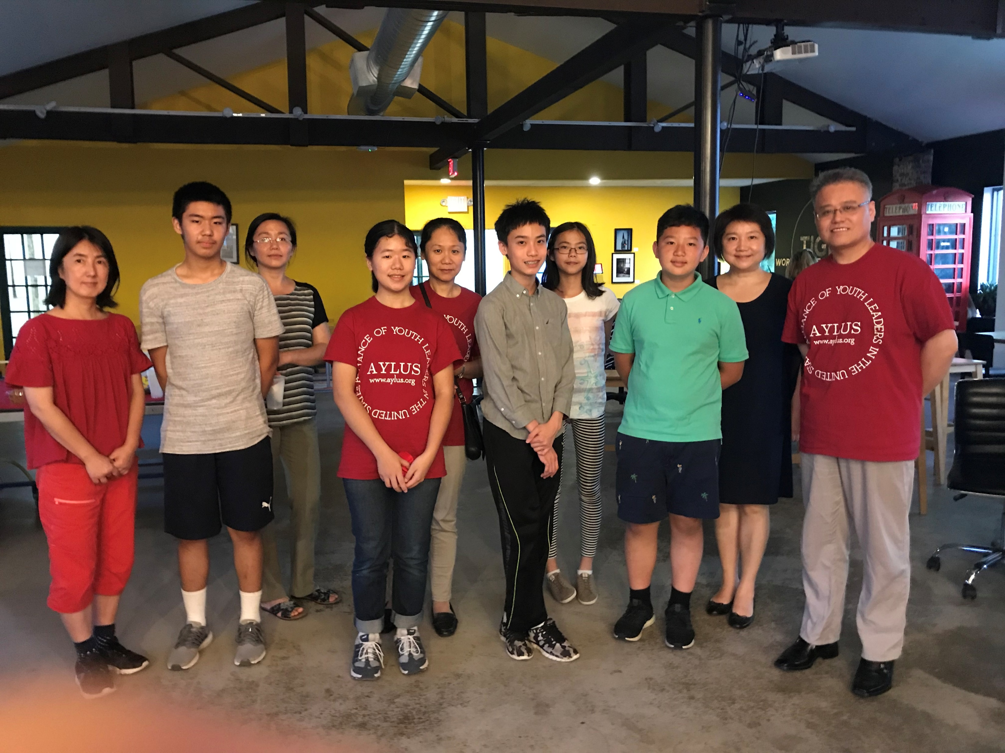
Checkpoint 4: Business Development
Solutions
AYLUS –Local youth group of volunteers
www.aylus.org
Collection items will be gathered in GIVING CHAIN BAGS that will have a bar code attached
GIVING CHAIN BAGS 100 bags with bar code attached that will have Project Logo and Logo of Sponsors will be dispersed to local Farmers and giving organizations.
Bag will be delivered to drop off location on agreed upin date.

Slide 35
Checkpoint 5: Product Development
Checkpoint Questions
Solutions
Working Code
Technology Decisions
Minimal Viable Product
Technology Stack: Google maps API, database management systems, public-private keys (cryptography), excel
Tracking on an instance of Sawtooth blockchain on a single node (Dev);

Slide 36
Checkpoint 5: Product Development
Minimal Viable Product
MVP
A Donor, Volunteer and Recipient (Actor) logins or interfaces
Ability for each actor to create their own key pairs pseudonymously
Ability to define assets that are fungible (from bulk donation to granular distribution - Asset name; Unit type and Units (numbers, lbs. etc.)
Ability to assign assets (by donor or self assigned by volunteer) for trace-ability purposes
Ability to track assigned assets with the options of:
  Tracking the assets themselves
  Or tracking the packaging the asset is included into (E.g. bags, crates etc.)
Security and audit-ability from bad actors (theft, diversion etc.)
Trace ability to final recipient (final recipient acknowledges receipt)

Slide 37
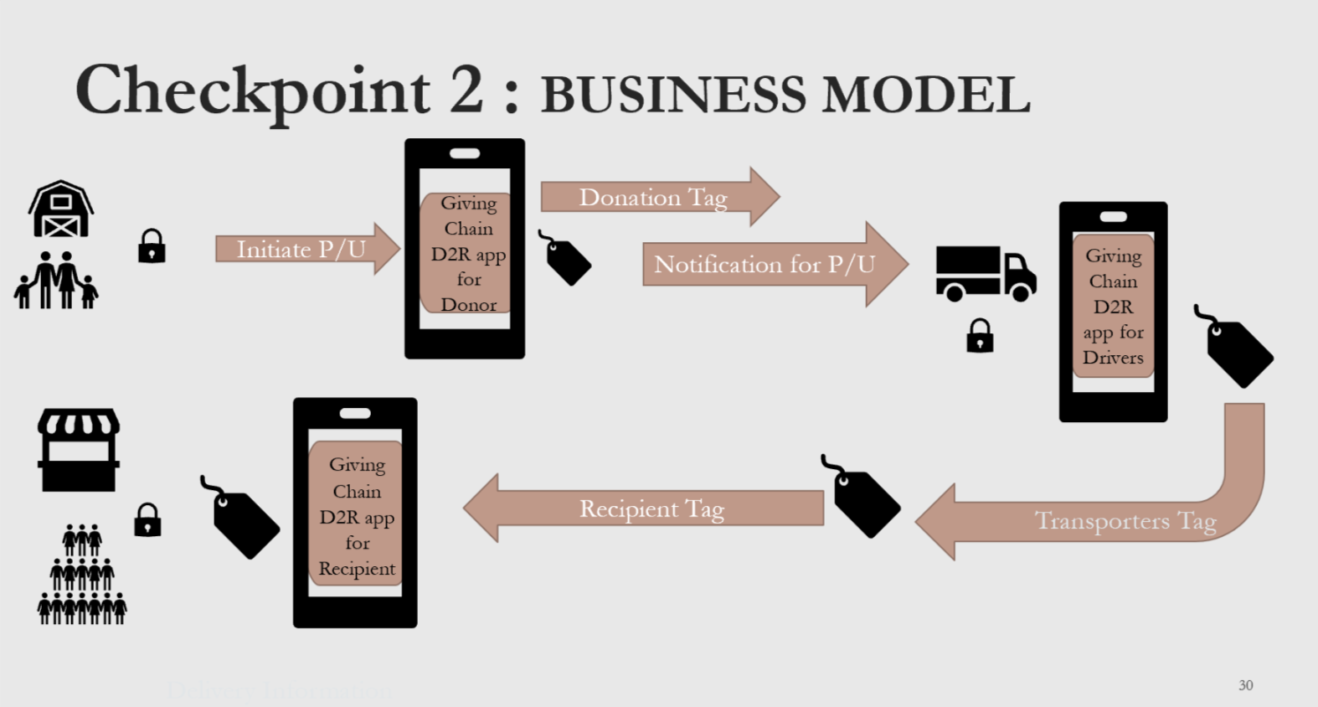
Checkpoint 6: Final Product Delivery

Slide 38
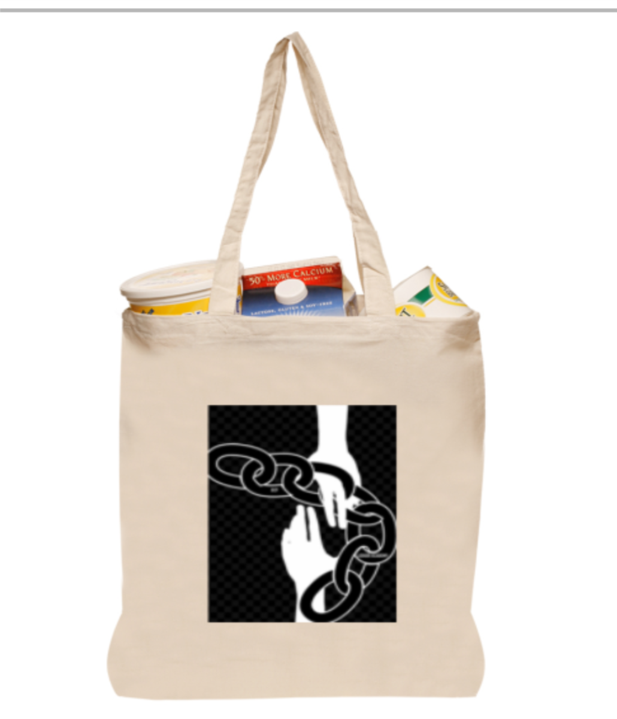
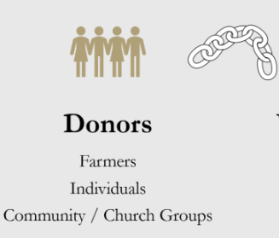
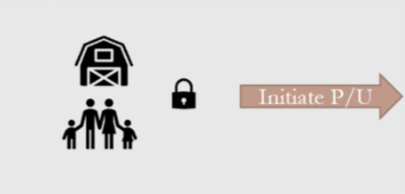

Donor Blockchain - View

Slide 39
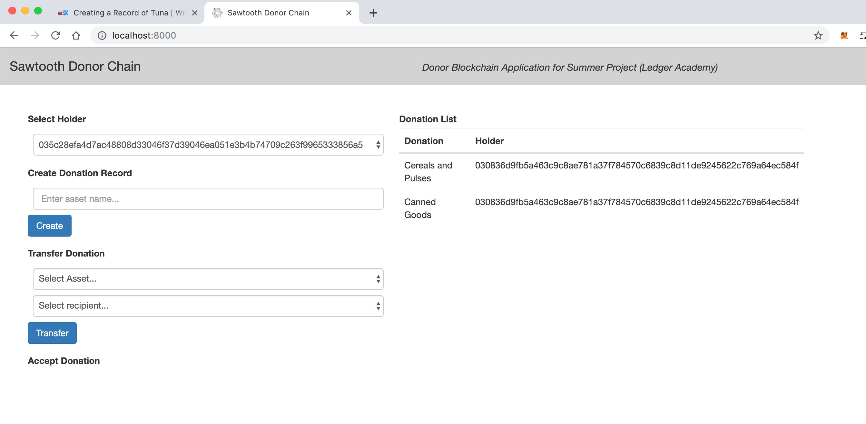
Donor Blockchain - View
Scanning the bar code generates the Tag with the unique “key” for the collected item
Creation of Tag for DONOR Last digits of Hash Tag 56A5

Slide 40
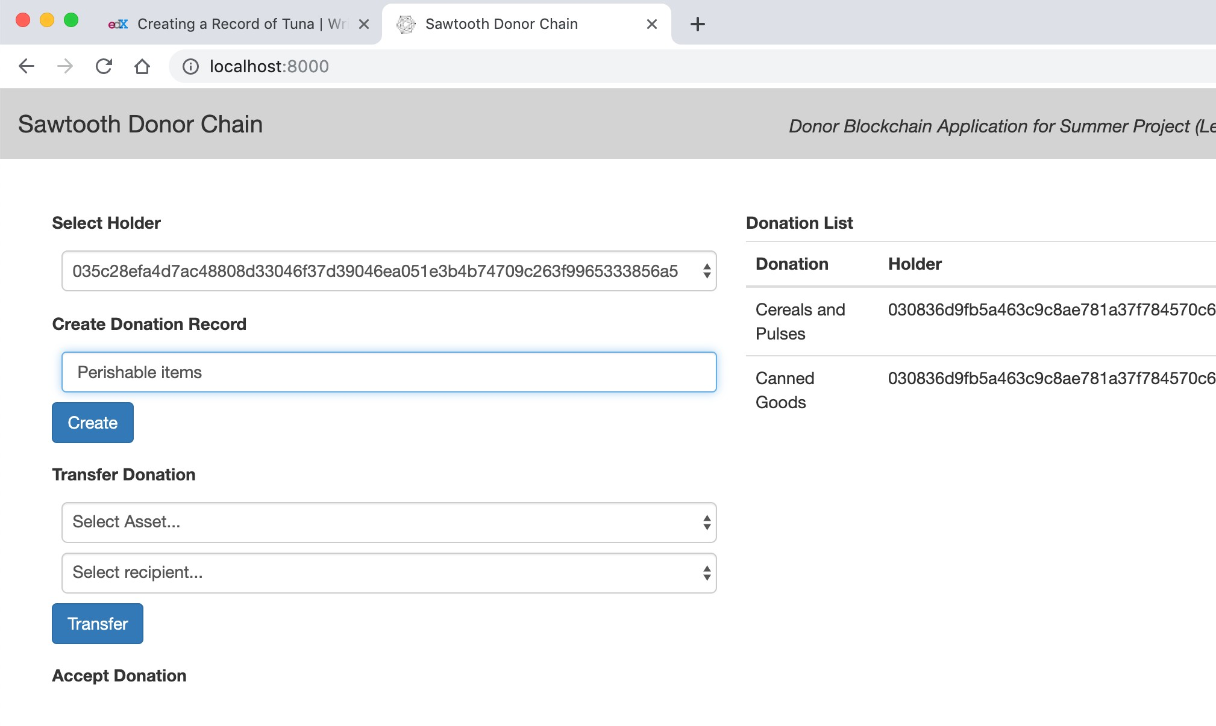
Donor Blockchain - Donation record
Week 3: Technical Architecture
Product Development Working Group

Slide 41
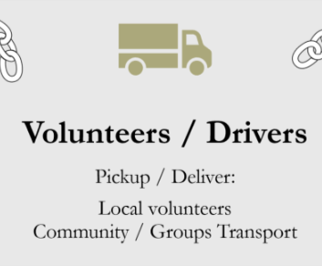
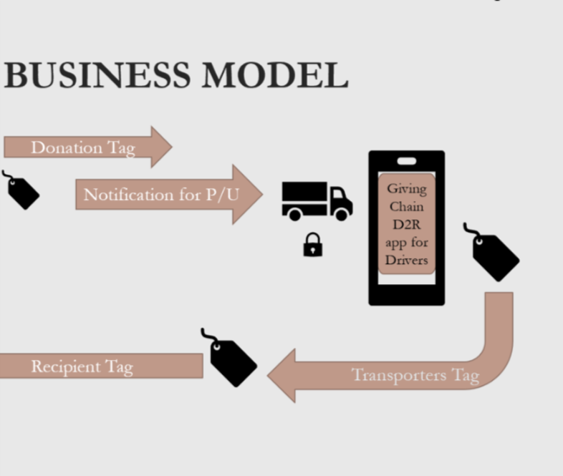
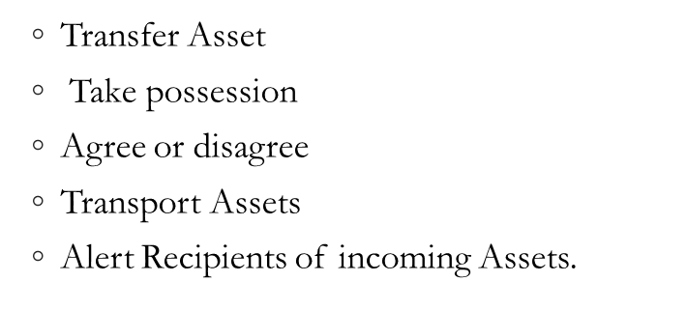
Driver Blockchain View

Slide 42
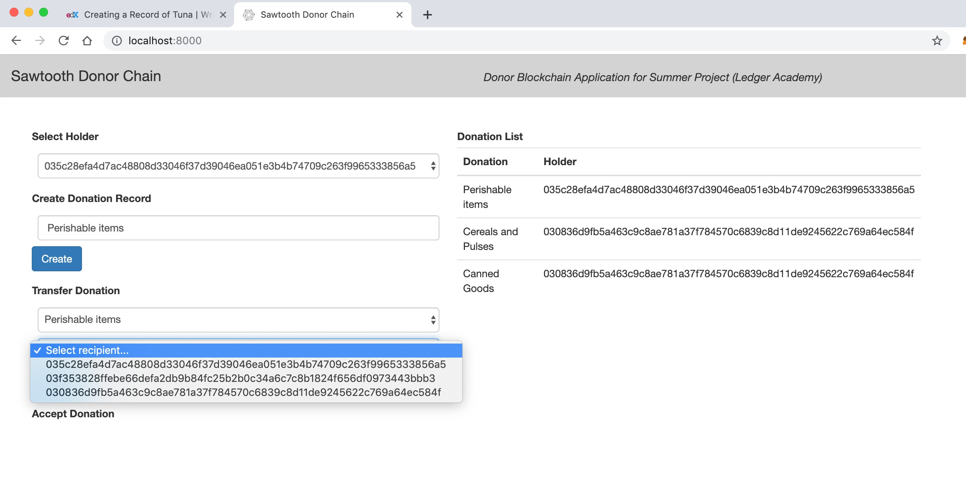
Driver Blockchain - Transfer
Transfer of Tag Last digits of Hash Tag 56A5

Slide 43
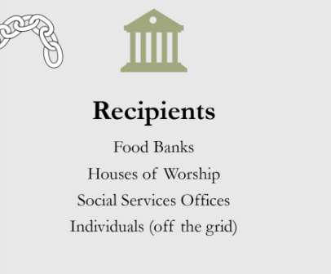
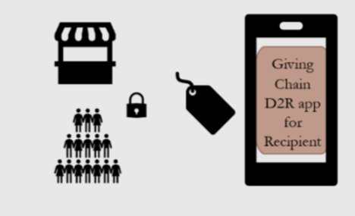
Recipients Blockchain - View
Recipients get notified of an available donation an accept it notifying driver where to deliver.

Slide 44
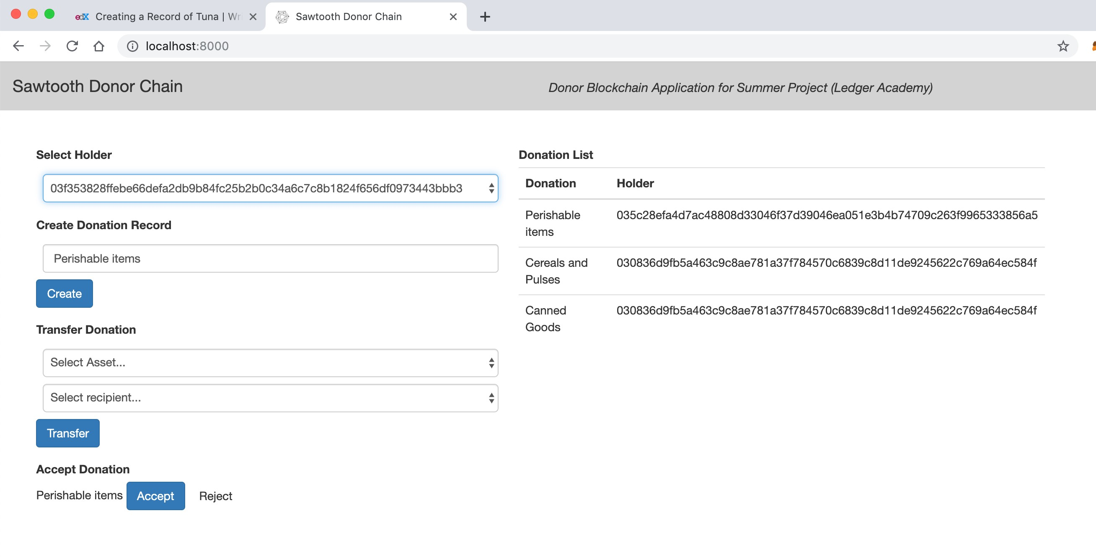
Recipient is notified and accepts donation with Last digits of Hash Tag 56A5

Slide 45
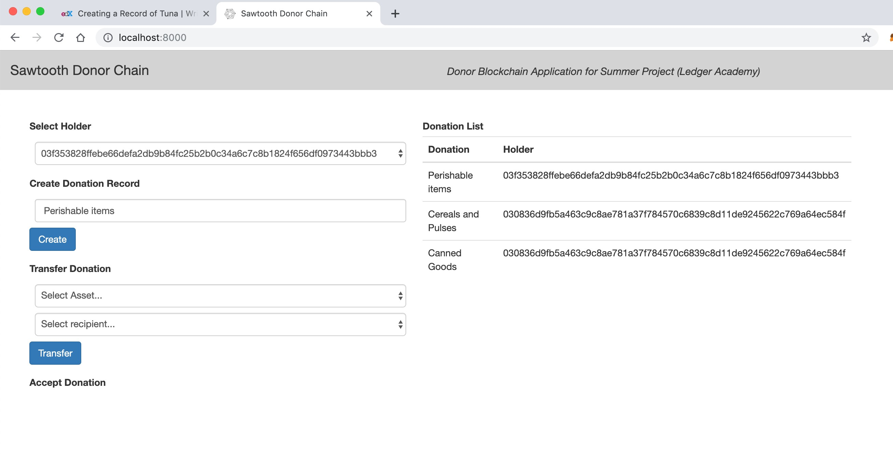
Recipient Blockchain - Change in Holder
donation with Last digits of Hash Tag 56A5 received

Slide 46
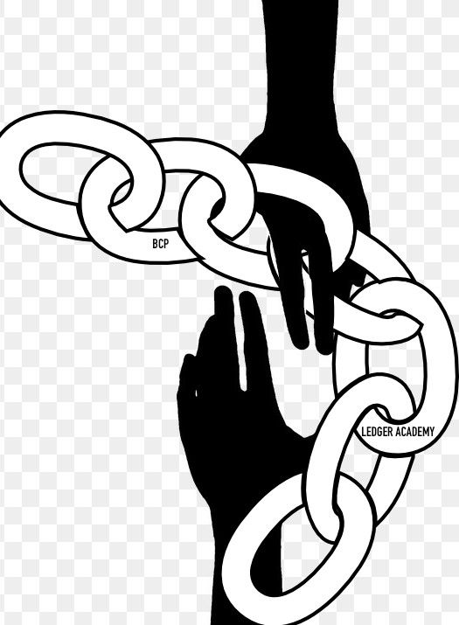
BCPrinceton
THANK YOU
www.BCPrinceton.com

Slide 47
Moving Forward
Housekeeping
Princeton Blockchain Community
Social Impact Projects
Summer Blockchain Project
Discussion
Moving Forward
Notes:
David

Slide 48
Business Development Working Group
Donor Issues
Announce August 25th Giving Chain Date
Bag Ordering (sponsor finalized)
Bag dispersement :
Sponsors covering donations ( Gymnastics Unlimited, GPA, Hilltop Farms)
Updating Social Media for Big Apps requirements
Marketing Materials
Web Site
Develop user Guides
Drop Off
Determine Locations
Collect Bags
Sponsors:
Logos
Work product
Donations

Slide 49
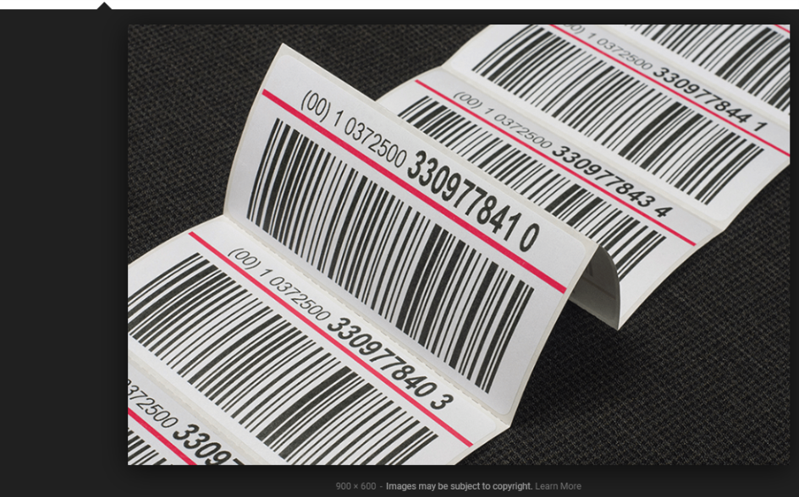
Bar coded Bag
* Must keep track of donor bags

Slide 50
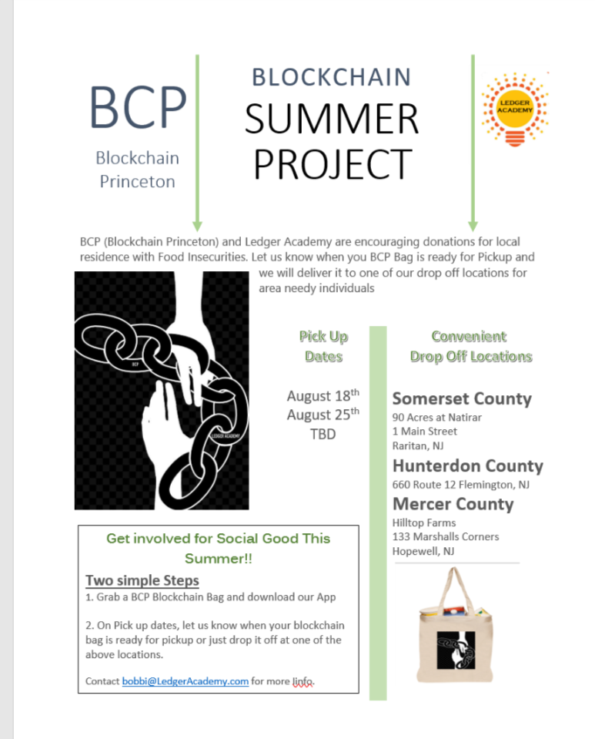
Donor Marketing Material
WEEK 2 : BUSINESS MODEL VALIDATION
Blockchain Princeton) and Ledger Academy are encouraging donations for local residence with Food Insecurities. Let us know when your BCP Bag is ready for Pickup and we will deliver it to one of our drop off locations for area needy individuals
Get involved for Social Good This Summer!!
Two simple Steps
1. Grab a BCP Blockchain Bag and download our App
2. On Pick up dates, let us know when your blockchain bag is ready for pickup or just drop it off at one of the above locations.
Contact bobbi@LedgerAcademy.com for more Iinfo.

Slide 51
Sponsor Opportunities
Sponsorship levels:
Silver:
$100 donation:
Name on Chain
Listed on Website
Gold:
$250 donation Name / Logo on back of bag.
Company name on Chain
Logo / Name on Web Site
Bitcoin Address: 3NCm4bvtcNCuwPsPRfKYexWYhQzMvV3AbQ
Ethereum Address 0x6d4e761ef446d0013c2692279b021b481b357984

Slide 52
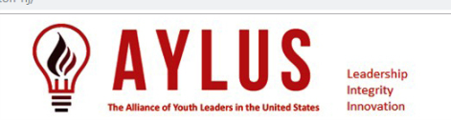
Business Development Working Group
Alliance of Youth Leaders group (AYLUS) Princeton Chapter leadership team members
On November 30, 2018, 49 students led by Cassie Tammy Wang, an Award Winning and Published Artist at West Windsor-Plainsboro High School South in New Jersey, founded the 44th branch for the Alliance of Youth Leaders in the United States (AYLUS): Greater Princeton, NJ.

Slide 53
AYLUS: ACTION ITEMS https://docs.google.com/spreadsheets/d/1WZCDLrCxaz-A6vuWksXmb-_GNKWy3sEZNKKNNhTLFs4/edit?usp=sharing .
website: http://aylus.org/branches/greater-princeton-nj/
Description of Greater Princeton AYLUS:
Greater Princeton AYLUS (GPA) members would like to use our talents in art, music, math, sports, science, engineering, bilingual skills, reading and writing to create unique service projects, such as Benefit "Music from the Heart, You Could Save a Life" Fundraising Performance, In person or Zoom "Tailored Volunteer Teaching", "Art Exhibition for Charity", "Culture Promotion" with newspaper, "Conservation" with Natural Resources Conservation Service, United States Geological Survey, "Humanitarian Care" for people in need, "Book Drive" for seniors and children, and more, to better serve our communities.
The best of all, GPA members have the greatest flexibility to choose from all kinds of volunteer team projects, offline or online volunteering projects, etc. that fit into their own needs and schedule.
So far 212 students have signed up with GPA. We welcome students of all grade groups, as long as they want to help someone, so that together we grow up as a strong team, and eventually make our community a better place!

Slide 54
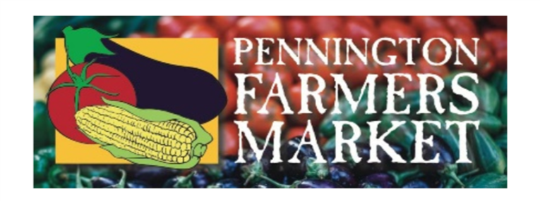





Sponsors
Paramount

Slide 55
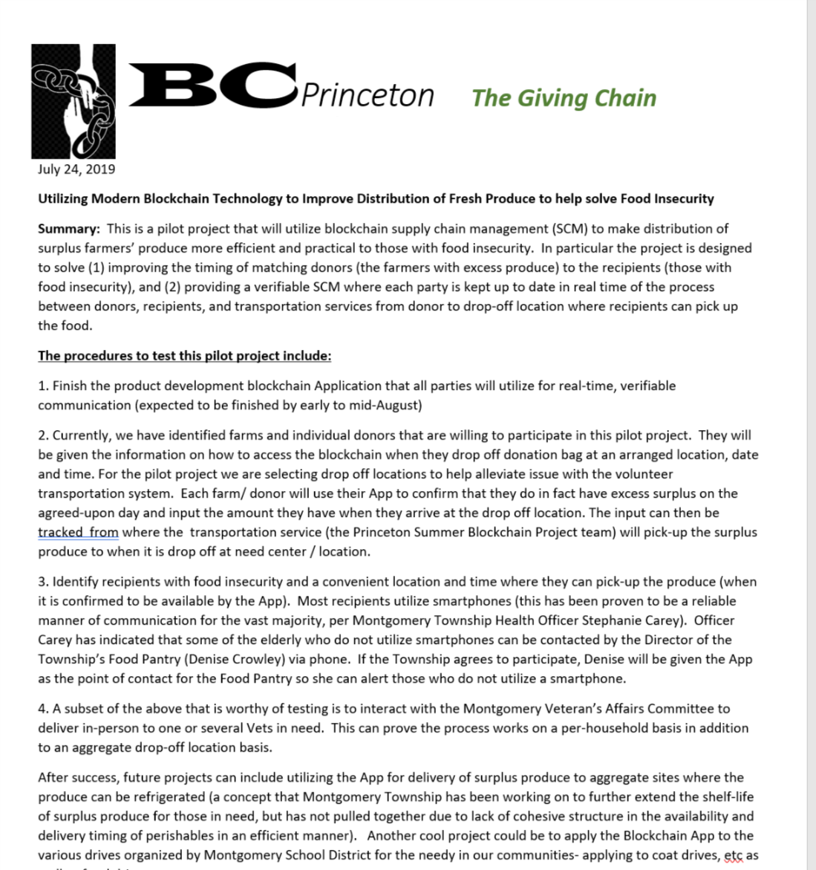
Recipients
Flemington Food Bank
Montgomery Food Bank
Off Grid US Veterans
Meeting with Montgomery Twp. Dept of Health
Supplied township with Project Summary and Procedures
Waiting to Hear.

Slide 56
Web Site: www.bcprinceton.com

Slide 57
Product Development Working Group
D2RA - Hyperledger Sawtooth Chain - MVP
Sl. No. | Things to be accomplished | Description of work and any constraints to be overcome | Assigned to (please include your name based on your time and skills) | Comments / Remarks
1 | Multiple nodes | Create multiple nodes of Sawtooth chain and demonstrate workability of the chain - Sawtooth chain needs to be brought up inside docker (or any other container) and should run on all instances; should be able to connect with each node |  | Can be on multiple instances in cloud (Eg: AWS EC2) or multiple macs Hemal Panji has done some research
2 | Define Transaction Processor | Be able to create transaction families and define Transactions on the chain (not the front end) - business logic on the server and able to bundle transactions into a block for validation |  | Transaction processor node(s) within Sawtooth
3 | Define Validator | Be able to assign validator nodes and / or create validators that will take the transaction families for validating and creating a block |  | Validator node(s) in Sawtooth
4 | Define any REST API | Be able to connect the client (Front end interface) to the chain |  | Connectors to chain from front end client (HTML, JSON etc.)
5 | Create Donor, Volunteer interfaces / logins | Provide the ability for Donors and volunteers to interact with the chain to login, create assets, transfer assets etc. |  | Current single screen from POC may need to be split into multiple with respective functionalities
6 | Create assets | Define what an asset attributes need to be (Asset name, asset type, unit type, unit measure etc.) Master template for assets (minimum values to be picked while defining assets that answers questions like - What am I donating, how much and if it can be picked up by multiple volunteers - one donor to many volunteers) |  | Solve for Fungibility of assets - Lindsley Medlincan articulate / elaborate.
7 | Tracking assets in the supply chain | How does the asset get tracked - Bar code, Mobile phone (Suyog Navarkar can elaborate), individual asset being tracked or the bag / crate. |  | Cost effective tracking mechanisms - pls remember that this is a social impact project and not a commercial one

Slide 58
Proof of Concept
Is available as an instance of Sawtooth chain on a single node (Dev); with the ability to create key-pairs; create assets; Transfer assets and accept or reject the asset. A tracking of the current holder of the asset is also view-able from the current front end interface.
MVP
Needs to be developed and will probably need to meet the following requirements (team to add anymore - high level requirements and constraints)
A Donor, Volunteer and Recipient (Actor) logins or interfaces
Ability for each actor to create their own key pairs pseudonymously
Ability to define assets that are fungible (from bulk donation to granular distribution - Asset name; Unit type and Units (numbers, lbs etc.)
Ability to assign assets (by donor or self assigned by volunteer) for trace-ability purposes
Ability to track assigned assets with the options of:
  Tracking the assets themselves
  Or tracking the packaging the asset is included into (Eg: bags, crates etc.)
N2H for MVP:
  Security and audit-ability from bad actors (theft, diversion etc.)
  Trace ability to final recipient (final recipient acknowledges receipt)
  The above 2 may have to be currently based on the "honor system" for the MVP and a robust security and trace-ability may need to be developed in next phase

Slide 59
Product Development Working Group
Hi Bobbi,
Saptarshi and Shane are in Japan attending Hyperledger conference. I will be able to attend. May I know the time.
Regards
Pramod Sajja
Paramount Software Solutions, Inc
Ph: 770 857 8348 x 302
Cell: 770 331 1030
Pramod Sajja sajja@paramountsoft.net
We will set up a zoom room for 7:30 ET tonight. Will send you detail 10 minutes prior . We just need somethings clarified and some advise.
Bobbi

Slide 60
Week 5: Code
Prototype your solution in some manner. Examples include:
  Working code
  Analog prototype / Mock-ups
  Tech Stack and Wireframes
  Create blockchain and implement.
End of Week Deliverable

Slide 61
BCPrinceton’s The Giving Chain
Schedule: Tiger Labs
Checkpoint 5
  Next Working Group August 7th
  Next Presentation:
  August 11th
  Project Date
  Sunday August 25th
Five checkpoints to be presented at meetups:
Impact Opportunity
Business Model Validation
Technical Architecture
Business Development
Product Development
Delivery.

Slide 62
THANK YOU
Notes:
David

