Slide 1
Welcome to
Blockchain Summer Project hosted by:
Hyperledger Princeton * Blockchain Princeton *
Blockchain Fundamentals * Ledger Academy
July 2, 2019

Slide 2
Blockchain Summer project

Slide 3
AGENDA
Housekeeping
Princeton Blockchain Community
Project Re-Cap Summer Blockchain Project
Discussion
Moving Forward
Notes:
David

Slide 4
Housekeeping
Housekeeping
Princeton Blockchain Community
Re-Cap Project Kickoff Meeting
Summer Blockchain Project
Discussion
Moving Forward
Notes:
David

Slide 5

HOUSEKEEPING
Tiger Labs:
Co-working Space in Princeton New Jersey
Current Home to Ledger Academy
Bobbi Muscara, Chair of Hyperledger Learning Materials Working Group.
Location for Princeton Meetups
Incubator space for start ups.

Slide 6
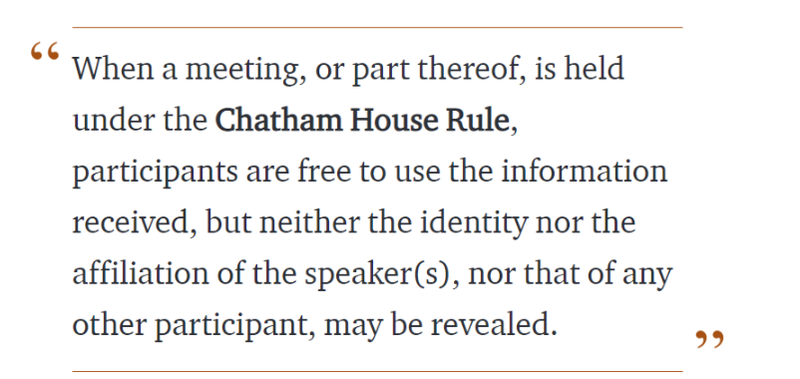
Chatham House Rule
Antitrust Policy Antitrust Policy Notice
Meetings involve participation by industry competitors, and it is the intention of the Ledger Academy to conduct all of its activities in accordance with applicable antitrust and competition laws. It is therefore extremely important that attendees adhere to meeting agendas, and be aware of, and not participate in, any activities that are prohibited under applicable US state, federal or foreign antitrust and competition laws. If you have questions about these matters, please contact your company counsel, or if you are a member of the Linux Foundation, feel free to contact Andrew Updegrove of the firm of Gesmer Updegrove LLP, which provides legal counsel to the Linux Foundation.

Slide 7
Princeton Blockchain Community
Housekeeping
Princeton Blockchain Community
Re-Cap Project Kickoff Meeting
Summer Blockchain Project
Discussion
Moving Forward
Notes:
David

Slide 8
meetups
HYPERLEDGER PRINCETON
  Hosted by Linux Foundation, is comprised of people interested in learning and developing projects using the Hyperledger solutions.
PRINCETON BLOCKCHAIN AND AI
  Princeton Blockchain and AI is focused on COMMUNITY. Discussions are developed by meetup participants.
BLOCKCHAIN FUNDEMENTALS / Ledger Academy
  Meetups focused on Education.

Slide 9
Hyperledger
June Newsletter
Project
Hyperledger Justitia helps users create and maintain consortiums on fabric. HIP 0.1
New : https://wiki.hyperledger.org/display/HYP/Hyperledger+Justitia+Proposal
New Coding Guidlines
https://wiki.hyperledger.org/display/fabric/Coding+Guidelines

Slide 10
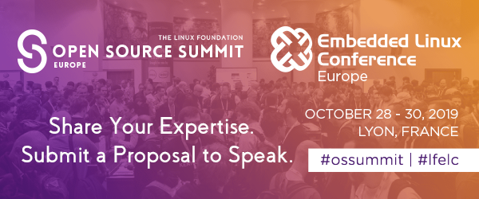
Hyperledger Princeton

Slide 11
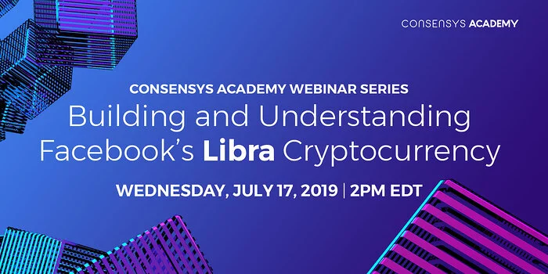
Princeton Blockchain and AI
New Meetup https://www.meetup.com/Princeton-School-of-AI/

Slide 12
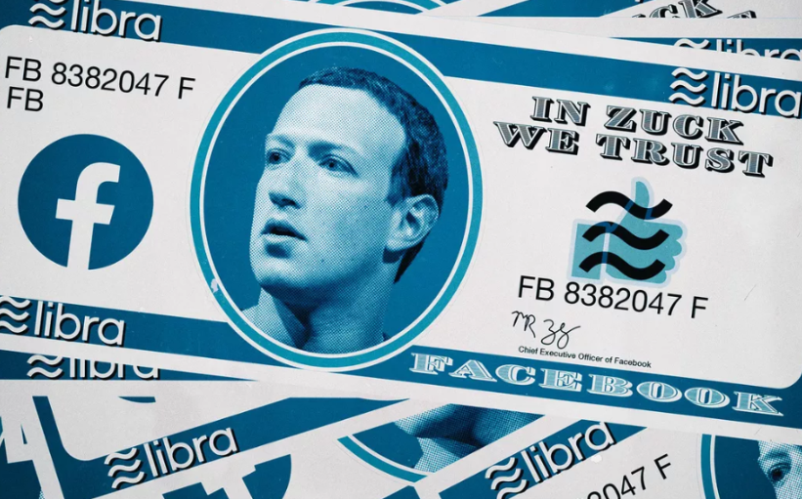
Facebook’s new cryptocurrency.
Libra’s value is indexed to a basket of world currencies, not any one currency.
It is very annoying if you live your life in dollars and use Libra occasionally to pay for stuff online: Your Libras will always fluctuate in value and you’ll never quite know how much things cost online.
But turn it around: If you live your life in the Republic of Facebook, use Libra for everything, and only occasionally use dollars to buy things at quaint non-Libra-accepting offline businesses, the dollars will start seeming annoying.
How inconvenient that you never know how many Libras a dollar will buy, that the dollar fluctuates in value against the one world currency!
By Matt Levine
July 1, 2019, 12:00 PM EDT
Matt Levine is a Bloomberg Opinion columnist covering finance. He was an editor of Dealbreaker, an investment banker at Goldman Sachs, a mergers and acquisitions lawyer at Wachtell, Lipton, Rosen & Katz, and a clerk for the U.S. Court of Appeals for the 3rd Circuit.

Slide 13
Wall Street Blockchain Association
Wall Street Blockchain Association:
UPCOMING WSBA EVENTS and WORKING GROUP MEETINGS:
Legal Working Group
Monday, July 8th from 11:00 AM - 12:00 PM EST
Enterprise Solutions Working Group
(w/special guest Vincent Annunziato of the U.S. Customs and Border Protection Agency)
Thursday, July 11th from 10:00 AM - 11:00 AM EST
Cryptoassets Working Group
Monday, July 16th from 10:00 AM - 11:00 AM EST
Legal Working Group
Monday, July 8th from 11:00 AM - 12:00 PM EST
Real Estate Working Group
Monday, July 25th from 10:00 AM - 11:00 AM EST
Members and relevant Working Group participants should already have meetings in calendar. Members interested in joining, please let us know.

Slide 14

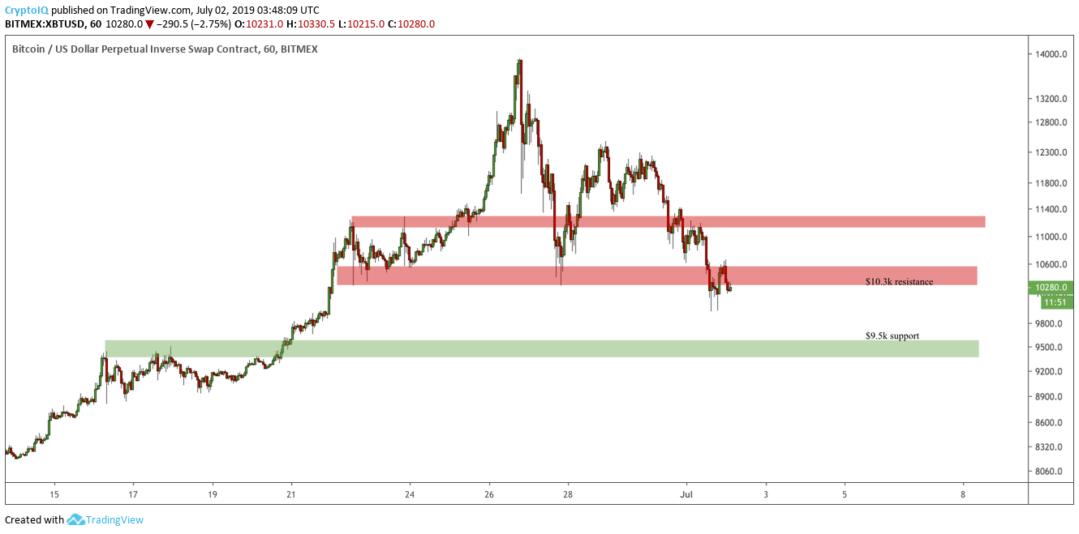
The Dip Continues
Resistance
The $10.3k support has now broken and will be a level for bulls to break above in terms of resistance.
Support
$9.5k is a key level of support and one that bids should be placed at for a chance of buying a dip that would lead to a reversal/bounce.
CONCLUSION
A break below $9.5k will be a concern, but for now, this is just a cooling off period for BTC in the macro bull market. Look to buy at $9.5k or a confirmation of a new uptrend with a break above $10.8k.

Slide 15
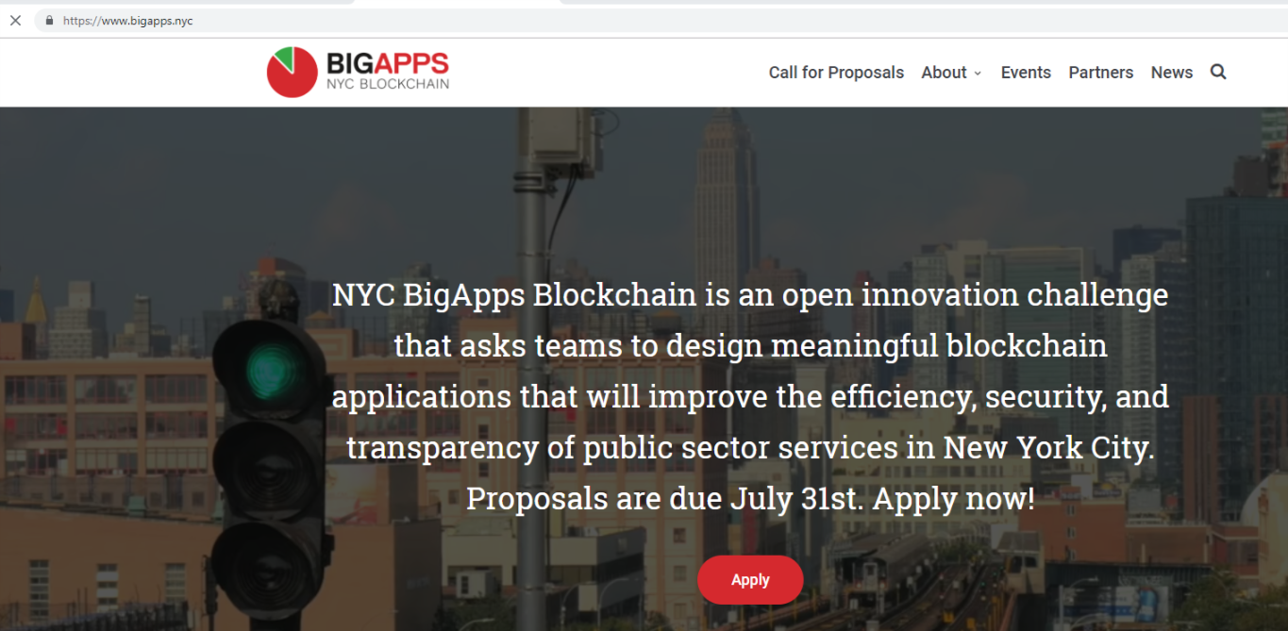

Slide 16
FAQs
1. What is blockchain?
○ For the purposes of this Challenge, blockchain is any type of digital, distributed
ledger, including both public and private, or permissioned and permissionless
systems. For more information on how to get started with blockchain, check out
our list of educational resources .
2. How do I enter? What constitutes a complete submission?
○ All Applicants must complete the Submission Form at www.bigapps.nyc;
completion of the Submission Form will constitute an official entry into the
challenge. All submissions must be completed by July 31st at 11:59PM ET.
3. Am I eligible to compete?
○ BigApps is open to legal residents, ages 13 or older, of the 50 United States (plus
the District of Columbia). All corporations or other organizations participating
must be legally domiciled in the United States or incorporated in the United
States at the time of entry.
4. We are an organization. Can we enter?
○ Yes, organizations that have not raised more than $500,000 in funding in the last
12 months for this particular Proposal may enter and compete for cash and
in-kind prizes as well as post-challenge support and implementation resources. If
this particular proposal is publicly available, it must not have been in the market
for more than 12 months prior to the time of submission to the Challenge.

Slide 17
5. I’m not a coder. Can I still participate?
○ BigApps is open to everyone, including government employees, engineers,
designers, marketers, content creators, and anyone else interested in improving
New York City.
6. Can I enter the same Proposal in multiple Challenge areas?
○ No. Each Proposal shall only be submitted to one challenge.
7. Is there a limit to how many projects I can submit or participate in?
○ You may submit up to 5 entries. An individual may also participate on behalf of
more than one team, corporation, or nonprofit organization.
8. Is there a limit to how many people I can have on my team?
○ There is no limit to how many people can participate on a single team. If a team
of individuals, or an organization is selected as a prize winner, the Administrator
will issue prize money to the primary team member listed on the submission
form. It will be up to the winning team or organization to allocate the prize money,
if they deem it appropriate.

Slide 18
9. Do I retain intellectual property ownership?
○ Yes, all entrants, regardless of winner status, will retain intellectual property
ownership of their submissions. However, as a condition of entering the BigApps
Challenge, City, Sponsor and Administrator will maintain a royalty-free license to:
a) post the Submissions on BigApps.NYC; b) make the Proposals available for
the course of the Challenge and 12 months after the conclusion of the Challenge;
and c) use the Proposals for noncommercial purposes for a period of 12 months
after the conclusion of the Challenge Submission Period. The BigApps Sponsors
and Administrator will have the right to display and promote your submission to
the public on the NYC BigApps website and partner sites. They will also be
allowed to publicize your name in connection with the submission and the NYC
BigApps Challenge.
10. How else can I get involved with the Challenge?
○ There are many ways to get involved with BigApps besides submitting a
Proposal. You can sponsor the Challenge or Demo Day; contribute data & other
resources; serve as a mentor or volunteer; and help promote BigApps. Please
contact us at info@nycbigapps.com for more information.
11. I have more questions. How do I contact you?
○ Please email your questions to info@nycbigapps.com.

Slide 19
Re-Cap Project Kick off Meeting
Blockchain for Social Imapct
Housekeeping
Princeton Blockchain Community
Re-Cap Project Kickoff Meeting
Summer Blockchain Project
Discussion
Moving Forward
Notes:
David

Slide 20
Blockchain and social responsibility
    Philanthropy and remittances (donation traceability, aid transparency, digital currencies in aid and development, governance and accountability)
    Financial empowerment (financial inclusion, microfinance, microinsurance)
    Identity and land rights (refugee assistance, land ownership documentation)
    Governance and democracy (fighting censorship and fake news, voting rights and protections, election integrity)
    Supply chain and environmental protections (sustainable supply chain, fair trade, ethical sourcing, fair labor practices)
Blockchain Summer Project Goals
following a project from idea to production.
create a working blockchain project
have a positive impact in our area this summer.
Work with a team using the latest collaboration tools
Checkpoints, Working Groups and Recaps.

Slide 21
Summer Blockchain Project
Housekeeping
Princeton Blockchain Community
Re-Cap Project Kickoff Meeting
Summer Blockchain Project
Discussion
Moving Forward
Notes:
Hyperledger Quilt
Business Blockchain Tool
● Contributed by NTT Data and Ripple
● Java implementation of the Interledger protocol
● Interledger protocol provides:
○ atomic swaps between ledgers (even non-blockchain or distributed ledgers)
○ a single account namespace for accounts within each ledger

Slide 22
Weekly Checkpoints
Week 1: Impact Opportunity
Week 2: Business Model Validation
Week 3: Technical Architecture
Week 4: Impact Measurement
Week 5: Code
Week 6: Final Submissions Due

Slide 23
Week 1: Impact Opportunity
Develop an agile & transparent network for connecting surplus foods & supplies to communities in need.
To create a decentralized system that collect excess food supplies from local resources and distributes these resources to local food insecure individuals.
Limiting the POC to a small number of local farmers with excess food supplies (two pick up dates TBD ) to be picked up by transportation volunteers who will transport food supplies to agreed upon drop off point .
A supply chain model has been determined to be the best way to initiate, track and deliver excess food supplies. The above model has many unknown individuals who do not need to form a relationship with the parties at the other end of the supply chain.

Slide 24
Week 1: Impact Opportunity
For our POC we will limit the size of the volunteer pool and we will determine the best spot to deliver. Current discussion revolves around local food banks, shelters, and Veterans connections. The industry we are attempting to impact is the Local Charity Giving by creating a system where unknown parties can easily on-board and contribute. Also create a system that can adapt to varoius giving initiatives.
Local Farmers with excess food are more than excited to be a part of the project. Transporters might prove a challenge The food insecure people who receive a donation should be handled with privacy and dignity and the system develop should reflect this.
Some factors are SUSTANABILITY, food spoilage , timing of transportation as well as dignified deliver system.
  Potential for food spoilage.
  Product liability associated with being a supplier of food.
  Supply pipeline to get foods from Donor to Consumer must be efficient enough to avoid complexities 1 and 2.

Slide 25
Weekly Checkpoints
Week 1: Impact Opportunity
Week 2: Business Model Validation
Week 3: Technical Architecture
Week 4: Impact Measurement
Week 5: Code
Week 6: Final Submissions Due

Slide 26
Week 2: Business Model Validation (questions)
Who are your clients/users? Sketch out the persona of your user.
Donors:
  Local farmers, Farm to table restaurant, Individual Donors
  Recipients : Food insecure individuals
What are their pain points?
  Donors : Lack of organization
  Precipitants – DO NOT WANT HELP
How does your solution solve them? I
  Local delivery system less intimidating
  New for pick up schedules and drop off points organized.

Slide 27
Initial project focus of “Donor Goods” will be food
Future Goods can include: Clothing, Blankets, Toiletry Items, Paper Products
Business Model
Donors
Farmers
Restaurants
Wholesalers
Individuals
Volunteers / Drivers
Pickup / Deliver
Local Transporters
Uber model-??
Recipients
Food Banks
Houses of Worship
Social Services Offices
Individuals (off the grid)

Slide 28
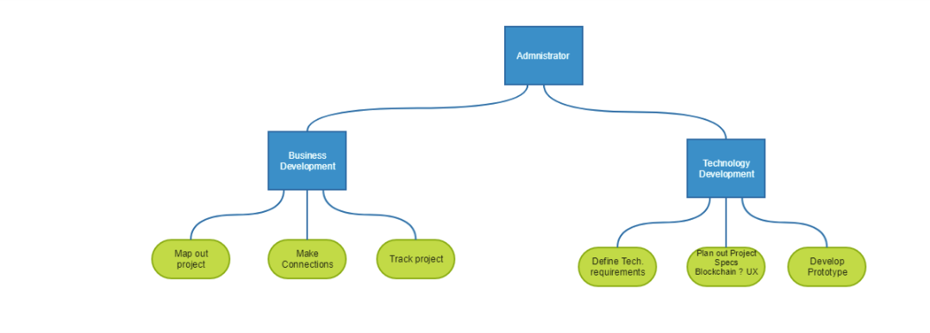
Teams

Slide 29
Teams
Business:
Establish Business Team:James Bushong : Charitable Partnerships: Meet with Montgomery Food Pantries, Email Montgomery Veteran Assoc.
Mike Lightman Big Idea Ventures
Ron Keegan Work with Rooster
Lindsley Medlin - Will review workflow
Jennifer Yuan Try AWS Blockchain
Scott Schneider Whitpaper

Slide 30
Teams
Technology
      Establish Tech Team
        Wesam Elsayed Sawtooth
        Laxman Molugu Hyperledger / Sawtooth
        Suyog Navarkar
        P.Prabhu
        Hemal Panji
        Phillip Thomas
        Gary Teekahi

Slide 31
Business Model
Donors
Volunteers
Recipients
Farmers, Restaurants, Individuals, etc.
Wants
Needs
Challenges
Transporters, Pick/up Facility / Location
Wants
Needs
Challenges
Veterans, Food Banks, Families, etc
Wants
Needs
Challenges

Slide 32
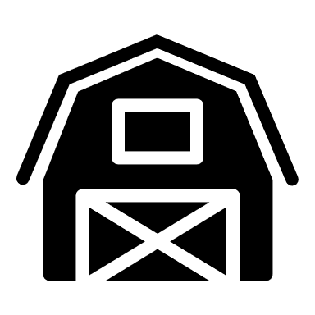

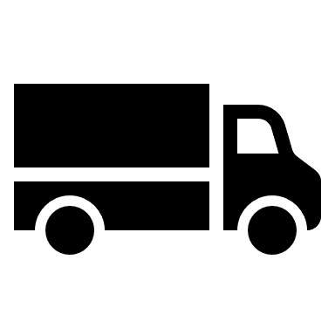
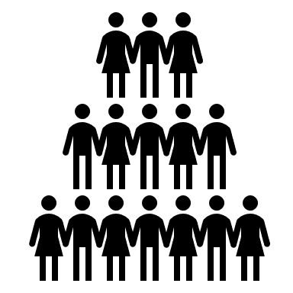
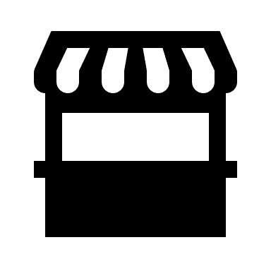
Business Model System Design
Initiate P/U
BD2RS
Donation Tag
Notification for P/U
Donor
BD2RS
Recipient Request
Volunteer
BD2RS
Recipient Tag
Recipient
Delivery Information

Slide 33
Impact Opportunity
NJ Food Bank Organizations – partial list
Community Foodbank of NJ https://www.cfbnj.org/ 908-355-3663 Hillside
609-383-8843 Egg Harbor Township
Feeding America https://www.feedingamerica.org/find-your-local-foodbank/community-foodbank-of-new-jersey
Foodbank of South Jersey https://foodbanksj.org/ 856-662-4884, Pennsauken
Food Pantries.org https://www.foodpantries.org/st/new_jersey
Fulfill 732-918-5600 Neptune City
Need Help Paying Bills https://www.needhelppayingbills.com/html/new_jersey_food_banks.html
NJ Department of Agriculture https://www.nj.gov/agriculture/news/press/2018/approved/press181113.html
Facebook page https://www.facebook.com/communityfoodbankofnj/

Slide 34
Impact Opportunity
Farmers - partial list
90 Acres – Farm to table restaurant
Rosedale Mills Farmers Market

Slide 35
Whitepaper
Scott Schneider
Tinton Falls, NJ 07724
732.500.3848
DRAFT 6/29/19
White Paper Title:
Princeton Blockchain Group - Donor to Recipient App (D2RA)
Purpose of this paper:
To discuss the framework of developing a simple, agile & transparent app to connect a network of local surplus food suppliers (donors) to local communities in need (recipients) connected by a volunteer local transportation group (drivers).
The initial scope will be limited to a small number of local farmers (donors) with excess food to be picked up by transportation volunteers (drivers) who will transport food to an agreed upon drop off point for people in need (recipients).
Goal:
Create a simple app utilizing the Hyperledger Sawtooth platform to seamlessly connect Donors to Recipients via Drivers: Blockchain Donor to Recipient App (D2RA)
Initial Scope:
Food from local farmers to hungry US veterans in need
Future Scope:
Food, Clothing, Blankets, Toiletry Items, Paper Products, etc. donated by Farmers, Restaurants, Wholesalers, Individuals, Suppliers, Manufactures, etc. to a wide range of recipients including Food Banks, Houses of Worship, Social Services Offices, Individuals (off the grid), to be transported by a network of drivers.
Intended Audience:
People interested in making a social impact in our community by volunteering to connect surplus food (in the future other items) to people in need.
Reference:
https://wiki.hyperledger.org/display/LMDWG/SUMMER+PROJECT+IDEAS

Slide 36
Whitepaper
Bobbi Muscara | bobbi@Ledgeracademy.com
Scott Schneider | srsgroup25@gmail.com
Colin Pinto | pintocolin@gmail.com
Lindsley Medlin | lmedlin@njblockchain.io
Mammohan Khandelwal | mkhandelwal@yahoo.com
Cherni Ghosh | cgh2010@gmail.com
Jennifer Yuan | jennyuan18@gmail.com
Houri Ramo | houriramo@gmail.com
Suyog Navarkar | navarkarsuyog@gmail.com
Prafull Kotecha | prafullKotecha@gmail.com
Ron Keegan | rkeegan1@comcast.com
Cydel Girandel | giraudelc@hotmail.com
Hemal Panji | Hemalpanji@gmail.com
P. Prabhu | pcube@hotmail.com
Sundar Raj | sundarraj1194@gmail.com
Tony Lopez | Lopez.tony0811@aol.com
Harper Hoffman | harperhh10@gmail.com
Gary Teekah | gteekah@opxconsultingservices.com
Wesam Elsayed | wesam.a.elsayed@gmail.com
Acknowledgements:

Slide 37
Whitepaper
Introduction:
Why is blockchain needed to solve this problem?:
This white paper explains why Blockchain, specifically the Hyperledger Sawtooth platform is needed to solve the problem delivering excess food to people in need.
Currently (without Blockchain or the Hyperledger Sawtooth platform or the Blockchain Donor to Recipient App) local farmers do not have a reliable method of delivering their excess food/produce to people in need.
By the time arrangements and logistics are figured out and coordinated, much of the produce is spoiled and the true amount of the intended donated food does not end up at the final location. In addition often times the true donated quantity is not the same quantity delivered to people in need, in other words portions of the donated food gets taken out by others and is sold by other means.
Due to its decentralized nature, multiple stakeholders can utilize blockchain to efficiently record, report on and track verified interactions. This makes it easier to track and manage the sourcing, storage, transfer and distribution of food donations. Blockchain will ensure the specified amount of donated food is delivered in a timely fashion (no spoilage) to the pre-determined group of people in need.
How Blockchain will benefit this social impact project.
The Blockchain Donor to Recipient App (D2RA) will utilize Blockchain technology and the Hyperledger Sawtooth platform to efficiently connect donors to recipients via volunteer drivers and track the status and location of the food at any time.
By utilizing Blockchain, the Blockchain Donor to Recipient App (D2RA) will capture and verify the quantity and delivery of food and easily share where the food is sourced from and who the recipients are.
A supply chain model has been determined to be the best way to initiate, track and deliver excess food supplies. The supply chain model has many unknown individuals who do not need to form a relationship with the parties at the other end of the supply chain.

Slide 38
TRANSACTIONS IN OUR WORKFLOW:
*help to identify the implicit transactions and features to be supported by this blockchain application solution via business network APIs.
Business Model – Technical
Identify an initial list of Consumers who will require a daily food supply. List will expand with additional Consumers.
Identify the location of the Consumers. Locations will expand with additional locations serviced.
Identify an initial list of Donors who will donate food daily. List will expand with additional Donors.
Identify the location of the Donors. Locations will expand with additional Donors.
Identify an initial list of Transporters - an initial list which will expand as additional Donors volunteer their services.
Identify the location of Transporters. Locations will expand with additional Donors.
Identify attributes of Consumers, Donors, Transporters that will help with identification and communication to ensure supply pipeline efficiency.
Donor provides notification that they have a food supply ready for pickup by Transporters for delivery to Consumers.
The Donor indicates the available quantity of food they are supplying.
Transporter monitors the blockchain to determine when food is available for pickup.
Transporter matches the Donor supply with specific Consumers (whose daily needs have not been filled) to whom they can deliver this food supply.
Transporter volunteers to pickup the available supplies and deliver to specific Consumers (criteria may be location proximity).
Transporter picks up the available food supply from the Donor.
Transporter delivers the available food supply to the Consumers.
Transporter records that they have provided this service.
The Donor's quantity of food supply available for transport is decremented.
The Consumer is checked-off as having had their daily needs filled.
If additional quantities of food is still available from this Donor, the Donor notification remains active else it is closed.
Application metrics are updated (e.g., quantify the amount of food delivered, the cost of delivered food, etc.) for analytics.
At the end of day, all pending transactions are closed to reset for a new day of deliveries.

Slide 39
Hyperledger Summer Project
Sawtooth Set up and requirements
Presented by: Prabhu (pcube@hotmail.com)

Slide 40
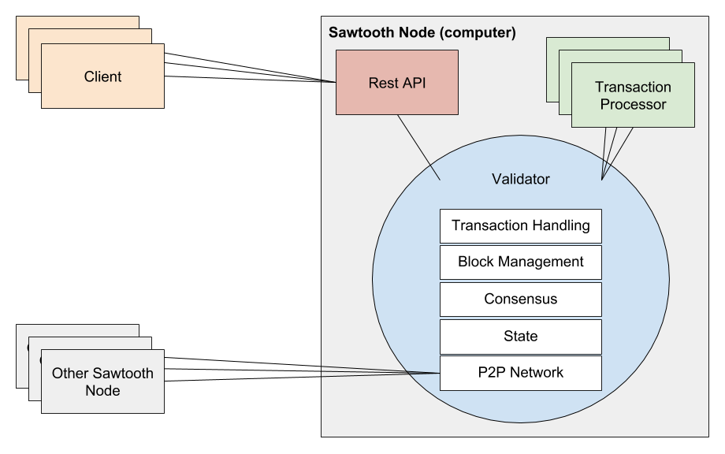
Overview of Sawtooth Architecture
Set up needs:
Clients – these are the users of the system (Mobile app, desktop app etc.)
Validators – these are nodes that are authorized to validate and batch transactions into Sawtooth (mostly work on PoET consensus algorithm) – each Organization runs at least one and receives blocks that are broadcasted
Transaction processor – Server side business logic that operates on assets within the network (Sawtooth separates app layer from consensus and core framework layer) – each node needs one
Node – A peer on the Peer-to-peer Sawtooth network

Slide 41
Set up Sawtooth
Prerequisites:
  Needs set up of cURL, Git, Docker and Docker Compose on your mac (see link for details of set up)
Steps: (For Mac – Terminal)
  Download sawtooth-default.yaml (See Github repository link at the end of this document)
  Start and run Docker (See Docker download instructions separately)
  Run the command below from Terminal (from the location of the .yaml file)
    $ docker-compose -f sawtooth-default.yaml up
    Will download Docker images for Sawtooth, may take a few minutes
  Next log in to the container
      $ docker exec -it sawtooth-shell-default bash
      If successful, you should see something like root@75b380886502:/# (this is the client container)
  Test to see if Validator is up and running and accessible from Client container
    $ curl http://rest-api:8008/blocks
    You should see json object response with “data”, array of batches, header, etc
  Test to confirm connectivity from host computer (run this in a separate terminal window)
    $ curl http://localhost:8008/blocks
    You should see the same json object response with “data”, array of batches, etc.
You will now need to create the Validators, Transaction Processors, etc. - A sample repository is available here:
  $ git clone https://github.com/hyperledger/education.git
  $ cd education/LFS171x/sawtooth-material/sawtooth-tuna
Next step is to set up and run State entries for “Assets” and “Transfers” (More on this later – interested folks can try this independently

Slide 42
Requirements and Limitations - Issues to deal with
Should not have anything else running on port 8008 or port 4004 (I am trying to trouble shoot the port 4004 not accessible docker error)
The instance that is set up needs to run in the terminal window (you use another terminal window to run any commands). To bring this down you need to:
  First press Ctrl+c
  Then run: $ docker-compose -f sawtooth-default.yaml down
  This is one limitation of using this Dev type setup. You will need a machine that runs docker compose to keep the environment live; as any work will be lost once you exit the container (unless you are mounting a host directory into the container – not sure how to do this)
The application and Business logic still needs to be brainstormed and written separately

Slide 43
Other Options / Evaluations
AWS Blockchain is an option – but it appears this is not free for the first 12 months as advertised (need to understand the commercial model, there is a per hour and per gig price besides the 12 month free trial)
Multiple laptops / macs set up in a lab environment
Mounting a host directory into the container

Slide 44
Few useful links
An Introduction to Hyperledger Blockchain Technologies Provided by The Linux Foundation (LinuxFoundationX)
  https://www.edx.org/course/blockchain-for-business-an-introduction-to-hyperledger-technologies
  The above is a free course and you only need to pay if you want to get a verified certificate
Github repository for Sawtooth set up files:
  https://github.com/Git-Prabhu/Hyperledger.git
Docker container download and set up:
  https://docs.docker.com/docker-for-mac/install/

Slide 45
Checkpoint 3 Technical :
Colin Pinto Microtrac Inc & Shaantek Consultants / Mohanram Teekah https://wiki.hyperledger.org/display/LMDWG/Working+Space
This write-up is more appropriate for a workspace dedicated to the Technical Working Group - perhaps this one can be repurposed.
An assignment for the technical working group as part of Checkpoint #3 was to prepare suggestions for the Business Network Model including STATE and ASSETS.
An Excel document will be provided that includes the information below. These recommendations are to be peer reviewed by members of the Technical Working Group. These are not final thoughts - just ideas to stimulate initial design discussions in preparation for constructing our Minimum Viable Product/POC.
Colin Pinto Microtrac Inc & Shaantek Consultants
https://wiki.hyperledger.org/display/LMDWG/Working+Space

Slide 46
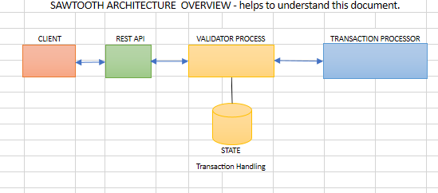
Business Network Information
Prepared by: Gary T.

Slide 47
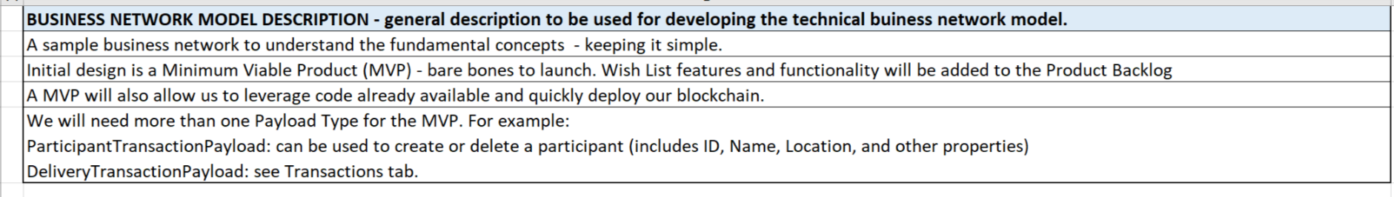
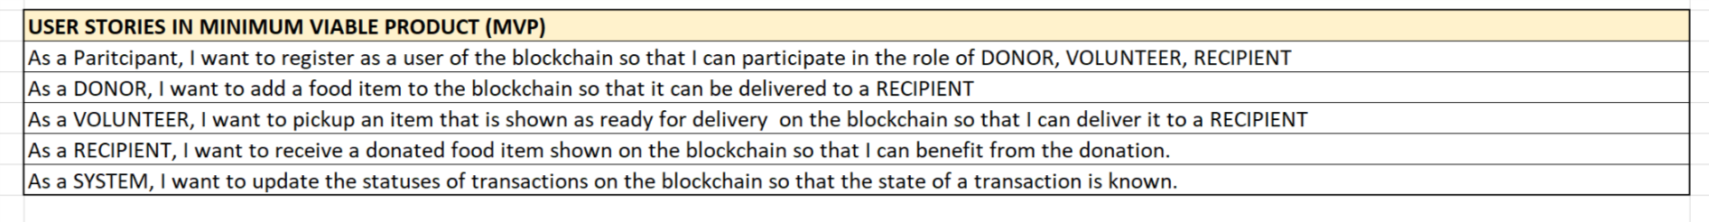
Business Networks and Transaction
Business Network

Slide 48
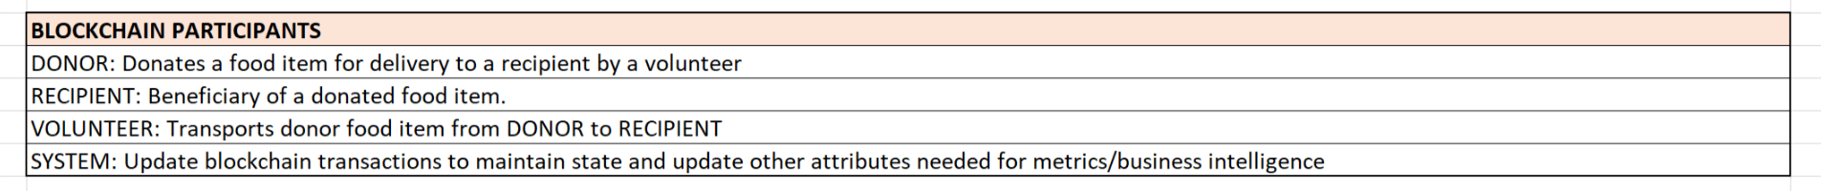
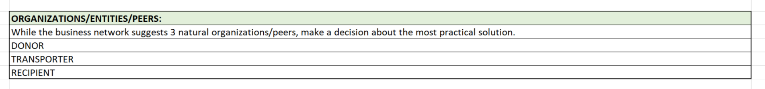
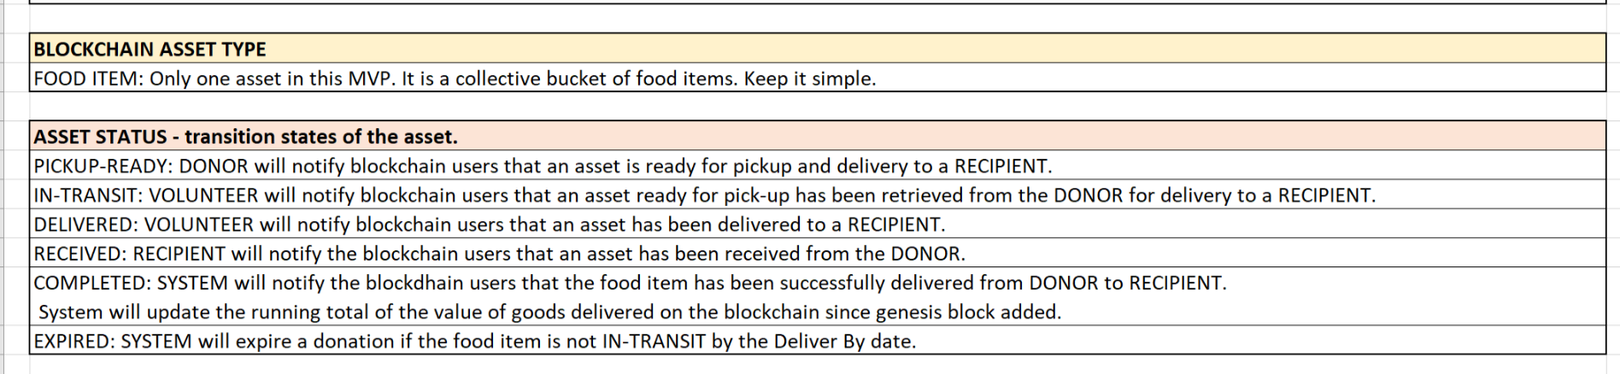
Business Network

Slide 49
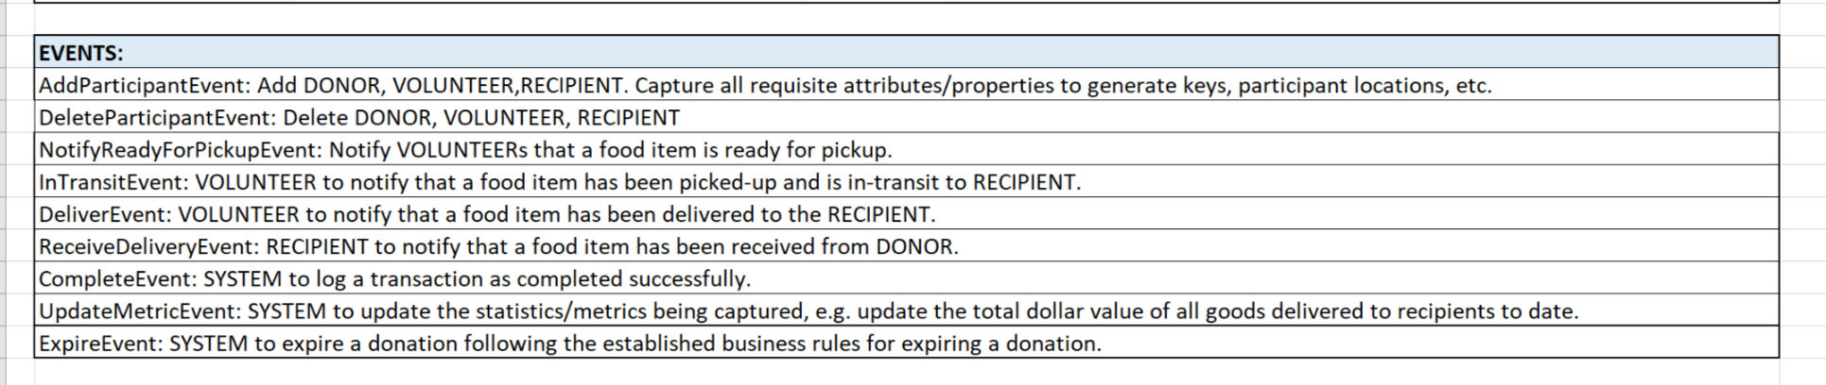
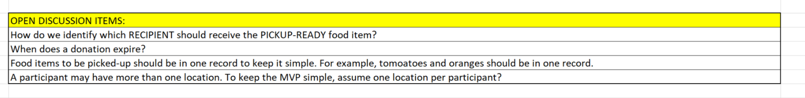
Business Network

Slide 50
Transactions
TRANS ID | STATUS | DONOR | VOLUNTEER | RECIPIENT | FOOD ITEM (ASSET) | ITEM-ID | ITEM VALUE | DELIVER-BY MM/DD/YYYY, TIME | CREATED MM/DD/YYYY, TIME | RECORDED_BY | ITEM VALUE TOTAL TO DATE
Current ID+1 | PICKUP-READY | FARMER-1 |  |  | Tomatoes | TRANS ID + SEQ | $100.00 | 7/1/19 9:00 PM | 7/1/19 10:00 AM | Donor-ID/Key
Current ID+1 | IN-TRANSIT | FARMER-1 | VOLUNTEER-1 | FOOD BANK-1 | Tomatoes | TRANS ID + SEQ | $100.00 | 7/1/19 9:00 PM | 7/1/19 6:00 PM | Volunteer-ID/Key
Current ID+1 | DELIVERED | FARMER-1 | VOLUNTEER-1 | FOOD BANK-1 | Tomatoes | TRANS ID + SEQ | $100.00 | 7/1/19 9:00 PM | 7/1/19 6:30 PM | Volunteer-ID/Key
Current ID+1 | RECEIVED | FARMER-1 | VOLUNTEER-1 | FOOD BANK-1 | Tomatoes | TRANS ID + SEQ | $100.00 | 7/1/19 9:00 PM | 7/1/19 6:30 PM | Reciever-ID/Key
Current ID+1 | COMPLETED | FARMER-1 | VOLUNTEER-1 | FOOD BANK-1 | Tomatoes | TRANS ID + SEQ | $100.00 | 7/1/19 9:00 PM | 7/1/19 6:30 PM | System-ID/Key | Current Total + Item Value
Current ID+1 | PICKUP-READY | FARMER-2 |  |  | Oranges | TRANS ID + SEQ | $100.00 | 7/2/19 6:00 PM | 7/1/19 3:00 PM | Donor-ID/Key
Current ID+1 | EXPIRED | FARMER-2 | VOLUNTEER-3 | CHURCH PANTRY-3 | Oranges | TRANS ID + SEQ | $50.00 | 7/2/19 6:00 PM | 7/2/19 6:00 PM | System-ID/Key

Slide 51
Product Backlog
PRODUCT BACKLOG ITEMS - future system implementation
As a VOLUNTEER, I want to return an item in-transit if it cannot be delivered so that the DONOR can retain ownership of the goods donated.

Slide 52
PROTOTYPE
Presented by: Prabhu (pcube@hotmail.com)
POC / Prototype
The deck contains screenshots of a Prototype / POC developed on the Sawtooth framework using starter code available on Github of edX.
The purpose is to validate our thoughts and iterate any changes for further development.
For anyone interested in experimenting or in further development, you are welcome to fork the repository available at this link (or use the template - click green button that says "Use this template"): https://github.com/Git-Prabhu/Sawtooth.git

Slide 53
Hyperledger Sawtooth
Donor Blockchain for Summer Project (Ledger Academy)

Slide 54
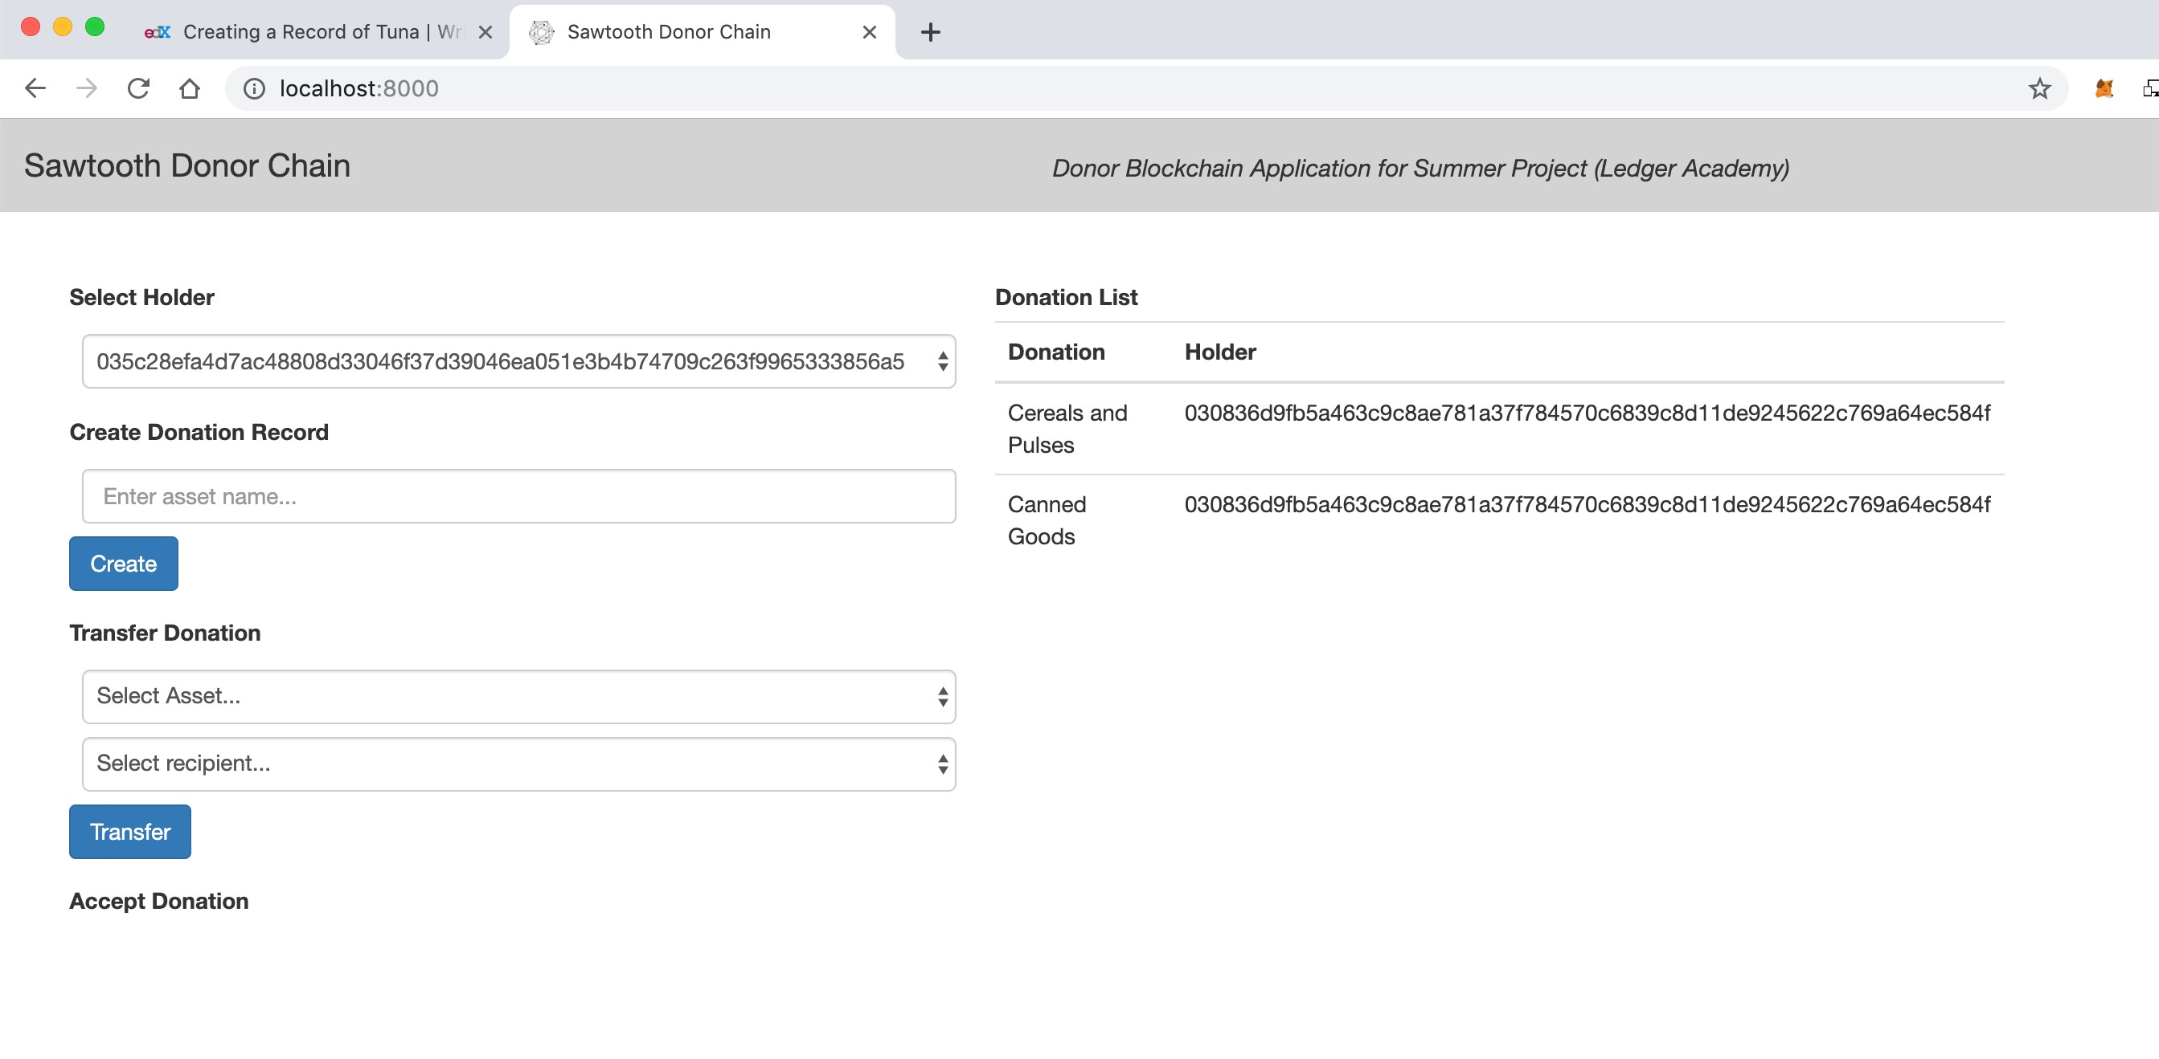
Donor Blockchain - View

Slide 55
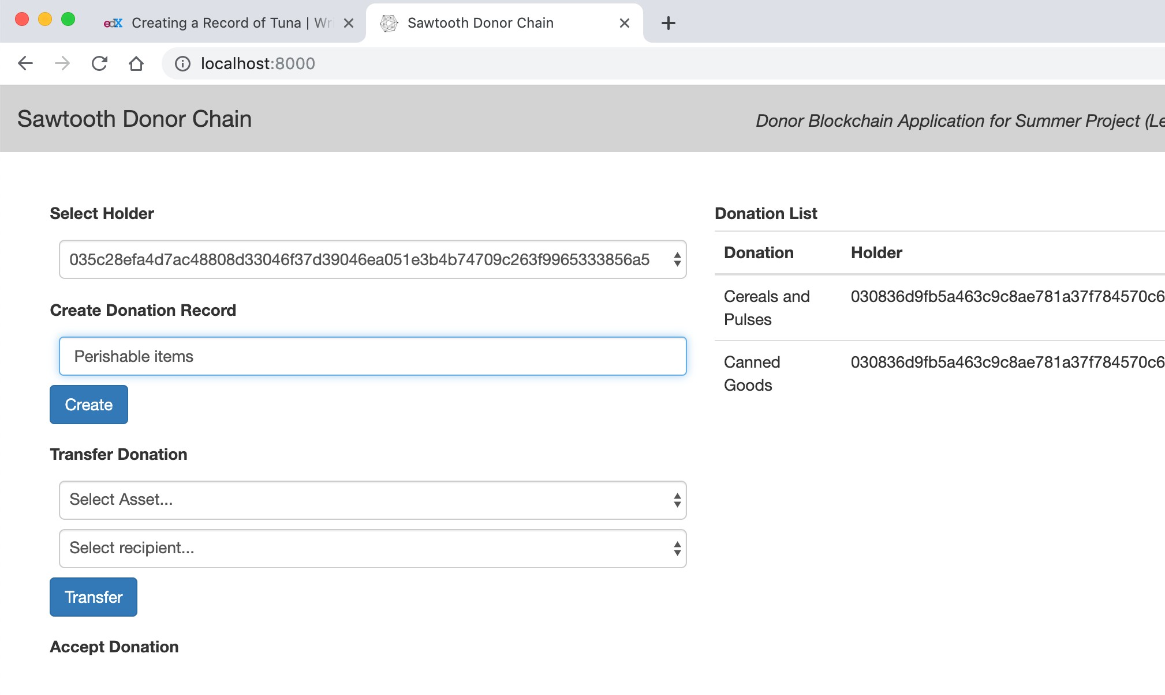
Donor Blockchain - Donation record

Slide 56
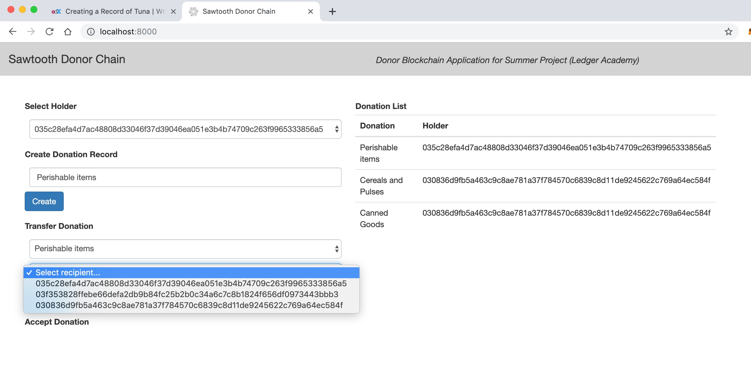
Donor Blockchain - Transfer

Slide 57
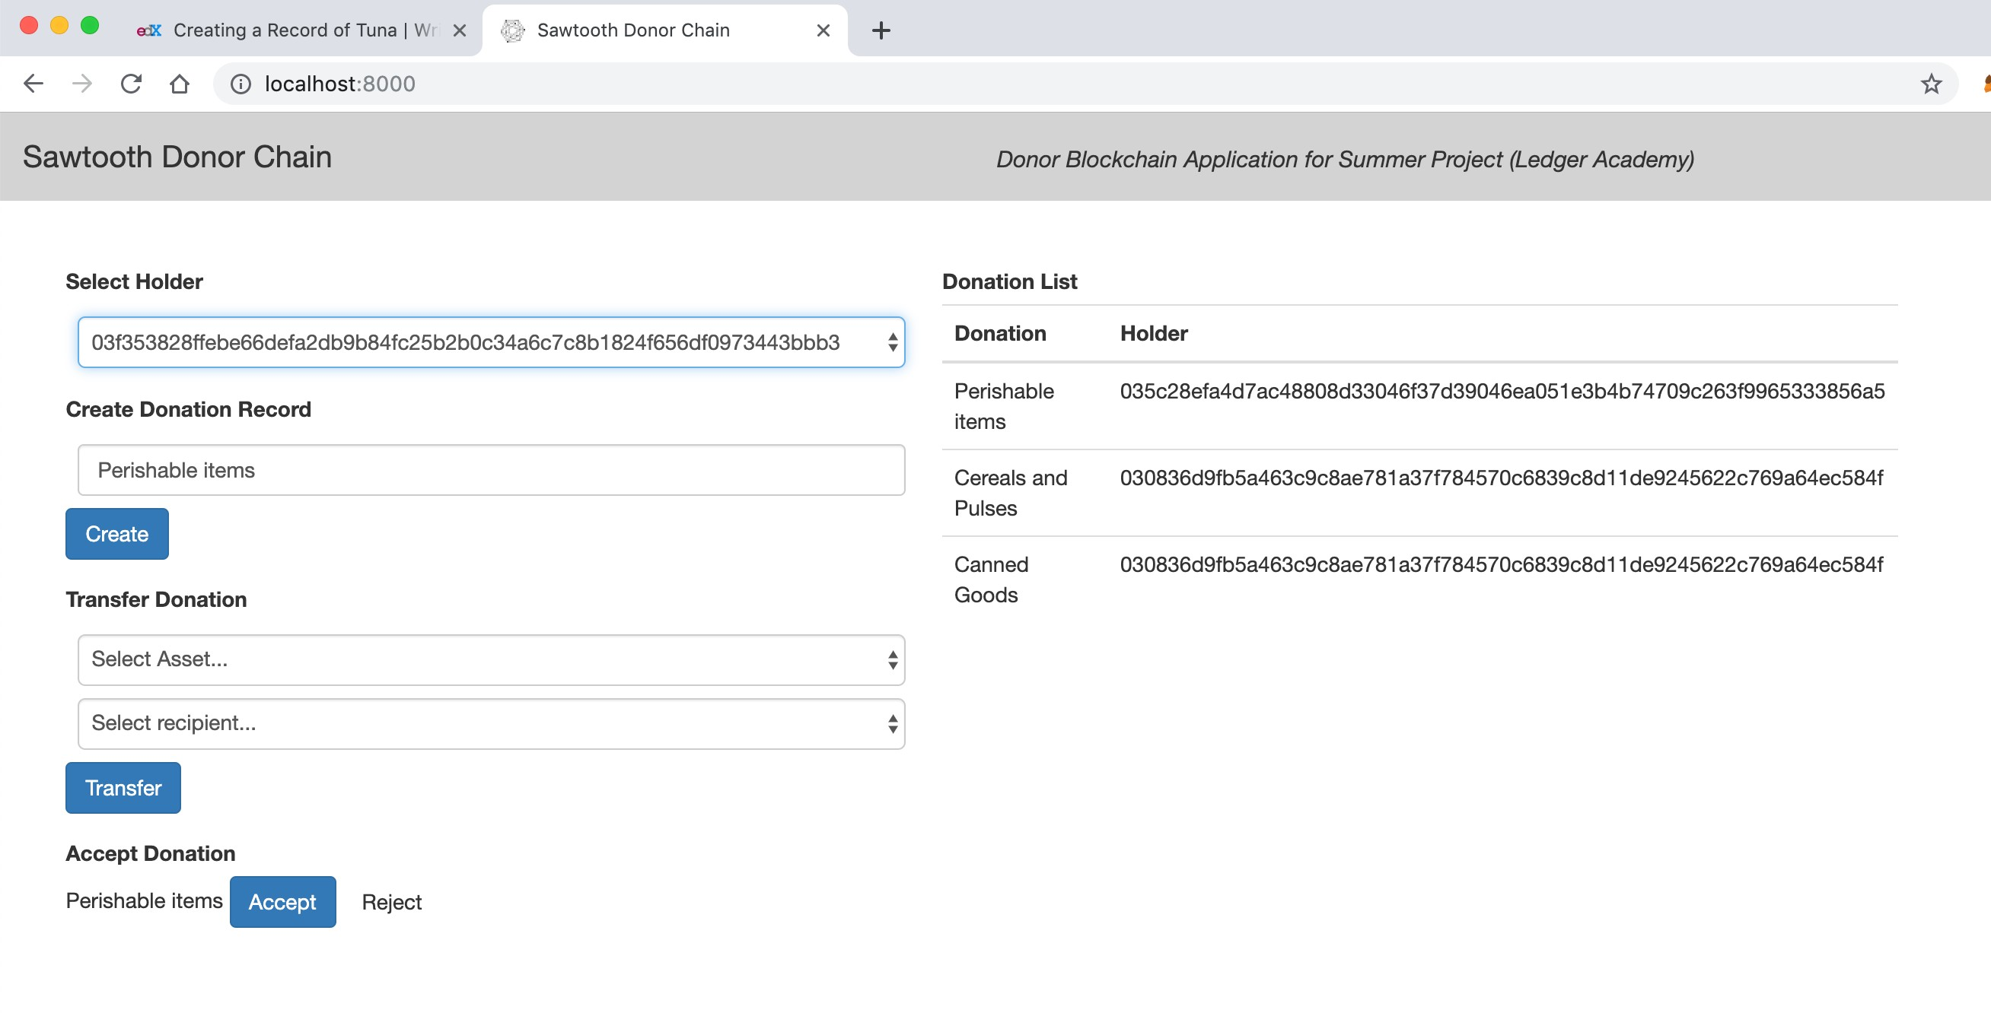
Donor Blockchain - Accept Donation

Slide 58
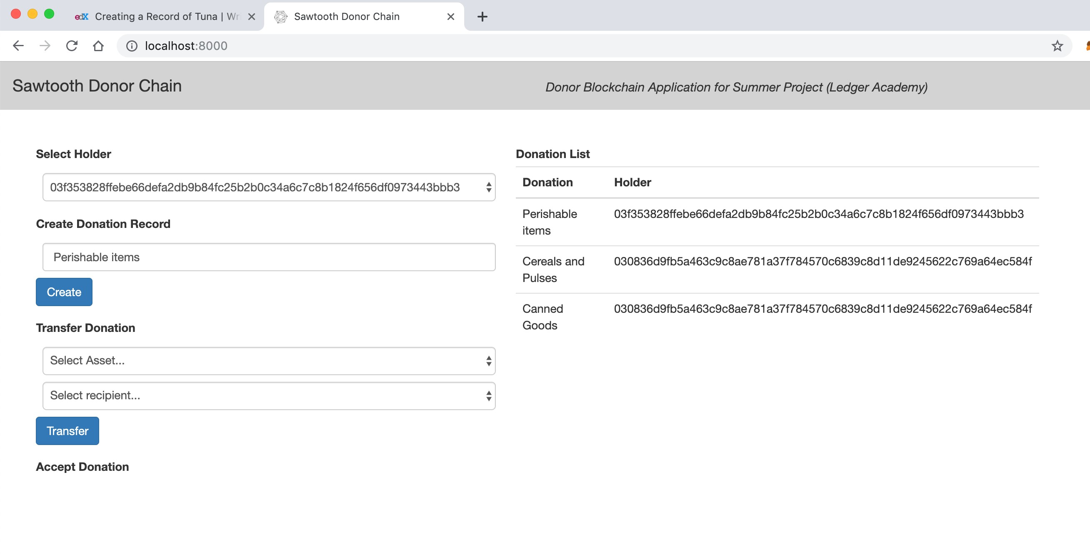
Donor Blockchain - Change in Holder

Slide 59
Key Takeaways
Farmer records data for food supply treating that as a single batch of transactions. As a reminder, a batch is a cluster of transactions that are committed to state together. Using a batch, Farmer is able to record everything together, while still being able to specify data for each individual item. If one of the item transaction is invalid, the entire shipment is invalidated; that is, nothing within the batch of food supply is validated.
A Batch of many transactions can be submitted to the network, the network’s consensus algorithm would choose a node to publish this batch as a block on the ledger
If the Proof of Elapsed Time consensus algorithm is used, the validator with the shortest wait time publishes the transaction block. The transaction block is then broadcasted to the publishing nodes.
To start, a user creates a batch containing one or more transactions, and submits it to a validator, usually via a client that communicates with a REST API. The validator then checks the transactions and applies the batch if all transactions are considered valid, resulting in a change to the state. In our case, Farmer creates a batch with attributes such as unique ID, farmer’s name, location, food item specifics , timestamp , quantity etc. Depending on decision of what attributes are mandatory, a batch of transaction will be accepted by validated and applied and global state will be updated.
Currently, Hyperledger Sawtooth supports the following consensus implementations:
•
Proof of Elapsed Time, or PoET, a Nakamoto-style consensus algorithm that is designed to be a production-grade protocol capable of supporting large networks
•
Dev mode, a simplified random-leader algorithm that is useful for development and testing on single-node or small networks.
With PoET , we need to be mindful of forks being created . For our purpose, therefore Dev mode can make more sense .

Slide 60
Discussion
Housekeeping
Princeton Blockchain Community
Blockchain and Social Impact Projects
Summer Blockchain Project
Discussion
Moving Forward
Notes:
David

Slide 61
Moving Forward
Housekeeping
Princeton Blockchain Community
Social Impact Projects
Summer Blockchain Project
Discussion
Moving Forward
Notes:
David

Slide 62
PRINCETON BLOCKCHAINFOR SOCIAL IMPACT
June12 , 2019
Schedule: Tiger Labs
Checkpoint 3 Technical Architecture
Next Working Group July 10th
Next Presentation:
  July 16th
Five checkpoints to be presented at meetups:
Impact Opportunity
Business Model Validation
Technical Architecture
Impact Measurement Prototype
Delivery.

Slide 63
THANK YOU
Notes:
David

Slide 64
Hi Bobbi,
I see that you recently have shown interest in Microsoft Azure, and I'd like to offer our support in answering any questions you might have as you get started.
Our team of Microsoft certified partners can answer questions about getting started, architecture and design, or help with a proof of concept. They're also happy to help with any pricing or estimating questions you may have.
Would you like me to connect you with a Microsoft certified partner?
Thanks,
David Kitchen | Automated Solution Assistant
Microsoft Corporation
One Microsoft Way
Redmond, WA 98052 USA

