Slide 1
Welcome to
Blockchain Summer Project hosted by:
Hyperledger Princeton * Blockchain Princeton *
Blockchain Fundamentals * Ledger Academy
August 13, 2019

Slide 2
Blockchain Summer project

Slide 3
AGENDA
Housekeeping
Princeton Blockchain Community
Project Re-Cap Summer Blockchain Project
Discussion
Moving Forward
Notes:
David

Slide 4
Housekeeping
Housekeeping
Princeton Blockchain Community
Re-Cap Project Kickoff Meeting
Summer Blockchain Project
Discussion
Moving Forward
Notes:
David

Slide 5

HOUSEKEEPING
Tiger Labs:
Co-working Space in Princeton New Jersey
Current Home to Ledger Academy
Hyperledger Learning Materials Working Group
Meetup space for blockchain groups.

Slide 6
Princeton Blockchain Community
Housekeeping
Princeton Blockchain Community
Re-Cap Project Kickoff Meeting
Summer Blockchain Project
Discussion
Moving Forward
Notes:
David

Slide 7
meetups
HYPERLEDGER PRINCETON
  Hosted by Linux Foundation, is comprised of people interested in learning and developing projects using the Hyperledger solutions.
PRINCETON BLOCKCHAIN AND AI
  Princeton Blockchain and AI is focused on COMMUNITY. Discussions are developed by meetup participants.
BLOCKCHAIN FUNDEMENTALS / Ledger Academy
  Meetups focused on Education.

Slide 8
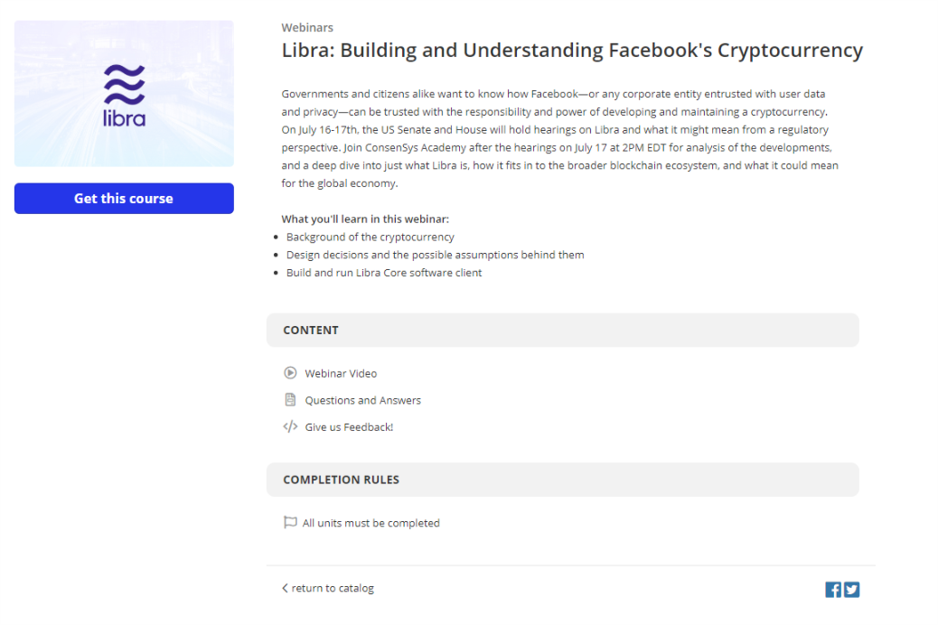
https://learn.consensys.net/catalog/info/id:169

Slide 9
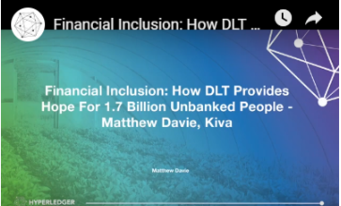
Social Impact
This week we have another awesome speaker lined up, Matthew Davie from Kiva who will be sharing their projects in blockchain including an impressive digital identity initiative in Sierra Leone and their involvement in Libra.

Slide 10
Hyperledger Communities
https://wiki.hyperledger.org/display/LMDWG/Learning+Materials+Development+Working+Group

Slide 11
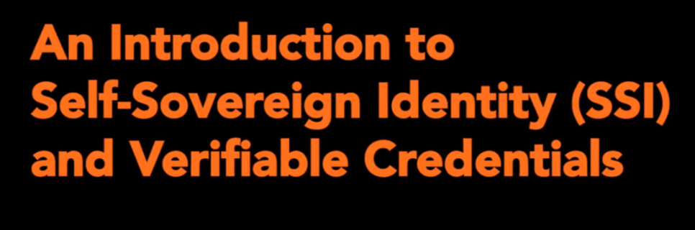
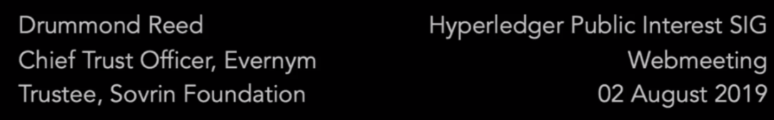
HYPERLEDGER PRINCETON
Digital Identity

Slide 12
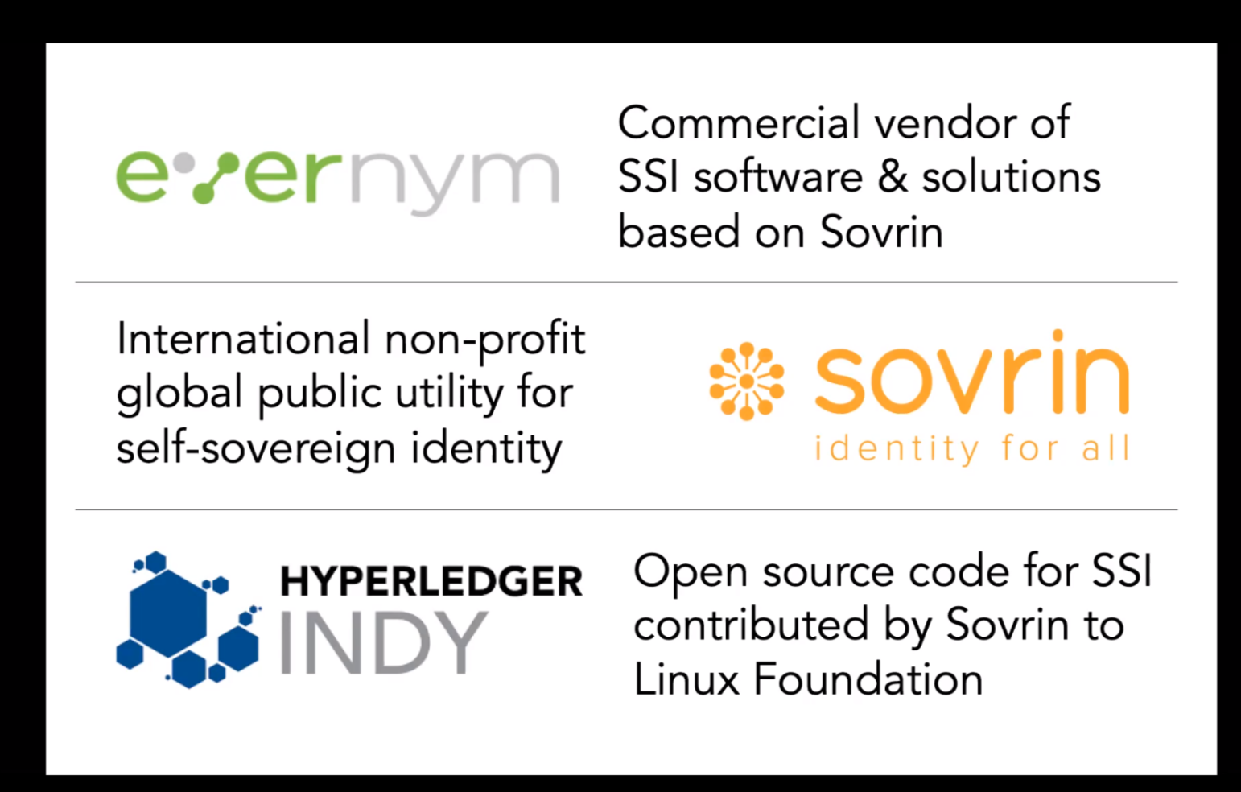

Slide 13
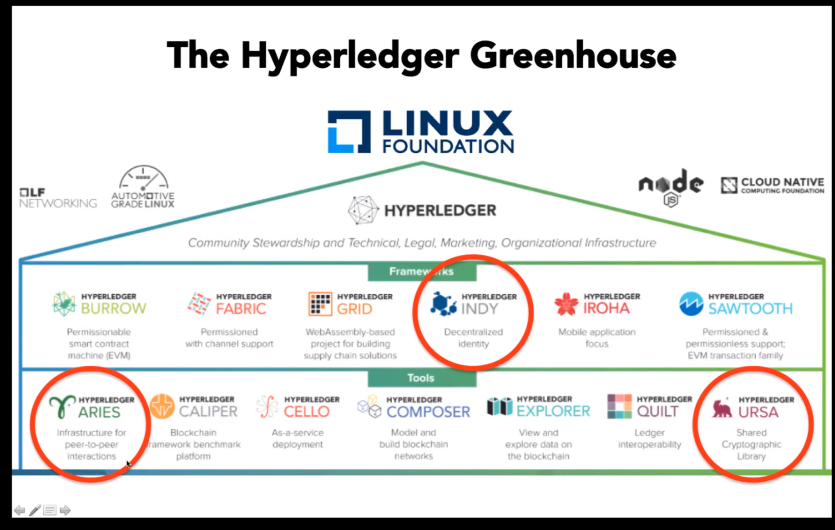

Slide 14
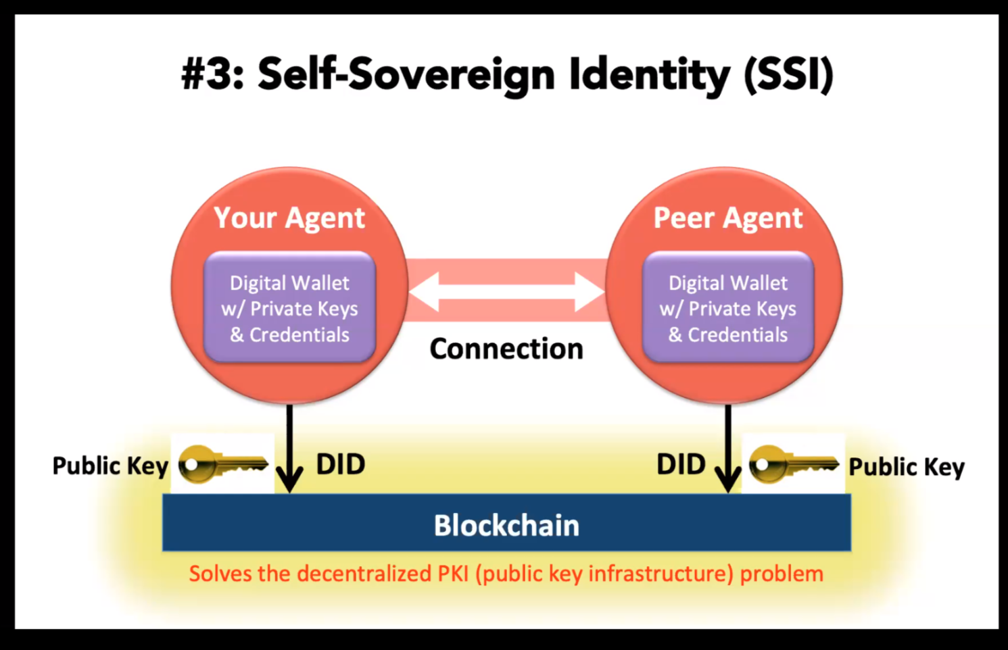
Aries
Ursa
Indy

Slide 15
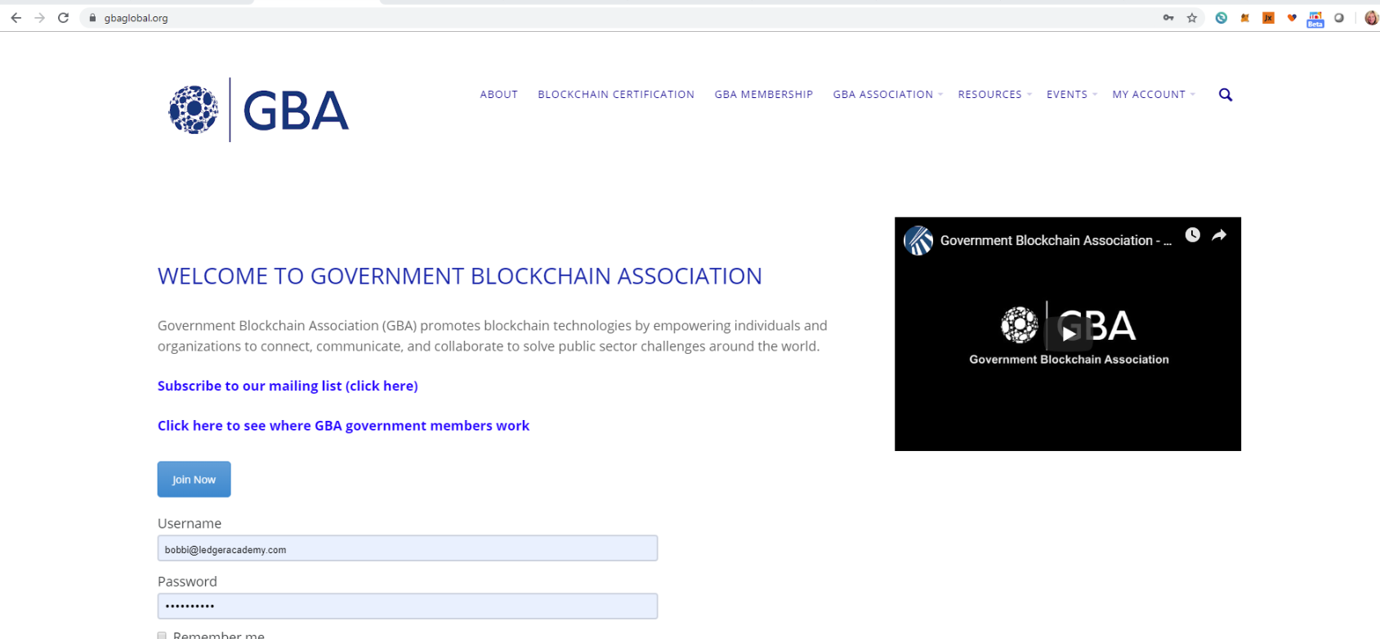
Blockchain Princeton
Bryant Nielson
chairman of the GBA Education & Training Working Group (ETWG).
Stepping down , If you are interested, it is my recommendation that you reach out to our Executive Director Gerard Dache or to Eric Guthrie for consideration of this role.m the "Education Working Group" group: https://www.gbaglobal.org/groups/education-working-group/

Slide 16
Blockchain Princeton
Wall Street Blockchain Alliance
Legal Working Group
Monday, August 19th from 11:00 am - 12:00 pm EST
WSBA Member only webinar with Maker
Wednesday, August 21st from 2:00 pm - 3:00 pm EST

Slide 17
Ledger Academy
The U.S. Securities and Exchange Commission delayed making a decision on three bitcoin exchange-traded fund (ETF) proposals Monday.
The ETFs, proposed earlier this year by asset managers
Bitwise Asset Management
VanEck/SolidX
Wilshire Phoenix,
and filed with exchanges NYSE Arca and Cboe BZX, are all seeking to become the first such investment vehicle based on bitcoin.
Final decisions on two of the proposals are now scheduled for September and October.
TEZOs ON COINBASE
Tezos (XTZ) now goes live here and in the Coinbase Android and Apple apps. Coinbase customers can now log in to sell, buy, convert, receive, send, or store XTZ."
— Coinbase (@coinbase) 8th of August, 2019

Slide 18
Launch of a new podcast called Venture Unplugged.
Each episode of Venture Unplugged brings a unique story of the trials, tribulations, and eventual triumphs that come with investing in any business — or starting your own. Guests featured on season one include:
Justin Kan (Founder, Twitch and Atrium)
Tim Draper (Founder, Draper University & Draper Associates)
Leah Busque Sollivan (Founder, TaskRabbit)
Jonathan Swanson (Founder, Thumbtack)
Joe Lubin, (Founder, Ethereum and Consensys)
Nick Grossman (Partner, USV)
Mike Novogratz (founder of Galaxy Digital)
Ben Cogan (Founder, Hubble Contacts)
Nick Greenfield (Founder, Candid Co)
Muneeb Ali (Founder, Blockstack)
Craig Elbert (Founder, Care/of)
https://blockworksgroup.io/venture-unplugged

Slide 19
Re-Cap Project Kick off Meeting
Blockchain for Social Imapct
Housekeeping
Princeton Blockchain Community
Re-Cap Project Kickoff Meeting
Summer Blockchain Project
Discussion
Moving Forward
Notes:
David

Slide 20
Blockchain and social responsibility
    Philanthropy and remittances (donation traceability, aid transparency, digital currencies in aid and development, governance and accountability)
    Financial empowerment (financial inclusion, microfinance, microinsurance)
    Identity and land rights (refugee assistance, land ownership documentation)
    Governance and democracy (fighting censorship and fake news, voting rights and protections, election integrity)
    Supply chain and environmental protections (sustainable supply chain, fair trade, ethical sourcing, fair labor practices)
Blockchain Summer Project Goals
following a project from idea to production
create a working blockchain project
have a positive impact in our area this summer
Work with a team using the latest collaboration tools
Build a project through checkpoints, Working Groups and Recaps.

Slide 21
Summer Blockchain Project
Housekeeping
Princeton Blockchain Community
Re-Cap Project Kickoff Meeting
Summer Blockchain Project
Discussion
Moving Forward
Notes:
Hyperledger Quilt
Business Blockchain Tool
● Contributed by NTT Data and Ripple
● Java implementation of the Interledger protocol
● Interledger protocol provides:
○ atomic swaps between ledgers (even non-blockchain or distributed ledgers)
○ a single account namespace for accounts within each ledger

Slide 22
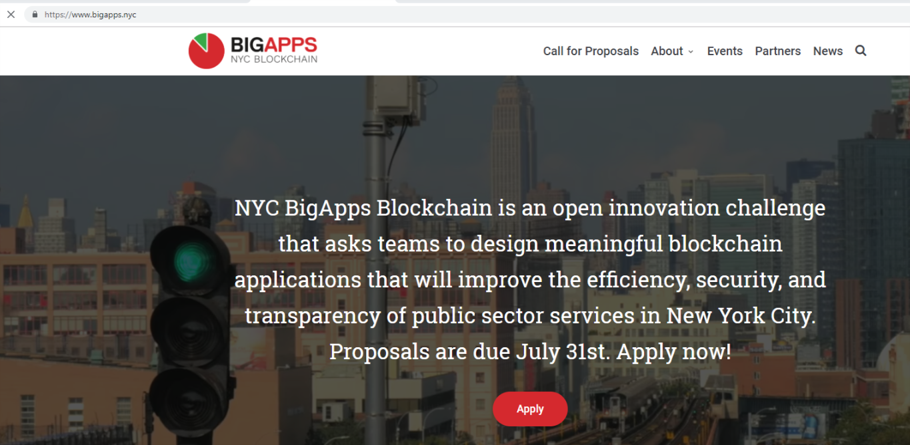
Big Apps Challenge

Slide 23
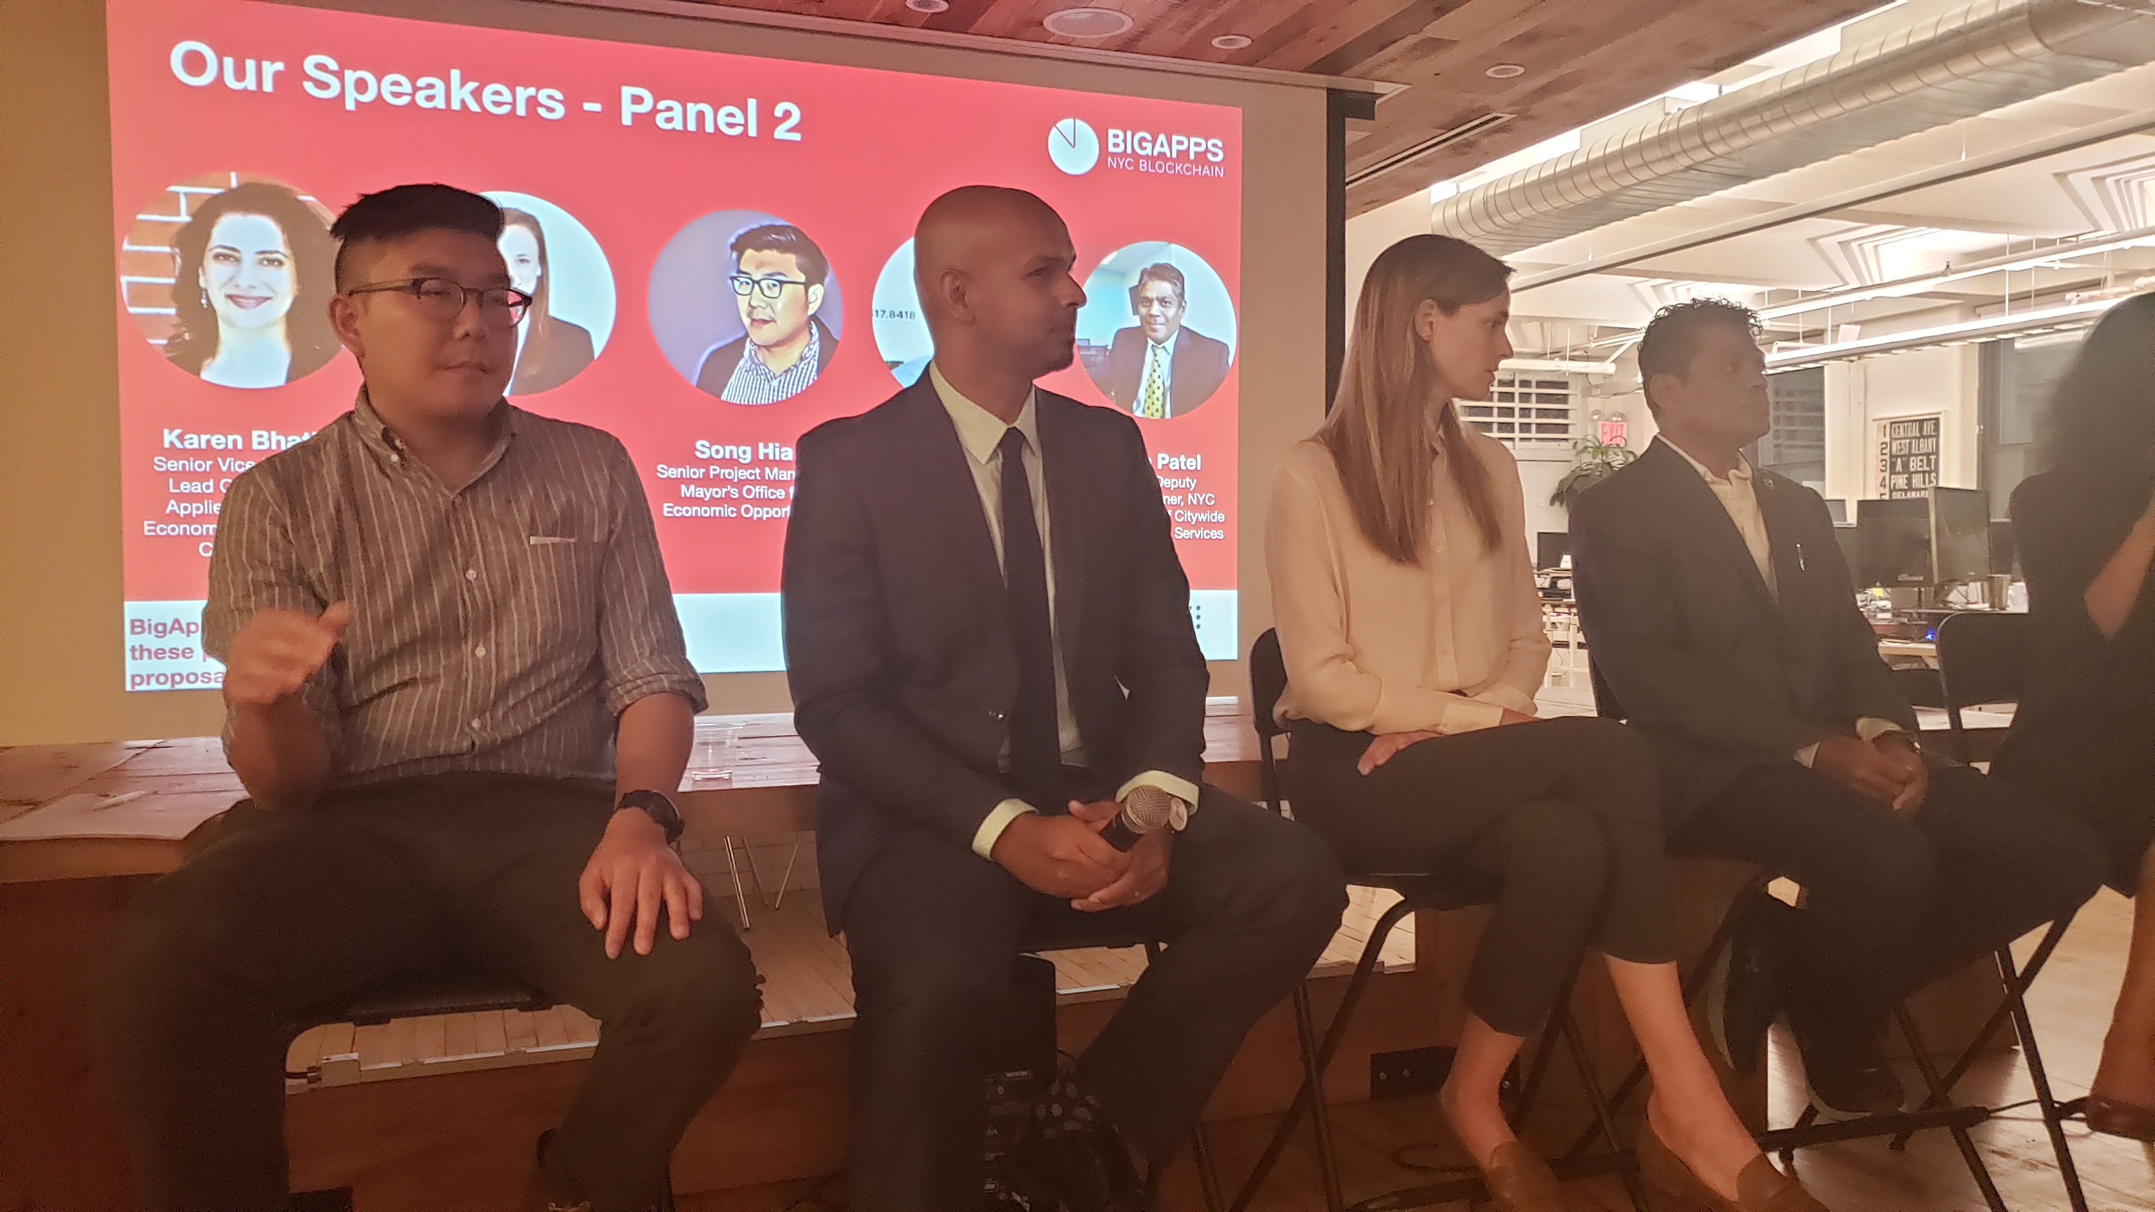
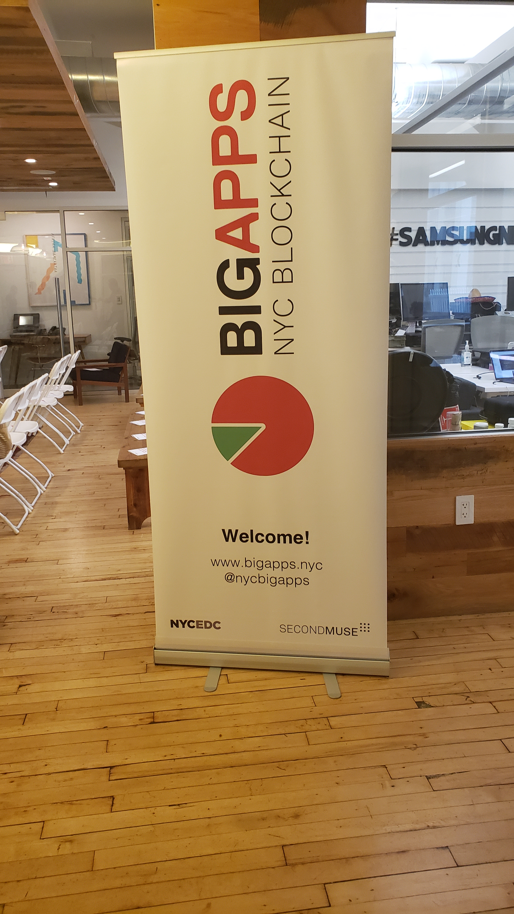
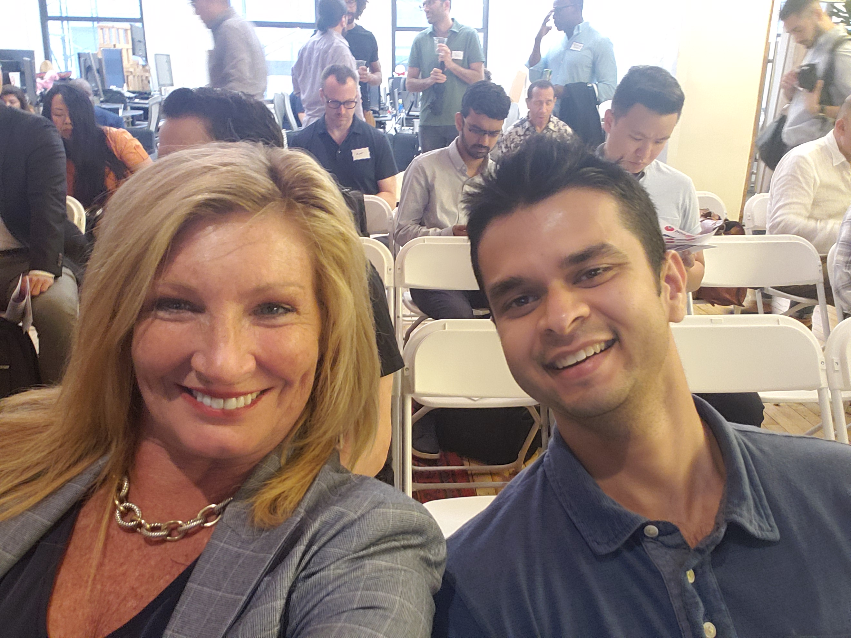
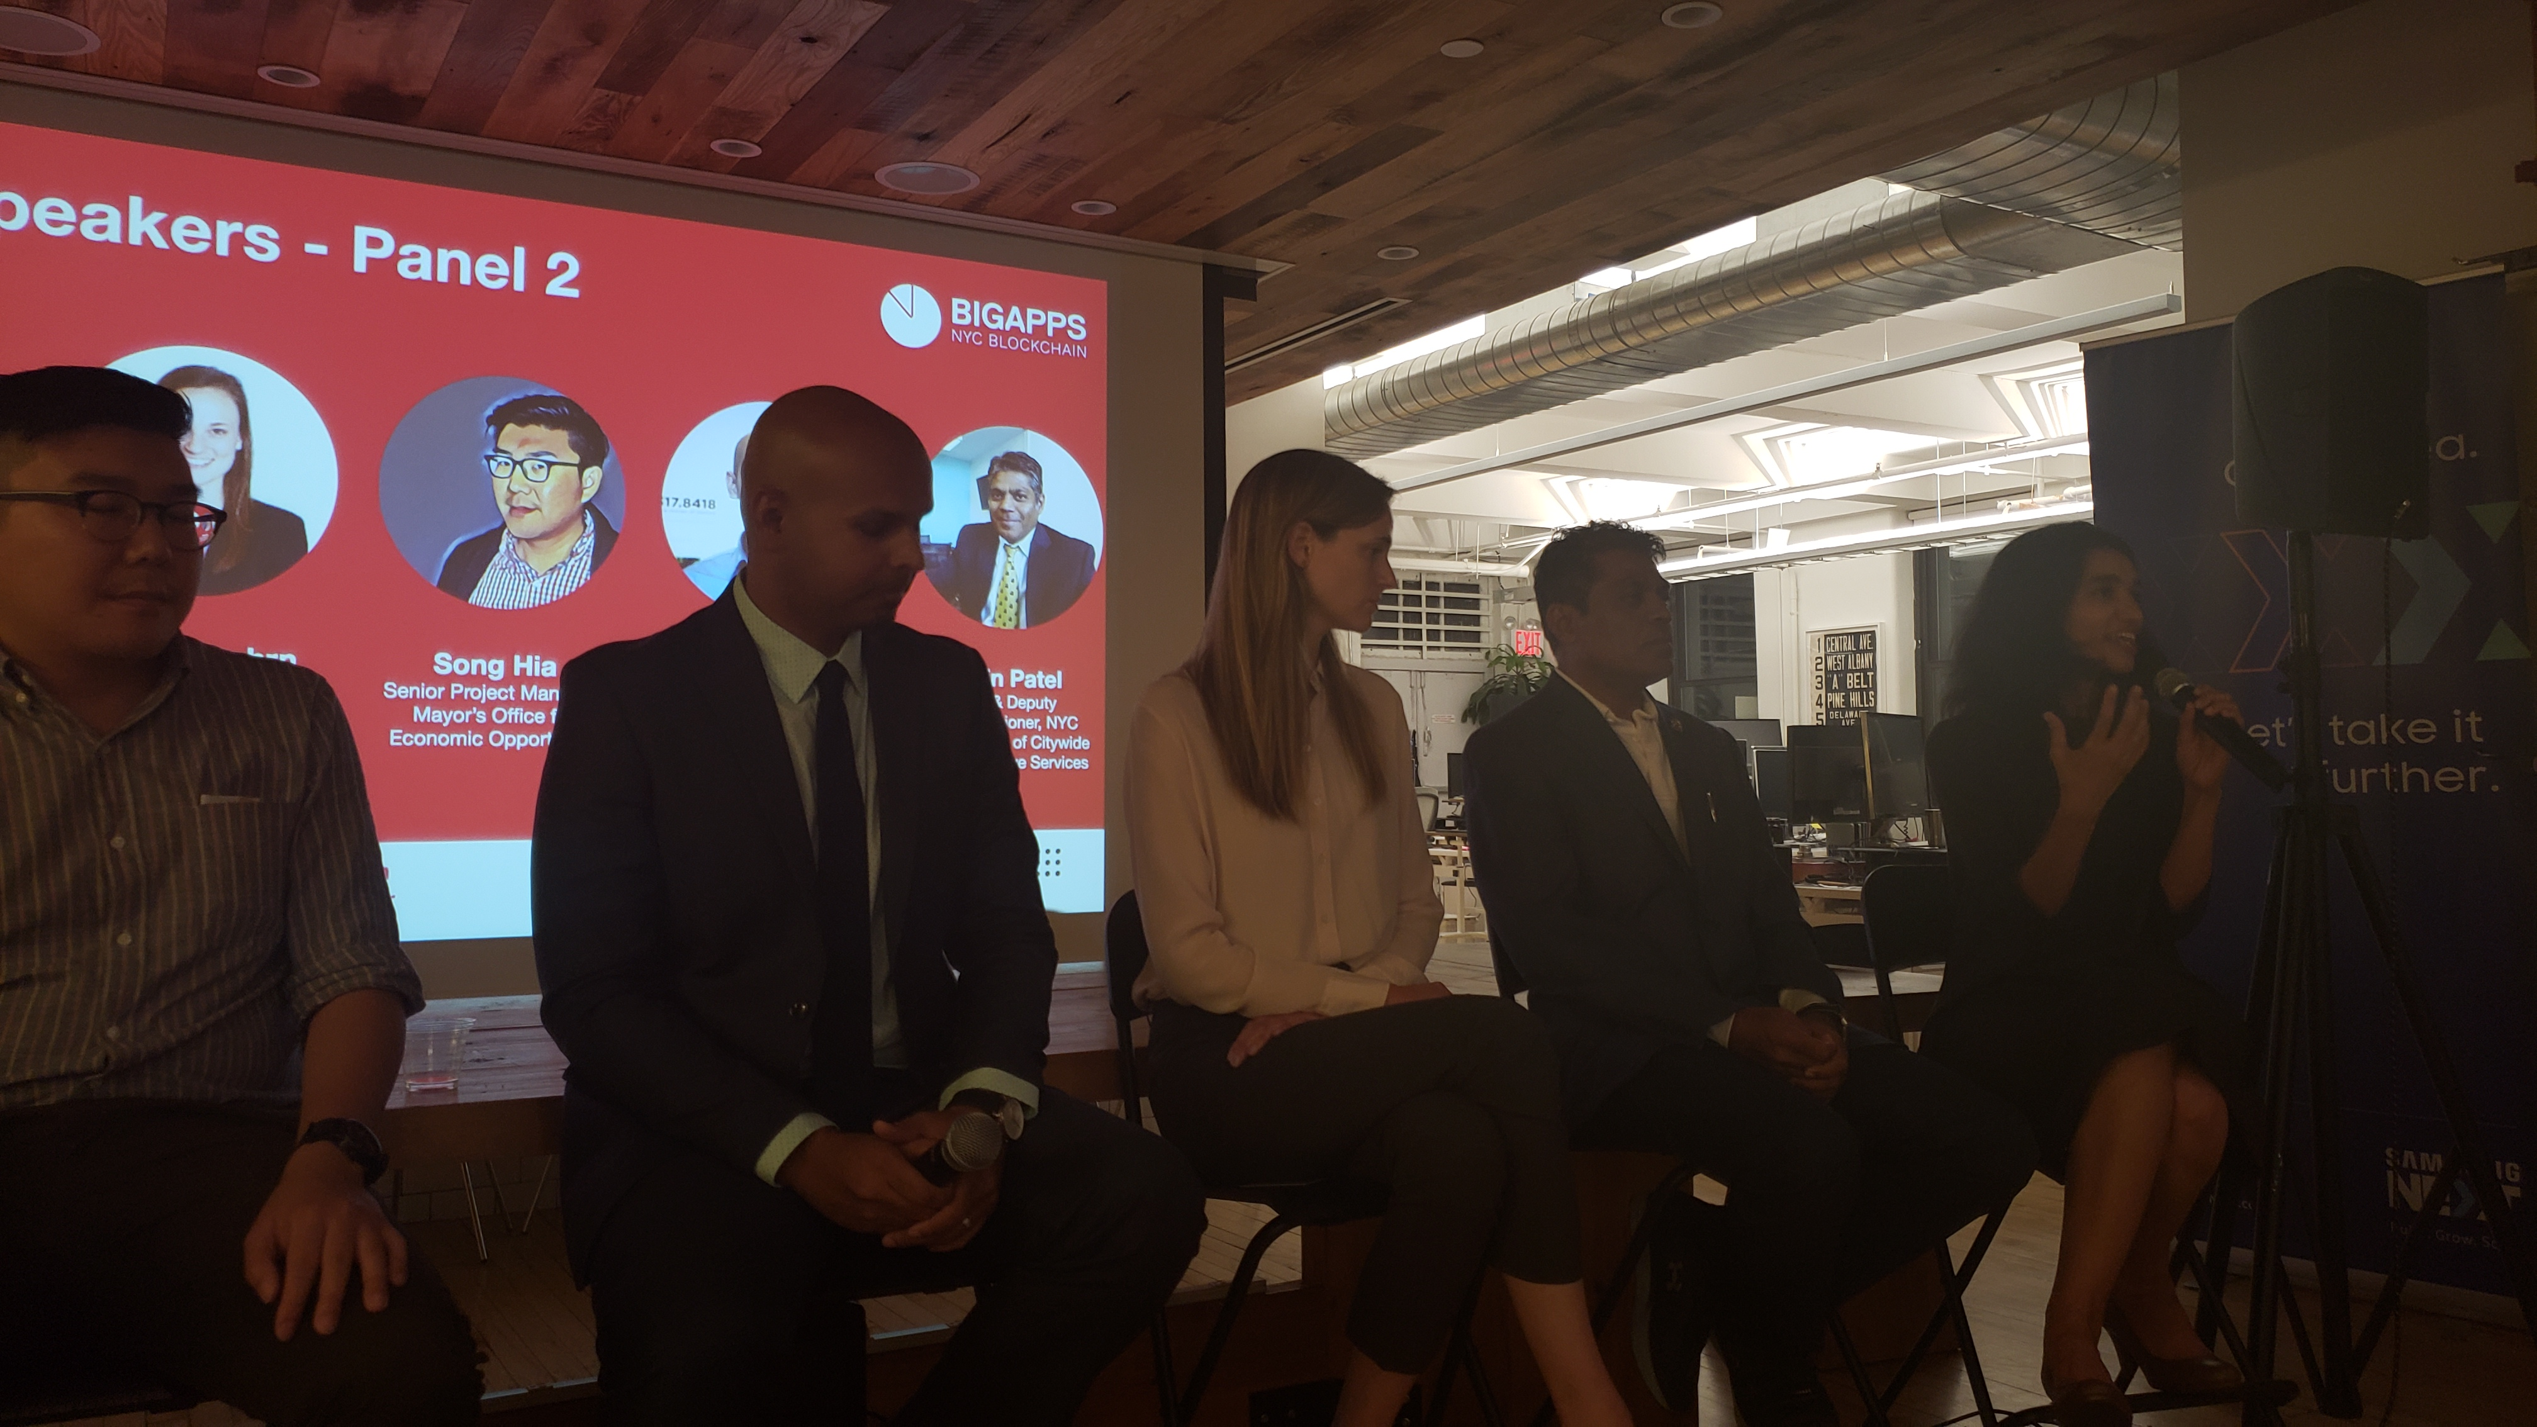

Slide 24
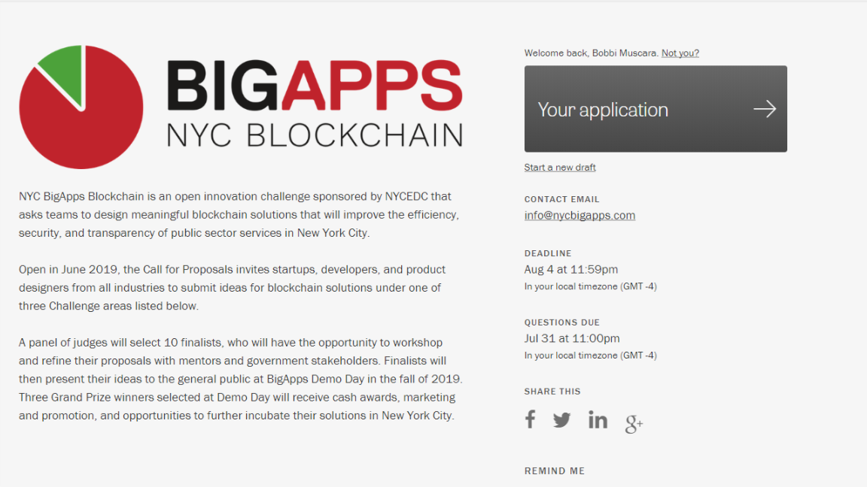

Slide 25
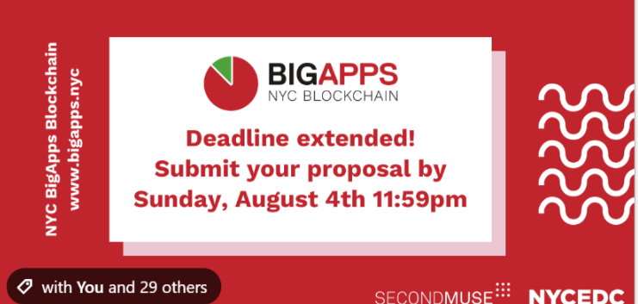

Slide 26
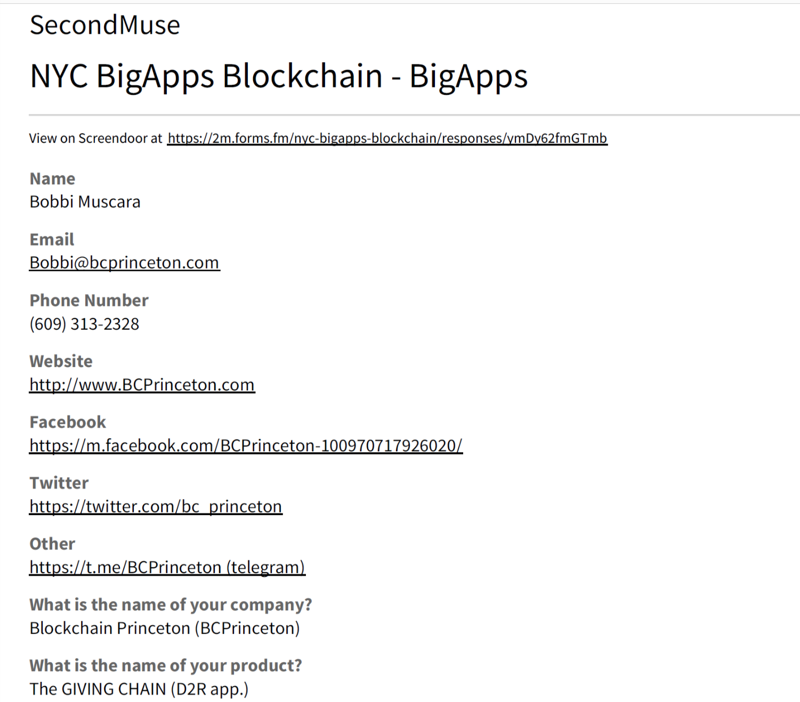

Slide 27
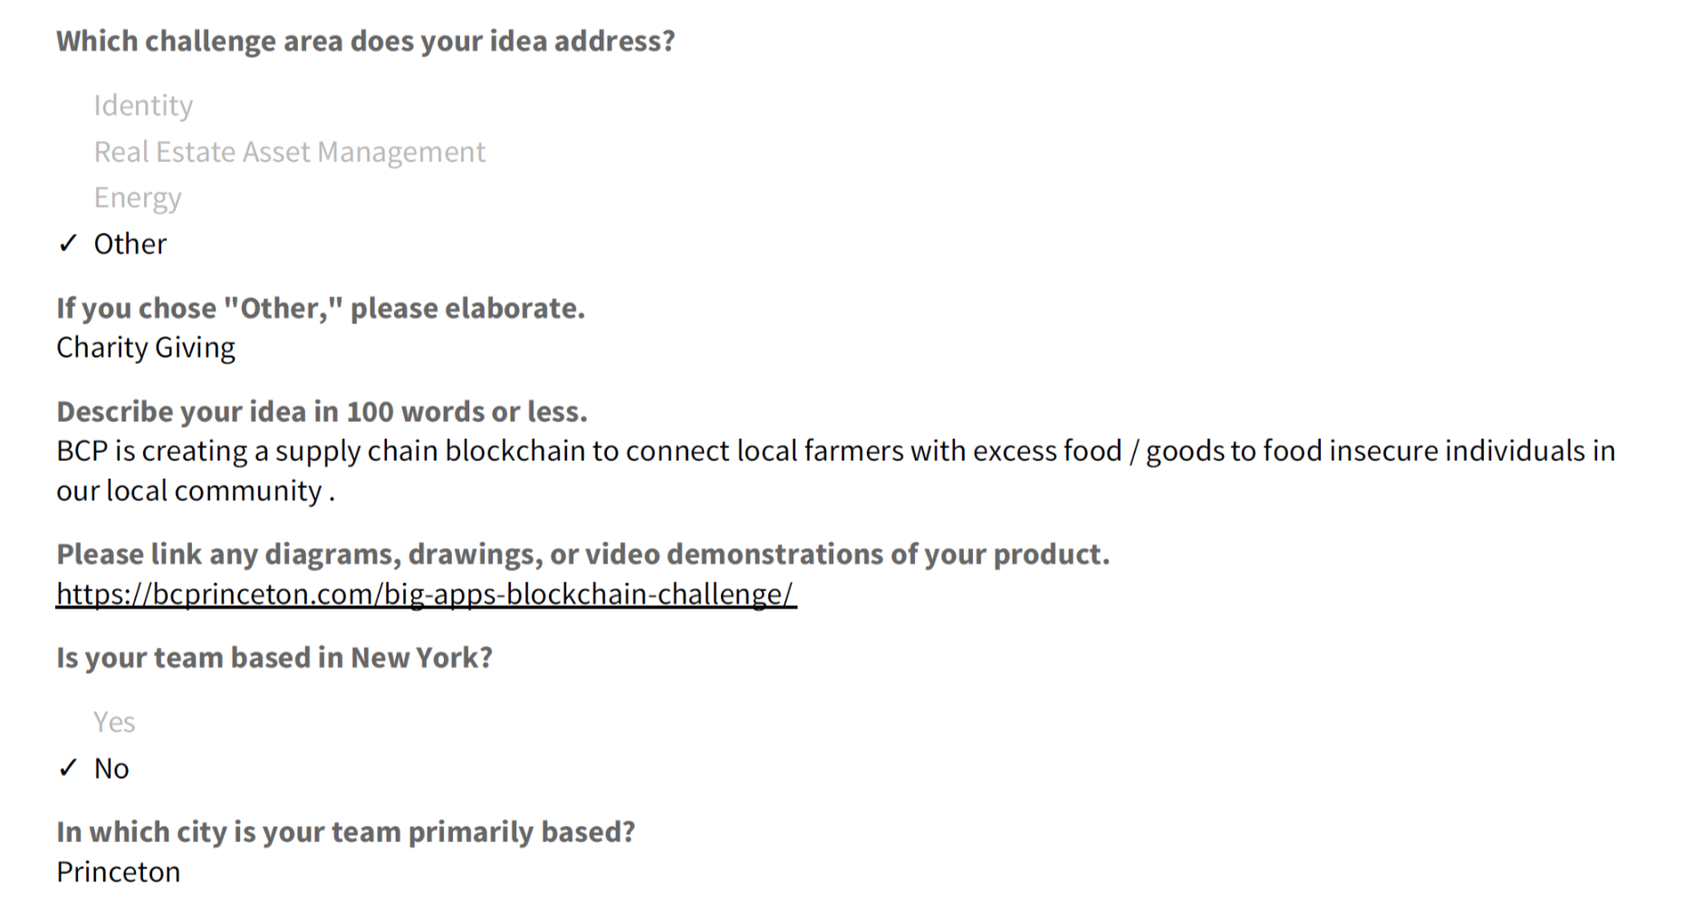

Slide 28
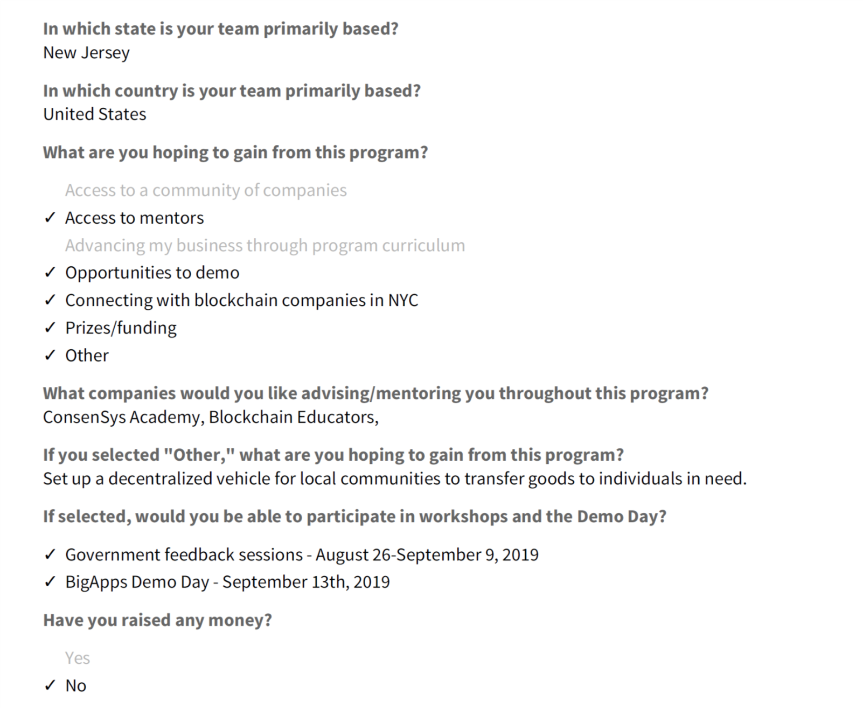

Slide 29
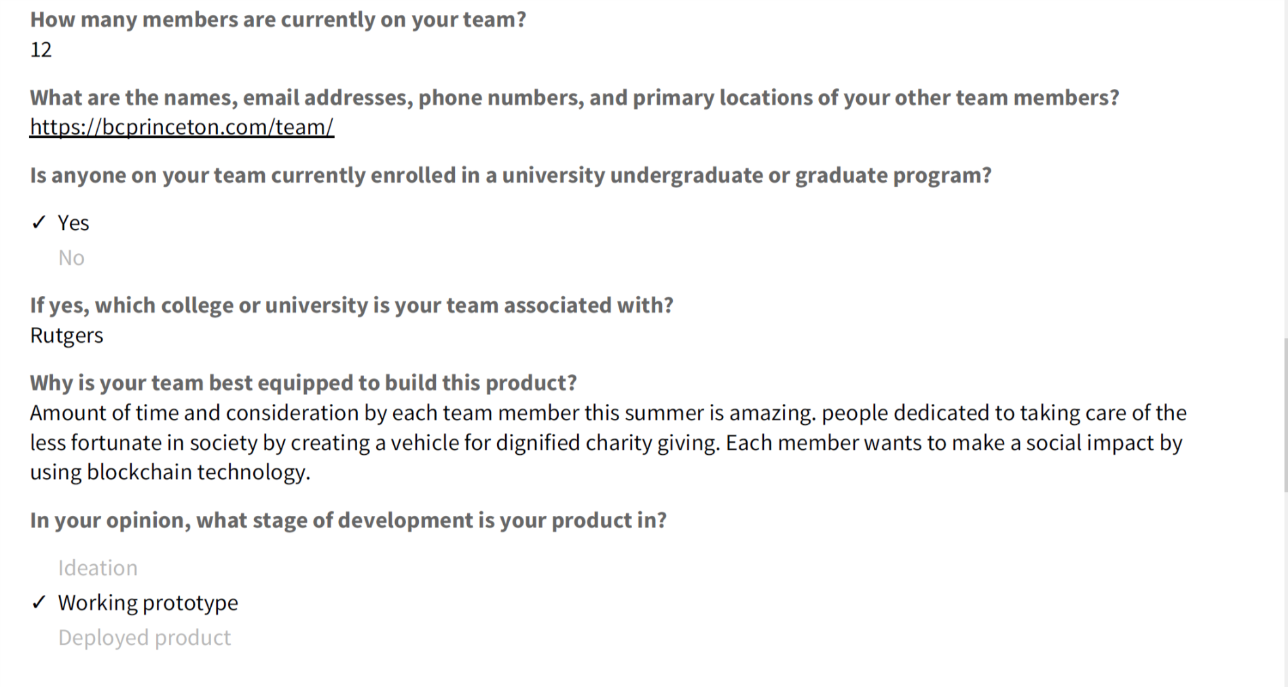

Slide 30
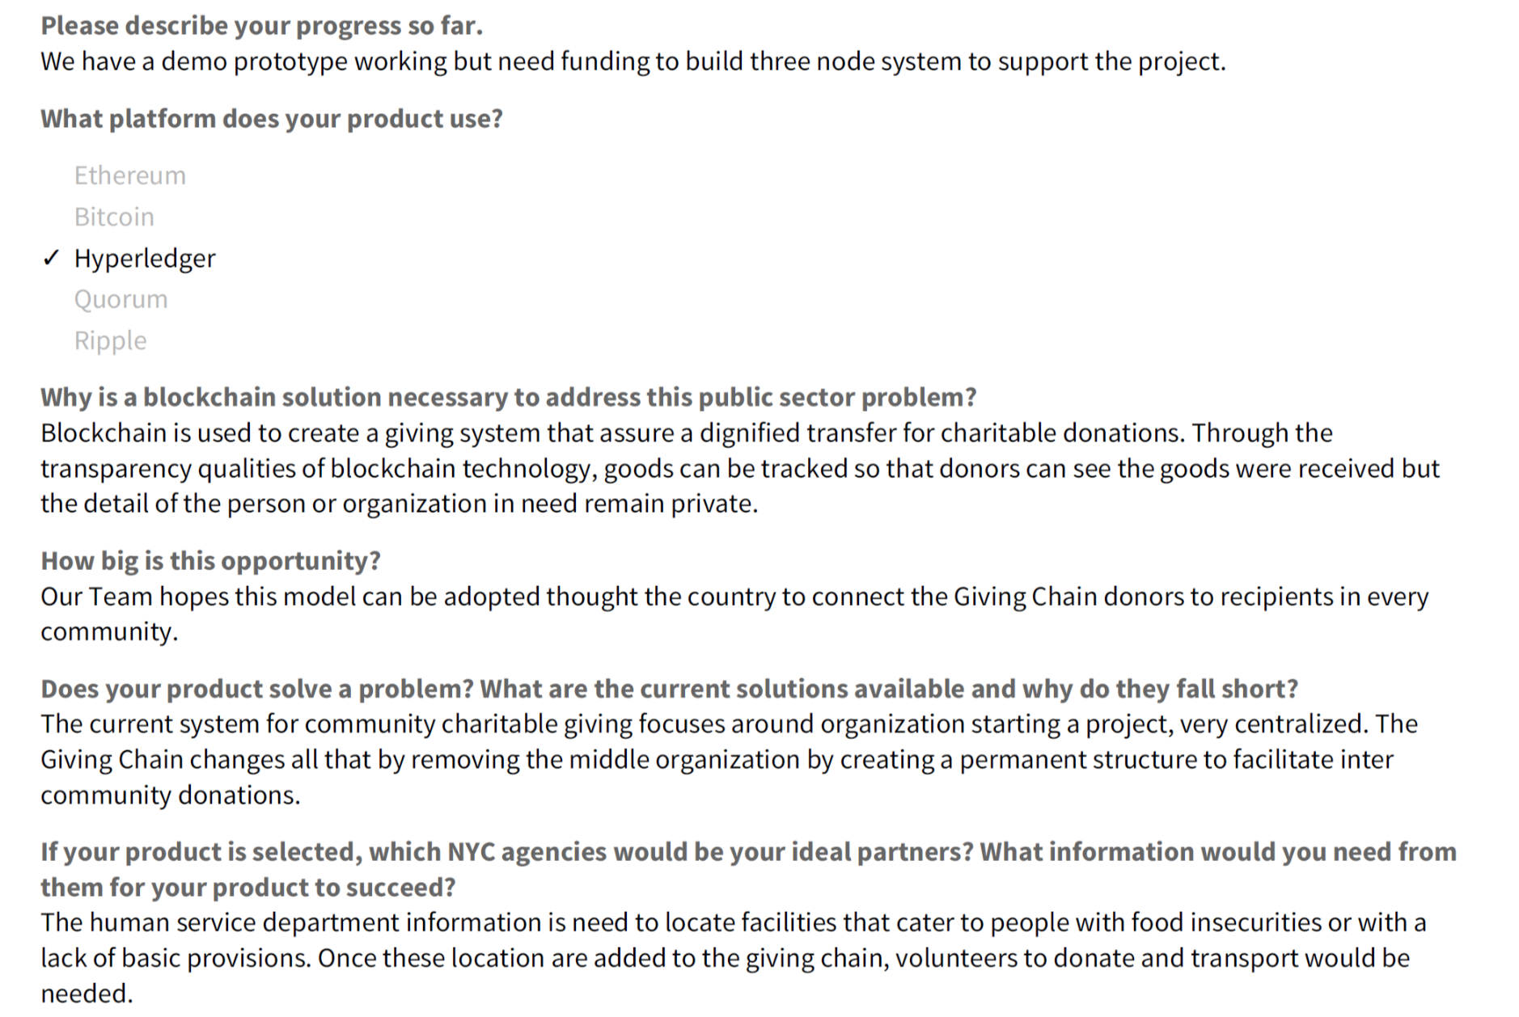

Slide 31
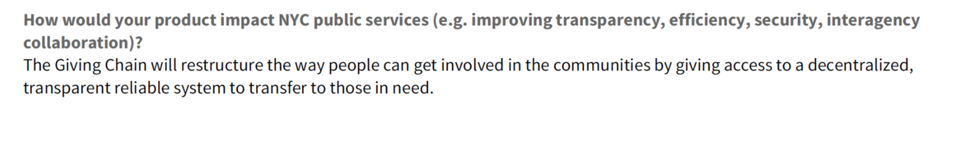
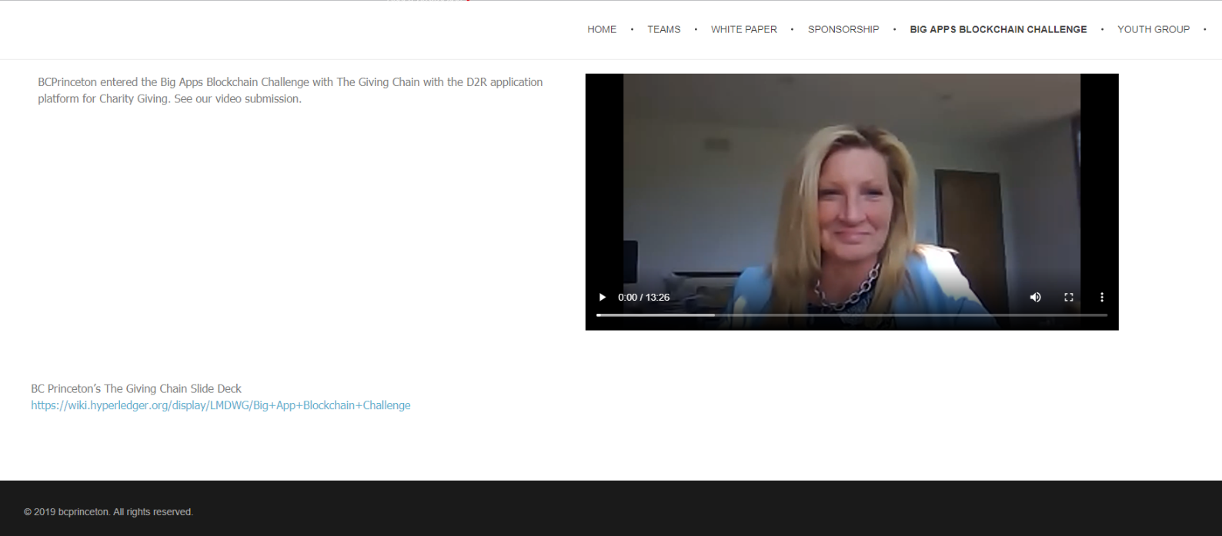

Slide 32

BC Princeton
Presents
Summer Blockchain Project
The Giving Chain
BIG APPS BLOCKCHAIN CHALLENGE
August 2019

Slide 33
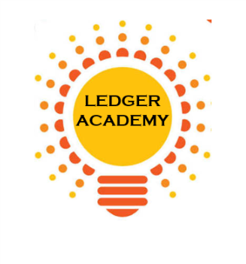
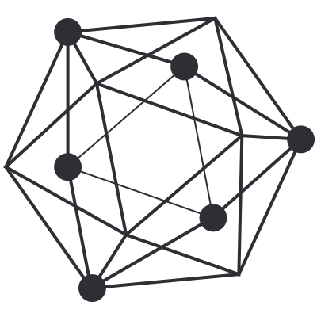
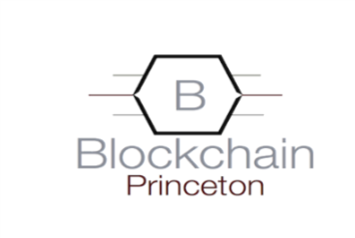
Who We Are
Ledger Academy
  Blockchain Princeton
  BC Princeton represents the combined efforts of the three local Princeton Blockchain Meetup Groups.
  The Princeton blockchain meetup groups consist of a diverse group of people who have dedicated countless hours this summer to form a team to change Local Charity Giving.
  By creating the Giving Chain we hope to create a working blockchain project to have a positive impact in our area this summer
Hyperledger Princeton
Princeton’s Blockchain and AI

Slide 34
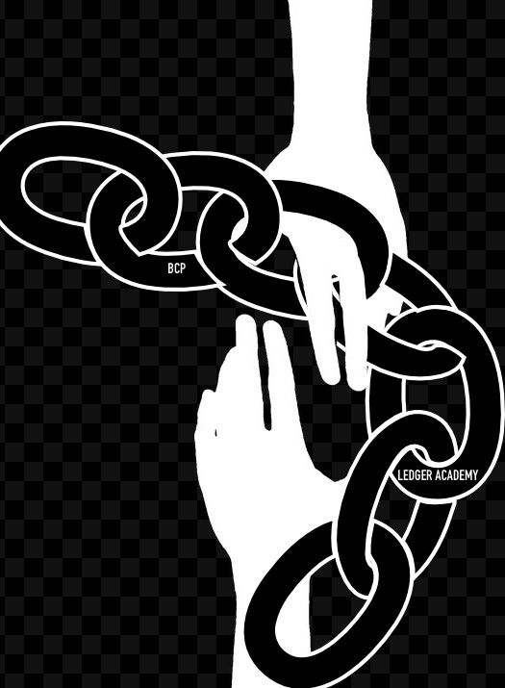
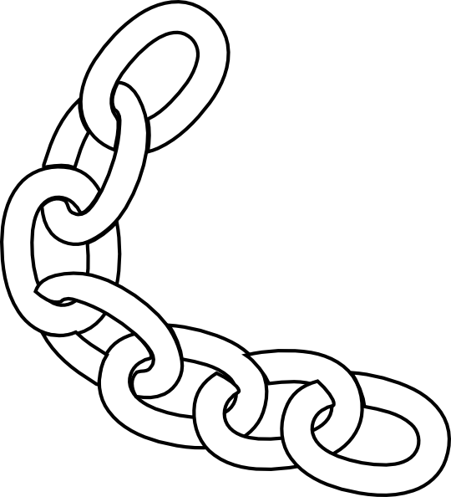

Giving Chain
A new look at local charity giving.

Slide 35
How Are We doing it
  In order to create the giving chain BCPrinceton is working through 6 Checkpoints.
  BCPrinceton Checkpoints
Checkpoint 1: Impact Opportunity
Checkpoint 2: Business Model Validation
Checkpoint 3: Technical Architecture
Checkpoint 4: Business Development
Checkpoint 5: Product Development
Checkpoint 6: Final Project Delivery

Slide 36
Checkpoint 1: Impact Opportunity
Checkpoint Questions
Define Project and team members.
Define the scope of problem you are addressing.
Why is blockchain needed to solve this problem?
What is the size of the market? What demographics will you serve?
What are some current solutions to the problem you identified? Do they work effectively?
Who are the stakeholders involved? How are they thinking/feeling/acting currently?
What are the geopolitical, cultural-social-economic factors that must be taken into consideration? What are some nuances and complexities that must be addressed?

Slide 37
Checkpoint 1
Solution
Develop an agile & transparent network for connecting surplus foods & supplies to communities in need
impact the current Local Charity Giving model
Create a decentralized system that collect excess farm produce (and other resources) from local residence and distributes these resources to food insecure individuals / Community Centers in local communities
Initiate a supply chain Blockchain to initiate, track and deliver excess food supplies. The above model has many unknown individuals who do not need to form a relationship with the parties at the other end of the supply chain.

Slide 38
Checkpoint 2: Business Model
Checkpoint Questions
Who are your clients/users? Sketch out the persona of your user.
What are their pain points? How does your solution solve them? Indicate your unique value proposition.
Does your solution depend on context? Can it be scaled?
What is your go-to-market strategy? Who can you partner with?
How will your product generate revenue / benefit ? Will it be financially sustainable in the long-term?
What are the implicit and explicit assumptions being made in your business and financial model (user-profiles, partnerships, costs, etc.)? How do you plan on validating them?
What is the vision for your product? Can it significantly change the current state?

Slide 39
Checkpoint 2: The Giving Chain
Solutions
The industry we are attempting to impact is the Local Charity Giving by creating a system where unknown parties can easily on-board and contribute. Also create a system that can adapt to various giving initiatives
For our POC we will limit the size of the volunteer pool and we will determine the best spot to deliver. Current discussion revolves around local food banks, shelters, and Veterans connections
Local Farmers with excess food are more than excited to be a part of the project. Transporters might prove a challenge The food insecure people who receive a donation should be handled with privacy and dignity and the system develop should reflect this.
Some Challenges / Factors are SUSTANABILITY, food spoilage, timing of transportation as well as dignified deliver systems
  Potential for food spoilage / Product liability associated with being a supplier of food
  Developing a Community of volunteers
  Sufficient pipeline to get foods from Donor to Recipients, able to continue without central authority.

Slide 40
Checkpoint 2: Giving Chain
Business Model
Donors
Farmers
Individuals
Community / Church Groups
Volunteers / Drivers
Pickup / Deliver:
Local volunteers
Community / Groups Transport
Recipients
Food Banks
Houses of Worship
Social Services Offices
Individuals (off the grid)

Slide 41
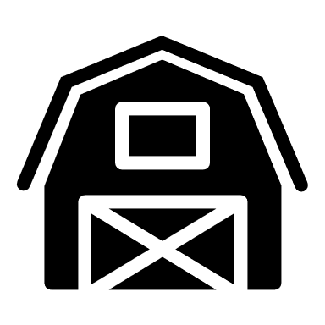



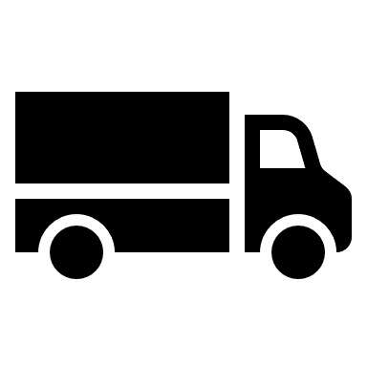

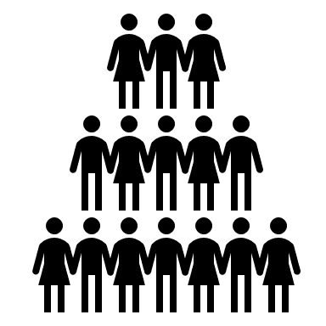
Checkpoint 2 : BUSINESS MODEL
Donation Tag
Giving Chain D2R app for Donor
Initiate P/U
Notification for P/U
Giving Chain D2R app for Drivers
Giving Chain D2R app for Recipient
Recipient Tag
Transporters Tag
Delivery Information

Slide 42
Checkpoint 3: Technical Architecture
Checkpoint Questions
Define the technical specifications of your system's architecture. Include a description of system requirements, processes, business logic, technology stack, user flows, attack factors and any other technical specifications. Attach some visuals as bonus.
Define your Minimum Viable Product (MVP) testing approach.
Product Tests: Sketches, Wireframes, Mockups, Interactive, Prototype, Wizard of Oz, Concierge, Live Product
Outline a development roadmap with a realistic timeline that takes into account your product vision, market readiness, team capabilities, functional upgrades and testing plans. What are your goals for each phase? How will your product evolve? Will you integrate other technologies?

Slide 43

Checkpoint 3: Technical Architecture
Proof of Concept D2R app.
Sawtooth Technology Explained
Is available as an instance of Sawtooth chain on a single node (Dev) with the ability to:
  create key-pairs
  create assets
  Transfer assets ( accept or reject the asset)
  Explorer: a view-able tracking of the current holder of the asset from the current front-end interface.

Slide 44
Checkpoint 4: Business Development
Checkpoint Questions
What is the impact goal of your solution? How do you ensure to capture needs of those who are traditionally underserved within your category?
What are the tools needed to collect and track goods?
How will recipients be selected?
How will Data Points be collected?
What are some obstacles you may face on the ground?

Slide 45
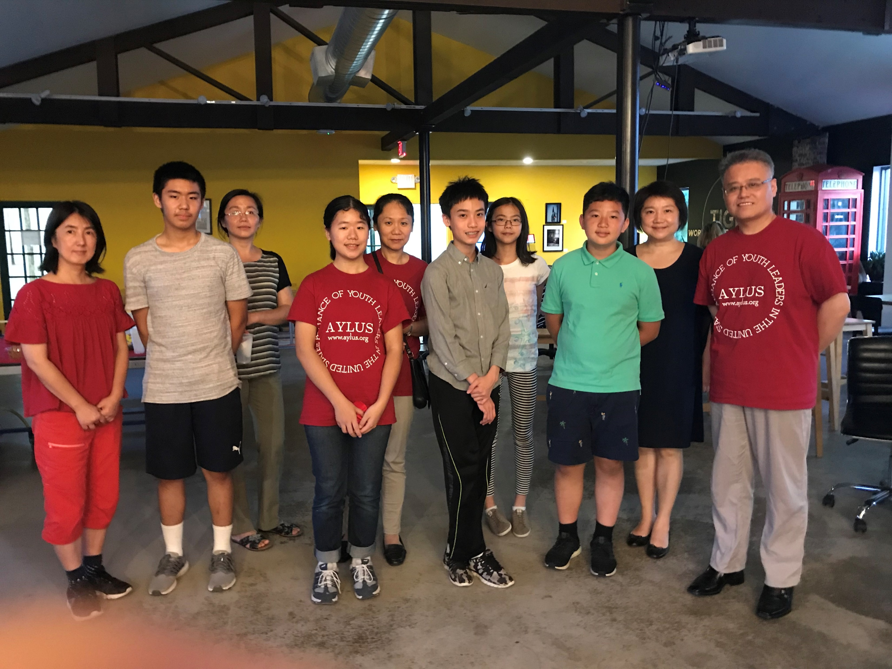
Checkpoint 4: Business Development
Solutions
AYLUS –Local youth group of volunteers
www.aylus.org
Collection items will be gathered in GIVING CHAIN BAGS that will have a bar code attached
Project Logo and Logo of Sponsors will be on Giving Chain bags to be given to local farmers, individuals, and giving organizations who want to help
100 GIVING CHAIN BAGS will be delivered to drop off locations on agreed upon date
Bags delivered to Local Food Bank.

Slide 46
Checkpoint 5: Product Development
Checkpoint Questions
Solutions
Working Code
Technology Decisions
Minimal Viable Product
Technology Stack: Google maps API, database management systems, public-private keys (cryptography), excel
Tracking on an instance of Sawtooth blockchain on a single node (Dev).

Slide 47
Checkpoint 5: Product Development
Minimal Viable Product
MVP
A Donor, Volunteer and Recipient (Actor) logins or interfaces
Ability for each actor to create their own key pairs pseudonymously
Ability to define assets that are fungible (from bulk donation to granular distribution - Asset name; Unit type and Units (numbers, lbs. etc.)
Ability to assign assets (by donor or self assigned by volunteer) for trace-ability purposes
Ability to track assigned assets with the options of:
  Tracking the assets themselves
  Or tracking the packaging the asset is included into (E.g. bags, crates etc.)
Security and audit-ability from bad actors (theft, diversion etc.)
Traceability to final recipient (final recipient acknowledges receipt).

Slide 48
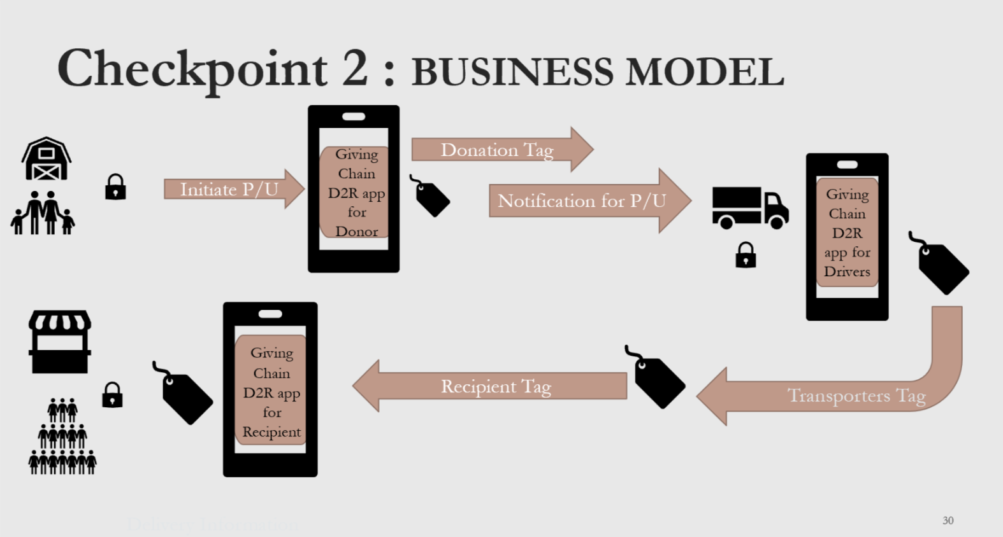
Checkpoint 6: Final Product Delivery

Slide 49
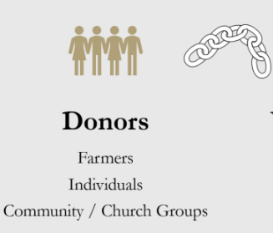
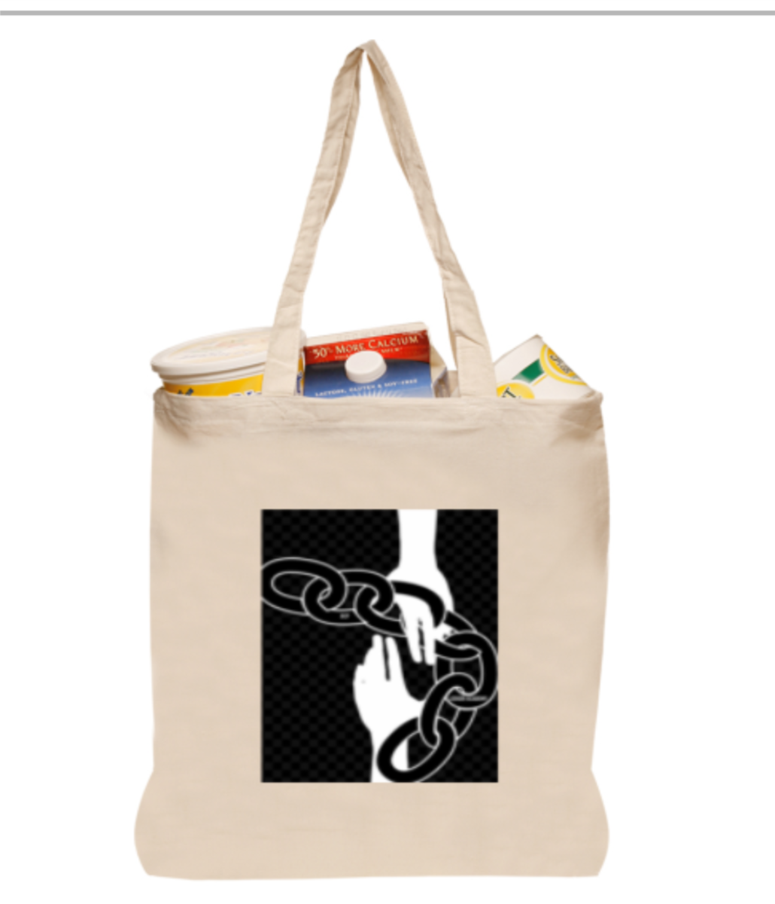

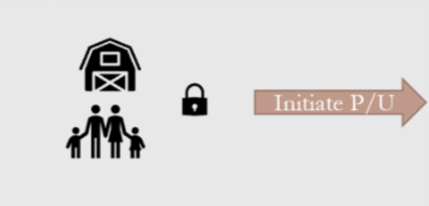
Donor Blockchain - View

Slide 50
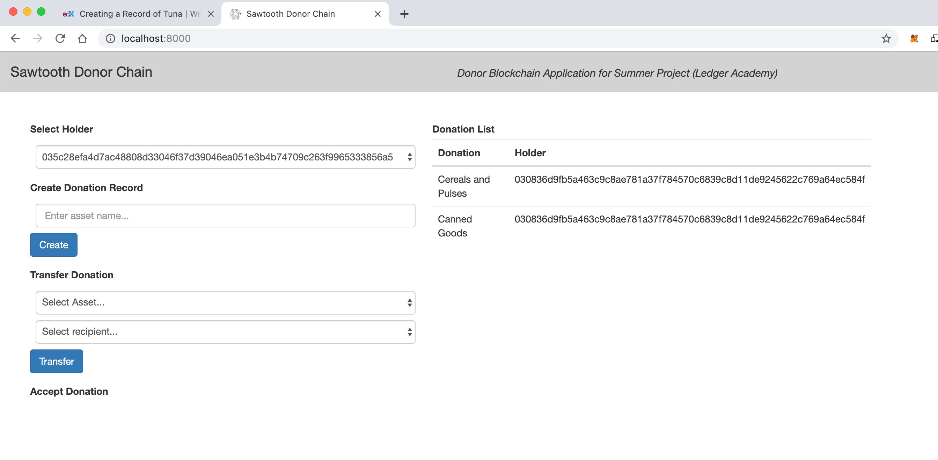
Donor Blockchain - View
Scanning the bar code generates the Tag with the unique “key” for the collected item
Creation of Tag for DONOR Last digits of Hash Tag 56A5

Slide 51
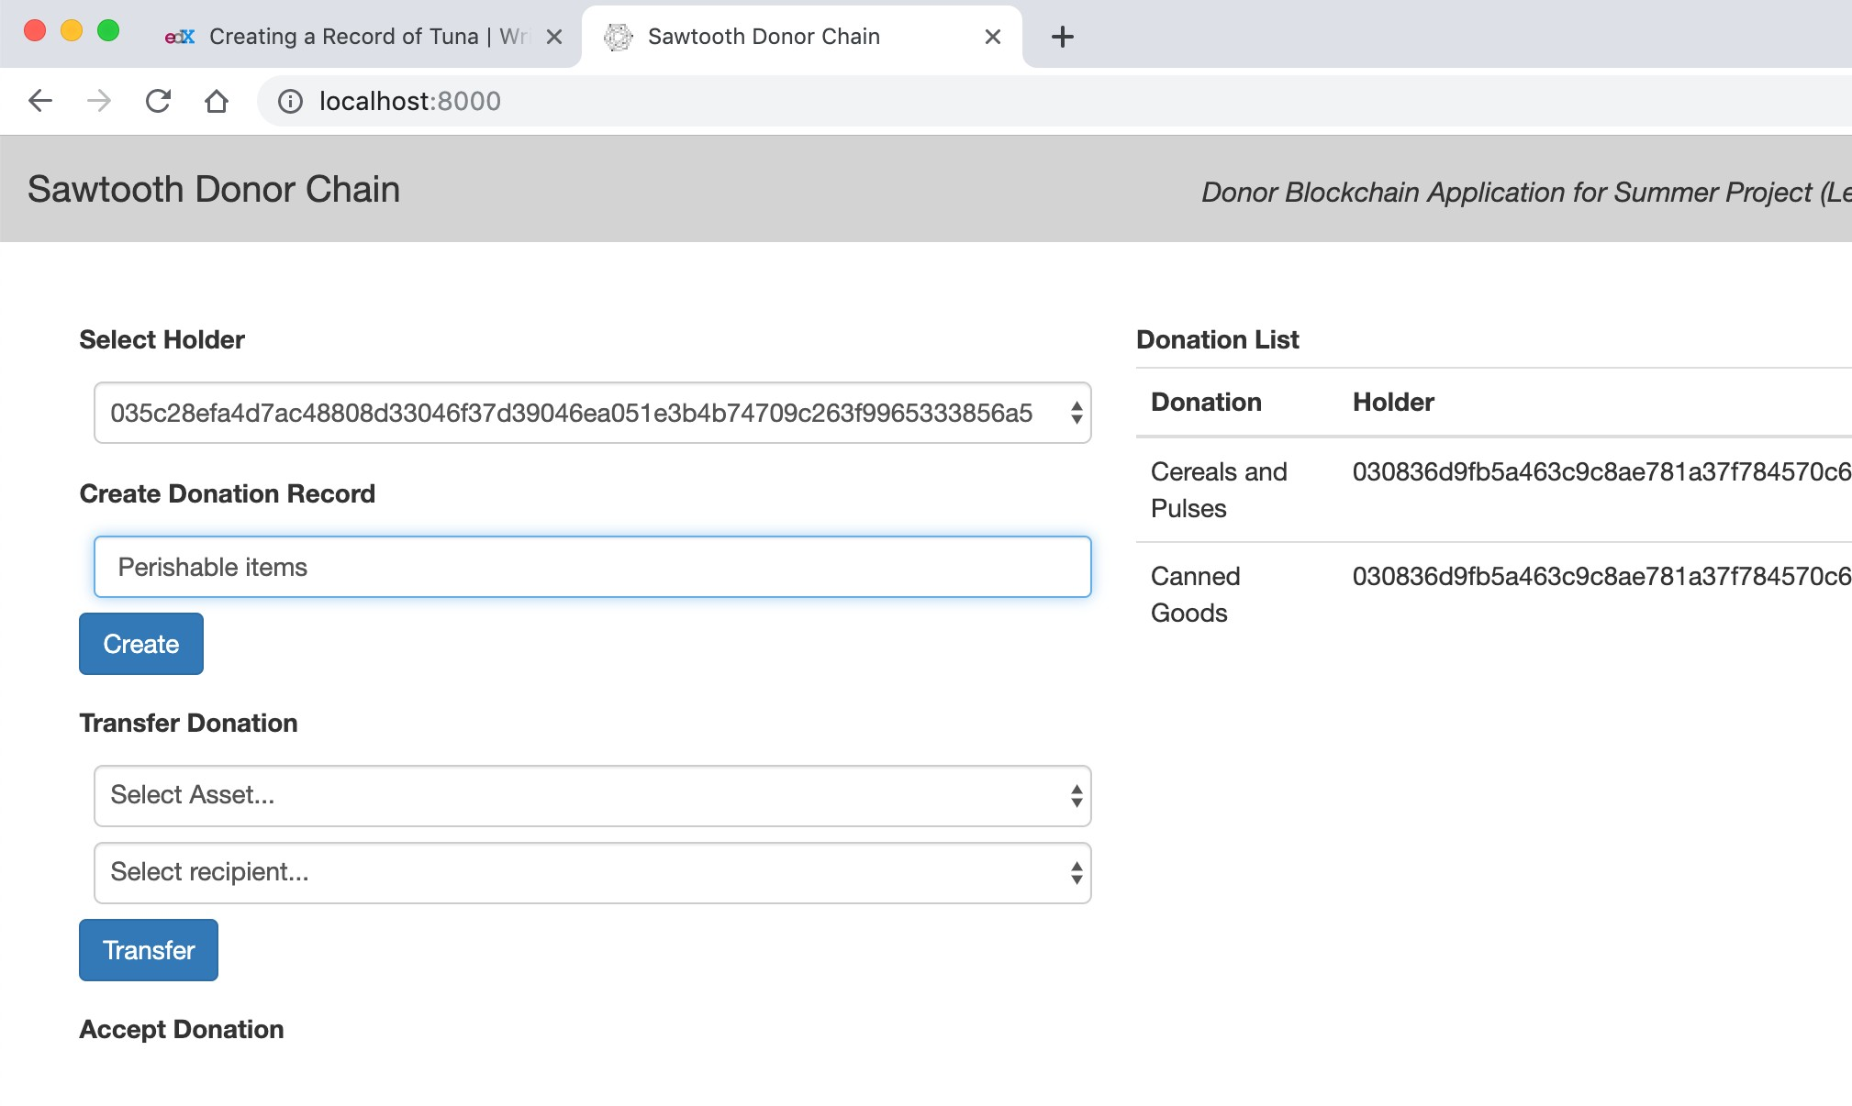
Donor Blockchain - Donation record
Week 3: Technical Architecture
Product Development Working Group

Slide 52
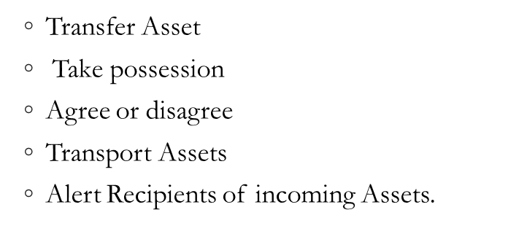
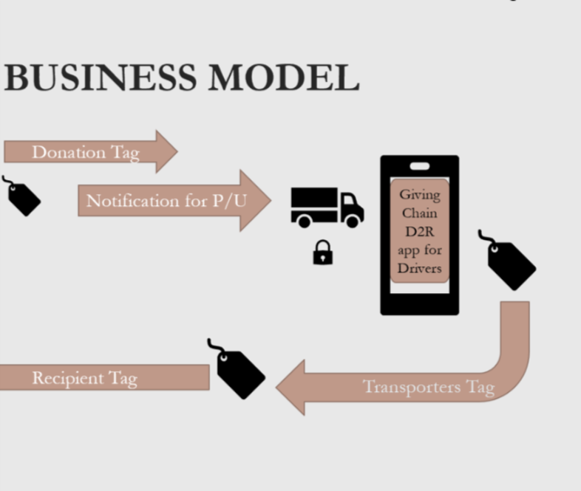
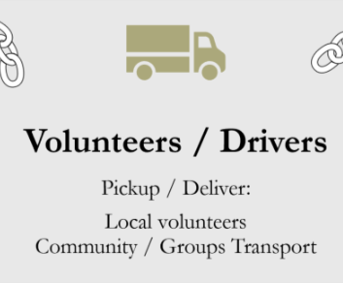
Driver Blockchain View

Slide 53
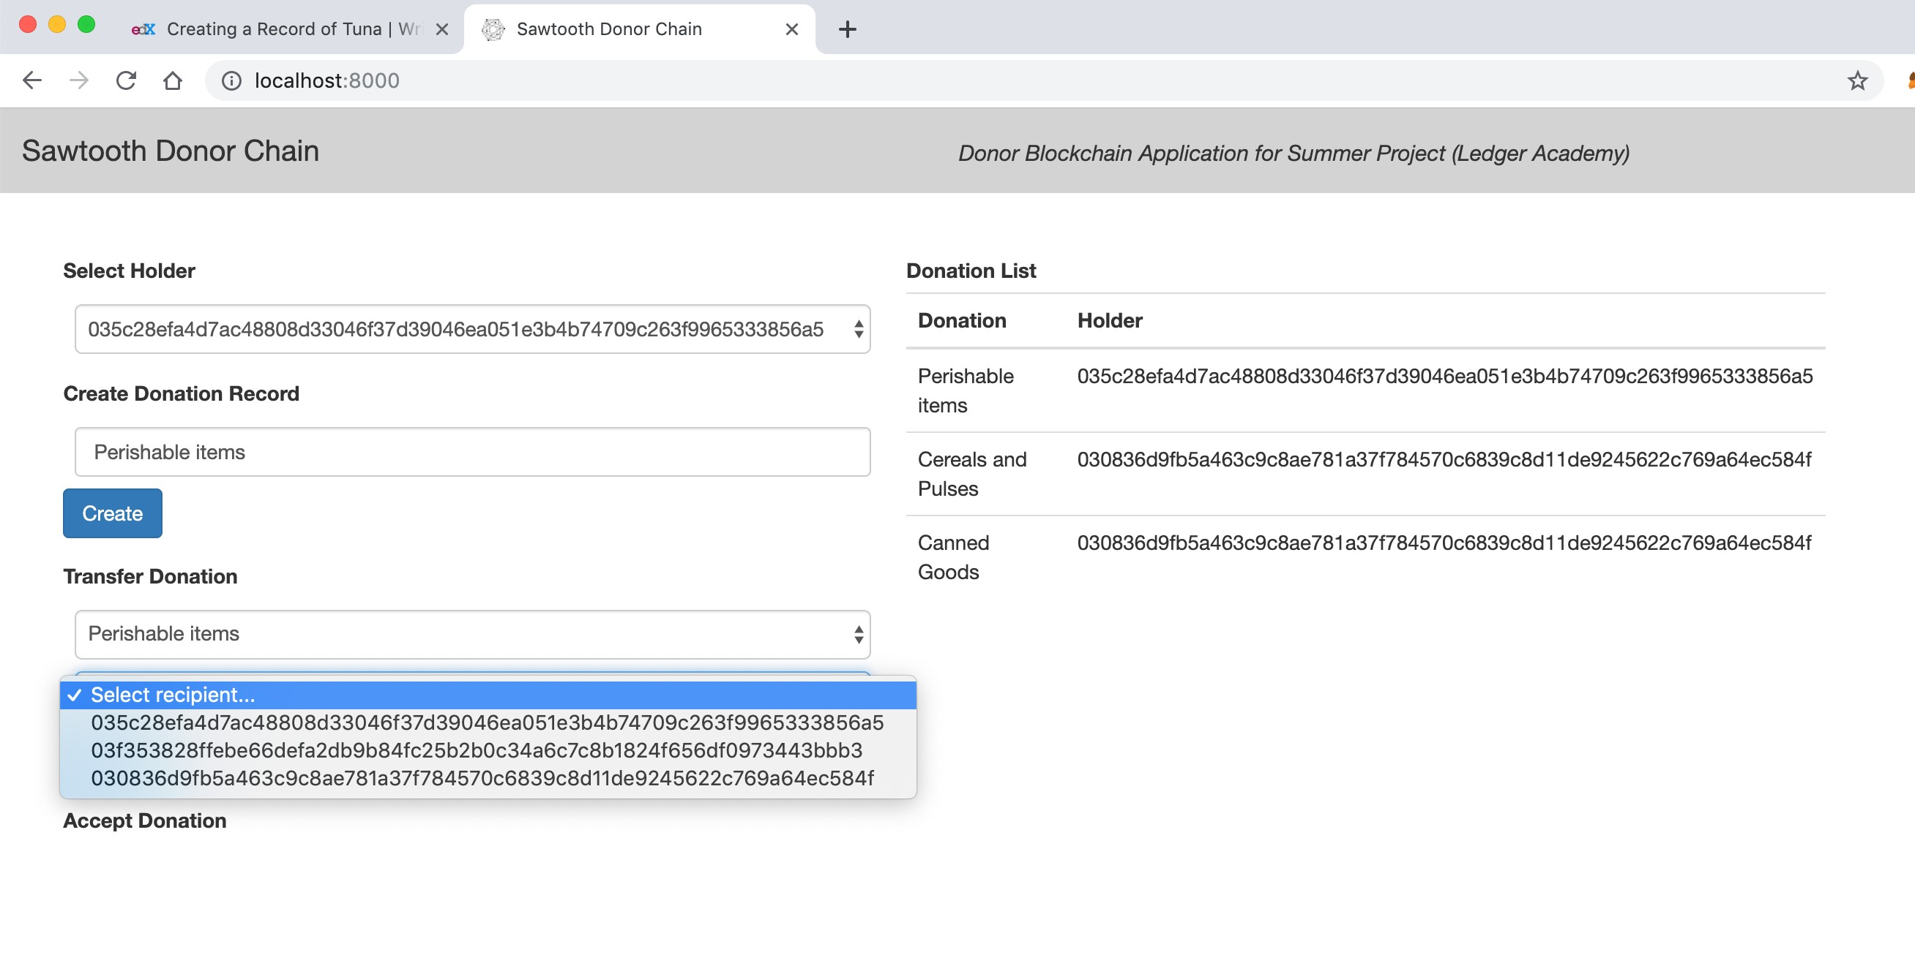
Driver Blockchain - Transfer
Transfer of Tag Last digits of Hash Tag 56A5

Slide 54
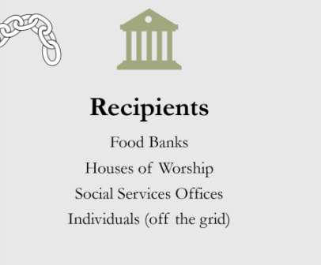
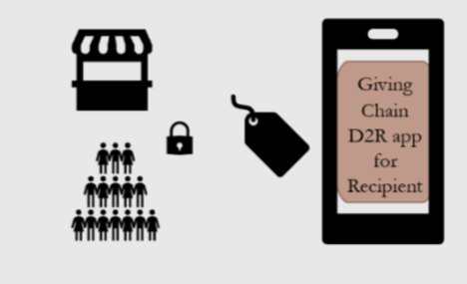
Recipients Blockchain - View
Recipients get notified of an available donation an accept it notifying driver where to deliver.

Slide 55
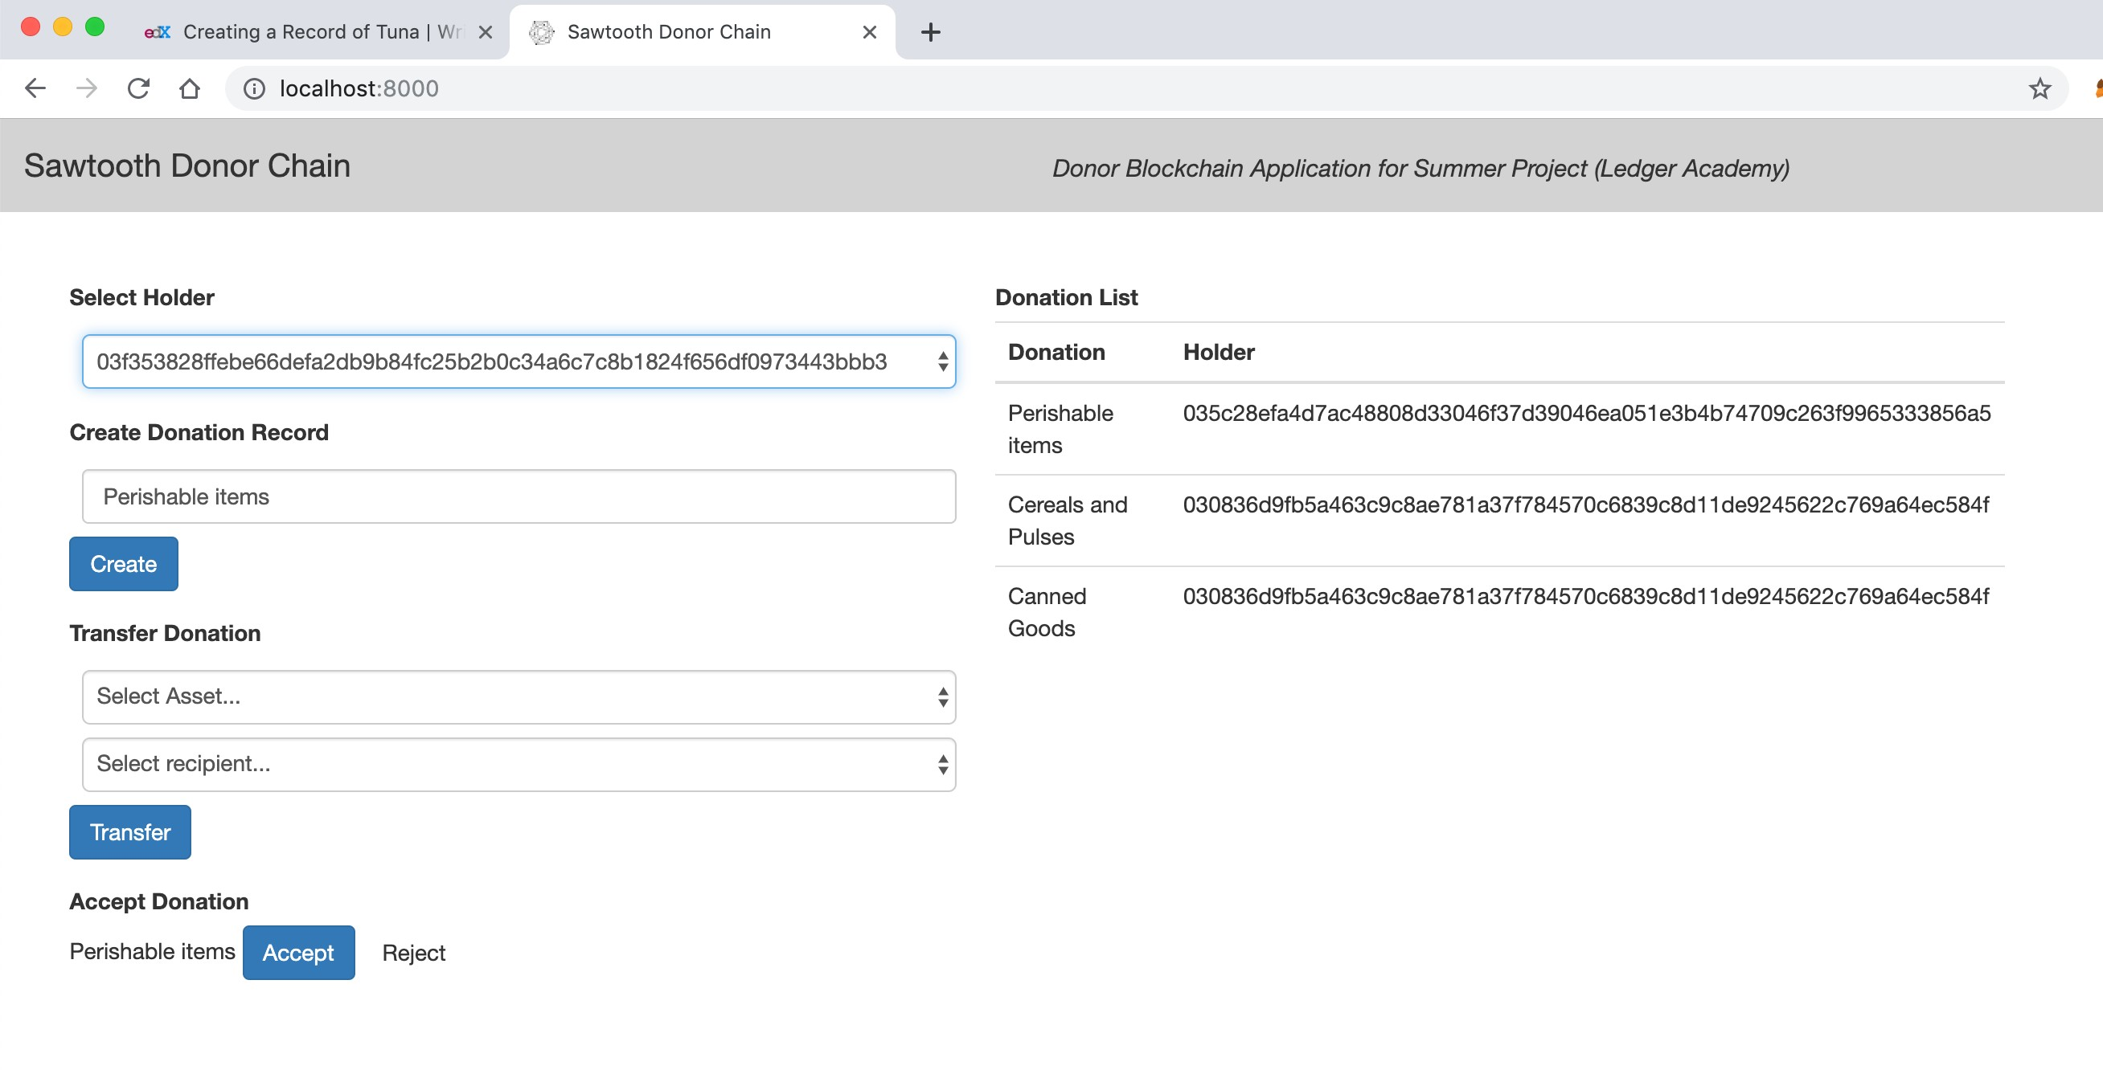
Recipient is notified and accepts donation with Last digits of Hash Tag 56A5

Slide 56
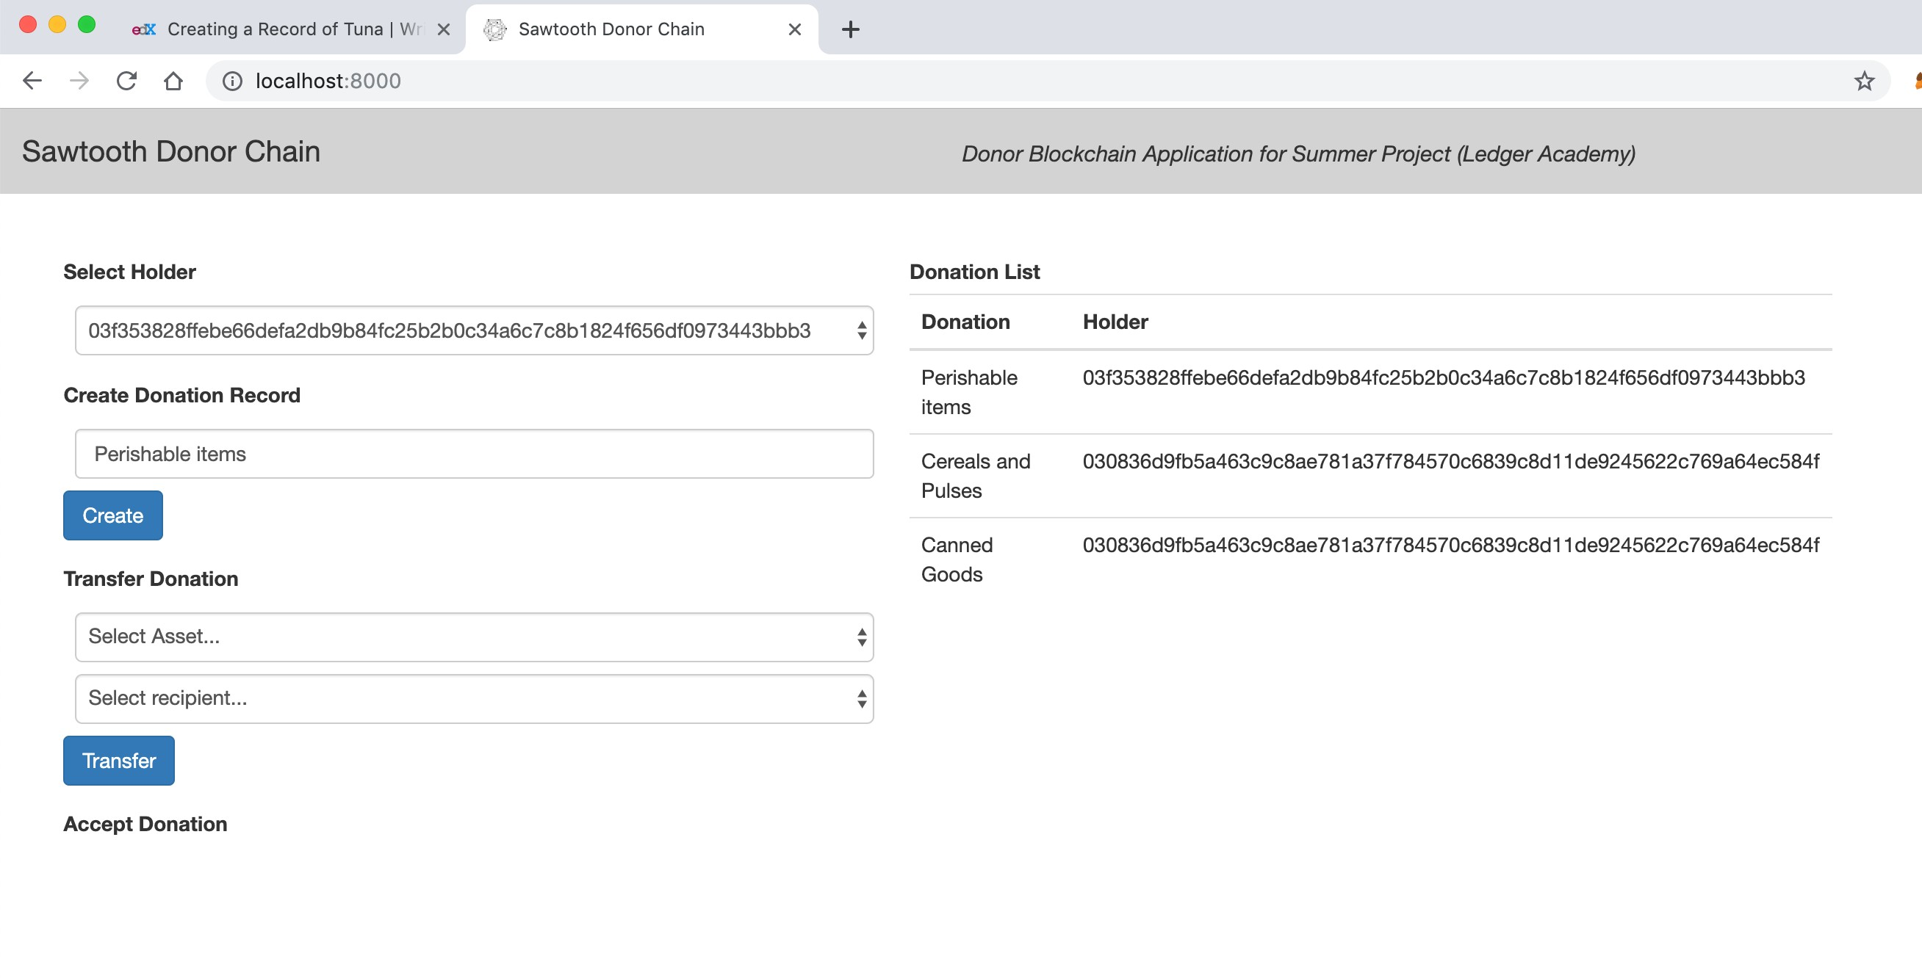
Recipient Blockchain - Change in Holder
donation with Last digits of Hash Tag 56A5 received

Slide 57
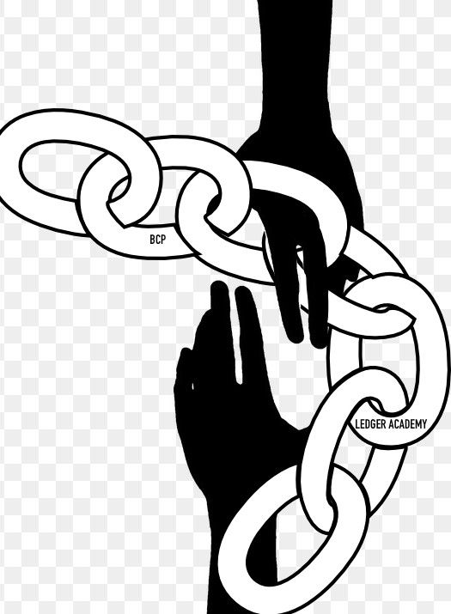
BCPrinceton
THANK YOU
www.BCPrinceton.com

Slide 58
Moving Forward
Housekeeping
Princeton Blockchain Community
Social Impact Projects
Summer Blockchain Project
Discussion
Moving Forward
Notes:
David

Slide 59
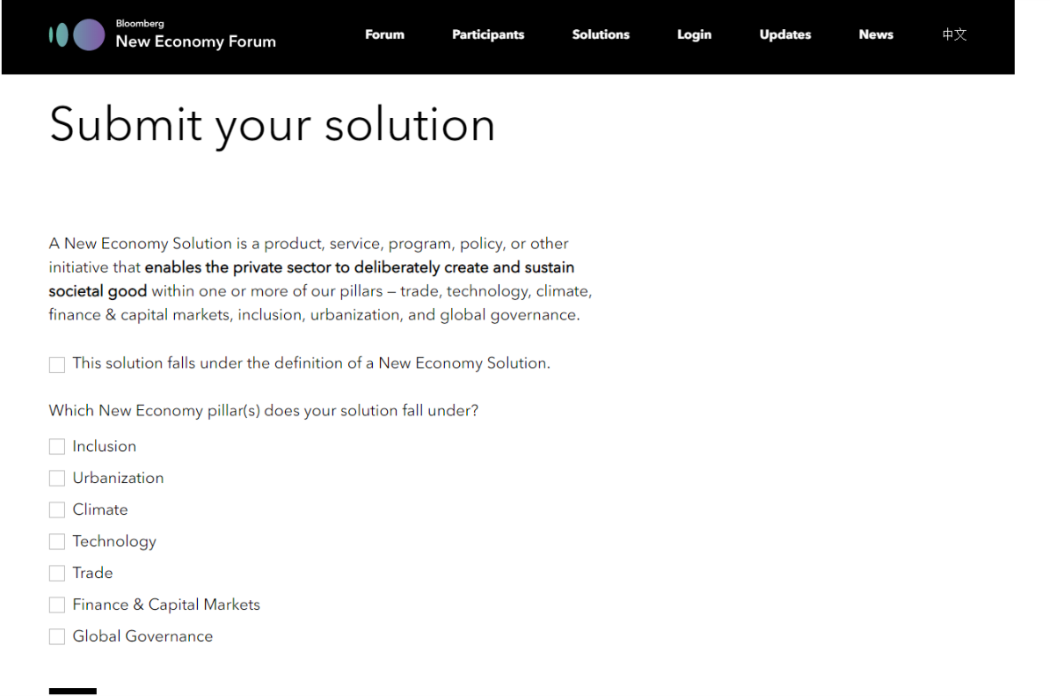
Bloomberg New Economy Solutions
https://www.neweconomyforum.com/solutions-submission/#form

Slide 60
Business Development Working Group
Donor Issues
Announce August 25th Giving Chain Date
Bag Ordering (sponsor finalized)
Bag dispersement :
Sponsors covering donations ( Gymnastics Unlimited, GPA, Hilltop Farms)
Updating Social Media for Big Apps requirements
Marketing Materials
Web Site
Develop user Guides
Drop Off
Determine Locations
Collect Bags
Sponsors:
Logos
Work product
Donations

Slide 61
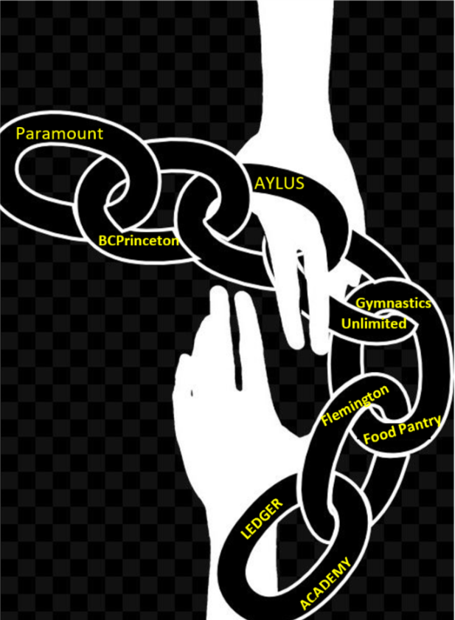

Slide 62


Slide 63
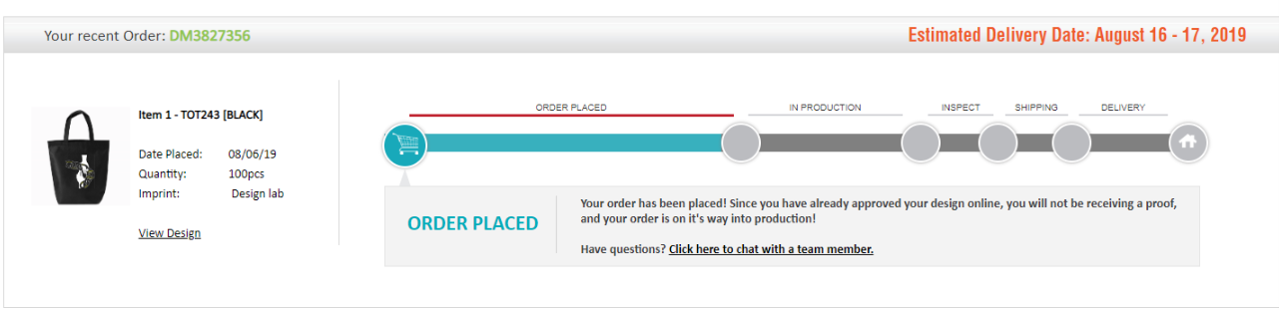
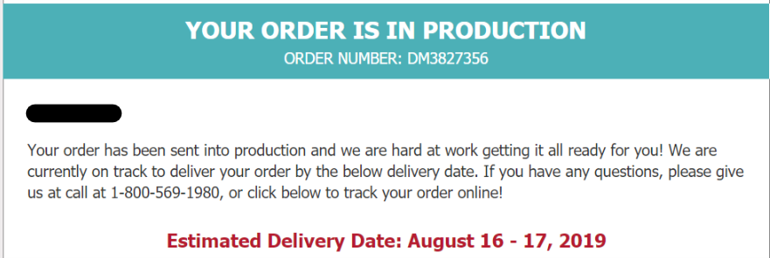
Giving Bag Order

Slide 64


Slide 65

Donor Marketing
Material
Purpose:
To desginate collection location.
Tiger Labs
Gymnastrics Unlimited
for irect donor base on collection process.
BUSINESS MODEL

Slide 66

Business Development Working Group
Alliance of Youth Leaders group (AYLUS) Princeton Chapter leadership team members
https://bcprinceton.com/youth-group/
On November 30, 2018, 49 students led by Cassie Tammy Wang, an Award Winning and Published Artist at West Windsor-Plainsboro High School South in New Jersey, founded the 44th branch for the Alliance of Youth Leaders in the United States (AYLUS): Greater Princeton, NJ.

Slide 67


Blockchain Explained
Presented by: Richard Wang
Presentation date: August 17 and 18

Slide 68

What is Blockchain?
New way of storing data
More secure than other methods
Stores data in “blocks”
Blocks linked together is called “Blockchain”

Slide 69

How does Blockchain work?
Stores a piece of data in a “block”
Each block also contains a timestamp
The new block is then linked to the previous block, forming a chain
Old blocks are unchangeable, if something is changed, the new data will be recorded in a new block, increasing security
Each block is encrypted with a special code and only users who know this special code are able to edit the blockchain

Slide 70

How does Blockchain work? (pt. 2)
Some people might have access to view data in a Blockchain but might not be able to edit it.
Others might be able to edit one section but only view another section
Blockchains are not owned by one person, meaning that one person does not have all the power in a Blockchain
The data in the blocks is open to everyone in the Blockchain
All of this increases the security of the Blockchain

Slide 71

The Benefits of Blockchain
Increased security of data
Gets rid of 3rd party in transactions
  Increased efficiency
  Increase in speed
Increased traceability
  Items’ origins can be found easier
Reduces costs
  Removal of 3rd party
  Don’t need to review a large amount of documentation from these 3rd parties

Slide 72

Real World Applications of Blockchain
Cryptocurrency
  Bitcoin
Banking
  Helps keep track of money location
Voting
  Identification as well as voter fraud
Internet Security
  Reduces risk of hackers
Stock Trading
  Make trading more automated and efficient
Identification
  Reduce threat of identity theft

Slide 73

What is our project?
Collect unneeded household goods from willing donors within the community
Fill 25 “giving bags” with all of the collected household goods
Deliver the bags to food banks and other parties in need on August 25 using some Blockchain technology

Slide 74

How are we using Blockchain?
Supply chain
Track location of goods
Find out origin of goods (where have the goods gone before they arrive at the recipient?)

Slide 75

Recap
We are utilizing Blockchain in a community service project
This is just one of the ways Blockchain can be used
Many companies are already starting to use Blockchain because of its many benefits
  Increased security
  Reduction in overall costs

Slide 76
Sources
https://hackernoon.com/how-is-blockchain-disrupting-the-supply-chain-industry-f3a1c599daef
https://www.forbes.com/sites/bernardmarr/2018/03/23/how-blockchain-will-transform-the-supply-chain-and-logistics-industry/#308e11035fec
https://medium.com/s/story/how-does-the-blockchain-work-98c8cd01d2ae

Slide 77

Business Development Working Group
Gymnastics Unlimited Summer Giving Project
Families of student will fill the BCPrinceton Giving Bag and deliver to the Gym between 3:00pm 5:00pm on Sunday August 25th.
Summer Fundraising Event

Slide 78




Sponsors

Slide 79

Recipients
Flemington Food Bank
Montgomery Food Bank
Off Grid US Veterans
Update on Montgomery Food Banks

Slide 80


Recipients
Jeannine Gorman
Executive Director

Slide 81

Web Site: www.bcprinceton.com

Slide 82
White Paper
DRAFT 8/9/19
Princeton Blockchain Group The Giving Chain
Donor to Recipient App (D2R)
Introduction:
This white paper explains why blockchain is needed to solve the problem of delivering excess food to people in need. It will discuss the framework for developing a simple, agile and transparent app to connect a network of local surplus food suppliers (“donors”) to local communities in need (“recipients”) connected by a volunteer local transportation group (“drivers”).

Slide 83
White Paper
Background:
A group of individuals in New Jersey with a passion for blockchain and a desire to improve social issues came together to form the Blockchain Princeton Group (BPG). BPG desired to learn how to build a blockchain with a hands-on project that would also provide social good in the local community. The team is composed of a diverse group of men and women with a variety of skills and industry experiences.

Slide 84
White Paper
Need:
Currently, local farmers do not have a reliable method of delivering their excess food and produce to people in need. By the time arrangements and logistics are identified and coordinated, much of the produce is spoiled and the true amount of the intended donated food does not end up at the final location. Additionally, at times the true donated quantity is not the same quantity delivered to people in need. In other words, portions of the donated food get taken out by others and sold by other means.

Slide 85
White Paper
Solution:
Create a simple Blockchain Donor to Recipient App (D2RA) utilizing the Hyperledger Sawtooth platform to create a blockchain supply chain management (SCM) system to seamlessly connect donors to recipients via drivers and track the status, source, and recipients of the food at any time. The project is designed to (1) solve the timing issue of matching donors with excess produce to recipients with food insecurity, and (2) provide a verifiable SCM where each party is kept up to date of the process between donors, recipients, and drivers in real-time.
Due to the decentralized nature of blockchain, multiple stakeholders can utilize blockchain to efficiently record, track and report on verified interactions. This makes it easier to track and manage the sourcing, storage, transfer and distribution of food donations. Blockchain will ensure the specified amount of donated food is delivered in a timely fashion (i.e., no spoilage) to the pre-determined recipients.
A supply chain model has been determined to be the best way to initiate, track and deliver excess food supplies. The supply chain model has many unknown individuals who do not need to form a relationship with the other parties in the supply chain.

Slide 86
White Paper
Initial Scope:
The initial scope will be limited to a small number of donors with excess food to be picked up by drivers who will transport the food to an agreed-upon drop off point for recipients, including US Veterans. This limited scope will allow for the viability of the system to be determined.
1. Finish the smartphone App that all parties will utilize for real-time, verifiable communication (expected to be finished by early to mid-August)
2. Identify 5-10 farms that are willing to participate in this pilot project. They will be given the App and arrange for a day of the week for their surplus produce to be picked up. Each farm will use their App to confirm that they do in fact have excess surplus on the agreed-upon day and input the amount they have, and the transportation volunteers will pick-up the surplus produce.
3. Identify recipients with food insecurity and a convenient location and time where they can pick-up the produce when it is confirmed to be available by the App. Most recipients utilize smartphones. This has been proven to be a reliable manner of communication for the vast majority. Recipients who do not utilize smartphones can be contacted by the director of the township’s food pantry via phone.

Slide 87
White Paper
Future Scope:
The system can be expanded to include clothing, blankets, toiletry items, paper products, and other items donated by farmers, restaurants, wholesalers, individuals, suppliers, manufacturers and retailers to a wide range of recipients including food banks, houses of worship, social services offices, and off the grid individuals.

Slide 88
White Paper
Bobbi Muscara | bobbi@Ledgeracademy.com
Scott Schneider | srsgroup25@gmail.com
Colin Pinto | pintocolin@gmail.com
Lindsley Medlin | lmedlin@njblockchain.io
Mammohan Khandelwal | mkhandelwal@yahoo.com
Cherni Ghosh | cgh2010@gmail.com
Jennifer Yuan | jennyuan18@gmail.com
Houri Ramo | houriramo@gmail.com
Suyog Navarkar | navarkarsuyog@gmail.com
Prafull Kotecha | prafullKotecha@gmail.com
Ron Keegan | rkeegan1@comcast.com
Cydel Girandel | giraudelc@hotmail.com
Hemal Panji | Hemalpanji@gmail.com
P. Prabhu | pcube@hotmail.com
Sundar Raj | sundarraj1194@gmail.com
Tony Lopez | Lopez.tony0811@aol.com
Harper Hoffman | harperhh10@gmail.com
Gary Teekah | gteekah@opxconsultingservices.com
Wesam Elsayed | wesam.a.elsayed@gmail.com

Slide 89
D2R application- Hyperledger Sawtooth Chain - MVP
Sl. No. | Things to be accomplished | Description of work and any constraints to be overcome | Assigned to (please include your name based on your time and skills) | Comments / Remarks
1 | Multiple nodes | Create multiple nodes of Sawtooth chain and demonstrate workability of the chain - Sawtooth chain needs to be brought up inside docker (or any other container) and should run on all instances; should be able to connect with each node |  | Can be on multiple instances in cloud (Eg: AWS EC2) or multiple macs Hemal Panji has done some research
2 | Define Transaction Processor | Be able to create transaction families and define Transactions on the chain (not the front end) - business logic on the server and able to bundle transactions into a block for validation |  | Transaction processor node(s) within Sawtooth
3 | Define Validator | Be able to assign validator nodes and / or create validators that will take the transaction families for validating and creating a block |  | Validator node(s) in Sawtooth
4 | Define any REST API | Be able to connect the client (Front end interface) to the chain |  | Connectors to chain from front end client (HTML, JSON etc.)
5 | Create Donor, Volunteer interfaces / logins | Provide the ability for Donors and volunteers to interact with the chain to login, create assets, transfer assets etc. |  | Current single screen from POC may need to be split into multiple with respective functionalities
6 | Create assets | Define what an asset attributes need to be (Asset name, asset type, unit type, unit measure etc.) Master template for assets (minimum values to be picked while defining assets that answers questions like - What am I donating, how much and if it can be picked up by multiple volunteers - one donor to many volunteers) |  | Solve for Fungibility of assets - Lindsley Medlincan articulate / elaborate.
7 | Tracking assets in the supply chain | How does the asset get tracked - Bar code, Mobile phone (Suyog Navarkar can elaborate), individual asset being tracked or the bag / crate. |  | Cost effective tracking mechanisms - pls remember that this is a social impact project and not a commercial one
Product Development Working Group

Slide 90
Proof of Concept
Is available as an instance of Sawtooth chain on a single node (Dev); with the ability to create key-pairs; create assets; Transfer assets and accept or reject the asset. A tracking of the current holder of the asset is also view-able from the current front end interface.
MVP
Needs to be developed and will probably need to meet the following requirements (team to add anymore - high level requirements and constraints)
A Donor, Volunteer and Recipient (Actor) logins or interfaces
Ability for each actor to create their own key pairs pseudonymously
Ability to define assets that are fungible (from bulk donation to granular distribution - Asset name; Unit type and Units (numbers, lbs etc.)
Ability to assign assets (by donor or self assigned by volunteer) for trace-ability purposes
Ability to track assigned assets with the options of:
  Tracking the assets themselves
  Or tracking the packaging the asset is included into (Eg: bags, crates etc.)
N2H for MVP:
  Security and audit-ability from bad actors (theft, diversion etc.)
  Trace ability to final recipient (final recipient acknowledges receipt)
  The above 2 may have to be currently based on the "honor system" for the MVP and a robust security and trace-ability may need to be developed in next phase
How do we track the pack and logistically and digitally
How to create the three user interfaces?
How do we create a muli node system for consensys?
How do we define Transaction Families and Data Points?

Slide 91


Product Development Working Group

Slide 92


How To Track Project
Top part entered into data base at collection points
2-part ticket filled out with bag contents
Bag #
Items
__________
Bag #
Items
Bottom part collected at receiptant location and recorded into database.
Numbered Bag

Slide 93
Fabric for Android
Fabric
Many powerful tools, one easy platform.
Fabric is a mobile platform with modular kits you can mix and match to build the best apps. Fabric is tightly integrated into your dev environment, making adding new services a breeze. Start with what you need from Fabric today, and quickly add more kits as your needs grow.
Getting Started
To get up and running with Fabric, sign up for a free account and follow the on-screen instructions to quickly get set up!
Once your account is configured, it’s time to onboard your first app to Fabric by installing a kit. Kits can be installed manually or using the Fabric IDE plugin for Android Studio or IntelliJ.
Note

Slide 94


Slide 95


Slide 96

Fabric for Android
Applications
Organizations
Accounts
Notifications

Slide 97


Slide 98


Slide 99
BCPrinceton’s The Giving Chain
Five checkpoints to be presented at meetups:
Impact Opportunity
Business Model Validation
Technical Architecture
Business Development
Product Development
Delivery.
Schedule: Tiger Labs
Checkpoint 6
  Next Working Group August 20th
  PROJECT COLLECTION Sunday August 25th
  Project Wrap Up August 27th

Slide 100
THANK YOU
Notes:
David

