Slide 1
Hyperledger
Supply Chain Special Interest Group -
6/6/2019
Jay Chugh, SIG Chair
Jay.chugh@oracle.com

Slide 2
Antitrust Policy Notice
Linux Foundation meetings involve participation by industry competitors, and it is the intention of the Linux Foundation to conduct all of its activities in accordance with applicable antitrust and competition laws. It is therefore extremely important that attendees adhere to meeting agendas, and be aware of, and not participate in, any activities that are prohibited under applicable US state, federal or foreign antitrust and competition laws.
Examples of types of actions that are prohibited at Linux Foundation meetings and in connection with Linux Foundation activities are described in the Linux Foundation Antitrust Policy available at http://www.linuxfoundation.org/antitrust-policy. If you have questions about these matters, please contact your company counsel, or if you are a member of the Linux Foundation, feel free to contact Andrew Updegrove of the firm of Gesmer Updegrove LLP, which provides legal counsel to the Linux Foundation.

Slide 3
Meeting Agenda
Recap & logistics
Hyperledger Grid Overview by Dave Cecchi
Brief Introductions from each attendee
Project Proposal brainstorm & team formation

Slide 4
RECAP – Our Guiding Principles
Outcomes-oriented SIG, outcomes delivered through projects
Your contribution in projects is critical to our combined success
The best ideas win regardless of who they come from
Vendor-neutral, pitch free

Slide 5
Comments from Last time
Question on how different Hyperledger components could or would be used – e.g. Sawtooth, Fabric, etc. We will look to include different hyperledger components as based on projects suggested and pursued.
John Hopkins: "I’m looking to bring Overlay Data Capture Architecture to the supply chain world to help groups of businesses operate based on common schemas. I’d love to enlist some folks who are more knowledgeable about supply chain to help me with an RFP for Hyperledger GRID. Any takers? (Happy to share more detail with whoever is interested)" https://drive.google.com/drive/u/0/folders/1-Q3CBSYXlRNEvTu7XQfGo-6W5H_yyOA3 - John, please share this in mailing list/project proposal for others to express interest
Soren: "to what extent do we want to use established frameworks such as APICS SCOR (Supply Chain Operational Reference model) or other?” Please share this in mailing list.
Stefan: "There is also https://www.bita.studio/ . Any thoughts regarding their work?” – We will look to cross-pollinate with them, invite guest speakers. They are not focused on Hyperledger, and mostly company pitches not projects.

Slide 6
SIG Logistics & Housekeeping
Bi-weekly calls. Thursday, 9am PST, Active Poll, vote now.
Bookmark SIG Home page: https://wiki.hyperledger.org/x/rwCw
Sign up for SIG mailing list: https://lists.hyperledger.org/g/supply-chain-sig
Sign up for Linux Foundation Account: https://identity.linuxfoundation.org/ for your participation in the community.
Notes:
Meeting agenda, notes, recording will be made available on wiki.
Linux foundation account will allow you to work in any of the channels: Jira, wiki, lists etc.

Slide 7

Join Now
Supply Chain Special Interest Group
(SC SIG)
What is it?
A vendor-neutral, industry-wide approach to develop and advance Blockchain best practices in Supply Chain, in a collaborative and open ecosystem enabled by Hyperledger & The Linux Foundation
Who is it for?
Open to any verticals engaged in blockchain initiatives for logistics & supply chain – e.g. Transportation, Shipping, Semiconductors, Retail, Healthcare, Pharma, etc.
Types of companies may include carriers, shippers, manufacturers, 3PL, Software/Hardware vendors, public sector agencies, service providers, consultants, etc.
For both, technical and business participants
How to Join?
Subscribe to mailing list: https://lists.hyperledger.org/g/supply-chain-sig
Learn More – Home Page:
https://wiki.hyperledger.org/display/SCSIG/Supply+Chain+SIG

Slide 8
Overview of Hyperledger Grid Project
By Dave Cecchi, Cargill, Sr. Director, Enterprise Data

Slide 9
Introduce Yourself – 30s-1min
Name, Your Location (city/state)?
Where do you work?
What motivated you to join SC-SIG?
Project proposal(s) you’d like to participate in actively?

Slide 10
Project Proposals #1
Logistics and Supply Chain Blockchain Use Case and Reference Architectures Repository
Crowdsource a robust inventory of practical use cases and reference architectures by industry vertical - Food, Pharma, Electronic manufacturing, healthcare, etc.
Capture practical, real-world guidance and learnings relating to solutions - both business, and technical aspects in as much detail as possible.
Notes:
Can use the SIG to initiate set of mini projects to crowdsource knowledge-base - e.g. logistics & supply chain use cases, types of supply chain documents exchanged, supply chain participating organization types (3PL, shippers, distributors, freight forwarders, customs/port authorities, brokers, manufacturers, retailers, etc.), devices used to connect to blockchain, apps used, integrations connectors, definitions, industry regulations and their implications to blockchain projects, others?

Slide 11
Project Proposals #2
Blockchain & EDI Best Practices Paper
Define best practices for blockchain to work with EDI
Provide short-term and long term business and technical guidance to supply chain practitioners
Notes:
Can use the SIG to initiate set of mini projects to crowdsource knowledge-base - e.g. logistics & supply chain use cases, types of supply chain documents exchanged, supply chain participating organization types (3PL, shippers, distributors, freight forwarders, customs/port authorities, brokers, manufacturers, retailers, etc.), devices used to connect to blockchain, apps used, integrations connectors, definitions, industry regulations and their implications to blockchain projects, others?

Slide 12
Proposal # 3
Best Practices Paper: Tracking of Goods, Documents, and Stakeholders in Supply Chains
Develop best practices for stakeholder onboarding, verification of their identity
Develop best practices to track goods as they traverse a logistics supply chain
Develop best practices to track documents, & endorsements by verified stakeholders

Slide 13
Project Proposals #4
Defining Smart Contracts Templates
Suggest best practices and define one or more smart contract templates for Logistics & Supply Chain use cases, for example:
Penalties and fees for loss/damage by transacting parties
Product lifecycle tracking & tracing
Consider Hyperledger Grid framework: https://wiki.hyperledger.org/display/GRID/Hyperledger+Grid

Slide 14
Project Proposal #5
Blockchain for DSCSA – Proposed by Siddharth Jain
Anyone interested in developing a blockchain based on Hyperledger Fabric to solve the Drug Supply Chain Security Act (DSCSA) requirements?
[Baiju Jacob, Marco Carvalho]

Slide 15
Project Proposal #6
Blockchain for Food Safety – Proposed by Adnan Iftekhar
food supply chain
logistics in perspective of food safety
supply chain visibility from initial supplier to end consumer
[Marco Carvalho]

Slide 16
Thank you
Questions?

Slide 17
SC-SIG Governance
Chair – Jay Chugh, Oracle Cloud, jay.chugh@oracle.com
Vice-Chair – Joshua Satten, Wipro, joshua.satten@wipro.com
Hyperledger Team: Marta Piekarska, Daniela Barbosa
Key activities: Manage SIG operations (agenda, minutes, recordings, wiki), facilitate project discussions and decisions, democratic voting process on key decisions (survey)
3-month re-election for Chair and Vice-Chair roles
Notes:
Overall:
manage group's membership, programming, outreach, representation, motivation, direction, and as the organizational person as well, in charge of Google folders, calendars, time zones, wiki pages, sub-group onboarding, zoom recording, notetaking, reporting, charters, etc.
Chair:
Sending agendas for meetings to make meetings more productive
Facilitates the meetings
Sending out cancellation notices prior to the meeting
Focuses on the deliverables of the group
Ensuring that working group updates to the Hyperledger POC are done on a quarterly basis, and uploaded to the wiki.
Engages the community during the calls
Enforcing the Working Group’s adherence to the Hyperledger Code of Conduct
Ensures the group has an official and up-to-date charter.
Facilitating the group and helping ensure that the goals and objectives are set
Vice Chair
Engages the group on the channels like the mailing list and chat (we want as much of the discussion to happen there to be inclusive of the time zones)
Researches the field to find topics for the group to work on
Supports the group with their knowledge and expertise and experience
Sends out meeting minutes, makes sure that the minutes are taken, recordings made
Manages the calendars, time zones, updates on wiki.
Onboards the sub-groups

Slide 18
SC-SIG Introduction
Welcome to the Supply Chain Special Interest Group
A vendor-neutral, industry-wide approach to develop and advance Blockchain best practices in Supply Chain, in a collaborative and open ecosystem enabled by Hyperledger & The Linux Foundation
Open to any verticals engaged in blockchain initiatives for logistics & supply chain use cases – e.g. Transportation, Shipping, Semiconductors, Retail, Healthcare, Pharma, etc.
Types of organizations may include carriers, shippers, manufacturers, 3PL, Software/Hardware vendors, public sector agencies, service providers, consultants, etc.
For both, technical and business participants

Slide 19
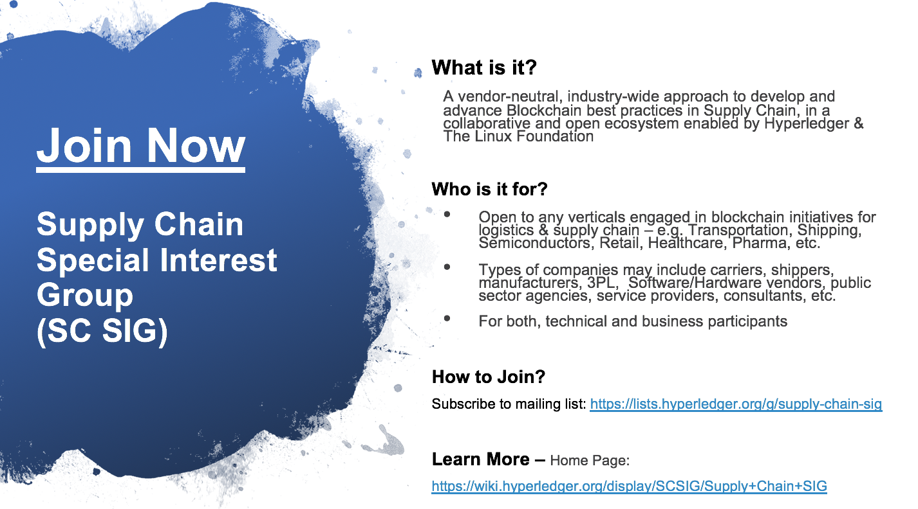
Help Promote the SIG – Invite Members
Invite your customers, partners to join
Self sign-up to SIG mailing list: https://lists.hyperledger.org/g/supply-chain-sig
Promote Socially - Sample Tweet/Linked-In
The #Hyperledger Supply Chain Special Interest Group (SIG) has now launched! To learn more , and find out how you can be more involved with this SIG, visit https://wiki.hyperledger.org/display/SCSIG/Supply+Chain+SIG #SCSIG
Promote via email, newsletters; using this:
(Promo Card/Image)
(Editable slide)

Slide 20
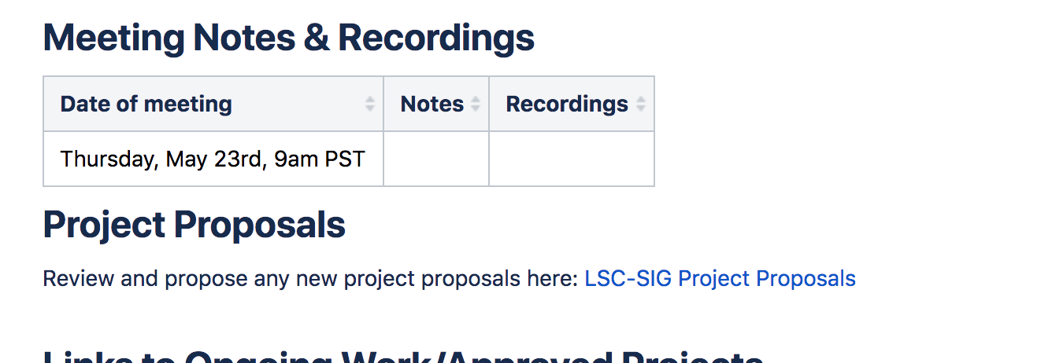
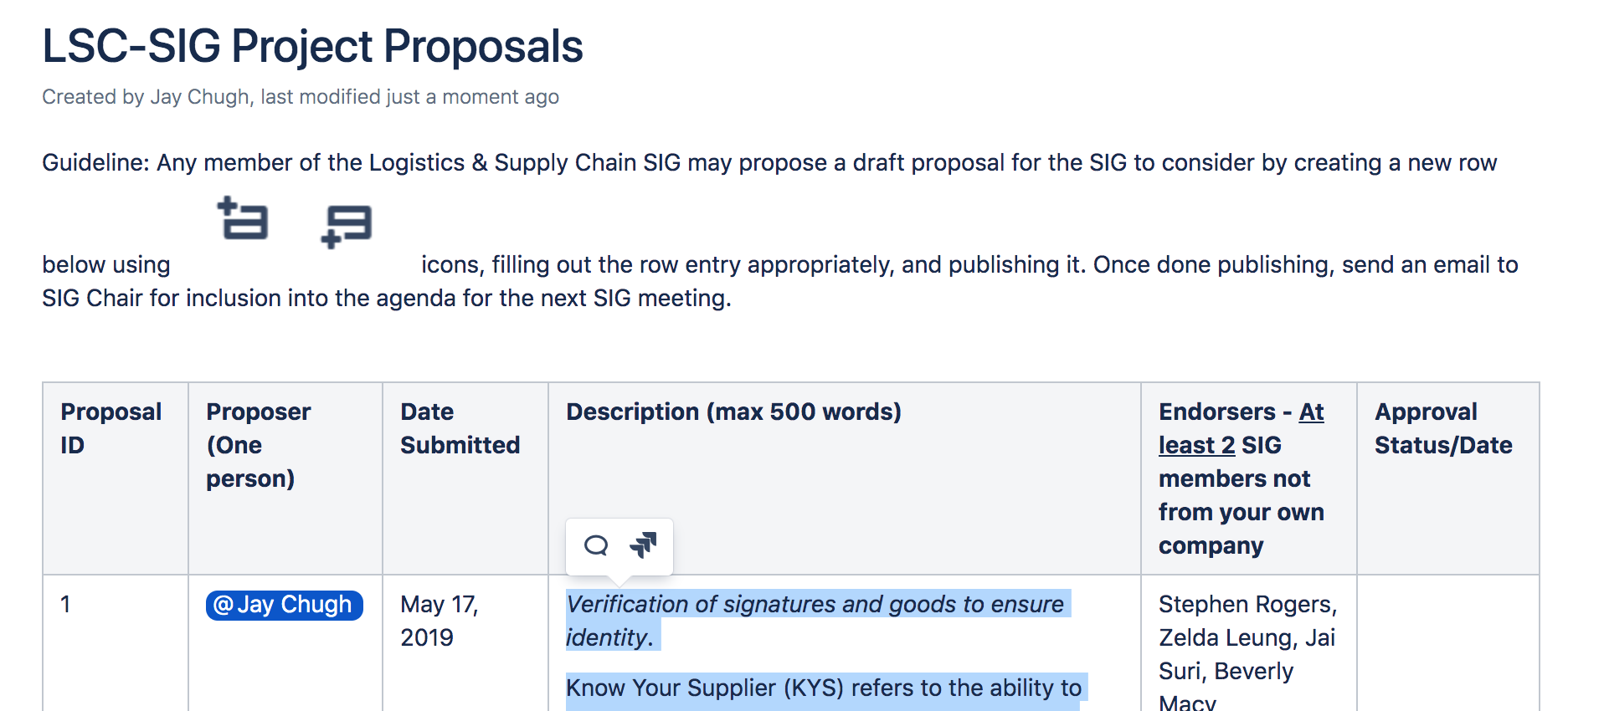
Project Proposals
SIG Wiki Home Page (Scroll Down)
Anyone can propose projects
Submitting proposals is easy! See=>
Fill out a row with your proposal
Discuss in meetings & vote poll
4 Proposals currently on the table
Notes:
Can use the SIG to initiate set of mini projects to crowdsource knowledge-base - e.g. logistics & supply chain use cases, types of supply chain documents exchanged, supply chain participating organization types (3PL, shippers, distributors, freight forwarders, customs/port authorities, brokers, manufacturers, retailers, etc.), devices used to connect to blockchain, apps used, integrations connectors, definitions, industry regulations and their implications to blockchain projects, others?

